Slide 1
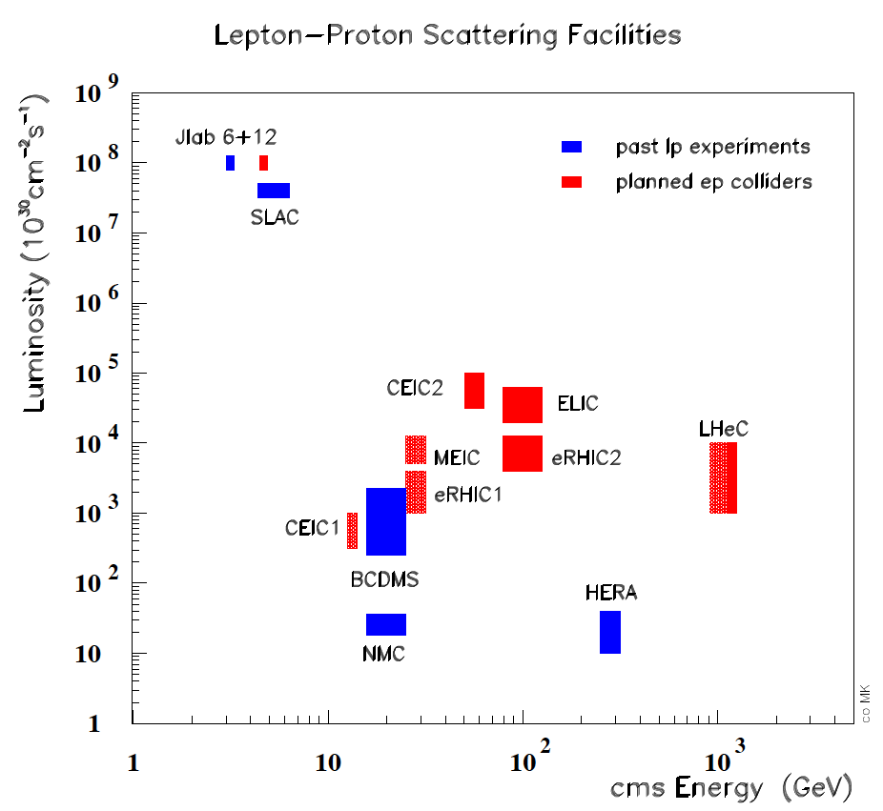
Large Hadron Electron Collider - LHeC
Information on http://cern.ch/lhec
ep/A synchronous to pp/AA
- LHC is the only place for TeV energy DIS
- ~60 GeV electron beam upgrade to the LHC
- DIS at TeV energies: Q²_{max}10⁶, x > 10⁻⁶
- New, affordable detector. Low radiation.
Noteable:
Unprecedent precision (α_{s} to per mille)
Complete unfolding of PDFs (1st time)
Precision electroweak measurements
Novel precision input for LHC physics
BSM (RPV SUSY, e*, CI, lq resonances?)
Quark Gluon Plasma – initial formation
QCD
Discovery/disproval of saturation at low x
Less conventional partons (kt, diff., GPDs)
Nuclear structure in huge kinematic range
Top with 10pb cross section in DIS, tPDF
Max Klein, Les Houches 12.6.13
The LHeC is a new laboratory for energy frontier particle physics of unique character.
Ref’s: CDR arXiv:1205:2913, summary: arXiv:1211.4831, relation to LHC: arXiv:1211:5102

Slide 2
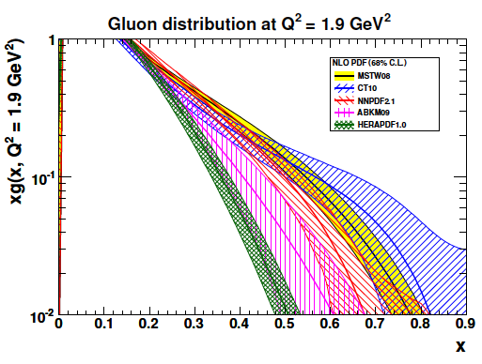
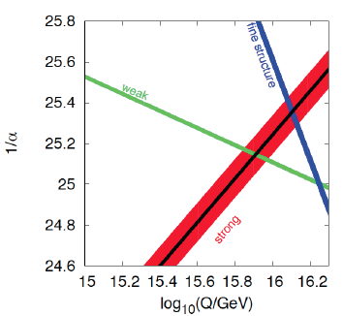
LHeC – Partons and α_{s}
Per mille measurement accuracy
Testing QCD lattice calculations
α_{s} small in DIS or high with jets?
DIS without BCDMS..
Leads to unprecedented level
of precision in all of DIS, e.g.
charm mass to 3MeV; N³LO
Constraining GUT (CMSSM40.2.5)
LPCC LHeC Workshop at CERN– April12+ 13: indico: 244768 and 244990
Gluon at large x > 0.5 unknown
LHeC: xg to 10% accuracy at x=0.7
Saturation, BFKL at low x?
Full set of PDFs over uncovered
range of x and Q² from NC+CC:
uv,dv,dbar,ubar,s,sbar,c,b,top, xg
Partons from LHeC comprise:
unintegrated, diffractive, GPD
photon, neutron, nuclear
PDG
LHeC
Max Klein, Les Houches 12.6.13
Ref’s: CDR arXiv:1205:2913, summary: arXiv:1211.4831, relation to LHC: arXiv:1211:5102

Slide 3
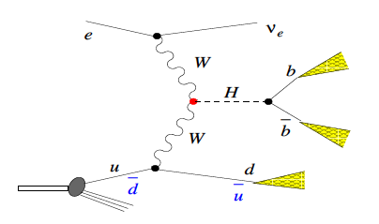
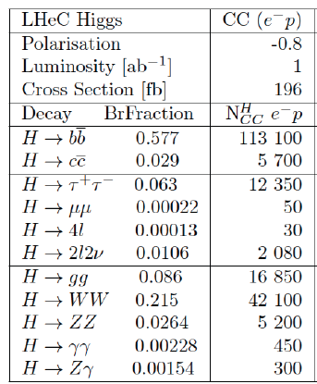
Higgs with the LHeC
ZZ → H ~10 times lower rate
LPCC LHeC Workshop at CERN– April12+ 13: indico: 244768 and 244990
Unique production mechanism (WW,ZZ)
Clean experimental conditions:
No pileup, simpler final state …
LHeC at 10^34cm-1s-1: arXiv:1211:5102
Nb: Cross section and luminosity as large
as are projected for the ILC. Access to
difficult channels (ττ, cc – under study)
With its unique Higgs measurements and
precision N³LO PDFs and δα_{s} ,
ep upgrade transforms the LHC facility
into a precision Higgs factory.
[cf arXiv:1211:5102 + OB, MK: arXiv:1305:2090]
Rates for E_{e}=60 GeV, proportional to E_{e}
Initial study for CDR:
H →bbar: selection efficiency: ~2.5%
which gives 5000 events with S/B=1.
corresponding to 0.7% coupling precision.
[cf: CDR, U.Klein ICHEP12, B.Mellado LPCC]
Max Klein, Les Houches 12.6.13

