Slide 1
For Achille
Some slides on Project, Physics, Detector, ERL/PERLE
7.9.2021

Slide 2
Project and Accelerator

Slide 3
LHeC, PERLE and FCC-eh
Powerful ERL for Experiments @ Orsay
CDR: 1705.08783 J.Phys.G
CERN-ACC-Note-2018-0086 (ESSP)
Operation: 2025+, Cost: O(20) MEuro
LHeC ERL Parameters and Configuration
I_{e}=20mA, 802 MHz SRF, 3 turns →
E_{e}=500 MeV → first 10 MW ERL facility
BINP, CERN, Daresbury, Jlab, Liverpool, Orsay (IJC), +
50 x 7000 GeV²: 1.2 TeV ep collider
Operation: 2035+, Cost: O(1) BCHF
CDR: 1206.2913 J.Phys.G (550 citations)
Upgrade to 10³⁴ cm⁻²s⁻¹, for Higgs, BSM
CERN-ACC-Note-2018-0084 (ESSP)
arXiv:2007.14491, J.Phys.G to appear
60 x 50000 GeV²: 3.5 TeV ep collider
Operation: 2050+, Cost (of ep) O(1-2) BCHF
Concurrent Operation with FCC-hh
FCC CDR:
Eur.Phys.J.ST 228 (2019) 6, 474 Physics
Eur.Phys.J.ST 228 (2019) 4, 755 FCC-hh/eh
Future CERN Colliders: 1810.13022 Bordry+

Slide 4
ERL: Accelerator Energy Frontier
FCC-ee
400 pages update of 2012 CDR - to appear
Vladimir Litvinenko et al, 1909.04437
ECFA: Interest of young scientists 2002.02837
60 GeV ERL design applied to FCC-he
4-6 turns
50 GeV to limit cost [1/4 or 1/5 of U(LHC)]
Three pass ERL, two ~800m long linacs
I_{e}=20mA for 10³⁴ luminosity, f=801.58 MHz
(Erk at Daresbury 16, Frank M at Orsay 18)
Operation concurrent to LHC (+dedicated)
(when) will that happen.? We don’t know
I met Abhay Deshpande in Snowmass 2001,
when he presented the EIC, not for the 1st time
HL-LHC dominates all of PP,
Its programme will extend to 2040
E/linac = M_{Z,..HH}/(2 * N_{turn})
EIC: Polarised eh Collider at BNL
IBS: emittance growth: needs ERL 100mA (!)
CW e beam cooling of p/A beam (for CBETA)
cf e.g. F Willeke APS talk, April 2018
Coherent Electron Cooling
V.N. Litvinenko, Y.S. Derbenev, PRL 102, 114801, 2009

Slide 5
LHeC Configuration (for two electron beam energies) [CERN, BNL, Jlab for CDR]
Energy recovery linac(s)
20mA I_{e}
Concurrent ep + pp
operation with LHC
Integrated luminosity
in e⁻p up to O(1) ab⁻¹
U(ep) = 1/n U(LHC)
Likely n=3 (CDR) → n=4
gains 20-30% cost. E< 60
H, BSM, top, low x..
require E > 50 GeV
Frequency set to 802 MHz,
commensurate with LHC
and 401/802 at CERN+FCC.
also beam-beam stability
3-turn energy recovery racetrack configuration. Modular for LHeC/FCC-eh

Slide 6
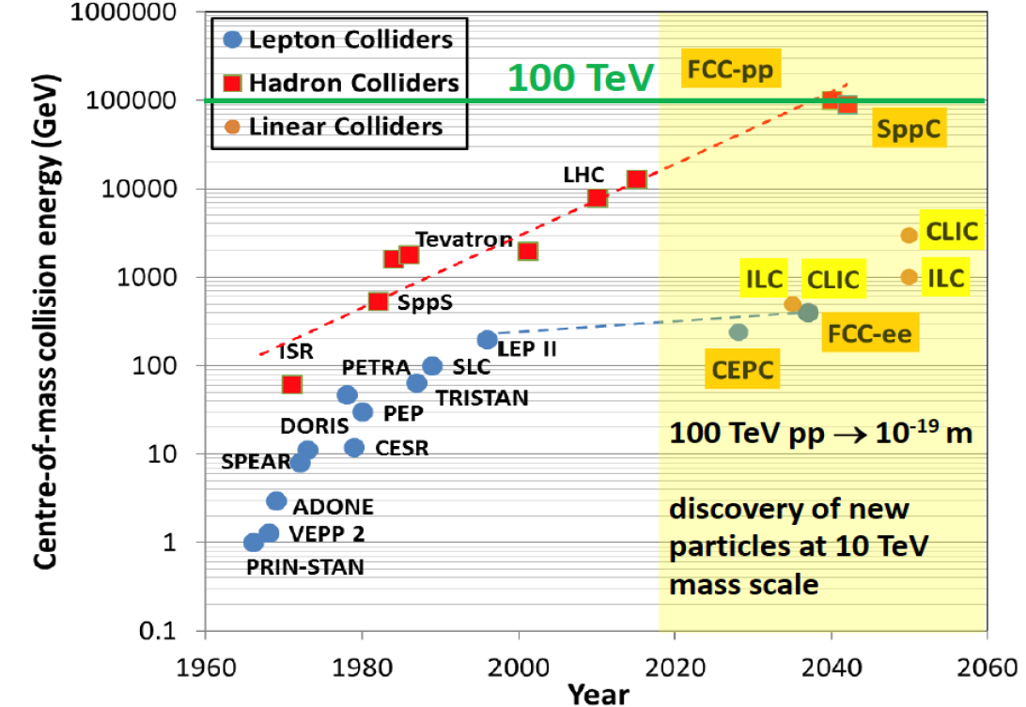

title
Hundred
Years of
HEP
Colliders
FCC-pp
40 TeV
FCC-eh
LHeC
HERA
EIC
ep/A
Parameters:
MK EPS 7/19. adapted from M Benedikt (3/19)

Slide 7
Published in 2020
arXiv:2007:14491 (400 pages, 300 authors)
5 page summary: ECFA Newsletter Nr 5., August 20
https://cds.cern.ch/record/2729018/files/ECFA-Newsletter-5-Summer2020.pdf
156 Institutions involved

Slide 8
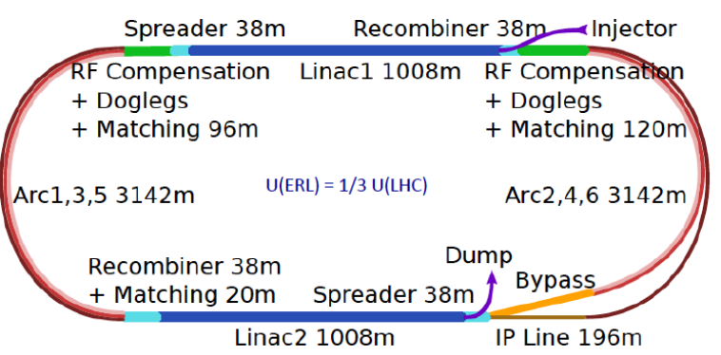
Concluding Remarks
This is indeed affordable - O(1) billion CHF for another TeV collider
It sustains the HL-LHC and exploits this massive O(5) BCHF investment
Physics: Unique: Microscope of substructure (not resolved!), empowers
LHC searches and Higgs measurements challenging e⁺e⁻, Discovery
in electroweak and strong i.a. sector, Revolution of HI physics
Technology: Accelerator: highest energy ERL application - green.
Detector: exciting place for new technology (CMOS, timing,
thin calo.. etc) in classic DIS, low radiation environment, no pileup.
Exciting place also for known technology to reappear and work.
Merging LHeC with A3 resolves conceptual conflict on IP2 and
promises to lead to new chapter of HI and accelerator physics (tentative)
Next steps: PERLE facility at Orsay, considerations for a detector
proposal to LHCC, embedded and subject to CERN’s future,
which is also related to that of the CEPC.
The LHeC group believes that diversity (at the energy frontier too) is
key to help particle physics theory to restore its predictive power..

Slide 9
Physics

Slide 10
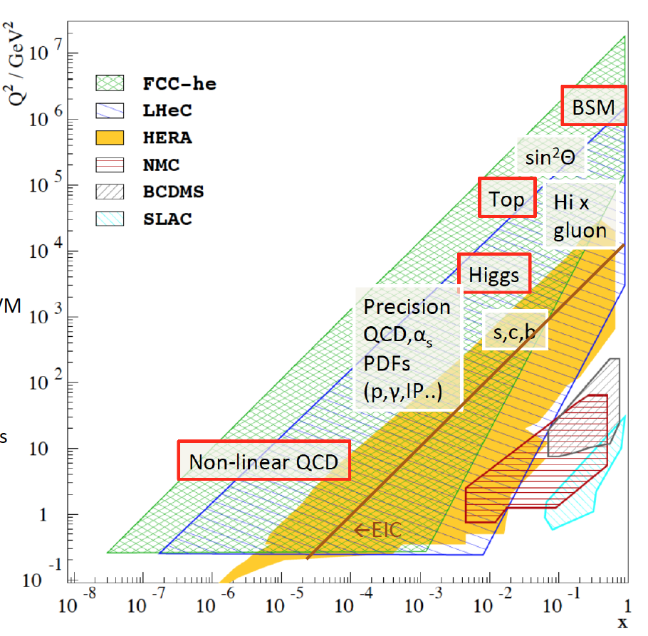
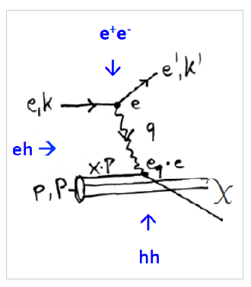
Physics with Energy Frontier DIS
Deep Inelastic Scattering
Raison(s) d’etre of ep/eA
at the energy frontier
Cleanest High Resolution
Microscope: QCD Discovery
Empowering the LHC/FCC
Search Programme
Transformation of LHC/FCChh into
high precision Higgs facility
Discovery (top, H, heavy ν’s..)
Beyond the Standard Model
A Unique
Nuclear Physics Facility

Slide 11
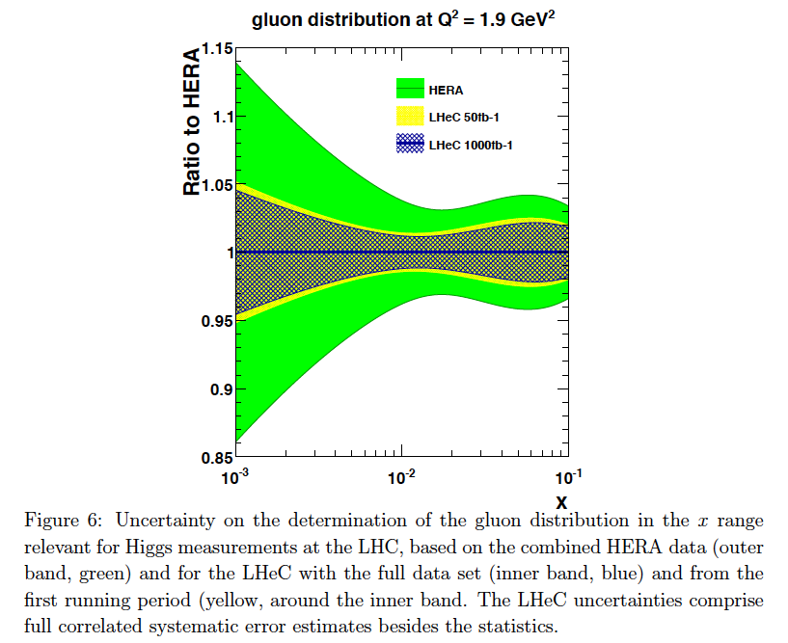
Parton Distributions
Complete unfolding of parton contents in
unprecedented kinematic range: u,d,s,c,b,t, xg
Strong coupling to permille accuracy (incl + jets):
Crucial for LHC:
- high precision eweak, Higgs measurements
- Extension of high mass search range
- Non-linear low x parton evolution; saturation?
DIS: clean theory, light cone, redundant e/h FS reconstruction, ..
For LHC to have an impact on
the search and precision physics
program at HL-LHC it is crucial
that PDF and QCD information
is available early.
PDF study with 50 vs 1000 fb⁻¹
Remove essential party of
QCD uncertainties of gg→ H
cf C. Gwenlan, talk at DIS19 and
M Cooper Sarkar yesterday at EPS
FCC-eh
← LHeC
← EIC
Note that 50fb⁻¹ is 100 times H1‘s total luminosity: Low x needs 1fb⁻¹.
← HERA

Slide 12
Higgs in ep and pp [LHC and FCC]
LH(e)C

Slide 13
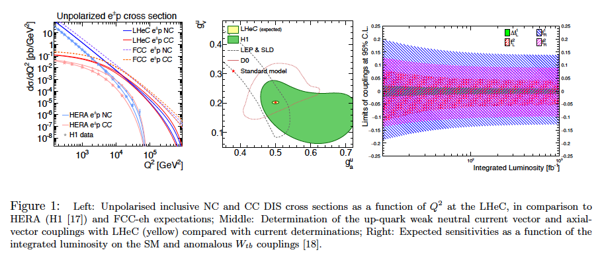
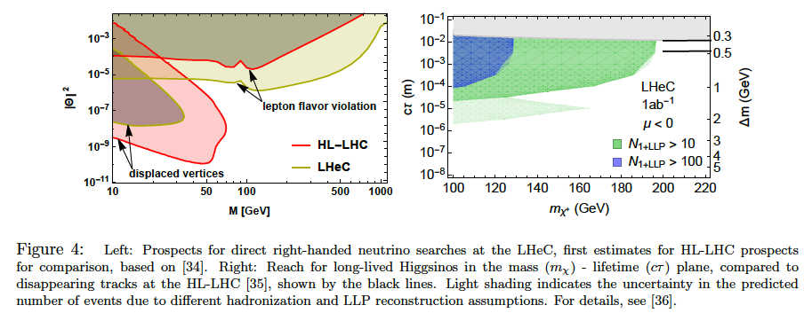
Precision
Electroweak
Physics
Anomalous
Wtb couplings
Electroweak+Top Physics
From LHeC strategy paper CERN-ACC-NOTE-2018-0084
cf EPS talks by
D Britzger and
C Schwanenberger
Higgsinos
Heavy Neutrinos
BSM + Searches
MK at EPS 2019

Slide 14
title
Beate Heinemann

Slide 15
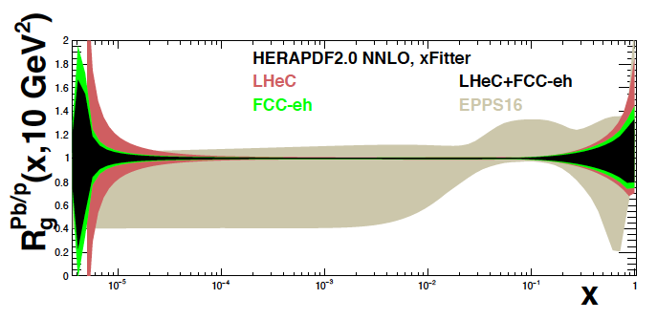
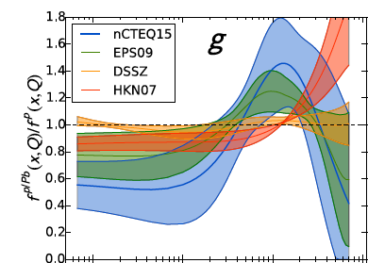

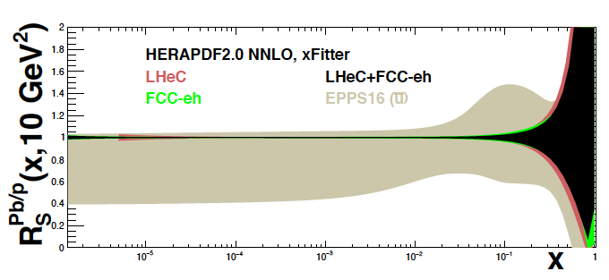
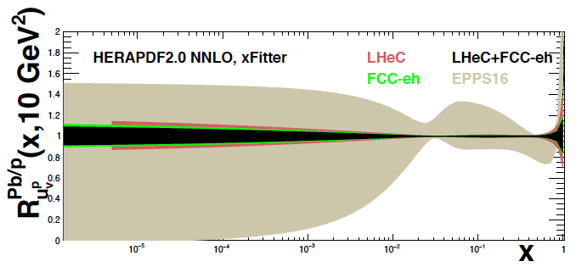
Nuclear PDFs at LHeC/FCCeh
Unique nuclear/HI physics programme
Extension of fixed target range by 10 ³⁻⁴
QCD of QGP, de-confinement, saturation..
nPDFs independent of p PDFs
1509.00792
High
luminosity
~ 10 ³³
enables
high statistics
in short
eA runs
cf J Jowett et al
present
status →
on xg
Pb/p
gluon
N Armesto, FCC Physics Week 1/2018
sea
valence
cf talk by
A Stasto today
LHeC: Full error, Δχ² =1. EPPS Δχ² =52

Slide 16
Detector

Slide 17
The LHeC Detector Design
LHeC Detector Design 7/2020
No pile up, low radiation wrt pp; high precision through overconstrained kinematics: e-h; modular for rapid installation
Tracker radius 40 → 60cm, B 3.5T; LxD =13 x 9m² [CMS 21 x 15m² , ATLAS 45 x 25 m²]..
arXiv:1206.2913+2007.14491

Slide 18
Kinematics: fwd: in p beam direction, bwd: e direction
fwd
bwd
fwd
bwd
Electrons in bwd direction have low energy (E’_{e} < E_{e} beam)
in fwd direction high energy up to Ep, Rutherford backscattering
Q²=1 GeV² is 179º, or eta =4.74 = ln tan theta/2, ~ E_{e}² !
Hadrons in bwd direction have low energy E_{h} < E_{e} beam
in fwd direction hadrons carry energy up to E_{p} beam
Asymmetric energy coverage of LHeC detector. Fwd region: resembles hh conditions

Slide 19
LHeC Calorimeters
Complete coverage to +- 5 in (pseudo)rapidity
Central Region: 2012: LAr, 2020 Sci/Fe option.
Forward Region: dense, high energy jets of few TeV
H → bb and other reactions demand resolution of HFS
Backward Region: in DIS only deposits of E < E_{e}
Barrel Calorimeters
Forward/Backward Calorimeters
arXiv:2007.14491

Slide 20
The LHeC Detector Design
Inner Tracker
Rapidity to ~5
r_{O} = 60 cm
impact resolution
5-10 µm
40.7 m² Si

Slide 21
PERLE

Slide 22
title
PERLE is progressing (source, injector, magnets, HOMs.. – radiation safety - in its recognition). International Collaboration
Max Klein, Chavannes, 24.10.2019
9

Slide 23
SRF Cavities
← f < 1 GHz
Bob Rimmer
PERLE/LHeC (20 x 6 mA) and FCC-ee 802MHz Nb Cavity
Frank Marhauser et al. at Jlab (FM talk at PERLE workshop)
10

Slide 24
Low Energy Physics with ERLs
Three examples from Long Write-UP
Proton Radius Puzzle [role for high intensity ERL, Jan Bernauer
ERL Symposium 6/21
MESA at Mainz
0.15mA
polarised
1mA (HOM!)
105 MeV
AMBER (CERN), MUSE (PSI), PRAD (Jlab), ULQ2 (Tohoku), Mainz .. ??
Nuclear Photonics [inverse y’s: L(PERLE) = O(10³) L(ELI)]
June 17, 2021, to appear
- 1.3 GHz, two ELBE type cryomodules, up to 3 passes
- New building, beam by 2024
- Polarimetry to 0.5% precision
- Current upgrade (unpolarised to 10 mA)
P2 – external target sin²O, w/o energy recovery (“EB”)
MAGIX – gas jet internal target, dark photons, p radius (“ER”)
also: IGS: nuclear security, novel medical isotope research
Electrons Probing Exotic Nuclei
New field, pioneering: SCRIT@RIKEN, PRL 118, 2017
PERLE 500 MeV, 20mA, DESTIN project at Orsay
Outlook: eRI facility at GANIL (Caen, F) 200mA, ~2040
-
17

Slide 25
Current and coming activities [from an Interim ERL report 7/21]
Facilities
Electron beam energy [MeV] vs current [mA]
SRF Technology, Funding
Technology limit
Main goals of development and study:
High current sources, SRF to take ~100 mA load and high Q₀
CSR, HOMs, small emittance, efficient multi-turn operation
8

