Slide 1
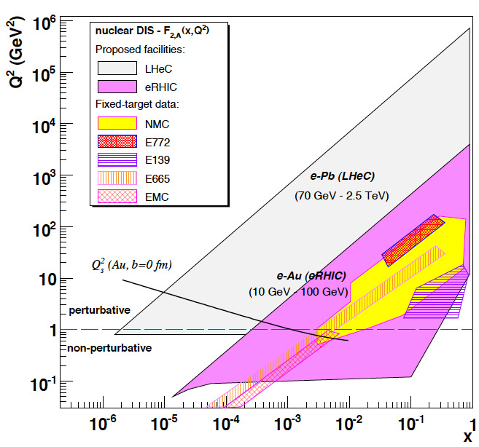
The LHeC – a New Facility for Nuclear Physics
50..150 (e±) GeV on 2.7 (Pb), 3.5 (D), 7(p) TeV
The LHeC extends the
kinematic range of eA by
four orders of magnitude.
Project
Accelerator
Detector
Physics
www.lhec.org.uk
D’Enterria arXiv0707.4182
Max Klein
University of Liverpool
NuPECC Scoping Workshop
Frankfurt/Main 13/10/09
x: fractional parton momentum
Q²: -four momentum transfer²

Slide 2
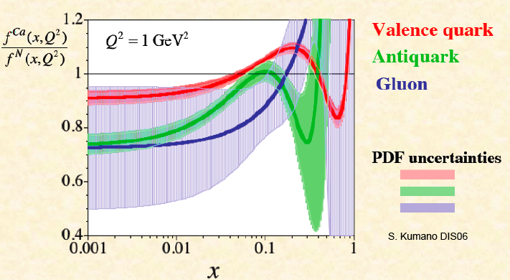
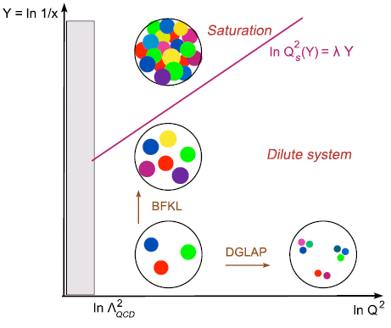
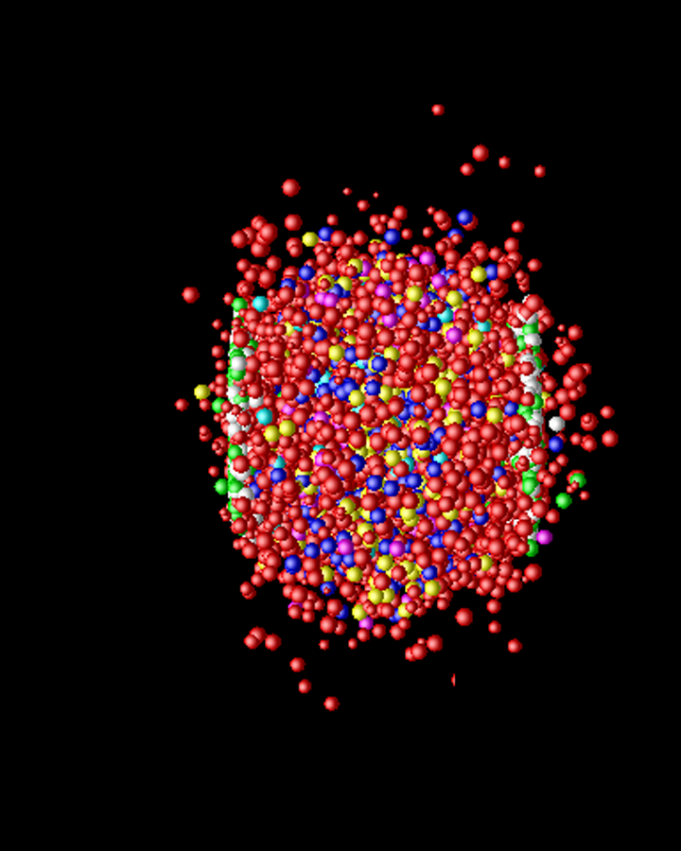
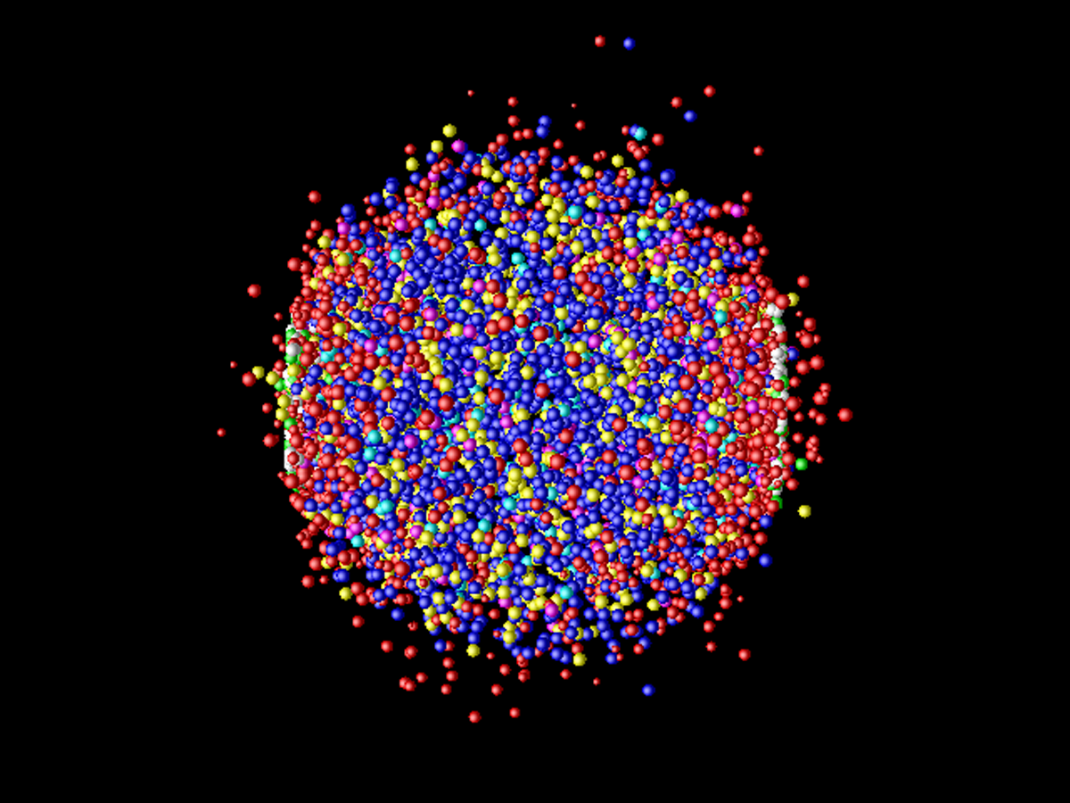
Nuclear Physics with the LHeC
1. Nuclear Parton Distribution Functions
2. Saturation (low x, nonlinear QCD)
3. Quark Gluon Plasma, its initial and final states
Gluon emission from saturated nuclei Glasma? QGP Reconfinement

Slide 3
Project Development
www.lhec.org.uk
1990: LEP-LHC Workshop at Aachen
2006: J. Dainton, M.Klein, P.Newman, E.Perez, F.Willeke 2006 JINST 1 10001
2007: (r)ECFA and CERN invite for CDR.
organise Steering Group, SAC, six working groups.
2008: Reports to NuPECC (9/08), ICFA (10/08) and ECFA (11/08)
2009: 2nd CERN-ECFA-NuPECC workshop on the LHeC at Divonne (9/09)
2010: Conceptual Design Report (CDR)
[machine, interaction region, detector, physics: BSM, QCD+elweak, HPD]
Further consideration depends on CDR, on the LHC and on all of us.
Project may be realised within 10 years and thus fit to the 2nd phase of LHC

Slide 4
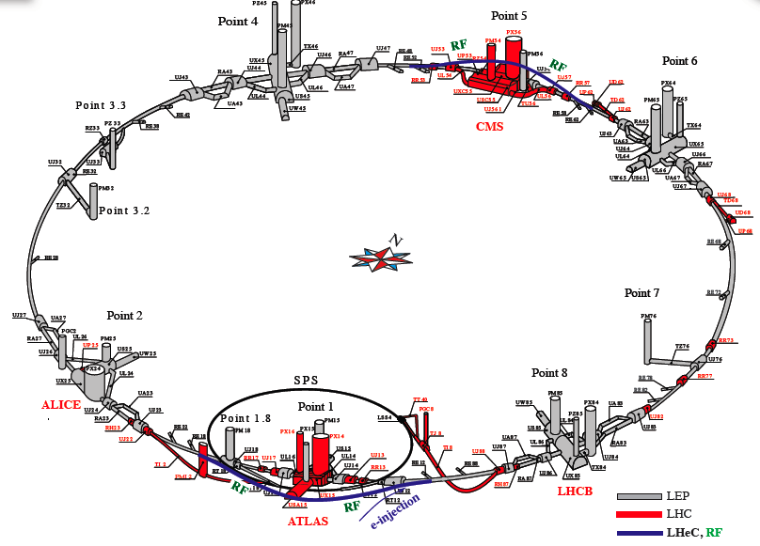
Ring-Ring ep/eA
E_{e}=E_{inj} … 80 GeV. L_{ep}~10³³cm⁻²s⁻¹ (100 times HERA)
1/x and Q² ~ 10⁴⁽²⁾ times larger in eA (ep) than so far
F.Willeke
B.Holzer
et al

Slide 5
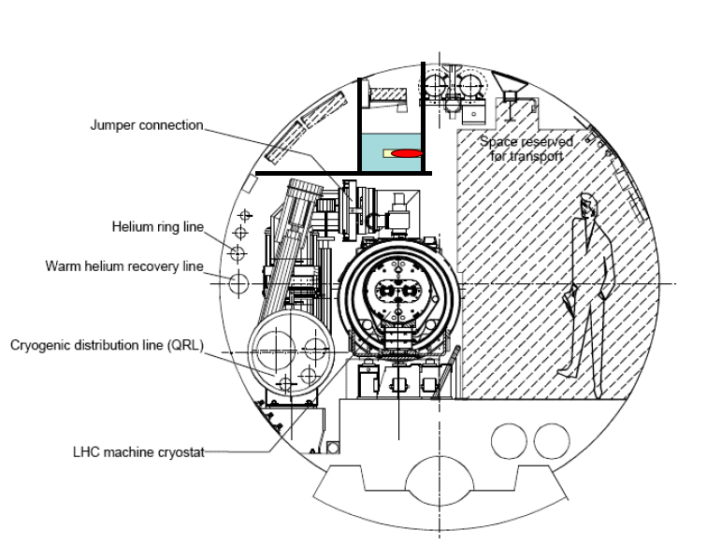
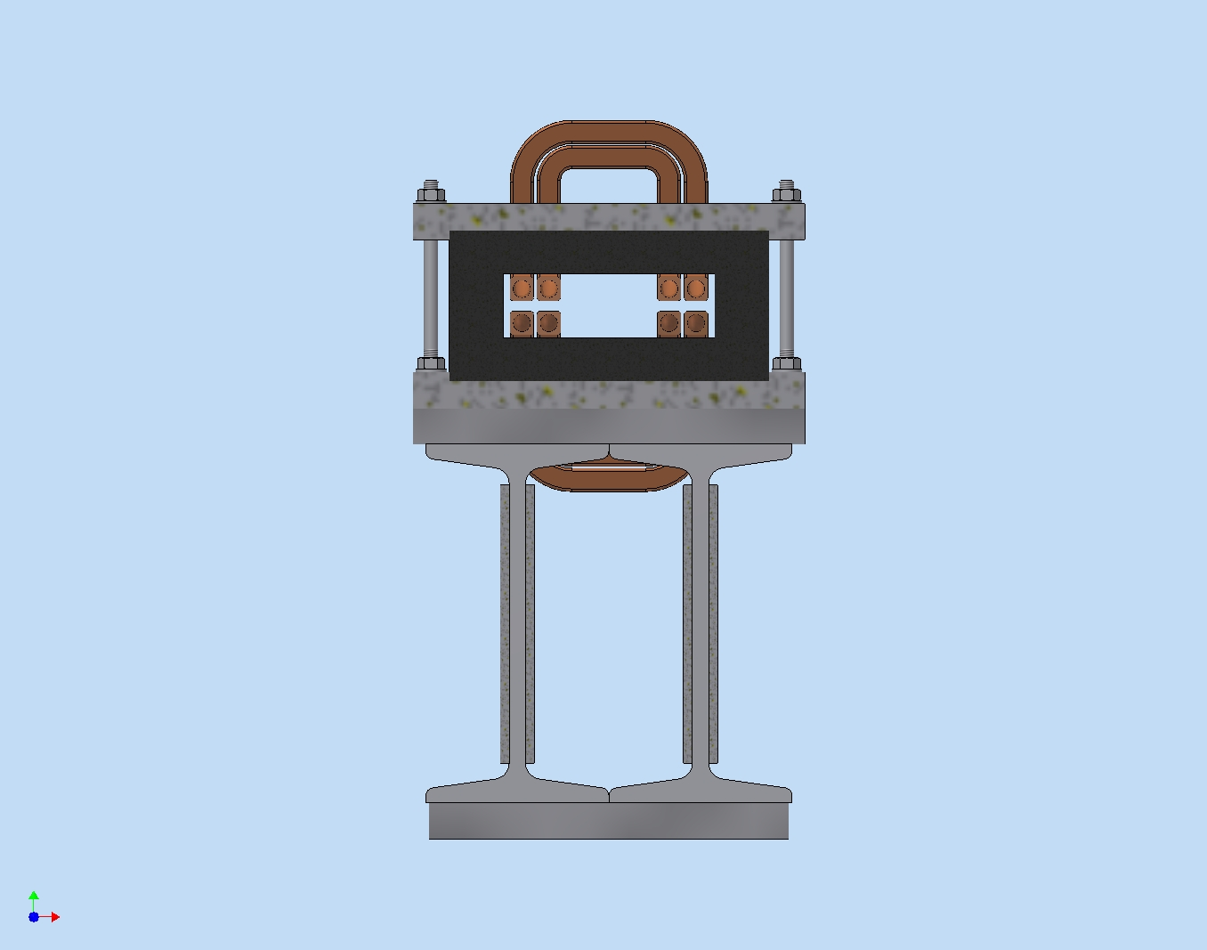
Major Ring Developments
Study of machine installation
New dipole magnet (BNP)
O-shaped magnet with ferrite core
P.Wobbly, I.Morosov
F.Willeke, Kh.Mess
Sketch of bypass tunnel around CMS (double tunnel, 1 shaft, houses rf)
J.Osbourne, S.Myers, H.Burckardt

Slide 6
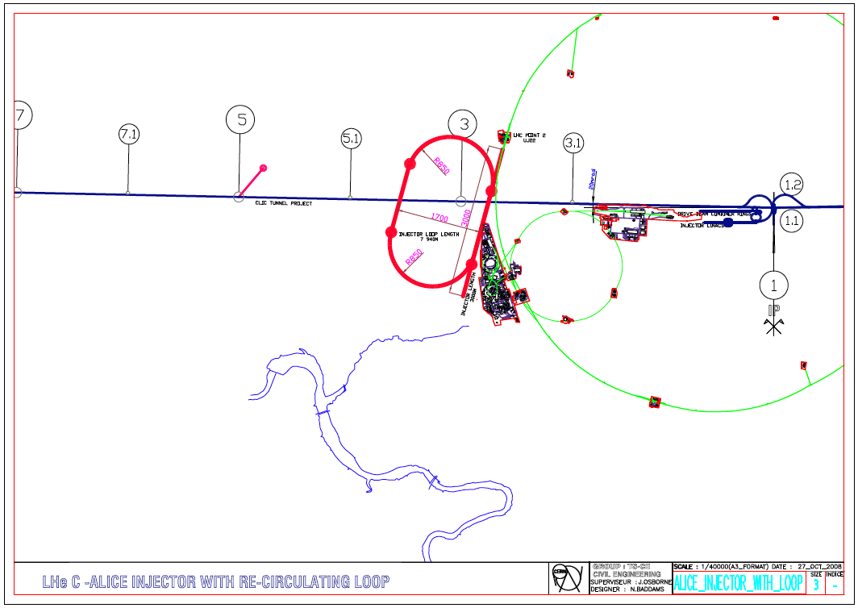
title
Linac-Ring ep/eA
LINAC Characteristics
ILC type cavities 15-25 MV/m
Intense e⁺ source
Energy limited by cost
Luminosity boost with energy recovery
10-15km of tunnel but independent of LHC
F.Zimmermann, C.Adolphson,
S.Chattopadhyay, A.Eide et al

Slide 7
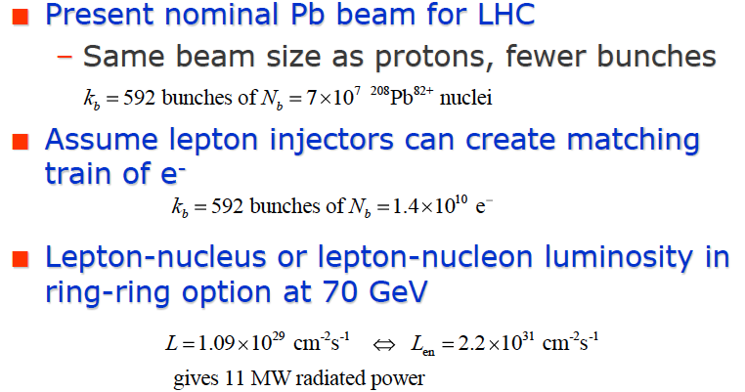
e-A Collisions
J.Jowett
L(en) in Pb may be similar or better than L(ep) HERA.
Need to maintain ion injector beyond LHC first phase
and possibly extend it to Calcium and Deuterons

Slide 8
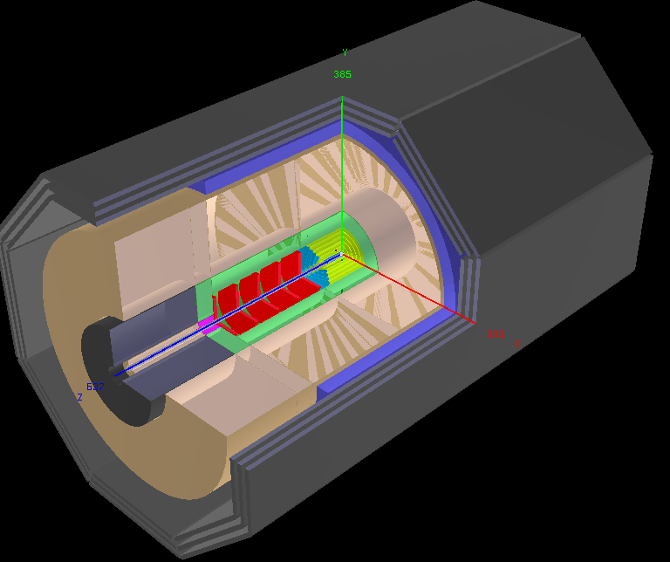
LHeC Detector: version for low x and eA
Muon chambers
(fwd,bwd,central)
Coil (r=3m l=8.5m, 2T)
[Return Fe not drawn,
2 coils w/o return Fe studied]
Central Detector
Hadronic Calo (Fe/LAr)
El.magn. Calo (Pb,Sc)
GOSSIP (fwd+central)
[Gas on Slimmed Si Pixels]
[0.6m radius for 0.05% * pt in 2T field]
Pixels
Elliptic beam pipe (~3cm)
Fwd Spectrometer
(down to 1º)
Tracker
Calice (W/Si)
FwdHadrCalo
Bwd Spectrometer
(down to 179º)
Tracker
Spacal (elm, hadr)
Pkostka, A.Pollini et al., April2009
Extensions in fwd direction (tag p,n,d) and backwards (e,γ) under study.

Slide 9
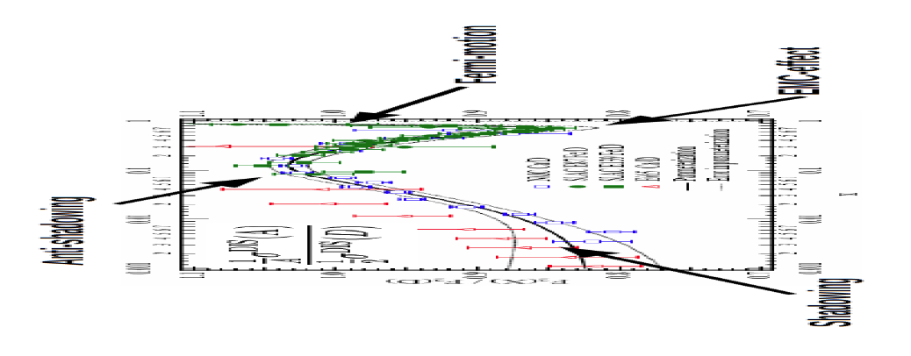
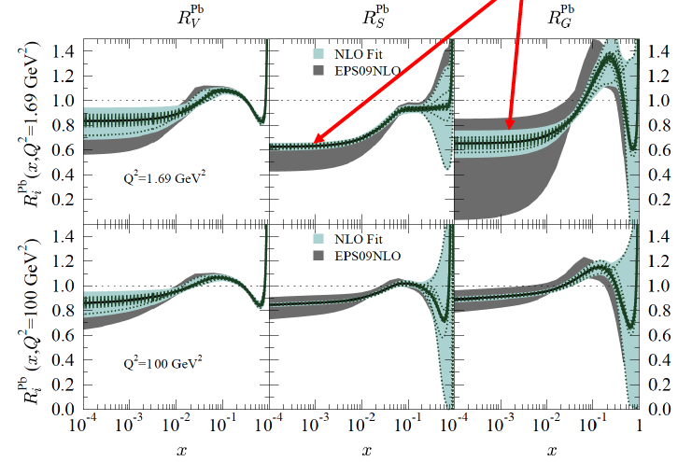
1. Nuclear Parton Distributions
Study using eA LHeC pseudodata
Quantitative improvement, but
based on DIS `DATA’ for the 1st time
Shadowing ← diffraction
Fermi motion ← p tagging
p, D, Ca, Pb
LHeC will have immense
impact on the partonic
structure of nuclei
→ A complete determination of nPDFs in grossly extended range, into nonlinear regime
K.Eskola, H.Paukkunen, C.Salgado, Divonne09

Slide 10
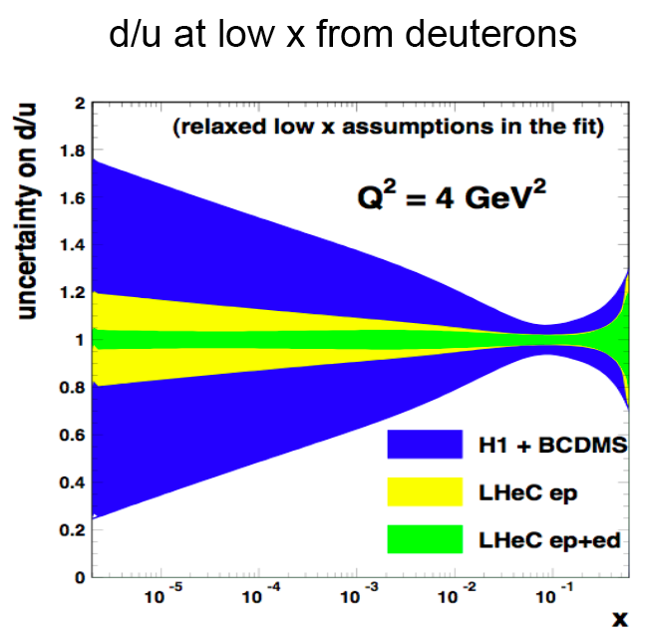
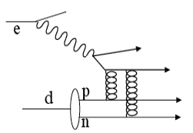
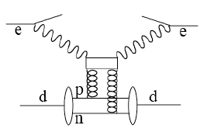
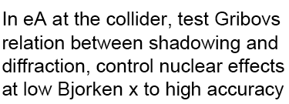
The ignored Neutron
Neutron structure unknown in HERA
range and below. Crucial to resolve its
parton structure and to predict scattering
on nucleons rather than proton targets.
Collider unique to en (p tag, diffraction)

Slide 11
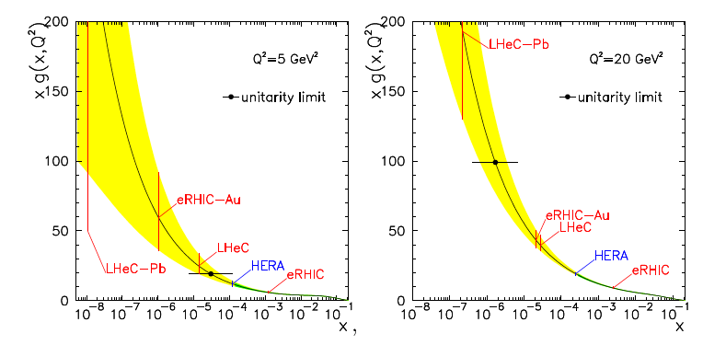
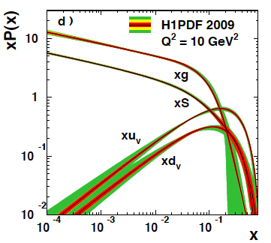
2. Colour Glass Condensate - Saturation
Perturbatively calculable via non-linear evolution equations
HERA: Quark and gluon densities
in p rise towards low Bjorken x.
Gluon dominant but no clear
proof of nonlinear effects.
T.Lastovicka, M.Klein, DIS06
Expect saturation of rise at Q²_{s} ≈ xg α_{s} ≈ c x^{-λ}A^{1/3}
Qualitative change of scattering behaviour:
Saturation of cross sections amplified with A^{1/3} (A wider than p)
Rise of diffraction to 50% of cross section
hot spots of gluons or BDL?
The LHeC is bound to discover saturation in DIS
both in ep and in eA in a region where α_{s} is small
H1 Collaboration, EPJ to appear

Slide 12
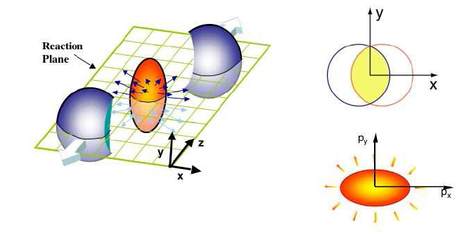
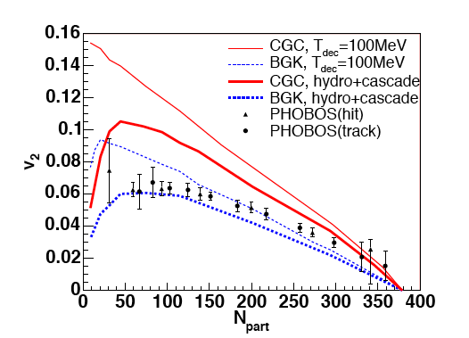
3. Quark Gluon Plasma
Landau 1953. RHIC: QGP strongly coupled plasma with liquid behaviour
instead of weakly interacting gas of partons
Related to cold atoms and to
superstring theory [AdS/CFT]
M.Tannenbaum, Rept.Prog.Phys 65 (2006) 2005
Collective flow in non-central collisions anisotropic
Anisotropy proportional to 1/viscosity of fireball,
dominantly elliptic (“v₂” coefficient)
QGP most perfect liquid – smallest shear viscosity/entropy
Conclusions depend on initial fireball eccentricity
eA to measure the initial conditions of QGP.
Hirano et al, Phys.Lett.B636(2006)299
U.Heinz arXiv:0907.4256 (nucl.th)

Slide 13
In-medium Hadronisation
The study of particle production in eA (fragmentation functions and hadrochemistry)
allows the study of the space-time picture of hadronisation (the final phase of QGP).
Low energy (ν): need of
hadronization inside.
Parton propagation: pt broadening
Hadron formation: attenuation
High energy (ν): partonic
evolution altered in the
nuclear medium.
W.Brooks, Divonne09
LHeC :
+ study the transition from small to high energies in much extended range wrt. HERMES, Jlab
+ testing the energy loss mechanism crucial for understanding of the medium produced in HIC
+ detailed study of heavy quark hadronisation …
Notes:
13

Slide 14
Summary
The LHC offers a unique opportunity to build a new electron-hadron collider for which a
Conceptual Design Report has been invited by CERN and ECFA. This is being worked out
in a series of CERN-ECFA-NuPECC workshops with the aim to deliver the CDR in 2010.
The LHeC promises to exceed HERA by factors of 100 in luminosity and kinematic reach.
As an eA collider, building on the heavy ion programme at the LHC, the LHeC extends the
range of lepton-A scattering by 4 orders of magnitude in x and Q² . It has to violate unitarity.
The HEP programme is extremely rich with unique potential in physics beyond the
standard model and high precision, thus far reaching, QCD and electroweak measurements
and essential complementarity to the LHC pp programme (SM and BSM).
The LHeC may find excited leptons (electrons and neutrinos) or quarks and thus lead
to a new layer of matter (below 10⁻¹⁹m) or study quark-lepton states should these exist.
For proton’s and nuclear structure, the LHeC offers unique prospects as on the complete
experimental unfolding of the partonic contents of the proton, neutron and nuclei.
The LHeC is bound to discover saturation and thus to determine the initial state of the QGP.
This has far reaching theoretical (QCD, strings, Hydrodynamics..) and experimental
(LHC, neutrino-astrophysics) consequences. The programme is much wider than 1-3.
The project requires addition of a new electron beam to the LHC and building a suitable
detector for high precision measurements. It thus represents challenging tasks for the
development and maintenance of the technical art of our joint fields (HEP and NP).
The project may fit to the LHC upgrade in time and operation. Ion beams are to be kept.
Special thanks to
N.Armesto
O.Bruening,
B.Cole,
P.Kostka,
P.Newman,
A.Stasto,
U.Wiedemann
and many others
spending time on
the LHeC,
and to NuPECC
for its interest.
You are invited to take further part in accelerator, detector, physics developments

Slide 15
Physics Programme of the LHeC
+ Unfolding completely the parton structure of the proton (neutron and photon)
and search for sub-substructure down to ten times below HERA’s limit
+ Sensitive exploration of new symmetries and the grand unification of particle
interactions with electroweak and strong interaction measurements of
unprecedented precision.
+ Search for and exploration of new, Terascale physics, in particular for singly
produced new states (RPV SUSY, LQ, excited fermions) complementary to the LHC
+ Exploration of high density matter [low x physics beyond the expected unitarity
limit for the growth of the gluon density]
+ Unfolding the substructure and parton dynamics inside nuclei and the study of
quark-gluon plasma matter by an extension of the kinematic range by four
orders of magnitude.

Slide 16
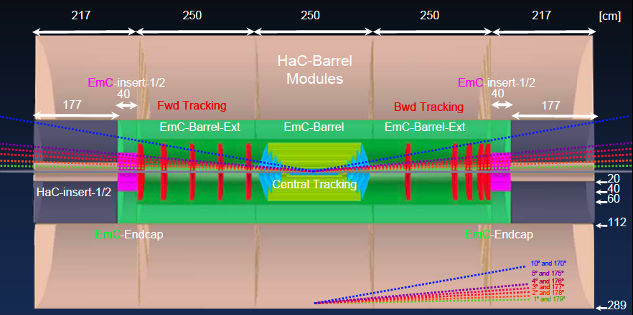
Detector under Design (low x, high Q², eA)
P.Kostka, A.Pollini, R.Wallny et al, 9/09
high precision, large acceptance, LHC/ILC/HERA related, Forward tagging of p, n, d

