Slide 1
Summary of ep configuration study
M. Klein FCC coordination meeting, 4 March, 2016
See also : presentations by Frank at Washington (3/15) and Daniel at Chavannes (6/15)

Slide 2
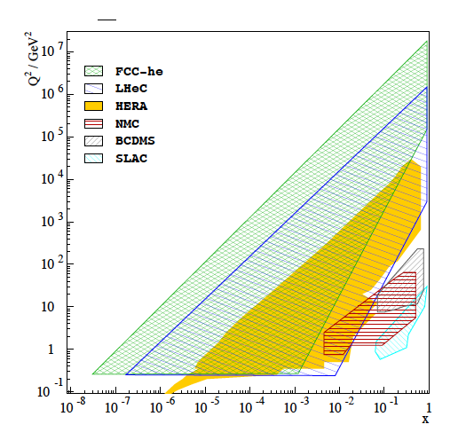
Higgs factory
BSM in ep and pp
New QCD+El.weak physics
The world’s cleanest
possible microscopes
of hadronic substructure
Design study of new ep (and eA) colliders based on the LHC and FCC hadron beams
Huge extension of kinematic range wrt HERA. Luminosity O(10³⁴) → 1 ab⁻¹ (vs 1 fb⁻¹ HERA)

Slide 3
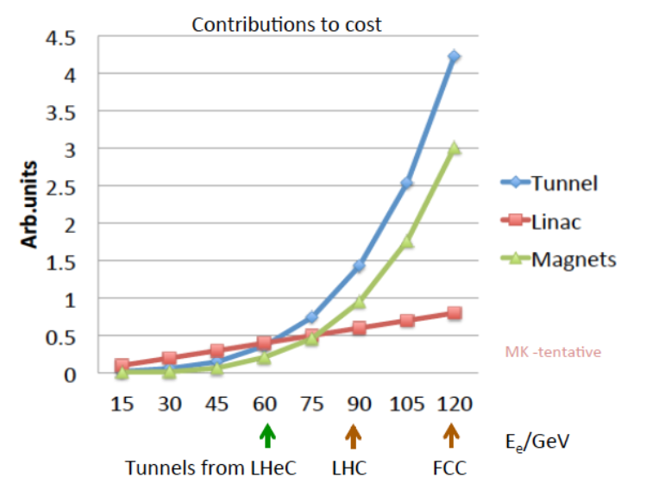
Choice of Baseline Configuration = f(cost,E_{e},s)
Cost strongly rising with tunnel circumference. Presently stick to LHeC default.
Maximise independence of ring installation, design for synchronous ep and pp OP

Slide 4
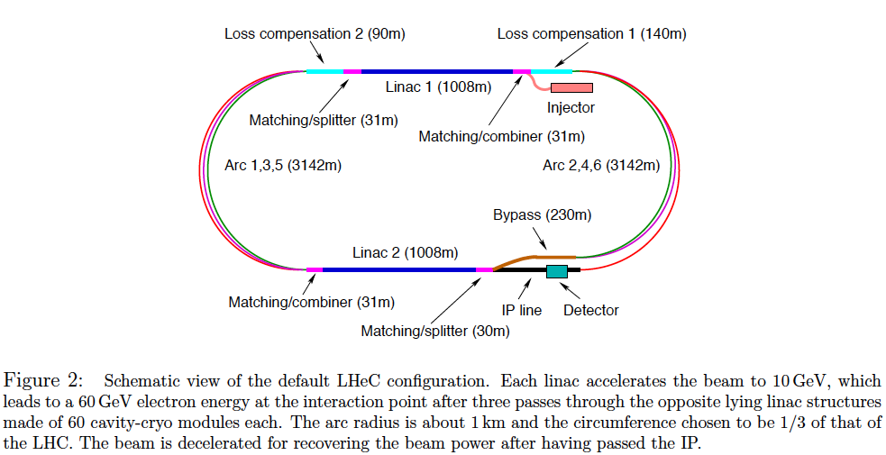
Baseline Electron Beam Configuration*⁾
*) LHeC CDR, arXiv:1206.2913

Slide 5
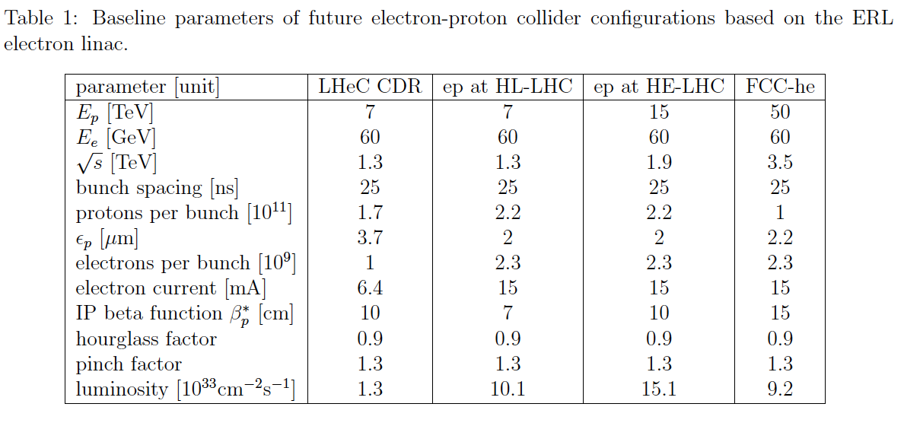
Current Baseline Parameters
4.3.2016

Slide 6
Further, ongoing considerations:
Consider variations of baseline:
peak luminosity of beginning and at the end of run
performance with ‘ultimate’ assumptions
dedicated ep: worth considering: O(10) times higher luminosity
brightness, constant p current during operation, lifetime, β*
include eA estimates
Plan: An FCC note for Rome and a paper following that.

Slide 7
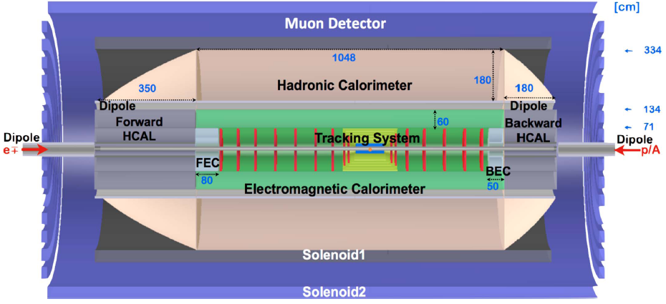
FCC-he Detector (B)
Version B of FCC-eh detector design (twin solenoid version)L L=20m, D=10m, about.
P.Kostka et al.

Slide 8
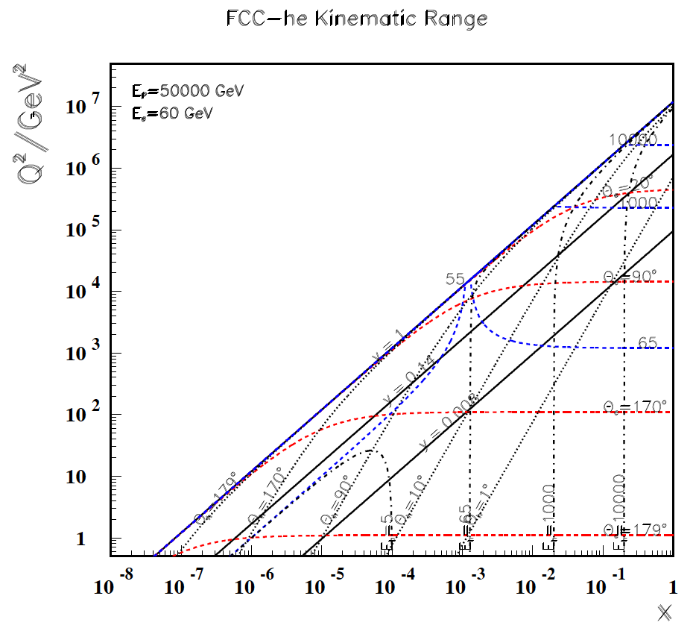
→ Kinematics covered despite the big Ee-Ep asymmetry, high x needs LHeC before

