Slide 1
Remarks on FCC-he
Max Klein and Rogelio Tomás
U Liverpool and CERN
For the FCC-he Study Group
Introduction
Physics
IR and Parameters
Outlook
ICHEP, Valencia, 4th of July, 2014
http://lhec.web.cern.ch
he = ep and eA: part of the FCC study as an configuration designed to be available when pp runs.

Slide 2
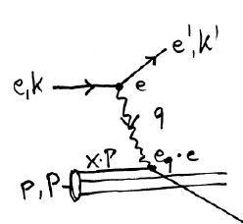
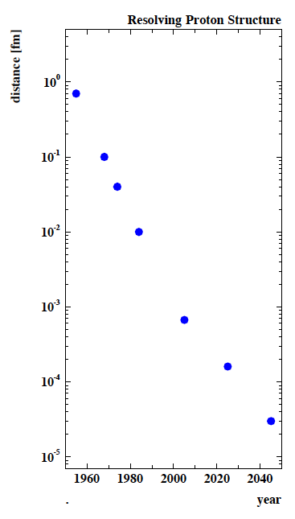
Deep Inelastic Scattering [eh → e’X]
e⁺e⁻
HERA-LHeC-FCC-eh: finest microscopes
with resolution varying like 1/√Q²
→
eh →
Finite p Radius
X
Stanford
→
Quarks
SLAC
hh
FNAL
Quark
Gluon
Dynamics
Parton momentum fixed by electron kinematics
Incl. NC (γ,Z) and CC (W±) independent of hadronisation
Rigorous theory: Operator expansion (lightcone)
Parton momentum distributions to be measured in DIS
Collider- HERA: y_{h}=y_{e} : Redundant kinematics
CERN
100 years of lp scattering
→ 5 orders of magnitude
deeper into matter
HERA
LHeC
?
FCC-he
electromagnetic radius

Slide 3
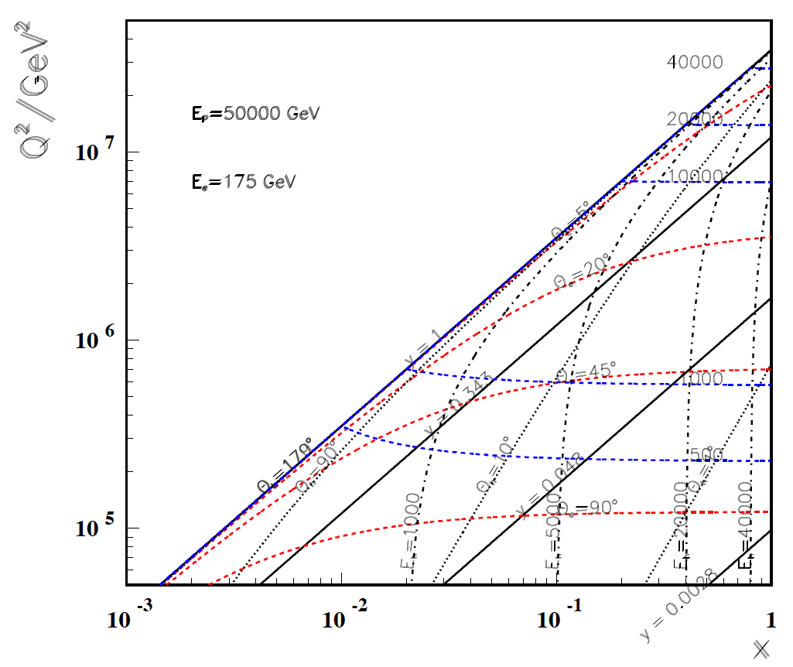
High Q²
Rutherford backscattering
of dozens of TeV e- energy
FCC-he
175 GeV
60 GeV
LHeC
← ϑ_{h}=1º
Large imabalance
of e and p energies
is surprisingly
tolerable for the
high Q², x kinematics,
LHeC to bridge
from HERA to FCC
← HERA

Slide 4
Energy Frontier DIS
Also see physics talks at kickoff: Cole, D’Onofrio, Klein (2x)

Slide 5
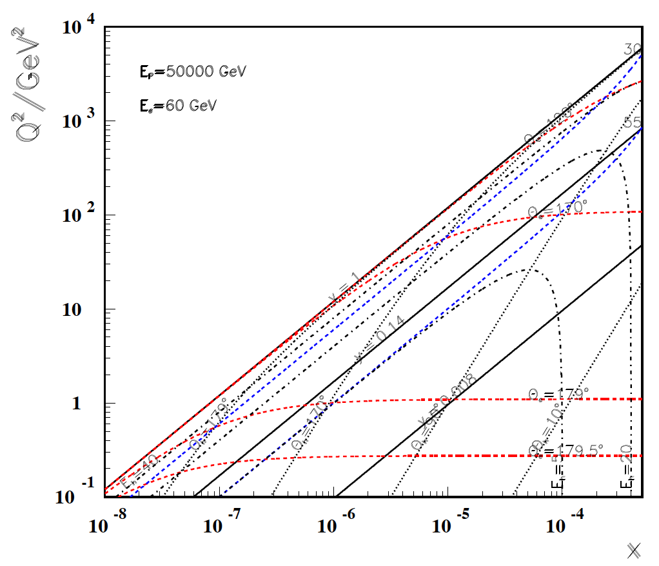
Low x
FCC-he
60 GeV
LHeC
Backward
region, low x
is governed
solely by E_{e}!
-----------
179º
@ 180 GeV
.. very low x
requires not
the maximum
of E_{e}
Very low x
reaches
direct
range of
UHE
neutrino
physics →
HERA
x
For x < 10⁻³ no (average) energy deposition exceeding the electron beam energy

Slide 6
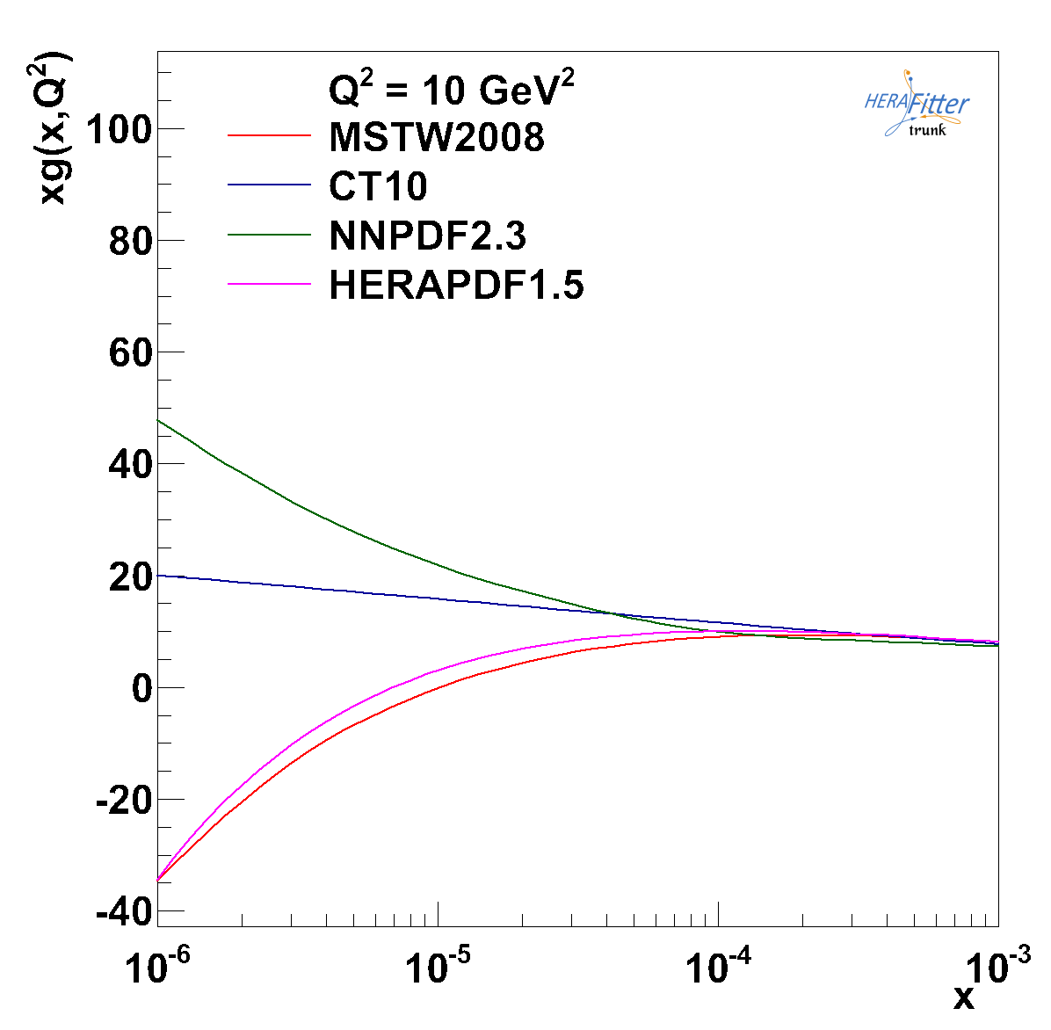
PDFs – example: gluon xg at low x
No clue about xg
for x < 10⁻⁴
Evolution law unlikely
to be linear DGLAP
Precision PDFs for FCC
search program
test of factorisation,
resummation…
Affects FCC-pp rates
because
x=M/√(s) exp(+-y)
LHeC →
HERA →
FCC-he →

Slide 7
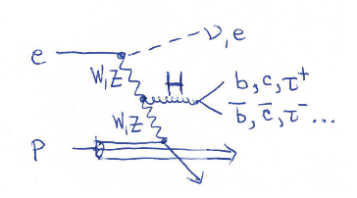
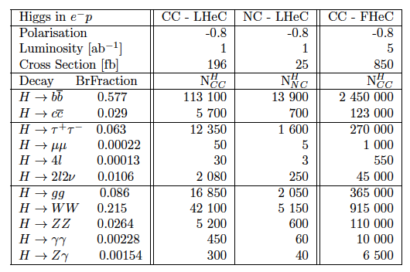
From Higgs facility (LHeC) to Higgs ‘factory’ (FCC-he)
Cross section
1pb ep→ vHX
Luminosity
> 10³⁴ crucial
for H → HH
0.5 fb
and rare decays

Slide 8
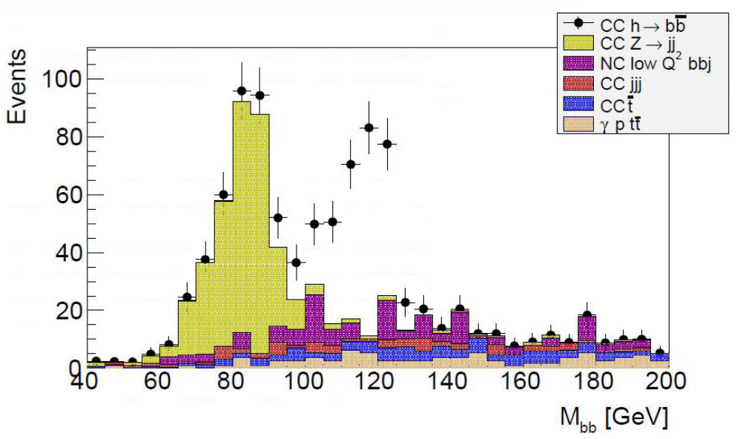
H → bbar
LHeC
Clean Higgs
physics in ep
LHeC
cut based analysis
S/B ~ 1
With FCC_he
have an order
of magnitude more
Higgs bosons
(higher cross section)
than with LHeC
and the ILC
100 times this signal!
ep (new) Simulation 100 fb⁻¹
With DIS and yp (top..) background, cut based!
See Poster U. Klein Higgs in ep – this conference

Slide 9
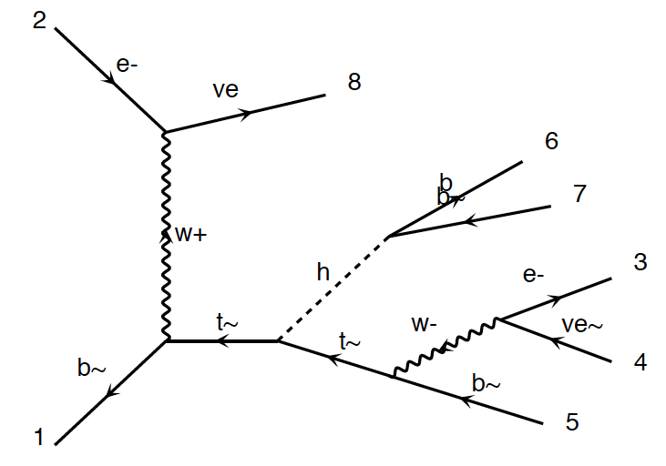
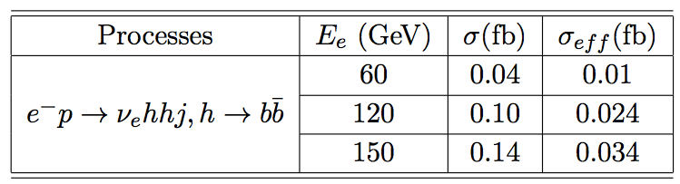
HH and tHt in ep
New
Tentative
Studies
FCC-he unpolarised
Cross section at 3.5 TeV:
total : 0.7 fb
fiducial : 0.2 fb
using pt(b,j)>20 GeV
ΔR(j.b)>0.4
η(j) <5
η(b) < 3
Polarisation, max lumi, tuning cuts, bb and WW
decays may provide O(10%) precision - tentative
Require time for reliable result
(detector, analysis, backgrounds..)
Uta Klein, Masahiro Khuze, Bruce Mellado et al

Slide 10
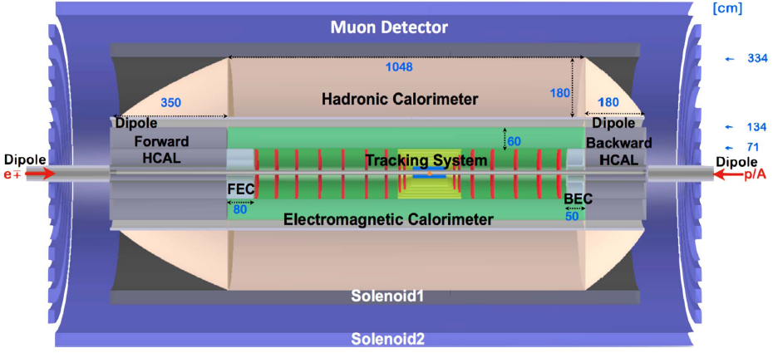
FCC-he Detector (B) – 0.1
Crab cavities for p instead of dipole magnet for e bend to ensure head on collisions
1000 H → μμ may call for better muon momentum measurement
H→ HH → 4b (and large/low x) call for large acceptance and optimum hadr. E resolution
Detector for FCC scales by about ln(50/7) ~2 in fwd, and ~1.3 in bwd direction
Full simulation of LHeC and FCC-he detectors vital for H and H-HH analysis
P.Kostka et al.

Slide 11
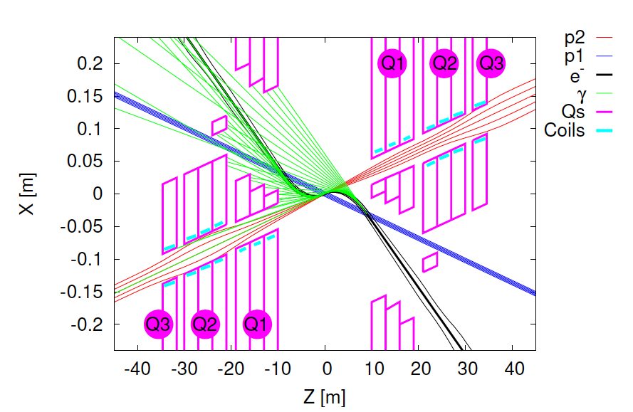
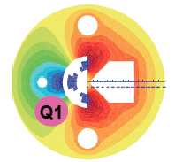
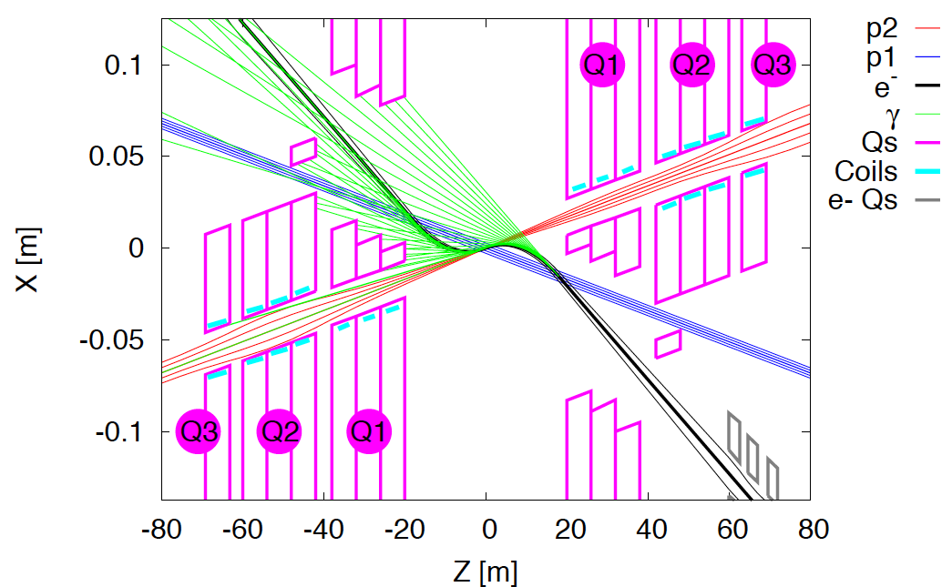
Interaction Regions for ep with Synchronous pp Operation
LHeC (CDR)
60 GeV * 7 TeV
Still work in progress:
may not need half
quad if L*(e) < L*(p)
Non colliding p beam
FCC-he (ERL)
60 GeV * 50 TeV
Tentative: ε_{p}=2μm, β*=20cm → σ_{p}=3μm ≈σ_{e} matched! ε_{e}=5μm ..

Slide 12
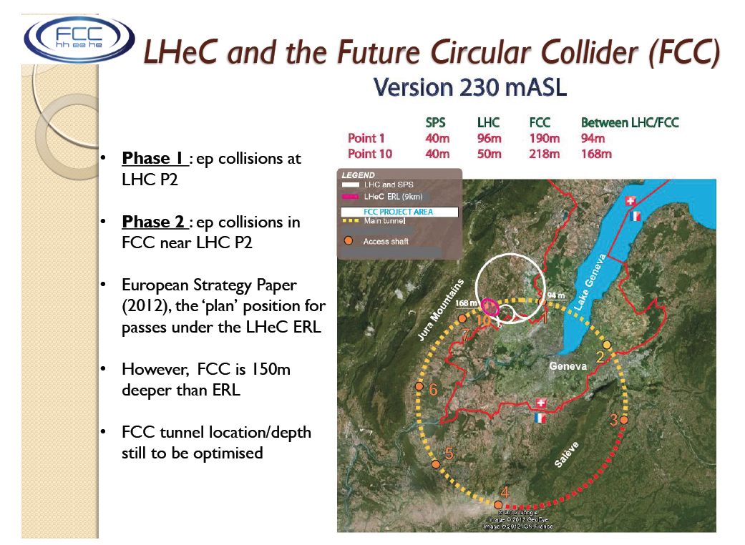
title
J Osborne at IAC Meeting 6/14

Slide 13
collider parameters | FCC ERL | FCC-ee ring |  | protons
species | e⁻ (e⁺?) | e± | e± | p
beam energy [GeV] | 60 | 60 | 120 | 50000
bunches / beam | - | 10600 | 1360 | 10600
bunch intensity [10¹¹] | 0.05 | 0.94 | 0.46 | 1.0
beam current [mA] | 25.6 | 480 | 30 | 500
rms bunch length [cm] | 0.02 | 0.15 | 0.12 | 8
rms emittance [nm] | 0.17 | 1.9 (x) | 0.94 (x) | 0.04 [0.02 y]
β_{x,y}*[mm] | 94 | 8, 4 | 17, 8.5 | 400 [200 y]
σ_{x,y}* [μm] | 4.0 | 4.0, 2.0 |  | equal
beam-b. parameter ξ | (D=2) | 0.13 | 0.13 | 0.022 (0.0002)
hourglass reduction | 0.92 (H_{D}=1.35) | ~0.21 | ~0.39
CM energy [TeV] | 3.5 | 3.5 | 4.9
luminosity[10³⁴cm⁻²s⁻¹] | 1.0 | 6.2 | 0.7
F.Zimmermann
ICHEP14, June
PRELIMINARY

Slide 14
Possible Developments and Discoveries
AdS/CFT
Instantons
Odderons
Non pQCD
QGP
N^{k}LO
Resummation
Saturation and BFKL
Non-conventional PDFs …
Take QCD as an important area
Breaking of Factorisation
Free Quarks
Unconfined Color
New kind of coloured matter
Quark substructure
New symmetry embedding QCD
QCD may break .. (Quigg DIS13)
The LHeC and the FCC-he are not more of the same but may change our view on the
substructure of matter (why differ leptons from quarks?) and lead beyond the SM!

Slide 15

New LHeC International Advisory Committee
The IAC was invited in 12/13 by the DG with the following
Guido Altarelli (Rome)
Sergio Bertolucci (CERN)
Nichola Bianchi (Frascati)
Frederick Bordry (CERN)
Stan Brodsky (SLAC)
Hesheng Chen (IHEP Beijing)
Andrew Hutton (Jefferson Lab)
Young-Kee Kim (Chicago)
Victor A Matveev (JINR Dubna)
Shin-Ichi Kurokawa (Tsukuba)
Leandro Nisati (Rome)
Leonid Rivkin (Lausanne)
Herwig Schopper (CERN) – Chair
Jurgen Schukraft (CERN)
Achille Stocchi (LAL Orsay)
John Womersley (STFC)
Mandate 2014-2017
Advice to the LHeC Coordination Group and the CERN directorate
by following the development of options of an ep/eA
collider at the LHC and at FCC, especially with:
Provision of scientific and technical direction for the physics
potential of the ep/eA collider, both at LHC and at
FCC, as a function of the machine parameters and of a
realistic detector design, as well as for the design and
possible approval of an ERL test facility at CERN.
Assistance in building the international case for the accelerator
and detector developments as well as guidance to the resource,
infrastructure and science policy aspects of the ep/eA collider.
*) IAC Composition June 2014, and
Oliver Brüning Max Klein ex officio

Slide 16
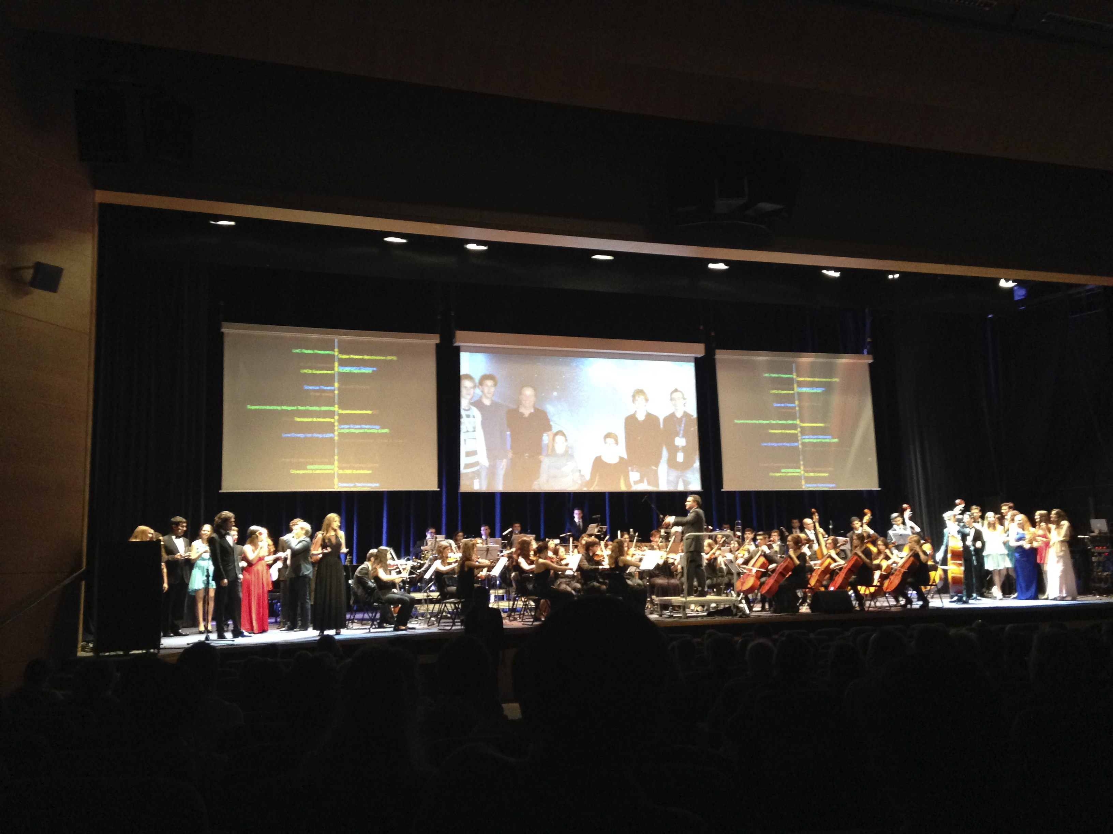
title
Thank you
Further information: FCC kickoff meeting at Geneva, (2 plenaries, 7 parallel) + FCC-hh workshop, May 14
lhec.web.cern.ch

Slide 17
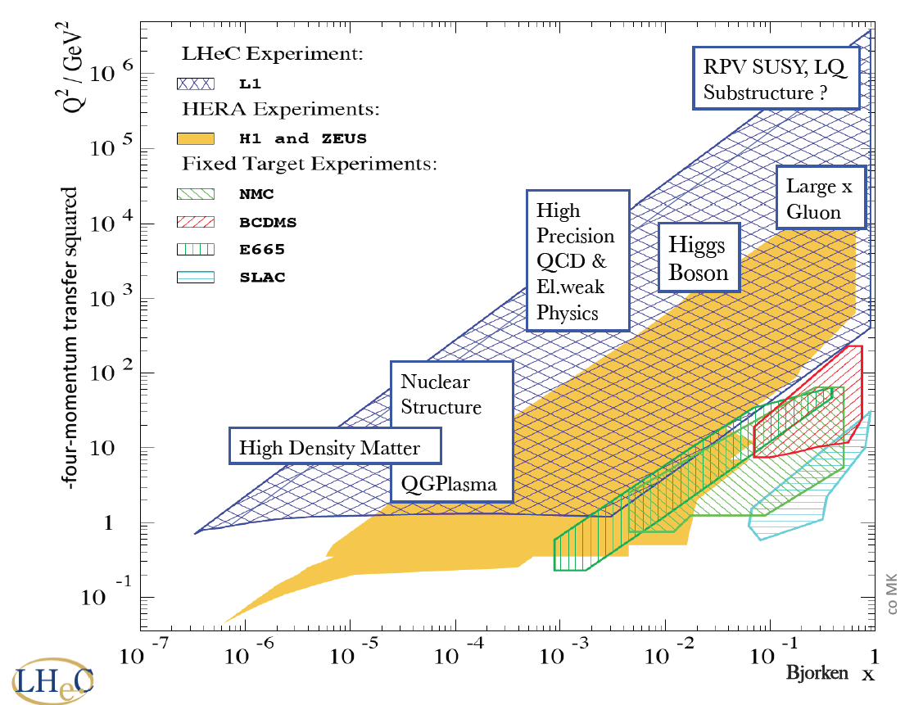
New dreieck
FCC_he

Slide 18
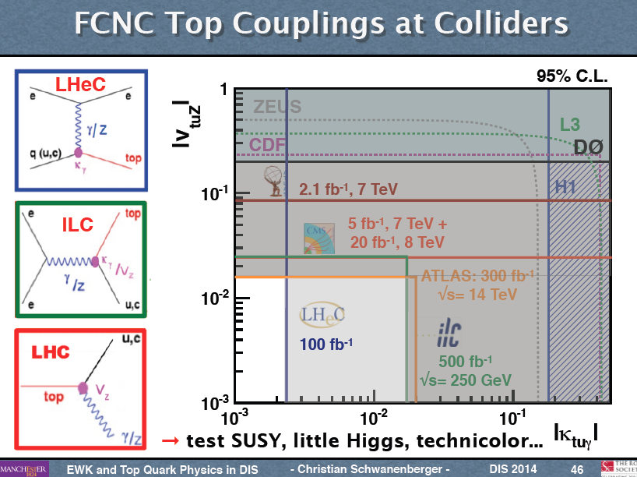
Top Quark Physics

