Slide 1

Energy Frontier DIS
Studies on Physics with the LHeC and the FCC_he
Max Klein
U Liverpool and CERN
For the LHeC Study Group
Beyond HERA
QCD (PDFs)
Nuclear Structure
Electroweak
Higgs
BSM
A Way Forward
Talk at the 1st FCC_hh Workshop, CERN, Geneva, 27. May 2014
http://lhec.web.cern.ch
← new web page since weekend

Slide 2
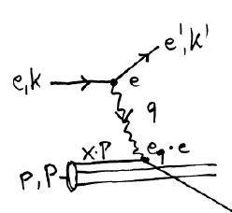
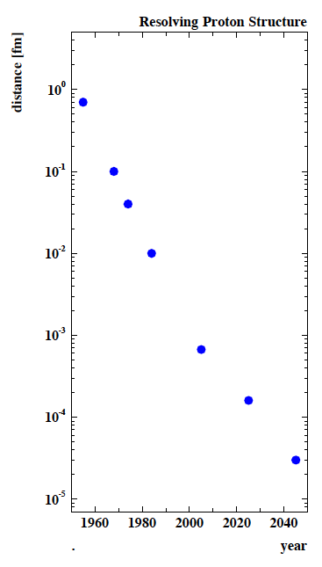
Deep Inelastic Scattering [eh → e’X]
e⁺e⁻
HERA-LHeC-FCC-eh: finest microscopes
with resolution varying like 1/√Q²
→
eh →
Finite p Radius
X
Stanford
→
Quarks
SLAC
hh
FNAL
Quark
Gluon
Dynamics
Parton momentum fixed by electron kinematics
Incl. NC (γ,Z) and CC (W±) independent of hadronisation
Rigorous theory: Operator expansion (lightcone)
Parton momentum distributions to be measured in DIS
Collider- HERA: y_{h}=y_{e} : Redundant kinematics
CERN
100 years of lp scattering
→ 5 orders of magnitude
deeper into matter
HERA
LHeC
?
FCC-he
electromagnetic radius

Slide 3
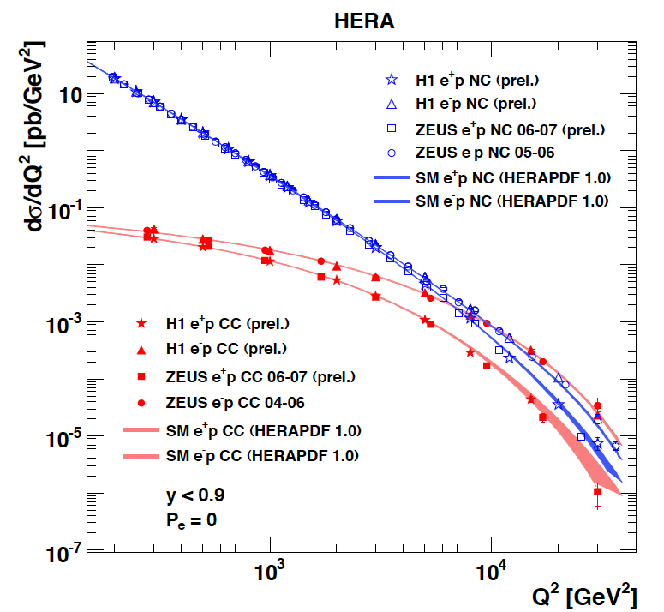
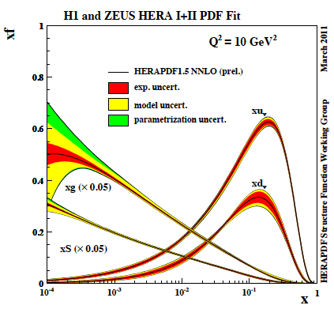
Beyond HERA
HERA has been a huge success, and of crucial relevance for the LHC, final data to come
L low → no access to high x (or H) E low → DGLAP seemingly ok at low x
Discoveries were beyond 319 GeV..
Need: L=O(10³⁴) for H, high Q²; high precision for high x (e-h); N³LO (H,alphas-s)
acceptance: electrons up to 179 (low Q²), hadrons down to 1 (fwd jets)

Slide 4
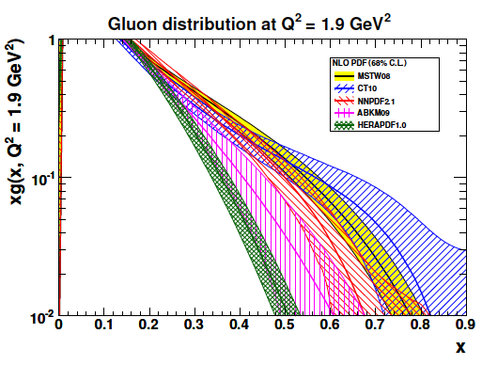
(Un)certainty on PDFs
Light Quarks:
valence x < 0.01, u_{v} x > 0.8, d_{v} x>0.6
light sea (related to strange) -8% ATLAS/F₂,
light sea quark asymmetry, d/u=?
Isospin relations (en!) ??
Strange: unknown, =dbar? strange valence?
Charm: need high precision to % for α_{s}
(recent HERA 5%)
Beauty: HERA 10-20%, bb → A?
Top: tPDF at high Q² >M_{t}² - unknown
Gluon: low x, saturation?, high x - unknown
medium x: preciser for Higgs!
Recent review: cf E.Perez, E.Rizvi 1208.1178, in RPP
..unintegrated, diffractive, generalised,
polarised, photonic, nuclear PDFs ???
A new, required level of determination of PDFs can only be achieved with the LHeC.

Slide 5
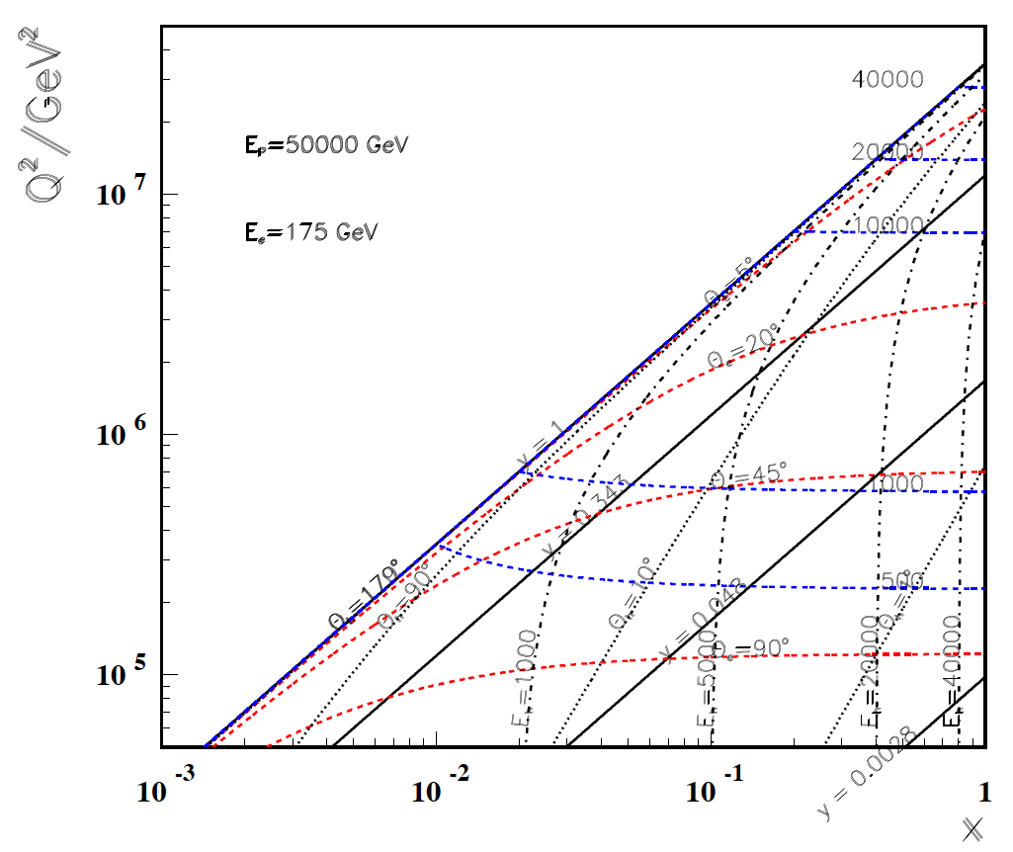
High Q²
Rutherford backscattering
of dozens of TeV e- energy
FCC-he
175 GeV
60 GeV
LHeC
← ϑ_{h}=1º
← HERA

Slide 6
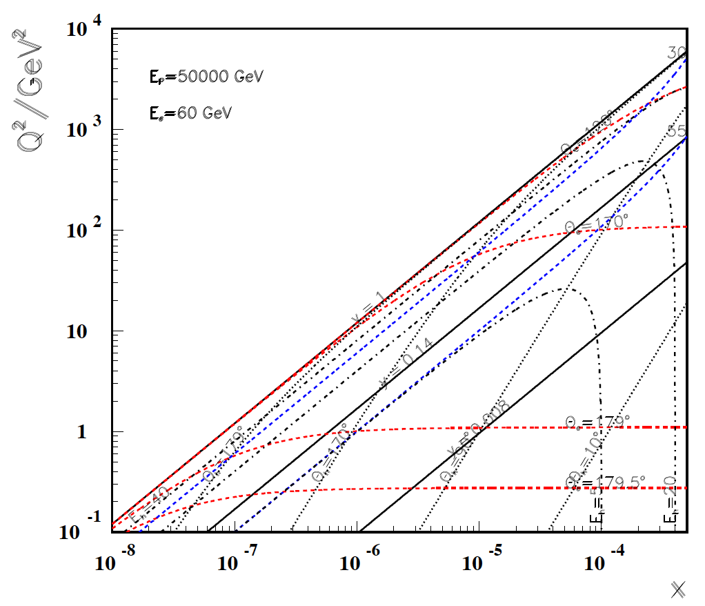
Low x
FCC-he
60 GeV
LHeC
-----------
179º
@ 180 GeV
.. very low x
requires not
the maximum
of E_{e}
Very low x
reaches
direct
range of
UHE
neutrino
physics →
HERA
x
For x < 10⁻³ no (average) energy deposition exceeding the electron beam energy

Slide 7
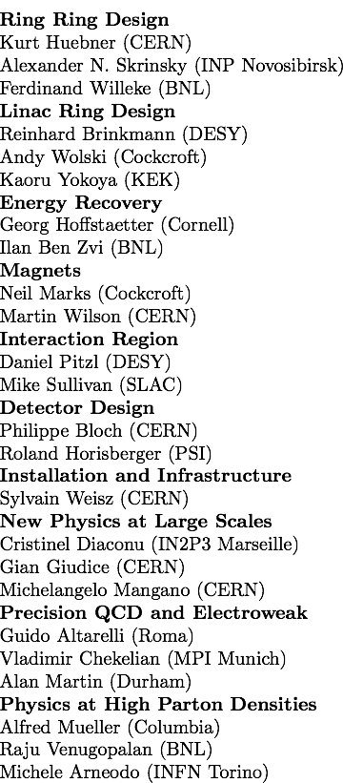
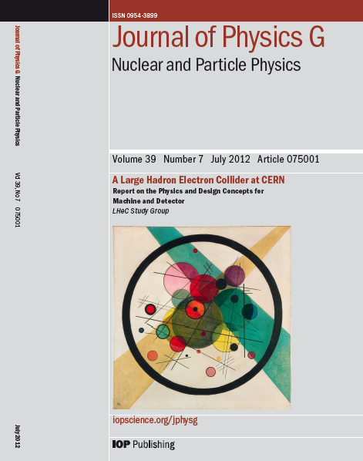
Design Report 2012
CERN Referees
arXiv:1206.2913 http://cern.ch/lhec
The theory of DIS has developed much further: J.Blümlein Prog.Part.Nucl.Phys. 69(2013)28
DIS is an important part of particle physics: G.Altarelli, 1303.2842, S.Forte, G.Watt 1301:6754

Slide 8
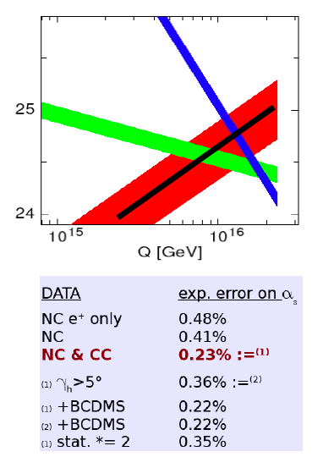
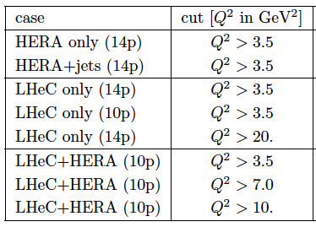
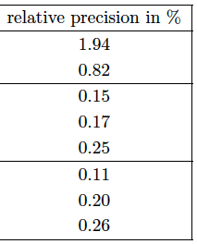
Strong Coupling Constant
α_{s} least known of coupling constants
Grand Unification predictions suffer from δα_{s}
DIS tends to be lower than world average (?)
LHeC: per mille - independent of BCDMS.
Challenge to experiment and to h.o. QCD →
A genuine DIS research programme rather than
one outstanding measurement only.
1/α
fine structure
weak
strong
Two independent QCD analyses using LHeC+HERA/BCDMS

Slide 9
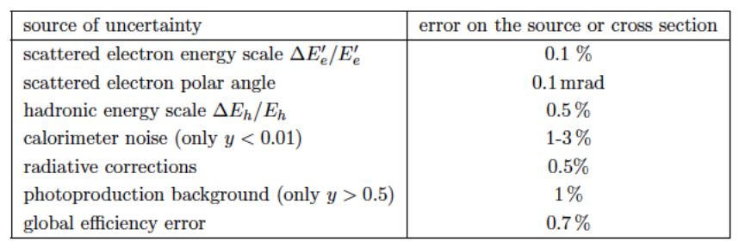
Simulated LHeC Data (Note=CDR=OLD)
Scenario “B”: (Lumi e^{+/-}p = 50 fb⁻¹) Ep=7 TeV, Ee=50 GeV, Pol=±0.4
  Kinematic region: 2 < Q² < 500 000 GeV² and 0.000002 < x < 0.8
Scenario “H”: (Lumi e⁻p = 1 fb⁻¹) Ep=1TeV, Ee=50 GeV, Pol=0
  Kinematic region: 2 < Q² < 100 000 GeV² and 0.000002 < x < 0.8
Typical uncertainties:
Full simulation of NC and CC inclusive cross section measurements including statistics, uncorrelated and correlated uncertainties – based on typical best values achieved by H1
  Statistical it ranges from 0.1% (low Q²) to ~10% for x=0.7 in CC
  Uncorrelated systematic: 0.7 %
  Correlated systematic: typically 1-3% (for CC high x up to 9% )
This set is available on LHAPDF

Slide 10
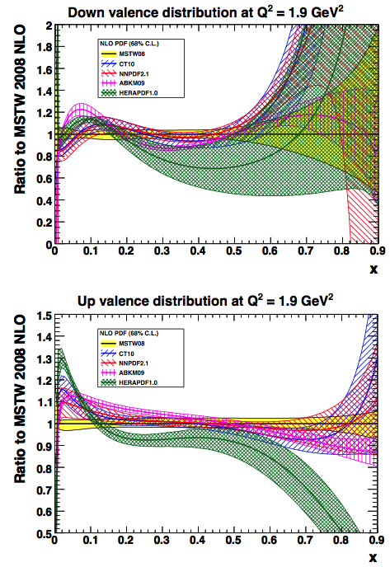
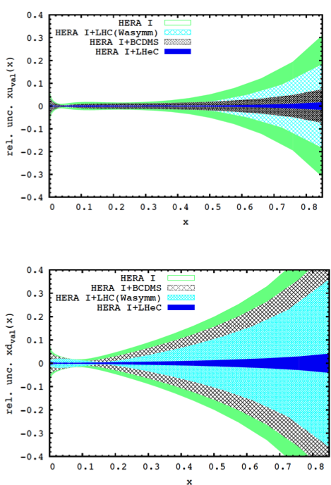
Valence quark distributions
Now…
…Then
Current knowledge is limited at high x:
  Lumi barrier
  challenging systematic
  nuclear effects
  Effects of higher
  twists
LHeC could improve the knowledge of the valence at high x to a precision of:
  2% (uval) x=0.8
  4% (dval) x=0.8
  Important for d/u limit clarification
dval
uval
uval
dval

Slide 11
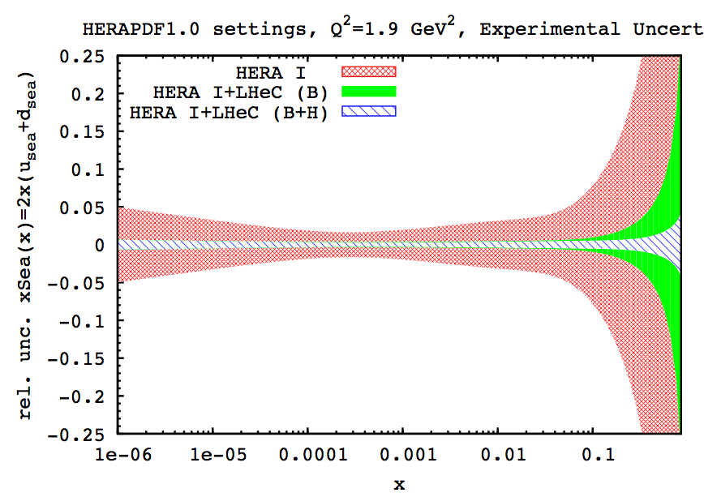
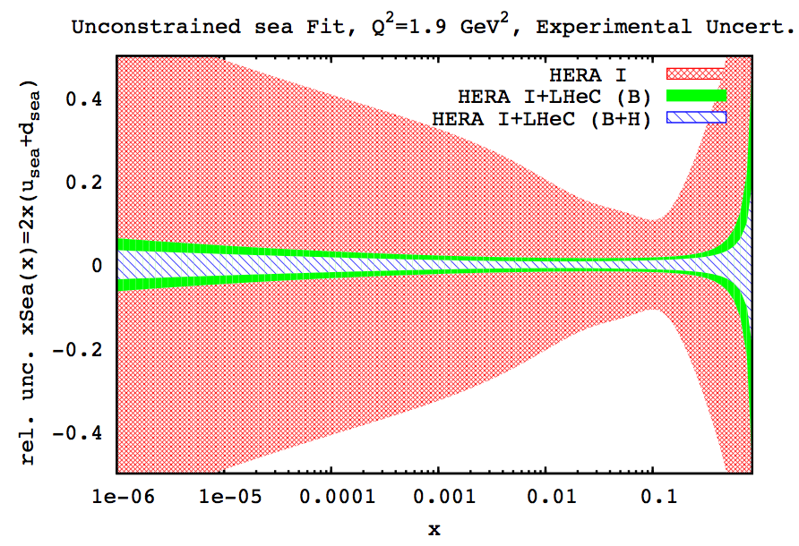
Unconstrained setting at low x
Usual assumptions for light quark decomposition at low x may not necessary hold.
Relaxing the assumption at low x that u=d , we observe that uncertainties escalate:
constrained (u=d)
unconstrained
  One can see that for HERA data, if we relax the low x constraint on u and d,the errors are increased tremendously!
  However, when adding the LHeC simulated data, we observe that uncertainties are visibly improved even without this assumption.
  Further important cross check comes from the deuteron measurements, with tagged spectator and controlling shadowing with diffraction…

Slide 12
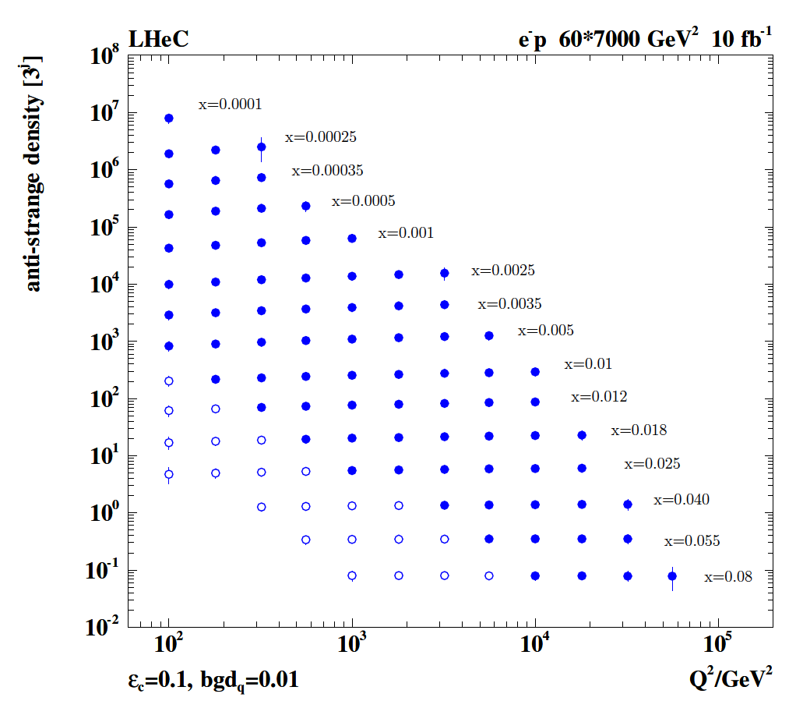

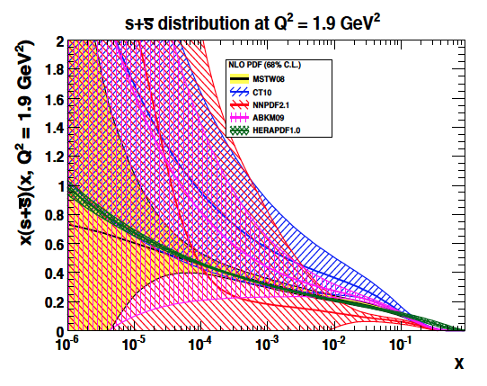
Strange Quark Distribution
High luminosity
High Q²
Small beam spot
Modern Silicon
NO pile-up..
First (x,Q²)
measurement of
the (anti-)strange
density, HQ valence?
x = 10⁻⁴ .. 0.05
Q² = 100 – 10⁵ GeV²
Initial study (CDR): Charm tagging efficiency of 10% and 1% light quark background in impact parameter

Slide 13
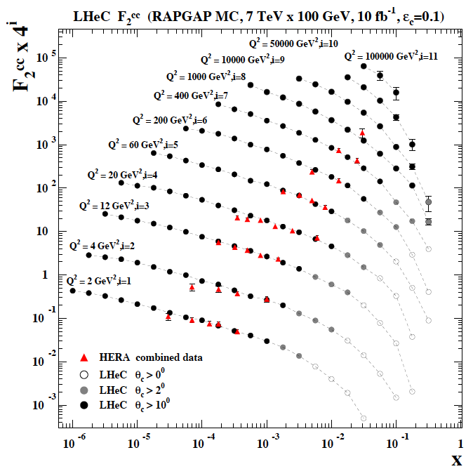
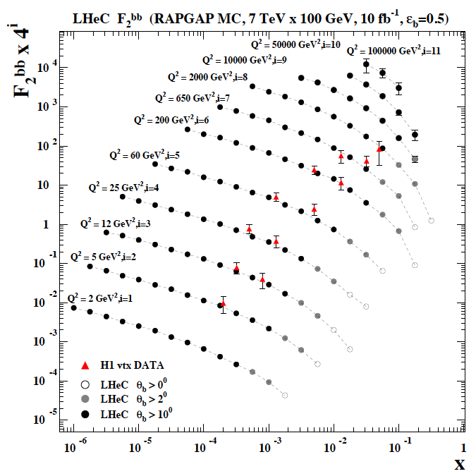
F₂^{charm} and F₂^{beauty} from LHeC
Hugely extended range and much improved precision (δM_{c}=60 HERA → 3 MeV)
will pin down heavy quark behaviour at and far away from thresholds, crucial for precision t,H..
In MSSM, Higgs is produced dominantly via bb → H (Pumplin et al) , but where is the MSSM..

Slide 14
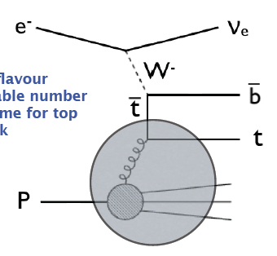
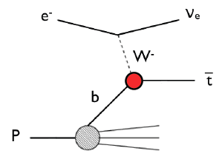
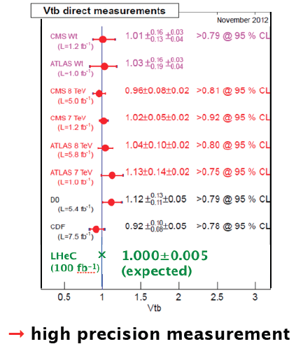
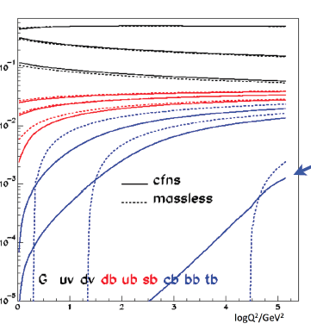
Top PDF
Vtb
TDF
momentum fraction
6 VFNS - at very high Q² top gets ‘light’

Slide 15
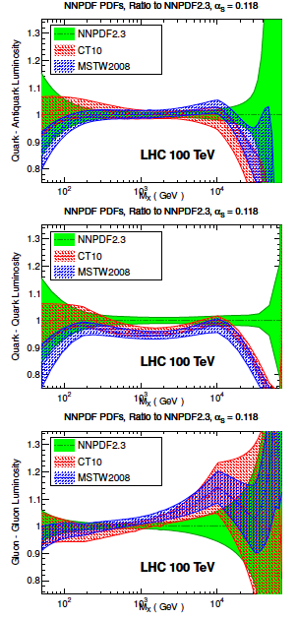
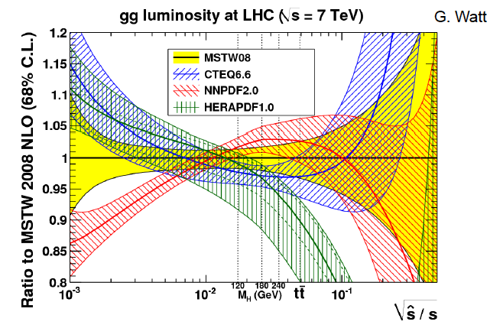
FCC_hh and L(gg)
Need to know the PDFs much better than
so far, for nucleon structure, q-g dynamics,
Higgs, searches, future colliders FCC-hh,
and for the development of QCD.
The LHC will provide further constraints too
but cannot resolve them precisely (MCS).
Snowmass13 QCD WG report J.Rojo

Slide 16
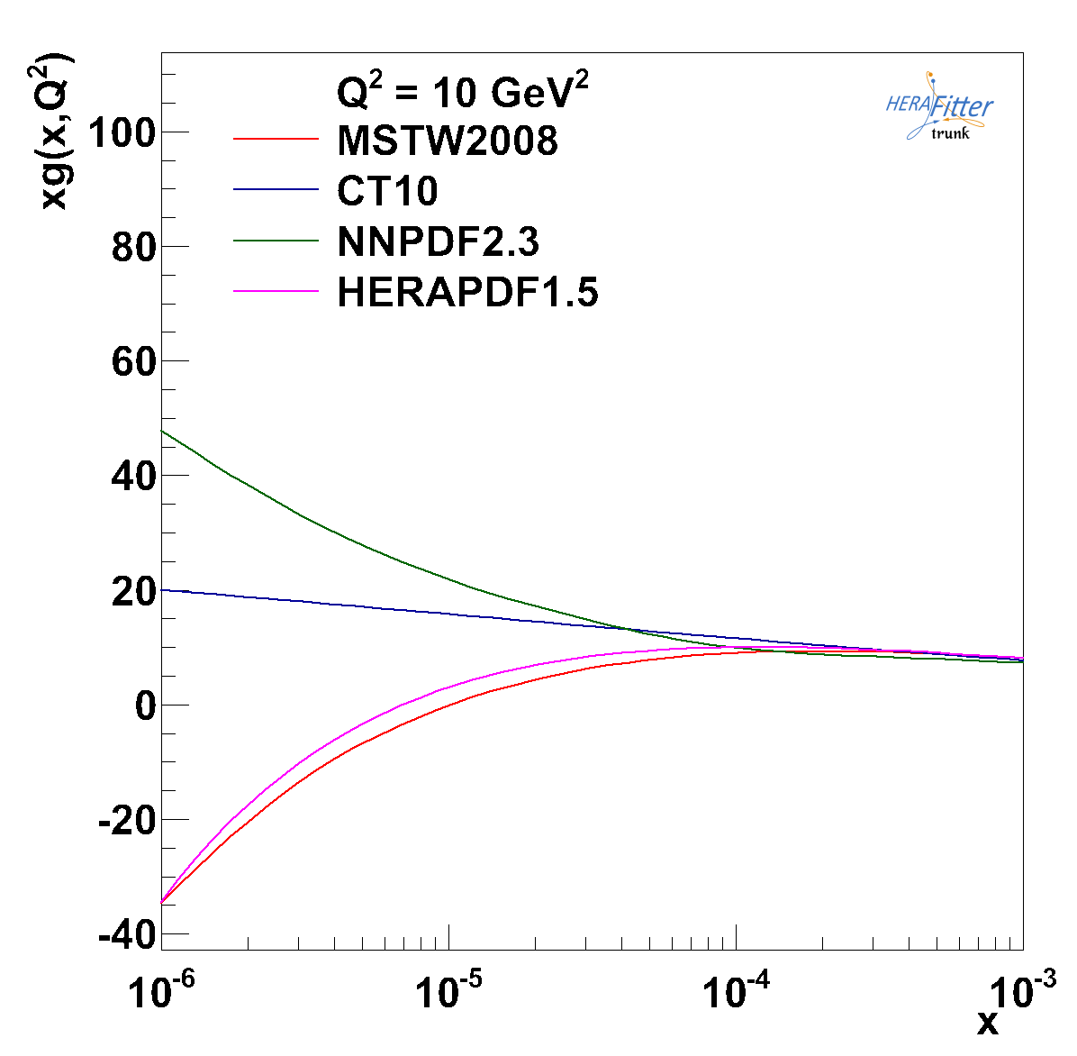
xg at low x
No clue about xg
for x < 10⁻⁴
Evolution law may
not be DGLAP
Affects FCC-pp rates
because
x=M/sqrt(s) exp(+-y)

Slide 17
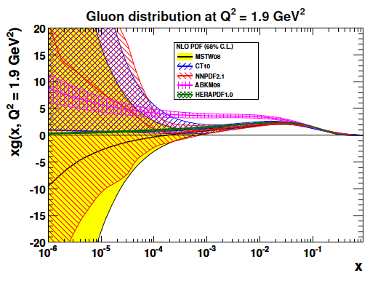
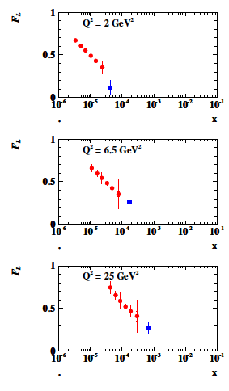
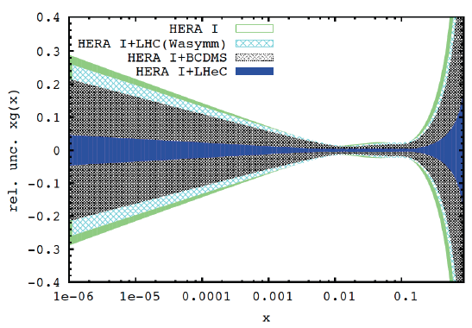
Gluon Saturation at Low x?
LHeC
H1
Gluon measurement down to x=10⁻⁵, Saturation or no saturation (F₂ and precise F_{L})
Non-linear evolution equations? Relations to string theory, and SUSY at ~10 TeV?
cf H.Kowalski, L.Lipatov, D.Ross, arXiv:1205.6713

Slide 18
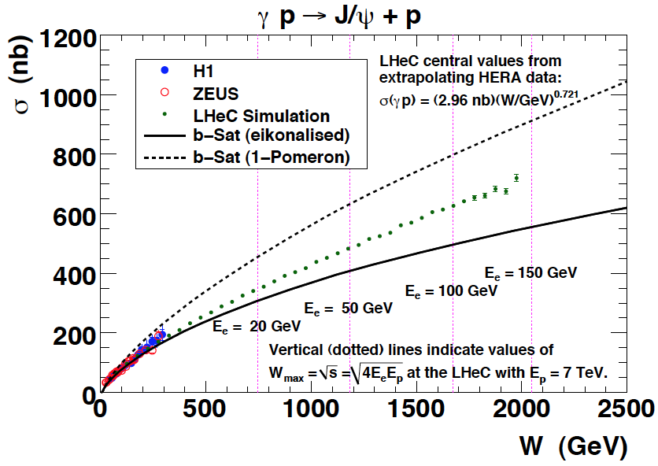
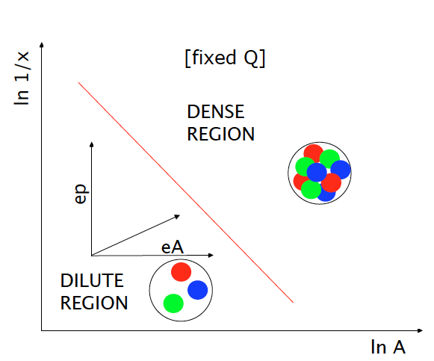
Vector Mesons
Precision Measurements of vector mesons and diffraction to very high M_{X} ~ xg²
FCC-he
LHeC
HERA
5 TeV
W = √ (ys) extends to ~ 4 TeV at FCC-he
Black body limit, interference pattern of σ
Higher energy (1/x), higher A

Slide 19
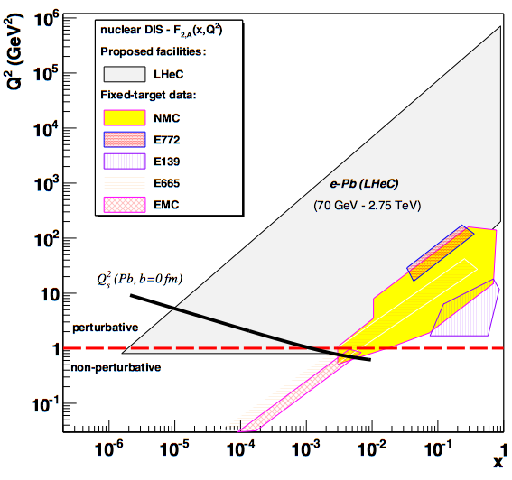
LHeC-FCC_he: Electron Ion Collider
FCC-he
LHeC is part of NuPECCs
long range plan since 2010
L_{eN} ~ 10³² cm⁻² s⁻¹
Extension of kinematic range in lA
by 4-5 orders of magnitude will
change QCD view on nuclear
structure and parton dynamics
May lead to genuine surprises…
No saturation of xg (x,Q²) ?
Small fraction of diffraction ?
Broken isospin invariance ?
Flavour dependent shadowing ?
Expect saturation of rise at
Q²_{s} ≈ xg α_{s} ≈ c x^{-λ}A^{1/3}
Precision QCD study of parton dynamics in nuclei
Investigation of high density matter and QGP
Gluon saturation at low x, in DIS region.

Slide 20
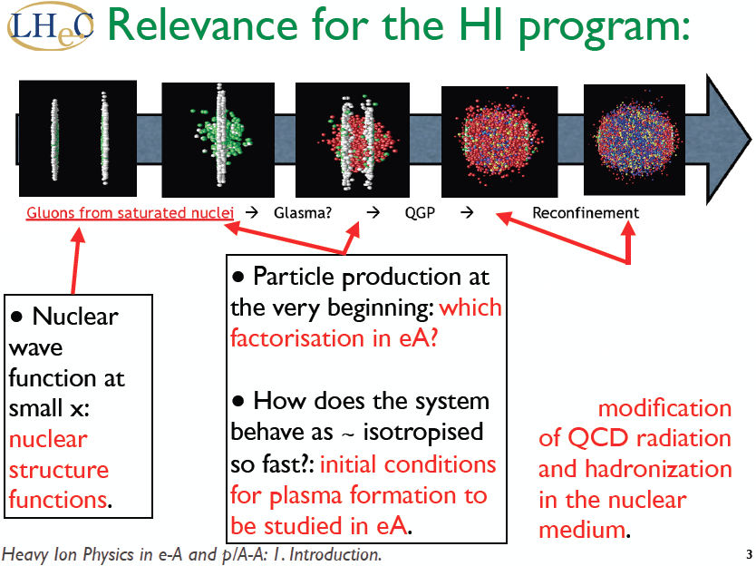
Energy Frontier DIS
Nestor Armesto Chavannes 1/14

Slide 21
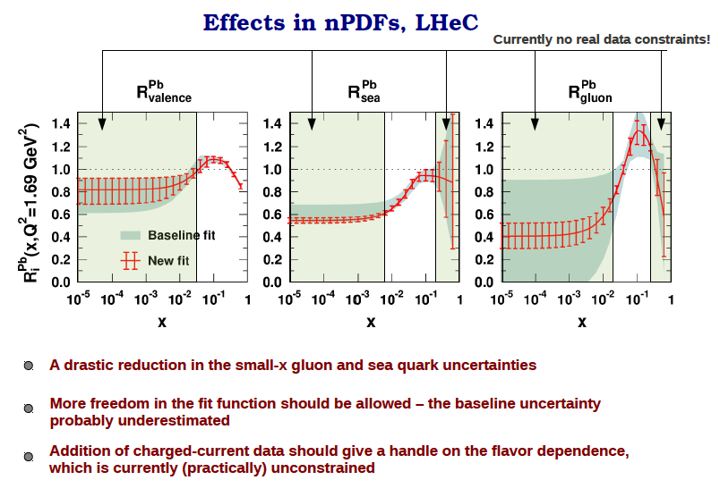
Energy Frontier DIS
Hannu Paukkunen, Chavannes LHeC Workshop 1/14

Slide 22
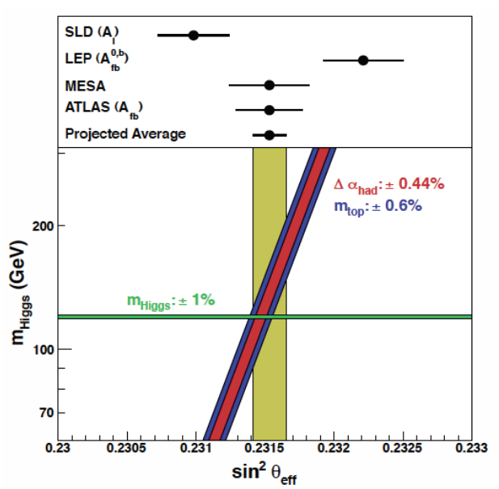
Electroweak Physics in ep
In Deep Inelastic Scattering:
Polarisation Asymmetry A⁻(Q)
NC-to-CC Ratio R- for P=±0.8
Measure weak mixing angle
redundantly with very
high precision of about 0.0001
as a function of the scale.
1% δM_{top} is about δ = 0.0001
PDF uncertainty comes in at
second order and ep provides
very precise PDFs
LHeC
*)
*) first rough estimate, scheme dependent, syst+thy errors..

Slide 23
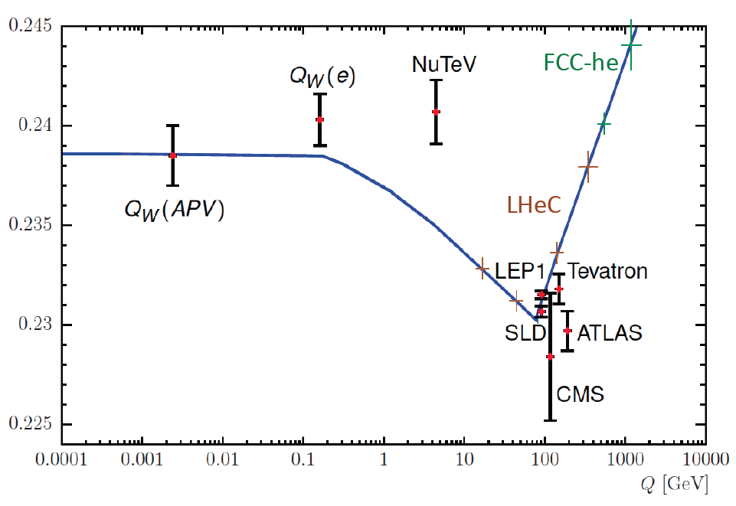
Scale dependence of sin²θ_{W}
Preliminary illustration

Slide 24
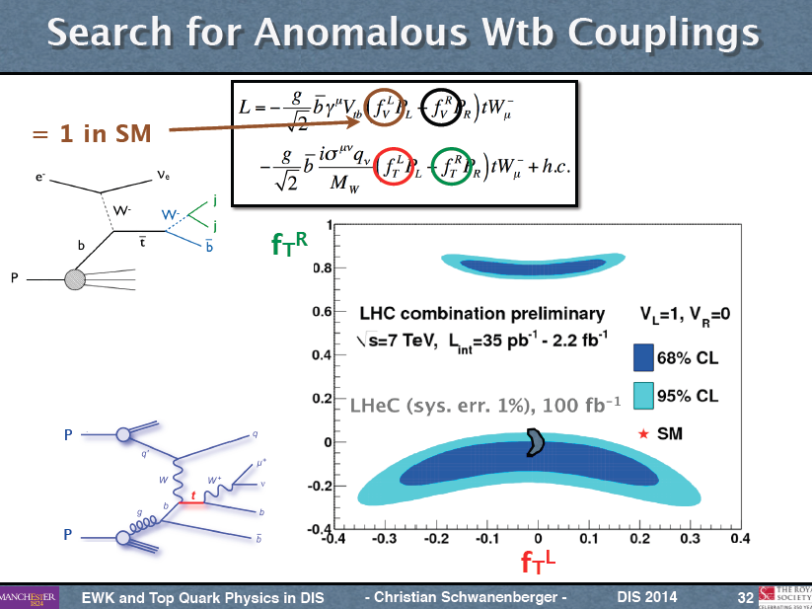

Top Quark Physics

Slide 25
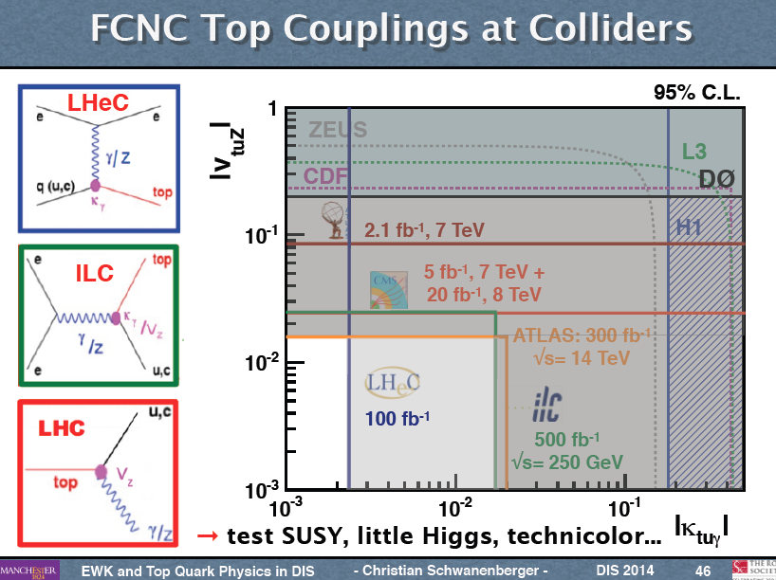
Top Quark Physics

Slide 26
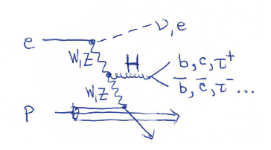
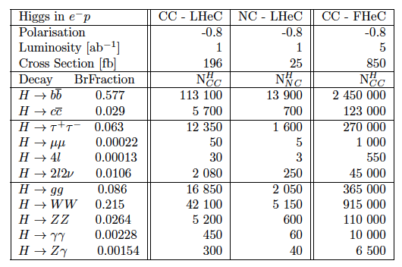
From Higgs facility (LHeC) to Higgs ‘factory’ (FCC-he)
Cross section
1pb ep→ vHX
Luminosity
> 10³⁴ crucial
for H → HH
0.5 fb
and rare decays
First sets of
Parameters for
LR and RR

Slide 27
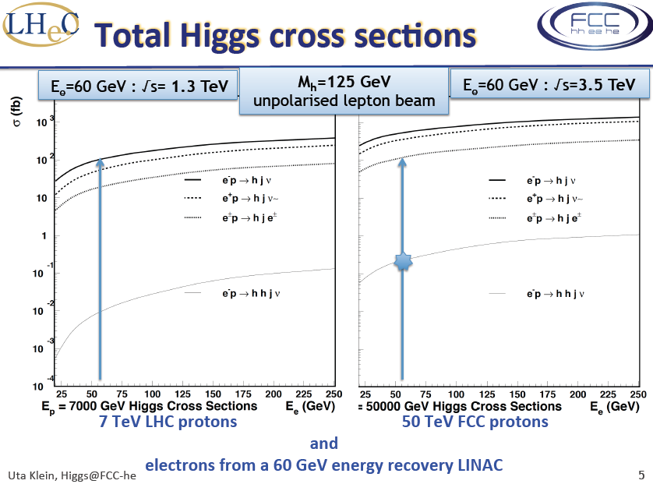
Introduction

Slide 28
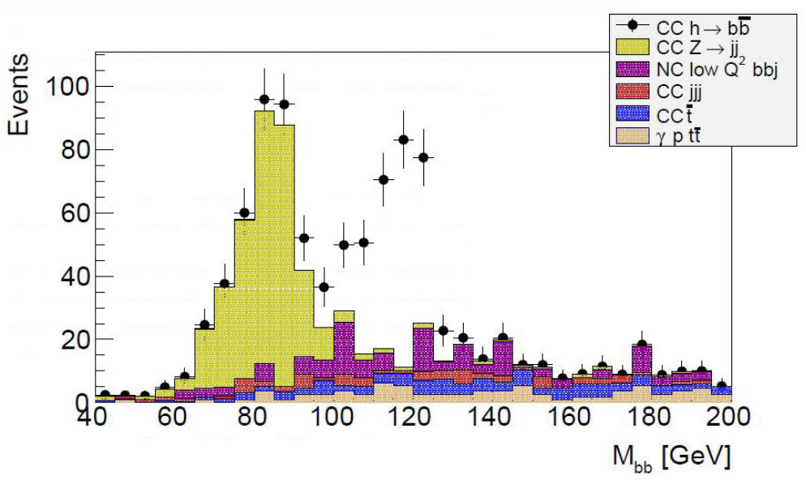
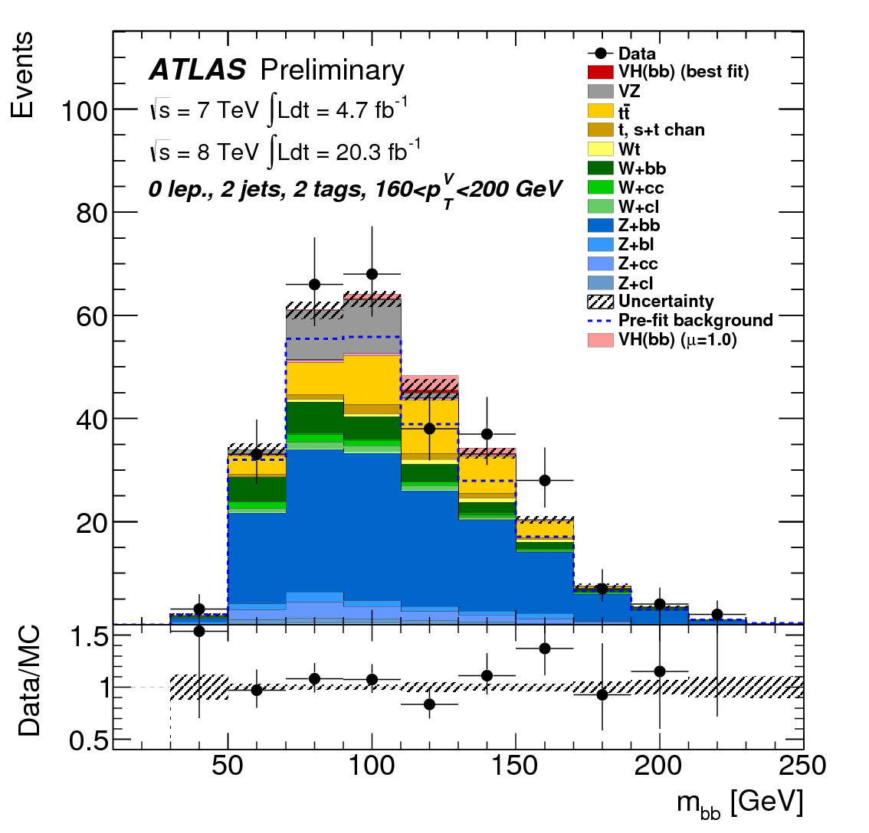
H → bbar
ep→ νH(bb)X
charged currents
σBR~120 fb
S/B ~1-2 → crucial for QCD of H
μ=0.1
1% coupling at 1 ab⁻¹
pp→ X₁W(lν)H(bb)X₂
associated VH
σBR~130 fb
S/B <~0.01
μ~40
ep (new) Simulation 100 fb⁻¹
Ellis Kay (U Liverpool) ~ ok with M.Tanaka (Tokyo)
Master Thesis 5/14 with U.Klein
Next: PGS → LHeC detector + optimisation
pp 2013: Measurement
ATLAS CONF-2013-079

Slide 29
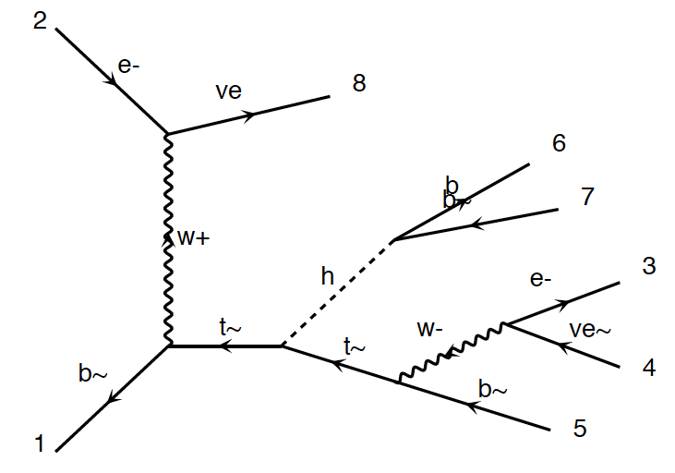
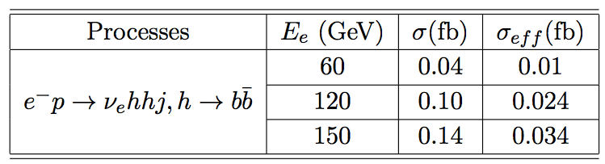
HH and tHt in ep
New
Tentative
Studies
FCC-he unpolarised
Cross section at 3.5 TeV:
total : 0.7 fb
fiducial : 0.2 fb
using pt(b,j)>20 GeV
ΔR(j.b)>0.4
η(j) <5
η(b) < 3
Polarisation, max lumi, tuning cuts, bb and WW
decays may provide O(10%) precision - tentative
Require time for reliable result
(detector, analysis, backgrounds..)
Uta Klein, Masahiro Khuze, Bruce Mellado et al

Slide 30
Theory uncertainties on H in pp - LHC
Exp uncertainty
of predicted H
cross section is
0.25% (sys+sta),
using LHeC only.
Leads to H mass
sensitivity.
Strong coupling
underlying
parameter
(0.005 → 10%).
LHeC: 0.0002 !
Needs N³LO
HQ treatment
important …
O.Brüning and M.Klein arXiv:1305.2090, MPLA 2013
Need MUCH better PDFs, MUCH better alpha_s and N³LO
[FCC_hh: O(800)pb, <x> 0.001, DGLAP?, scales, ep 0.3%]

Slide 31

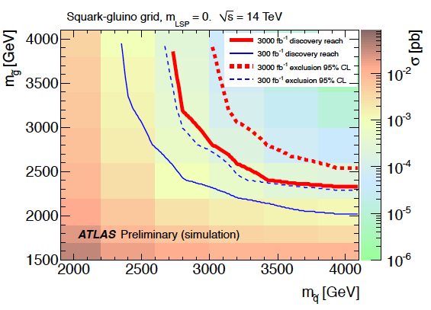
PDFs and HL-LHC Searches
LHeC: arXiv:1211.5102
ATLAS October 2012 “Physics at High Luminosity”
With high energy and luminosity, the LHC search range will be extended to high masses,
up to 4-5 TeV in pair production, and PDF uncertainties come in ~ 1/(1-x), CI effects?

Slide 32
HL-LHC - Searches
High precision
PDFs are needed
for the HL-LHC
searches in order
to probe into the
range opened by
the luminosity
increase and to
interprete possibly
intriguing effects
based on external
information.
LHeC BSM poster at EPS13 M.D’Onofrio et al. see also arXiv:1211:5102 Relation LHeC-LHC
Simulated PDFs from LHeC are on LHAPDF (Partons from LHeC, MK, V.Radescu LHeC-Note-2013-002 PHY)

Slide 33
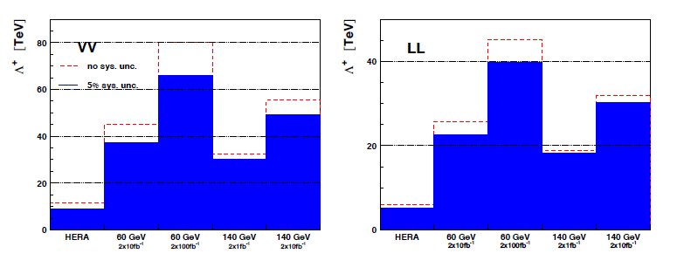
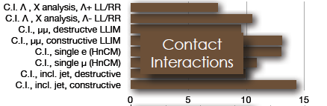
Contact interactions (eeqq)
New currents or heavy bosons may produce indirect effect via new particle exchange interfering with γ/Z fields.
Reach for Λ (CI eeqq): 25-45 TeV with 10 fb⁻¹ of data depending on the model
Similar to LHC
ATLAS and CMS constraints on
eeqq CI (expected up to 30-40
TeV at c.o.m. 14 TeV LHC)

Slide 34
Energy Frontier DIS

Slide 35


LeptoQuarks
LHeC
FCC 60 GeV
FCC 175 GeV
Study in Progress
G.Azuelos

Slide 36
Practical Steps

Slide 37
CDR Footprint of the LHeC ERL Electron Beam for synchronous ep and pp OP @ LHC
60 GeV electron beam energy, L= 10³³ cm⁻²s⁻¹, √s=1.3 TeV: Q²_{max}= 10⁶ GeV², 10⁻⁶ < x< 1
Recirculating linac (2 * 1km, 2*60 cavity cryo modules, 3 passes, energy recovery)
Ring-ring as fall back. “SAPHIRE” 4 pass 80 GeV option to do mainly: γγ→ H. CDR

Slide 38


ERL Test-Facility at CERN (LTFC)
TARGET PARAMETER* | VALUE
Injection Energy [MeV] | 5
Final Beam Energy [MeV] | 900
Normalized emittance γε_{x,y} [μm] | 50
Beam Current [mA] | 10
Bunch Spacing [ns] | 25 (50)
Passes | 3
Jlab-CERN-Mainz 802 MHz
Cavity cryo module under design
B. Rimmer, E.Jensen, K. Aulenbacher et al
A. Bogazc, A.Valloni et al
SCRF, ERL, Magnet Tests, Photon and ep Physics, Injector to LHeC… Design by 2015

Slide 39

Energy Frontier DIS

Slide 40

FCC-he Detector (B) – 0.1
Crab cavities for p instead of dipole magnet for e bend to ensure head on collisions
1000 H → μμ may call for better muon momentum measurement
H→ HH → 4b (and large/low x) call for large acceptance and optimum hadr. E resolution
Detector for FCC scales by about ln(50/7) ~2 in fwd, and ~1.3 in bwd direction
Full simulation of LHeC and FCC-he detectors vital for H and H-HH analysis
P.Kostka et al.

Slide 41
Further Path Determined with IAC + Mandate
The IAC was invited in 12/13 by the DG with the following
Guido Altarelli (Rome)
Sergio Bertolucci (CERN)
Frederick Bordry (CERN)
Stan Brodsky (SLAC)
Hesheng Chen (IHEP Beijing)
Andrew Hutton (Jefferson Lab)
Young-Kee Kim (Chicago)
Victor A Matveev (JINR Dubna)
Shin-Ichi Kurokawa (Tsukuba)
Leandro Nisati (Rome)
Leonid Rivkin (Lausanne)
Herwig Schopper (CERN) – Chair
Jurgen Schukraft (CERN)
Achille Stocchi (LAL Orsay)
John Womersley (STFC)
Mandate 2014-2017
Advice to the LHeC Coordination Group and the CERN directorate
by following the development of options of an ep/eA
collider at the LHC and at FCC, especially with:
Provision of scientific and technical direction for the physics
potential of the ep/eA collider, both at LHC and at
FCC, as a function of the machine parameters and of a
realistic detector design, as well as for the design and
possible approval of an ERL test facility at CERN.
Assistance in building the international case for the accelerator
and detector developments as well as guidance to the resource,
infrastructure and science policy aspects of the ep/eA collider.
*) IAC Composition End of February 2014 +
Oliver Brüning Max Klein ex officio

Slide 42


Clarification and Tradition
Herwig Schopper (Chair IAC) at Chavannes in the Panel Discussion with the CERN Directorate

Slide 43

Summary of the LHeC Physics Programme
CDR, arXiv:1211.4831 and 1211.5102 http://cern.ch/lhec
New since CDR: Higgs discovered, 10³³ →10³⁴, and the FCC horizon – much to do
Truth is stranger than fiction, but it is because fiction is obliged to stick to possibilities
Mark Twain, cited by Stan Brodsky at Chavannes

Slide 44

CERN: LHC+FCC: the only realistic opportunity for energy frontier deep inelastic scattering
Huge step in energy (Q²,1/x) and 3 orders of magnitude higher luminosity than HERA

Slide 45


“BFKL evolution and Saturation in DIS”
“Critical gravitational collapse”
Circles in a circle
V. Kandinsky, 1923
Philadelphia Museum of Art
5d tiny black holes and perturbative saturation
Talk by A.S.Vera at LHeC Workshop 2008

Slide 46

http://cern.ch/lhec
LHeC Study group and CDR authors [May13]

Slide 47
backup

Slide 48

Electroweak Physics in ep [sin²θ_{W}]

Slide 49
Nuclear Parton Distributions
Data | DIS lA | DIS νA | DY ll | dAu π± | dAu πº | p Base | Ref.
EPS09 | + | - | + | - | + | MSTW | JHEP
DSSZ | + | + | + | + | + | CTEQ6 | PRD
nCTEQ | + | - | + | - | - | CTEQ6 | Prel.
*)
NLO QCD fits of nuclear correction factors with reference to a proton PDF set
Very restricted range of DIS measurements → “no predictive power below x ~ 0.01” FGS
Single pion data used to constrain the gluon – depends on fragmentation fct., thy uncertain
No flavour decomposition (strange may be large, charm, bottom?)
Further assumptions: no nuclear effects in D, isospin invariance, Δχ² tolerances..
*) see also Hirai, Kumano, Nagai, 0709.3038 (2007)

Slide 50



Present nPDFs
DIS input data from NMC and SLAC
Frankfurt, Guzey, Strikhman, 1106.2091
πº input from RHIC
A.Kusina May 2013 Pittsburgh
For full set of plots cf D.De Florian 1112.6324
Strong variations of results and just
parametric behaviour at x < 0.01

Slide 51

High Precision DIS
High Precision DIS
Q² >> M_{Z,W}², high luminosity, large acceptance
Unprecedented precision in NC and CC
Contact interactions probed to 50 TeV
Scale dependence of sin²θ left and right to LEP
→ A renaissance of deep inelastic scattering ←
Solving a 30 year old puzzle:
α_{s} small in DIS or high with jets?
Per mille measurement accuracy
Testing QCD lattice calculations
Constraining GUT (CMSSM40.2.5)
Charm mass to 3MeV, N³LO

Slide 52

The strong coupling constant
α_{s} is the worst measured
fundamental coupling constant.
Is there grand unification?
In DIS, values (NNLO) range from
0.113 to 0.118.
τ leads to about 0.120
Lattice predictions seem to
determine the world average.
The LHeC has the potential to
measure αs to permille accuracy
(0.0002) from a consistent
data set. This leads to high
precision understanding of all
related effects (low x, δM_{c}=3MeV)
and pQCD at N³LO
J.Bluemlein, Why Precision, arXiv:1205.4991

Slide 53
What HERA could not do or has not done
Test of the isospin symmetry (u-d) with eD - no deuterons
Investigation of the q-g dynamics in nuclei - no time for eA
Verification of saturation prediction at low x – too low s
Measurement of the strange quark distribution – too low L
Discovery of Higgs in WW fusion in CC – too low cross section
Study of top quark distribution in the proton – too low s
Precise measurement of F_{L} – too short running time left
Resolving d/u question at large Bjorken x – too low L
Determination of gluon distribution at hi/lo x – too small range
High precision measurement of α_{s} – overall not precise enough
Discovering instantons, odderons – don’t know why not
Finding RPV SUSY and/or leptoquarks – may reside higher up
…
The H1 and ZEUS apparatus were basically well suited
The machine had too low luminosity and running time
HEP needs a TeV energy scale machine with 100 times
higher luminosity than HERA to develop DIS physics
further and to complement the physics at the LHC. The
Large Hadron Collider p and A beams offer a unique
opportunity to build a second ep and first eA collider
at the energy frontier.
HERA in one box
the first ep collider
E_{p}*E_{e}=
920*27.6GeV²
√s=2√E_{e}E_{p}=320 GeV
L=1..4 10³¹cm⁻²s⁻¹
→ ΣL=0.5fb⁻¹
1992-2000 & 2003-2007
Q²= [0.1 -- 3 * 10⁴ ] GeV²
-4-momentum transfer²
x=Q²/(sy) ≅10⁻⁴ .. 0.7
Bjorken x
y≅0.005 .. 0.9
inelasticity

Slide 54

xg at low x
Uncertainty
holds to
high Q2
and the
evolution
will not be DGLAP
It needs ep
to resolve this

Slide 55

Energy Frontier DIS
U Klein at FCC kickoff on H in ep: ‘simple’ cut based analysis, clean(er) final state, no pileup

Slide 56



Higgs in pp HL-LHC and PDF uncertainties
Studies for High Luminosity LHC shows that PDF uncertainties will be a limiting factor for several channels at the HL-LHC
With LHeC: huge improvements in PDFs and precision in α_{S} → full exploitation of LHC data for Higgs physics
Similar conclusion and relations expected for FCC-he ←→ FCC-hh

Slide 57
Tentative Parameters for FHeC (RR)
collider parameters | e± scenarios |  |  |  | protons
species | e± | e± | e± |  | p
beam energy [GeV] | 60 | 120 | 250 |  | 50000
bunch spacing [μs] | 0.125 | 2 | 33 |  | 0.125 to 33
bunch intensity [10¹¹] | 3.8 | 3.7 | 3.3 |  | 3.0
beam current [mA] | 477 | 29.8 | 1.6 |  | 384 (max)
rms bunch length [cm] | 0.25 | 0.21 | 0.18 |  | 2
rms emittance [nm] | 6.0, 3.0 | 7.5, 3.75 | 4, 2 |  | 0.06, 0.03
β_{x,y}*[mm] | 5.0, 2.5 | 4.0, 2.0 | 9.3, 4.5 |  | 500, 250
σ_{x,y}* [μm] | 5.5, 2.7
b-b parameter ξ | 0.13 | 0.050 |  | 0.056 | 0.017
hourglass reduction | 0.42 | 0.36 |  | 0.68
CM energy [TeV] | 3.5 | 4.9 |  | 7.1
luminosity[10³⁴cm⁻²s⁻¹] | 21 | 1.2 |  | 0.07
F.Zimmermann at Beijing 16.12.13

Slide 58





















Accelerator Design: Participating Institutes
TOBB ETU
Source | Power [MW]
Cryogenics (linac) | 21
Linac grid power | 24
SR compensation | 23
Extra RF cryopower | 2
Injector | 6
Arc magnets | 3
Total | 78
KEK

