Slide 1




FCC-eh – Status and CDR Plan
Baseline
Physics
Towards the CDR
FCC-eh
E_{p} =50 TeV
HE LHC
E_{p}=12.5 TeV
+ ERL electrons
E_{e}=60 GeV
Max Klein
University of Liverpool
For the electron-hadron study group
For references,
please consult
lhec.web.cern.ch
LHeC CDR
arXiv:1206.2913
J.Phys. G39 (2012) 075001
FCC Annual Workshop, Berlin, 29th of May 2017

Slide 2
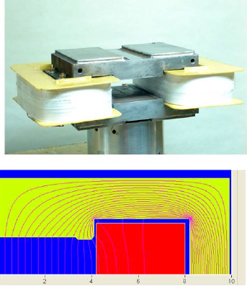
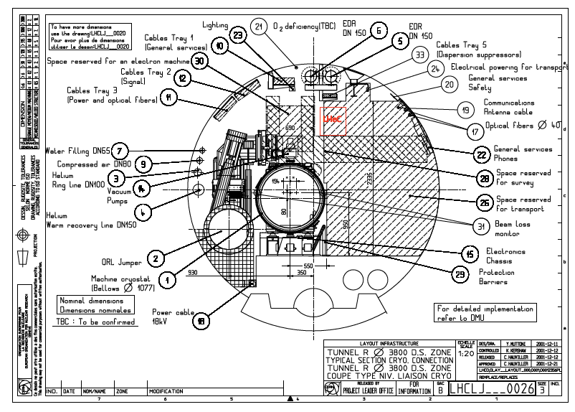
Introduction: eh + hh
With the LHC, CERN has unique, highest energy and intensity hadron beams (p, Pb)
Obvious question, since Lausanne 1984, has been how to utilise these for eh + why.
CDR on LHeC: arXiv:1206.2913 (J.Phys.G)
600 refereed pages on ep/eA with LHC
Dipole magnet prototypes built by BINP (foto)
and CERN (also in LHeC CDR), all met spec’s
→ Much lighter and slimmer than LEP dipoles
Location of electron magnets in LHC tunnel
Conclusion for LH(e)C: electron accelerator better outside the main tunnel (HE LHC?)

Slide 3
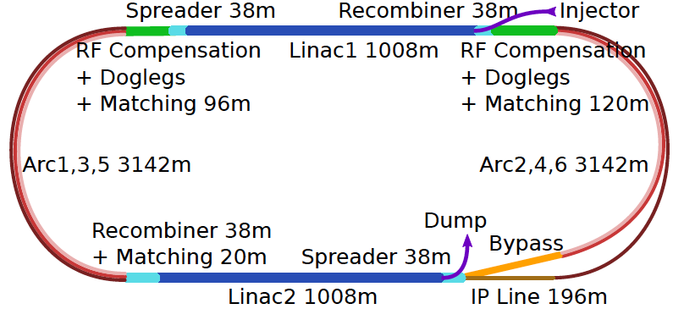
ERL Baseline for LHeC and FCC-eh
Concurrent operation to pp, LHC/FCC become 3 beam facility. P(e) < 100 MW
F Zimmermann Monday and O Bruening on Thursday (IR work in progress with BNL/CERN)

Slide 4
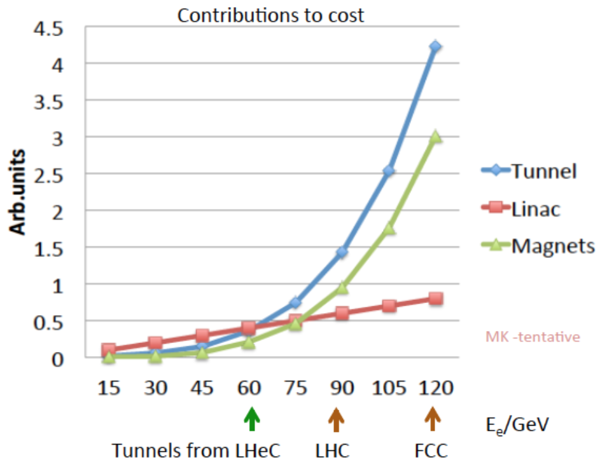
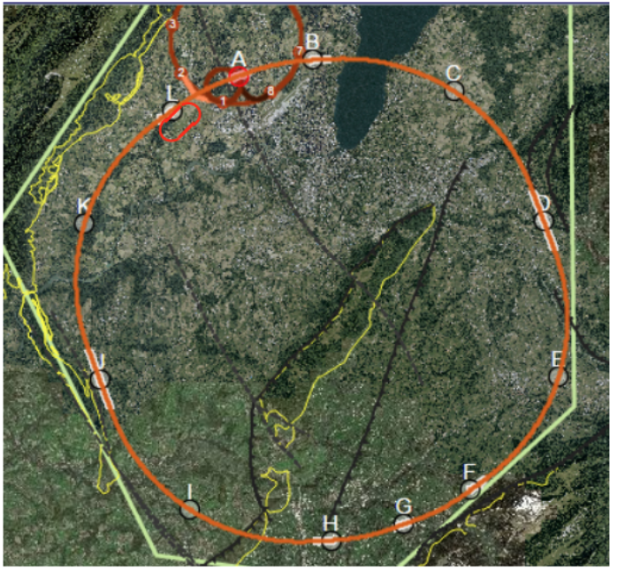
FCC-eh Default Configuration
With the FCC-hh (HE LHC) CERN, again, should have the world lead on hh beams
Jo Stanyard/J Osborne on Thursday
A rough extrapolation of a 3-turn ERL shows how
the cost rises strongly with the electron beam
energy. We therefore, currently stick to 60 GeV
which maximizes physics return.
ERL is of modular, multi-use for eh at CERN
CE prefers the 9km circumference ERL to be placed to L,
For HE LHC the ERL would be in place.
Conclusion for FCC-eh: consider the ERL
as baseline for eh: for CDR, refer to LHeC

Slide 5
Five Major Themes of eh Physics
Cleanest High Resolution Microscopes
Joint ep and pp Physics
High Precision Higgs Exploration
Discovery Beyond the Standard Model
A Unique Nuclear Physics Facility

Slide 6
Five Major Themes of eh Physics
Cleanest High Resolution Microscopes
Joint ep and pp Physics
High Precision Higgs Exploration
Discovery Beyond the Standard Model
A Unique Nuclear Physics Facility

Slide 7
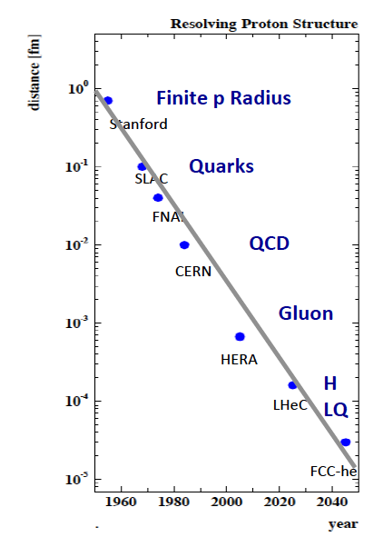
Microscope
Resolve with spectacular range (each high
energy ep collider probes range down to
SLAC’s 0.1fm as scale varies) and precision:
Structure and Dynamics of
Proton, neutron, photon, pomeron, jets..
In momentum and transverse space
PDFs, TMDs, DVCS, generalised PDFs, ..
Here rely on CDR of LHeC + updates
Prospect and challenge: Resolution up
by 5 orders of magnitude in 100 years

Slide 8
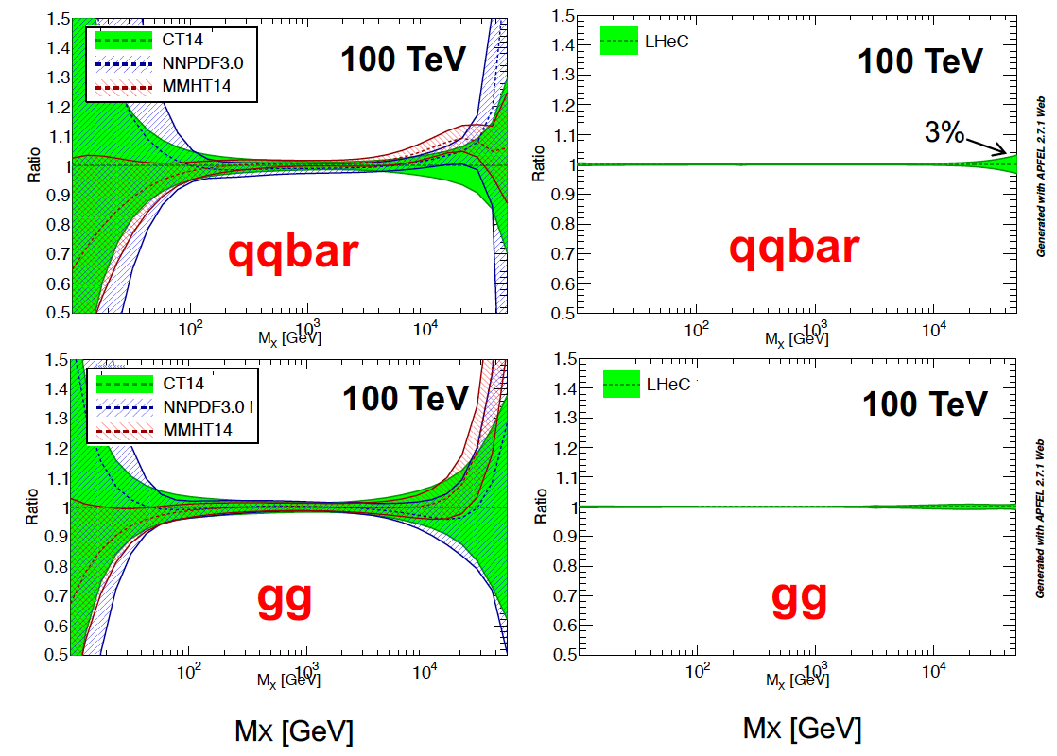
Unravelling structure of matter
Resolve parton structure of the proton completely: u_{v},d_{v},s_{v}?,u,d,s,c,b,t and xg
Unprecedented range, sub% precision, free of parameterisation assumptions,
Resolve p structure, solve non linear and saturation issues, test QCD, N³LO…
Strong
Coupling in
inclusive
DIS to
O(0.1)%
Lattice??
Jets??
ee?
BCDMS??
GUTs?
Higgs in pp
…
Completely
new PDF
Analysis
under
way
for
CDR(s)
D.Britzger
On Thursday
Note that LHC is about to reach its own limits on PDFs. pp is NOT DIS, cf ATLAS W,Z to 0.5%

Slide 9
Five Major Themes of eh Physics
Cleanest High Resolution Microscopes
Joint ep and pp Physics
High Precision Higgs Exploration
Discovery Beyond the Standard Model
A Unique Nuclear Physics Facility

Slide 10
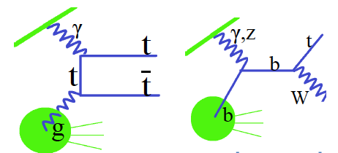
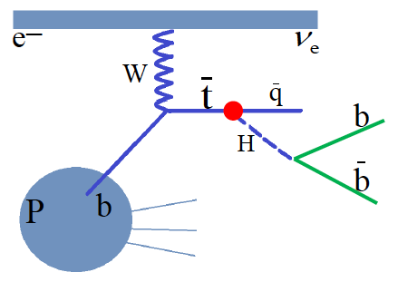
Top Physics
Top electric charge
EDM and MDM
Anomalous t-q-y and t-g-Z
V_{tb}
Top spin
W-t-b
Top PDF
Top mass
Top-Higgs (1602.04670)
CP nature of ttH (1702.03426)
As we study find a huge potential of top physics in ep at high energies
Pair production Single production
Huge rise of cross section
from LHeC to FCC-eh
Very active, new studies
Complementarity in FCC
Unique sensitivity
FCNC top Higgs CC interaction

Slide 11

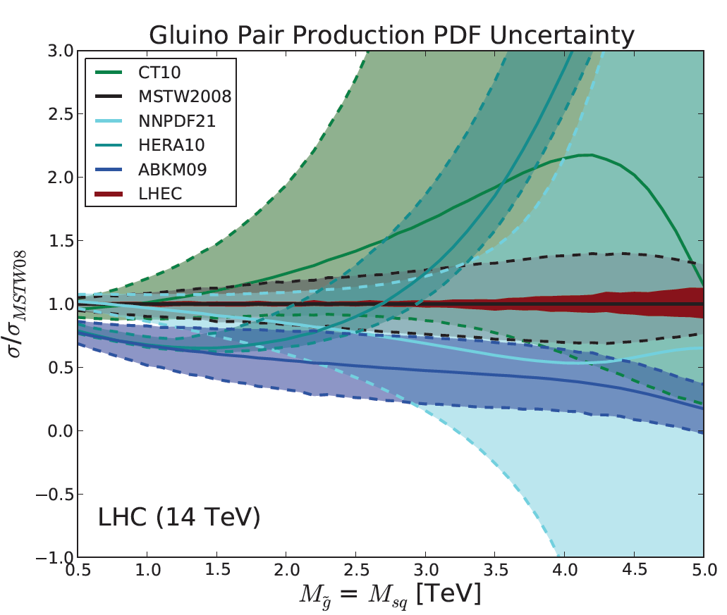
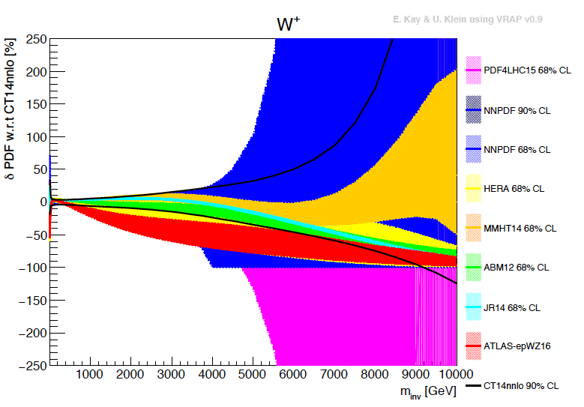
Empowering pp Discoveries
External, reliable input (PDFs, factorisation..) is crucial for range extension + CI interpretation
GLUON
QUARKS
SUSY, RPC, RPV, LQS..
Exotic+ Extra boson searches at high mass
ATLAS
today
FCC-he: mass range:50/7 larger: eh vital to resolve high mass (x) region: “synergy” for CDR

Slide 12
Five Major Themes of eh Physics
Cleanest High Resolution Microscopes
Joint ep and pp Physics
High Precision Higgs Exploration
Discovery Beyond the Standard Model
A Unique Nuclear Physics Facility

Slide 13
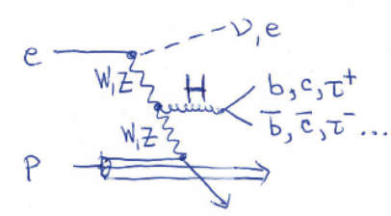
Higgs Physics with ep
High cross section (cc: LHeC 200fb, FCC-eh 1pb)
Electroweak production, uniquely CC vs NC
Access to WW-H-WW and ZZ-H-ZZ
No pileup, clean theory, challenging simulations
SM coupling measurement expectations
κ in % | HL LHC | LHeC HL | LHeC HE | FCC-eh
H → bb | 10? | 0.5 | 0.3 | 0.2
H → cc | 50?? | 4 | 2.8 | 1.8
ep when added to pp turns the
pp colliders into high precision
Higgs facilities. Removes gg-H
QCD uncertainties (N³LO) in pp
Recent Higgs-in-ep studies for CDR: Higgs self coupling from FCC-eh
associated top-Higgs production, Higgs into invisible (dark matter),
Exotic Higgs physics: H into light scalars, H⁻ ⁻ and others
U.Klein on Thursday
for CDR: complete SM (τ,W,g?) and add BSM Higgs studies, integrate with hh/ee

Slide 14
Five Major Themes of eh Physics
Cleanest High Resolution Microscopes
Joint ep and pp Physics
High Precision Higgs Exploration
Discovery Beyond the Standard Model
A Unique Nuclear Physics Facility

Slide 15
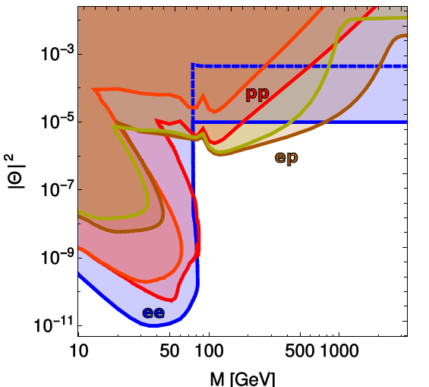
Possible Discoveries Beyond SM with eh
QCD:
(No) saturation of the gluon density
QCD radiation pattern (BFKL?) – hh!
New QCD states (instantons)
Higher symmetry embedding QCD
Electroweak:
EFTs, CI to 300 TeV, RPV SUSY
Exotic Higgs Decays (Dark Matter..)
Extension of Higgs Sector (H⁺⁺..)
Sterile Neutrinos …
Search for Sterile Neutrinos
(LHC/FCChh FCCee LHeC/FCCeh)
K Wang
on Thursday
O Fischer talk Tuesday
“It would be a waste not to exploit the 7 TeV beams for ep and eA physics at some
stage during the LHC time” (Guido Altarelli – 2008)

Slide 16
Five Major Themes of eh Physics
Cleanest High Resolution Microscopes
Joint ep and pp Physics
High Precision Higgs Exploration
Discovery Beyond the Standard Model
A Unique Nuclear Physics Facility

Slide 17
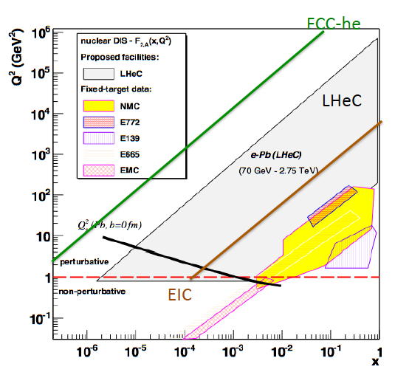
Electron-Ion Nuclear and Particle Physics
Extension of kinematic range
by 4 orders of magnitude:
will change our view on nuclear
structure and colour dynamics
Relates to LHC Heavy Ion Physics
- Quark Gluon Plasma
- Collectivity of small nuclei (p)?
..
May lead to genuine surprises
Saturation: non-linear gluon i.a.s
saturation needs very high energy:
Discovery in ep and verification eA
G Milhano on Thursday
For CDR: update in view of LHC (AA,pA) and new simulations, new ansatz to p+N PDFs..

Slide 18
Detector and ERL Development

Slide 19
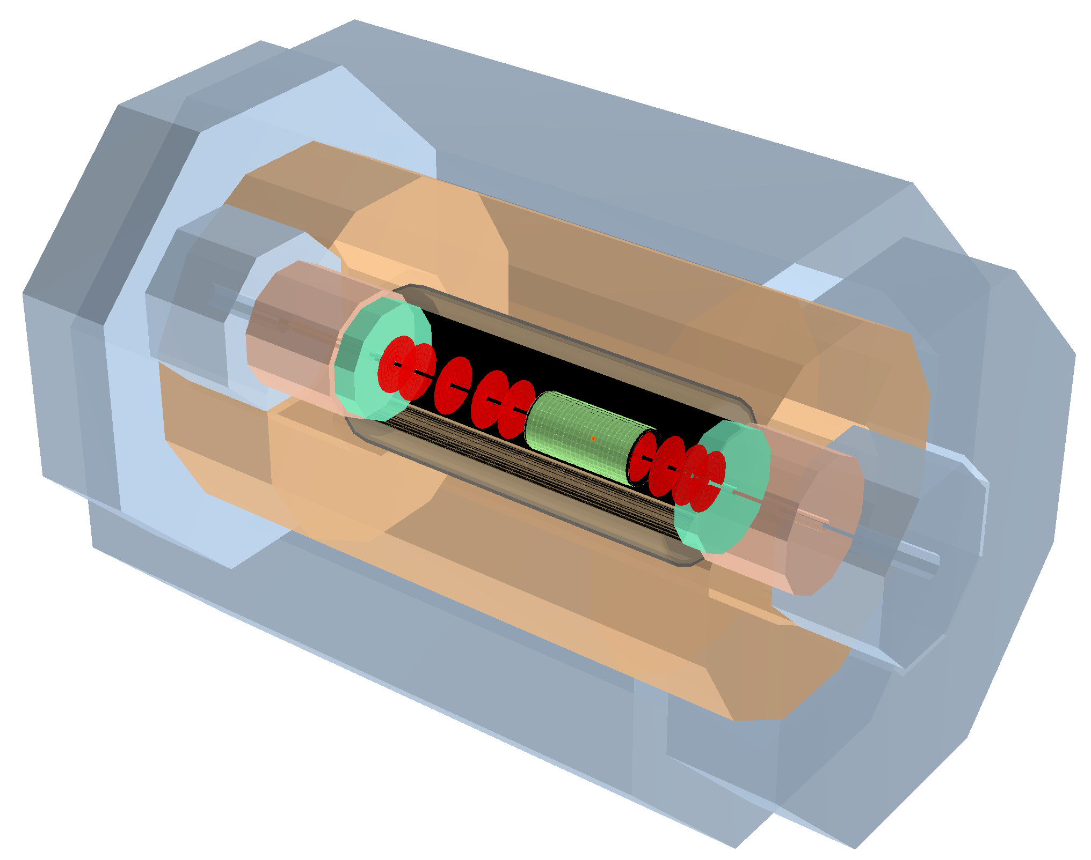
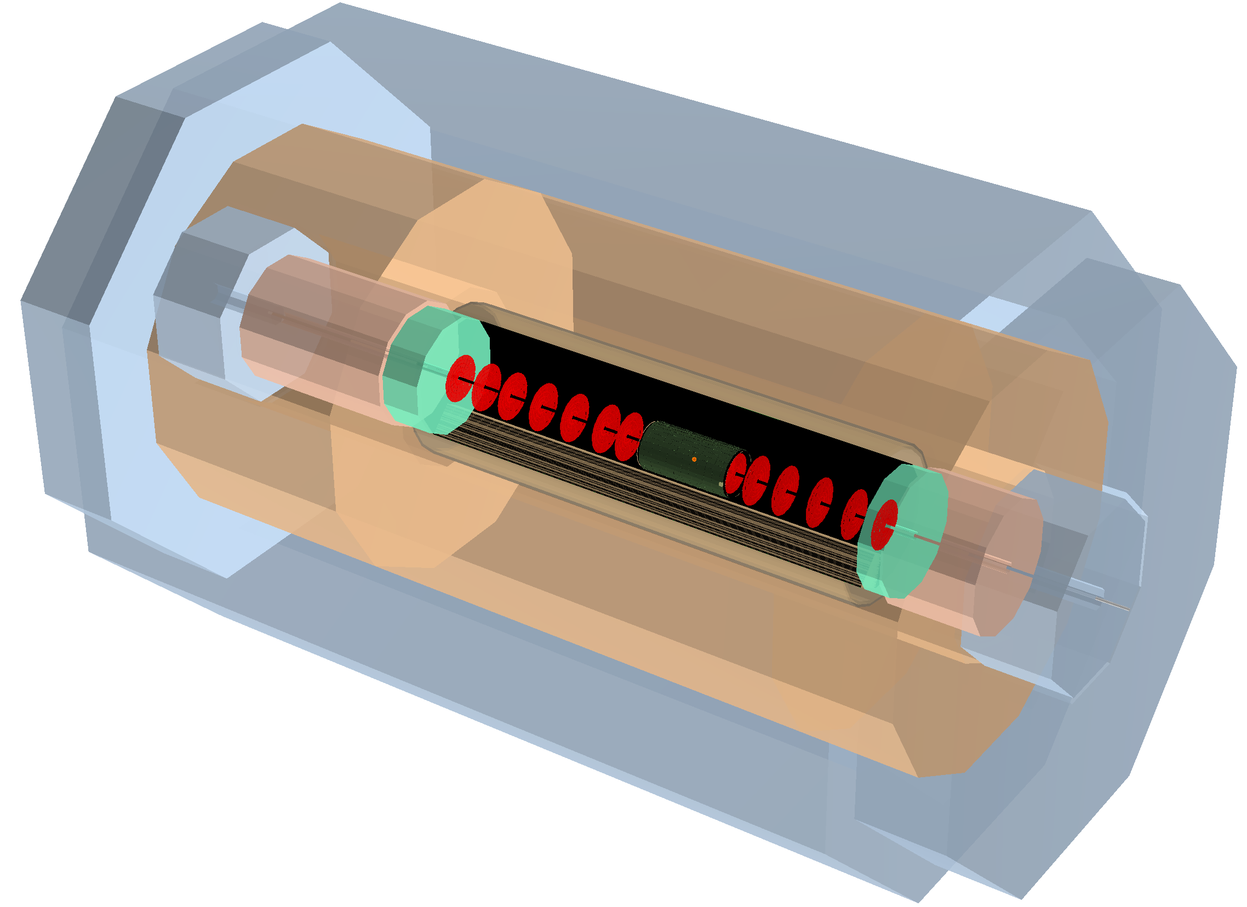
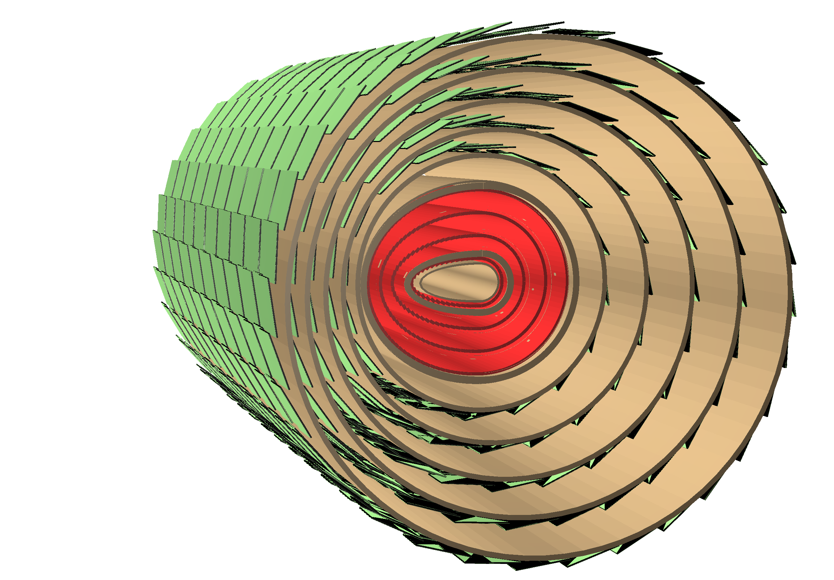
FCC-he Detector Layout - Scaled Version of LHeC Detector
Inner Dipoles and Solenoid
LHeC Detector
Hadron
Fwd-Endcap
Muon Detector
e∓
Dipole
Fwd-HCalo
Insert
Hadronic Barrel Calorimeter
Electromagn.-
Fwd-Endcap
Solenoid
Hadron
Bwd-Endcap
Fwd Tracker
Central
Tracker
Electromagnetic Calorimeter
Bwd Tracker
Dipole
Bwd-HCalo
Insert
Electromagn.-
Fwd-Endcap
p/A
Central Tracker
circular-elliptical beam pipe
4 layers Si-pixel
5 layers Si-strixel
(see Table of Detector Dimensions/Parameters)
Length of Inner Solenoid ~12m

Slide 20
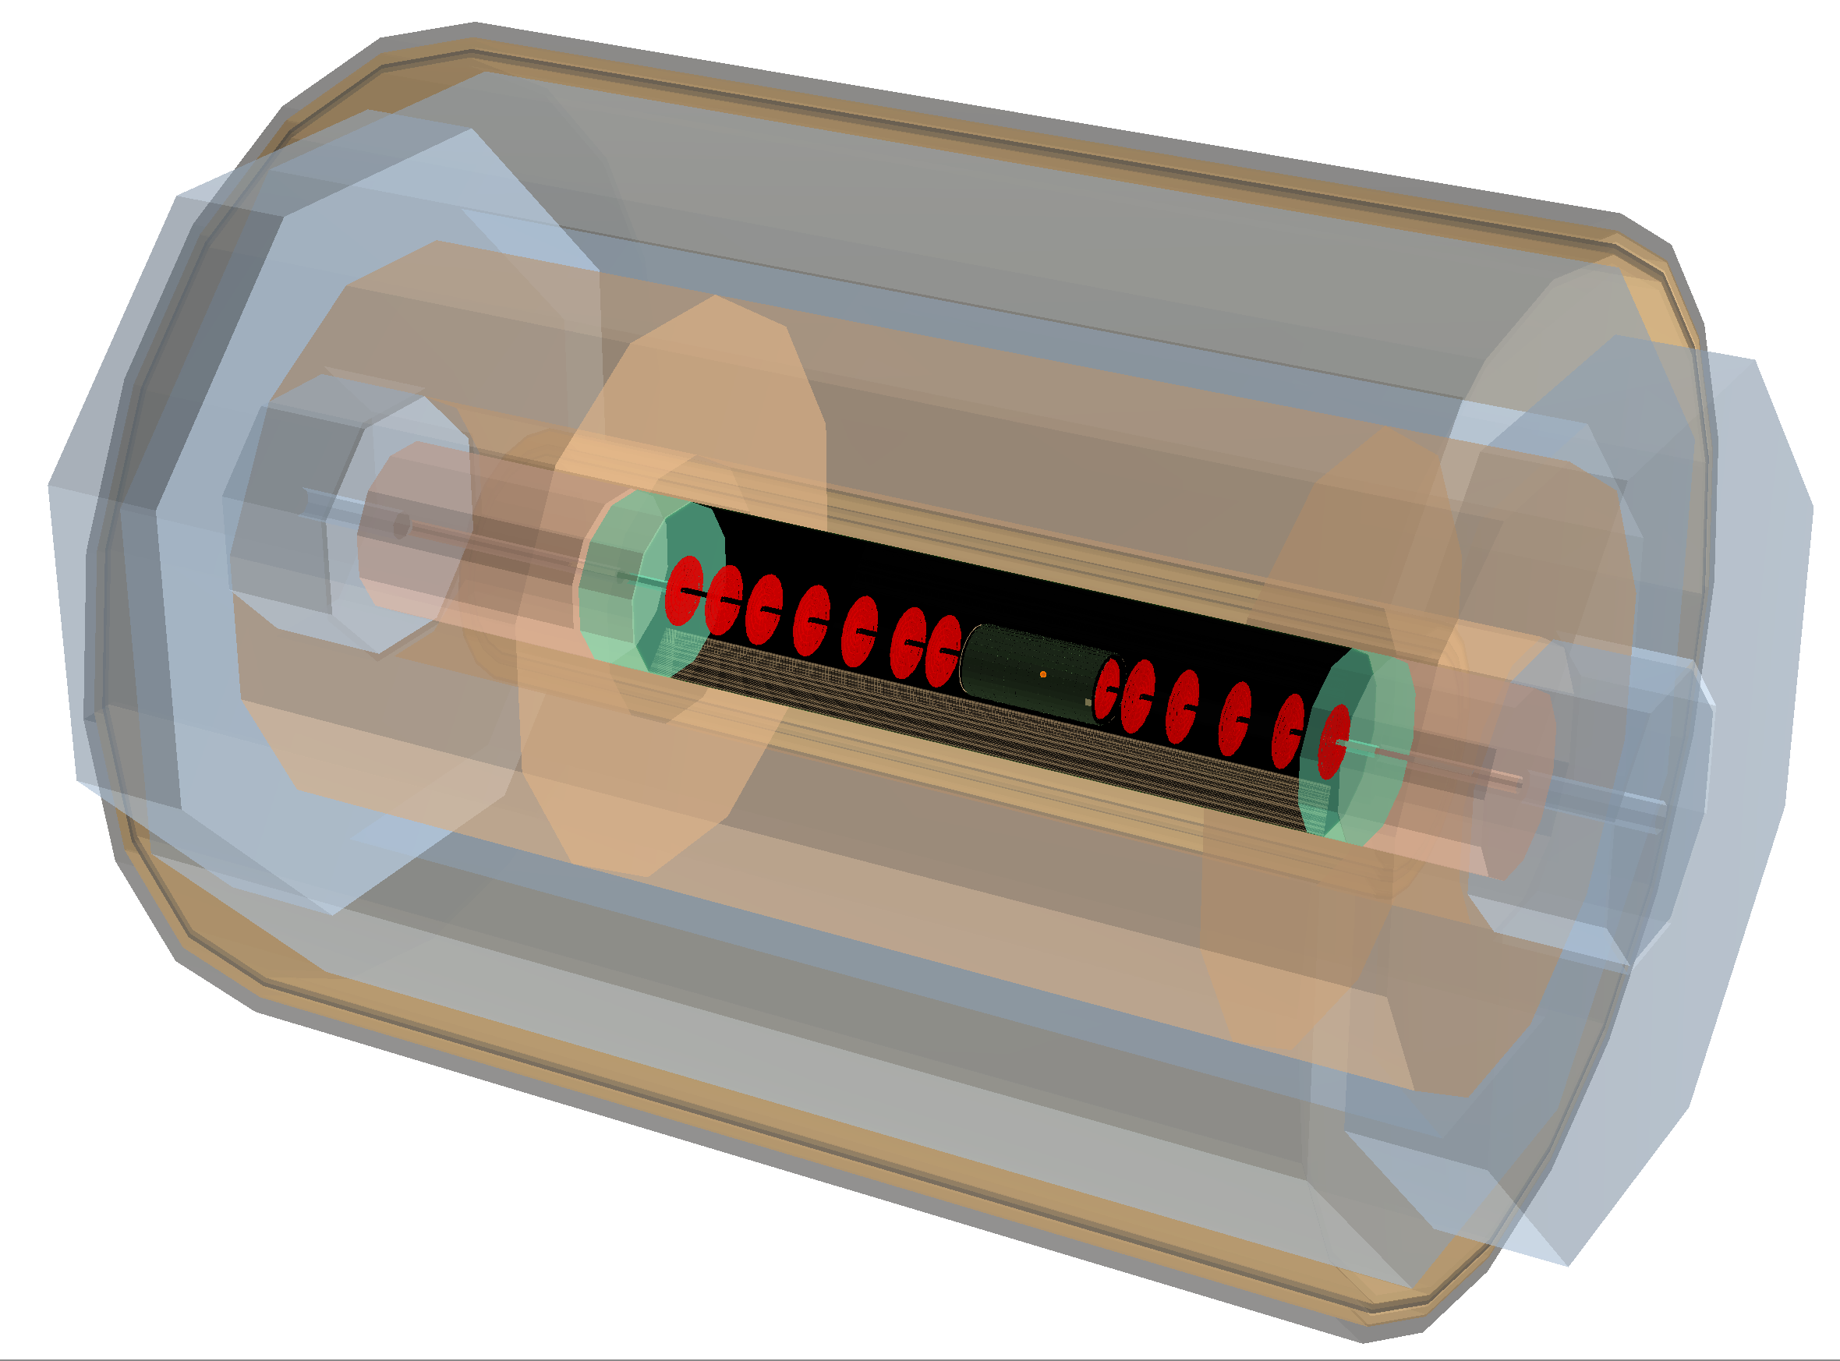
FCC-he Detector Layout - Scaled Version of LHeC Detector
Inner Dipoles and Solenoid + Outer Solenoid
Outer Solenoid
Hadron
Fwd-Endcap
Muon Detector
e∓
Dipole
Fwd-HCalo
Insert
Hadronic Barrel Calorimeter
Electromagn.-
Fwd-Endcap
Solenoid
Hadron
Bwd-Endcap
Fwd Tracker
Central
Tracker
Electromagnetic Calorimeter
Bwd Tracker
Dipole
Bwd-HCalo
Insert
Electromagn.-
Fwd-Endcap
p/A
Length of Inner Solenoid ~12m
Length of Outer Solenoid ~19m
Radius “ ~6m

Slide 21
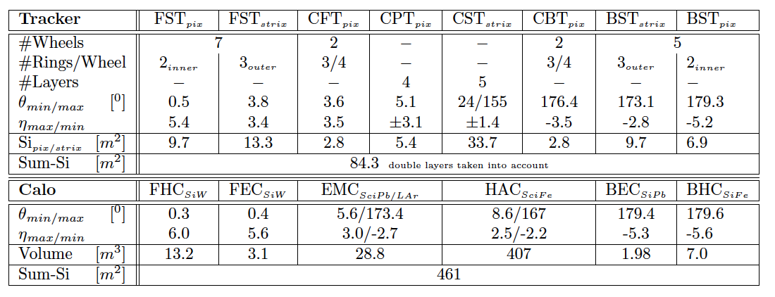
FCC-eh: Tracker, Calorimeters and Steps
Input to detector design: HERA, ATLAS/CMS+their upgrades, CALICE, LHeC (CDR and update)
At FCC-eh unlike LHeC we think muon momentum measurement is vital (H-μμ)
Next steps: final choice of CDR technology, IR integration, joint eh-hh consideration, software

Slide 22
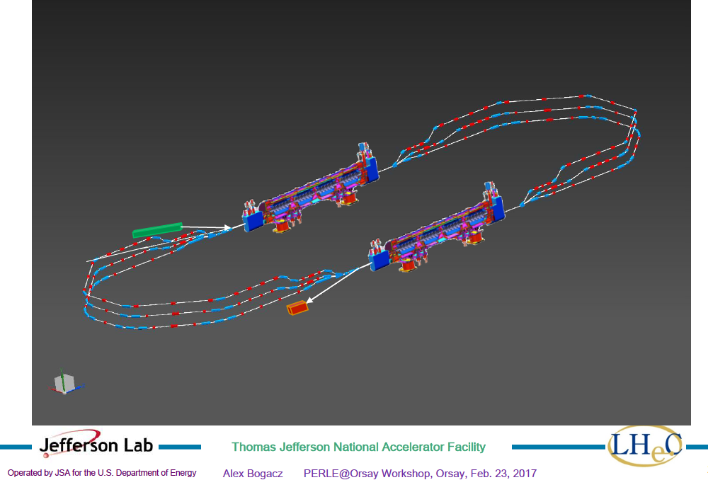
title
Powerful ERL for Experiments (ep,γp): PERLE at Orsay
PERLE at Orsay (LAL/INP) Collaboration: BINP, CERN, Daresbury/Liverpool, Jlab, Orsay +
3 turns, 2 Linacs, 400 MeV, 15mA, 802 MHz, Energy Recovery Linac facility
-Demonstrator of ERL for ep at LHC/FCC
-SCRF Beam based development facility
-Low E electron and photon beam physics
-High intensity: O(100) x ELI
5.5 x 24m²
CDR to appear in J Phys G [arXiv:1705. 08783]
See also https://indico.lal.in2p3.fr/event/3428/
A.Bogacz

Slide 23
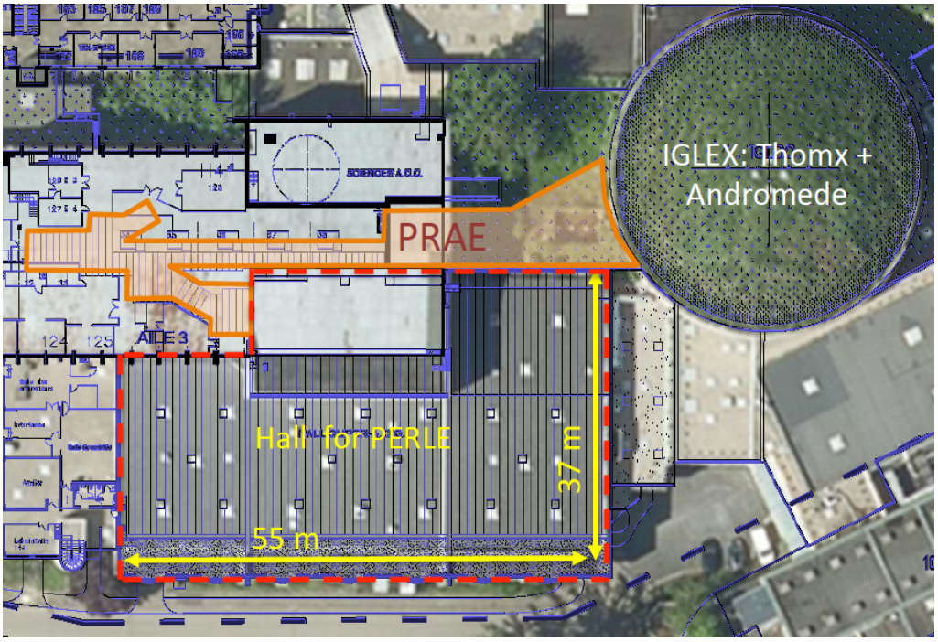
Site of PERLE at LAL/IPN Orsay
Described in PERLE CDR: arXiv:1705. 08783

Slide 24
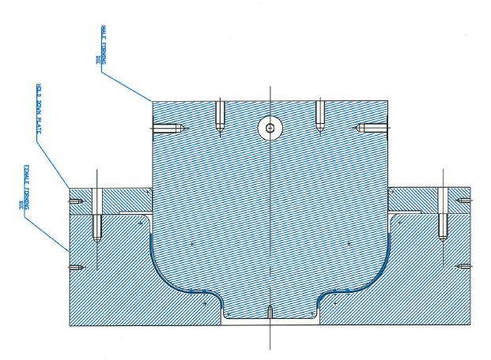
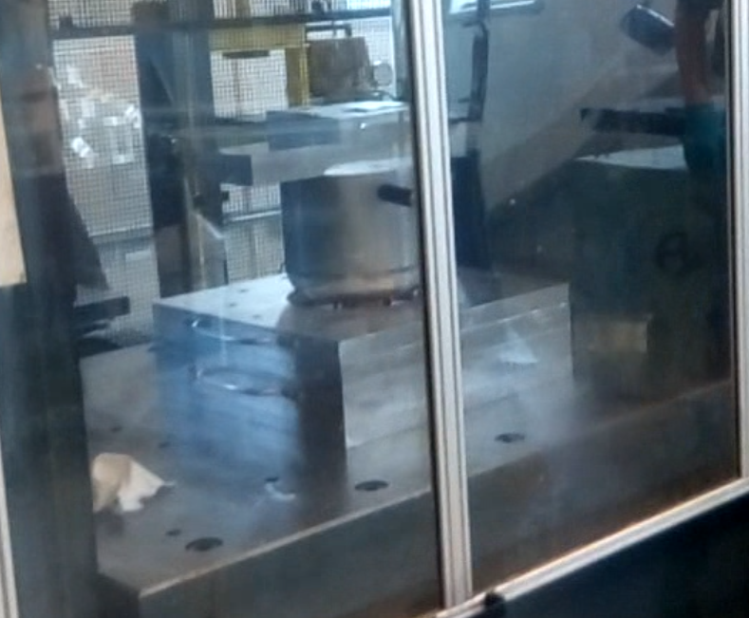
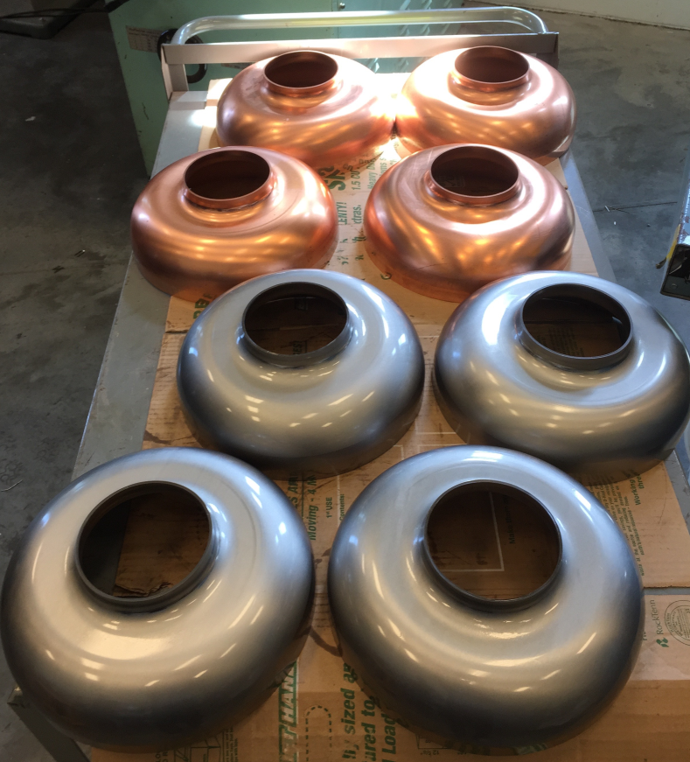
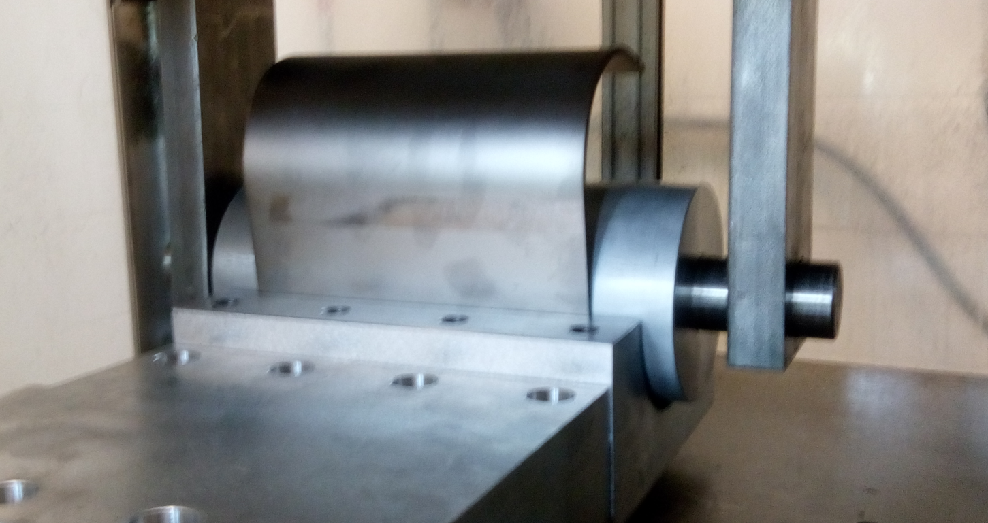
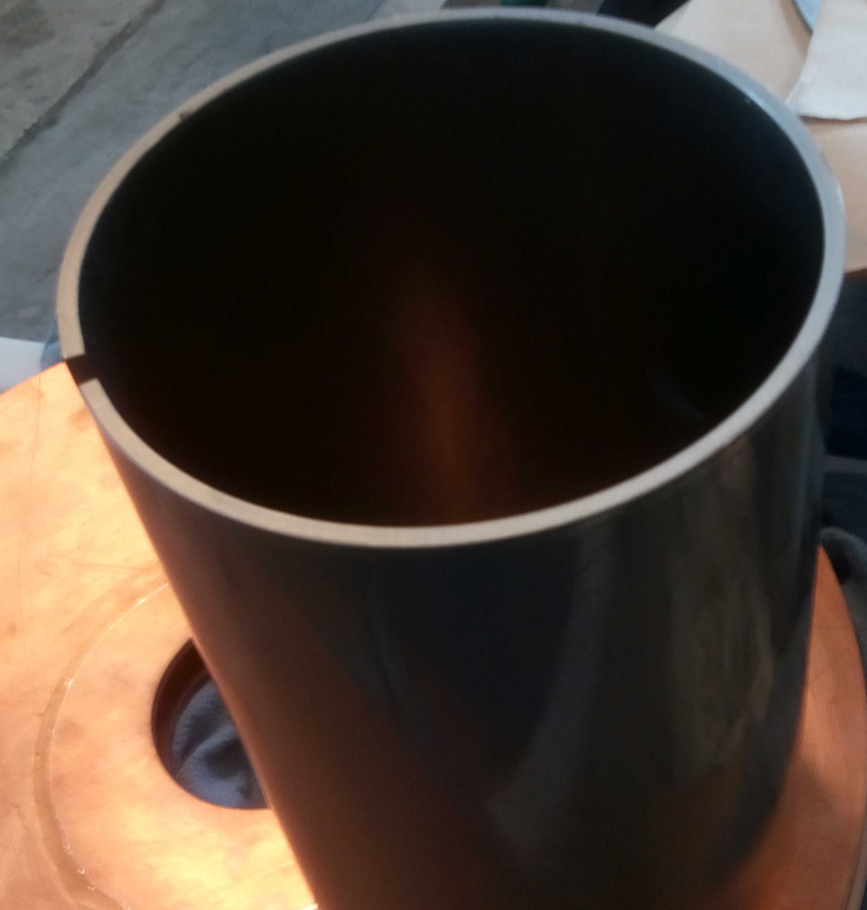
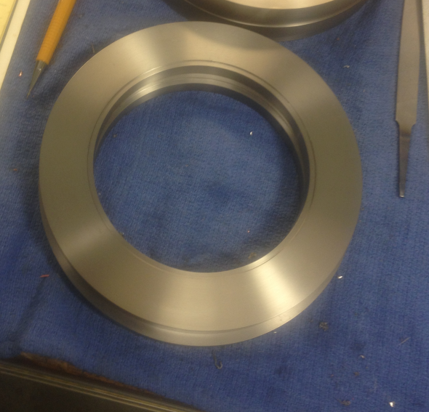
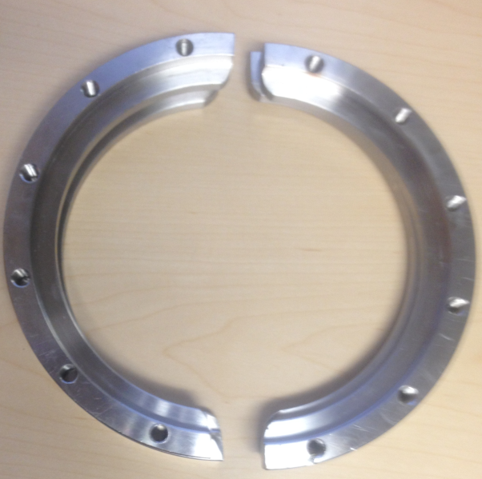
802 MHz Cavity Fabrication Status
802 MHZ Nb and Cu prototype cavities progressing well
F. Marhauser
Status 05-25-2017
Deep-drawn 802 MHz Nb and Cu half-cells (Status April ‘17)
802 MHz deep-drawing die set and machining fixtures (completed)
NbTi flanges
(completed)
Rolling of beam tubes and EBW before machining (completed),
beam tubes are being machined (to be completed soon, 05/17)
RF test hardware for OD = 6.5” flanges available
24

Slide 25
Main eh Tasks for Completion of CDR
4 areas of activity
Accelerator: Update of the eh IR design for LHC/HE-LHC/FCC at 10³⁴
PERLE: Technical design and fabrication+test of an 802 MHz cavity
Detector: Update detector technology choice (collaboration with hh)
Physics: Update wrt LHC results and integration with hh+ee
Contributions to 4 FCC CDR Books (see M Benedikt today)
B1: Physics with the FCC (hh-he-ee)
B2: Summary of FCC-hh with integrated FCC-eh
B3: Details to B2
B6: HE LHC with eh (based on LHeC CDR Update B0)
a total of ~300 FCC pages

Slide 26
Electron-Hadron Scattering at the Energy Frontier –
A Higgs Physics Facility Resolving the Substructure of Matter
Draft Table of Contents
Introduction: The LHC, Modern Particle Physics and the Rôle of ep/eA
Physics: QCD/PDFs, Higgs, top, BSM, small x, eA at the LHeC; key items at 1.9/3.4 TeV
ERL electron beam: Design, Components, Injector, Dump, Civil Engineering ..
LHeC Performance: Collider Parameters, Luminosity, Joint Operation, Infrastructure..
Detector: Machine Interface (IR), Design and Performance, Components, Software
6. Installation of the Machine and Detector
7. Summary
Appendix:
- Status of PERLE and ERL Developments
- Cost-Energy Relation and Cost Estimate for LHeC
- Detector Cost Estimate
- Extensions into the HE LHC Phase
- Electron-Hadron Scattering with the FCC (link to FCC CDR)
Update of the LHeC CDR^{*)} and input to EU strategy, reference document for FCC-eh + HE LHC
*) arXiv:1206.2913
29.5.2017

Slide 27

Road beyond Standard Model
Next decades
Rolf Heuer at
Aix Les Bains
1. 10. 2013
LHC results vital to guide the way at the energy frontier
At the energy frontier through synergy of
hadron - hadron colliders (LHC, (V)HE-LHC?)
lepton - hadron colliders (LHeC ??)
lepton - lepton colliders (LC (ILC or CLIC) ?)

Slide 28
Road beyond Standard Model
Next decades
Rolf Heuer at
Aix Les Bains
1. 10. 2013
LHC results vital to guide the way at the energy frontier
At the energy frontier through synergy of
hadron - hadron colliders (LHC, FCC-hh/HE LHC)
lepton - hadron colliders (LHeC,FCC-eh)
lepton - lepton colliders (LC (ILC or CLIC) - FCC/SepC)
Modified MK

Slide 29
There is much to be discussed on the future of accelerator based particle physics
Energy frontier electron-proton and e-ion physics can make it substantially richer.
Many thanks to CERN for support and to my colleagues who share the pleasure
and challenge to work on cinderella, the sister of the beautys hh and ee.
Thanks to Michael, Frank, Johannes and the FCC coordination group.

Slide 30
backup

Slide 31


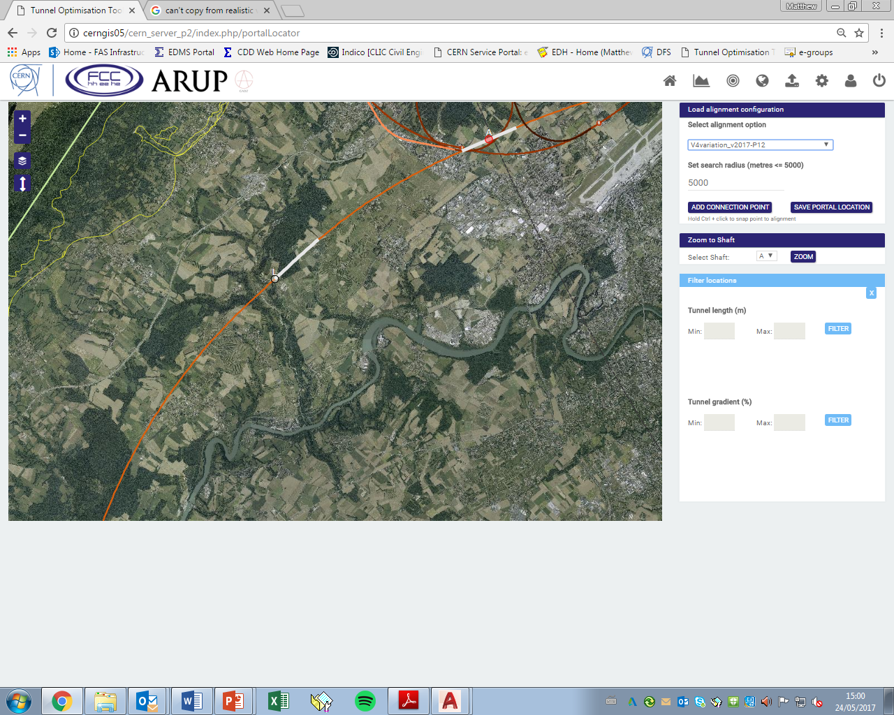
FCC-eh Civil Engineering
Why is experimental point L preferred?
Positives:
Low geological risk compared to other locations, anticipated tunnelling in molasse only.
Close to current CERN site.
Relatively shallow depth of tunnel therefore shallower shafts.
Remaining problems:
Potential clash with injection lines needs to be studied.
Connection to main FCC tunnel needs to be studied.
LHC/SPS
FCC experimental point L.
Civil Engineering for FCC-eh IR – J.L Stanyard Thursday 14:25

Slide 32
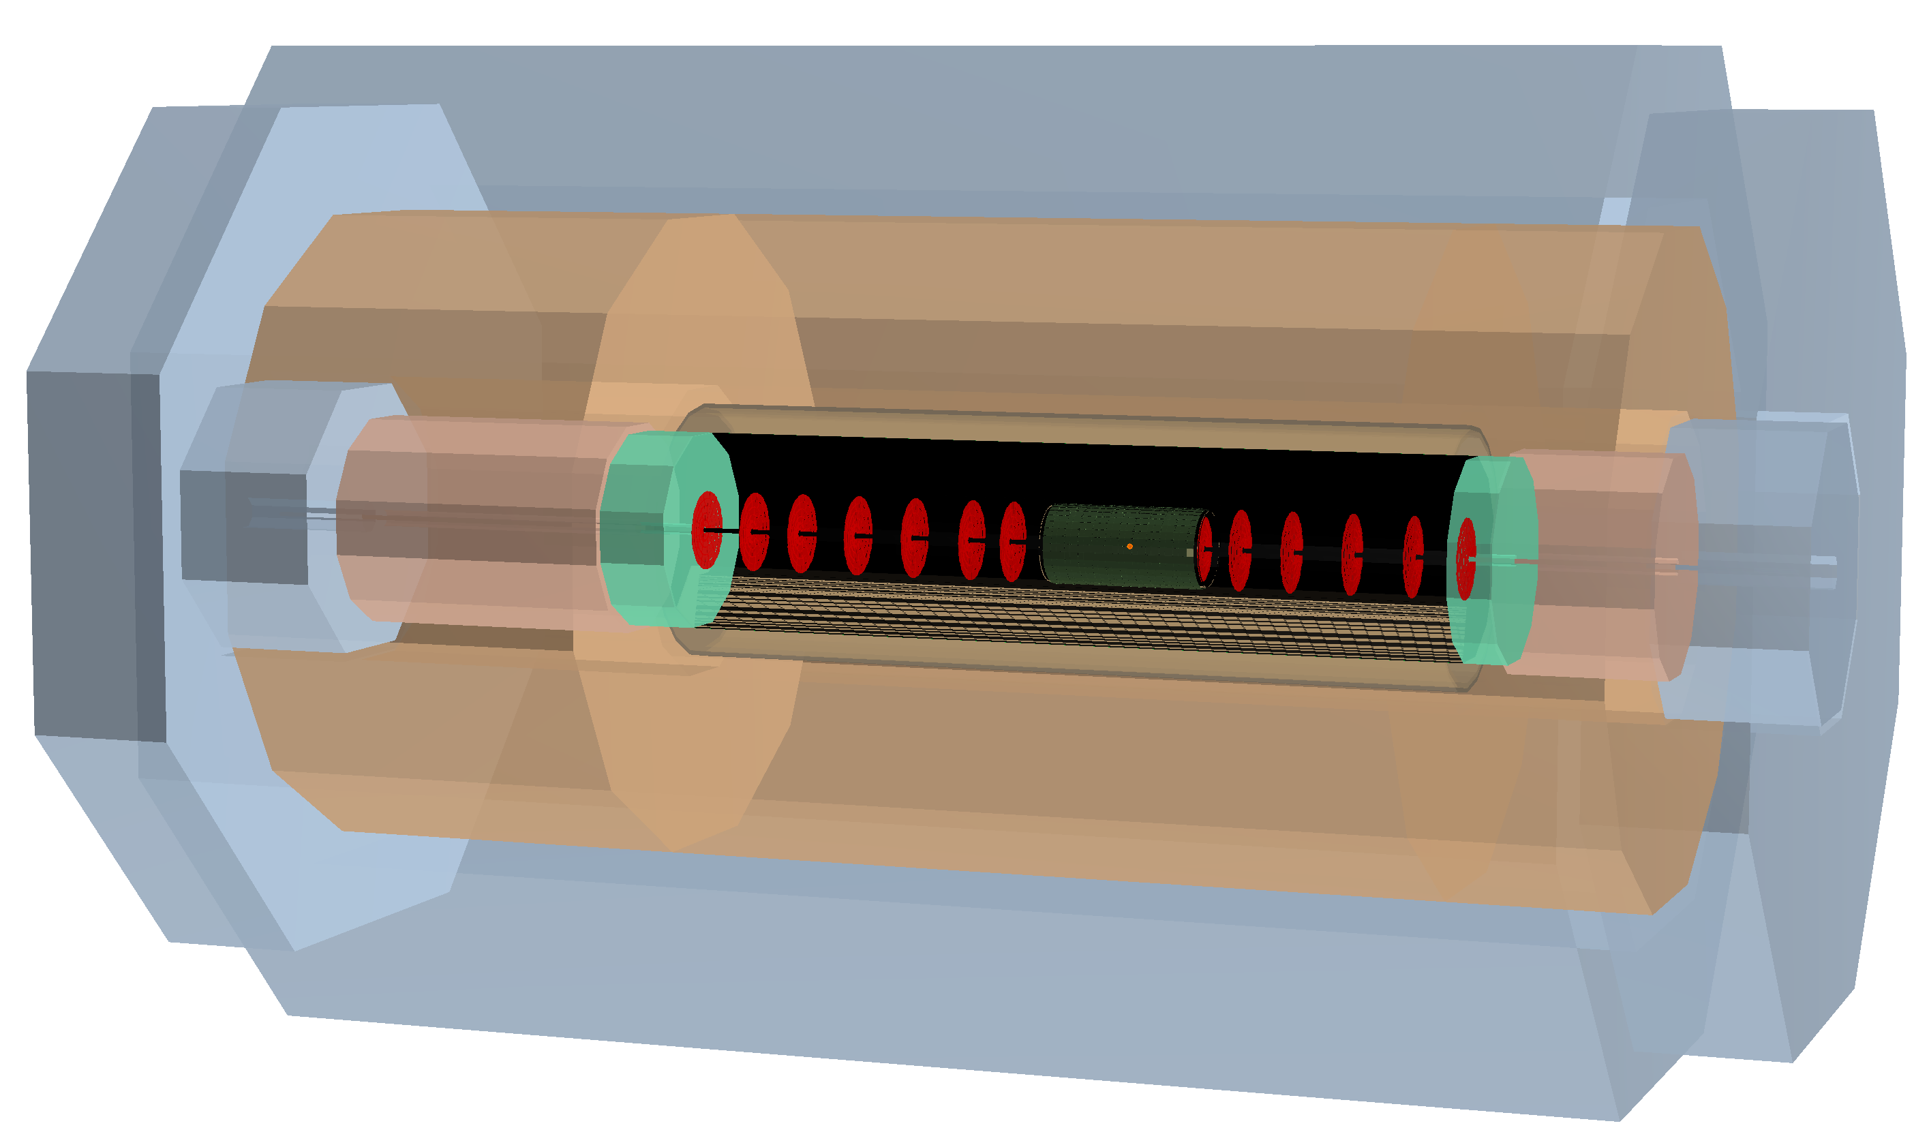
FCC-eh Detector

Slide 33
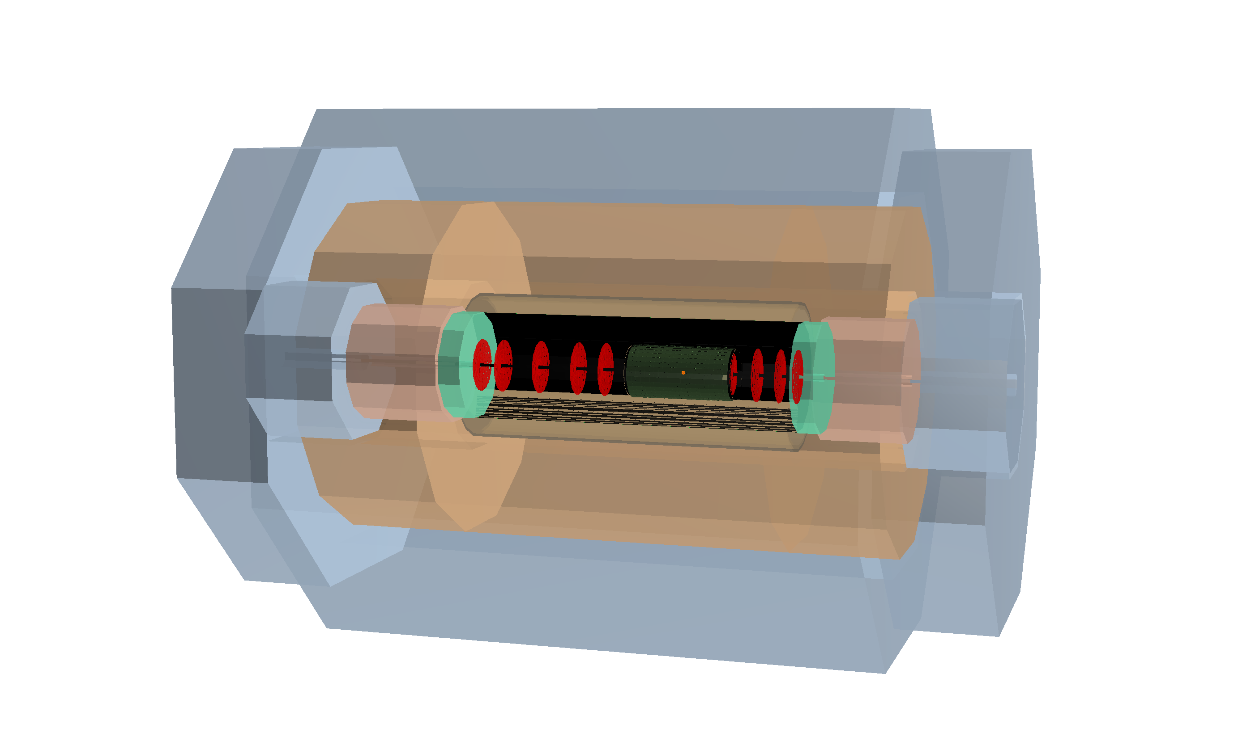
FCC Detector is a scaled version of LHeC Detector

Slide 34
eh and hh Relations
Physics:
- high precision of ep essential for pp: Higgs, strong coupling (link to ee too)…
- high Bjorken x: resolve PDF uncertainties to enable searches at highest mass in pp
- low Bjorken x: clarify parton evolution (BFKL? gluon saturation?) to understand pp
- Complement searches: spectroscopy of leptoquarks, sterile neutrinos (ee-eh-hh),..
Detector: very smilar requirements in forward (h) beam direction as for hh
backward similar to ee
Accelerator:
Concurrent operation of pp and ep – no significant loss of pp luminosity
Development of technologies: SCRF for ep and ee, for example
Conclusion: eh is genuine part of hh and should occur in the FCC-hh CDR books

Slide 35
Higgs in ep beyond precision couplings

Slide 36
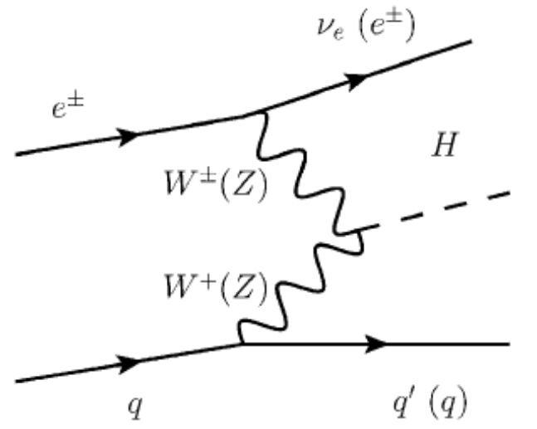
Higgs Physics with ep
κ in % | HL LHC | LHeC HL | LHeC HE | FCC-eh
H → bb | 10 | 0.5 | 0.3 | 0.2
H → cc | 50? | 4 | 2.8 | 1.8
Higgs is produced via an EW process in ep collisions
  No involvement of ggF and no pile-up
  Precise theoretical control of the cross-section
Superior sensitivity of ep with respect to pp in various aspects:
  h → bb,cc,tautau couplings, unique access to WW-H-WW
    Access to h → gg?
  Structure of hVV and top Yukawa couplings
Access to hh and invisible decays (dark matter) in ep collisions
Removal of QCD uncertainties to gg → H calculation for LHC
With ep, pp becomes very high precision Higgs facility
of important complementarity to ee (LH(e)C and FCC-pp+ep

Slide 37
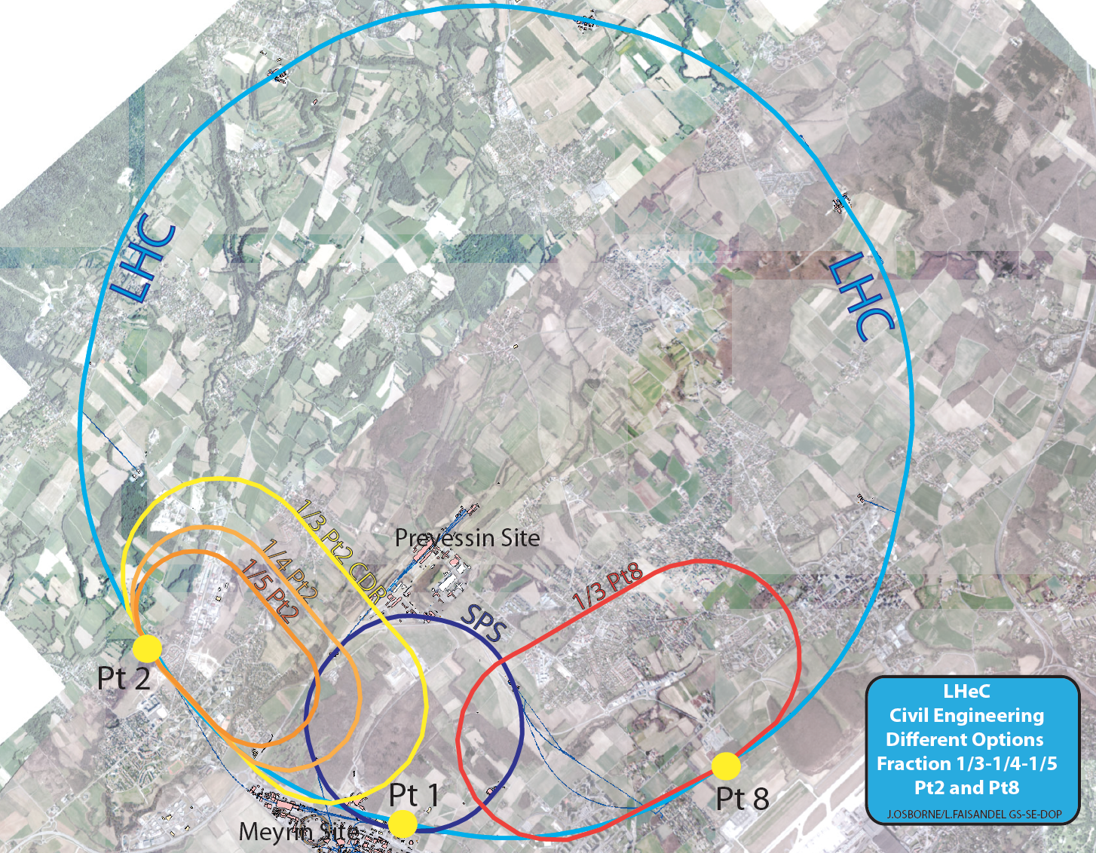
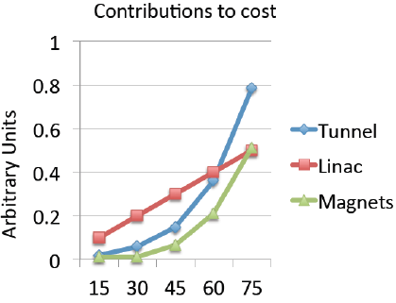
LHeC Default Configuration
E_{e}/GeV
A rough extrapolation of a 3-turn ERL shows how
the cost rises non-linearly with the electron beam
energy. Reliable cost estimate work in progress
9km: 1/3 of U(LHC) leads to 60 GeV e energy
5.4km : 1/5 of LHC circumference: 51 GeV
energy driven by H, top, BSM and low x physics
Conclusion on LHeC: may build an ERL tangential to LHC (HL and HE in sight).
Choice of energy from optimization of physics, cost, effort, time schedule..
F Zimmermann on Monday

Slide 38
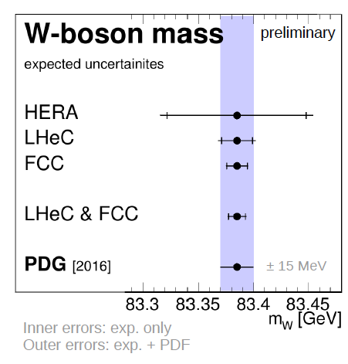
High Precision for the LHC
Higgs pp Cross Section
D.Britzger on
Thursday
Predict the Higgs cross section in pp to
0.2% precision which matches the M_{H}
measurement and removes the PDF error
Spacelike M_{W} to 10 MeV from ep
→ Electroweak thy test at 0.01% !
Predict M_{W} in pp to 2.8 MeV →
Remove PDF uncertainty on M_{W} in pp
ep+pp deliver high precision of Higgs and
qcd and electroweak physics – compl to ee

