Slide 1
Development of the FCC-he Study
Max Klein
U Liverpool and CERN
for the FCC-he Study Group
DIS
Accelerator
Physics
Detector and IR
Test Facility
Project Status
Istanbul, 11th of March, 2016
http://lhec.web.cern.ch
An invitation to join the study (acc, det, phys)
max.klein@cern.ch

Slide 2
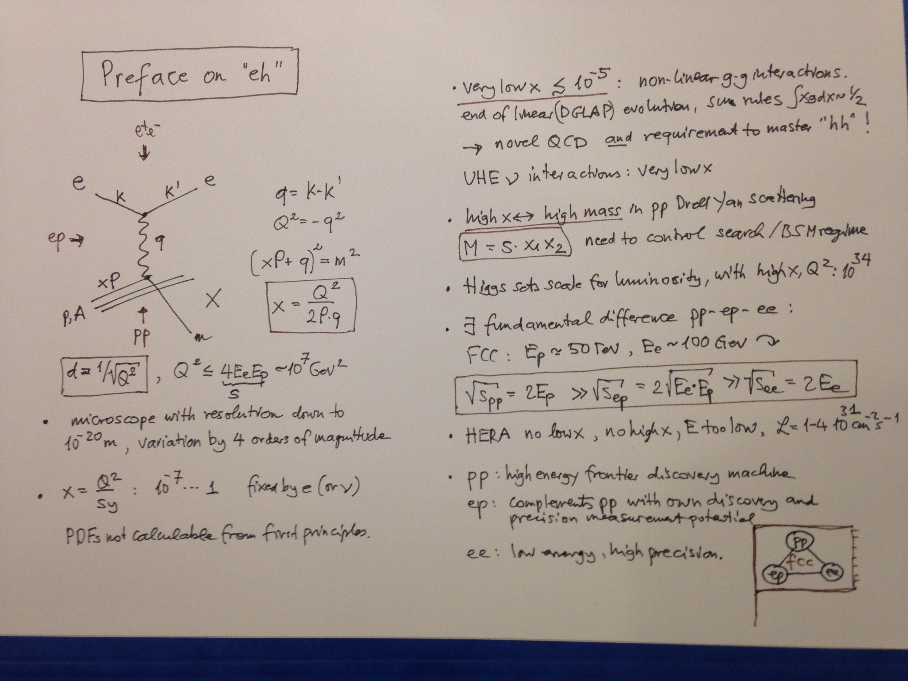

Slide 3
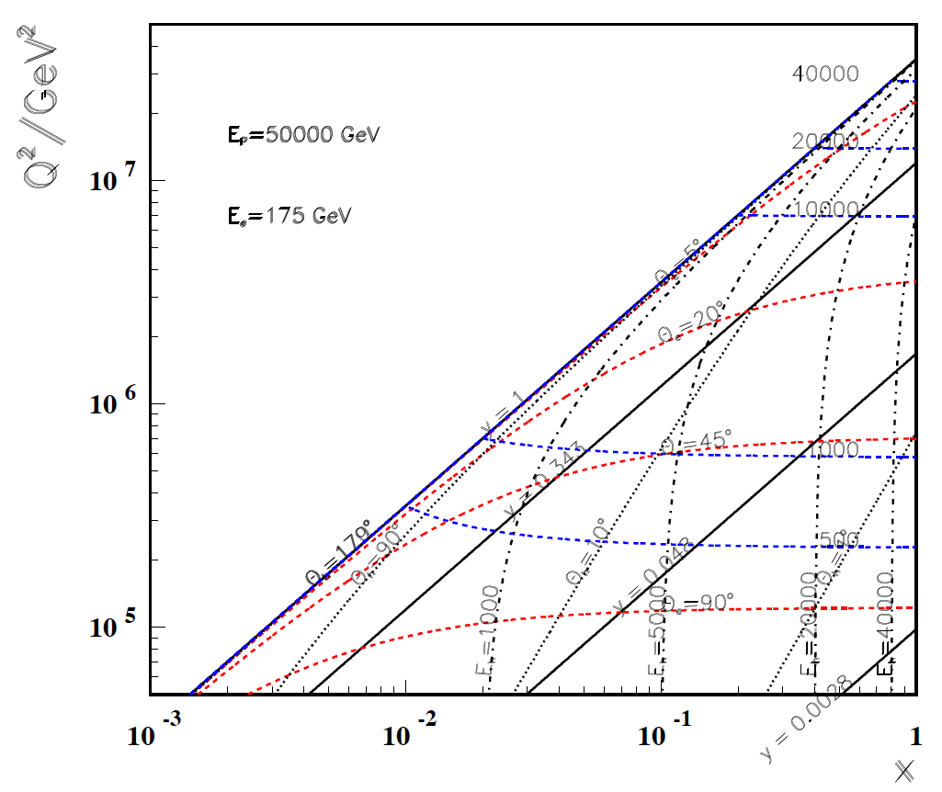
High Q²
Rutherford backscattering
of dozens of TeV e- energy
FCC-he
175 GeV
60 GeV
LHeC
← ϑ_{h}=1º
Large imabalance
of e and p energies
is surprisingly
tolerable for the
high Q², x kinematics,
LHeC to bridge
from HERA to FCC
← HERA

Slide 4
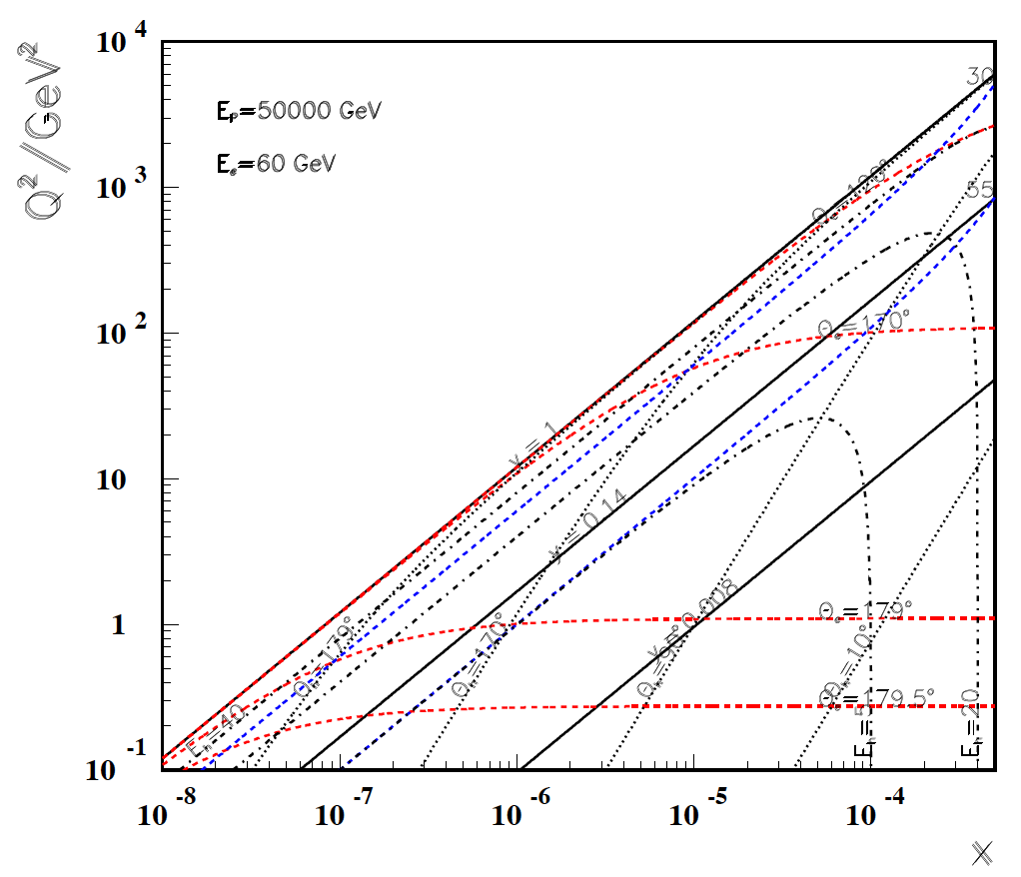
Low x
FCC-he
60 GeV
LHeC
Backward
region, low x
is governed
solely by E_{e}!
-----------
179º
@ 180 GeV
.. very low x
requires not
the maximum
of E_{e}
Very low x
reaches
direct
range of
UHE
neutrino
physics →
HERA
x
For x < 10⁻³ no (average) energy deposition exceeding the electron beam energy

Slide 5
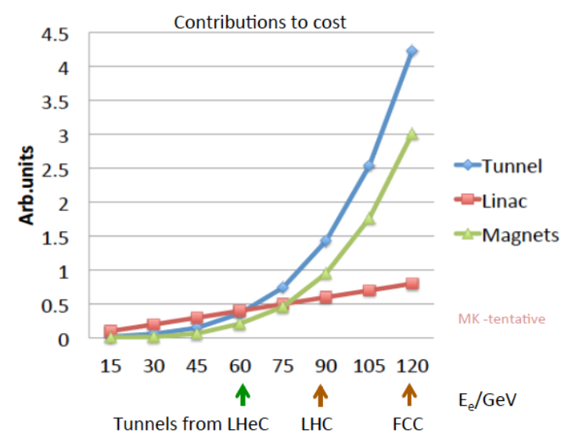
Choice of Baseline Configuration = f(cost,E_{e},s)
Cost strongly rising with tunnel circumference. Presently stick to LHeC default.
Maximise independence of ring installation, design for synchronous ep and pp OP

Slide 6
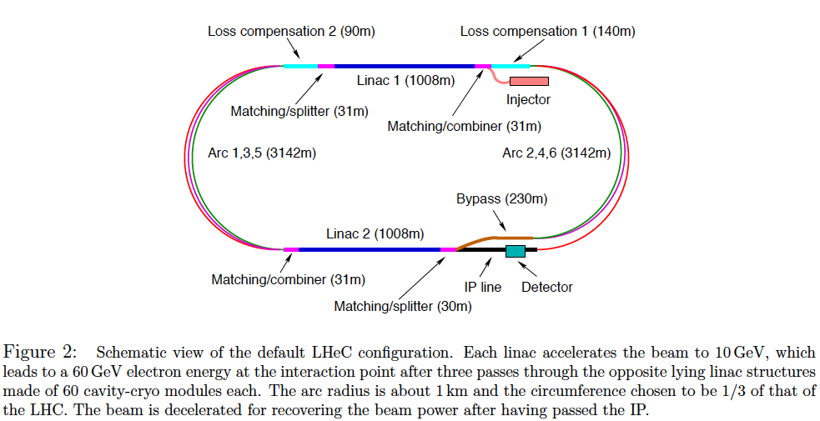
Baseline Electron Beam Configuration*⁾
*) LHeC CDR, arXiv:1206.2913

Slide 7
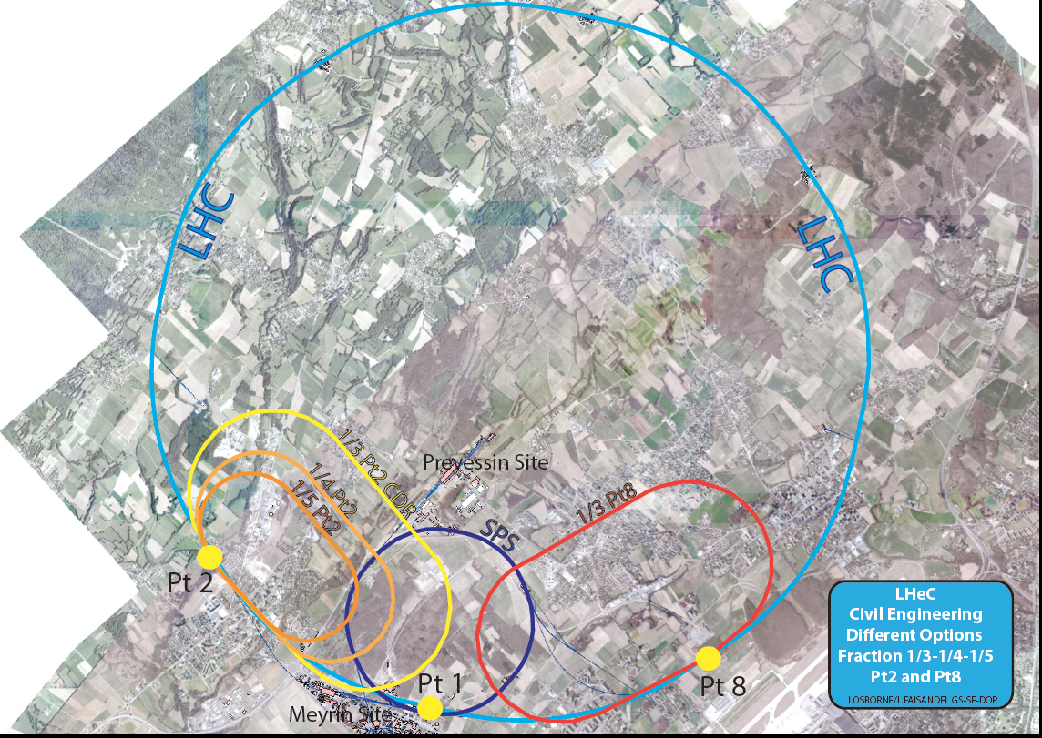
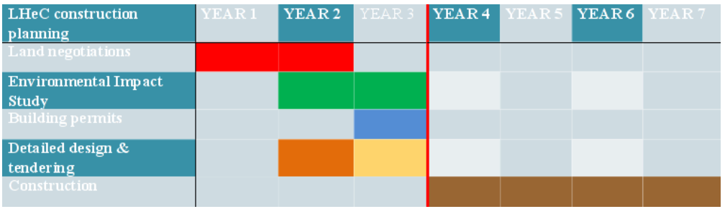
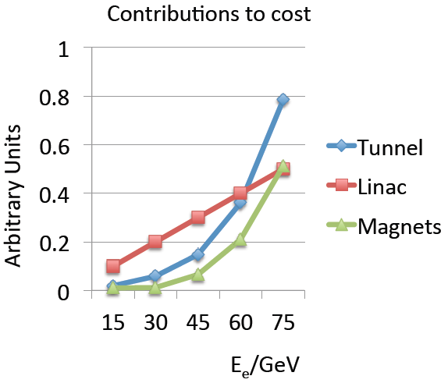
backup
Civil Engineering
Footprint
7 years for 9km
Civil Engineering
MK 6/14
Max Klein ICFA Beijing 10/2014

Slide 8
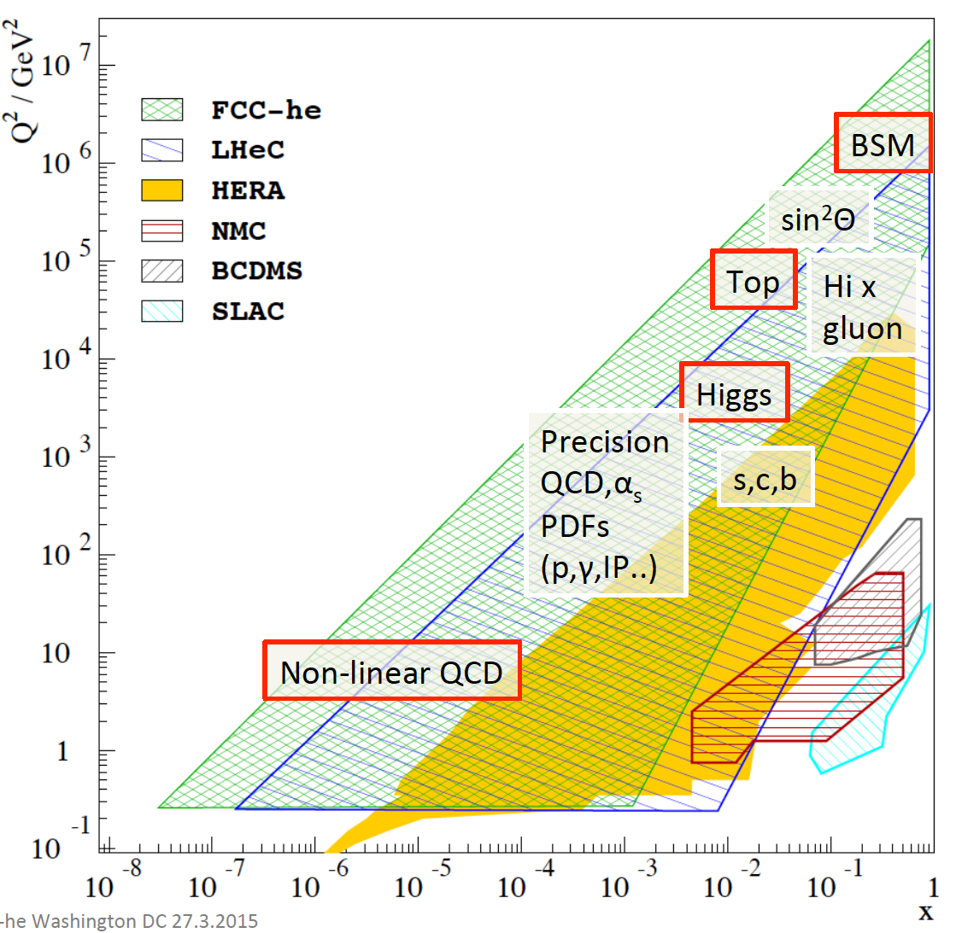
Summary of ep Physics

Slide 9
Energy Frontier DIS
Search for + verification of Contact Interactions into O(100)TeV. eq Fusion: Leptoquarks M<√s

Slide 10

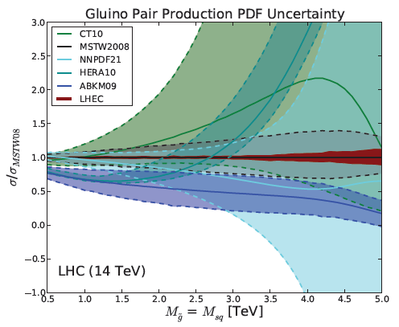
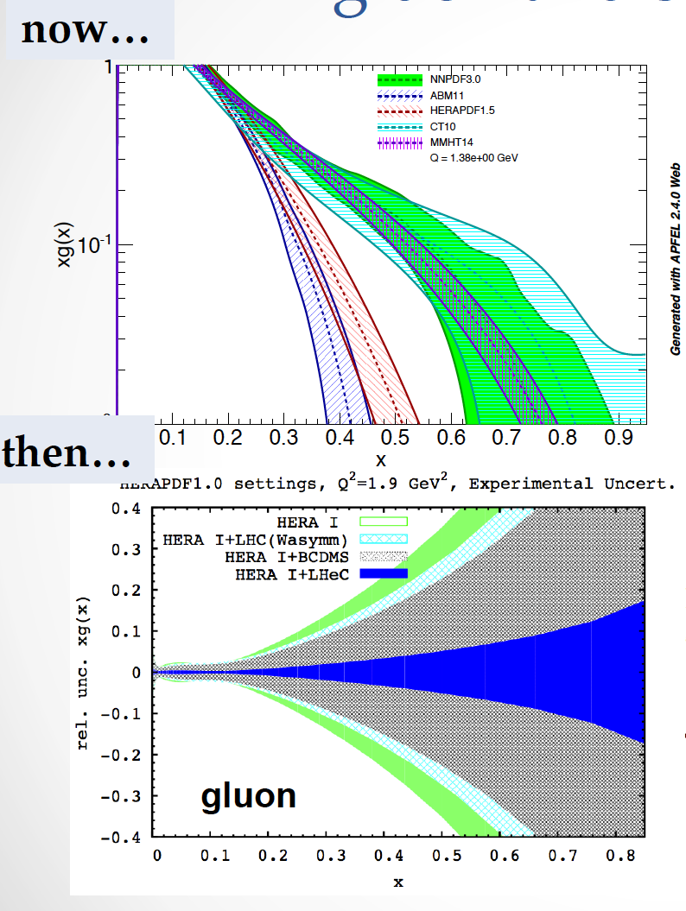
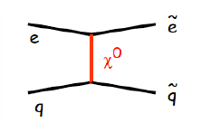
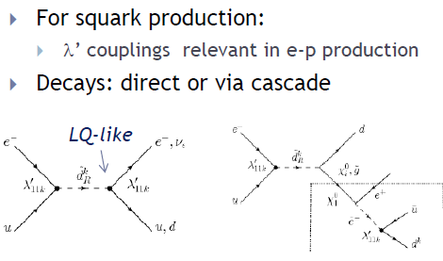

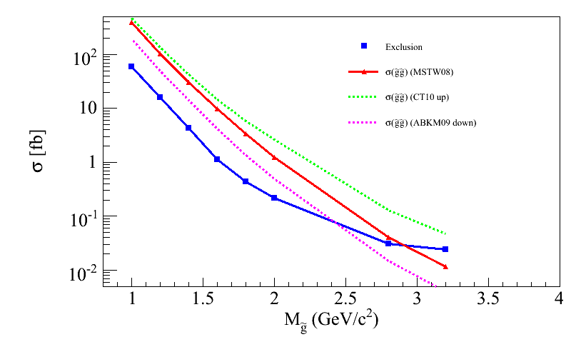
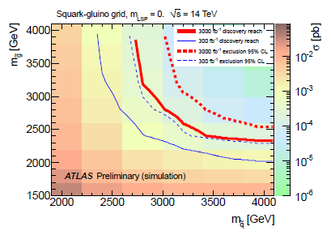
Precision PDFs for BSM Searches
Gluons for SUSY
C. Gwenlan @DIS2015
LHeC
xg(x)
LHeC
Using 2012 NLO PDFs
LHeC Note 2012-005 [arXiv:1211.5102]
LHeC-PDF accessible via LHAPDF, MK, V.Radescu
Using 2014 NNLO PDFs
Searches for Supersymmetry
Direct searches for Supersymmetry at the LHeC can be performed in the context of R-parity conserving or violating scenarios:
R-parity = (-1)^{3(B-L)+2s} (R = 1 for SM particles, -1 for MSSM partners)
If conserved:
  Sensitivity for selectron-squark
  production
  → sizeble σ for m(sele)=500 GeV
  Exclusion limits set by the LHC
  depend on the SUSY mass hierarchy assumed
If no evidence for RPC SUSY is found in Run II, SUSY particles may be out of reach for LHC → interplay in terms of PDF fundamental for HL-LHC
If violated, various terms arising from superpotential
Reach up to 1 TeV squark masses
Feasibility of these searches will
depend on LHC findings
Strong impact of improved PDF fits on the theoretical predictions for SUSY process at high sparticle masses.
Ex.: gluino pair production (m_gl = m_sq)
Dependency on discovery potential and exclusion limits
at 300 and 3000 /fb for 14 TeV c.o.m. at the LHC
CT10 up
ABKM09 down
MSTW08 (equivalent to LHeC PDF )
Effect up to 1 TeV (plot to be replaced)
ATLAS-PUB-2012-001
Poster presented on behalf of the LHeC Study Group
References: J. L. A. Fernandez et al. [LHeC Study Group Collaboration], J. Phys. G 39 (2012) 075001 [arXiv:1206.2913]; arXiv:1211.4831; arXiv:1211.5102.

Slide 11
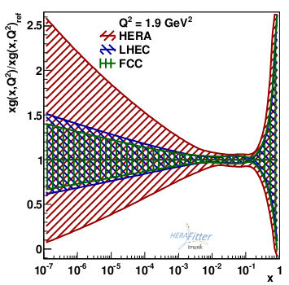
FCC-eh vs LHeC vs HERA
gluon
unknown
FCC-eh: Ep=50 TeV, Ee=100 GeV
NC and CC: e-p, P=80%, 1000 fb⁻¹
stat: 0.1 – 30%, uncor 0.7%, syst 1 – 5%
coverage down to x=2×10-7, up to Q² = 10⁷ GeV²
FCC LHeC HERA
need FCC to constrain much below x=10⁻⁵
FCC-eh can further improve, and explore low-x phenomenology

Slide 12
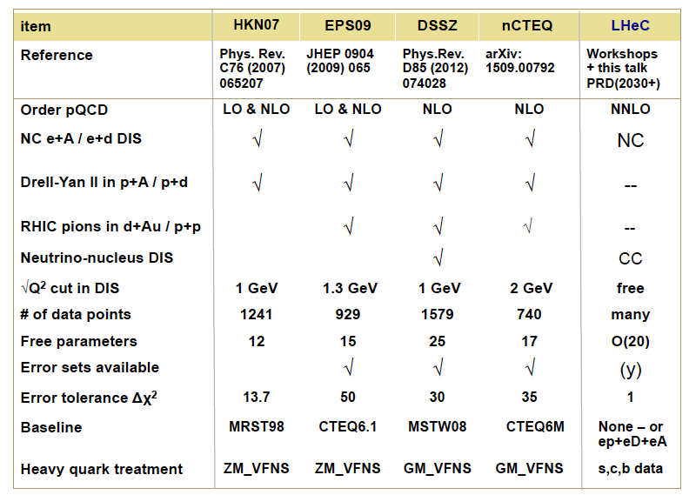
Electron Ion Physics
HERA had no eA phase. Thus the LHeC (FCC-eh) extends the Q²,1/x range of nuclear DIS
by 4(5) orders of magnitude → a revolution of understanding nuclear dynamics+structure
Cf recent talks on LHeC web page and paper (M.K.) in POETIC2015

Slide 13
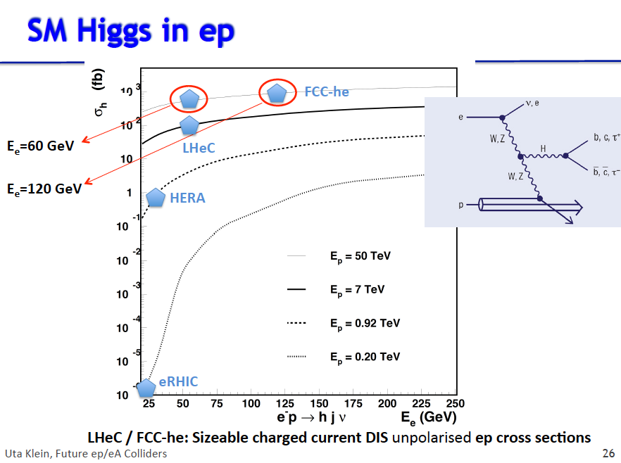
Clean production
High xsection (5xee)
Clean final state
No pile-up in ep
Unique and
complementary H lab
High Precision →
Window to BSM, DM

Slide 14
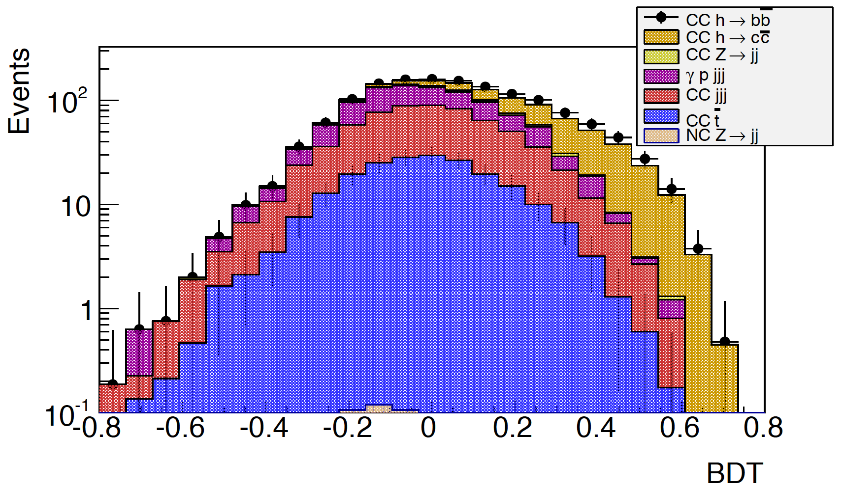
Very first BDT results : Higgs→ cc
[P=-0.8, BR=0.029]
Using jet lifetime tags
Assuming very well understood background after 8-10 years running!
105< M_{jj} < 135 GeV
1000 fb⁻¹
All backgrounds assumed to 1%
BDT cut >0.3: Hcc Signal events : 133
S/√S+B=1.5 → κ(Hcc) = 7% for 1000 fb⁻¹
➔ There is a clear potential to measure Hcc at LHeC
→ Further optimisation ongoing, e.g. using R=0.7 jets will double statistics
Uta Klein
Imperial 2/16

Slide 15
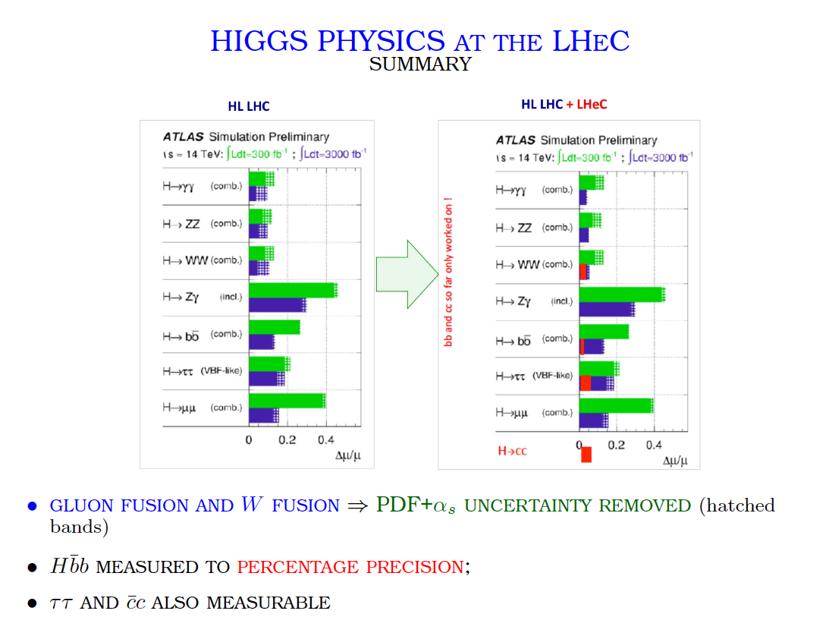
Meeting with Eckhard Elsen
Turn LHC into precision
Higgs facility: add PDFs
add ep channels (bb,cc.)
S.Forte ECFA 9/15

Slide 16
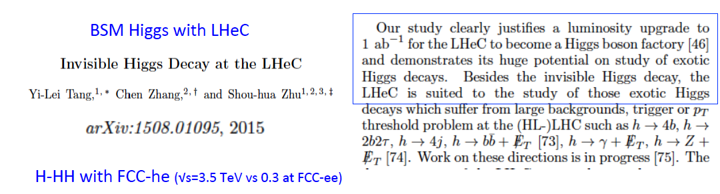
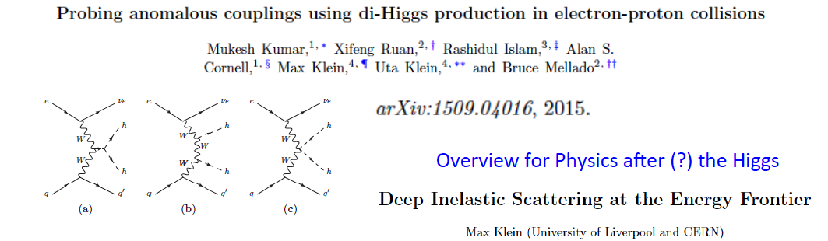
Further Recent Studies on Higgs in ep
Higgs cross section at FCC-ep is O(1pb) →striking potential being explored
Physics summary artiicle - Published in Annals of Physics 1/16

Slide 17
top quark electroweak interactions
precise measurement of couplings between SM bosons and fermions sensitive test of new physics (search for deviations) : top quark expected to be most sensitive to BSM physics, due to large mass
high precision measurements of Vtb and search for anomalous Wtb couplings
direct measurement of top quark charge and search for anomalous ttbarγ couplings (eg. EDM, MDM)
measurement of top isospin and search for anomalous ttbarZ couplings (eg. EDM, MDM)
sensitive search for FCNC couplings will constrain BSM models that predict FCNC (eg. SUSY, little Higgs, technicolour)

Slide 18
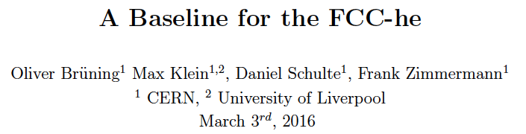
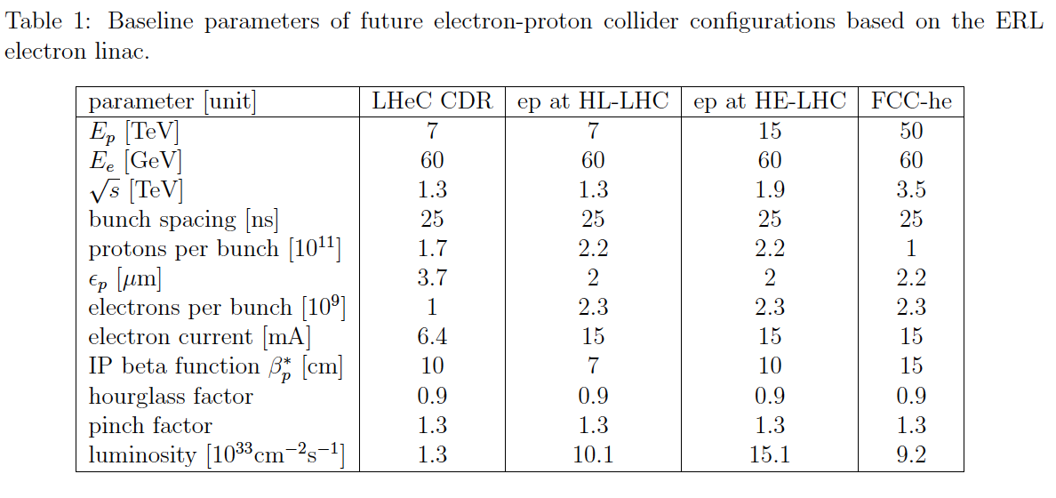
4.3.2016 - work in progress Study value of dedicated operation O(10³⁵ cm⁻² s⁻¹), also eA

Slide 19
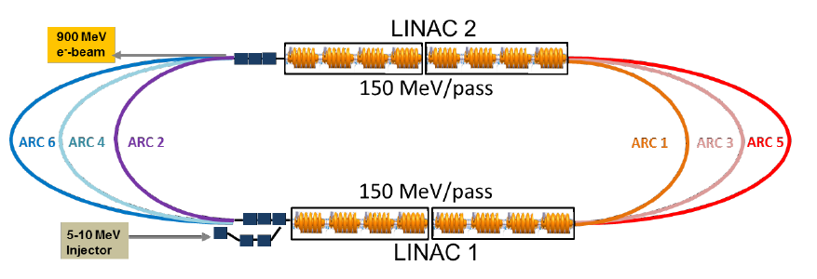
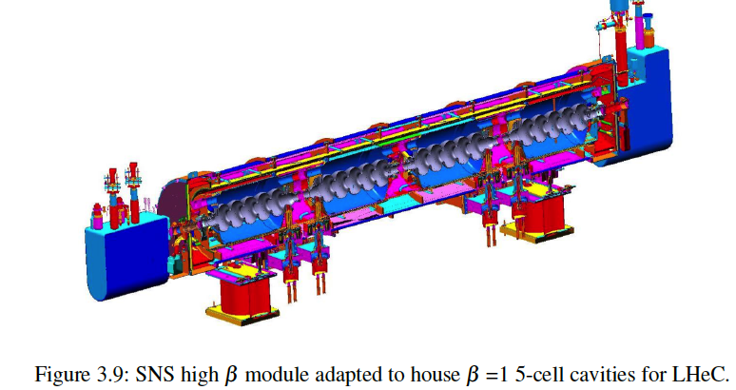
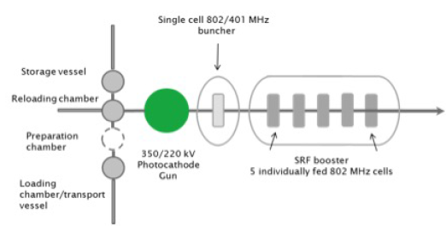
Test and Physics Facility
Source (Boris Mlytsin, CI)
ICFA BeamNewsletter68 (1/16) and to be published

Slide 20
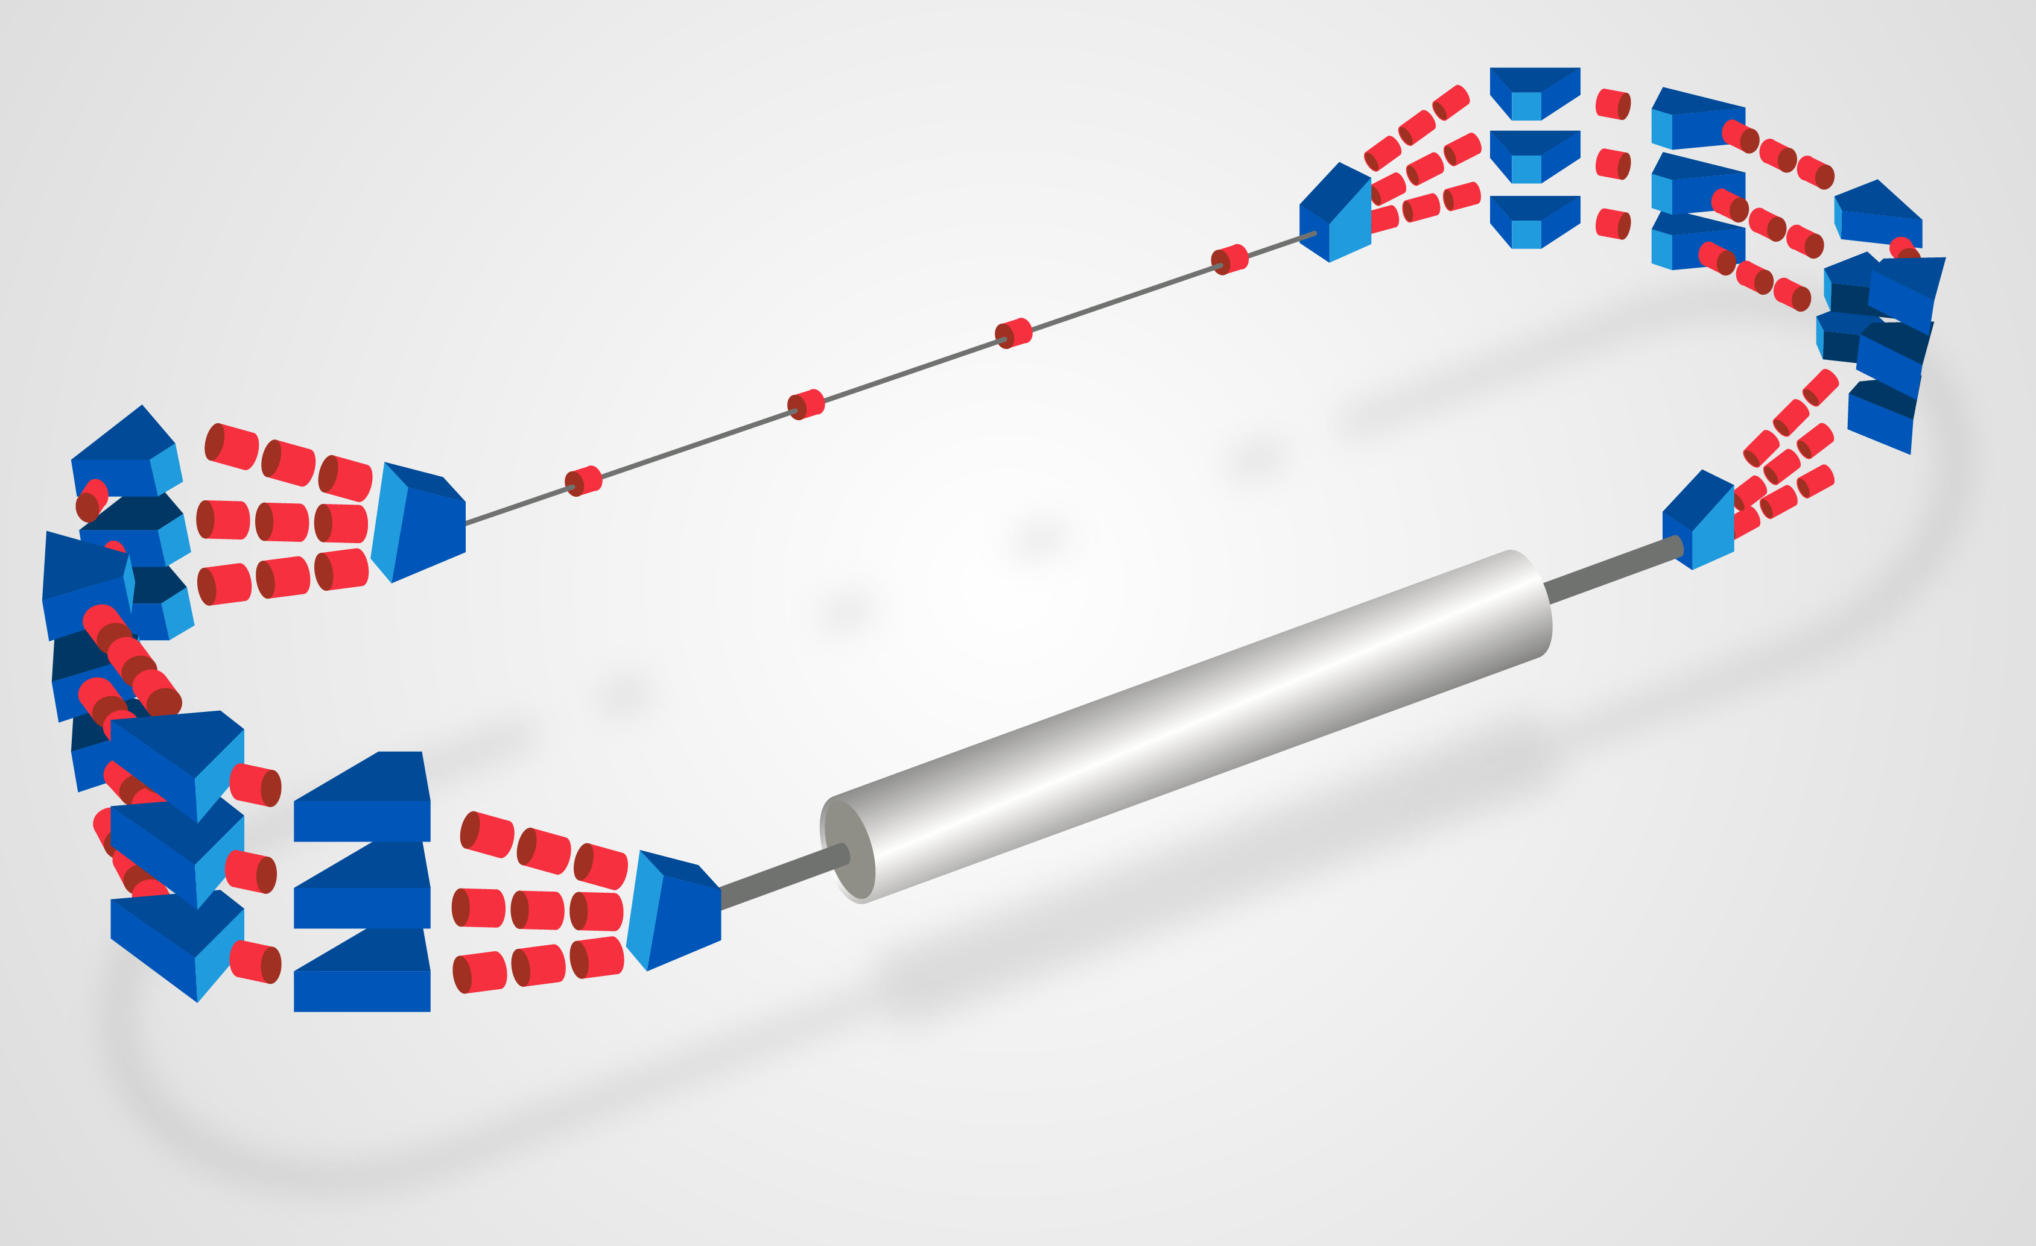
ERL Demonstrator
Demonstration of high current
(10mA), multi(3)turn ERL
Test and development of 802MHz
SCRF technology
E_{e} = 200 (400) MeV with 1(2) module
A.Valloni 2/16
Parameter | Value
Dipoles per arc Dipole length Max B Field | 3/4 50 cm 1.1 T
Quadrupoles per arc Quadrupoles in straight lines | 5 4
Dipoles in Spreader/Combiner Quads in Spreader/Combiner | 1-3 3
Dipoles for Injection-Extraction | 6
Work in progress

Slide 21
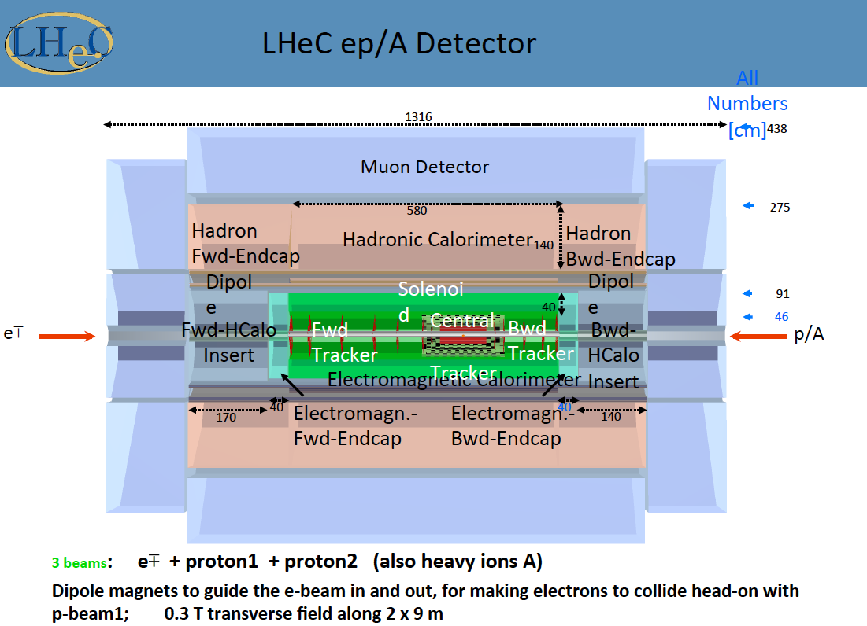
title
150 pages in CDR. New
Software and Physics
Developments

Slide 22
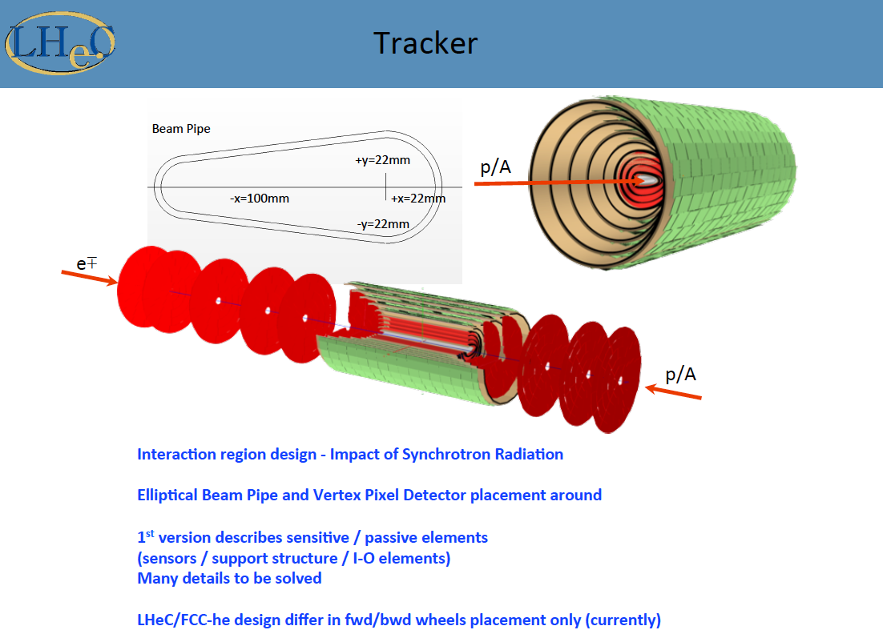
title
Direct synergy
LHeC and FCC-eh
Common study.
Note huge progress
in thin Si technology
post HL LHC!

Slide 23
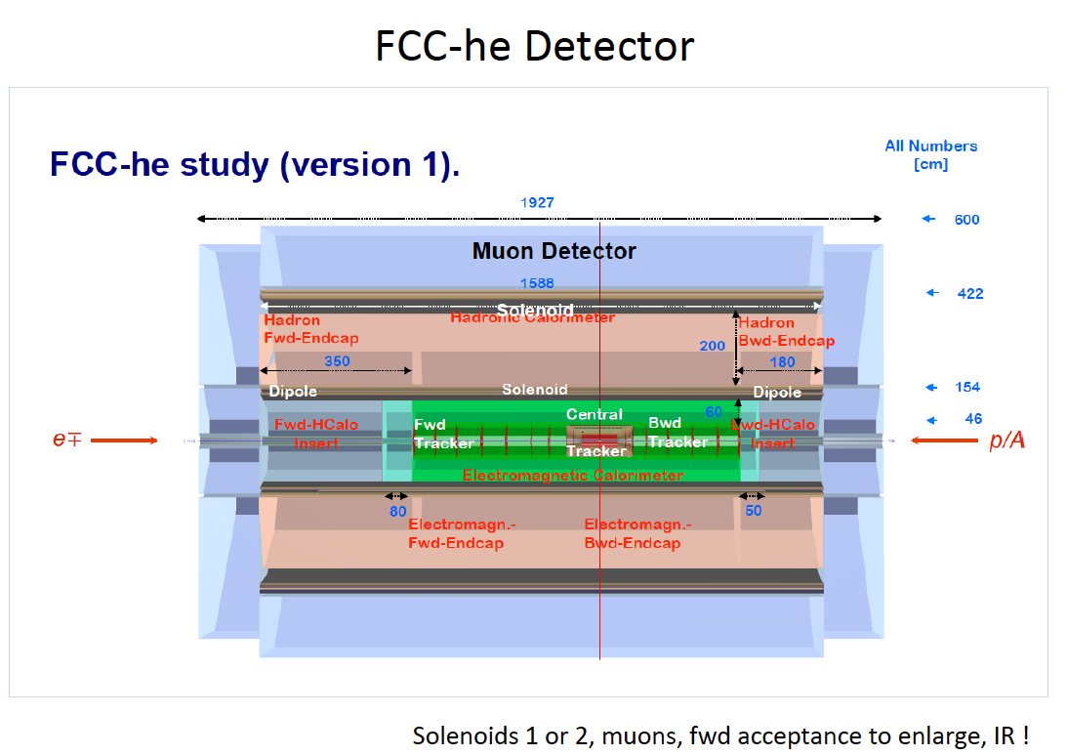
title

Slide 24
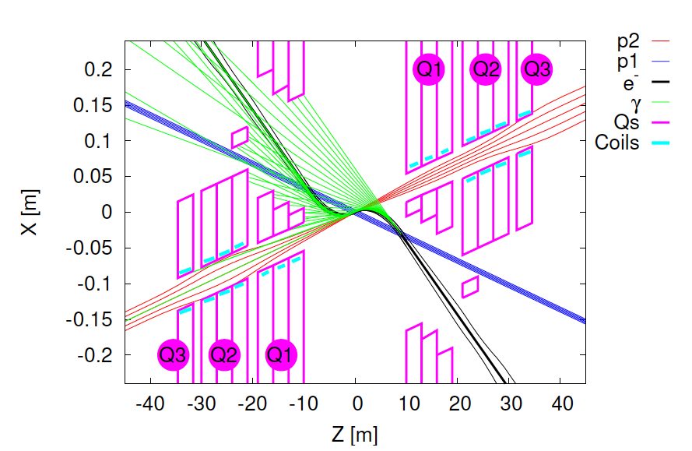
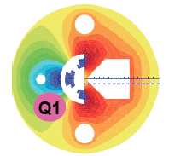
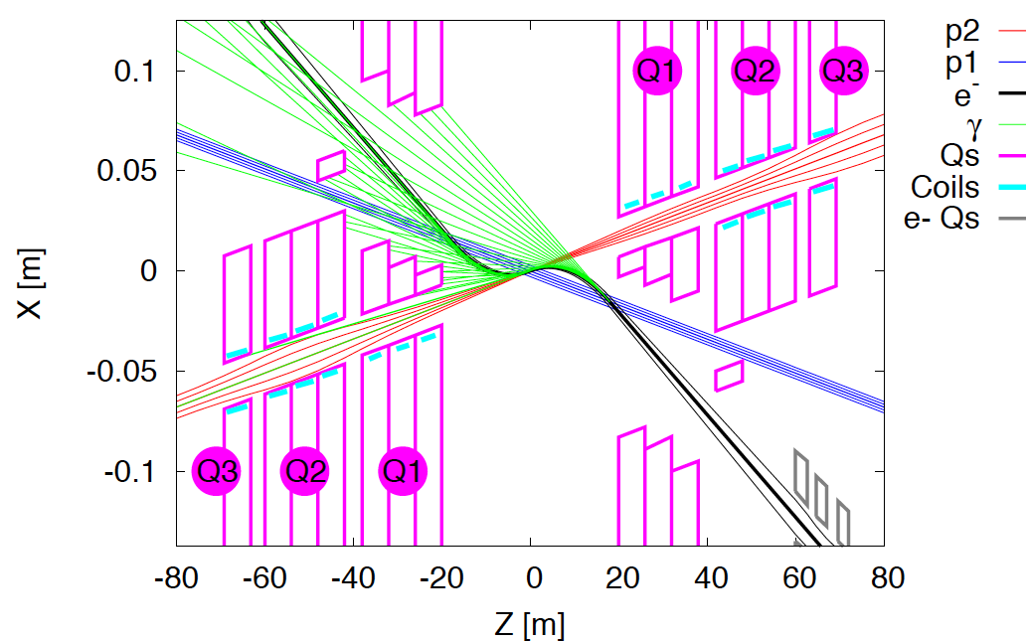
Interaction Regions for ep with Synchronous pp Operation
LHeC (CDR)
60 GeV * 7 TeV
Still work in progress:
may not need half
quad if L*(e) < L*(p)
Non colliding p beam
FCC-he (ERL)
60 GeV * 50 TeV
Tentative: ε_{p}=2μm, β*=20cm → σ_{p}=3μm ≈σ_{e} matched! ε_{e}=5μm ..
Rogelio Tomas et al

Slide 25
Remarks on the Project Status
LHeC: CDR in 2012 (300 authors, 600 pages). 2014: CERN Mandate to continue the study:
Mandate to the International Advisory Committee 2014-2017
Advice to the LHeC Coordination Group and the CERN directorate by following the
development of options of an ep/eA collider at the LHC and at FCC, especially with:
Provision of scientific and technical direction for the physics potential of the ep/eA
collider, both at LHC and at FCC, as a function of the machine parameters and of a
realistic detector design, as well as for the design and possible approval of an ERL
test facility at CERN.
Assistance in building the international case for the accelerator and detector
developments as well as guidance to the resource, infrastructure and science
policy aspects of the ep/eA collider.
Chair: Herwig Schopper
Next major goals:
Development of SC RF (802 MHz) with Jlab. Design of Test Facility (10mA, 3 turn, ERL)
Update of the CDR by 2018: LHC physics, 10³⁴ lumi, detector and accelerator updates
FCC-eh: Utilize the LHeC design study to describe baseline ep/A option.
Emphasis: 3 TeV physics, IR and Detector: synchronous ep-pp operation.
Open to other configurations and new physics developments (750..)

Slide 26
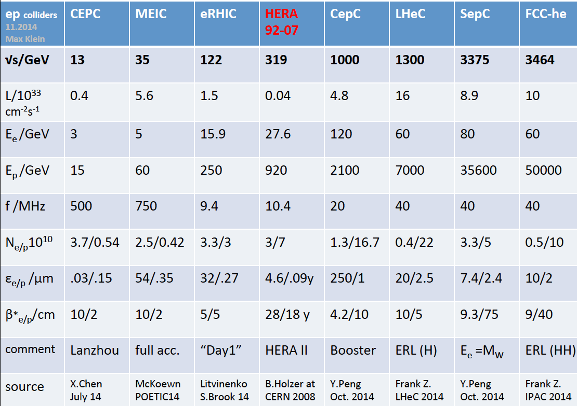
title
A Revival of electron-proton (ion) colliders following HERA

Slide 27

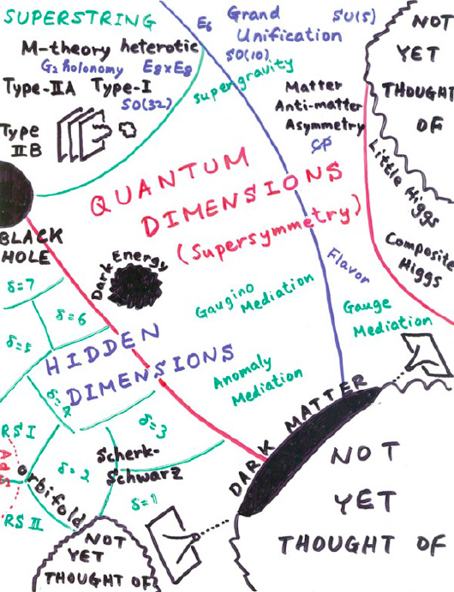
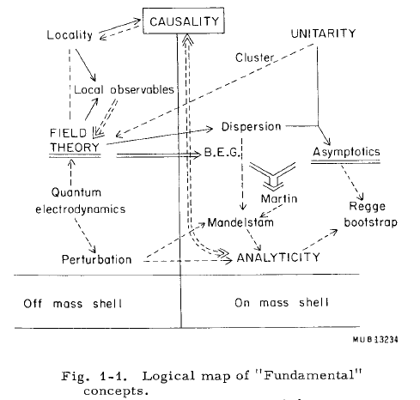
THEORY
M.Froissart ICHEP (“Rochester”) 1966
H.Murayama – ICFA11
→ Quarks in 1969
→ ?in 2015+?
We like to see particle physics as driven by experiment … Burt Richter

Slide 28
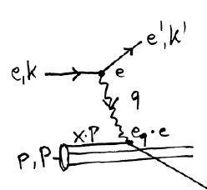
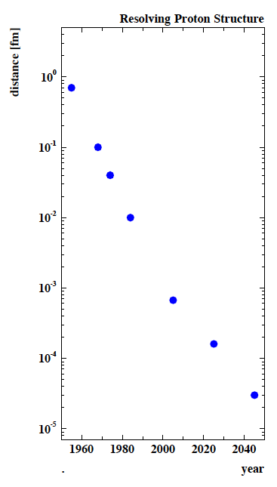
Deep Inelastic Scattering [eh → e’X]
e⁺e⁻
→
eh →
Finite p Radius
X
Stanford
→
Quarks
SLAC
hh
FNAL
Quark
Gluon
Dynamics
Parton momentum fixed by electron kinematics
Incl. NC (γ,Z) and CC (W±) independent of hadronisation
Rigorous theory: Operator expansion (lightcone)
Parton momentum distributions to be measured in DIS
Collider- as at HERA: y_{h}=y_{e} : Redundant kinematics
DIS is an ideal laboratory for the development of
particle physics into the multi TeV energy scale era.
The CERN hadron beams are the unique base for
building the “Hubble” equivalents to explore the inner
structure and pursue novel measurements leading
to discovery. In this quest, hh, eh and ee are a unity.
CERN
100 years of lp scattering
→ 5 orders of magnitude
deeper into matter
HERA
LHeC
?
FCC-he

Slide 29
POETIC VI Workshop, 7.-11.9.2015, Paris
http://poetic6.sciencesconf.org
Michael Benedikt, Lepton Photon Conference, 15.08.2015, Ljubljana
http://indico.cern.ch/event/325831/session/18/contribution/60/attachments/1143145/1638099/150822-MBE_FutureCircularColliders_ap.pdf
Fabiola Gianotti, EPS 2015, 29.07.2015, Vienna
https://indico.cern.ch/event/356420/timetable/#20150729.detailed
LHeC Workshop, CERN (24 June) and Chavannes-de-Bogis (25-26 June)
https://indico.cern.ch/event/356714/
DIS2015, 27. April -1 May 2015, Dallas, Texas
https://indico.cern.ch/event/341292/
First Annual FCC Meeting, 23-29 March 2015, Washington, U.S.A.
http://indico.cern.ch/event/340703/
Higgs & BSM at 100 TeV, 11-13 March 2015, CERN
http://indico.cern.ch/event/352868/
Nima Arkani-Hamed, SUSY2013, Trieste
https://www.youtube.com/watch?v=xNVZg694ct8
  M. Mangano, ”Future Colliders”, UK Forum 11/2014
http://conference.ippp.dur.ac.uk/event/394/
11th ICFA Seminar in Beijing, 27.-30.10.14
http://indico.ihep.ac.cn/conferenceOtherViews.py?view=standard&confId=3867
“On the Relation of the LHeC and the LHC” [arXiv:1211.5102]

