Slide 1
Introduction to the FCC-he
Detector Development
Work in progress
eh Baseline
IR
Kinematics
Detector Structure
Simulation
Remarks
Paul Laycock with Peter Kostka, Max Klein, Alessandro Polini et al

Slide 2
CE: favoured eh
site is point H

Slide 3
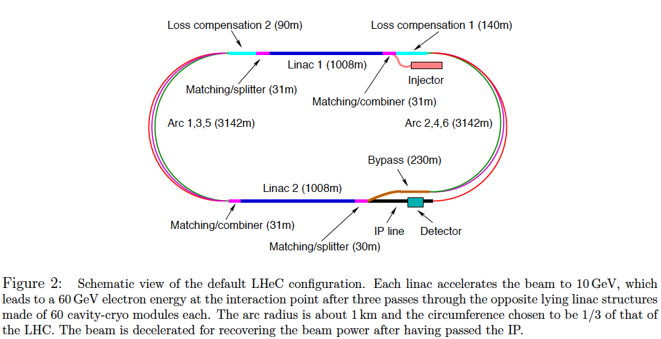
Baseline Electron Beam Configuration*)
e±
3 beam IR
h
h
For cost, development and physics reasons, the LHeC ERL is adopted as the FCC-eh baseline. It is possible that physics
at high masses (LQs as a prominent example) demands E_{e} to much exceed 60 GeV. Then the FCC-eh cost approached
a much higher target than hitherto assumed and the configuration and physics change substantially.
*) LHeC CDR, arXiv:1206.2913

Slide 4
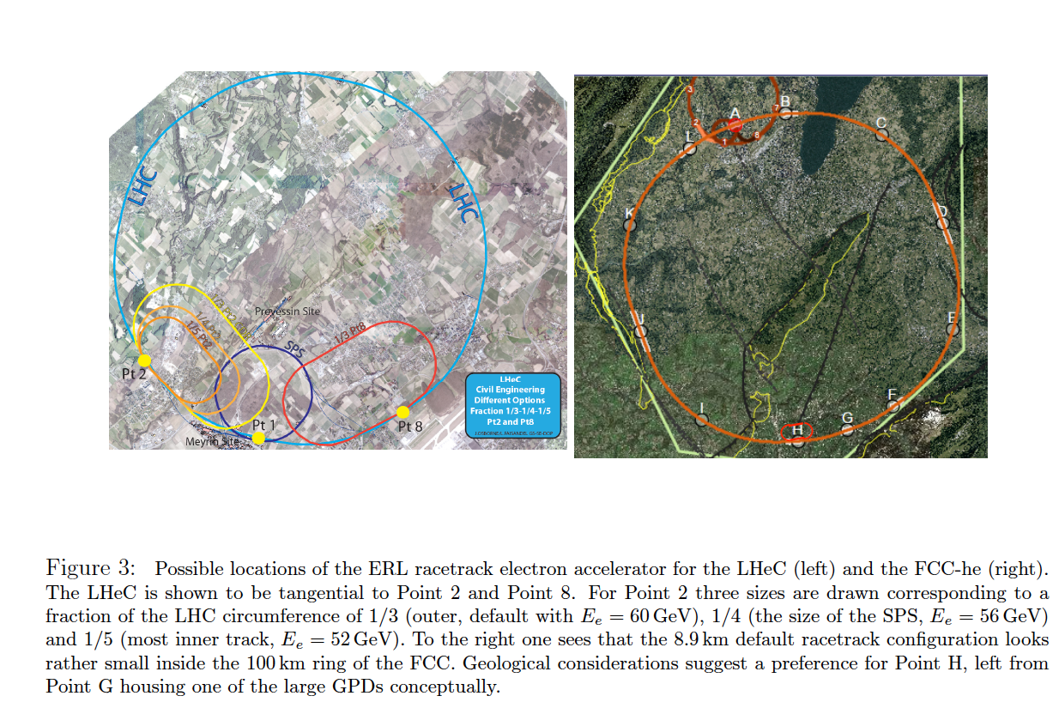
Configurations of Future ep Colliders at CERN
LHeC
FCC-eh

Slide 6
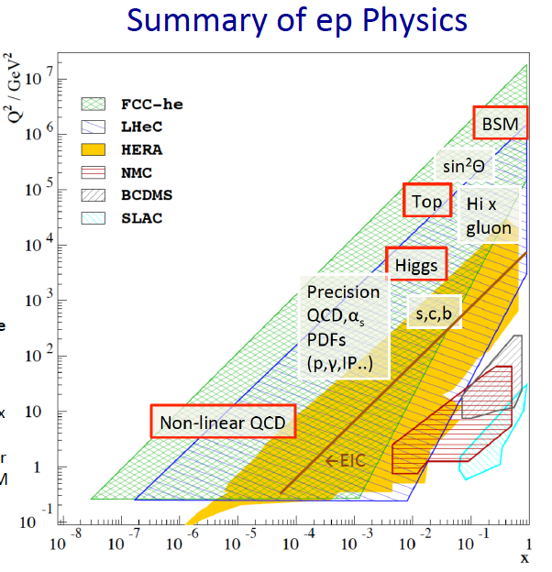

Slide 7
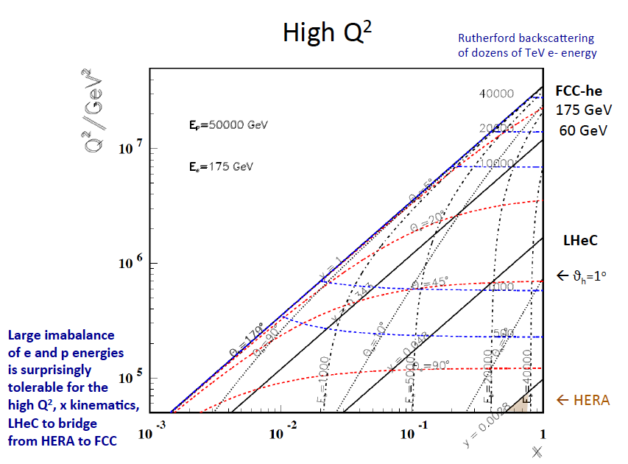

Slide 9
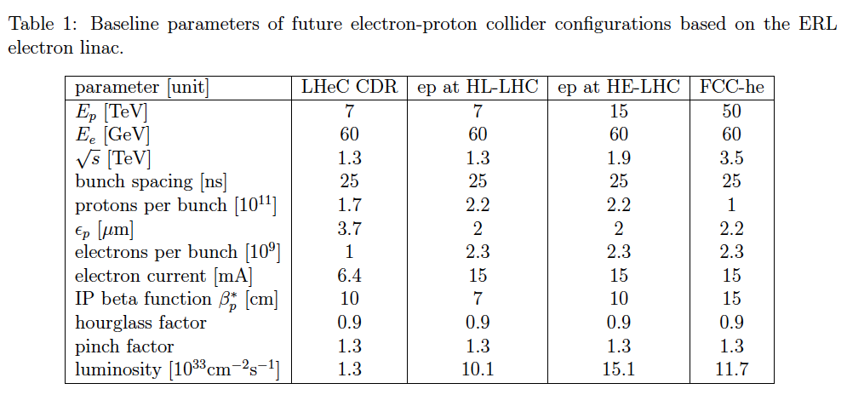
Baseline Parameters of ep at LHC and FCC
The Higgs discovery has raised the L(ep) goal to 10³⁴. The pile-up is O(1) at FCC-eh

Slide 10
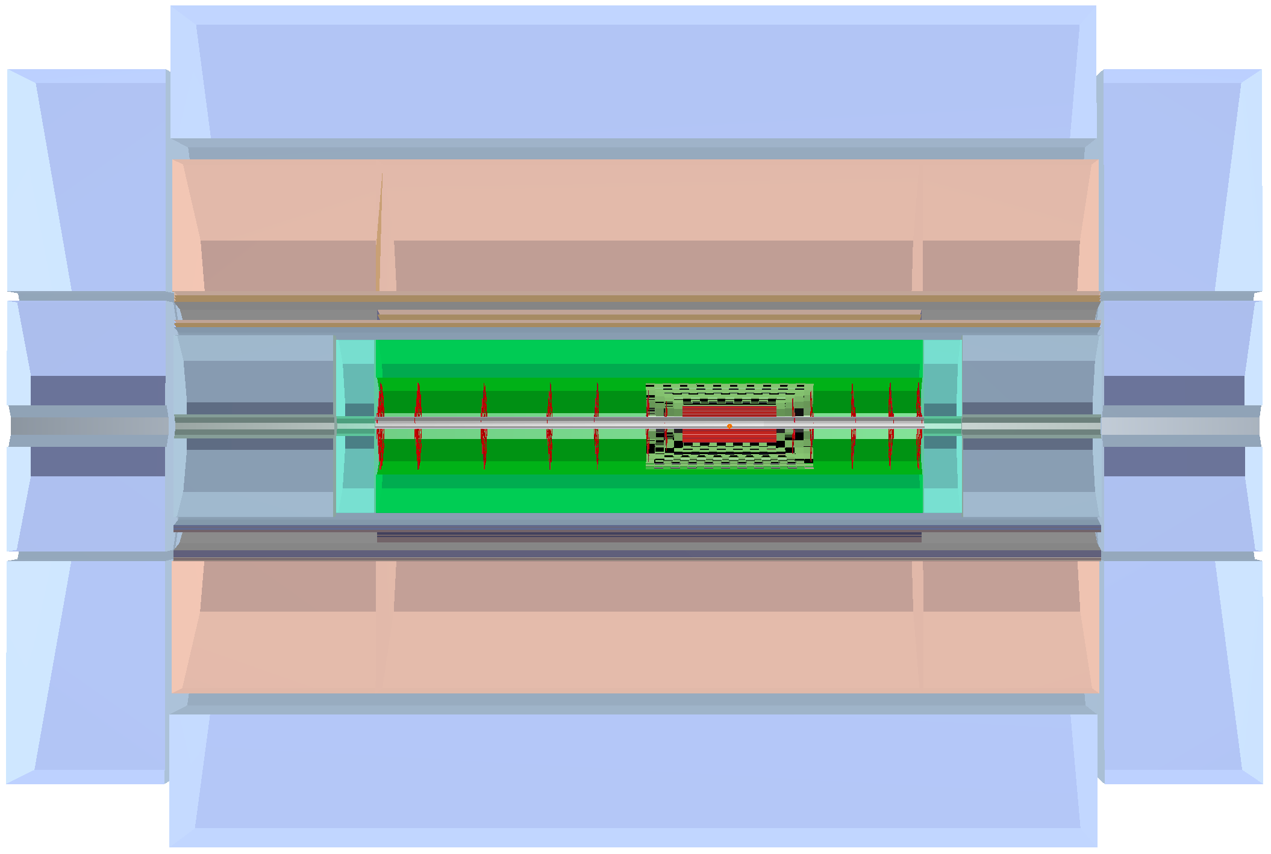
LHeC Detector Basic Layout
All Numbers [cm]
1316
438
Muon Detector
580
275
Hadron
Fwd-Endcap
Hadronic Calorimeter
Hadron
Bwd-Endcap
140
Dipole
Solenoid
Dipole
40
91
e∓
Fwd-HCalo
Insert
Fwd Tracker
Central
Tracker
Bwd
Tracker
Bwd-HCalo
Insert
46
p/A
Electromagnetic Calorimeter
170
40
Electromagn.-
Fwd-Endcap
Electromagn.-
Bwd-Endcap
40
140
Detailed report and study in LHeC CDR (150 pages). Includes taggers (fwd,bwd)
Basic change for FCC_eh: extension of fwd dimensions by log(50/7), bwd ~ similar

Slide 12
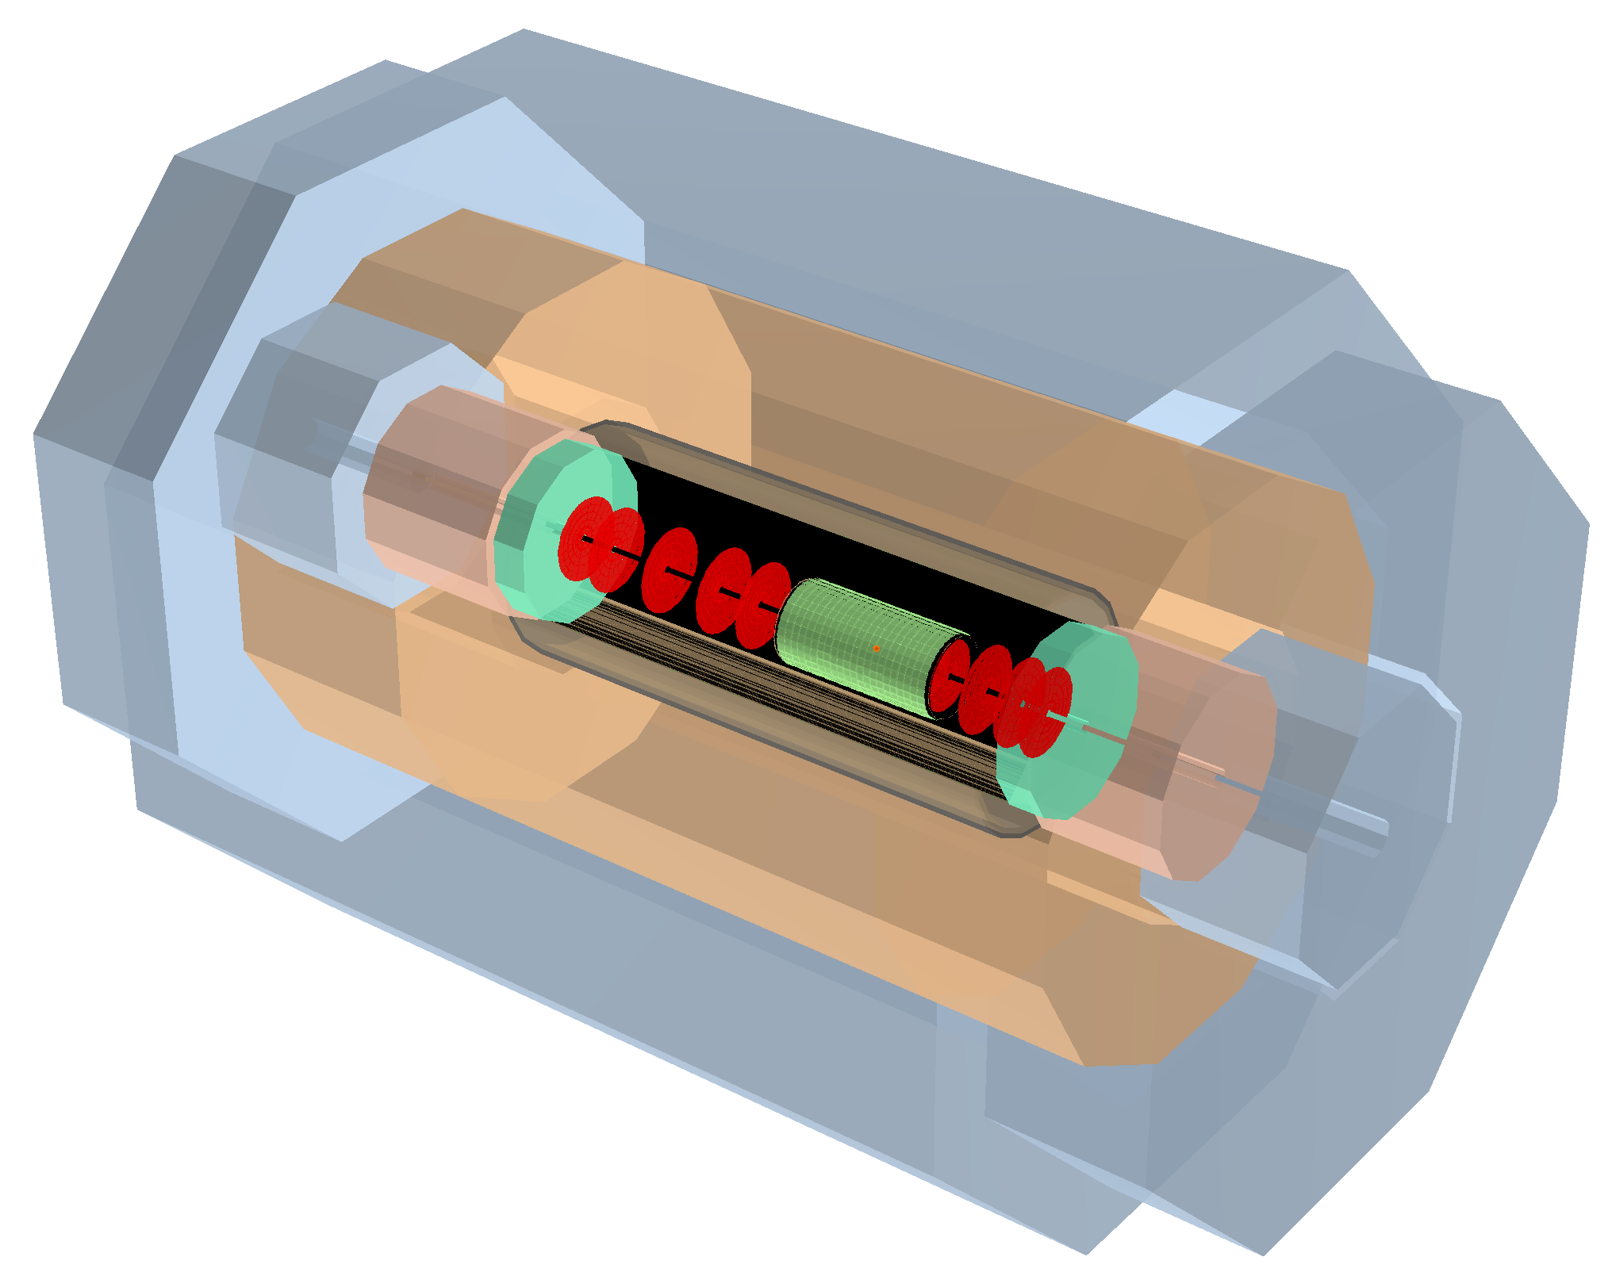
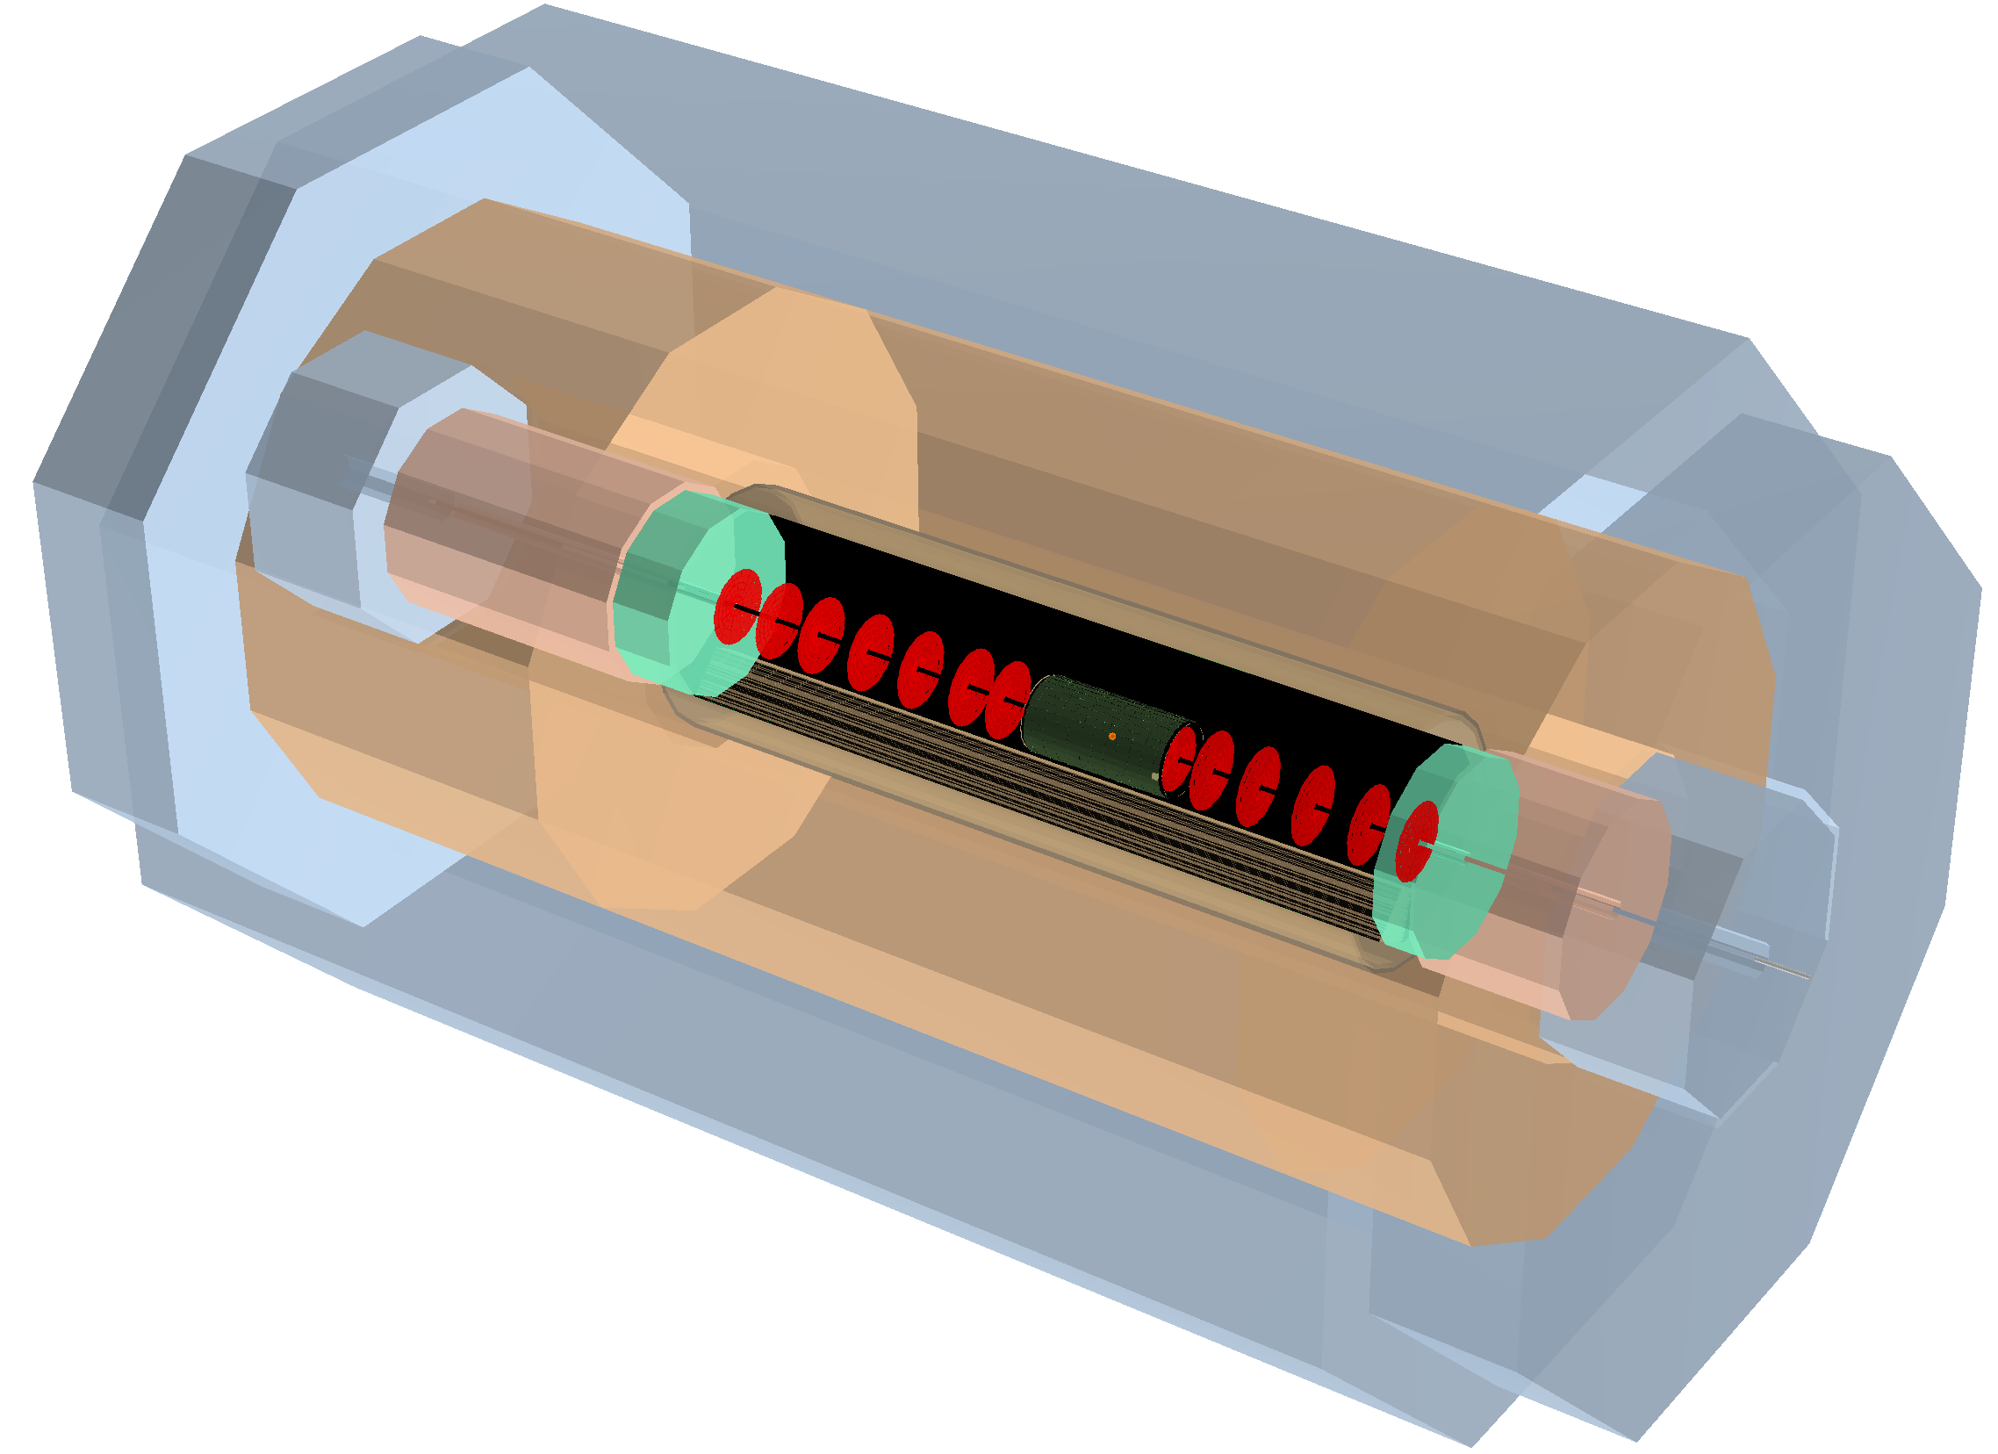
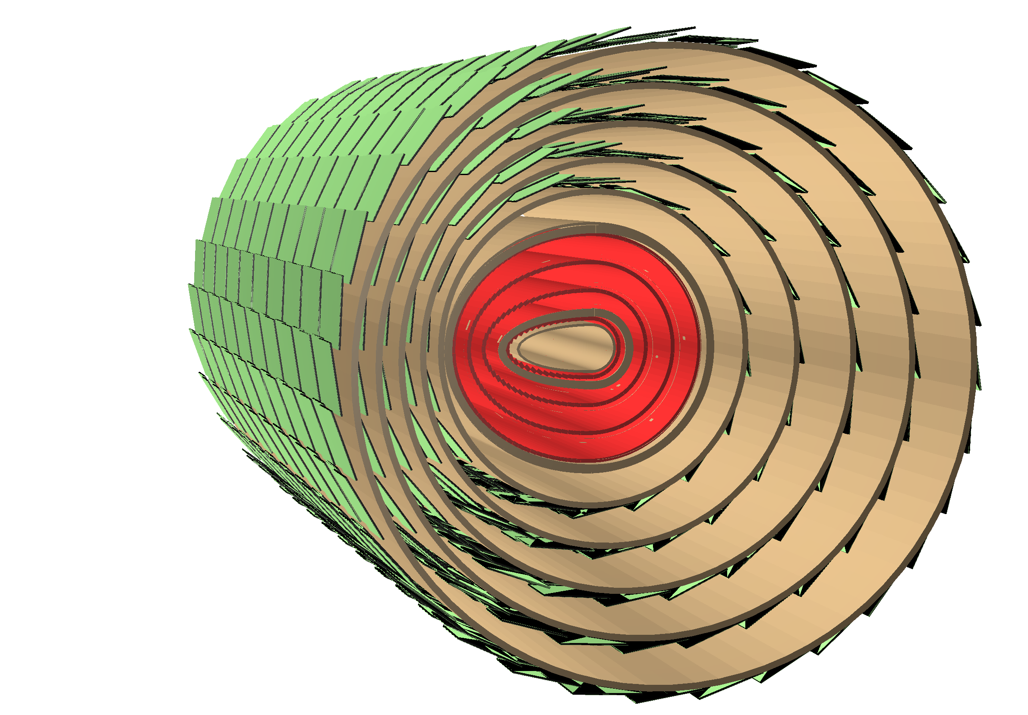
FCC-he Detector Layout - Scaled Version of LHeC Detector
Inner Dipoles and Solenoid
3 beams:
e∓ + proton1 + proton2 (also heavy ions A)
Dipole magnets to guide the e-beam in and out, for making electrons to collide head-on with p-beam1; 0.3 T transverse field along 2 x 9 m (internal shown only)
Hadron
Fwd-Endcap
Muon Detector
LHeC Detector
e∓
Dipole
Fwd-HCalo
Insert
Hadronic Barrel Calorimeter
Electromagn.-
Fwd-Endcap
Solenoid
Hadron
Bwd-Endcap
Fwd Tracker
Central
Tracker
Electromagnetic Calorimeter
Bwd Tracker
Dipole
Bwd-HCalo
Insert
Electromagn.-
Fwd-Endcap
p/A
Central Tracker
circular-elliptical beam pipe
4 layers Si-pixel
5 layers Si-strixel
(see Table of Detector Dimensions/Parameters)
Length of Inner Solenoid ~12m

Slide 13
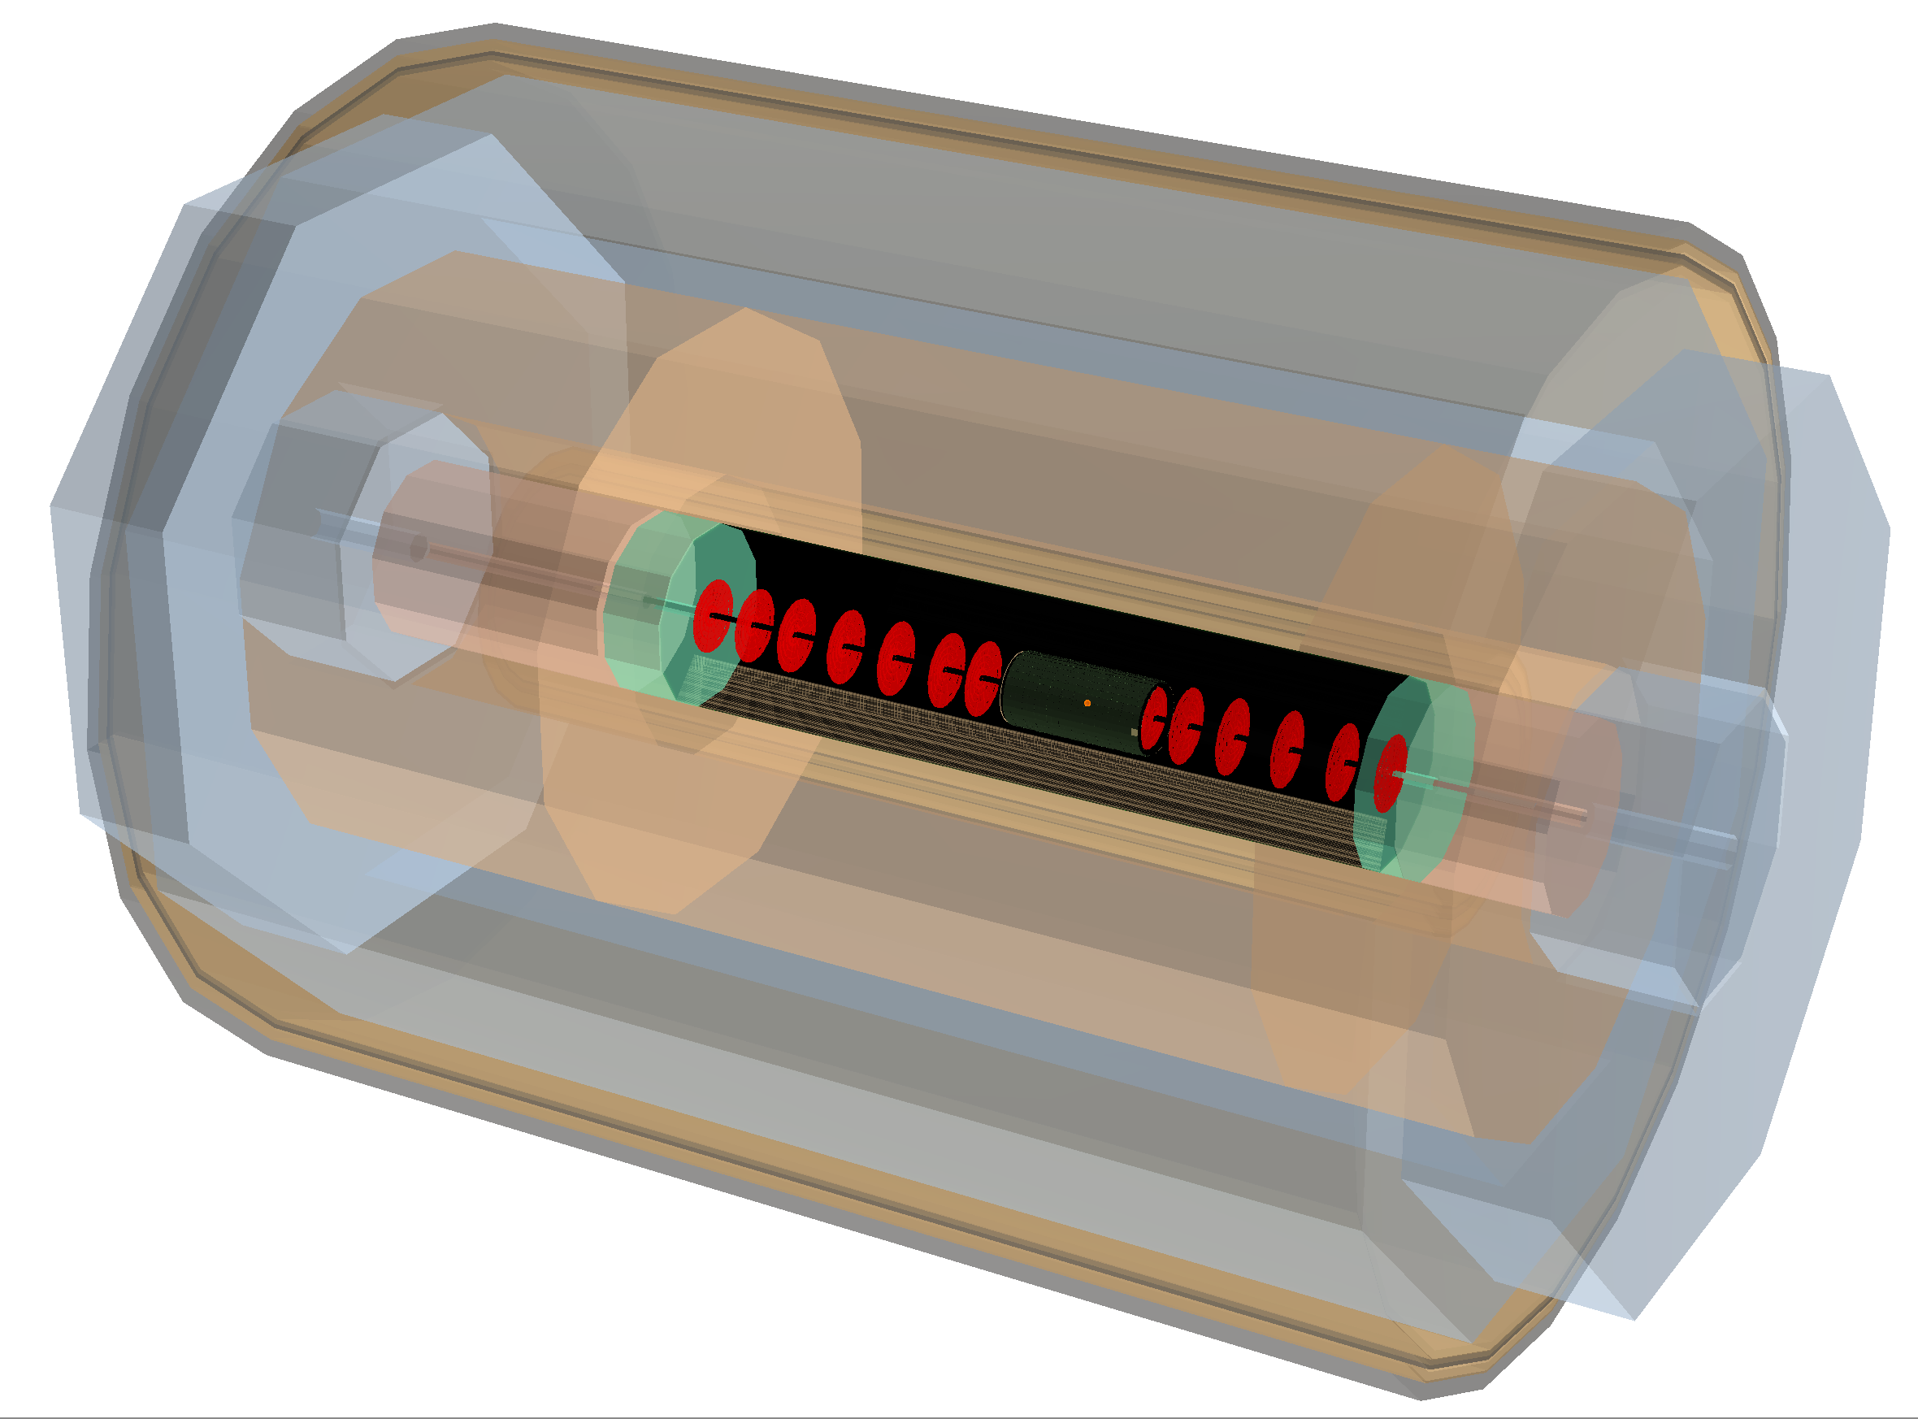
FCC-he Detector Layout - Scaled Version of LHeC Detector
Inner Dipoles and Solenoid + Outer Solenoid
Based on the LHeC design; figure shows the version using a twin solenoid system; Solenoid_2 outside of Muon-Det.: independent momentum measurement - hadrons, min. interacting leptons.
Outer Solenoid
Hadron
Fwd-Endcap
Muon Detector
e∓
Dipole
Fwd-HCalo
Insert
Hadronic Barrel Calorimeter
Electromagn.-
Fwd-Endcap
Solenoid
Hadron
Bwd-Endcap
Fwd Tracker
Central
Tracker
Electromagnetic Calorimeter
Bwd Tracker
Dipole
Bwd-HCalo
Insert
Electromagn.-
Fwd-Endcap
p/A
Central Tracker
circular-elliptical beam pipe
4 layers Si-pixel
5 layers Si-strixel
(see Table of Detector Dimensions/Parameters)
Length of Inner Solenoid ~12m
Length of Outer Solenoid ~19m
Radius “ ~6m

Slide 14
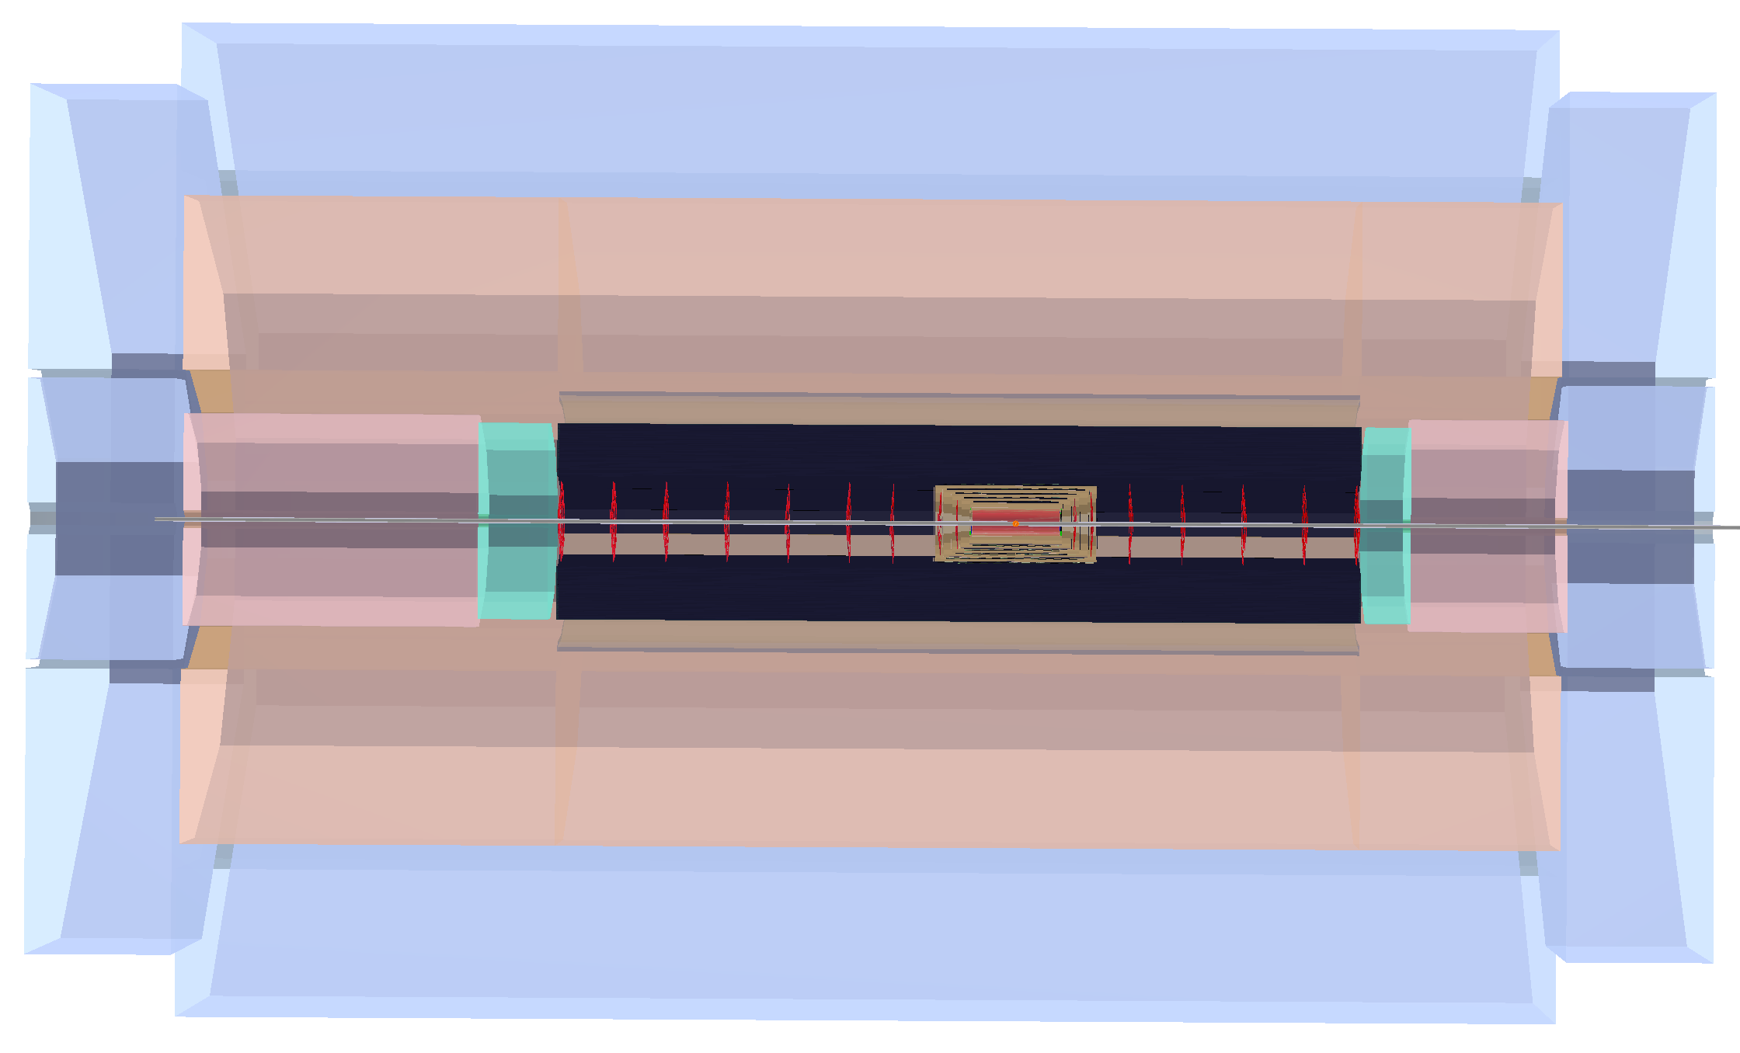
FCC-he Detector Basic Layout
FCC Interaction Point H
All Numbers [cm]
1927
600
Muon Detector
580
433
Hadron
Fwd-Endcap
Hadronic Calorimeter
Hadron
Bwd-Endcap
200
Dipole
Solenoid
Dipole
154
Fwd-HCalo
Insert
Fwd Tracker
Central
Tracker
Bwd
Tracker
60
46
e∓
Bwd-HCalo
Insert
p/A
Electromagnetic Calorimeter
350
80
50
180
Electromagn.-
Fwd-Endcap
Electromagn.-
Bwd-Endcap
Based on the LHeC design; figure shows the version using a single solenoid system; Solenoid&Dipoles between Electromagnetic Calorimeter and Hadronic Calorimeter.

Slide 15
FCC-he Detector Basic Element Layout

Slide 16
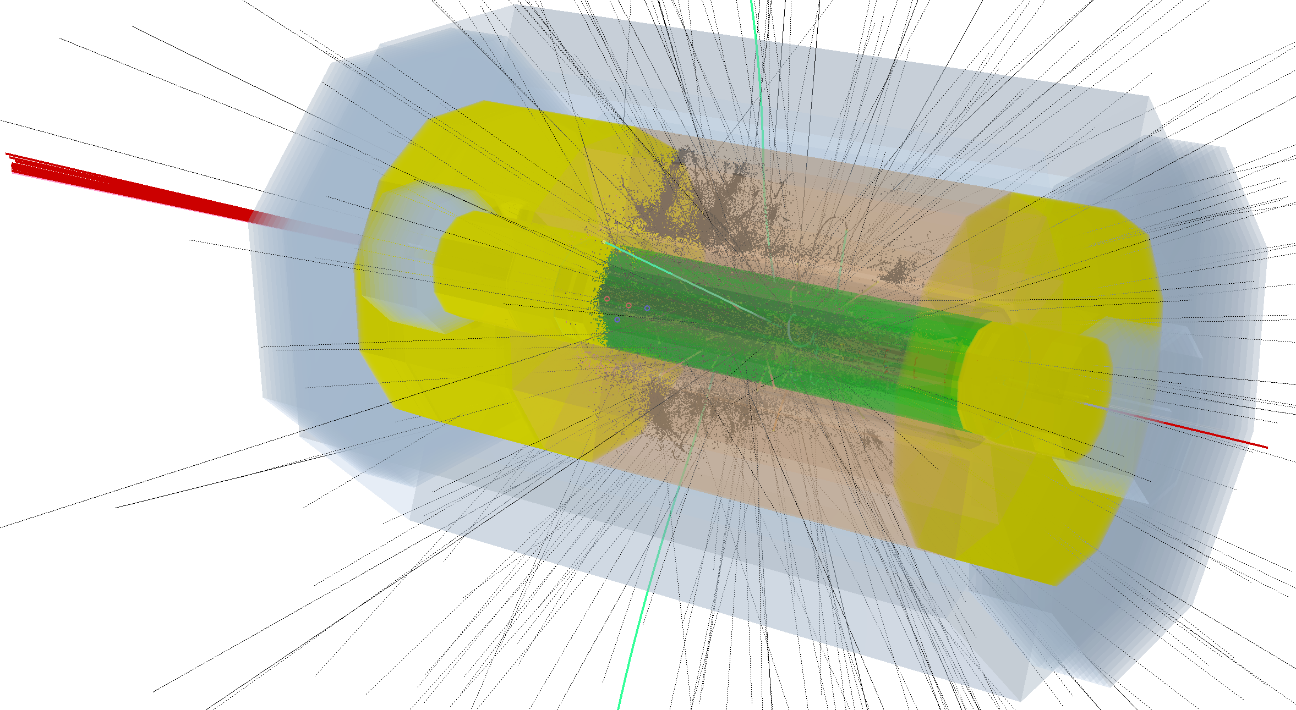
Simulation of exotic Higgs in FCC-he Detector
R-Phi view
R-Z view
DD4Hep/DDG4 Detector Design / Simulation / Reconstruction Environment
linked to and working with ROOT-6.08.00 and GEANT4-10.03
e⁻
p
Identical software for LHeC and FCC detector - DD4hep xml-description adopted only

Slide 17
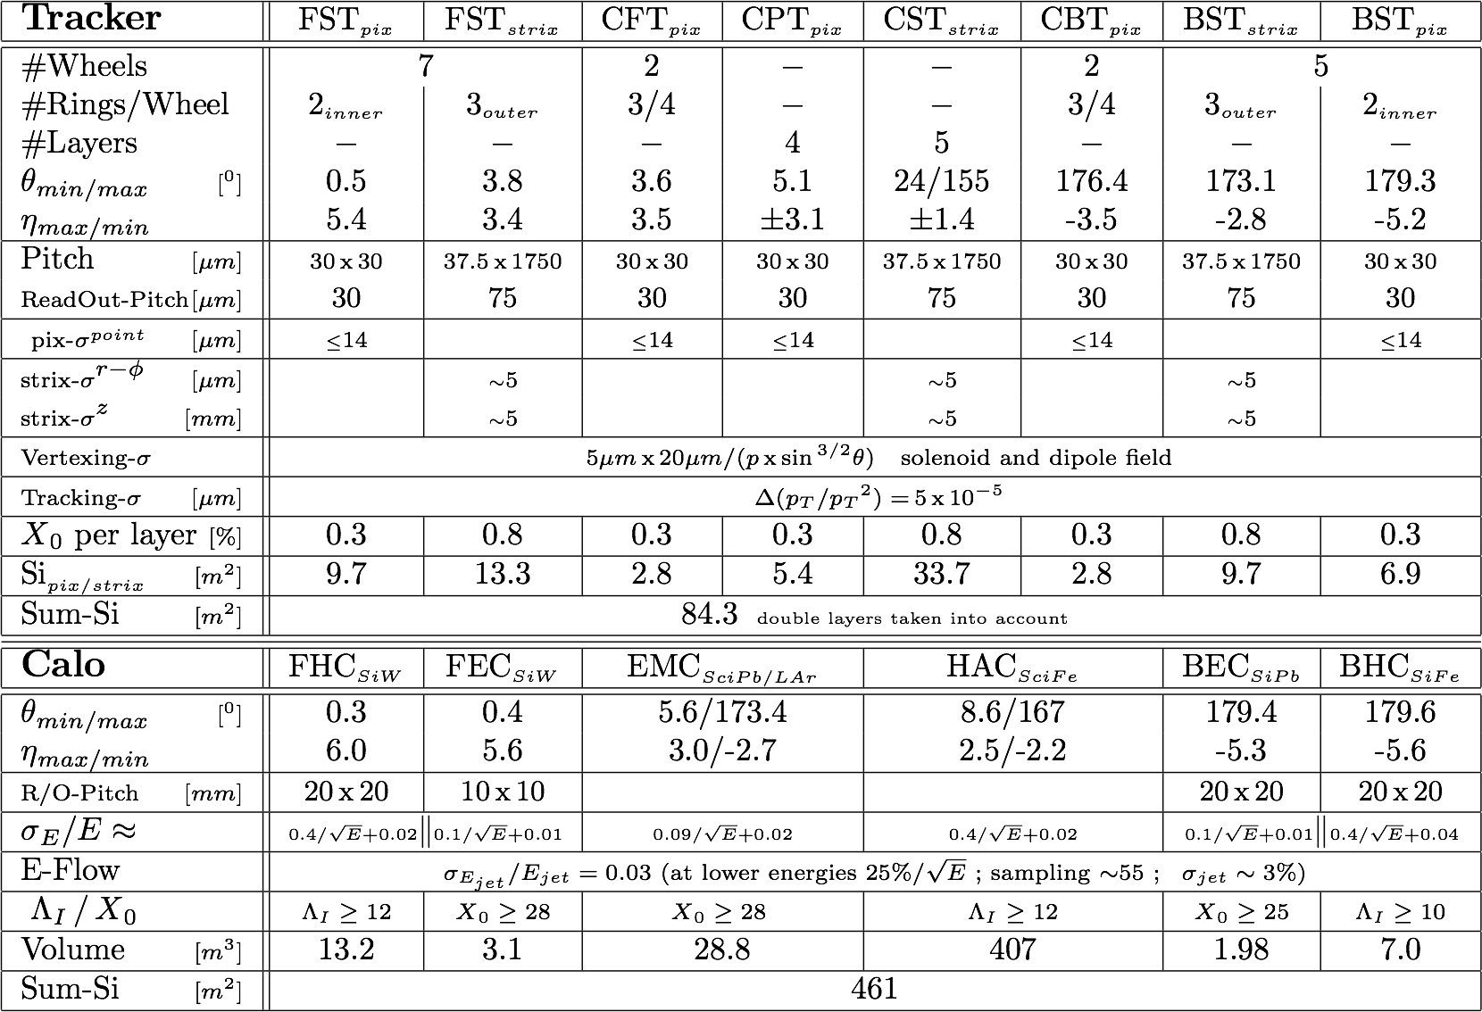
FCC-he Detector Dimensions/Parameters

Slide 18
Remarks
Based on HERA (and LHC) there exist very clear concepts for eh detector which will be fun to work on.
The experimental demands are lighter than for pp due to much reduced radiation level, no pileup concern and a cleaner final state
The redundant DIS kinematics leads to cross calibration and very high precision, such as 0.1% electron energy scale calibration.
Modern technology is being developed in HEP, enabling high precision tracking and high energy, O(10) TeV, forward particle and jet reconstruction also in ep
Specific eh demands are the 3-beam IR for synchronous ep and pp operation and the need to bend the e beam for head-on collision with the p beam.
The Higgs and top studies pose a higher demand on the fwd acceptance and spatial and energy jet resolutions which leads the current developments beyond the 2012 LHeC CDR
Software till now aligned to ILC induced DD4hep/DDG4/GEAR - based on EDM: LCIO
Expect Synergies when following closer the FCC-SW initiative - new EDM, geometry/material definitions based of DD4hep as well, using GAUDI for overall steering; aspects of commonly used tracking software introduced (ACTS)

Slide 19
Backup

Slide 21
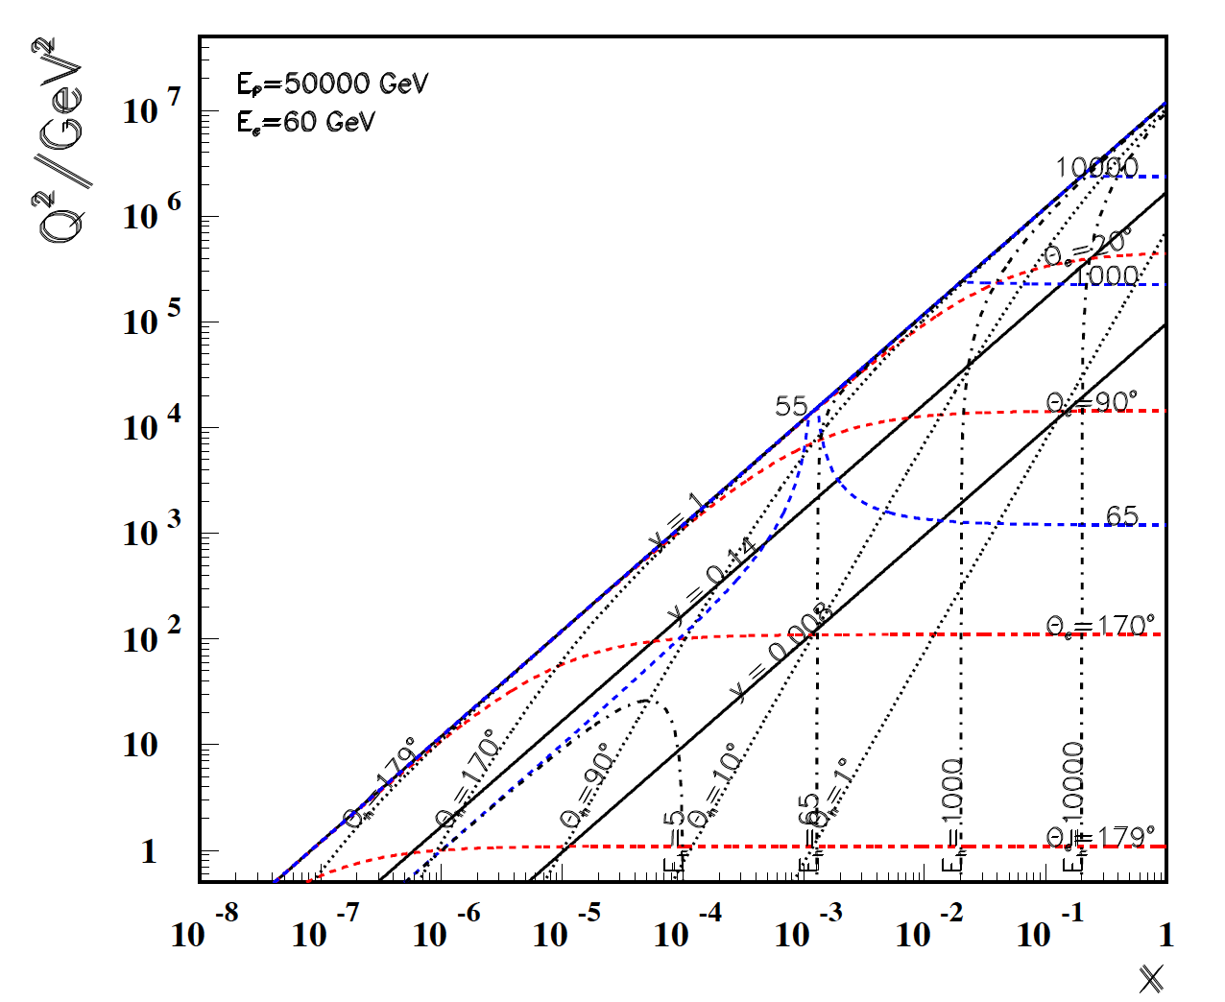

Slide 22
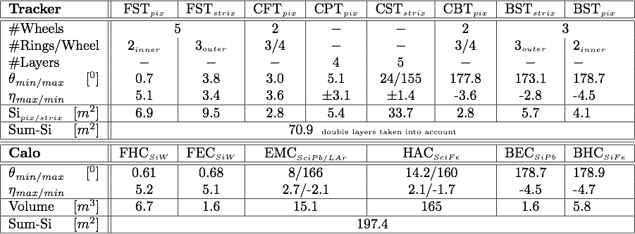
LHeC Detector Basic Element Layout
LHeC

Slide 23
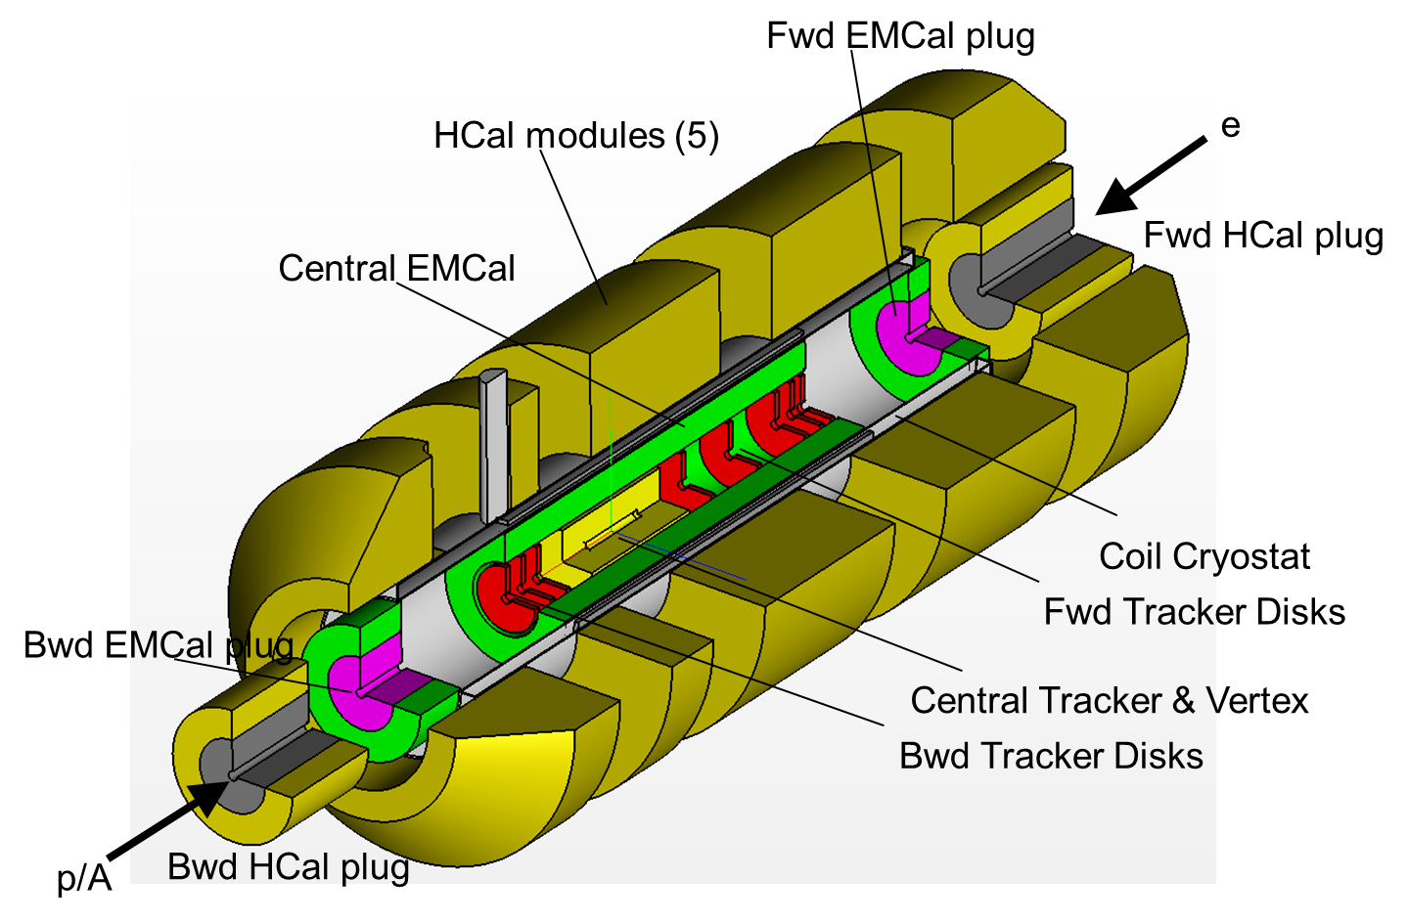
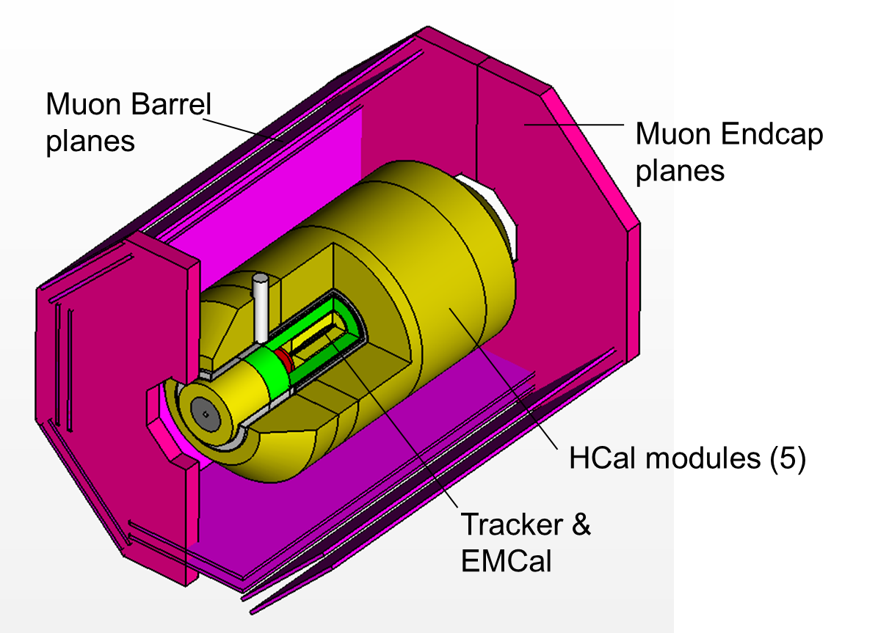
FCC-he Detector Segmenting/CMS-like-Install
First studies for the realization of the LHeC detector and perform its installation during a LHC Long Shutdown
Preliminary installation and maintenance scenarios using LHC P2 interaction region
Pre-mounting of detector and commissioning of the coil system on surface, lowering and commissioning of the detector underground. At IP2
mount detector inside L3 magnet support structure.
Time for field map of solenoid and beam-pipe bake out & vacuum pumping.
Estimated total time is about compliant with LHC shutdown durations.
Courtesy A. Gaddi

Slide 24
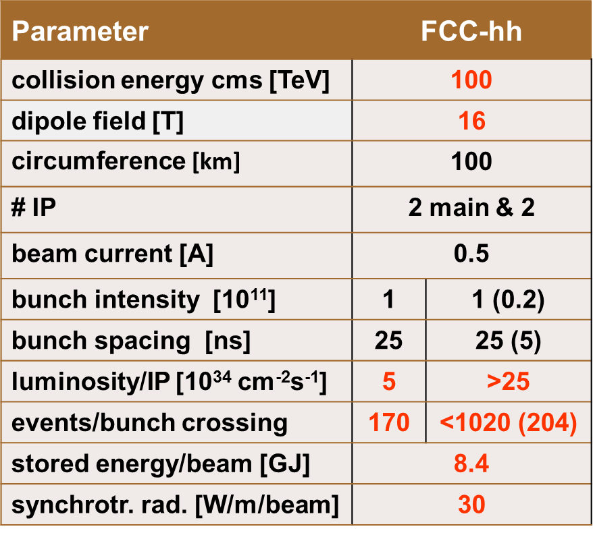
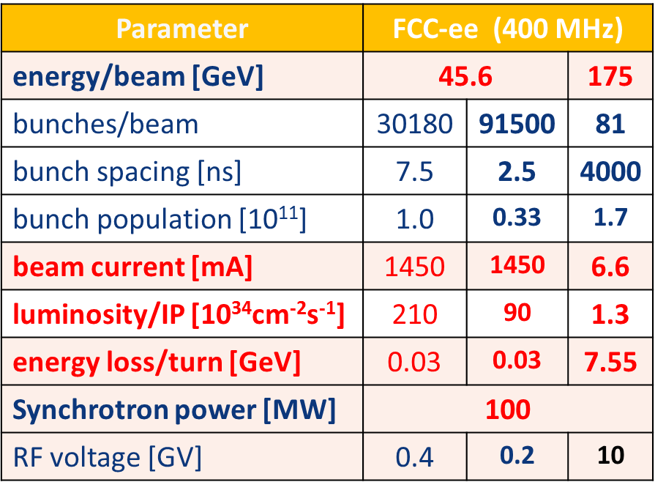
From LHeC to FCC
Beam Energies:
7 TeV p vs 60 GeV e± (LHeC(ERL))
50 TeV p vs 60 GeV e± (FCC-h vs LHeC(ERL))
50 TeV p vs 50-175 GeV e± (FCC-h vs FCC-e)
Data Taking:
Concurrent running with FCC-hh (pp)
i.e. 3 beams interaction region:
e± p plus counter-rotating spectator p beam
Bunch Spacing:
LHeC: 25 ns (LHC) bunch spacing
FCC-hh: 25 ns (5 ns?)
25 ns: similar constraints (electron head-on steering)
5 ns: problematic for parasitic interactions (higher B field required)
Instantaneous Luminosity:
LHeC: up to 10³⁴ cm⁻²s⁻¹ (i.e pileup ~ 0.2)
FCC-he: O(10³⁴) cm⁻²s⁻¹ (i.e. max pileup ~1)

Slide 25
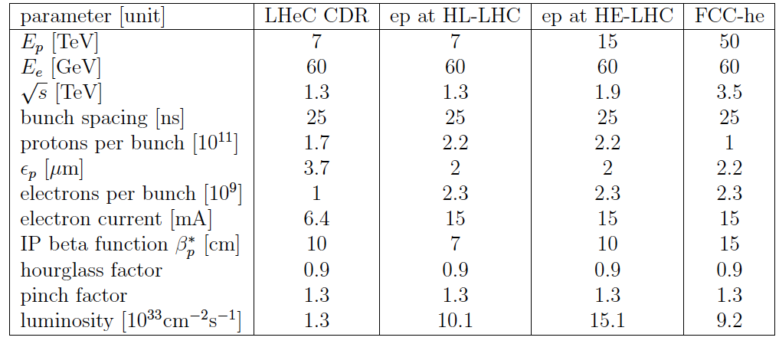
Ep/eA Luminosities
Nominal case: 60 GeV ERL electron beam against the hadron beams.
e-p (as of March 2016):
LHeC e-Pb:
N_{Pb}=7×10⁷/bunch (2012 values) ⇒ ~0.1 fb⁻¹/month
L_{eN} = 9 x 10³¹ cm⁻² s⁻¹ (Nominal Pb) (*)
L_{eN} = 1.6 x 10³² cm⁻² s⁻¹ (Ultimate Pb)
(*) Pb numbers ~ 3 times higher with updated Pb parameters
FCC-he:
Crude estimates: (N_{Pb}=2×10⁸/bunch - 2016 values) and rescaling hadron parameters only ➔ L_{eN}=3×10³³ cm⁻²s⁻¹ ~4 fb⁻¹ /month (J. Jowett).
L_{eD}= 3 x 10³¹ cm⁻² s⁻¹ (eD)

Slide 26
FCC-he Baseline
FCC-he: Utilize the LHeC design study to describe baseline ep/A option.
Emphasis: 3 TeV physics; IR and Detector; synchronous ep-pp operation.
Open to other configurations and new physics developments
Caveats:
Interaction region not yet well defined
Need specifications/simulations to allow for detector concept or design
Optics, beam-pipe, B Fields, masks, synchrotron radiation estimations.
Preliminary and practical approach
Start from LHeC CDR design
Adapt existing detector (energies, resolutions) to larger beam energies (larger c.m.s. energy, larger forward boost, wider kinematic space) and the physics reach and scope
Aim at an update of the CDR (LHeC+ FCC-he) by 2018
Establish interaction region/ Machine detector interface.
Focus on Software simulations, follow detector technologies R&D
Key aspect: Manpower, Synergies with other FCC projects

Slide 28
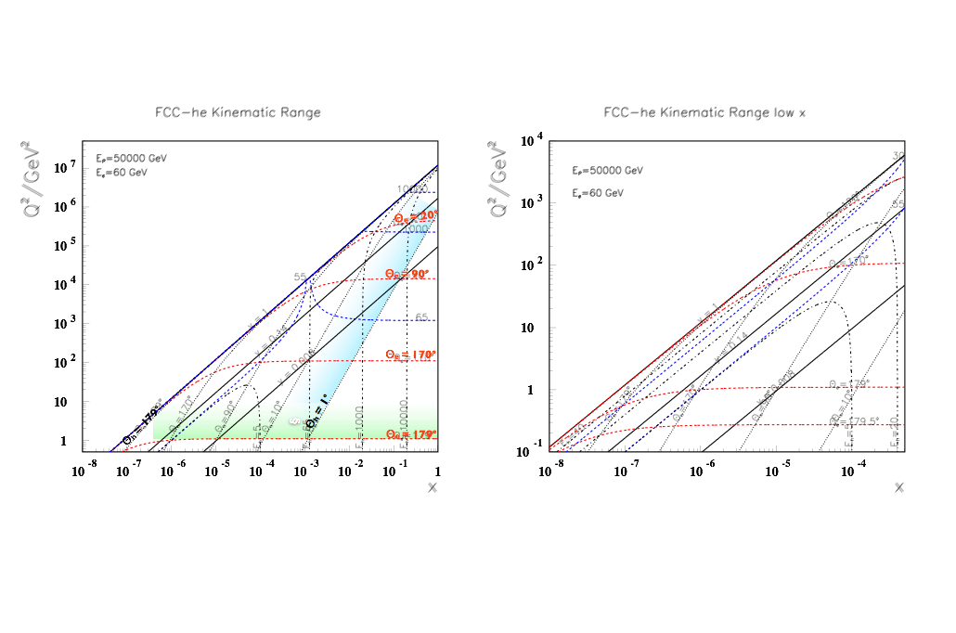
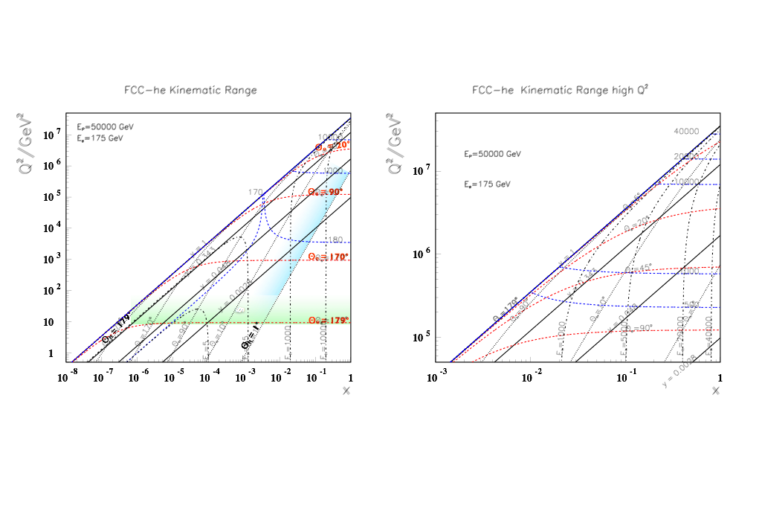
FCC-he Kinematic Range (low x; high Q²)
Forward calorimeter containment up to few 10thTeV down to 1⁰ →
~doubling the calorimeter depth compared to LHeC
Kinematic coverage can also be achieved by lowering Ee (goes squared to lower Q²) and lowering Ep (accesses larger x) e/A interactions - splash of particles produced - to be measured
Eh = 10000
Linac-Ring: LHeC ERL e∓ at 60 GeV on p/A at 50 TeV (i.e. Pb at 20TeV (=50 x 82/207)
Eh = 40000
Ring-Ring: max e∓ at 175 GeV on p/A at 50 TeV

Slide 29
Baseline Electron Beam Configuration*)
FCC-he: Utilize the LHeC design study to describe baseline ep/A option.
Emphasis: 3 TeV physics; IR and Detector; synchronous ep-pp operation.
Open to other configurations and new physics developments
Caveats:
Interaction region not yet well defined
Need specifications/simulations to allow for detector concept or design
Optics, beam-pipe, B Fields, masks, synchrotron radiation estimations.
Preliminary and practical approach
Start from LHeC CDR design
Adapt existing detector (energies, resolutions) to larger beam energies (larger c.m.s. energy, larger forward boost, wider kinematic space) and the physics reach and scope
Aim at an update of the CDR (LHeC+ FCC-he) by 2018
Establish interaction region/ Machine detector interface.
Focus on Software simulations, follow detector technologies R&D
Key aspect: Manpower, Synergies with other FCC projects

Slide 30
Challenges
The ep configuration uniquely selects the WW-H and ZZ-H vertices for production
ep → νH(bb)X: O(1)% precision on H-bb couplings with matching theoretical uncertainty
FCC-he reaches the H→μμ decay, with O(1000) events
μ measurement essential - magnet placement essential!
Very demanding and to be studied in detail e.g.:
ep → νHHX ep produces the Higgs from WW → double Higgs
FCC-he will be a Higgs factory and the consequences are to be studied
desire to measure also rare decays,
maximum coverage for all kinds of decays
Extrapolation from LHeC: the FCC-he detector is feasible, the design will benefit from coming technology progress (sensors, magnets, low power consumption, cooling, mechanical systems, electronics …)

