Slide 1
FCC-eh
Future Deep Inelastic Scattering at CERN on 1p
FCC-eh in the CDR (main physics topics, configuration)
Cost Estimate for ERL
LHeC: submission to Strategy and plans
PERLE
Future, Scenarios and ep
Oliver Bruening (CERN) and Max Klein (U Liverpool)
for the LHeC/FCC-eh and PERLE Collaborations
Presented at the 2019 FCC Week at Brussels, Belgium, 28.6.2019

Slide 2
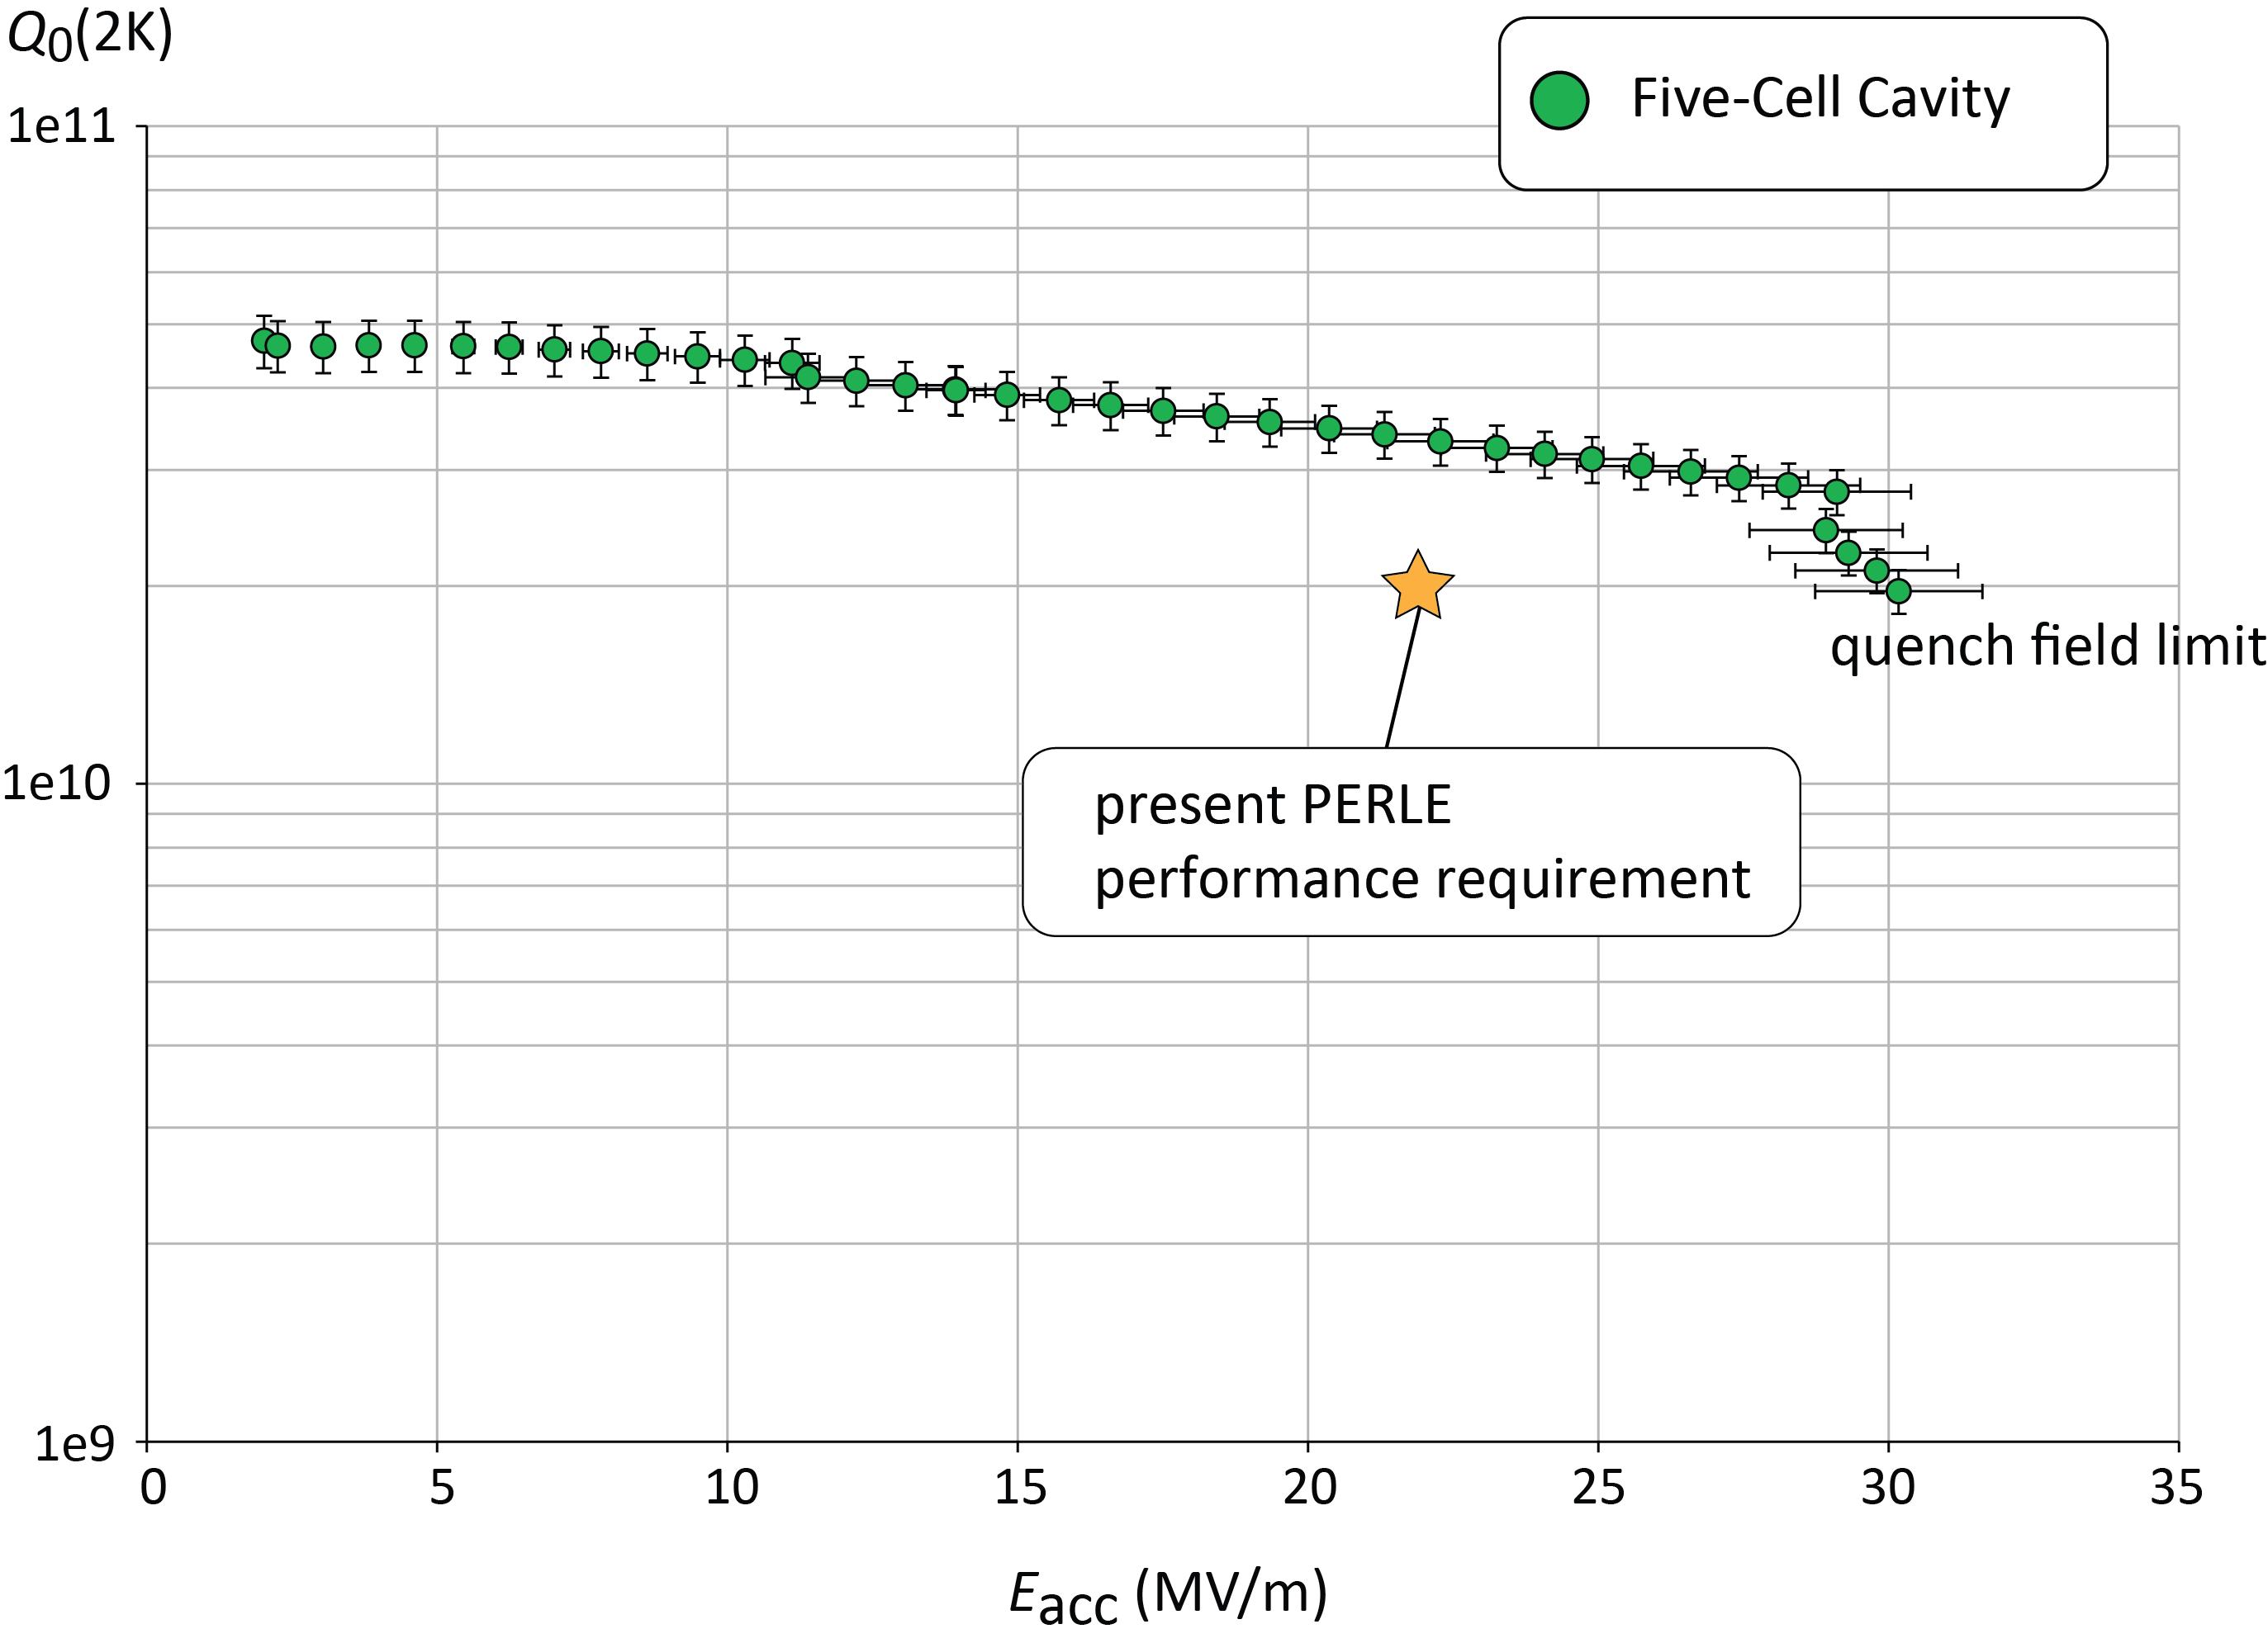
Energy Frontier in Deep Inelastic ep/eA Scattering with LHC & FCC
Cleanest high resolution microscope for proton and nuclear matter.
Discovery in QCD and electroweak sector. High precison Higgs in ep+pp
50-60 GeV energy: 1.3-1.6 MCHF
802 MHz SCRF: Q₀ > 10¹⁰
Power: < 100 MW wall-plug
Luminosity 10³⁴cm⁻²s⁻¹ → 1 / 2 ab⁻¹
with LHeC / HE-LHeC and FCC-eh
F.Bordry et al: arXiv:1810.13022
CDR: 1206.2913
Update: 10/2019
Highest energy application of novel energy recovery principle.
1000 x more luminous than HERA, hugely extended Q²,x range.
Concurrent ep+pp operation. IP2 at LHC and point L at FCC
First 802 MHz cavity, CERN – Jlab
ERL Development at PERLE@LAL

Slide 3
FCC-eh in the CDR [V1 Physics and V3 hh]
Volume 1 had been the collaborative effort to present the entity of FCC physics, in ee, pp and ep, including AA and eA
Volume 3 on FCC hh contains a short summary of the main characteristics of FCC-eh and the detector concept
Some striking physics eh prospects are on searches and the high precision measurements on Higgs and proton structure:
3
Complementary prospects to
discover rh massive neutrinos
in ee, ep and pp
[mixing angle vs mass]
Unique resolution of partonic contents of
and dynamics inside the proton, providing
precise and independent parton luminosities
for interpretation and searches on FCC-hh
Prospects for high precision measurements of
Higgs couplings at FCC ee and ep. Note ee gets
the width with Z recoil. ee is mainly ZHZ, while
ep is mainly WWH: complementary also to pp

Slide 4
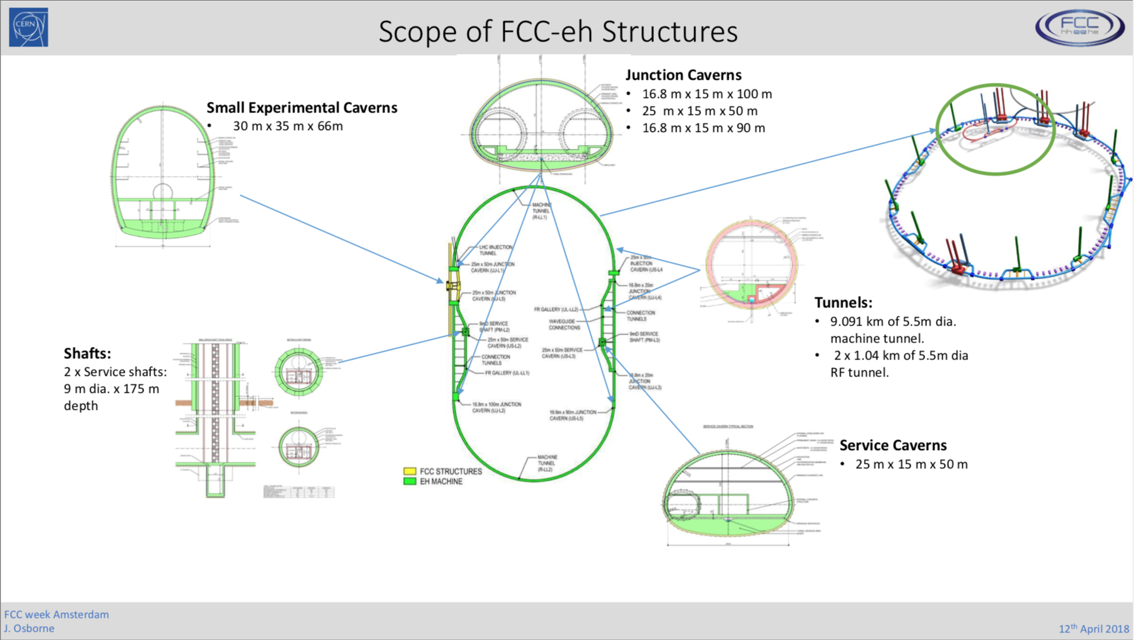

Slide 5
ERL Validation Needs and Experience
Operational experience up to 1MW virtual beam power:
ERL Test Facilities
ERL Collider Projects
JLab pioneering
eRHIC [6]
LHeC [3]
Proposed Collider Projects [e.g. LHeC and FCC-eh] extrapolate demonstrated virtual beam power from 1MW in single turn to several 100MW in multi-turn operation!!!
C-Beta [4]
EUV KEK [1]
IR-ERL JLab [1]
bERLpro [1]
PERLE [3]
cERL @KEK [1]
MESA [2]
ERL demo [1]
ARIEL TRIUMF [1]
CBAF-ER [1]
ERL@CBAF [5]
CeC@RHIC [1]
1.5MW Highest
demonstrated
Virtual beam
power
Test ERL@BNL [1]
ALICE [1]
sDALINAC [2]
ERL Applications
Only operational ERL with SRF operates << 1MW beam power!!!
C-Beta and PERLE are the only planned multi-turn ERL O(10MW)

Slide 6
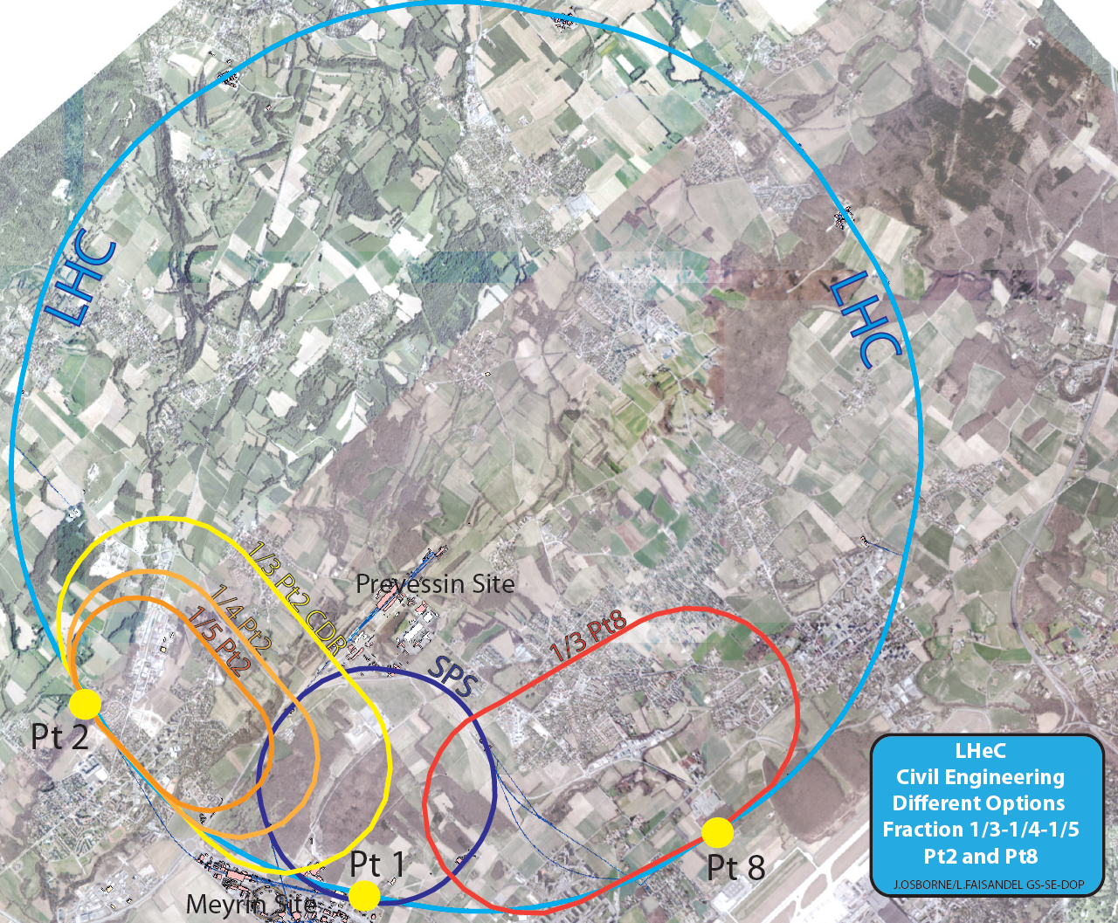
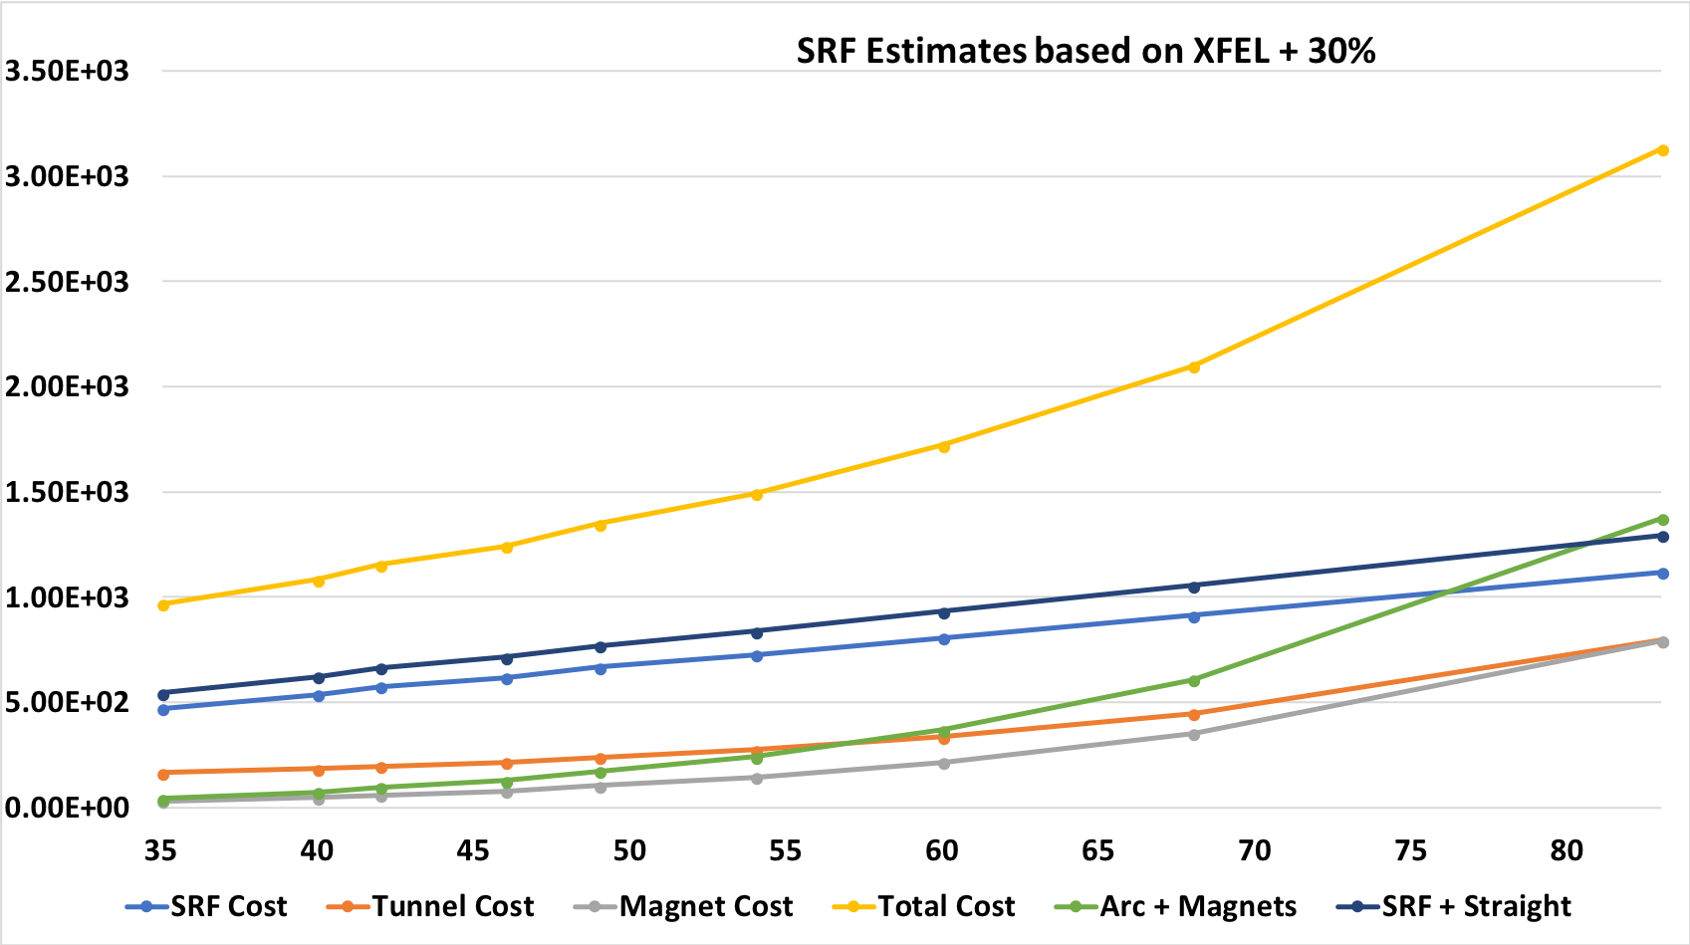
FCC-eh Configuration: Layout & Civil Engineering
Configuration:
Preliminary cost estimates based on XFEL, LCLS-II budgets
These estimates also fit well with estimates from CBETA
and ESS studies:
Different Size Variations: e.g LHeC
SRF is the main cost driver up to energies of 70GeV!!!
The E⁴ dependence on the arc length only becomes dominant for beam energies above 75GeV!
[Unless the SRF cost becomes significantly lower!]

Slide 7
Detector Design
High precision, large acceptance detector including taggers
to measure luminosity, control photoproduction and do
diffractive physics. Detector is about L x R = 19 x 6 m² (~CMS)
Recent:
Updated software
Enlarged tracker radius to 60cm
Updates on technology choices

Slide 8
FCC-eh
Walid Kaabi (Orsay)

Slide 9
Recent PERLE Progress
Field homogeneity 8 10⁻²
Transfer of ALICE (Daresbury) gun + equipment to LAL (5/19)
Hiring of personell at Orsay
Design of source/booster/injector at Daresbury/Liverpool
Encouraging radiation protection survey at Orsay
...
arrival of the
ALICE gun in
the PERLE hall
10.5.19
LAL/IPNO and BINP-Novosibirsk applied for the H2020 European program (CRIMLINplus) and ask for fund for dipole design & prototyping and for a post-doc position.
cf Walid Kaabi
27.6. in FCCeh

Slide 10
FCC-eh

Slide 11
title
Contribution to
Strategy Update
Basic ERL Configuration. Cost+Effort Preference for 50 GeV
Provisional Time Schedule
FCC-eh relies on LHeC development, both are part of the deliberations of the European Strategy

Slide 12
FCC-eh with FCC-hh at 20 TeV p beam energy
The direct transition from HL-LHC to FCC-hh in a scenario where ee takes place in Asia enables FCC-eh to take place too.
Higgs and PDF studies have been pursued for a 60 GeV x 20 TeV ep collider of 2.2 TeV cms energy and 2ab⁻¹ luminosity.
Sea Quark
Gluon Distribution
Uncertainties on kappa
Decay FCCep HL-LHC
bb 0.9 2.7
WW 0.3 1.2
gg 1.7 2.2
tau 1.5 1.6
cc 1.9 --
ZZ 0.5 1.0
yy 3.3 1.7
in percent. SM width.

Slide 13
Remarks on the Further Development
There are a number of important tasks and issues leading beyond this year:
Physics is evolving with LHC and prospects need to be deeper studied
(for example the genuine EFT application of Higgs physics in ep)
The LHeC in order to be realised has to be accepted and affordable (Oliver Bruening*)
The ERL technology is advancing (recent success of cBeta) worldwide a
one of the indeed few radically new accelerator technologies and ideas!
PERLE will be the genuine 802 MHz, high current multi-turn demonstrator
(AsTeC, BINP, CERN, Liverpool, Jlab, Orsay (LAL+IPN) + (Walid Kaabi *)
The 3-beam interaction region design is challenging [Q1 prototype]
(Kevin Andre and Emilia Cruz*) ...
The future of FCC-eh is linked to that of FCC. If CERN embarks on FCC-ee directly
after HL-LHC then FCC-eh is deferred by many decades and basically postponed.
If CERN goes directly to an FCC-hh (then at lower energy) eh should be part of
it and not considered an option later as it is an asset for the success of hh.
The FCC-eh development relies on that of the LHeC.
Following the much cited CDR arXiv:1206.2913
the intention is to deliver a comprehensive report
on the LHeC at HL-LHC by the end of 2019. You are
invited to contribute and join the workshop, which
will be held at Chavannes near CERN, 24/25.10.
*) speakers yesterday

Slide 14
FCC-eh

Slide 15
FCC-eh Tracking Concept

