Slide 1
LHeC ERL & Test Facility
Some Initial Choices and Possible Directions
Erk Jensen,
Rama Calaga, Ed Ciapala, Joachim Tückmantel
(CERN)

Slide 2
ERL overview
Part 1

Slide 3
Assumptions for LHeC
LHeC with Linac-Ring Option
Linac with Energy Recovery
LHeC parameters:
 | Units | Protons | RR e- | LR e-
Energy | [GeV] | 7000 | 60 | 60
Frequency | [MHz] | 400.79 | 721.42 or 1,322.6
Norm. ε | [mm] | 3.75 | 50 | 50
I_{beam} | [mA] | >500 | 100 | 6.6
Bunch spacing | [ns] | 25, 50 | 50 | 50
Bunch population |  | 1.7· 10¹¹ | 3.1· 10¹⁰ | 2.1· 10⁹
Bunch length | [mm] | 75.5 | 0.3 | 0.3

Slide 4
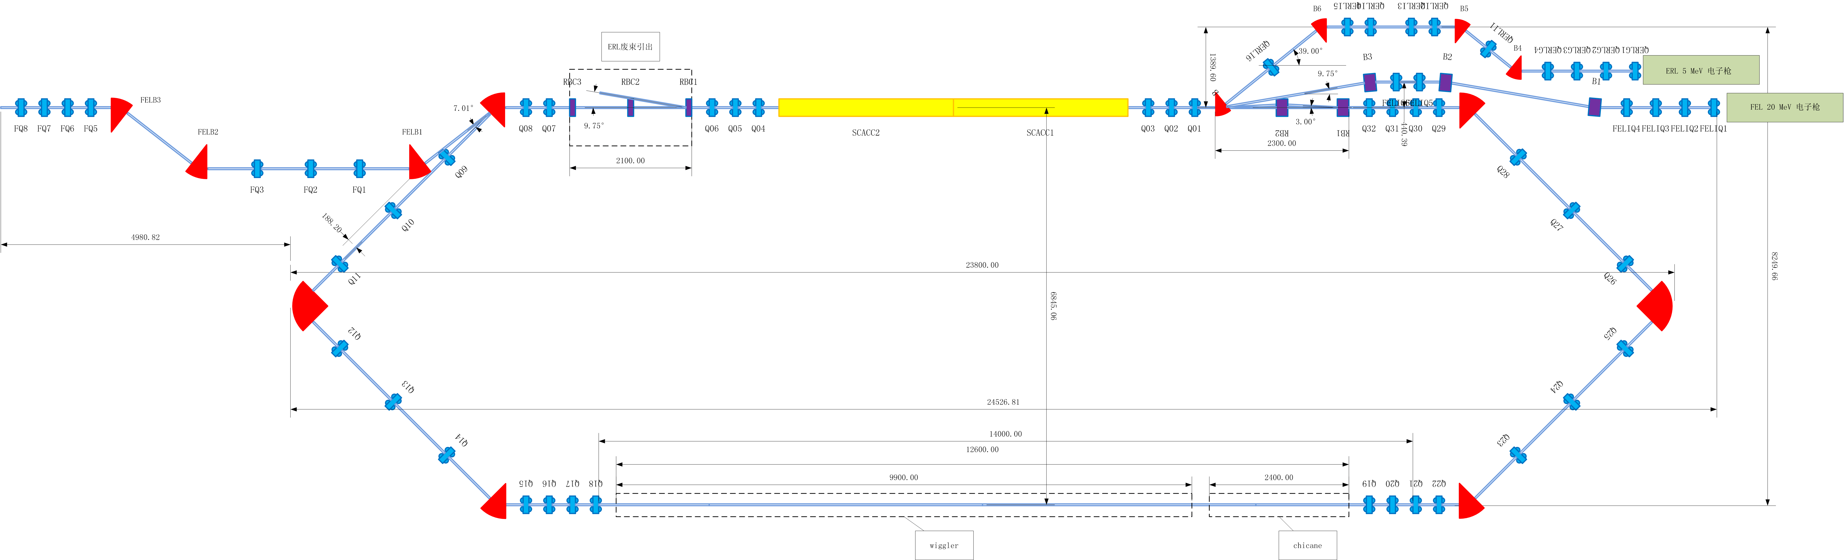
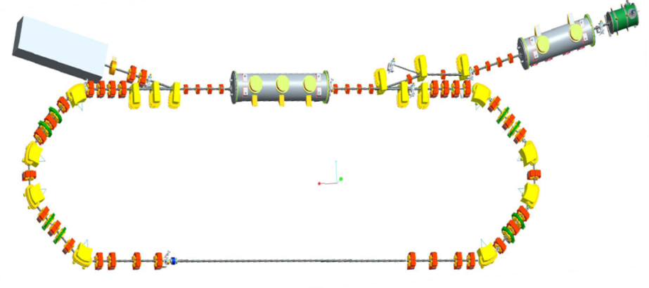
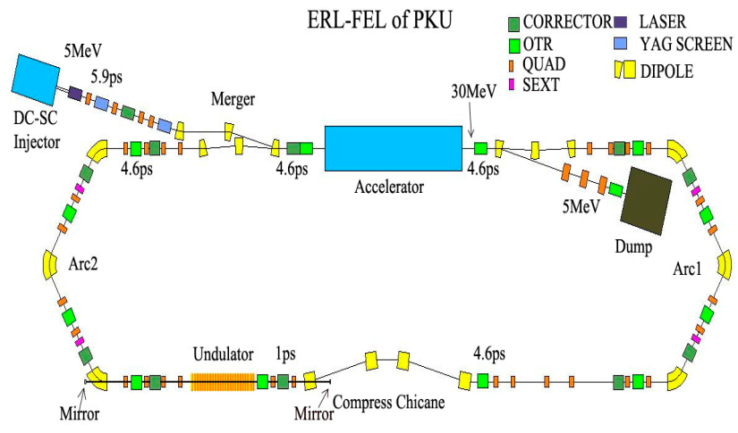
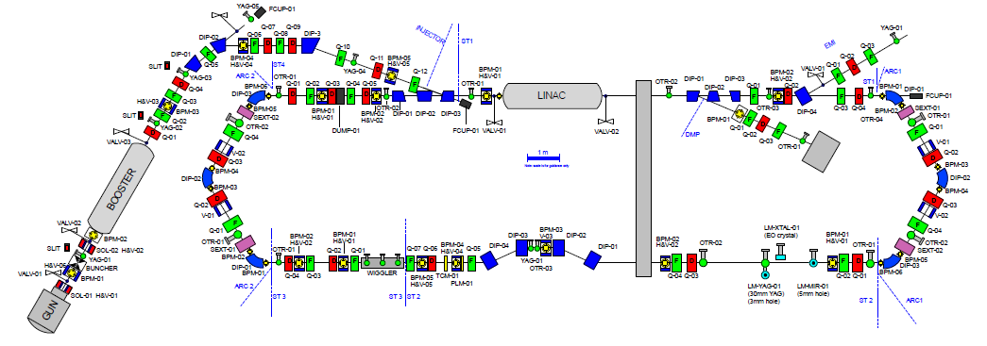
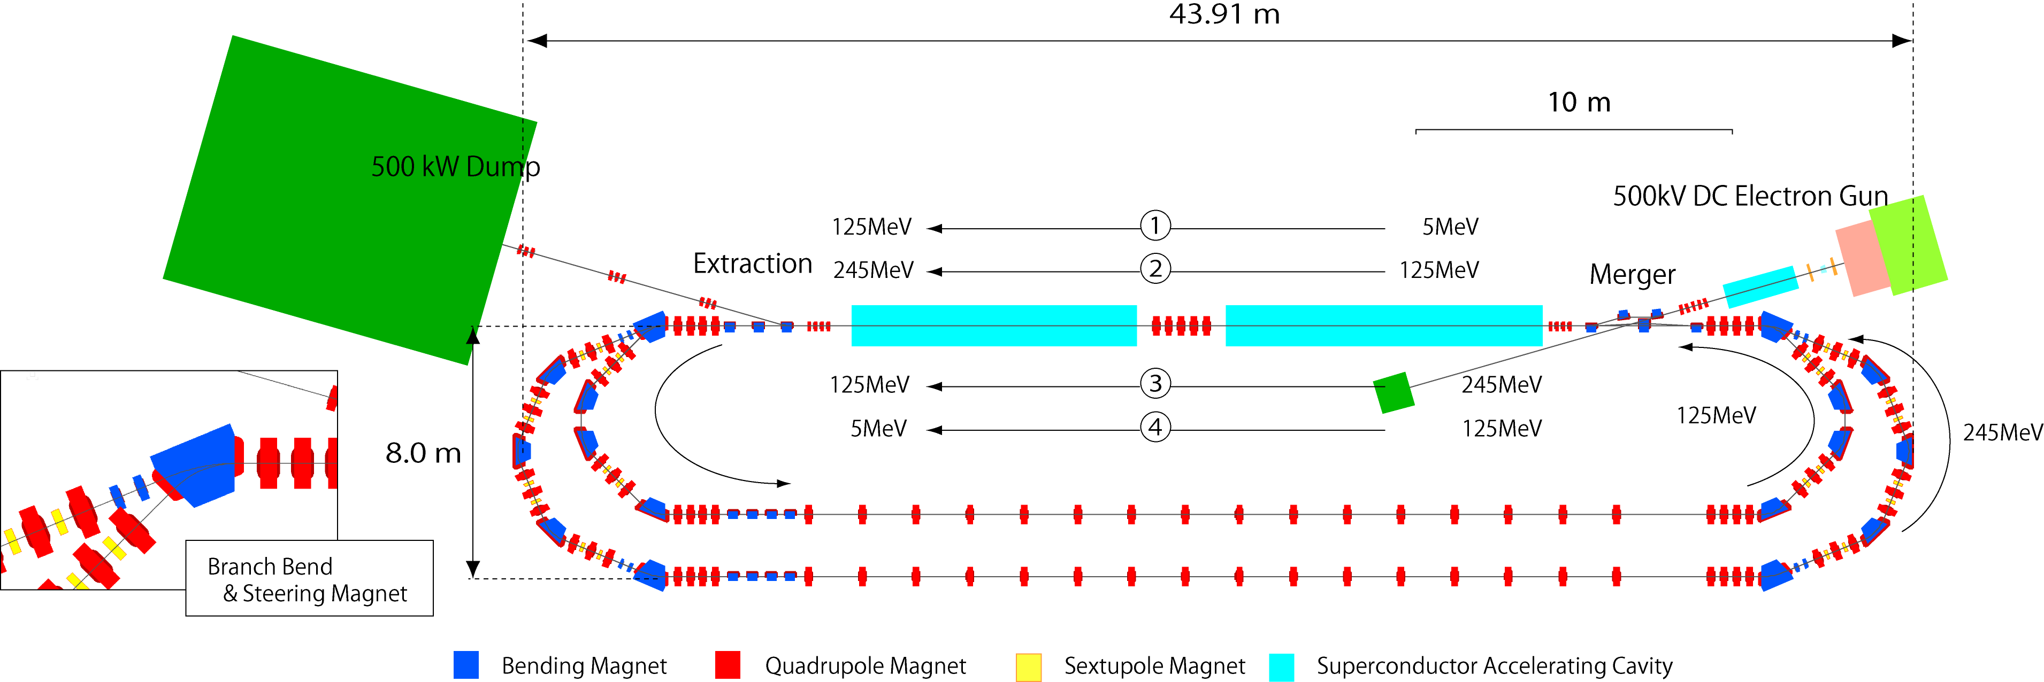
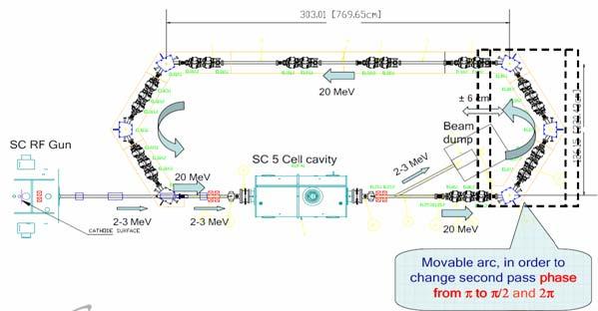
Low Energy ERL’s and ERL test facilities
IHEP ERL, Beijing
BERLinPro
2 x 7 cell 1.3 GHz + DC Gun
10mA, 35MeV, 2ps
3 x 7 cell cavities, 1.3 GHz
100mA, 50MeV, 1 mm mrad (norm), 2ps
Peking ERL-FEL
ALICE, Daresbury
1 x 9 cell, 1.3 GHz
60 pC, 30 MeV, 2 ms bunch train
2 x 9 cell, 1.3 GHz
100 pC, 10 MeV, 100 µs bunch train
2loop-CERL, KEK
Brookhaven ERL
1 x 5 cell, 704 MHz
0.7-5 nC, 20 MeV, CW
9 cell, 1.3 GHz cavities, 4 modules
77 pC, 245 MeV, 1-3 ps

Slide 5
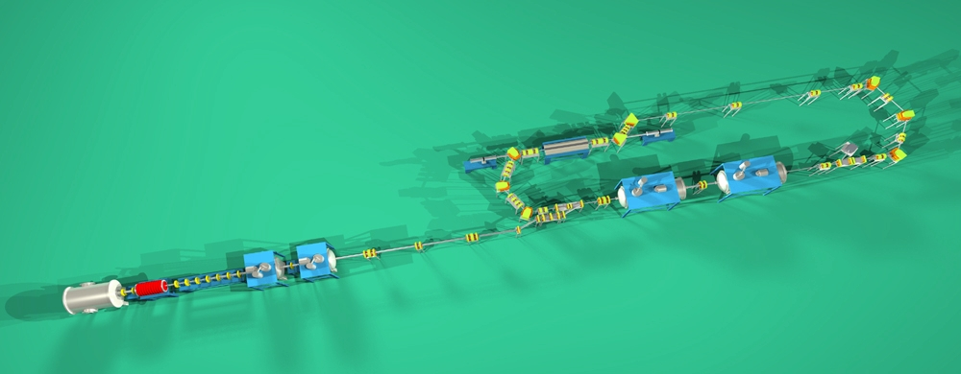
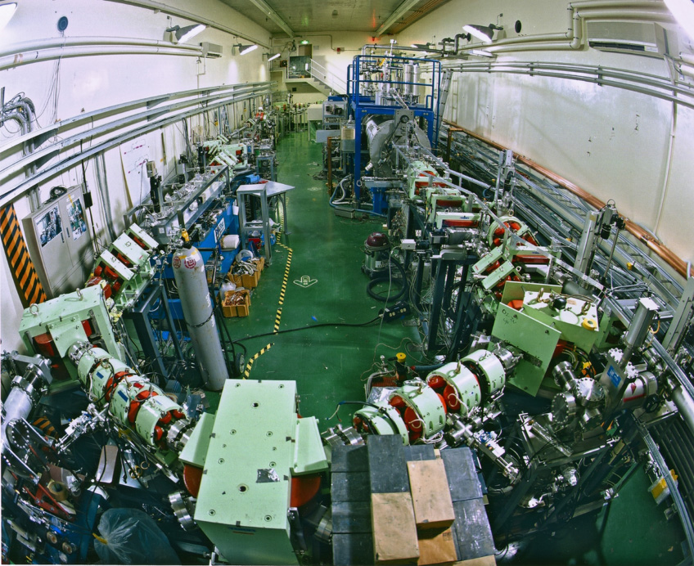
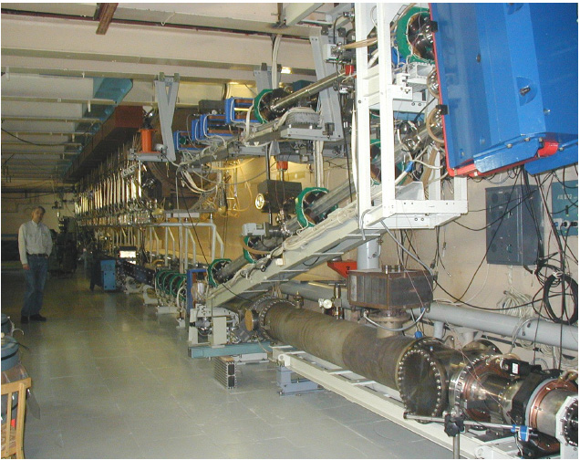
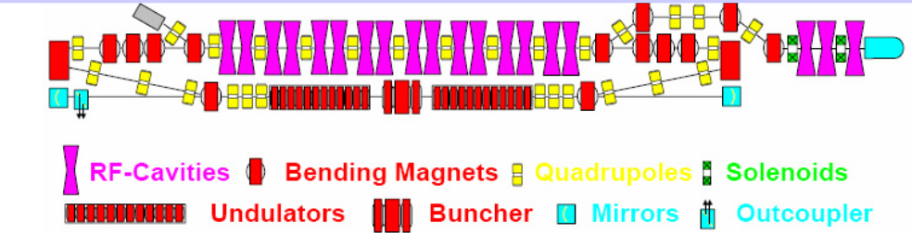
Low Energy ERL’s and ERL test facilities (contd.)
500 MHz + DC Gun
5 mA, 17 MeV, 12 ps
JAERI, Tokai
Normal Conducting 180 MHz + DC Gun
30 mA, 11 MeV, 70-100 ps
BINP, Novosibirsk

Slide 6
Low Energy ERL’s and ERL test facilities (contd.)
IHEP ERL-TF | HZB BERLinPro | BINP | Peking FEL | BNL ERL-TF | KEK cERL | Daresbury ALICE | JAERI
35 MeV | 100 MeV | 11-40 MeV | 30 MeV | 20 MeV | 245 MeV | 10 MeV | 17 MeV
1.3 GHz 9 cell | 1.3 GHz | 180 MHz | 1.3 GHz 9-cell | 704 MHz 5-cell | 1.3 GHz 9-cell | 1.3 GHz 7 and 9-cell | 500 MHz
10 mA | 100 mA | 30 mA | 50 mA | 50-500 mA | 10-100 mA | 13 µA | 5-40 mA
60 pC | 10-77 pC | 0.9-2.2 nC | 60 pC | 0.5-5 nC | 77 pC | 80 pC | 400 pC
2-6 ps | 2 ps | 70-100ps | 1-2 ps | 18-31 ps | 1-3 ps | ~10 ps | 12 ps
1 pass | 1-2 pass | 4 passes | 1 pass | 1 pass | 2-passes | 1-pass | 1-pass
Under construction | Planned / construction | operating |  | Under construction | Under construction | operating | operating

Slide 7
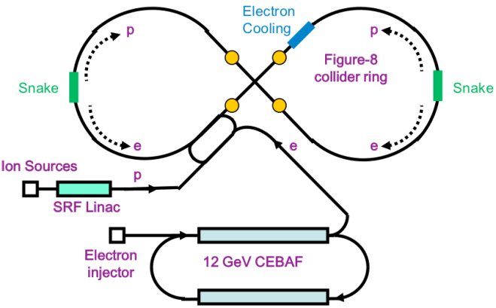
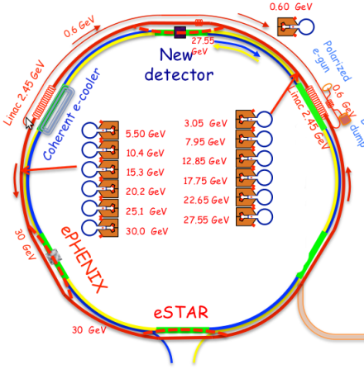
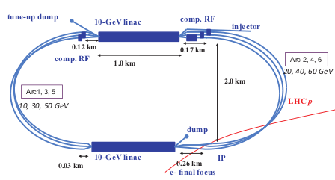
High Energy ERL’s, EIC’s (election-ion)
JLAB, MEIC
BNL, eRHIC
JLab MEIC | BNL eRHIC | CERN LHeC
5-10 GeV | 20 GeV | 60 GeV
750 MHz ? passes | 704 MHz 6 passes | 704 MHz 3-passes
3 A | 50 mA | 6.4 mA
4 nC | 3.5 nC | 0.3 nC
7.5 mm | 2 mm | 0.3 mm
Planned | Planned | Planned
CERN, LHeC

Slide 8
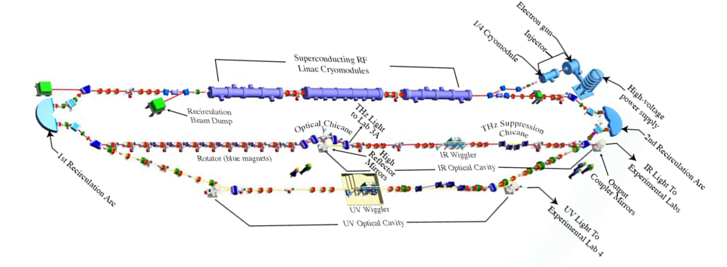
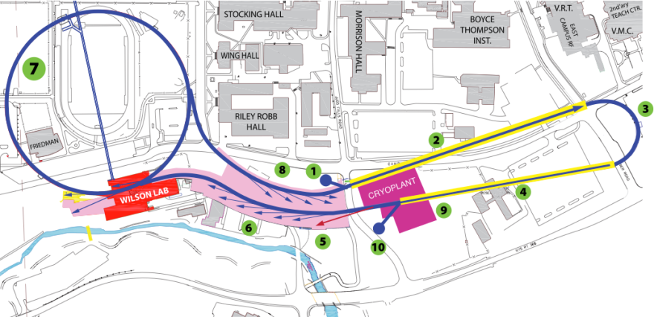
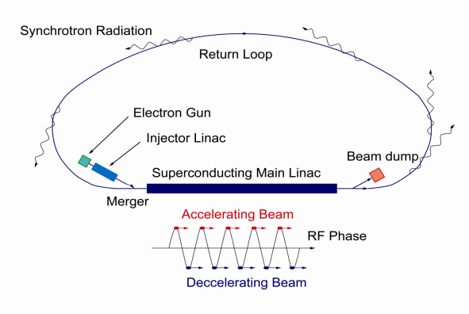
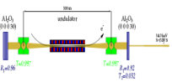
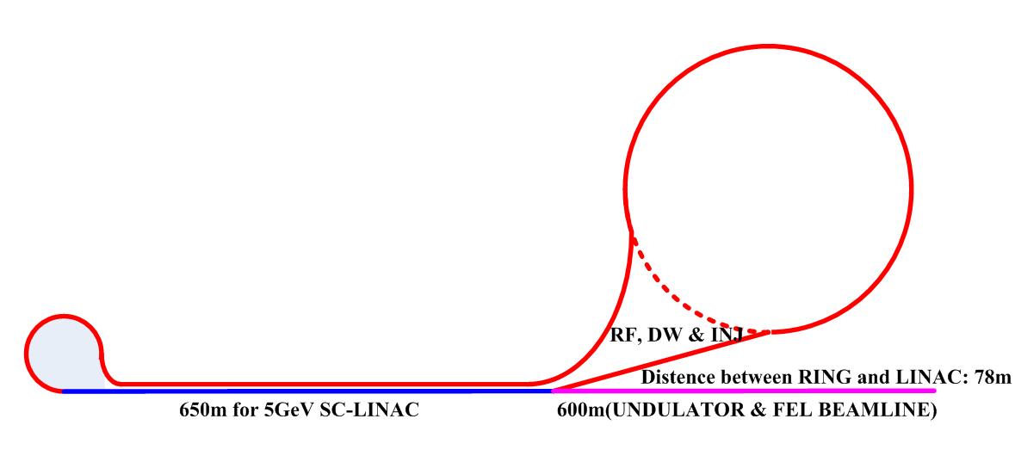
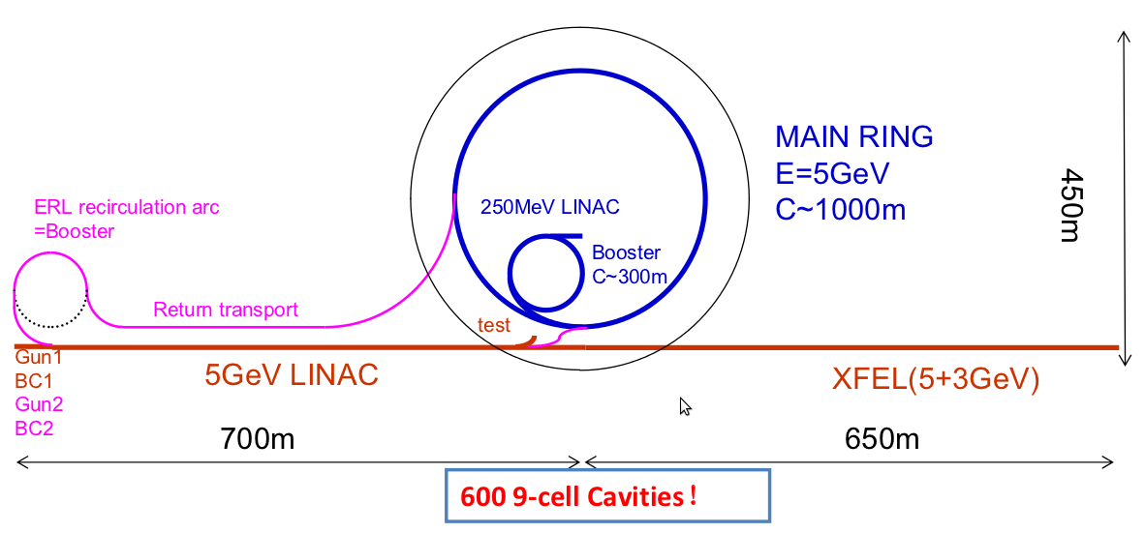
High Energy ERL’s, Light sources, FEL
Cornell ERL Light Source, 5 GeV
JLAB, FEL, 160 MeV
KEK-JAEA
XFEL-O 2nd Phase
7GeV
Double Acc.
3GeV ERL
First Stage
APS-ERL Upgrade
5 GeV, 1-2 passes
APS
Beijing Advanced
Photon Complex

Slide 9
High Energy ERL’s, Light sources, FEL’s
JLab FEL (IR, UV) | Argonne Light Source | Cornell Light source | Mainz, MESA ERL | KEK-JAEA Light Source | Beijing Photon Source
160 GeV | 7 GeV | 5 GeV | 100-200 MeV | 3 GeV | 5 GeV
1.5 GHz | 1.4 GHz 1-2 passes | 1.3 GHz | ? 2 passes | 1.3 GHz | 1.3 GHz 9 cell
10 mA | 25-100 mA | 100 mA | 0.15-10 mA | 0.01-100 mA | 10 mA
135 pC | 77 pC | 77pC | 7.7 pC | 7.7-77 pC | 77 pC
0.045-0.15 mm |  | 0.6 mm | - ps | 2 ps | 2 ps
Operating | Planned | Planned | ? | Planned | Planned
CEBAF not in the list since it is not normally operated in ER mode.
(Is this so? – Please correct me if wrong! – and help fill my other blanks!)

Slide 10
Choice of frequency
Part 2

Slide 11
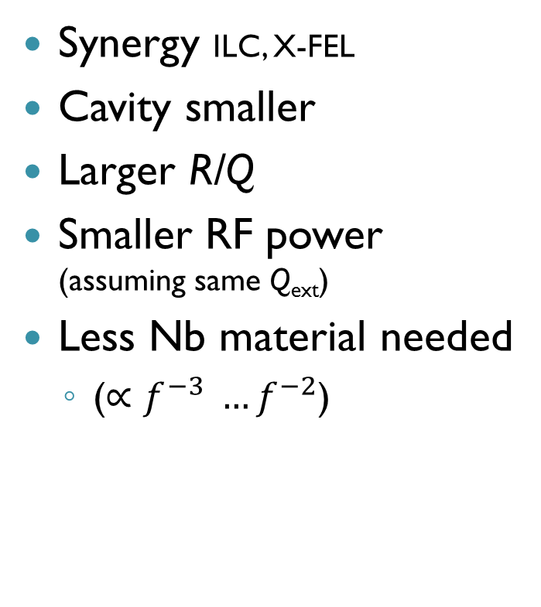
Which frequency?
700 MHz vs. 1300 MHz
Advantages 700 MHz
Advantages 1300 MHz
Synergy SPL, ESS, JLAB, eRHIC
Smaller BCS resistance
Less trapped modes
Smaller HOM power
Beam stability
Smaller cryo power
Power couplers easier
Power source easier
Synergy ILC, X-FEL
Cavity smaller
Larger R/Q
Smaller RF power (assuming same Q_{ext})
Less Nb material needed
  ($∝f^{−3} …f^{−2}$)

Slide 12
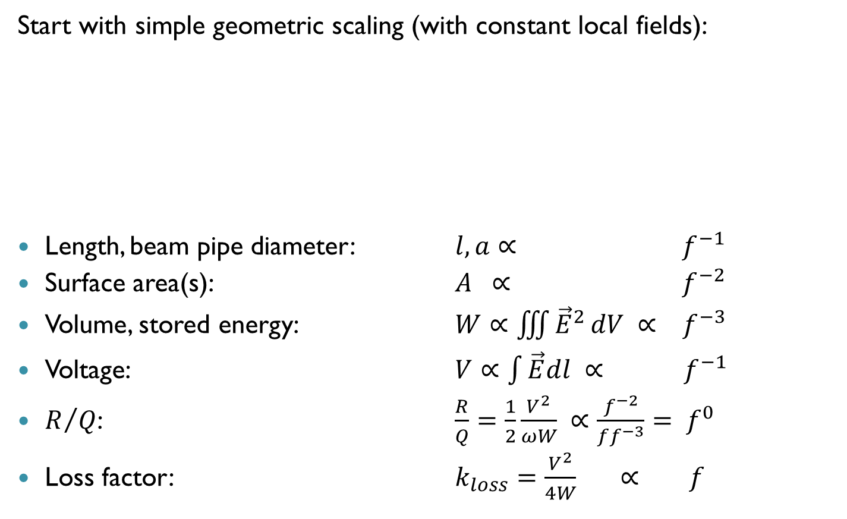


Scaling 700 MHz → 1400 MHz
(J. Tückmantel, 2008 for SPL)
Start with simple geometric scaling (with constant local fields):
Length, beam pipe diameter: $l, a∝ f^{−1}$
Surface area(s): $A ∝ f^{−2}$
Volume, stored energy: $W∝\iiint{{\vec{E}}^{2}}dV ∝ f^{−3}$
Voltage: $V∝\int{\vec{E}dl} ∝ f^{−1}$
$R/Q$: $\frac{R}{Q}=\frac{1}{2}\frac{V^{2}}{ωW} ∝\frac{f^{−2}}{ff^{−3}}= f^{0}$
Loss factor: $k_{loss}=\frac{V^{2}}{4W} ∝ f$
$$f=1400 MHz$$
$$f=700 MHz$$

Slide 13
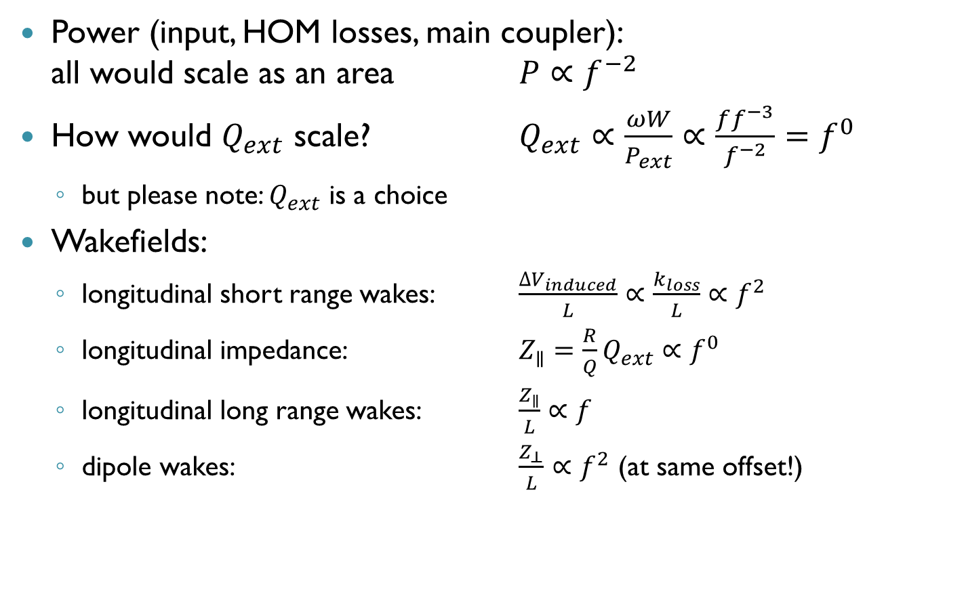
Scaling 700 MHz → 1400 MHz
(continued)
Power (input, HOM losses, main coupler):
all would scale as an area $P∝f^{−2}$
How would $Q_{ext}$ scale? $Q_{ext}∝\frac{ωW}{P_{ext}}∝\frac{ff^{−3}}{f^{−2}}=f^{0}$
  but please note: $Q_{ext}$ is a choice
Wakefields:
  longitudinal short range wakes: $\frac{{∆V}_{induced}}{L}∝\frac{k_{loss}}{L}∝f^{2}$
  longitudinal impedance: $Z_{∥}=\frac{R}{Q}Q_{ext}∝f^{0}$
  longitudinal long range wakes: $\frac{Z_{∥}}{L}∝f$
  dipole wakes: $\frac{Z_{⊥}}{L}∝f^{2}$ (at same offset!)

Slide 14
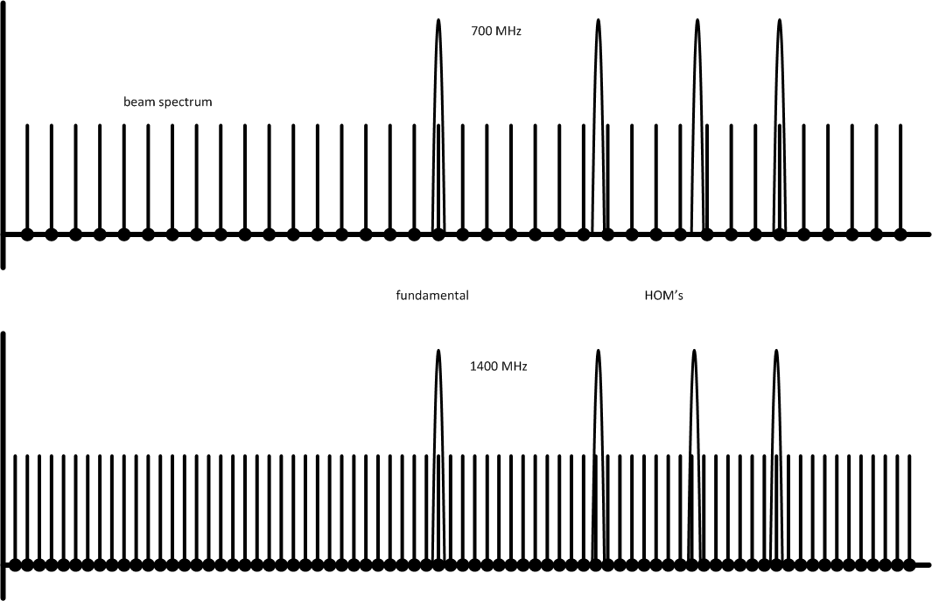

Scaling 700 MHz → 1400 MHz
(continued)
Meaning of this latter scaling $\frac{Z_{⊥}}{L}∝f^{2}$: the beam break-up threshold scales as $f^{2}$!
Beam spectrum (multiples of 40 MHz, plus betatron and synchrotron sidebands)

Slide 15
Scaling 700 MHz → 1400 MHz
(continued)
But at higher f you have also to increase the number of cells!
n cells – n modes!
2 cells
10 cells
4 cells
3 cells
6 cells

Slide 16
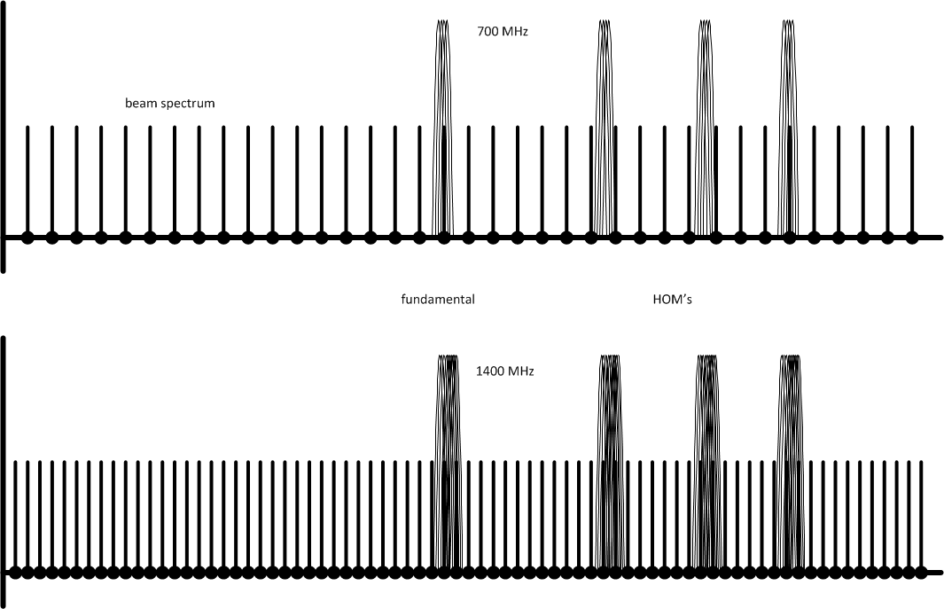
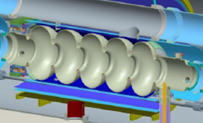
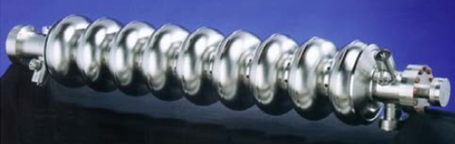
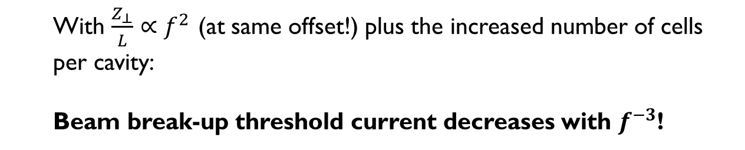
Scaling 700 MHz → 1400 MHz
(continued)
  With $\frac{Z_{⊥}}{L}∝f^{2}$ (at same offset!) plus the increased number of cells per cavity:
  Beam break-up threshold current decreases with $f^{−3}$!

Slide 17
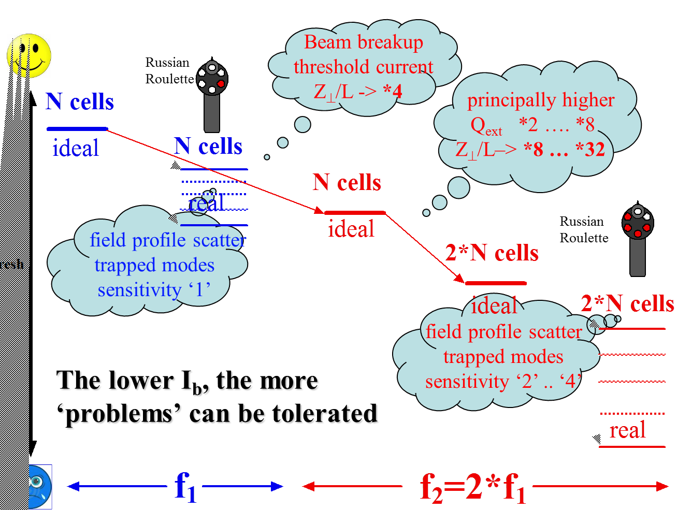


Lower f, larger currents possible
Stable beam current limit

Slide 18
721 MHz much larger stable beam current limit than 1323 MHz!
… but also:

Slide 19
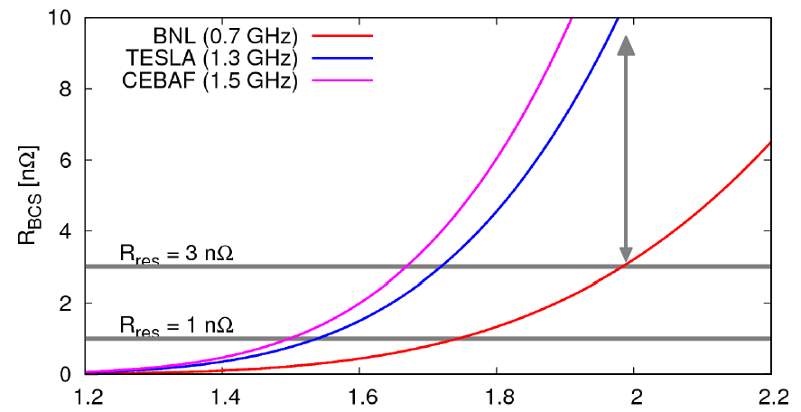
Dynamic wall losses
R_{s} = R_{BCS} + R_{res}
T [K]
For small R_{res}, this clearly favours smaller f.

Slide 20
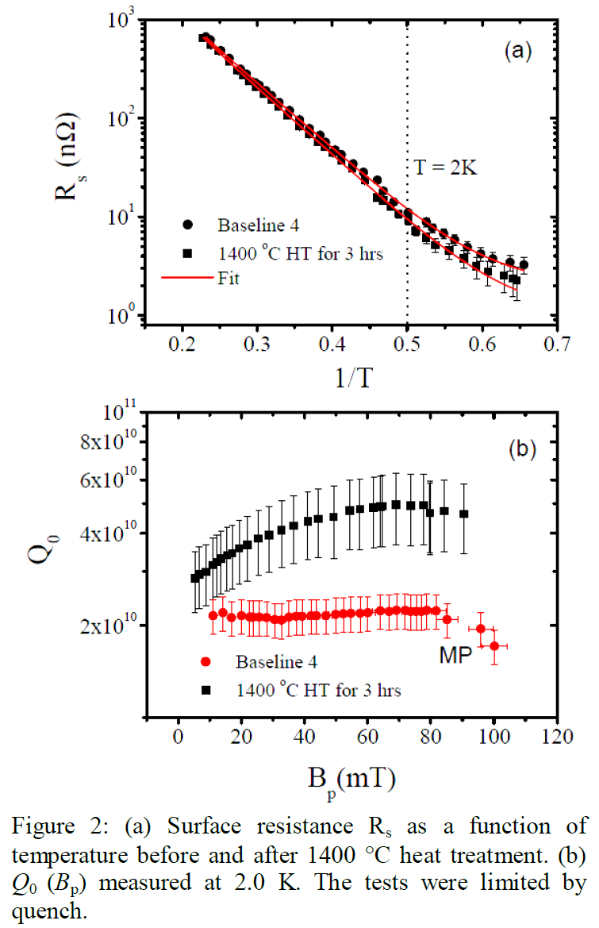
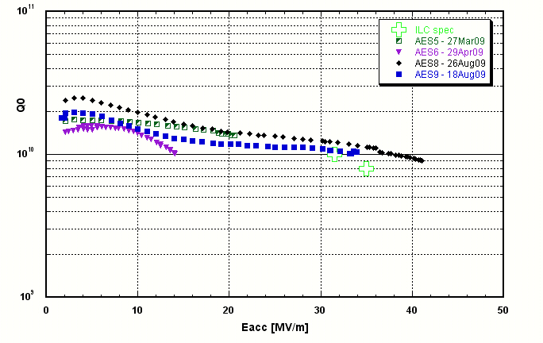
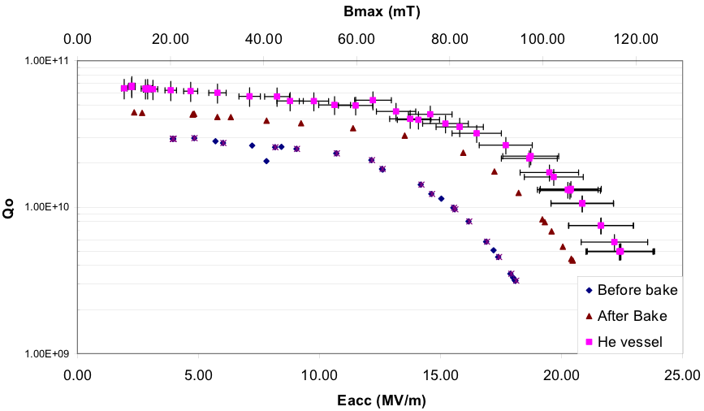
One should aim for very large Q₀
ILC Cavities 1.3 GHz, BCP + EP (R. Geng SRF2009)
BNL 704 MHz test cavity, BCP only! (A. Burill, AP Note 376)
first cavities – large potential
JLAB, 1.5 GHz, (Dhakal, Ciovati, Myneni 2012: http://arxiv.org/abs/1205.6736

Slide 21
ERL-TF @ CERN
Part 3: - some initial thoughts on
very sketchy and preliminary …
You are invited to contribute!

Slide 22
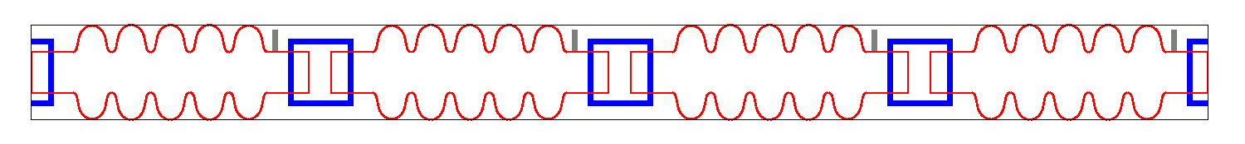
ERL-TF @ CERN
Dump
SCL2
200-400 MeV ERL Layout
4 x 5 cell, 721 MHz
SCL1
5 MeV Injector
~6.5 m
 | units | 1-CM | 2-CM
Energy | [MeV] | 100 | 200-400
Frequency | [MHz] | 721 | 721
Charge | [pC] | ~500 | ~500
Rep. rate |  | CW | CW

Slide 23
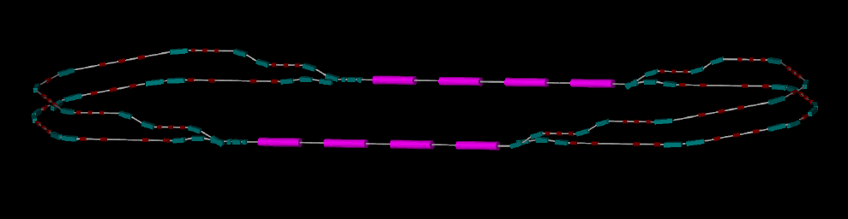
ERL-TF (300 MeV) − Layout
This model and animation by Alex Bogacz, Jefferson Lab
ΔE = 75 MeV
5 MeV
ΔE = 75 MeV
5 MeV
ΔE = 75 MeV
ΔE = 75 MeV
ΔC = λ/2
ΔC = λ/2
5 MeV
5 MeV
Two passes ‘up’ + Two passes ‘down’

Slide 24
Why ERL TF @ CERN?
Physics motivation:
  ERL demonstration, FEL, γ-ray source, e-cooling demo!
  Ultra-short electron bunches
One of the 1st low-frequency, multi-pass SC-ERL
  synergy with SPL/ESS and BNL activities
High energies (200 … 400 MeV) & CW
Multi-cavity cryomodule layout – validation and gymnastics
Two-Linac layout (similar to LHeC)
  …could test CLIC-type energy recovery from SCL2 → SCL1
MW class power coupler tests in non-ER mode
Complete HOM characterization and instability studies
Cryogenics & instrumentation test bed
A place to work, practise and to train people!
Could this become the LHeC ERL injector (see next page)?
…

Slide 25
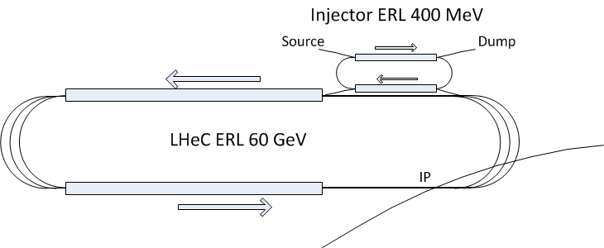
Could the TF later become the LHeC ERL injector ERL?
very preliminary – just an idea right now.

Slide 26
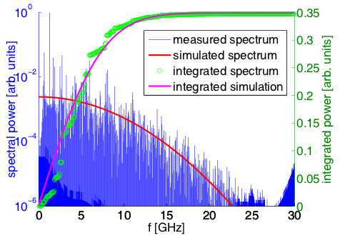
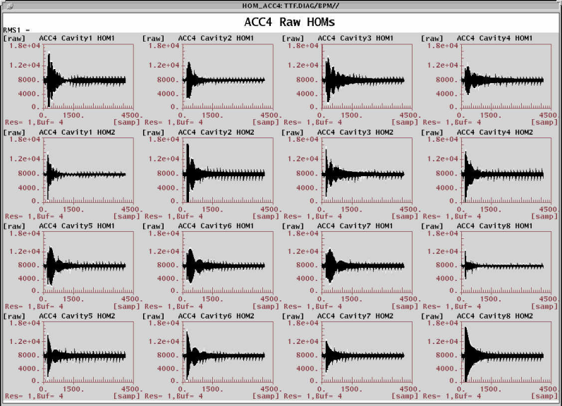
HOM Measurements
1.3 GHz, M. Liepe et al., IPAC2011
Complete characterization of HOM
Benchmark simulations
Improvements on damping schemes
N. Baboi et al. (FLASH)
Precision measurement of orbit
Cavity & CM alignment

Slide 27
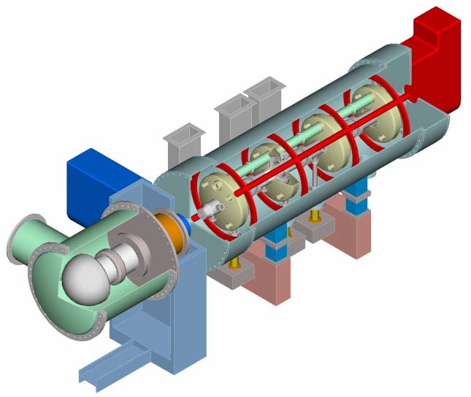
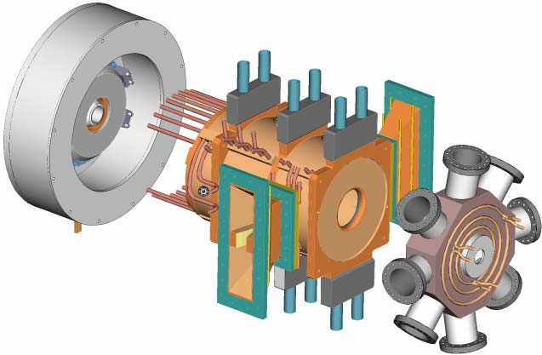
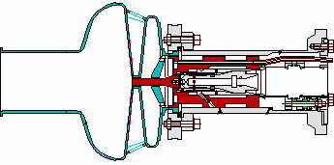
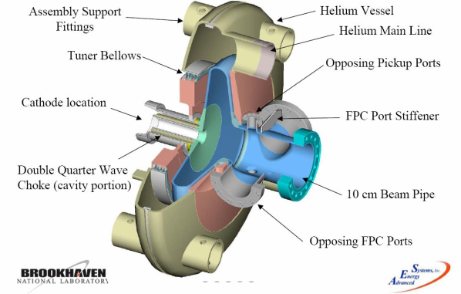
Injector R&D (~700 MHz)
DC Gun + SRF CM (JLAB-AES)
NC Gun (LANL-AES)
SRF Gun (FZR-AES-BNL)
 | DC+SRF-CM | NC | SRF
Energy | 2-5 MeV | ? | 2 MeV
Current | 100 mA | 100 mA | 1000 mA
Long. Emit | 45 keV-ps | 200 keV-ps | -
Trans. Emit | 1.2 µm | 7 µm | < 1 µm
SRF Gun (BNL-AES)

Slide 28
RF Power
5 MeV injector → P_{beam} ~ 50 kW (10 mA)
Will need higher powers if we go to 100 mA+
Peak detuning
Main LINAC
(zero beam loading)
 | 721 MHz
Q=1 x 10⁶ | 250 kW
Q=5 x 10⁶ | 50 kW
Q=1 x 10⁷ | 25 kW
Commercial television
IOT @700 MHz
Reach steady state with increasing beam current

Slide 29
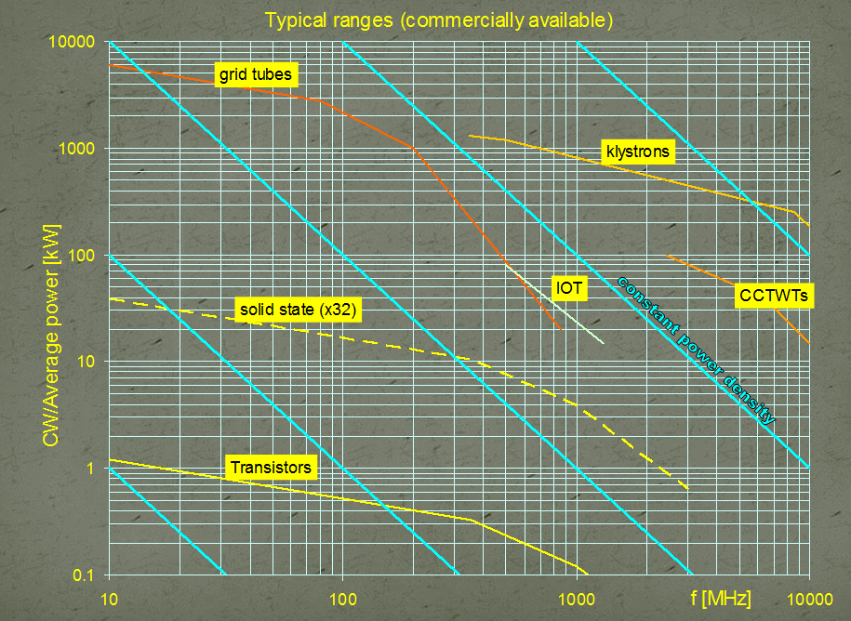
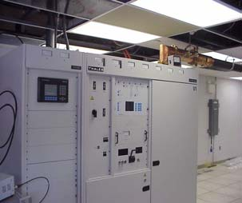
RF Power
Use of IOTs ~ 50-100 kW at 700 MHz
High efficiency, low cost
Amplitude and phase stability
50 kW TV Amplifier, BNL
At 700 MHz

Slide 30
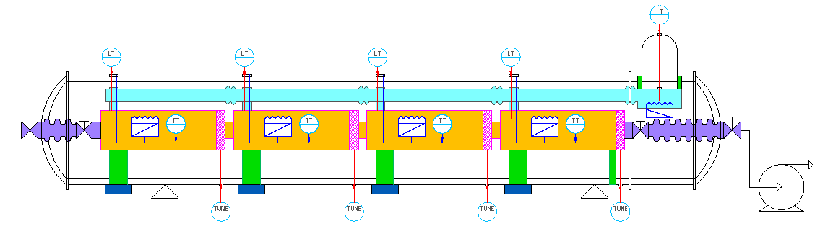
Cryogenic System
Can use the SPL like cryo distribution system
No slope at the C-TF → the distribution line can be in center ?
To cryo distribution
Cryo fill line
Phase separator
V. Parma, Design review of short cryomodule

Slide 31
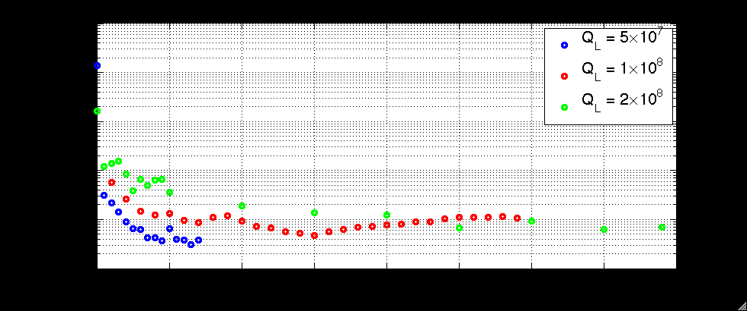
RF Controls
Development of digital LLRF system (Cornell type ?)
Amplitude and phase stability at high Q₀ ~ 1 x 10⁸
Reliable operation with high beam currents + piezo tuners
In case of failure scenarios: cavity trips, arcs etc..
9-cell cavities at HoBiCaT, Liepe et al.
10⁻¹
10⁻²
Rms amplitude stability
10⁻³
10⁻⁴
Propotional Gain

Slide 32
RF Failures
Slow failures (for example: power cut)
Q_{ext} is very high → perhaps need to do nothing
Fast failures (coupler arc)
If single cavity → additional RF power maybe ok
Reduce beam currents or cav gradients gradually
If entire LINAC → lot of RF power
Perhaps play with 2-LINAC config for safe extraction of high energy beam

Slide 33
Timeline & Costs
If:
SPL R&D CM can be used, then very fast turn-around (cheap option)
Else:
3-4 years of engineering & development (SRF + beam line)
The costs should be directly derived from SPL CM construction (< 5 MCHF ?)
Do we need high power couplers ?
R&D of HOM couplers
Will be needed for probing high current & CW
Key question: where to place the ERL-TF to have maximum flexibility ?

Slide 34
Conclusions
We (CERN) are beginners in ERLs – but there are many ERLs and ERL-TFs out there …
… and of course expertise which will help us with the LHeC ERL and the TF.
We welcome collaboration with external experts (JLAB, CI, …)!
f-choice: I personally prefer the lower frequency (721 MHz) for transverse beam stability!
There is interesting R&D – synergetic with other activities.
An dedicated ERL-TF looks attractive and complementary to other facilities. It will also be a place to learn the tricks of the trade “hands-on”.
We’re pleased to welcome Alessandra Valloni on board!

