Slide 1
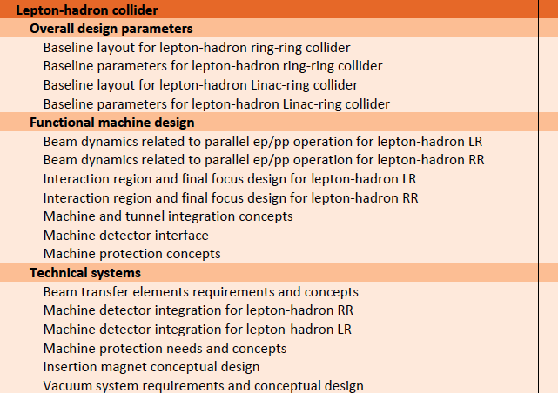

Deep Inelastic Scattering at High Energy
Max Klein
University of Liverpool
For the ep/eA study group
FCC Meeting. 14.2.2014
University of Geneva
http://cern.ch/lhec
60 GeV x 7 TeV (LHC)
60 … 175 GeV x 50 TeV (FCC-h)

Slide 2

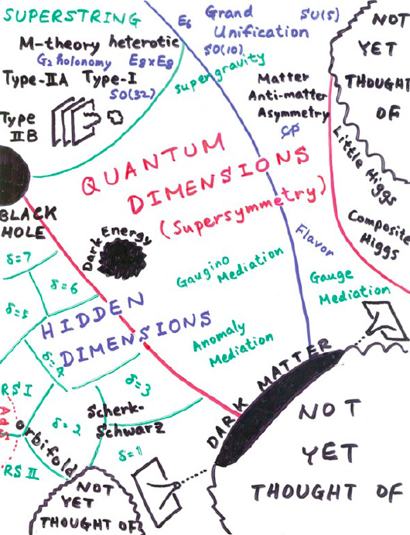
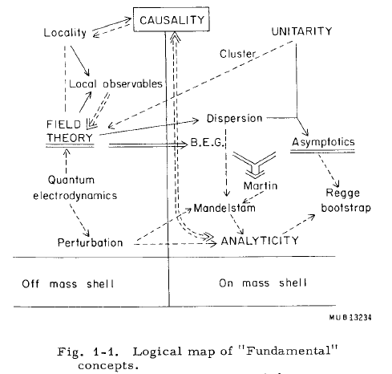
THEORY
M.Froissart ICHEP (“Rochester”) 1966
H.Murayama – ICFA11
→ Quarks in 1969
→ ?in 2015+?
We like to see particle physics as driven by experiment … Burt Richter

Slide 3
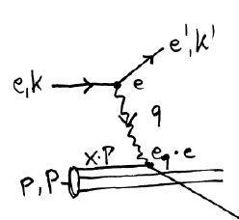
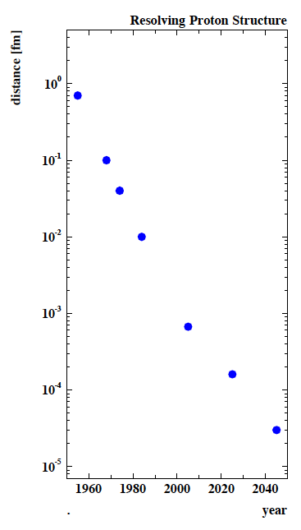
Deep Inelastic Scattering [eh → e’X]
e⁺e⁻
HERA-LHeC-FCC-eh: finest microscopes
with resolution varying like 1/√Q²
→
eh →
Finite p Radius
X
Stanford
→
Quarks
SLAC
hh
FNAL
Quark
Gluon
Dynamics
Parton momentum fixed by electron kinematics
Incl. NC (γ,Z) and CC (W±) independent of hadronisation
Rigorous theory: Operator expansion (lightcone)
Parton momentum distributions to be measured in DIS
Collider- HERA: y_{h}=y_{e} : Redundant kinematics
CERN
HERA
LHeC
?
FCC-he
electromagnetic radius

Slide 4
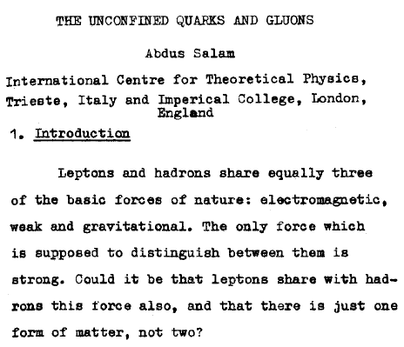
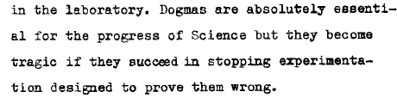
Tbilissi →
1976

Slide 5
Possible QCD Developments and Discoveries
AdS/CFT
Instantons
Odderons
Non pQCD
QGP and Nuclei
N^{k}LO
Resummation
Saturation and BFKL
Non-conventional PDFs …
Breaking of Factorisation
Free Quarks
Unconfined Color
New kind of coloured matter
Quark substructure
New symmetry embedding QCD
QCD may break .. (Quigg DIS13)
QCD is the richest part of the Standard Model Gauge Field Theory and
will (have to) be developed much further, for its own and as background

Slide 6
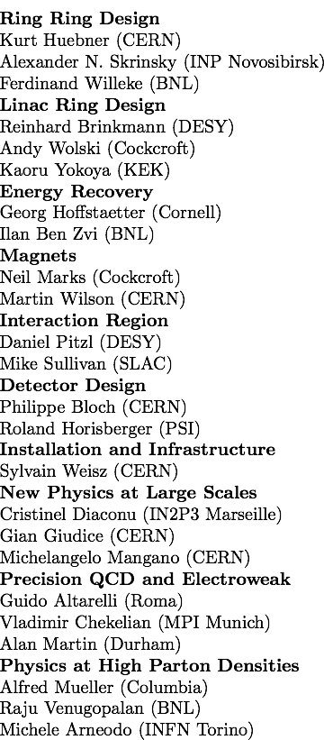
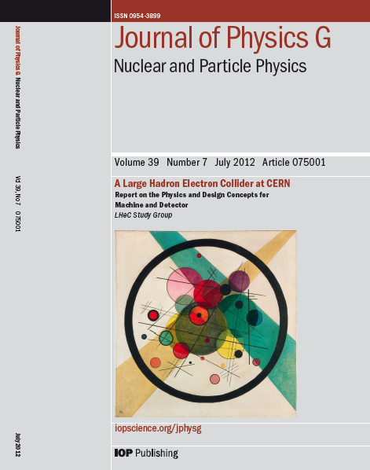
Design Report 2012
CERN Referees
arXiv:1206.2913 http://cern.ch/lhec
The theory of DIS has developed much further: J.Blümlein Prog.Part.Nucl.Phys. 69(2013)28
DIS is an important part of particle physics: G.Altarelli, 1303.2842, S.Forte, G.Watt 1301:6754

Slide 7
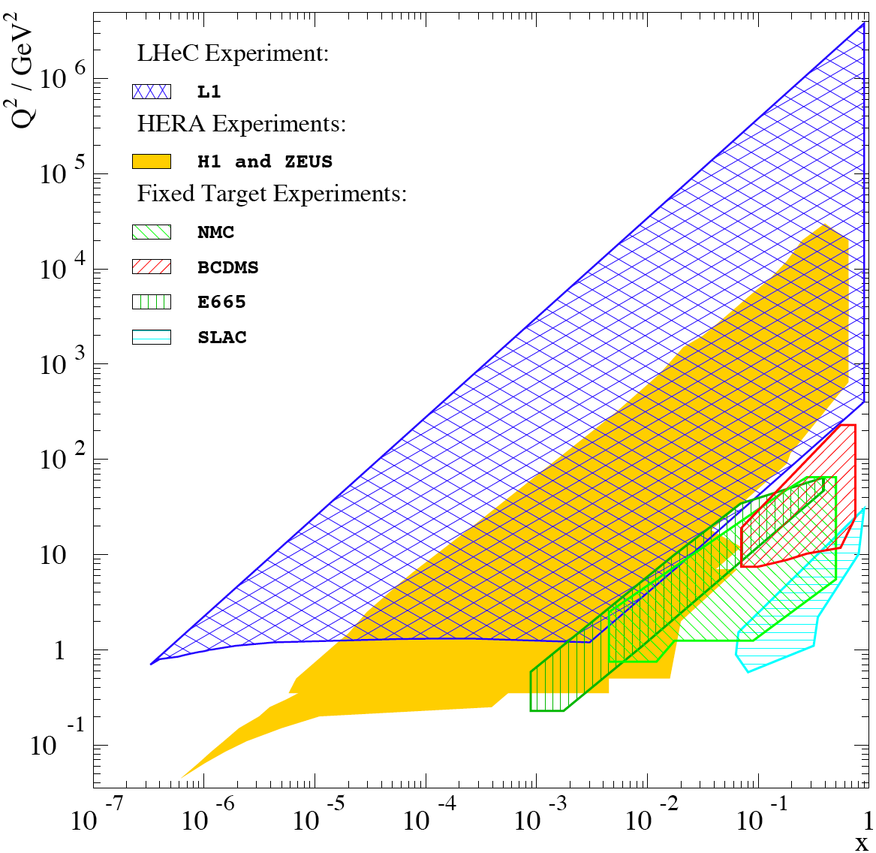
Physics and Range
RPV SUSY, LQ
Substructure ?
Large x
Gluon
High
Precision
QCD &
El.weak
Physics
Higgs
Boson
-four-momentum transfer squared
Nuclear
Structure
QGPlasma
High Density Matter
co MK
Bjorken

Slide 8
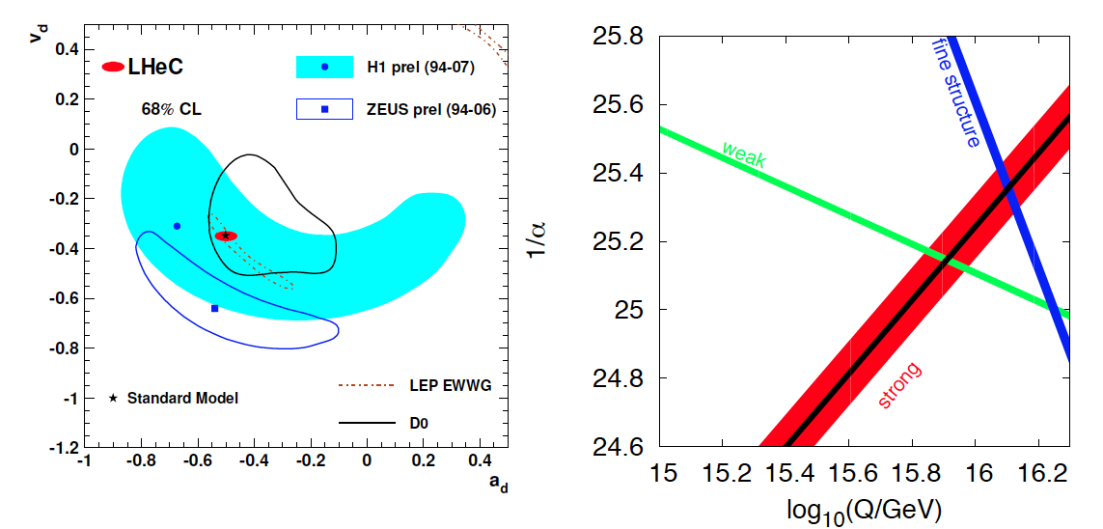
High Precision DIS
High Precision DIS
Q² >> M_{Z,W}², high luminosity, large acceptance
Unprecedented precision in NC and CC
Contact interactions probed to 50 TeV
Scale dependence of sin²θ left and right to Z
→ A renaissance of deep inelastic scattering ←
Solving a 30 year old puzzle:
α_{s} small in DIS or high with jets?
Per mille measurement accuracy
Testing QCD lattice calculations
Constraining GUT (CMSSM40.2.5)
Charm mass to 3MeV, N³LO

Slide 9
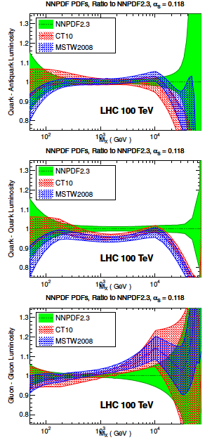
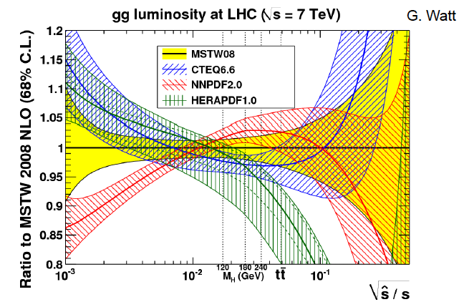
Parton Distributions
Need to know the PDFs much better than
so far, for nucleon structure, q-g dynamics,
Higgs, searches, future colliders FCC-hh,
and for the development of QCD.
The LHC will provide further constraints too
but cannot resolve them precisely (MCS).
Snowmass13 QCD WG report J.Rojo

Slide 10
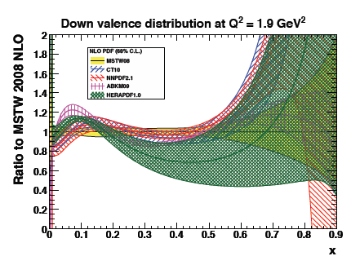
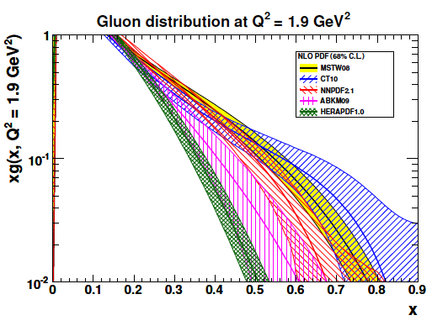
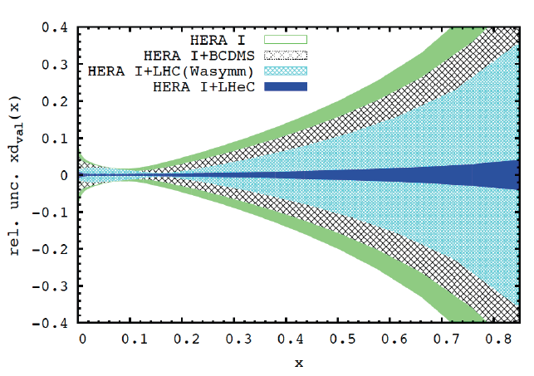
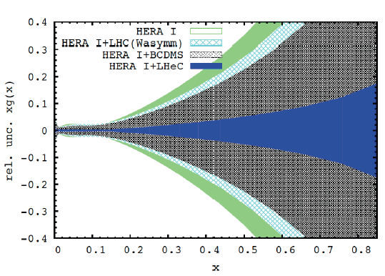
PDFs at Large x
No higher twist corrections, free of nuclear uncertainties, high precision test of factorisation

Slide 11

HL-LHC - Searches
High precision
PDFs are needed
for the HL-LHC
searches in order
to probe into the
range opened by
the luminosity
increase and to
interprete possibly
intriguing effects
based on external
information.
LHeC BSM poster at EPS13 M.D’Onofrio et al. see also arXiv:1211:5102 Relation LHeC-LHC
Simulated PDFs from LHeC are on LHAPDF (Partons from LHeC, MK, V.Radescu LHeC-Note-2013-002 PHY)

Slide 12
Electron accelerator - basic concept
JPhysG:39(2012)075001, arXiv:1206.2913 http://cern.ch/lhec
CDR: default design. 60 GeV. L=10³³cm⁻²s⁻¹, P< 100 MW → ERL, synchronous ep/pp

Slide 13
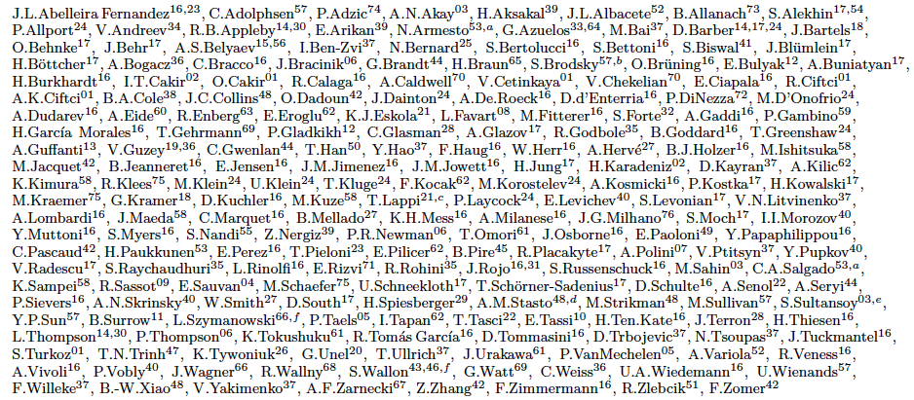
http://cern.ch/lhec
Present (May 13) - LHeC Study group and CDR authors
Thanks to all above, to CERN and the IAC, and for the rush to this kickoff special thanks to
Alessandra Valoni, Monica D’Onofrio, Uta Klein, Voica Radescu and a similar number of men

Slide 14

FCC-he Context of These Days
Thursday: Overview Monica D’O
Yesterday: outbreak:
Introduction - Max K
LHeC – Oliver B
Testfacility – Alessandra V
Interaction Region – Rogelio T
Detector – Alessandro P
FCC-he - Frank Z
DIS - Max K
Heavy Ions – Brian C
Transition to pheno-session
Higgs – Uta K

Slide 15
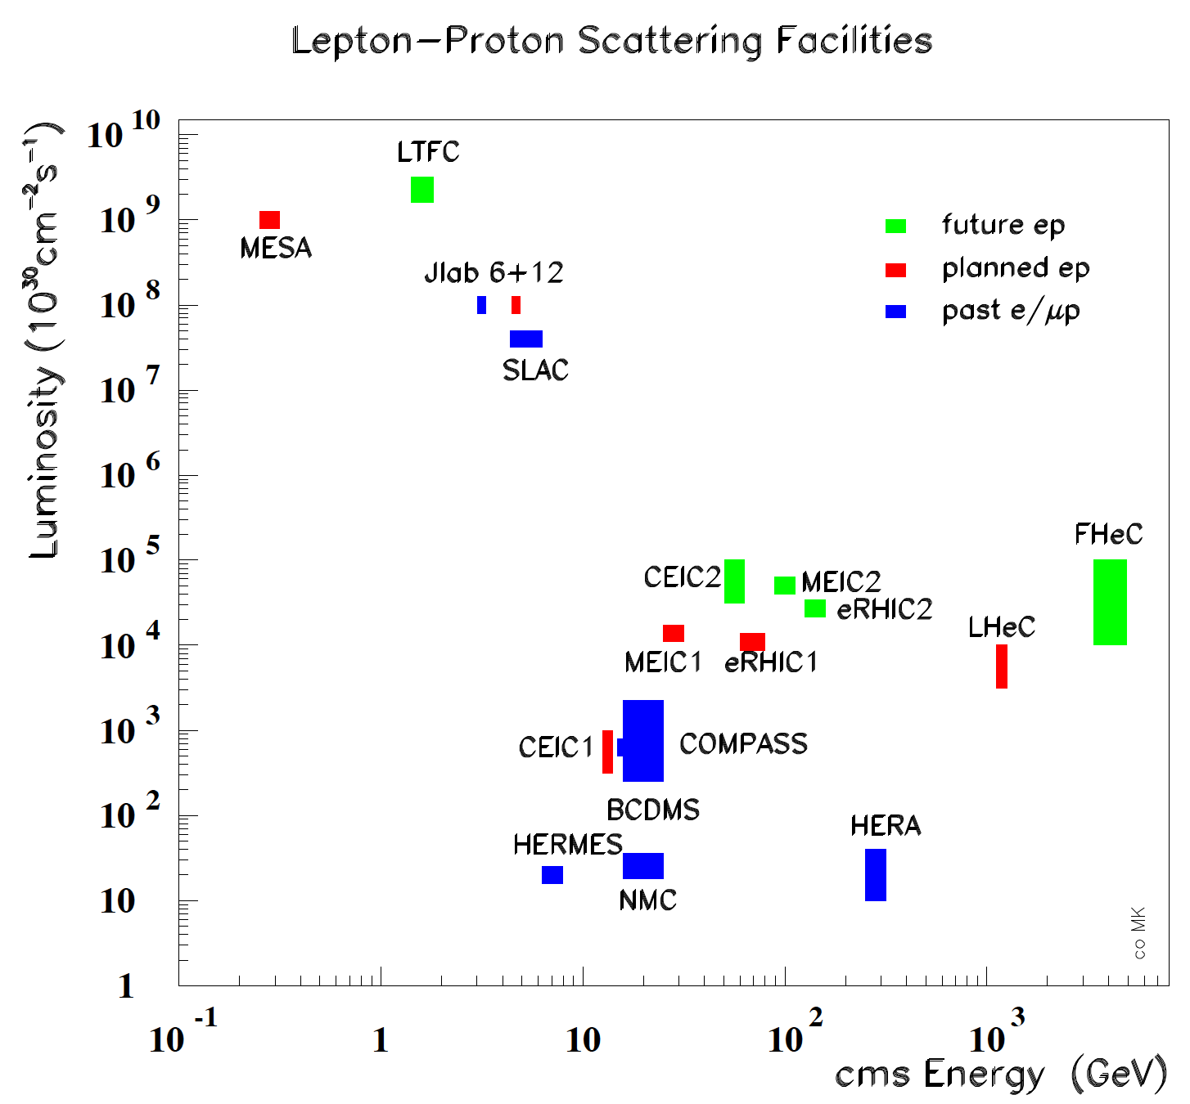
CERN: LHC+FCC: the only realistic opportunity for energy frontier deep inelastic scattering
Huge step in energy (Q²,1/x) and 3 orders of magnitude higher luminosity than HERA

Slide 16
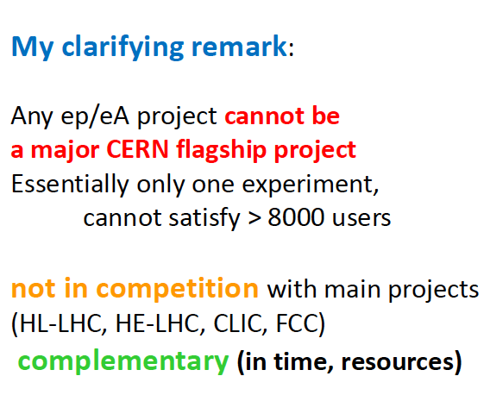
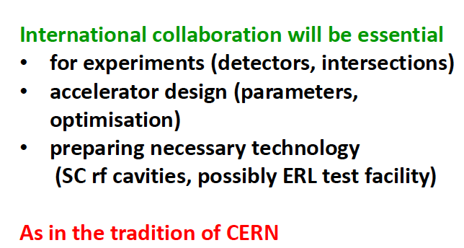
Workshop at Chavannes 20/21.1.2014
Herwig Schopper (Chair IAC) at Chavannes in the Panel Discussion with the CERN Directorate
Truth is stranger than fiction, but it is because fiction is obliged to stick to possibilities
Mark Twain, cited by Stan Brodsky at Chavannes

Slide 17
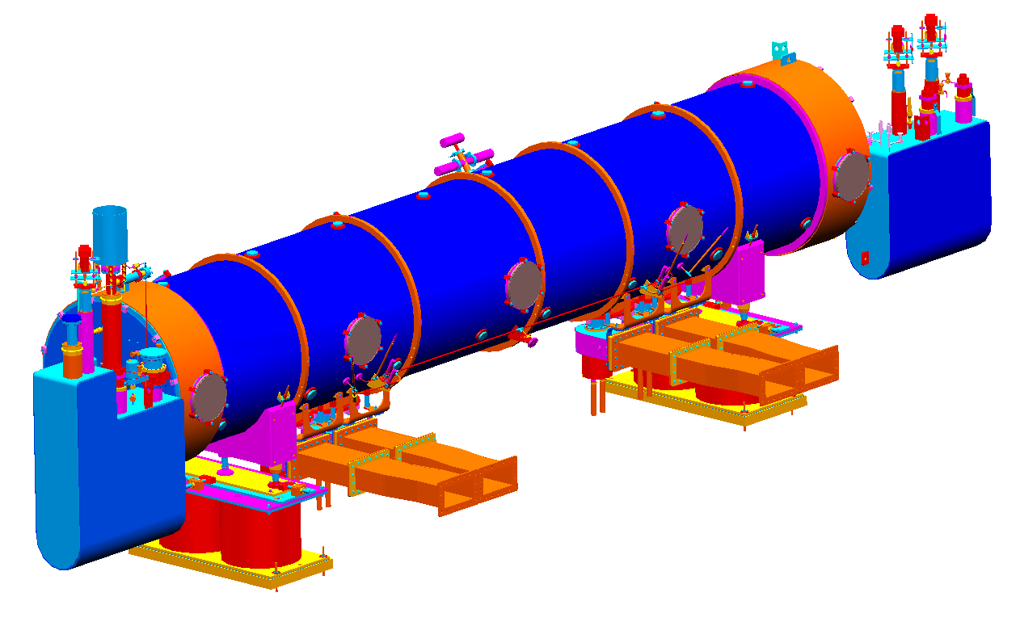
ERL Test-Facility
Purpose
Test facility for SCRF cavities and modules
Test facility for multi-pass multiple cavity ERL
Test facility for controlled SC magnet quench tests
  Injector studies: DC gun or SRF gun
  Study reliability issues, operational issues!
  Could be foreseen as the injector to LHeC ERL
  LHeC may serve as injector to FCC-ee
  Experimental Facility (electron and photon exp’s)
  …
E. Daly, J. Henry, A. Hutton, J. Preble and R. Rimmer
JLab Accelerator Division 20-JAN-2014
4 cavity SNS style – design for 802 MHz
TARGET PARAMETER* | VALUE
Injection Energy [MeV] | 5
Final Beam Energy [MeV] | 900
Normalized emittance γε_{x,y} [μm] | 50
Beam Current [mA] | 10
Bunch Spacing [ns] | 25 (50)
Passes | 3
First endorsed step: 802 MHz Cavity-cryo
module in collaboration with partners.
Important goal: Design of LTF: End of 2015
(open to wide international collaboration)
A.Valloni

Slide 18
Collaborations and International Activities:
-MESA @ University Mainz
      ➔ SC RF cavity and cryostat prototypes
      ➔ includes collaboration with JLab
-JLab ERL (‘LHeC like’, injector, halo, op. experience)
-BNL SC RF activities & ERL
(HOM, eRHIC, applications, frequency choice,
cost and complexity)
-Cornell ERL (frequency choice, high Q₀, errors, HOM)
-ALICE ERL and UK (operational experience)
O.Bruening

Slide 19
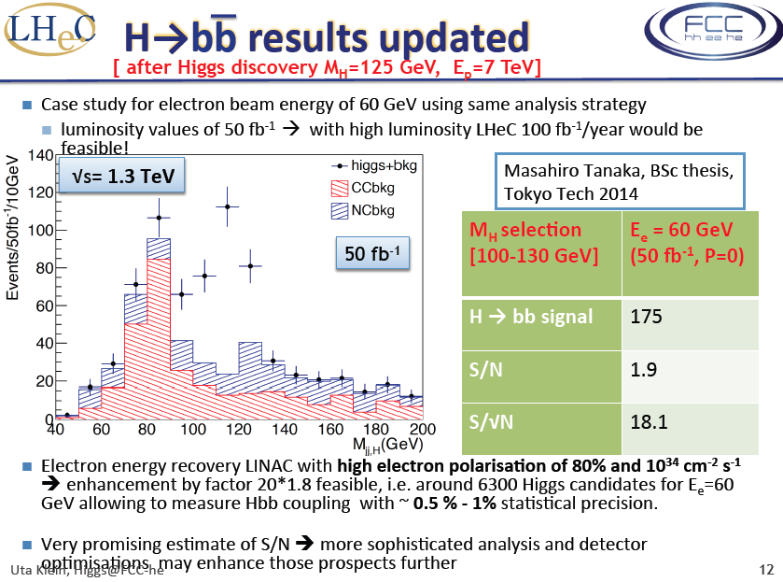
Introduction

Slide 20
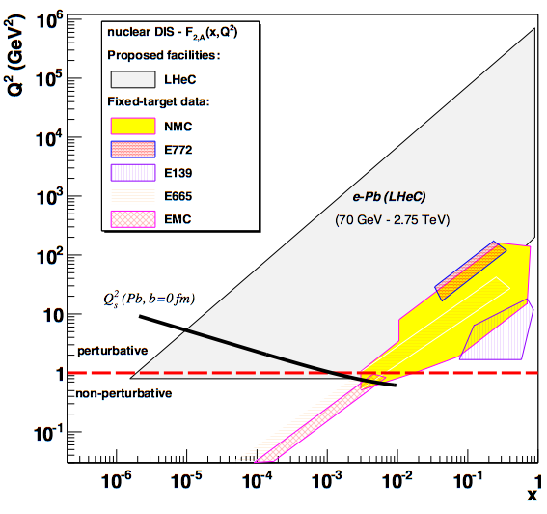
LHeC-FCC-he: Electron Ion Collider
FCC-he
LHeC is part of NuPECCs
long range plan since 2010
L_{eN} ~ 10³² cm⁻² s⁻¹
Extension of kinematic range in lA
by 4-5 orders of magnitude will
change QCD view on nuclear
structure and parton dynamics
May lead to genuine surprises…
No saturation of xg (x,Q²) ?
Small fraction of diffraction ?
Broken isospin invariance ?
Flavour dependent shadowing ?
Expect saturation of rise at
Q²_{s} ≈ xg α_{s} ≈ c x^{-λ}A^{1/3}
Precision QCD study of parton dynamics in nuclei
Investigation of high density matter and QGP
Gluon saturation at low x, in DIS region.

Slide 21
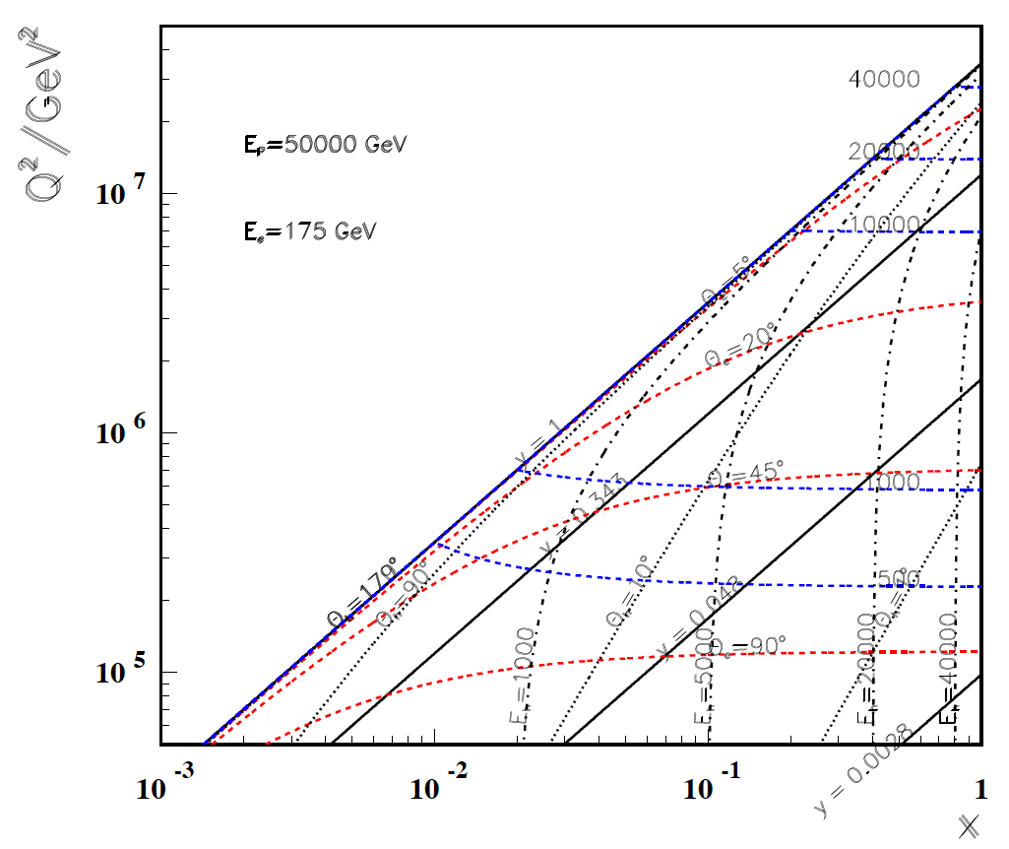
High Q²
Rutherford backscattering
of dozens of TeV e- energy
FCC-he
LHeC
← ϑ_{h}=1º
← HERA

Slide 22
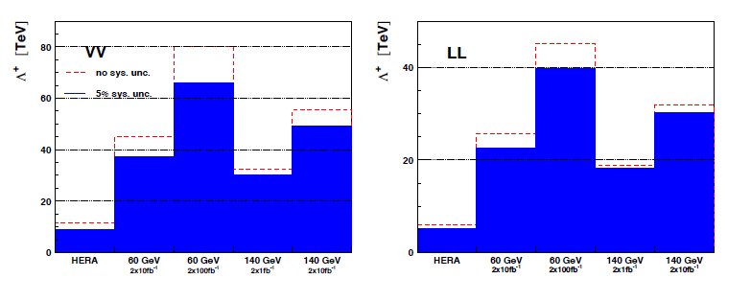
Reach for CI (eeqq) at FCC-he
300 TeV
150
-
FCC-he
FCC-he
Very preliminary scaling from LHeC
Reach about O(100) TeV, expected to be competitive with FHC
VV
LL
200
100
← LHeC →
← LHeC →
HERA
HERA
2x1 ab⁻¹
2x1 ab⁻¹

Slide 23
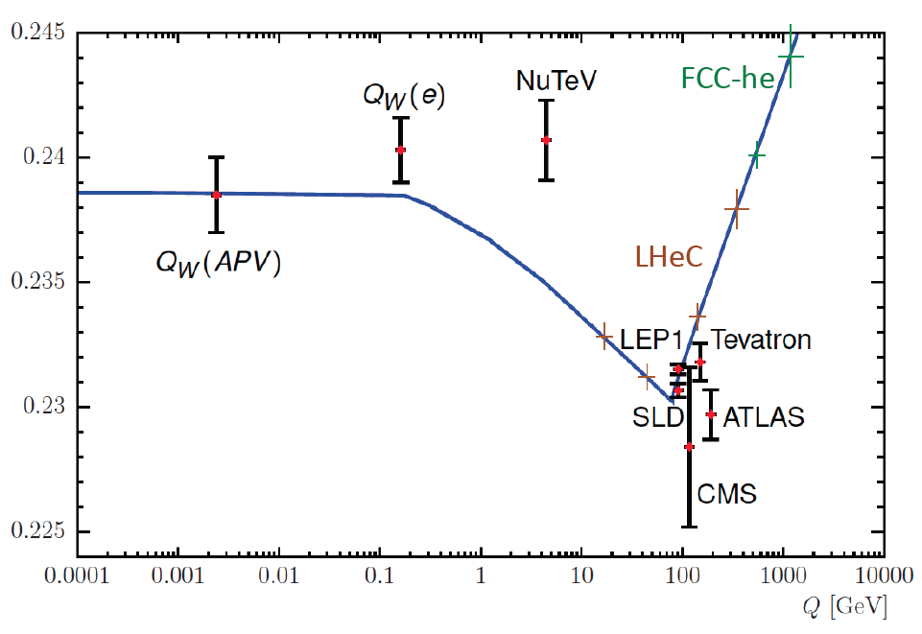
Scale dependence of sin²θ_{W}
Preliminary illustration

Slide 24
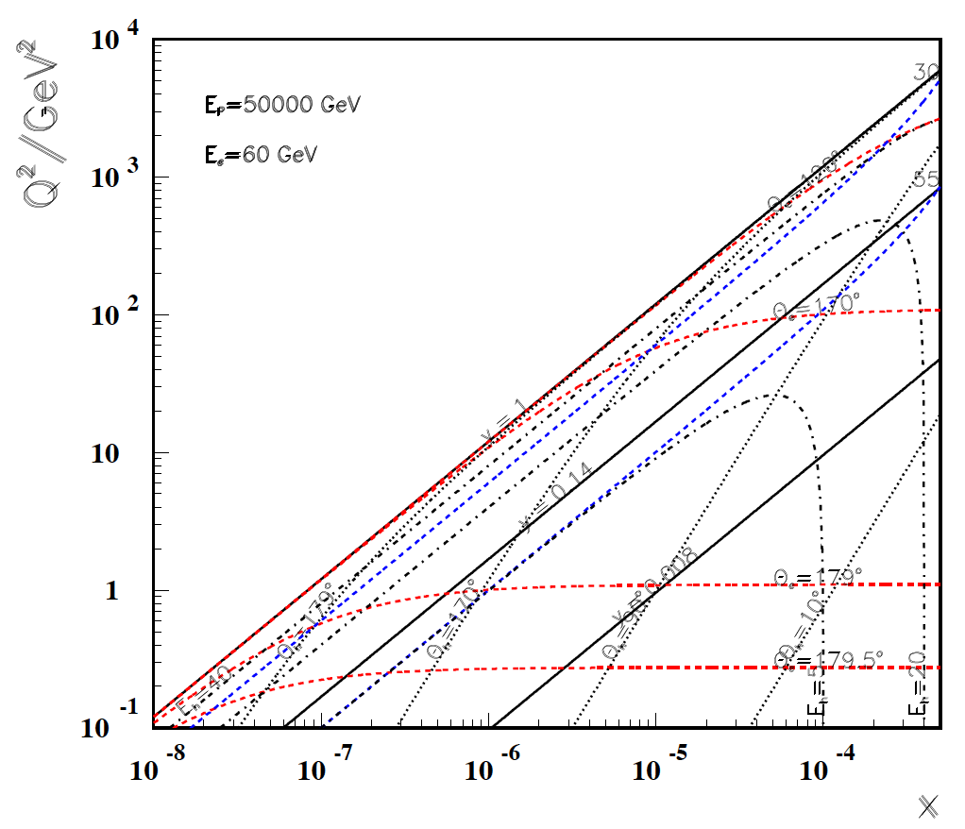
Low x
FHeC
LHeC
-----------
179º
@ 180 GeV
.. very low x
requires not
the maximum
of E_{e}
Very low x
reaches
direct
range of
UHE
neutrino
physics →
HERA
x
For x < 10⁻³ no (average) energy deposition exceeding the electron beam energy

Slide 25
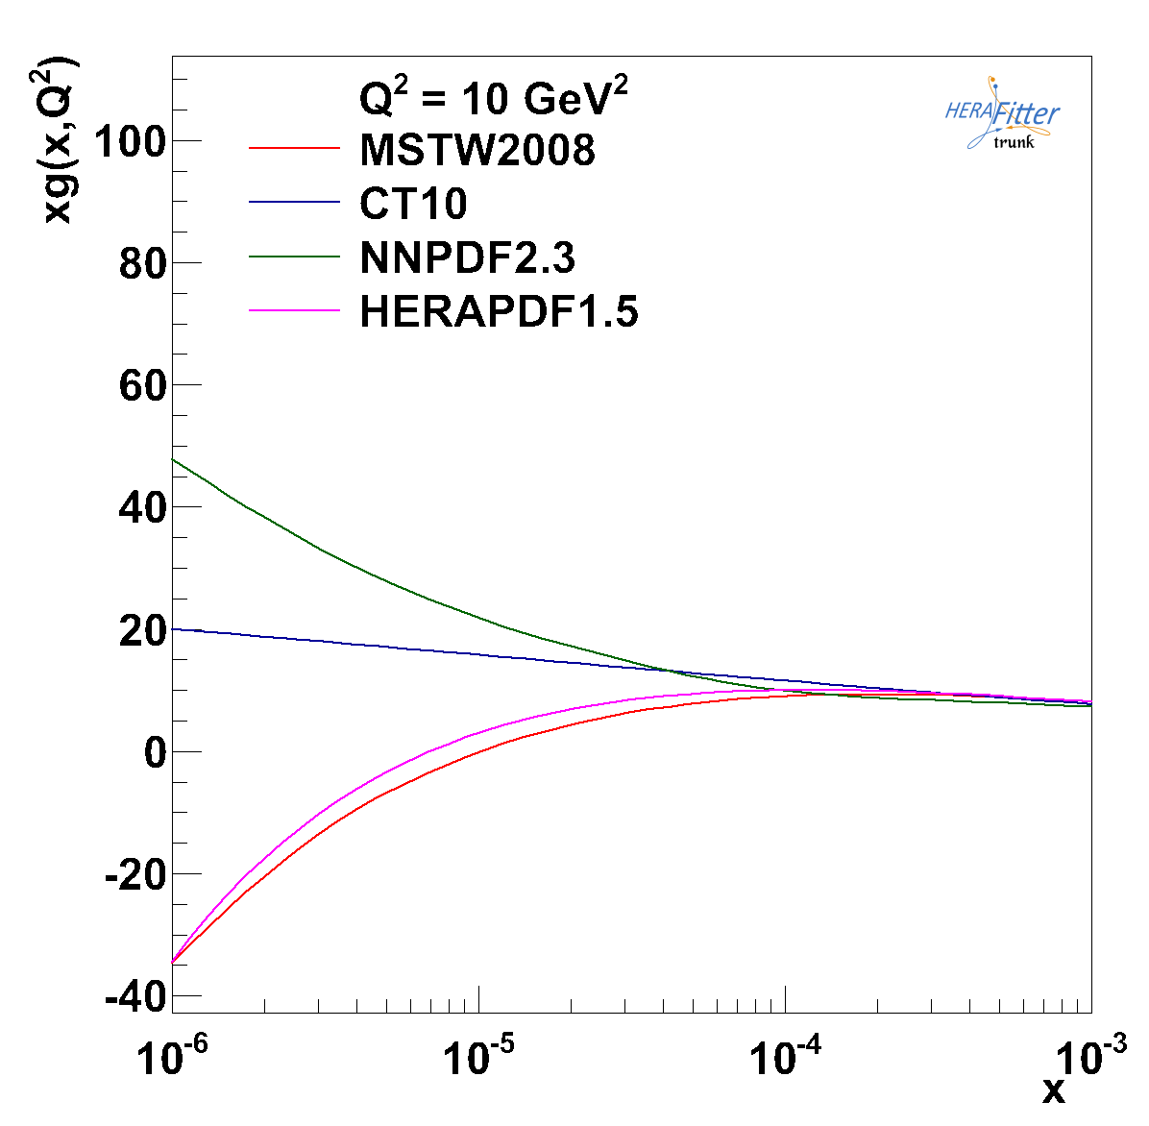
xg at low x
No clue about xg
for x < 10⁻⁴
Evolution law may
not be DGLAP
Affects FCC-pp rates
because
x=M/sqrt(s) exp(+-y)
note x(Higgs) at FCC-pp
for y=0 is 10⁻³ ..

Slide 26
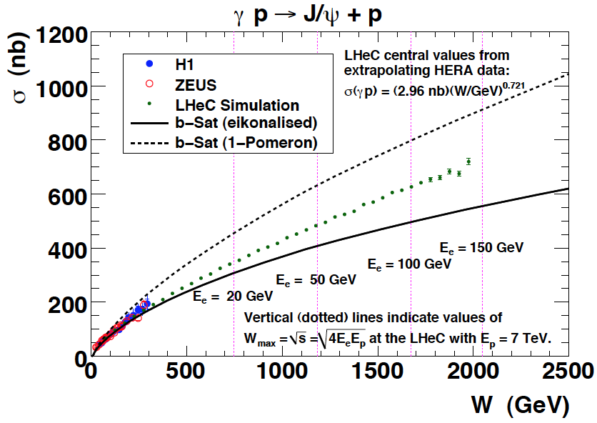
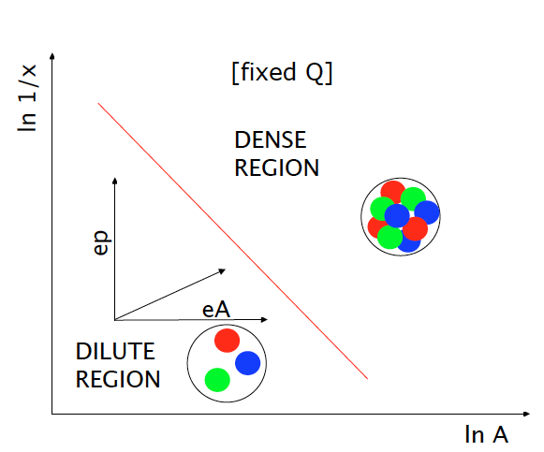
Vector Mesons
Precision Measurements of vector mesons and diffraction to very high M_{X} ~ xg²
FCC-he
LHeC
HERA
5 TeV
W = √ (ys) extends to ~ 5 TeV at FCC-he
Black body limit, interference pattern of σ
Higher energy (1/x), higher A

Slide 27
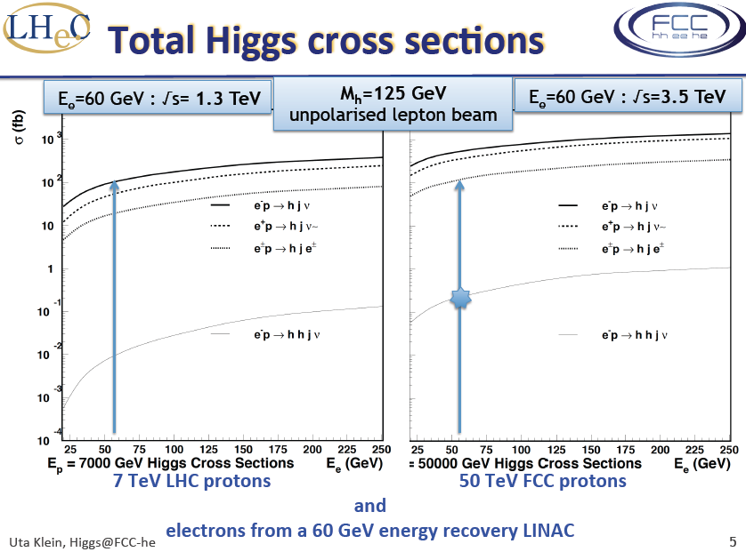
Introduction

Slide 28
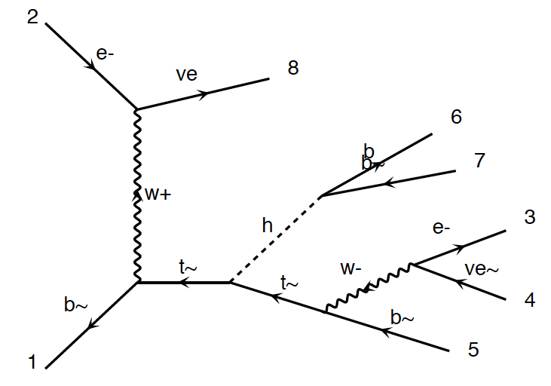
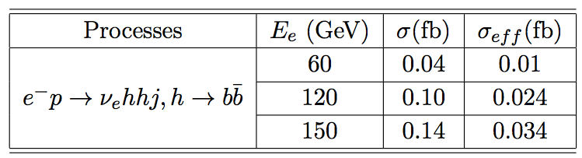
HH and tHt in ep
New
Tentative
Studies
FCC-he unpolarised
Cross section at 3.5 TeV:
total : 0.7 fb
fiducial : 0.2 fb
using pt(b,j)>20 GeV
ΔR(j.b)>0.4
η(j) <5
η(b) < 3
Polarisation, max lumi, tuning cuts, bb and WW
decays may provide O(10%) precision - tentative
Require time for reliable result
(detector, analysis, backgrounds..)
Bruce Mellado, Uta Klein, Masahiro Khuze et al

Slide 29
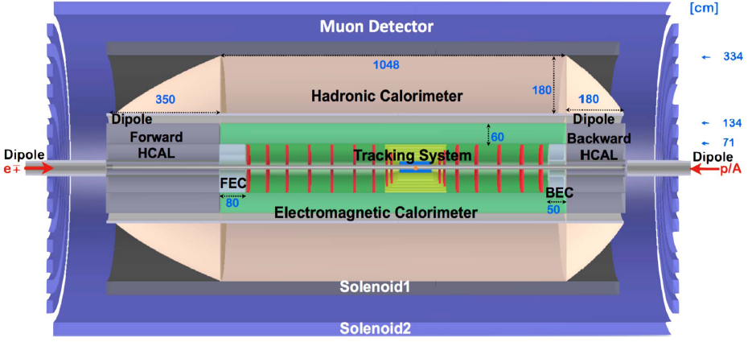
FCC-he Detector (B) – 0.1
Crab cavities for p instead of dipole magnet for e bend to ensure head on collisions
1000 H → μμ may call for better muon momentum measurement
H→ HH → 4b (and large/low x) call for large acceptance and optimum hadr. E resolution
Detector for FCC scales by about ln(50/7) ~2 in fwd, and ~1.3 in bwd direction
Full simulation of LHeC and FCC-he detectors vital for H and H-HH analysis
P.Kostka et al.

Slide 30
DRAFT - Structure of further work
Physics | Detector | Testfacility | Accelerator | Infrastructure
Higgs Top LHC-LHeC eA Low x Theory | Simulation Design Taggers Collaboration | Cavcryo module Magnets Source Optics Operation Coordination | Optimisation Optics IR Q1,2 Pipe+Vacuum Positrons Deuterons | Installation CE Resources Conferences Outreach Relations
Last December, CERN called a coordination group with a 4 years mandate:
The group has the task to coordinate the study of the scientific potential
and possible technical realisation of an ep/eA collider and the associated
detectors at CERN, with the LHC and the FCC, over the next four years. It
also should coordinate the design of an ERL test facility at CERN as part of the
preparations for a larger energy electron accelerator employing ERL techniques.
The group will cooperate with CERN and an International Advisory Committee,
chaired by the emeritus DG of CERN, Professor Herwig Schopper, who also
advises the CERN directorate. The Coordination Group is asked to represent
the ep/eA collider development towards CERN, its committees and the
international community. The currently tentative composition is listed left.
CERN has asked Max Klein to chair and Oliver Brüning to co-chair this activity

Slide 31
Important Milestones for the first FCC Phase
2014: Higgs, … Physics → Validate Configuration of LHeC for 10³⁴, Footprint
Front-end simulation of the ERL
Detailed p beam dynamics studies with complete integration into HL LHC
Detector-IR integration for 10³⁴
Detector Simulation for more realistic physics simulation studies
Collaboration agreements, for RF: 802 MHz Cavity-Cryo Module, warm magnets..
2015: March: FCC Workshop
‘he’ Physics in the ‘hh’ (LHC/FCC) and ‘ee’ (FCC, LC) context
ERL integration with HL-LHC and FCC-hh
ERL Testfacility as FCC-ee injector
Detector design and IR (LR and RR)
Design of the Testfacility, including its applications
Further development of International Detector Collaboration …
Your input and collaboration is vital – please contact us (Physics, Detector, Accelerator)
Draft as discussed in yesterdays breakout session and to be further developed. Demanding program

Slide 32
Summary
LHeC and FCC-he will be the worlds cleanest, high resolution microscopes.
They have a huge potential for discovery (QCD, BSM, Higgs), for novel phenomena
(non-standard partons, neutron, nuclear, photon, pomeron structure..) and
for measurements of unprecedented reach and precision (couplings..)
Only the LHeC and subsequently the FCC-he will be able to completely resolve
the partonic structure of the nucleon and map xg for 6 orders of magnitude in x.
This eventually will break DGLAP and affect the physics of the FCC-hh.
TeV energy, high luminosity, polarised ep scattering has a unique potential
for precision Higgs physics (200-1000 fb) and to access rare H processes.
By its size and ambition, ep is not in competition with the HEP flagship projects,
but compliments these, as is evident from the PDF-H and -BSM relation.
Understanding the multi-TeV energy scale and the development of DIS require
a TeV energy he-collider, for which the LHC and FCC at CERN provide unique bases.
For the electron beam, there are two options under consideration, and for
both the ERL is vital to develop. A crucial next step is related to the ERL testfacility
at CERN which has a multitude of possible applications of international interest.

Slide 33
Deep Inelastic Scattering [eh → e’X]
e⁺e⁻
HERA-LHeC-FCC-eh: finest microscopes
with resolution varying like 1/√Q²
→
eh →
Finite p Radius
X
Stanford
→
Quarks
SLAC
hh
FNAL
Quark
Gluon
Dynamics
Parton momentum fixed by electron kinematics
Incl. NC (γ,Z) and CC (W±) independent of hadronisation
Rigorous theory: Operator expansion (lightcone)
Parton momentum distributions to be measured in DIS
Collider- HERA: y_{h}=y_{e} : Redundant kinematics
CERN
100 years of lp scattering
→ 5 orders of magnitude
deeper into matter
HERA
LHeC
?
FCC-he
electromagnetic radius

Slide 34
backup

Slide 35
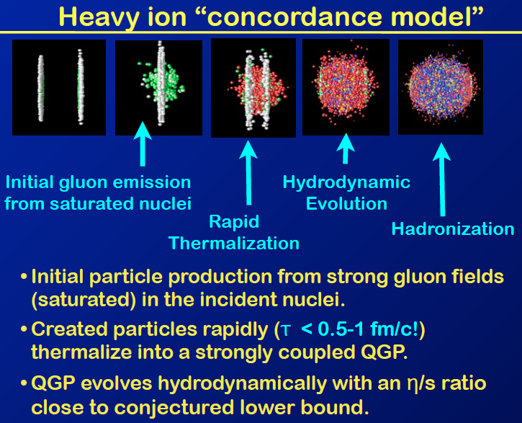
Introduction
Brian Cole

Slide 36
Reducing the thy uncertainties in pp → H
Exp uncertainty
of predicted H
cross section is
0.25% (sys+sta),
using LHeC only.
Leads to H mass
sensitivity.
Strong coupling
underlying
parameter
(0.005 → 10%).
LHeC: 0.0002 !
Needs N³LO
HQ treatment
important …
O.Brüning and M.Klein arXiv:1305.2090, MPLA 2013

Slide 37
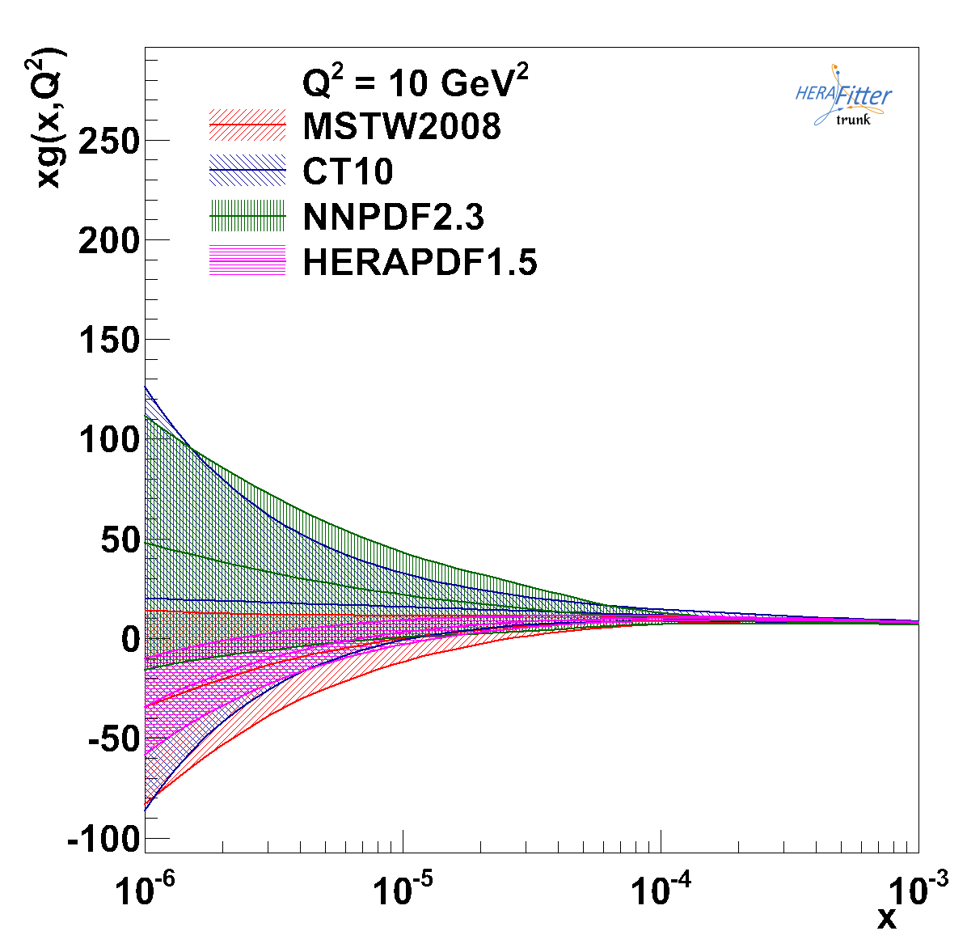
xg at low x

Slide 38
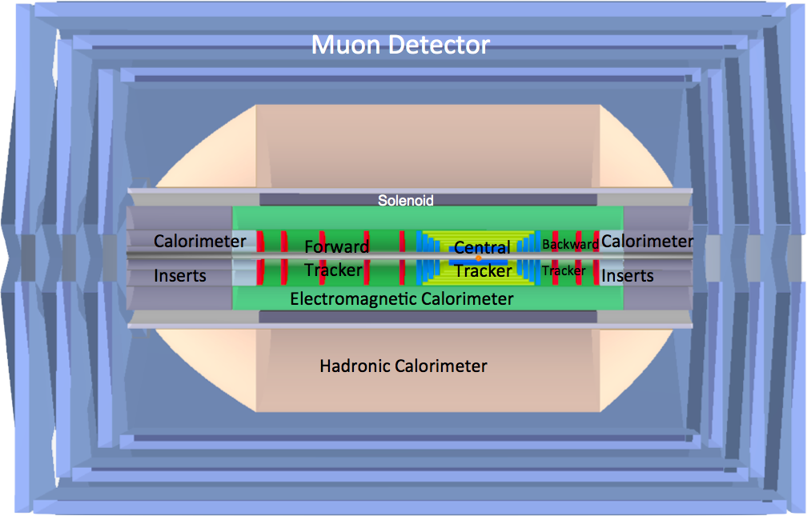
LHeC Detector Overview
LAr electromagnetic calorimeter
Tile Calorimeter
Detector option 1 for LR and full acceptance coverage
Forward/backward asymmetry in energy deposited and thus in geometry and technology
Present dimensions: LxD =14x9m² [CMS 21 x 15m² , ATLAS 45 x 25 m²]
Taggers at -62m (e),100m (γ,LR), -22.4m (γ,RR), +100m (n), +420m (p)

Slide 39
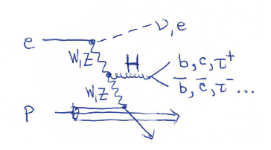
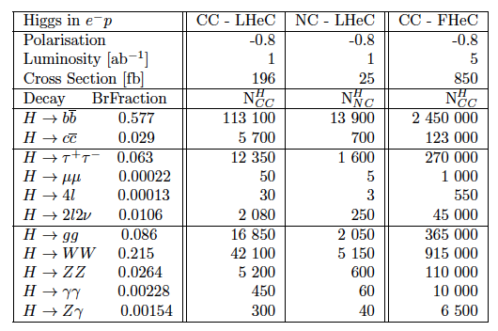
From Higgs facility (LHeC) to Higgs ‘factory’ (FCC-he)
Cross section
1pb ep→ vHX
Luminosity
> 10³⁴ crucial
for H → HH
0.5 fb
and rare decays
First sets of
Parameters for
LR and RR
cf F.Z yesterday

Slide 40
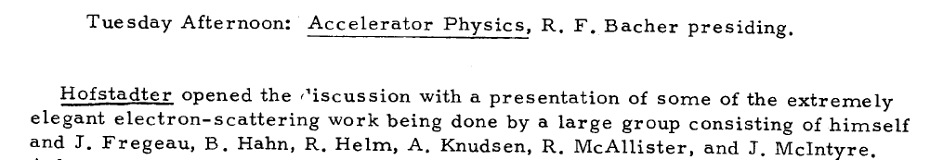
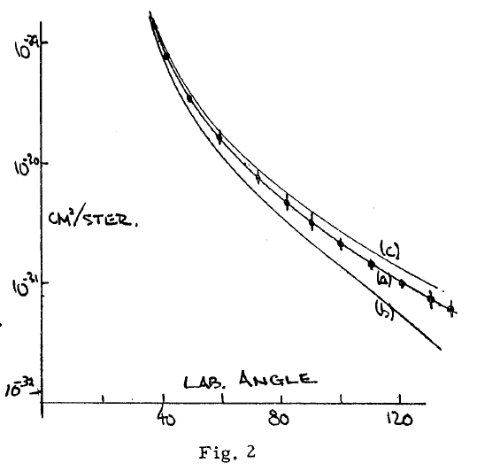
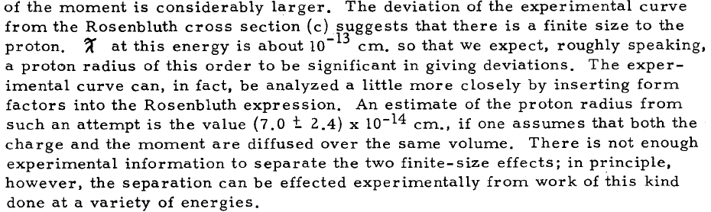
Hofstadter
Rochester Conf 1955

Slide 41
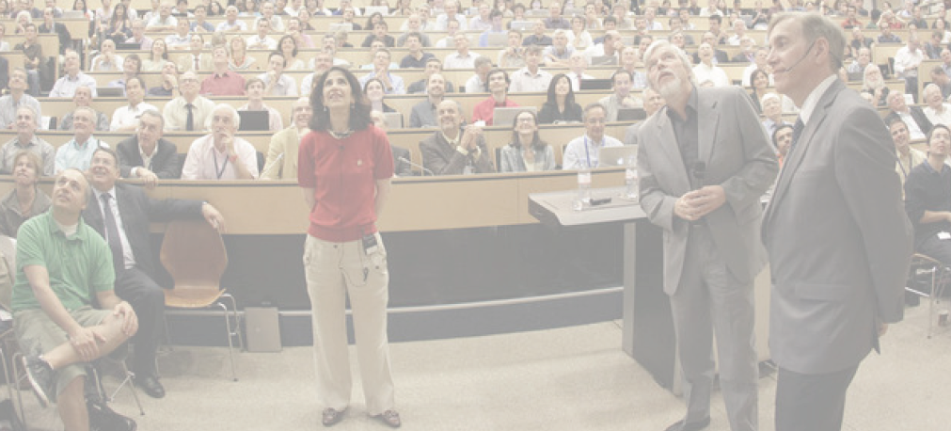
A New Era of Particle Physics
4.7.2012 greeting Melbourne from CERN
“The Higgs: So simple and yet so unnatural” G.Altarelli,arXiv:1308.0545

Slide 42
Further Path Determined with IAC Mandate
The IAC was invited in 12/13 by the DG with the following
Guido Altarelli (Rome)
Sergio Bertolucci (CERN)
Frederick Bordry (CERN)
Stan Brodsky (SLAC)
Hesheng Chen (IHEP Beijing)
Andrew Hutton (Jefferson Lab)
Young-Kee Kim (Chicago)
Victor A Matveev (JINR Dubna)
Shin-Ichi Kurokawa (Tsukuba)
Leandro Nisati (Rome)
Leonid Rivkin (Lausanne)
Herwig Schopper (CERN) – Chair
Jurgen Schukraft (CERN)
Achille Stocchi (LAL Orsay)
*)
Mandate 2014-2017
Advice to the LHeC Coordination Group and the CERN directorate
by following the development of options of an ep/eA
collider at the LHC and at FCC, especially with:
Provision of scientific and technical direction for the physics
potential of the ep/eA collider, both at LHC and at
FCC, as a function of the machine parameters and of a
realistic detector design, as well as for the design and
possible approval of an ERL test facility at CERN.
Assistance in building the international case for the accelerator
and detector developments as well as guidance to the resource,
infrastructure and science policy aspects of the ep/eA collider.
*) IAC Composition End of January 2014 +
Oliver Brüning Max Klein ex officio

Slide 43
Coordination Group for Future DIS at CERN
LCG (2014-2017) *)
Nestor Armesto
Oliver Brüning
Stefano Forte
Andrea Gaddi
Bruce Mellado
Max Klein
Peter Kostka
Daniel Schulte
Frank Zimmermann
Directors (ex-officio)
Sergio Bertolucci, Frederick Bordry
The coordination group was invited end of December 2013 by the
CERN directorate with the following mandate (2014-2017)
The group has the task to coordinate the study of the scientific potential
and possible technical realisation of an ep/eA collider and the associated
detectors at CERN, with the LHC and the FCC, over the next four years. It
also should coordinate the design of an ERL test facility at CERN as part of the
preparations for a larger energy electron accelerator employing ERL techniques.
The group will cooperate with CERN and an International Advisory Committee,
chaired by the emeritus DG of CERN, Professor Herwig Schopper, who also
advises the CERN directorate. The Coordination Group is asked to represent
the ep/eA collider development towards CERN, its committees and the
international community. The currently tentative composition is listed left.
CERN has asked Max Klein to chair and Oliver Brüning to co-chair this activity
*) LCG Composition early January 14

Slide 44

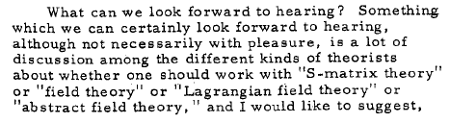

Gell Mann 1966
…
Rochester 1966

Slide 45
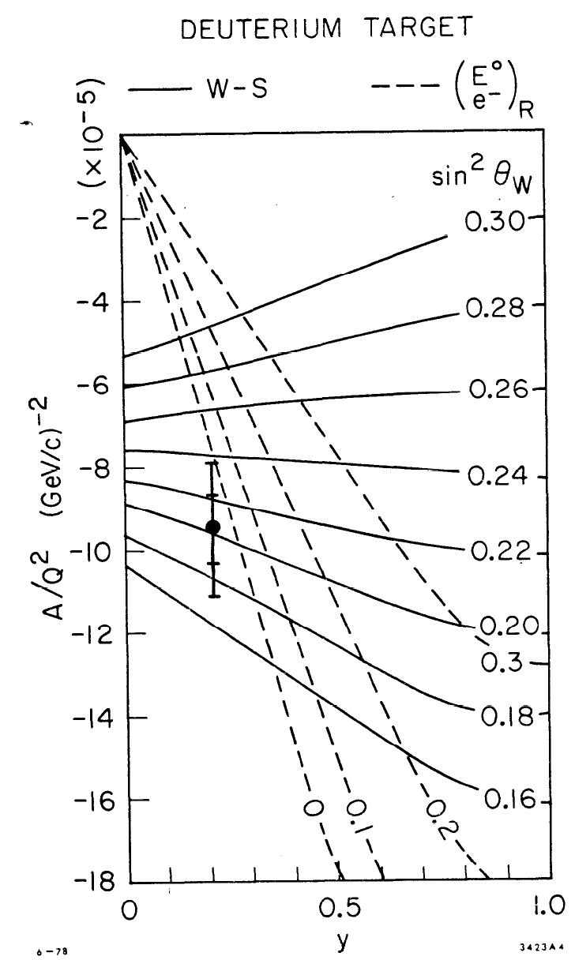
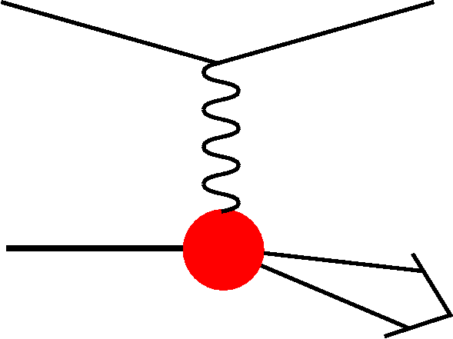
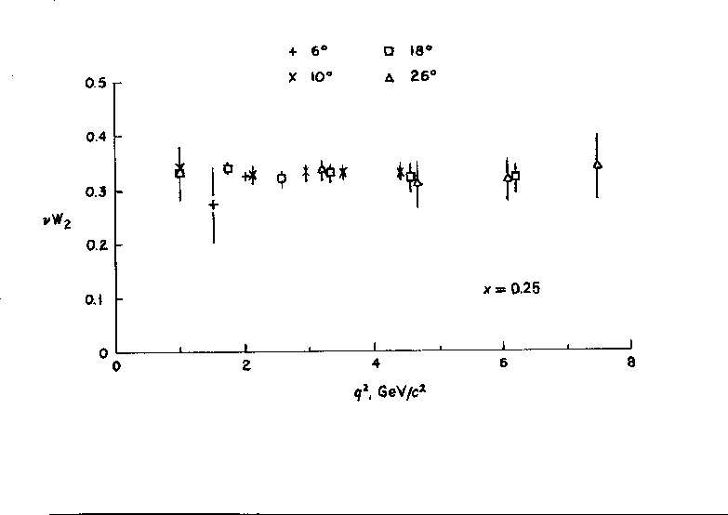


Early ep Scattering
Hofstadter et al, 1955, r_{p}=0.74±0.20fm
In DIS the
x and Q²
scales are
prescribed
by the
electron
kinematics
SLAC-MIT 1968 Bj Scaling → Partons
Prescott et al, 1978, I_{3,R}^{e}=0

Slide 46
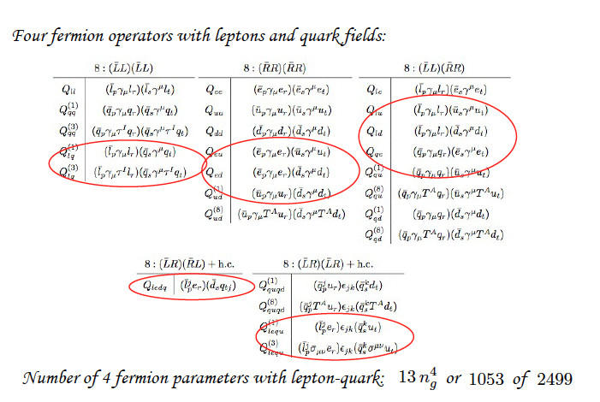
Exploit the Higgs Potential in ep
M.Trott at Chavannes 20.1.2014

Slide 47
What HERA could not do or has not done
Test of the isospin symmetry (u-d) with eD - no deuterons
Investigation of the q-g dynamics in nuclei - no time for eA
Verification of saturation prediction at low x – too low s
Measurement of the strange quark distribution – too low L
Discovery of Higgs in WW fusion in CC – too low cross section
Study of top quark distribution in the proton – too low s
Precise measurement of F_{L} – too short running time left
Resolving d/u question at large Bjorken x – too low L
Determination of gluon distribution at hi/lo x – too small range
High precision measurement of α_{s} – overall not precise enough
Discovering instantons, odderons – don’t know why not
Finding RPV SUSY and/or leptoquarks – may reside higher up
…
The H1 and ZEUS apparatus were basically well suited
The machine had too low luminosity and running time
HEP needs a TeV energy scale machine with 100 times
higher luminosity than HERA to develop DIS physics
further and to complement the physics at the LHC. The
Large Hadron Collider p and A beams offer a unique
opportunity to build a second ep and first eA collider
at the energy frontier.
HERA in one box
the first ep collider
E_{p}*E_{e}=
920*27.6GeV²
√s=2√E_{e}E_{p}=320 GeV
L=1..4 10³¹cm⁻²s⁻¹
→ ΣL=0.5fb⁻¹
1992-2000 & 2003-2007
Q²= [0.1 -- 3 * 10⁴ ] GeV²
-4-momentum transfer²
x=Q²/(sy) ≅10⁻⁴ .. 0.7
Bjorken x
y≅0.005 .. 0.9
inelasticity

Slide 48
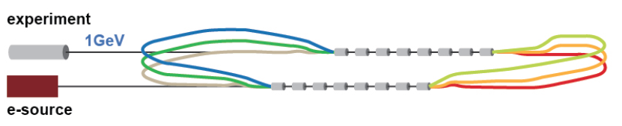
SC RF and ERL Test Facility at CERN
ERL Workshop at Daresbury: January 2013. f=801.54 MHz, I=10mA, Q₀ > 2 10¹⁰
Applications
Development of SuperConducting RF technology at CERN (November 13 – ok)
Operation and experience with S.C energy recovery linac
Injector to LHeC → injector to a future e+/e- machine
Testbed for SC magnets, cables, stacks – in high dose, non-radiative environment
Experiments with electron beam: PV at Q² ~ 1 GeV², proton radius
Experiments with photon beam: much higher intensity than ELI-NP

