Slide 1
LHeC and FCC-eh to Snowmass
Introduction
European Strategy
Energy Recovery
Bits of Physics
White Paper
Summary
Large Hadron electron Collider:
e:10-60 GeV, p: 1-7 TeV (LHC)
s = 4 E_{e} E_{p}
FCC-eh: Few TeV cms eh collider
e:10-60 GeV, p: 20 .. 50 TeV
Max Klein
University of Liverpool, ATLAS, H1
For the LHeC/FCC-eh and PERLE Collaborations
For LHeC: see Conceptual Design Report arXiv:1206.2913 (J.Phys.G) and Update and
plethora of talks and papers, Web site http://lhec.web.cern.ch (needs update)
For FCC-eh see FCC books 1 (physics) and 3 (FCC-hh with eh integrated)
See also the CDR presentation in March 2019: https://indico.cern.ch/event/789349/
with talks on FCC-eh machine (OB), Higgs in eh (UK) and QCD (MK).
Brief Introduction to Conversation with Snowmass Energy Frontier Convenors, 9.6.2020

Slide 2
title
New default
electron
energy for
LHeC: 50 GeV
instead of
60 GeV to
economise
~400 M SF
and effort.
Thoughts
about higher
electron
energy for
FCC-eh,
especially if
E_{p} is lowered.
Max Klein, Chavannes, 24.10.2019
2

Slide 3
title
The CDR in 2012 was very detailed and extensively refereed. It is time for an update, deadline November - this year.
Max Klein, Chavannes, 24.10.2019
3

Slide 4
title
DIS: the cleanest high
resolution microscope
and a laboratory for
new particles and
new dynamics.
Max Klein, Chavannes, 24.10.2019
4

Slide 5
Organisation
Working Groups
International Advisory Committee
Mandate by CERN (2014+17) to define
“..Direction for ep/A both at LHC+FCC”
PDFs, QCD
Fred Olness,
Claire Gwenlan
Higgs
Uta Klein,
Masahiro Kuze
BSM
Georges Azuelos,
Monica D’Onofrio
Oliver Fischer
Top
Olaf Behnke,
Christian Schwanenberger
eA Physics
Nestor Armesto
Small x
Paul Newman,
Anna Stasto
Detector
Alessandro Polini
Peter Kostka
Coordination Group
Accelerator+Detector+Physics
Sergio Bertolucci (CERN/Bologna)
Nichola Bianchi (Frascati)
Frederick Bordry (CERN)
Stan Brodsky (SLAC)
Hesheng Chen (IHEP Beijing)
Eckhard Elsen (CERN)
Stefano Forte (Milano)
Andrew Hutton (Jefferson Lab)
Young-Kee Kim (Chicago)
Victor A Matveev (JINR Dubna)
Shin-Ichi Kurokawa (Tsukuba)
Leandro Nisati (Rome)
Leonid Rivkin (Lausanne)
Herwig Schopper (CERN) – Chair
Juergen Schukraft (CERN)
Achille Stocchi (LAL Orsay)
John Womersley (ESS)
Gianluigi Arduini
Nestor Armesto
Oliver Brüning – Co-Chair
Andrea Gaddi
Erk Jensen
Walid Kaabi
Max Klein – Co-Chair
Peter Kostka
Bruce Mellado
Paul Newman
Daniel Schulte
Frank Zimmermann
5(12) are members of the
FCC coordination team
OB+MK: co-coordinate FCCeh
We miss Guido Altarelli.

Slide 6
Strategy and Expectations
Physics at
Fermiscale
Recognition of the complementarity → Support for
of pp/AA, ep/A and ee, and the special technical (IR..) and
role of DIS to supplement hh, LHC/FCC detector developments
Recognition of energy recovery as a → Support the development
revolutionary, novel technology for of ERL technology and the
next generation colliders of high impact international PERLE Coll.
Physics at
TeV scale
The future is under discussion (cf A Stocchi on Friday) and DIS has
become part of it. The big question is on the next big machine.
Max Klein, Chavannes, 24.10.2019
12

Slide 7
Welcome
The strategy puzzle as seen by the Chair of CERN Council, Ursula Bassler
Max Klein, Chavannes, 24.10.2019
14

Slide 8
High-energy DIS collider for QCD:
Summary on QCD of Jorgen D‘Hondt and Krzysztof Redlich, Granada May 2019
15
Max Klein, Chavannes, 24.10.2019

Slide 9
ERL: Accelerator Energy Frontier
FCC-ee
400 pages update of 2012 CDR - to appear
Vladimir Litvinenko et al, 1909.04437
ECFA: Interest of young scientists 2002.02837
60 GeV ERL design applied to FCC-he
4-6 turns
50 GeV to limit cost [1/4 or 1/5 of U(LHC)]
Three pass ERL, two ~800m long linacs
I_{e}=20mA for 10³⁴ luminosity, f=801.58 MHz
(Erk at Daresbury 16, Frank M at Orsay 18)
Operation concurrent to LHC (+dedicated)
(when) will that happen.? We don’t know
I met Abhay Deshpande in Snowmass 2001,
when he presented the EIC, not for the 1st time
HL-LHC dominates all of PP,
Its programme will extend to 2040
E/linac = M_{Z,..HH}/(2 * N_{turn})
EIC: Polarised eh Collider at BNL
IBS: emittance growth: needs ERL 100mA (!)
CW e beam cooling of p/A beam (for CBETA)
cf e.g. F Willeke APS talk, April 2018
Coherent Electron Cooling
V.N. Litvinenko, Y.S. Derbenev, PRL 102, 114801, 2009

Slide 10
title
PERLE is progressing (source, injector, magnets, HOMs.. – radiation safety - in its recognition). International Collaboration
Max Klein, Chavannes, 24.10.2019
9

Slide 11
LHeC Detector
L=13.6 m [FCCeh:19.3 about CMS size]
R=4.6 m
[6.2 FCCeh]
Study of installation (sequence)
of LHeC detector in IP2 cavern
using L3 magnet support structure
[commensurate with 2 year shutdown]
A. Ghaddi et al, LHeC Workshop 2015
12/2018
Currently: increase radius of tracker, choose technology, summarise/simulate response: update this fall

Slide 12
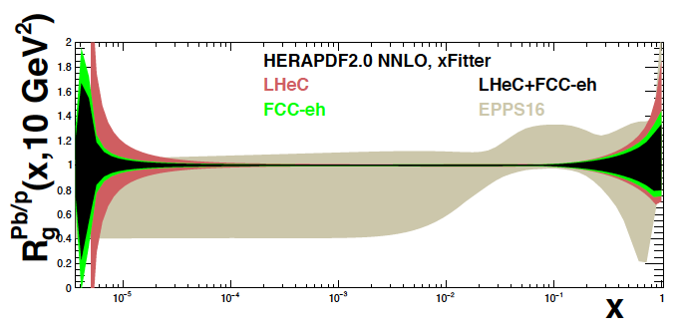
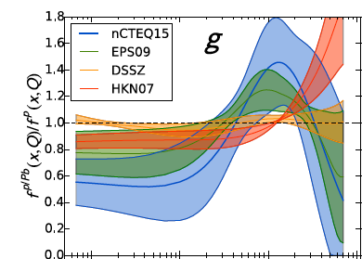

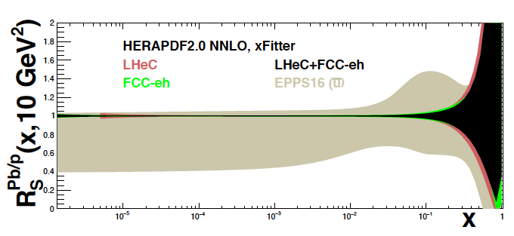
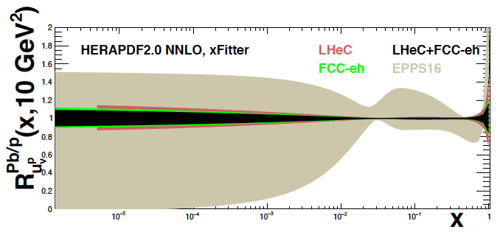
Nuclear PDFs at LHeC/FCCeh
Unique nuclear/HI physics programme
Extension of fixed target range by 10 ³⁻⁴
QCD of QGP, de-confinement, saturation..
nPDFs independent of p PDFs
1509.00792
High
luminosity
~ 10 ³³
enables
high statistics
in short
eA runs
cf J Jowett et al
present
status →
on xg
Pb/p
gluon
N Armesto, FCC Physics Week 1/2018
sea
valence
LHeC: Full error, Δχ² =1. EPPS Δχ² =52

Slide 13
Higgs in ep and pp [LHeC and HL-LHC]
Determination of SM Higgs couplings from pp + ep
Results for FCC-eh at
20 TeV E_{p} x 60 GeV E_{e}
Uncertainties on kappa
Decay FCCep HL-LHC
bb 0.9 2.7
WW 0.3 1.2
gg 1.7 2.2
tau 1.5 1.6
cc 1.9 --
ZZ 0.5 1.0
yy 3.3 1.7
in percent. SM width.
1%
The combined ep+pp at LHC reaches below 1% for dominant channels
ep adds charm. Analysis in EFT framework work in progress (aTGCs in ep..)

Slide 14
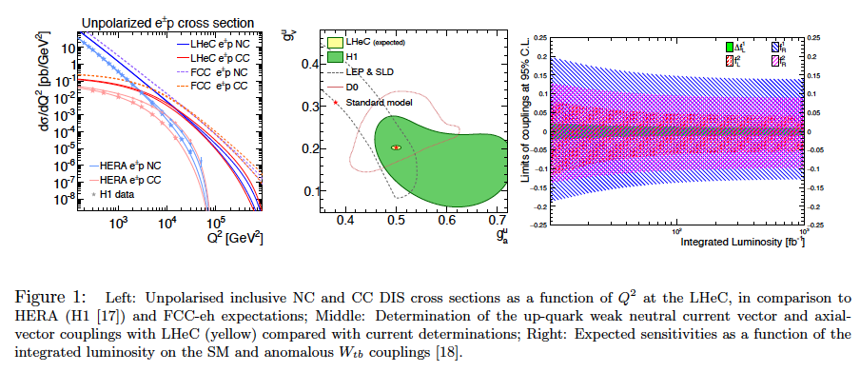
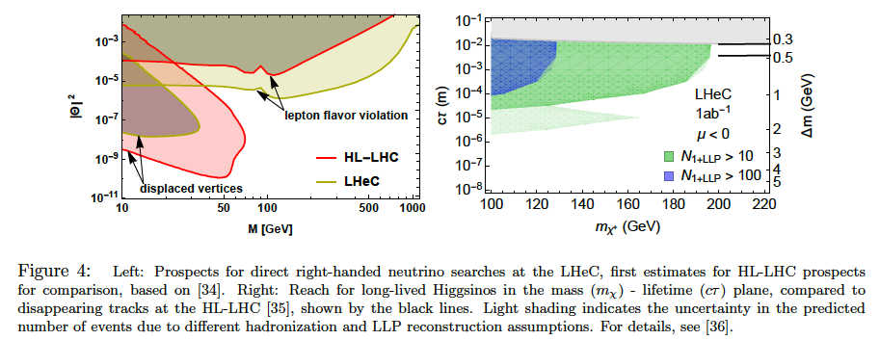
Precision
Electroweak
Physics
Anomalous
Wtb couplings
Electroweak+Top Physics
From LHeC strategy paper CERN-ACC-NOTE-2018-0084
cf EPS talks by
D Britzger and
C Schwanenberger
Higgsinos
Heavy Neutrinos
BSM + Searches
MK at EPS 2019

Slide 17
Statement of the IAC (reproduced in CDR Update)

Slide 18
Beyond the LHC/LHeC: FCC
Higher energy than 60 GeV ?
Particle Physics has a long term future,
many of its quests are unresolved,
Nr of families, GUT, substructure, DM..
Max Klein, Chavannes, 24.10.2019
18

Slide 19
Beyond Europe: eh in China ? and the EIC
The Chinese 100km tunnel housing p and e
EICs in US and China: spin, eh complementary
US: expect support in CDi and site selection
→ CERN is the unique place for high energy eh
Max Klein, Chavannes, 24.10.2019
20

Slide 20
Remarks
LHeC and FCCeh are the only and unique possibilities to keep DIS as part of HEP in this century. A high responsibility of CERN.
The luminosity is 100-1000 times that of HERA and the kinematic range extends to x=10⁻⁶ (LHeC) → 10⁻⁷ (FCC-eh)
With their BSM, PDF, small x, top, Higgs, HI .. programme they are different to EIC (like H1/ZEUS and HERMES/COMPASS)
which is hosted by the NP community
Organisation: contacts Nestor Armesto and Oliver Fischer
Talk on LHeC Machine: Oliver Bruening on 24.6. (today invited by V Shiltsev)
Many of us are interested to join
For these DIS projects to happen it will be crucial they are scrutinised and and eventually supported by the US HEP community
European Strategy paper expected to be released in June.

Slide 21
backup

Slide 22
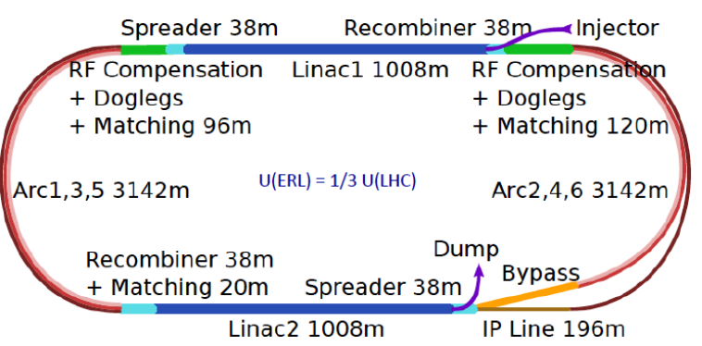
Three Raisons d’etre of the LHeC
With many thanks to
all collaborators
from exp, acc + thy
CERN Directors
Advisory Committee
and its Chair,
H Schopper, em DG
Our home institutions
and colleagues for
supporting this
engagement for the
future
The LHeC/FCC
coordinating groups
and convenors
..
Physics
- Microscope: World’s Cleanest High Resolution
- Empowerment of the LHC Physics Programme
- Creation of a high precision, novel Higgs facility
- Discovery Beyond the Standard Model
- Revolution of Nuclear Particle Physics
Sustainability and Cost
LHC:
- see: SM, Higgs and no BSM
- use: Investment of O(5) BSF
- run: HL LHC until ~2040
LHeC [1206.2913]
- 1.2 TeV ep/A for O(1)BSF
→ Establish novel ep+pp
Twin Collider Facility at CERN:
sustains HL LHC and bridges to
CERN’s long term future
For installation during LS4 (2030+)
and long term use (HE LHC, FCCeh)
Technology
Accelerator: Novel SRF ERL, green power facility
Detector: Novel high tech (CMOS..) apparatus
Keep accelerator and detector base uptodate
while preparing for colliders that cost O(10)BSF
MK at EPS 2019

Slide 23
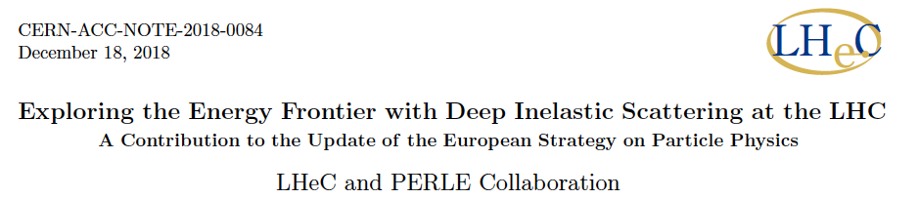
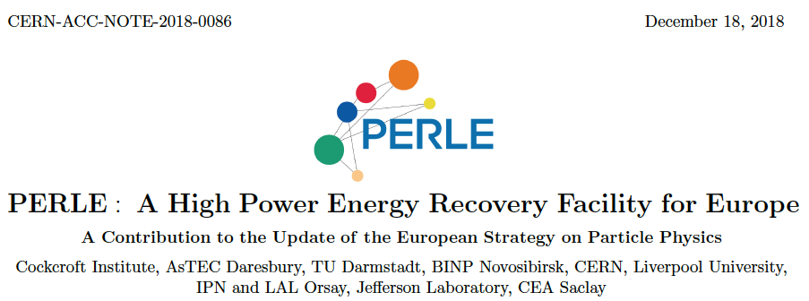
title
LHeC also described in the ES paper by A.Caldwell, A.Levy, R.Ent, P.Newman and F.Olness
Summary
Papers
submitted
to the
European
Strategy
12/2018

Slide 24
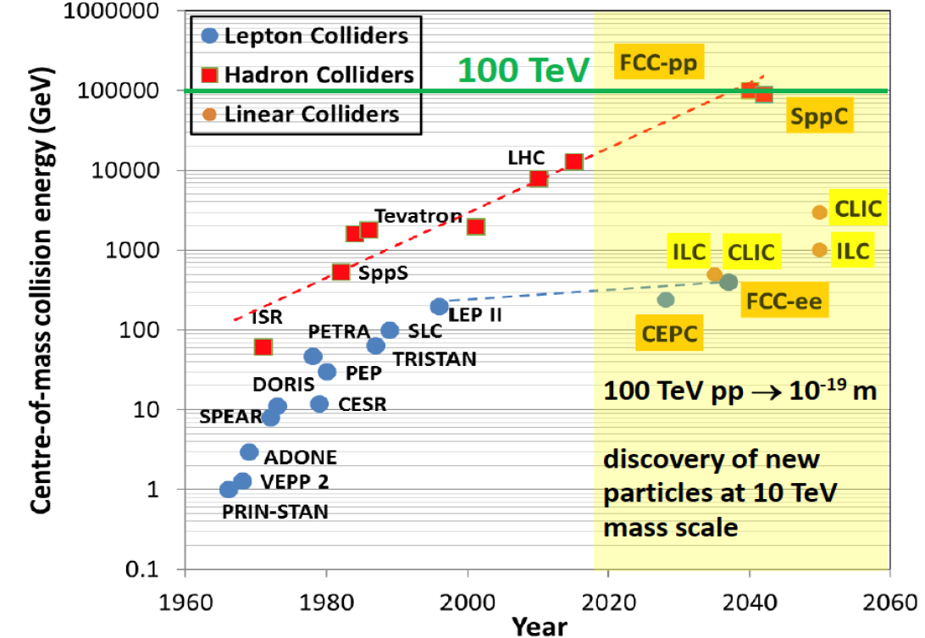

title
Hundred
Years of
HEP
Colliders
FCC-pp
40 TeV
FCC-eh
LHeC
HERA
EIC
ep/A
Parameters:
MK EPS 7/19. adapted from M Benedikt (3/19)

Slide 25
FCC-eh in the CDR [V1 Physics and V3 hh]
Volume 1 had been the collaborative effort to present the entity of FCC physics, in ee, pp and ep, including AA and eA
Volume 3 on FCC hh contains a short summary of the main characteristics of FCC-eh and the detector concept
Some striking physics eh prospects are on searches and the high precision measurements on Higgs and proton structure:
3
Complementary prospects to
discover rh massive neutrinos
in ee, ep and pp
[mixing angle vs mass]
Unique resolution of partonic contents of
and dynamics inside the proton, providing
precise and independent parton luminosities
for interpretation and searches on FCC-hh
Prospects for high precision measurements of
Higgs couplings at FCC ee and ep. Note ee gets
the width with Z recoil. ee is mainly ZHZ, while
ep is mainly WWH: complementary also to pp

Slide 26
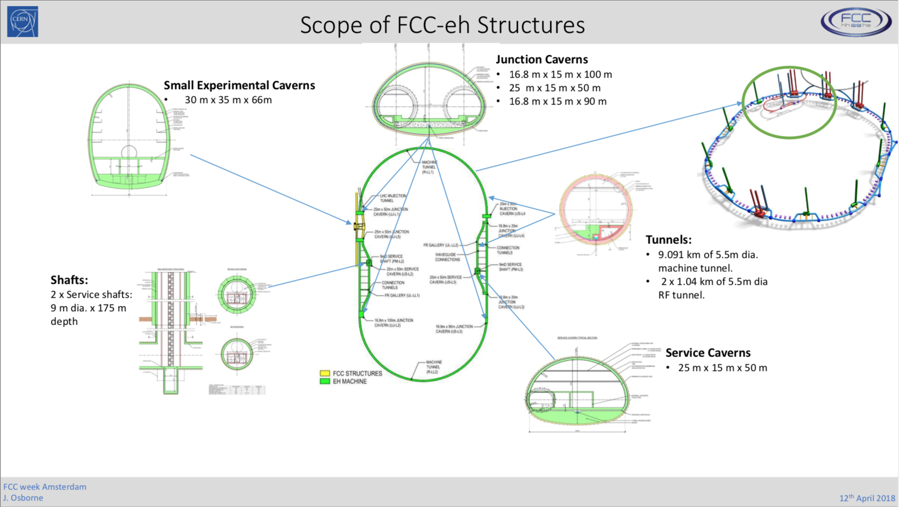

Slide 27
title

