Slide 1

Deep Inelastic ep/eA Scattering at the Energy Frontier
Introduction
Physics
Preparations
Outlook
lhec.web.cern.ch
A 60 GeV e beam
added to the LHC
scattered off 7 TeV
60 GeV from ERL or
120 GeV from e ring
scattered off 50 TeV
Max Klein (University of Liverpool and CERN)
Epiphany Conference Cracow, 10th of January 2015 - for the LHeC/FCC_he Study Group

Slide 2
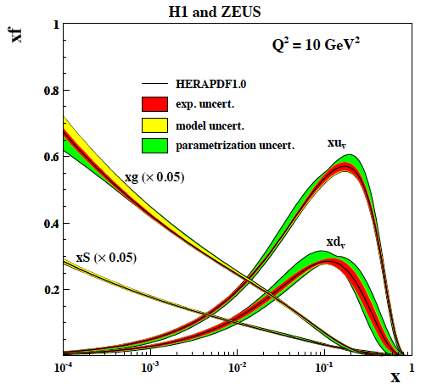
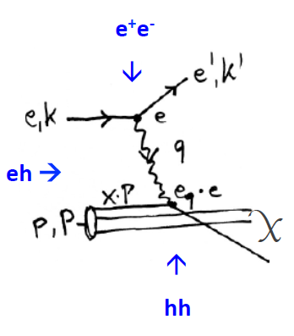
HERA (1984 →1992-2007→2017)
HERA was the first ep collider. L = 1-4 10³¹ cm⁻² s⁻¹ with E_{e}=27 GeV and E_{p}=920 GeV
It discovered the non-saturating rise of sea and gluon densities towards low x, DGLAP,
and no Leptoquarks. It observed 10% of diffractive events and NC/CC approaching 1.
It has been essential for interpreting Tevatron (hi Et excess) and LHC (Higgs) results…

Slide 3
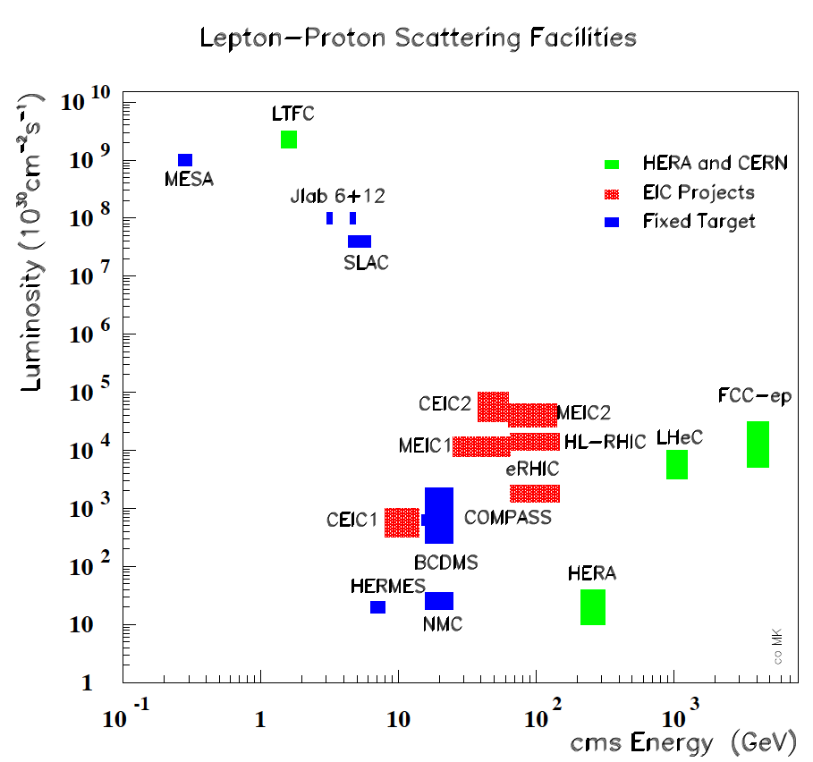
New ep and eA Colliders are being developed
From CERN Courier
MK, H.Schopper
June 2014
With input from
A.Hutton, R.Ent,
F.Maas, T.Rosner

Slide 4
ep colliders 11.2014 Max Klein | CEPC | MEIC | eRHIC | HERA 92-07 | CepC | LHeC | SepC | FCC-he
√s/GeV | 13 | 35 | 122 | 319 | 1000 | 1300 | 3375 | 3464
L/10³³ cm⁻²s⁻¹ | 0.4 | 5.6 | 1.5 | 0.04 | 4.8 | 16 | 8.9 | 10
E_{e} /GeV | 3 | 5 | 15.9 | 27.6 | 120 | 60 | 80 | 60
E_{p} /GeV | 15 | 60 | 250 | 920 | 2100 | 7000 | 35600 | 50000
f /MHz | 500 | 750 | 9.4 | 10.4 | 20 | 40 | 40 | 40
N_{e/p}10¹⁰ | 3.7/0.54 | 2.5/0.42 | 3.3/3 | 3/7 | 1.3/16.7 | 0.4/22 | 3.3/5 | 0.5/10
ε_{e/p} /μm | .03/.15 | 54/.35 | 32/.27 | 4.6/.09y | 250/1 | 20/2.5 | 7.4/2.4 | 10/2
β*_{e/p}/cm | 10/2 | 10/2 | 5/5 | 28/18 y | 4.2/10 | 10/5 | 9.3/75 | 9/40
comment | Lanzhou | full acc. | “Day1” | HERA II | Booster | ERL (H) | E_{e} =M_{W} | ERL (HH)
source | X.Chen July 14 | McKoewn POETIC14 | Litvinenko S.Brook 14 | B.Holzer at CERN 2008 | Y.Peng Oct. 2014 | Frank Z. LHeC 2014 | Y.Peng Oct. 2014 | Frank Z. IPAC 2014

Slide 5
Main physics goals of new DIS Colliders^{*)}
Substructure of nucleons
Development of QCD, Discoveries
Structure of y, Pomeron, n, D, A..
Precision eweak measurements ..
Low energy (smaller HERA)
Nuclear structure
Electroweak below Z
p Spin composition
Spin structure
“Proton Holography 3d” …
High Energy (bigger HERA)
Unfolding of all partons (NC+CC)
New physics (Higgs, DM, RPV SUSY, LQs..)
Electroweak below and beyond Z
Non linear QCD in ep and eA (QGP)
Top physics …
FCC-he: 10 times higher H-HH cross section
10 times lower x
4 times larger mass range for NP ..
as compared to LHeC
but the FCC is later + more expensive.
Why are quarks and leptons different?
Salam 1976
^{*)} incomplete

Slide 6
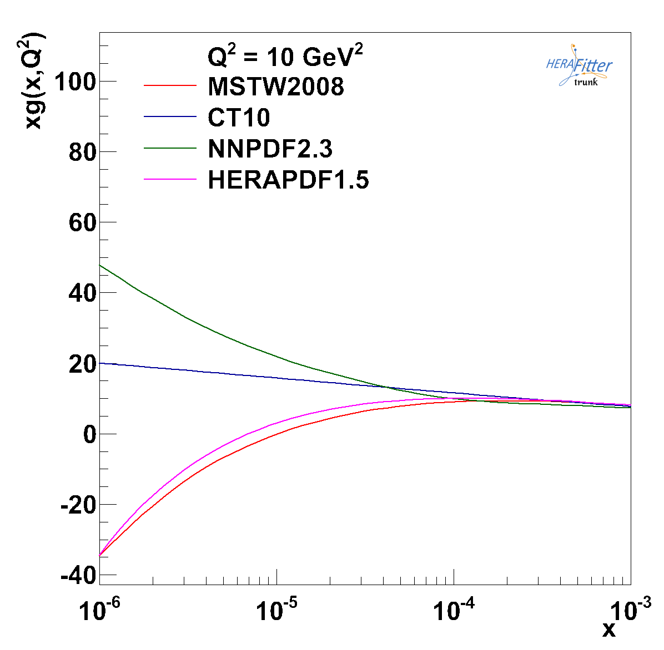
High Energy ep Physics
High mass and Q² region
Low x Physics
← unknown →
FCC
LHeC
HERA
Huge extension of reach for new physics Very low x – close to UHEν region, BFKL?
Leptoquark reach to √s ≈ 4 TeV Need energies and L beyond HERA for
being of interest for HEP and the search
for and interpretation of new physics.

Slide 7
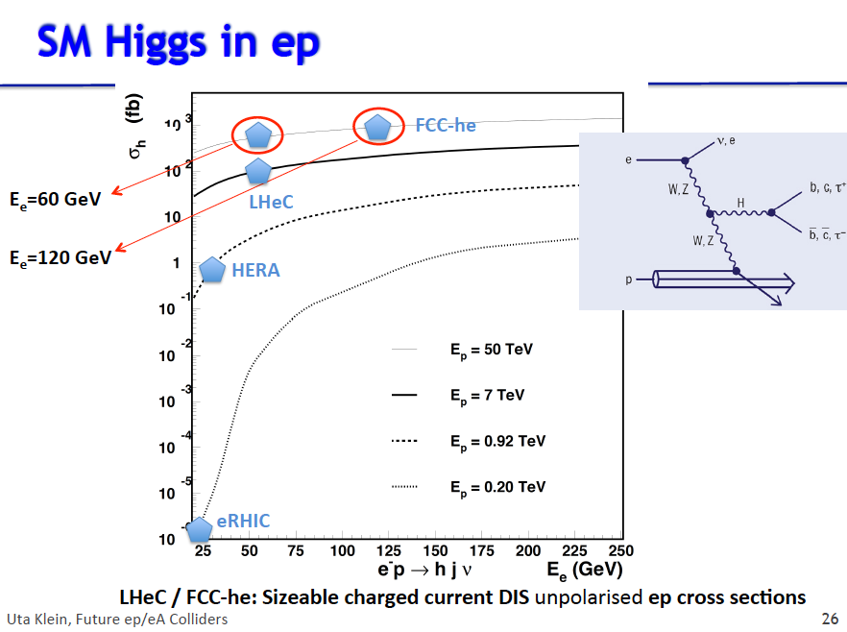
Higgs physics in ep possible at high energy and Luminosity

Slide 8
International Advisory Committee + Mandate
The IAC was invited in 12/13 by the DG with the following
Guido Altarelli (Rome)
Sergio Bertolucci (CERN)
Nichola Bianchi (Frascati)
Frederick Bordry (CERN)
Stan Brodsky (SLAC)
Hesheng Chen (IHEP Beijing)
Andrew Hutton (Jefferson Lab)
Young-Kee Kim (Chicago)
Victor A Matveev (JINR Dubna)
Shin-Ichi Kurokawa (Tsukuba)
Leandro Nisati (Rome)
Leonid Rivkin (Lausanne)
Herwig Schopper (CERN) – Chair
Jurgen Schukraft (CERN)
Achille Stocchi (LAL Orsay)
John Womersley (STFC)
Mandate 2014-2017
Advice to the LHeC Coordination Group and the CERN directorate
by following the development of options of an ep/eA
collider at the LHC and at FCC, especially with:
Provision of scientific and technical direction for the physics
potential of the ep/eA collider, both at LHC and at
FCC, as a function of the machine parameters and of a
realistic detector design, as well as for the design and
possible approval of an ERL test facility at CERN.
Assistance in building the international case for the accelerator
and detector developments as well as guidance to the resource,
infrastructure and science policy aspects of the ep/eA collider.
IAC Composition June 2014, plus
Oliver Brüning Max Klein ex officio
Max Klein ICFA Beijing 10/2014

Slide 9
2.Physics Examples
PDFs and Folklore
(we know them , we get them from pp, we do not need them..)
ep-pp
Heavy Ion QCD
Higgs Physics with ep
( no time for top, sin2theta(Q), v,a, jets, photoproduction..)
A new ep collider facility is a rich new physics lab. It is yet
not competitive with the huge ee and pp collider projects
since by construction it it is an add-on to LHC/FCC.

Slide 10
Parton (Quark and Gluon) Distributions
PDF comment LHeC/FCC-he
u valence
d valence after 40 years still do no know d/u at high x CC free of nuclear effects
up sea
down sea not distinguished at HERA NC and CC
strange unknown basically (neutrinos, W,Z) Ws → c : CC at high Q²
charm HERA to ~5%, threshold, intrinsic (sea=anti??) NC
beauty HERA ~20%. bb→ A ? HQ treatment in QCD NC
top takes % of p momentum CC at LHeC [first time]
gluon low x saturation?, medium x Higgs, high x BSM df2/dlnQ²
*
*
*
LHeC: extended kinematic range: low x, high x, high Q² → the ONLY way to unfold all PDFs
ep/eA further determine neutron, photon, pomeron, nuclear densities – HUGE potential

Slide 11
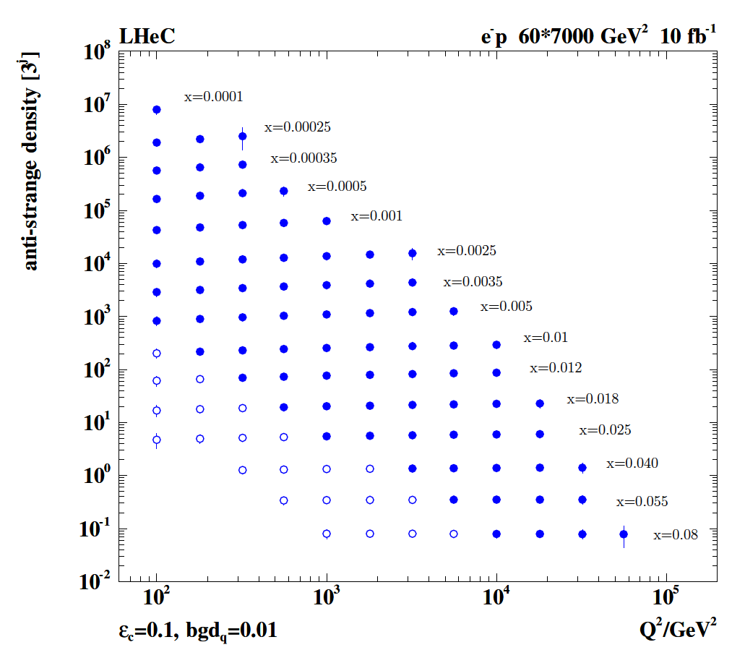

Strange Quark Distribution from LHeC
High luminosity
High Q²
Small beam spot
Modern Silicon
NO pile-up..
First (x,Q²)
measurement of
the (anti-)strange
density, HQ valence?
x = 10⁻⁴ .. 0.05
Q² = 100 – 10⁵ GeV²
Initial study (CDR): Charm tagging efficiency of 10% and 1% light quark background in impact parameter

Slide 12
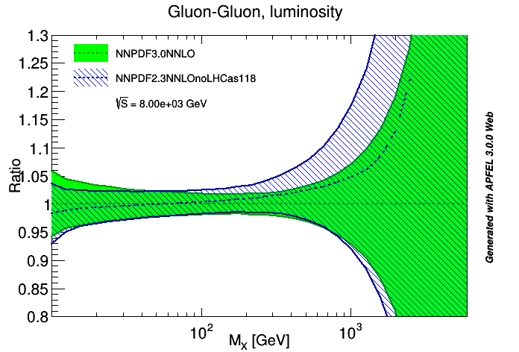
Sensitivity of PDFs to LHC - Gluon
No LHC
With LHC
NNPDF3.0
(Oct. 2014)
S.Forte et al
Large uncertainties
at high mass
yy induced proc.s
k factors
eweak corrections
…
U.Klein LesHouches
arXiv:1405.1063
LHC: W+c, P_{T}(W), top, double differential W,Z data + previous input to NNPDF
New physics appearing as contact interaction would be confused with PDFs
Long range onset effects of new resonances: new physics or PDFs ??
High luminosity, high mass searches requires independent, precise PDFs ep--pp

Slide 13
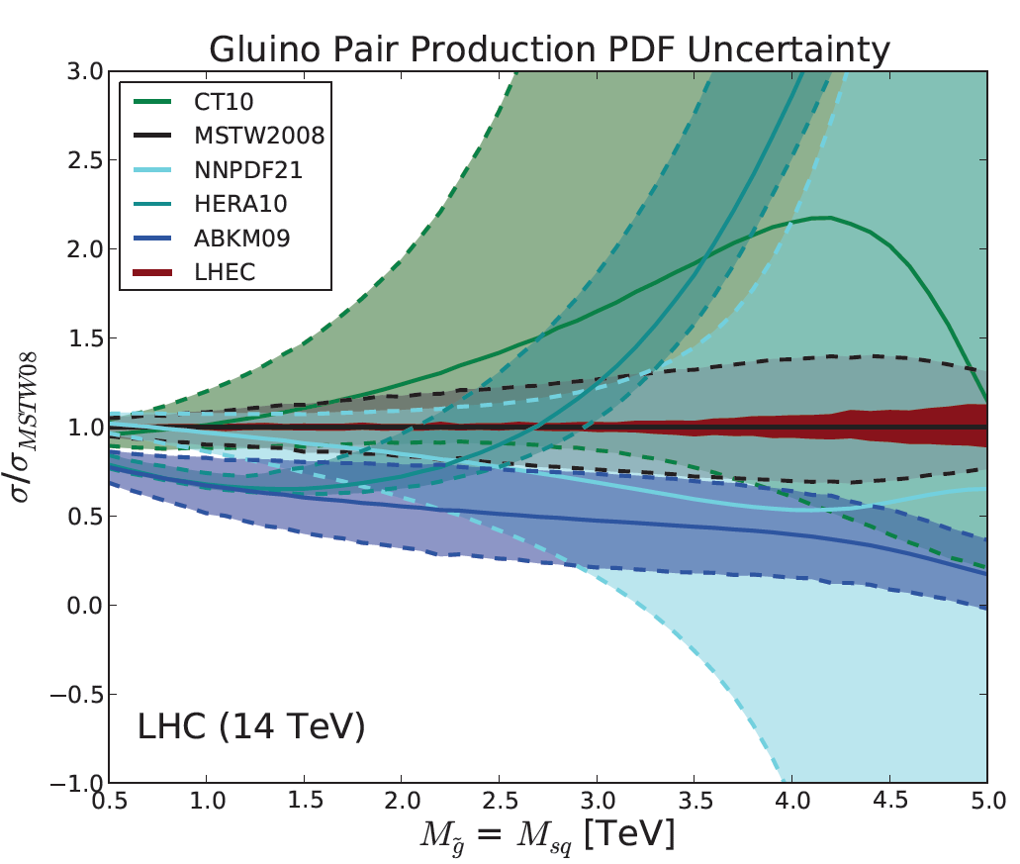

Gluon-Gluon Luminosity with LHeC
LHeC Note 2012-005
arXiv:1211.5102
LHeC PDFset on LHAPDF
V.Radescu, MK
Full detector simulation (CDR of LHeC) reveals high precision on gluon from LHeC alone.
With the LHC moving to high luminosity we conquer the few TeV mass region and need
to know the partons at high x in order to take advantage of the luminosity upgrade.

Slide 14
Precision PDFs for Higgs at the LHC
LHeC:
Exp uncertainty
of predicted H
cross section is
0.25% (sys+sta),
using LHeC only.
Leads to H mass
sensitivity.
Strong coupling
underlying
parameter
(0.005 → 10%).
LHeC: 0.0002 !
Needs N³LO
HQ treatment
important …
O.Brüning and M.K. arXiv:1305.2090, MPLA 2013

Slide 15
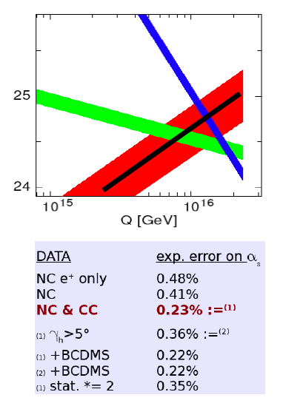
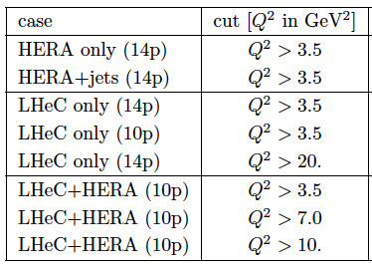
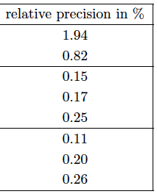
Strong Coupling Constant – GUT?
α_{s} least known of coupling constants
Grand Unification predictions suffer from δα_{s}
Is DIS lower than world average (?)
LHeC: per mille - indep. of BCDMS.
Challenge to experiment and to h.o. QCD →
A genuine DIS research programme rather than
one outstanding measurement only.
More or as accurate as lattice QCD
(cf Les Houches 2013)
1/α
fine structure
weak
strong
LHeC
Two independent QCD analyses using LHeC+HERA/BCDMS

Slide 16
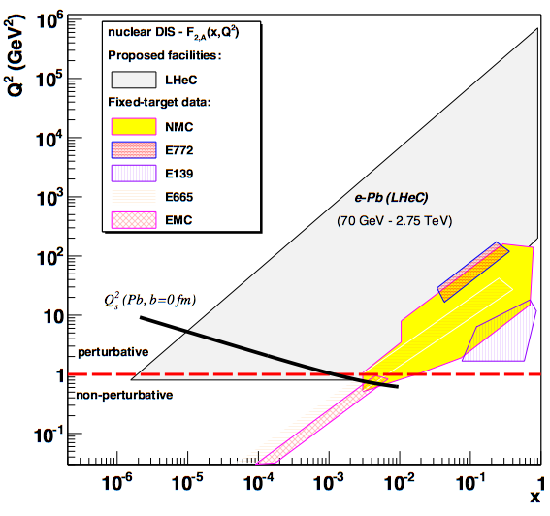
LHeC-FCC-he as Electron Ion Collider(s)
FCC-he
LHeC is part of NuPECCs
long range plan since 2010
L_{eN} ~ 10³² cm⁻² s⁻¹
LHeC
Extension of kinematic range in lA
by 4-5 orders of magnitude will
change QCD view on nuclear
structure and parton dynamics
May lead to genuine surprises…
No saturation of xg (x,Q²) ?
Small fraction of diffraction ?
Broken isospin invariance ?
Flavour dependent shadowing ?
EIC
Expect saturation of rise at
Q²_{s} ≈ xg α_{s} ≈ c x^{-λ}A^{1/3}
Precision QCD study of parton dynamics in nuclei
Investigation of high density matter and QGP
Gluon saturation at low x, in DIS region.

Slide 17
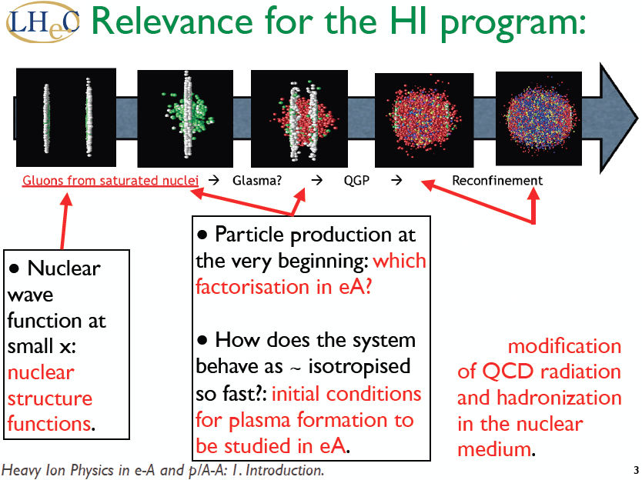
Energy Frontier DIS
Nestor Armesto Chavannes 1/14

Slide 18
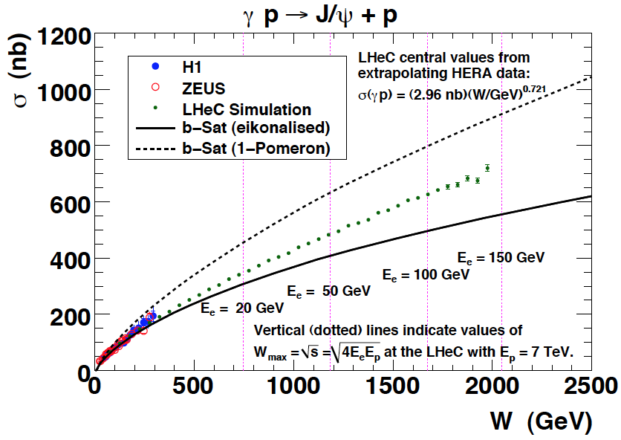
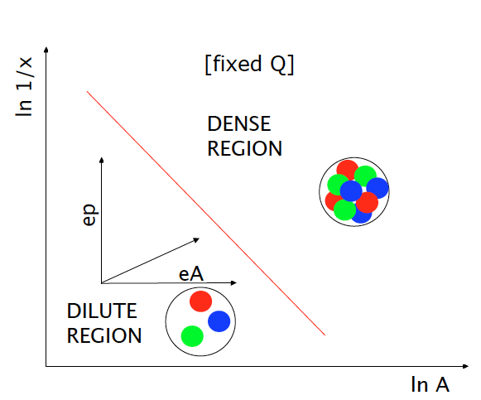
Vector Mesons
Precision Measurements of vector mesons and diffraction to very high M_{X} ~ xg²
FCC-he
LHeC
HERA
5 TeV
W = √ (ys) extends to ~ 4 TeV at FCC-he
Black body limit, interference pattern of σ
Higher energy (1/x), higher A

Slide 19
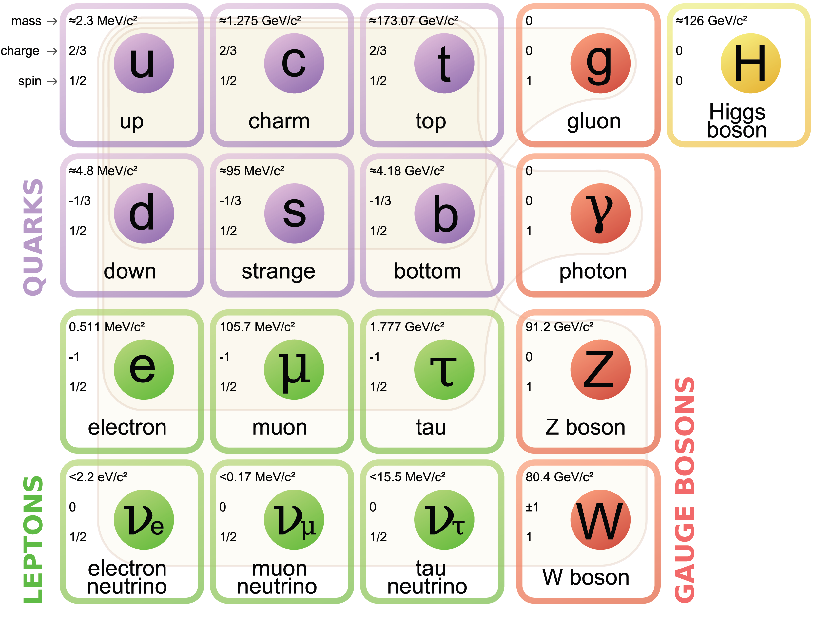
Remarks on the Higgs
High precision measurements for access to new physics (new heavy particles in loops)
Dark matter: Higgs decay to invisible, DM in loop, Higgs + MET
Extended Higgs sector (scheme above not supersymmetric ..)
LHC: will address all these questions, it is the prime facility we have! LHeC vital addition:
gg → H needs more precise xg, cross section: PDFs, alphas; H-HH hard to impossible
Need independent, complementary and more precise Higgs facilities, ep is one of them

Slide 20
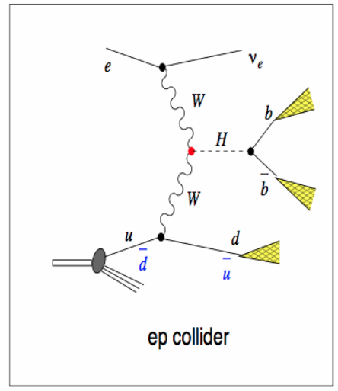
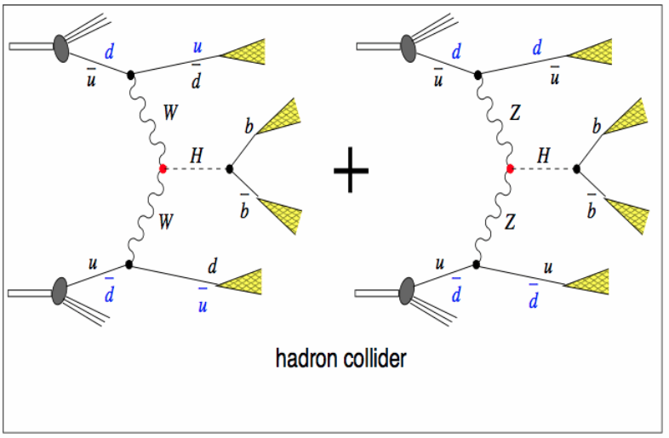
VBF Higgs Production at the LH(e)C
e
Higgs production in ep comes
uniquely from either CC or NC
Cross section at LHeC ~200fb
(about as at the e⁺e⁻ colliders).
Pile-up in ep at 10³⁴ is 0.1, 25ns
Clean(er) bb final state, S/B ~ 1
e-h Cross Calibration → Precision
Z
OR
Z
Higgs production in pp comes
predominantly from gg→ H
VBFC cross section about 200fb
(about as at the LHeC).
Pile-up in pp at 5 10³⁴ is 150, 25ns
S/B very small for bb

Slide 21
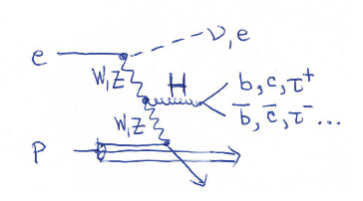
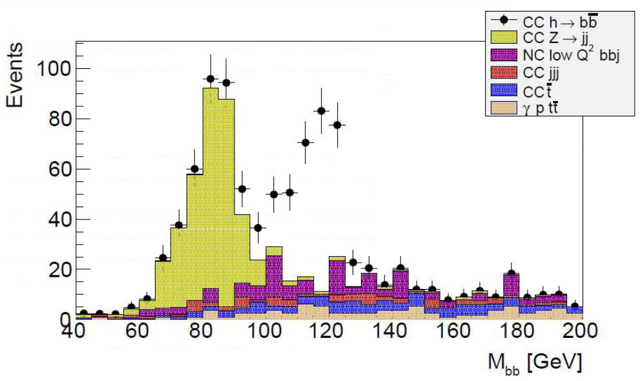
Higgs in ep → νHX
Simulation of H→ bb Measurement at the LHeC, 100fb⁻¹
ep→ νH(bb)X
charged currents
σBR~120 fb
μ=0.1
S/B ~1-2
Cut based only
[LHC: VH - BDT’s
σ(VH) ~ 130fb 8 TeV
arXiv:1409.6212]
LHeC Higgs Group U.Klein et al.
This reconstructs 60% of H in ep with very comfortable S/B ~1 , in CC and NC
Enables BSM Higgs (tensor structure of HVV, CP, dark H?) and H-HH at FCC-he
O(1)% precision on H-bb couplings with small thy uncertainty [high lumi crucial!]
Further decay channels will reflect branching ratio in their expected precision

Slide 22
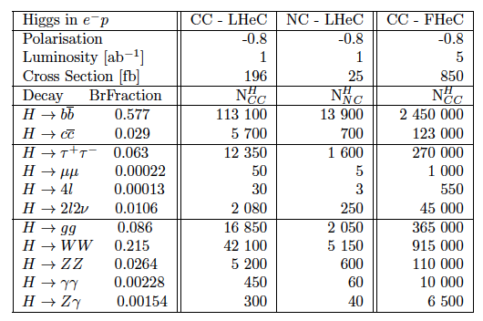
Higgs Physics in DIS at the LHeC and FCC-he
Cross section
at FCC-he
1pb ep→ vHX
Luminosity
O(10³⁴) is
crucial for
H → HH [0.5 fb]
and rare H decays
Event rates for 1ab⁻¹. Note the LHeC WW-H cross section is as large as the Z*→ ZH
cross section at the ILC or FCC- or CEPC, but it is much larger at the FCC-he

Slide 23
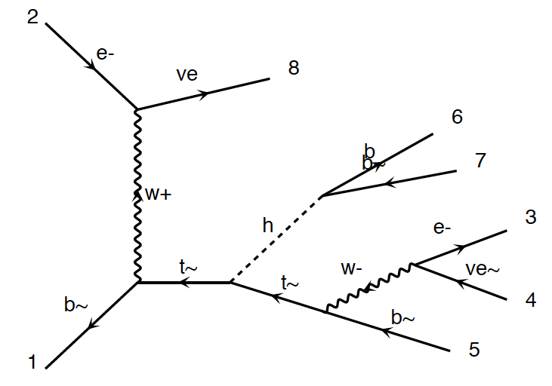
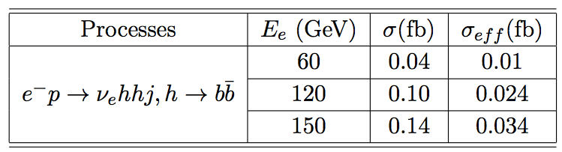
HH and tHt in ep
New
Tentative
Studies
FCC-he unpolarised
Cross section at 3.5 TeV:
total : 0.7 fb
fiducial : 0.2 fb
using pt(b,j)>20 GeV
ΔR(j.b)>0.4
η(j) <5
η(b) < 3
Polarisation, max lumi, tuning cuts, bb and WW
decays may provide O(10%) precision - tentative
Require time for reliable result
(detector, analysis, backgrounds..)
Uta Klein, Masahiro Khuze, Bruce Mellado et al

Slide 24
3.Preparations
ERL
SCRF 802 MHz and Test facility
Synchronous high luminosity ep
Cost and Size
Interaction region (LHeC and FCC-he)
Detector LHeC
Extension to FCC-he
(no time for any detail
See also CDR of LHeC published in 2012)
Goals: Testfacility design by end of 2015, Update of Physics and Detector vs LHC, FCC-he (hh,ee)

Slide 25
Large Hadron Electron Collider for synchronous ep and pp OP @ LHC
LR option
from CDR
1206.2913
60 GeV electron beam energy, L= 10³³ cm⁻²s⁻¹, √s=1.3 TeV: Q²_{max}= 10⁶ GeV², 10⁻⁶ < x< 1
Recirculating linac (2 * 1km, 2*60 cavity cryo modules, 3 passes, ERL, < 100MW, 1/3 LHC)

Slide 26
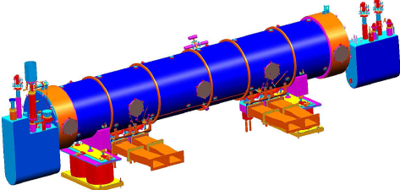
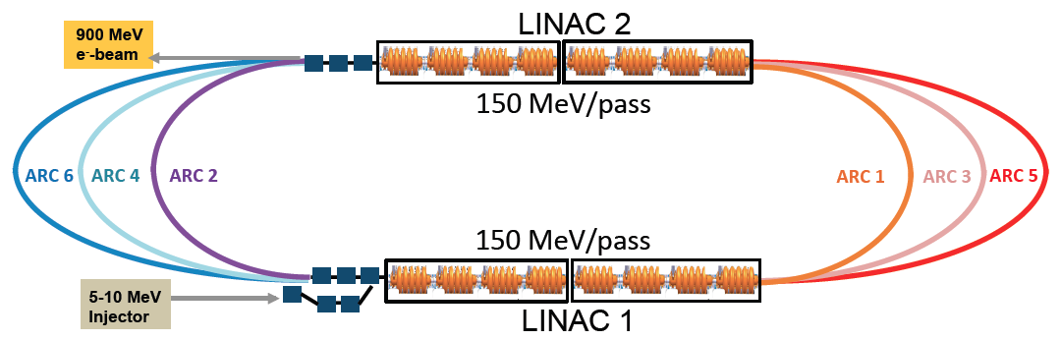
SCRF and LTFC
Superconducting RF and ERL Test Facility Design at CERN
Frequency 802 MHz
Design and built of 2 Modules (CERN+Jlab+)
Conceptual Design of the LTFC – end of 2015:
SCRF under beam conditions, applications,
high quality, high current, multipass, ERL
Interest for participation expressed by
BINP, BNL, CORNELL, IHEPBj, JLAB ..
R.Calaga, A.Hutton, B. Rimmer, E.Jensen et al.
Arc optics, Multipass linac optics, Lattice, Magnet specification, … first passes done
Max Klein ICFA Beijing 10/2014
A. Bogazc, A.Valloni, A.Milanese et al.

Slide 27
Areas of Study Post-CDR ^{*)}
More realistic with dedicated or new tools and evaluation of high luminosity prospect
Choice of RF Frequency – 802 MHz
Optimisation of IR Design [L*(e) < L*(p), inner triplet half? quad…]
Integration of p optics into HL-LHC
Integration of e optics into HL-LHC
Beam-beam effects (phase space deformation)
Multi-bunch beam break up
Wakefield effects on multi-bunch instability at IP
Emittance growth
Coherent synchrotron radiation
Fast beam-ion instability (1/3 gap compensated by 1.3 from pinch effect)
Arc optics FODO vs FMC (flexible momentum compaction)
Lattice design
Spreader and combiner
Civil engineering
…
So far no showstopper found for O(10³⁴)cm⁻² s⁻¹: it requires
further serious study and the development of SCRF within a Testfacility
*) Recent presentations by A.Bogacz, O.Bruening, E.Cruz, E.Jensen, D.Schulte, A.Valloni – see Webpage
Work by E.Cruz, M.Korostelev, E.Nissen, J.Osborne, D.Pellegrini, A.Letina, A.Milanese, A.Valloni and others

Slide 28
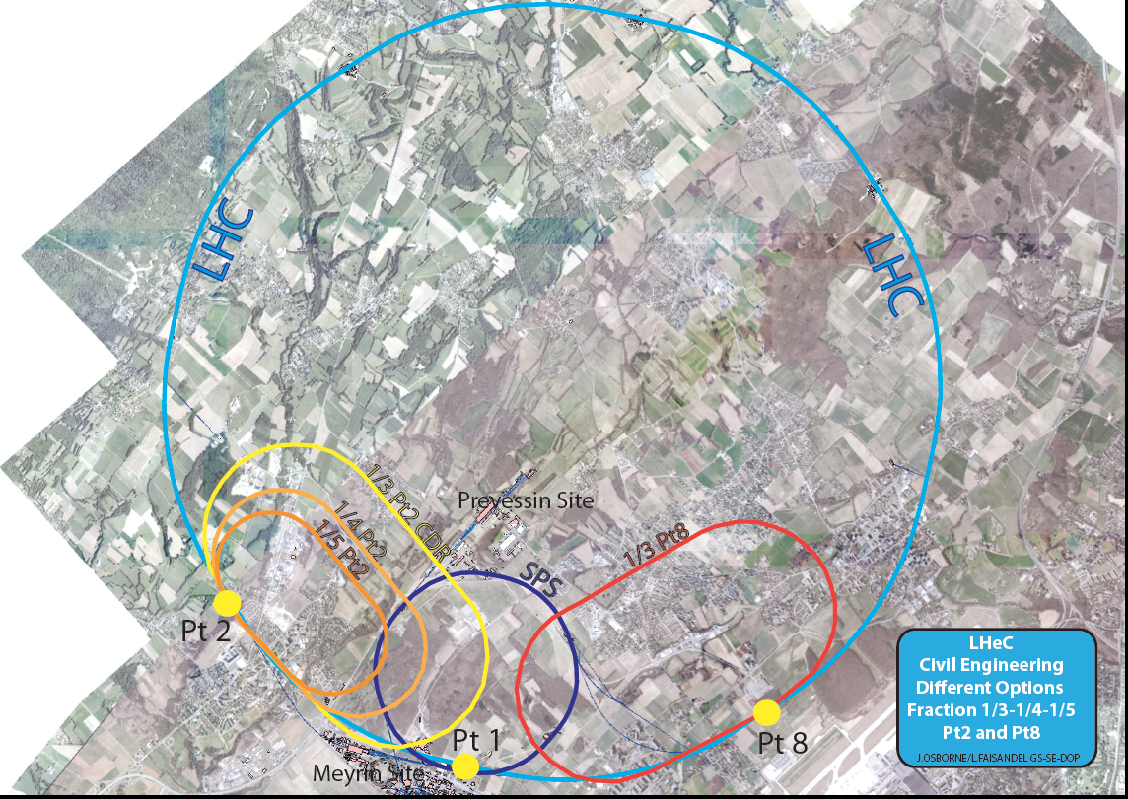
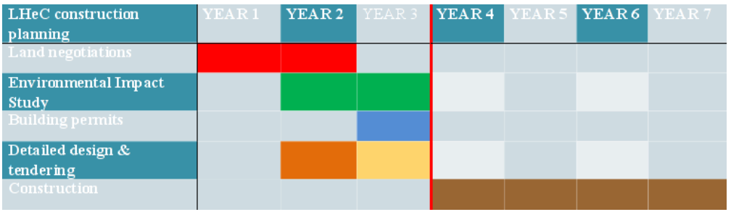
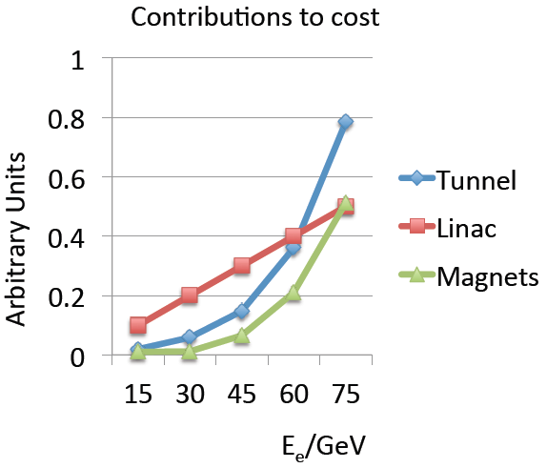
backup
Civil Engineering
Footprint
7 years for 9km
Civil Engineering
MK 6/14
Max Klein ICFA Beijing 10/2014

Slide 29
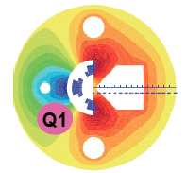
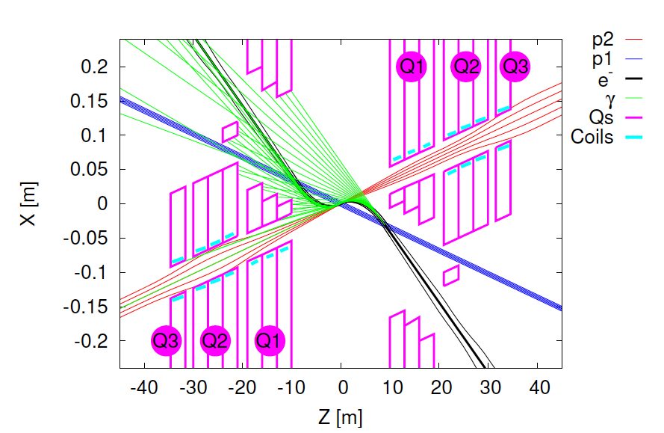
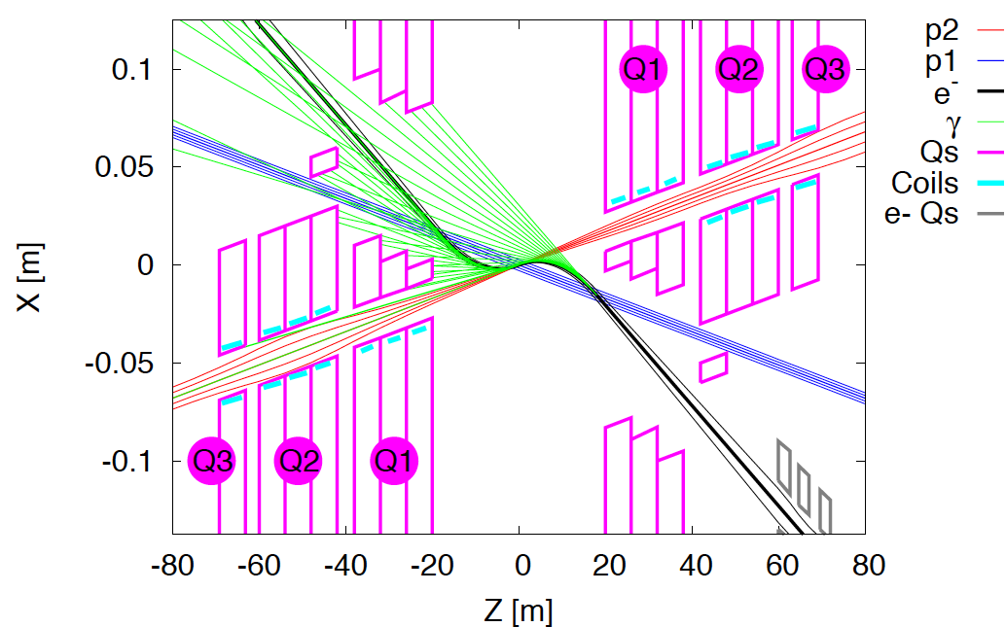
Interaction Regions for ep with Synchronous pp Operation
LHeC (CDR)
60 GeV * 7 TeV
Likely one IR.
Matching e and p beams
Limit synchrotron radiation
Design of inner magnets
Beam-beam effects ….
Non colliding p beam
Rogelio Tomas, Max Klein, ICHEP14
FCC-he (ERL)
60 GeV * 50 TeV
Tentative: ε_{p}=2μm, β*=20cm → σ_{p}=3μm ≈σ_{e} matched! ε_{e}=5μm ..

Slide 30
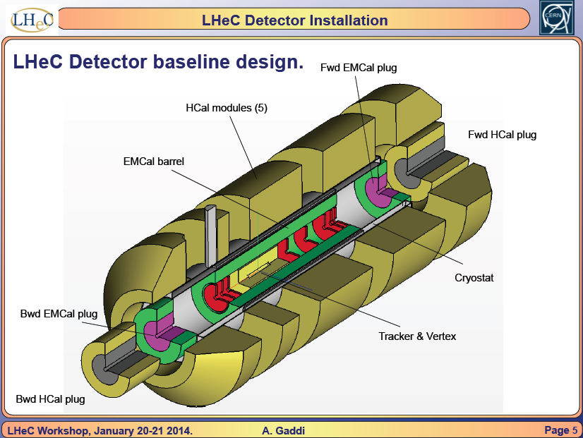
Energy Frontier DIS

Slide 31
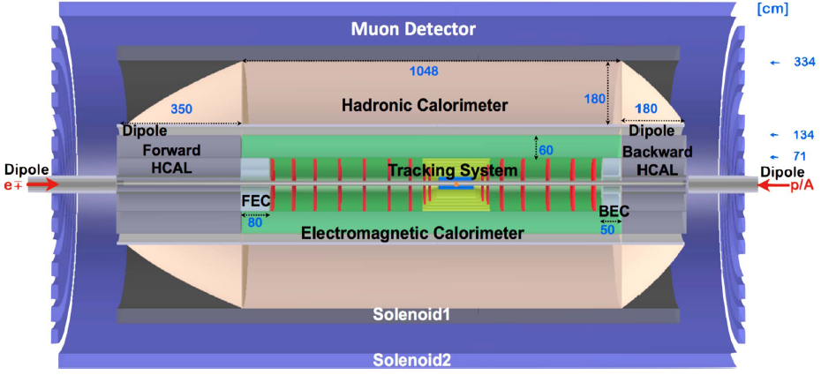
FCC-he Detector (B) – 0.1
Crab cavities for p instead of dipole magnet for e bend to ensure head on collisions
1000 H → μμ may call for better muon momentum measurement
H→ HH → 4b (and large/low x) call for large acceptance and optimum hadr. E resolution
Detector for FCC scales by about ln(50/7) ~2 in fwd, and ~1.3 in bwd direction
Full simulation of LHeC and FCC-he detectors vital for H and H-HH analysis
P.Kostka et al.

Slide 32
collider parameters | FCC ERL | FCC-ee ring |  | protons
species | e⁻ (e⁺?) | e± | e± | p
beam energy [GeV] | 60 | 60 | 120 | 50000
bunches / beam | - | 10600 | 1360 | 10600
bunch intensity [10¹¹] | 0.05 | 0.94 | 0.46 | 1.0
beam current [mA] | 25.6 | 480 | 30 | 500
rms bunch length [cm] | 0.02 | 0.15 | 0.12 | 8
rms emittance [nm] | 0.17 | 1.9 (x) | 0.94 (x) | 0.04 [0.02 y]
β_{x,y}*[mm] | 94 | 8, 4 | 17, 8.5 | 400 [200 y]
σ_{x,y}* [μm] | 4.0 | 4.0, 2.0 |  | equal
beam-b. parameter ξ | (D=2) | 0.13 | 0.13 | 0.022 (0.0002)
hourglass reduction | 0.92 (H_{D}=1.35) | ~0.21 | ~0.39
CM energy [TeV] | 3.5 | 3.5 | 4.9
luminosity[10³⁴cm⁻²s⁻¹] | 1.0 | 6.2 | 0.7
F.Zimmermann
ICHEP14, June
PRELIMINARY
L is 1000*HERA

Slide 33
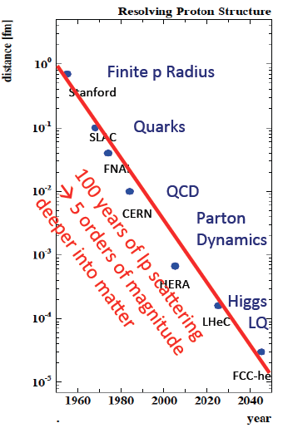
Outlook
ep/eA’s Big Questions
Structure of the Visible Matter
Lepton-Quark Symmetry
BSM (Higgs, DM, CI’s, RPV SUSY..)
BSM (Free colour, low x QCD)
ep/eA’s Prominent Contributions
Resolving the Proton PDFs
Photon,Pomeron, GPDs, Neutron, A
Higgs in WW and ZZ
QCD of HI physics (NPDFs)
Electroweak Physics beyond Z and H
Surprises…
The LHeC is a new DIS collider of
unprecedented precision and reach,
an affordable precision Higgs facility
leading to new accelerator and
detector technologies/applications.
The FCC leads into a very long and
exciting future for ee, hh and eh.
Perhaps then we know why quarks and leptons differ

Slide 34

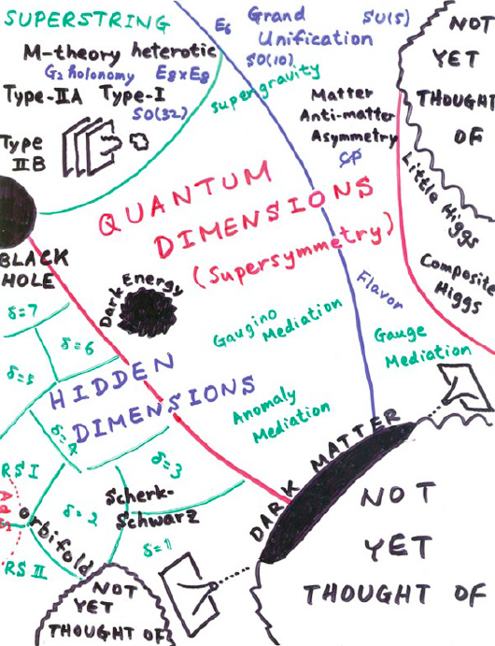
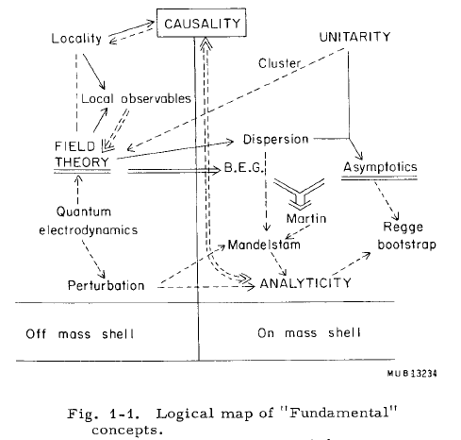
THEORY
M.Froissart ICHEP (“Rochester”) 1966
H.Murayama – ICFA11
→ Quarks in 1969
→ ?in 2015+?
We like to see particle physics as driven by experiment … Burt Richter

Slide 35
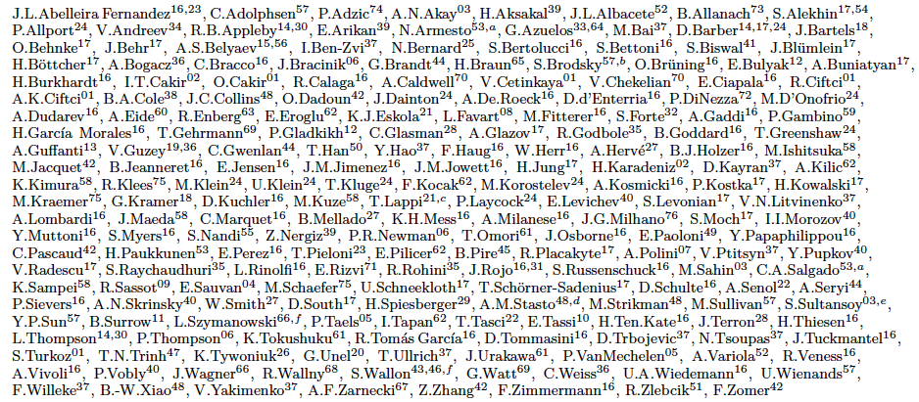
http://cern.ch/lhec
LHeC Study group and CDR authors [May13]

Slide 36
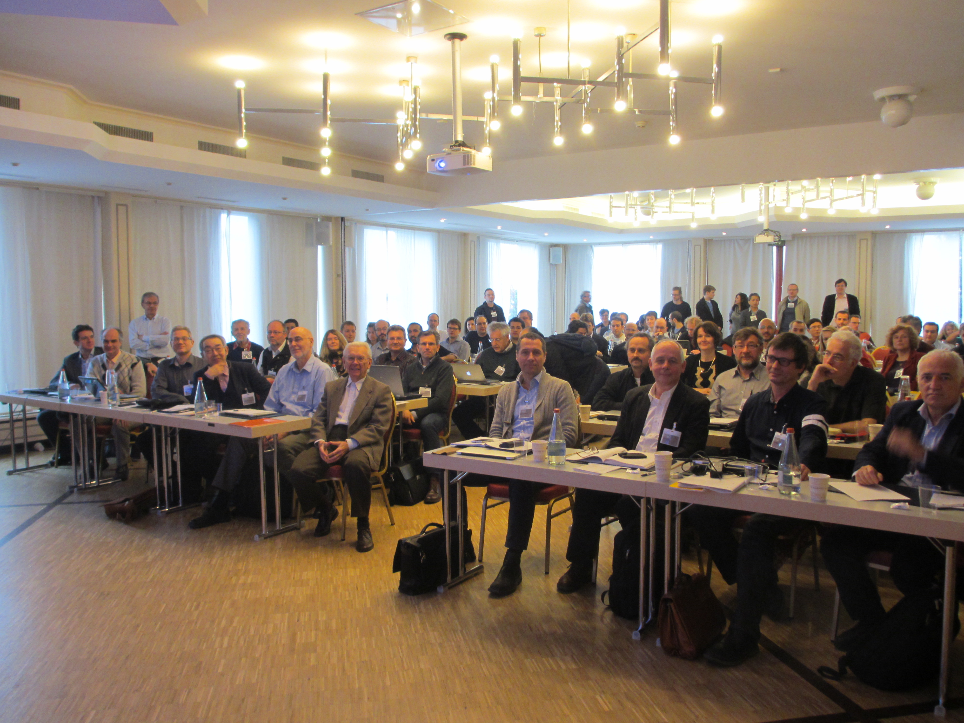
title
Max Klein ICFA Beijing 10/2014
Workshop at Chavannes, I/14

Slide 37
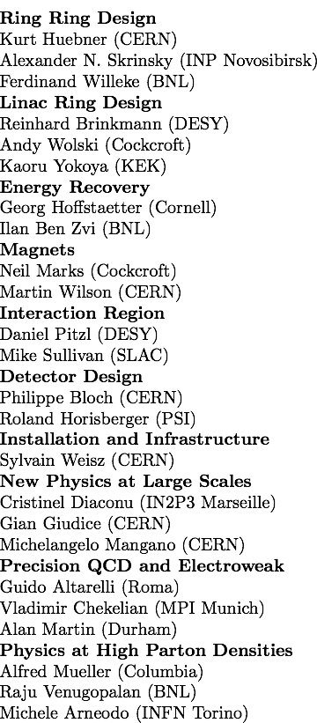
Thanks to the whole
LHeC
Study
Group to the FCC team and
Coordination Group
Nestor Armesto
Oliver Brüning
Stefano Forte
Andrea Gaddi
Erk Jensen
Max Klein
Peter Kostka
Bruce Mellado
Paul Newman
Daniel Schulte
Frank Zimmermann
Referees for Design Report
CERN Referees
www.lhec.cern.ch
Physics Study Groups (Convenors)
PDFs, QCD Fred Olness, Voica Radescu
Higgs Uta Klein, Masahiro Khuze
BSM Georges Azuelos, Monica D’Onofrio
Top Olaf Behnke, Christian Schwanenberger
Nuclei Nestor Armesto
Small x Paul Newman, Anna Stasto
The LHeC design has been a strong community effort
Welcome to join us: Washington 23-27 March 15
CERN and Chavannes 24-27. June 2015 (thy, acc, exp)
CDR: arXiv:1206.2913

Slide 38
backup

Slide 39
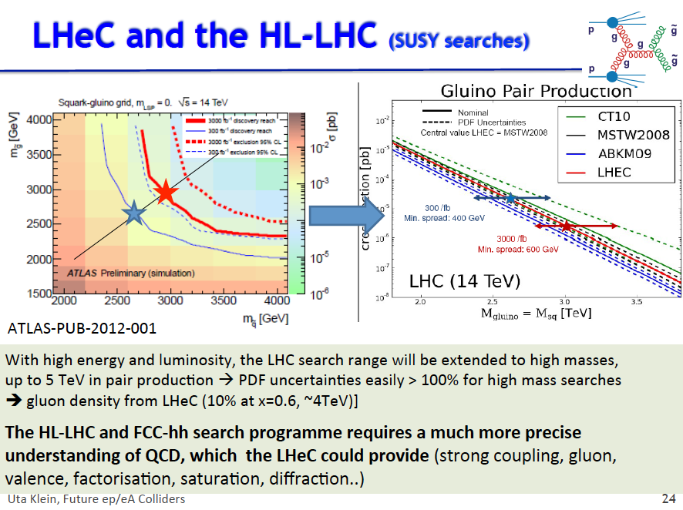
Relation of PDFs and Hi Mass Search
Cf M D’Onofrio at ICFA Beijing 2014

Slide 40
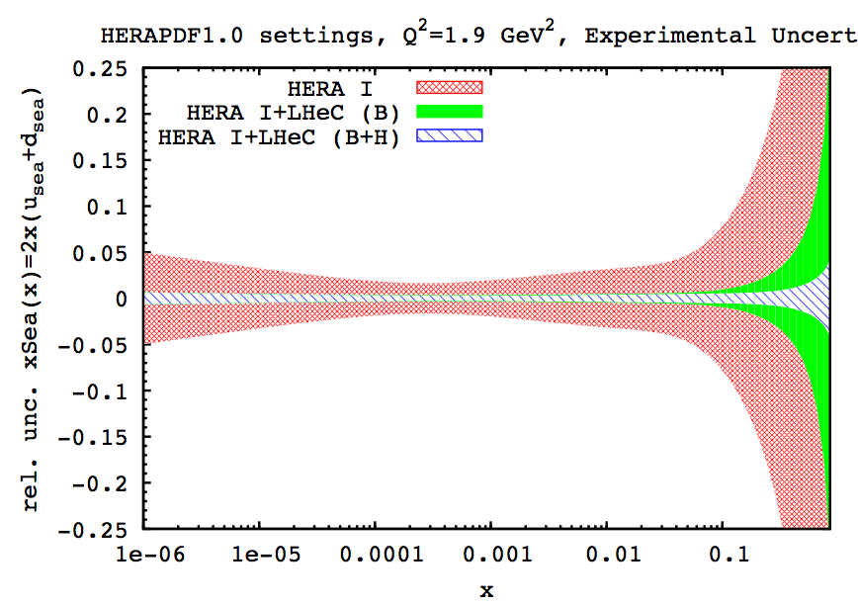
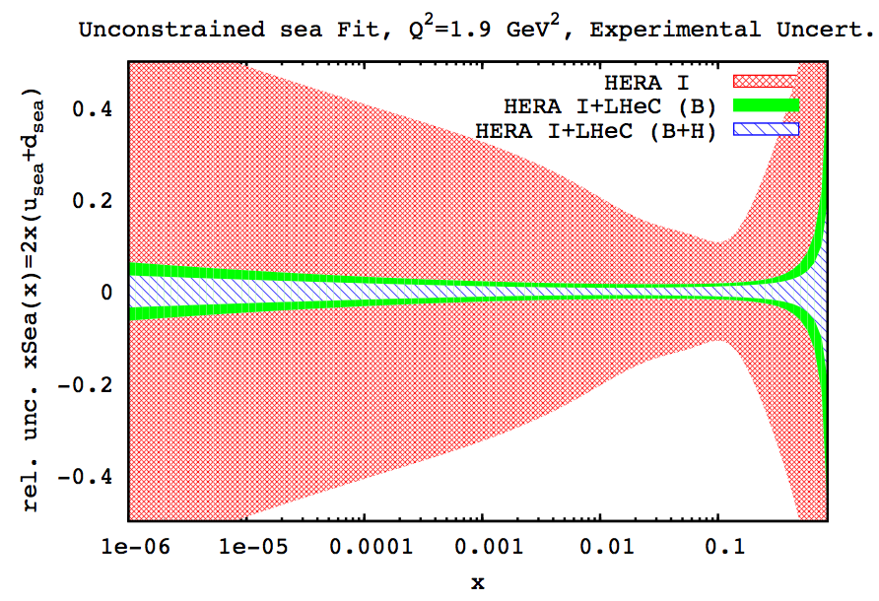
Resolving Partonic Structure free of symmetry assumptions
Usual assumptions for light quark decomposition at low x may not necessary hold.
Relaxing the assumption at low x that u=d , we observe that uncertainties escalate:
constrained (u=d)
unconstrained
  One can see that for HERA data, if we relax the low x constraint on u and d,the errors are increased tremendously!
  However, when adding the LHeC simulated data, we observe that uncertainties are visibly improved even without this assumption.
  Further important cross check comes from the deuteron measurements, with tagged spectator and controlling shadowing with diffraction…

Slide 41
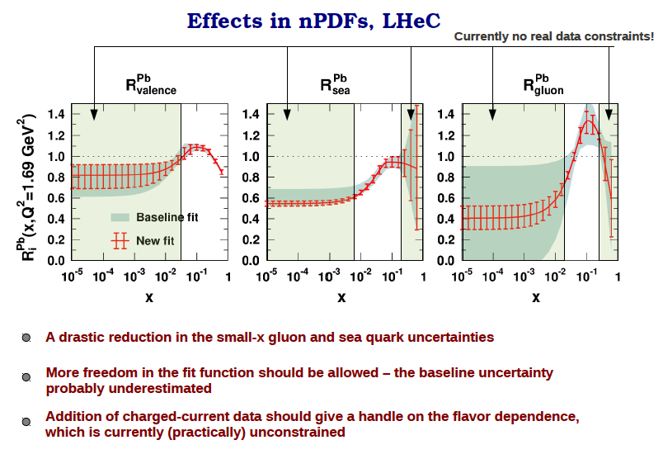
Energy Frontier DIS
Hannu Paukkunen, Chavannes LHeC Workshop 1/14

Slide 42
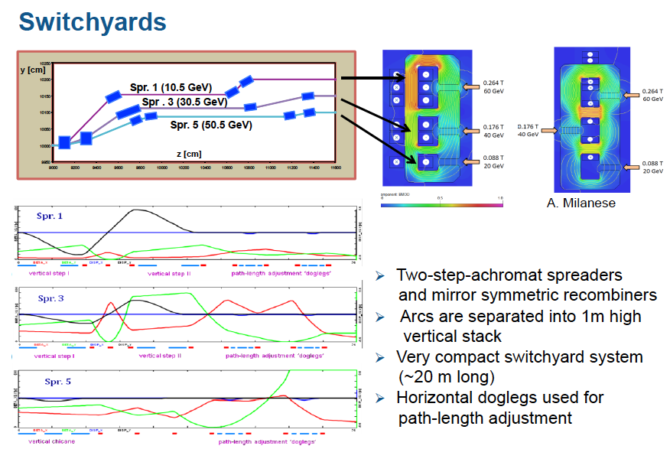
A.Bogasz (Jlab), A.Milanese, A.Valloni (CERN) et al

Slide 43
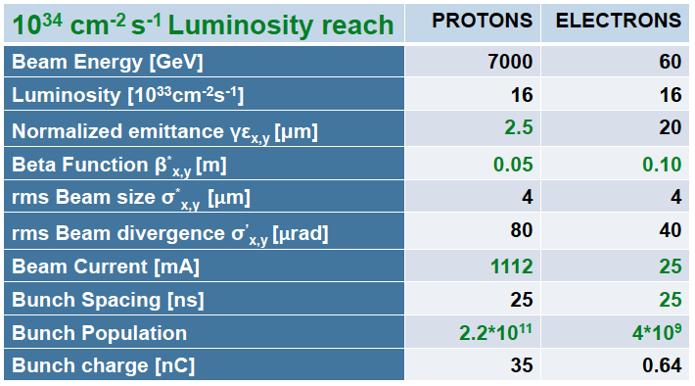
Higgs Parameter List “H-LHeC”
HL-LHC proton beam parameters
1000 times HERA Luminosity and 4 times cms Energy
Max Klein ICFA Beijing 10/2014

Slide 44
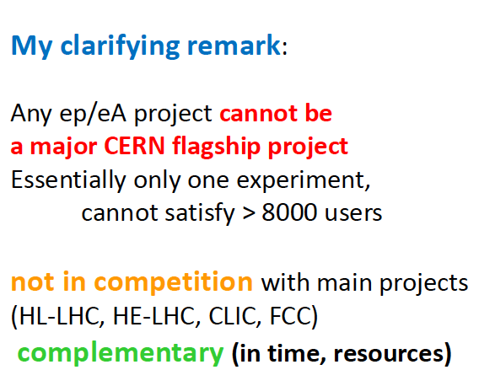
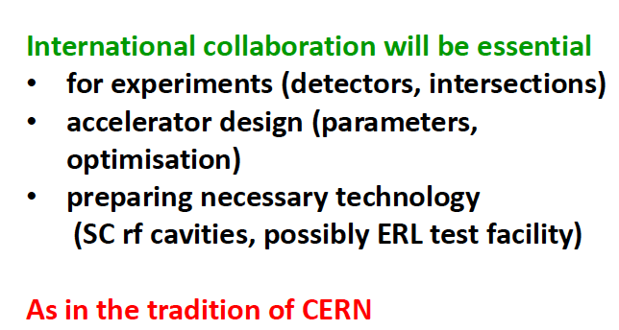
Clarification and Tradition
Herwig Schopper at Chavannes 1/14 in the Panel Discussion with the CERN Directorate
H.Schopper, M.K. CERN Courier June 2014

Slide 45
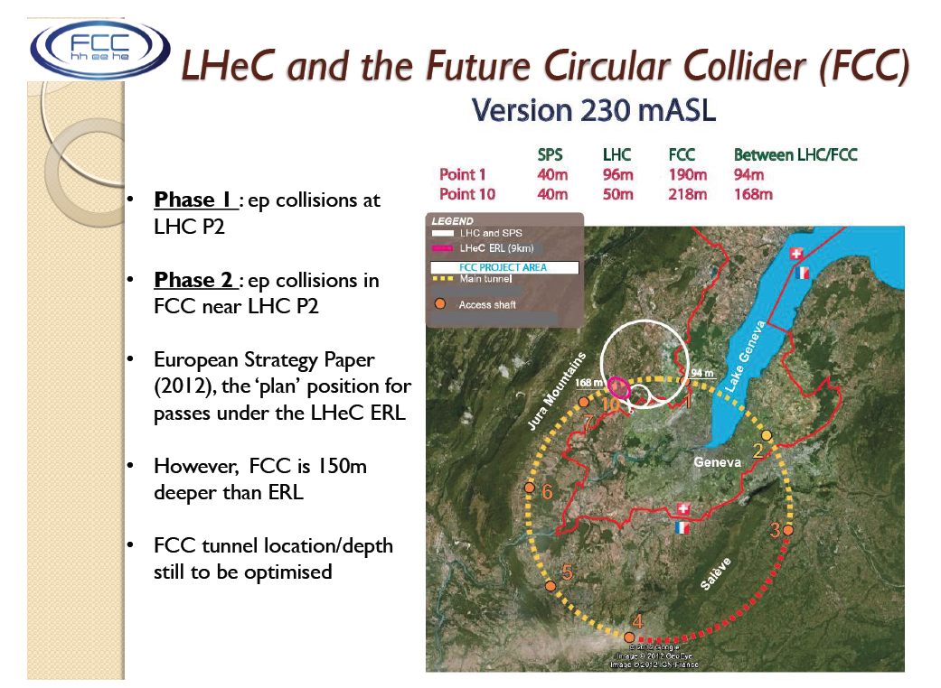
title
J Osborne at IAC Meeting 6/14

Slide 46
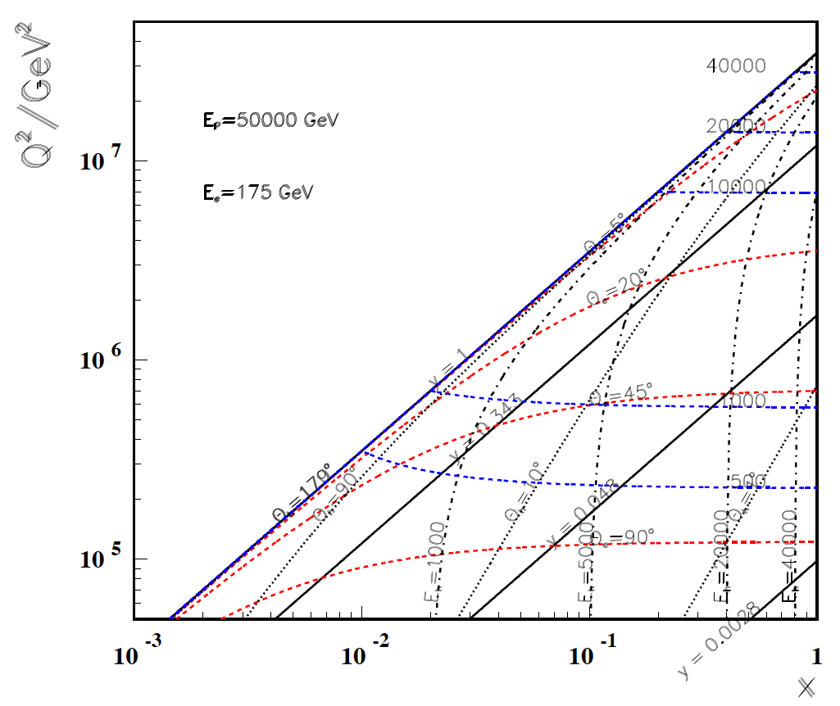
High Q²
Rutherford backscattering
of dozens of TeV e- energy
FCC-he
175 GeV
60 GeV
LHeC
← ϑ_{h}=1º
Large imabalance
of e and p energies
is surprisingly
tolerable for the
high Q², x kinematics,
LHeC to bridge
from HERA to FCC
← HERA

Slide 47
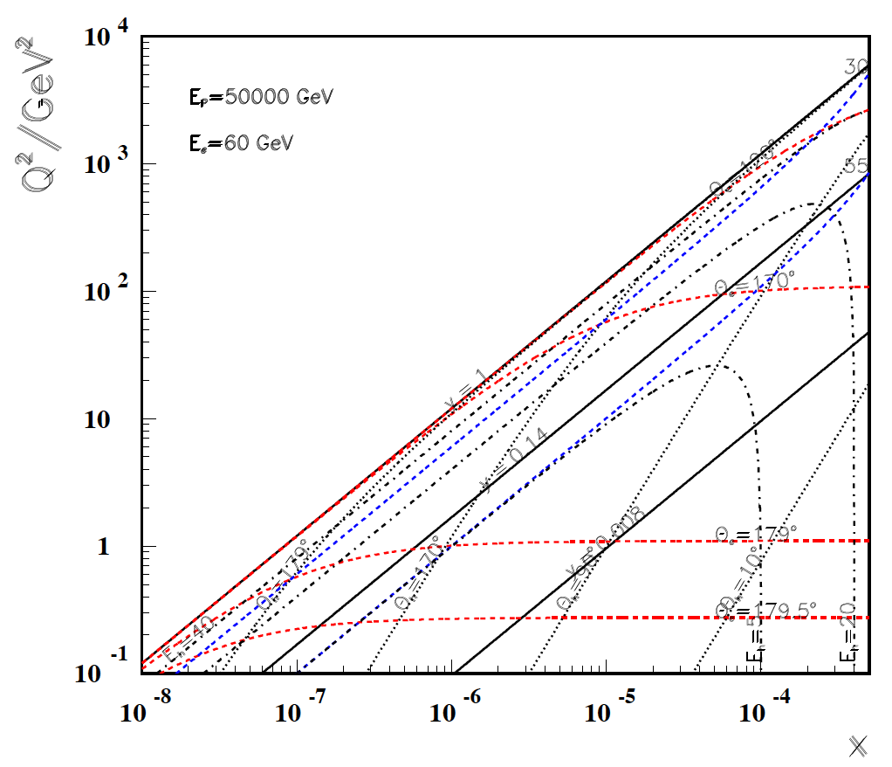
Low x
FCC-he
60 GeV
LHeC
Backward
region, low x
is governed
solely by E_{e}!
-----------
179º
@ 180 GeV
.. very low x
requires not
the maximum
of E_{e}
Very low x
reaches
direct
range of
UHE
neutrino
physics →
HERA
x
For x < 10⁻³ no (average) energy deposition exceeding the electron beam energy

Slide 48

backup
F.Zimmermann, IPAC14, June 14, Dresden

Slide 49




Time Schedule – 2 – Detector
A.Gaddi Chavannes 1/14
Pre-mounting at the surface of a modular detector – independent of LHC
Lowering (7), Installation (2), Connection (6), Field Map (1), Pipe (1) … min of 15 Month
which would be compliant with LS3 and may be with LS4 – depends on the LHC

Slide 50

backup

Slide 51

Scale dependence of sin²θ_{W}
EIC
Running sin²Θ_{W} from polarisation asymmetries and NC/CC in DIS
Low scales from MAMI, Jlab and possibly the CERN Testfacility

Slide 52


Top Quark Physics

Slide 53

New dreieck
FCC_he
Max Klein ICFA Beijing 10/2014

Slide 54

Physics Overview
LHeC Note 2012-004, arXiv:1211.5102
LHeC: 20 times 1/x and Q² and 100-1000 times luminosity as compared to HERA
→ Very rich programme on DIS, ions, Higgs and new physics in much extended range
Max Klein ICFA Beijing 10/2014

