Slide 1


Future Electron-Hadron Colliders at the energy frontier
LHeC: ep at √s = 1.3 TeV
FCC-eh and eh in China at ~4 TeV
Remarks on projects, accelerator, detector and (selected) physics prospects
Max Klein
University of Liverpool, H1 and ATLAS
For the LHeC and FCC-eh Study Groups and the PERLE Collaboration
Talk at the IAS Hongkong Conference on High Energy Physics, 24.1.2018

Slide 2
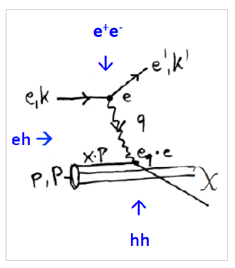
Deep Inelastic Lepton-Hadron Scattering
Calculated to N²LO
J Vermaseren et al,
and N³LO to come
Redundant determination of the scattering kinematics: x, Q² ≤ 4E_{e}E_{p}=s → high precision
Resolution of substructure d=1/√Q² (protons and nuclei: the ‘forgotten’ task of HERA)
Proton, neutron, diffractive, nuclear, generalised, unintegrated partons. Much more than ‘PDFs’.
Q²=sxy varies by 7(8) orders of magnitude, 0.1-10⁶⁽⁷⁾ GeV² for LHeC (FCCeh)
Small x > 1/s ( Q²>M_{p}²): new parton dynamics, confinement, UHE neutrino scattering…
Electroweak γ,W,Z-parton scattering: clean final state, no pile-up (μ=0.1 at the LHeC), tag γ*p
The LHeC and the FCC-eh are the cleanest high resolution microscopes the world can build.

Slide 3
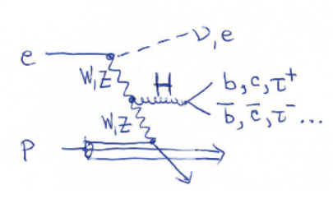
Deep Inelastic Lepton-Hadron Scattering
Can produce heavy new states (Higgs, 750 GeV ghost..) and reach to O(200) TeV
by indirect constraints, such as high precision contact interaction measurements
pp, ep and ee are ordered in energy reach: 2E_{p} >> 2√(E_{p}E_{e}) >> 2E_{e}
For the FCC this translates to 100 TeV vs 3.5 TeV vs 0.25-0.35 TeV.
Drell-Yan production in pp of new states with mass M in pp: M² = s x₁ x₂
Resolving high mass physics needs PDFs at high x. Note: Higgs at FCC will be low x physics
For pp need to separate new physics from QCD dynamics in the proton

Slide 4
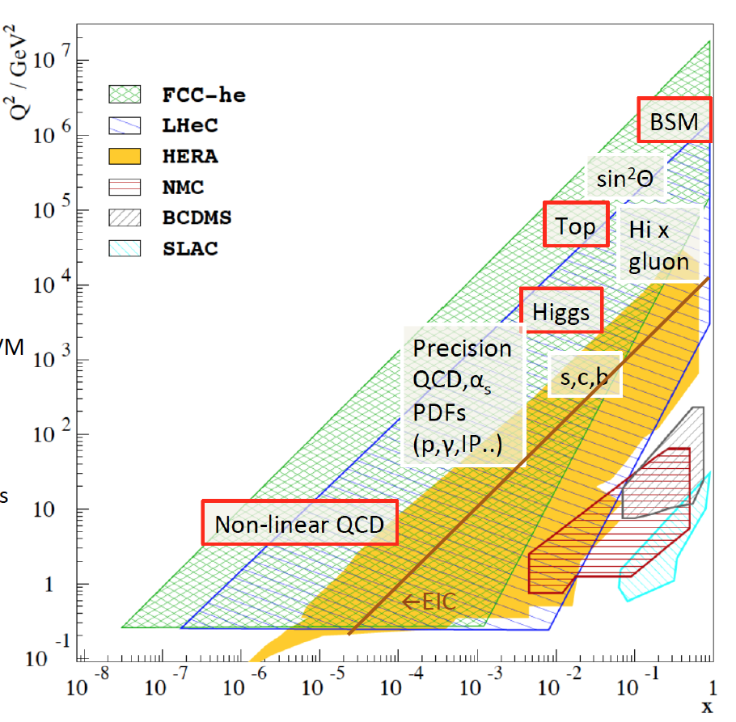
Pursue New Physics of Deep Inelastic Scattering

Slide 5

.. and yet, ep is usually treated like the early Cinderella
→ Needs radiant appearance (lumi, physics, technology), readiness to work and a bit of luck..

Slide 6
Outline
0. Bits of Information
1. Parameters and Configuration of the LHeC
2. PERLE Testfacility for Energy Recovery Physics and SCRF
3. Detector Development for LHeC and Installation Issues
4. Selected Physics Highlights (PDFs, Higgs, BSM)
5. Extension to the multi TeV range (FCCeh and in China)

Slide 7
Particle Physics with pp-ee-ep
SM was completed with a series of pp, ee and ep machines exploring the 10 GeV scale (ISR,SppS – PETRA, Tristan – electron, muon and neutrino experiments) and the Fermi scale (Tevatron – LEP, SLC – HERA), besides further dedicated experiments [ep SLAC78..].
All three types of colliding experiments were instrumental in the SM establishment:
For example: LEP predicted the top mass and Tevatron found the top quark;
HERA measured the gluon distribution and LHC discovered gg→Higgs→ 4l, yy.
Tevatron saw excess in high pt jets, yet attributed to PDFs with DIS etc
For the first time since decades we have NO definite guidance, no SM particle to find. Note, however, that the Tevatron, LEP and HERA proposals largely emphasised NOT the SM but the BSM (SUSY, LQ) physics. Rarely the SM was a funding argument before either
and the theory was no less speculative . Theory only guides: e.g. Weinberg 1980 SU(5):
end of colliders, go underground to see proton decay … to find neutrino oscillations ..
The LHC stands alone, it has no ep partner to explore the 1 TeV scale and it has no ee partner to study the Higgs boson. Can we build in time a 1 TeV ep collider (yes we could) and can we build a higher (than LEP) energy ee collider (for others to discuss)
The FCC study has hh, ee and eh: yet 5?: time, cost, technology, theory, detectors
+ the public acceptance of such a major step into the unknown and below Lac Leman
MK, presented to UK PPAP, July 2017

Slide 8
Framework of the Development
Following the CDR in 2012: Mandate issued by CERN:2014 (RH), confirmed in 2016 (FG)
Mandate to the International Advisory Committee
Advice to the LHeC Coordination Group and the CERN directorate by following the
development of options of an ep/eA collider at the LHC and at FCC, especially with:
Provision of scientific and technical direction for the physics potential of the ep/eA
collider, both at LHC and at FCC, as a function of the machine parameters and of a
realistic detector design, as well as for the design and possible approval of an ERL
test facility at CERN.
Assistance in building the international case for the accelerator and detector
developments as well as guidance to the resource, infrastructure and science
policy aspects of the ep/eA collider.
Chair: Herwig Schopper, em. DG of CERN. IAC+CERN have invited four of its members to follow the study with special attention (Stefano Forte, Andrew Hutton, Leandro Nisati and Lenny Rifkin). Collaboration also with the FCC Review Committee chaired by Guenther Dissertori.
LHeC has been a development for and initiated by CERN, ECFA and NuPECC, so far, it’s formal status is that of a community study, not a proposal, which holds for the FCC also, of which ‘eh’ is a part.

Slide 9
Organisation^{*)}
Working Groups
International Advisory Committee
“..Direction for ep/A both at LHC+FCC”
PDFs, QCD
Fred Olness,
Claire Gwenlan
Higgs
Uta Klein,
Masahiro Kuze
BSM
Georges Azuelos,
Monica D’Onofrio
Top
Olaf Behnke,
Christian Schwanenberger
eA Physics
Nestor Armesto
Small x
Paul Newman,
Anna Stasto
Detector
Alessandro Polini
Peter Kostka
Coordination Group
Accelerator+Detector+Physics
Sergio Bertolucci (CERN/Bologna)
Nichola Bianchi (Frascati)
Frederick Bordry (CERN)
Stan Brodsky (SLAC)
Hesheng Chen (IHEP Beijing)
Eckhard Elsen (CERN)
Stefano Forte (Milano)
Andrew Hutton (Jefferson Lab)
Young-Kee Kim (Chicago)
Victor A Matveev (JINR Dubna)
Shin-Ichi Kurokawa (Tsukuba)
Leandro Nisati (Rome)
Leonid Rivkin (Lausanne)
Herwig Schopper (CERN) – Chair
Jurgen Schukraft (CERN)
Achille Stocchi (LAL Orsay)
John Womersley (ESS)
Nestor Armesto
Oliver Brüning – Co-Chair
Andrea Gaddi
Erk Jensen
Walid Kaabi
Max Klein – Co-Chair
Peter Kostka
Bruce Mellado
Paul Newman
Daniel Schulte
Frank Zimmermann
5(11) are members of the
FCC coordination team
OB+MK: FCC-eh responsibles
MDO: physics co-convenor
We miss Guido Altarelli.
*)September 2017

Slide 10
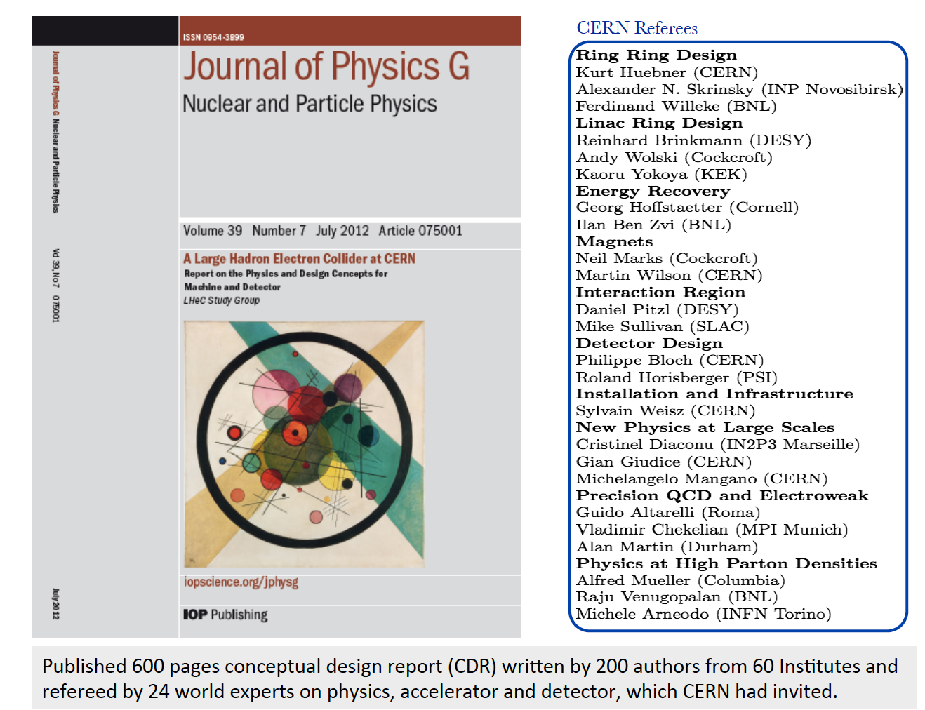
title

Slide 11
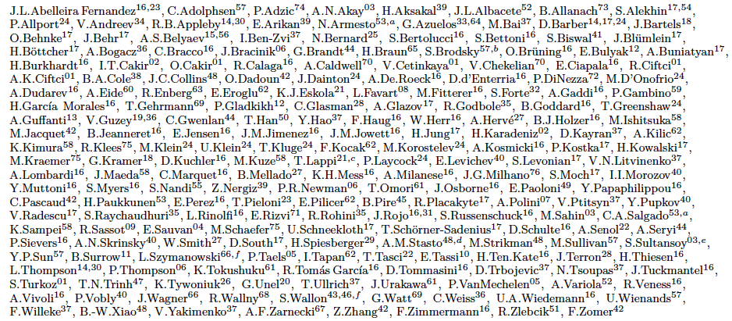
http://lhec.web.cern.ch
LHeC Study group and CDR authors 2014
“you never walk alone”

Slide 12
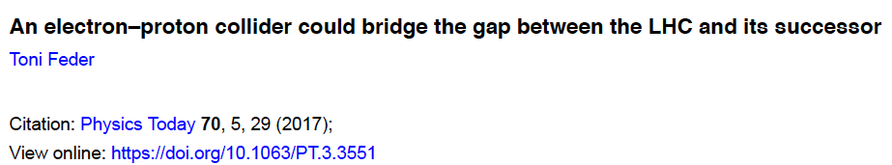
Information on LHeC
Conceptual Design Report: arXiv:1206.2913
Discussion of move to 10³⁴: O. Bruening, MK: arXiv:1305.2090 published MPLA
MK: To be submitted
to the arXiv
Increasing number of papers (e.g. D Curtin et al, 1712.07135) and talks: https://lhec.web.cern.ch

Slide 13
Outline
0. Bits of Information
1. Parameters and Configuration of the LHeC
2. PERLE Testfacility for Energy Recovery Physics and SCRF
3. Detector Development for LHeC and Installation Issues
4. Selected Physics Highlights (PDFs, Higgs, BSM)
5. Extension to the multi TeV range (FCCeh and in China)

Slide 14
ep/A with the LHC
Conceptual Design Report: arXiv:1206.2913, published in JPhysG
LHeC: 60 GeV off 7 TeV, L(ep) =10^{33 →34} cm⁻² s⁻¹ (1000 x HERA) in synchronous ep+pp operation
Non default: An expensive generalisation to achieve E_{e}= 500 GeV or more

Slide 15
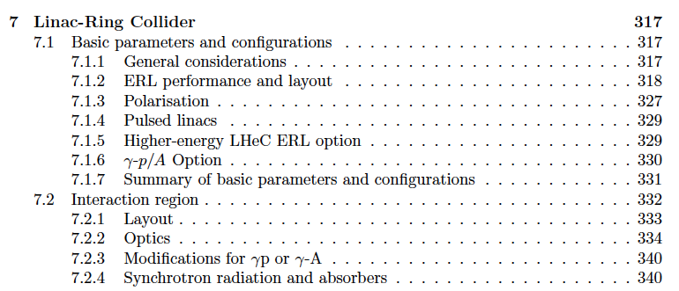
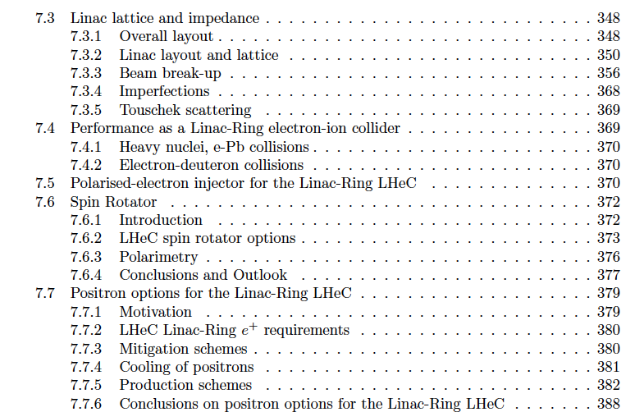
Performance
Interaction Region
Optics
Ions
Polarisation (80-90%)
Positrons
CDR: VERY detailed design of the LHeC Linac (and Ring) – Ring Collider, + components, CE..

Slide 16
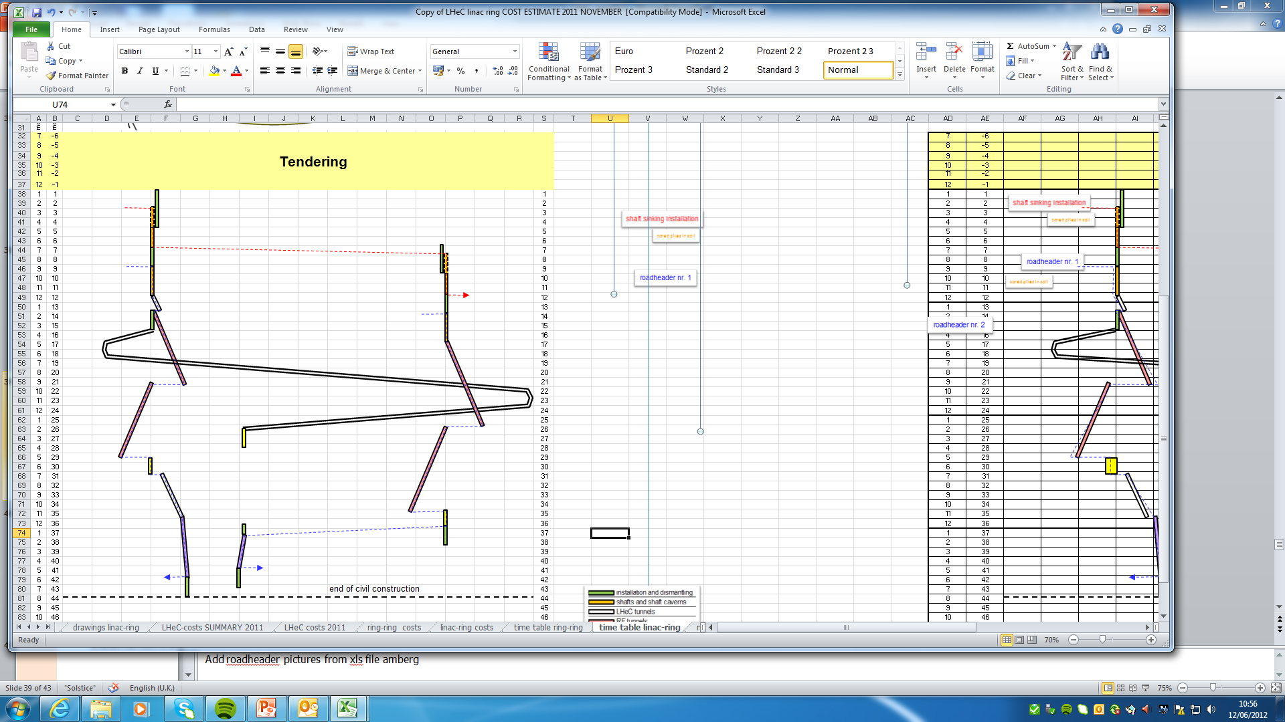
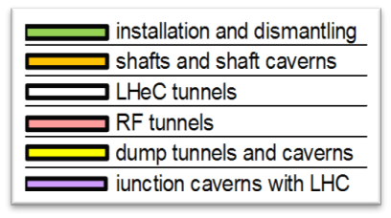
Civil Engineering – full design made
Shaft sinking installation
CDR: Evaluation of CE, analysis
of ring and linac by Amber Zurich.
Detailed estimate of cost and time:
3.5 years for underground works using 2 roadheaders and 1 TBM
More studies will be needed for
- Integration with all services
- (EL,CV, transport, survey etc).
- Geology
- Understanding vibration risks
- Environmental impact assessment
Tunnel connection in IP2
Roadheader 1
Roadheader 2
J.Osborne et al.

Slide 17
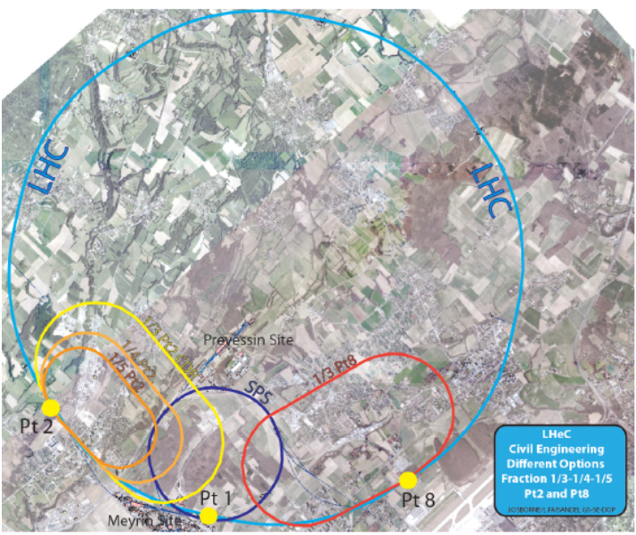
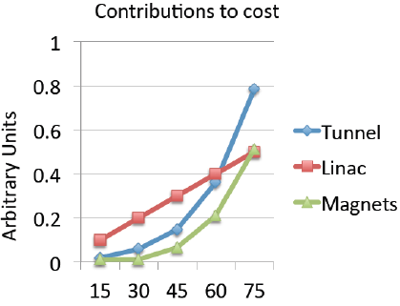
Location, Footprint, Use of the Electron Racetrack
e beam external to LHC. Location suitable for both HL and HE LHC. Program in the transition:
yy collider, high energy FEL, fixed target
MK, F Zimmermann
- We don’t have six sites as the CEPC..
- U(ERL) = 1/n U(LHC): 60 GeV: 1/3
- BSM, top, Higgs, Low x all want maximum E_{e}
Initial, tentative, rough scaling estimate of
basic cost (tunnel, linac (XFEL), magnets
Energy – Cost – Physics – Footprint are being reinvestigated for EU strategy

Slide 18
Physics Considerations on the Choice of E_{e}
Tentative
SM Higgs Couplings
H→ bb (cc): 0.5 (4)% coupling uncertainty, for 1ab⁻¹, 60 GeV, polarised
This becomes 2(15)% for 0.5ab⁻¹ and 30 GeV: Under these conditions
one looses high H precision and the ep portal to new physics potential
and the neutral current Higgs programme disappears
New Higgs+top Physics
Heavy new objects: Htt coupling: 17 → 31 % for 60 → 40 GeV (M Kumar)
Discovery potential for anomalous tqH: 0.5 – 3.2 -22% precision for
60 → 50 → 40 GeV (H Sun). At 40 GeV the discovery potential is gone.
Longitudinal Structure Function – THE path to saturation
Low x physics: Saturation requires 1% measurement of F_{L}. That needs
y=0.9=1-E’/Ee. HERA: big complication: E’ at high y too small for precision
(eID, background, charge symmetry): needs ~twice E_{e} to be safe.
50 GeV the programme stands, 40 GeV it looses BSM, t, 30 GeV: precision gone
Keep the electron energy as high as it can be afforded, and not lower than 50 GeV

Slide 19
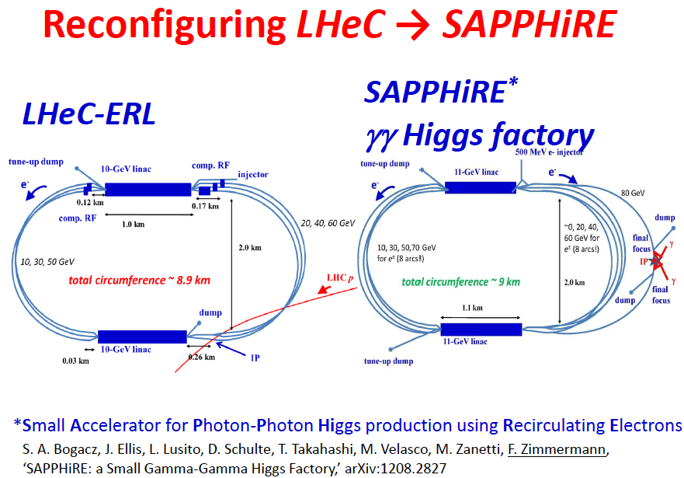
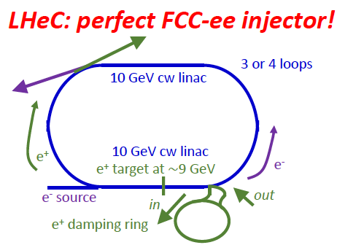
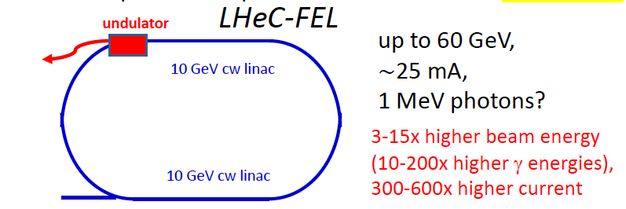
Further use of ERL in between HL and HE LHC
F.Zimmermann at LHeC WS 9/17
XFEL: 20GeV e, 0.03mA, 24keV photons. LCLSII: 4 GeV e, 0.06mA, 5 keV photons

Slide 20
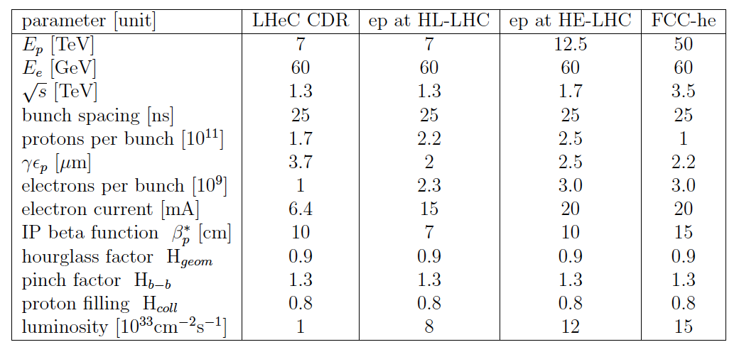

Luminosity for LHeC, HE-LHeC and FCC-ep
Contains update on eA:
6 10³² in e-Pb for LHeC.

Slide 21
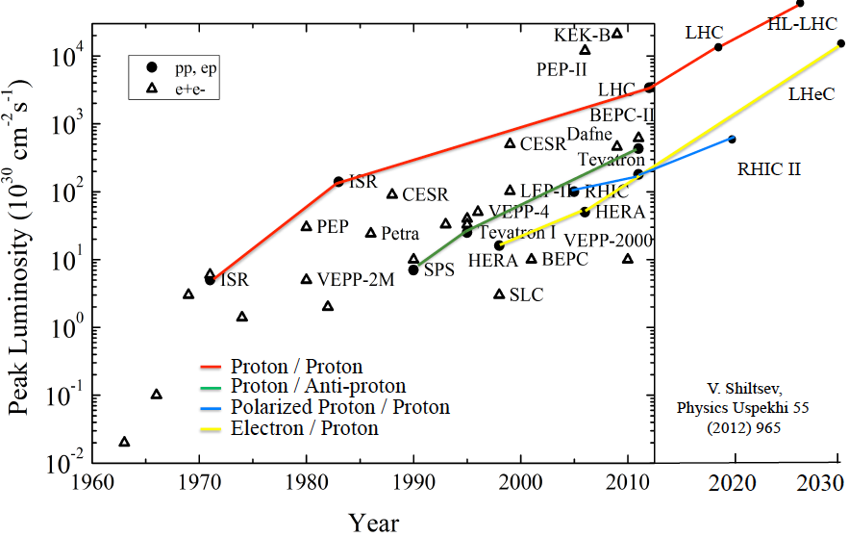
Collider Luminosities vs Year (pp and ep)
O. Bruening 2/17
HL LHC programme: 3ab⁻¹ (in pp scattering) in 10 years of operation: LHC until almost 2040

Slide 22
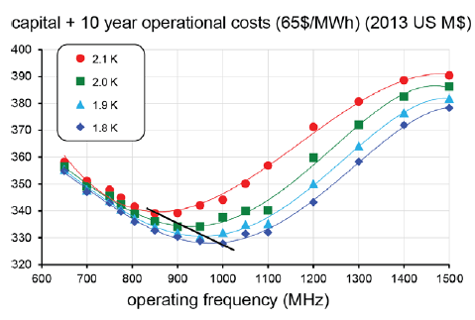
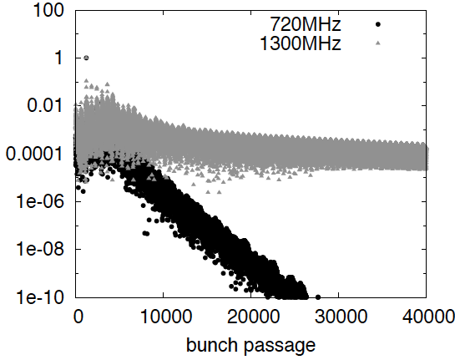
Frequency Choice: 801.58 MHz
Cost, dynamic heat losses, resistance, Q₀… point to f < 1 GHz (F Marhauser, Orsay 2/17)
Beam beam interactions unstable for f > 1 GHz (D Schulte, D Pellegrini March 2013)
Compatibility with LHC: Decision for 802 MHz ( E Jensen CI Workshop 1/2015, FM input)

Slide 23
Outline
0. Bits of Information
1. Parameters and Configuration of the LHeC
2. PERLE Testfacility for Energy Recovery Physics and SCRF
3. Detector Development for LHeC and Installation Issues
4. Selected Physics Highlights (PDFs, Higgs, BSM)
5. Extension to the multi TeV range (FCCeh and in China)

Slide 24


Powerful Energy Recovery Linac for Experiments
15mA and 60 GeV correspond to 900 MW power
This can only be realised using energy recovery.
New: high current, high energy, multi-pass: study!
BINP, CERN, Daresbury, Jefferson Laboratory, U Liverpool, Orsay (LAL+INP), + Collaboration

Slide 25
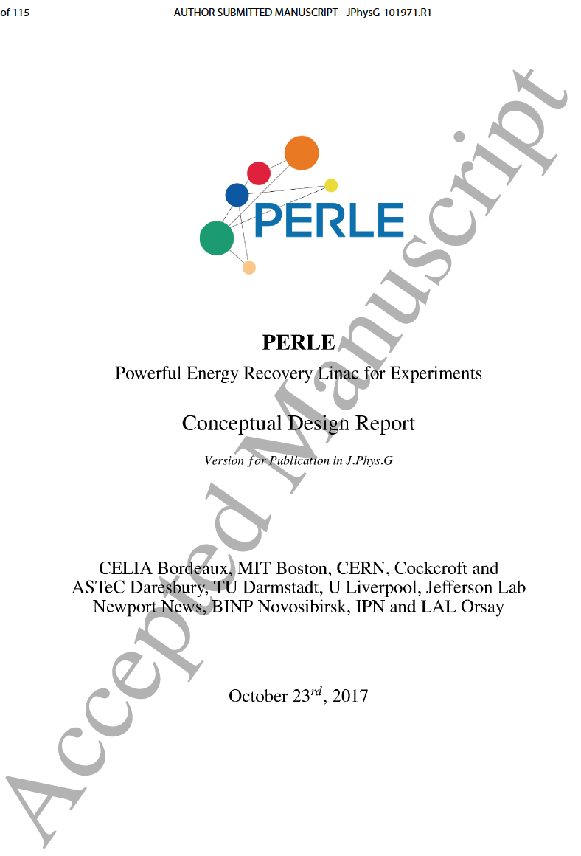
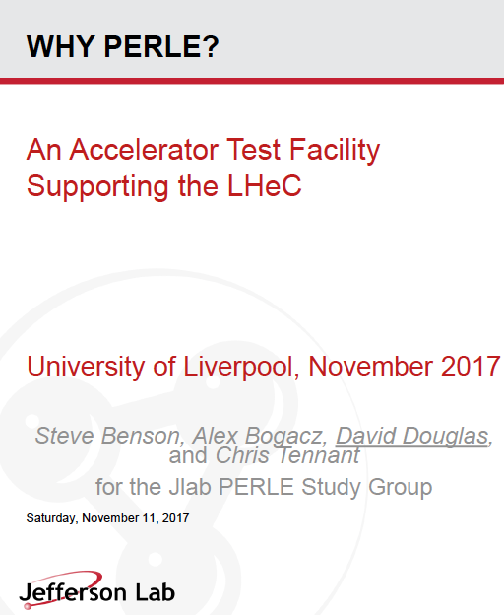
Powerful ERL for Experiments
Collaboration of BINP, CERN, Daresbury/Liverpool, Jlab, Orsay INP+LAL + : CDR 2016/17, TDR 2018/19 ..
https://indico.cern.ch/event/680603/
arXiv:1705.08783
ERL facility: high current and energy
low energy nuclear, particle and astro physics
J Phys G in print

Slide 26
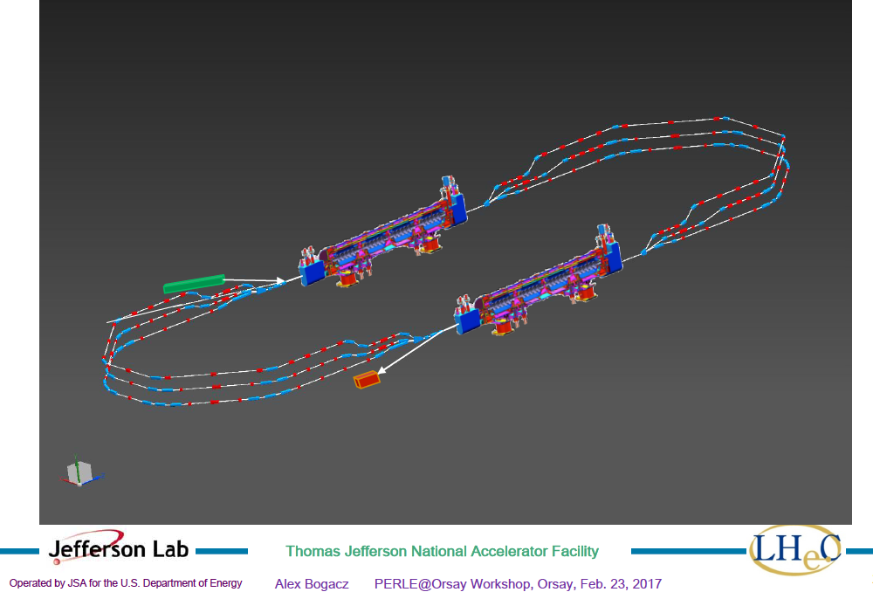
title
PERLE at Orsay
PERLE at Orsay (LAL/INP) Collaboration: BINP, CERN, Daresbury/Liverpool, Jlab, Orsay +
3 turns, 2 Linacs, 500 MeV, 20mA, 802 MHz, Energy Recovery Linac facility
-Demonstrator of ERL for ep at LHC/FCC
-SCRF Beam based development facility
-Low E electron and photon beam physics
-High intensity: O(100) x ELI
5.5 x 24m²
CDR to appear in J Phys G [arXiv:1705. 08783]
Strong low energy physics program:
p radius, sin2theta, dark photons, photon-nuclear physics, ..
A.Bogacz
See also https://indico.lal.in2p3.fr/event/3428/

Slide 27
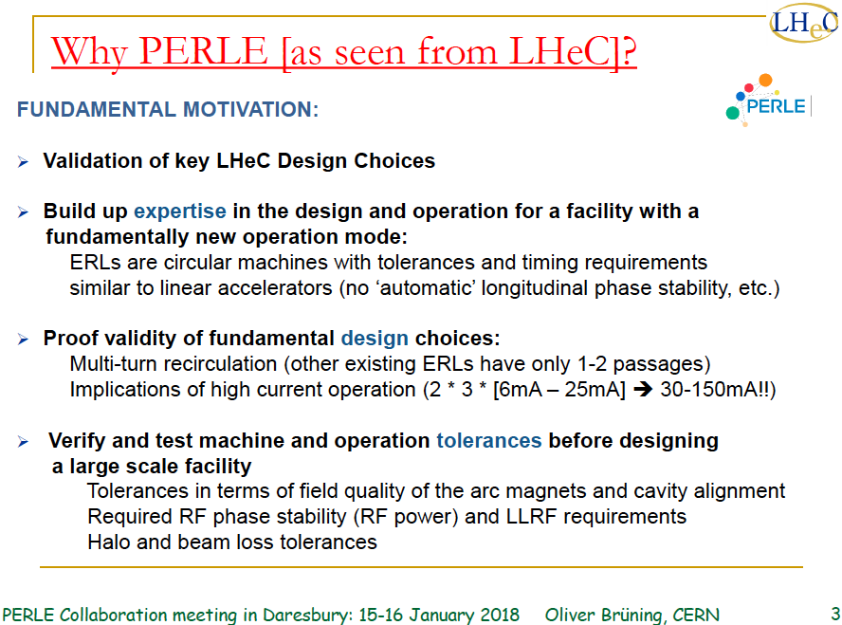

Slide 28
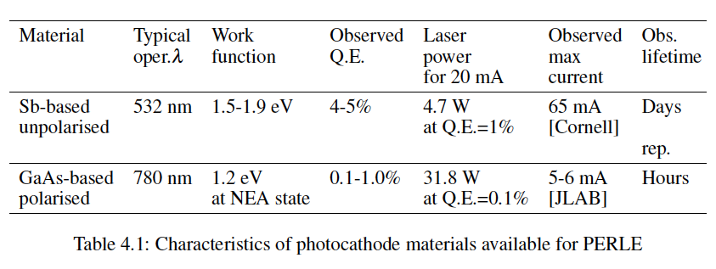
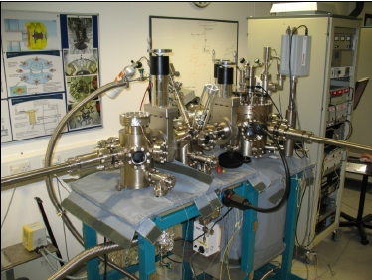

Source: DC Photocathode
← Boris Militsyn’s kukhnja at Daresbury

Slide 29
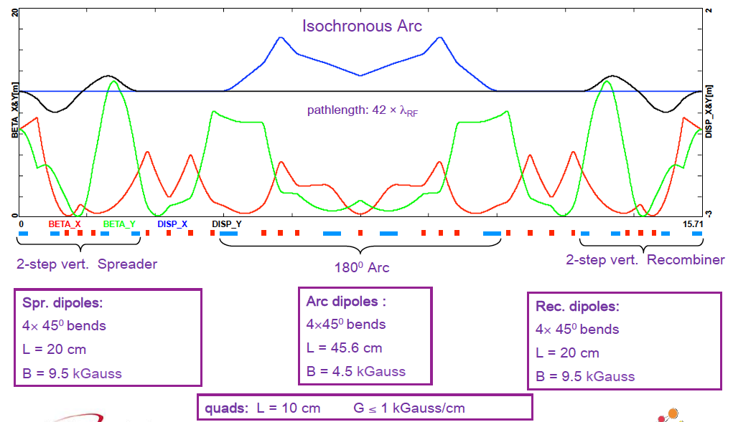
PERLE 3 turn optics (80 MeV Arc)
A Bogacz (24.5.17)
70 Dipoles and 114 Quadrupoles footprint 22 x 5.5 m2

Slide 30
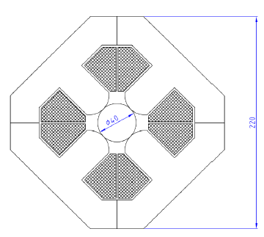
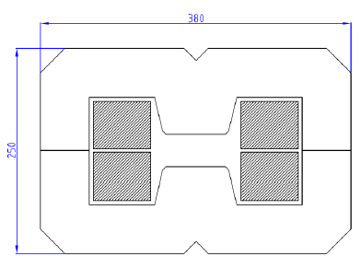
PERLE Magnets
70 dipoles 0.45-1.29 T
+- 20 mm aperture, l=200,300,400 mm
May be identical for hor+vert bend
7A/mm2 (in grey area) water cooled
DC operated
220 mm
380 mm
114 quadrupoles max 28T/m
Common aperture of 40mm all arcs
Two lengths: 100 and 150mm
DC operated
250 mm
P Thonet, A Milanese (CERN), C Vallerand (LAL), Y Pupkov (BINP)

Slide 31
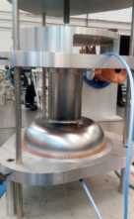
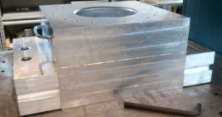
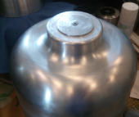
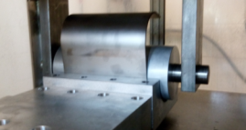
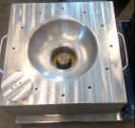
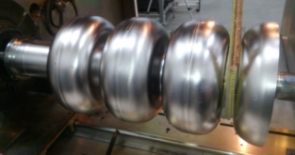
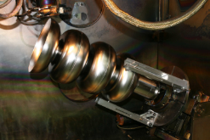
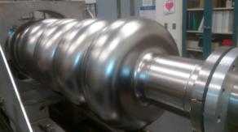
Cavity Fabrication
We developed all tooling for cavity fabrication
Fixture for female die with blank holder
Male die
Beam tube rolling die
RF half cell/dumbbell
measurements fixture
Five-cell cavity in EBW machine prepared for subsequent dumbbell and endgroup welding with both outside and inside welds in tilted position
Five-cell cavity on tuning bench

Slide 32
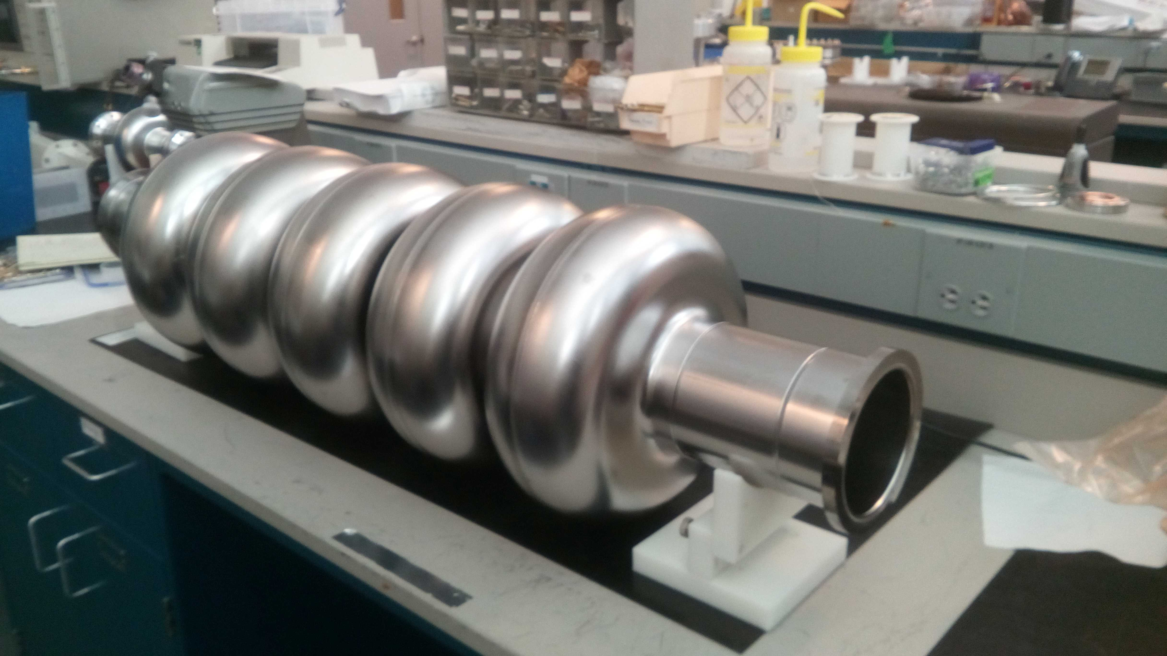
1st 802 MHz Cavity
Tests ongoing. CERN-Jlab design, produced at Jefferson Laboratory November 2017
Goal: 16 MV/m, Q₀ > 10¹⁰ operated in CW in the PERLE+LHeC ERLs, prototype also for FCC-ee

Slide 33
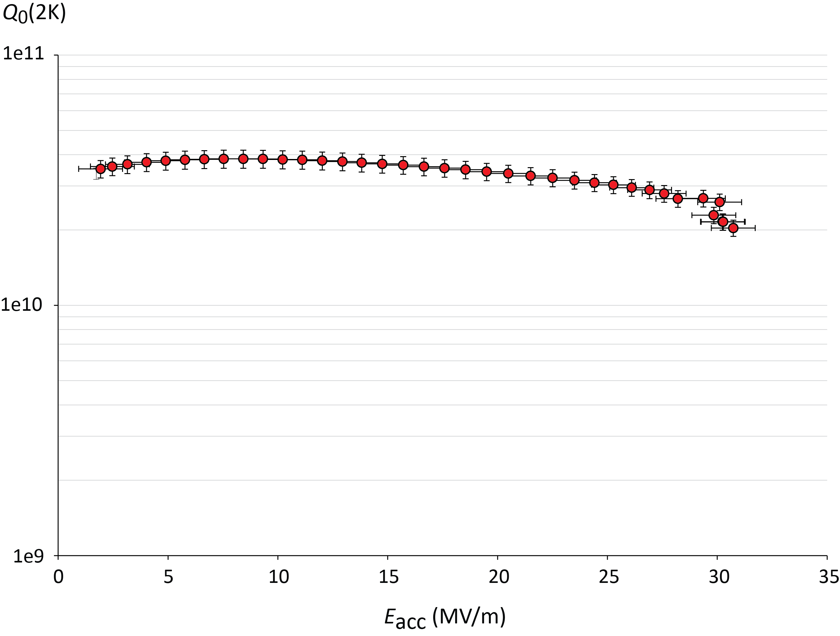
Initial 2K Test of 802 MHz Nb Cavity. December 17
High quality, CW: operation point at about 18 MV/m. Quench at 31 MV/m
Rerinsing for field emission suppression, observed at higher gradients.
Next: HOM adapter and cryomodule design – cavity production to proceed.

Slide 34
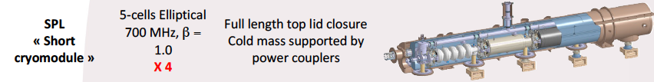
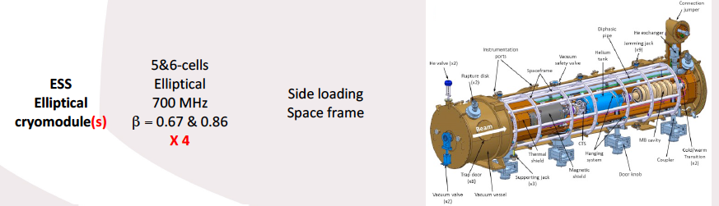

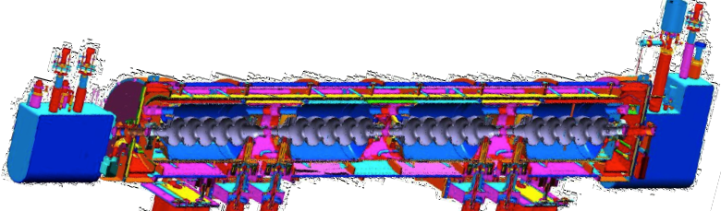

Next Step: Cryomodule
Plan for production of PERLE cryomodules (2) by IPN Orsay in collaboration with Jlab+CERN
Jlab
SNS 805 MHz cryomodule

Slide 35
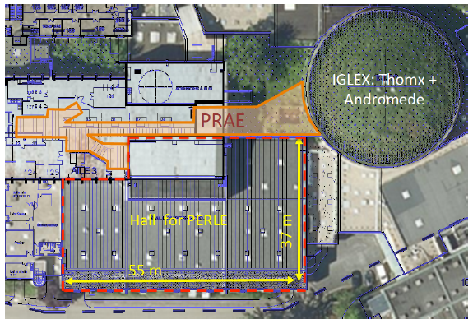
title

Slide 36
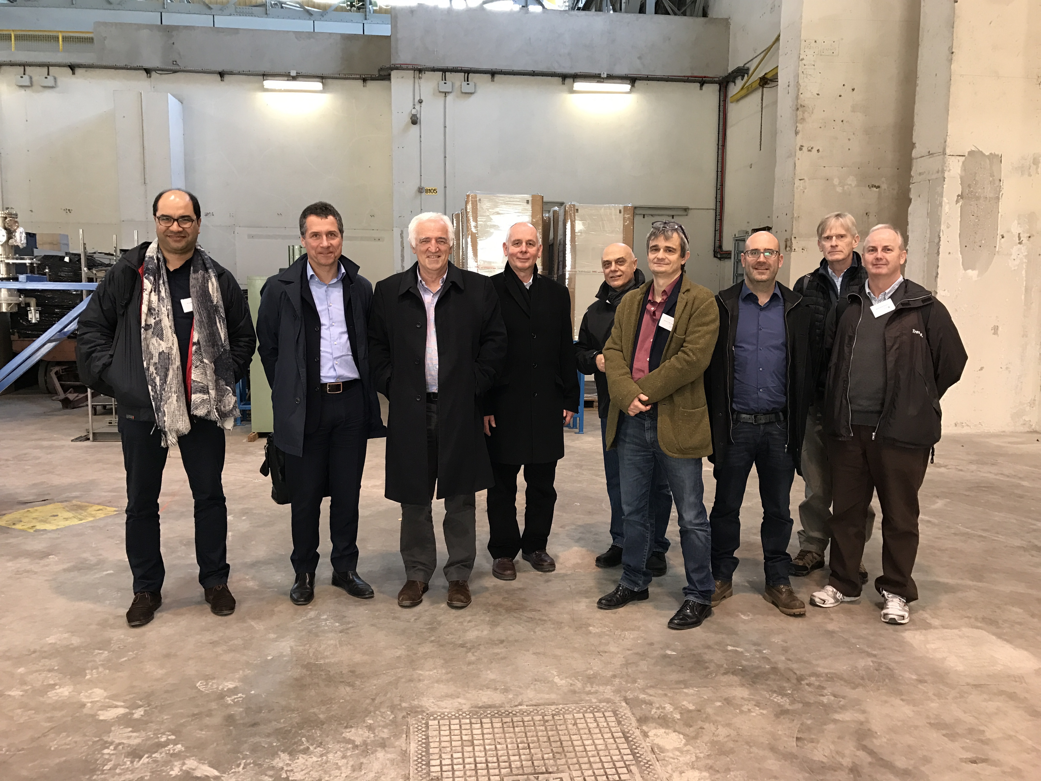
title

Slide 37
Outline
0. Bits of Information
1. Parameters and Configuration of the LHeC
2. PERLE Testfacility for Energy Recovery Physics and SCRF
3. Detector Development for LHeC and Installation Issues
4. Selected Physics Highlights (PDFs, Higgs, BSM)
5. Extension to the multi TeV range (FCCeh and in China)

Slide 38
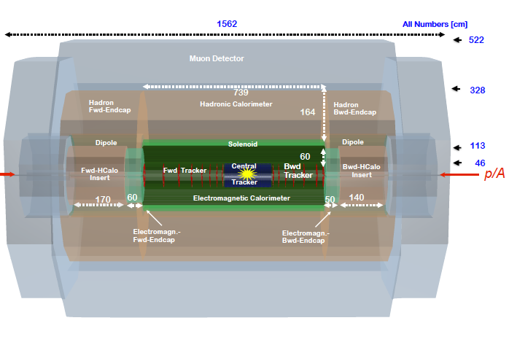
title
LHeC Detector for the HE LHC
e
P.Kostka et al
Length x Diameter: LHeC (13.3 x 9 m²) HE-LHC (15.6 x 10.4) FCCeh (19 x 12)
ATLAS (45 x 25) CMS (21 x 15): [LHeC < CMS, FCC-eh ~ CMS size]
If CERN decides that the HE LHC comes, the LHeC detector should anticipate that

Slide 39
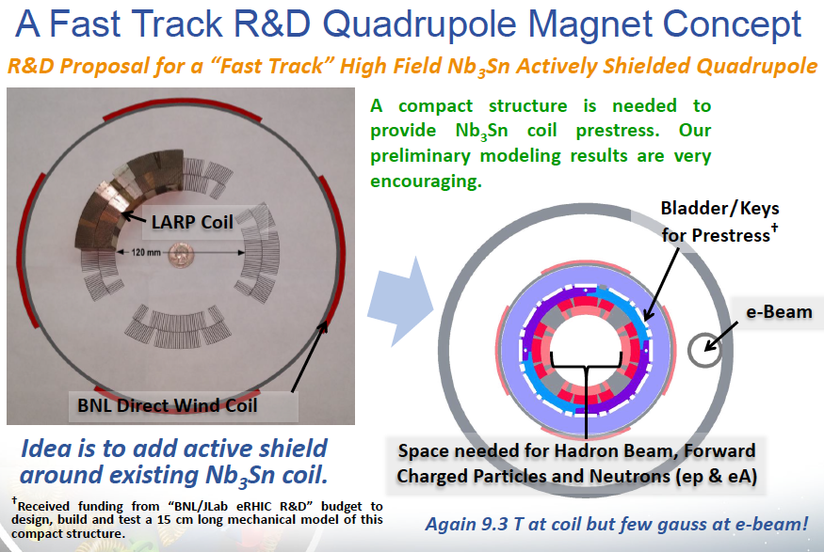
Concluding Work on IR (3 beams, cf CDR)
Brett Parker at September 2017 LHeC Workshop. Replace Q1 of CDR by another design

Slide 40
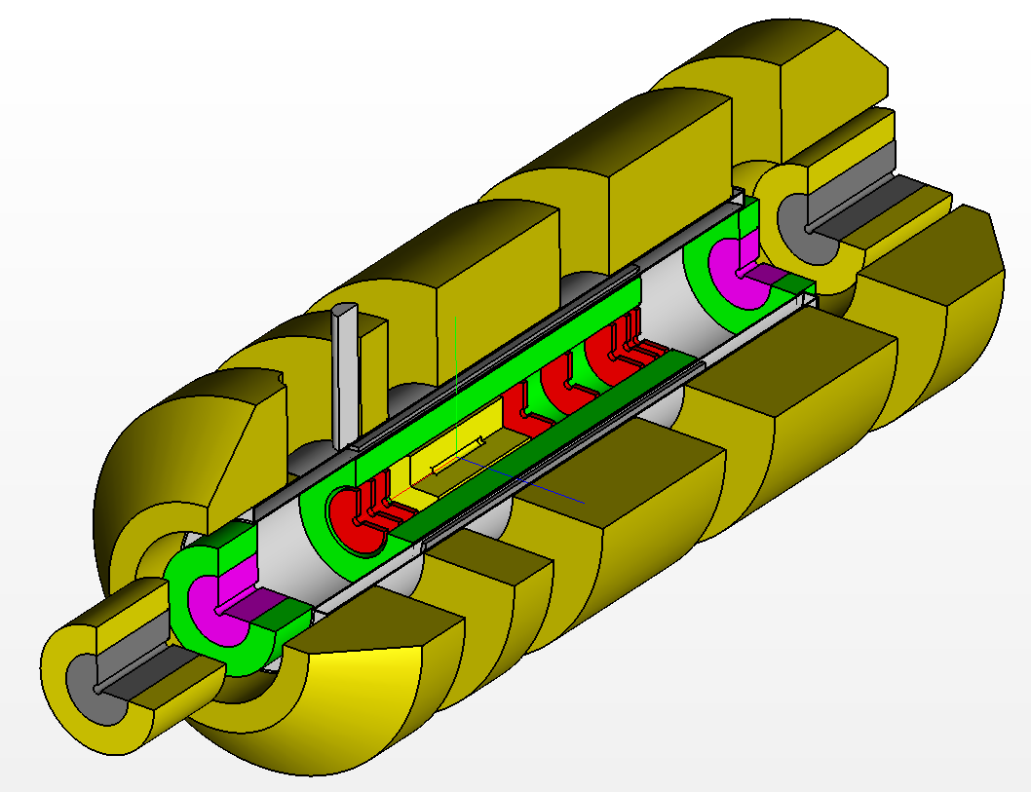
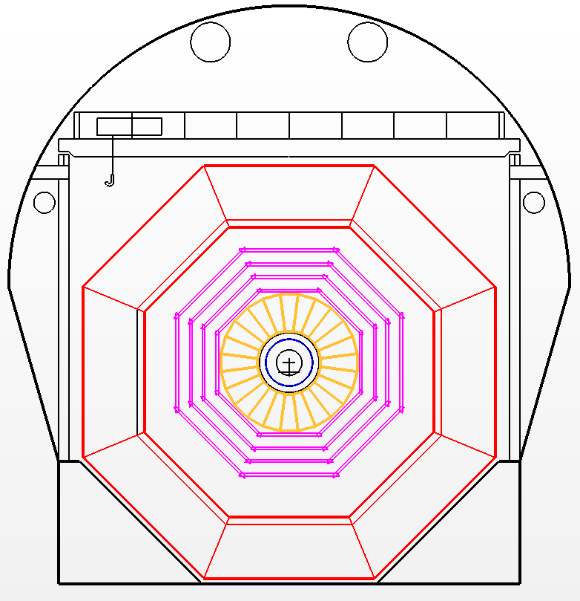
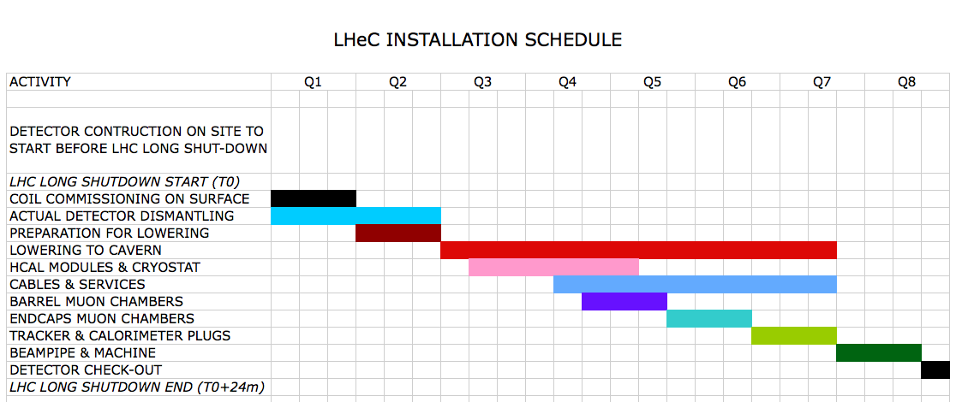
Installation
Study to fit into LHC shutdown needs directed to IP2
Andrea Gaddi et al
Detector fits in L3 magnet support
Modular structure

Slide 41
Outline
0. Bits of Information
1. Parameters and Configuration of the LHeC
2. PERLE Testfacility for Energy Recovery Physics and SCRF
3. Detector Development for LHeC and Installation Issues
4. Selected Physics Highlights (PDFs, t, Higgs, BSM)
5. Extension to the multi TeV range (FCCeh and in China)

Slide 42
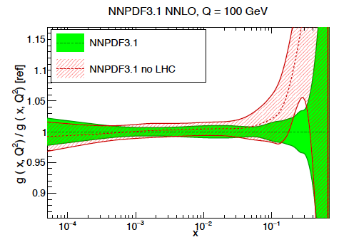
LHC Folklore: PDFs come from pp
LHC data constrain PDFs, BUT do not determine them:
Needs complete q_{i},g unfolding (miss variety)
at all x, as there are sumrules
- Needs strong coupling to permille precision, not in pp
Needs stronger effects (miss Q² variation)
cannot come from W,Z at Q²=10⁴ GeV²
Needs clear theory (hadronisation, one scale)
Needs heavy flavour s,c,b,t measured and VFNS fixed
Needs verification of BFKL at low x (only F₂-F_{L})
Needs N³LO (as for Higgs)
Needs external input to find QCD subtleties
such as factorisation, resummation…to not go wrong
- Needs external precise input for subtle discoveries
Needs data which yet (W,Z) will hardly be better
Needs agreement between the PDfs and χ²+1 ..
NNPDF3.1 arXiv:1706.00428
PDFs are not derived from pp scattering. And yet we try, as there is nothing else.., sometimes
with interesting results as on the light flavour democracy at x ~ 0.01 (nonsuppressed s/dbar).
Can take low pileup runs, mitigate PDF influence .. – but can’t do what is sometimes stated.
LHeC vs HERA: Higher Q²: CC; higher s: small x/g saturation?; high lumi: x→ 1; s, c,b,t. …

Slide 43
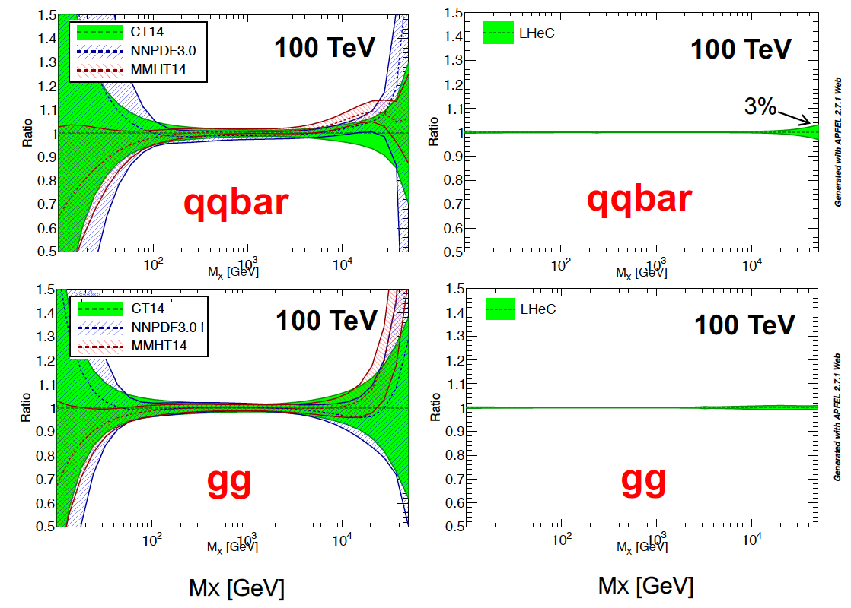
The LHeC PDF Programme
Resolve parton structure of the proton completely: u_{v},d_{v},s_{v}?,u,d,s,c,b,t and xg
Unprecedented range, sub% precision, free of parameterisation assumptions,
Resolve p structure, solve non linear and saturation issues, test QCD, N³LO…
Strong
Coupling in
inclusive
DIS at LHeC
to 0.1%
Lattice??
Jets??
BCDMS??
GUTs?
Higgs in pp
Solve the PDF issues for pp and test QCD with permille measurement of strong coupling

Slide 44


Slide 45


Slide 46



Empowering pp Discoveries
External, reliable input (PDFs, factorisation..) is crucial for range extension + CI interpretation
GLUON
QUARKS
SUSY, RPC, RPV, LQS..
Exotic+ Extra boson searches at high mass
ATLAS
today

Slide 47

High Precision for the LHC
Spacelike M_{W} to 10 MeV from ep
→ Electroweak thy test at 0.01% !
Predict M_{W} in pp to 2.8 MeV →
Remove PDF uncertainty on M_{W} LHC
Predict the Higgs cross section in pp to
0.2% precision which matches the M_{H}
measurement and removes the PDF error

Slide 48
LHeC Higgs Physics
High precision coupling measurements
Higgs as portal to new physics (in decay and production of non SM Higgses)
CC cross section: 200 fb. That is the ‘same’ value as for Z* → HZ in e⁺e⁻
NC cross section: 25 fb. ZZ → H (→ WW) and WW → H(→ ZZ) uniquely distinguishable.
VBF cross sections in pp at LHC are O(100) fb also.
Final state in ep clean. Pileup 0.1 at LHeC. Theory clear. Luminosity to 0.5-1%.
Detector: full acceptance to η = 4.7 Requirement for high resolution hadron calorimeter
First studies: complete detector, S and B simulation and BDT for H→ bb and cc
New: MADGRAPH based extension to other channels using bb and cc experience
New also: various, often Chinese publications on exotic Higgs physics in ep, cf below
and talks by Uta Klein and Kechen Wang last week at FCC Physics at CERN
H-HH: very hard at LHeC, possible to ~30% at FCC-eh: see arXiv:1509.04016 M Kumar et al

Slide 49

title

Slide 50

Comparison LH(e)C and CEPC
preliminary
LHC: ATLAS 2014
(will be better)
LHeC: MK+UK
FCC WS1/18
LHC: pp (no thy) + ep
CEPC: M Ruan, 14.1.17
scaled to 1ab⁻¹
Signal strength in %
The ep and the e⁺e⁻ prospects of measuring Higgs decays are (about) the same for same L.
Note that 1ab⁻¹ is 10 years of operation at 10³⁴ , at high reliability.
J Gao: CEPC wants 3 10³⁴ and hopes for 5 ab⁻¹. Theorists write about a 350 GeV operation.
LHeC NC: ZZ→H → bb at high precision which should fix the H-ZZ coupling to 2%.. Γ ??
Sum of all major decay channels: LHC 0.89+-0.12, LHeC 0.99 +- 0.02, LHCep+pp: 1.00+-0.01
In ep couplings are overconstrained. Fit to do. EFT analyses may then include ep.
The addition of the LHeC to the HL LHC transforms that into a high precision Higgs facility

Slide 51



Top Physics
Top electric charge
EDM and MDM
Anomalous t-q-y and t-g-Z
V_{tb} and W-t-b
Top spin
Top PDF
Top mass
Top-Higgs (1602.04670)
CP nature of ttH (1702.03426)
LHeC and even more FCC-eh are top factories with huge BSM potential
For top itself: maximise Ee. For t as background for Higgs: not too much
Pair production Single production
cf Christian Schwanenberger, Top in ep, Talk at FCC Physics Week 17.1.18

Slide 52


Slide 53

Uta Klein, Higgs in ep, Talk at FCC Physics Week, 16.1.18

Slide 54




Lots of important new papers on BSM in ep
Sterile (heavy) Neutrinos in ep → NX
Search for Higgsino at LHeC
arXiv:1612.02728
arXiv:1712.07135
Joint study on pp/pe/ee

Slide 55
QCD - Developments and Discoveries
AdS/CFT
Instantons
Odderons
Non pQCD
QGP
N^{k}LO
Resummation
Saturation and BFKL
Non-conventional PDFs …
Breaking of Factorisation
Free Quarks
Unconfined Color
New kind of coloured matter
Quark substructure
New symmetry embedding QCD
QCD may break .. (Quigg DIS13)
QCD is the richest part of the Standard Model Gauge Field Theory and
will (have to) be developed much further, on its own and as background.

Slide 56

Electron-Ion Nuclear and Particle Physics
Extension of kinematic range in lA
by 4 orders of magnitude:
will change QCD view on nuclear
structure and parton dynamics
May lead to genuine surprises…
No saturation of xg (x,Q²) ?
Small fraction of diffraction ?
Broken isospin invariance ?
Flavour dependent shadowing ?
Relates to LHC Heavy Ion Physics
- Quark Gluon Plasma
- Collectivity of small nuclei (p)?
..
Saturation: needs large xg at small x
ep and eA

Slide 57
Five Major Themes of Electron-Hadron Physics at the energy frontier
Cleanest High Resolution Microscope
Joint ep and pp Physics at LHC and FCC
High Precision Higgs Exploration
Discovery Beyond the Standard Model
A Unique Nuclear Physics Facility
CERN has the obligation to utilize its potential fully: the HL LHC programme can and should not
“fade away”, new discoveries have to be correctly interpreted, and the world’s Collider
future is with CERN. DIS has to be part of it, as Guido Altarelli and Lev Lipatov had taught us.

Slide 58
Outline
0. Bits of Information
1. Parameters and Configuration of the LHeC
2. PERLE Testfacility for Energy Recovery Physics and SCRF
3. Detector Development for LHeC and Installation Issues
4. Selected Physics Highlights (PDFs, Higgs, BSM)
5. Extension to the multi TeV range (FCC-eh and in China)

Slide 59

FCC-eh
60 GeV ERL tangential to FCC-hh. IP: L for geological reasons. L= 1.5 10³⁴ Higher s, Q², 1/x

Slide 60

More than 60 GeV E_{e}? Not for the FCC CDR
Higher E_{e} is desirable for BSM, LQ, RPV SUSY.., hhh, forward angular coverage.
It could be thought of with the LHC or FCC tunnels, or an e-p linac (Litvinenko)
Still: plan for synchronous ep and pp operation and appropriate cost, power, effort..
It thus appears most natural to consider the LHeC ERL as the electron beam for eh
Max Klein Summary FCC-he Washington DC 27.3.2015

Slide 61





Tunnels: Triple Arc and LINACs
Arc
DRAFT: for ERL in any pp combi.
cf Matt Stewart et al. 12.9.17
RF Gallery
LINAC

Slide 62

FCCeh
Claire Gwenlan PDFs at FCCeh – FCC Week 1/2018

Slide 63

Electroweak Physics: LHeC and FCCeh

Slide 64


FCC-eh
Impressive flow of new
physics in ep studies is
being digested for 2018
Kechen Wang, BSM in ep, FCC Workshop 1/2018 at CERN

Slide 65

FCC-eh
ep combines: high energy, high luminosity with clean final state: unique BSM potential
see the discussion in D Curtin et al on Higgsino search: 1712.07135
Kechen Wang, BSM in ep, FCC Workshop 1/2018 at CERN

Slide 66

title
Uta Klein, Talk at FCC Workshop 16.1.18

Slide 67

title

Slide 68
FCCeh: Higgs SM Coupling Prospects
δκ/κ [%]
Charged Current ep →νHX
Neutral Current ep → eHX
preliminary
HL LHC: ATLAS-PUB-2014-016 14 TeV 3ab⁻¹ – LHC has no gg, no cc, and poor bb, but rare channels as γγ
LHeC: 1ab⁻¹, 60 GeV x 7 TeV - Work in progress. ep also provides precise: xg, α_{s} and PDFs to N³LO..
LHC (ep+pp): HL LHC with reduced theory uncertainty combined with LHeC
FCCeh: 2ab⁻¹, 60 GeV x 50 TeV - Work in progress. ep also provides precise: xg, α_{s} and PDFs to N³LO..
Improvements: ATLAS 2014 conservative, no CMS. ep (LHeC/FCCeh) are overconstrained:
CC+NC, ratios, sum(br)=1.. → joint coupling determination: especially WW and ZZ should improve
U+M Klein, Contribution to FCC Workshop, 16.1.2018, preliminary. cf talk by Uta Klein

Slide 69



LHeC/FCC ep/eA detector
Muons
LHeC Detector
Hadron
Fwd-Endcap
FCCeh Detector
e∓
Dipole
Fwd-HCalo
Insert
Hadronic Barrel Calorimeter
Electromagn.-
Fwd-Endcap
Solenoid
Hadron
Bwd-Endcap
Fwd Tracker
Central
Tracker
Electromagnetic Calorimeter
Bwd Tracker
Dipole
Bwd-HCalo
Insert
Electromagn.-
Fwd-Endcap
p/A
Central Tracker
circular-elliptical beam pipe
4 layers Si-pixel
5 layers Si-strixel
(see Table of Detector Dimensions/Parameters in backup)
Length of Inner Solenoid ~12m

Slide 70

FCC-eh
Jie Gao, HKUST Conference, 22.1.18

Slide 71

FCC-eh
Jie Gao, HKUST Conference, 22.1.18

Slide 72
Luminosity for LHeC, HE-LHeC and FCC-ep
Contains update on eA:
6 10³² in e-Pb for LHeC.

Slide 73

title

Slide 74
Final Remarks
ep physics at the energy frontier has 4 big themes:
Cleanest high resolution microscope on the substructure of and dynamcis inside matter
Empowering the search and precision measurement potential of the LHC/FCC
Transformation of LHC (HE LHC+ FCC-hh) into high precision Higgs facility/ies
Discovery beyond the SM, through high precision and direct discovery, also QCD
eA at the energy frontier is a unique NP facility to establish QCD of QGP + nuclear structure
eh and hh belong and can operate together.
Luminosities beyond 10³⁴ are crucial to achieve (1000 x HERA), ERL is a green technology
The CERN electron beam solution is unique: 3 pass, 802 MHz, high current ERL, its
test opens new horizons for SCRF and low energy physics and other applications (I:100 x ELI),
the ERL facilities can be turned to next generation FEL labs, huge potential impact
The LHeC opens the opportunity to build a new, high tech detector in the twenties, with
high resolution, precise tracking and large acceptance needs, at no pile-up and low radiation
Next steps: PERLE TDR, Brief input to the European strategy, Workshop 27-29.6. Paris,
Update of the LHeC CDR towards a new experiment at the LHC, summary for FCC CDR
You are welcome to join any or all of these activities. Cinderella’s life is not so bad.

Slide 75

Workshops
September 2017
https://indico.cern.ch/event/639067/
Next: 27-29 June 2018 Orsay
https://indico.cern.ch/event/698368/
Preparation for strategy:
Physics, Accelerator, Detector, PERLE
Many eh related workshops
FCC: Last week Physics (CERN)
and in April (Amsterdam)
POETIC in March (Regensburg)
DIS in April (Kobe)
HL-HE LHC Physics 17/18 (CERN)
which includes ep/eA
https://lhec.web.cern.ch

Slide 76

Logo of the CDR
W.Kandinsky: “Circles in a circle” (1923) Philadelphia (USA) Museum of Art
First shown in LHeC context in a talk by A.S.Vera Workshop 2008
Many thanks to the LHeC/FCC-eh collaborators, the IAC, to CERN and our labs
https://lhec.web.cern.ch

Slide 77

The LHeC is not the first racetrack of the world.
It can be built and will lead to fundamental
progress in particle physics and technology
in our lifetimes, the elder ones included..
An early racetrack embedded in the Vatican (XV century)

Slide 78

“The future belongs to those who believe in the beauty of their dreams.”
Anna Eleanor Roosevelt
(1884-1962)
Universal Declaration of Human Rights (1948)
cited by Frank Zimmermann at the FCC Meeting at Washington DC, March 2015

Slide 79
title

Slide 80

title
HL LHC offers unique opportunity for ep and eA detector in the 30ies
O Bruening, F Bordry

Slide 81





Exotic Higgs Decays
1% branching with 1ab⁻¹ at FCC-eh (prel)
Search for Higgsinos. D Curtin et al
To appear next week
LLP: ep unique: energy higher than in ee, much cleaner than pp

Slide 82

title

Slide 83

FCC-eh Detector Parameters

Slide 84


Search for Higgsino in ep

Slide 85
How it developed - DGs
1984 Herwig Schopper: Lausanne Meeting on LHC
1990 Carlo Rubbia at ICHEP Singapore: pp 1996, ep 1998 ..
1997 Chris Llewellyn Smith: LHC approval, with ‘ions and ep as a bonus’
2007 Robert Aymar, rECFA: Mandate to develop LHeC → CDR in 2012
2013 Rolf Heuer: “SM developed through synergy of pp,ee and ep” – new IAC
2016 Fabiola Gianotti: Reconfirmation of that Mandate for the IAC → update 2018

Slide 86

FCC-eh
Kechen Wang, BSM in ep, FCC Workshop 1/2018 at CERN

Slide 87

V.N. Gribov, L.N. Lipatov, Gluboko neuprugoe ep-rasseyanie v teorii vozmushchenii, Yadernaya fizika, 15(4), 781-807 (1972).
2.5.1940 Leningrad
4.9.2017 Dubna
The Pomeranchuk Singularity in Nonabelian Gauge Theories: E.A.Kuraev, L, V.S.Fadin, SJNP 45(77)199
The Pomeranchuk Singularity in QCD: Ya.Ya.Balitsky, L Lipatov: SJNP 28 (78) 822
Small x Physics in perturbative QCD Physics Reports 286 (1997)131, hep-ph/9610276
More recently Lipatov has taken these ideas into the hot, new field in theoretical physics: the anti-de Sitter/conformal-field theory correspondence (ADS/CFT) – a hypothesis put forward by Juan Maldacena in 1997. This states that there is a correspondence – a duality – in the description of the maximally supersymmetric N=4 modification of QCD from the standard field-theory side and, from the "gravity" side, in the spectrum of a string moving in a peculiar curved anti-de Sitter background – a seemingly unrelated problem. However, Lipatov's experience and deep understanding of re-summed perturbation theory has enabled him to move quickly into this new territory where he has developed and tested new ideas, considering first the BFKL and DGLAP equations in the N=4 theory and computing the anomalous dimensions of various operators. The high symmetry of this theory, in contrast to standard QCD, allows calculations to be made at unprecedented high orders and the results then compared with the "dual" predictions of string theory. It also facilitates finding the integrable structures in the theory (Lipatov 2009).
D Diakonov, CERN Courier July 2010

Slide 88

title
CDR: Default configuration, 60 GeV, 3 passes, 720 MHz, synchronous ep+pp, L_{ep}=10³³ cm⁻² s⁻¹
→Update in 2018 (to be published in the fall): 60 GeV + staging, 802 MHz, joint ep+pp, 10³⁴

Slide 89



Forward Tracking at LHeC
Polar angle > 1º ←
0
Work in progress, on tracker layout,
with emphasis on forward acceptance,
and technical issues as asymmetric beam
pipe and material budget.
cf talks by A Pollini, P Kostka and A Gaddi
September LHeC workshop : https://indico.cern.ch/event/639067

Slide 90



Strong Coupling Constant
- α_{s} least known of coupling constants
Grand Unification predictions need smaller δα_{s}
- Is α_{s}(DIS) lower than world average (?)
- LHeC: per mille - independent of BCDMS!
- High precision from inclusive data – α_{s}(jets)??
- Challenge lattice QCD
Uncertainty on Higgs cross section
Giulia Zanderighi, Vietnam 9/16,
from C.Anastasiou et al, 1602.00695
who also discuss the ABM alpha_s..
LHeC simulation, NC+CC inclusive, total exp error
PDG
LHeC

Slide 91




Other Facilities
Normal Conducting 180 MHz + DC Gun
30 mA, 11 MeV, 70-100 ps
BINP, Novosibirsk
+D: MESA at Mainz and S-Dalinac Darmstadt
Also: CEBAF (single pass, 5 GeV, .. CBETA (50mA, 3 pass, FFAG, 1.3GHz)
Strong possibilities for collaboration (ERL workshop 19-23.6.2017 at CERN, E Jensen et al)

Slide 92




Energy frontier eh Physics
BSM
Rise or fall of xg
Non-linear QCD
Nuclear structure
UHEν physics..
Higgs
σ(ep→νhhX→ν4bj)
Low x ~ 1/s
SM
g_{hhh}
CI to 300 TeV
LQ to 4 TeV
Compositeness
??
Higgs couplings bb to 0.2%
h-hh in 4b, cut based: 5-8σ
ep - cost effective Higgs facility
Update 2018 of : Max Klein Summary FCC-he Washington DC 27.3.2015

Slide 93

FCCeh
Claire Gwenlan PDFs at FCCeh – FCC Week 1/2018

Slide 94

Future Nuclear PDFs with LHeC
From an eA collider one can determine nuclear PDFs in a novel, the classic way.
Currently: use some proton PDF base and fit a parameterised shadowing term R.
Then: use the NC and CC eA cross sections directly and get R(x,Q²;p) as p/N PDFs.
Gluon density uncertainty in eA
Charm density in nuclei
preliminary
1fb⁻¹ of sole eA isoscalar data fitted
Impact parameter measurement in eA

Slide 95

Possible Discoveries Beyond SM with LHeC
QCD:
No saturation
BFKL
Instantons
Higher symmetry embedding QCD
Electroweak:
EFTs
Exotic Higgs Decays
Extension of Higgs Sector
Sterile Neutrinos …
Search for Sterile Neutrinos (LHC LHeC)
It is a wasted p that does NOT collide with an e beam
(Oliver Fischer - 2017)
It would be a waste not to exploit the 7 TeV beams for ep and eA physics at some
stage during the LHC time (Guido Altarelli – 2008)

Slide 96
FCCeh
Claire Gwenlan PDFs at FCCeh – FCC Week 1/2018

Slide 97







Post-Processing - Electropolishing (EP)
New flange adapters were required to enable electropolishing with existing machine
  Cavity just fits into system (largest cavity so far eletropolished at JLab)
Electropolishing carried out successfully with outside temperature control (water spraying, cavity walls < 25 deg. C)

Slide 98

Dissidents are normally excluded → PDF or α_{s} uncertainty diminished
perhaps tolerable for average use,
not for precision, not for searches
Claire Gwenlan at FCC Week, January 2018, CERN

Slide 99
Can CERN host pp and DIS at once?

Slide 100




.. in the 80ies it successfully did
Charged Currents
BEBC, CDHS(W), CHARM, CHORUS
UA1
Neutral Currents
UA2
Pierre Darriulat
BCDMS, EMC, SMC, COMPASS

