Slide 1
DIS with the LHC
LHeC – CDR (Refereed, NuPECC, ECFA)
Scaling the Effort and Physics
A Next Step
For the DG of CERN, Rolf Heuer. M.Klein, CERN, 19.2.2013

Slide 2
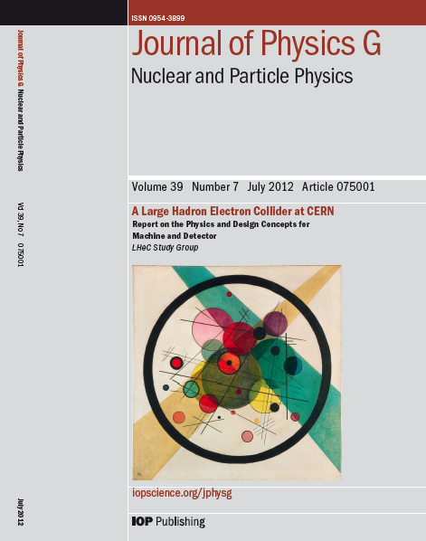
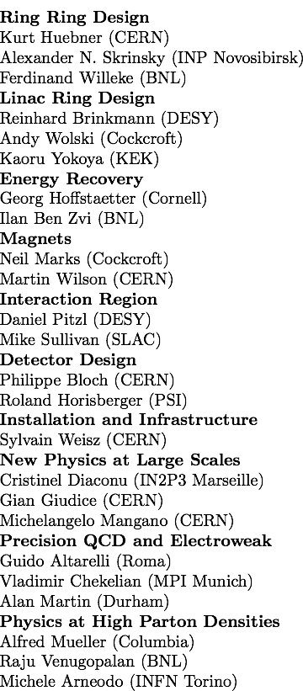
CERN Referees
Published 600 pages conceptual design report (CDR) written by 200 authors from 60 Institutes and
refereed by 24 world experts on physics, accelerator and detector, which CERN had invited.

Slide 3
Close Link of ep (and eA) to the LHC
“Removal” of QCD uncertainties for
H at the LHC (PDFs, δα_{s}~0.2%, GUT?)
High mass searches (SUSY, ED..)

Slide 4
Scaling of the LHeC with the Electron Beam Energy
Cost and Tunnel Length
Higgs Cross Section and Luminosity
E_{e} [GeV]
E_{e} [GeV]
Cost w/o contingency. 80GeV ~ 1.5BSF
The core detector cost is 106 MSF (CDR).
Luminosity at constant power ~ 1/E_{e} while σ(E_{e}) ~ E_{e}
This corresponds to 5-10k WW→ H in e- CC per year,
independently of E_{e} (modulo acceptance change)

Slide 5

E_{e} = 60 GeV
E_{e} = 30 GeV = 3 * 2 * 5 GeV
[The tunnel length is not only a function of the energy but also dependent on future upgrade capabilities.]

Slide 6
The LHC provides the only, single opportunity to develop DIS as part of HEP for decades

Slide 7
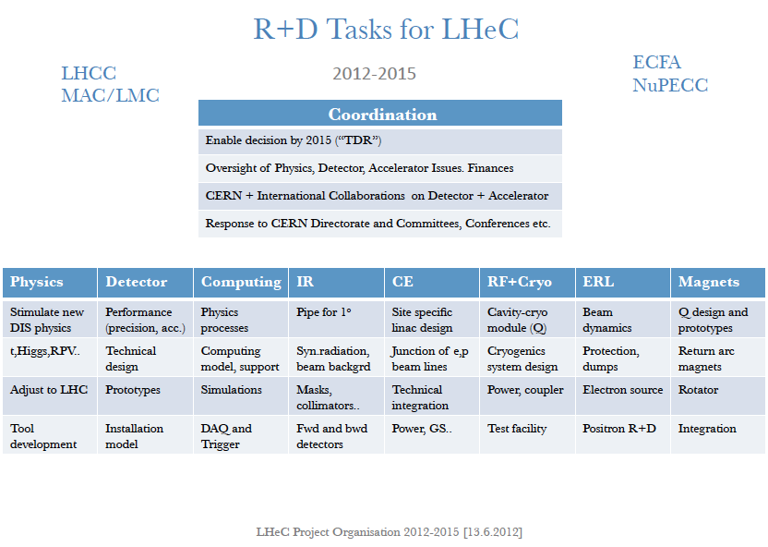
New LHeC project organisation, as considered at Chavannes (June 2012)

Slide 8
Remark
It is feasible to realise an unchallengeable ep and eA DIS physics programme with the LHC.
An accelerator and detector project organisation would have to be built for preparing
such an experiment for the HL phase of operation, following the example of the first
MoU’s in preparation for the LHeC energy recovery testfacility. A sketch of such an
organisation has been considered. Collaborators have expressed interest worldwide
but can only be attracted with a declaration of CERN’s support.
Reducing the electron beam energy, but using energy recovery techniques, it seems
possible to essentially maintain the full physics programme of the 60 GeV LHeC. If
the electron beam energy is halved the cost seems to be 1/3 of the full cost, about.
The final choice of energy depends on the 13 TeV run, and the developments around
the major facilities, the LHC upgrade and the ILC and future considerations. One can
imagine also a genuine synergy with the LHeC as a yy collider (to be studied).

Slide 9
backup

Slide 10
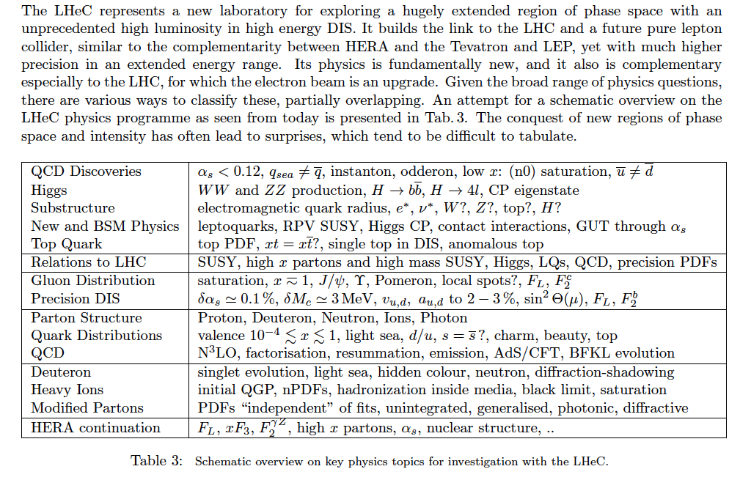
Summary of LHeC Physics [arXiv:1211:4831+5102]

Slide 13
Ring vs Linac - Tentative “Core” Cost
Only for the CERN Directorate and only indicative 24.1.2012
Item | Ring | Linac | Source of information
Civil Engineering | 98+40 | 240+96 | Amber+40% (LHC model)
Rf | 50 | 30 | Guess
Magnets+support | 22k*3946=87 7k*3000=21 | 22k*5118=114 10*3600=36 | Davide Tommassini
Injector | 50 | 5 | Estimate
Cryogenics | 15 | 150 | Friedrich Haug
Linac | -- | 120*1.8=216 | Brinkmann
Total | 361 → 450 | 887 → 1100 | ¼ extra added
Scaling of Linac (and Return Arc) cost leads to 590 instead of 887 for 50 GeV

Slide 14
For the DIS dreams for the very far future an ep/A “bridge” is absolutely crucial.

