Slide 1
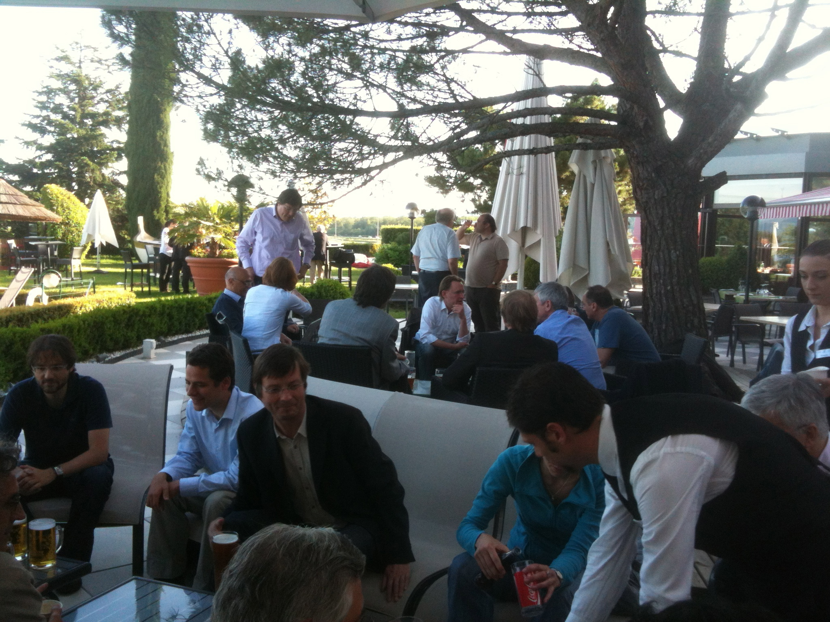
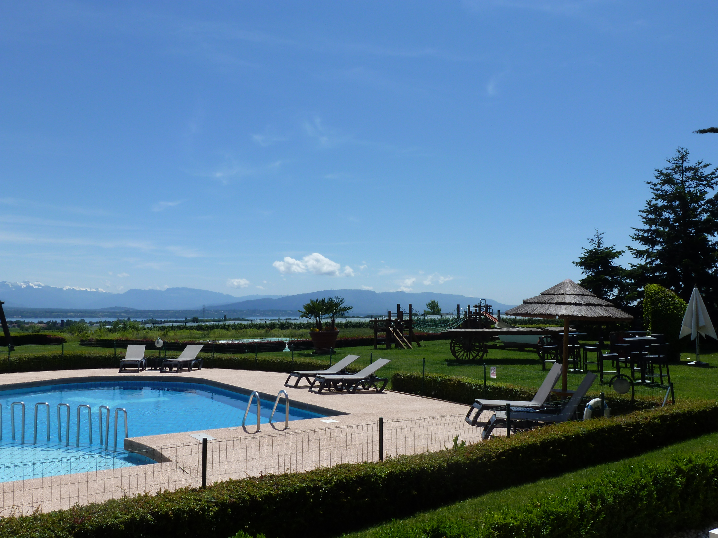
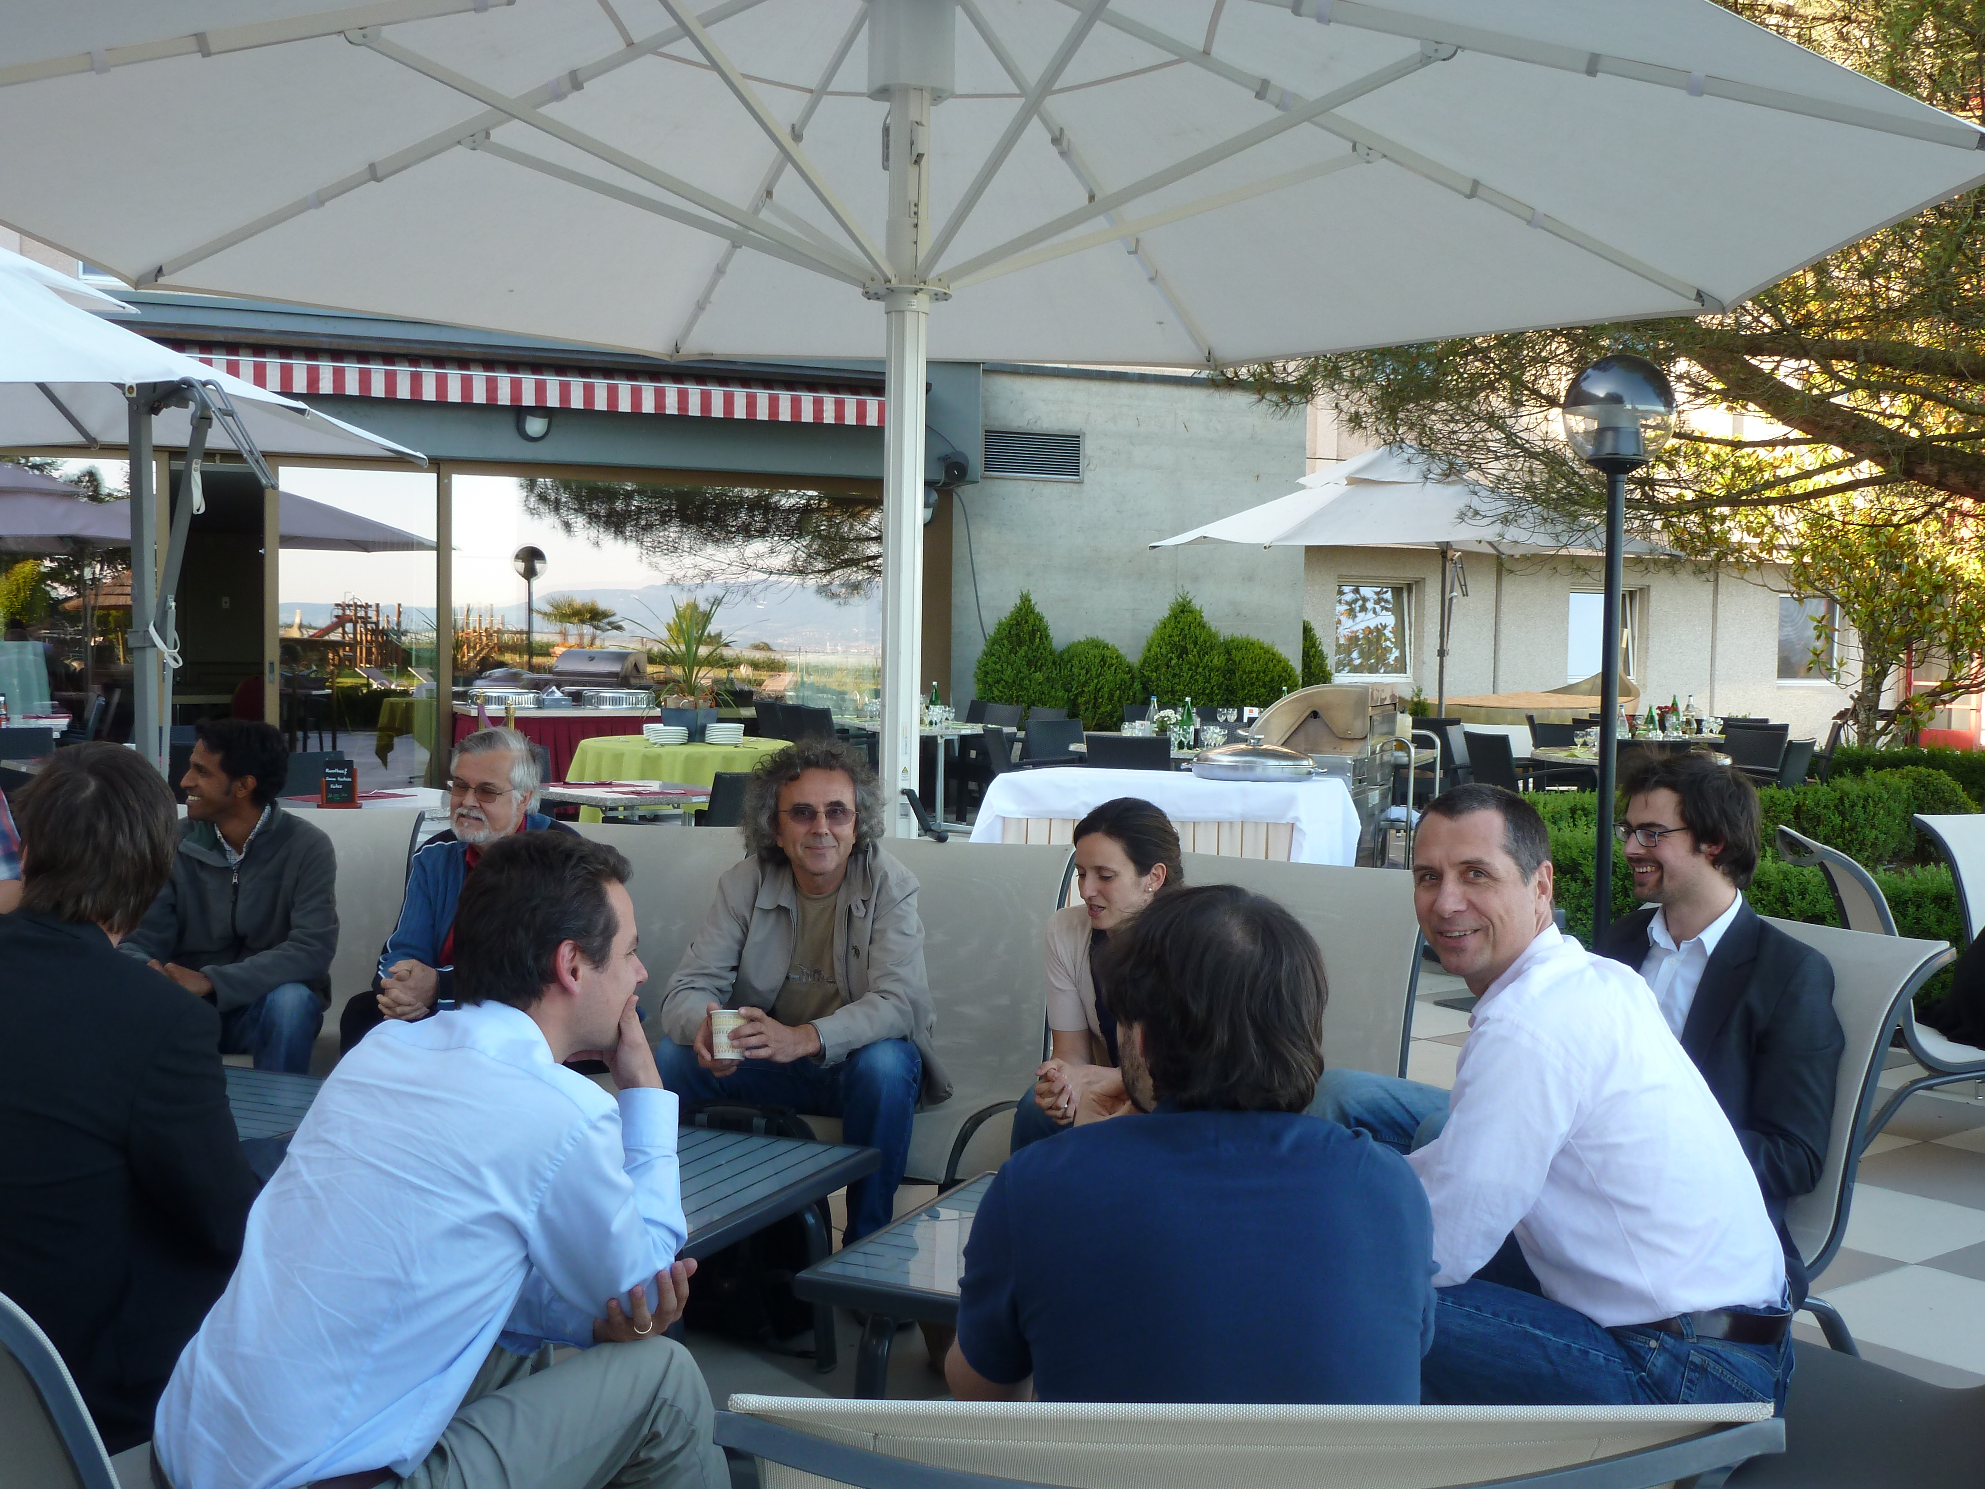
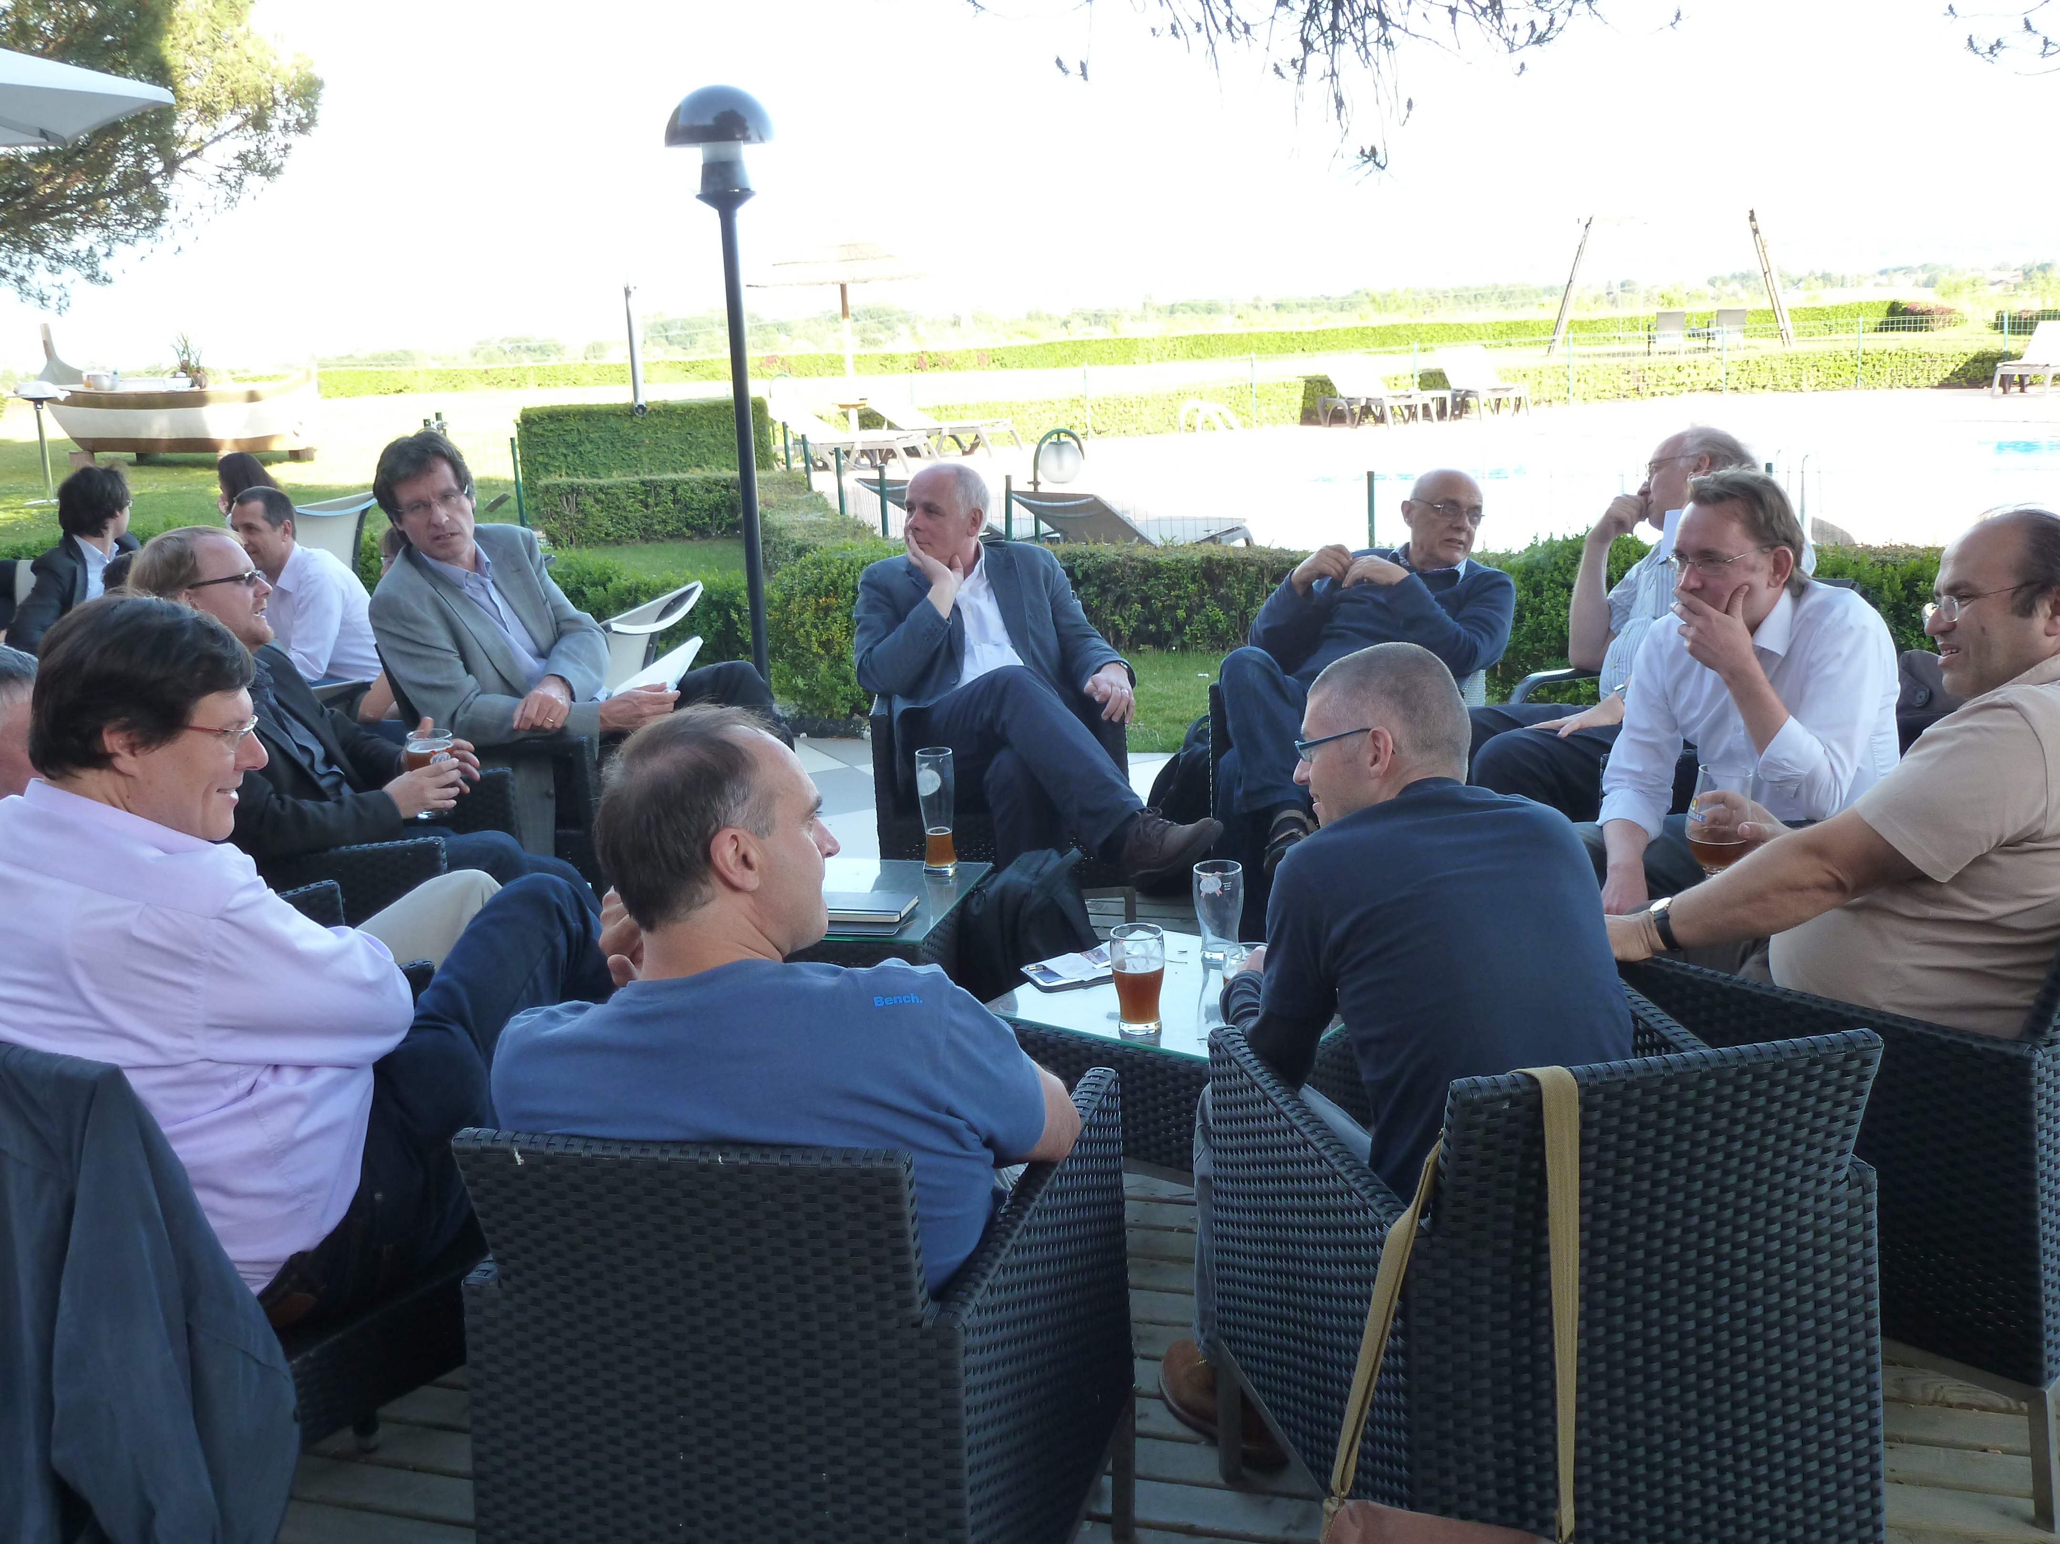
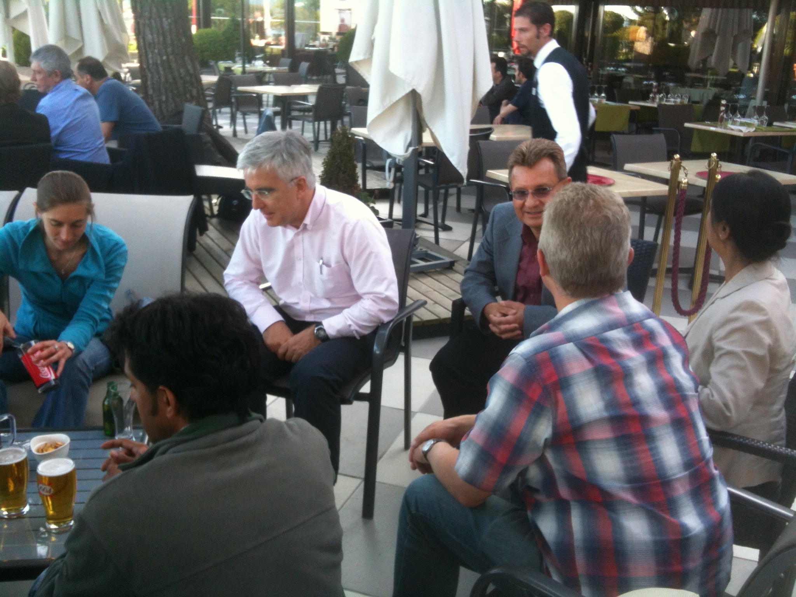

From Chavannes June 2012 to Chavannes January 2014
Max Klein
20.1.2014

Slide 2
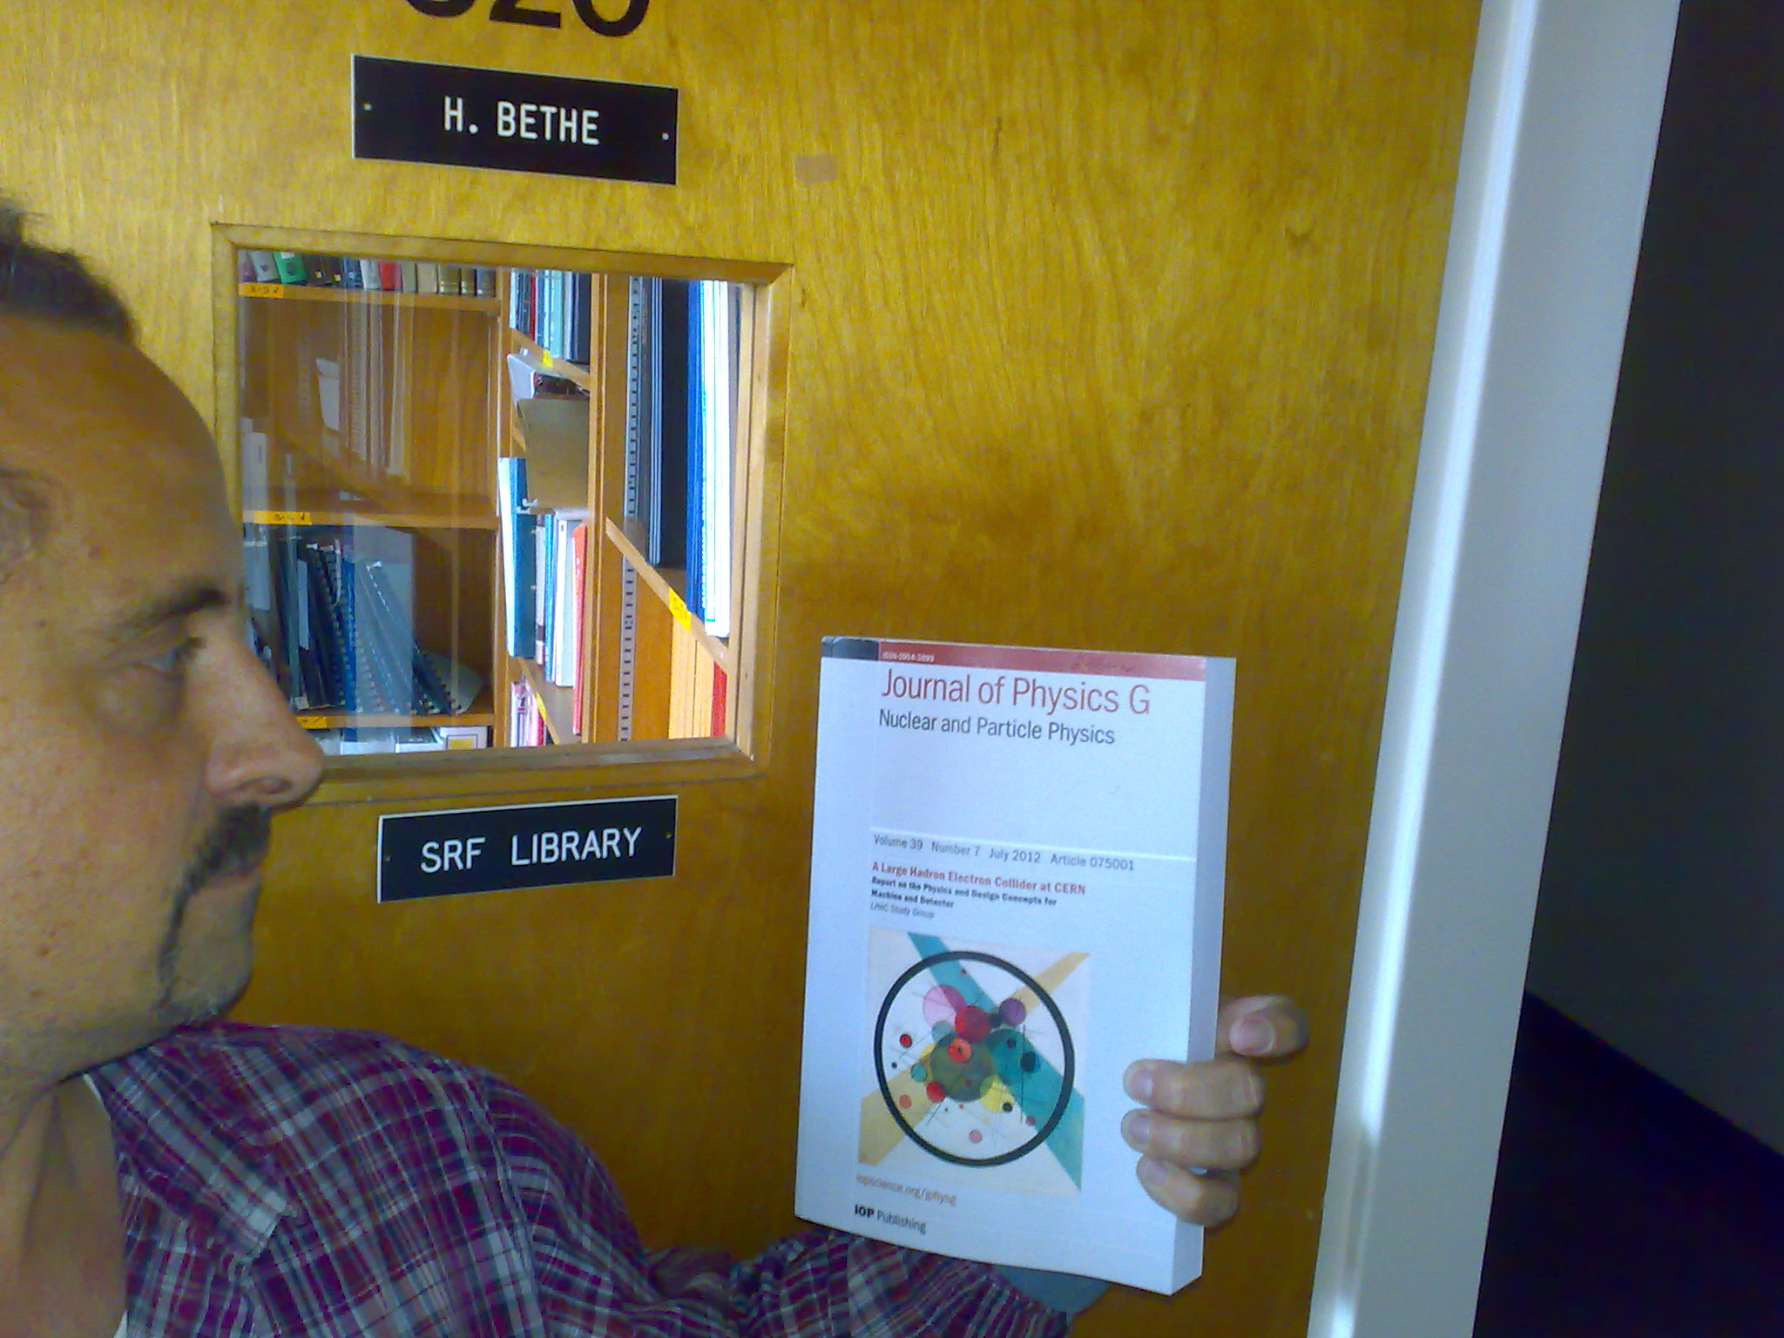
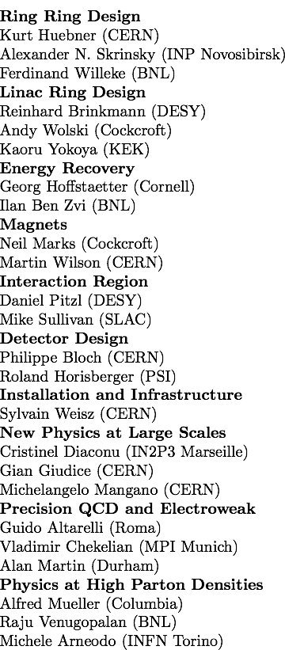
title
CERN Referees
The CDR has found its way
into famous libraries …
What does it say?
R.Eichhorn@Cornell

Slide 3
LHC electron beam upgrade
JPhysG:39(2012)075001, arXiv:1206.2913 http://cern.ch/lhec
CDR: default design. 60 GeV. L=10³³cm⁻²s⁻¹, P< 100 MW → ERL, synchronous ep/pp

Slide 4
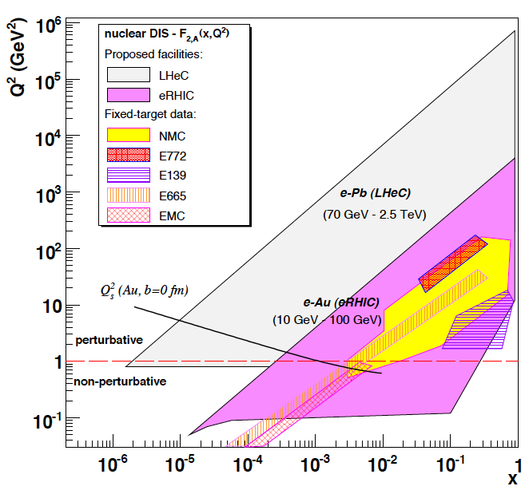
Energy Frontier Electron Ion Collider
LHeC is part of NuPECCs
long range plan since 2010
L_{eN} ~ 10³² cm⁻² s⁻¹
Extension of kinematic range in lA
by four orders of magnitude will
change QCD view on nuclear
structure and parton dynamics
May lead to genuine surprises…
No saturation of xg (x,Q²) ?
Small fraction of diffraction ?
Broken isospin invariance ?
Flavour dependent shadowing ?
D.D’Enterria
Expect saturation of rise at
Q²_{s} ≈ xg α_{s} ≈ c x^{-λ}A^{1/3}
Precision QCD study of parton dynamics in nuclei
Investigation of high density matter and QGP
Gluon saturation at low x, in DIS region.

Slide 5
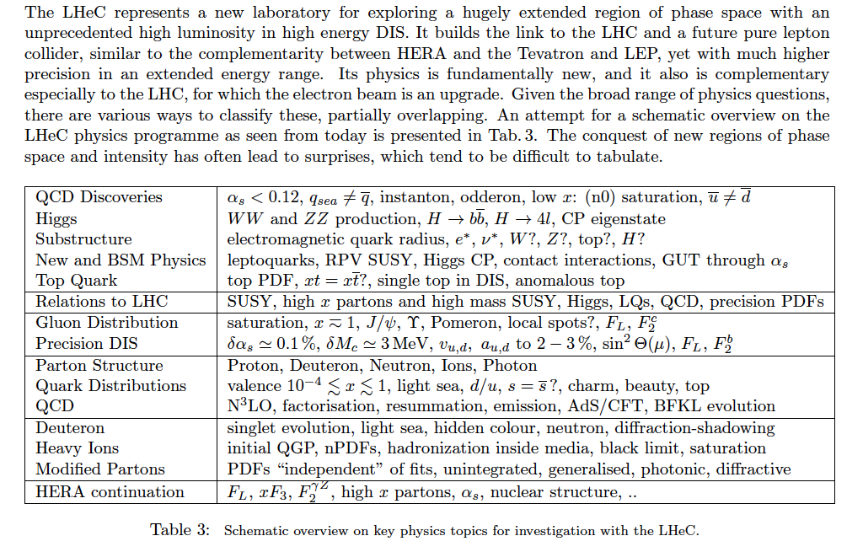
Summary of LHeC Physics [arXiv:1211:4831+5102]

Slide 6
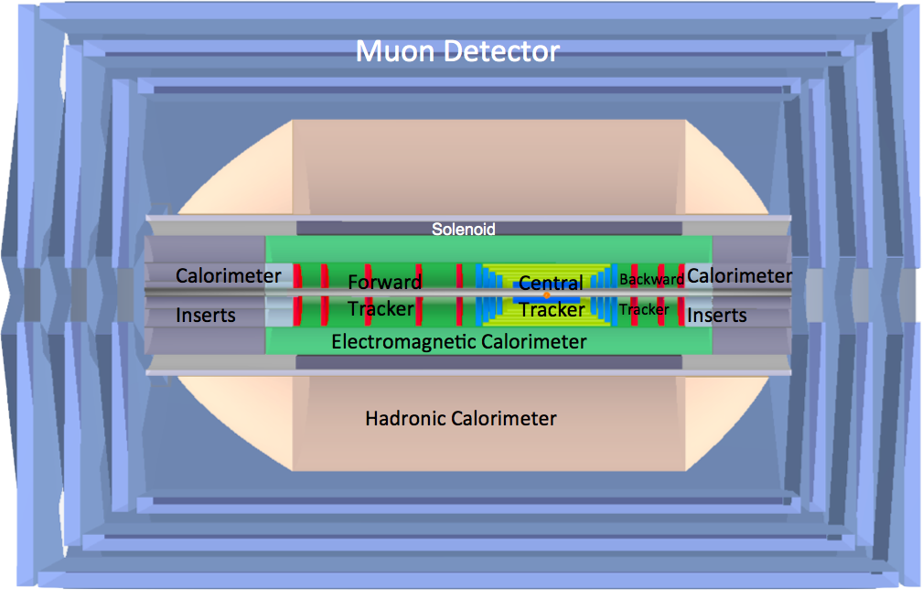
LHeC Baseline Detector - CDR
LAr electromagnetic calorimeter
Tile Calorimeter
Detector option 1 for LR and full acceptance coverage
Forward/backward asymmetry in energy deposited and thus in geometry and technology
Present dimensions: LxD =14x9m² [CMS 21 x 15m² , ATLAS 45 x 25 m²]
Taggers at -62m (e),100m (γ,LR), -22.4m (γ,RR), +100m (n), +420m (p)

Slide 7
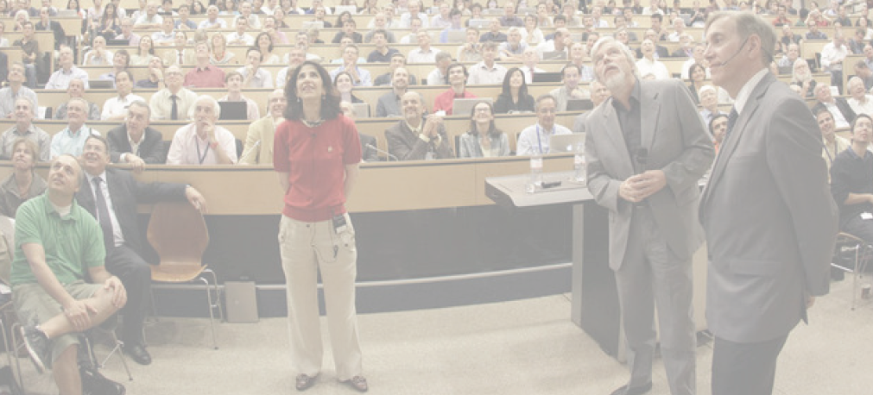
A New Era of Particle Physics
July 2012
4.7.2012 greeting Melbourne from CERN
“The Higgs: So simple and yet so unnatural” G.Altarelli,arXiv:1308.0545
LHeC presented at Melbourne in various sessions, including a talk (UK) on the Higgs in ep

Slide 8
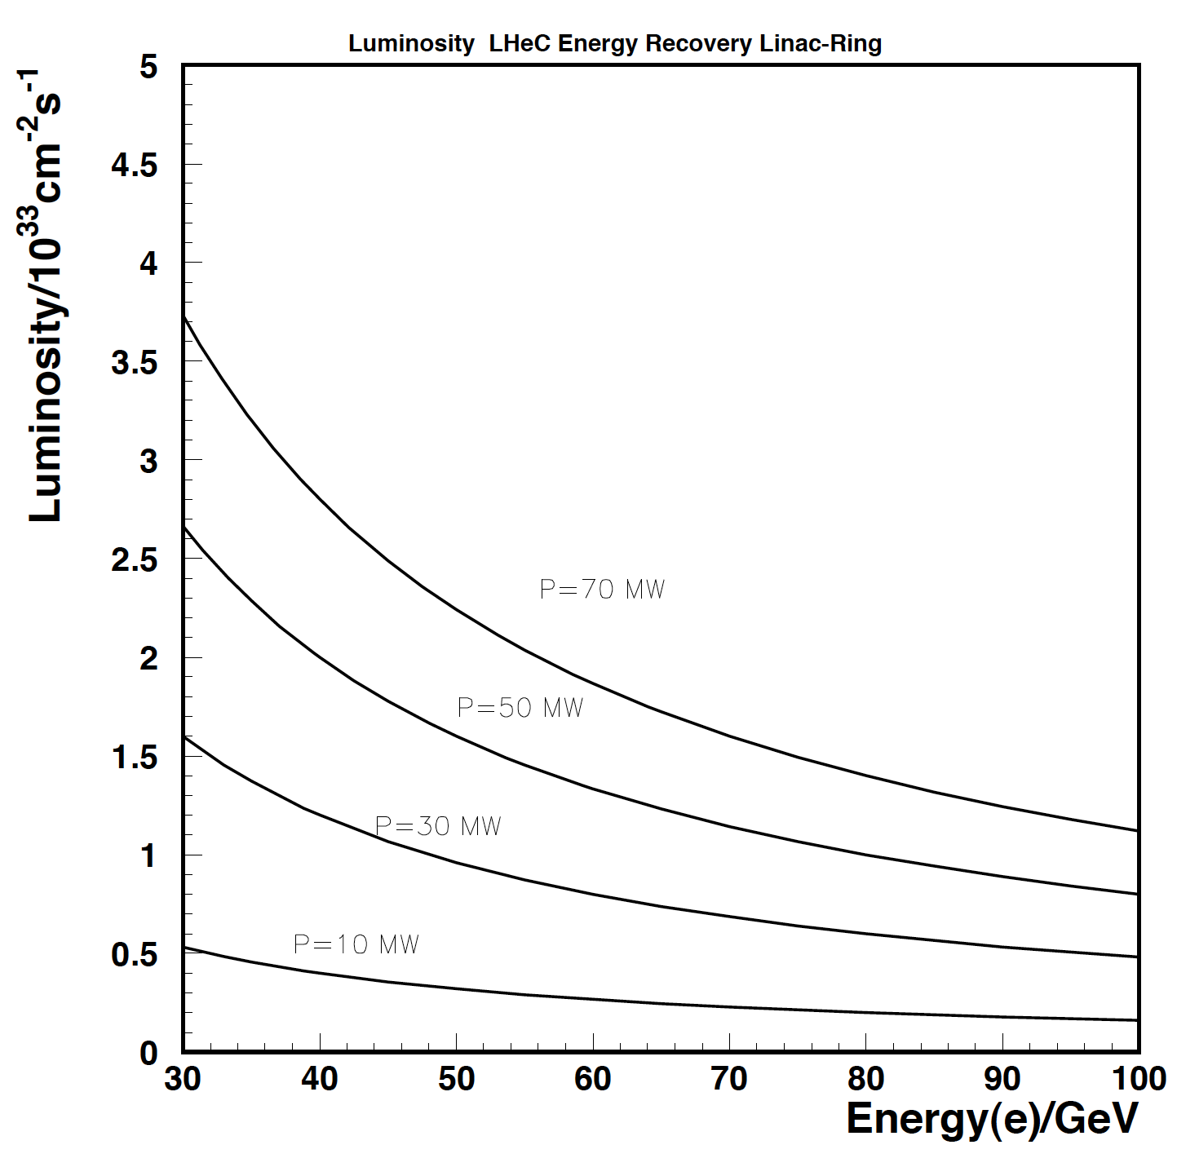
Luminosity
October 2012
The CDR Luminosity
Higgs in ep sets
scale for luminosity!
… so do searches,
high x and special
conditions such as
positron, deuteron,
eA or low energy..
CDR
after the Higgs arXiv:1211.5102
2.5 * brightness, 2 * I_{e} , 0.5 * β*
LHeC Luminosity → 10³⁴ cm⁻² s⁻¹
L(E,P) subject of
current study:
beam-beam, ion
gap stability…
H*pinch(e⁻)*gap-loss ~ 1

Slide 9
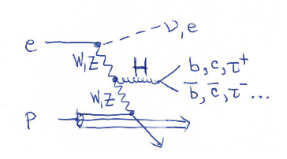
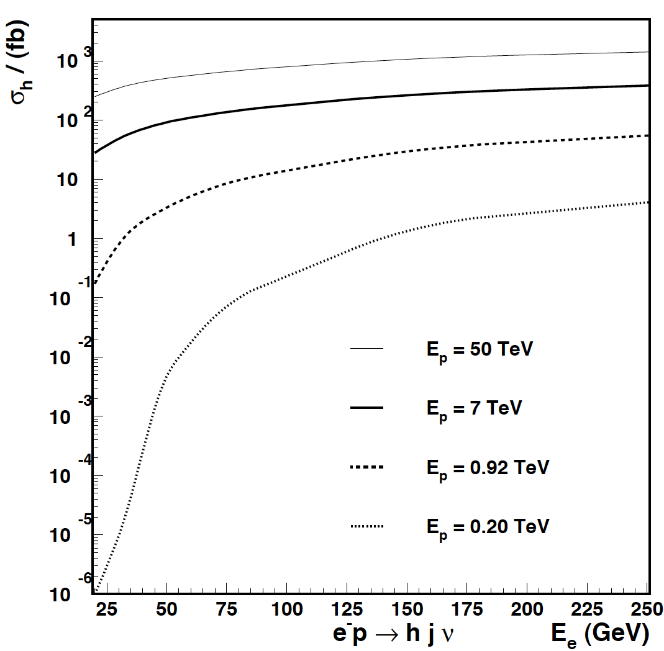
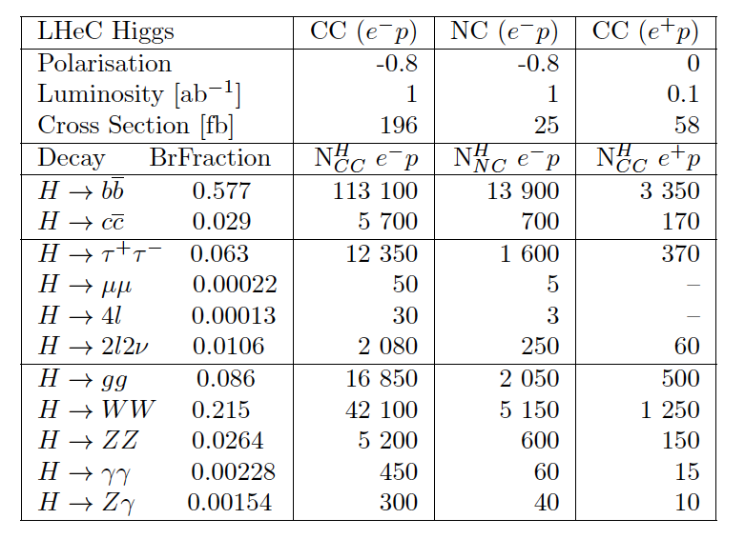
Higgs in Deep Inelastic Scattering
October 2012
R. Godbole PRD 18 (78) 95
FHeC
LHeC
HERA
LHeC O(10⁵) H from VBF
bb: S/N = 1: coupling to 1%
Under study cc, ττ, …. CP
with LHeC detector
takes much effort+time
EIC
Co UK
Charged current ep: Cross section as large as at TLEP/ILC

Slide 10
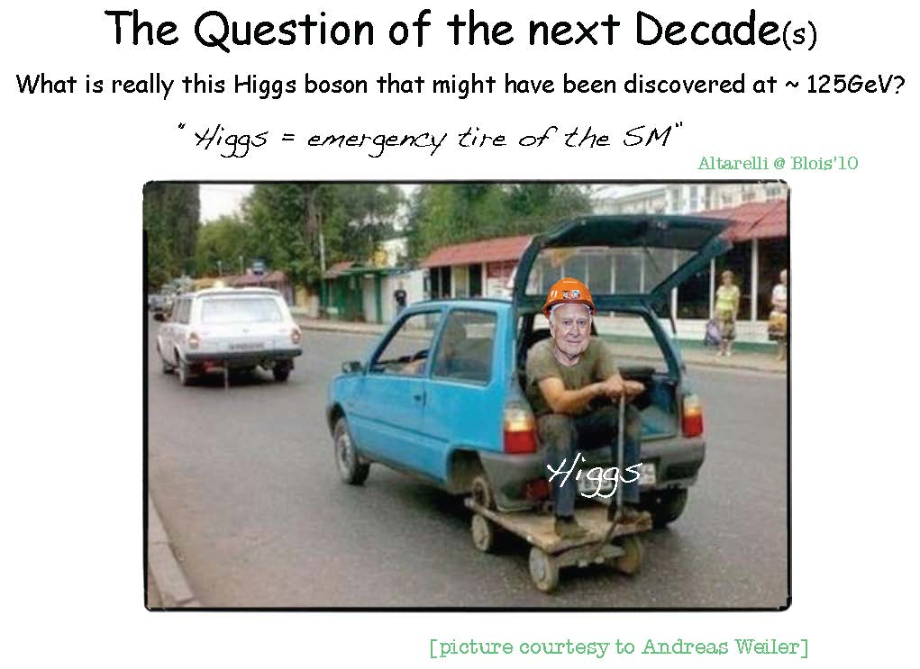

Slide 11
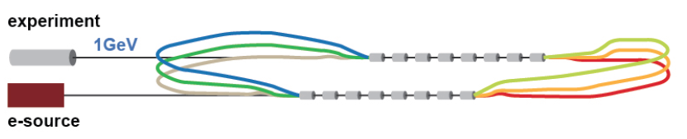
ERL Test Facility at CERN
January 2013
ERL Workshop at Daresbury: January 2013. f=801.54 MHz, I=10mA, Q₀ > 2 10¹⁰
Need a design a bit more specific than the poster sketch ..
Applications
Development of SuperConducting RF technology at CERN (November 13 – ok)
Operation and experience with S.C energy recovery linac
Injector to LHeC → injector to a future e+/e- machine
Testbed for SC magnets, cables, stacks – in high dose, non-radiative environment
Experiments with electron beam: PV at Q² ~ 1 GeV², proton radius
Experiments with photon beam: much higher intensity than ELI-NP

Slide 12
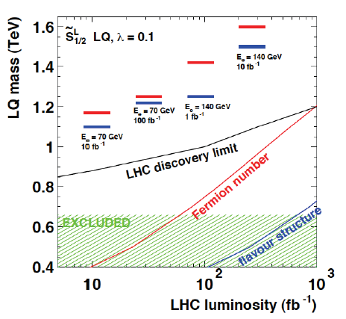
LPCC mini workshop on LHeC 17/18.4.2013 at CERN
April 2013
Review of CDR
Updates and discussion with LHC
LHeC at LPCC
PDFs – V.Radescu
Heavy PDFs – R.Placakyte
Accelerator – O.Brüning
Higgs – B. Mellado
BSM LH(e)C – M.D’Onofrio
QCD at low x – A.Stasto
eA Physics – N.Armesto
http://cern.ch/lhec
From CDR 6/12
BSM with LHeC:
RPV SUSY,LQs, r_{quark}, excited leptons, CI
“ The LHC is the primary machine to search for physics beyond the SM at the TeV scale.
The role of the LHeC is to complement and possibly resolve the observation of new phenomena…”
LHeC CDR

Slide 13
Possible QCD Developments
April 2013
DIS at
Marseille
AdS/CFT
Instantons
Odderons
Non pQCD
QGP
N^{k}LO
Resummation
Non-conventional PDFs …
Breaking of Factorisation
Free Quarks
Unconfined Color
New kind of coloured matter
Quark substructure
New symmetry embedding QCD
QCD may break .. (Quigg DIS13)
QCD is the richest part of the Standard Model Gauge Field Theory and
will (have to) be developed much further, on its own and as background

Slide 14
May 2013
Precision for Higgs at the LHC
LHeC:
Exp uncertainty
of predicted H
cross section is
0.25% (sys+sta),
using LHeC only.
Leads to H mass
sensitivity.
Strong coupling
underlying
parameter
(0.005 → 10%).
LHeC: 0.0002 !
Needs N³LO
HQ treatment
important …
O.Brüning and M.Klein arXiv:1305.2090, MPLA 2013

Slide 15
A tunnel under Lac Leman
May 2013
The ERL may be connected
to the new tunnel for an
“FHeC” if that is included in the CE planning.
Important constraint will be injection into the big tunnel.
ERL could be injector for “TLEP”.
Three phases of FCC project
exploration 2014
baseline 2015/16
consolidation 2017 – CDR
The (very) long term FCC future
opens a further dimension also
for the LHeC development.
^{*) “}Civil Engineering Feasibility Studies for Future Ring Colliders at CERN”, Contributed by
O.Brüning, M.Klein, S.Myers, J.Osborne, L.Rossi, C.Waaijer, F.Zimmerman to IPAC13 Shanghai

Slide 16

Road beyond Standard Model
Next decades
Rolf Heuer at
Aix Les Bains
1. 10. 2013
LHC results vital to guide the way at the energy frontier
At the energy frontier through synergy of
hadron - hadron colliders (LHC, (V)HE-LHC?)
lepton - hadron colliders (LHeC ??)
lepton - lepton colliders (LC (ILC or CLIC) ?)

Slide 17
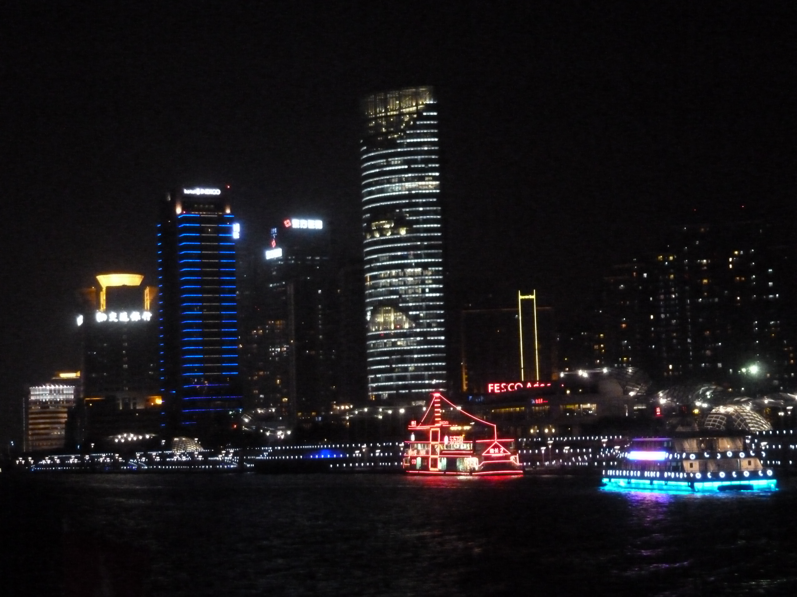
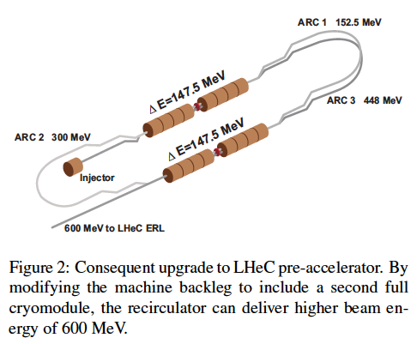
title
May 2013
IPAC13 Shanghai
CERN-Jlab, A.Valloni et al
Various contributions
to IPAC13 and one
invited talk on LHeC
无法找到该页
您正在搜索的页面可能已经删除、更名或暂时不可用。

Slide 18

EPS Stockholm (H, Searches, eA, Det, ACC)
July 2013
The gain in reach
with high luminosity
at the HL LHC is
basically similar to
the uncertainty at
high mass due to
high x PDFs
LHeC + High Lumi
for optimum use of
luminosity upgrade.
Example process:
LHeC BSM poster at EPS13 M.D’Onofrio et al. see also arXiv:1211:5102 Relation LHeC-LHC
Simulated PDFs from LHeC are on LHAPDF (Partons from LHeC, MK, V.Radescu LHeC-Note-2013-002 PHY)

Slide 19
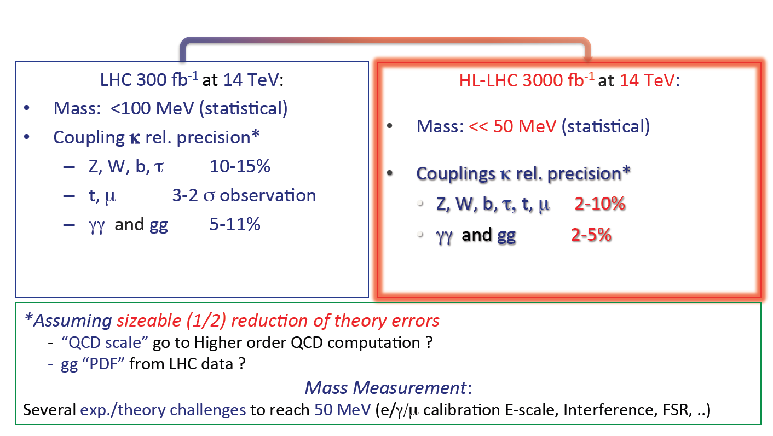
Higgs with HL-LHC
July 2013
F.Cerutti, “Properties of the New Boson” EPS13 Stockholm
Higgs physics at the LHC is a long term challenge [di-H, CP, M, VV damping..]

Slide 20
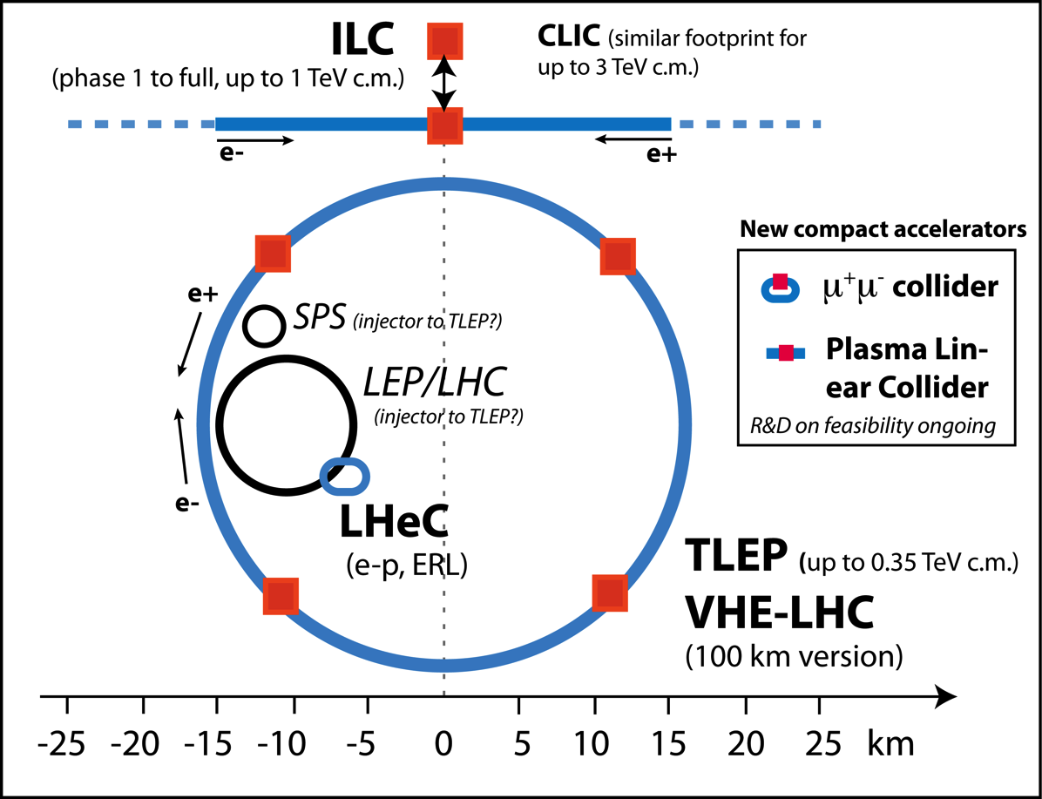
Lepton collider options beyond LHC
R.Aβmann, EPS13
TDR to be
worked out

Slide 21
Structure of further work
September 2013
Physics | Detector | Testfacility | Accelerator | Infrastructure
Higgs Top LHC-LHeC eA Low x Theory | Simulation Design Taggers Collaboration | Cavcryo module Magnets Source Optics Operation Coordination | Optimisation Optics IR Q1,2 Pipe+Vacuum Positrons Deuterons | Installation CE Resources Conferences Outreach Relations
ERL Workshop at Novosibirsk
Presentations on the LHeC and on the ERL Testfacility by Oliver and Erk

Slide 22
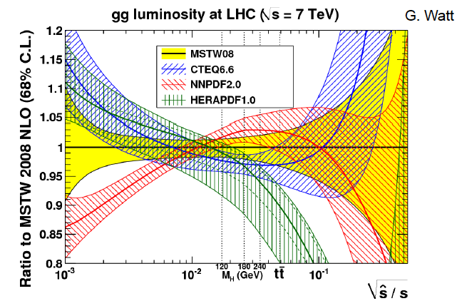
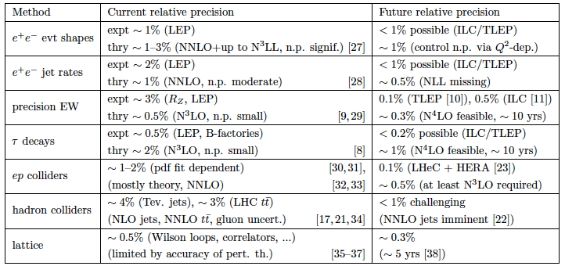
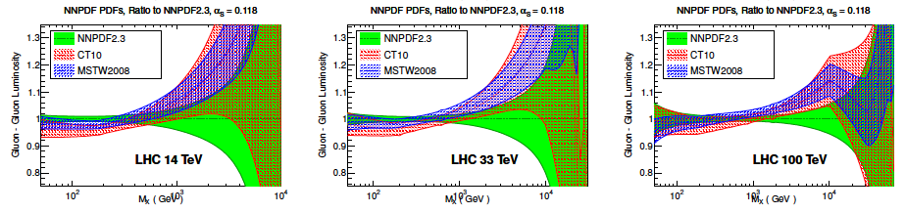
“Snowmass” 2013
January-October 2013
arXiv:1310.5189
Important constraints from pp, but
precision with ep! eA is unknown
Strong coupling constant to better than lattice precision
PDFs for QCD, H, BSM …
Gluon-gluon luminosity at the LHC, HE LHC and FCC

Slide 23
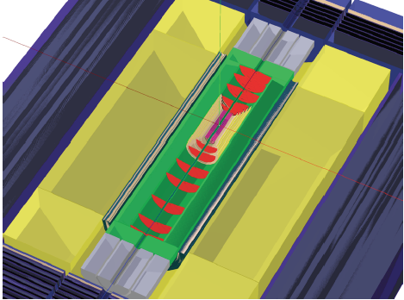
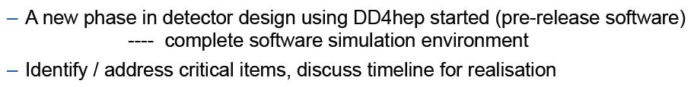
mDetector
Workshop at CERN
November 2013
HL LHC optics – synchrotron radiation, detector dipole,
Masks and absorber - IR design
Beam pipe and forward/backward tracking acceptance near beam axis,
Detector performance for vertexing, particle flow, fwd jets
Solenoid position
Software framework for generation, simulation, reconstruction
Generators for ep and eA → Realism in Design and Physics Studies (H)
P.Kostka

Slide 24
A long projected lifetime of the LHC
November 2013
F.Bordry LHCC 11/2013

Slide 25
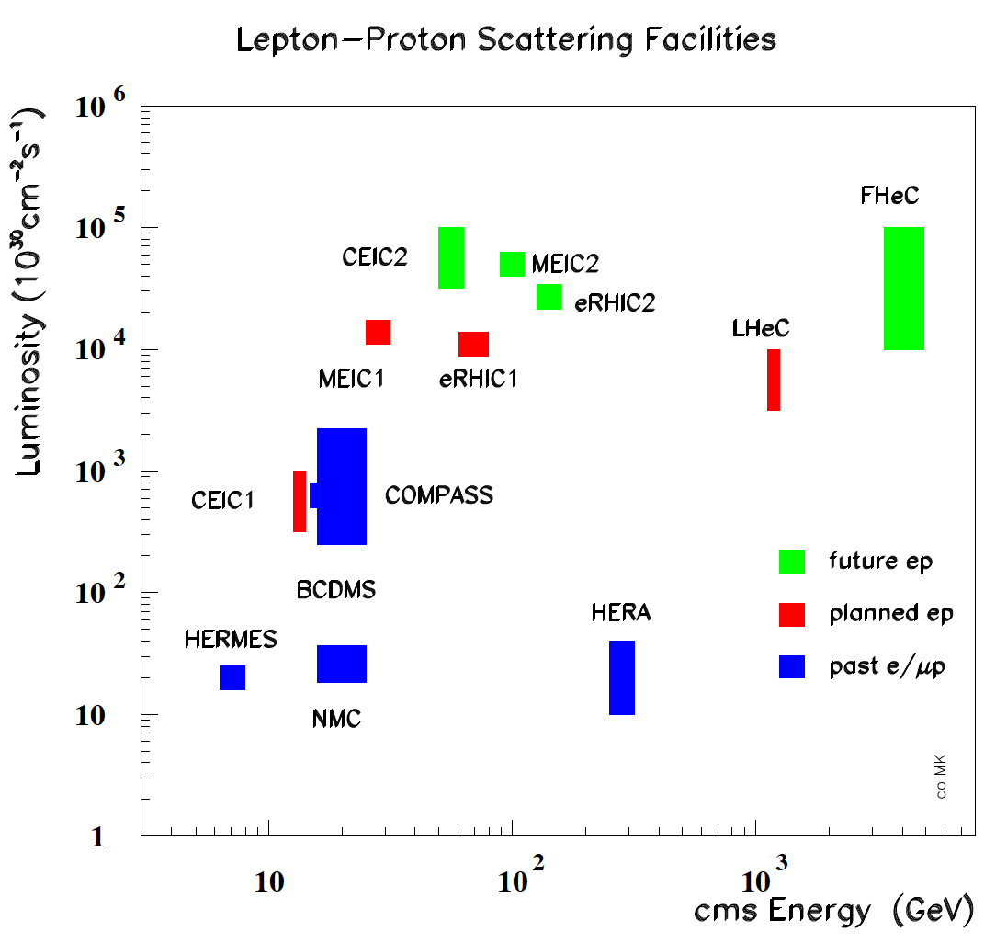

Slide 26
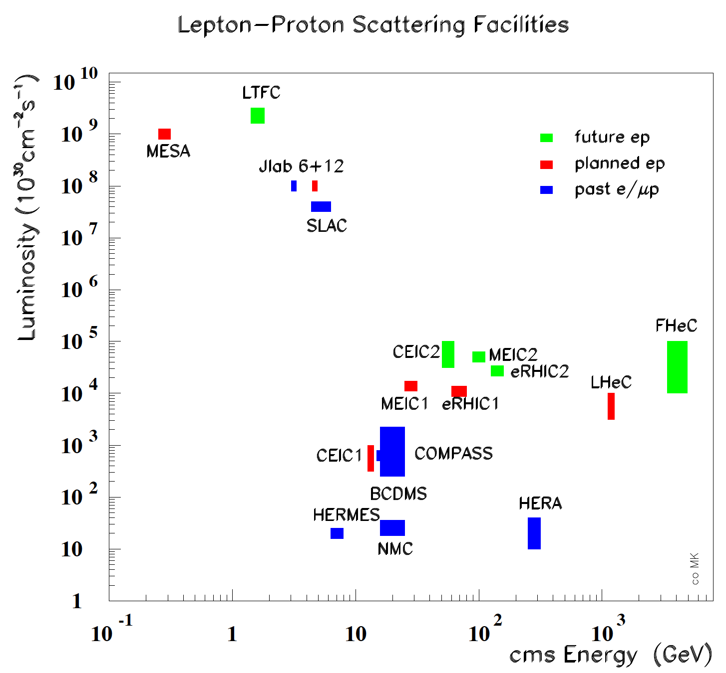

Slide 27
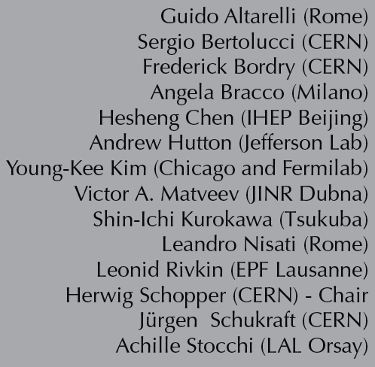
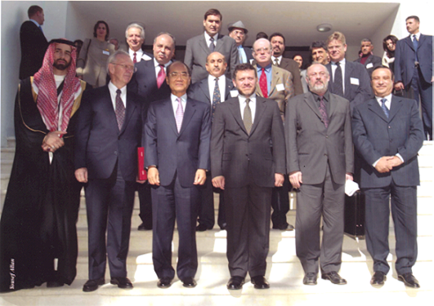
International Advisory Committee
December 2013
*)
The IAC was invited in 12/13 by the DG with the following
Mandate 2014-2017
Advice to the LHeC Coordination Group and the CERN directorate
by following the development of options of an ep/eA
collider at the LHC and at FCC, especially with:
Provision of scientific and technical direction for the physics
potential of the ep/eA collider, both at LHC and at
FCC, as a function of the machine parameters and of a
realistic detector design, as well as for the design and
possible approval of an ERL test facility at CERN.
Assistance in building the international case for the accelerator
and detector developments as well as guidance to the resource,
infrastructure and science policy aspects of the ep/eA collider.
*) IAC Composition early January 2014

Slide 28
LHeC Coordination Group
December 2013
LCG (2014-2017) *)
Nestor Armesto
Oliver Brüning
Stefano Forte
Andrea Gaddi
Bruce Mellado
Max Klein
Peter Kostka
Daniel Schulte
Frank Zimmermann
Directors (ex-officio)
Sergio Bertolucci, Frederick Bordry
The coordination group was invited end of December 2014 by the
CERN directorate with the following mandate (2014-2017)
The group has the task to coordinate the study of the scientific potential
and possible technical realisation of an ep/eA collider and the associated
detectors at CERN, with the LHC and the FCC, over the next four years. It
also should coordinate the design of an ERL test facility at CERN as part of the
preparations for a larger energy electron accelerator employing ERL techniques.
The group will cooperate with CERN and an International Advisory Committee,
chaired by the emeritus DG of CERN, Professor Herwig Schopper, who also
advises the CERN directorate. The Coordination Group is asked to represent
the ep/eA collider development towards CERN, its committees and the
international community. The currently tentative composition is listed left.
CERN has asked Max Klein to chair and Oliver Brüning to co-chair this activity
*) LCG Composition early January 14

Slide 29
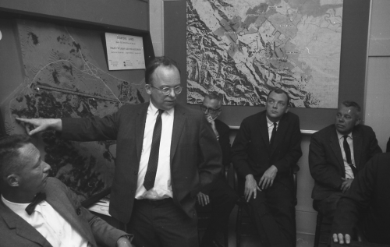
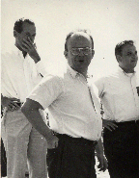
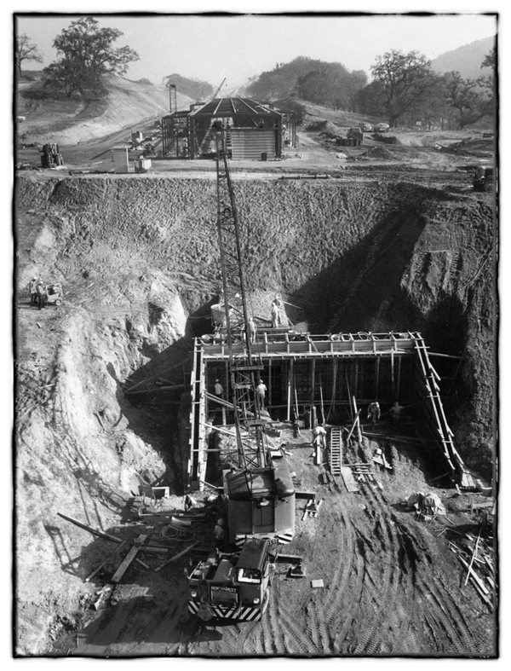
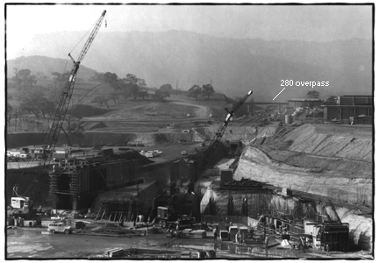
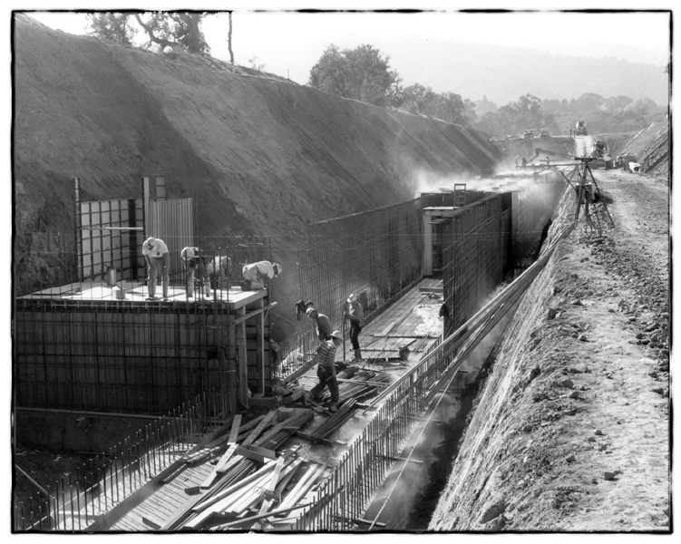
can one build a 2-3-km long linac?
it has been done before
Courtesy F.Zimmermann

Slide 30

Alessandra Valloni - LHeC Meeting 15.1.2014

Slide 31

A New Web Page and Information
This comes tonight

Slide 32
Workshop Information
Monday: Plenary opening – Photograph – Lunch – Parallel Sessions – Dinner (19.30)
Tuesday: Parallel sessions – Lunch – Summaries of Physics/Det and Acc/TF – conclusion
91 – 89 – 86 – 106 – 103
Welcome to the Workshop

Slide 33
backup

Slide 34
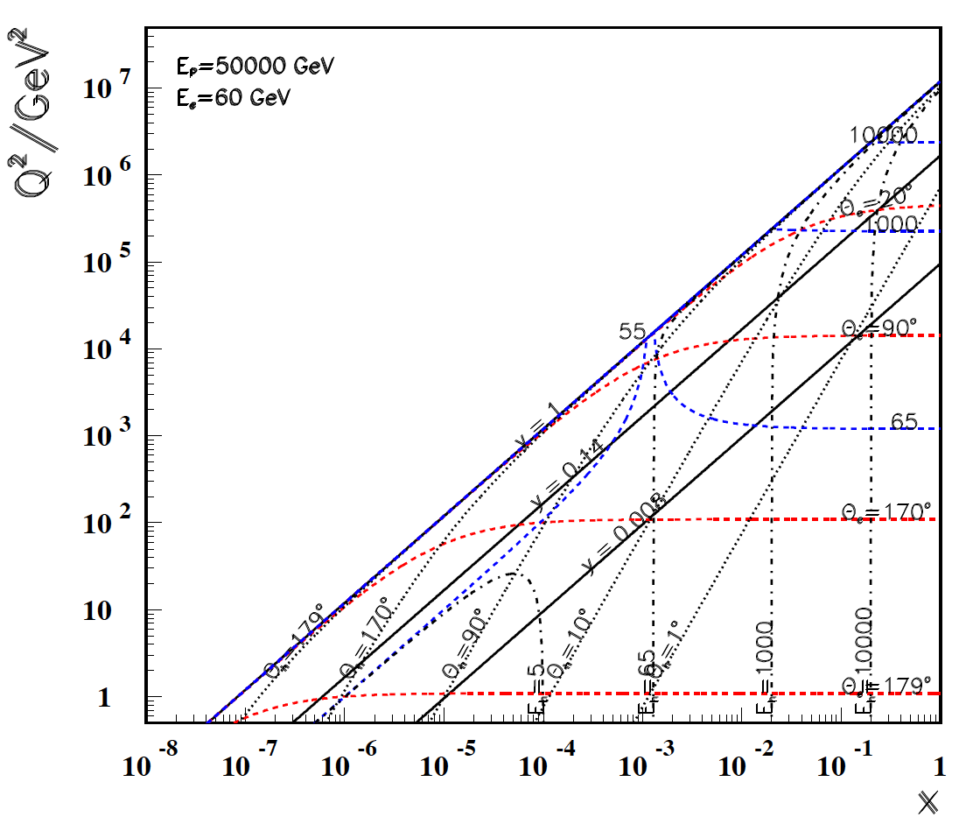
Questions on the FCC – ep
Isn’t E_{p}=50 TeV too high
for acceptance with a
lower energy electron
beam (60-200 GeV) ?
Surprisingly not.
Low x: Q²_{min} ~ E_{e}²
Large x: needs very fwd
tracking (to 1º)
FHeC comes with HERA
and after LHeC

Slide 35
Questions on the FCC – ep
Isn’t E_{p}=50 TeV too high
for acceptance with a
lower energy electron
beam (60-200 GeV) ?
Surprisingly not.
Low x: Q²_{min} ~ E_{e}² →
For low x keep Ee at ~ 60 GeV
Large x: needs very fwd
tracking (to 1º)
FHeC comes with HERA
and after LHeC
LHeC
HERA

Slide 36
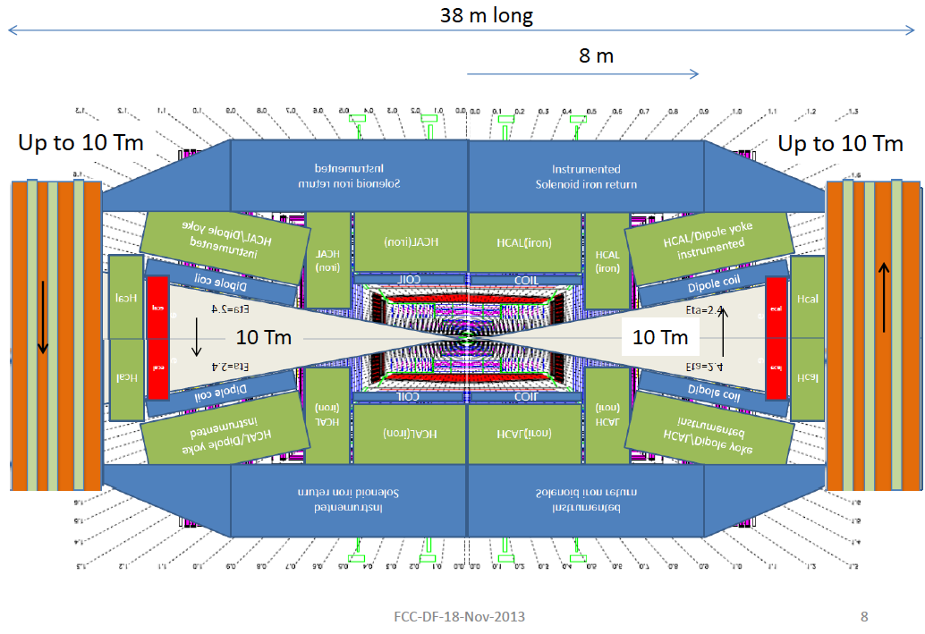
Questions on the FCC – ep
How would a detector
look like?
Perhaps sth between
the LHeC and the FCC
detector
FHC: From D.Fournier with F.Gianotti, L.Pontecorvo, H.TenKate Nov13 FHC Meeting at CERN
LHeC: From Conceptual Design Report

Slide 37
Questions on the FCC – ep
How would a detector
look like?
Perhaps sth between
the LHeC and the FCC
detector
FHC: From D.Fournier with F.Gianotti, L.Pontecorvo, H.TenKate November 2013 - FHC Meeting at CERN
LHeC: From Conceptual Design Report

Slide 38
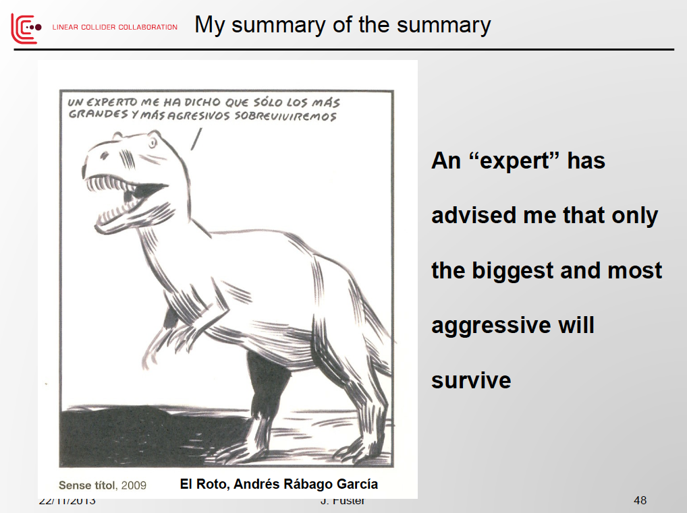
FEC- future electron-positron colliders
Juan Fuster’s
Plenary ECFA talk by Juan Fuster, November 2013 at CERN, on the Linear Collider

Slide 39
Tentative Parameters for FHeC (RR)
collider parameters | e± scenarios |  |  |  | protons
species | e± | e± | e± |  | p
beam energy [GeV] | 60 | 120 | 250 |  | 50000
bunch spacing [μs] | 0.125 | 2 | 33 |  | 0.125 to 33
bunch intensity [10¹¹] | 3.8 | 3.7 | 3.3 |  | 3.0
beam current [mA] | 477 | 29.8 | 1.6 |  | 384 (max)
rms bunch length [cm] | 0.25 | 0.21 | 0.18 |  | 2
rms emittance [nm] | 6.0, 3.0 | 7.5, 3.75 | 4, 2 |  | 0.06, 0.03
β_{x,y}*[mm] | 5.0, 2.5 | 4.0, 2.0 | 9.3, 4.5 |  | 500, 250
σ_{x,y}* [μm] | 5.5, 2.7
b-b parameter ξ | 0.13 | 0.050 |  | 0.056 | 0.017
hourglass reduction | 0.42 | 0.36 |  | 0.68
CM energy [TeV] | 3.5 | 4.9 |  | 7.1
luminosity[10³⁴cm⁻²s⁻¹] | 21 | 1.2 |  | 0.07
F.Zimmermann at Beijing 16.12.13

Slide 40
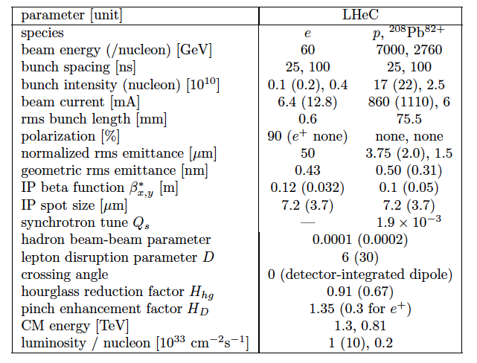
Design Parameters
arXiv:1211:5102
Designed for synchronous ep and pp operation during the HL-LHC phase.

