Slide 1

From Divonne to Chavannes and Beyond
Introduction
to the 3rd CERN/ECFA/NuPECC
Workshop on the Design of the LHeC
Max Klein
LHeC Workshop Chavannes-de-Bogis, 12.11.10

Slide 2
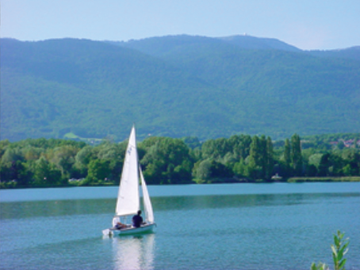
Divonne 2009

Slide 3
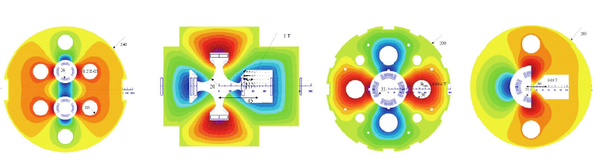
Chavannes 2010
S. Russenschuck

Slide 4
Two Options
Ring-Ring
Power Limit of 100 MW wall plug
“ultimate” LHC proton beam
60 GeV e± beam
L = 2 10³³ cm⁻²s⁻¹ → O(100) fb⁻¹
HERA 0.5fb⁻¹ with 100 times less L
[1 and 10º differ by factor 2..]
LINAC Ring
Pulsed, 60 GeV: ~10³²
High luminosity:
Energy recovery: P=P₀/(1-η)
β*=0.1m
[5 times smaller than LHC by
reduced l*, only one p squeezed
and IR quads as for HL-LHC]
L = 10³³ cm⁻²s⁻¹ → O(100) fb⁻¹
140 GeV LINAC few times 10³²

Slide 5

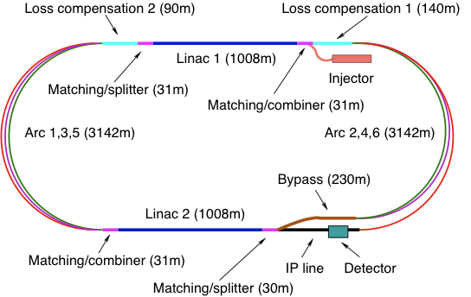
A 60 GeV Energy Recovery “LINAC”
A 140 GeV pulsed LINAC

Slide 6
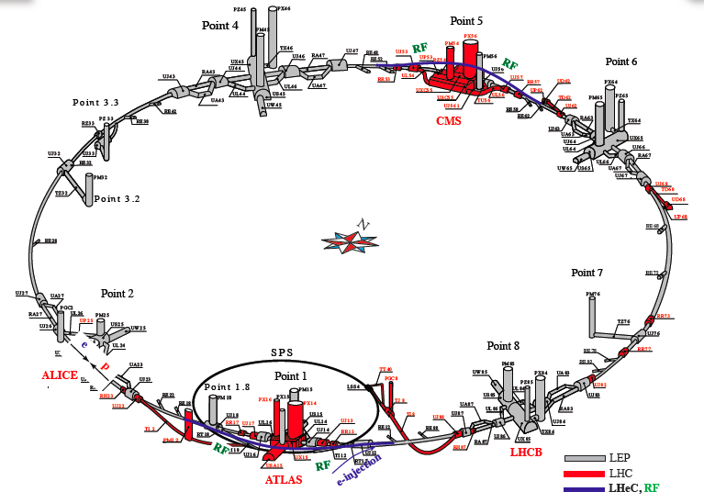
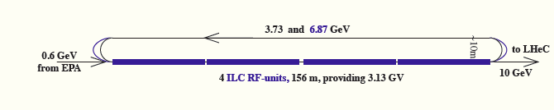
A 60 GeV Ring with 10 GeV LINAC Injector

Slide 7
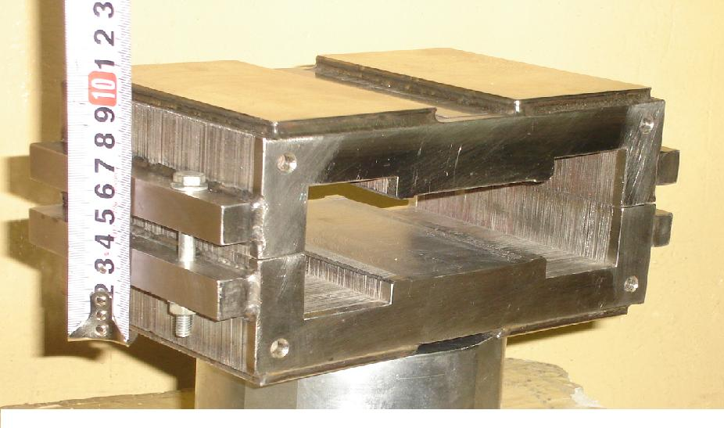
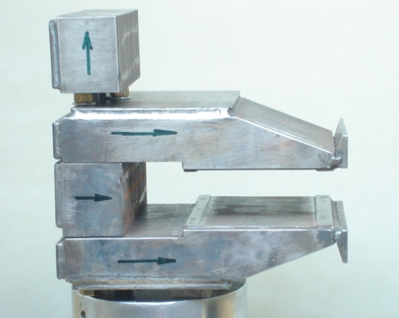
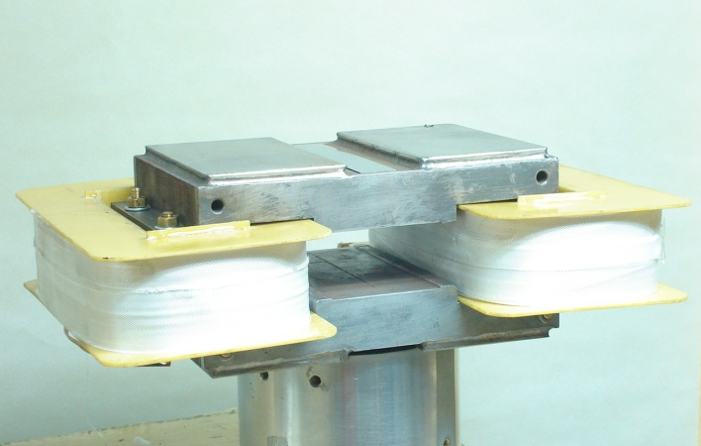
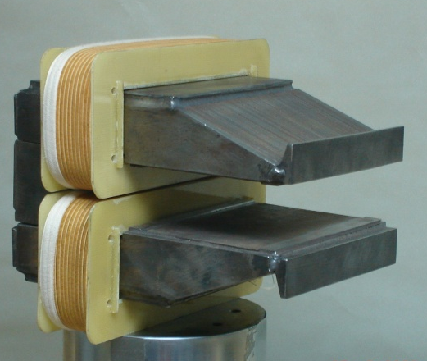
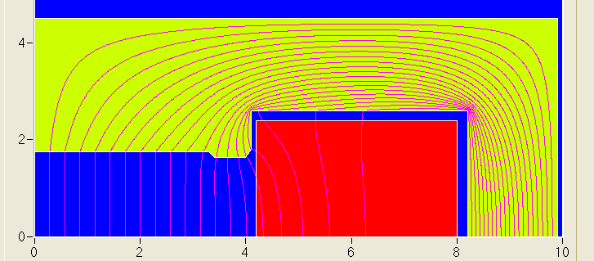
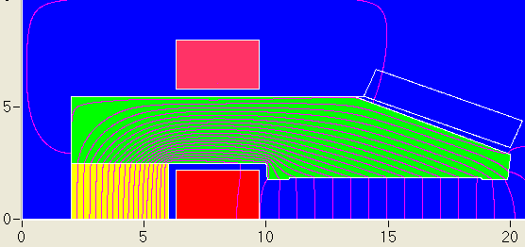
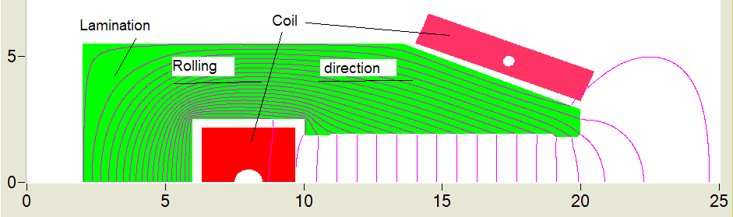
The First Bit of Hardware Built for the LHeC - BINP
22A/m
6A/m
3408 grain oriented steel
0.35 mm thick laminations
same results for the two alternatives
laminations of alternated rolling
Reproducibility of injection filed is below 0.1 Gauss!
Cf talk of D. Tommassini

Slide 8
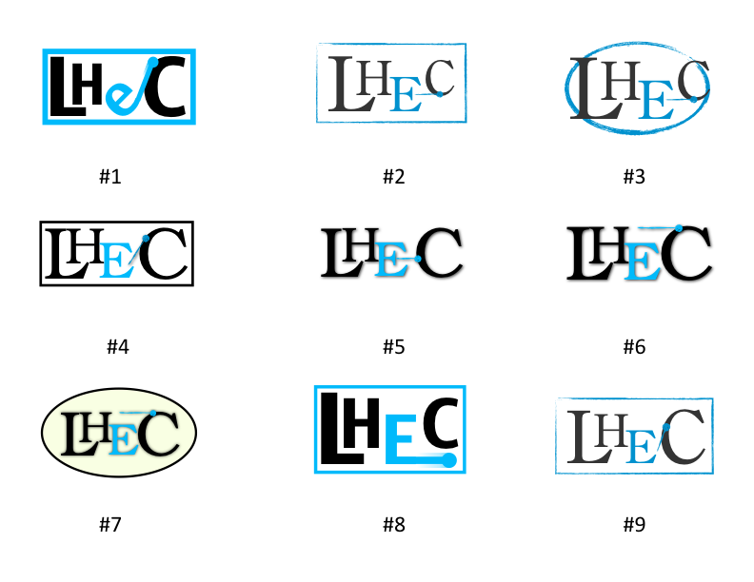
2
1
7
0
2
3
3
0
0

Slide 9

or an alternative
Oxford
Georgia – on my mind

Slide 10
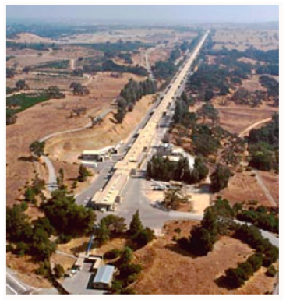

SLAC
CalTech-SLAC-MIT
“… to collect data which may be
of use for future experiments..”
3km: Q²=20 GeV²
9-26 km: Q²=1000000GeV²
“A bold extrapolation of existing technology ‘’
(R.Taylor)
Gell-Mann 1966

Slide 11
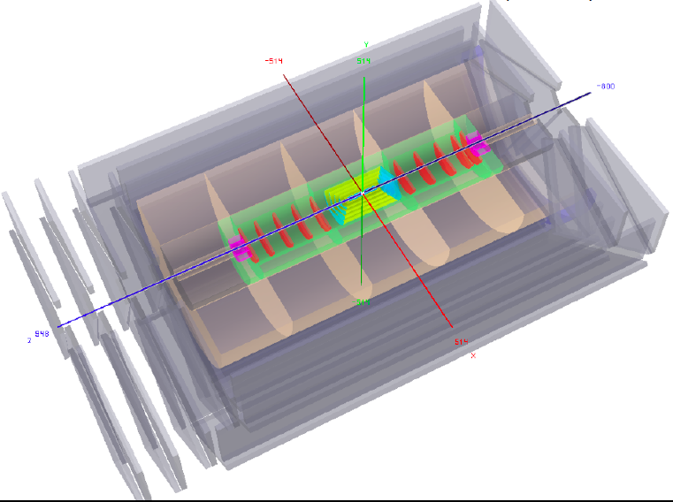
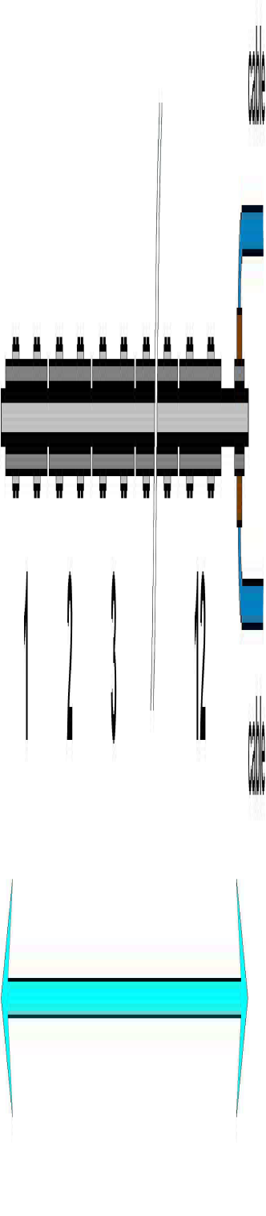
Detector design and
machine-detector
interface consolidating
Use existing technology (developments)
Detector for 150*15000 GeV² ?
ATLAS
upgrade
1.2m

Slide 12
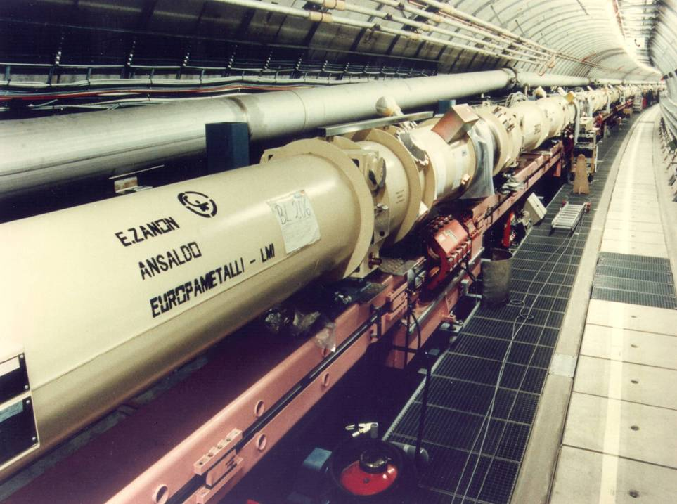
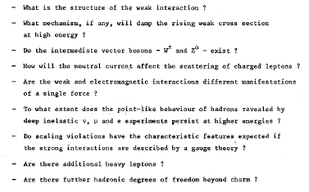
B.Wiik. C.Llewellyn Smith, DESY 77/38

Slide 13
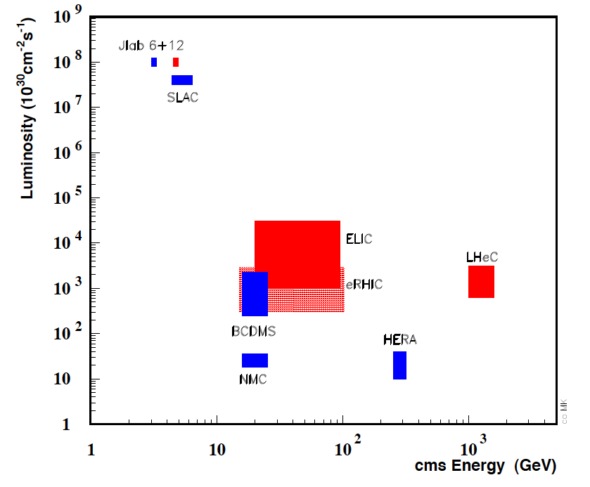
Lepton-Proton Scattering Experiments
done
planned
?
Status 2009
LHeC is a unique DIS machine project at the high energy frontier
Scale of new physics is TeV, Unitarity violation in ep and eA, Electroweak physics, Single top, Higgs..
This machine also does large x, low Q² , photoproduction, amplitudes…, NOT polarised-polarised lN

Slide 14
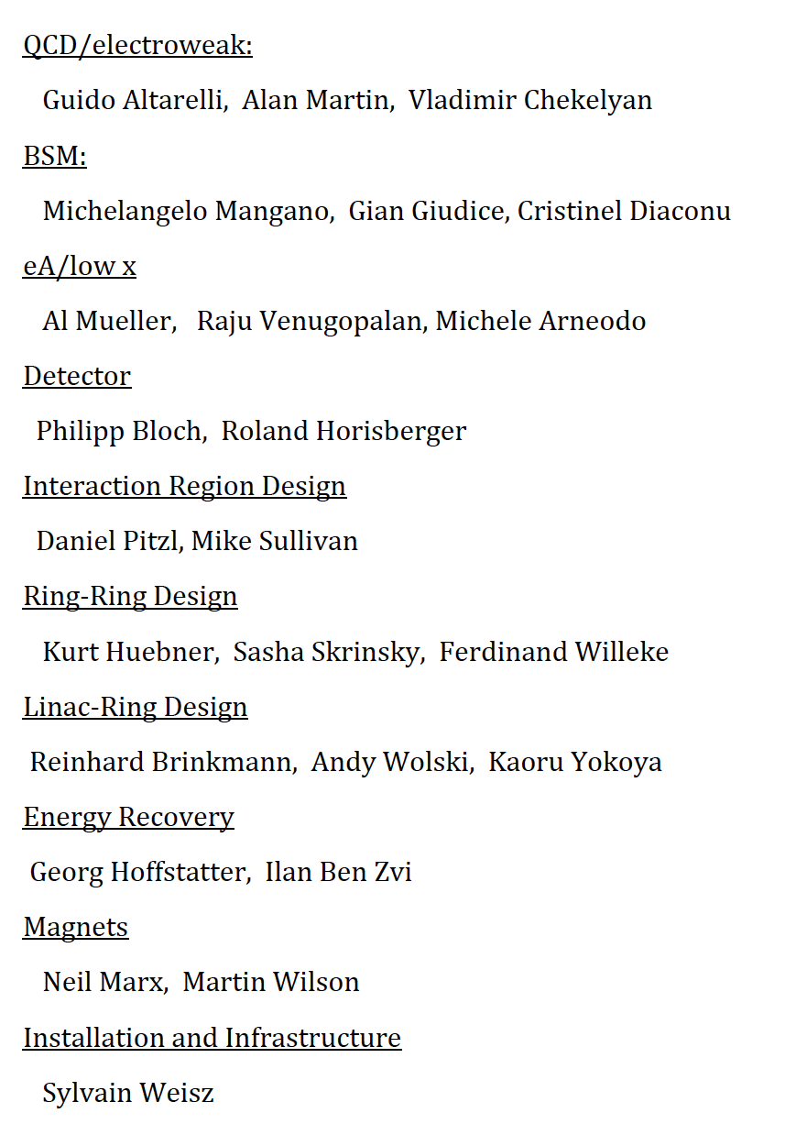
Editorial Process
ECFA 26.11.2010
Draft 0.9 [about 500 pages]
Editorial Board:
Oliver Bruening, John Dainton, Stefano Forte,
Max Klein, Paul Laycock, Wesley Smith
31.1. – Draft 1.0 to Referees
31.3. – Feedback from Referees
(consultation with authors+CERN)
… Update of CDR^{*)} including plan for
R+D, installation, schedule [Oliver today]
… formal response from referees
-- Print → Europe’s Strategy Debate
LHeC CDR Referees invited by CERN Directors
^{*)} this CDR presents a design concept and its motivation

Slide 15
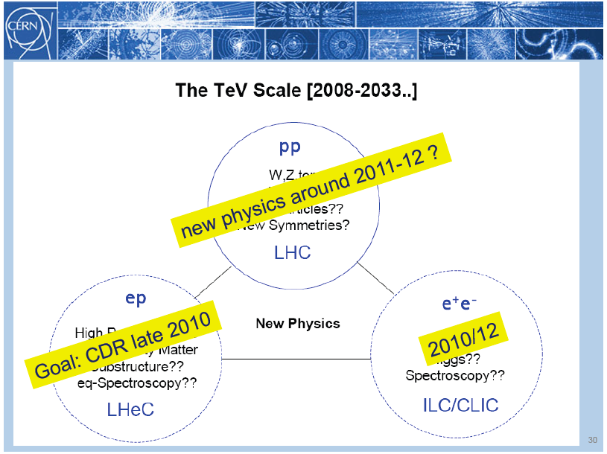
title
Rolf Heuer: 3/4. 12. 09 at CERN: From the Proton Synchroton to the Large Hadron Collider
50 Years of Nobel Memories in High-Energy Physics

Slide 16
Conclusion
[Oliver in the afternoon]
Keeping an LHeC option open for the LHC requires:
launch of R&D and design activities for key components
(magnets, RF) needs to start very soon
planning the installation of the ring-ring option requires careful
synchronization with LHC operation schedule (assume minimum of
two long shut downs for installation)
Civil engineering must start before 2018
Requirements:
The above work can not be done with the current arrangement and
requires a focused team and sufficient resources
Conclusion:
Decision on LHeC option should be taken by 2012
3rd CERN-ECFA-NuPECC workshop on the LHeC , 12-13 November 2010
16

Slide 17
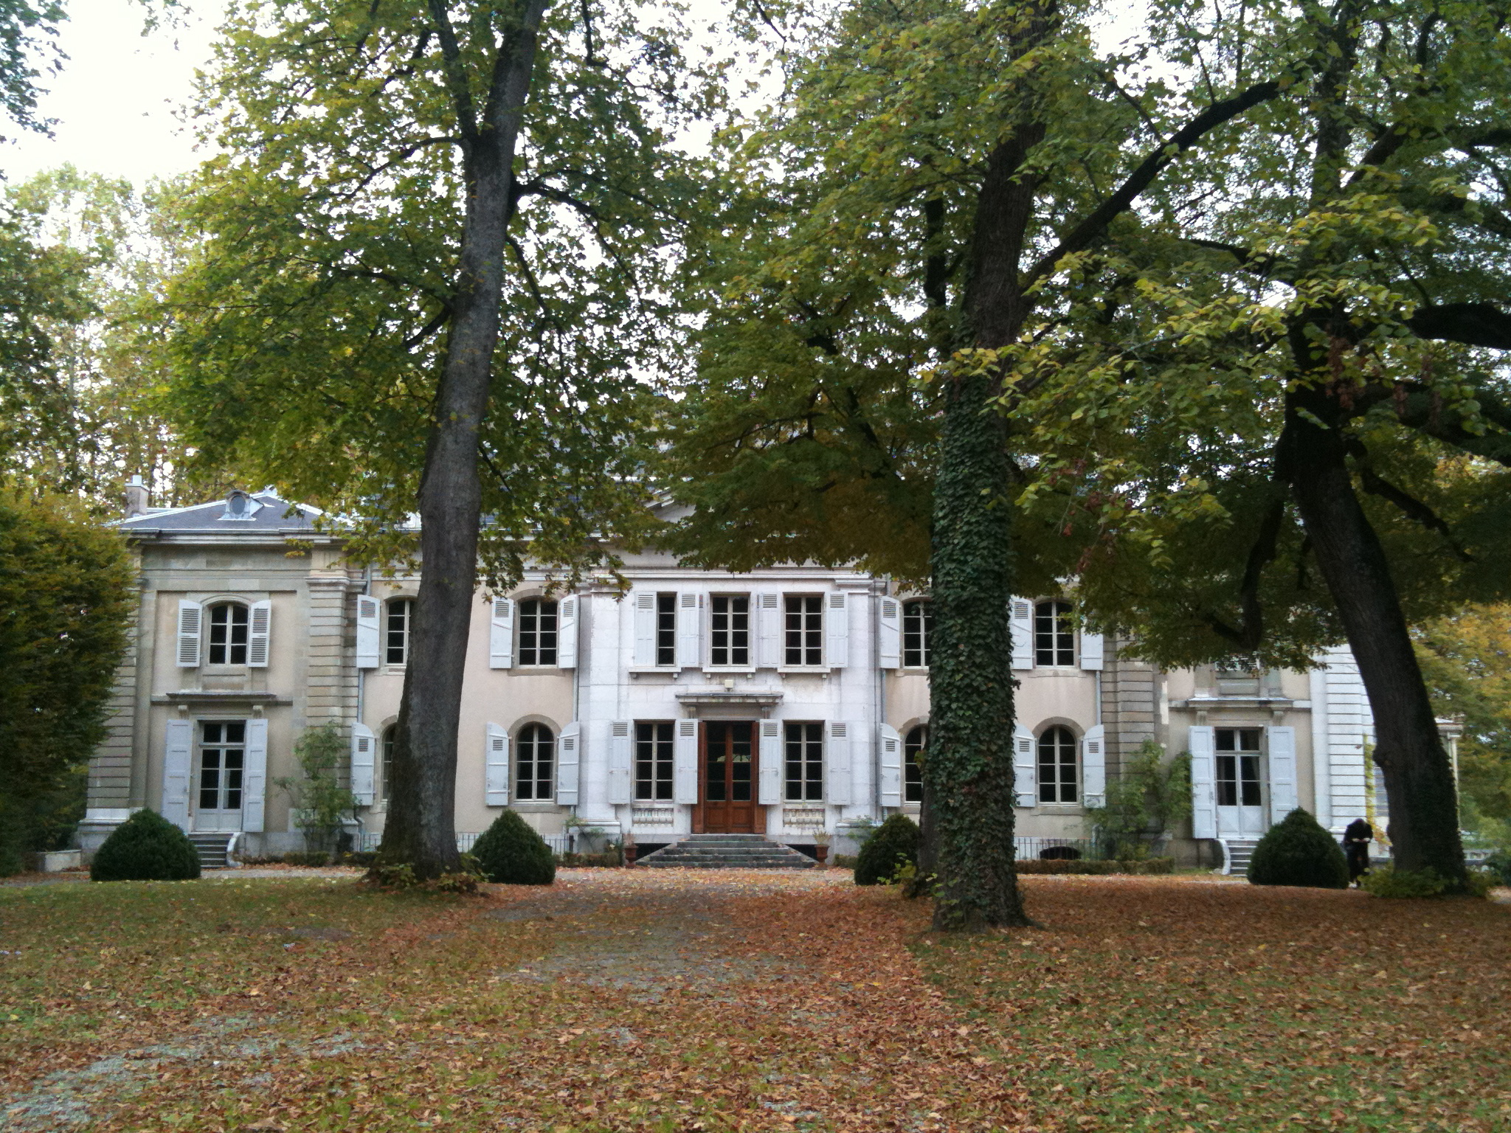
title
Chateau Ferney Voltaire (bought 1758)

Slide 18
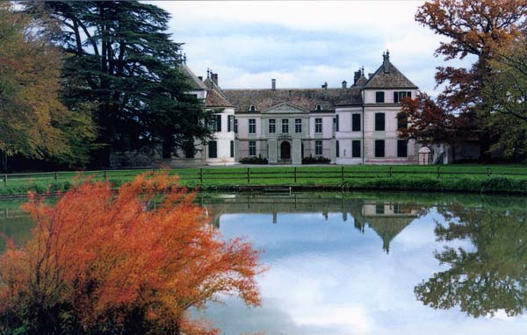
title
Chateau Coppet – Jaques Neckar (1776 Louis XVI; bought 1784)
Thanks to Johannes Bluemlein

Slide 19
Workshop
Friday: 10.30-13.00 14:00-16:30 17:00-19:30
Physics: QCD/electroweak New Physics at High Scales High Parton Densities
Detector: Overview/Tracking joint IR Comparison/Calo/y,n..
Accelerator: Overview IR Hardware
Lunch 13:00-14:00 Dinner at 20:00
Saturday:
9-10:30 Physics 11:00-12:30 Detector and Accelerators
Thank you all for coming, for your continuous interest and encouraging work
Thanks to CERN (Rolf, Sergio, Steve) /ECFA (Tatsuya) /NuPECC (Guenther, JJ) for support

Slide 20
Rudern zwei
Rudern zwei durch die Nacht
Ist der eine kundig des Meeres
Ist der andere kundig der Sterne
Und in der Erinnerung
Das Meer wird blau sein
Reiner Kunze
Dedicated to Anna-Dorothea Klein
born 12. November 1925

