Slide 1
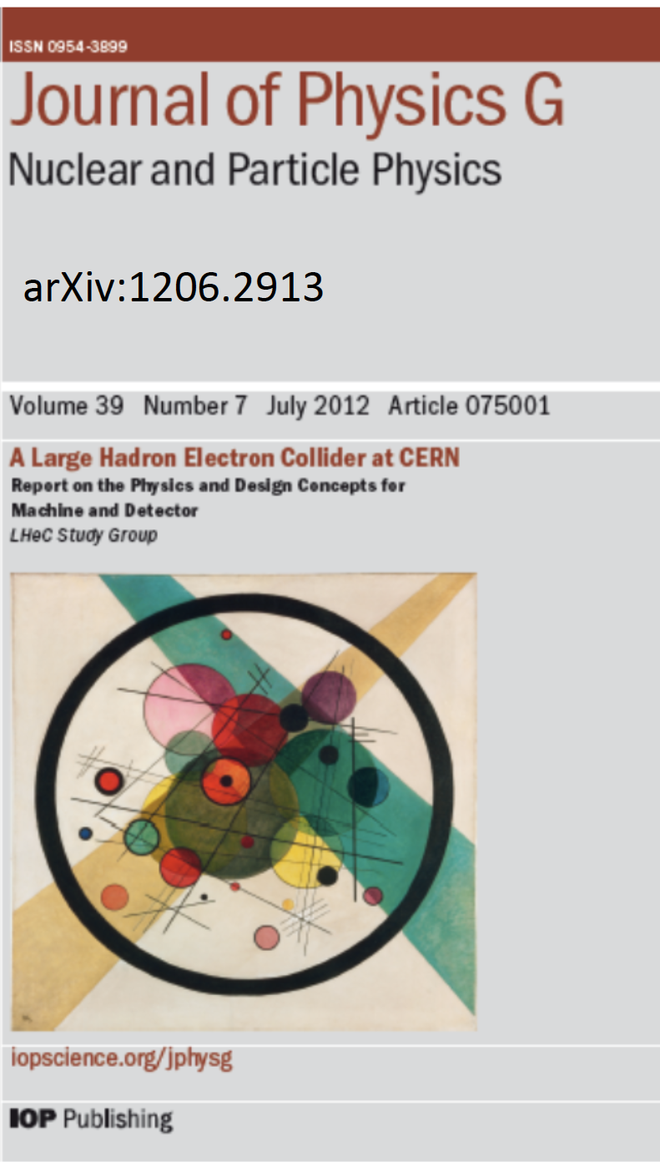

The Case for the LHeC
From the CDR 2012 to the time ahead 2018+
Particle Physics
Physics Case
Preparations
Max Klein
Contribution to a Panel on Future DIS, 17.4.2018, Kobe, for the LHeC/FCCeh Study Group
Max Klein Kobe 17.4.18
http://lhec.web.cern.ch

Slide 2
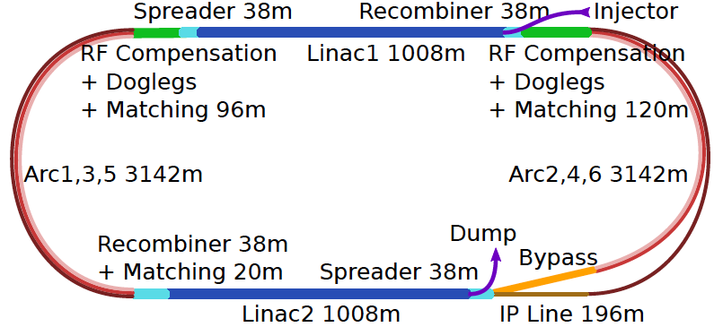
60 GeV Electron ERL added to LHC
U(ERL) = 1/3 U(LHC)
Concurrent operation to pp, LHC/FCC become 3 beam facilities. Power limit: 100 MW
10³⁴ cm⁻² s⁻¹ luminosity and factor of 15/120 (LHC/FCCeh) extension of Q², 1/x reach
1000 times HERA luminosity. It therefore extends up to x~1.
Four orders of magnitude extension in deep inelastic lepton-nucleus (ion) scattering.
Max Klein Kobe 17.4.18

Slide 3
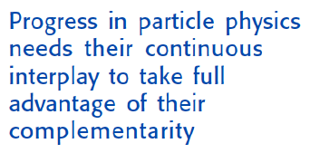
Towards a strategy for European Particle Physics
“Two Problems” of HEP
1980: Leon Lederman at ICHEP in Madison:
“Shortage of Money and Overconfidence of Theorists” [SU(5)/SUSY ahead times..]
Today:
Shortage of Money and Missing Confidence of Theory [EFT/ SUSY passed times?]
Reminiscent of the situation as experienced 50 years ago:
before the SM and discovery of partons in ep at Stanford
→
In 2014 CERN decided
to set up a new LHeC
organisation and an IAC
to “assist building the
international case of an
ep/A collider” at CERN
IAC: Two main tasks:
Update CDR + Testfacility
Time for high precision,
high energy,
high luminosity
collider experiments
ee, pp and ep:
→
Guido Altarelli, DIS 2009, Madrid
Max Klein Kobe 17.4.18

Slide 4
Organisation^{*)}
Working Groups
International Advisory Committee
Mandate by CERN to define
“..Direction for ep/A both at LHC+FCC”
PDFs, QCD
Fred Olness,
Claire Gwenlan
Higgs
Uta Klein,
Masahiro Kuze
BSM
Georges Azuelos,
Monica D’Onofrio
Oliver Fischer
Top
Olaf Behnke,
Christian Schwanenberger
eA Physics
Nestor Armesto
Small x
Paul Newman,
Anna Stasto
Detector
Alessandro Polini
Peter Kostka
Coordination Group
Accelerator+Detector+Physics
Sergio Bertolucci (CERN/Bologna)
Nichola Bianchi (Frascati)
Frederick Bordry (CERN)
Stan Brodsky (SLAC)
Hesheng Chen (IHEP Beijing)
Eckhard Elsen (CERN)
Stefano Forte (Milano)
Andrew Hutton (Jefferson Lab)
Young-Kee Kim (Chicago)
Victor A Matveev (JINR Dubna)
Shin-Ichi Kurokawa (Tsukuba)
Leandro Nisati (Rome)
Leonid Rivkin (Lausanne)
Herwig Schopper (CERN) – Chair
Jurgen Schukraft (CERN)
Achille Stocchi (LAL Orsay)
John Womersley (ESS)
Gianluigi Arduini
Nestor Armesto
Oliver Brüning – Co-Chair
Andrea Gaddi
Erk Jensen
Walid Kaabi
Max Klein – Co-Chair
Peter Kostka
Bruce Mellado
Paul Newman
Daniel Schulte
Frank Zimmermann
5(12) are members of the
FCC coordination team
OB+MK: co-coordinate FCCeh
We miss Guido Altarelli.
Max Klein Kobe 17.4.18
*) April 2018

Slide 5
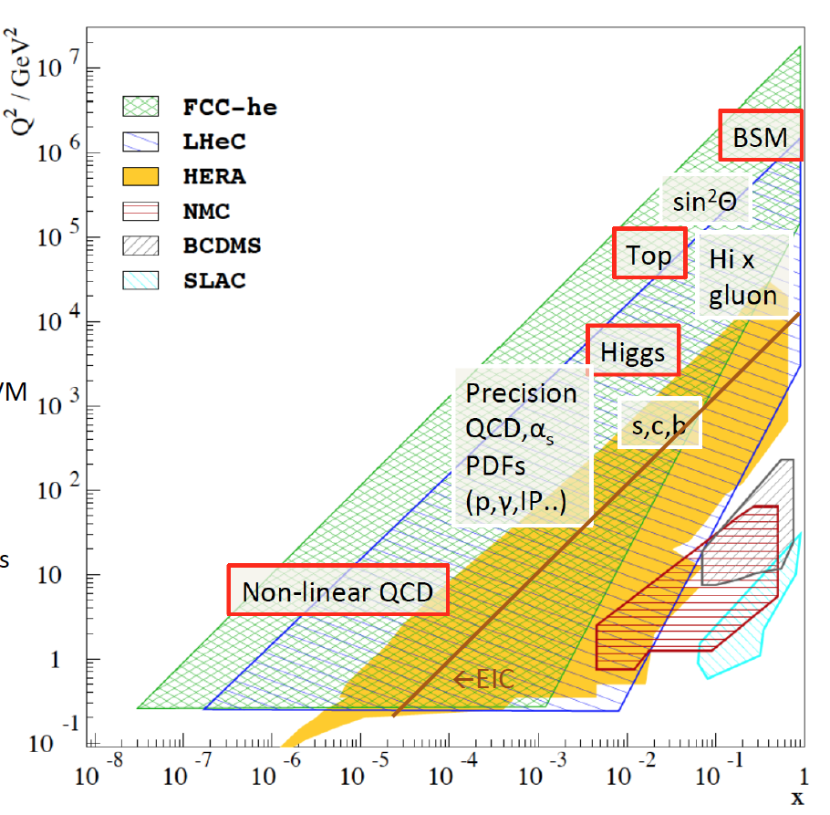
Physics with Energy Frontier DIS
Raison(s) d’etre of the LHeC
Cleanest High Resolution
Microscope: QCD Discovery
Empowering the LHC
Search Programme
Transformation of LHC into
high precision Higgs facility
Discovery (top, H, heavy ν’s..)
Beyond the Standard Model
A Unique
Nuclear Physics Facility
Max Klein Kobe 17.4.18

Slide 6
Huge increase in energy and luminosity enables unique development of particle physics
The Classic DIS Programme with the LHeC: 0 < Q² < 10⁶ GeV2, 1 < x < 10⁻⁶
Generalised Parton Distributions [DVCS] – “proton in 3D - tomography”
Unintegrated Parton Distributions [Final State] – DGLAP/BFKL?
Diffractive Parton Distributions [Diffraction] – pomeron, confinement??
Photon Parton Distribution [Photoproduction Dijets,QQ; F_{2,L}] - fashionable..
Neutron Parton Distributions [Tagged en (eD) Scattering] – ignored at HERA
see the CDR 1206.2913 + updates
Max Klein Kobe 17.4.18

Slide 7
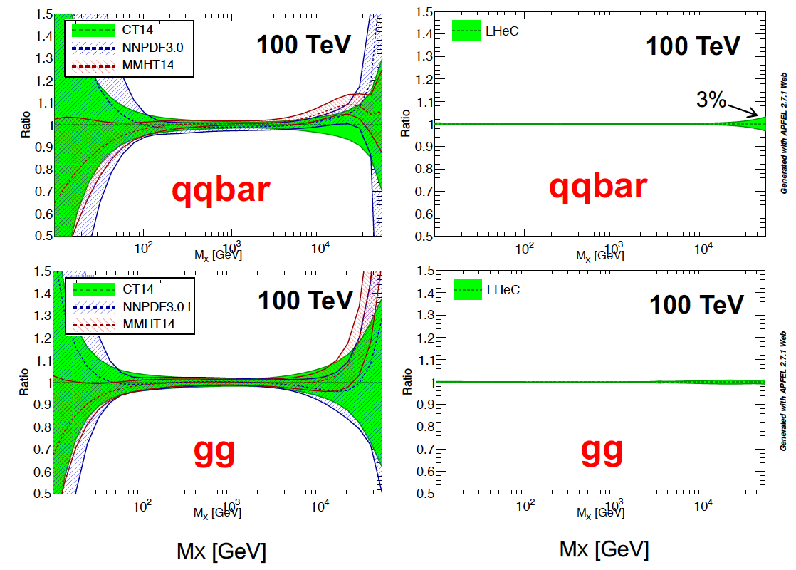
The LHeC collinear proton (and nuclear) PDF Programme
Resolve parton structure of the proton completely: u_{v},d_{v},s_{v}?,u,d,s,c,b,t and xg
Unprecedented range, sub% precision, free of parameterisation assumptions,
Resolve p structure, solve non linear and saturation issues, test QCD, N³LO…
NP?
PDFs
are NOT
determined
in pp
but in ep
cf backup
SUSY?
H
20 GeV
40 TeV
Max Klein Kobe 17.4.18
Empowers the LHC H, BSM + SM Physics

Slide 8

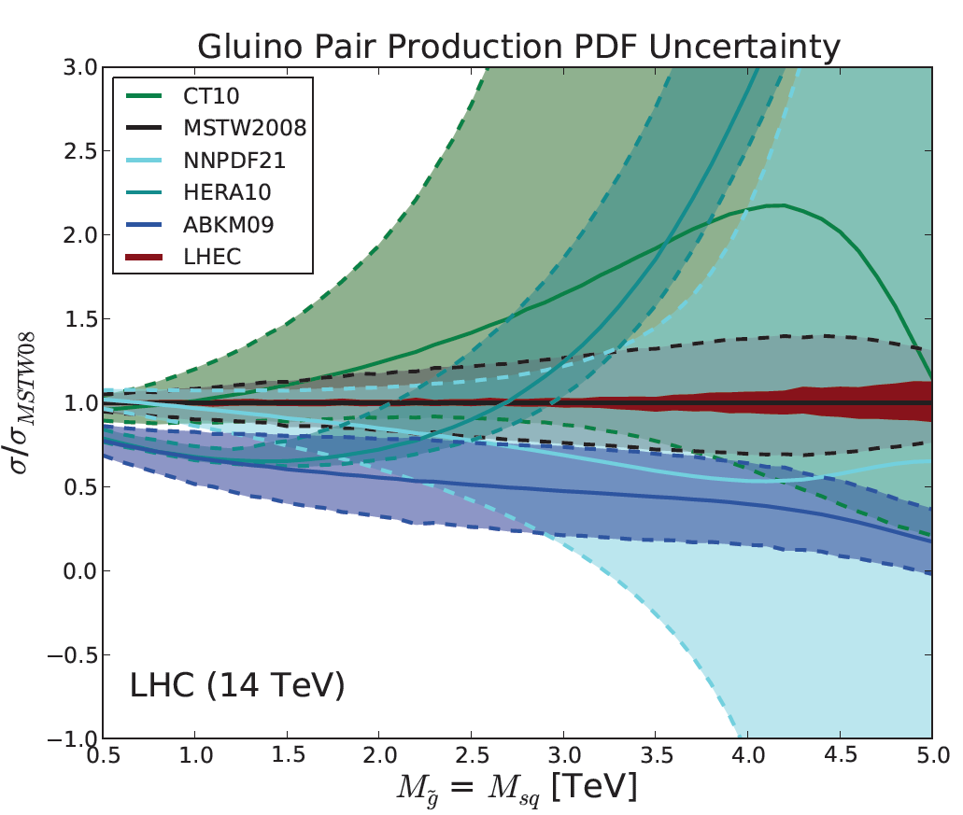
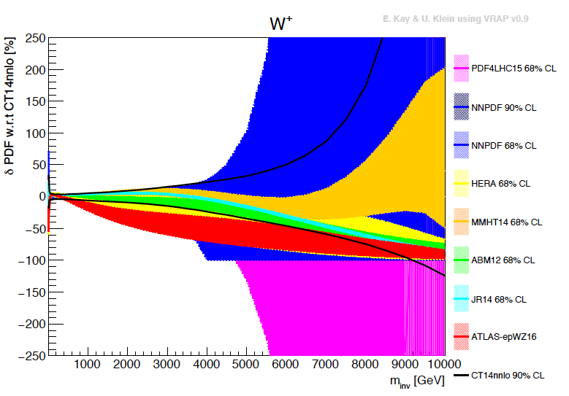
Empowering pp Discoveries
External, reliable input (PDFs, factorisation..) is crucial for range extension + CI interpretation
GLUON
QUARKS
SUSY, RPC, RPV, LQS..
Exotic+ Extra boson searches at high mass
ATLAS
today
Max Klein Kobe 17.4.18

Slide 9
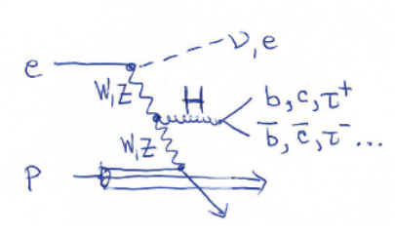
Determination of SM Higgs Couplings, HL-LHC and LHeC → LHC
δκ/κ [%]
preliminary
J. De Blas, M.+U. Klein, 16.4.2018
ttH at LHeC to 15%
LHC: ATLAS prospects PUB Note 2014-016
The addition of ep to pp (LHeC to LHC (HL,HE) and FCC-eh to FCC-pp) transforms these
machines into precision Higgs facilities. Vital complementarity with e⁺e⁻ (JdB Amsterdam)
Note that the HL LHC prospects are being updated (HL/HE LHC Physics workshop).
Max Klein Kobe 17.4.18

Slide 10
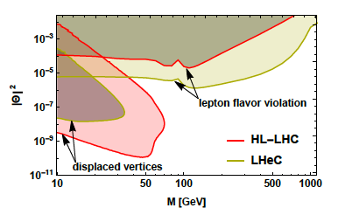
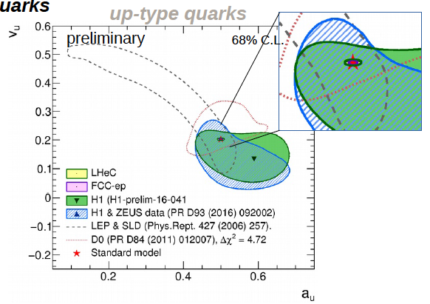
New Physics through High Precision
Masses:
Charm HERA 40 MeV LHeC 3 MeV
W LHC 19→ 10 MeV LHeC 15 MeV
and prediction to ±2.8 MeV for pp
Top: to be studied
Proton: gluon we are made of…
Higgs: Cross section to 0.3%: Mass
dependent. OB, MK 1305.2090
Neutrinos: Heavy “sterile” Neutrinos
CKM, electroweak, alpha_s, …
V_{tb}: to 0.01
V_{cs}: to 0.02 [LHC+LHeC, like ATLAS+HERA]
α_{s} to 0.2% [0.1% with HERA] – GUT?
sin²θ_{W} (μ)
LHC: better than LEP with LHeC PDFs
LHeC: scale dependence from
0.4 GeV (PERLE) to 1 TeV (LHeC)
NC couplings
Antusch, Cazzato, Fischer – work still in progress
Max Klein Kobe 17.4.18
Britzger, MK, Spiessberger, Zhang – work still in progress

Slide 11
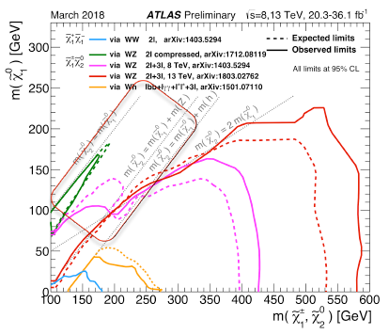
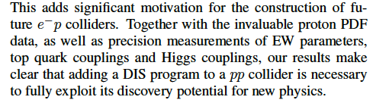
Beyond the Standard Model
Higgs into Dark Matter
Higgs into Neutralinos (RPV SUSY)
Higgs into Scalars → 4b
H±± in Vector Boson Scattering
H± in Vector Boson Scattering
H⁺ in 2HDM
Triple Gauge Couplings
Top FCNC
Contact Interactions
Empower LHC Discoveries
Higgsinos: mass degenerate
Wino/bino compressed
Prompt decays or long lifetimes
SUSY ewk sector most
challenging for pp colliders
cf U Klein + M Donofrio at Amsterdam FCC
D Curtin et al
arXiv:1712.07135
Max Klein Kobe 17.4.18

Slide 12
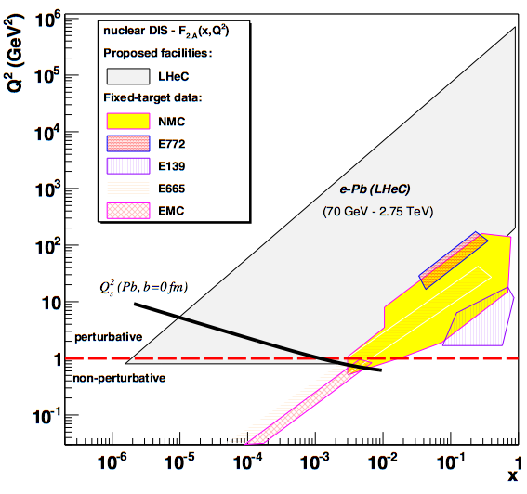
LHeC as Electron Ion Collider
FCC-he
Extension of kinematic range in lA
by 4-5 orders of magnitude will
change QCD view on nuclear
structure and parton dynamics
May lead to genuine surprises…
No saturation of xg (x,Q²) ?
[discover saturation in ep
THEN analyse eA –separate
nonlinear g from nuclear effects]
Small fraction of diffraction ?
Broken isospin invariance ?
Flavour dependent shadowing ?
Safe: nuclear PDFs like at HERA
→ R(x,Q²) flavour dependent
LHeC
EIC
Precision QCD study of parton dynamics in nuclei
Investigation of high density matter and QGP
DGLAP to BFKL – vital for LHC and FCCpp physics
L_{eN} = 6 10³² cm⁻² s⁻¹
Max Klein Kobe 17.4.18

Slide 13
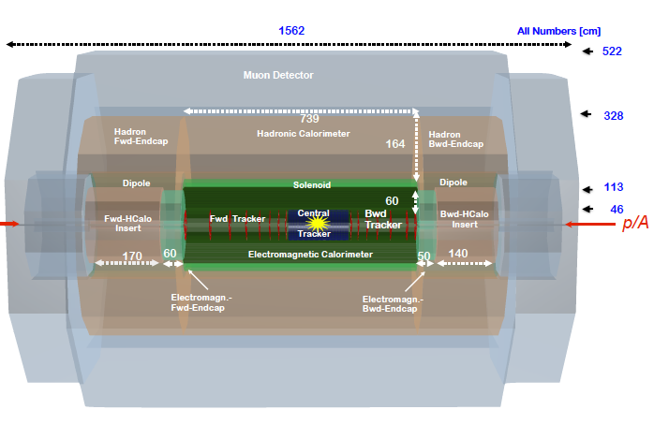
title
LHeC Detector for the HL/HE LHC
e
P.Kostka et al
Length x Diameter: LHeC (13.3 x 9 m²) HE-LHC (15.6 x 10.4) FCCeh (19 x 12)
ATLAS (45 x 25) CMS (21 x 15): [LHeC < CMS, FCC-eh ~ CMS size]
If CERN decides that the HE LHC comes, the LHeC detector should anticipate that
Max Klein Kobe 17.4.18

Slide 14
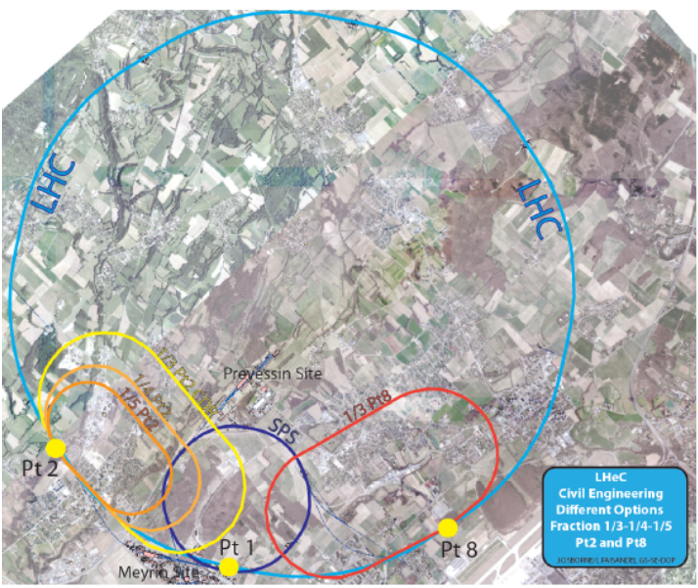
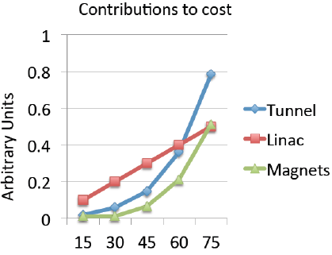
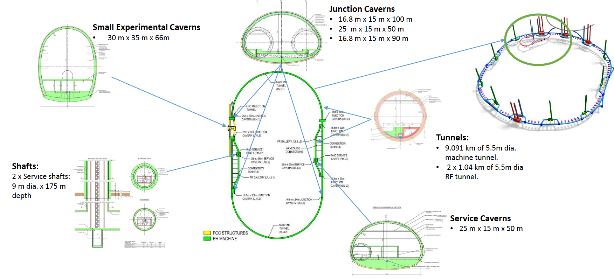
Civil Engineering and Cost Optimisation
Linac cost driver
E_{e}- physics – cost
for Halina to come
Staging? HL→ HE
2nd full civil
engineering study
Amberg + ILF consult
John Osborne et al
Amsterdam FCC 12.4.
Max Klein Kobe 17.4.18

Slide 15
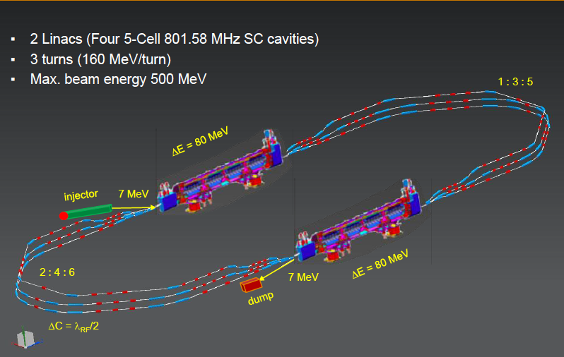

Powerful ERL for Experiments at Orsay
at 20mA → 10 MW
5.5 x 24m²
cf Walid Kaabi at Amsterdam FCC
New SCRF, High Intensity (100 x ELI) ERL Development Facility with unique low E Physics
Max Klein Kobe 17.4.18

Slide 16
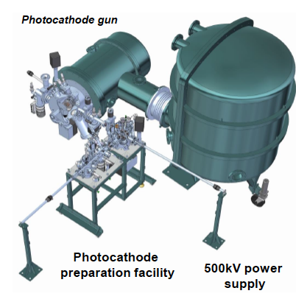
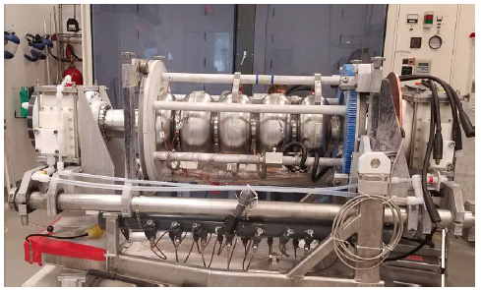
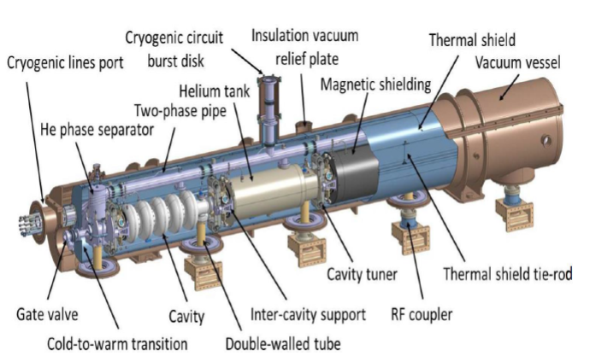
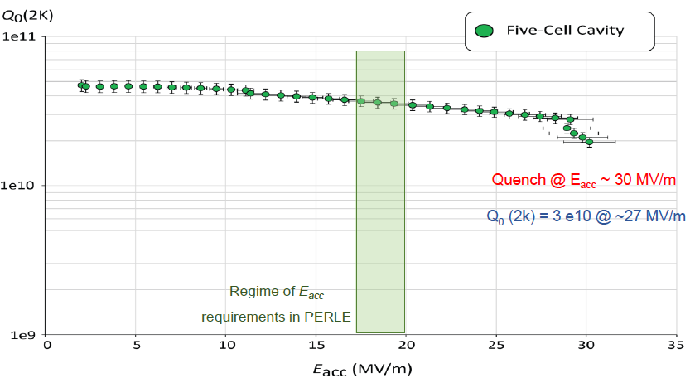
Towards PERLE: 802 MHz cavity, Source, Cryomodule, Magnets
First 802 MHz cavity successfully built (Jlab)
BINP, CERN, Daresbury/Liverpool, Jlab, Orsay, +
CDR 1705.08783 [J.Phys G] → TDR in 2019
Max Klein Kobe 17.4.18

Slide 17
Recent Presentations on LHeC and FCCeh
http://lhec.web.cern.ch
FCC Week Amsterdam 9-13.4.18
Theory
Jo Rudermann, Jorge de Blas
Overviews
Bruce Mellado, Uta Klein
QCD Max Klein
Top Christian Schwanenberger
and Orhan Cakir
Higgs Uta Klein
BSM Monica D’Onofrio
Detector Peter Kostka
Machine Oliver Bruening
Civil Engineering John Osborne
Cavity Frank Marhauser
IR Roman Martin
PERLE Walid Kaabi
DIS Workshop Kobe 16.4.-18.4.
Machine+PERLE Gianluigi Arduini
PDFs Claire Gwenlan
Low x+Diffraction Paul Newman
Nuclear PDFs Nestor Armesto
Higgs Uta Klein
Top Hao Sun
Electroweak Max Klein
New and BSM Jose Zurita
Project Max Klein
Structure of the Proton Uta Klein
FCC David D’Enterria
Max Klein Kobe 17.4.18

Slide 18

Large Hadron Electron Collider on one page
E_{e} = 10-60 GeV, E_{p} =1-7 TeV: √s = 200 – 1300 GeV. Kinematics: 0 < Q² < s, 1 > x ≥ 10⁻⁶ (DIS)
Electron Polarisation P=±80%. Positrons: significantly lower intensity, unpolarised
Luminosity: O(10³⁴) cm⁻² s⁻¹. integrated O(1) ab⁻¹ for HL LHC and 2 ab⁻¹ for HE LHC/FCCeh
e-ions 6 10³² cm⁻² s⁻¹ O(10)fb⁻¹ in ePb . O(1)fb⁻¹ for ep F_{L} measurements
Physics: QCD: develop+break? The worlds best microscope. BSM (H, top, ν, SUSY..)
Transformations: Searches at LHC, LHC as Higgs Precision Facility, QCD of Nuclear Dynamics
The LHeC has a deep, unique QCD, H and BSM precision and discovery physics programme.
Time: Determined by the Large Hadron Collider (HL LHC needs till ~2040 for 3 ab⁻¹ )
LHeC: Detector Installation in 2 years, earliest in LS4 (2030/31).
HE LHC: re-use ERL. In between HL-HE, 10 years time of ERL Physics (laser, γγ..)
Very long term: FCC-eh
Challenges: Development of ERL Technology (high electron current, multi-turn)
Design 3-beam IR for concurrent ep+pp operation, New Detector with Taggers - in 10 years.
The LHeC is a great opportunity to sustain deep inelastic physics within future HEP.
The cost of an ep Higgs event is O(1/10) of that at any of the 4 e⁺e⁻ machines under consideration
It can be done: the Linac is shorter than 2 miles and the time we have longer than HERA had.
CERN and world HEP: Vital to make the High Luminosity LHC programme a success.
1802.04317
http://lhec.web.cern.ch
Max Klein Kobe 17.4.18

Slide 19
backup

Slide 20
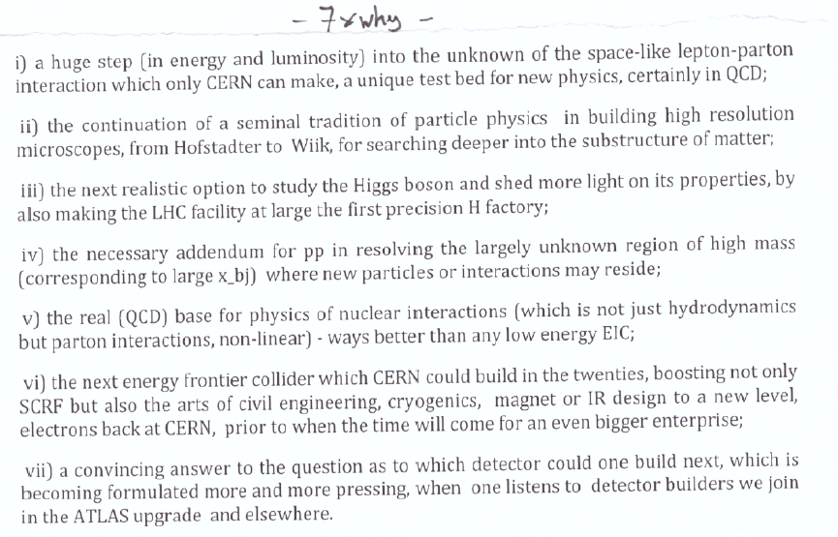
dis

Slide 21
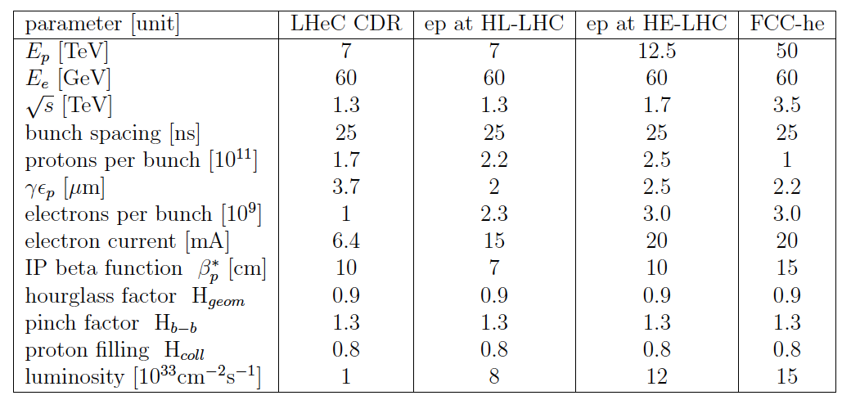

Luminosity for LHeC, HE-LHeC and FCC-ep
Contains update on eA:
6 10³² in e-Pb for LHeC.

Slide 22
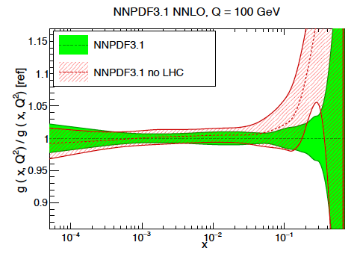
LHC Folklore: PDFs come from pp
LHC data constrain PDFs, BUT do not determine them:
Needs complete q_{i},g unfolding (miss variety)
at all x, as there are sum-rules
- Needs strong coupling to per mille precision, not in pp
Needs stronger effects (miss Q² variation)
cannot come from W,Z at Q²=10⁴ GeV²
Needs clear theory (hadronisation, one scale)
Needs heavy flavour s,c,b,t measured and VFNS fixed
Needs verification of BFKL at low x (only F₂-F_{L})
Needs N³LO (as for Higgs)
Needs external input to find QCD subtleties
such as factorisation, resummation…to not go wrong
- Needs external precise input for subtle discoveries
Needs data which yet (W,Z) will hardly be better
Needs agreement between the PDfs and χ²+1 ..
NNPDF3.1 arXiv:1706.00428
PDFs are not derived from pp scattering. And yet we try, as there is nothing else.., sometimes
with interesting results as on the light flavour democracy at x ~ 0.01 (nonsuppressed s/dbar).
Can take low pileup runs, mitigate PDF influence .. – but can’t do what is sometimes stated.
LHeC vs HERA: Higher Q²: CC; higher s: small x/g saturation?; high lumi: x→ 1; s, c,b,t. …

Slide 23
That’s it?? That may not be it..
Developments Discoveries
AdS/CFT
Instantons
Odderons
TOTEM ? CERN EP 2017-335
Non pQCD, Spin
Quark Gluon Plasma
QCD of Higgs boson
N^{k}LO, Monte Carlos..
Resummation
Saturation and BFKL
Photon, Pomeron, n PDFs
Non-conventional partons
(unintegrated, generalised)
Vector Mesons
The 3 D view on hadrons..
CP violation in QCD?
Massless quarks?? Would solve it..
Electric dipole moment of the neutron?
Axions, candidates for Dark Matter
Breaking of Factorisation [ep-pp]
Free Quarks
Unconfined Color
New kind of coloured matter
Quark substructure
New symmetry embedding QCD
C. Quigg, arXiv1308.6637
QCD has an exciting future with the FCC

Slide 24
SM Higgs Couplings from the LHeC
δκ/κ [%]
preliminary
M+U Klein 3.4.18
LHeC: 60 GeV x 7 TeV. CLIC: 350 GeV [arXiv:1608.07538, “model dependent fit”]
The principal advantage of e⁺e⁻ is the measurement of the inclusive ZH production cross section.
For a joint ee/ep/pp FCC Higgs analysis see Jorge De Blas Amsterdam FCC week.

Slide 25
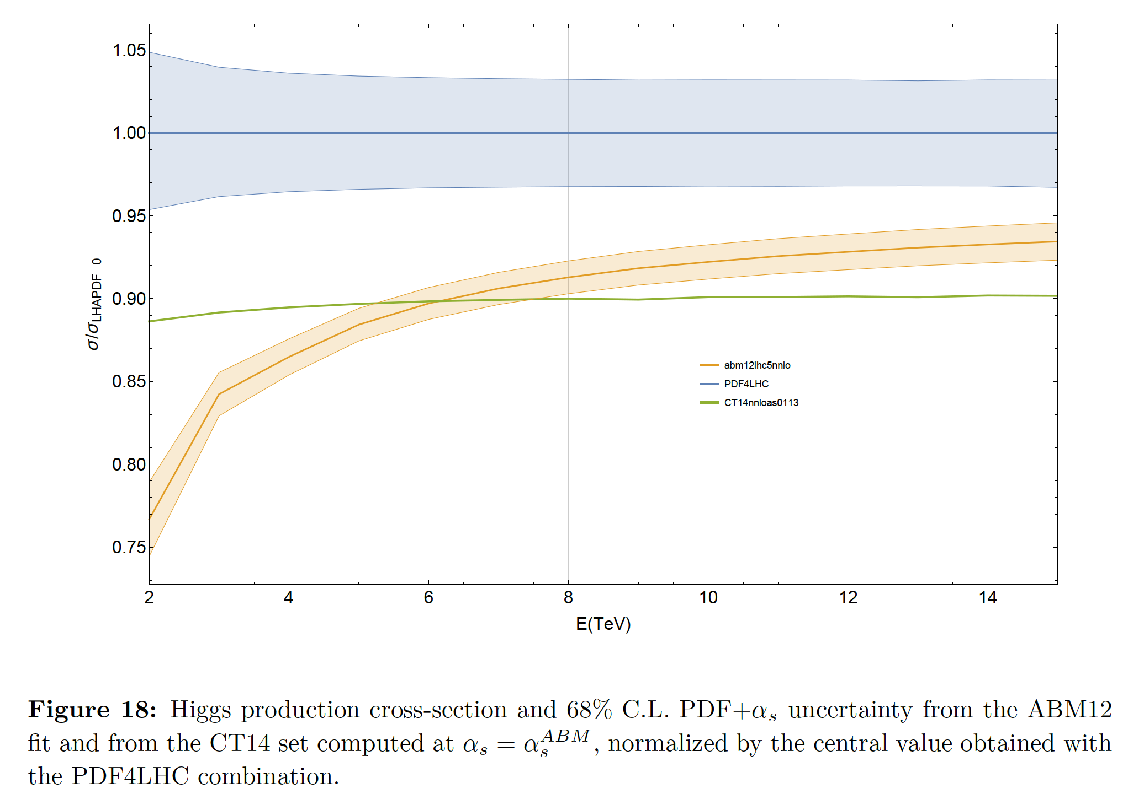
QCD of the Higgs Boson
← LHeC
1305.2090
True PDF errors?
[LHeC/FCCeh at
per-mille level,
mass and xsection]
PDFs to N³LO →
DIS to N³LO
[10 years program]
σ ~ (α_{s} xg)²
High precision pp
Higgs physics requires
high precision
for PDFs and α_{s}
C Anastasiou et al, arXiv:1602.00695

Slide 26
Observations post CDR/EUSPP - 2012+ affecting ep at CERN:
LHC lifetime now extended to ~2040 to collect 3 [4] ab⁻¹ . LS3 2024-2026+..
Discovery of the Higgs: L(ep): 10³³ → 10³⁴ cm⁻² s⁻¹ [HERA in days]
LHC brightness N_{p}/ε about 3 times higher than “ultimately” expected
No further discovery at the LHC, so far
Detector technology developments (LHC Det. Upgrades)
Strong accelerator technology developments, notably SCRF
ERL. LHeC: 720 → 802 MHz. enhanced Q₀ > 10¹⁰
EU strategy 13: exploit LHC, study Higgs, develop SCRF+,
CERN: new accelerators “with emphasis on pp and ee”
Fine with the LHeC cost being a small fraction of ILC,CLIC,FCC
CERN in 14 set up a new LHeC organisation with a new mandate
and IAC (H.Schopper et al) to prepare for the next EU strategy 2019+
Two main tasks (IAC): Update of CDR for HL-LHeC/FCCeh + Testfacility

Slide 27
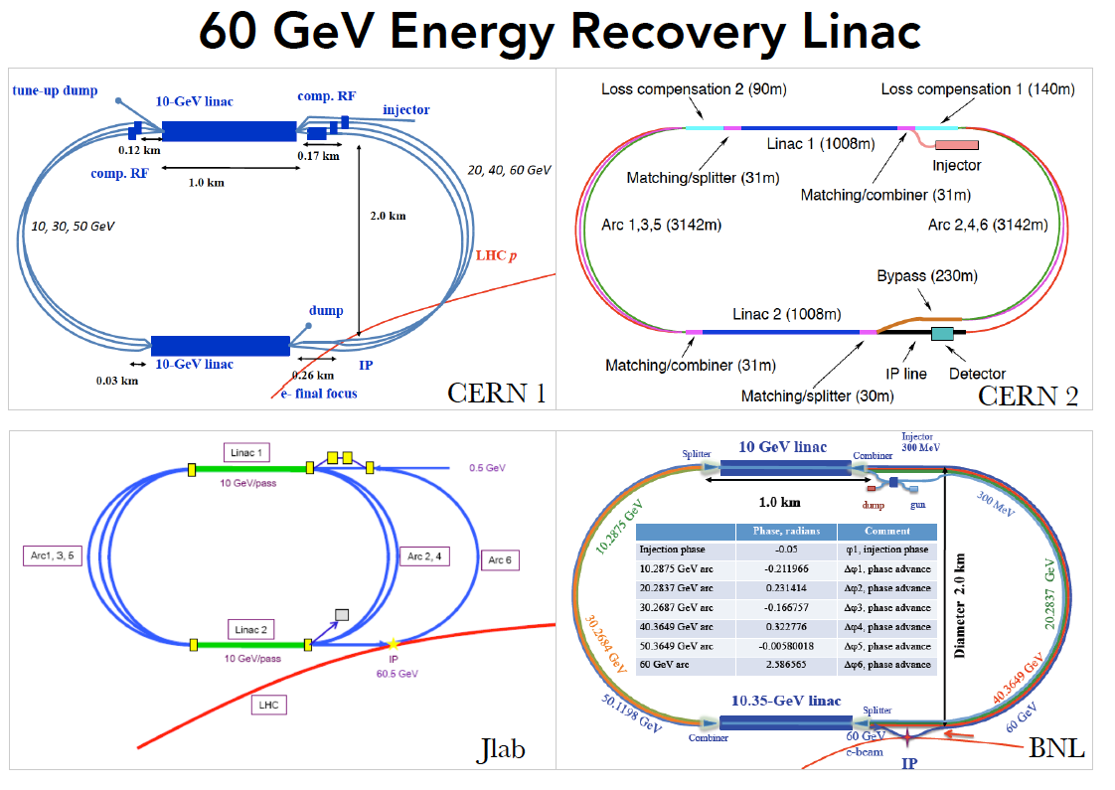
title
CDR+: Default configuration, 60 GeV, 3 passes, 802 MHz, synchronous ep+pp, L_{ep}=10³⁴

Slide 28
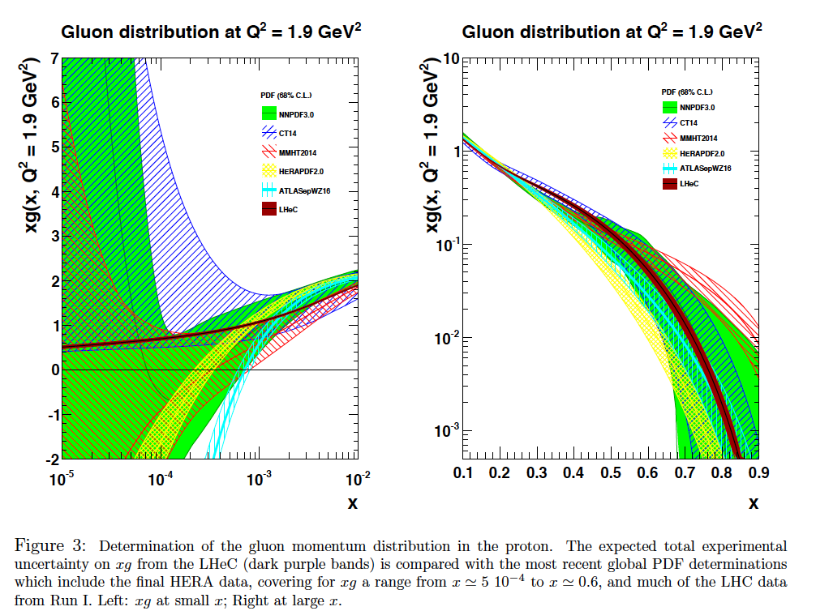
LHeC: High Precision F₂ and F_{L} to discover BFKL (CDR)
C Gwenlan, V Radescu, MK

Slide 29
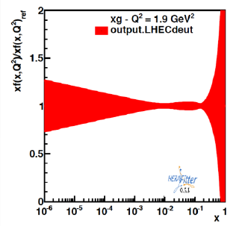
Nuclear QCD through eA at FCCeh/LHeC
Beauty in Lead
δGluon in Lead
unknown
badly
known
unknown ←
preliminary
eA: extends kinematic range in Q², 1/x by 3-4 orders of magnitude. Lumi 6 10³² (J.Jowett)
Measure nPDFs as in ep scattering and determine then the ratio R(x,Q²)=nPDF/PDF
Shadowing? A1/3 amplification? Saturation? Colour Flow? QGP initial state, collective effects
LHeC has been co-initiated and supported by NuPECC
see: Nestor Armesto FCC week 1/2018, CDR (LHeC) M.K. DOI: 10.1051/epjconf/201611203002

