Slide 1


Electrons for the LHC and remarks on the past and future of particle physics
The Standard Model
Large Hadron Collider Physics
The LHeC
Further Future
Max Klein
University of Liverpool, H1 and ATLAS
For the LHeC and FCC-eh Study Groups and the PERLE Collaboration
Invited Talk at the 2018 Session of the Turkish Physical Society, Bodrum 8.9.18

Slide 2
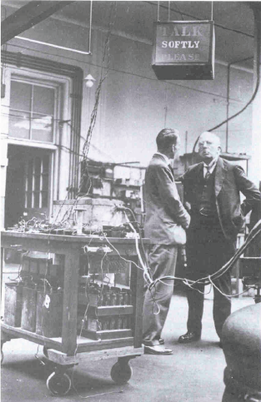
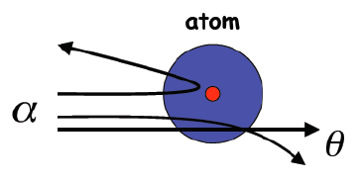
The early beginning
1900
The electron was discovered,
next to 92 chemical elements.
Lord Kelvin: There is nothing new to
be discovered in physics. All that remains
is more and more precise measurement.
1909
Discovery of the atomic nucleus in
a scattering experiment
E = 5 MeV
Geiger, Marsden, Rutherford

Slide 3
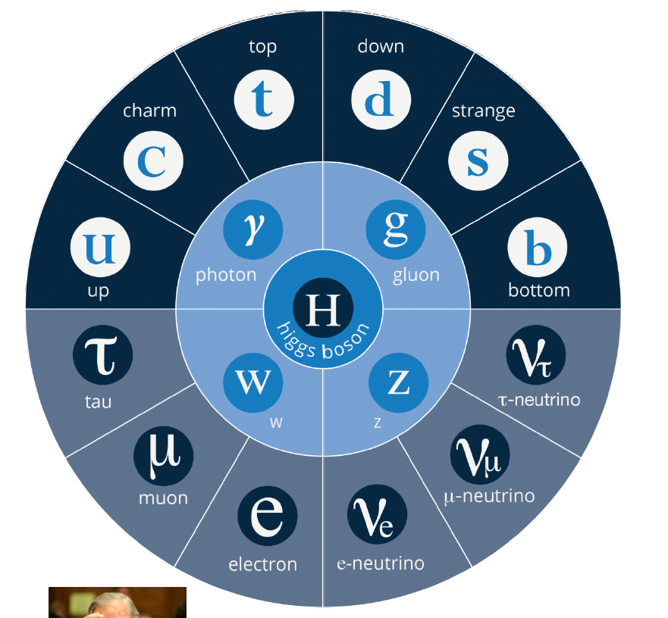
The Standard Model of Particle Physics
Up Quarks
Down Quarks
Charged
Leptons
Neutrinos
SU(2)_{L} x U(1) x SU(3)_{c}: Gauge Field Theory. Mediators: Photon, W,Z and 8 Coloured Gluons
Mass of the Elementary Fermions, of W and Z; NO Mass for the Photon: Higgs Mechanism
Mass of the Proton, Neutron .. the baryonic Universe: Gluon self-interaction NOT the Higgs.

Slide 4
Particle Physics at O(10) GeV ~1968-1988
Two Decades
One may connect the
birth of the Standard Model
with the discovery of quarks
in ep, Stanford 1968, and
“The Model of Leptons”
by Steven Weinberg +.. :
Experiment and accelerator
technology and theory
have been interlinked.
(--)
pp
Fixed target, ISR, SppS
Drell Yan
Charm
W,Z
Jets
lh
e⁺e⁻
SLAC, CDHS, BCDMS, EMC..
PETRA, PEP, Tristan
SU(2)_{L} x U(1)
QCD
Quarks
Neutral currents
Singlet e_{R}
Asymptotic Freedom
Charm
3 colours
Gluon Jets

Slide 5
Particle Physics at O(100) GeV ~1985-2015
Three Decades
Tevatron, LEP and HERA
established the SM, its
missing center, the
Higgs Boson was then
discovered at the LHC.
They found no BSM sign.
Particle Physics had
managed to have
hh, ee and eh collisions,
for securing its progress.
pp
Tevatron
b quark
top quark
M_{W}
No SUSY, BSM
ep
e⁺e⁻
HERA
LEP/SLC
The Standard
Model Triumph
M_{Z} , sin² Θ
Three neutrino families
h.o. el.weak → mt,mH
No SUSY, BSM
Gluon dominance, low x
Electroweak Unification
h.o. strong → PDFs, c, b
No SUSY, BSM
Neutrino Physics
Oscillations, PMNS
CKM - B factories

Slide 6
Fundamental, Unresolved Questions for PP
New: We lost the SM guidance
Do we have too many particles? 12 leptons, 36 quarks, 12 mediators, 1 Higgs = 61
Is there a further layer of structure (preons?)
How can we unify the 3 + 1 interactions (SU(5) failed in 1980 but established neutrino physics)
Why are leptons and quarks different?
Can one restore the boson-fermion symmetry (SUSY since 1972)
Why do we have 3 families?
Neutrino puzzles: Majorana, sterile neutrinos – Oscillations (98), Pontecorvo (57)
Is the proton stable?
How to we stabilise the Higgs Mass
…
And: what is “behind” dark matter.. ? Not fully sure that is a particle physics question?

Slide 7
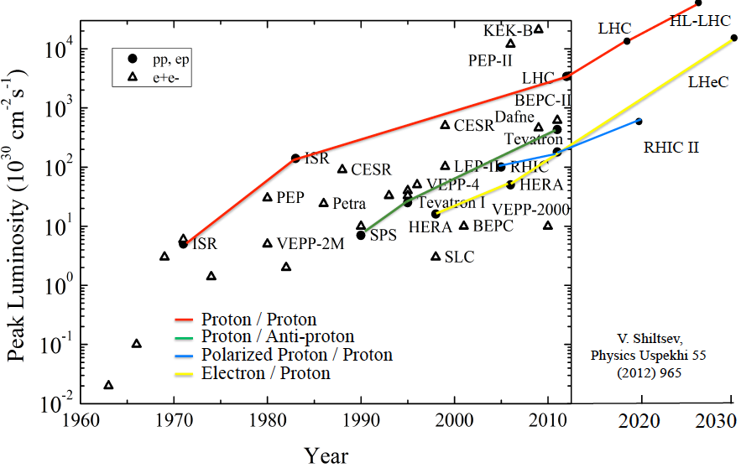
Accelerators: History and Near Prospects (pp ee ep)
.
ILC, CepC
--- Electron / Positron
O. Bruening 2/17

Slide 8
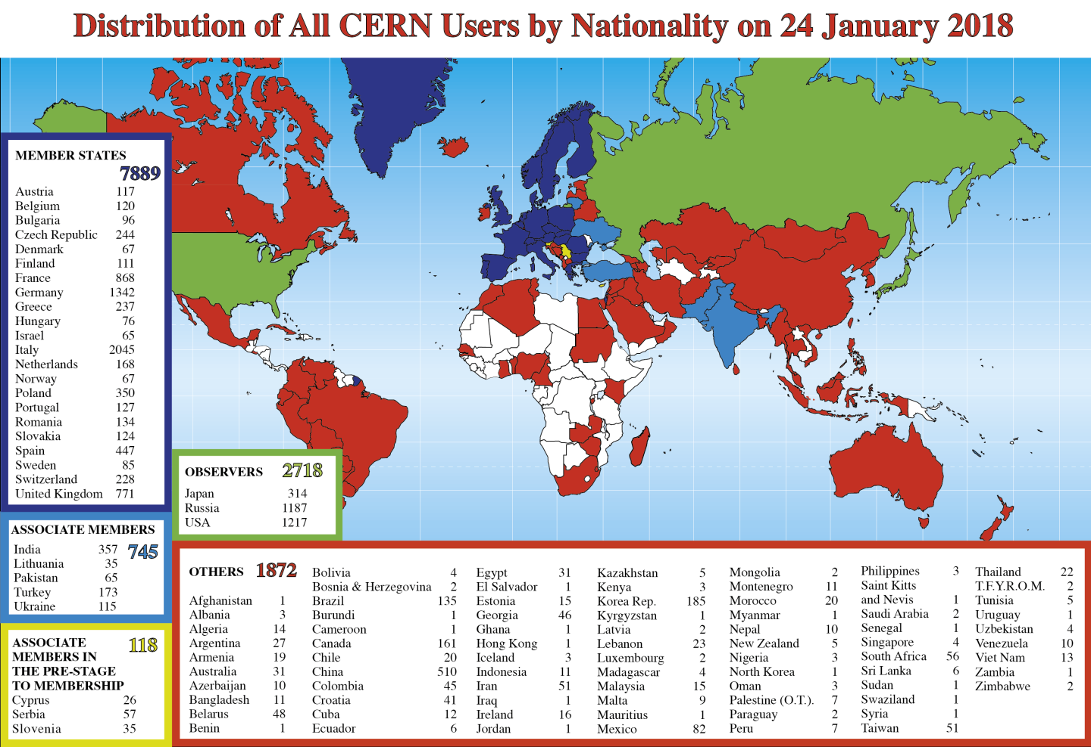
2015: Turkey becomes associate member

Slide 9
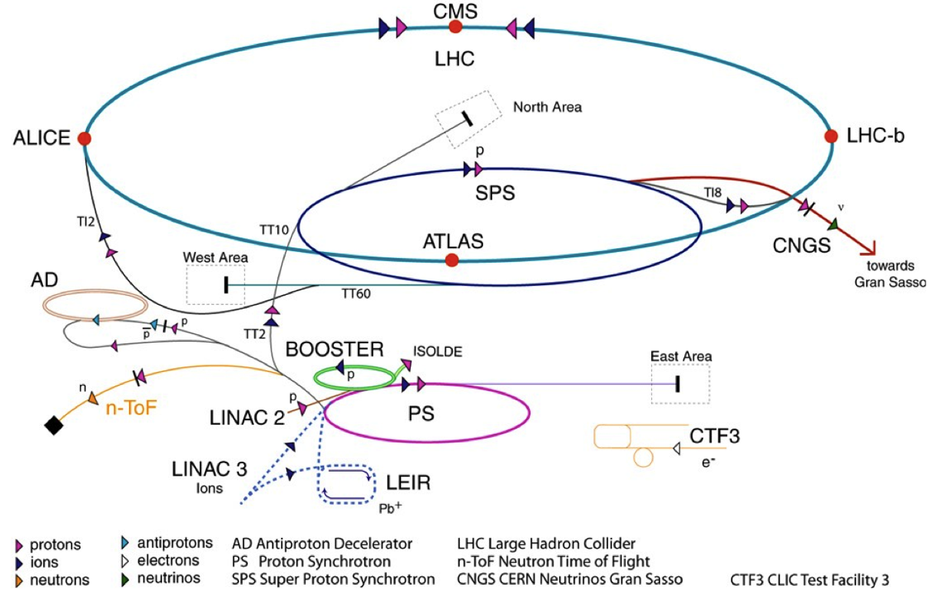
CERN’s current accelerators
CERN’s Current Accelerators
LHC: 1232 SC 8.3T Dipoles.
500 Quads, 8000 corrector magnets
16 SC Cavities. 13+27km of beam line

Slide 10
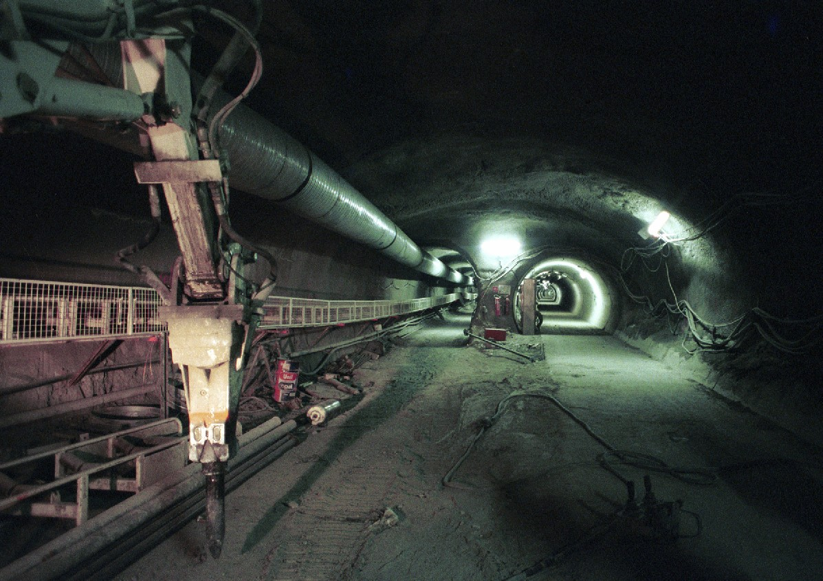
LHC tunnel 2002
10 years from here to the Higgs boson …

Slide 11
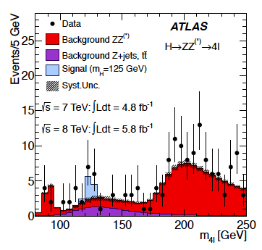
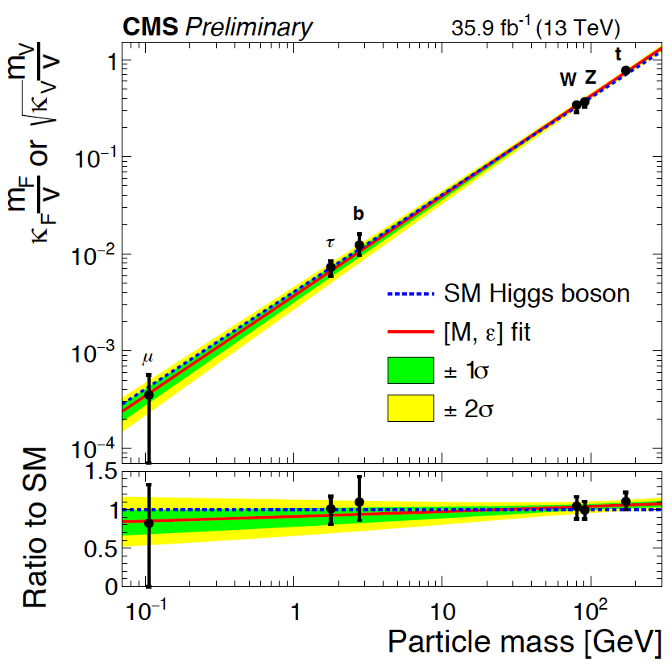
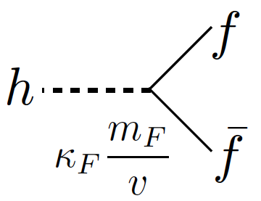
Higgs Boson: Discovery and Status
arXiv:1207.7214
H
Discovery: ATLAS+CMS
July 2012 (ICHEP Melbourne)
Last week: H → bb with 5σ
both CMS and ATLAS
Higgs: Key part of HL LHC programme: 3000 fb⁻¹

Slide 12
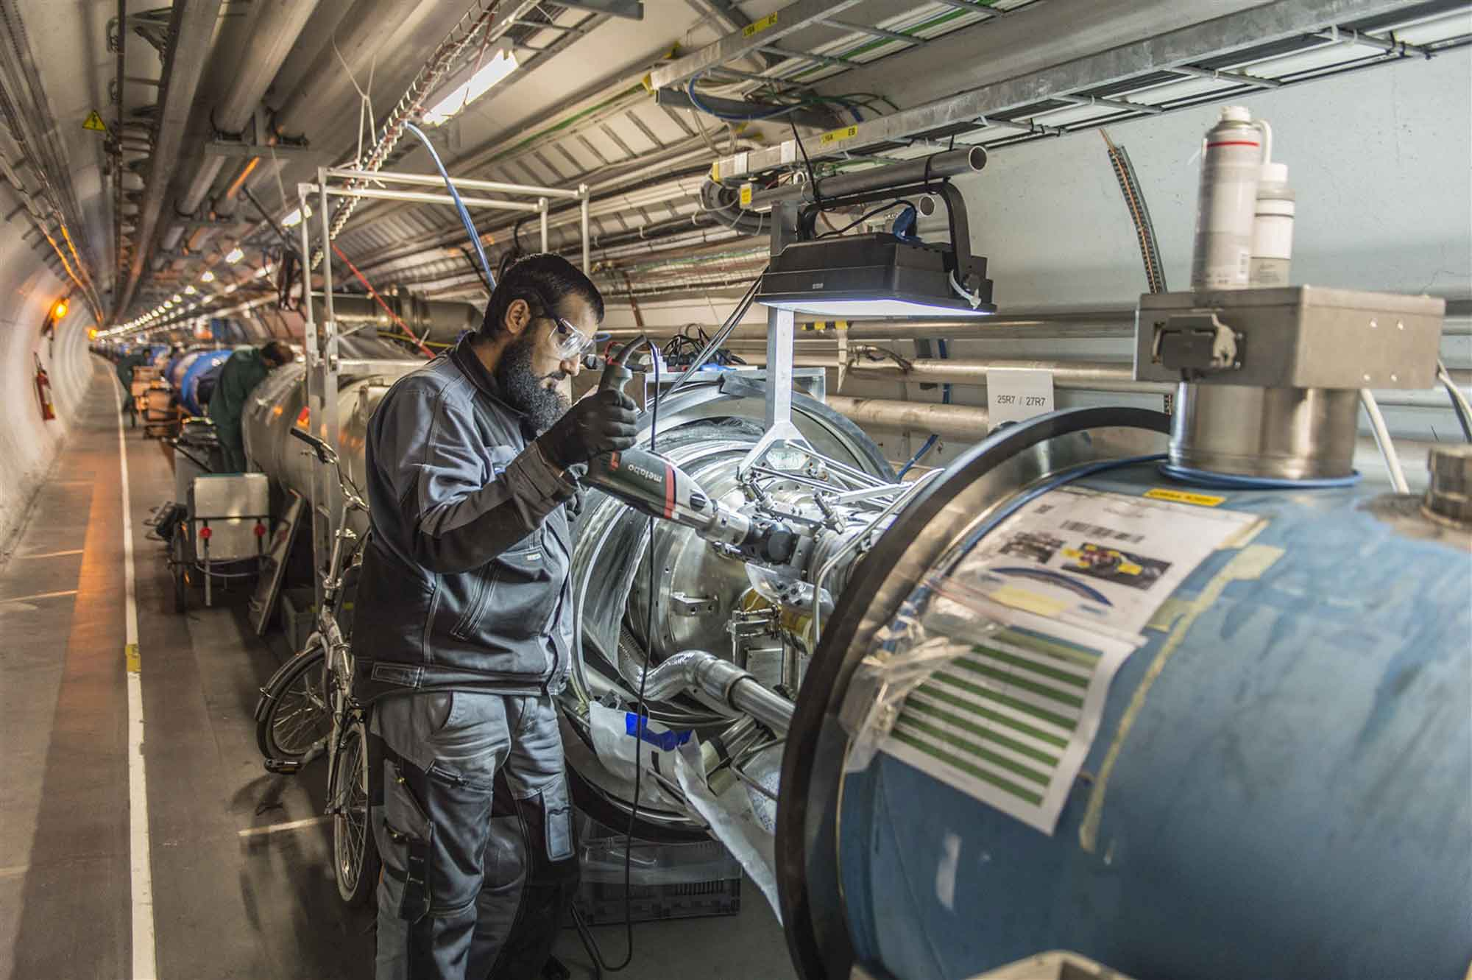
CERN and the Large Hadron Collider
Consolidation work in LS1

Slide 13
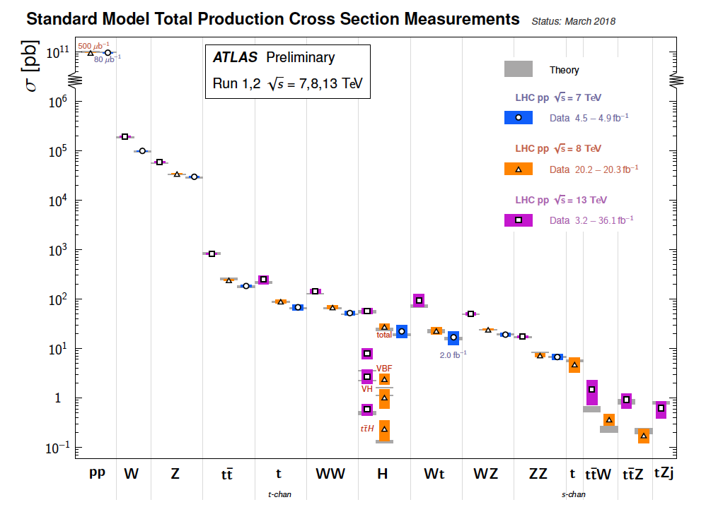
title
Beautiful confirmation of the Standard Model: New analyses & h.o. QCD + Eweak theory

Slide 14
title
So far, no sign for physics beyond the standard model (BSM). Limits from sub TeV to 10 TeV

Slide 15
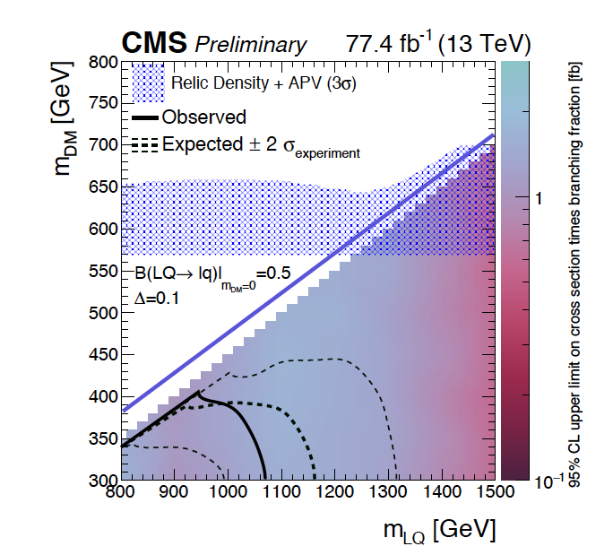
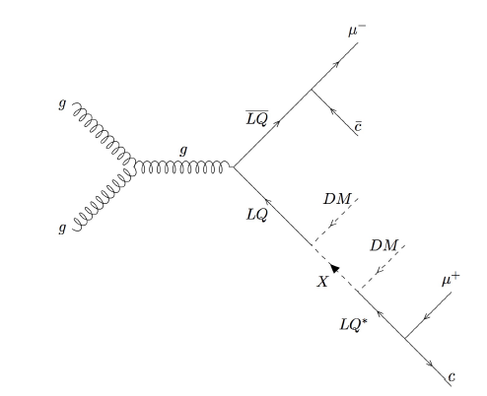
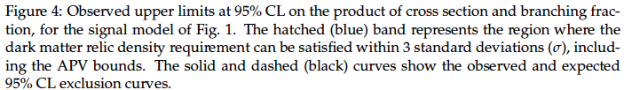
Search for Dark Matter and Leptoquarks
LHC: Energy frontier: major activity: searches for new physics, increasingly challenging: eg

Slide 16
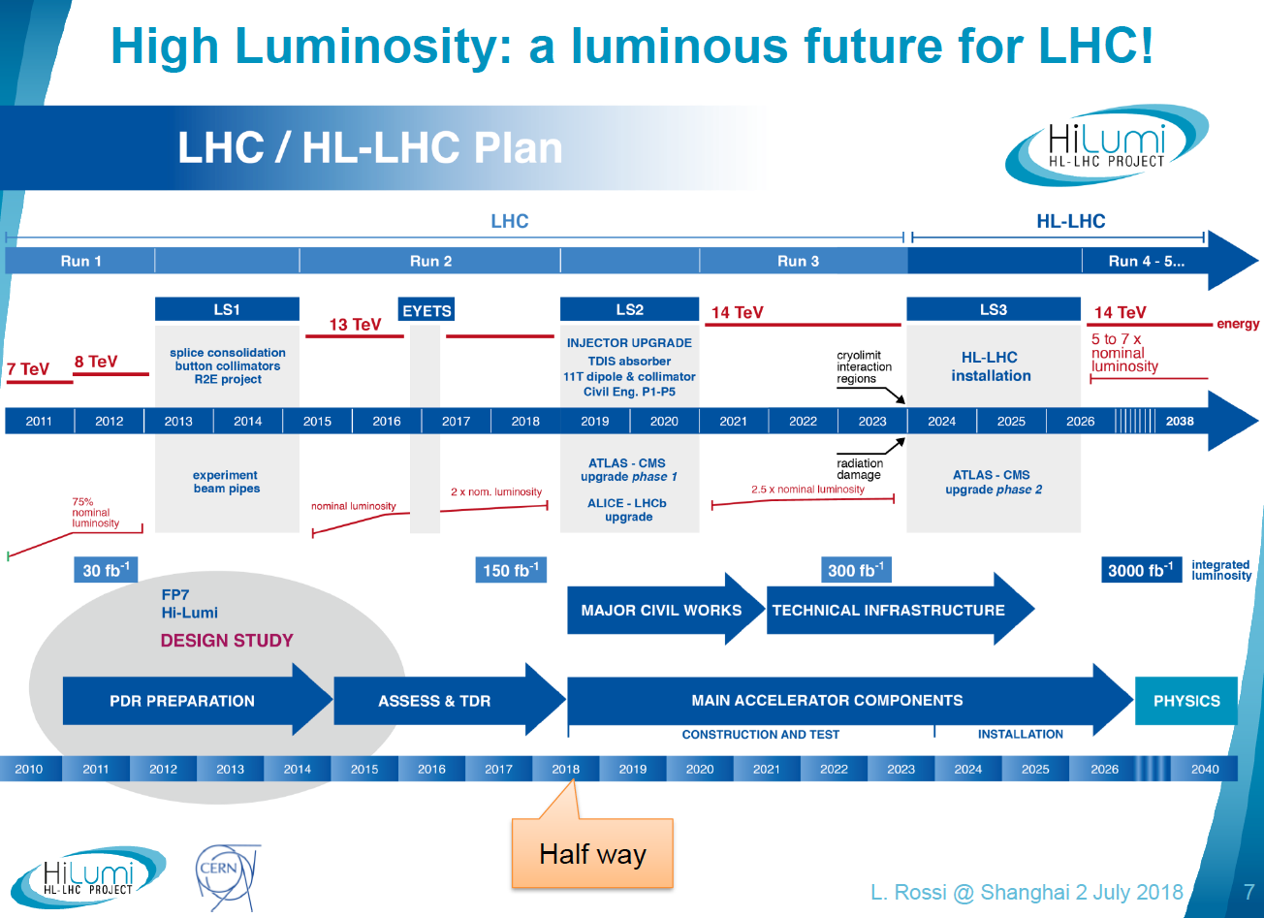
High Field Dipole Magnets

Slide 17
The LHC and its experiments operate very well.

Slide 18
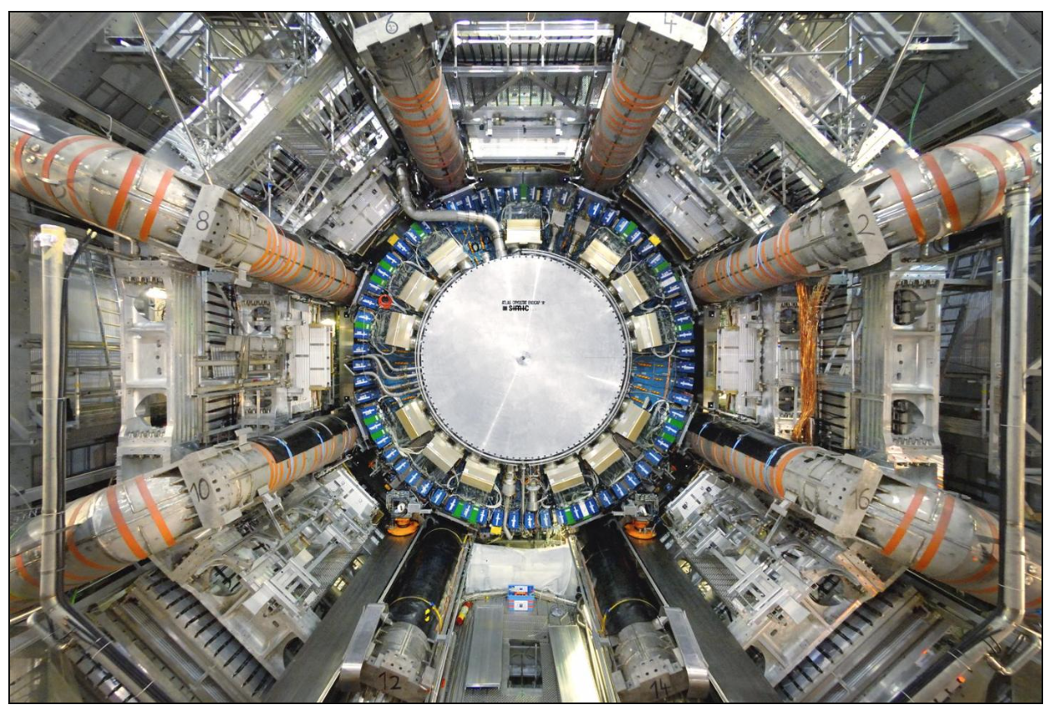
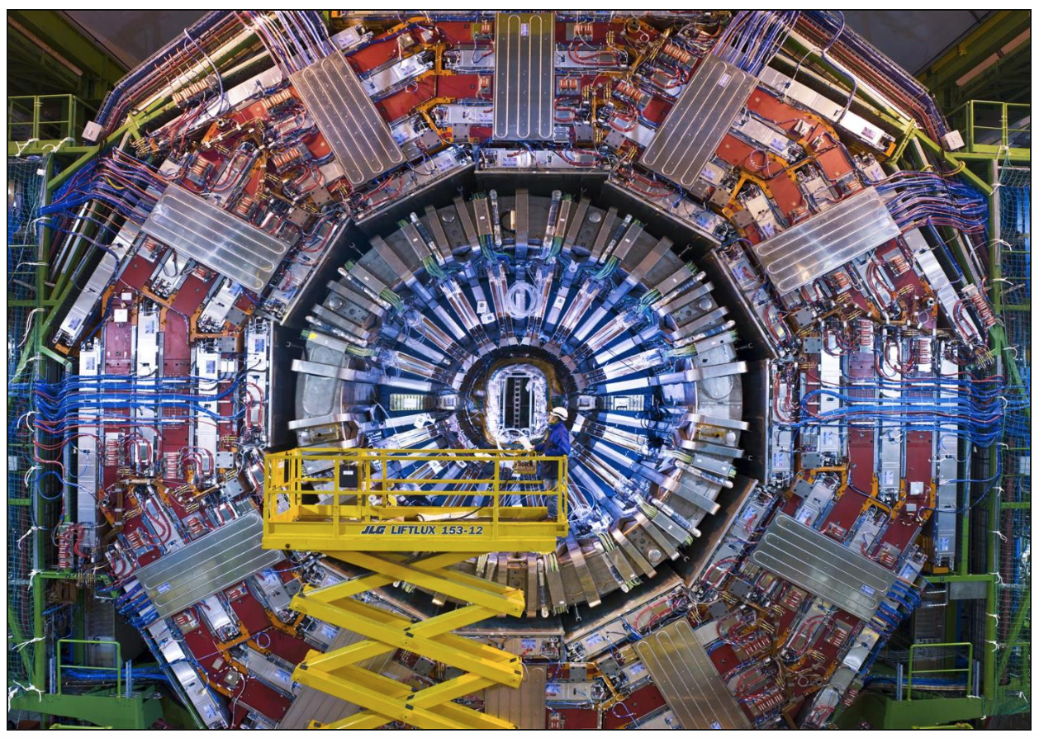
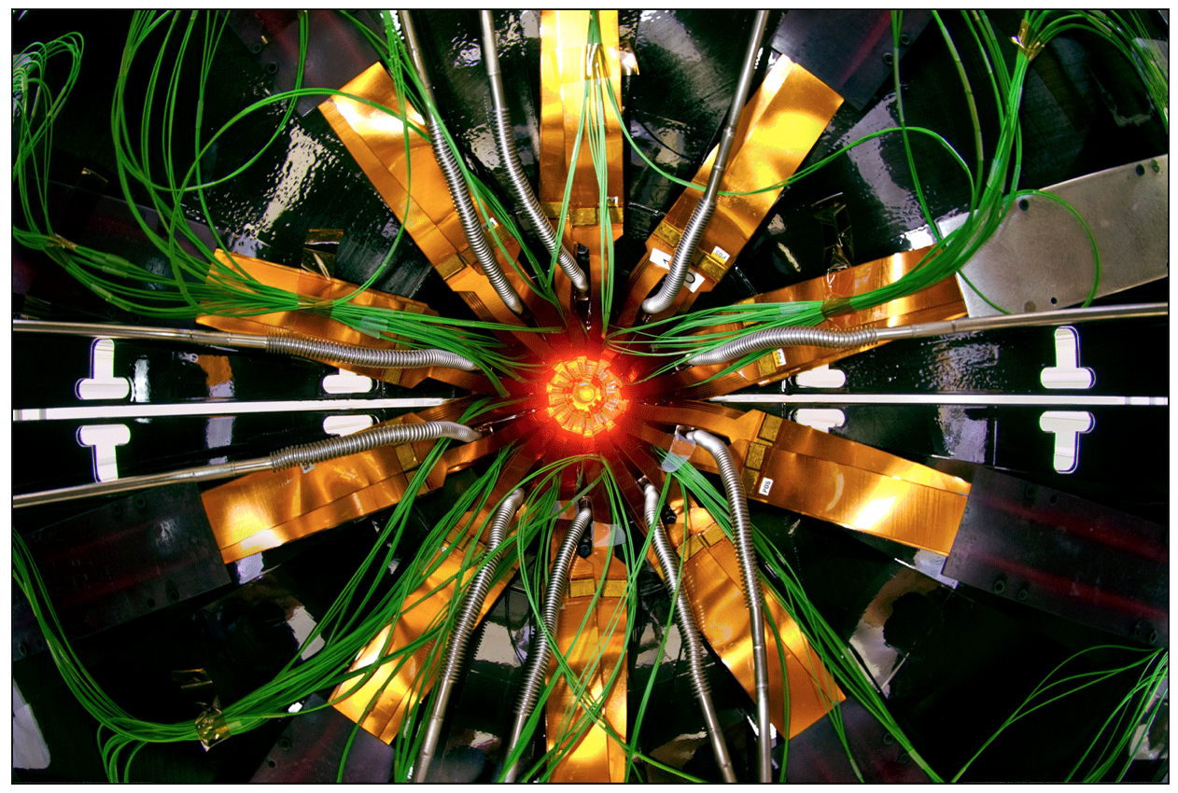
TR PARTICIPATION IN COLLIDER EXPERIMENTS
ATLAS
Turkish physicists have participated in a number of CERN experiments. They are active in collider experiments ALICE, ATLAS, CMS.
In CMS, Turkey contributes to data acquisition, trigger and mechanics for the forward HCAL, while the contribution to ATLAS includes mainly software and testing the TRT detector, and that for ALICE is to the computing. For all three high energy experiments, Turkey is also contributing to the physics data analysis.
A team of Turkish physicists is also engaged in simulations and theoretical work connected with CLIC, LHeC and FCC.
2 Inst & 37 scientists
CMS
4 Inst & 95 collaborators
ALICE
2 Inst & 5 members

Slide 19
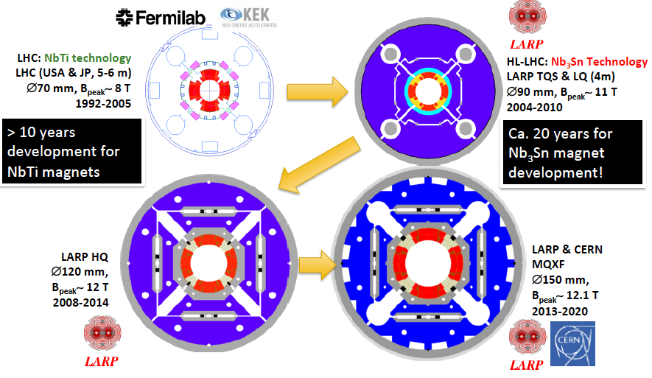
HL LHC – LHC: Inner Quadrupoles, Exp: Trackers..
Inner triplet quadrupoles receive 25MGy of radiation from 300fb⁻¹ of pp at the LHC →
Larger aperture, larger field to ensure high luminosity performance: 1-2 decades of design
ATLAS and CMS undertake a huge effort to prepare for higher luminosity and radiation
by exchanging their trackers and partially calorimeters and adding new technology also.

Slide 20
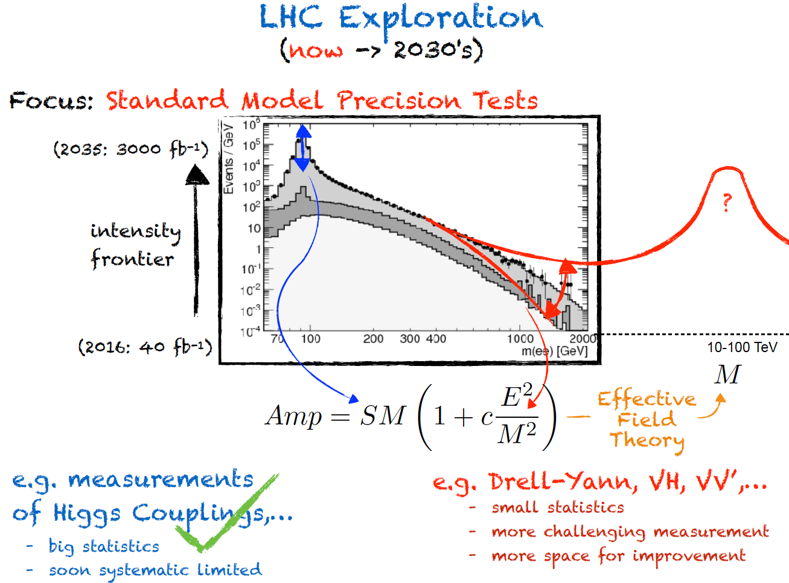
title
F Riva
High precision defines the sub distance frontier, high luminosity extends mass range. Needs ep

Slide 21
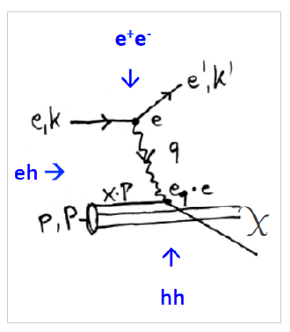
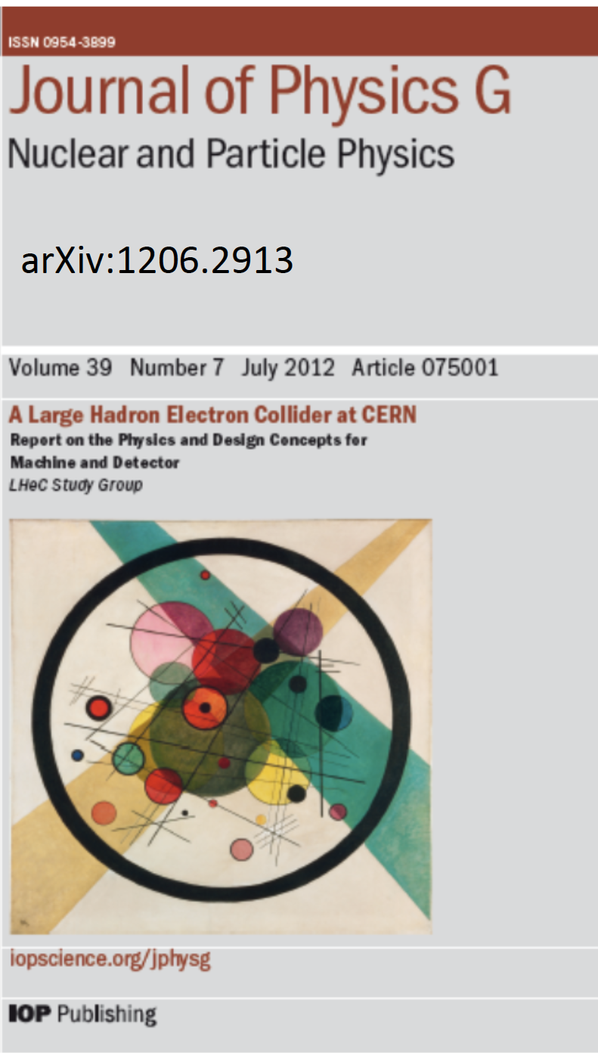
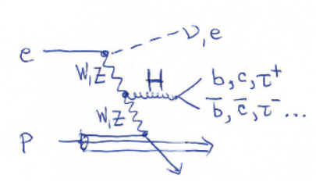
Electrons for the LHC
Deep Inelastic Scattering
Design report in 2012
Most recent workshop
http://lhec.web.cern.ch

Slide 22
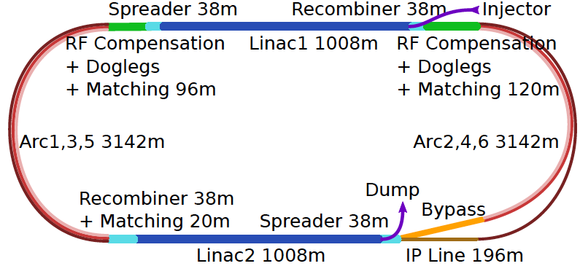
60 GeV Electron ERL added to LHC
U(ERL) = 1/3 U(LHC)
Concurrent operation to pp, LHC/FCC become 3 beam facilities. Power limit: 100 MW
10³⁴ cm⁻² s⁻¹ luminosity and factor of 15/120 (LHC/FCCeh) extension of Q², 1/x reach
1000 times HERA luminosity. It therefore extends up to x~1.
Four orders of magnitude extension in deep inelastic lepton-nucleus (ion) scattering.

Slide 23
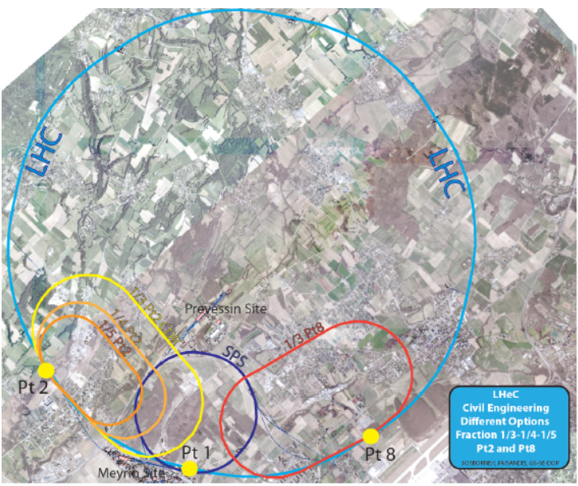
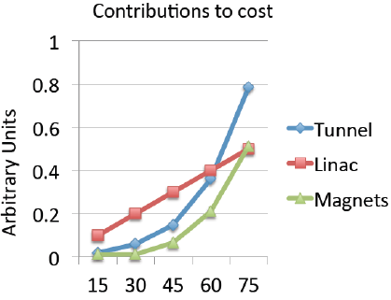
Location, Footprint, Use of the Electron Racetrack
e beam external to LHC. Location suitable for both HL and HE LHC. Program in the transition:
yy collider, high energy FEL, fixed target
MK, F Zimmermann
- U(ERL) = 1/n U(LHC): 60 GeV: 1/3
- BSM, top, Higgs, Low x all want maximum E_{e}
Initial, tentative, rough scaling estimate of
basic cost (tunnel, linac (XFEL), magnets
With much higher investments we would consider much higher E_{e} (Saleh Sultansoy)
Physics findings (such as on leptoquarks) may eventually justify to increase E_{e}

Slide 24
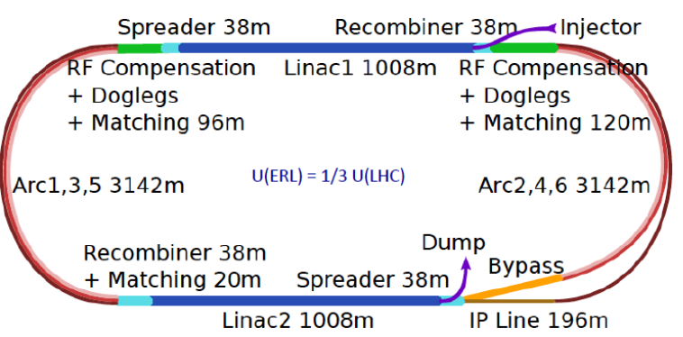
Three Raisons d’etre of the LHeC
Physics
- Microscope: World’s Cleanest High Resolution
- Empowerment of the LHC Physics Programme
- Creation of a high precision, novel Higgs facility
- Discovery Beyond the Standard Model
- Revolution of Nuclear Particle Physics
Sustainability and Cost
LHC:
- see: SM, Higgs and no BSM
- use: Investment of O(5) BSF
- run: HL LHC until ~2040
LHeC [1206.2913, update 2/19]
- 1.2 TeV ep/A for O(1)BSF
→ Establish novel ep+pp
Twin Collider Facility at CERN:
sustains HL LHC and bridges to
CERN’s long term future
For installation during LS4 (2030+)
and long term use (HE LHC, FCCeh)
Technology
Accelerator: Novel SRF ERL, green power facility
Detector: Novel high tech (CMOS..) apparatus
Keep accelerator and detector base uptodate
while preparing for colliders that cost O(10)BSF

Slide 25
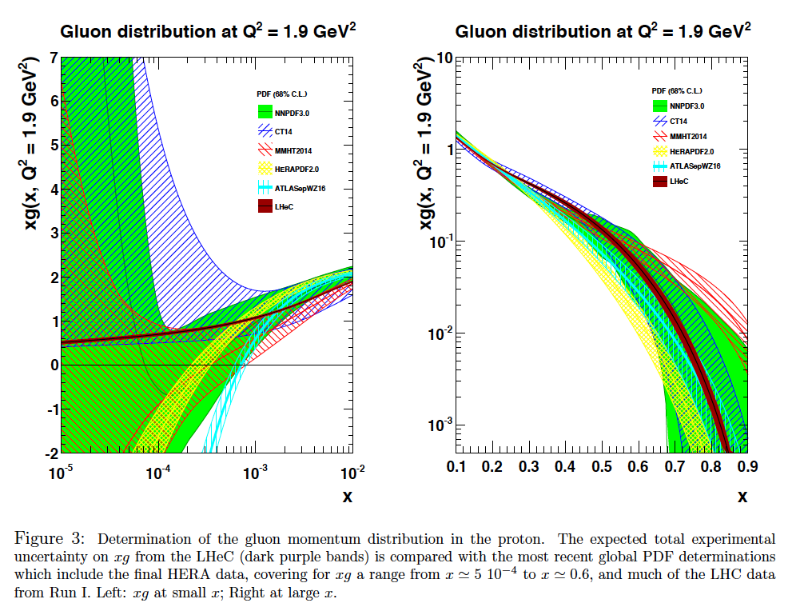
LHeC: High Precision F₂ and F_{L} to discover BFKL (CDR)
C Gwenlan, V Radescu, MK

Slide 26

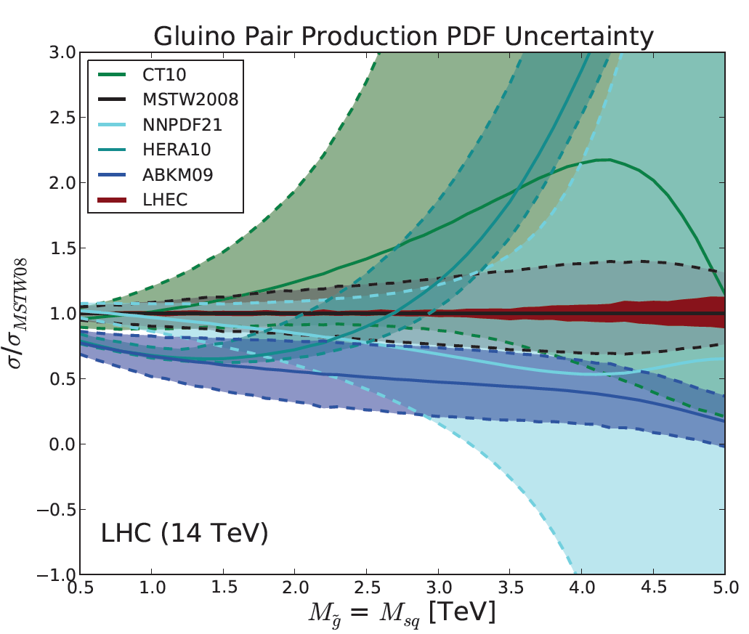
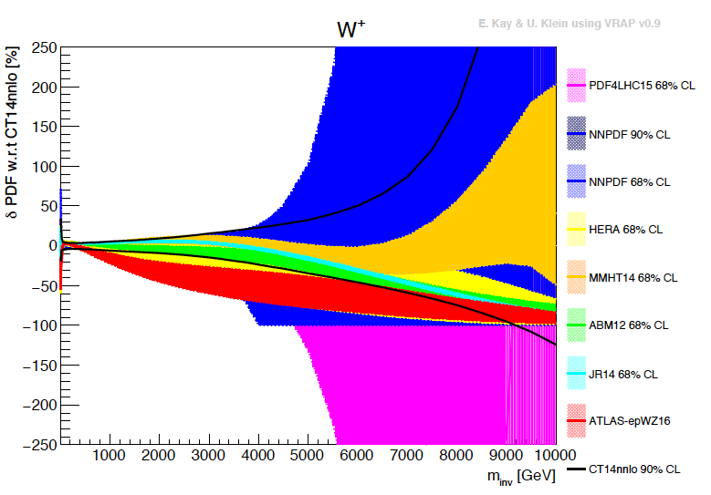
Limits at High Mass: insufficient control of p structure
External, reliable input (PDFs, factorisation..) is crucial for range extension + CI interpretation
GLUON
QUARKS
SUSY, RPC, RPV, LQS..
Exotic+ Extra boson searches at high mass
ATLAS
today

Slide 27
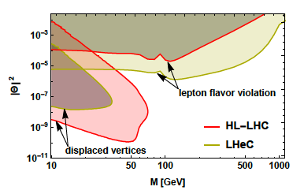
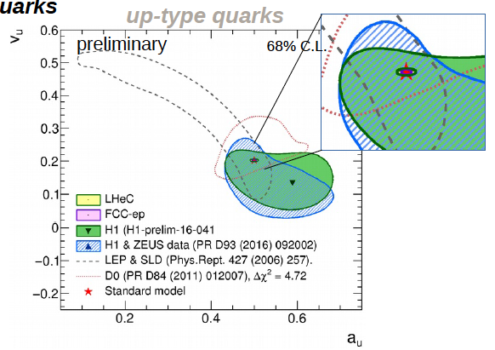
New Physics through High Precision
Masses:
Charm HERA 40 MeV LHeC 3 MeV
W LHC 19→ 10 MeV LHeC 15 MeV
and prediction to ±2.8 MeV for pp
Top: to be studied
Proton: gluon we are made of…
Higgs: Cross section to 0.3%: Mass
dependent. OB, MK 1305.2090
Neutrinos: Heavy “sterile” Neutrinos
CKM, electroweak, alpha_s, …
V_{tb}: to 0.01
V_{cs}: to 0.02 [LHC+LHeC, like ATLAS+HERA]
α_{s} to 0.2% [0.1% with HERA] – GUT?
sin²θ_{W} (μ)
LHC: better than LEP with LHeC PDFs
LHeC: scale dependence from
0.4 GeV (PERLE) to 1 TeV (LHeC)
NC couplings
Antusch, Cazzato, Fischer – work still in progress
Max Klein Kobe 17.4.18
Britzger, MK, Spiessberger, Zhang – work still in progress

Slide 28
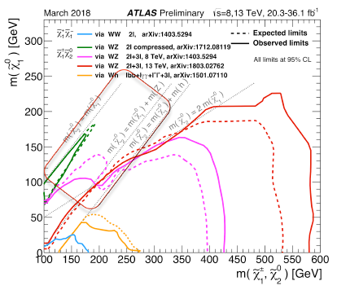
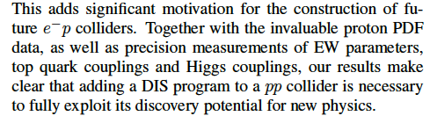
Beyond the Standard Model
Higgs into Dark Matter
Higgs into Neutralinos (RPV SUSY)
Higgs into Scalars → 4b
H±± in Vector Boson Scattering
H± in Vector Boson Scattering
H⁺ in 2HDM
Triple Gauge Couplings
Top FCNC
Contact Interactions
Empower LHC Discoveries
Challenge QCD
Higgsinos: mass degenerate
Wino/bino compressed
Prompt decays or long lifetimes
SUSY ewk sector most
challenging for pp colliders
cf U Klein + M Donofrio at Amsterdam FCC
D Curtin et al
arXiv:1712.07135

Slide 29
SM Higgs Physics Prospects: pp+ep+ee
Most abundant SM Higgs decays
Huge potential for exploring Higgs
at percent accuracy with pp+ep+ee
in the about 20 years ahead.
Striking example for pp+ep+ee
synergy at TeV scale.
δκ/%
preliminary
Rare SM H decays
→ HL LHC area
≤ 1% from ee and ep combination.
Note WW & ZZ synergy. Γ_{tot} in ee
Little influence of HL LHC on dominant channels
SM rare Higgs decays are for the pp collider →
δκ/%
preliminary
Kappa framework analysis by J. De Blas, prel.: Input:
pp: 3 ab⁻¹ ATLAS’14 w/o thy unc.– update: HL LHC WS ..
ep: 1ab⁻¹, LHeC Study Group, U.Klein et al., prel.,
ee: 2 ab⁻¹ ILC250 signal strength 1708.08912

Slide 30
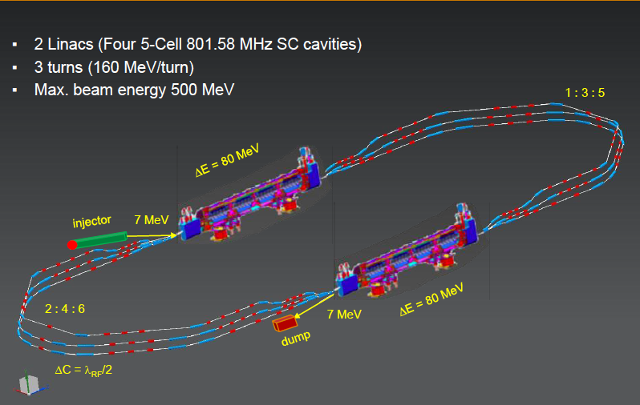

Powerful ERL for Experiments at Orsay
at 20mA → 10 MW
5.5 x 24m²
cf Walid Kaabi at Amsterdam FCC
New SCRF, High Intensity (100 x ELI) ERL Development Facility with unique low E Physics
Max Klein Kobe 17.4.18

Slide 31
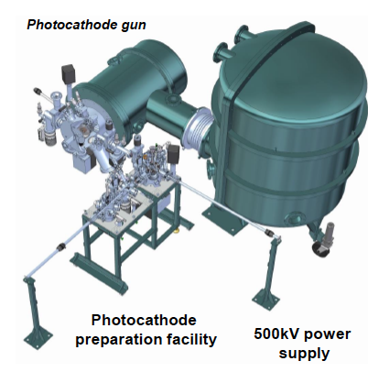
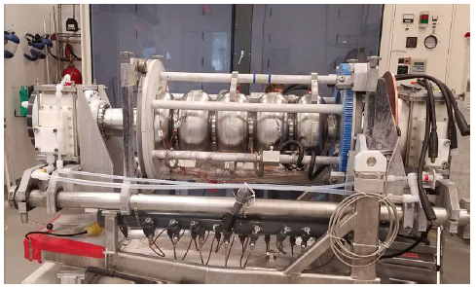
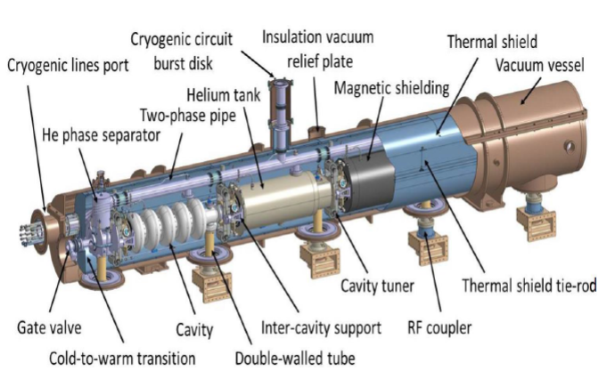
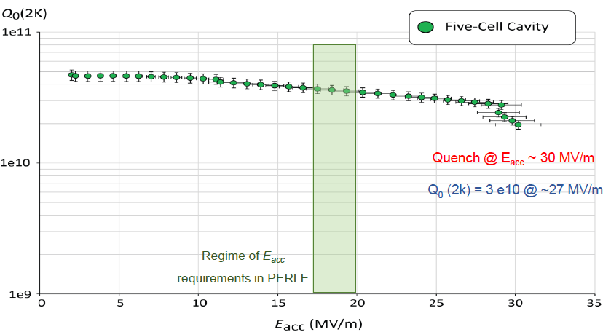
Towards PERLE: 802 MHz cavity, Source, Cryomodule, Magnets
First 802 MHz cavity successfully built (Jlab)
BINP, CERN, Daresbury/Liverpool, Jlab, Orsay, +
CDR 1705.08783 [J.Phys G] → TDR in 2019
Max Klein Kobe 17.4.18

Slide 32
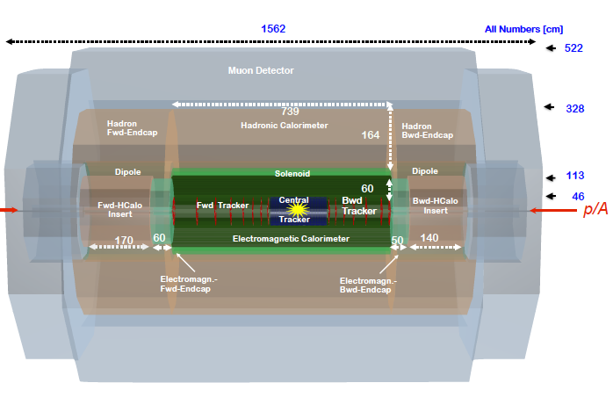
title
LHeC Detector for the HL/HE LHC
e
Length x Diameter: LHeC (13.3 x 9 m²) HE-LHC (15.6 x 10.4) FCCeh (19 x 12)
ATLAS (45 x 25) CMS (21 x 15): [LHeC < CMS, FCC-eh ~ CMS size]
If CERN decides that the HE LHC comes, the LHeC detector should anticipate that
P.Kostka et al: strong participation of many colleagues from Turkish Institutes, which we hope continues

Slide 33
Particle Physics at O(1) TeV ~2010-2050
Four Decades
The goal of current
developments is to
maximally exploit the
LHC and to complement
It with ep (LHeC) and
ee (ILC, CepC..??)
colliders to explore
the TeV scale and find
new directions of HEP as
theory is less prescriptive
pp
Electrons may be brought
to the LHC and a new
1 TeV energy eh collider
can be built, with its own
fundamental physics, at
a cost O(1/10) that of the
ee machines in sight.
LHC(b)
Rare Higgs Decays, H-HH?
Precision W,Z,top,
QCD, Flavour
No SUSY, BSM - yet
ep
e⁺e⁻
LHeC
Higgs + New Physics?
High Precision & Searches
ILC, CepC, CLIC
Maximise LHC Physics:
Precision QCD, α_{s} , el.weak
Precision Higgs
BSM?
Precision Higgs
Precision el.weak
α_{s}
BSM?
eA
Neutrino Physics
Hierarchy, CP, .. factory
SuperB

Slide 34
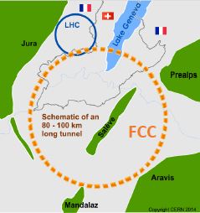
The Far Future of CERN
e ERL
A Design Study of a joint electron-positron, hadron-hadron and electron-hadron complex
Most recent FCC workshop: Amsterdam, April 2019. Conceptual Design Report: 1/19
Key: 100 TeV pp collider housed in a 100 km tunnel, suitable for ee. and adjacent ep.
CERN has also been pursuing a linear ee collider design, CLIC, with energy up to 3 TeV

Slide 35
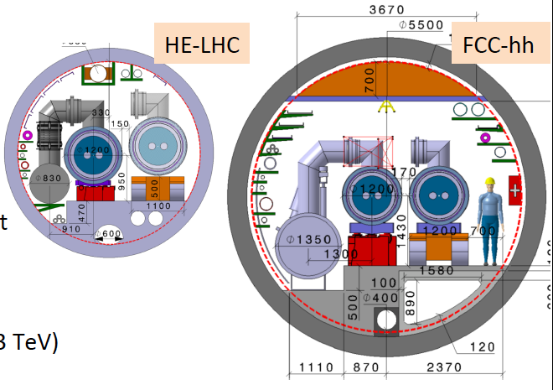
Hadron Collider Energy Frontier at CERN
Basically the same high field dipole magnets: 16 T. Options are considered to reach beyond 20 T
Luminosity: HE LHC 20 ab⁻¹ in 20 years of operation, commencing 2045+. FCC: 30ab⁻¹ in 25 years
The HE LHC is a realistic energy doubler, tripler of the LHC, but a major enterprise (acc+det)

Slide 36
The FCC - Particle Physics at O(10) TeV ~2050-2100
Five Decades
The far future is least defined
There will big questions remain
and new ones shall be posed
Crucial:
LHC and 1 TeV exploration
Developments of
Accelerator Technology
Experiments
Theoretical Physics
Peace for world collaboration
pp
FCC - hh
Higgs Potential
Rare H Decays
SUSY
GUT
??
ep
l⁺l⁻
FCC - eh
CLIC, FCC - ee
High Precision Higgs
BSM in multi TeV range
DIS of top, g saturation
Leptoquarks and GUT
High Precision Higgs
Top and BSM
Rh Neutrinos
Neutrino Physics
Factory, Proton Decay
Muon Collider ?

Slide 37

title
Jo Rudermann
It is a special challenge to determine the path for the future, also since we know, that
“The truth does not depend on whether it is shared by a majority of people or not.” G Bruno
We, experimentalists, have to extend the basis: HL/E LHC, ep at LHC and e⁺e⁻ to explore the
O(1) TeV energy scale, in a global collaboration. There follows the grand perspective
to reach the O(10) TeV scale, through major work in experiment, technology + theory

Slide 38
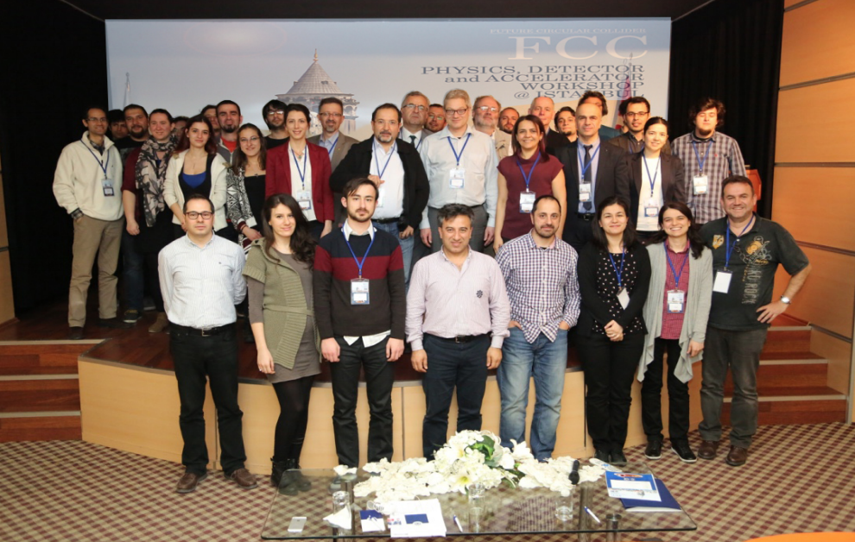

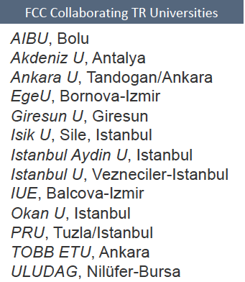
Thank you and good luck for the joint future

Slide 39
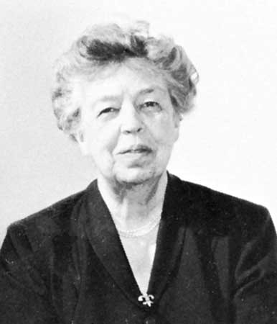
“The future belongs to those who believe in the beauty of their dreams.”
Anna Eleanor Roosevelt
(1884-1962)
Universal Declaration of Human Rights (1948)
cited by Frank Zimmermann at the FCC Meeting at Washington DC, March 2015

Slide 40
title

Slide 41

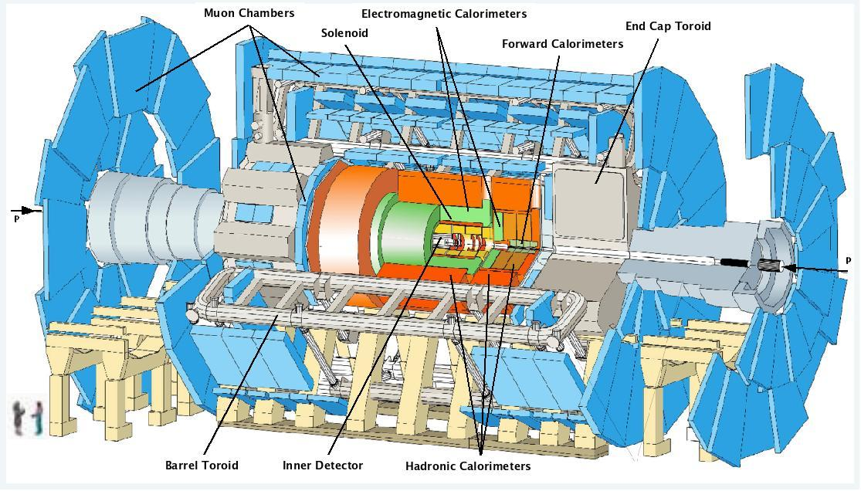
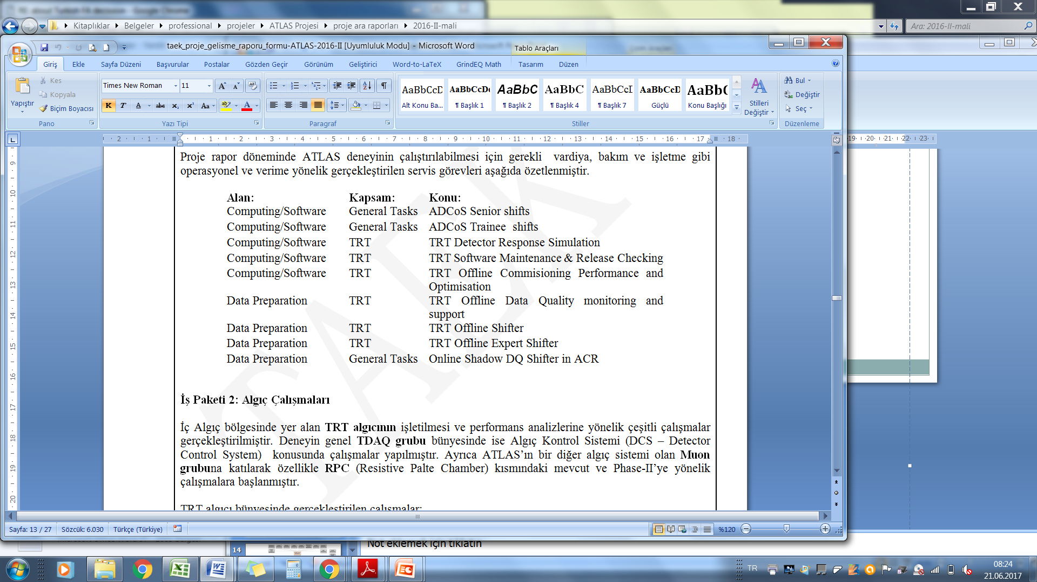
TR INVOLVEMENTS WITHIN ATLAS
Contributions in Operation Tasks:
ACR, ADCoS, Muon DQ,
Muon RPC, TRT offline
and qualification tasks (QT)
Institutional Responsibilities
(operational):
TRT Offline Monitoring
TRT Data Quality
Detector Activities:
TRT Performance Studies
TDAQ: B-jet triggers, DCS
Phase II upgrade: Barrel Inner RPC (2 students doing QT + 1 engineer)
Physics Analysis:
Exotics Physics WG: HQT subgroup, new heavy quark searches (vector-like, E6, FCNC), Compositeness searches (color octet fermions, leptoquarks)
B-Physics WG: Ξ_{b}⁻ and B^{+/-} searches

Slide 42
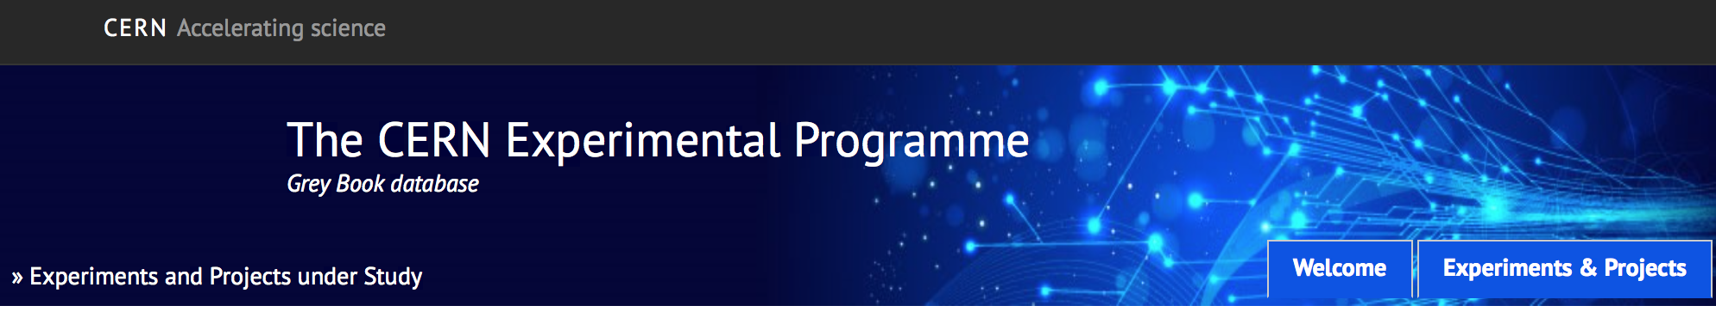
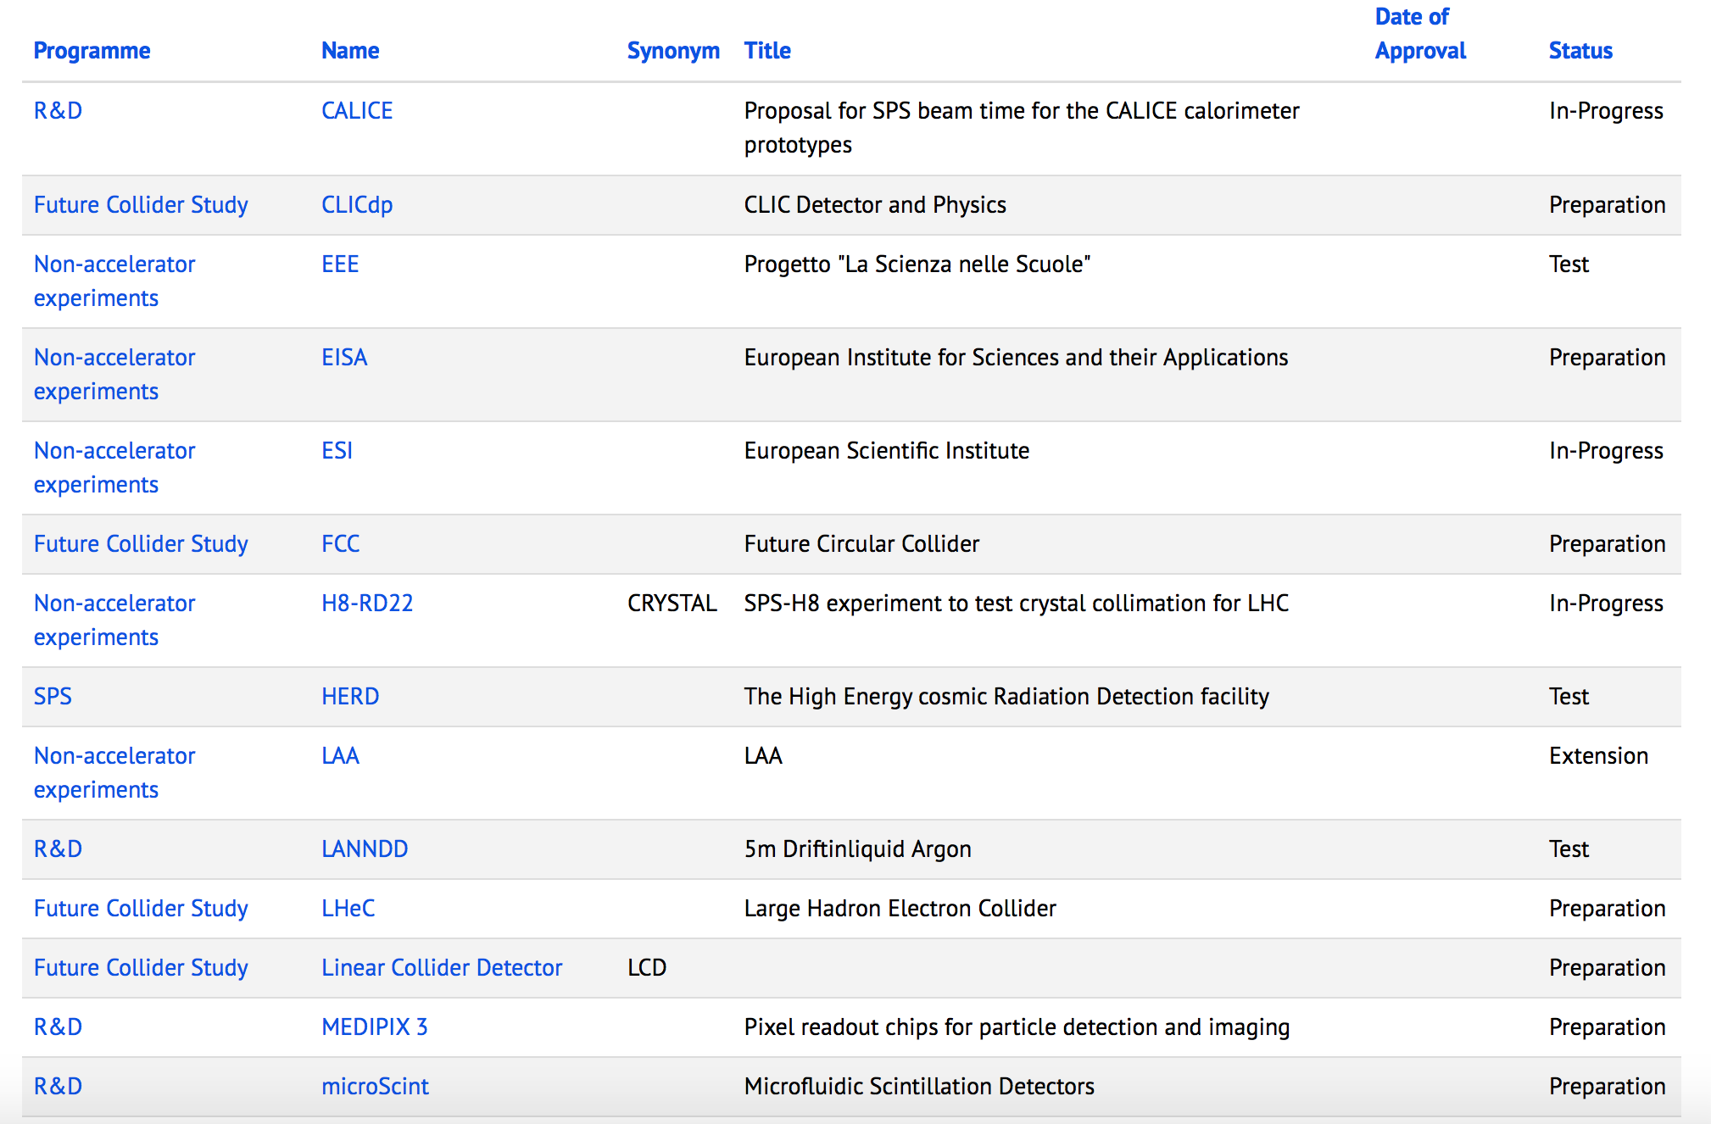

Slide 43


TR PARTICIPATION TO FCC COLLABORATION
FCC-hh: 100 TeV pp collider as long term goal
FCC-ee: e⁺e⁻ collider, potential intermediate step
FCC-eh: integration aspects of ep collisions
FCC
FCC Collaborating TR Universities
AIBU, Bolu
Akdeniz U, Antalya
Ankara U, Tandogan/Ankara
EgeU, Bornova-Izmir
Giresun U, Giresun
Isik U, Sile, Istanbul
Istanbul Aydin U, Istanbul
Istanbul U, Vezneciler-Istanbul
IUE, Balcova-Izmir
Okan U, Istanbul
PRU, Tuzla/Istanbul
TOBB ETU, Ankara
ULUDAG, Nilüfer-Bursa
Main goal of FCC collaboration is to complete CDR of FCC at the end of 2018
Recent Workshop FCC Week 2018 (9-13 April 2018, Amsterdam)
Previous workshop FCC Week 2017 (29 May-02 June 2017, Berlin)
TR Contributions in workshop (presentations)
13 Turkish Universities signed MoU and three of them (Ankara, AIBU and Giresun) signed an
Addendum with CERN-FCC to give contributions on accelerator, detector and physics studies.

Slide 44
The Way to SUSY
The Higgs mass is subject to vacuum corrections (loops with q,l, H and W,Z parts)
These corrections are quadratically divergent. Recall: the W was introduced to
remove the divergence of the 2→2 fermion scattering cross section. The Higgs
is introduced to remove the divergence of the ff→WW cross section. Now we
seem to need something to keep the Higgs mass finite.
SM: Incredible fine tuning of parameters [Hierarchy problem]
Technicolour: Higgs not elementary but composite at a scale of 1 TeV would
introduce a cut-off to loop corrections. At this scale the ‘weak interactions
become strong’ . [Susskind et al.]
SUSY: cancel divergencies by introducing partners for ALL particles with same
quantum numbers and identical couplings, and similar (?) masses
There is a huge variety of further theoretical expectations as on mini Higgses, Higgsless theories,
Un-Particles, Extra Dimensions, Left-Right Symmetry Models ..
– Nice time for theory, nice + challenging times for experiment-
M.Klein 28.4.2014 L14

Slide 45

Physics with Energy Frontier DIS
Raison(s) d’etre of the LHeC
Cleanest High Resolution
Microscope: QCD Discovery
Empowering the LHC
Search Programme
Transformation of LHC into
high precision Higgs facility
Discovery (top, H, heavy ν’s..)
Beyond the Standard Model
A Unique
Nuclear Physics Facility
Max Klein Kobe 17.4.18

Slide 46

The LHeC collinear proton (and nuclear) PDF Programme
Resolve parton structure of the proton completely: u_{v},d_{v},s_{v}?,u,d,s,c,b,t and xg
Unprecedented range, sub% precision, free of parameterisation assumptions,
Resolve p structure, solve non linear and saturation issues, test QCD, N³LO…
NP?
PDFs
are NOT
determined
in pp
but in ep
cf backup
SUSY?
H
20 GeV
40 TeV
Empowers the LHC H, BSM + SM Physics

