Slide 1


Slide 2

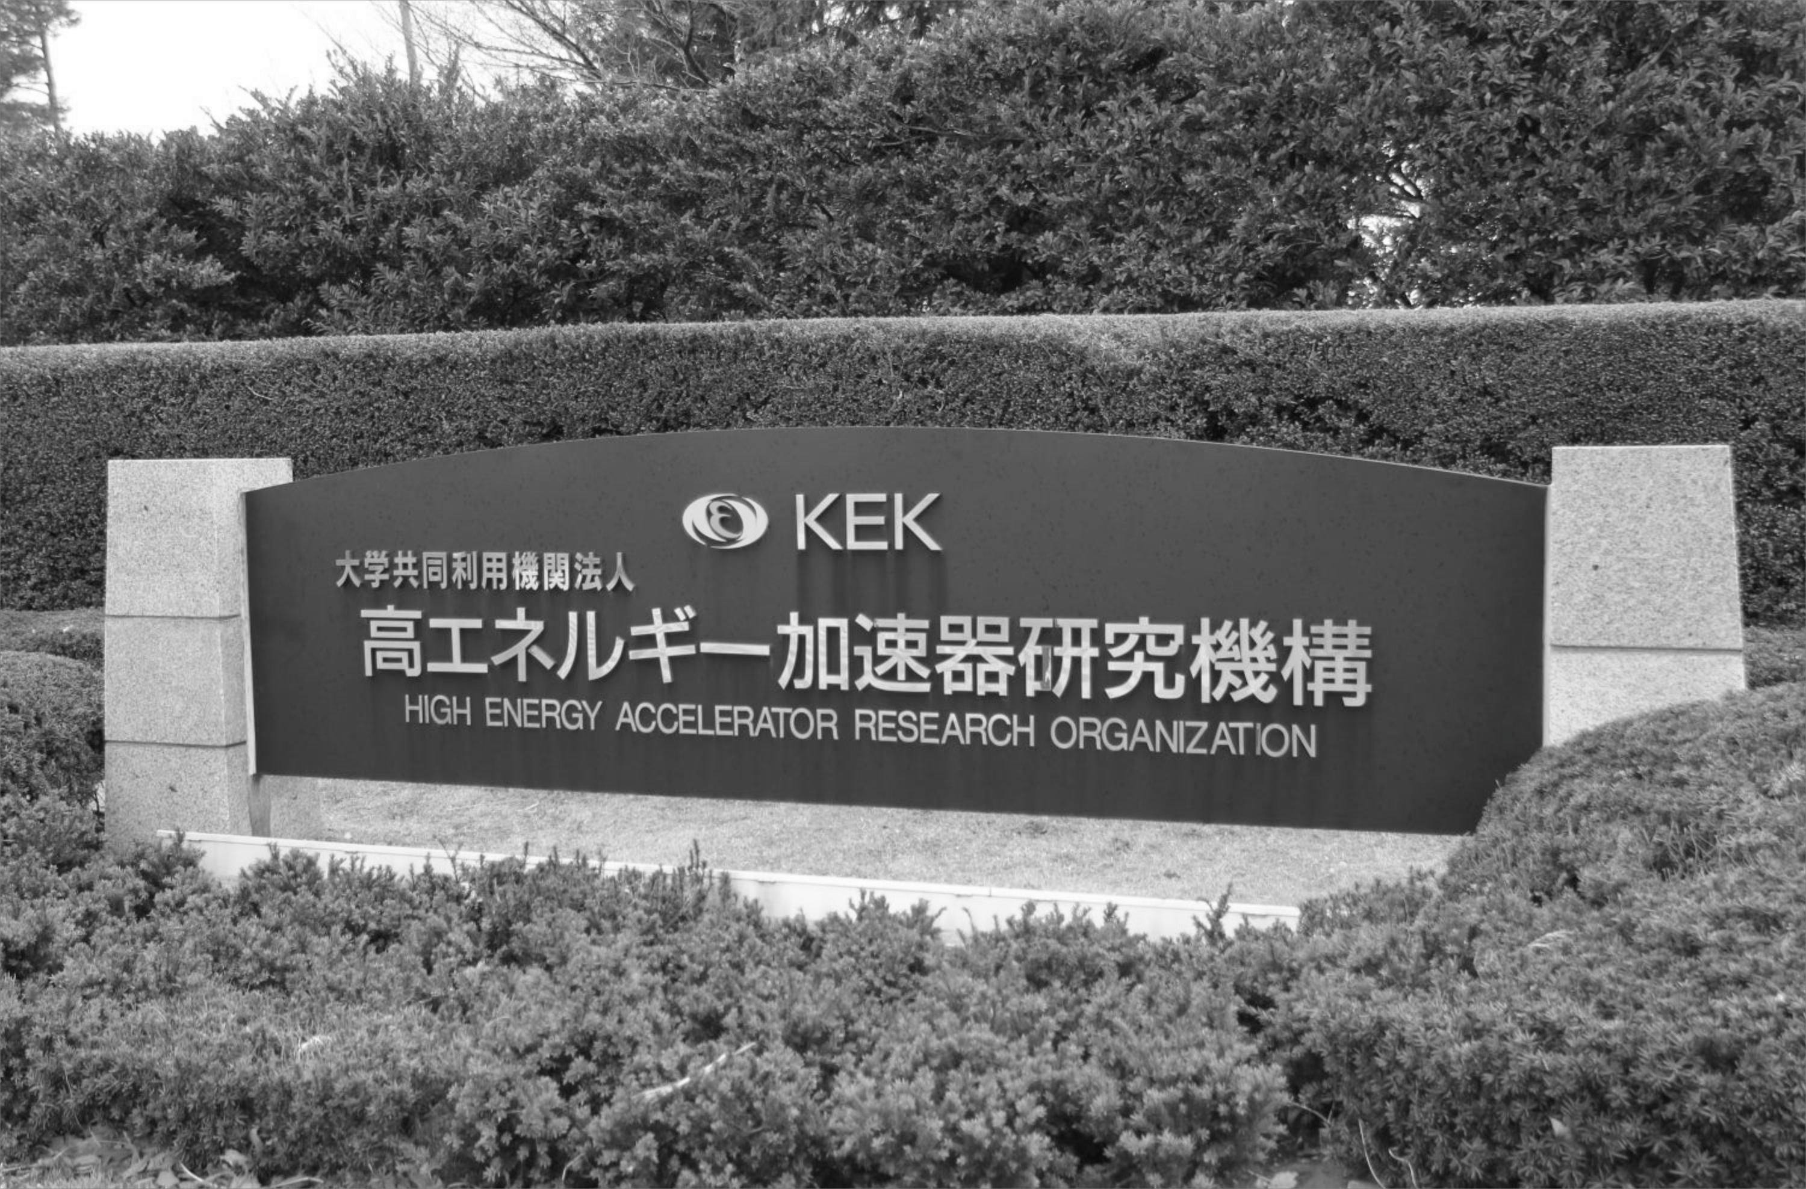
Alessandra Valloni on behalf of the LHeC collaboration
KEK Seminar
Accelerator Development for
LHeC and LTF
KEK, High Energy Accelerator Research Organization, 12th June

Slide 3
Alessandra Valloni on behalf of the LHeC collaboration
ありがとうございます
Thanks for your hospitality, time, help and support
KEK, High Energy Accelerator Research Organization, 12th June

Slide 4
^{Outline}
1. THE LHeC : Baseline parameters and configuration
- Goals
- physics requirements
2. General Design considerations
- LINAC-Ring collider
3. Post cdr plans
- an ERL test facility
4. Planning and timeline
5. Next steps and r&D activities

Slide 5
The LHeC study team and collaboration

Slide 6



















The LHeC participating institutes
…

Slide 7
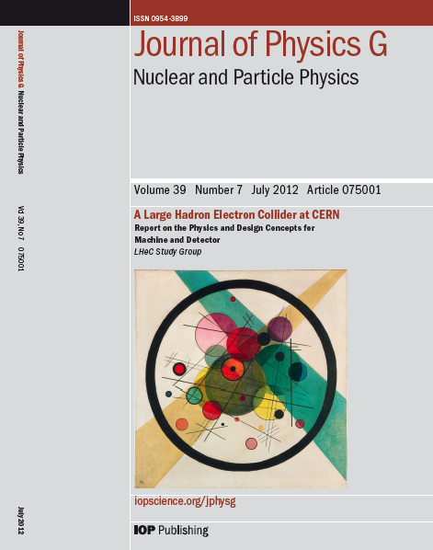
^{LHeC Overview}
1. introduction
2. Physics
3. accelerator
4. Detector
5. Conclusions

Slide 8
^{LHeC Overview}
1. introduction
2. Physics
- Precision QCD and Electroweak Physics
- Physics at High Parton Densities
- New Physics at high energy
3. Accelerator
4. Detector
5. Conclusions

Slide 9
^{LHeC Overview}
1. introduction
2. Physics
3. Accelerator
- Ring-Ring Collider
- Linac-Ring Collider
- System Design
- Civil Engineering and Services
4. Detector
5. Conclusions

Slide 10
^{LHeC Overview}
1. introduction
2. Physics
3. Accelerator
4. Detector
- Detector Requirements
- Central detector
- Forward and Backward Detectors
5. Conclusions

Slide 11


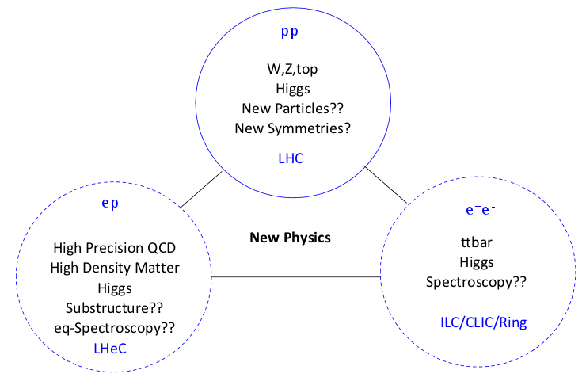
^{Physics Programme}
LHeC is a new collider: the cleanest microscope of the world
Energy (√s= 1.2 TeV) 4x
luminosity (10³³ cm⁻²s⁻¹) 100x
Increase luminosity (5x10³⁴ cm⁻²s⁻¹⁾ in IP1 (ATLAS) and IP5 (CMS)
Exploration of the energy frontier, complementing the LHC and its discovery potential for physics beyond the Standard Model with high precision deep inelastic scattering measurements
Investigation of a variety of fundamental questions in strong and electroweak interactions
Electron-deuteron and electron-ion scattering in a (Q², 1/x) range extended by 4 orders
of magnitude as compared to previous lepton-nucleus DIS experiments
Novel investigations of neutron's and nuclear structure, the initial conditions of Quark-Gluon Plasma formation and further quantum chromodynamic phenomena

Slide 12
^{LHeC Goal}
Collide LHC beam with electrons or positrons
LHC hadron beams: E_{p} = 7 TeV
CM collision energy: E²_{CM} = 4 E_{e}* E_{p,A}
Required lepton energy 50 GeV to 150 GeV
Integrated e±p : O(100) fb⁻¹ ≈ 100 * L(HERA)
Synchronous ep and pp operation
Luminosity of ≈ 10³³cm^{‐2}s^{‐1} (proposal for 10³⁴cm^{‐2}s^{‐1} exists)
Power consumption for lepton complex ≤ 100 MW
Beam Power < 70 MW
Polarisation
No interference with pp physics

Slide 13
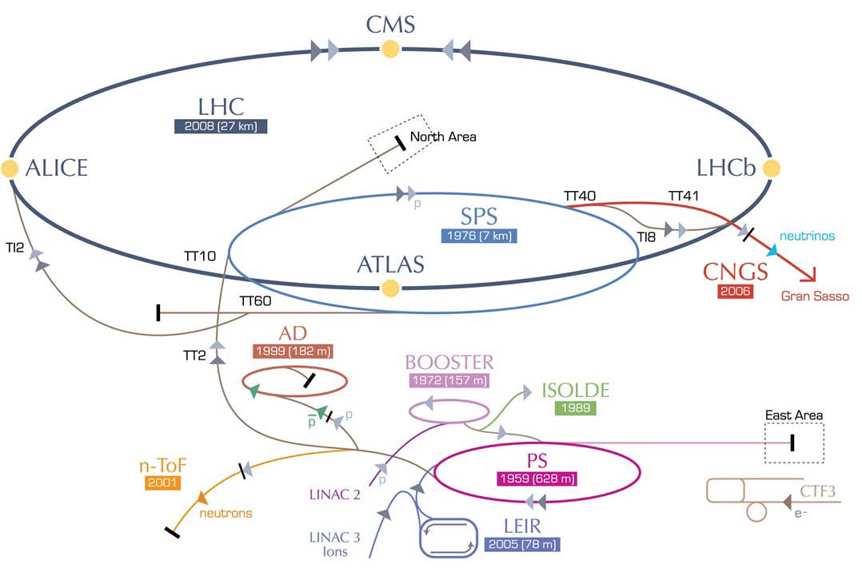
^{LHeC option: RR and LR}
RR LHeC:
new ring in LHC tunnel,
with bypasses around
existing experiments
LR LHeC:
RLA with
energy recovery
RR LHeC
e-/e+ injector
Study team provided CDR:
Ring‐ring option, feasible but impact LHC operation during installation
Linac‐ring option, the baseline
A solution exists, will now have to find the best solution
Already have a baseline and alternatives for some components

Slide 14
^{CERN Mandate (2012)}
Studies and prototyping of the following key technical components:
Superconducting RF system for CW operation in an ERL
Superconducting magnet development of the insertion regions of the LHeC with three beams
Studies related to the experimental beam pipes with large beam acceptance
The design and specification of an ERL test facility for the LHeC
The finalization of the ERL design for the LHeC (optics design, beam dynamics studies and identification of potential performance limitations)

Slide 15
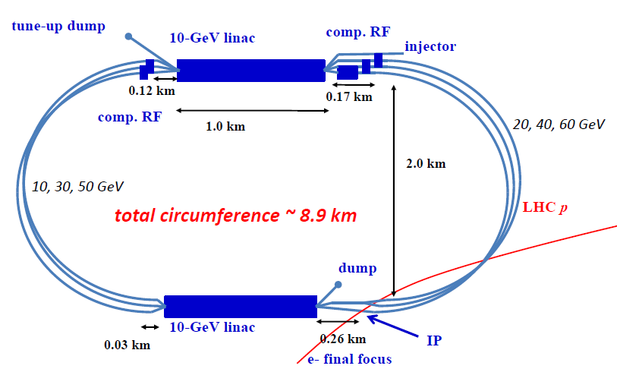
Recirculating Linear Accelerator Complex : Schematic Layout
Loss compensation 2 (90m)
Loss compensation 1 (140m)
Linac 1 (1008m)
Matching/splitter (31m)
Injector
Matching/combiner (31m)
Arc 1,3,5 (3142m)
Arc 2,4,6 (3142m)
Bypass (230m)
Linac 2 (1008m)
Matching/combiner (31m)
IP line
Detector
Matching/splitter (30m)
RECIRCULATOR COMPLEX
1. 0.5 Gev injector
2. A pair of SCRF linacs with energy gain 10 GeV per pass
3. Six 180° arcs, each arc 1 km radius
4. Re-accelerating stations to compensate energy lost by SR
5. Switching stations at the beginning and end of each linac
6. Matching optics
7. Extraction dump at 0.5 GeV

Slide 16
Linac-Ring layout: IP Parameters
10³³ cm⁻² s⁻¹ Luminosity reach | PROTONS | ELECTRONS
Beam Energy [GeV] | 7000 | 60
Luminosity [10³³cm⁻²s⁻¹] | 1 | 1
Normalized emittance γε_{x,y} [μm] | 3.75 | 50
Beta Function β*_{x,y} [m] | 0.1 | 0.12
rms Beam size σ*_{x,y} [μm] | 7 | 7
rms Beam divergence σ’_{x,y} [μrad] | 70 | 58
Beam Current [mA] | 430 (860) | 6.6
Bunch Spacing [ns] | 25 (50) | 25 (50)
Bunch Population | 1.7*10¹¹ | (1*10⁹) 2*10⁹
Bunch charge [nC] | 27 | (0.16) 0.32

Slide 17
Linac-Ring layout: IP Parameters
10³³ cm⁻² s⁻¹ Luminosity reach | PROTONS | ELECTRONS
Beam Energy [GeV] | 7000 | 60
Luminosity [10³³cm⁻²s⁻¹] | 1 | 1
Normalized emittance γε_{x,y} [μm] | 3.75 | 50
Beta Function β*_{x,y} [m] | 0.1 | 0.12
rms Beam size σ*_{x,y} [μm] | 7 | 7
rms Beam divergence σ’_{x,y} [μrad] | 70 | 58
Beam Current [mA] | 430 (860) | 6.6
Bunch Spacing [ns] | 25 (50) | 25 (50)
Bunch Population | 1.7*10¹¹ | (1*10⁹) 2*10⁹
Bunch charge [nC] | 27 | (0.16) 0.32
Energy 4 times
Luminosity 100 times
larger than HERA

Slide 18
Linac-Ring layout: IP Parameters
10³⁴ cm⁻² s⁻¹ Luminosity reach | PROTONS | ELECTRONS
Beam Energy [GeV] | 7000 | 60
Luminosity [10³³cm⁻²s⁻¹] | 16 | 16
Normalized emittance γε_{x,y} [μm] | 2.5 | 20
Beta Function β*_{x,y} [m] | 0.05 | 0.10
rms Beam size σ*_{x,y} [μm] | 4 | 4
rms Beam divergence σ’_{x,y} [μrad] | 80 | 40
Beam Current [mA] | 1112 | 25
Bunch Spacing [ns] | 25 | 25
Bunch Population | 2.2*10¹¹ | 4*10⁹
Bunch charge [nC] | 35 | 0.64

Slide 19
Linac-Ring layout: IP Parameters
10³⁴ cm⁻² s⁻¹ Luminosity reach | PROTONS | ELECTRONS
Beam Energy [GeV] | 7000 | 60
Luminosity [10³³cm⁻²s⁻¹] | 16 | 16
Normalized emittance γε_{x,y} [μm] | 2.5 | 20
Beta Function β*_{x,y} [m] | 0.05 | 0.10
rms Beam size σ*_{x,y} [μm] | 4 | 4
rms Beam divergence σ’_{x,y} [μrad] | 80 | 40
Beam Current [mA] | 1112 | 25
Bunch Spacing [ns] | 25 | 25
Bunch Population | 2.2*10¹¹ | 4*10⁹
Bunch charge [nC] | 35 | 0.64
Luminosity 1000 times
larger than HERA

Slide 20
Recirculating Linear Accelerator Complex : Schematic Layout
Loss compensation 2 (90m)
Loss compensation 1 (140m)
Linac 1 (1008m)
Matching/splitter (31m)
Injector
Matching/combiner (31m)
Arc 1,3,5 (3142m)
Arc 2,4,6 (3142m)
Bypass (230m)
Linac 2 (1008m)
Matching/combiner (31m)
IP line
Detector
Matching/splitter (30m)
RECIRCULATOR COMPLEX
1. 0.5 Gev injector
2. A pair of SCRF linacs with energy gain 10 GeV per pass
3. Six 180° arcs, each arc 1 km radius
4. Re-accelerating stations to compensate energy lost by SR
5. Switching stations at the beginning and end of each linac
6. Matching optics
7. Extraction dump at 0.5 GeV

Slide 21
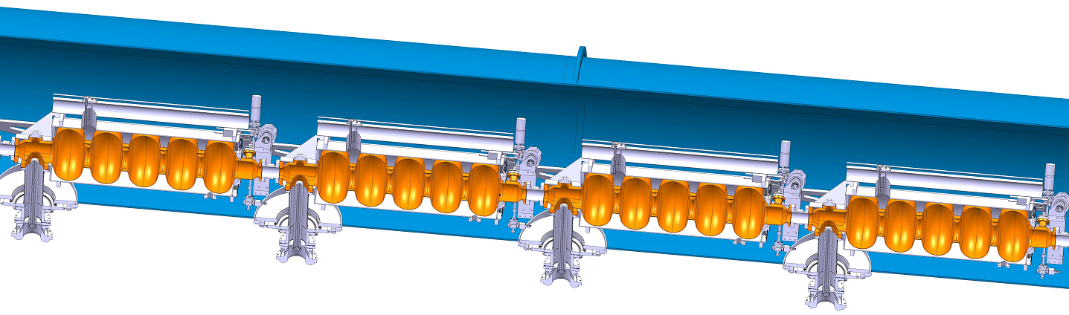
^{Linac Design}
In CDR: 8 cavities per 14 m long module
Choice between O(720 MHz) and O(1.3 GHz) made in January 2013
~ 720 MHz had been baseline for CDR
Half Cryomodule: 4 RF cavities ×1.7 m = 6.8 m
Half cryomodule, 4 RF Cavities
721.4 MHz RF, 5-cell cavity
λ = 41.557 cm, L_{c} = 5l/2 = 103.89 cm
Grad = 18 MeV/m (18.7 MeV per cavity)
ΔE= 74.8 MV per Half Cryomodule
Q₀=2.5*10¹⁰ assumed,
R=1.43*10¹³ Ω (ILC: R=1.04*10¹³ Ω)
2 modules per quadrupole pack (2 m)
~ 60 modules per 1000 m long linac

Slide 22
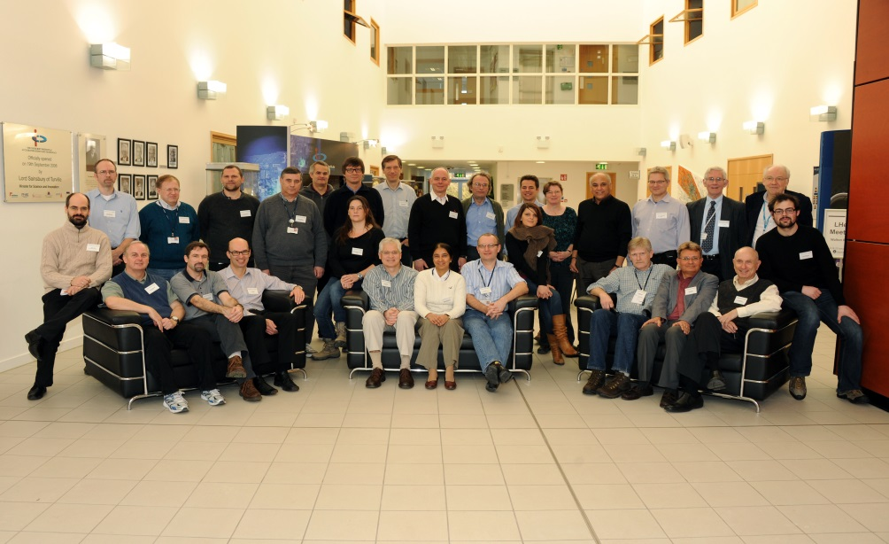



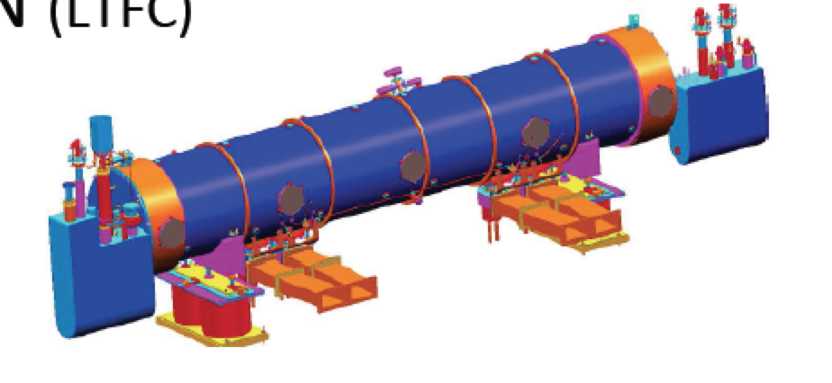
^{Post CDR frequency choice}
LHeC Meeting at Daresbury Laboratory, January 2013
FINAL CHOICE: 801.58 MHz
Frequency of a future LHC
harmonic system
JLAB-CERN-Mainz 802MHz
Cavity cryo module under design
B.Rimmer, E.Jensen, K.Aulenbacher et al.

Slide 23
^{Return Arc Optics}
Matching/splitter (31 m)
Matching/combiner (31 m)
Linac 1 (1008 m)
Switchyard
Matching sections
Arc lattices
Arc 1,3,5 (3142 m)
Arc 2,4,6 (3142 m)
Linac 2 (1008m)
Matching/combiner (31 m)
Matching/splitter (31 m)
Arc-to-Linac Synchronization - Momentum compaction
  Quasi-isochronous lattices
  Choice of Arc Optics - Flexible Momentum Compaction
Arc Optics Choice - Emittance preserving lattices
  Arcs based on variations of FMC optics (Im. γ_{t}, DBA, TEM)
Acceptable level of emittance dilution and momentum spread
  Magnet apertures

Slide 24
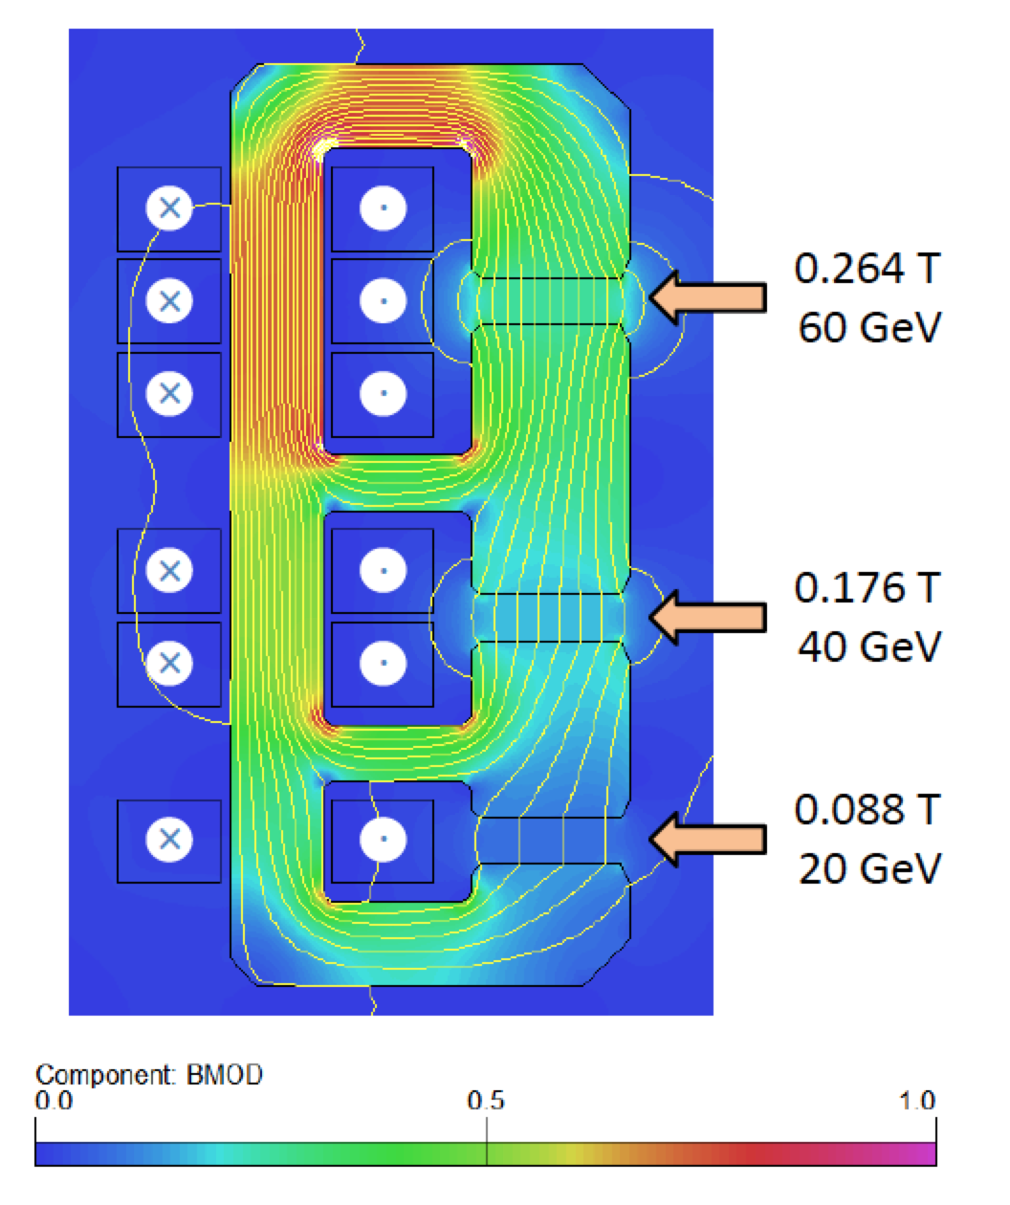
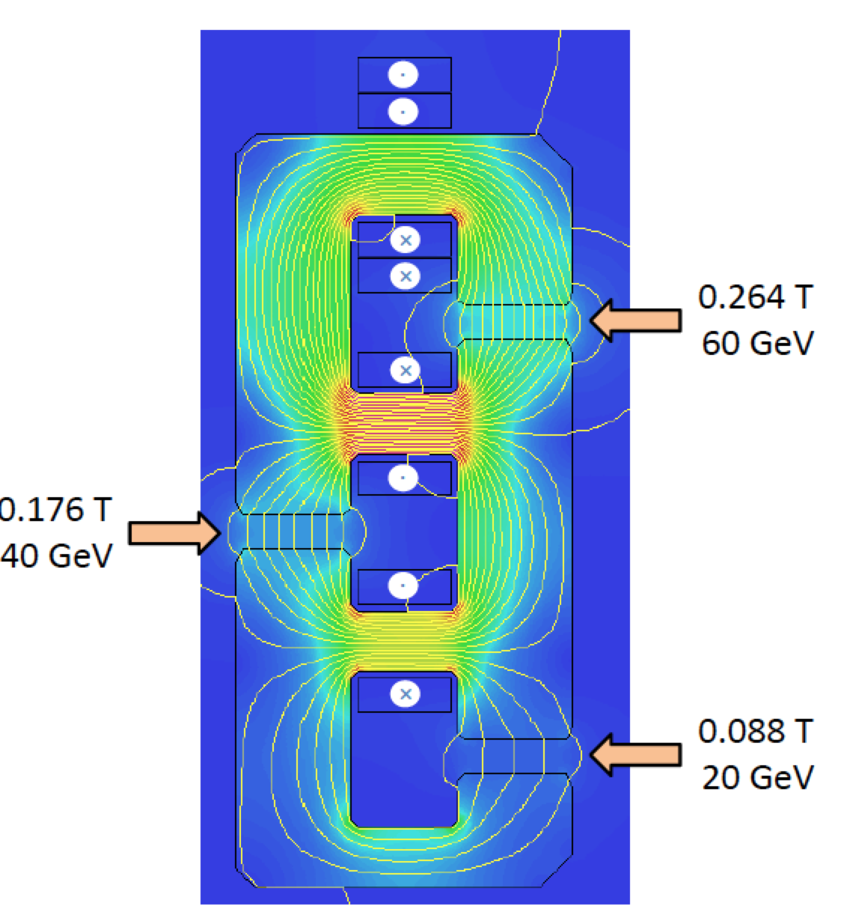
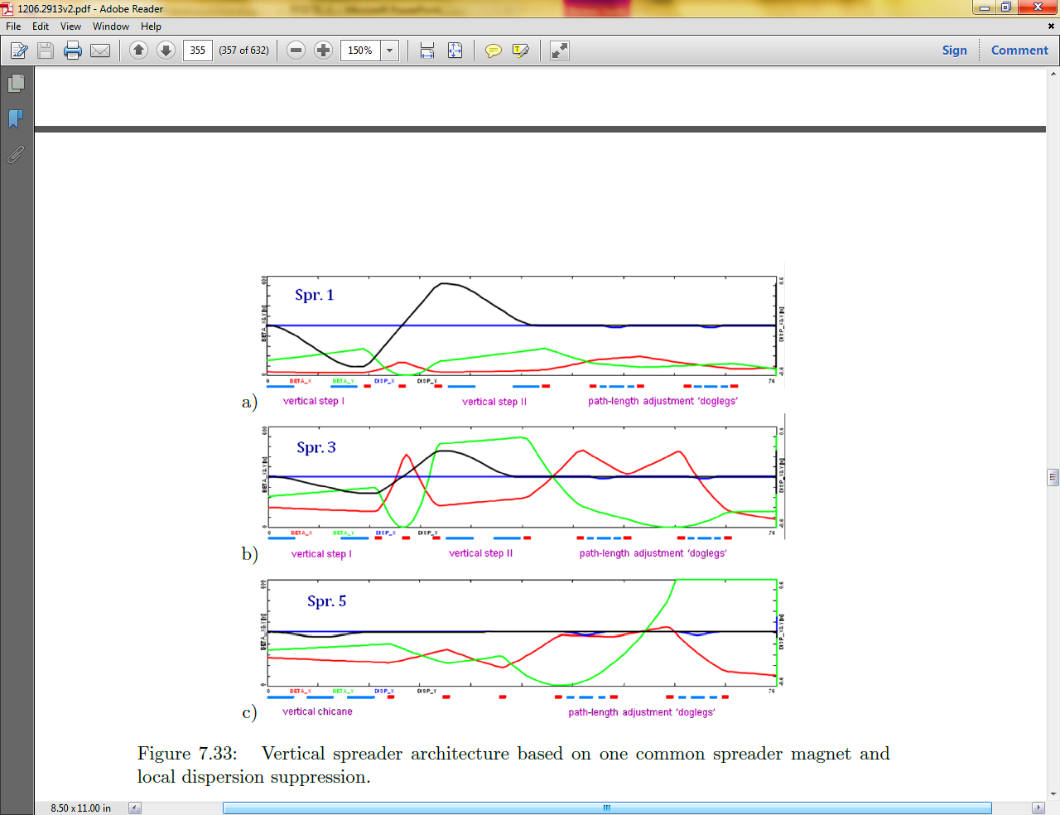
^{Switchyards}
10250
y [cm]
10200
Spr. 1 (10.5 GeV)
10150
Spr . 3 (30.5 GeV)
10100
Spr. 5 (50.5 GeV)
10050
10000
z [cm]
9950
9000
9200
9400
9600
9800
10000
10200
10400
10600
10800
11000
11200
11400
11600
A. Milanese
Two-step-achromat spreaders
and mirror symmetric recombiners
Arcs are separated into 1m high
vertical stack
Very compact switchyard system
(~20 m long)
Horizontal doglegs used for
path-length adjustment
Alex Bogacz

Slide 25
Emittance Preserving Arc Optics
Proper lattice design in the arcs to address
the effect of SR on electron beam phase-space:
cumulative emittance and momentum growth due to quantum excitations
Various flavors of FMC Optics used
Emittance not exceeding 50 μrad required for the LHeC luminosity
Alex Bogacz

Slide 26
Synchrotron radiation in return arcs (1/2)
Energy loss due to synchrotron radiation in the arcs
Integrated energy spread induced by synchrotron radiation
ARC | E [GeV] | ΔE [MeV] | σE/E [%]
1 | 10.4 | 0.678 | 0.00052
2 | 20.3 | 9.844 | 0.00278
3 | 30.3 | 48.86 | 0.00776
4 | 40.2 | 151.3 | 0.01636
5 | 50.1 | 362.3 | 0.02946
6 | 60 | 751.3 | 0.04829
7 | 50.1 | 362.3 | 0.06366
8 | 40.2 | 151.3 | 0.08065
9 | 30.3 | 48.86 | 0.10808
10 | 20.3 | 9.844 | 0.16205
11 | 10.4 | 0.678 | 0.31668
dump | 0.500 | 0 | 6.66645
Total loss per particle about ~1.9 GeV
Compensated by additional linacs
60% wall plug to beam efficiency
12.2 MW beam power
20.3 MW

Slide 27
Synchrotron radiation in return arcs (2/2)
Emittance growth in each individual arc*
Integrated growth including all previous arcs
ARC | E [GeV] | Δε_{ARC} [μm] | Δε_{t} [μm]
1 | 10.4 | 0.0025 | 0.0025
2 | 20.3 | 0.140 | 0.143
3 | 30.3 | 0.380 | 0.522
4 | 40.2 | 2.082 | 2.604
5 | 50.1 | 4.268 | 6.872
6 | 60 | 12.618 | 19.490
5 | 50.1 | 4.268 | 23.758
4 | 40.2 | 2.082 | 25.840
3 | 30.3 | 0.380 | 26.220
2 | 20.3 | 0.140 | 26.360
1 | 10.4 | 0.0025 | 26.362
Before the IP a total growth of ~ 7 μm is accumulated
The final value is ~ 26 μm

Slide 28
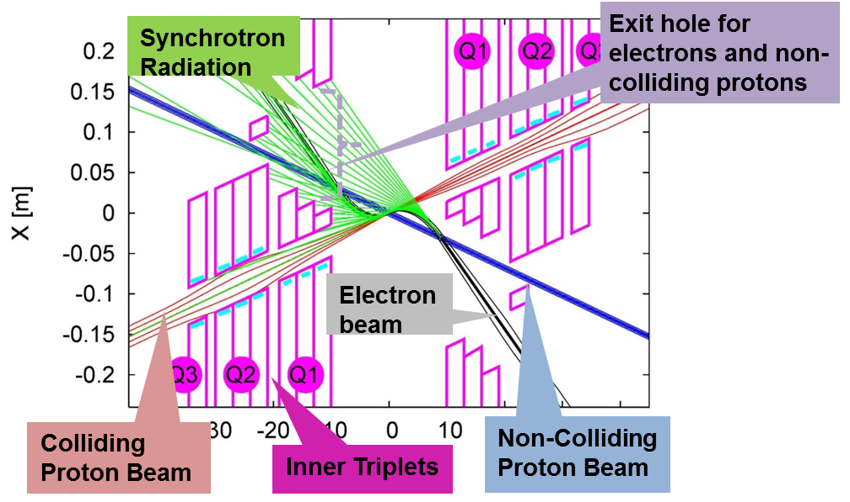
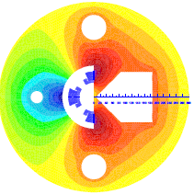
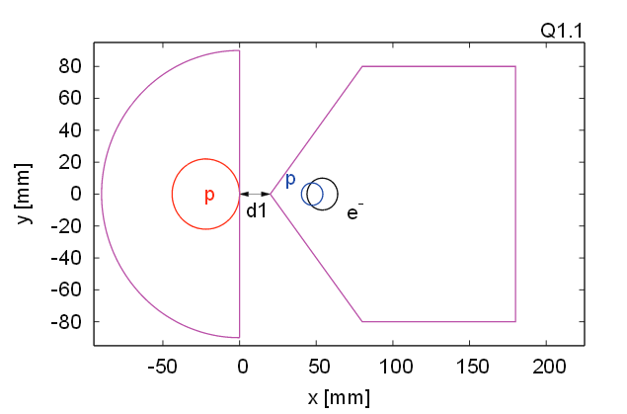
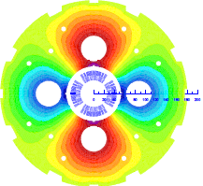
Interaction Region layout (CDR)
β*of 0.1 m with proton triplets close
to the IP to minimize chromaticity
Head-on p-e⁻ collisions achieved by
dipoles around the IP
6 mrad crossing angle between
the non-colliding p beams
Only the p beam colliding with the
e⁻ is focused
Mirror quadrupole design using
Nb₃Sn technology
Q1
Q2

Slide 29
^{Interaction Region layout}
Towards Luminosity ≥10³³ cm⁻²s⁻¹
Minimize β* = More Luminosity!
Normal way.
Focus 26 quads in IR2
β*=0.3 m
Limits quadrupole strengths
It causes huge chromatic aberrations
Achromatic Telescopic Squeezing
Focus 3x26 quads in IR1, IR2, IR3
β*=0.1 m

Slide 30
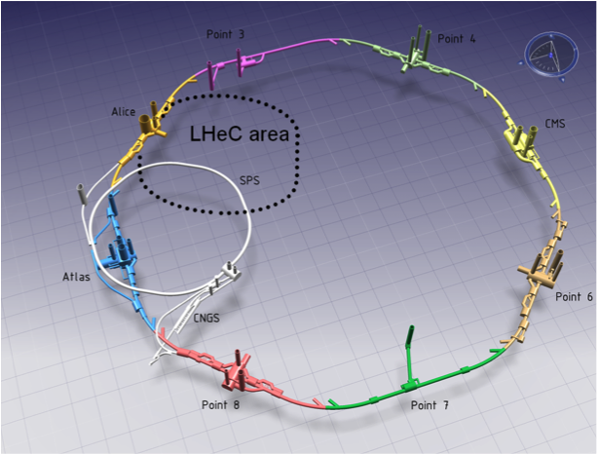
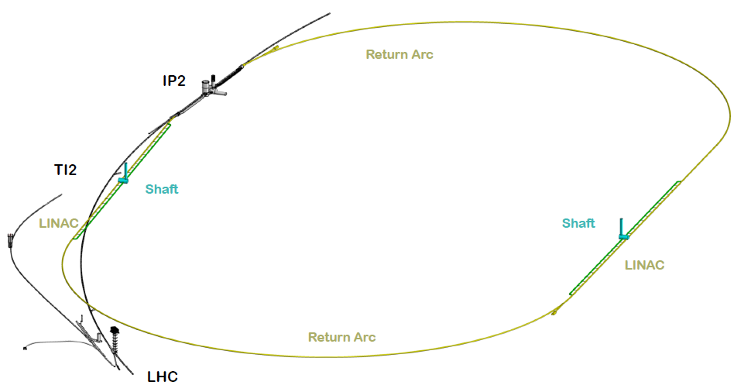
Civil Engineering Feasibility Studies
ERL placed inside the LHC ring and tangential to IP2
Two 1 km long LINACs; arcs have 1 km radius and are passed 3 times
Whole racetrack ~9 km long (1/3 of the LHC length)
~ 960 cavities
~ 60 cryomodules per linac
~ 4500 magnets in the 2*3 arcs
~ 600 - 4 m long dipoles per arc
~ 240 - 1.2 m long quads per arc

Slide 31
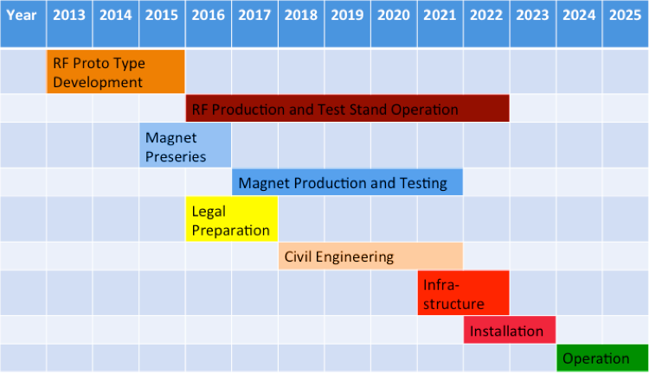
^{LHeC Planning and Timeline}
Installation decoupled from LHC operation and shutdown planning
Infrastructure investment with potential exploitation beyond LHeC
LHeC can be realised in about 10 years, as was for example HERA
The real installation plan will need to be agreed upon in the process of
endorsing the project, it also depends on the LHC physics and time schedule

Slide 32

International Advisory Committee
H. Schopper (CERN)
G. Altarelli (Rome)
S. Bertolucci (CERN)
F. Bordry (CERN)
O. Brüning (CERN)
S. Brodsky (SLAC)
H. Chen (IHEP Beijing)
A. Hutton (JLab)
Y. Kim (Chicago)
M. Klein (Liverpool)
S. Kurokawa (KEK)
V. Matveev (JINR Dubna)
S. Kurokawa (Tsukuba)
A. Nisati (Rome)
L. Rivkin (EPFL)
J. Schukraft (CERN)
A. Stocchi (LAL-IN2P3)
J. Womersley (STFC)
First IAC meeting at the
LHeC 5th workshop, Switzerland, January 2014

Slide 33
^{Mandate} ^{of the IAC (2014-2017)}
Advice to the LHeC Coordination Group and the CERN directorate by following the development of options of an ep/eA collider at the LHC and at FCC, especially with:
Provision of scientific and technical direction for the physics potential of the ep/eA collider both at LHC and at FCC, as a function of the machine parameters and of a realistic detector design, as well as for the design and possible approval of an ERL test facility at CERN
Assistance in building the international case for the accelerator and detector developments as well as guidance to the resource, infrastructure and science policy aspects of the ep/eA collider.

Slide 34
^{Outline}
1. THE LHeC : Baseline parameters and configuration
- Goals
- physics requirements
2. General Design considerations
- LINAC-Ring collider
3. The ERL test facility
3A. Stages of building design
- layouts
- baseline parameters
3B. Arc optics architecture
3C. Test facility for sc magnet tests
4. Planning and timeline
5. Next steps and r&D activities

Slide 35
^{LHeC test facility}
The next major step of the LHeC R&D is a demonstrator
at CERN of an energy recovery linac
The test facility would consist of SC linacs, recirculation and energy recovery
Among the purposes of this test facility are
1. Demonstrating the feasibility of the LHeC ERL design
- Study behaviour of a high energy multi-pass multiple cavity ERL for LHeC
  - Optics, RF power, synchronization & delay issues …
  - HOMs and HOM couplers, cryogenics, instrumentation, controls, LLRF …
2. Injector studies (DC or SRF gun)
3. Study real SCRF cavities with beam
4. Analyzing electron beam dynamics challenge
5. Reliability issues, operational issues
6. Beam facility for controlled SC magnet quench tests
7. Beam facility for HEP detector R&D
8. Demonstrator and study facility for e-cooling
9. Could it be foreseen as the injector to LHeC ERL ?

Slide 36
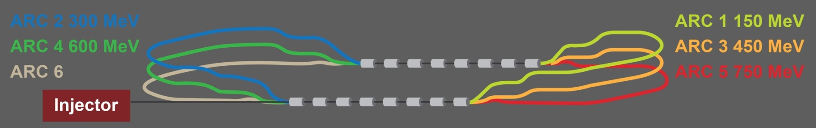
Goals of a CERN ERL Test Facility
Test facility for SCRF cavities and modules
Test facility for multi-pass multiple cavity ERL
  Injector studies: DC gun or SRF gun
  Study reliability issues, operational issues!
  Vacuum studies related to FCC
  Possible use for detector development, experiments and injector suggests ~1 GeV as final stage energy
  Test facility for controlled SC magnet quench tests
  Could it be foreseen as the injector to LHeC ERL and to FCC?
TARGET PARAMETER* | VALUE
Injection Energy [MeV] | 5
Final Beam Energy [MeV] | 900
Normalized emittance γε_{x,y} [μm] | 50
Beam Current [mA] | 10
Bunch Spacing [ns] | 25 (50)
Passes | 3
*in few stages

Slide 37
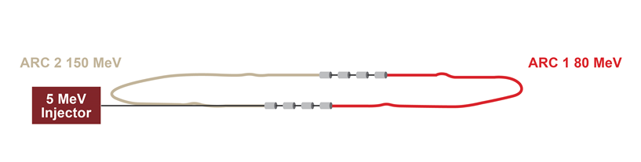
^{Planning for each stage}
STEP 1
SC RF cavities, modules and e⁻ source tests
- Injection at 5 MeV
- 1 turn
- 75 MeV/linac
- Final energy 150 MeV
ARC | Energy
ARC 1 | 80 MeV
ARC 2 | 155 MeV
LINAC 2*
LINAC 1*
*4 SRF 5-cell cavities at 802 MHz

Slide 38
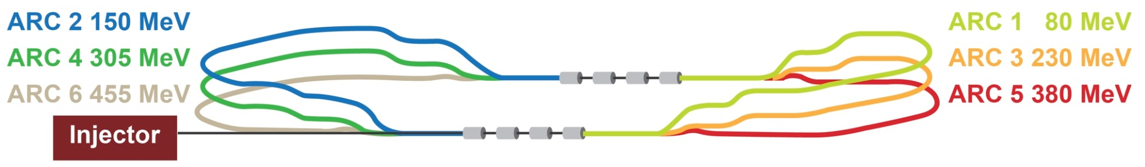
^{Planning for each stage}
STEP 2
Test the machine in Energy Recovery Mode
- Injection at 5 MeV
- 3 turns
- 75 MeV/linac
- Final energy 450 MeV
ARC | Energy
ARC 1 | 80 MeV
ARC 2 | 155 MeV
ARC 3 | 230 MeV
ARC 4 | 305 MeV
ARC 5 | 380 MeV
ARC 6 | 455 MeV
Recirculation realized with vertically stacked recirculation passes

Slide 39

^{Planning for each stage}
STEP 3
Additional SC RF modules test
Full energy test in Energy Recovery Mode
- Injection at 5 MeV
- 3 turns
- 150 MeV/linac
- Final energy 900 MeV
ARC | Energy
ARC 1 | 150 MeV
ARC 2 | 300 MeV
ARC 3 | 450 MeV
ARC 4 | 600 MeV
ARC 5 | 750 MeV
ARC 6 | 900 MeV

Slide 40
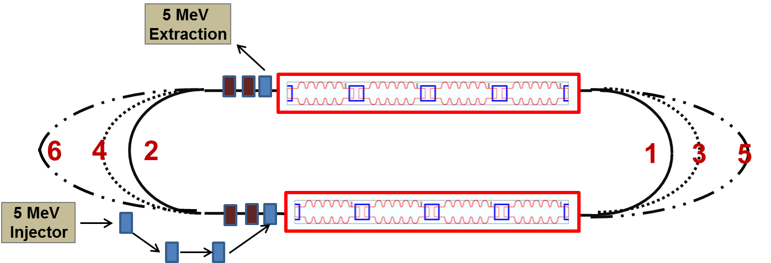
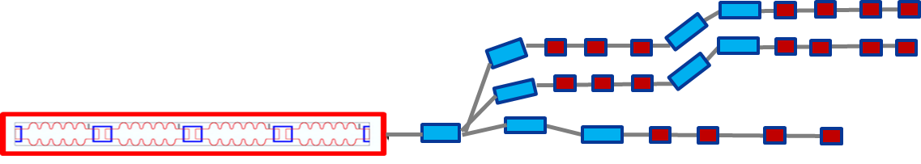
^{Layout}
ARC 1 – 155 MeV
ARC 3 – 455 MeV
ARC 5 – 755 MeV

Slide 41
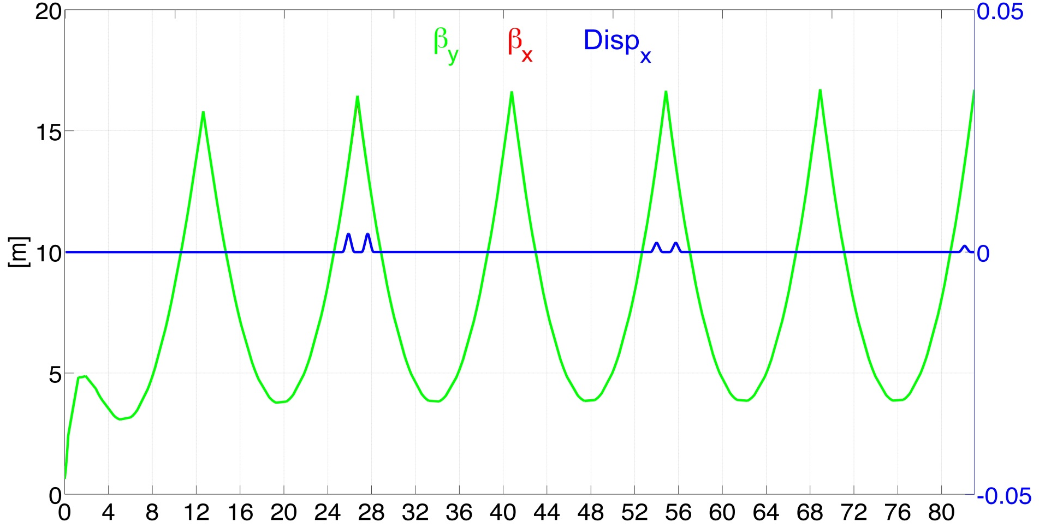
^{Linac 1 Multi-Pass Optics}
5 MeV
155 MeV
305 MeV
455 MeV
605 MeV
755 MeV
905 MeV

Slide 42
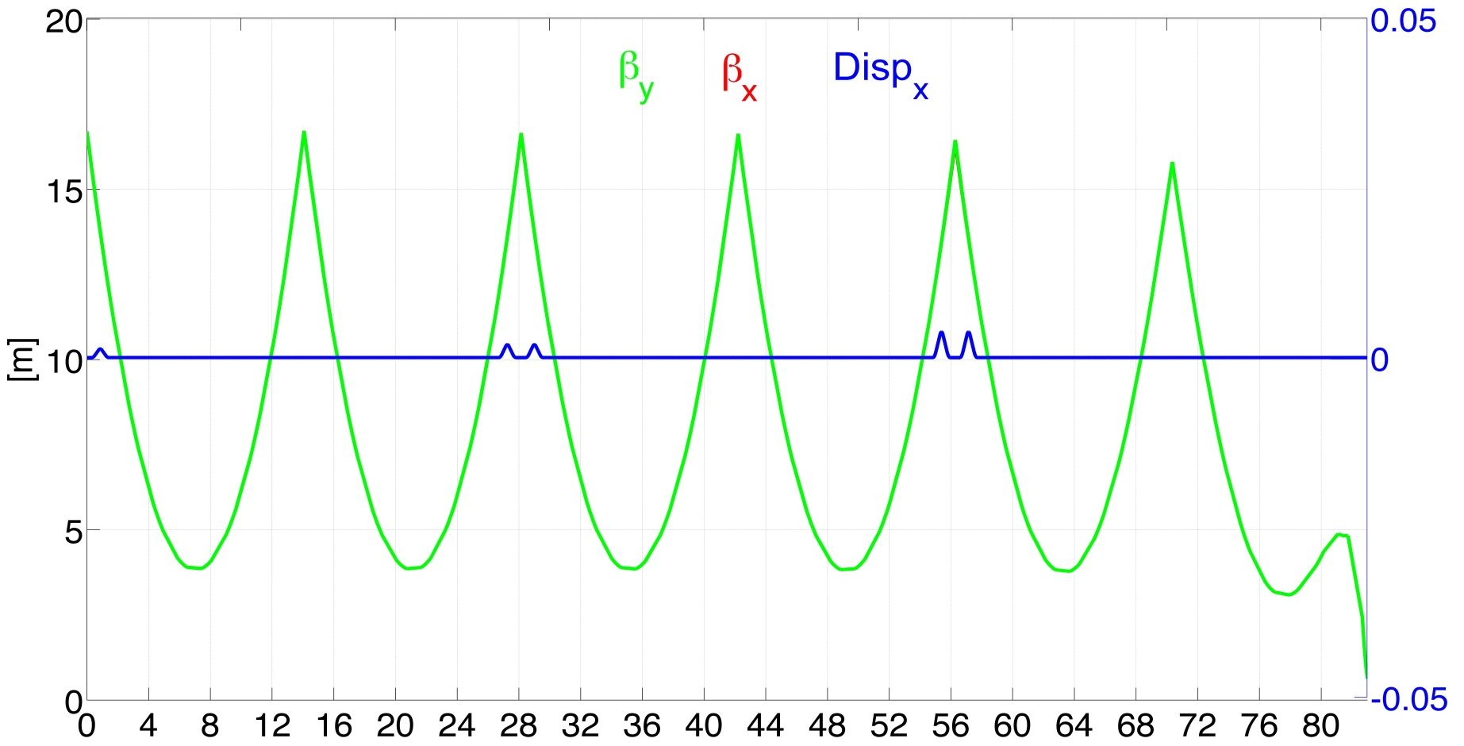
^{Linac 2 Multi-Pass Optics}
905 MeV
755 MeV
605 MeV
455 MeV
305 MeV
155 MeV
5
MeV

Slide 43
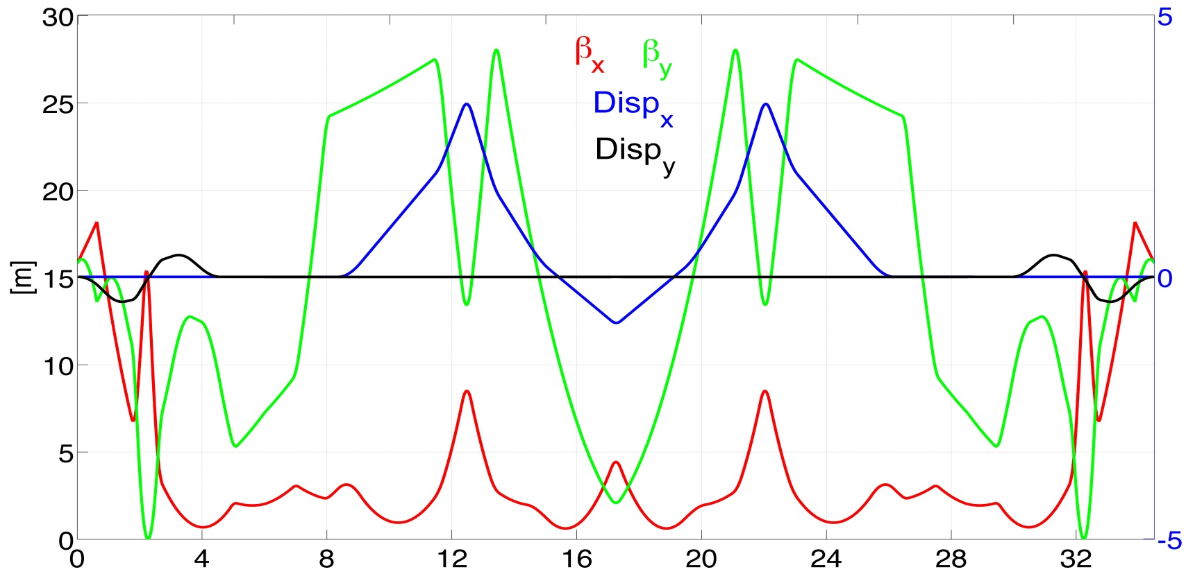
^{Arc 1 optics}
155 MeV
155 MeV
βx βy
Dx Dy
2-step vert.
Spreader
4×45° sector bends
2-step vert. Combiner
30° bends
(1 rec. + 3 sec.)
Arc dipoles :
Ldip = 71.8 cm
B = 5.67 kGauss
ρ = 91.45 cm
30° bends
(1 rec. + 3 sec.)

Slide 44
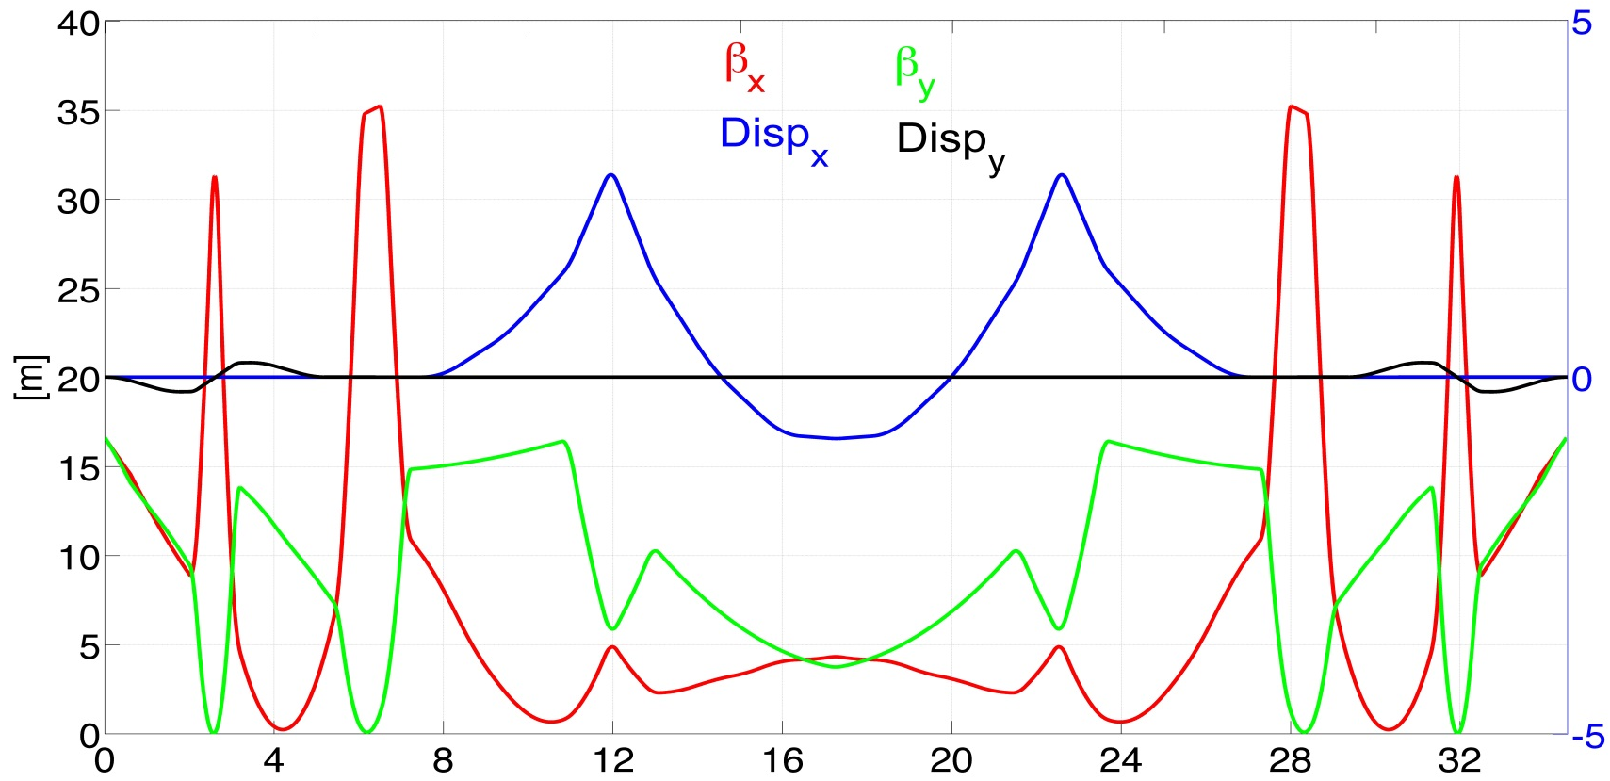
^{Arc 3 optics}
455 MeV
155 MeV
455 MeV
βx βy
Dx Dy
2-step vert.
Spreader
8×22.5° sector bends
2-step vert. Combiner
9.8° bends
(1 rec. + 3 sec.)
Arc dipoles :
Ldip = 90.58 cm
B = 6.58 kGauss
ρ = 230.66 cm
9.8° bends
(1 rec. + 3 sec.)

Slide 45
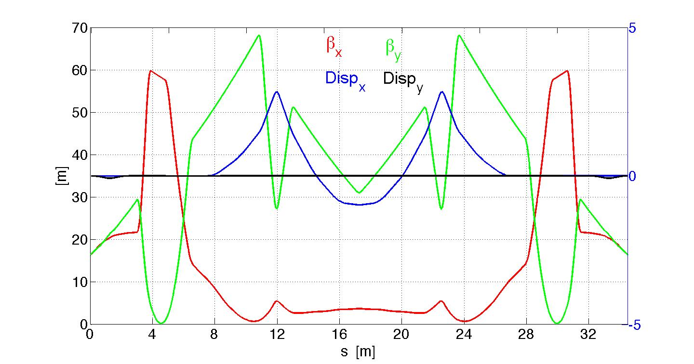
^{Arc 5 optics}
755 MeV
Vertical
chicane
8×22.5° sector bends
Vertical
chicane
Arc dipoles :
Ldip = 90.58 cm
B = 10.92 kGauss
ρ = 230.66 cm

Slide 46
^{Arc 1,3,5 layout}
Synchronous acceleration
Isochronous arcs
Achromatic arc
FMC optics
13.43 m
13.66 m
Total Arc length for Arc 1,3,5
34.5112 m
94 x λrf
92.6 cm
For 6 arcs:
84 dipoles
114 quadrupoles
41.06 cm
6 cm

Slide 47
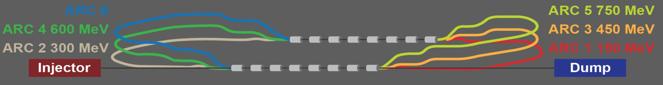
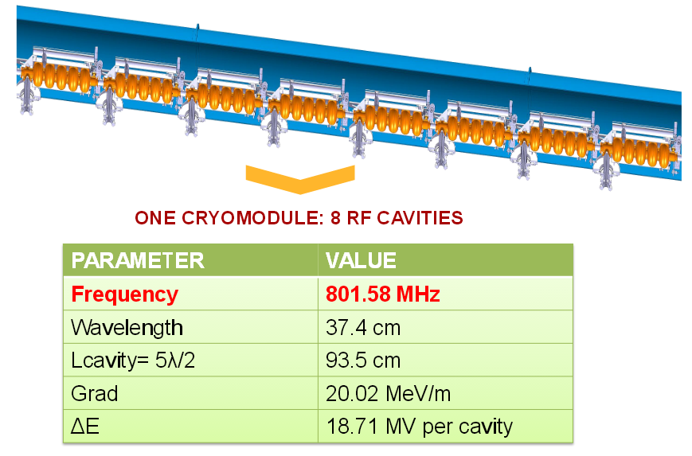
^{Footprint}
ARCS
LINAC
Total length for Arc 1,3,5
34.5112 m
94 x λrf
(last cavity linac1 to first cavity linac 2)
Total length for Arc 2,4
34.2704 m
101 x λrf
(last cavity linac1 to first cavity linac 2)
Total length for Arc 6
34.4574 m
101.5 x λrf
(last cavity linac 1 to first cavity linac 2)
Total length ~ 13 m
Chicane inj/extr
Length ~ 1.75 m
TOTAL DIMENSIONS
42 m x 13.7 m

Slide 48
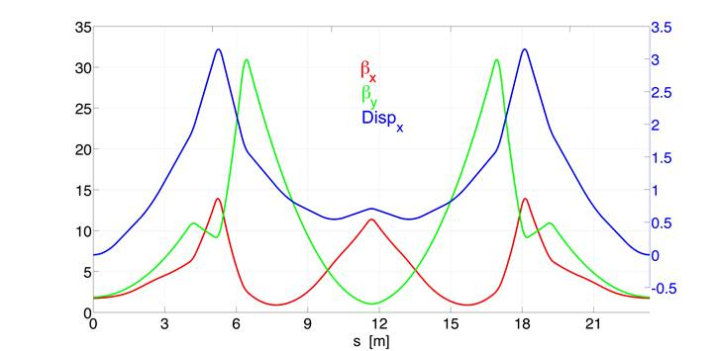
^{Arc optics OPTION 2}
Same optics layout for all the arcs 900/750/600/450/300/150 MeV
3 dipoles
on top of
each other
*Attilio Milanese
Arc dipoles :
8×22.5⁰ bends
Ldip = 100.6 cm
ρ = 256.3 cm
 | 1GeV | 750MeV | 600MeV | 450MeV | 300MeV | 150MeV
B FIELD | 1.30 T | 0.97 T | 0.78 T | 0.58 T | 0.39 T | 0.19 T
Arc quadrupoles
Lquads = 30 cm
 | Q1 | Q2 | Q3 | Q4
Kq[m⁻²] | -1.01 | 2.91 | 2.09 | 1.19

Slide 49
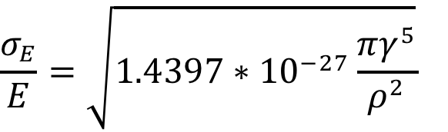
Incoherent Synchrotron radiation in return arcs
ARC | E [MeV] | ρ [cm] | ΔE [keV] | σE/E [%]
1 | 150 | 91.459 | 0.0280 | 1.17e-5
2 | 300 | 91.459 | 0.4191 | 6.42e-5
3 | 450 | 230.66 | 0.8230 | 8.13e-5
4 | 600 | 230.66 | 2.5726 | 1.53e-4
5 | 750 | 230.66 | 6.2394 | 2.73e-4
6 | 900 | 230.66 | 12.881 | 4.47e-4
7 | 750 | 230.66 | 6.2394 | 5.89e-6
8 | 600 | 230.66 | 2.5726 | 7.49e-6
9 | 450 | 230.66 | 0.8230 | 9.98e-6
10 | 300 | 91.459 | 0.4191 | 1.49e-6
11 | 150 | 91.459 | 0.0280 | 2.93e-3
Beam Energy loss
Beam Energy Spread

Slide 50
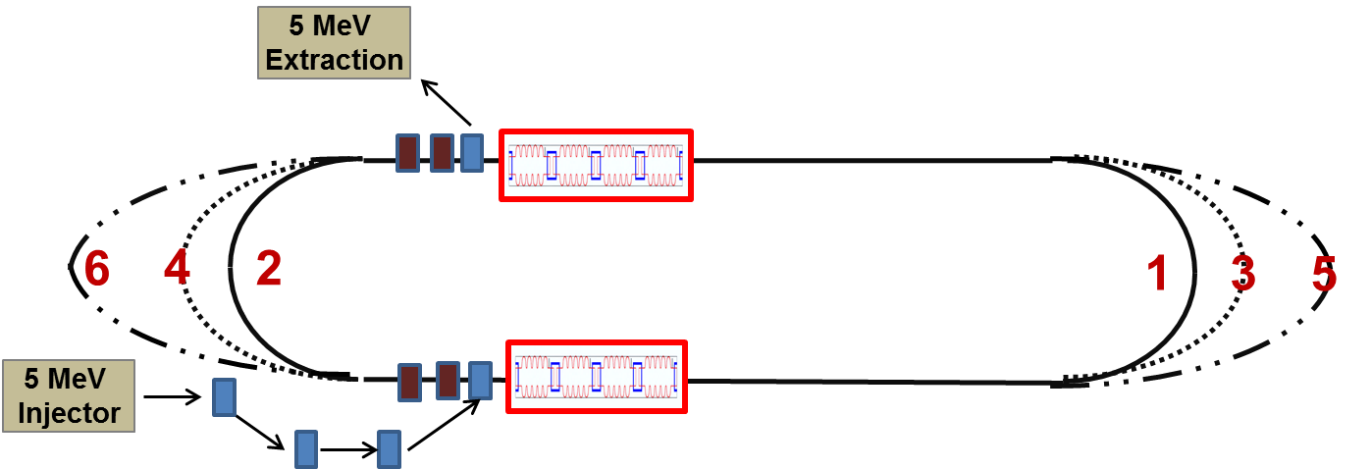
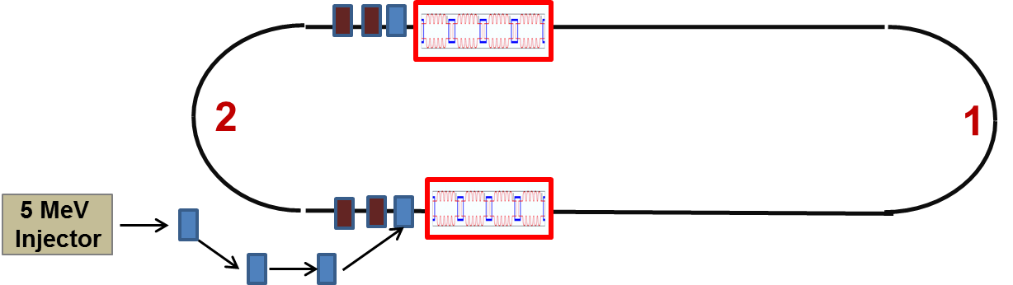
^{Next steps}
Complete Step 2 and Step 1 configuration and optics layout
Step 2
Available
space
Step 1

Slide 51
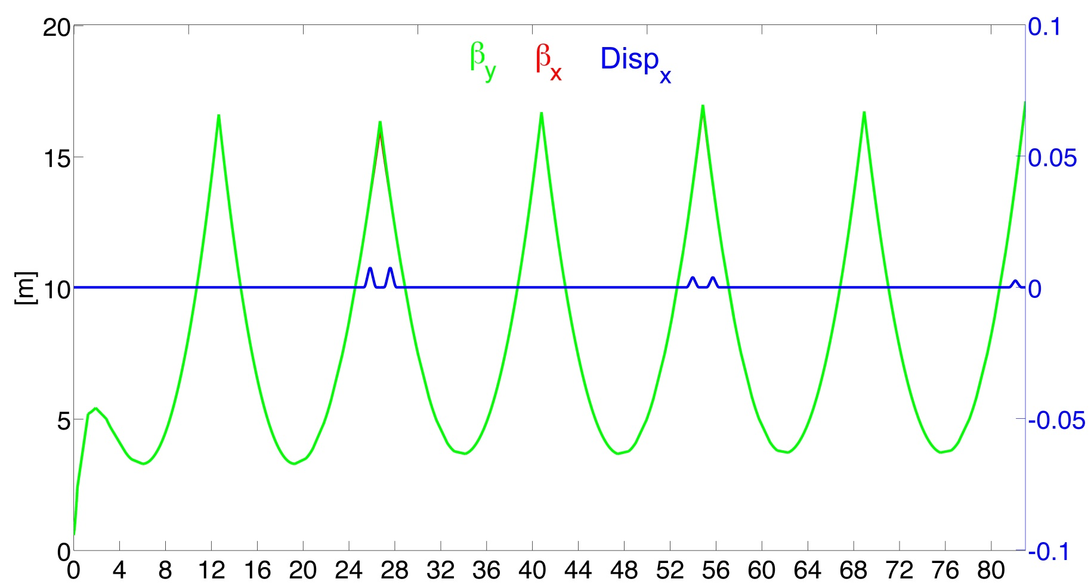
^{Linac 1 - Step 2}
DRIFT
DRIFT
DRIFT
5 MeV
85 MeV
155 MeV
235 MeV
305 MeV
380 MeV
455 MeV

Slide 52
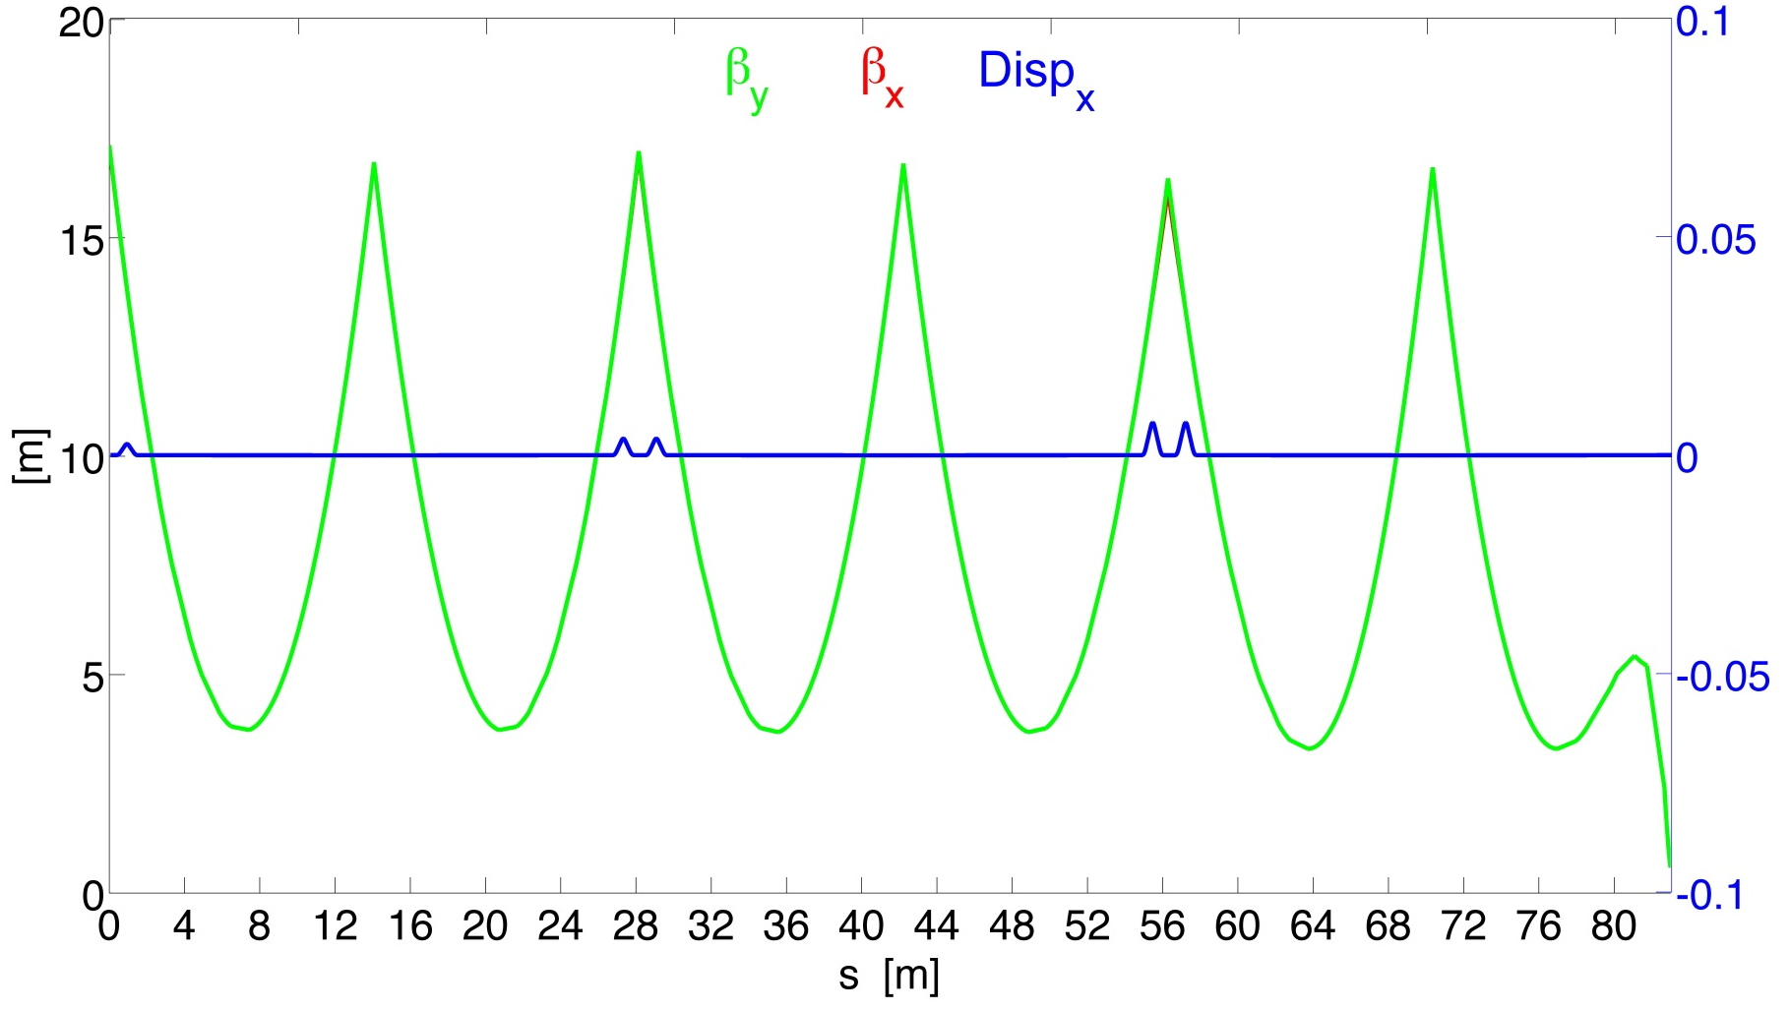
^{Linac 2 - Step 2}
DRIFT
DRIFT
DRIFT
455 MeV
380 MeV
305 MeV
230 MeV
155 MeV
80 MeV
5
MeV

Slide 53
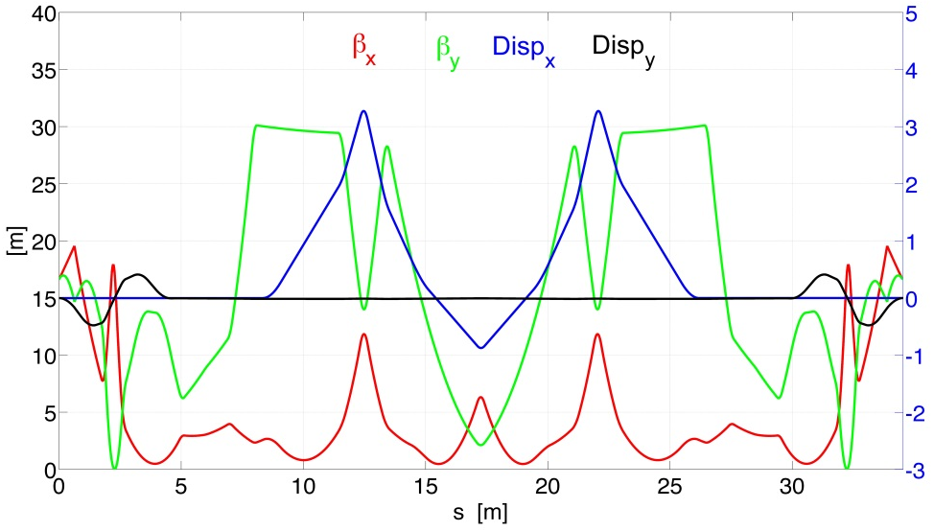
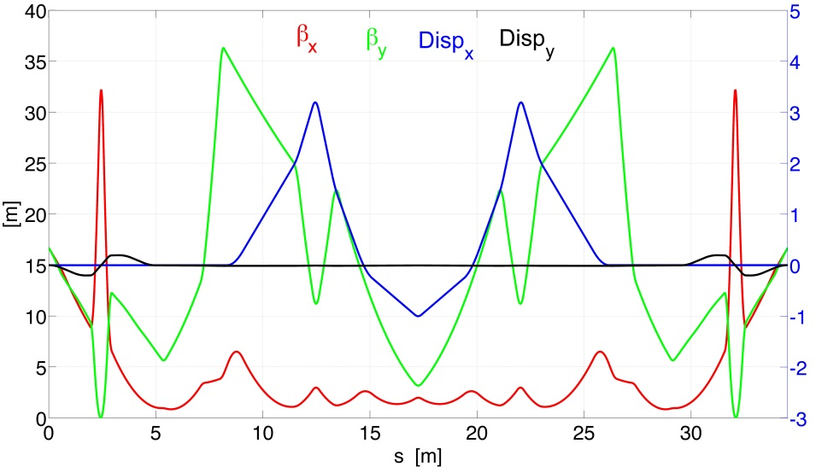
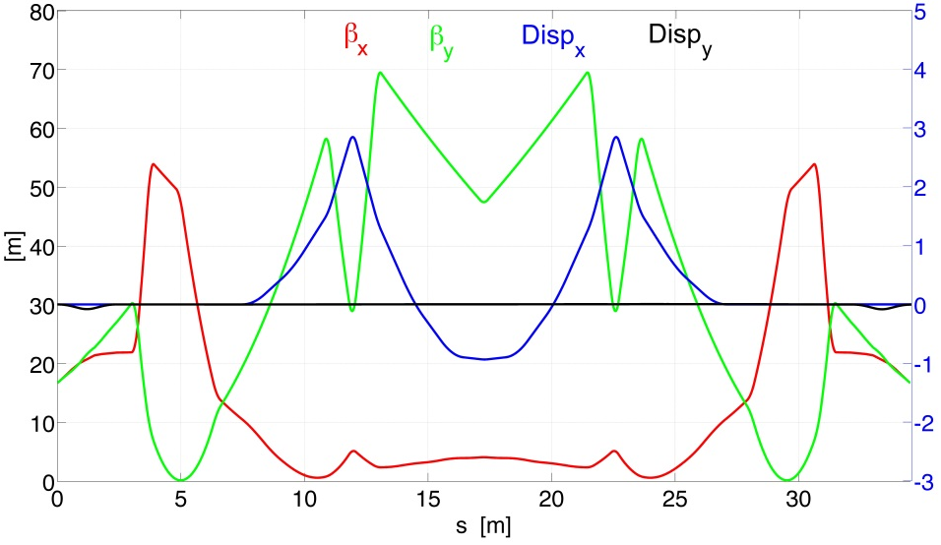
^{Step 2 optics}
80 MeV
230 MeV
380 MeV
13.43 m
13.66 m

Slide 54
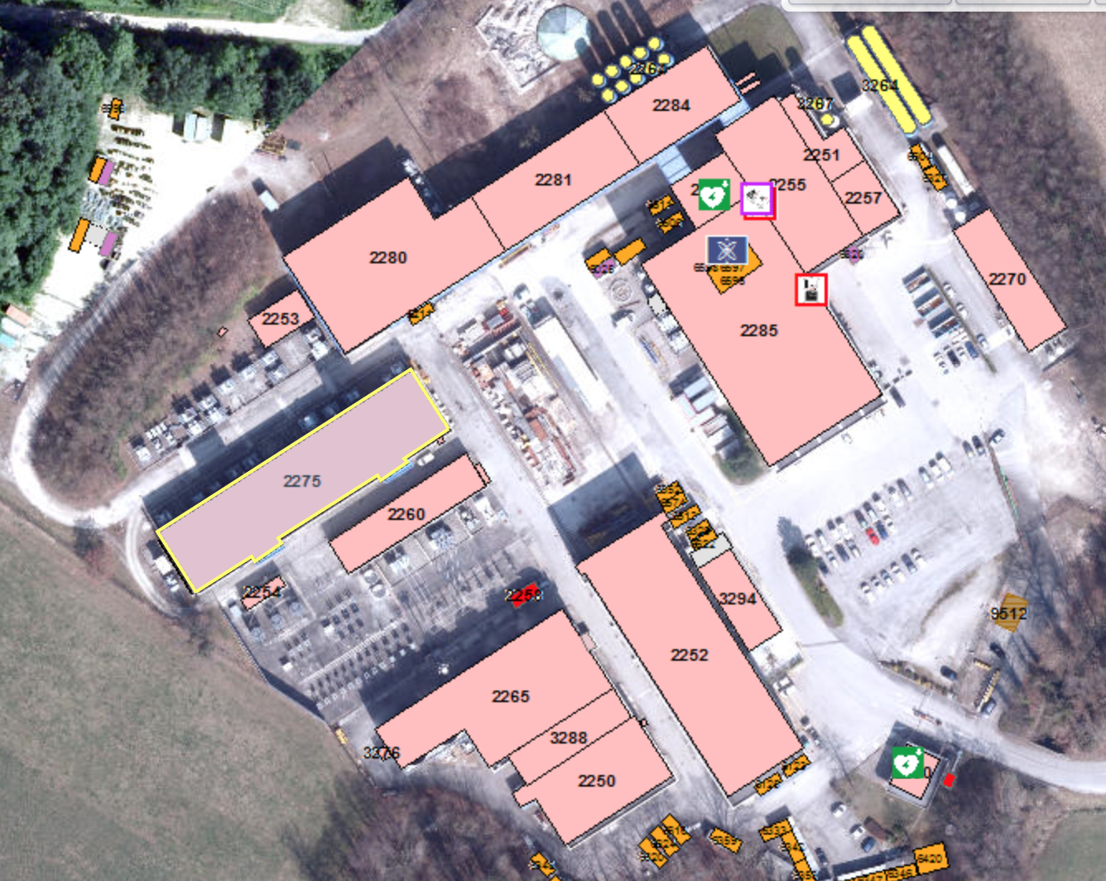
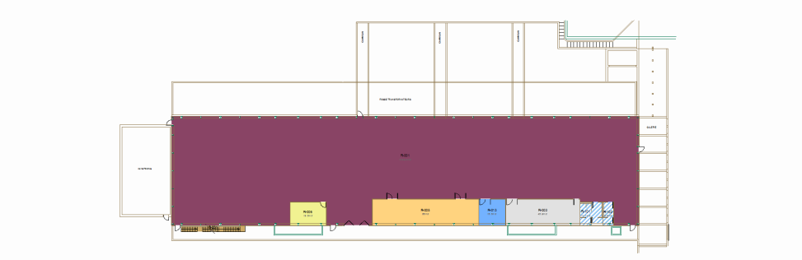
^{LTF Possible Site Choice}
We have started to look into
possible existing buildings suited to host
the ERL test facility.
A suitable hall could be in
Building 2275, near LHC P2
- Current use under investigation
- Power converters already in place
- Geographically perfect as injector
for LHeC ERL
- Slightly narrower than required
Can it be extended?
70 x 16.5
N. Catalan Lasheras

Slide 55
Controlled quench tests of SC magnets
We are investigating the possibility of using the test facility for SC magnet tests
Requirements in terms of:
Beam energy, intensity and pulse length (energy deposition)
Space for the magnet installation (possible tests of cable samples and
full cryo magnets)
Cryo requirements
Vacuum requirements
Powering needs

Slide 56
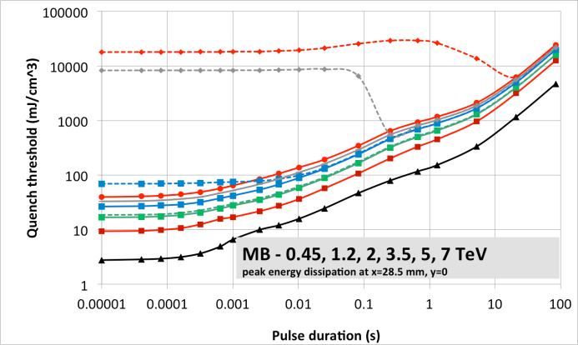
Controlled quench tests of SC magnets
Study beam induced quenches (quench thresholds, quenchino thresholds)
at different time scales for:
SC cables and cable stacks in an adjustable external magnetic field
Short sample magnets
Full length LHC type SC magnets
Quench limits of LHC dipole as expected from QP3 simulations for different pulse durations
Courtesy A. Verweij

Slide 57
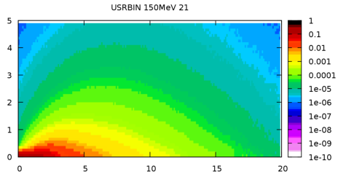
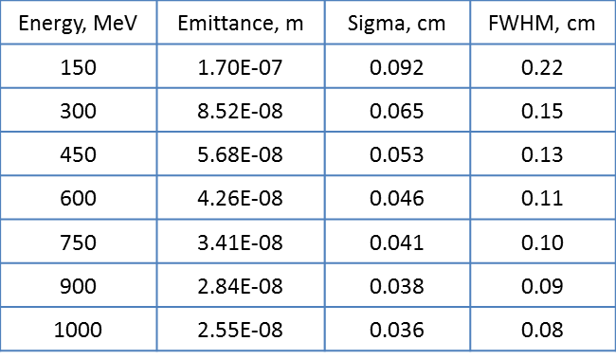
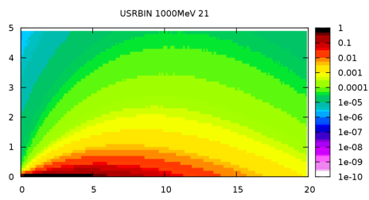
Beam parameters to generate a given amount of energy deposition
Calculations and FLUKA Simulations
Copper target
(no magnetic field)
Energy deposition, GeV/cm³/e⁻
Beam
150 MeV
Cylinder of copper
Radius = 50cm
Length = 100cm
Beam parameters
R,cm
1 GeV
Results are given for half of bulky target because of symmetry
Z, cm
Binning: 1 mm³ bins

Slide 58
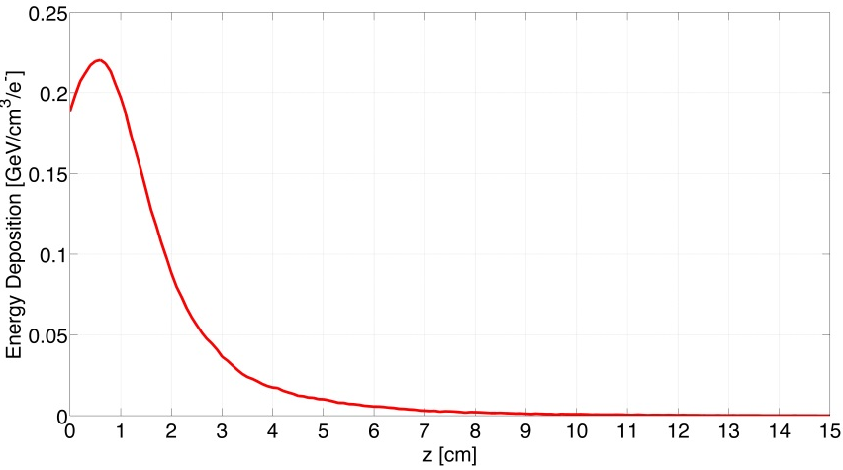
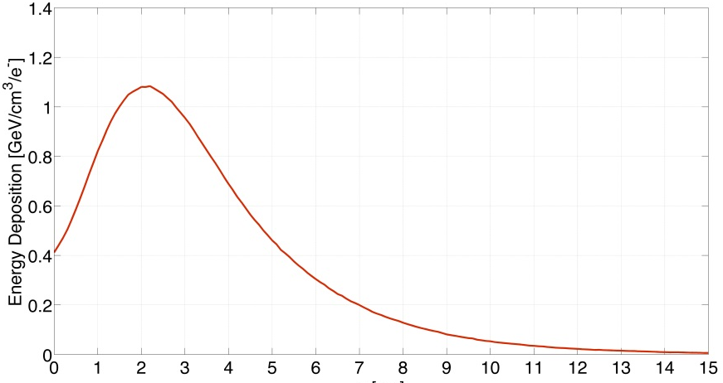
Beam parameters to generate a given amount of energy deposition
Calculations and FLUKA Simulations
Copper target
(no magnetic field)
Energy deposition, GeV/cm³/e⁻
Beam
Peak at z = 0.6 cm, r=0
Peak value = 0.2199 GeV/cm^3
Cylinder of copper
Radius = 50cm
Length = 100cm
Beam parameters
150 MeV
Peak at z = 2.1 cm, r=0
Peak value = 1.0785 GeV/cm^3
1 GeV
Results are given for half of bulky target because of symmetry
Binning: 1 mm³ bins
Z, cm

Slide 59
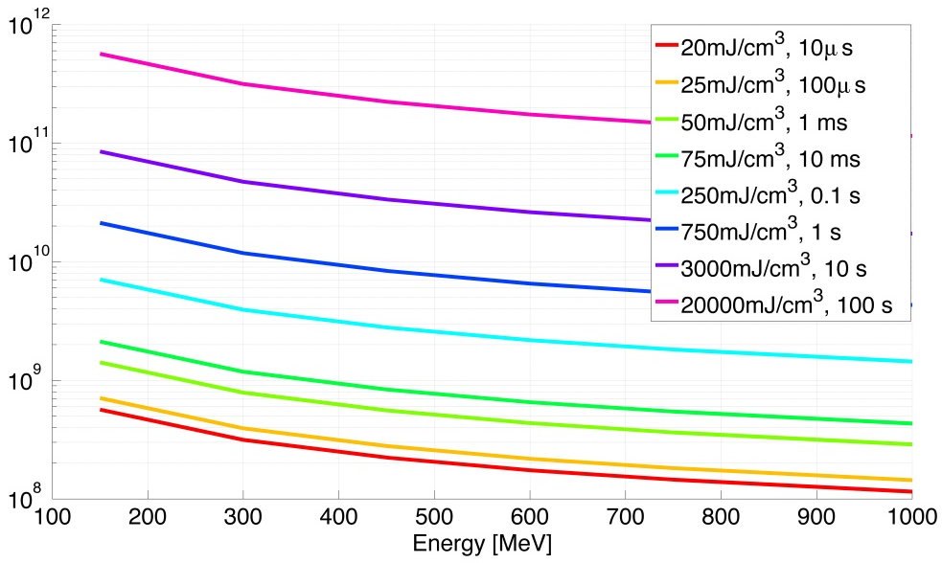
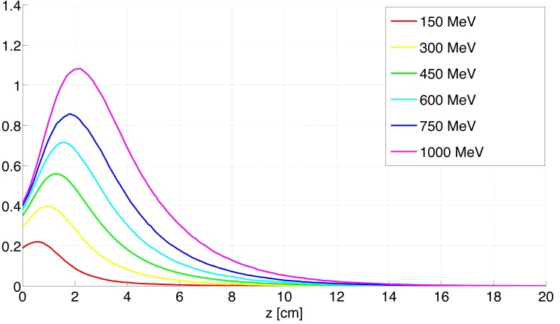
Beam parameters to generate a given amount of energy deposition
# electrons needed to quench the magnet
Quench threshold
Maximum value for
the energy deposition
MB quench limit @ 3.5 TeV
Energy Deposition, GeV/cm³/e⁻
Number of particles
1 GeV = 1.602 x 10⁻⁷ mJ
MB quench limit 450 GeV is 140mJ/cm³ in 10ms:
~2.2 x 10⁹ e⁻ @ 1GeV necessary
MB quench limit 7 TeV is 16 mJ/cm³ in 10ms:
~2.6 x 10⁸ e⁻ @ 1GeV necessary

Slide 60
^{Summary and Outlook}
LHeC appears feasible and can be realized in parallel with HL-LHC
Significant room for optimization in design
– Choice of RF frequency has now been done
– Basic parameter choice has been reviewed for further improvements
(higher luminosity)
Future plans
– R&D on individual components
– Ongoing parameter studies for cost optimization
(slightly lower beam energy for significantly lower circumference)
– Preparation of a TEST FACILITY proposal
Some (potential) international partners have declared large interest
(JLAB, Mainz, ASTeC and others).
– Completion of Conceptual design study of an ERL-TF at CERN
by the end of 2015

Slide 61
^{Some References}
1. J. L. Abelleira Fernandez, et al. [LHeC Study Group Collaboration], J. Phys. G 39 (2012) 075001
[arXiv:1206.2913 [physics.acc-ph]]
2. Electron-Ion Collider Workshop, Thomas Jefferson National Accelerator Facility, March 2104,
http://www.jlab.org/conferences/eic2014/
3. Future Circular Collider Study Kickoff Meeting, University of Geneva, February 2014,
http://indico.cern.ch/event/282344/
4. LHeC Collaboration, LHeC Meeting , Daresbury Laboratory, January 2013,
https://eventbooking.stfc.ac.uk/newsevents/lhec-meeting
5. S.A. Bogacz, et al., LHeC ERL Design and Beam-dynamics Issues , IPAC 2011, San Sebastian, Spain
6. M. Klein et al. , LHeC Design Report, J.Phys. G39 (2012) 075001 [arXiv:1206.2913]
7. F. Zimmermann, et al., Design for a Linac-Ring LHeC, Proceedings of IPAC’10, Kyoto, Japan
8. Overview of the LHeC Design Study at CERN, O.S. Brüning, MOZB201
9. Civil Engineering Feasibility Studies for Future Ring Colliders at CERN, J.A. Osborne et al., MOPWO036
10. LHeC IR Optics Design Integrated into the HL-LHC Lattice, M. Korostelev et al., MOPWO063
11. The LHeC as a Higgs Boson Factory, F. Zimmermann et al., MOPWO054
12. A Proposal for an ERL Test Facility at CERN, R.Calaga et al., WEPWO049
13. Strawman Optics design for the LHeC ERL Test Facility, A. Valloni et al., TUPME055
14. Electrons at the LHC: a new beginning, Max Klein and Herwig Schopper CERN Courier, June 2014
15. LHeC meetings https://indico.cern.ch/category/1874/

Slide 62
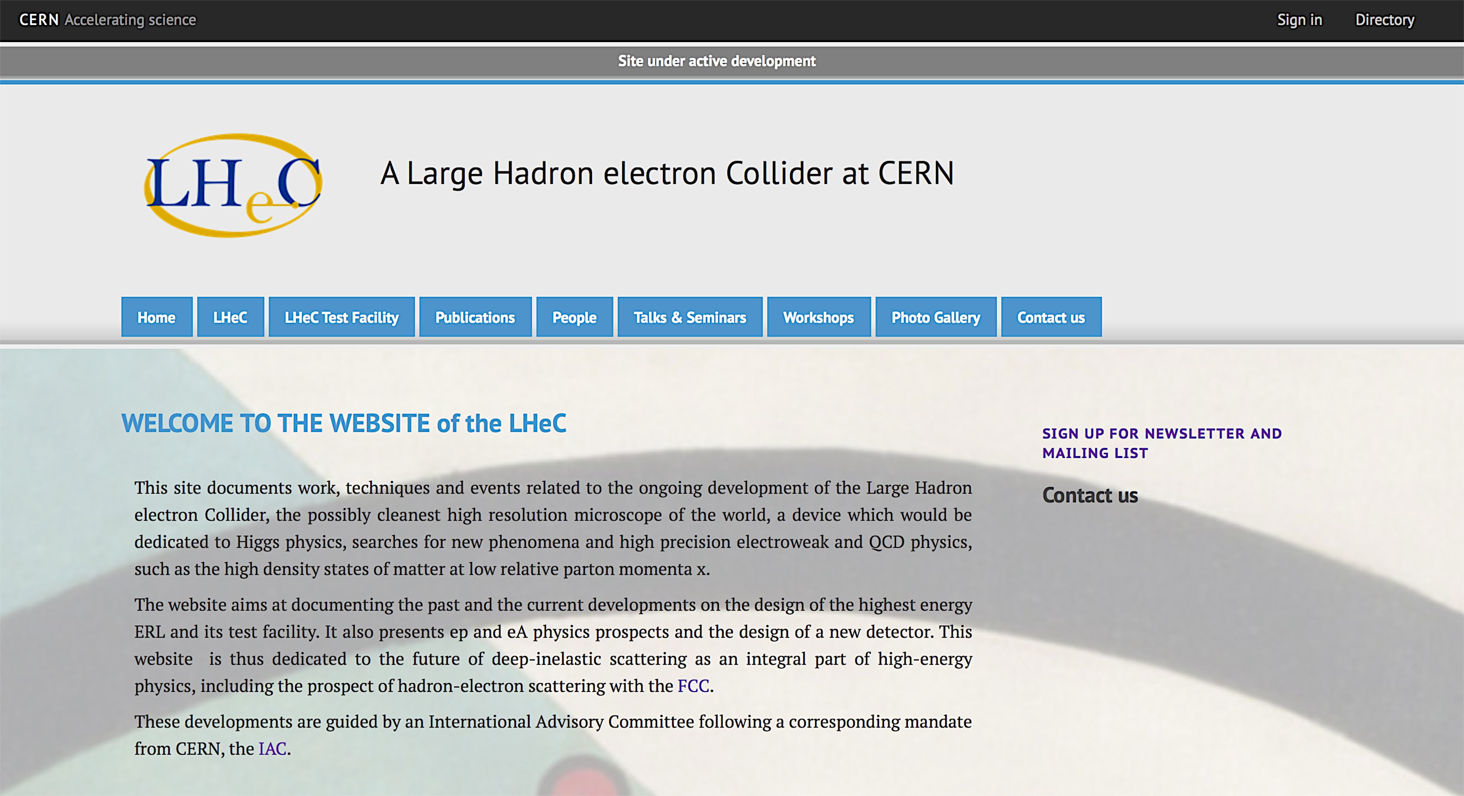
^{Some more References}
A complete list of Papers, Proceedings, Articles, Talks and Seminars can be found at http://lhec.web.cern.ch
Please fill out the “Contact us” form to sign up for the LHeC Newsletter and Mailing List

Slide 63
Alessandra Valloni on behalf of the LHeC collaboration
ありがとうございます
Thanks for your hospitality, time, help and support
KEK, High Energy Accelerator Research Organization, 12th June

Slide 64


Slide 66

Future Circular Collider Study
CDR and cost review for the next ESU (2018)
80-100 km tunnel infrastructure in Geneva area
pp-collider (FCC-hh) defining the infrastructure requirements
e⁺e⁻ collider (FCC-ee) as potential intermed. step and p-e (FCC-he) option
international collaboration hosted by CERN
~16 T ⇒ 100 TeV pp in 100 km
~20 T ⇒ 100 TeV pp in 80 km
Frank Zimmermann

Slide 67
Preliminary parameters for FCC-he-ERL w/o FCC-ee
Parameter [unit]
species | e- | p
beam energy (/nucleon) [GeV] | 60 | 50000
bunch spacing [ns] | 25 | 25
bunch intensity (nucleon) [10¹⁰] | 0.4 | 10
beam current [mA] | 25.6 | 500
normalized rms emittance [mm] | 20 | 2.0
geometric rms emittance [nm] | 0.17 | 0.04
IP beta function b_{x,y}* [m] | 0.10 | 0.4
IP rms spot size [mm] | 4.0 | 4.0
lepton D & hadron x | 32 | 0.0002
hourglass reduction factor H_{hg} | 0.94
pinch enhancement factor H_{D} | 1.35
luminosity / nucleon [10³³ cm⁻¹s⁻¹] | 6.4
Frank Zimmermann

Slide 68
LHeC - ion gaps & circumference
FHC
IP#2
IP#1
DC=k C_{LHeC}
LHC
C_{LHeC}=C_{LHC}/n
future: C_{LHeC+}=C_{FHC}/m
m, n (=3), k: integer
Frank Zimmermann

Slide 69
CERN has begun a study for a
100 TeV pp collider with an integrated ep facility. This has two options:
the ERL of the LHeC (60 GeV) coupled with the 50 TeV proton machine in
synchronous ep and pp mode.
b) the FCC electron and proton rings colliding which increases the energy available.
Both options are under study.
In terms of physics the FCC_he complex leads for example
-- to accessing the Higgs self coupling (under study),
-- to lepto-quark access up to ~4TeV and
-- to Bjorken x as low as 10^-7/8 (which is of direct interest for ultra high energy neutrino
scattering).
The vision of the LHeC followed by the FCC_he promises a 4 decade unique physics program

Slide 70



