Slide 1

ATLAS at Christmas 2014
LHC
Analysis and Physics
R+D and Upgrade
Max Klein - for the dauntless ATLAS Group - Liverpool 12.12.2014

Slide 2
new

Slide 3
Leading Roles
Liverpool ATLAS in 2014
    A Affolder: Deputy Strip Upgrade Project Leader, Upgrade (and UK) Strip Module Convenor
    P Allport: Upgrade Coordinator, Executive Board
    S Burdin: UK Upgrade Pixel Module Deputy Convenor
    G Casse: Upgrade Sensor Procurement Group
    P Dervan: UK Irradiation Coordination, UK Upgrade Pixel Module Deputy Convenor
    M D'Onofrio: SUSY and now Physics Modelling Group Convenor
    C Gwilliam: Physics Validation Convenor
    H Hayward: Upgrade Tracker Simulation Convenor, UK Super-symmetry & Exotics Convenor
    T Jones: Upgrade Strip Local Support Assembly Convenor, UK Upgrade Strip Mechanics Convenor
    M Klein: Team Leader, Collaboration Board
    U Klein: Advisory Board to Chair of the Collaboration Board, LPCC Contact
    J Kretzschmar: W,Z Working Group Convenor, Standard Model Working Group Convenor
    P Laycock: Analysis Software Group Convenor, Data Preparation Coordinator
    A Mehta: Heavy Quark Higgs Group Convenor, Analysis Release Coordinator
    J Vossebeld: UK Silicon Tracker Project Leader
    A.Greenall Strip Hybrid and Module Design
    I Tsurin Pixel Sensor, Hybrid and Module and Design in 2016, will have 4 PhD students and no postdoc

Slide 4

What is leadership?
And who can score alone?

Slide 5
ATLAS Hardware

Slide 6
ITk in next 10 years : The BIG picture
2014
2015
2016
2017
2018
2019
2020
2021
2022
2023
CB
Endorse
Pixel TDR
2017-2019
Preproduction
2-3 Years Pixel Production
ITk-IDR
APR-OCT
PIXEL
UCG, LHCC,
Pixel-MOU, RRB
Integration
UCG, LHCC,
Strip-MOU, RRB
STRIP
ITk Commission
on Surface 2023
Re-cost ITk
ITk-Kick off
EB Approval
Strips TDR
2016-2018
Preproduction
3-4 Year Strip Production
YR=1
2
3
4
5
6
7
8
9
10
CB= collaboration board, EB=executive board, IMOU=interim memorandum of understanding, UCG=upgrade cost group, RRB= Resources review board, IDR=initial design review (internal), TDR=technical design report (external)

Slide 7
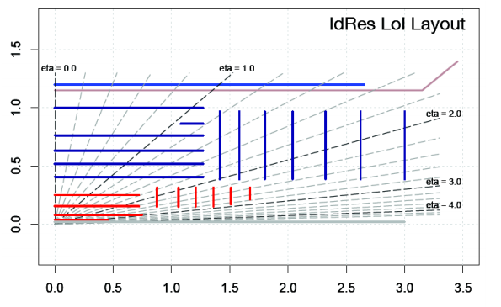
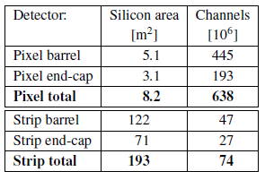
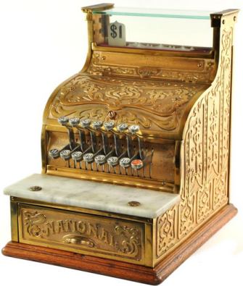
Reference Layout of the new Si Tracker
Tentatively the UK does:
half the barrel strips
(128SS+108LS staves
= 6136 modules total)
one pixel end cap
(1250 modules in 25 rings)
Liverpool: the leading centre
Four major considerations will lead to new layout:
(Helen co-coordinator of the layout simulation)
Physics: Extension to larger rapidity for VBF Higgs
Pile-up: Reconstruction efficiency
Services: Rings instead of Disks
Cost: Review in October 2015

Slide 8
Alternative Layouts of the new Si Tracker
Ring Layouts
5 Pixel Layouts
Liverpool has leadership on a few design concepts:
Ring layouts are the only currently viable options for pixel end cap (especially for forward extensions to η of 4)
5 pixel layouts could allow for smaller strip system. Better performance at low price.
CMOS active sensors for outer pixel layer could be even more performant and inexpensive

Slide 9
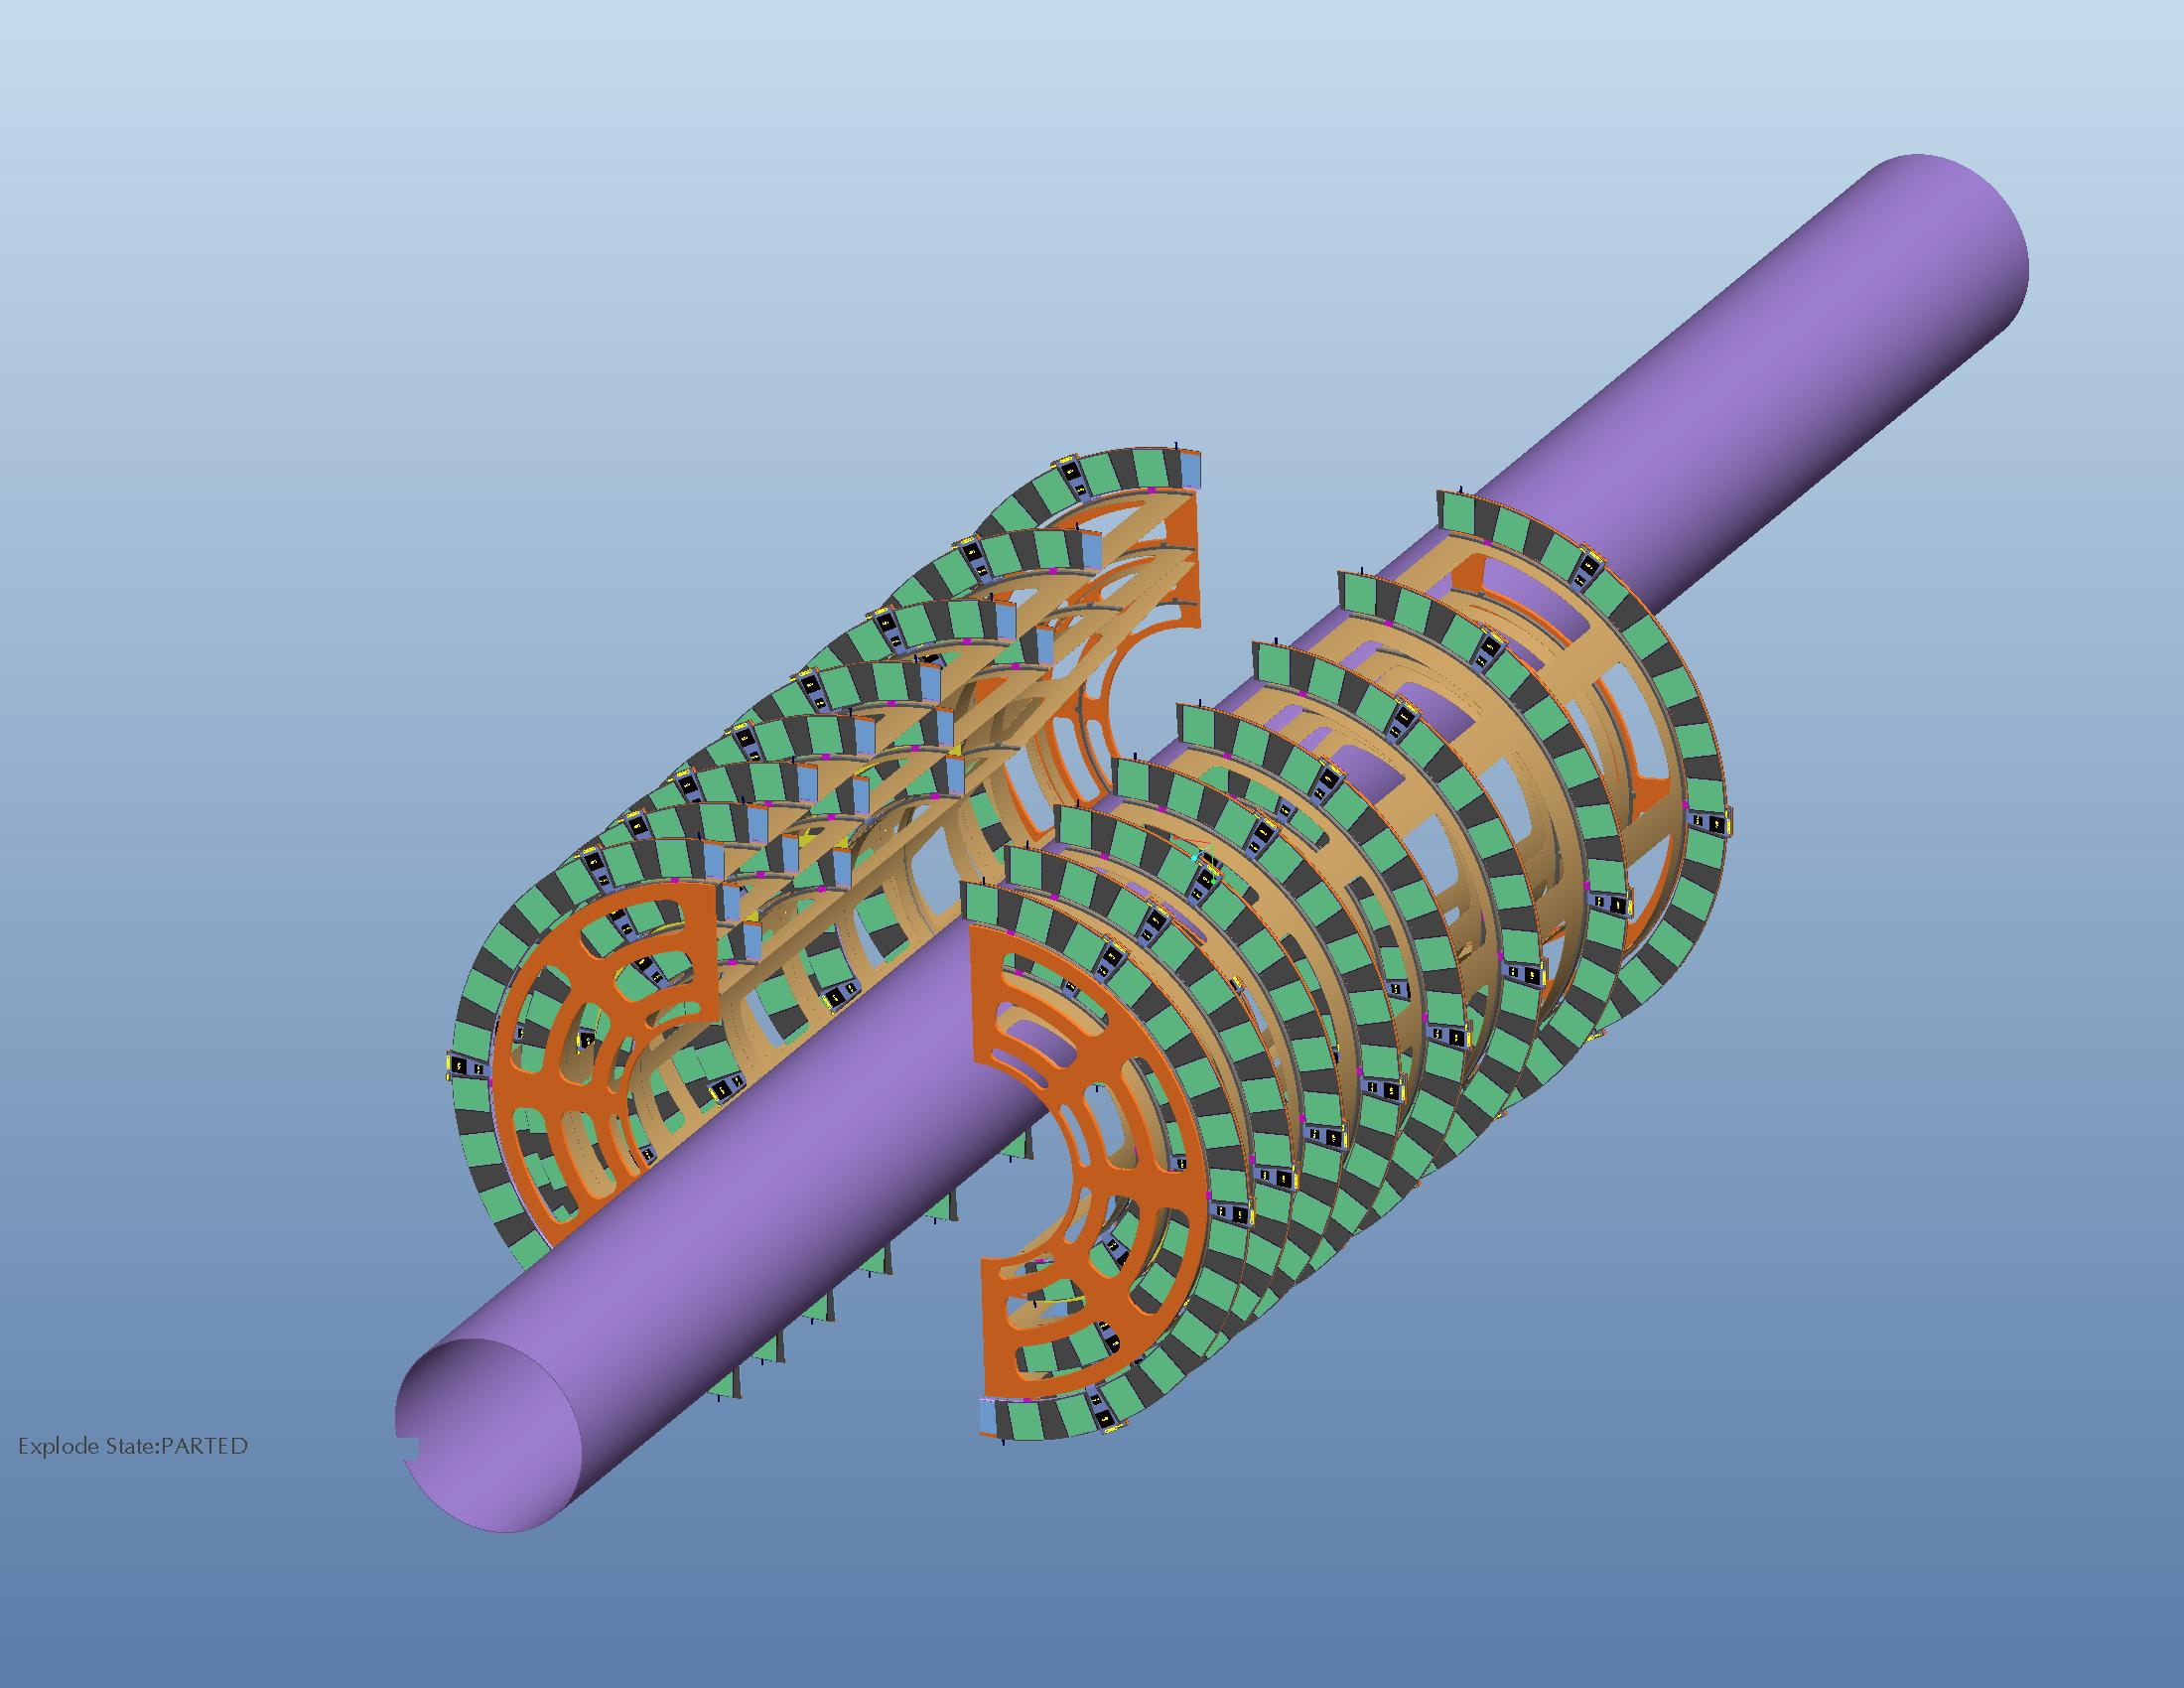
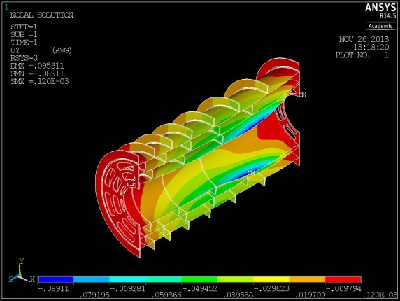
Pixel - Mechanics
Petal design studies: Manufacturing and thermal difficulties lead to ring design
Presently: CAD modelling of ring layout, engineering of rings and end-cap global supports
S.Burdin, T.Jones, P.Dervan, H.Hayward, N.Readioff, P.Sutcliffe, Workshop

Slide 10
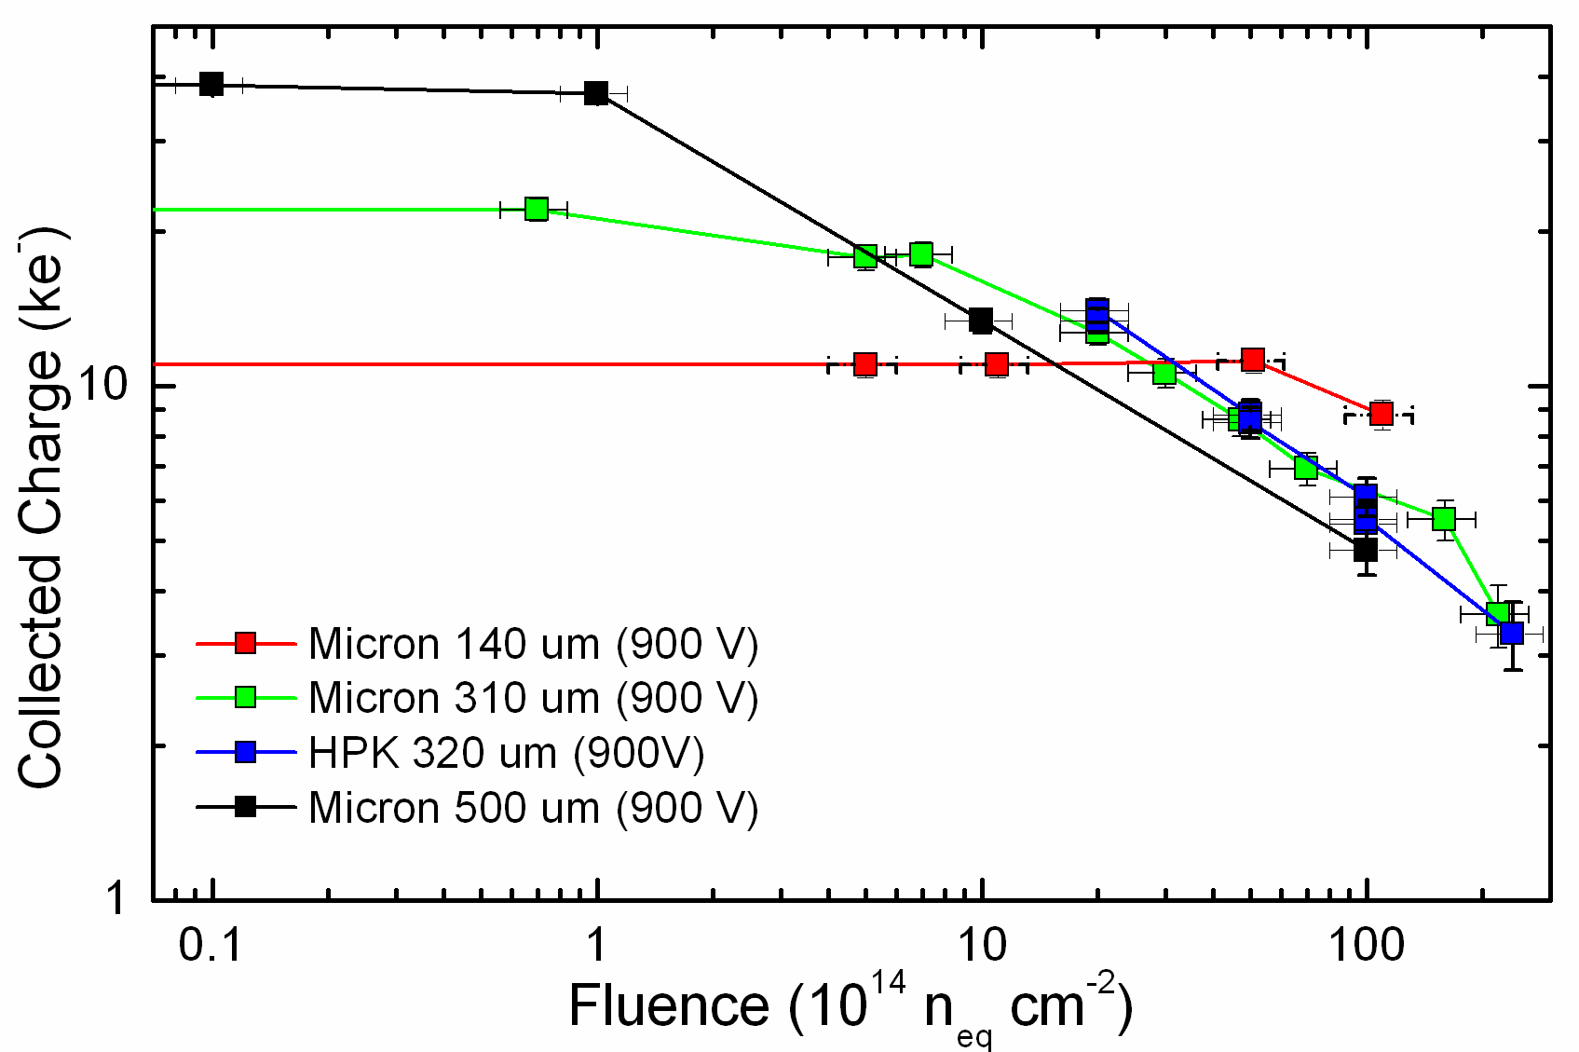
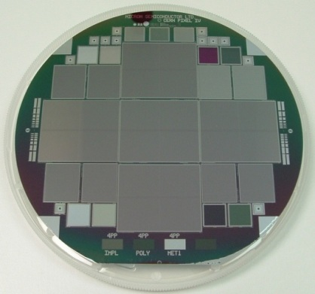
Pixel Sensors
4x4 cm sensors (n-in-p) 150mm diameter
Multiple submissions to improve high voltage performance, reduce inactive edge size, improve efficiency after irradiation, tests of the effects of sensor thickness and pixel sizes of efficiency and resolution.
Test Beam evaluation of devices
Bias to almost 1kV for inner layer
New p type Si radiation studies up to 2×10¹⁶ n/cm² and 1 Grad
Thinner sensor superior at high dose
Burdin, Casse, Dervan, Forshaw, Milovanovic, Tsurin, Wonsak, Wormald

Slide 11
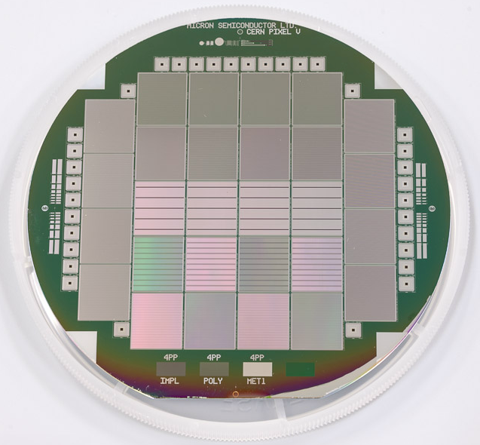
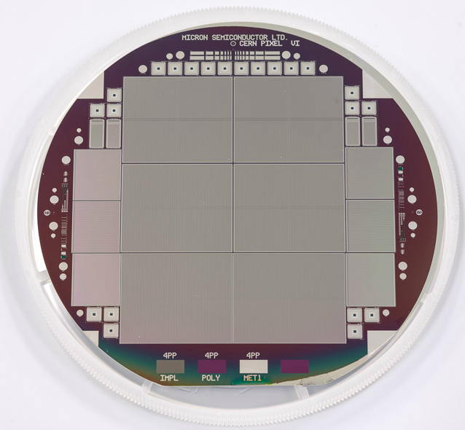
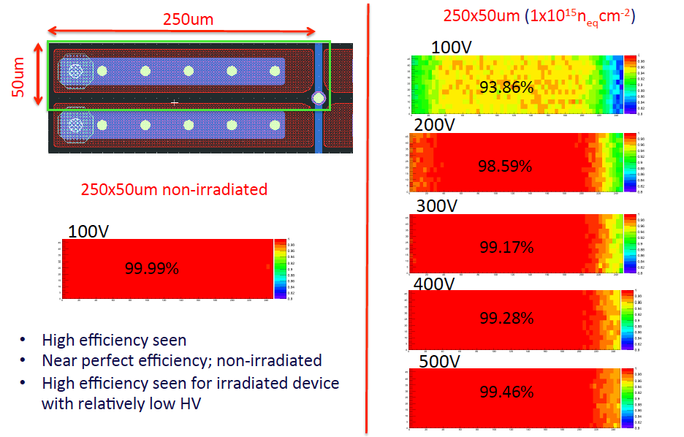
Pixel Test Beam Results
Succesful beam test of CPV, first with punch though bias. Stable to -40C, dedicated coolbox. Promising
noise performance with AC readout. Efficiency
restored with few 100 V bias after irradiation
Burdin, Casse, Dervan Forshaw, Milovanovic, Tsurin, Wonsak, Wormald, Workshop

Slide 12
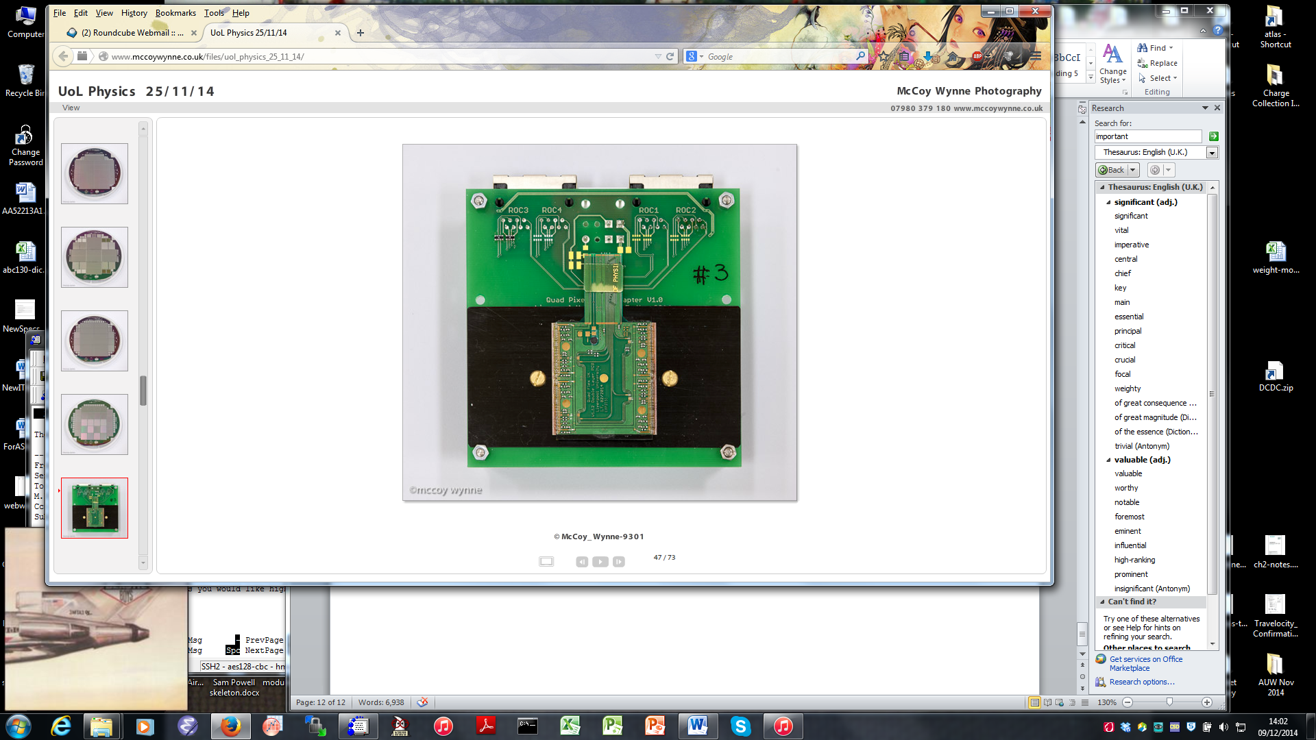
Pixel Hybrids and Modules
Hybrids, modules and tooling design for pixel EC by Liverpool
New single layer hybrid (lower material and cost) with flexibility to add power protection and data MUX
Plans for development for production rates
Dervan, Tsurin, Wormald, Workshop, LSDC

Slide 13
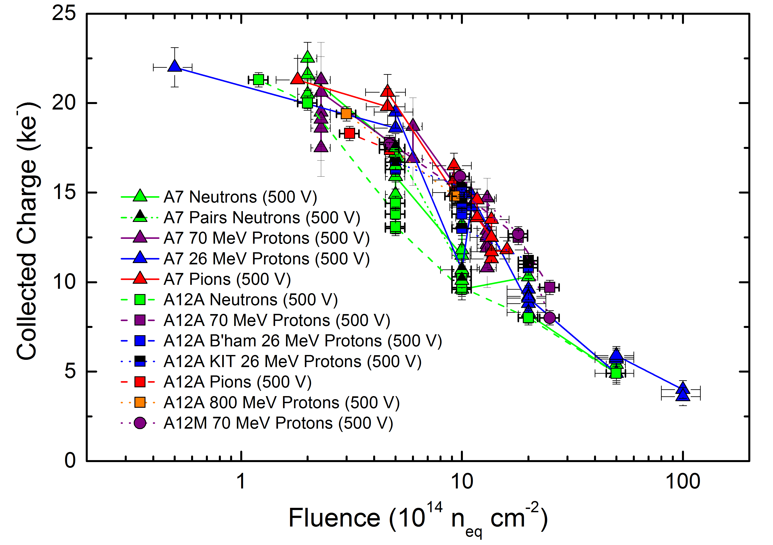
Strip Sensors
n-in-p baseline technology
4 rows of 2.4cm long strips with pitch of 74.5μm
Adapted to new 256 ABC130 ASIC
Hamamatsu but need 190m²
- R&D with Infineon underway. 8” wafers may be possible (lower cost and simpler end cap possible)
Irradiation organized and studied by group
Strips expected to get 2×10¹⁵n/cm², i.e. an order of magnitude less than pixels
Market survey launched with specification from our studies
Affolder, Allport, Casse, Dervan, Forshaw, Tsurin, Wonsak, LDSC

Slide 14
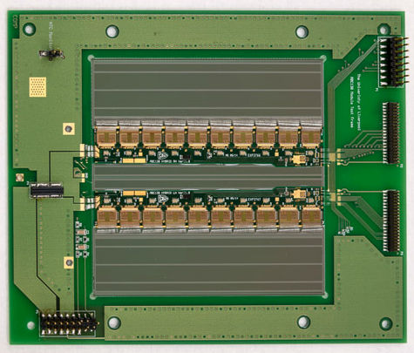
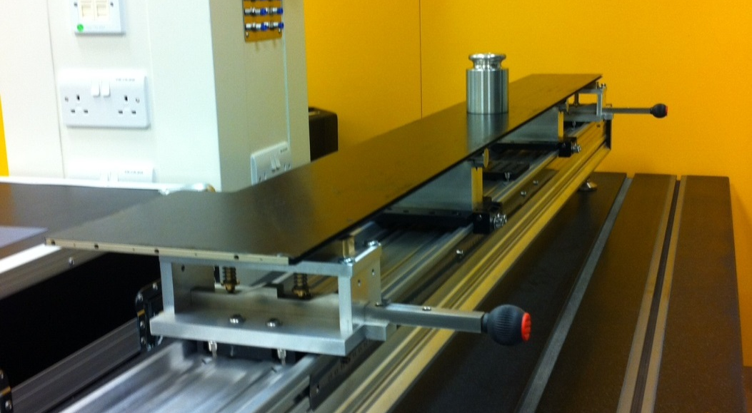
Strip Hybrids, Modules, Staves
Hybrids, modules and tooling design for barrel from Liverpool! End cap design based on ours.
Workshop produced all hybrid and module jigs for international barrel community
First hybrid and module using new ABC130 readout ASIC built at Liverpool
DC-DC power is now baseline (Liverpool improved packaging and demonstrated can be on module)
Stave core assembly jigs designed and assembled for international community at Liverpool
Affolder, Caroll, Greenall, Jones, Powell, Sutcliffe, Whitley, Wormald, Workshop, LSDC

Slide 15
Future Involvement in Si Tracker Upgrade^{*)}
UK deliverable is ½ strip barrel (one entire end) and a pixel endcap
  We are involved in:
    Strip sensor, hybrids, module, staves, module mounting, interlinks
    Pixel sensors, hybrids, modules, global supports and intergration
    Commissioning
    Simulation and Layout
    Physics Studies
Why such a wide breadth of involvement?? Good for experiment to have a few groups with a cross-section of the production chain. We have the staff, experience and facilities to do so. Great synergies between pixel and strip projects.

Slide 16
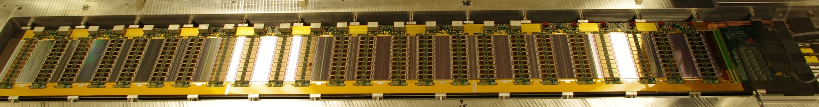
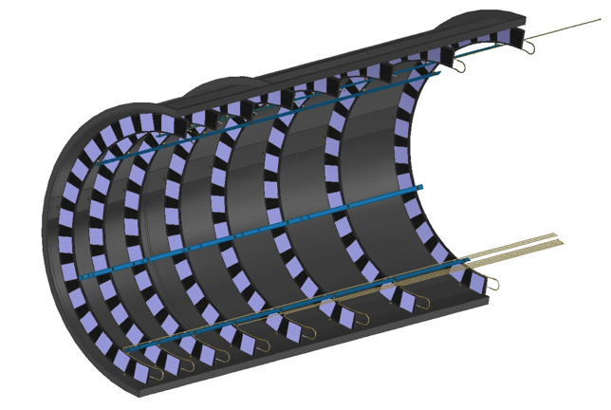
Future Involvement in Si Tracker Upgrade^{*)}
Strips: Hybrid Procurement, ½ Hybrids and 1/6 Modules,
½ Stave Core Assembly, ½ Module-to-Stave Assembly
Pixels: Sensor Procurement, Hybrid Procurement, ¼ Modules
Carbon Fibre Shells, End cap Integration
*) Coseners house 26.11.
and RG 2015, yet:
subject to intra-
and international
negotiations
and developments

Slide 17
backup

Slide 18
Institute Involvement
Pixel Detector
Module Production
TASK | Description | Institutes
3.1a | Sensor procurement | Liverpool
3.1 | Sensor QA | Liverpool,
3.2 | ASIC QA | Glasgow, RAL
3.3 | Hybrid QA | Liverpool
3.4a | Module assembly management | Glasgow
3.4 | Module Assembly & QA | Glasgow, Liverpool, Manchester/Edinburgh, Oxford
3.5 | 3-D Sensor & Module | Manchester
Mechanics & Macro Assembly
TASK | Description | Institutes
6.1 | Ring Manufacture and QA:
6.1b | On-disk tapes | Edinburgh
6.1c | EoS cards | Edinburgh/Manchester
6.1d | Carbon Fibre shells | Liverpool
6.1e | Foam cutting, ring assembly, QA | Manchester
6.1f | Cooling loop fabrication | Lancaster, Sheffield
6.2 | Module Mounting, QA | RAL, Glasgow
6.3 | Superstructure procurement, QA | QMUL,Liverpool
6.4 | Type-I service assemblies | Edinburgh, Sheffield, Lancaster
6.5 | Assembly of rings into endcap superstructures, QA | Liverpool, Sheffield, QMUL
6.6 | Delivery of assembled endcap to CERN | Liverpool
Notes:
This is derived from an internal document, working on an area does not mean planning to do so exclusively

Slide 19
Module Assembly & QA
Strip Detector
TASK | Description | Institutes
2.1 | Sensor QA | Cambridge, QMUL, Lancaster, Sheffield, Oxford
2.2 | ASIC QA | RAL, Glasgow
2.3 | Hybrid Assembly and QA | Birmingham, Liverpool
2.4 | Module Assembly and QA | Liverpool, Cambridge, Glasgow, Sheffield, B’ham, Oxford, RAL, Lancaster(QA)
Stave Core Assembly
TASK | Description | Institutes
4.1 | Raw Materials Batch Testing | Liverpool, Sheffield, (+RAL TD?)
4.2 | Bus-tape testing & co-curing | Oxford + Liverpool
4.3 | Cooling pipe manufacture | Lancaster, Sheffield
4.4 | Stave Frame Production | QMUL, Lancaster
4.5 | Stave core assembly | Liverpool & Oxford
4.6 | Stave core QA | Liverpool, Oxford, Sheffield & QMUL
Module Mounting and QA
TASK | Description | Institutes
5.1 | Module Reception Testing | RAL
5.2 | Stave Core Reception Testing | RAL
5.3 | EoS reception & QA | Oxford, RAL
5.4 | Module Mounting | RAL
5.5 | Wire bonding | RAL
5.6 | Stave electrical QA | RAL
5.7 | Reliability testing | RAL, Oxford

Slide 20
Strip Detector
Mechanics & Services
TASK | Description | Institutes
7.2 | Barrel support structure component manufacture | RAL, Liverpool, Oxford
7.3 | Type I service module manufacture | RAL, Oxford, Sheffield, Lancaster
7.4 | Stave installation tooling | Oxford
7.5 | Cooling connection tooling | Sheffield
20
Power and DAQ
TASK | Description | Institutes
8.2 | DAQ | Sheffield, Oxford, RAL;UCL
8.3 | Powering including power boards | RAL
8.4 | System Maintenance | UCL
8.5 | Irradiation Programme | Sheffield, Birmingham, Liverpool

