Slide 1
ATLAS at Christmas 2014
LHC
Analysis and Physics
R+D and Upgrade
Max Klein - for the dauntless ATLAS Group - Liverpool 12.12.2014

Slide 2
new

Slide 3
Leading Roles Liverpool ATLAS in 2014
A Affolder: Strip Tracker Upgrade Convenor, Upgrade (and UK) Strip Module Convenor
P Allport: Upgrade Coordinator, Executive Board
S Burdin: UK Upgrade Pixel Module Deputy Convenor
G Casse: Upgrade Sensor Procurement Group
P Dervan: UK Irradiation Coordination
M D'Onofrio: SUSY and now Physics Modelling Group Convenor
C Gwilliam: Physics Validation Convenor
H Hayward: Upgrade Tracker Simulation Convenor, UK Super-symmetry & Exotics Convenor
T Jones: Strip Module Mechanical Support Convenor, UK Upgrade Strip Stave Assembly Convenor
M Klein: Team Leader, Collaboration Board
U Klein: Advisory Board to Chair of the Collaboration Board, LPCC Contact
J Kretzschmar: W,Z Working Group Convenor, Standard Model Working Group Convenor
P Laycock: Analysis Software Group Convenor, Data Preparation Coordinator
A Mehta: Heavy Quark Higgs Group Convenor, Analysis Release Coordinator
J Vossebeld: UK Silicon Tracker Project Leader
A.Greenall Hybrid electronis
I Tsurin Chip and electronics design in 2016 the group will have 4 PhD students and no postdoc

Slide 4
What is leadership?
And who can score alone?

Slide 5
ATLAS Hardware

Slide 6
ITk in next 10 years : The BIG picture
2014
2015
2016
2017
2018
2019
2020
2021
2022
2023
CB
Endorse
Pixel TDR
2017-2019
Preproduction
2-3 Years Pixel Production
ITk-IDR
APR-OCT
PIXEL
UCG, LHCC,
Pixel-MOU, RRB
Integration
UCG, LHCC,
Strip-MOU, RRB
STRIP
ITk Commission
on Surface 2023
Re-cost ITk
ITk-Kick off
EB Approval
Strips TDR
2016-2018
Preproduction
3-4 Year Strip Production
YR=1
2
3
4
5
6
7
8
9
10
CB= collaboration board, EB=executive board, IMOU=interim memorandum of understanding, UCG=upgrade cost group, RRB= Resources review board, IDR=initial design review (internal), TDR=technical design report (external)

Slide 7
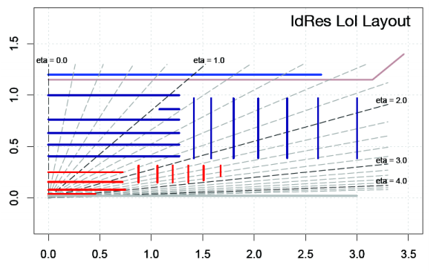
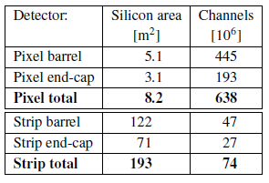
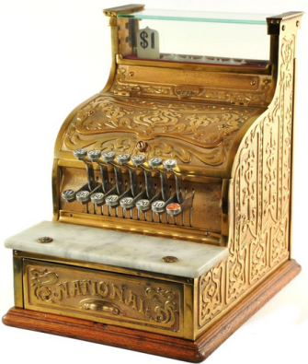
Reference Layout of the new Si Tracker
Tentatively the UK does:
half the barrel strips
(128SS+108LS staves
= 6136 modules total)
one pixel end cap
(1250 modules in 25 rings)
Liverpool: the leading centre
Four major considerations will lead to new layout:
(Helen co-coordinator of the layout simulation)
Physics: Extension to larger rapidity for VBF Higgs
Pile-up: Reconstruction efficiency
Services: Rings instead of Disks
Cost: Review in October 2015

Slide 8
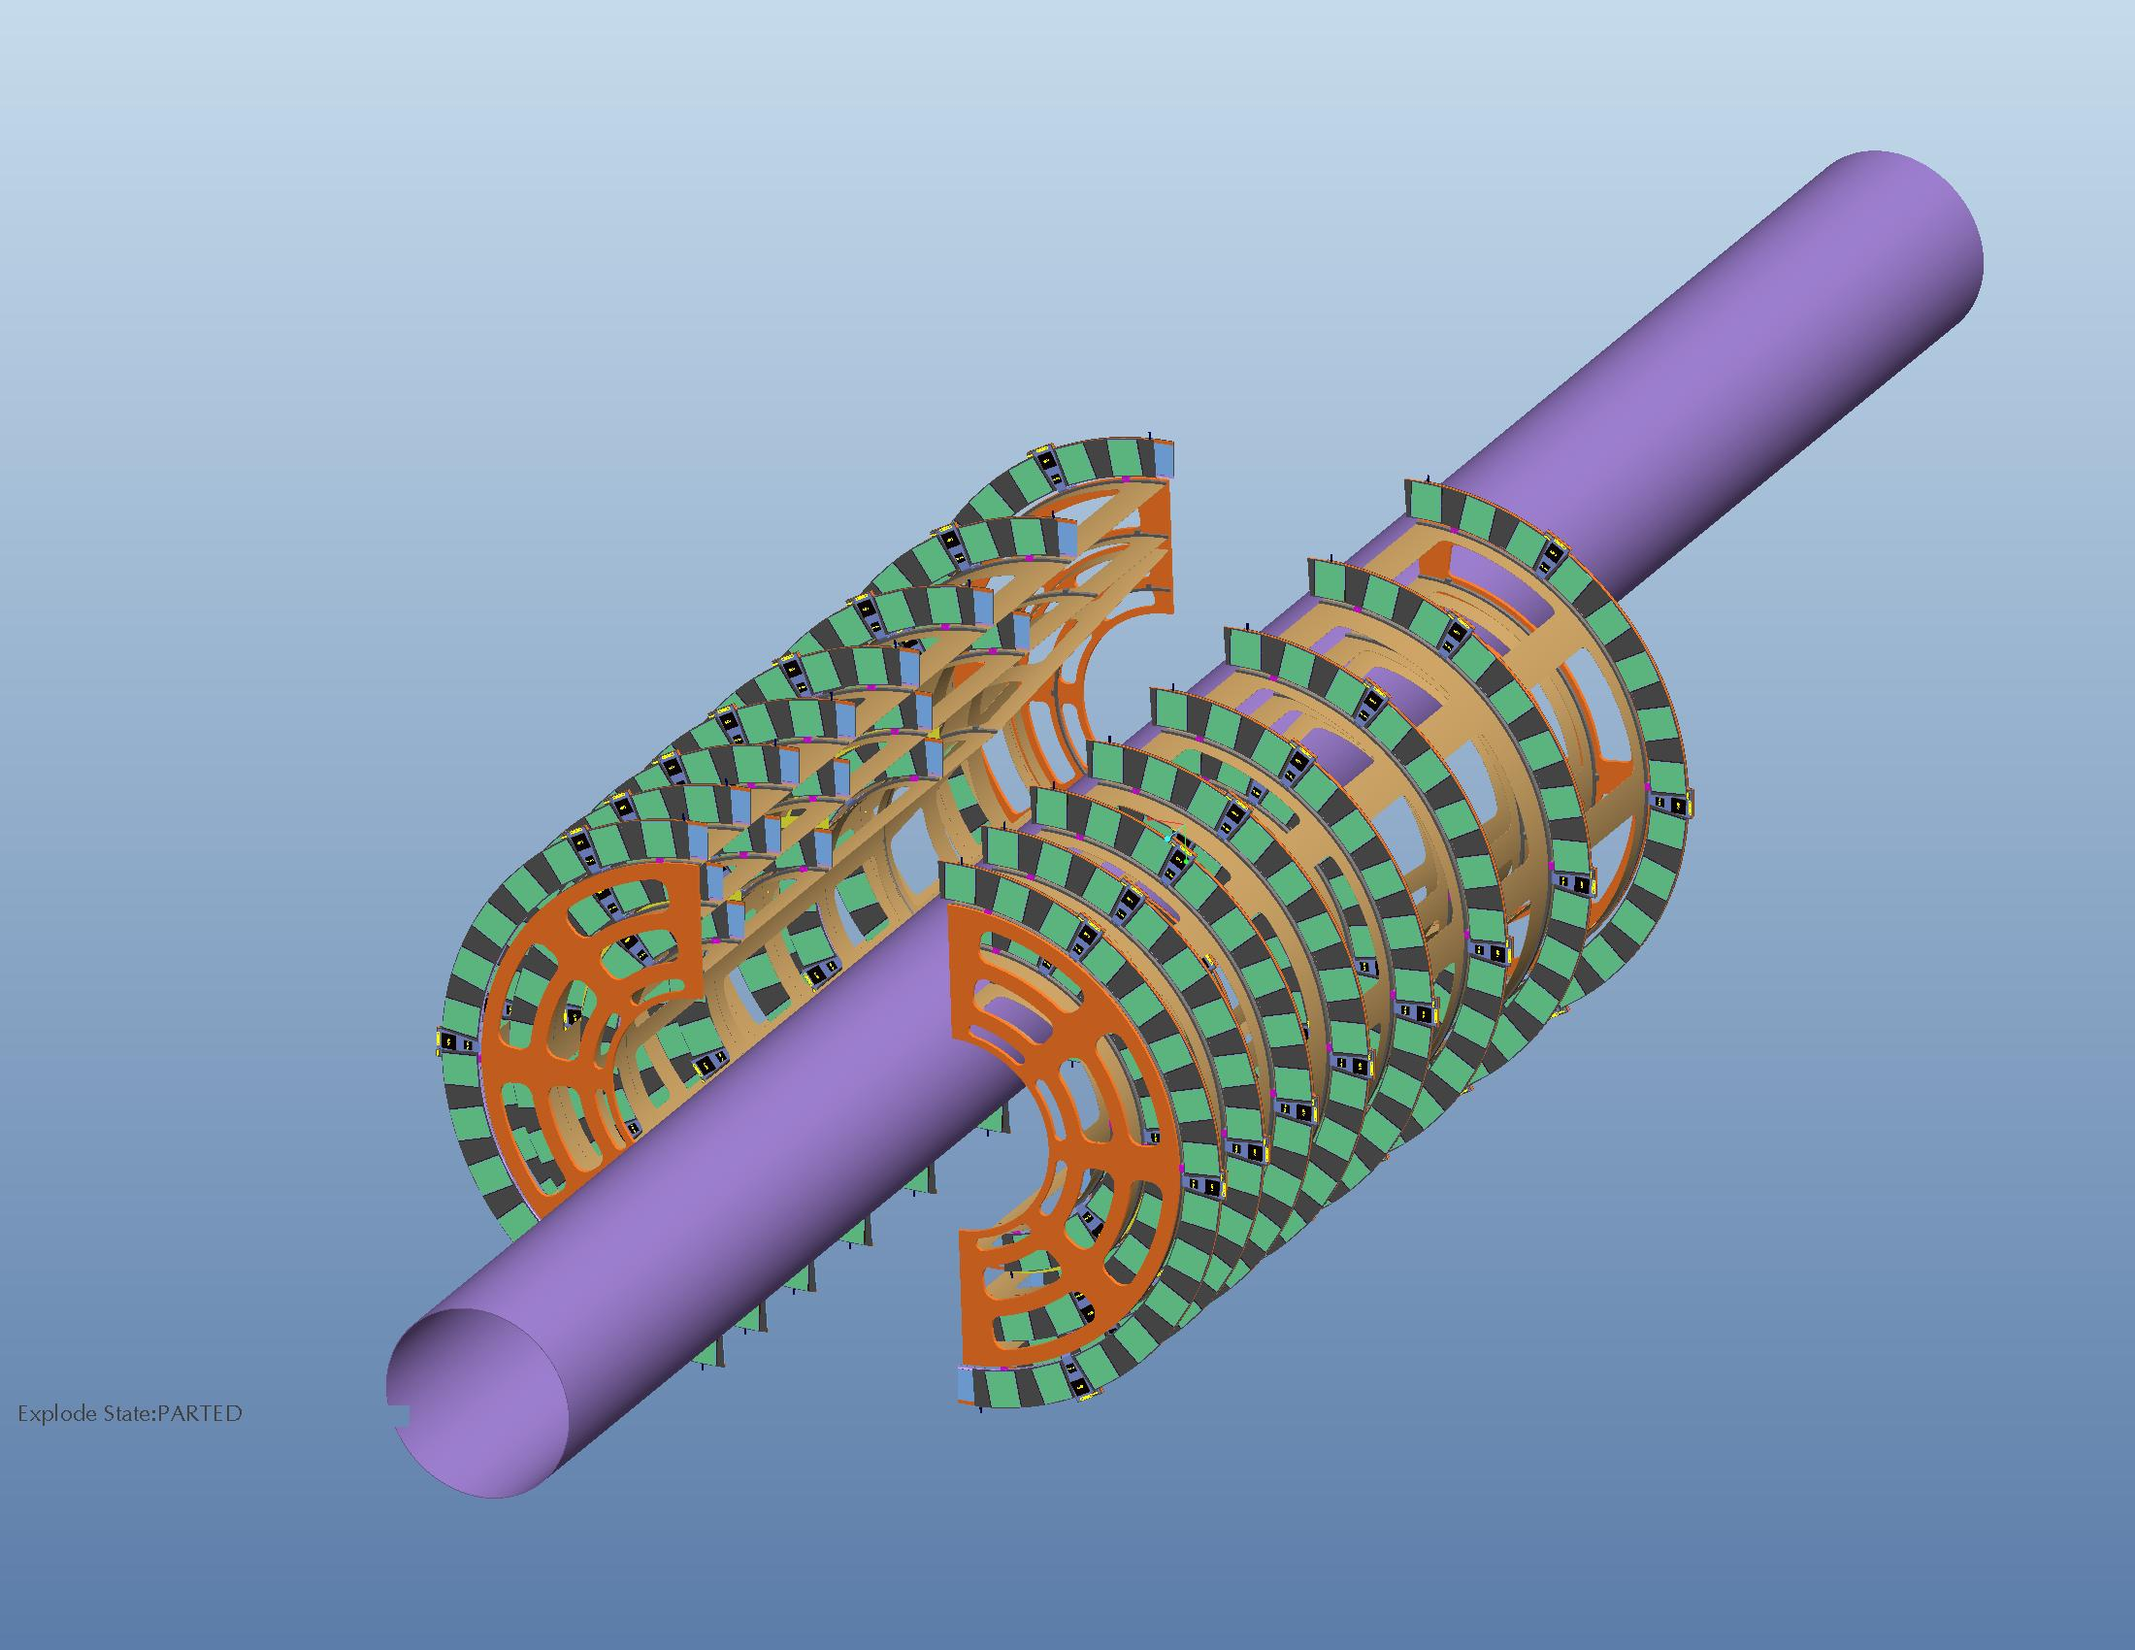
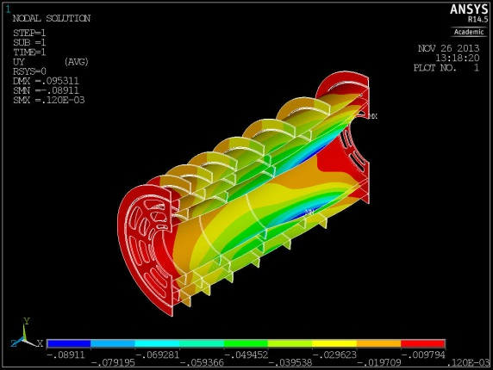
Pixel - Mechanics
Petal design studies. Manufacturing and thermal difficulties lead to ring design
Presently: CAD modelling of ring layout, engineering of rings and end-cap support
S.Burdin, T.Jones, P.Dervan, H.Hayward, N.Readioff, P.Sutcliffe, Workshop

Slide 9
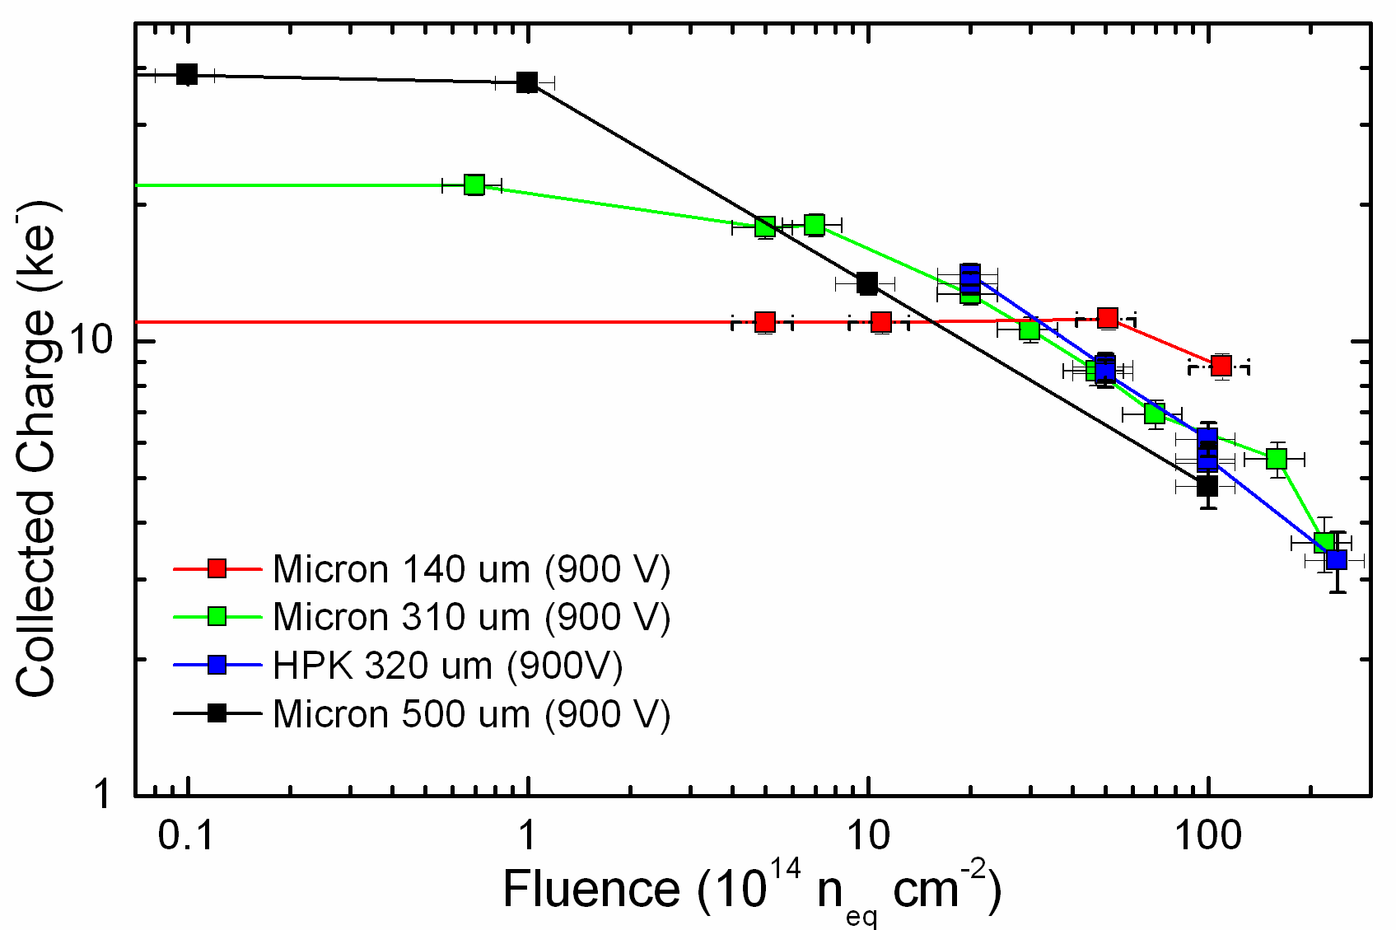
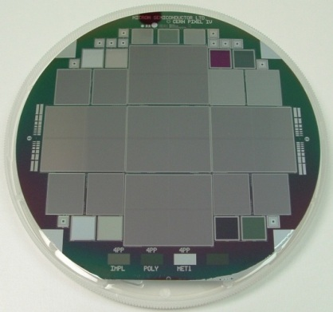
Pixel Sensors
Bias to almost 1kV;
New p type Si radiation studies
up to 2 10¹⁶ n/cm² and 1 Grad
Thinner sensor superior at high dose
(classic e gain is 20k electrons)
4x4cm sensors (n-in-p) 150mm diameter
Geometry variations for FE-14 r/o ASIC
Mask sets for high voltage performance,
reduced edges, various sensor thickness,
pixel sizes and assemblies. Beam tests
Affolder, Burdin, Carrol, Casse, Dervan, Forsaw, Milovanovic, Tsurin, Wormald

Slide 10
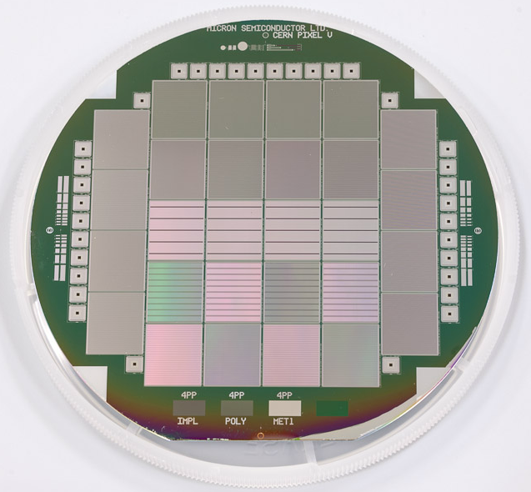
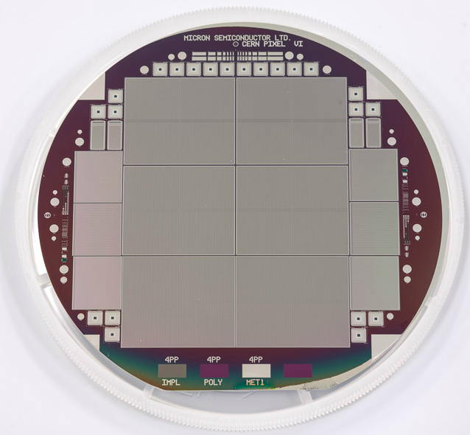
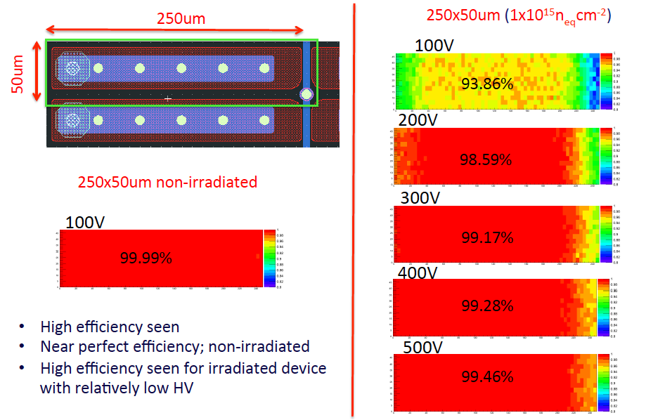
Pixel Test Beam Results
Succesful beam test of CPV, first with punch though bias. Stable to -40C, dedicated coolbox. Promising
noise performance with AC readout. Efficiency
Restored with few 100 V bias after irradiation
Burdin, Casse, Dervan Forshaw, Milanovic, Tsurin, Wonsak, Workshop

Slide 11
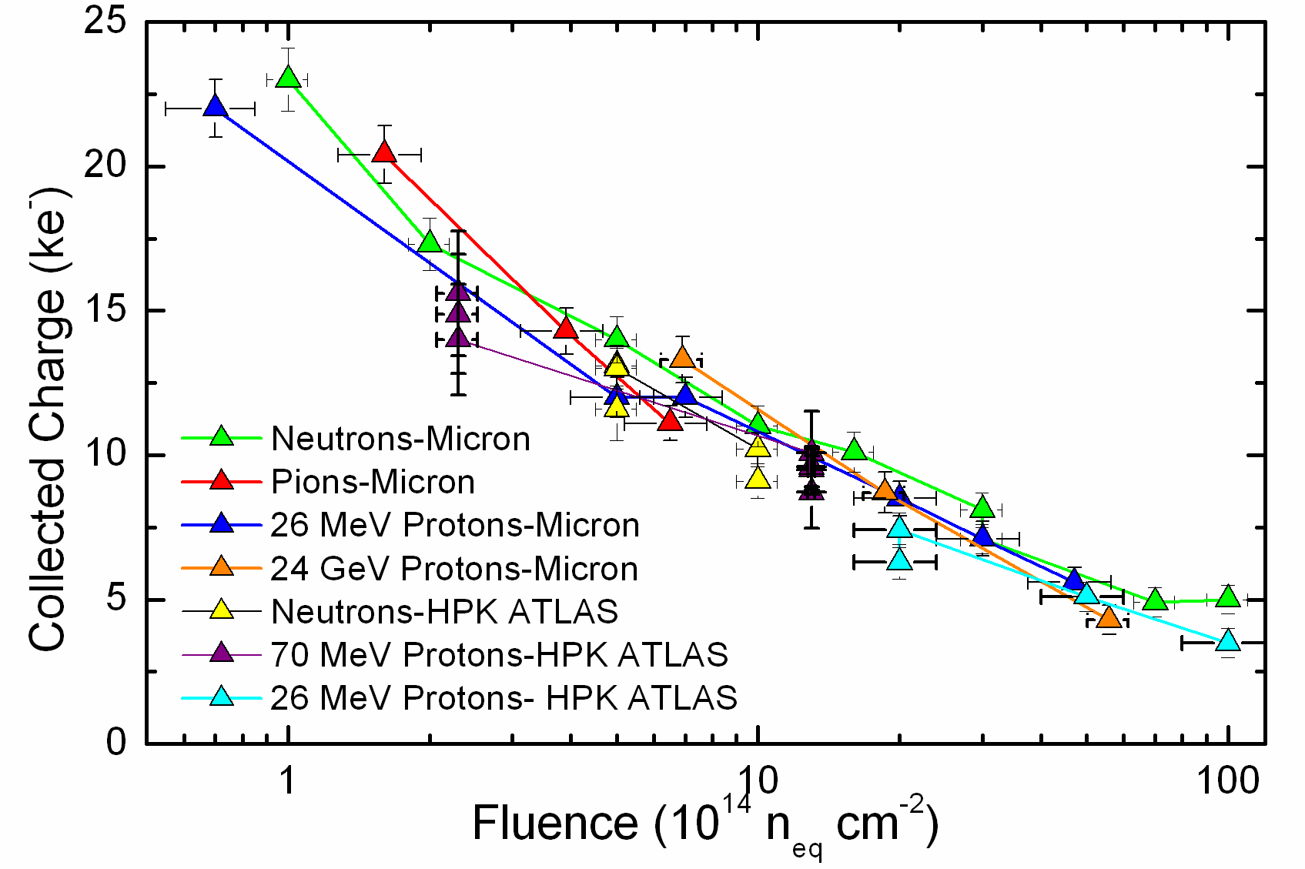
Strip Sensors
n-in-p baseline technology
4 rows of 2.4cm long strips
with pitch of 74.5μm
Adapted to new 256 ABC130 ASIC
Hamamatsu but need 190m²
- e2v (too low break down voltage)
- Infineon? 8” 300μm ?
Strips expected to get 2 10¹⁵n/cm², i.e.
an order of magnitude less than pixels
Affolder, Allport, Casse, Dervan, Tsurin, LDSC

Slide 12
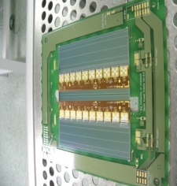
Strip Hybrids, Modules, Staves
old 2*10 250nm hybrid
All designs for the hybrids, modules and tooling for barrel and end-cap are Liverpool’s!
Kapton multi-layer hybrid glued to sensor, 8 circuits laminated to rigid FG4 carrier
1*10 columns; Powering DC-DC; 4-row bonding demonstrated to be feasible…
Affolder, Caroll, Greenall, Jones, Powell, Sutcliffe, Whitley, Wormald, Workshop

Slide 13
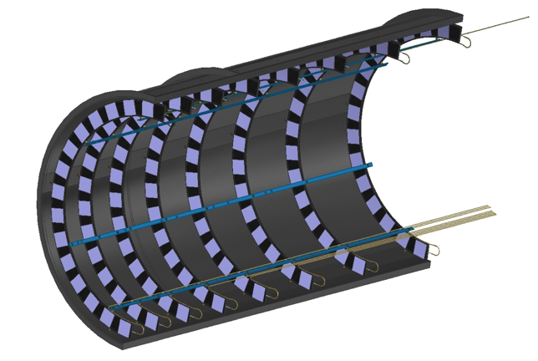
Future Involvement in Si Tracker Upgrade^{*)}
Physics Programme
Detector and Layout Simulation
Strips: Sensor QA, Hybrid and Module Assembly,
Stave Core Assembly, Module-to-Stave Assembly
Pixels: Sensor QA, Hybrid QA, Module Assembly
Carbon Fibre Shells, Assembly of Rings and one End Cap
*) Coseners house 26.11.
and RG 2015, yet:
subject to intra-
and international
negotiations
and developments
The whole Liverpool Silicon team, its base and the so-called academics

Slide 14
backup

Slide 15
Institute Involvement
Pixel Detector
Module Production
TASK | Description | Institutes
3.1a | Sensor procurement | Liverpool
3.1 | Sensor QA | Liverpool,
3.2 | ASIC QA | Glasgow, RAL
3.3 | Hybrid QA | Liverpool
3.4a | Module assembly management | Glasgow
3.4 | Module Assembly & QA | Glasgow, Liverpool, Manchester/Edinburgh, Oxford
3.5 | 3-D Sensor & Module | Manchester
Mechanics & Macro Assembly
TASK | Description | Institutes
6.1 | Ring Manufacture and QA:
6.1b | On-disk tapes | Edinburgh
6.1c | EoS cards | Edinburgh/Manchester
6.1d | Carbon Fibre shells | Liverpool
6.1e | Foam cutting, ring assembly, QA | Manchester
6.1f | Cooling loop fabrication | Lancaster, Sheffield
6.2 | Module Mounting, QA | RAL, Glasgow
6.3 | Superstructure procurement, QA | QMUL,Liverpool
6.4 | Type-I service assemblies | Edinburgh, Sheffield, Lancaster
6.5 | Assembly of rings into endcap superstructures, QA | Liverpool, Sheffield, QMUL
6.6 | Delivery of assembled endcap to CERN | Liverpool
Notes:
This is derived from an internal document, working on an area does not mean planning to do so exclusively

Slide 16
Module Assembly & QA
Strip Detector
TASK | Description | Institutes
2.1 | Sensor QA | Cambridge, QMUL, Lancaster, Sheffield, Oxford
2.2 | ASIC QA | RAL, Glasgow
2.3 | Hybrid Assembly and QA | Birmingham, Liverpool
2.4 | Module Assembly and QA | Liverpool, Cambridge, Glasgow, Sheffield, B’ham, Oxford, RAL, Lancaster(QA)
Stave Core Assembly
TASK | Description | Institutes
4.1 | Raw Materials Batch Testing | Liverpool, Sheffield, (+RAL TD?)
4.2 | Bus-tape testing & co-curing | Oxford + Liverpool
4.3 | Cooling pipe manufacture | Lancaster, Sheffield
4.4 | Stave Frame Production | QMUL, Lancaster
4.5 | Stave core assembly | Liverpool & Oxford
4.6 | Stave core QA | Liverpool, Oxford, Sheffield & QMUL
Module Mounting and QA
TASK | Description | Institutes
5.1 | Module Reception Testing | RAL
5.2 | Stave Core Reception Testing | RAL
5.3 | EoS reception & QA | Oxford, RAL
5.4 | Module Mounting | RAL
5.5 | Wire bonding | RAL
5.6 | Stave electrical QA | RAL
5.7 | Reliability testing | RAL, Oxford

Slide 17
Strip Detector
Mechanics & Services
TASK | Description | Institutes
7.2 | Barrel support structure component manufacture | RAL, Liverpool, Oxford
7.3 | Type I service module manufacture | RAL, Oxford, Sheffield, Lancaster
7.4 | Stave installation tooling | Oxford
7.5 | Cooling connection tooling | Sheffield
17
Power and DAQ
TASK | Description | Institutes
8.2 | DAQ | Sheffield, Oxford, RAL;UCL
8.3 | Powering including power boards | RAL
8.4 | System Maintenance | UCL
8.5 | Irradiation Programme | Sheffield, Birmingham, Liverpool

