Slide 1
LHeC Test Facility Meeting
OptiM - Computer code for linear and non-linear optics calculations
Alessandra Valloni, Thursday 18.10.2012

Slide 2
Outline
What does OptiM compute?
Input language description
Why do we use OptiM? ERL-LHeC schematic layout
Example of an input file: lattice for LHeC Recirculating Linear Accelerator Complex
OptiM for the LHeC Test Facility lattice design
Future works and questions

Slide 3
What Does Optim compute?
OptiM - Computer code for linear and non-linear optics calculations
- OptiM is aimed to assist with linear optics design of particle accelerators (calculations are based on 6x6 transfer matrices) but it is also quite proficient with non-linear optics, tracking and with linear effects due to space charge
- It computes the dispersion and betatron functions (for both uncoupled and X-Y coupled particle motions), as well as the beam sizes, the betatron phase advances, etc. The values can be plotted or printed along machine circumference or computed at the end of lattice or at any element
- It can also fit parameters of accelerator elements to get required optics functions
- It offers a wide choice of elements that allows designing both circular and linear accelerators, along with recirculators
- It can perform computations not only at the reference orbit but also at a closed orbit excited by machine errors, correctors or energy offset. In this case the program first finds a new "reference" orbit then expends nonlinear terms for machine elements and then performs computations. That allows one to perform both linear optics computations and non-linear tracking relative to this new orbit

Slide 4
Optim peculiarities
6D computations: - large set of optics elements
- x-y coupling, acceleration (focusing in cavities is taken into account)
Similar to MAD but has integrated GUI
Can generate MAD and MADX files from OptiM files
It has been used for Optics support of the following machines:
- Jefferson lab (CEBAF – optics redesign, analysis of optics measurements…)
- Fermilab (optics redesign, analysis of optics measurements. Completely done files
for rings, Tevatron, Debuncher, Transfer lines, Electron cooler)
Works on MS-Windows only (No GUI version can be used at any platform)
Written on BC++, the platform which is not supported anymore
Non-linearities are ignored for the combined function magnet (dipole with gradient)

Slide 5
Input file description
math header : numeric and text variables
INPUT PARAMETERS : initial beam energy and the particle mass in MeV, horizontal and vertical beam emittances, relative momentum spread at the start of the lattice (these values are used for beam envelope calculations and are modified in the course of beam acceleration to take into account the adiabatic damping; effects of the energy spread change due to longitudinal focusing of bunch with finite length are neglected), horizontal and vertical beta-functions, their negative half derivatives at the start of the lattice, initial betatron phases Qx and Qy (these two parameters are ignored in all calculations except printing of Twiss-functions), horizontal and vertical dispersions and their derivatives at the start of the lattice, position and angle of the beam trajectory at the start of the lattice
block making references to external files : e.g. description of field in accelerating cavity
LATTICE DESCRIPTION : order of the elements in the lattice
LIST BLOCK: list of elements with their parameters
service blocks : Fitting block, (Fitting-Betas), 4D Beta-functions block (Beta-functions block), Space Charge Block (Space Charge Menu) and Trajectory Parameters Block (see Trajectory)

Slide 6
Recirculating Linear Accelerator Complex : Schematic Layout
RECIRCULATOR COMPLEX
1) 0.5 Gev injector
2) A pair of 721.44 MHz SCRF linacs with energy gain 10 GeV per pass
3) Six 180° arcs, each arc 1 km radius
4) Re-accelerating stations to compensate energy lost by SR
5) Switching stations at the beginning and end of each linac to combine the beams from
different arcs and to distribute them over different arcs (Spreaders/Combiners)
6) Matching optics
7) Extraction dump at 0.5 GeV

Slide 7
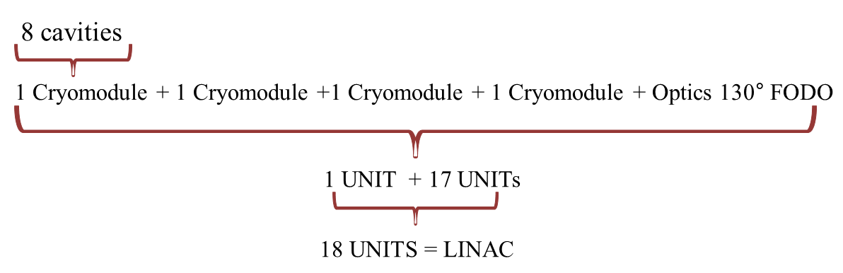
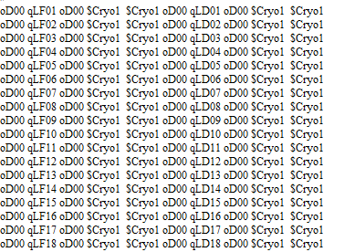
LINAC LAYOUT in OPTIM: Lattice description (1/3)
LATTICE DESCRIPTION :
order of the elements in the lattice
18 UNITS * 56m/UNIT = 1008m
1
1
0.1
0.1
13.4
13.4
0.1
0.1
13.4
13.4
56 m

Slide 8
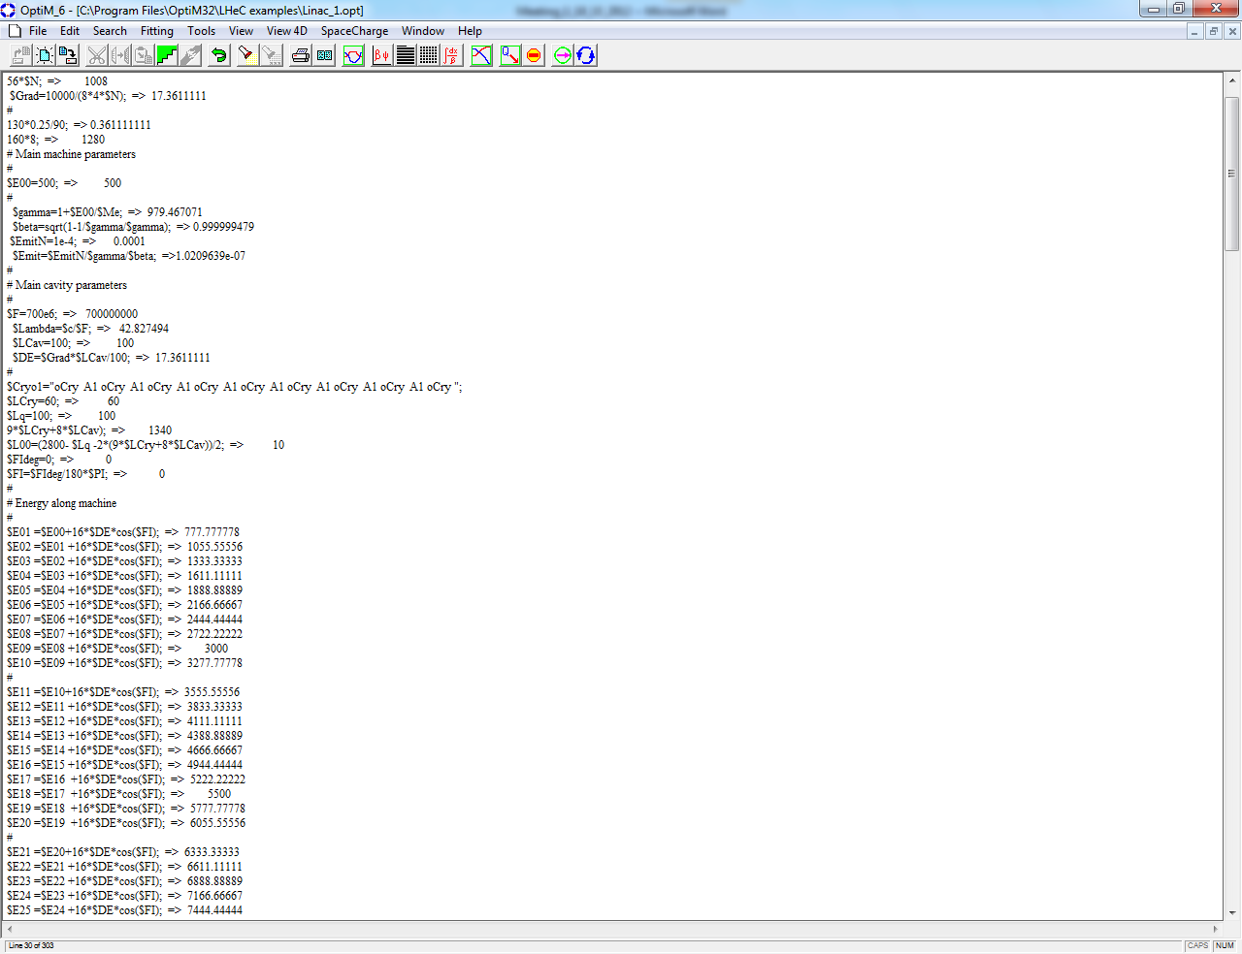
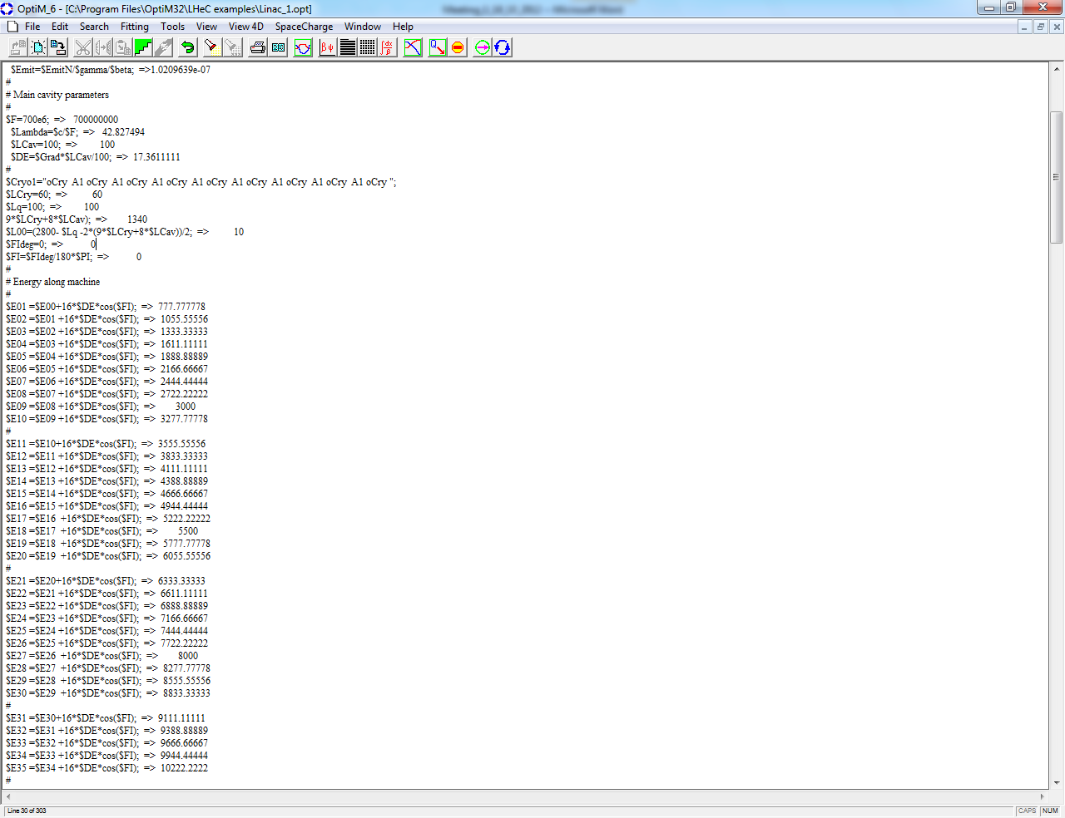
LINAC LAYOUT in OPTIM: Lattice description (2/3)
? ?
1 Cryomodule → 8 cavities
In 1 UNIT→ 4 Cryos → 32 cavities
$ΔE = energy gain per cavity = 17.36 MeV
$E00 = 500MeV (Injection Energy)
Energy gain/half unit :
$E01 = $E00 +16 *$DE*cos($Fi)
10 GeV Linac 1 :
500 MeV → 10500 MeV for the first pass

Slide 9
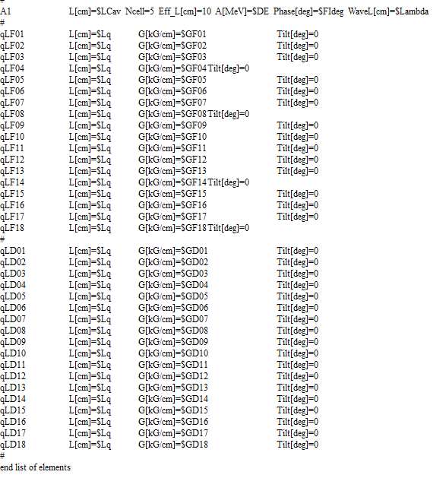
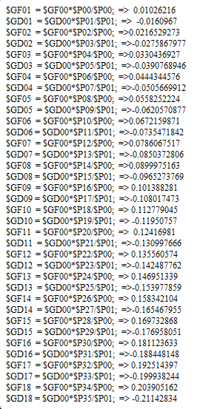
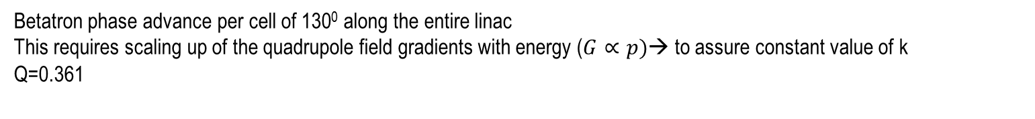
LINAC LAYOUT in OPTIM: Lattice description(3/3)
Gradient scaling
Betatron phase advance per cell of 130⁰ along the entire linac
This requires scaling up of the quadrupole field gradients with energy ($G∝p)$→ to assure constant value of k
Q=0.361

Slide 10
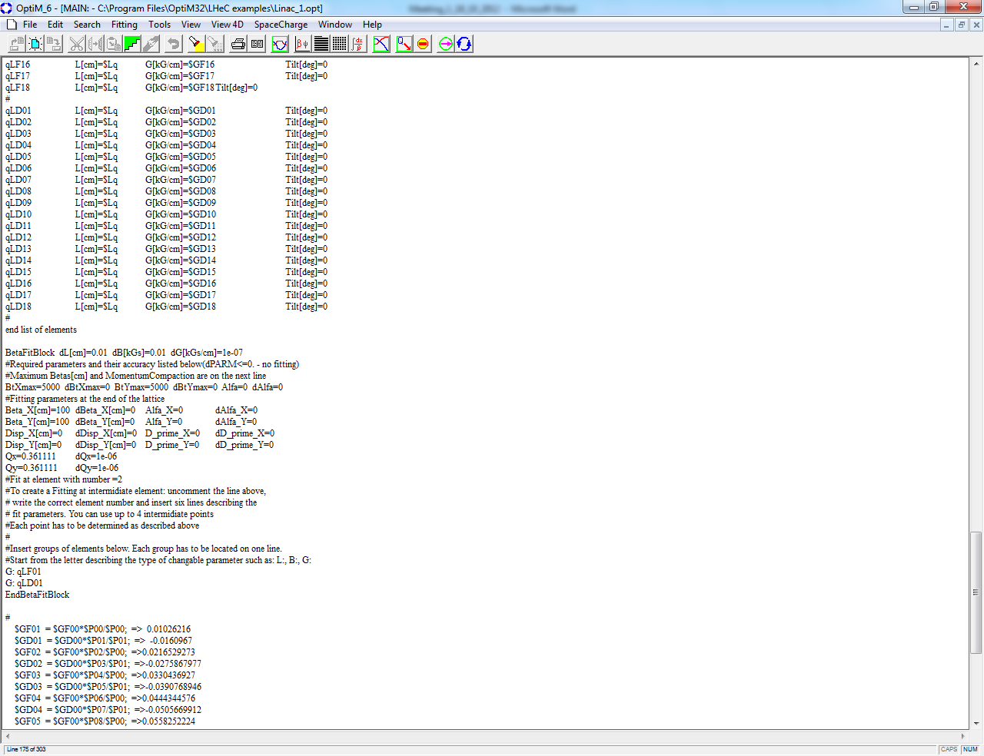
fitting of beta-functions, dispersion and momentum compaction
The program uses the steepest descend method with automatically chosen step. The initial values of steps for length, magnetic field and its gradient are determined here
Required parameters and their accuracy. To calculate the fitting error (which is minimized in the course of the fitting) the program uses the accuracy parameters for each of fitting parameters
Elements can be organized in groups so that the elements in each group are changed proportionally during fitting

Slide 11
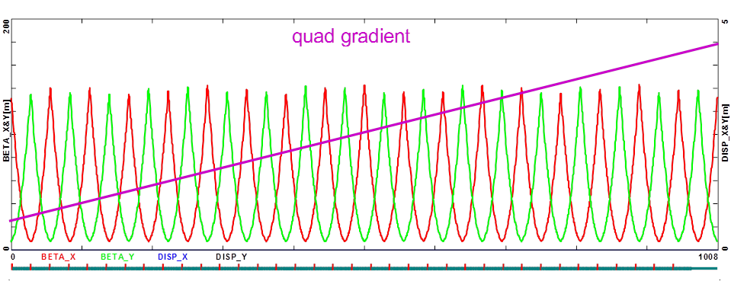
Optim output
130⁰
1 unit = 56m
1 unit = 56m

Slide 12
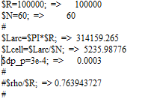
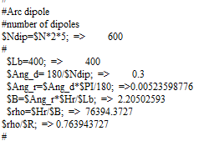
ARC OPTICS Layout in Optim (1/2)
MATH HEADER : numeric variables and calculation
Arc Radius = 1km
Cell number = 60
Arc Length = 3.14159km
Cell Length =52.35m
Total number of dipoles = 600
Dipole Length = 4m
B=p/(ρc)
Quad singlet + 5 Dipoles + Quads triplet + 5 Dipoles
1 cell

Slide 13
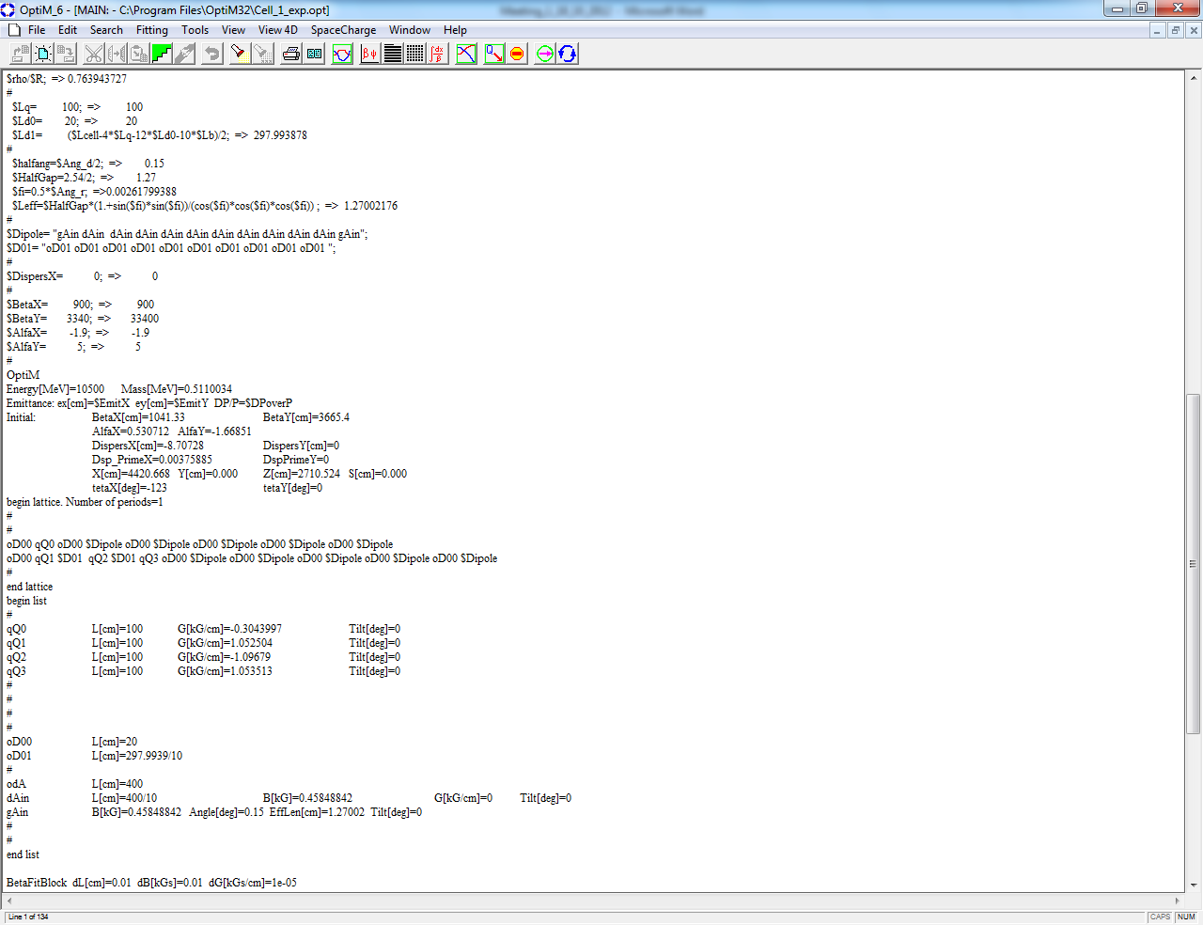
ARC OPTICS Layout in Optim (2/2)
Quad singlet + 5 Dipoles + Quads triplet + 5 Dipoles
1 cell
150
1.5
BETA_X&Y[m]
DISP_X&Y[m]
0
52.3599

Slide 14
ERL Test Facility

Slide 15
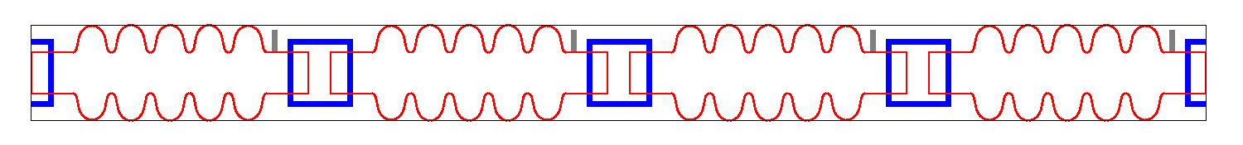
beam dynamics challenges for the
LHeC ERL which could be studied at the test facility
Multi-pass ERL optics tuning
Recirculative Beam Break Up
Ion accumulation, ion instabilities and ion clearing (?)
Electron beam stability in view of proton emittance growth (?)
SCL2
Dump
150-300 MeV ERL Layout
4 x 5 cell, 721 MHz
SCL1
5 MeV Injector
~6.5 m

Slide 16
LINAC :
Half Cryo Module → 4 Cavities
721.44 MHz RF, 5-cell cavity:
λ = 41.557 cm
L_{c} = 5l/2 = 103.89 cm
Grad = 18 MeV/m (18.7 MeV per cavity)
ΔE= 74.8 MV per Half Cryo Module
ARC 1 optics :
(80 MeV )
4 x 45° sector bends
Dipole + Quads triplet + Dipole + Quad singlet + Dipole +Quads triplet +Dipole
Dipole Length = 40cm B = 5.01 kG
Quadrupole Length = 10 cm
Q1 -> G[kG/cm] = -0.31 Q3 -> G[kG/cm] = -0.34
Q2 -> G[kG/cm] = 0.50 Q4 -> G[kG/cm] = -0.44
triplet: Q1 Q2 Q3
singlet: Q4
triplet: Q3 Q2 Q1
VERTiCAL
SPREADER
OPTICS:
Spreader for Arc 1 @ 80 MeV
2 Vertical steps (dipoles with
opposite polarity) and quads triplet
for hor. and vert. focusing
Spreader for Arc 3 @ 230 MeV
A vertical chicane plus and 2 quads
doublets
vertical step I
vertical step II
vertical chicane
Notes:
Correggere lambda

Slide 17
ARC 1 + vertical spreader and combiner optics
SCL2
Dump
150-300 MeV ERL Layout
4 x 5 cell, 721 MHz
SCL1
5 MeV Injector
~6.5 m
2-step vert. Spreader
Arc 1 optics
2-step vert. Recombiner

Slide 18


..and now what am I doing?
..going through many papers
..writing OptiM input files for ERL-TF in order to reproduce Alex Bogacz’s results!
Linac 1 input file
Arc 1 input file
Spreader/ combiner input file

Slide 19
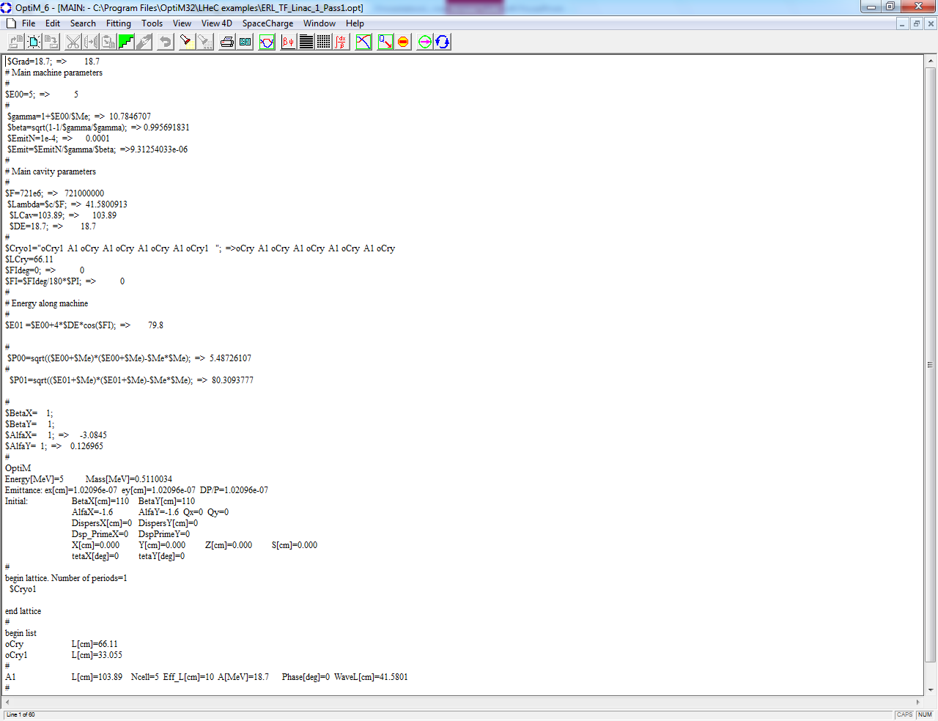
LINAC LAYOUT in OPTIM: Lattice description
721.4 MHz RF, 5-cell cavity:
λ = 41.557 cm
L_{c} = 5l/2 = 103.89 cm
Grad = 18 MeV/m (18.7 MeV per cavity)
ΔE= 74.8 MV per Half Cryo Module

Slide 20
..and what’s next?
..and what am I missing?
getting more comfortable with OptiM
writing OptiM input files for ERL-TF in order to reproduce Alex Bogacz ’s results
doing/understanding calculations on adverse effects in the arc optics design (cumulative emittance and momentum growth due to quantum excitations, momentum compaction, synchrotron radiation, etc.)
keep going through many papers
trying to understand all the beam dynamics challenges for the LHeC ERL in order to figure out parameters for the TF
Any comments and suggestions are welcomed
Thank you for your attention

Slide 21
Linac 1 − Multi-pass Optics
inj
12
5
Arc 1
BETA_X&Y[m]
DISP_X&Y[m]
5 MeV
0
0
BETA_X
BETA_Y
DISP_X
DISP_Y
6.8
0
80 MeV
Arc 2
12
5
Arc 3
BETA_X&Y[m]
DISP_X&Y[m]
0
0
155 GeV
0
BETA_X
BETA_Y
DISP_X
DISP_Y
7.4
230 MeV

Slide 22
Linac 1 − Multi-pass ER Optics
12
inj
Arc 1
Arc 2
Arc 3
Arc 4
BETA_X&Y[m]
0
0
BETA_X
BETA_Y
29
5 MeV
80 MeV
155 GeV
230 MeV
305 MeV

Slide 23
Linac 2 − Multi-pass ER Optics
12
Arc 2
Arc 4
Arc 3
Arc 1
dump
BETA_X&Y[m]
0
0
BETA_X
BETA_Y
29
305 MeV
230 MeV
155 GeV
80 MeV
5 MeV

Slide 24
Linac 1 and 2 − Multi-pass ER Optics
Linac 1
Linac 2

Slide 25
Arc 1 Optics – FMC Lattice
10
80 MeV
2
4×45⁰ sector bends
Q_{x,y} = 1.25
BETA_X&Y[m]
DISP_X&Y[m]
0
-2
0
BETA_X
BETA_Y
DISP_X
DISP_Y
7.09188
triplet: Q1 Q2 Q3
singlet: Q4
triplet: Q3 Q2 Q1
quadrupoles (10 cm long)
Q1 G[kG/cm] = -0.31
Q2 G[kG/cm] = 0.50
Q3 G[kG/cm] = -0.34
Q4 G[kG/cm] = -0.44
dipoles (40 cm long)
B = 5.01 kGauss

Slide 26
Arc 1 Optics – Isochronous Lattice
10
2
BETA_X&Y[m]
DISP_X&Y[m]
0
-2
0
BETA_X
BETA_Y
DISP_X
DISP_Y
7.09188
Synchronous acceleration in the linacs ⇨ Isochronous optics:

Slide 27
Arc 3 Optics – FMC Lattice
10
230 MeV
2
8×22.5⁰ sector bends
Q_{x,y} = 1.25
BETA_X&Y[m]
DISP_X&Y[m]
0
-2
0
BETA_X
BETA_Y
DISP_X
DISP_Y
7.07065
triplet: Q1 Q2 Q3
singlet: Q4
triplet: Q3 Q2 Q1
quadrupoles (15 cm long)
Q1 G[kG/cm] = -0.47
Q2 G[kG/cm] = 1.43
Q3 G[kG/cm] = -1.14
Q4 G[kG/cm] = -0.34
dipoles (40 cm long)
B = 7.47 kGauss

Slide 28
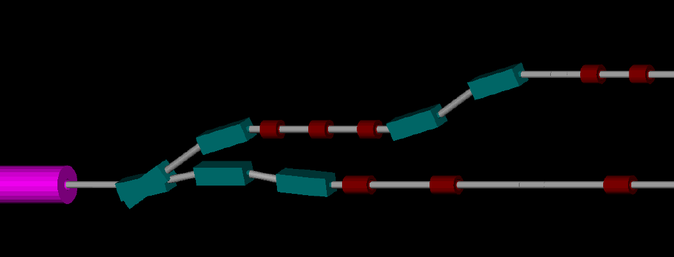
Switchyard - Vertical Separation of Arcs
Arc 1 (80 MeV)
Arc 3 (230 MeV)

Slide 29
Vertical Spreaders - Optics
Spr. 1
Spr. 3
20
1
20
1
BETA_X&Y[m]
DISP_X&Y[m]
BETA_X&Y[m]
DISP_X&Y[m]
0
-1
0
-1
0
BETA_X
BETA_Y
DISP_X
DISP_Y
3.92452
0
BETA_X
BETA_Y
DISP_X
DISP_Y
3.80042
vertical step I
vertical step II
vertical chicane
Alex Bogacz ERL-TF at CERN Mtg, Jefferson Lab, August 21, 2012

Slide 30
Arc 1 Optics (80 MeV)
20
2
Isochronous Arc
BETA_X&Y[m]
DISP_X&Y[m]
0
-2
0
BETA_X
BETA_Y
DISP_X
DISP_Y
14.9409
2-step vert. Spreader
180⁰ Arc
2-step vert. Recombiner
‘Arc 2’ = 2 × ‘Arc 1’
Spr. dipoles:
30⁰ bends (1 rec. + 3 sec.)
Lb = 30 cm
B = 5 kGauss
Arc dipoles :
4×45⁰ bends(sec.)
Lb = 40 cm
B = 5 kGauss
Rec. dipoles:
30⁰ bends (3 sec. + 1 rec.)
Lb = 30 cm
B = 5 kGauss
quads: Lq = 10-15 cm G ≤ 0.6 kGauss/cm

Slide 31
Arc 3 Optics (230 MeV)
20
2
Isochronous Arc
BETA_X&Y[m]
DISP_X&Y[m]
0
-2
0
BETA_X
BETA_Y
DISP_X
DISP_Y
14.6715
Chicane vert. Spreader
180⁰ Arc
Chicane vert. Recombiner
‘Arc 4’ = 4/3 × ‘Arc 3’
Spr. dipoles:
10⁰ -20⁰ -10⁰ bends ( rec.)
Lb = 30 cm
B = 5-10 kGauss
Arc dipoles :
8×22.5⁰ bends(sec.)
Lb = 40 cm
B = 5 kGauss
Rec. dipoles:
10⁰ -20⁰ -10⁰ bends ( rec.)
Lb = 30 cm
B = 5-10 kGauss
quads: Lq = 10-15 cm G ≤ 1.2 kGauss/cm

