Slide 1
W+Z Physics with ATLAS and CMS
DRAFT1.1-20.9.11
The talk has 20+5min and there are further LHC talks too/before.
Contact max.klein@cern.ch
Max Klein
For the ATLAS and CMS Collaborations
International Symposium on Multiparticle Dynamics, ISMD11, Hiroshima, Japan, 26.9.2011

Slide 2
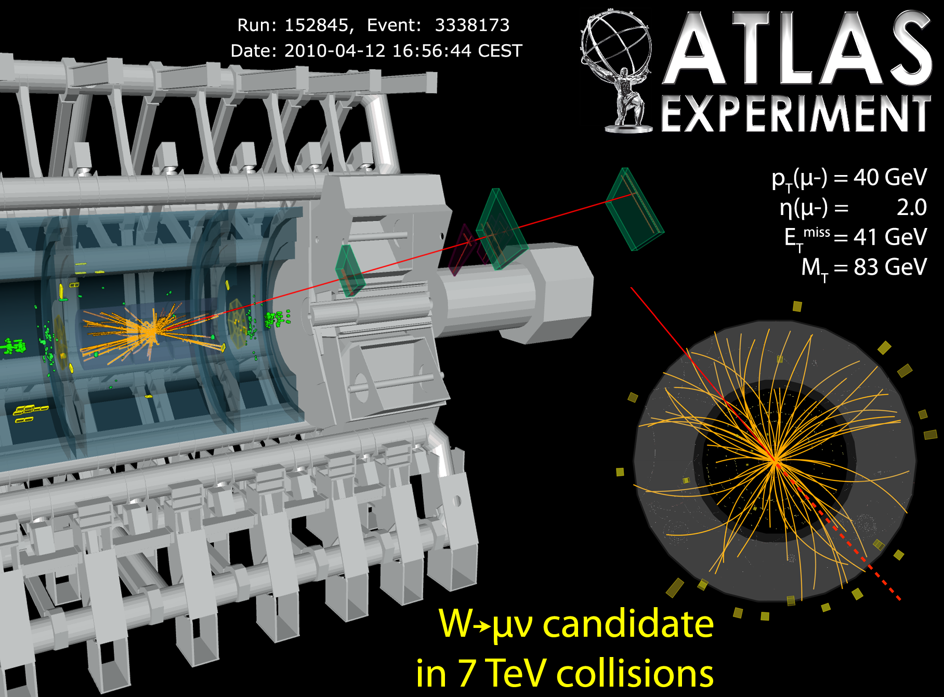
W and Z events in ATLAS
Clear signature, copious: about 1M W± and 100k Z in e+μ per 1fb⁻¹ luminosity
p_{T}^{l} > 20 GeV, p_{T}^{ν} >25 GeV, m_{T}>40 GeV p_{T}^{l} > 20 GeV, 66< M_{ll}< 116 GeV |η_{l}|<2.5 (|η_{e}|<4.9)

Slide 3
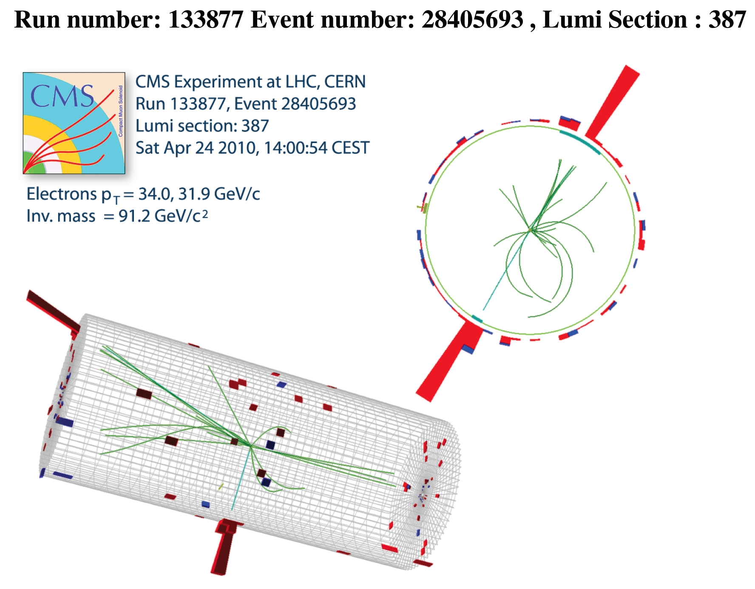
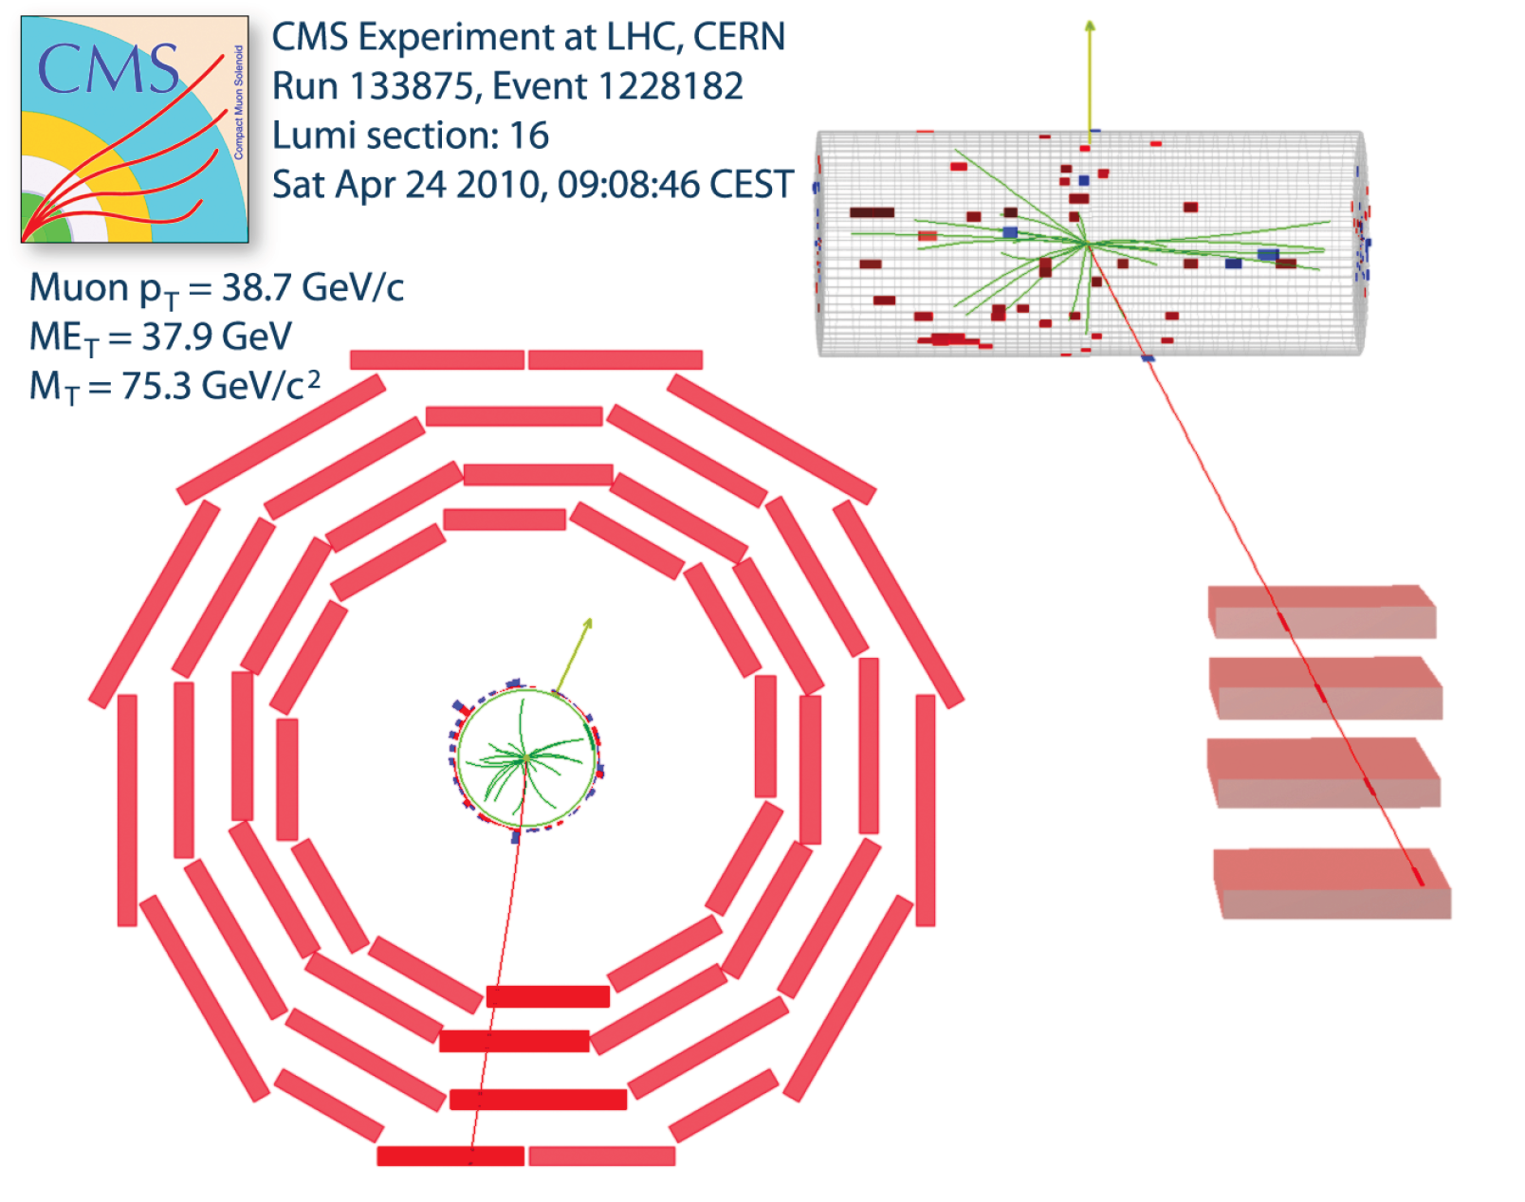
W and Z events in CMS
Clear signature and as copious as in ATLAS..
p_{T}^{l} > 25 GeV, p_{T}^{ν} >25 GeV, |η_{l}|<2.1, m_{T}>40 GeV p_{T}^{l} > 25 GeV, 60< M_{ll}< 120 GeV, |η_{l}|<2.1

Slide 4
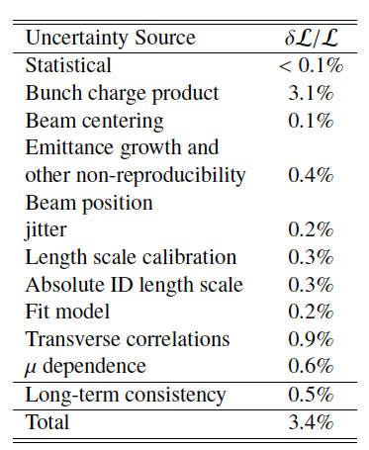
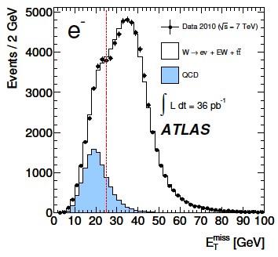
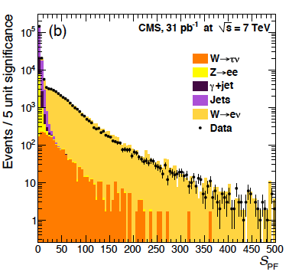
why W+Z with the LHC?
Old “folklore”
Monitor the Luminosity
2. Understand Detector: Calibration, alignment, MET:
ATLAS-CONF-2011-011
Beam separation scan (accurate to ATLAS 3.4%, CMS 4.0% in 2010 )
from new ATLAS WZ paper:
from recent CMS MET paper:
arXiv:1109:xxxx → PRD
arXiv:1106:5048 → JINST

Slide 5
why W+Z with the LHC?
Present Reasons
Constrain Parton Densities [dσ/dy,η,WZ+c,b]
Explore QCD in new kinematic domain [p_{T}(W,Z), WZ+jets]
Perform precision electroweak measurements [Pol_{W},sin²Θ,TGC]
H → WW and H→ ZZ→ 4l and H → ττ as Z → ττ
Here: focus on new high precision inclusive WZ cross section data
and present first results on W+c,b and p_{T}^{Z,W}
- W,Z + jets: S.Shimizu (ATLAS), A.Hinzmann (CMS)
- With high statistics, genuine electroweak measurements will become more precise
- Higgs: C.Bini (ATLAS), G.Schott (CMS)
- τ Physics: S.Dhaliwal (ATLAS)

Slide 6
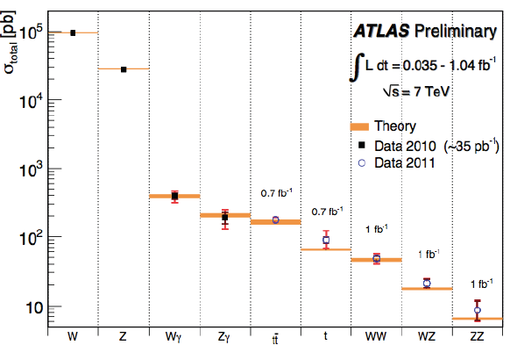
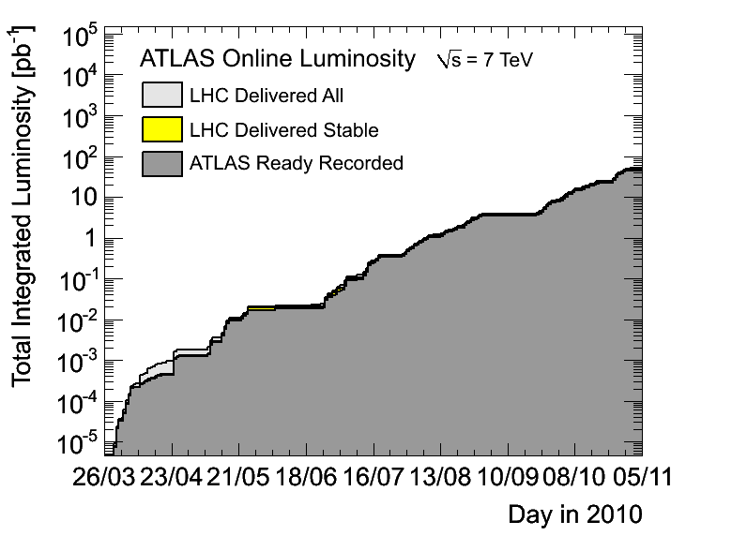
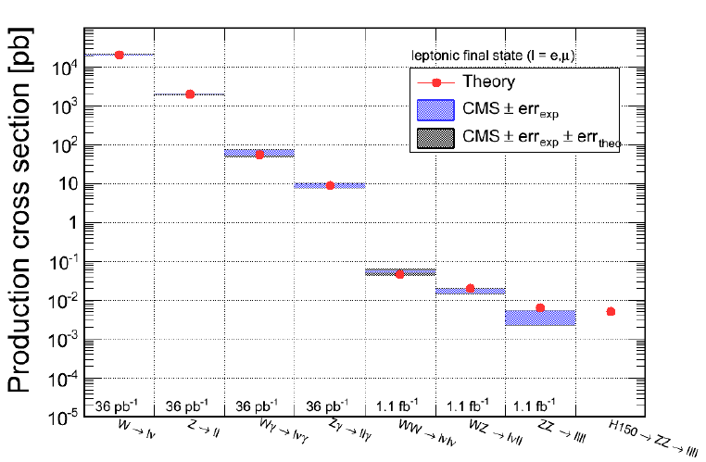
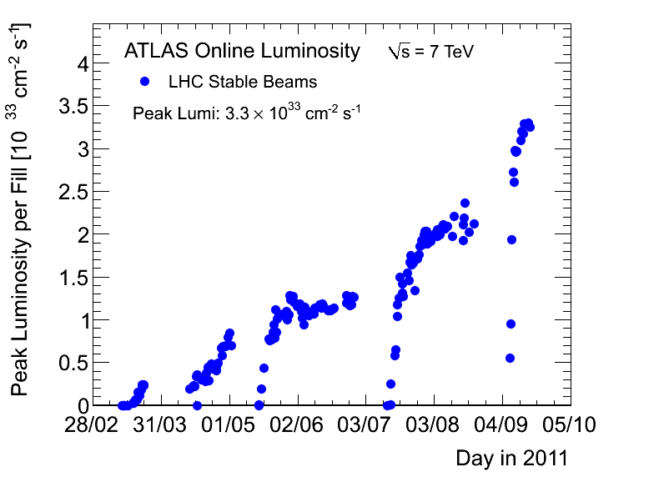
WZ Cross Sections with ATLAS and CMS
Total cross sections
2010
Current
publications
differential
W,Z cross
sections
35pb⁻¹: 270k W± 24k Z (in e+μ decay channels)
Total cross sections * Branching fracctions
2011
2d-differential
W,Z cross
sections
Precise
associate
cross sections
Note
HUGE L_{peak}
So far ATLAS and CMS collected 3.1 fb⁻¹ each

Slide 7
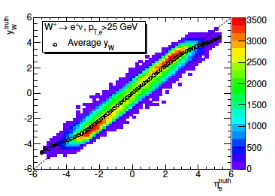
Drell-Yan and Deep Inelastic Scattering
for W use pseudo rapidity
P:propagator
Z (NC) channel
W± (CC) channel
New constraints to PDFs
low mass to access low x

Slide 8
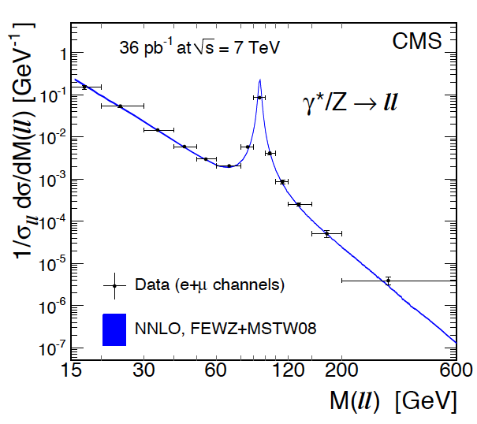
Drell-Yan Spectrum in Neutral Currents
CMS: arXiv:1108.0566 (August 2011)
Normalised DY spectrum measured with 2010 data
to 6% (~20GeV), 3% (Z peak) and 20% at highest M
MK911
Low and high mass dominated by Z production
γZ interference +- 5% left and right from Z peak
M_{Z’} > 2.xx TeV (ATLAS), 2.yy TeV (CMS)

Slide 9
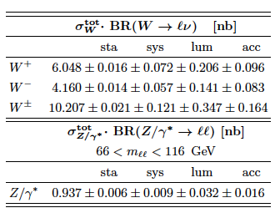
Total W+Z Cross Sections in l=e,μ Decay Mode
ATLAS
CMS
66<M<116 GeV
60<M<120 GeV
arXiv:1109:xxxx → PRD
arXiv:1107:4789 → JHEP
Electron and muon, ATLAS and CMS data are consistent.
Cross sections measured to 1% systematic uncertainty.
Acceptance uncertainty (1-2%) due to extrapolation to full phase space.

Slide 10
Total WZ Cross Sections vs NNLO Thy - CMS
Good agreement with NNLO (FEWZ+MWST08). Exp uncertainty dominated by Luminosity

Slide 11
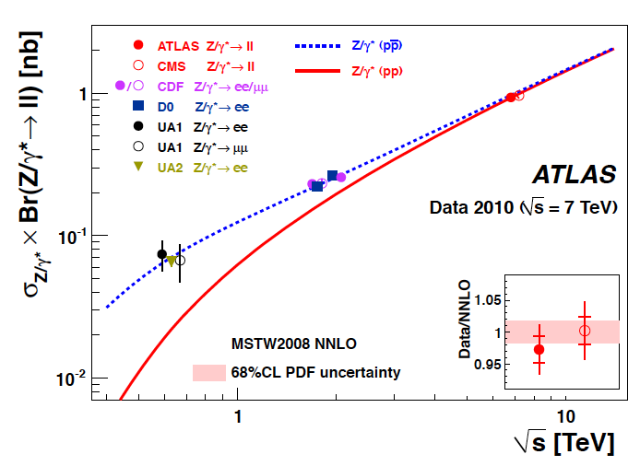
Total Z→ll Cross Sections vs √s=2E_{p}

Slide 12
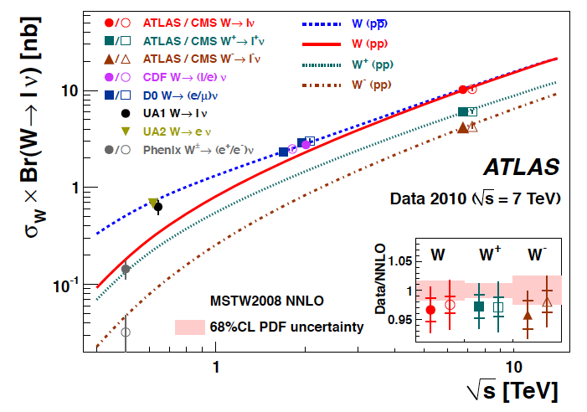
Total W→lν Cross Sections vs √s=2E_{p}

Slide 13
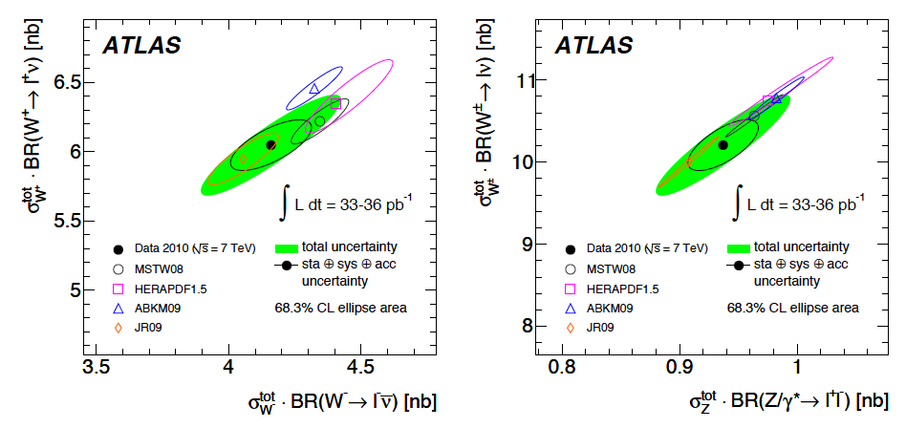
Total W-Z Cross Sections
Experimental correlation of cross sections dominated by luminosity.
Theoretical correlations dominated by PDF correlations,
e.g. W/Z for symmetric sea is about constant → very slim ellipses
arXiv:1109:xxxx → PRD

Slide 14
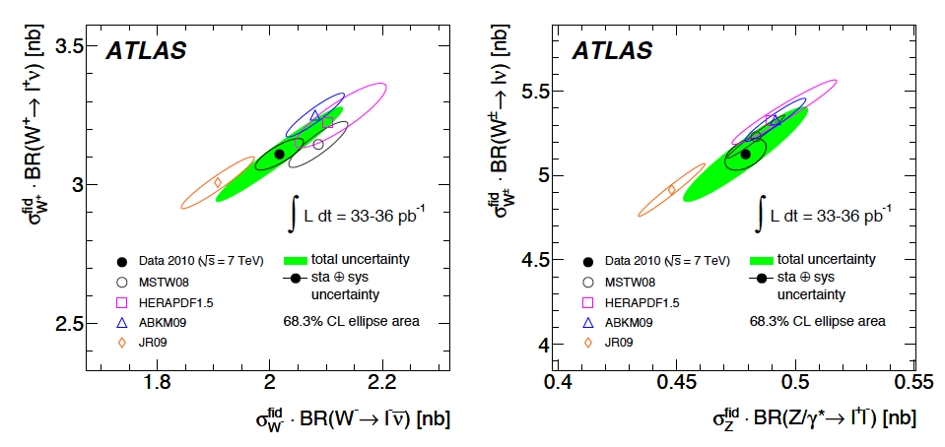
Integrated W-Z Cross Sections (in fiducial regions)
Measurement uncertainty reduced as acc (thy) error becomes negligible.
Theory errors taken as 68% for ellipse. PDF uncertainties only, which are
defined differently by fit groups. Comparison to NNLO required (and
possible with FEWZ and DYNNLO used) to reduce scale uncertainty effect.
arXiv:1109:xxxx → PRD
Cf also recent NNPDF NNLO paper (August11)

Slide 15
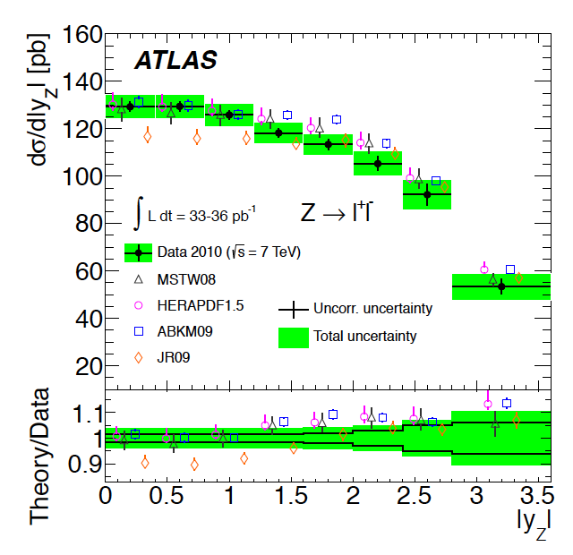
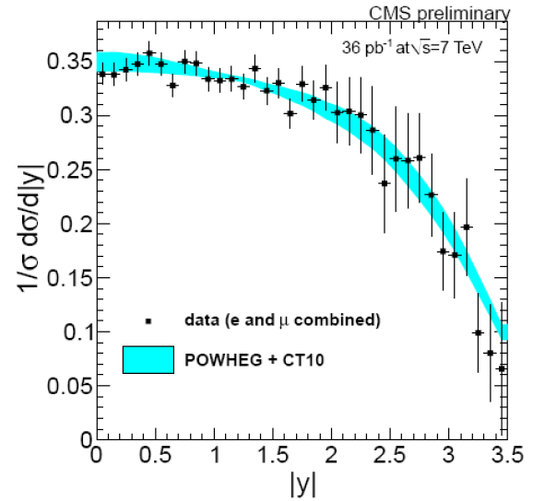
Differential Z Cross Section
Shape comparison of y_{Z}
with NLO (POWHEG, CT10)
Absolute differential cross section measurement
Experimental precision 2-6% plus 3.4% for L
Compared to NNLO in fiducial region. JR09 low
at central rapidity. Visible sensitivity to PDF’s
CMS PAS EWK 10-010 (March 2011)
arXiv:1109:xxxx → PRD

Slide 16
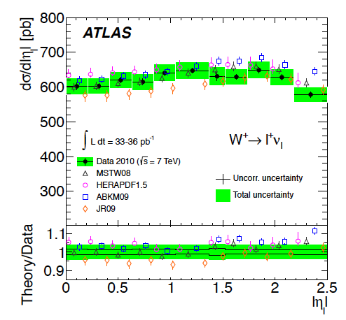
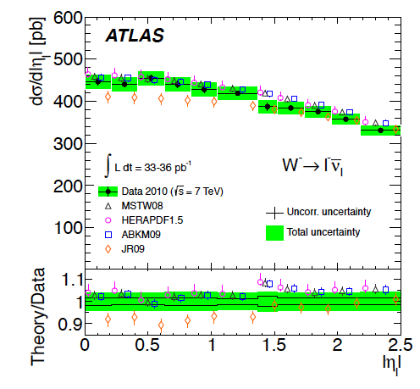
Differential W⁺ and W⁻ Cross Sections
2% precise measurement over full range of pseudorapidity, in fiducial region
comparison with NNLO (FEWZ/DYNNLO), as for Z: no weak corrections applied.
Sensitivity to PDFs apparent (JR09 low at low η, ABKM09 high at large η)
arXiv:1109:xxxx → PRD

Slide 17
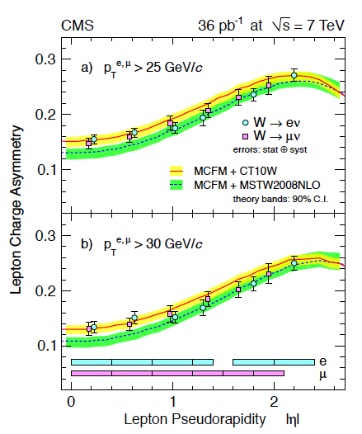
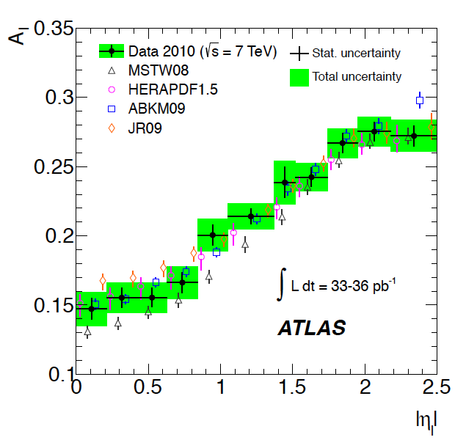
W Charge Asymmetry
Electron and muon information combined
Less information than in separate cross
sections and their correlations (here
ABKM09 appears to be best, cf previous slide)
CMS: separate e – μ comparison
Good agreement with NLO PDFs
arXiv:1109:xxxx → PRD

Slide 18
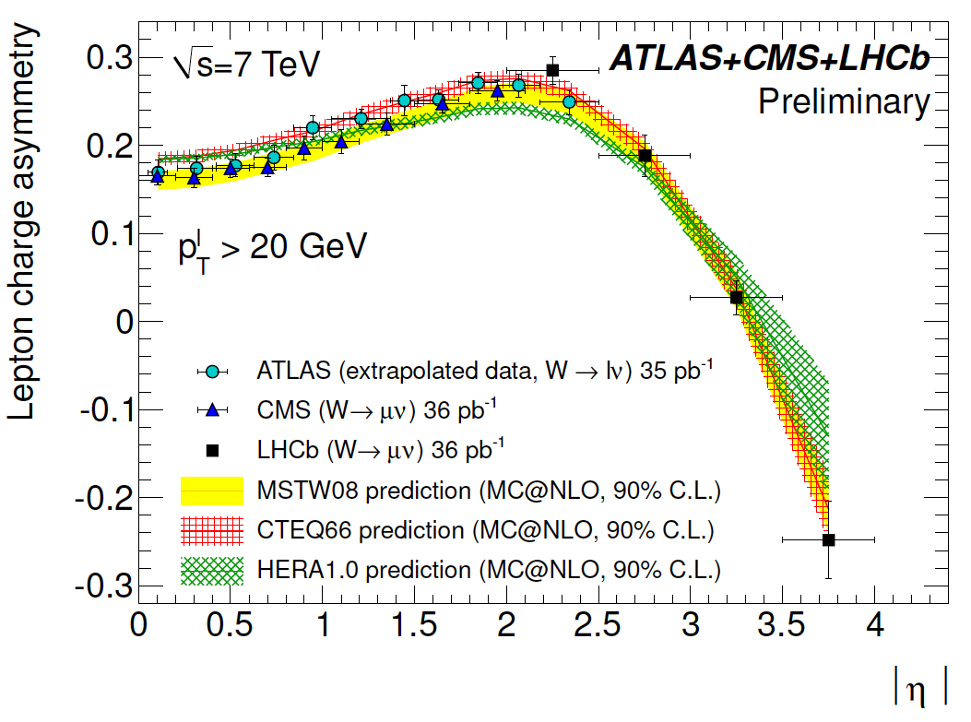
W Charge Asymmetry from LHC
Asymmetries evaluated for full phase space (with p_{T}^{l} > 20 GeV) for comparison
of 3 experiments. LHCb extending most forward. Theory to NLO with 90% CL.
ATLAS-CONF-2011-129 (August 2011)

Slide 19
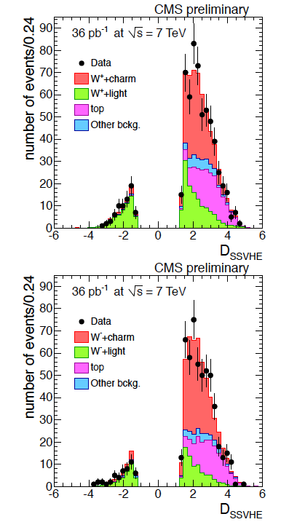
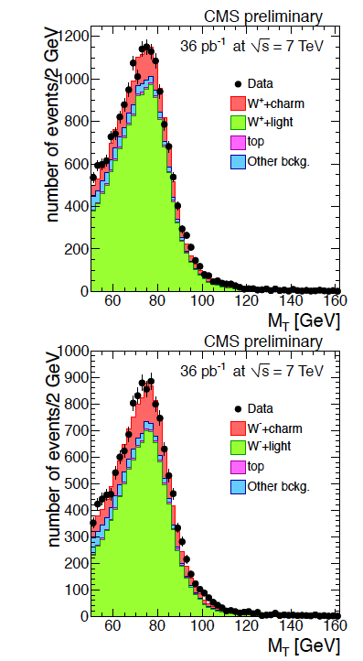
First Measurement of W+c
Sensitivity to (anti) strange distribution
W →μν
Lifetime tag
Measure:
R_{c}± = (W⁺+cbar)/(W⁻+c)
R_{c} = (W+c)/(W+jet)
Transverse mass in W+1 jet
SSVHE: 2nd vtx with >= 2 tracks

Slide 20
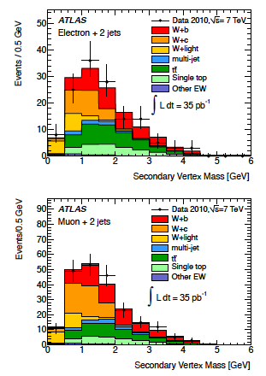
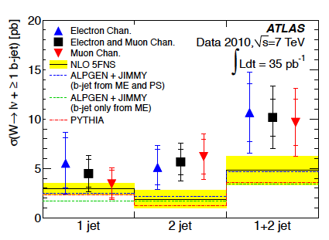
First Measurement of W+b
NLO QCD + heavy quarks in the initial state
CDF: 2.9σ above thy
[First measurement of b .. PRL 104(2010)131801]
ATLAS: 1.5σ above but consistent
arXiv:1109:1470 → PLB

Slide 21
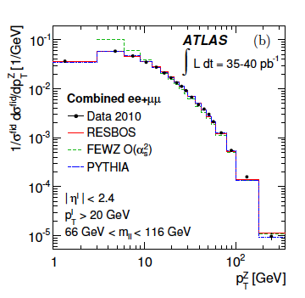
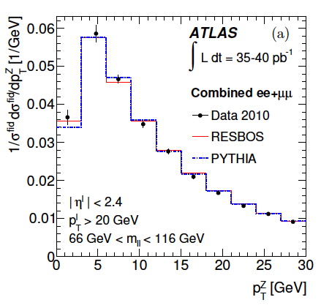
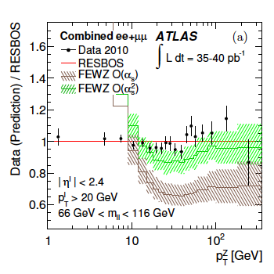
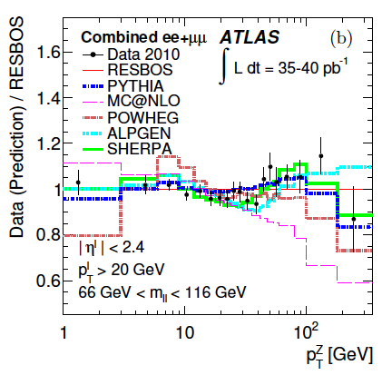
p_{T}^{Z}
Unfolded cross section vs p_{T}^{Z}
Low p_{T}:multiple soft g radiation
and non-perturbative effects
(MC tuning region)
RESBOS, SHERPA, ALPGEN ok
PYTHIA with ATLASMC10 ok too.
POWHEG low, FEWZ divergent..
MC@NLO different shape
High p_{T}: pQCD test, multijets
FEWZ to α_{s}² ok for p_{T}> 10 GeV
ATLAS
arXiv:1107:2381 subm to PLB

Slide 22
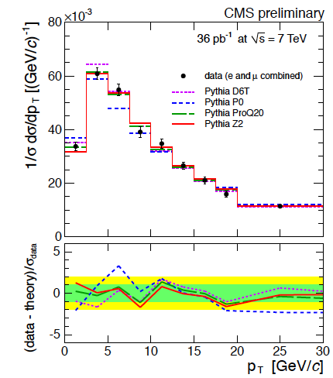
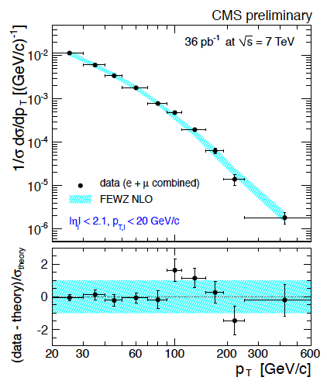
p_{T}^{Z}
PYTHIA tunes vs Z transverse momentum
POWHEG found low at low p_{T}Z too (as ATLAS)
Shape of p_{T}^{Z} distribution in agreement with
FEWZ at O(α_{s}) at high transverse momentum
CMS PAS EWK 10-010 (March 2011)

Slide 23
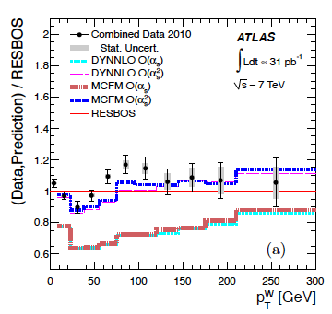
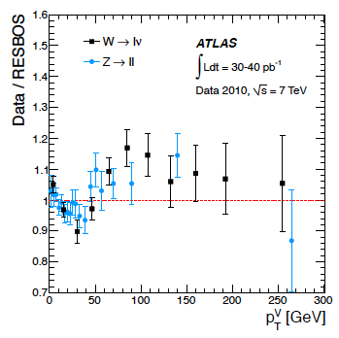
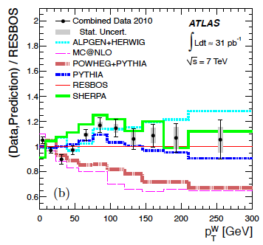
p_{T}^{W}
Comparison of W and Z p_{T}
Needs
α_{s}²
MCs
Similar to
p_{T}^{Z}
RESBOS, SHERPA, ALPGEN ok
PYTHIA with ATLASMC10 ok too.
POWHEG low, FEWZ divergent..
MC@NLO different shape
p_{T}^{W} from had. recoil
i.e. E_{calo} – E_{l}
p_{T}^{Z} from lepton pair
A step towards M_{W} …
arXiv:1108:6308 subm to PRD

Slide 24
Summary
To be written

Slide 25
backup

Slide 26
W Polarisation

Slide 27
sin²Θ

Slide 28
WW

