Slide 1
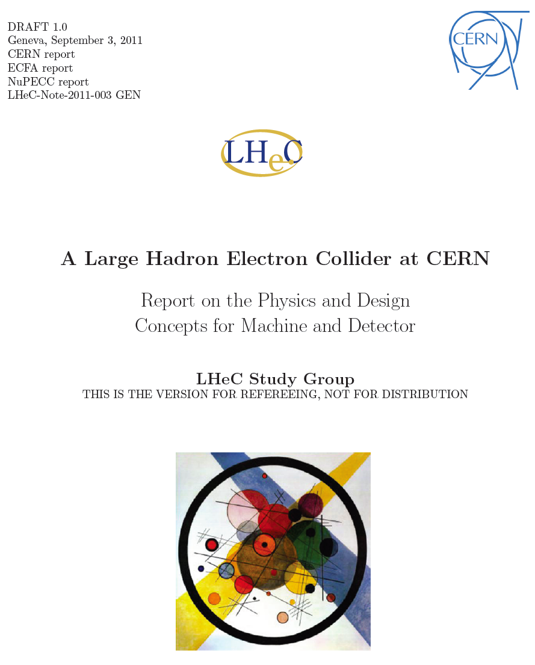
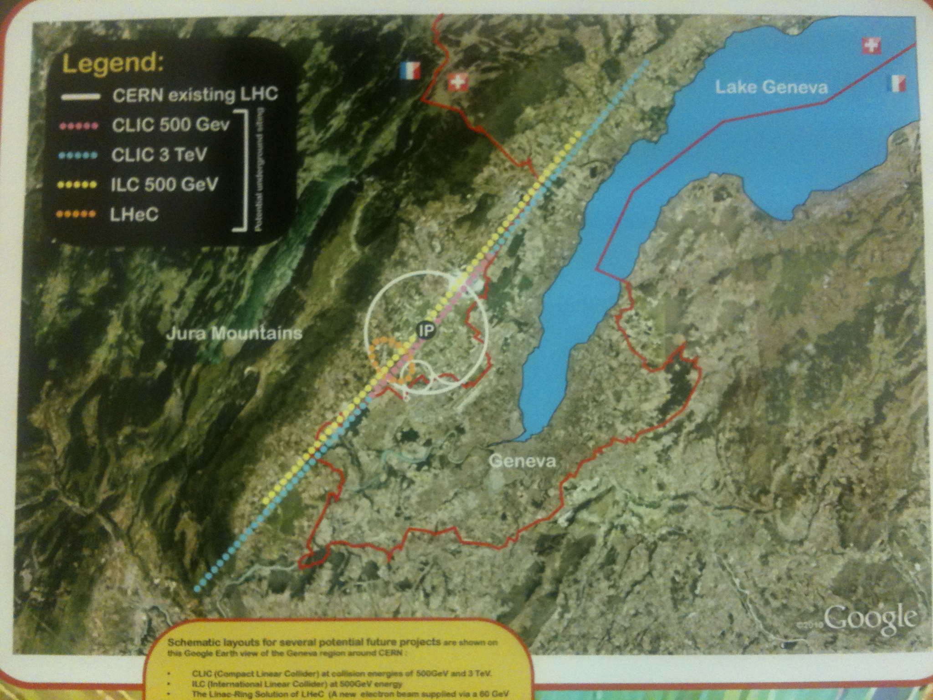
title
The LHeC Project at CERN
Design Concepts for the LHeC [WEODA03]
Max Klein (U.Liverpool+CERN)
for the LHeC Study Group
TUPC017
Civil Engineering Studies for Major Projects after LHC
Considerations
Physics
Accelerator
Detector
Time Schedule
IPAC, San Sebastian, 7.9.11 - Dedicated to Gus Weber (1925-2011)

Slide 2
The Fermi Scale [1985-2010]
pp
b quark
top quark
M_{W}, H?
Tevatron
ep
e⁺e⁻
The Standard
Model Triumph
M_{Z} , sin² Θ
3 neutrinos
h.o. el.weak (t,H?)
gluon
h.o. strong
c,b distributions
high parton densities
LEP/SLC
HERA

Slide 3
Two Options
Ring-Ring
Power Limit of 100 MW wall plug
“ultimate” LHC proton beam
60 GeV e± beam
L = 2 10³³ cm⁻²s⁻¹ → O(100) fb⁻¹
LINAC Ring
Pulsed, 60 GeV: ~10³²
High luminosity:
Energy recovery: P=P₀/(1-η)
β*=0.1m
[5 times smaller than LHC by
reduced l*, only one p squeezed
and IR quads as for HL-LHC]
L = 10³³ cm⁻²s⁻¹ → O(100) fb⁻¹
Synchronous ep and pp operation (small ep tuneshifts)
The LHC p beams provide 100 times HERA’s luminosity

Slide 4
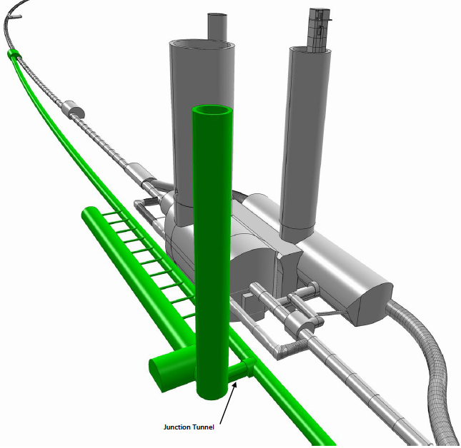
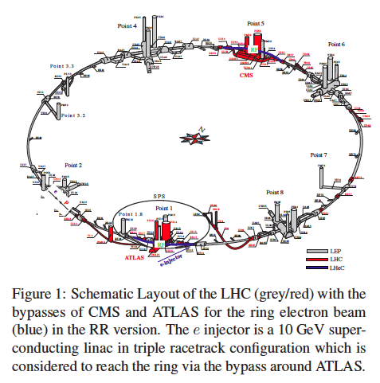
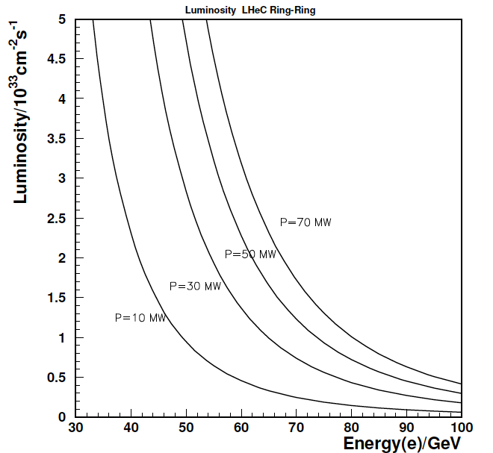
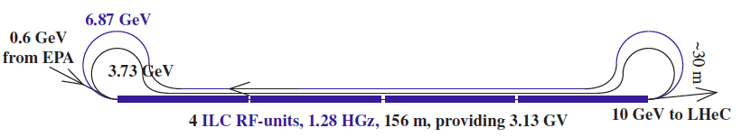
e Ring- p/A Ring
10 GeV injector

Slide 5

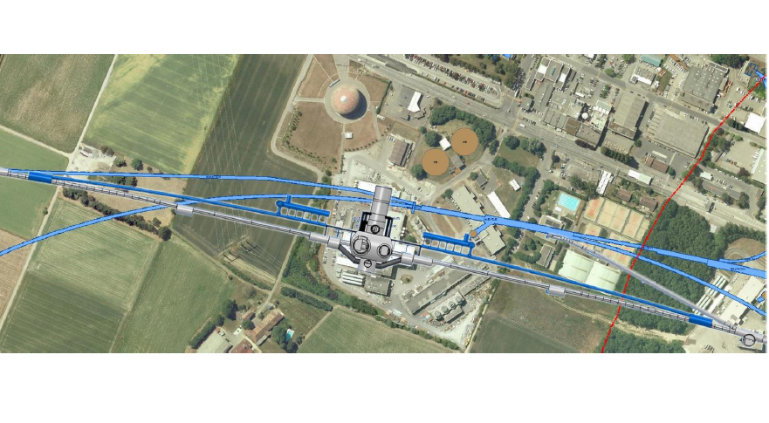
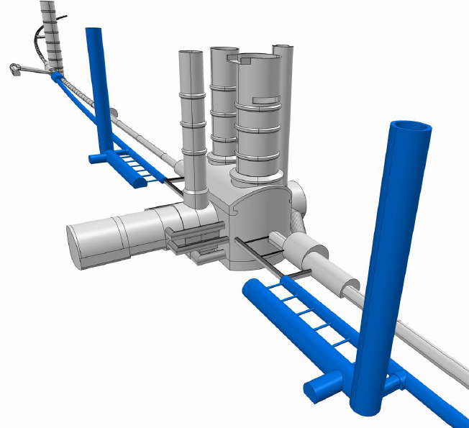
Bypassing ATLAS
For the CDR the bypass concepts
were decided to be confined to
ATLAS and CMS

Slide 6

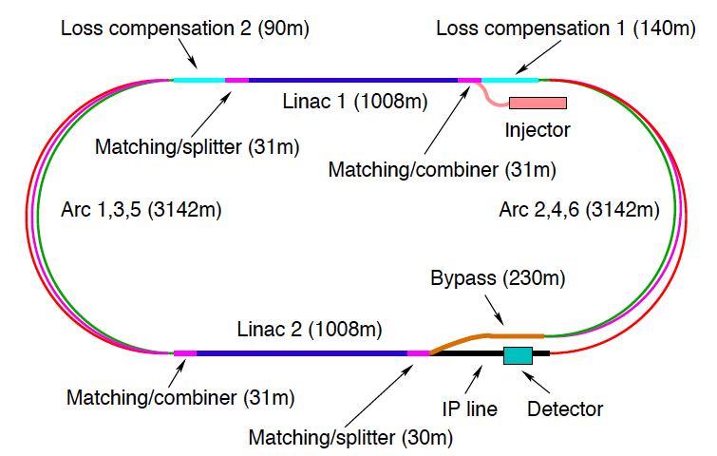
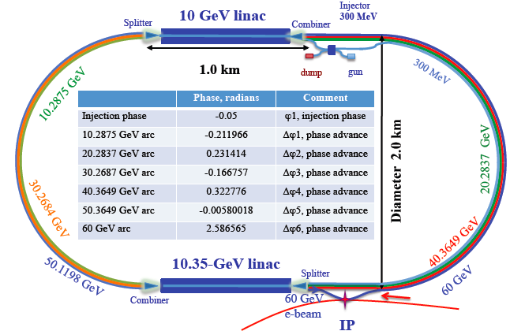
60 GeV Energy Recovery Linac
CERN 1
CERN 2
Jlab
BNL
Two 10 GeV energy recovery Linacs, 3 returns, 720 MHz cavities

Slide 7
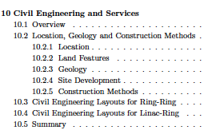
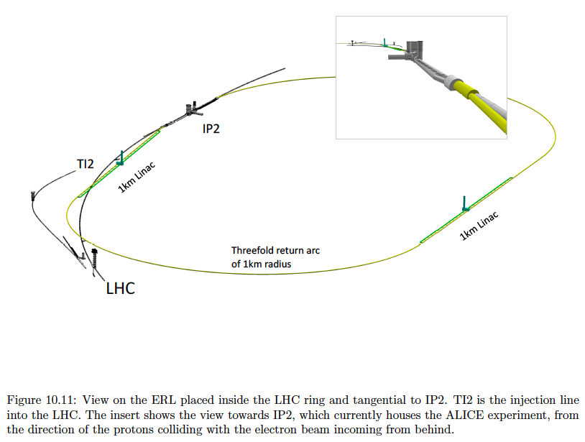
U_{LHeC}=U_{LHC}/3 : 1.5 x HERA
944 cavities
59 cryo modules per linac
721 MHz
20 MV/m CW
Multibunch wakefields - ok
Emittance growth - ok
[ILC 10nm, LHeC 10μm]
36σ separation at 3.5m - ok
Fast ion instability - probably ok
with clearing gap (1/3)

Slide 8
The TeV Scale [2010-2035..]
pp
W,Z,top
Higgs??
New Particles??
New Symmetries?
LHC
ep
e⁺e⁻
New Physics
ttbar
Higgs??
Spectroscopy??
High Precision QCD
High Density Matter
Substructure??
eq-Spectroscopy??
ILC/CLIC
LHeC

Slide 9
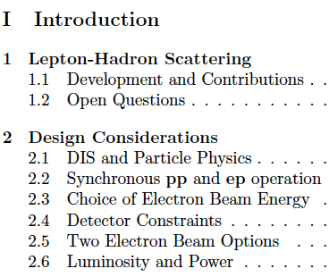
Why differ leptons from quarks? (Leptopartons)
Higgs? (production via gg (SM), bb(MSSM), quartic selfcoupling)
Mapping of the Gluon Field (next slide)
Non pQCD – 10 dim string theory (BFKL, odderon)
Ultimate precision of α_{s} and sin²Θ (0.1%, μ dependence)
Determination of ALL quark distributions
Confinement?? (Diffraction)
Generalised parton distributions (DVCS)
DGLAP → BFKL? (saturation of gluon density)
Structure of the neutron (no eD at HERA)
Partons in nuclei (4 orders of magnitude extended range)
New singly produced states (e*)
Unfolding of Contact interaction effects (up to 50 TeV)
…
The LHeC has an outstanding, unique programme,
which is complementary to the LHC. It requires:
High energy, high luminosity, polarised e±, p, D, A.
The LHC provides all of that if complemented
by an intense, high energy electron beam. This
determines the schedule, and the site is no question.
Default energy: E_{e}=60 GeV
So far LQ limits ~0.5 TeV
Q² >> M_{Z}²
Gluon saturation at x ~10⁻⁵
in the DIS region Q² >M_{p}²
Synchrotron radiation ~ E_{e}⁴
Cost and Luminosity:
L = 100 L_{HERA}, Q² and 1/x = 20 HERA
[LHC in 2014 may affect that choice.]

Slide 10
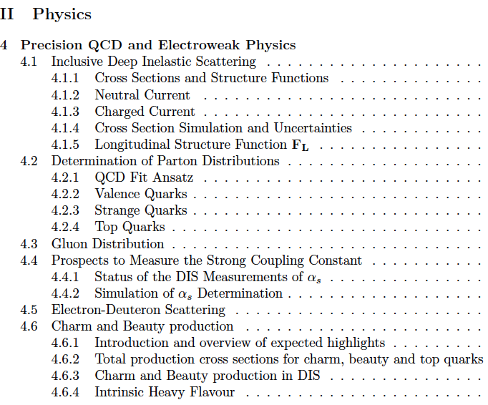
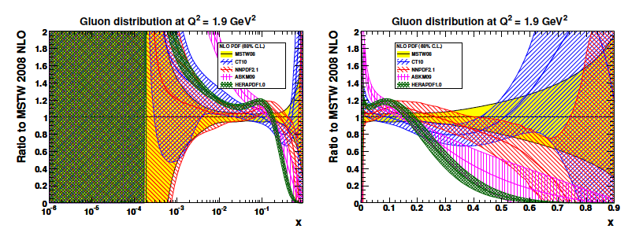
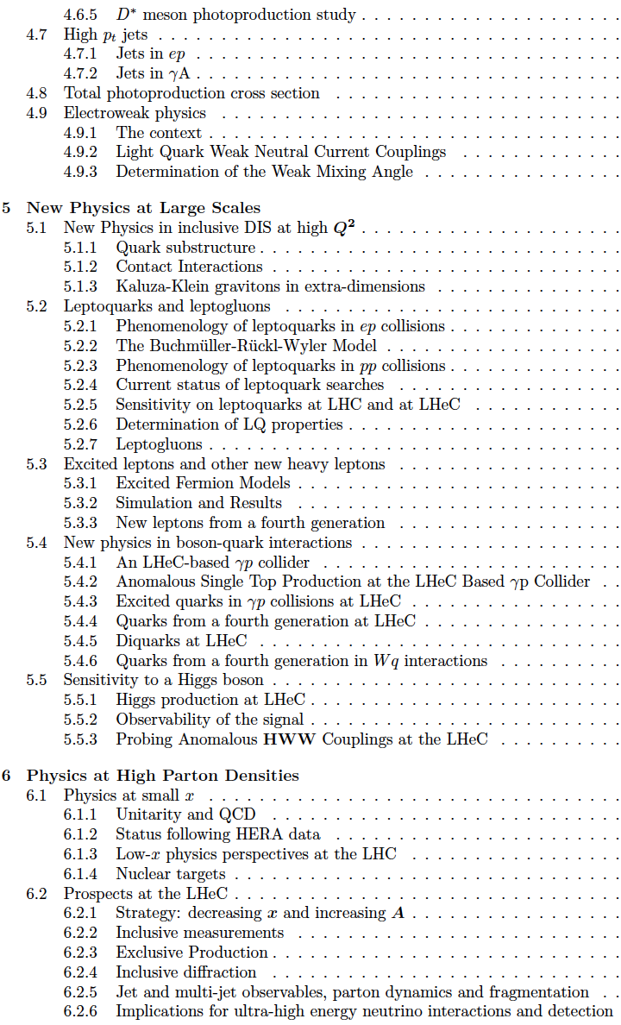
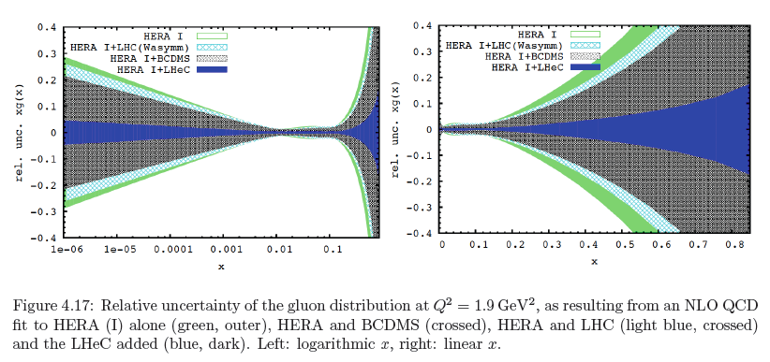
now
then
Precision measurement of gluon density to extreme x – α_{s}
Low x: saturation? radical change of understanding
High x: xg and valence quarks most crucial for new states
Gluon in Pomeron, odderon, photon, nuclei.. Local spots in p?
Heavy quarks intrinsic or only gluonic

Slide 11
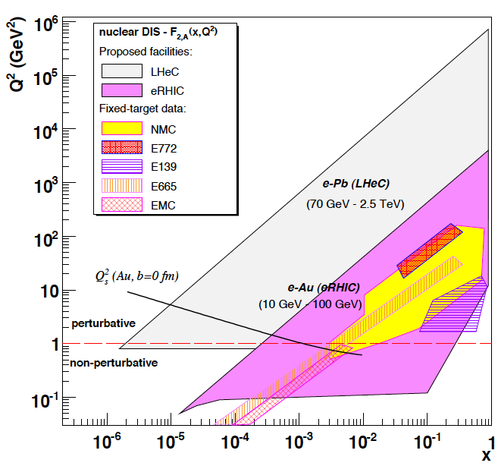
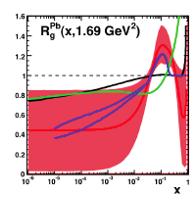
Electron-Ion Scattering: eA → eX
Qualitative change of behaviour
- Bb limit of F₂
Saturation of cross sections amplified
with A^{1/3}
Rise of diffraction to 50%?
partons in nuclei – widely unknown
gluon in p to lead
Q² = 4momentum transfer² Bjorken x: fraction of p’s momentum
Extension of kinematic range by 3-4 orders of
magnitude into saturation region (with p and with A)

Slide 12



















LHeC Accelerator Design: Participating Institutes
TOBB ETU
KEK

Slide 13
TUPC017 Civil Engineering Studies for Major Projects after LHC
John Andrew Osborne, Frederic Magnin, Eliseo Perez-Duenas
TUPC045 Recirculating Electron Linacs (REL) for LHeC and eRHIC
Dejan Trbojevic, Joanne Beebe-Wang, Yue Hao, Dmitry Kayran,
Vladimir N. Litvinenko, Vadim Ptitsyn, Nicholaos Tsoupas
TUPC054 LHeC ERL Design and Beam-dynamics Issues
Alex Bogacz, Ilkyoung Shin, Daniel Schulte, Frank Zimmermann
WEODA03 Design Concepts for the Large Hadron Electron Collider
Max Klein for the LHeC Study Group
WEPZ013 Design Status of LHeC Linac-Ring Interaction Region
Rogelio Tomas, Jose Luis Abelleira, Stephan Hans Russenschuck,
Frank Zimmermann, Nathan Rogers Bernard
THPZ014 LHeC Lattice Design
Miriam Fitterer, Oliver Sim Bruening, Helmut Burkhardt,
Bernhard Johannes Holzer, John M. Jowett, Karl Hubert Mess,
Thys Risselada, Anke-Susanne Mueller, Max Klein
THPZ015 Synchrotron Radiation in the Interaction Region for a Ring-Ring and Linac-Ring LHeC
Nathan Rogers Bernard, Bernhard Johannes Holzer, Rogelio Tomas,
Frank Zimmermann, Peter Kostka, Max Klein, Boris Nagorny,
Uwe Schneekloth, Robert Appleby, Luke Thompson
THPZ016 Interaction Region Design for a Ring-Ring LHeC
Luke Thompson, Bernhard Johannes Holzer, Miriam Fitterer,
Peter Kostka, Max Klein, Nathan Rogers Bernard, Robert Appleby
THPZ023 LHeC Spin Rotator
Mei Bai, Rogelio Tomas, Frank Zimmermann
Contributions
to IPAC11

Slide 14
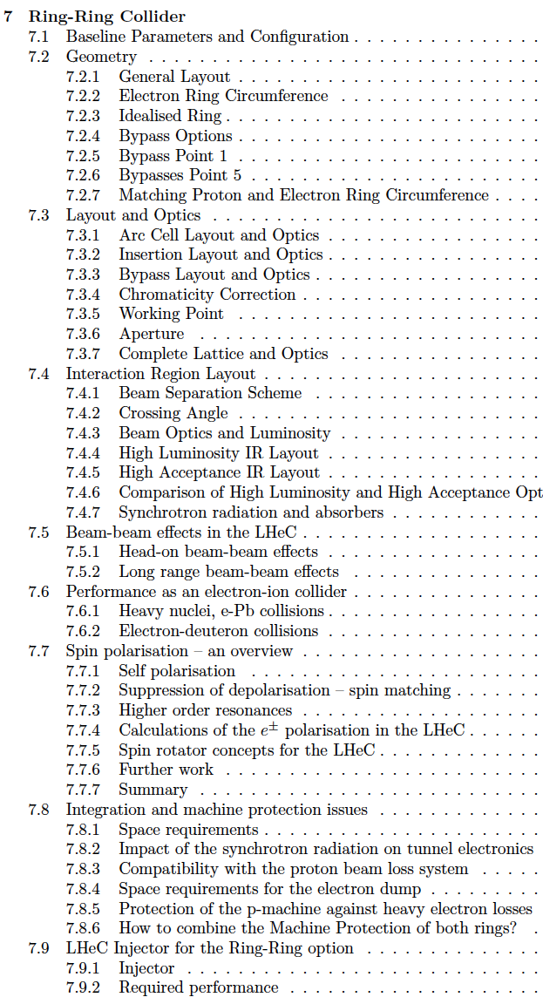
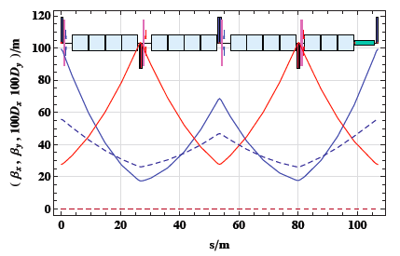
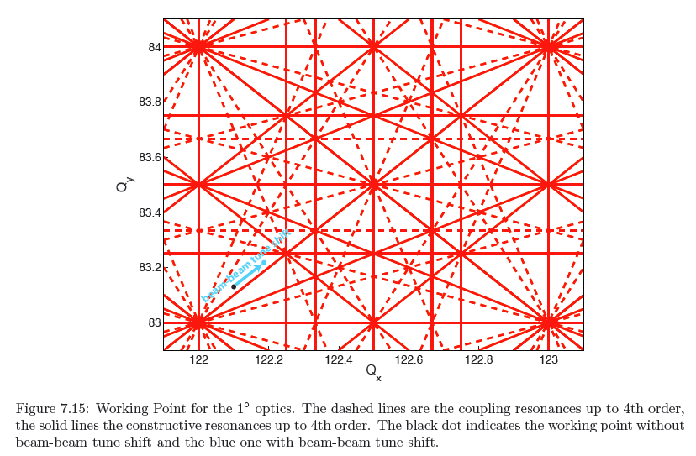

FODO (half LHC size, asy dipoles, 23 arc cells)
THPZ014 LHeC Lattice Design

Slide 15
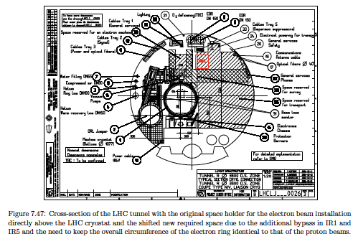
Constraints:
Bypass existing LHC experiments
U_{p}=U_{e} → shift of e ring to inside
100kg/m tunnel load limit: support from below (HERA)
Issues:
QRL service with jumper – asymmetric FODO
transport: magnets ok, cryo equipment full height
occurs during warmup – shift locally e beam?
dump area – reroute cables
proton rf -- e “just a pipe”
SEU’s from e: shielding, LHC power converters then out
IP3, LSS7, p collimation …
no show stopper found but challenging and CAD needed next

Slide 16
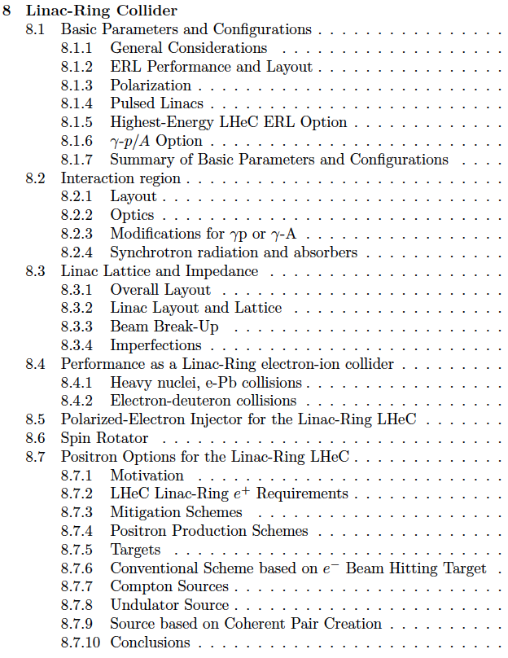
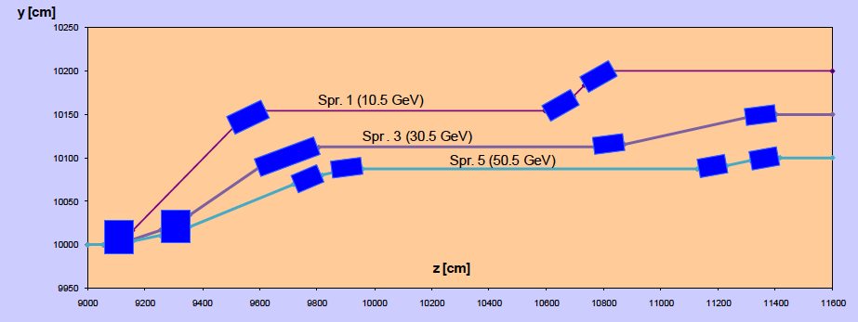
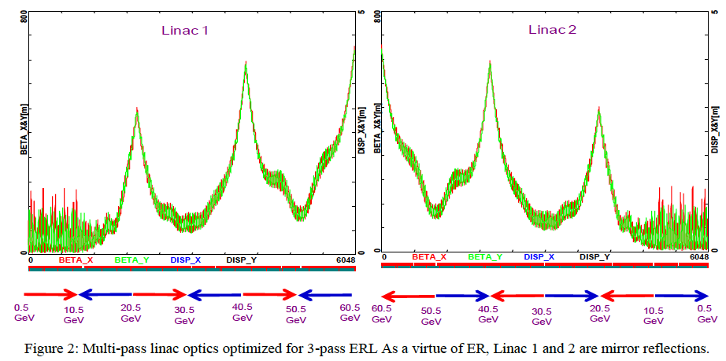
ERL stores energy while ring stores electrons
Same RF for acc and deacc. → rf acc power independent of I
Switchyard: two-step spreaders and mirror symmetric recomb.
Multipass linear optics: sharing of arcs by acc/deacc. passes
Cumulative transverse deflections
from each cavity so far ok to 5mA
TUPC054
LHeC ERL Design and Beam-dynamics Issues

Slide 17
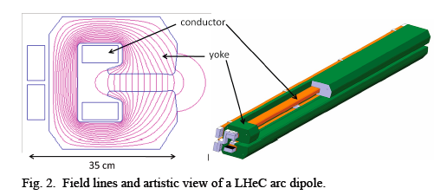
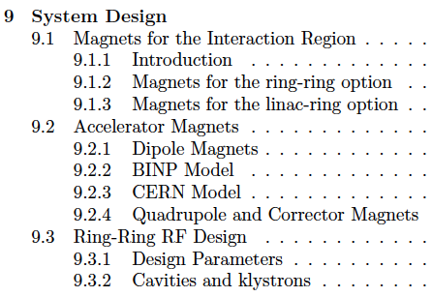
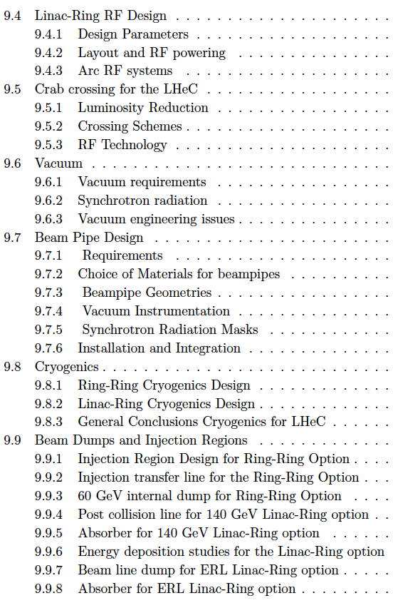
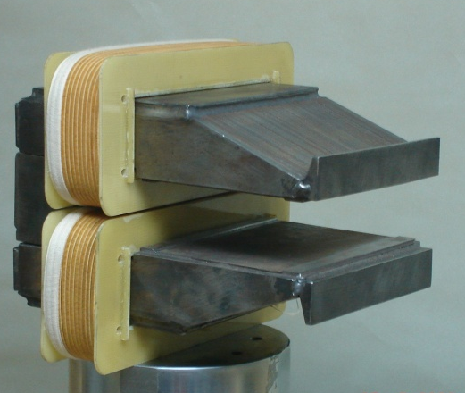
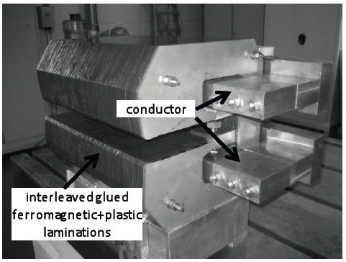
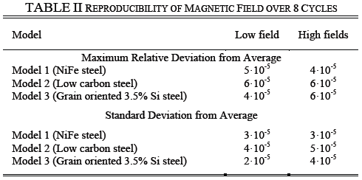
5.35 m
0.013-0.08 T
~200kg/m
Prototypes from BINP and CERN: function to spec’s

Slide 18
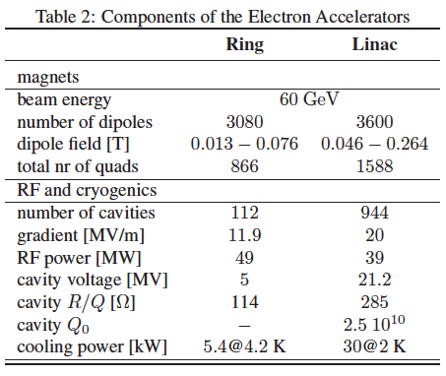
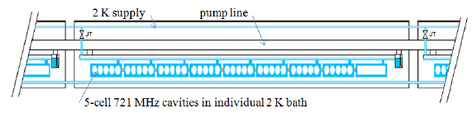

from CDR LHeC

Slide 19
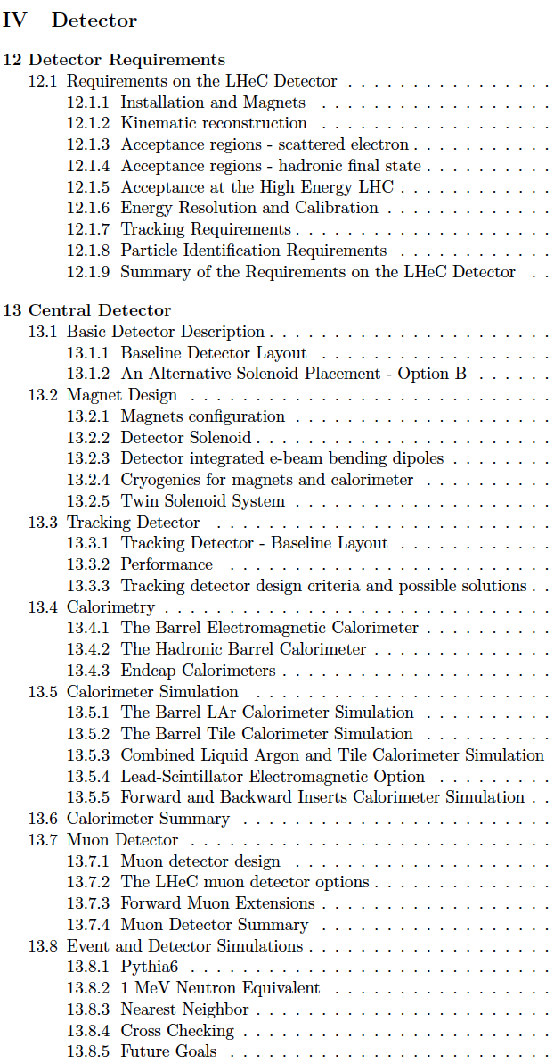
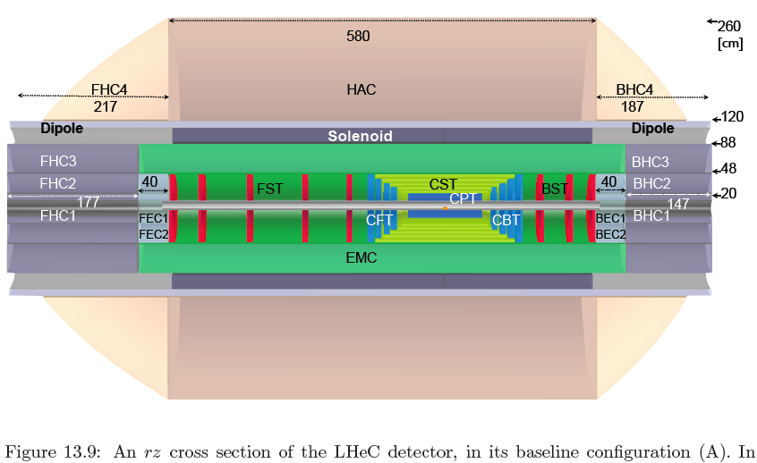
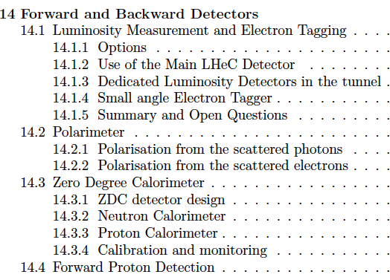
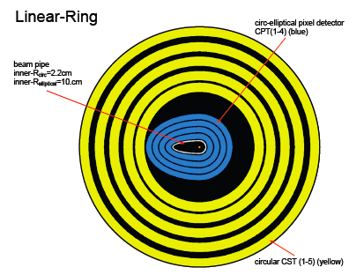
Requirements High Precision (resolution, calibration, low noise, tagging of b,c)
Modular for ‘fast’ installation
State of the art technology - ‘no’ R+D (HERA,LHC upgrade)
1-179º acceptance for low Q², high x (beam pipe, synrad)
Si tracker, LAr elm cal, sc coil 3.5T, Tile hcal, Muon detector not shown
Present dimensions: LxD =14x9m² [CMS 21 x 15m² , ATLAS 45 x 25 m²]
Taggers at -62m (e),100m (γ,LR), -22.4m (γ,RR), +100m (n), +420m (p)

Slide 20
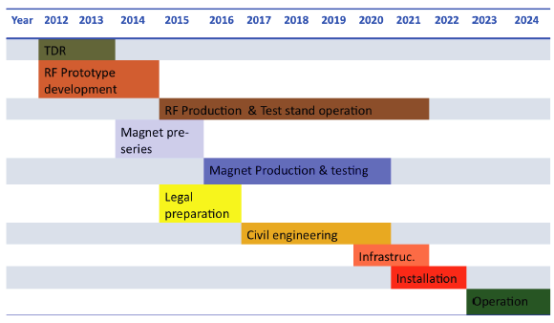
LHeC Tentative Time Schedule
LS3 --- HL LHC

Slide 21
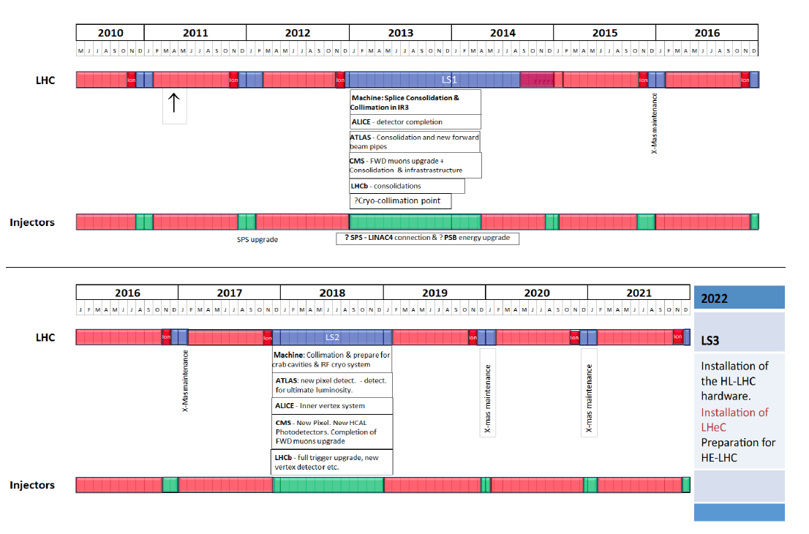

Slide 22
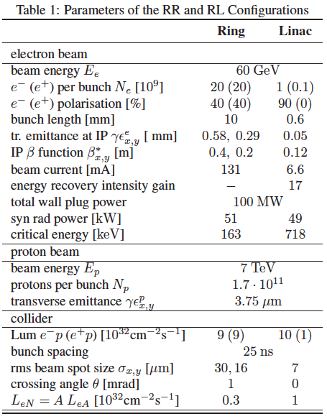
CERN-ECFA-NuPECC:
CDR Draft (530pages) being refereed
Publish early 2012
Steps towards TDR (tentative)
Prototype IR magnet (3 beams)
Prototype Dipole (1:1)
Develop Cavity/Cryomodule
Civil Engineering, …
Build international collaborations
for the accelerator and detector
development. Strong links to ongoing
accelerator and detector projects.
The LHC offers the unique perspective
for a further TeV scale collider. The
LINAC’s are of about 2mile length, yet
the Q² is 10⁵ times larger than was
achieved when SLAC discovered quarks.
Particle physics needs pp, ll and ep.
Here is a realistic prospect to progress.
Both the ring and the linac are feasible and both
come very close to the desired performance.
The pleasant challenge is to soon decide for one.

Slide 23
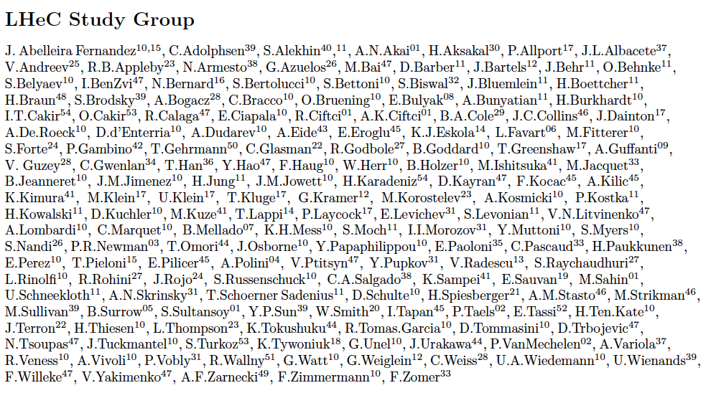
http://cern.ch/lhec
Thanks to all and to
CERN, ECFA, NuPECC
About 150 Experimentalists and Theorists from 50 Institutes
Tentative list

Slide 24
backup

Slide 25
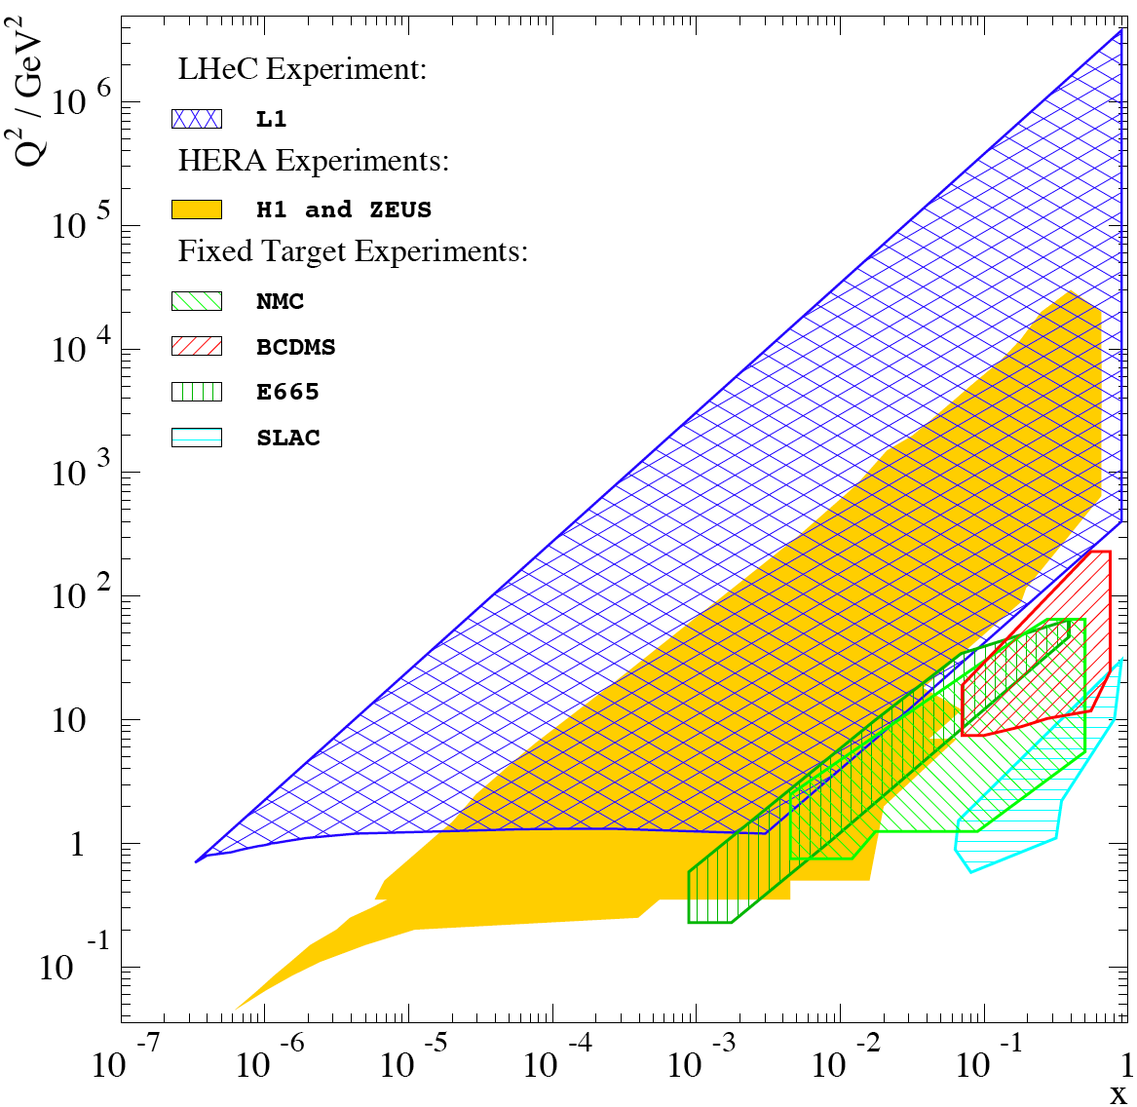
Physics and Range
New Physics
Physics
eQ states
GUT (δα_{s}=0.1%)
Excited fermions
Hot/cold spots
Single top
Higgs
PDFs
Multi-Jets
DVCS
Unintegrated
partons
Saturation
Vector Mesons
IP - graviton
Odderons
NC couplings
sin²Θ
Beauty
Charm
Partons in nuclei
Shadowing
….
Large x
High precision
partons in plateau
of the LHC
Nuclear
Structure
& dynamics
High Density Matter
Q² = 4momentum transfer² x = Bjorken x: fraction of p’s momentum

Slide 26
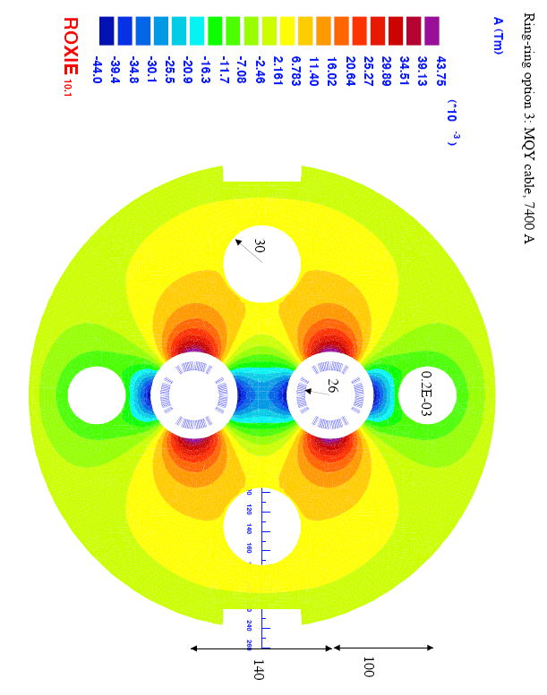
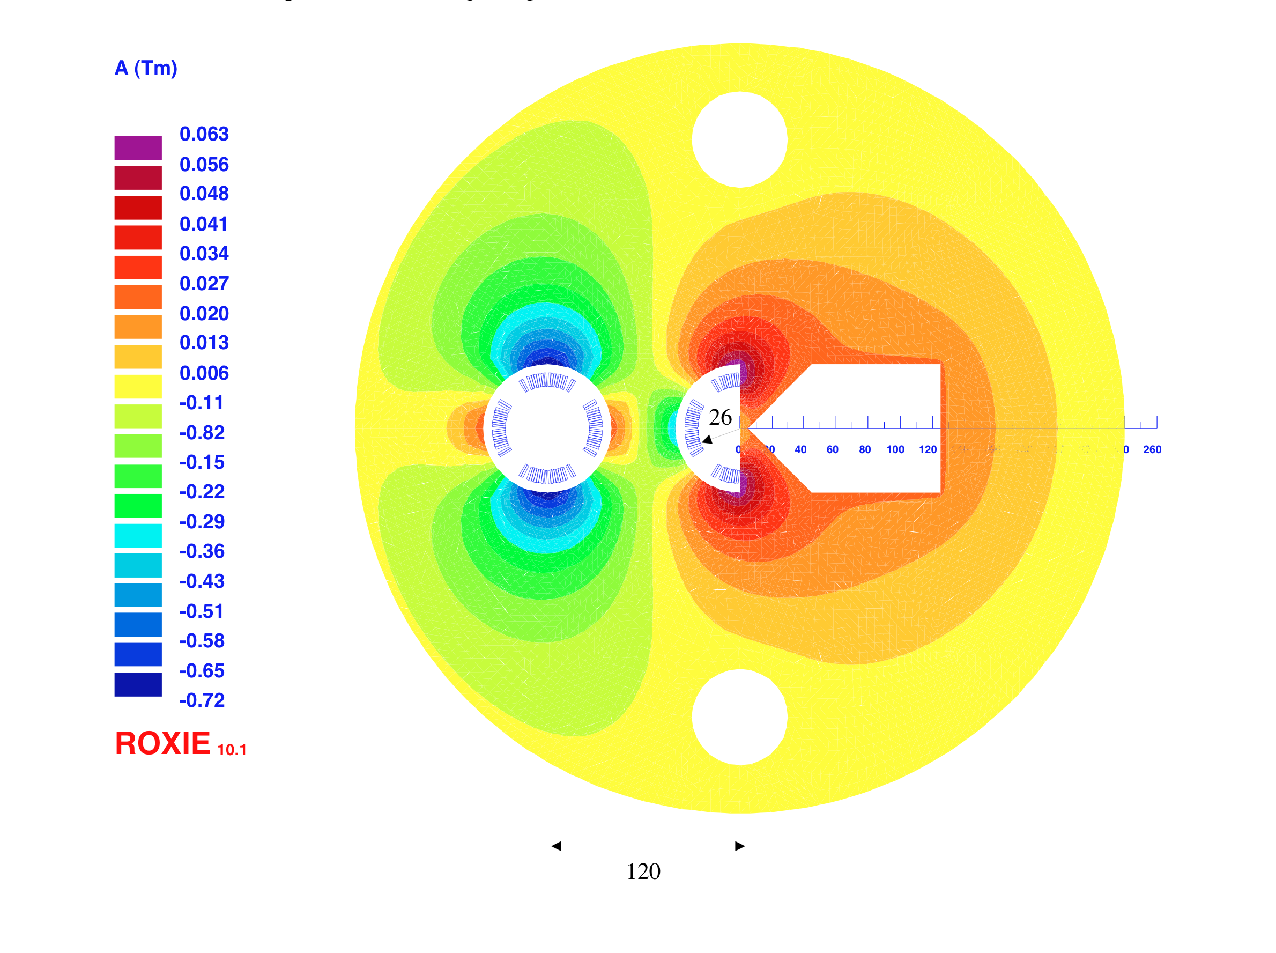
Interaction Region(s)
RR -Small crossing angle ~1mrad (25ns) to avoid first parasitic crossing (L x 0.77)
LR – Head on collisions, dipole in detector to separate beams
Synchrotron radiation –direct and back, absorption simulated (GEANT4) ..
[July 2010]
1st sc half quad (focus and deflect)
separation 5cm, g=127T/m, MQY cables, 4600 A
2nd quad: 3 beams in horizontal plane
separation 8.5cm, MQY cables, 7600 A

