Slide 1


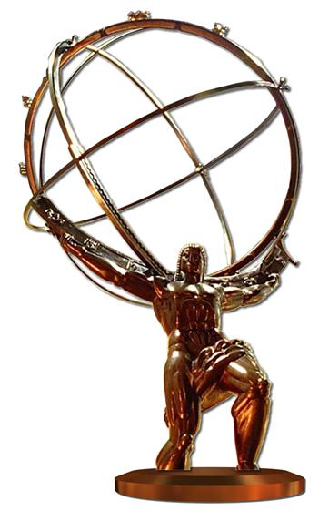

Electrons for the LHC
Future Deep Inelastic Lepton-Hadron Scattering at the Energy Frontier
Max Klein
DIS
CDR
LHC
Physics
PERLE
Detector+
http://lhec.web.cern.ch
CDR 2012, Update 2018
ep (and eA) at the LHC
Seminar at Saclay, 26.03.2018

Slide 2
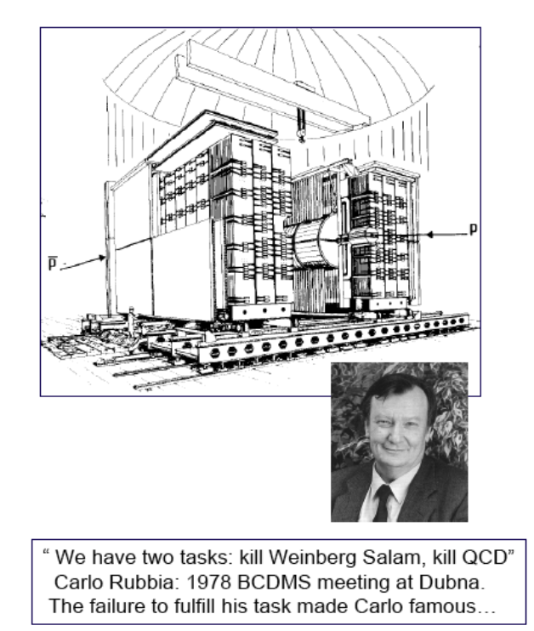
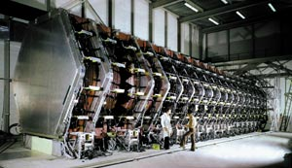
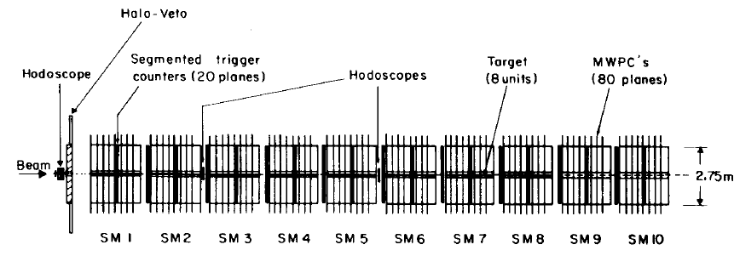

DIS and pp at CERN some 30-40 years ago
Charged Currents
BEBC, CDHS(W), CHARM, CHORUS
UA1
Neutral Currents
UA2
Pierre Darriulat
BCDMS, EMC, SMC, COMPASS

Slide 3
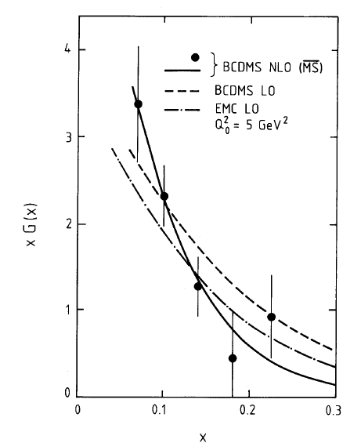
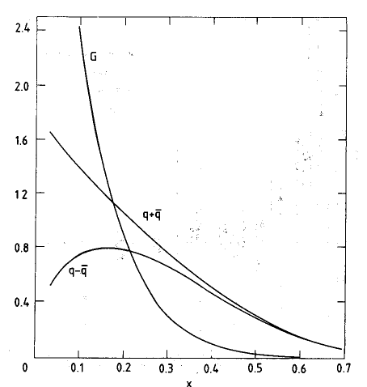


PDFs before HERA - Gluon - xg(x,Q²)
BCDMS
CDHS

Slide 4
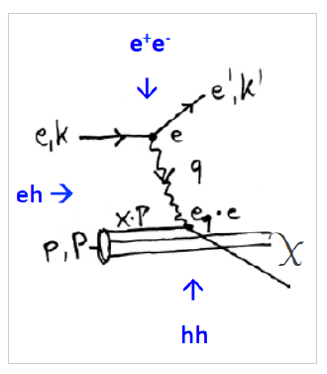
Deep Inelastic Lepton-Hadron Scattering
Calculated to N²LO
J Vermaseren et al,
and N³LO to come
ep Colliders:
Redundant determination of the scattering kinematics: x, Q² ≤ 4E_{e}E_{p}=s → high precision
Resolution of substructure d=1/√Q² (protons and nuclei: the ‘forgotten’ task of HERA)
Proton, neutron, diffractive, nuclear, generalised, unintegrated partons. Much more than ‘PDFs’.
Q²=sxy varies by 7(8) orders of magnitude, 0.1-10⁶⁽⁷⁾ GeV² for LHeC (FCCeh)
Small x > 1/s ( Q²>M_{p}²): new parton dynamics, confinement, UHE neutrino scattering…
Electroweak γ,W,Z-parton scattering: clean final state, no pile-up (μ=0.1 at the LHeC), tag γ*p
The LHeC and the FCC-eh are the cleanest high resolution microscopes the world can build.

Slide 5
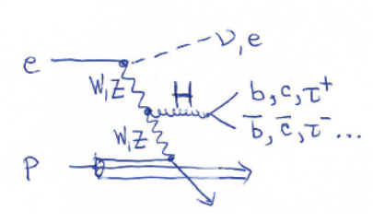
Deep Inelastic Lepton-Hadron Scattering
Can produce heavy new states (Higgs, 750 GeV ghost..) and reach to O(200) TeV
by indirect constraints, such as high precision contact interaction measurements
pp, ep and ee are ordered in energy reach: 2E_{p} >> 2√(E_{p}E_{e}) >> 2E_{e}
For the LH(e)C this translates to 14 TeV vs 1.3 TeV vs 0.25-0.35 TeV.
Drell-Yan production in pp of new states with mass M in pp: M² = s x₁ x₂
Resolving high mass physics needs PDFs at high x. Note: Higgs at FCC will be low x physics
For pp need to separate new physics from QCD dynamics in the proton

Slide 6
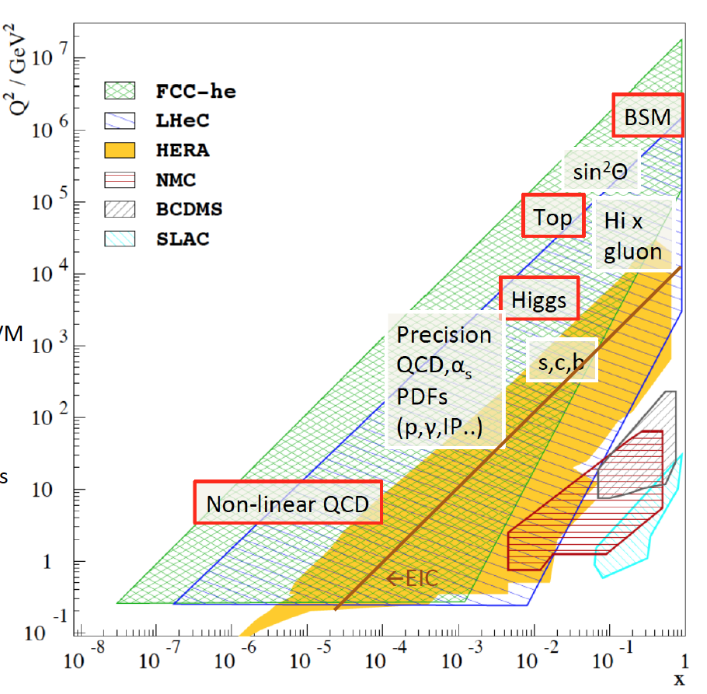
Pursue New Physics of Deep Inelastic Scattering

Slide 7

.. and yet, ep is usually treated like the early Cinderella
→ Needs radiant appearance (lumi, physics, technology), readiness to work and a bit of luck..

Slide 8
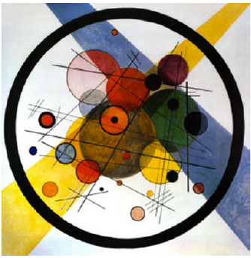
II The LHeC Conceptual Design Report
ep@LHC: Lausanne 1984
Aachen 1990
Rubbia: ICHEP Singapore 1990: pp in 1996 and ep in 1998
In 2007: the CERN SPC asks about ep: (r)ECFA+CERN Mandate
→ CDR in 2012
W.Kandinsky: “Circles in a circle” (1923) Philadelphia (USA) Museum of Art
First shown in LHeC context in a talk by A.S.Vera Workshop 2008

Slide 9
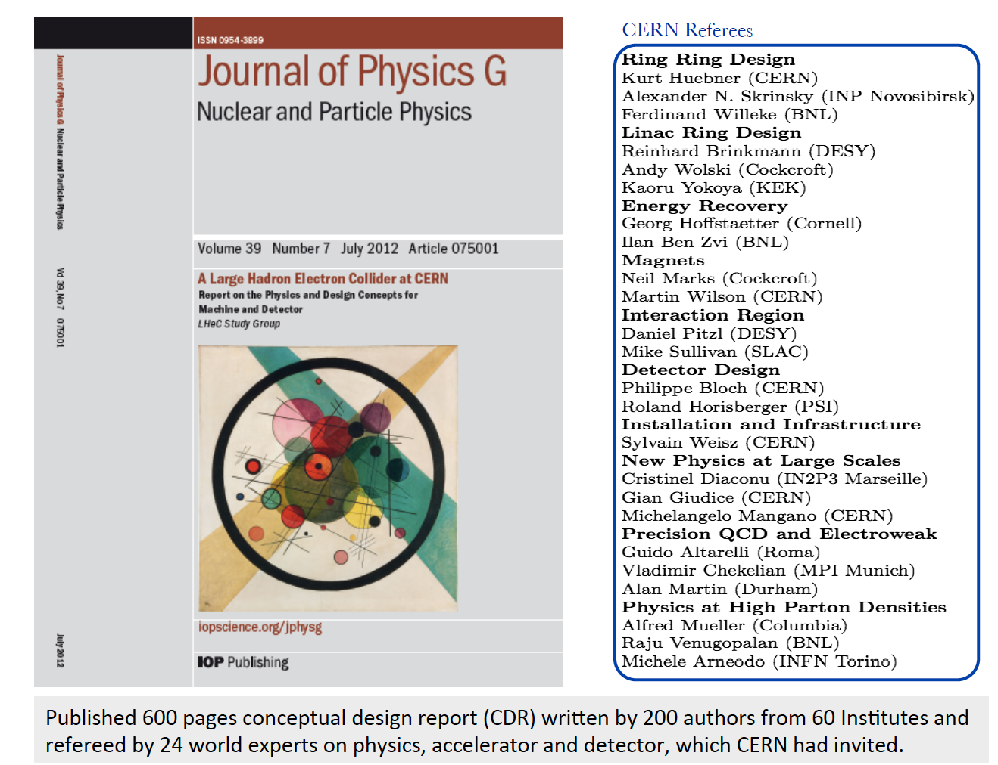
title
arXiv:1206.2913

Slide 10
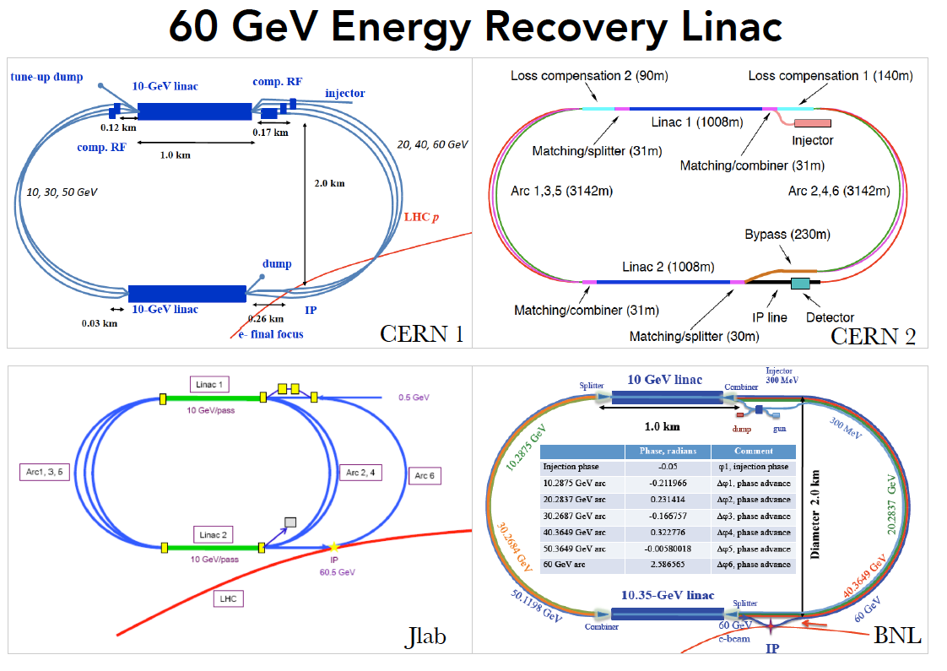
title
CDR: Default configuration, 60 GeV, 3 passes, 720 MHz, synchronous ep+pp, L_{ep}=10³³

Slide 11
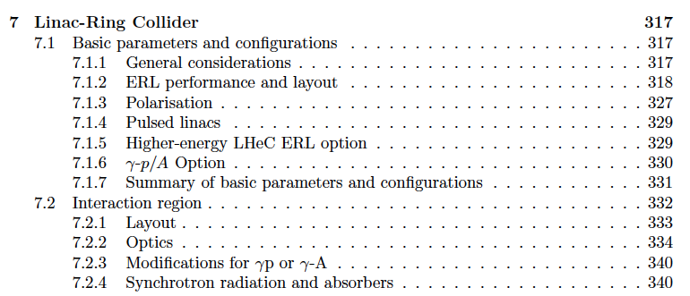
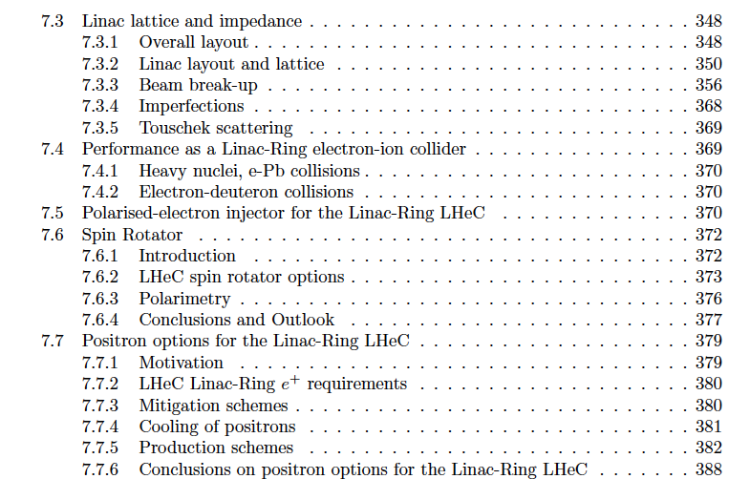
Performance
Interaction Region
Optics
Ions
Polarisation (80-90%)
Positrons
CDR: VERY detailed design of the LHeC Linac (and Ring) – Ring Collider, + components, CE..

Slide 12
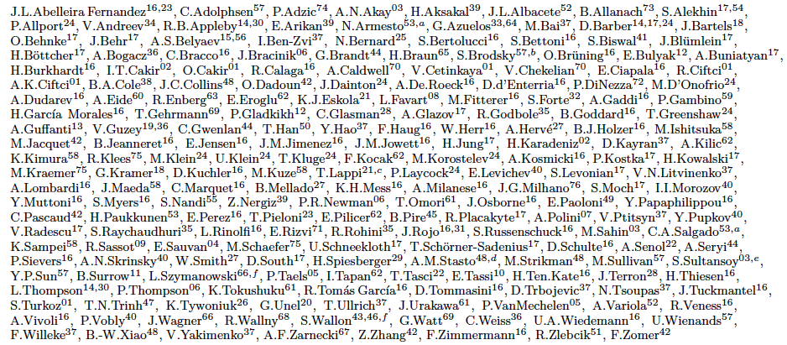
http://lhec.web.cern.ch
LHeC Study group and CDR authors 2014
“you never walk alone”

Slide 13
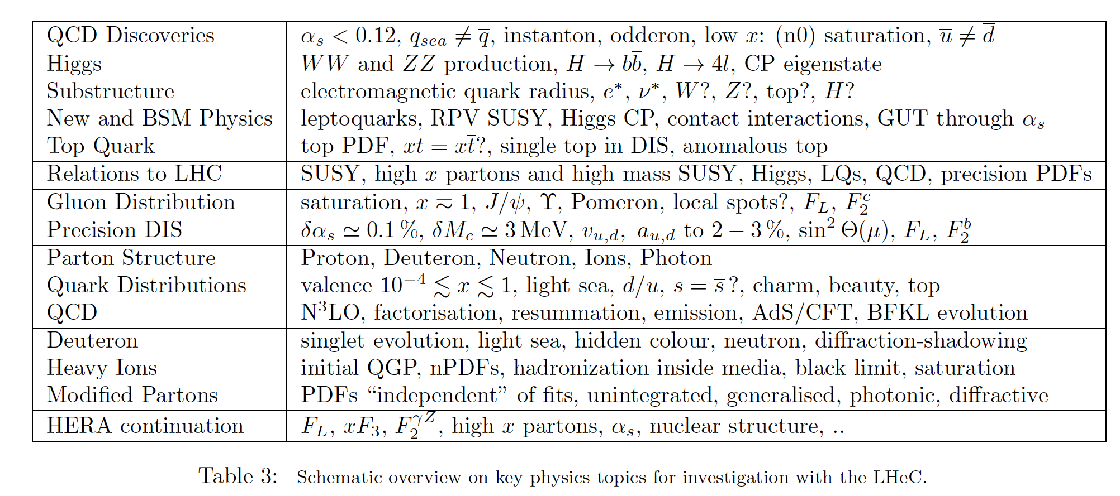
Physics Overview - CDR
LHeC Note 2012-004, arXiv:1211.5102
LHeC: 20 times 1/x and Q² and 100-1000 times luminosity as compared to HERA
→ Very rich programme on DIS, ions, Higgs and new physics in much extended range

Slide 14
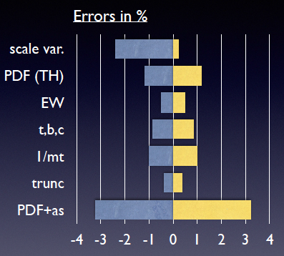
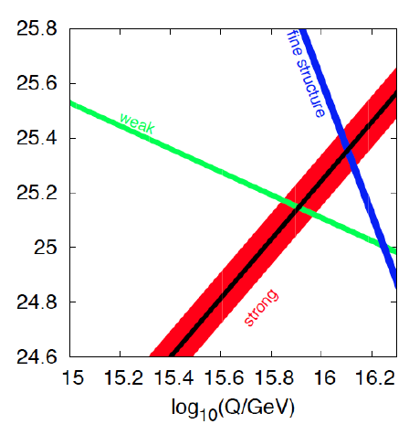
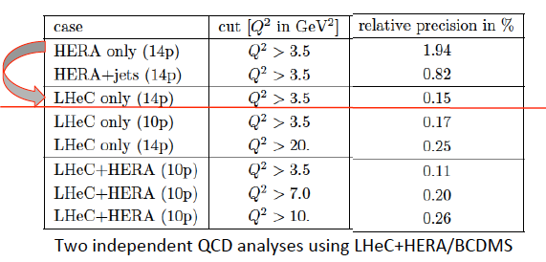
Strong Coupling Constant
- α_{s} least known of coupling constants
Grand Unification predictions need smaller δα_{s}
- Is α_{s}(DIS) lower than world average (?)
- LHeC: per mille - independent of BCDMS!
- High precision from inclusive data – α_{s}(jets)??
- Challenge lattice QCD
Uncertainty on Higgs cross section
Giulia Zanderighi, Vietnam 9/16,
from C.Anastasiou et al, 1602.00695
who also discuss the ABM alpha_s..
LHeC simulation, NC+CC inclusive, total exp error
PDG
LHeC

Slide 15
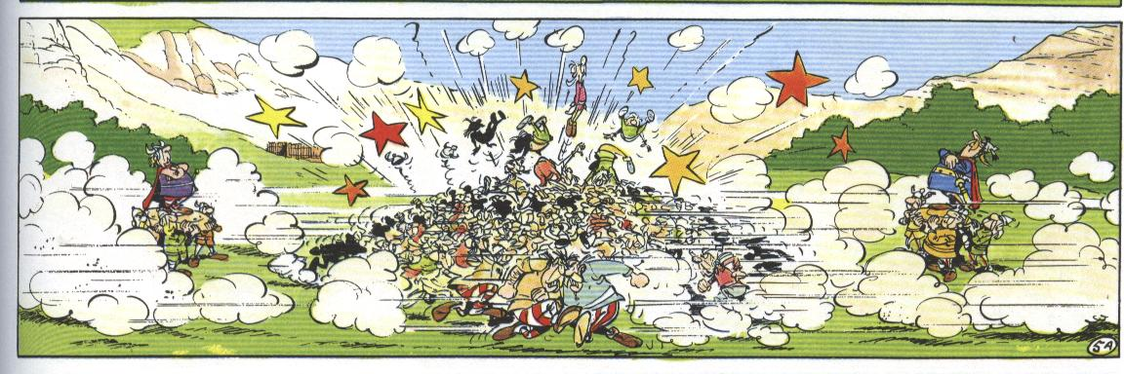
III LHC Physics
Superb LHC performance, reliable detectors and great experimental art
French artist’s view on LHC physics – pileup at HL LHC 140-200
2000 LHC papers published (ATLAS 100/year). No BSM Physics observed
Discovery of the Higgs Boson (Mass to W,Z,fermions + portal to BSM??)
Surprisingly high precision (e.g. ATLAS Wmass to 19 MeV → 0.02%)
The LHC exploits the large majority of HEP physicists, ATLAS: 1200 PhD’s
Programme HL LHC to operate until about/almost 2040

Slide 16
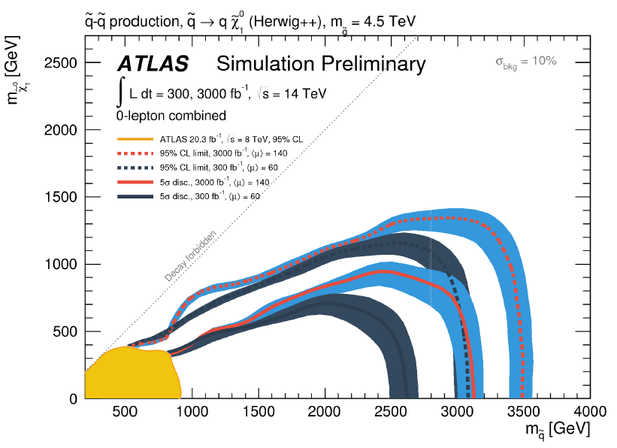
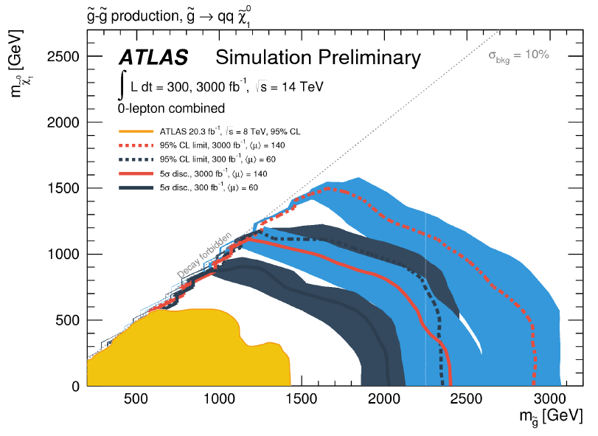
Extended Search Programme (SUSY?)
5σ up to ~2.5TeV gluinos
@ HL-LHC
ATLAS-PUB-2014-10
5σ up to ~3TeV squarks
5σ up to ~1.2 TeV stops
5σ up to ~1.3 TeV sbottoms
@ HL-LHC
SUSY is too beautiful to not exist but it is broken “heavier and heavier”
Physics studies of the HL LHC Potential: ongoing → HL/HE LHC Workshop 17/18

Slide 17
IV Recent LHeC Developments (mostly) past CDR

Slide 18
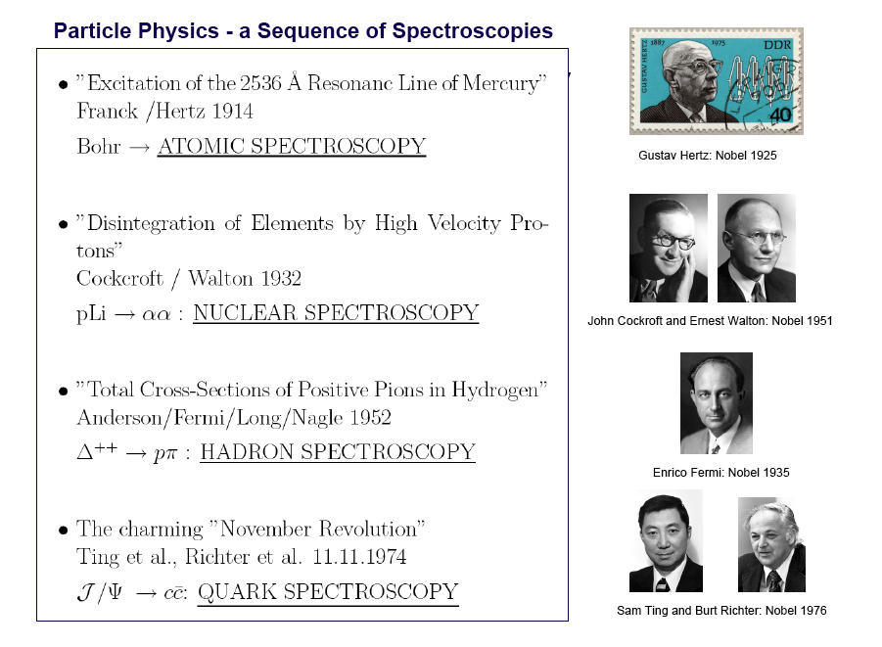
Spectroscopy
No new spectroscopy appeared – neither 1992 (LEP) nor 2012 (LHC),
No SUSY, neither at 100 GeV nor at 1000 GeV → a major surprise

Slide 19
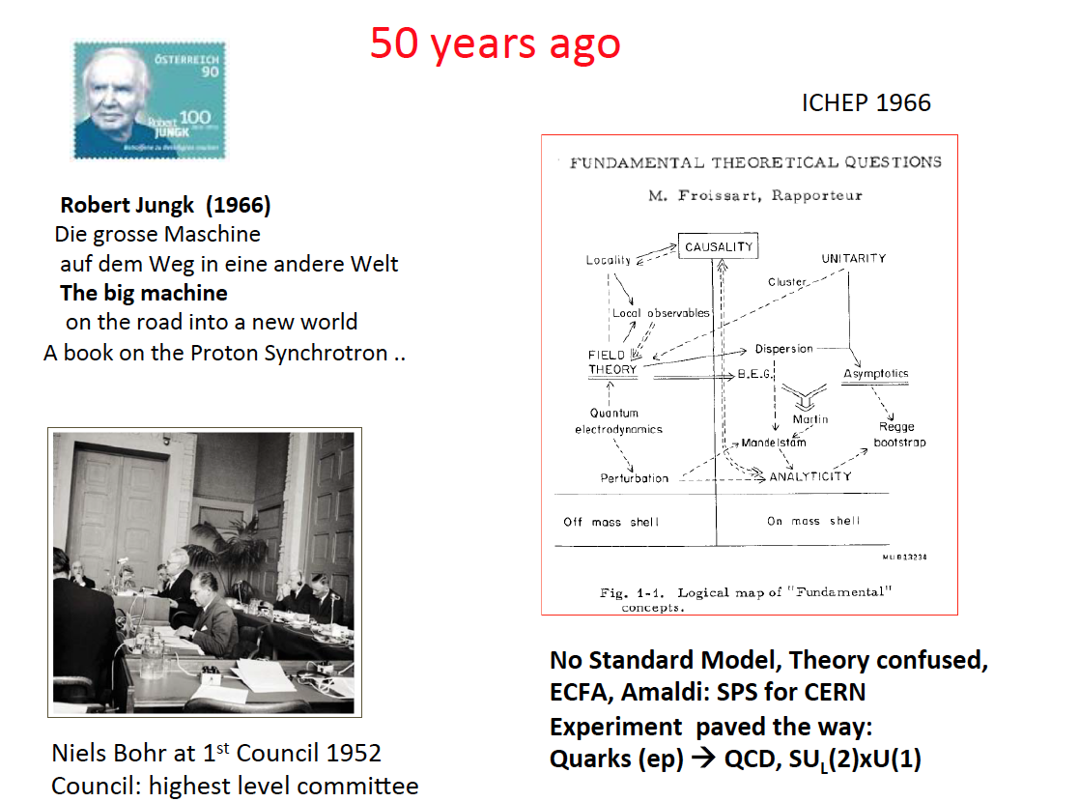
MK, presented to UK PPAP, July 2017
Today in various aspects resembles 50 years ago:
Some think our dreams are too ambitious
Our scientific standards are kept maximally high
- and the theory is pointing to every- or nowhere
Our science is experiment driven, it can’t be realised with pp alone

Slide 20
Framework of the Development
Following the CDR in 2012: Mandate issued by CERN:2014 (RH), confirmed in 2016 (FG)
Mandate to the International Advisory Committee
Advice to the LHeC Coordination Group and the CERN directorate by following the
development of options of an ep/eA collider at the LHC and at FCC, especially with:
Provision of scientific and technical direction for the physics potential of the ep/eA
collider, both at LHC and at FCC, as a function of the machine parameters and of a
realistic detector design, as well as for the design and possible approval of an ERL
test facility at CERN.
Assistance in building the international case for the accelerator and detector
developments as well as guidance to the resource, infrastructure and science
policy aspects of the ep/eA collider.
Chair: Herwig Schopper, em. DG of CERN. IAC+CERN have invited four of its members to follow the study with special attention (Stefano Forte, Andrew Hutton, Leandro Nisati and Lenny Rifkin). Collaboration also with the FCC Review Committee chaired by Guenther Dissertori.
LHeC has been a development for and initiated by CERN, ECFA and NuPECC, so far, it’s formal status is that of a community study, not a proposal, which holds for the FCC also, of which ‘eh’ is a part.

Slide 21
Organisation^{*)}
Working Groups
International Advisory Committee
“..Direction for ep/A both at LHC+FCC”
PDFs, QCD
Fred Olness,
Claire Gwenlan
Higgs
Uta Klein,
Masahiro Kuze
BSM
Georges Azuelos,
Monica D’Onofrio
Top
Olaf Behnke,
Christian Schwanenberger
eA Physics
Nestor Armesto
Small x
Paul Newman,
Anna Stasto
Detector
Alessandro Polini
Peter Kostka
Coordination Group
Accelerator+Detector+Physics
Sergio Bertolucci (CERN/Bologna)
Nichola Bianchi (Frascati)
Frederick Bordry (CERN)
Stan Brodsky (SLAC)
Hesheng Chen (IHEP Beijing)
Eckhard Elsen (CERN)
Stefano Forte (Milano)
Andrew Hutton (Jefferson Lab)
Young-Kee Kim (Chicago)
Victor A Matveev (JINR Dubna)
Shin-Ichi Kurokawa (Tsukuba)
Leandro Nisati (Rome)
Leonid Rivkin (Lausanne)
Herwig Schopper (CERN) – Chair
Jurgen Schukraft (CERN)
Achille Stocchi (LAL Orsay)
John Womersley (ESS)
Nestor Armesto
Oliver Brüning – Co-Chair
Andrea Gaddi
Erk Jensen
Walid Kaabi
Max Klein – Co-Chair
Peter Kostka
Bruce Mellado
Paul Newman
Daniel Schulte
Frank Zimmermann
5(11) are members of the
FCC coordination team
OB+MK: FCC-eh responsibles
MDO: physics co-convenor
We miss Guido Altarelli.
*)September 2017

Slide 22
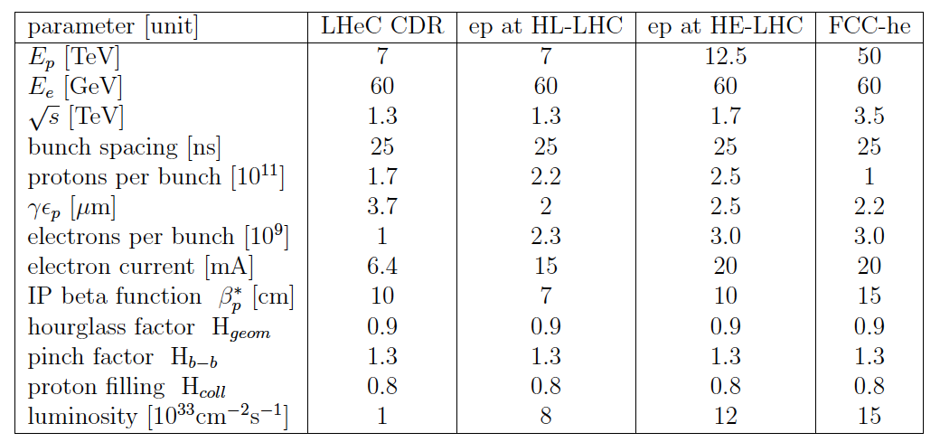

Luminosity for LHeC, HE-LHeC and FCC-ep
Contains update on eA:
6 10³² in e-Pb for LHeC.

Slide 23
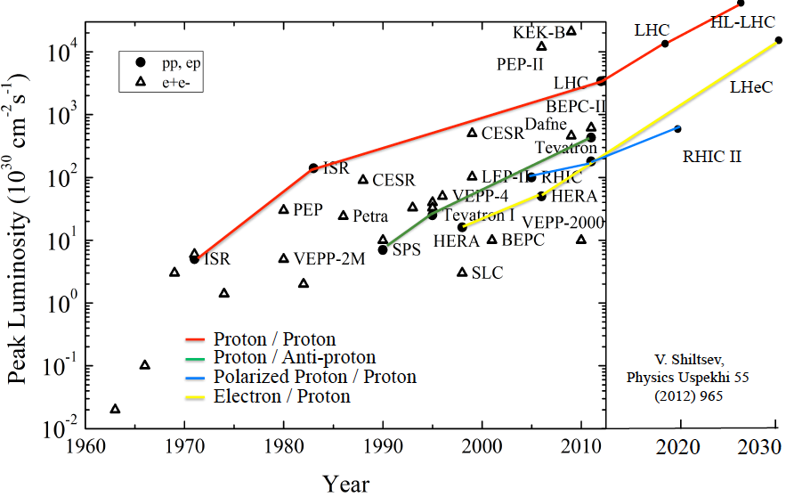
Collider Luminosities vs Year (pp and ep)
O. Bruening 2/17

Slide 24
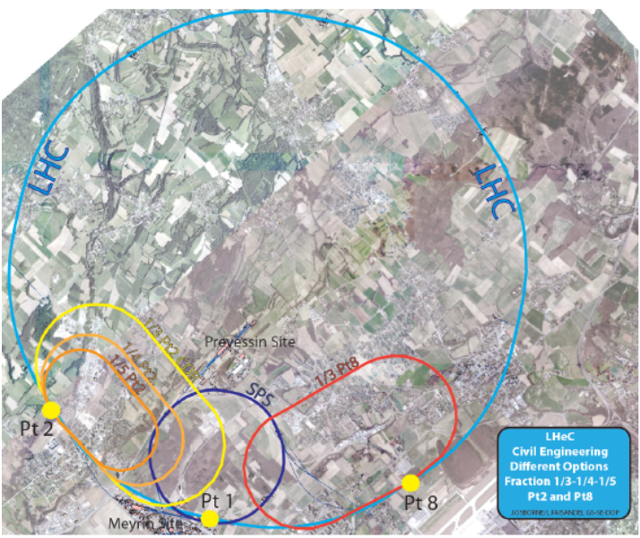
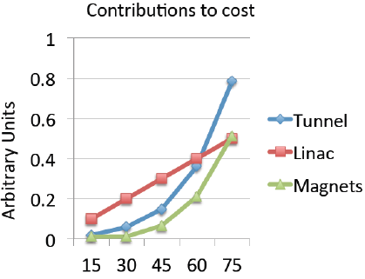
Location, Footprint, Use of the Electron Racetrack
e beam external to LHC. Location suitable for both HL and HE LHC.
MK, F Zimmermann
- U(ERL) = 1/n U(LHC): 60 GeV: 1/3
- BSM, top, Higgs, Low x all want maximum E_{e}
Initial, tentative, rough scaling estimate of
basic cost (tunnel, linac (XFEL), magnets
Energy – Cost – Physics – Footprint are being reinvestigated for EU strategy

Slide 25
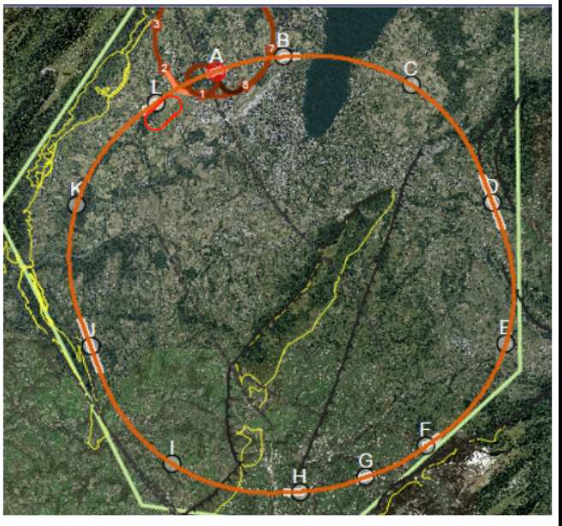
FCC-eh
60 GeV ERL tangential to FCC-hh. IP: L for geological reasons. L= 1.5 10³⁴ Higher s, Q², 1/x

Slide 26
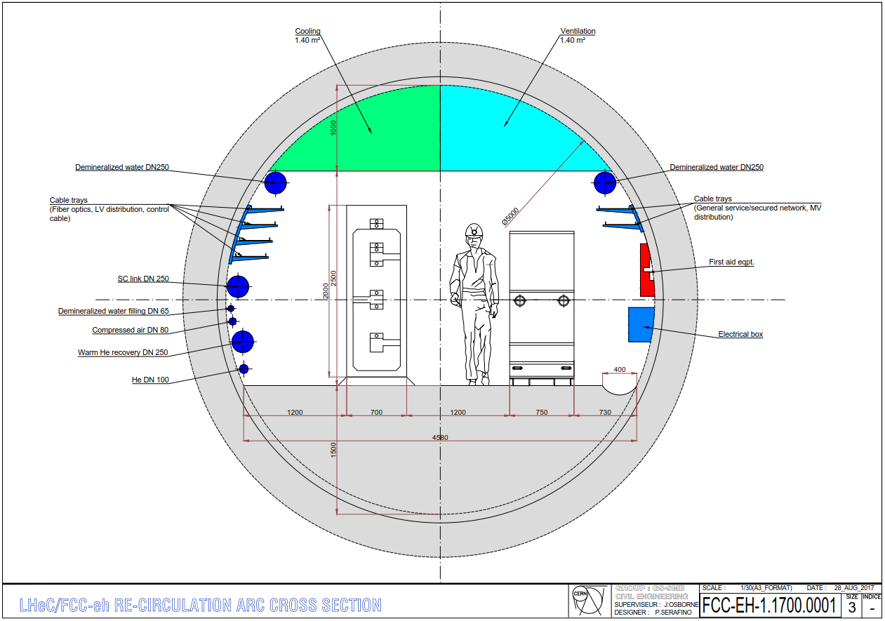
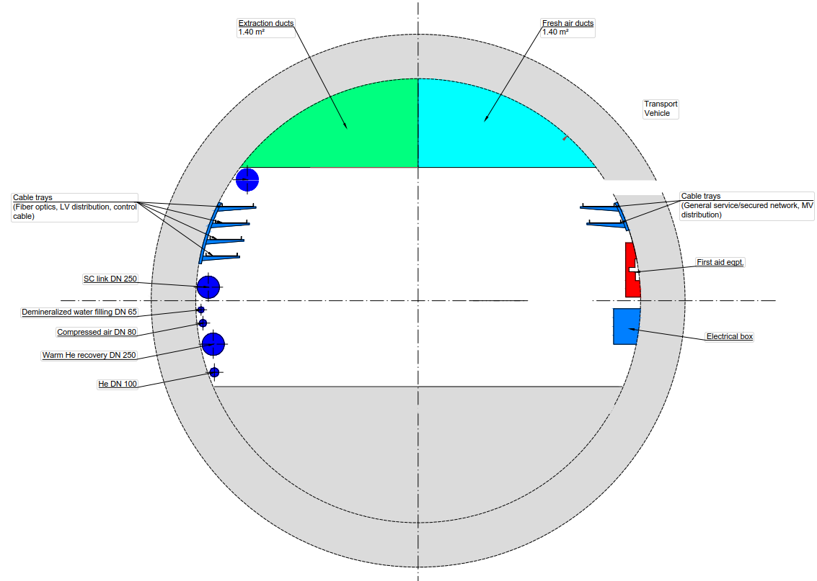
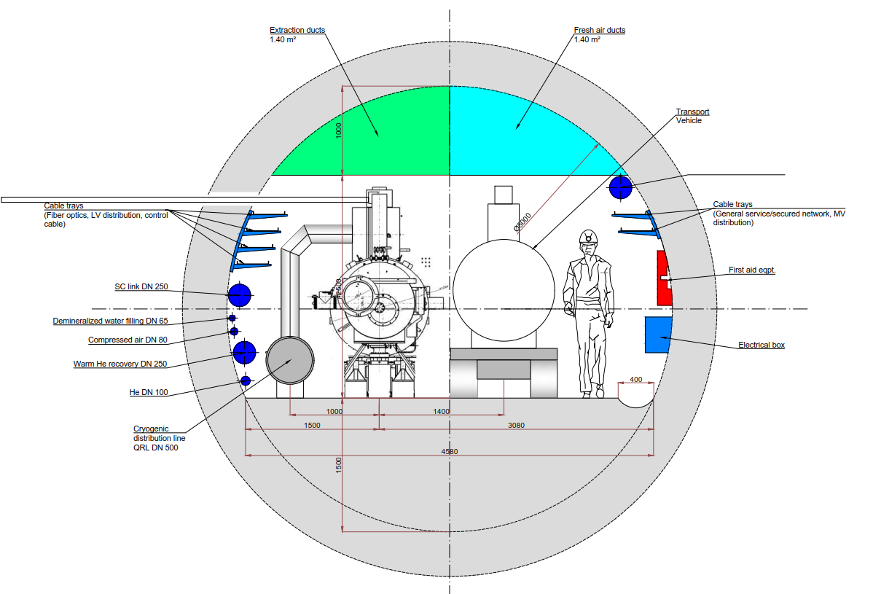
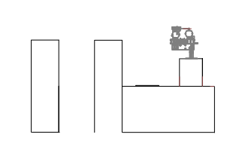

Tunnels: Triple Arc and LINACs
Arc
DRAFT: for ERL in any pp combi.
cf Matt Stewart et al. 12.9.17
RF Gallery
LINAC

Slide 27
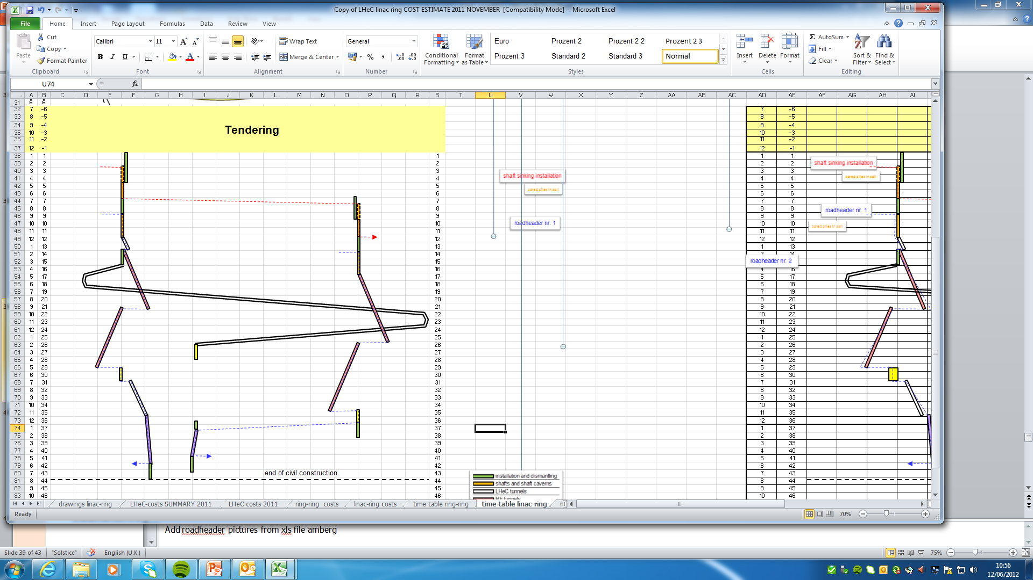
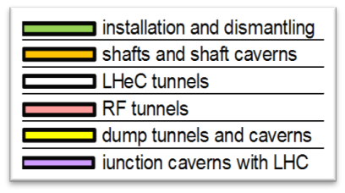
Civil Engineering – full design made
Shaft sinking installation
CDR: Evaluation of CE, analysis
of ring and linac by Amber Zurich.
Detailed estimate of cost and time:
3.5 years for underground works using 2 roadheaders and 1 TBM
More studies will be needed for
- Integration with all services
- (EL,CV, transport, survey etc).
- Geology
- Understanding vibration risks
- Environmental impact assessment
Tunnel connection in IP2
Roadheader 1
Roadheader 2
J.Osborne et al.

Slide 28
Physics Considerations on the Choice of E_{e}
Tentative
SM Higgs Couplings
H→ bb (cc): 0.5 (4)% coupling uncertainty, for 1ab⁻¹, 60 GeV, polarised
This becomes 2(15)% for 0.5ab⁻¹ and 30 GeV: Under these conditions
one looses high H precision and the ep portal to new physics potential
and the neutral current Higgs programme disappears
New Higgs+top Physics
Heavy new objects: Htt coupling: 17 → 31 % for 60 → 40 GeV (M Kumar)
Discovery potential for anomalous tqH: 0.5 – 3.2 -22% precision for
60 → 50 → 40 GeV (H Sun). At 40 GeV the discovery potential is gone.
Longitudinal Structure Function – THE path to saturation
Low x physics: Saturation requires 1% measurement of F_{L}. That needs
y=0.9=1-E’/Ee. HERA: big complication: E’ at high y too small for precision
(eID, background, charge symmetry): needs ~twice E_{e} to be safe.
50 GeV the programme stands, 40 GeV it looses BSM, t, 30 GeV: precision gone
Keep the electron energy as high as it can be afforded, and not lower than 50 GeV

Slide 29
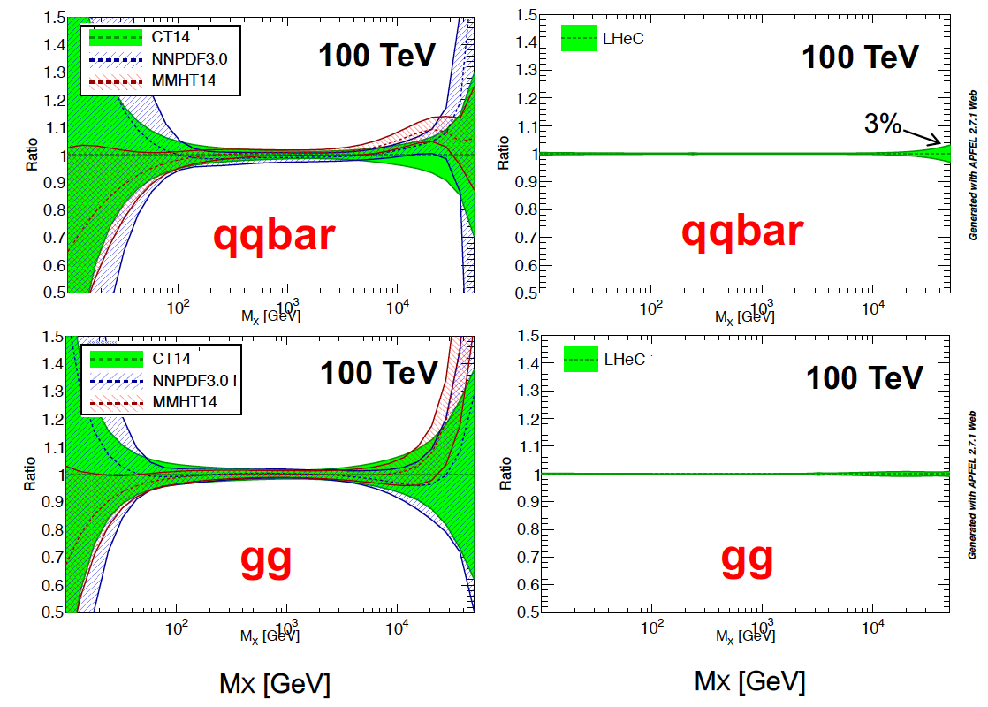
The LHeC PDF Programme
Resolve parton structure of the proton completely: u_{v},d_{v},s_{v}?,u,d,s,c,b,t and xg
Unprecedented range, sub% precision, free of parameterisation assumptions,
Resolve p structure, solve non linear and saturation issues, test QCD, N³LO…
Strong
Coupling in
inclusive
DIS at LHeC
to 0.1%
Lattice??
Jets??
BCDMS??
GUTs?
Higgs in pp
Solve the PDF issues for pp and test QCD with permille measurement of strong coupling

Slide 30
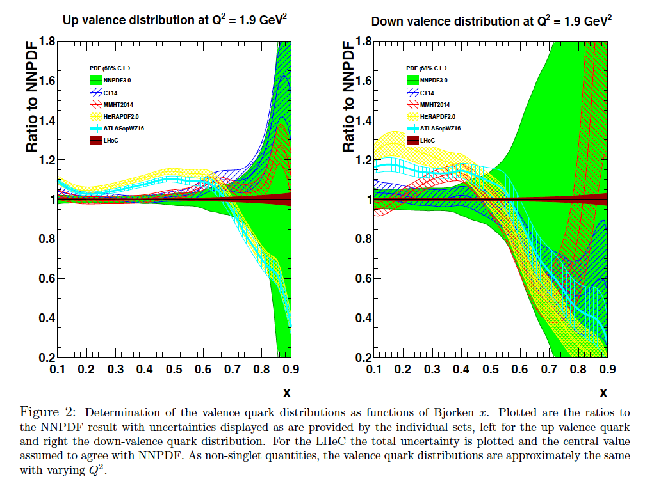

Slide 31
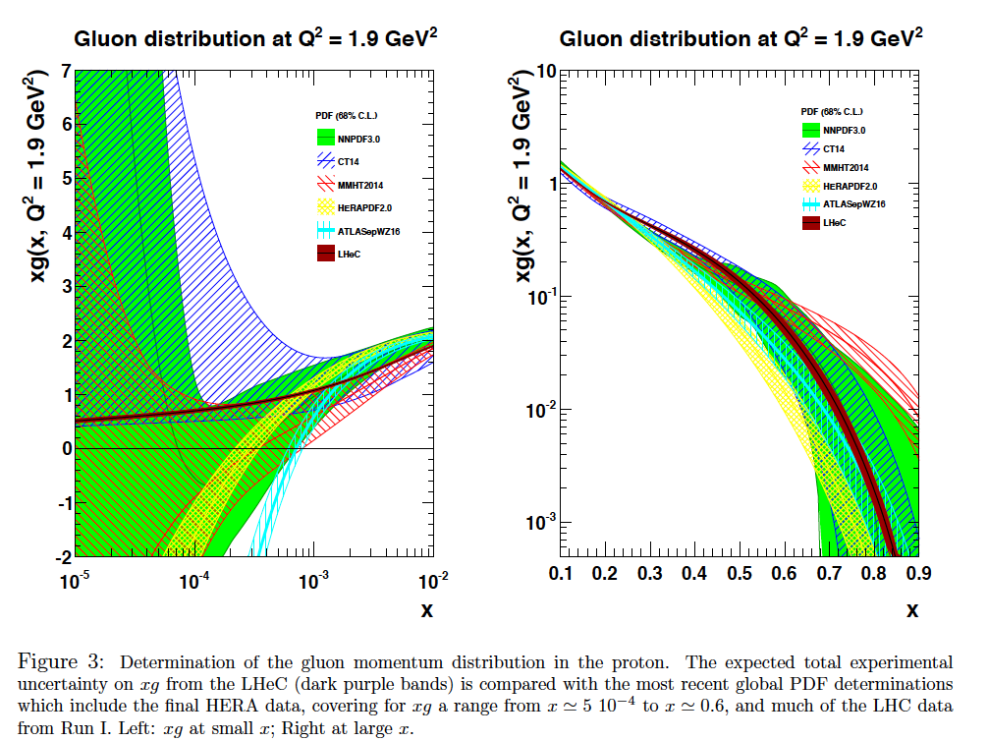

Slide 32
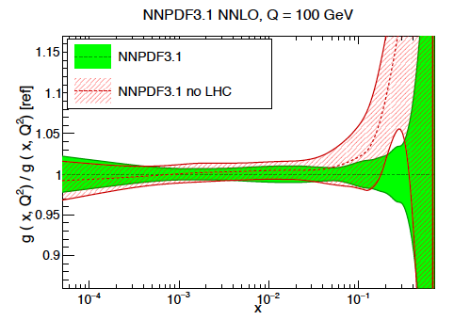
LHC Folklore: PDFs come from pp
LHC data constrain PDFs, BUT do not determine them:
Needs complete q_{i},g unfolding (miss variety)
at all x, as there are sum-rules
- Needs strong coupling to per mille precision, not in pp
Needs stronger effects (miss Q² variation)
cannot come from W,Z at Q²=10⁴ GeV²
Needs clear theory (hadronisation, one scale)
Needs heavy flavour s,c,b,t measured and VFNS fixed
Needs verification of BFKL at low x (only F₂-F_{L})
Needs N³LO (as for Higgs)
Needs external input to find QCD subtleties
such as factorisation, resummation…to not go wrong
- Needs external precise input for subtle discoveries
Needs data which yet (W,Z) will hardly be better
Needs agreement between the PDfs and χ²+1 ..
NNPDF3.1 arXiv:1706.00428
PDFs are not derived from pp scattering. And yet we try, as there is nothing else.., sometimes
with interesting results as on the light flavour democracy at x ~ 0.01 (nonsuppressed s/dbar).
Can take low pileup runs, mitigate PDF influence .. – but can’t do what is sometimes stated.
LHeC vs HERA: Higher Q²: CC; higher s: small x/g saturation?; high lumi: x→ 1; s, c,b,t. …

Slide 33
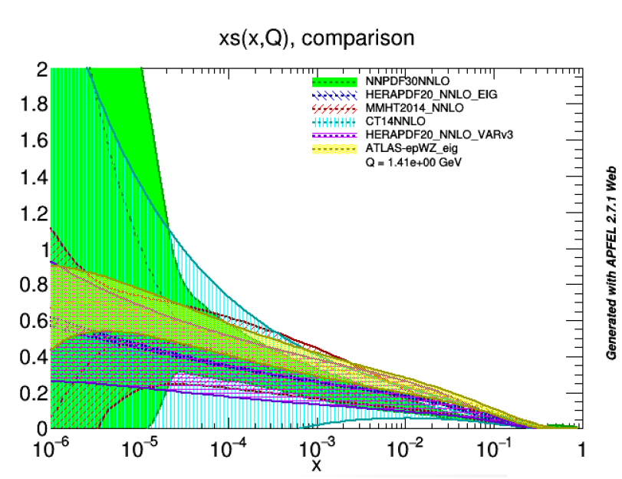
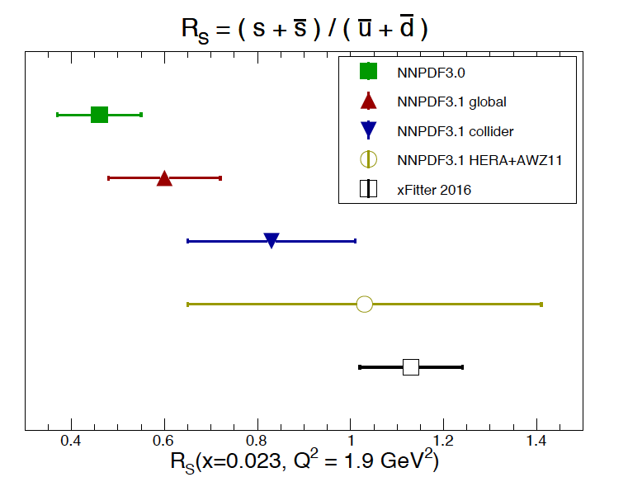
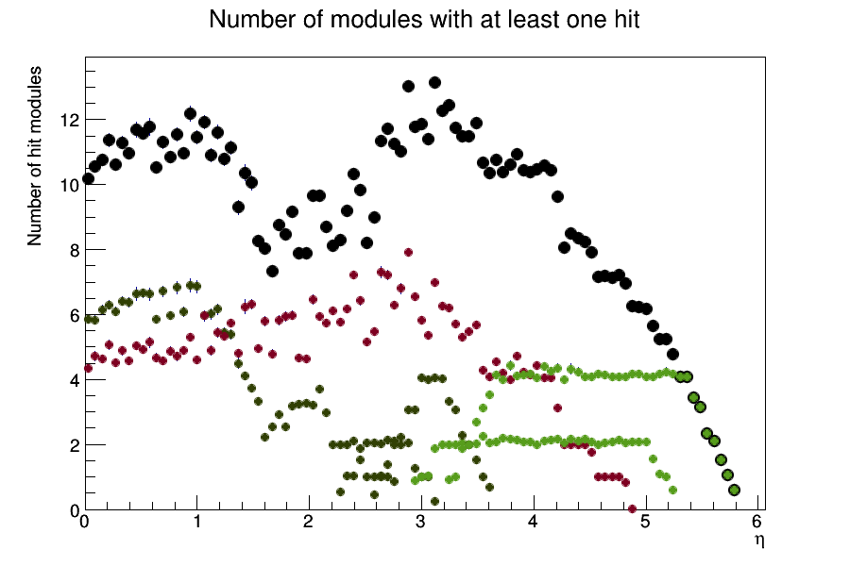
Strange Strange
Strange quark suppression [dimuons in neutrino data] vs light flavour democracy [W,Z LHC]
NNPDF3.1 arXiv:1706.00428, note:
“xFITTER16” = ATLAS: 1612.0301
Also look at MMHT and other results
A Cooper-Sarkar, DIS17
The strange quark density, after 60 years of DIS, has remained unknown. Is there a valence s?

Slide 34
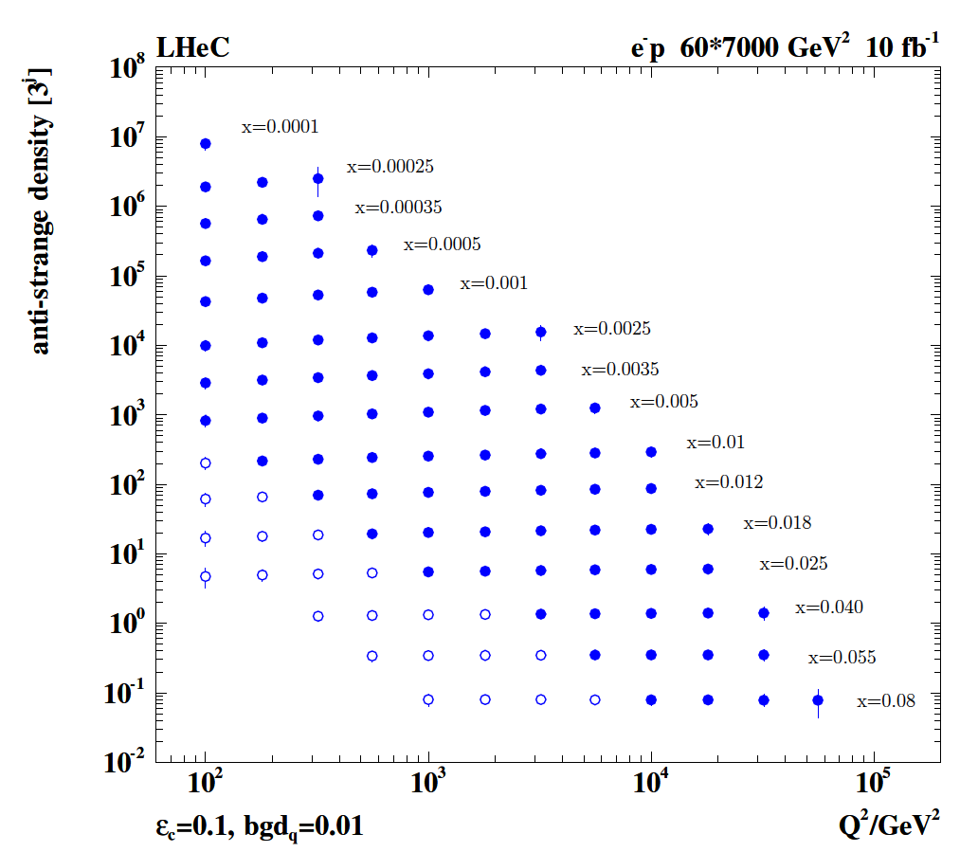
Strange Quark Distribution from LHeC
High luminosity
High Q²
Small beam spot
Modern Silicon
NO pile-up..
First (x,Q²)
measurement of
the (anti-)strange
density, HQ valence?
x = 10⁻⁴ .. 0.1
Q² = 100 – 10⁵ GeV²
Initial study (CDR): Charm tagging efficiency of 10% and 1% light quark background in impact parameter

Slide 35
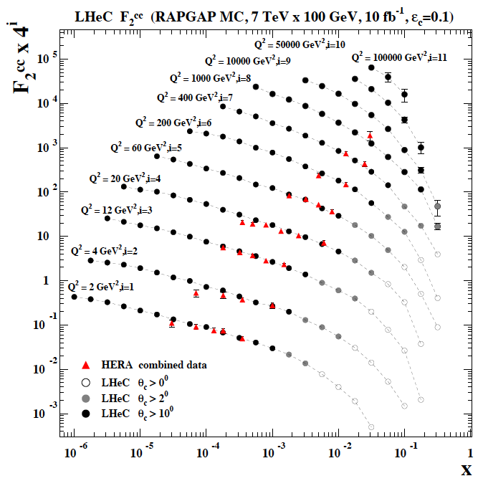
Charm F₂^{cc} and Mass
Heavy Flavour with LHeC
Beam spot (in xy): 7μm
Impact parameter: better than 10μm
Modern Silicon detectors, no pile-up
Higher E, L, Acceptance, ε, than at HERA
→ Huge improvements predicted
 | HERA | LHeC
m_{c}(m_{c})/GeV | 1.26 | ?
δ(exp) | 0.05 | 0.003
δ(mod) | 0.03 | ~0.002
δ(par) | 0.02 | ~0.002
δ(α_{s}) | 0.02 | 0.001
LHeC CDR arXiv:1206.2913
LHeC determines strong coupling to 0.1%
High precision PDF data will reduce the
mod and par errors by a very large amount.
Determination of charm mass to 3 MeV:
crucial for M_{W} in pp or H→ cc in ep
cf also NNPDF3.1 (arXiv:1706.00428) and refs
HERA 0.0005/2.5 .. 0.05/2000 GeV²
LHeC 0.00001/1 .. 0.2/200000 GeV²
ε(c) assumed 10%, 1% light background, ~3% δ(syst)

Slide 36

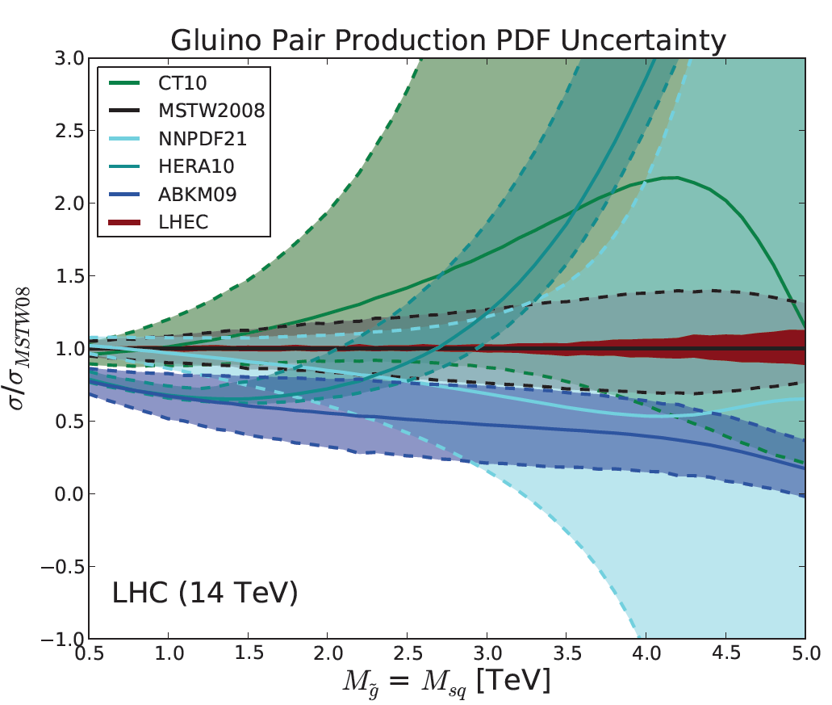
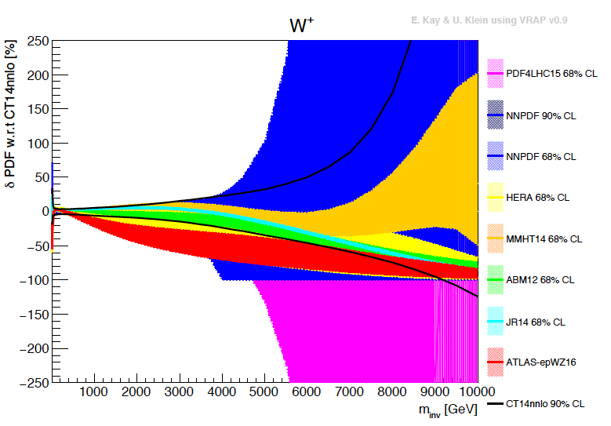
Empowering pp Discoveries
External, reliable input (PDFs, factorisation..) is crucial for range extension + CI interpretation
GLUON
QUARKS
SUSY, RPC, RPV, LQS..
Exotic+ Extra boson searches at high mass
ATLAS
today

Slide 37
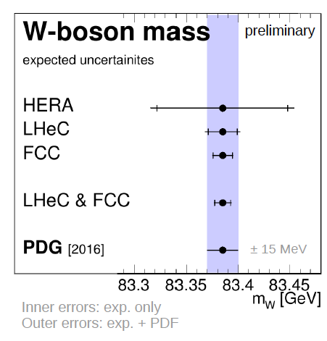
High Precision for the LHC
Spacelike M_{W} to 10 MeV from ep
→ Electroweak thy test at 0.01% !
Predict M_{W} in pp to 2.8 MeV →
Remove PDF uncertainty on M_{W} LHC
Predict the Higgs cross section in pp to
0.2% precision which matches the M_{H}
measurement and removes the PDF error

Slide 38
LHeC Higgs Physics
High precision coupling measurements
Higgs as portal to new physics (in decay and production of non SM Higgses)
CC cross section: 200 fb. That is the ‘same’ value as for Z* → HZ in e⁺e⁻
NC cross section: 25 fb. ZZ → H (→ WW) and WW → H(→ ZZ) uniquely distinguishable.
VBF cross sections in pp at LHC are O(100) fb also.
Final state in ep clean. Pileup 0.1 at LHeC. Theory clear. Luminosity to 0.5-1%.
Detector: full acceptance to η = 4.7 Requirement for high resolution hadron calorimeter
First studies: complete detector, S and B simulation and BDT for H→ bb and cc
New: MADGRAPH based extension to other channels using bb and cc experience
New also: various, often Chinese publications on exotic Higgs physics in ep, cf below
and talks by Uta Klein and Kechen Wang in January at FCC Physics at CERN
H-HH: very hard at LHeC, possible to ~30% at FCC-eh: see arXiv:1509.04016 M Kumar et al

Slide 39
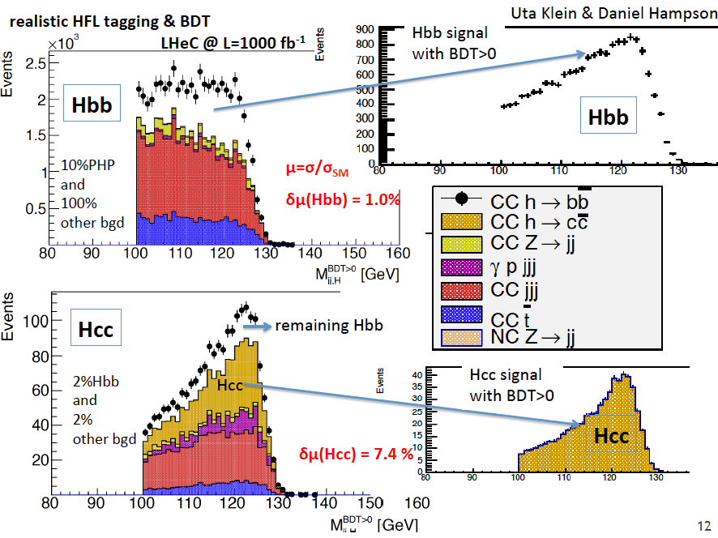
title

Slide 40
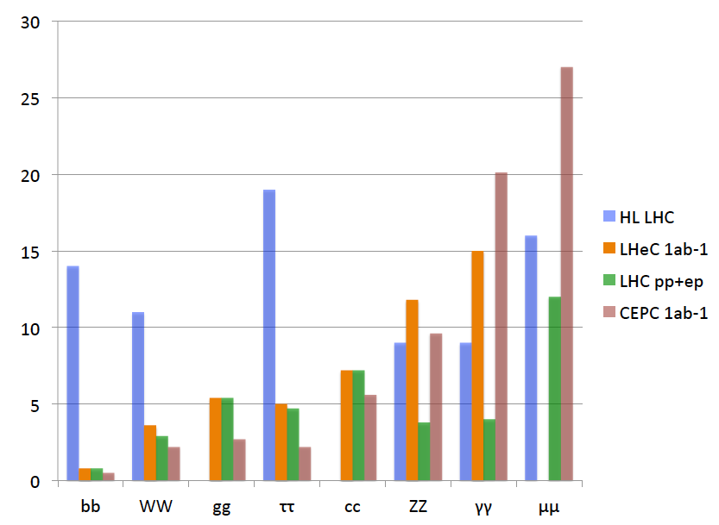
Comparison LH(e)C and CEPC
preliminary
LHC: ATLAS 2014
(will be better)
LHeC: MK+UK
FCC WS1/18
LHC: pp (no thy) + ep
CEPC: M Ruan, 14.1.17
scaled to 1ab⁻¹
Signal strength in %
The ep and the e⁺e⁻ prospects of measuring Higgs decays are (about) the same for same L.
Note that 1ab⁻¹ is 10 years of operation at 10³⁴ , at high reliability.
J Gao: CEPC wants 3 10³⁴ and hopes for 5 ab⁻¹. Theorists write about a 350 GeV operation.
LHeC NC: ZZ→H → bb at high precision which should fix the H-ZZ coupling to 2%.. Γ ??
Sum of all major decay channels: LHC 0.89+-0.12, LHeC 0.99 +- 0.02, LHCep+pp: 1.00+-0.01
In ep couplings are overconstrained. Fit to do. EFT analyses may then include ep.
The addition of the LHeC to the HL LHC transforms that into a high precision Higgs facility

Slide 41
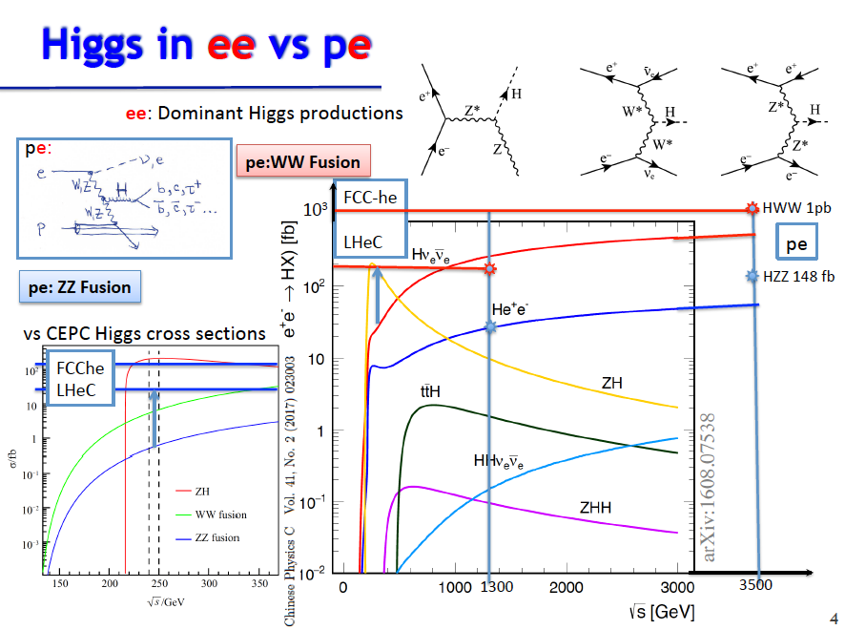
title
Uta Klein, Talk at FCC Workshop 16.1.18

Slide 42

title

Slide 43
FCCeh: Higgs SM Coupling Prospects
δκ/κ [%]
Charged Current ep →νHX
Neutral Current ep → eHX
preliminary
HL LHC: ATLAS-PUB-2014-016 14 TeV 3ab⁻¹ – LHC has no gg, no cc, and poor bb, but rare channels as γγ
LHeC: 1ab⁻¹, 60 GeV x 7 TeV - Work in progress. ep also provides precise: xg, α_{s} and PDFs to N³LO..
LHC (ep+pp): HL LHC with reduced theory uncertainty combined with LHeC
FCCeh: 2ab⁻¹, 60 GeV x 50 TeV - Work in progress. ep also provides precise: xg, α_{s} and PDFs to N³LO..
Improvements: ATLAS 2014 conservative, no CMS. ep (LHeC/FCCeh) are overconstrained:
CC+NC, ratios, sum(br)=1.. → joint coupling determination: especially WW and ZZ should improve
U+M Klein, Contribution to FCC Workshop, 16.1.2018, preliminary. cf talk by Uta Klein

Slide 44
Couplings from Joint Fit to NC and CC Input
δκ/%
SM Higgs Coupling Uncertainties in ep -- PRELIMINARY
UK/MK 2/2018
Work in progress

Slide 45


FCC-eh
Impressive flow of new
physics in ep studies is
being digested for 2018
Kechen Wang, BSM in ep, FCC Workshop 1/2018 at CERN

Slide 46




Lots of important new papers on BSM in ep
Sterile (heavy) Neutrinos in ep → NX
Search for Higgsino at LHeC
arXiv:1612.02728
arXiv:1712.07135
Joint study on pp/pe/ee

Slide 47
QCD - Developments and Discoveries
AdS/CFT
Instantons
Odderons
Non pQCD
QGP
N^{k}LO
Resummation
Saturation and BFKL
Non-conventional PDFs …
Breaking of Factorisation
Free Quarks
Unconfined Color
New kind of coloured matter
Quark substructure
New symmetry embedding QCD
QCD may break .. (Quigg DIS13)
QCD is the richest part of the Standard Model Gauge Field Theory and
will (have to) be developed much further, on its own and as background.

Slide 48

Electron-Ion Nuclear and Particle Physics
Extension of kinematic range in lA
by 4 orders of magnitude:
will change QCD view on nuclear
structure and parton dynamics
May lead to genuine surprises…
No saturation of xg (x,Q²) ?
Small fraction of diffraction ?
Broken isospin invariance ?
Flavour dependent shadowing ?
Relates to LHC Heavy Ion Physics
- Quark Gluon Plasma
- Collectivity of small nuclei (p)?
..
Saturation: needs large xg at small x
ep and eA

Slide 49


Powerful Energy Recovery Linac for Experiments
15mA and 60 GeV correspond to 900 MW power
This can only be realised using energy recovery.
New: high current, high energy, multi-pass: study!
BINP, CERN, Daresbury, Jefferson Laboratory, U Liverpool, Orsay (LAL+INP), + Collaboration

Slide 50


Powerful ERL for Experiments
Collaboration of BINP, CERN, Daresbury/Liverpool, Jlab, Orsay INP+LAL + : CDR 2016/17, TDR 2018/19 ..
https://indico.cern.ch/event/680603/
arXiv:1705.08783
ERL facility: high current and energy
low energy nuclear, particle and astro physics
J Phys G in print

Slide 51

title
PERLE at Orsay
PERLE at Orsay (LAL/INP) Collaboration: BINP, CERN, Daresbury/Liverpool, Jlab, Orsay +
3 turns, 2 Linacs, 500 MeV, 20mA, 802 MHz, Energy Recovery Linac facility
-Demonstrator of ERL for ep at LHC/FCC
-SCRF Beam based development facility
-Low E electron and photon beam physics
-High intensity: O(100) x ELI
5.5 x 24m²
CDR to appear in J Phys G [arXiv:1705. 08783]
Strong low energy physics program:
p radius, sin2theta, dark photons, photon-nuclear physics, ..
A.Bogacz
See also https://indico.lal.in2p3.fr/event/3428/

Slide 52


Frequency Choice
Cost, dynamic heat losses, resistance, Q₀… point to f < 1 GHz (F Marhauser, Orsay 2/17)
Beam beam interactions unstable for f > 1 GHz (D Schulte, D Pellegrini March 2013)
Compatibility with LHC: Decision for 802 MHz ( E Jensen CI Workshop 1/2015, FM input)

Slide 53


Slide 54


PERLE Magnets
70 dipoles 0.45-1.29 T
+- 20 mm aperture, l=200,300,400 mm
May be identical for hor+vert bend
7A/mm2 (in grey area) water cooled
DC operated
220 mm
380 mm
114 quadrupoles max 28T/m
Common aperture of 40mm all arcs
Two lengths: 100 and 150mm
DC operated
250 mm
P Thonet, A Milanese (CERN), C Vallerand (LAL), Y Pupkov (BINP)

Slide 55

1st 802 MHz Cavity
Tests ongoing. CERN-Jlab design, produced at Jefferson Laboratory November 2017
Goal: 16 MV/m, Q₀ > 10¹⁰ operated in CW in the PERLE+LHeC ERLs, prototype also for FCC-ee

Slide 56

Initial 2K Test of 802 MHz Nb Cavity. December 17
High quality, CW: operation point at about 18 MV/m. Quench at 31 MV/m
Rerinsing for field emission suppression, observed at higher gradients.
Next: HOM adapter and cryomodule design – cavity production to proceed.

Slide 57





Next Step: Cryomodule
Plan for production of PERLE cryomodules (2) by IPN Orsay in collaboration with Jlab+CERN
Jlab
SNS 805 MHz cryomodule

Slide 58

title

Slide 59

title

Slide 60
VI Towards e for the LHC

Slide 61

title
LHeC Detector for the HL/HE LHC
e
P.Kostka et al
Length x Diameter: LHeC (13.3 x 9 m²) HE-LHC (15.6 x 10.4) FCCeh (19 x 12)
ATLAS (45 x 25) CMS (21 x 15): [LHeC < CMS, FCC-eh ~ CMS size]
If CERN decides that the HE LHC comes, the LHeC detector should anticipate that

Slide 62



LHeC/FCC ep/eA detector - a test bed for new technology in the twenties
LHeC Detector
Hadron
Fwd-Endcap
Muon Detector
e∓
Dipole
Fwd-HCalo
Insert
Hadronic Barrel Calorimeter
Electromagn.-
Fwd-Endcap
Solenoid
Hadron
Bwd-Endcap
Fwd Tracker
Central
Tracker
Electromagnetic Calorimeter
Bwd Tracker
Dipole
Bwd-HCalo
Insert
Electromagn.-
Fwd-Endcap
p/A
Central Tracker
circular-elliptical beam pipe
4 layers Si-pixel
5 layers Si-strixel
(see Table of Detector Dimensions/Parameters in backup)
Length of Inner Solenoid ~12m

Slide 63

H→ bb in LHeC Detector

Slide 64

Dimensions and Multitudes - LHeC

Slide 65

Detector design: Inner Silicon Tracker (status 3/16)
More detailed designs for other components too. DD4HEP software developments..
An opportunity for R+D and building a novel, challenging 4π detector in the twenties.
Profit from HL LHC detector upgrades, also ILC, with no pileup and small radiation load

Slide 66



Interaction Regions for ep with Synchronous pp Operation
LHeC (CDR)
60 GeV * 7 TeV
Still work in progress:
may not need half
quad if L*(e) < L*(p)
Non colliding p beam
FCC-he (ERL)
60 GeV * 50 TeV
Tentative: ε_{p}=2μm, β*=20cm → σ_{p}=3μm ≈σ_{e} matched! ε_{e}=5μm ..
Rogelio Tomas et al

Slide 67



Installation
Study to fit into LHC shutdown needs directed to IP2
Andrea Gaddi et al
Detector fits in L3 magnet support
Modular structure

Slide 68

title
HL LHC offers unique opportunity for ep and eA detector in the 30ies
O Bruening, F Bordry

Slide 69
Projected Timelines for Future ep/eA Colliders
HL-LHC
HE-LHC
FCC
LHeC
LHeC
something yy? in between?
RHIC
Jlab12 GeV
EIC
2025
2035
2045
HERA: Proposal 1984, Data 1992-2007, Publications 1993-2018
VHEep: Plasma e – LHC. Chinese ep/A projects: Lanzhou (low E) and CEPC/SPPC
Dislaimer: For discussion and illustration at DIS17 only
MK+RY, April 7th, 2017, DIS at Birmingham

Slide 70



Further use of ERL in between HL and HE LHC
F.Zimmermann at LHeC WS 9/17
XFEL: 20GeV e, 0.03mA, 24keV photons. LCLSII: 4 GeV e, 0.06mA, 5 keV photons

Slide 71

Time Projections
European Strategy 2006
Most
likely,
the LHC
will have
been the
main base
for HEP
for ~50
years…
Apparently we are unable to deliver reliable time projections
… and yet we need optimism in order to progress ...
Max Klein - Future HEP - 1.5.15 at DIS2015 Dallas, Texas

Slide 72
Pursue New Physics of Deep Inelastic Scattering

Slide 73
Five Major Themes of Electron-Hadron Physics at the energy frontier
Cleanest High Resolution Microscope
Joint ep and pp Physics at LHC and FCC
High Precision Higgs Exploration
Discovery Beyond the Standard Model
A Unique Nuclear Physics Facility
CERN has the obligation to utilize its potential fully: the HL LHC programme can and should not
“fade away”, new discoveries have to be correctly interpreted, and the world’s Collider
future is with CERN. DIS has to be part of it, as Guido Altarelli and Lev Lipatov had taught us.

Slide 74


title

Slide 75

dis

Slide 76

“The future belongs to those who believe in the beauty of their dreams.”
Anna Eleanor Roosevelt
(1884-1962)
Universal Declaration of Human Rights (1948)
cited by Frank Zimmermann at the FCC Meeting at Washington DC, March 2015

Slide 77
title

Slide 78
Particle Physics with pp-ee-ep
SM was completed with a series of pp, ee and ep machines exploring the 10 GeV scale (ISR,SppS – PETRA, Tristan – electron, muon and neutrino experiments) and the Fermi scale (Tevatron – LEP, SLC – HERA), besides further dedicated experiments [ep SLAC78..].
All three types of colliding experiments were instrumental in the SM establishment:
For example: LEP predicted the top mass and Tevatron found the top quark;
HERA measured the gluon distribution and LHC discovered gg→Higgs→ 4l, yy.
Tevatron saw excess in high pt jets, yet attributed to PDFs with DIS etc
For the first time since decades we have NO definite guidance, no SM particle to find. Note, however, that the Tevatron, LEP and HERA proposals largely emphasised NOT the SM but the BSM (SUSY, LQ) physics. Rarely the SM was a funding argument before either
and the theory was no less speculative . Theory only guides: e.g. Weinberg 1980 SU(5):
end of colliders, go underground to see proton decay … to find neutrino oscillations ..
The LHC stands alone, it has no ep partner to explore the 1 TeV scale and it has no ee partner to study the Higgs boson. Can we build in time a 1 TeV ep collider (yes we could) and can we build a higher (than LEP) energy ee collider (for others to discuss)
The FCC study has hh, ee and eh: yet 5?: time, cost, technology, theory, detectors
+ the public acceptance of such a major step into the unknown and below Lac Leman
MK, presented to UK PPAP, July 2017

Slide 79

Three Lessons from HERA
Need higher energy, higher luminosity and to carefully design the IR
MK Future Deep Inelastic Scattering with the LHeC, arXiv:1802.04317

Slide 80

The strong coupling constant in DIS (today)

Slide 81


on “the strategy”
MK remarks made in the LHeC Coordination June 2017
At ICFA Seminar in Canada 11/17
Quin Qin, Frank Zimmermann
and Shinichiro Michizono

Slide 82

FCC-eh
Kechen Wang, BSM in ep, FCC Workshop 1/2018 at CERN

Slide 83
ep/A with the LHC
Conceptual Design Report: arXiv:1206.2913, published in JPhysG
LHeC: 60 GeV off 7 TeV, L(ep) =10^{33 →34} cm⁻² s⁻¹ (1000 x HERA) in synchronous ep+pp operation
Non default: An expensive generalisation to achieve E_{e}= 500 GeV or more

Slide 84
III LHC
1000 papers:
Higgs Discovery
No BSM up to O(TeV) SUSY RPV/RPC, W’, Z’, Kaluza Klein gravitons, DarkMatter…
QCD to high orders well established in new range
Precision Measurements: W,Z to 1/2 %, MW to 2 10⁻⁴
Some fluctuations
The LHC delivered now 100 fb⁻¹ and is scheduled to deliver 3-4 ab⁻¹ by 2040
Amazing detector performances and innovative analyses by few 1000 people.
30 times more luminosity, slight energy increase. Pileup from 40 to 150, radiation ..
Major detector upgrades (completely new tracker for ATLAS. ITK, perhaps with HGTD)

Slide 85


Strange Strange
Strange quark suppression [dimuons in neutrino data] vs light flavour democracy [W,Z LHC]
Confirmed with much higher precision
HERA+ATLAS → V_{cs}
Expect LHeC+HL LHC to be 10 x better
from +2-3% to surely 0.5% or below
ATLAS: 1612.0301, PRD

Slide 86



Source: DC Photocathode
← Boris Militsyn’s kukhnja at Daresbury

Slide 87

PERLE 3 turn optics (80 MeV Arc)
A Bogacz (24.5.17)
70 Dipoles and 114 Quadrupoles footprint 22 x 5.5 m2

Slide 88

HOM Assessment
Impedance of cavities + oscillating modes (F Marhauser) ≠ Spectral content of PERLE beam (D Pellegrini)

Slide 89
Electrons for the LHC
There are various reasons to indeed build the LHeC
Physics (cf slide before)
The uncertainty of HEP and its experience demand pp+ep+ee
The LHC HL Phase physics program would be transformed with ep/eA
CERN needs to build a new machine 20 years after LHC was built and
20 years before a next big machine may indeed be realised.
An ep detector would be a welcome task following the HL LHC.
There is a window of opportunity with the LHC lifetime, AA ending etc.
The ERL is green, high tech, innovative accelerator technology, in line with XFEL..
Veksler wanted one reason:
ep is the most precise and versatile microscope the world can build and CERN its place

Slide 90


High x Gluon Density Now
High x
Gluon prior to LHC data (2011)
Gluon with (first) LHC data (2015)
used by CT14,NNPDF,MMHT

Slide 91



Top Physics
Top electric charge
EDM and MDM
Anomalous t-q-y and t-g-Z
V_{tb} and W-t-b
Top spin
Top PDF
Top mass
Top-Higgs (1602.04670)
CP nature of ttH (1702.03426)
LHeC and even more FCC-eh are top factories with huge BSM potential
For top itself: maximise Ee. For t as background for Higgs: not too much
Pair production Single production
cf Christian Schwanenberger, Top in ep, Talk at FCC Physics Week 17.1.18

Slide 92

Electroweak Physics: LHeC and FCCeh

Slide 93
title

Slide 94

Uta Klein, Higgs in ep, Talk at FCC Physics Week, 16.1.18

