Slide 1
LHeC
60Gev Energy Recovery Linac
J.Osborne / A.Kosmicki CERN/GS

Slide 2
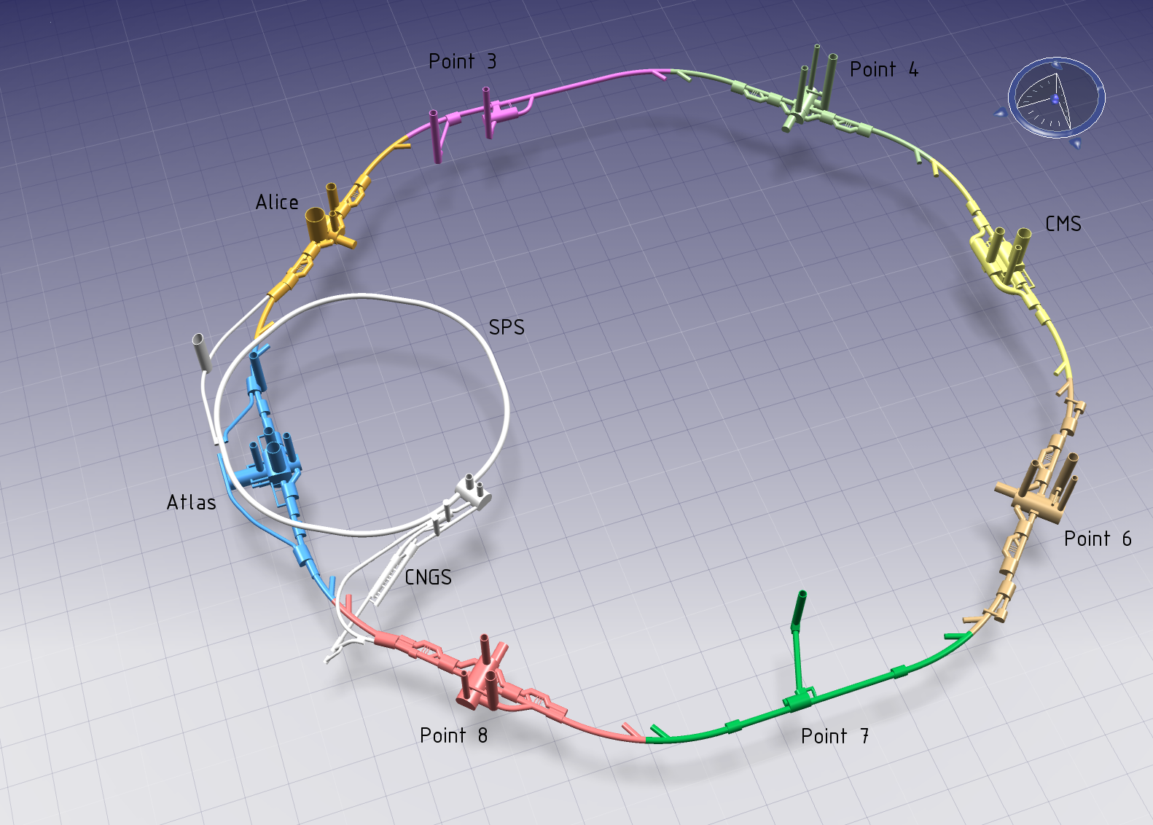
LHeC area
J.Osborne / A.Kosmicki CERN/GS

Slide 3
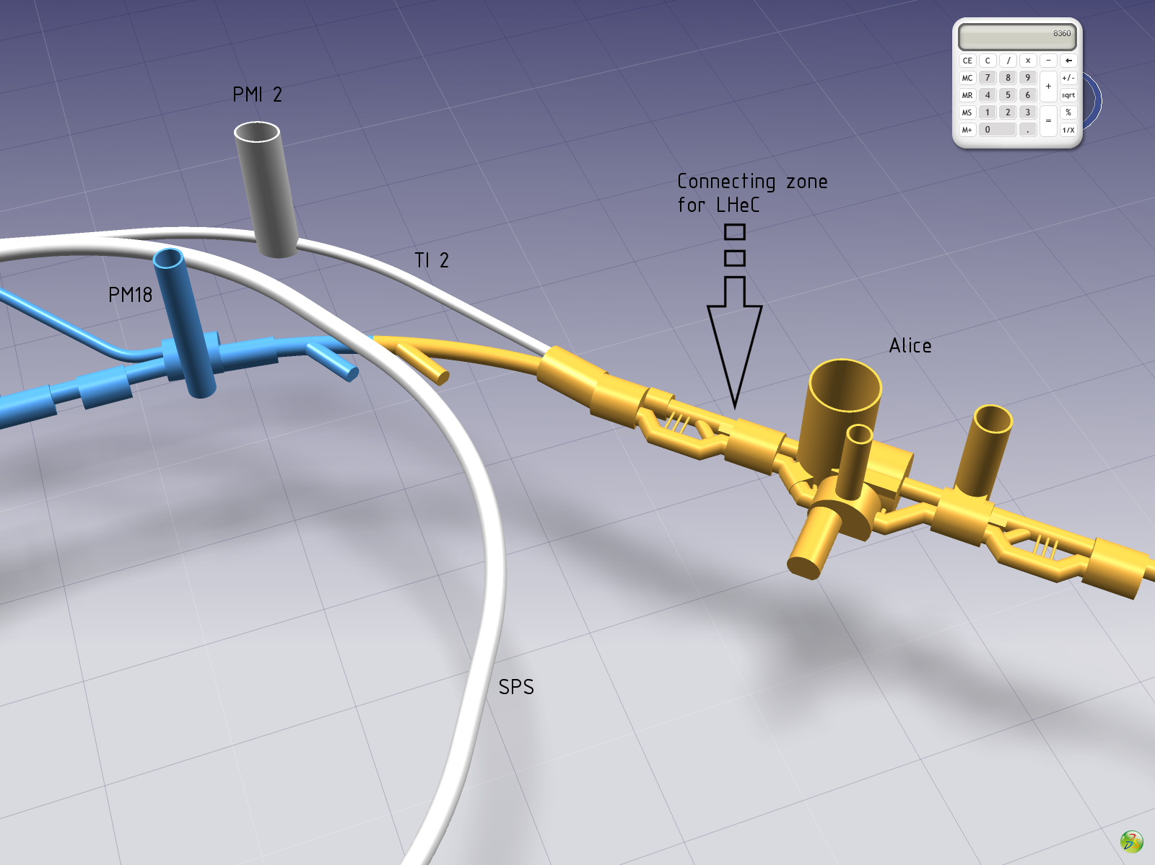
J.Osborne / A.Kosmicki CERN/GS

Slide 4
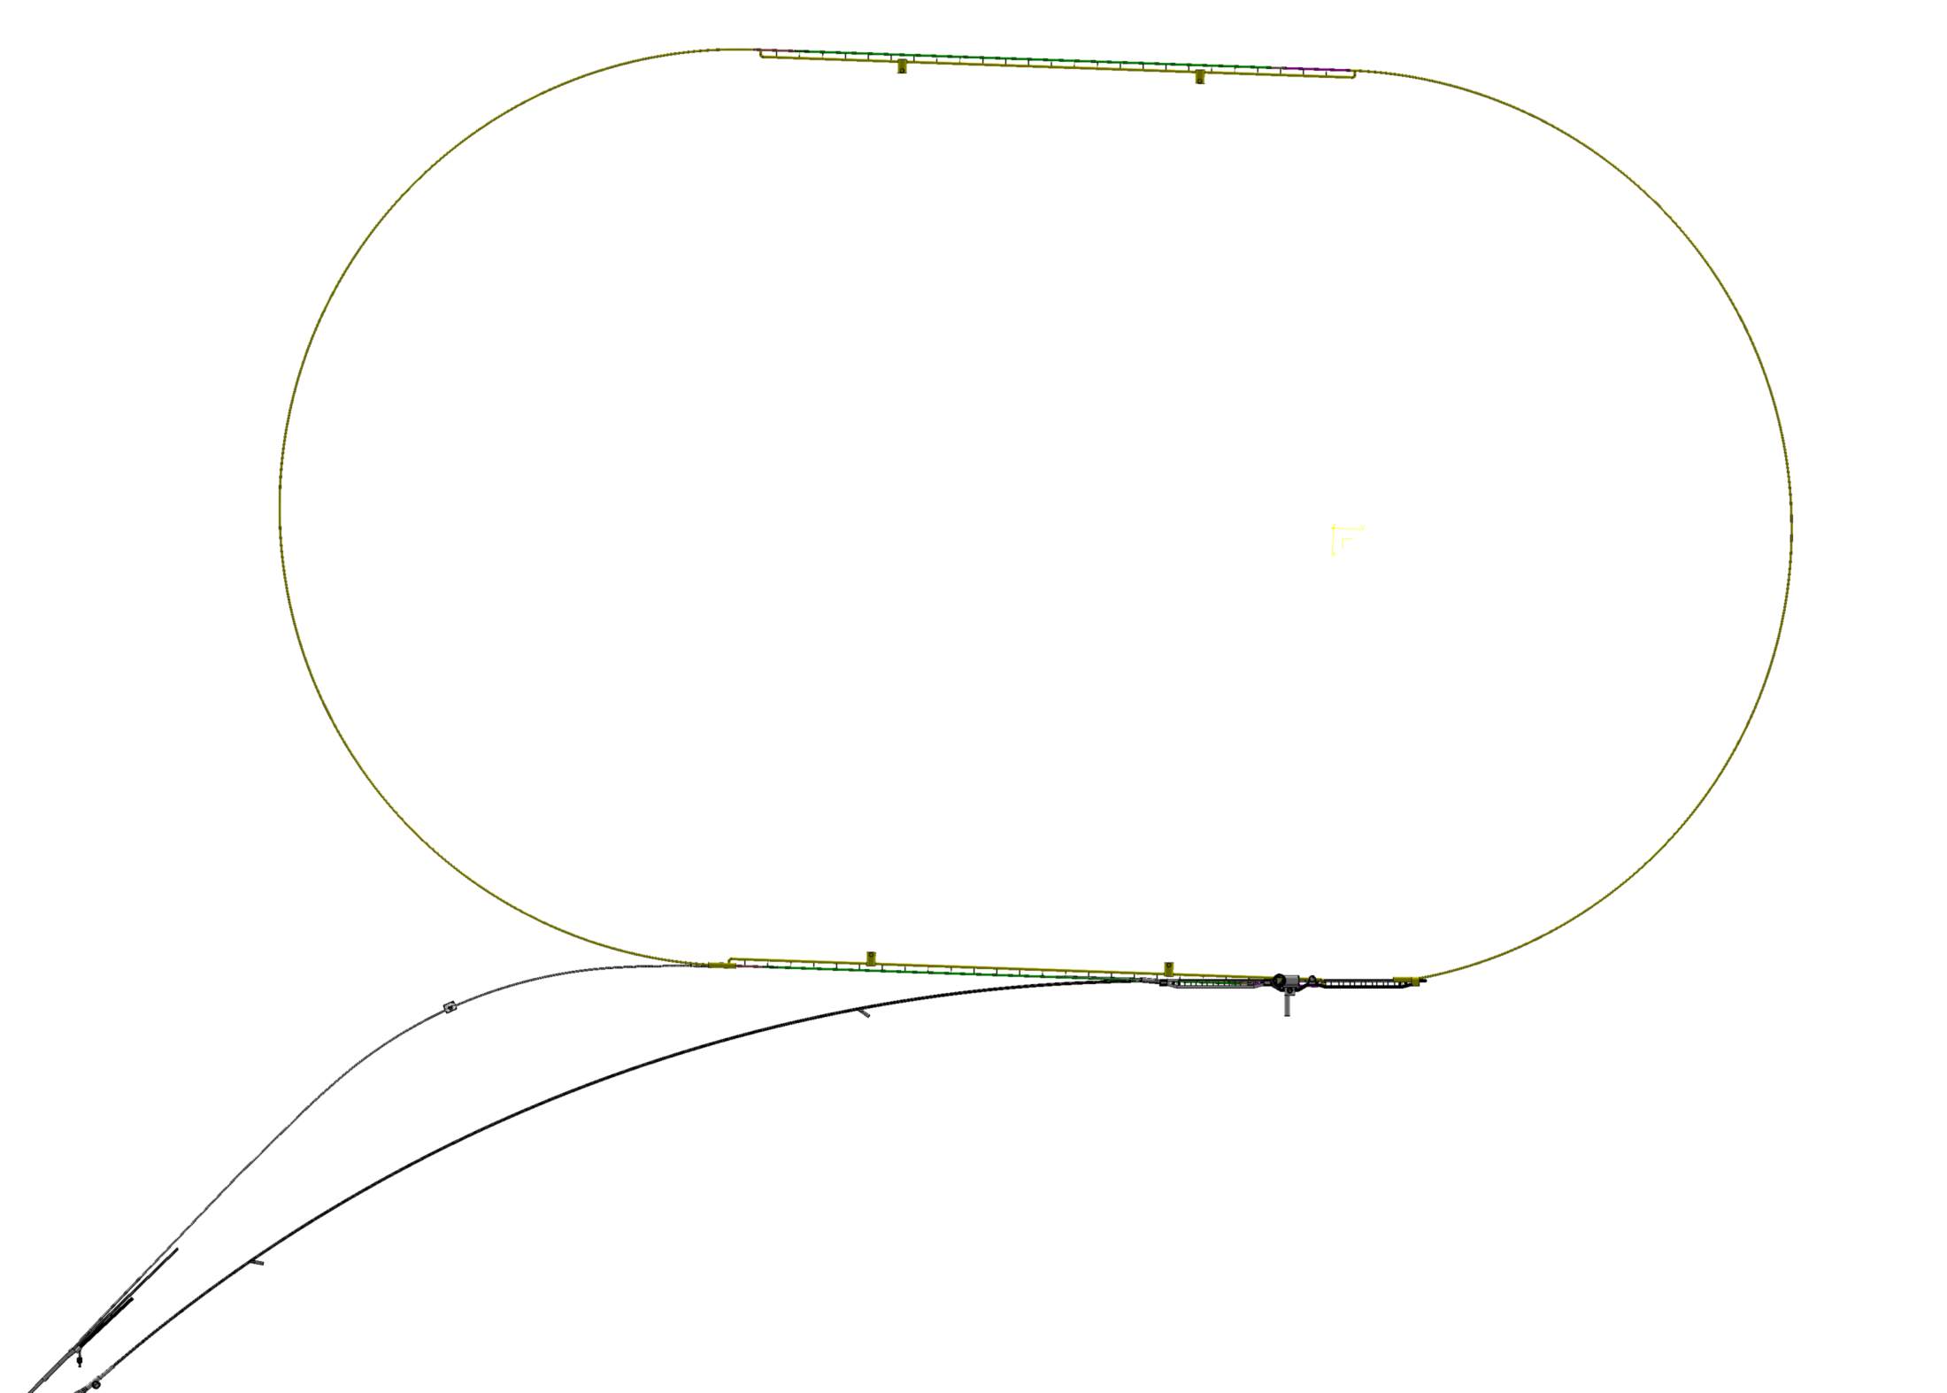
PMI2
TI2
ALICE
LHC
J.Osborne / A.Kosmicki CERN/GS

Slide 5
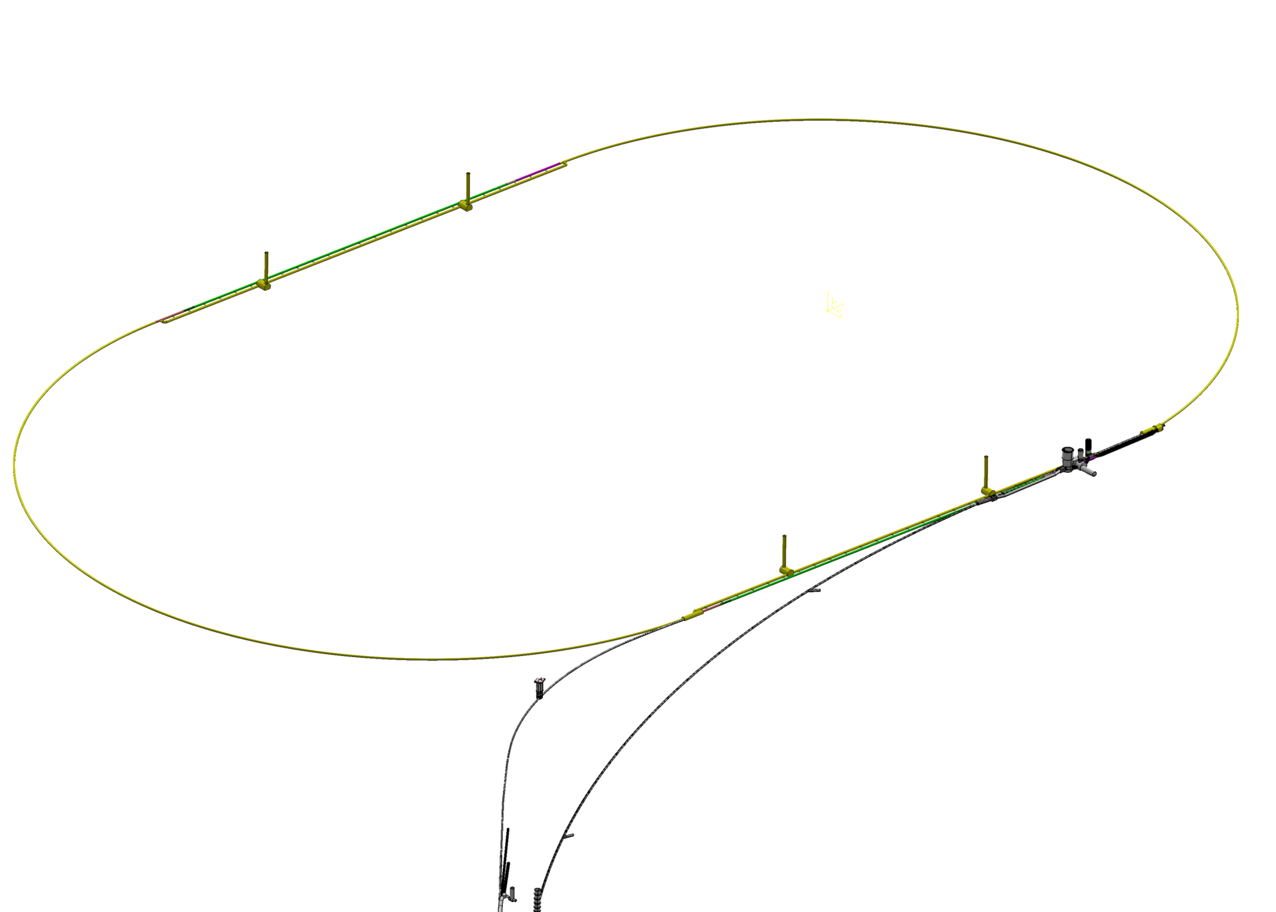
SHAFT #1
SHAFT #2
SHAFT #4
ALICE
SHAFT #3
PMI2
LHC
TI2
J.Osborne / A.Kosmicki CERN/GS

Slide 6
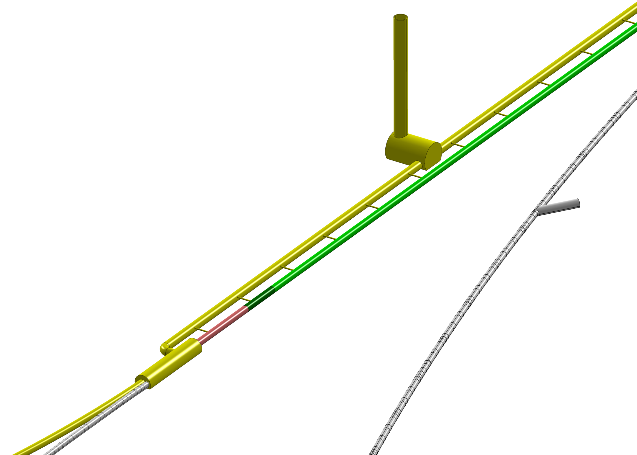
SHAFT #3
LHC
Connection cavern
TI2
J.Osborne / A.Kosmicki CERN/GS

Slide 7
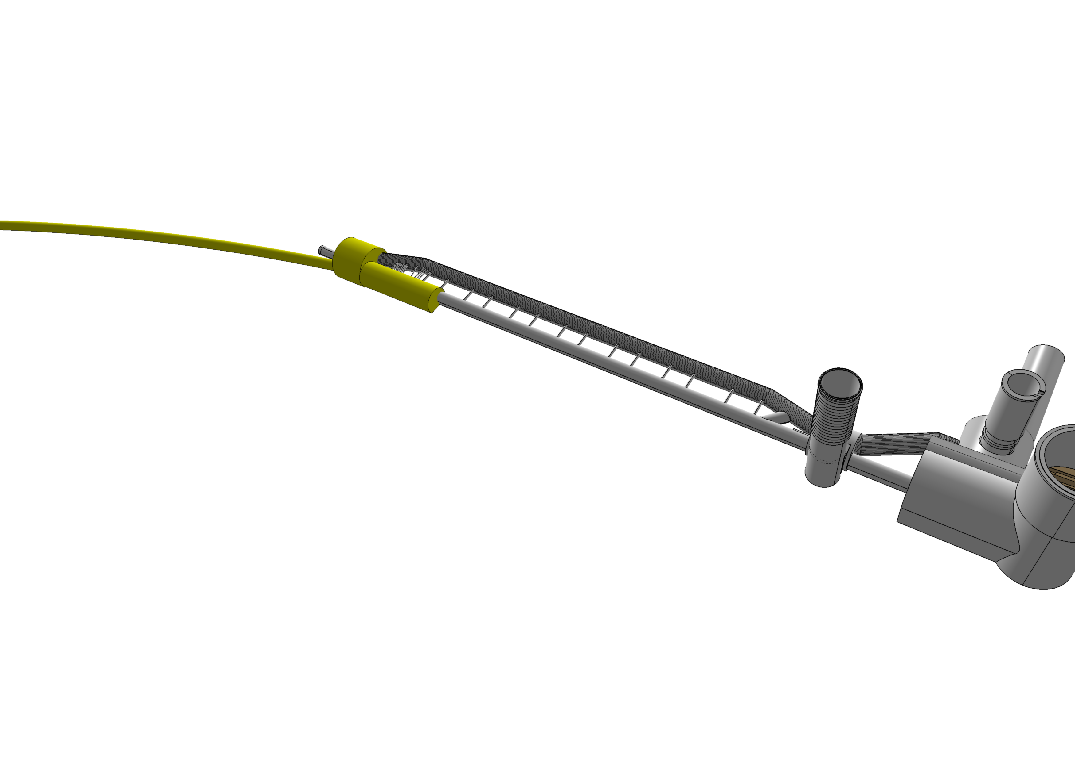
PGC2
ALICE
J.Osborne / A.Kosmicki CERN/GS

Slide 8
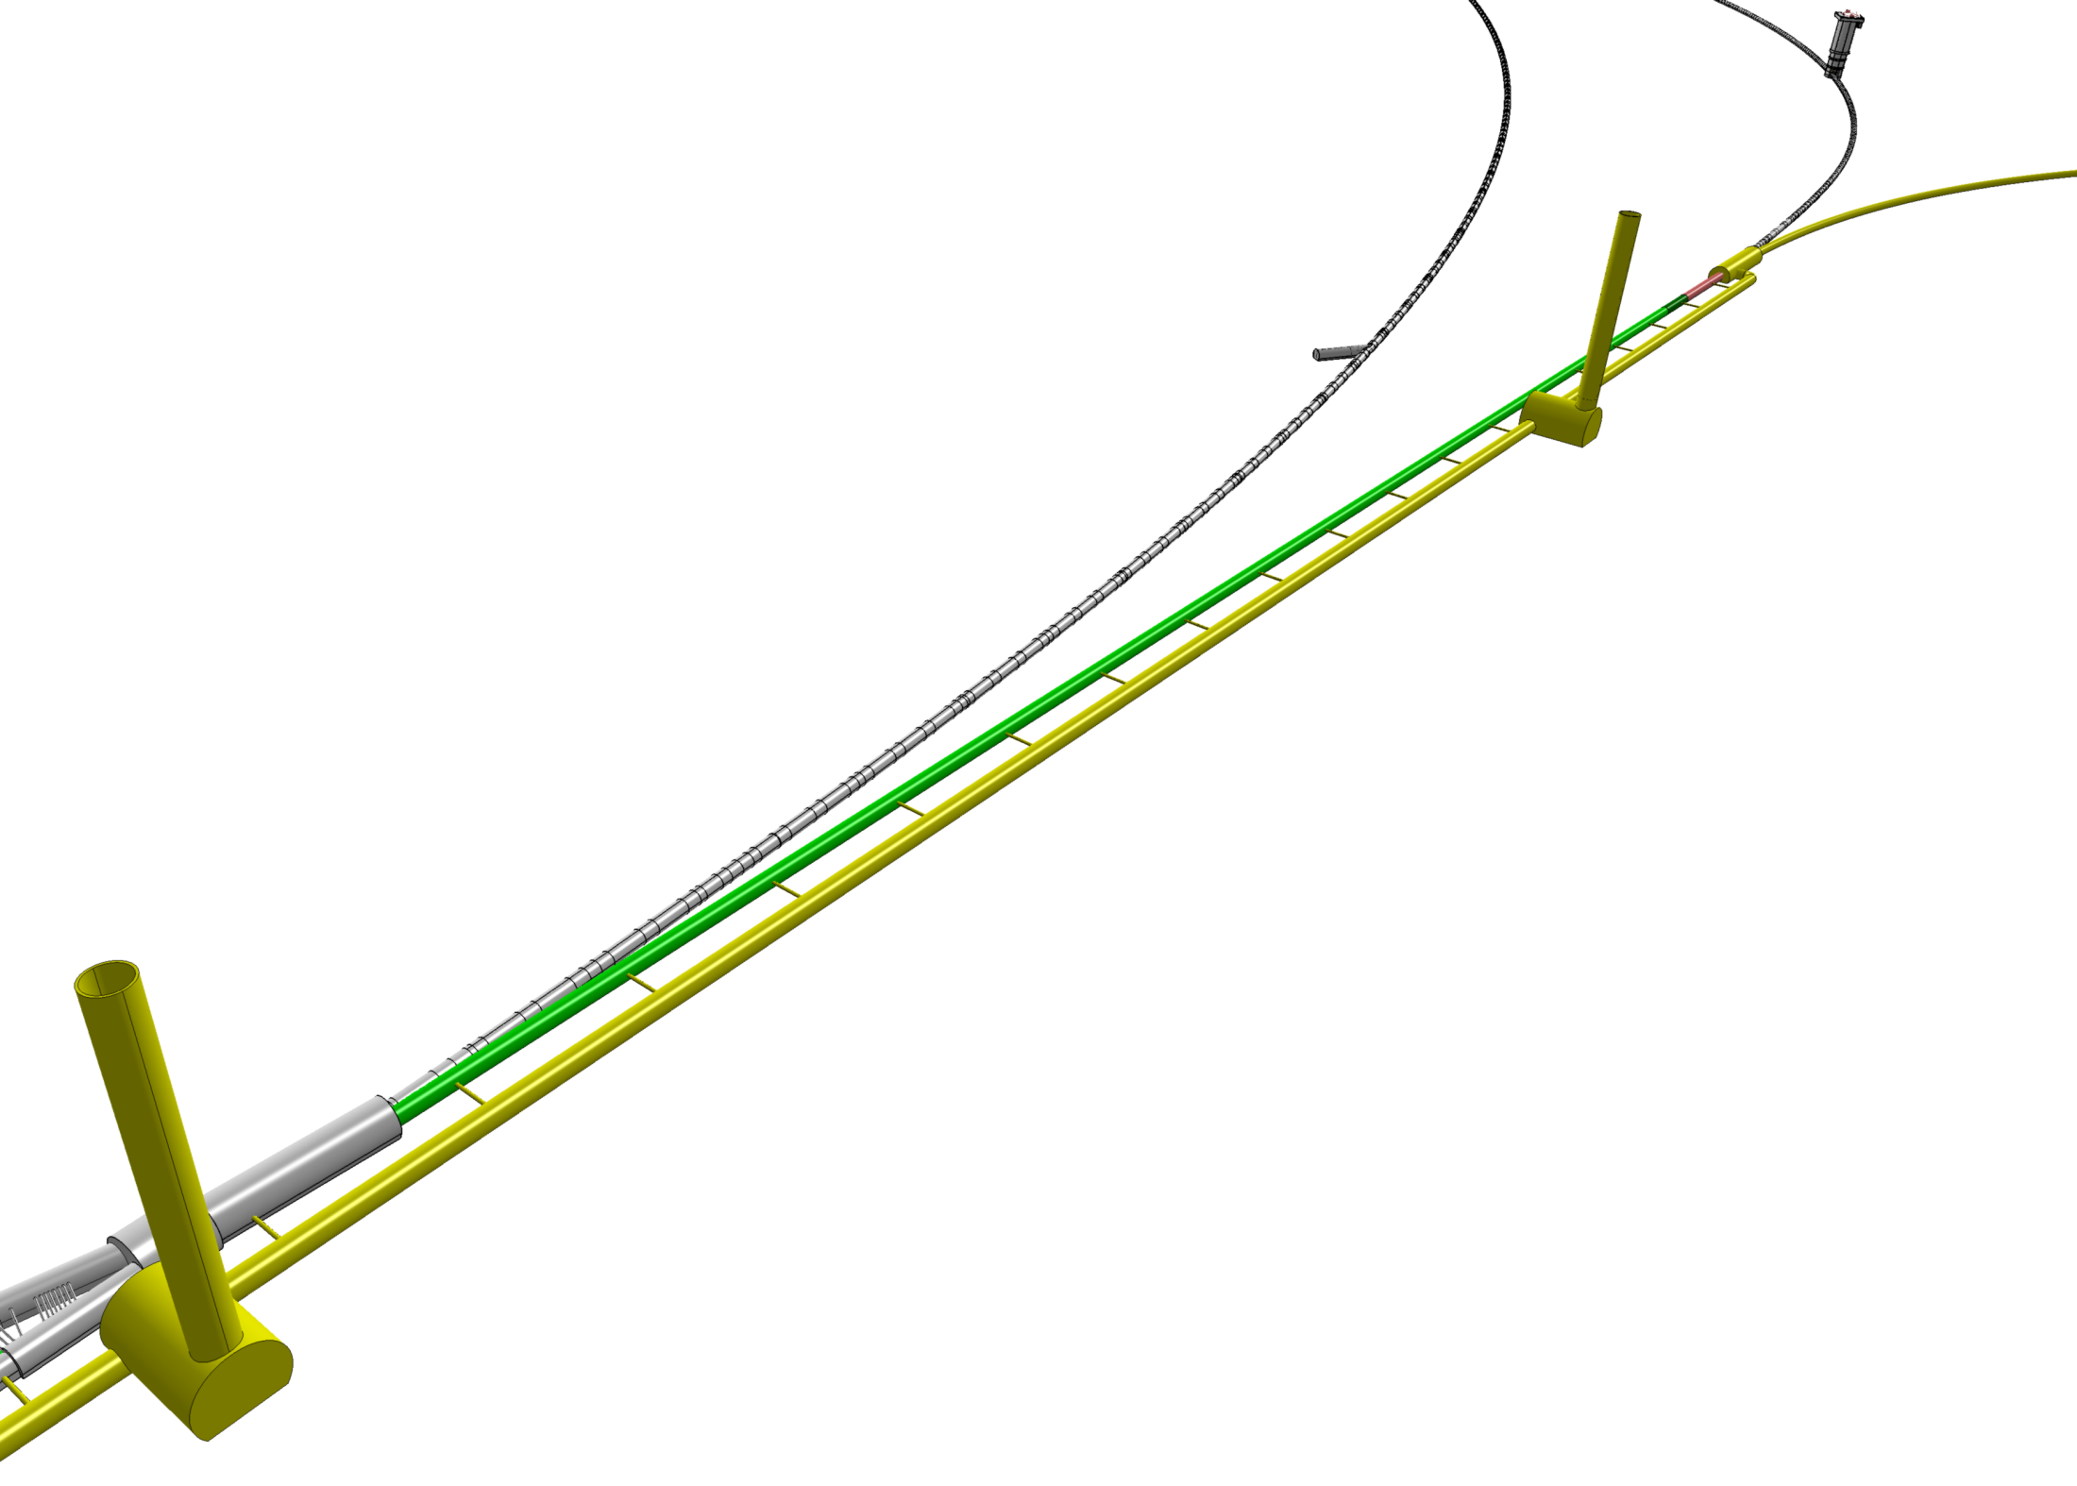
LHC
SHAFT #3
TI2
SHAFT #4
UJ22
J.Osborne / A.Kosmicki CERN/GS

Slide 9
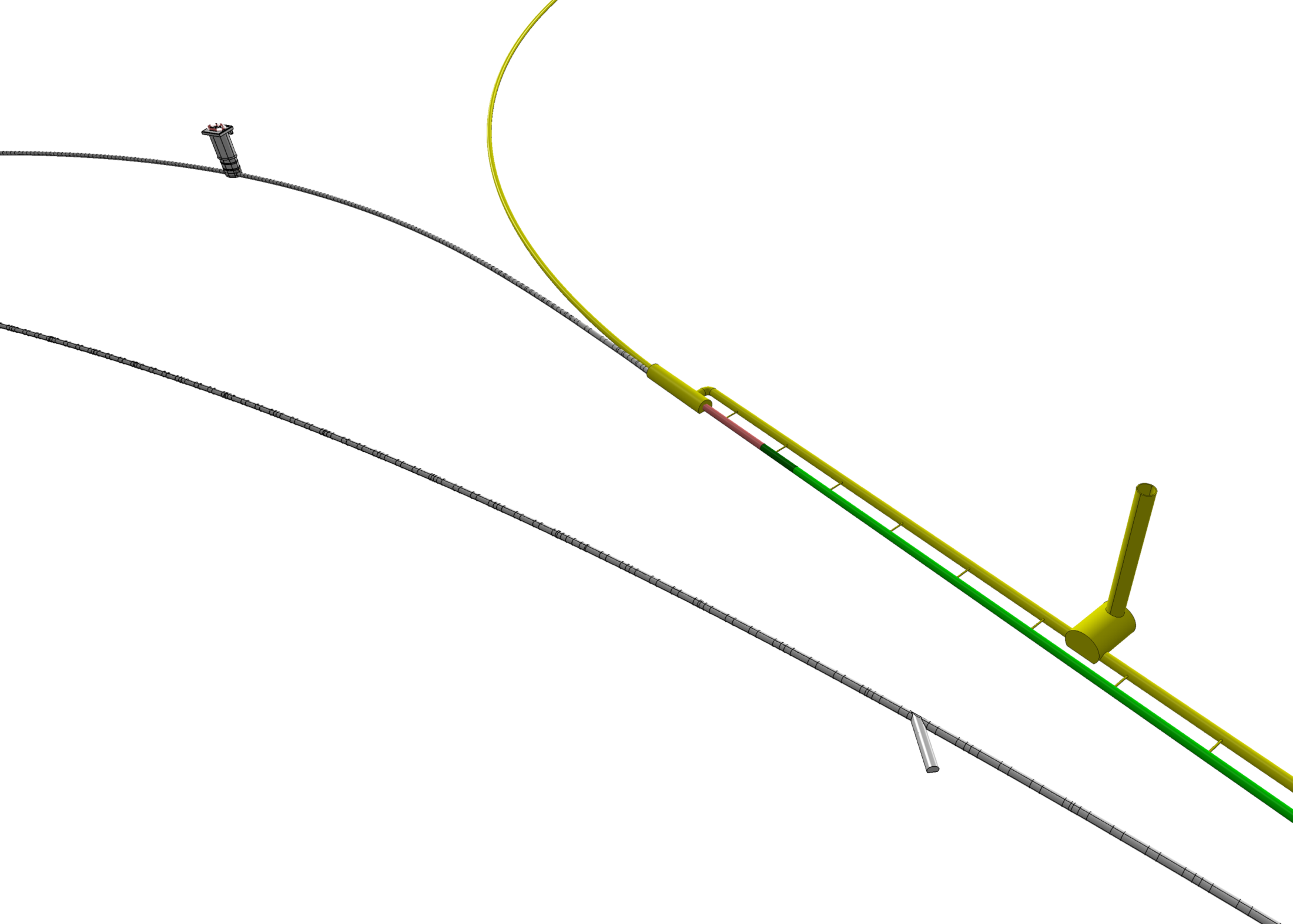
PMI2
TI2
Connection cavern
LHC
SHAFT #3
J.Osborne / A.Kosmicki CERN/GS

Slide 10
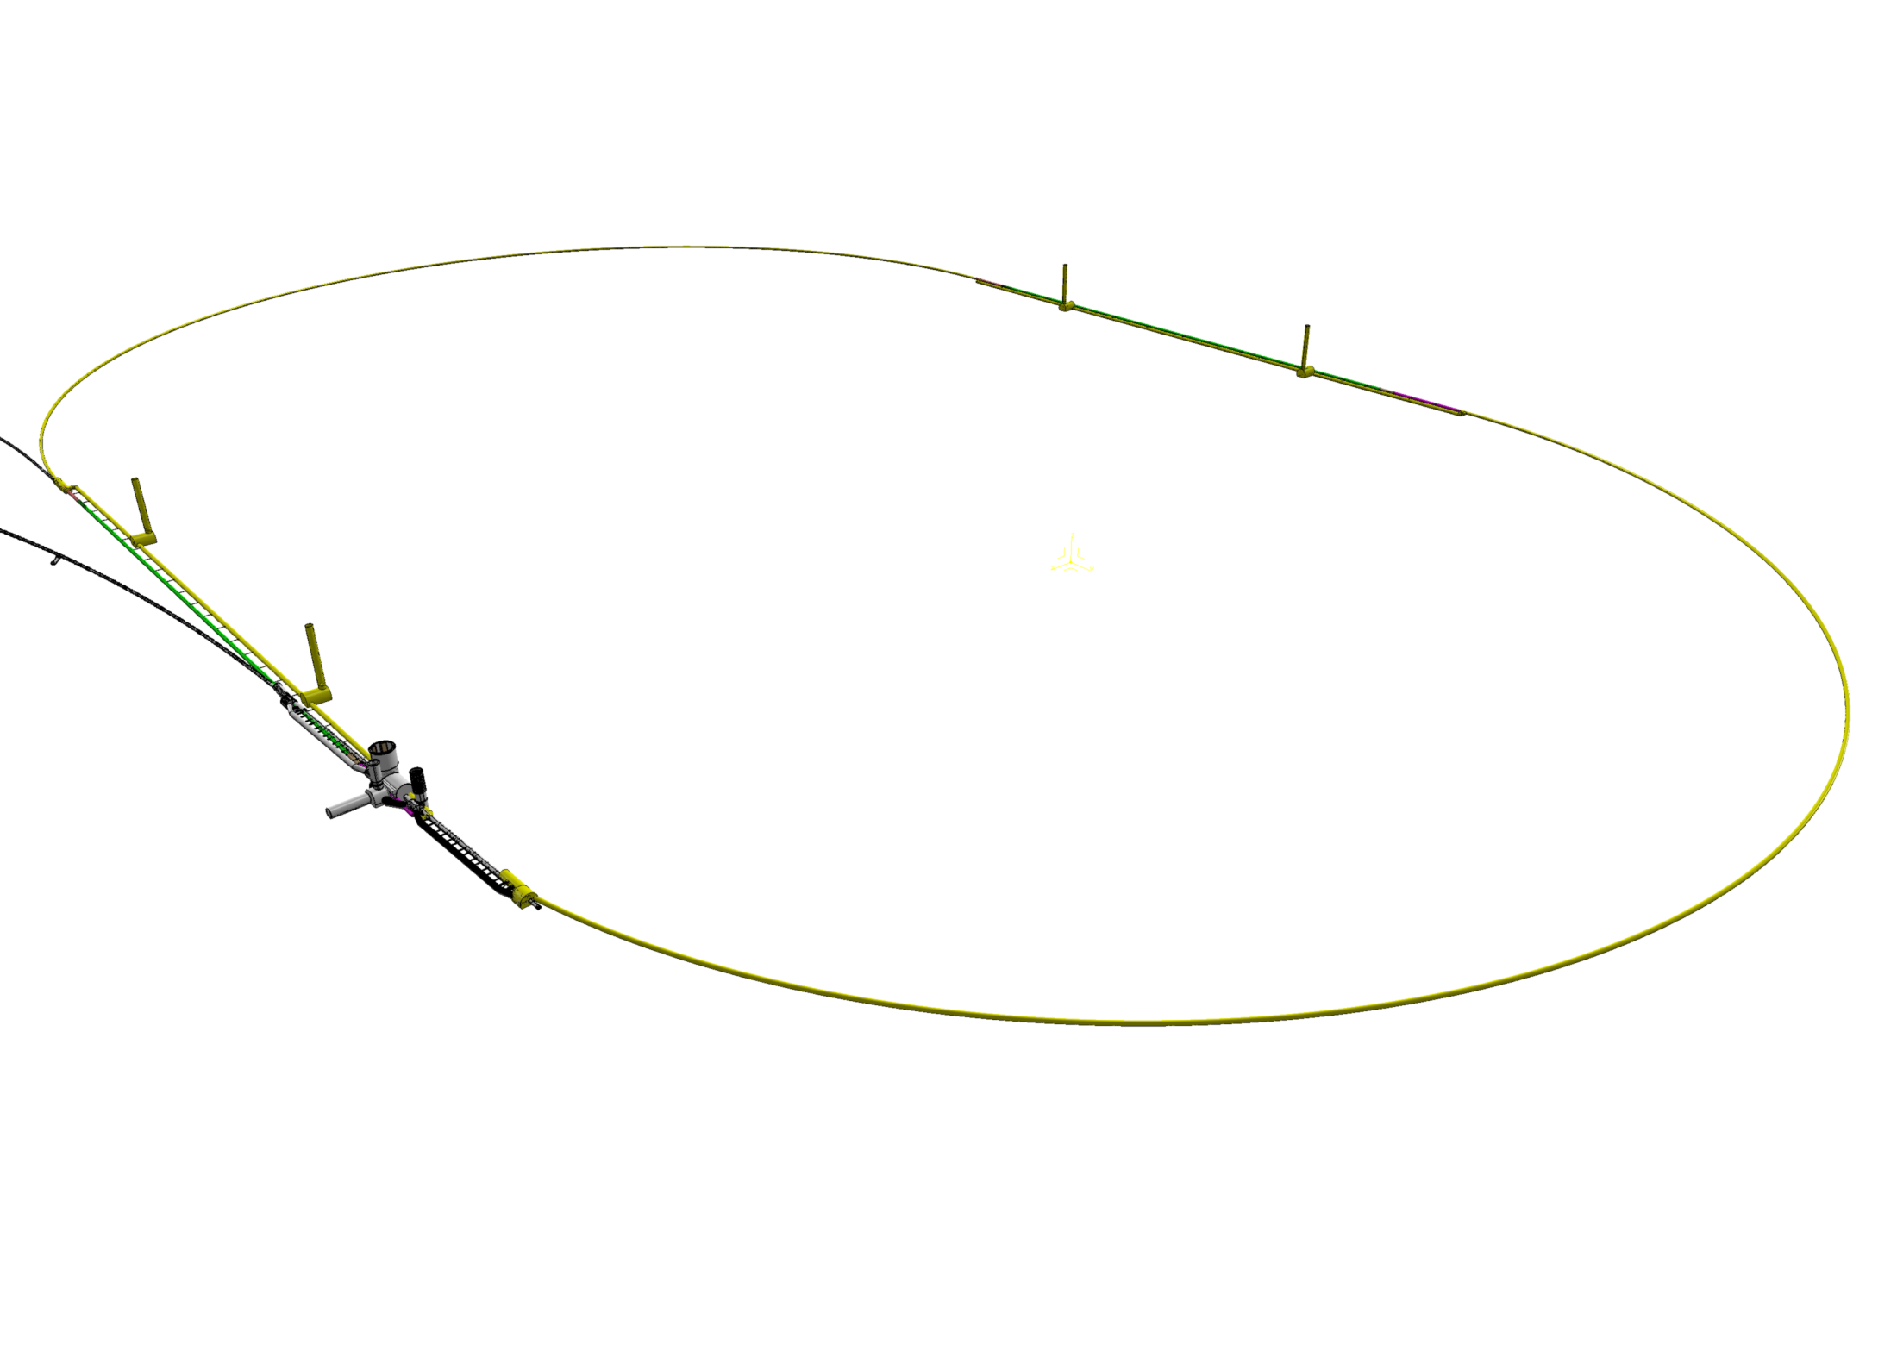
Point 2 - ALICE
J.Osborne / A.Kosmicki CERN/GS

Slide 11
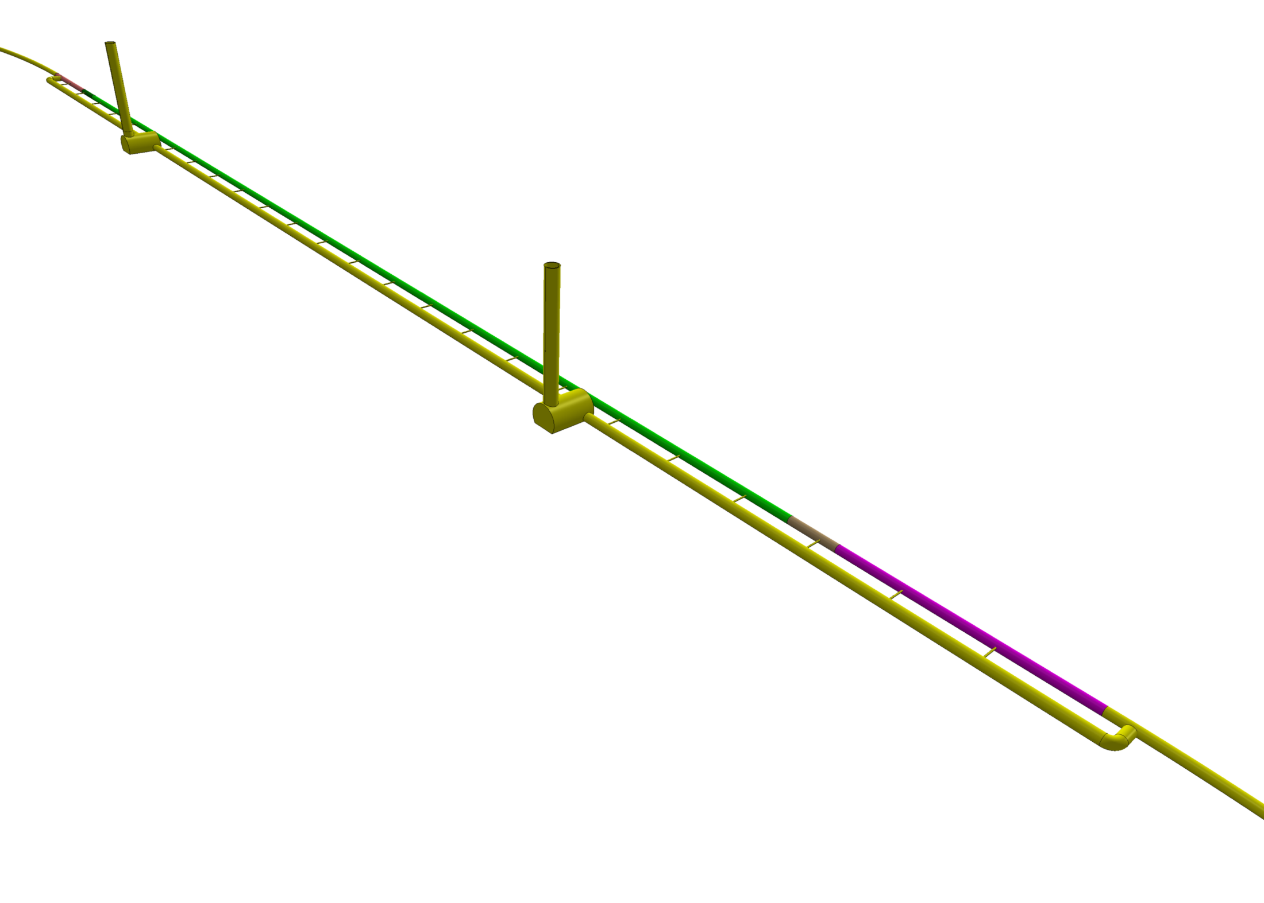
J.Osborne / A.Kosmicki CERN/GS

Slide 12
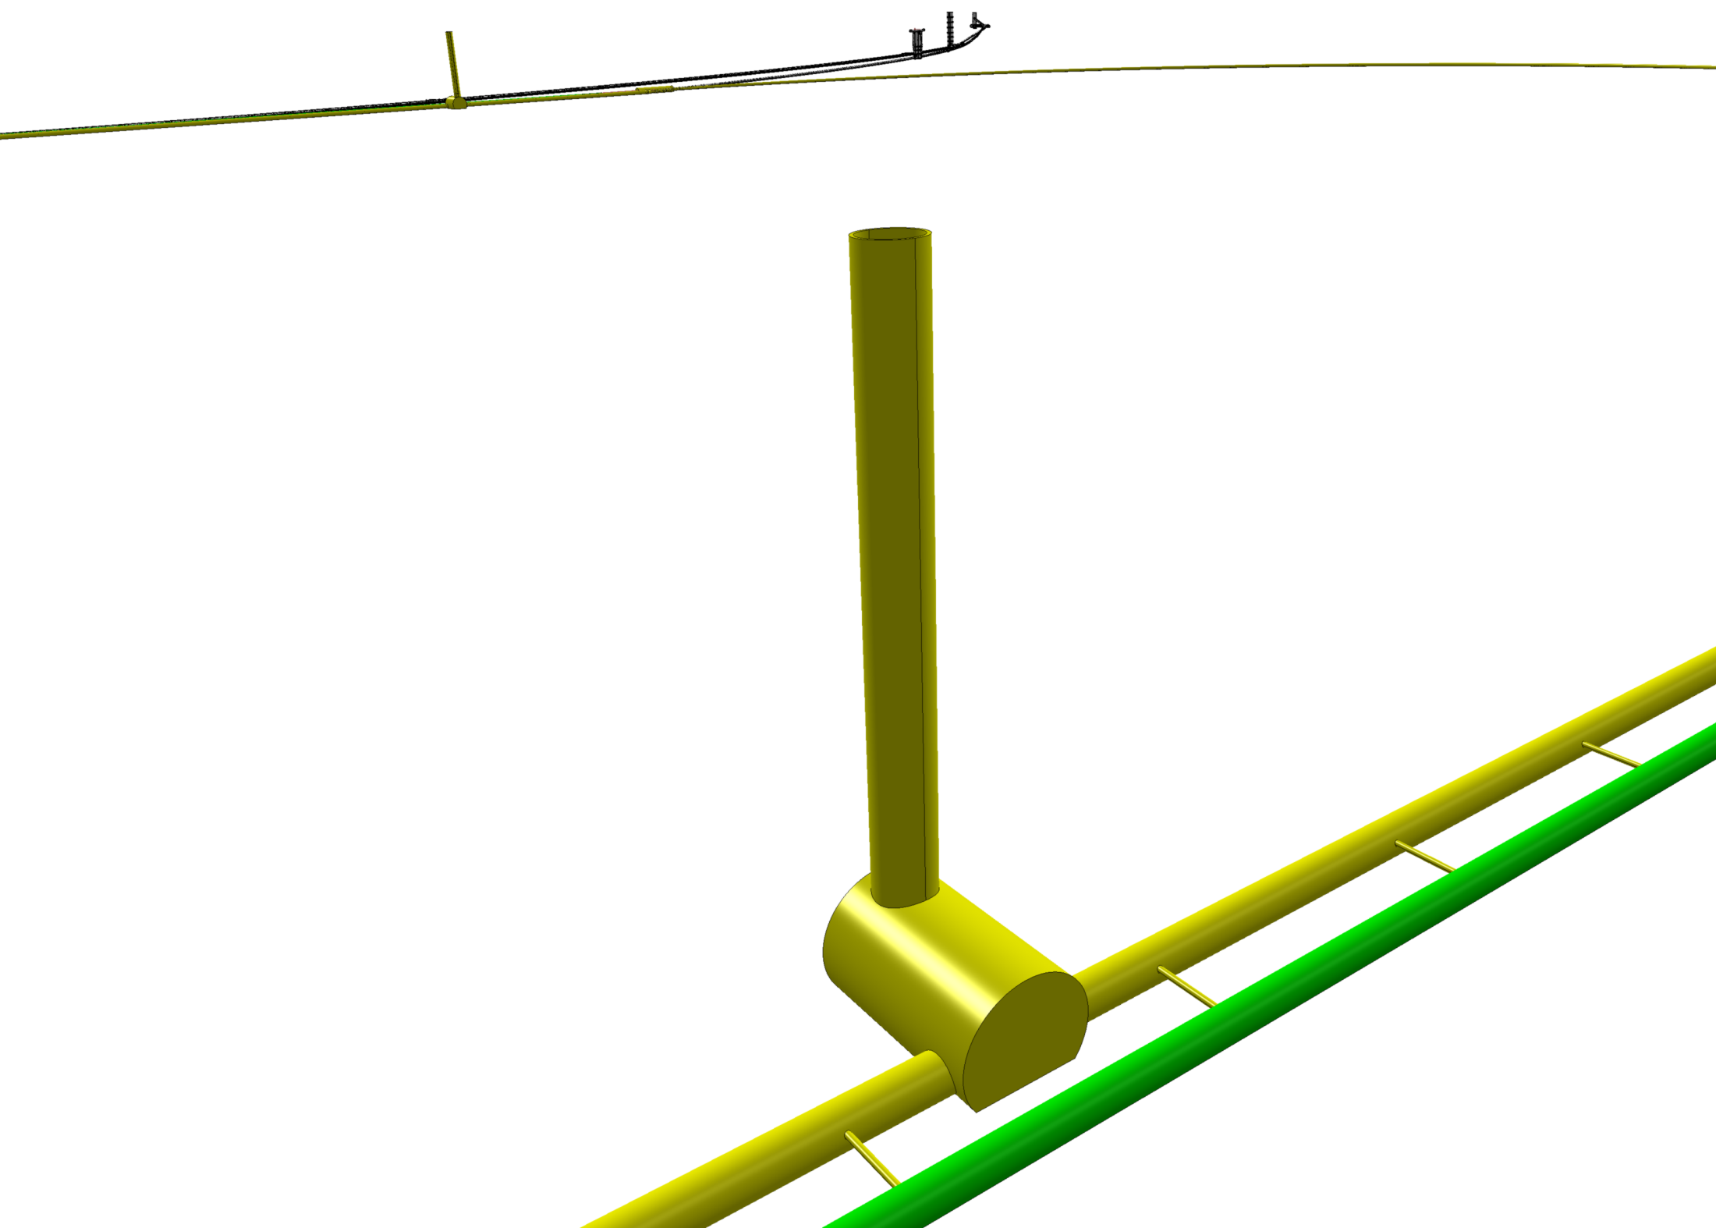
J.Osborne / A.Kosmicki CERN/GS

