Slide 1

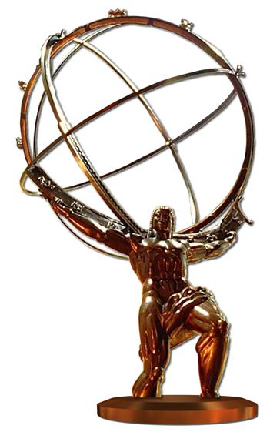

W+Z Physics with ATLAS and CMS
Recent PDF Related Results
Max Klein
Workshop on PDF and Standard Candles at the LHC - Karlsruhe, 19.3.2012

Slide 2
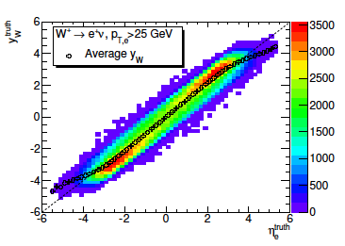


Drell-Yan and Deep Inelastic Scattering
for W use pseudorapidity
η_{l}=-ln tanθ_{l}/2
P:propagator
Z (NC) channel
W± (CC) channel
New constraints to PDFs
lo/hi mass to access lo/hi x
No nuclear corrections in pp
M.Klein, Karlsruhe 19.3.12

Slide 3
why W+Z at the LHC?
1. Energy Calibration and Lepton Identification [~1% reached]
2. Constrain Parton Densities [dσ/dy,η,W,Z+c,b]
3. Explore QCD in new kinematic domain [p_{T}(W,Z), W,Z+jets]
4. Perform precision electroweak measurements [Pol(W),sin²Θ,TGC]
5. Relation to Higgs: H → WW and H→ ZZ→ 4l and H → ττ as Z → ττ
Recent overview on ATLAS and CMS electroweak results:
J.Kretzschmar Moriond Electroweak and further talks at La Thuile and Moriond QCD
M.Klein, Karlsruhe 19.3.12

Slide 4
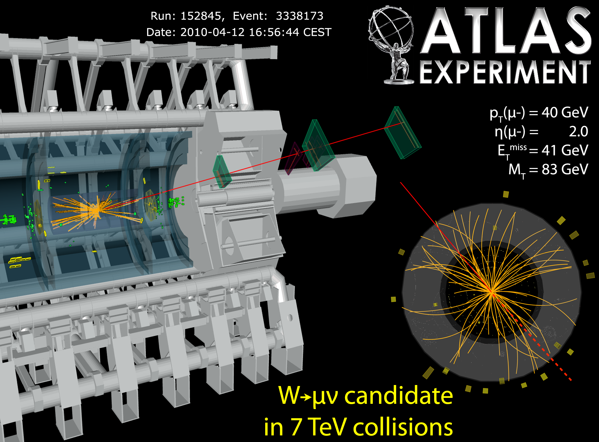
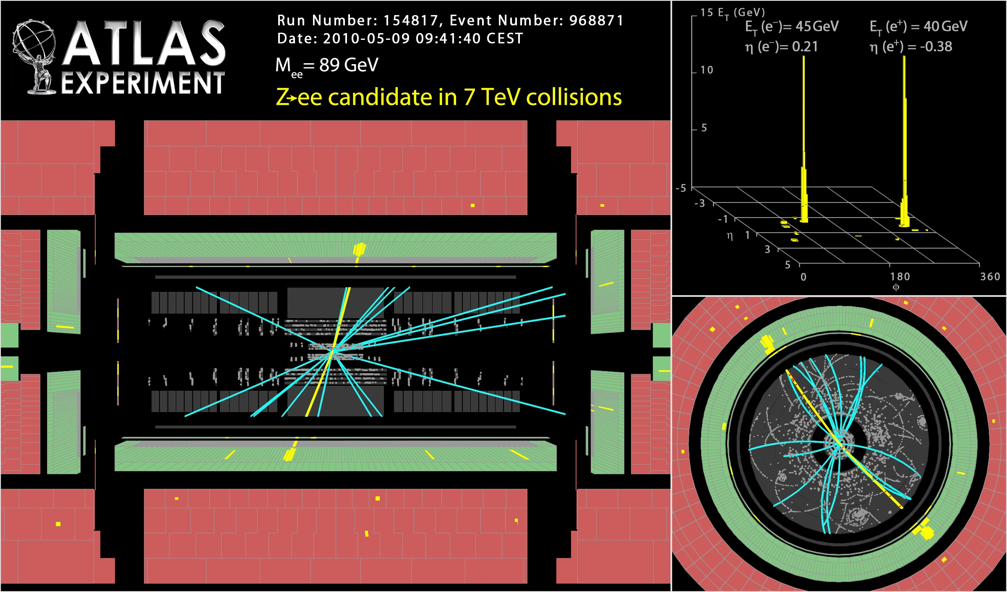
W and Z events in ATLAS
W → μν
Z → ee
Clear signature, copious: about 10M W± and 1M Z in e+μ per 1fb⁻¹ luminosity
p_{T}^{l} > 20 GeV, p_{T}^{ν} >25 GeV, m_{T}>40 GeV p_{T}^{l} > 20 GeV, 66< M_{ll}< 116 GeV |η_{l}|<2.5 (|η_{e}|<4.9)
M.Klein, Karlsruhe 19.3.12

Slide 5
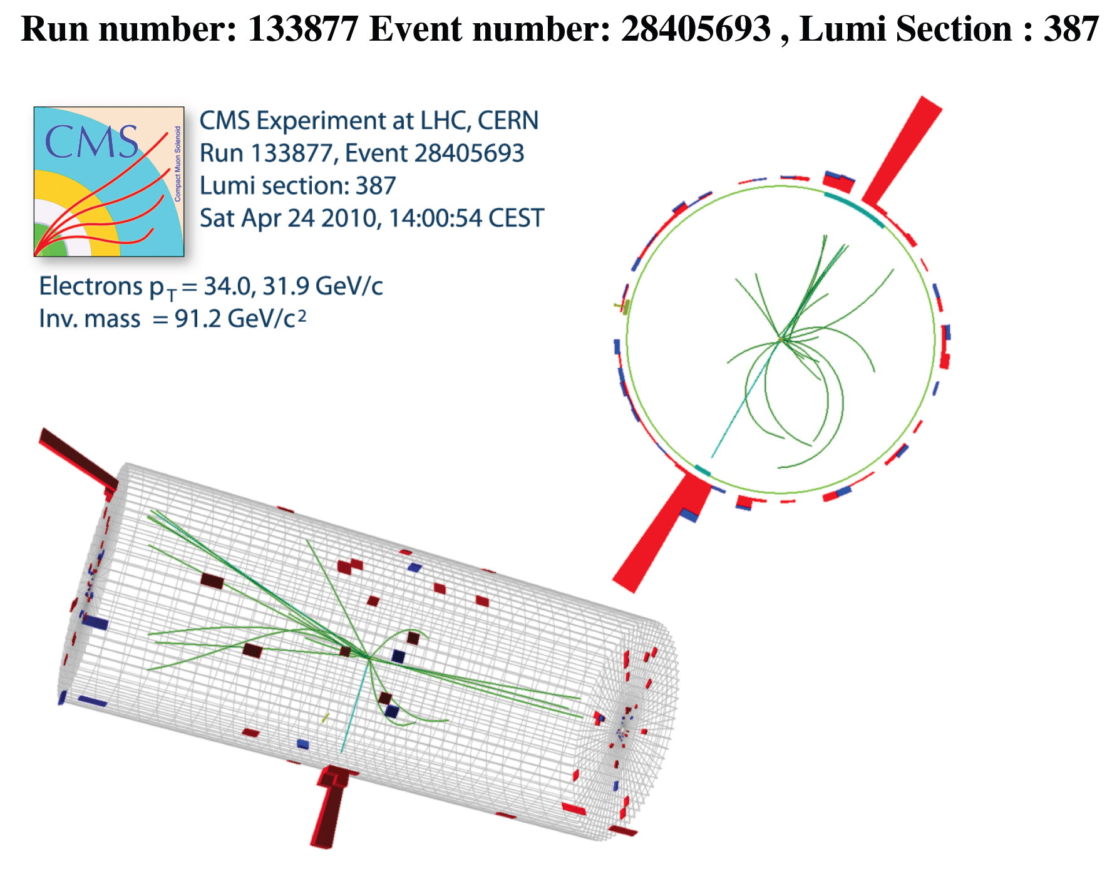
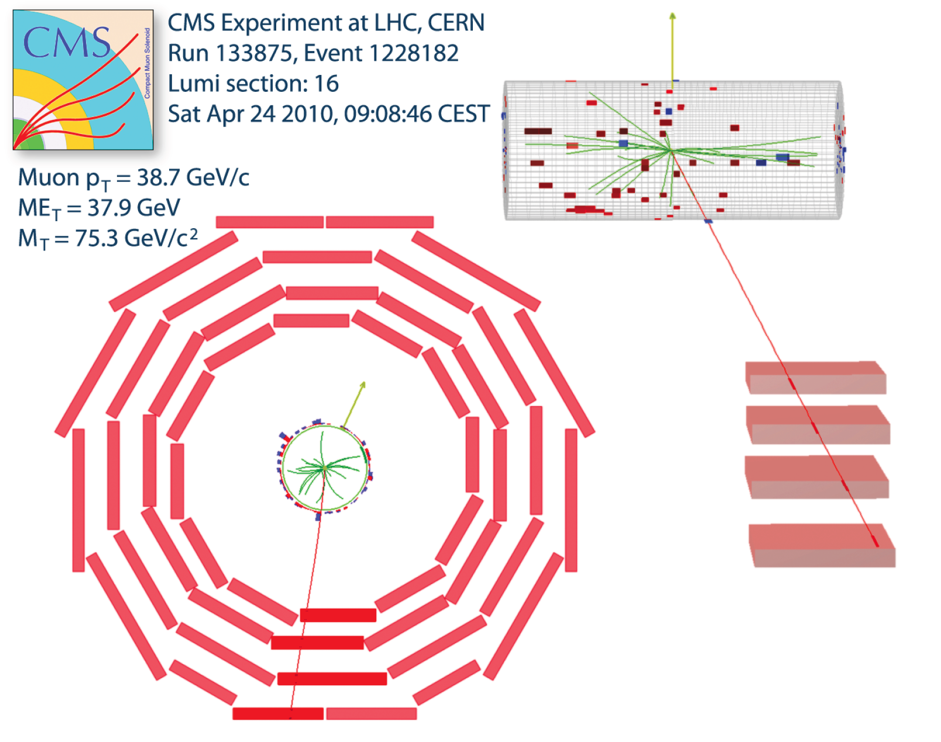
W and Z events in CMS
W → μν
Z → ee
Clear signature and as copious as in ATLAS [even a bit more?]..
p_{T}^{l} > 25 GeV, p_{T}^{ν} >25 GeV, |η_{l}|<2.1, m_{T}>40 GeV p_{T}^{l} > 25 GeV, 60< M_{ll}< 120 GeV, |η_{l}|<2.1
M.Klein, Karlsruhe 19.3.12

Slide 6
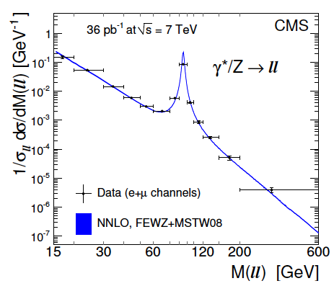
Drell-Yan Spectrum in Neutral Currents
MK911
CMS: arXiv:1108.0566 (August 2011) JHEP P10 (2011) 007
Normalised DY spectrum measured with 2010 data
to 6% (~20GeV), 3% (Z peak) and 20% at highest M
Low and high mass dominated by Z production
γZ interference +- 5% left and right from Z peak
M_{Z’} > 2.21 TeV (ATLAS), 1.94 TeV (CMS)
ATLAS-CONF-2012-007 CMS-EXO-11-019
M.Klein, Karlsruhe 19.3.12

Slide 7
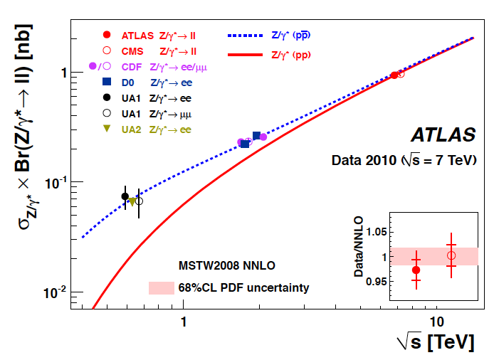
Total Z→ll Cross Sections vs √s=2E_{p}
Good agreement between ATLAS and CMS within few % measurement precision.
M.Klein, Karlsruhe 19.3.12

Slide 8
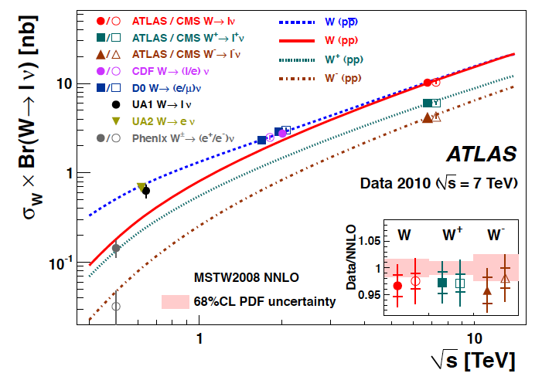
Total W→lν Cross Sections vs √s=2E_{p}
Good agreement between ATLAS and CMS within few % measurement precision.
M.Klein, Karlsruhe 19.3.12

Slide 9
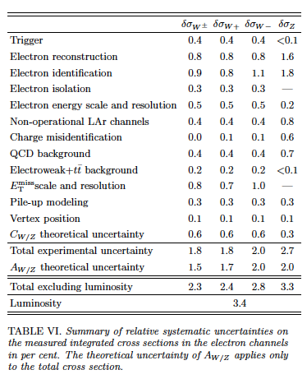
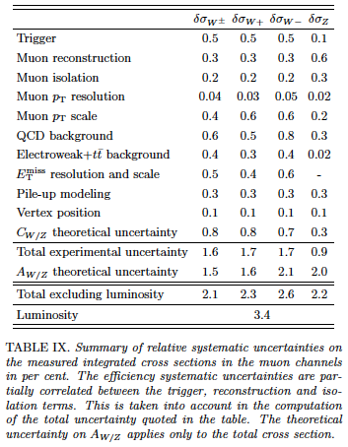
Integrated Cross Section Uncertainties
1-2% precise fiducial cross sections + 3.4% from luminosity. ATLAS
Data averaged with account for correlations.

Slide 10


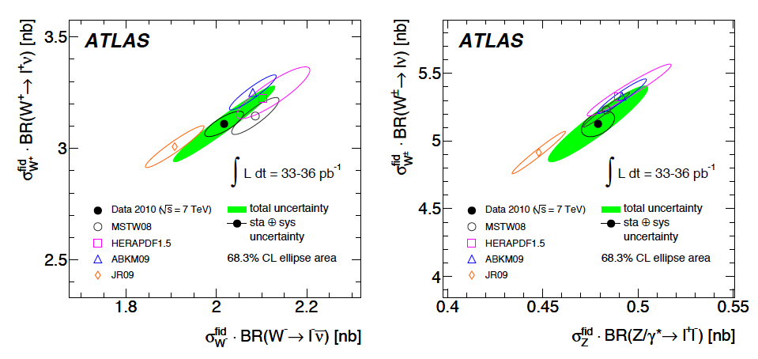
Integrated W-Z Cross Sections (in fiducial regions)
Measurement uncertainty vs σ^{tot} reduced as acc (thy) error becomes negligible.
Theory errors taken as 68% for ellipse. PDF uncertainties only, which are
defined differently by fit groups. Comparison to NNLO appropriate (and
possible with PDFs and FEWZ+DYNNLO). Reduces scale uncertainty effect.
arXiv:1109:5141 → PRD to appear
Cf also NNPDF NNLO paper (arXiv:1107.2652)
M.Klein, Karlsruhe 19.3.12

Slide 11
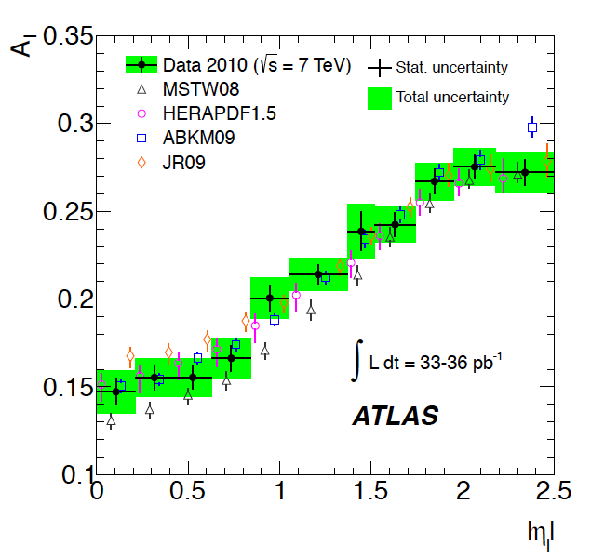

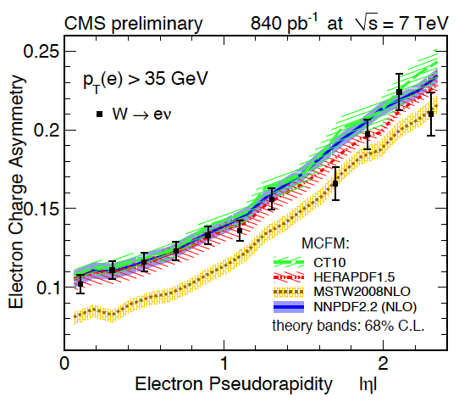
W Charge Asymmetry
CMS: New result 2011 (electron) data
Electron and muon information combined
Less information than in separate cross
sections and their correlations. Theory
calculated to NNLO.
MSTW08 has too many negative Ws.
Common trend in ATLAS + CMS
CMS PAS SMP-12-001 [7.3.2012]
arXiv:1109:5141 → PRD
M.Klein, Karlsruhe 19.3.12

Slide 12
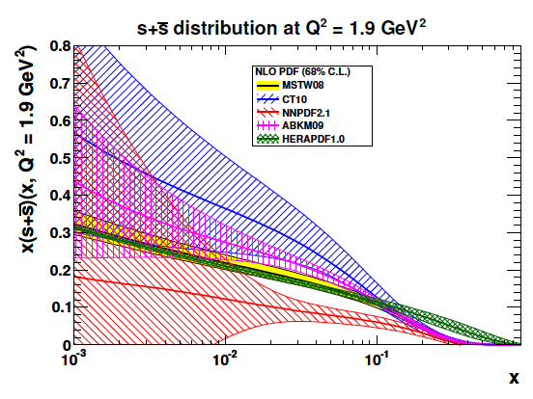
Strange Quark Density
SU₃ Flavour: s = u = d ?
M_{p} >> M_{s} >> M_{u,d}
NuTeV di-muon data:
small s, nuclear corrections
HERMES: N(K): s large
H1,ZEUS: weak sensitivity
through Charged Currents
Important for Sea Composition,
W Boson Mass, QCD..
νN→c..
G.Watt
W,Z at √s=7 TeV
M.Klein, Karlsruhe 19.3.12

Slide 13

WZ
Joint QCD Analysis of recent ATLAS
W,Z differential cross section data and
of HERA I inclusive NC,CC DIS data.
HERAPDF1.0 Ansatz [S.Glazov’s talk]
NNLO. K-factors, HERAFITTER
RT VFNS Scheme. 13 parameters
After χ² minimization. Fixed strange:
epWZ fixed s (r_{s}=0.5):
χ² =546.1/567 (HERA)
χ²=44.5/30 (ATLAS)
Free strange quark distribution:
xs(x)=A_{s} x^{Bs} (1-x)^{Cs}
fix B_{s} = B_{dbar}
15 parameters:
epWZ free s
χ² =538.4/565 (HERA)
χ²=33.9/30 (ATLAS)
Q²=Q₀²=1.9 GeV², x=0.023
*) submitted to arXiv today
M.Klein, Karlsruhe 19.3.12

Slide 14
W± Pseudorapidity Cross Sections
W distributions remain unaltered, small effect at large pseudorapidities.
Data from ATLAS W,Z inclusive cross section paper arXiv:1109.5141, PRD to appear
M.Klein, Karlsruhe 19.3.12

Slide 15
Z Rapidity Cross Section and r_{s}
Cross Checks of Observation: 1.00±0.20 (exp)
0.97 ± 0.26 if systematic errors cannot float
1.03 ± 0.19 in NLO analysis
1.05 ± 0.19 if c,b are treated as massless
0.96 ± 0.25 if ubar.ne.dbar
0.92 ± 0.31 using σ(Z) and A_{W}
0.66 ± 0.29 using σ(Z) and A_{W} from CDF
Consistent result: r_{s}=1.00 +0.26 -0.28
Small but notable change
of y_{Z} distribution related
to changing r_{s} from 0.5
(fixed) to 1 (from fit).
M.Klein, Karlsruhe 19.3.12

Slide 16
Strange Distribution and s/d Ratio (x)
_ _
The ATLAS analysis determines xs = A x^{B} (1-x)^{C}, linking B to the anti-down density.
M.Klein,
Karlsruhe
19.3.12

Slide 17
Light Quark Sea and W±/Z Ratio
The NNLO analysis of the HERA
and ATLAS data reproduces the
(W⁺+W⁻)/Zγ* ratio very well:
HERA has not measured the light quark
sea but F₂: A change of the strange density
with fixed F₂ must affect the light sea xΣ.
The present result enhances xΣ at x=10⁻³
and Q²=Q₀² by about 8%
Obtain: s/s=0.93 ± 0.15 (exp) in W charge
dependent determinations.
The r_{s} sensitivity is related to absolute
cross section measurements and to
very high precision on data [HERA 2,
LHC 2011] and the elw. theory control.
_
M.Klein, Karlsruhe 19.3.12

Slide 18
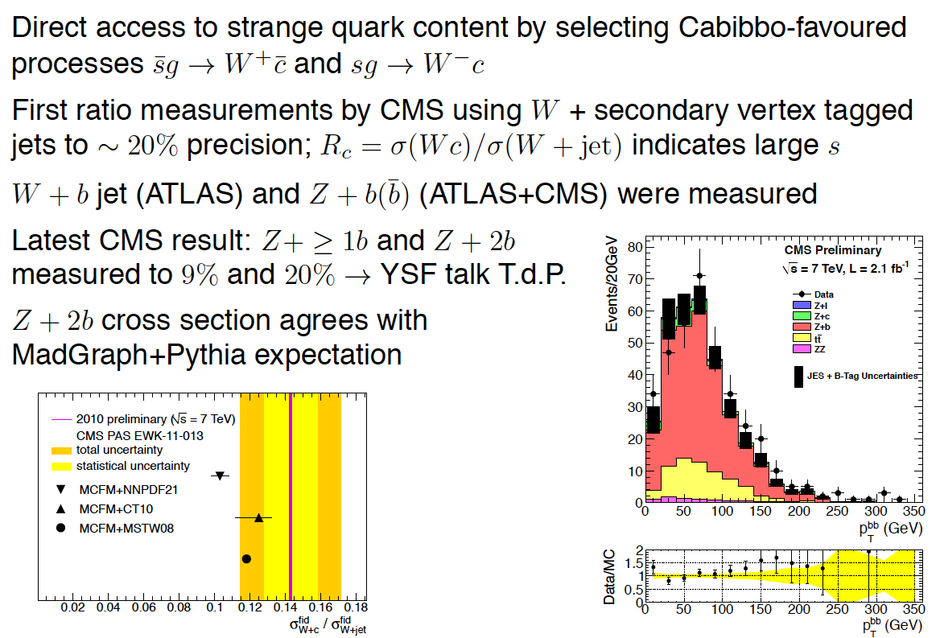
Associated W,Z + c,b Production
From J.Kretzschmar Moriond Eweak 7.3.12

Slide 19

Strange Quark Density from Ws→c in ep → νcX
Tag charm in CC
(10% efficiency)
Light quark bgd: 1%
e⁻ - anti-strange
e⁺ - strange xs(x,Q²)
Beam spot ≈10x30μm²
Systematic error ~5%
LHeC:
ep, eD, eA with 60 GeV.
100 times HERA Lumi.
Design report being
updated and refereed.
Synchronous LHeC
and HL-LHC operation
Upgrade of the LHC
http://cern.ch/lhec
DIS12 at Bonn
Workshop 14/15.6.12
M.Klein, Karlsruhe 19.3.12
Q² ≈ 100 - 5 10⁴ GeV² x ≈ 0.0001 – 0.1

Slide 20
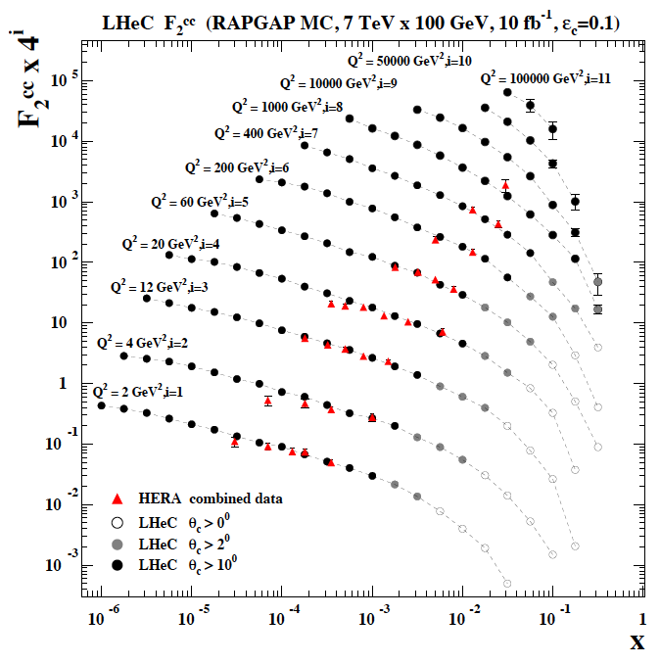
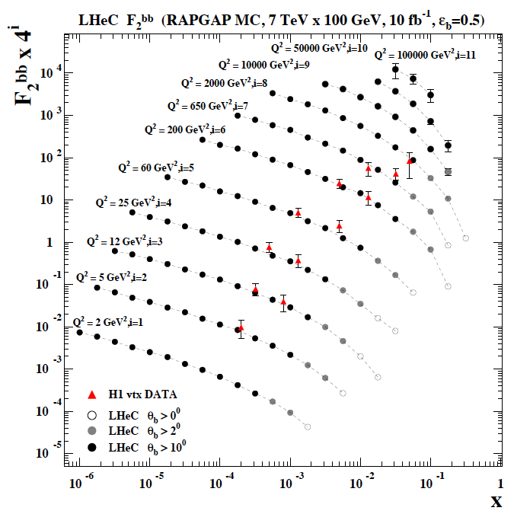
F₂^{charm} and F₂^{beauty} from LHeC
Hugely extended range and much improved precision will pin
down heavy quark behaviour at and away from thresholds
LHeC CDR 1.0 (2011)
M.Klein, Karlsruhe 19.3.12

Slide 21

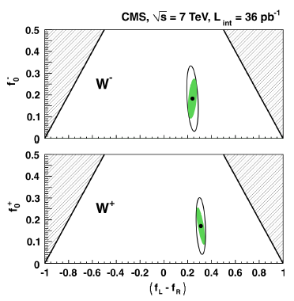
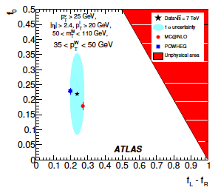
W polarisation
New measurements by CMS and ATLAS on the polarisation of W’s.
Production in L, R or 0 state. At large rapidities predominantly L following
influence of valence quarks. Three coefficients f_{L}+f_{R}+f₀=1. Measure angular
distribution as with L: L_{p}~0, R: L_{p}~1, 0: flat
PRL 107, 021802 (2011)
arXiv:1203.2165 → EPJ

Slide 22
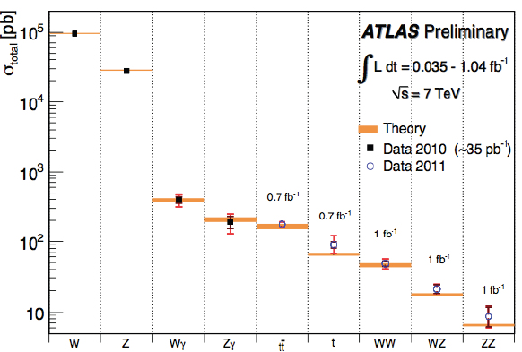
Smaller Cross Sections
M.Klein, Karlsruhe 19.3.12

Slide 23
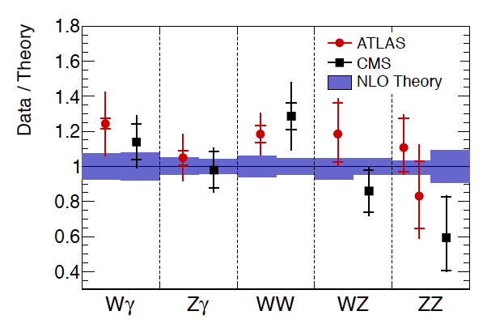
Di-Bosons
Cf J.Kretzschmar Moriond Electroweak 2012
The di-boson ATLAS and CMS cross section measurements
are in good agreement with each other, and with theory.
M.Klein, Karlsruhe 19.3.12

Slide 24
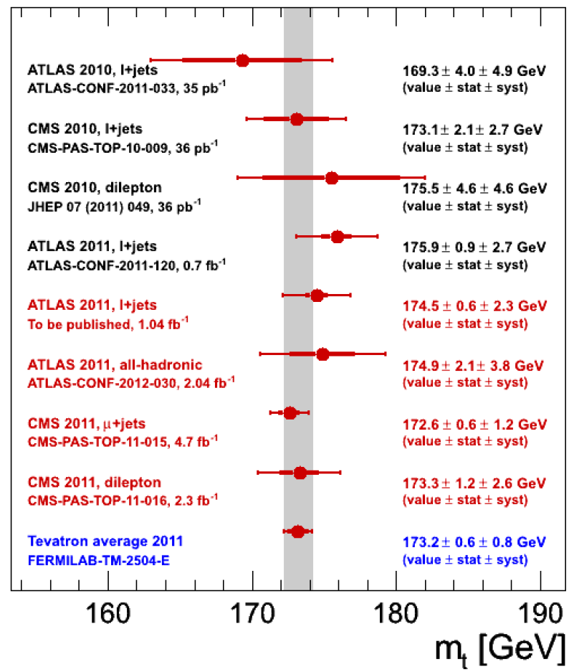
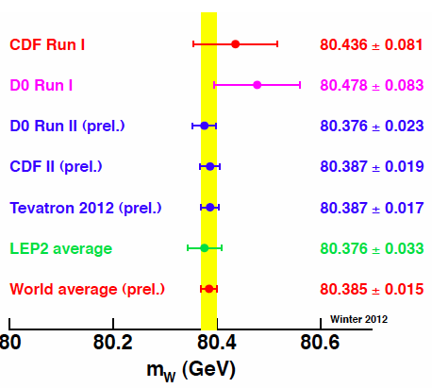
W and top Masses
Moriond: D0 and CDF: 23, 19 MeV error
CMS and ATLAS with consistent M_{t}
Interesting measurements of σ_{tt}
M.Klein, Karlsruhe 19.3.12

Slide 25
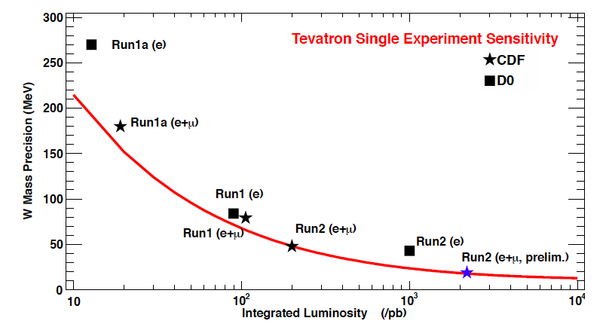
Precision vs Time/Luminosity
Bo Jayatilaka, Moriond Ewk
Tevatron W mass measurement may reach 10 MeV uncertainty. A big challenge for LHC.
M.Klein, Karlsruhe 19.3.12

Slide 26
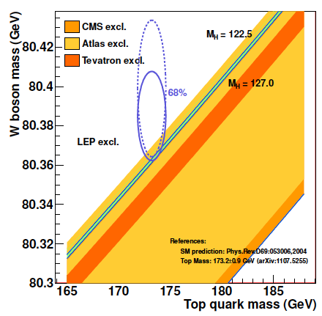
W and top Masses and the “SM BEH Scalar”
R.Lopes de Sa (Moriond 11.3.12)
M.Klein, Karlsruhe 19.3.12

Slide 27
Summary
The LHC and its experiments have had an extremely successful start into the TeV range.
ATLAS and CMS have made inclusive W,Z measurements of high precision at an
absolute luminosity precision significantly better than expected (and prospects to ~2%).
A novel W charge asymmetry result from CMS, based on ~1fb⁻¹, underlines PDF sensitivity.
The first differential W±, Z cross section data of ATLAS, jointly analysed with e±p cross sections
from HERA, suggest that the light quark sea is flavour symmetric and increased by ~8%.
This result is consistent with the large W+c/W+jet ratio as measured by CMS.
The strange quark density is an example for a symbiosis of precision pp and ep measurements,
which may be established when the HL-LHC and the LHeC ran synchronously in the 20ies.
A wealth of more analyses, as of all di-boson channels, has been performed and good
agreement with pQCD been observed. Not covered here are p_{T}(Z,W) measurements
as are important for approaching an M_{W} mass measurement precision of interest.
The top mass measurements of CMS and ATLAS approach the Tevatron precision.
The new CDF and D0 W mass measurements have 20 MeV precision. This predicts
the SM ‘Higgs’ particle to be lighter but just consistent with a possible 125GeV mass.
The ATLAS and CMS results presented here are initial observations
… more is to come, and the W polarisation a good example.
M.Klein, Karlsruhe 19.3.12

