Slide 1
Where do we stand in the development of energy frontier DIS and how to / shall we move on?
Oliver Bruening and Max Klein, Coordination Meeting, ZOOM, 26.10.2020
arXiv:2007:14491 (400 pages, 300 authors)
FCC Workshops: CDR March 2019: https://indico.cern.ch/event/789349/ see: http://lhec.web.cern.ch (to be updated)

Slide 2
LHeC, PERLE and FCC-eh
Max Klein (University of Liverpool)
for the LHeC/PERLE/FCCeh Collaboration
UK and FCC Meeting, 11.9.2020, Oxford online
Powerful ERL for Experiments @ Orsay
CDR: 1705.08783 J.Phys.G
CERN-ACC-Note-2018-0086 (ESSP)
Operation: 2025+, Cost: O(20) MEuro
LHeC ERL Parameters and Configuration
I_{e}=20mA, 802 MHz SRF, 3 turns →
E_{e}=500 MeV → first 10 MW ERL facility
BINP, CERN, Daresbury, Jlab, Liverpool, Orsay (IJC), +
50 x 7000 GeV²: 1.2 TeV ep collider
Operation: 2035+, Cost: O(1) BCHF
CDR: 1206.2913 J.Phys.G (550 citations)
Upgrade to 10³⁴ cm⁻²s⁻¹, for Higgs, BSM
CERN-ACC-Note-2018-0084 (ESSP)
arXiv:2007.14491, subm J.Phys.G
60 x 50000 GeV²: 3.5 TeV ep collider
Operation: 2050+, Cost (of ep) O(1-2) BCHF
Concurrent Operation with FCC-hh
FCC CDR:
Eur.Phys.J.ST 228 (2019) 6, 474 Physics
Eur.Phys.J.ST 228 (2019) 4, 755 FCC-hh/eh
Future CERN Colliders: 1810.13022 Bordry+

Slide 3
Beyond the LHC/LHeC: FCC
Far / Near Future
Particle Physics has a long term future,
many of its quests are unresolved,
Nr of families, GUT, substructure, DM..
It has been and will be science at a
global scale, with many question marks
for USA, China and Japan at present.
Former times:
CDHS,BCDMS../SppS/PETRA,PEP
HERA/Tevatron/LEP,SLC
Nearer future, perhaps
LHeC/LHC/ILC,CepC

Slide 4
Higgs in ep and pp [LHC and FCC]
LH(e)C
Results for FCC-eh at
20 TeV E_{p} x 60 GeV E_{e}
Uncertainties on kappa
Decay FCCep HL-LHC
bb 0.9 2.7
WW 0.3 1.2
gg 1.7 2.2
tau 1.5 1.6
cc 1.9 --
ZZ 0.5 1.0
yy 3.3 1.7
in percent. SM width.

Slide 5
We have given energy frontier DIS a future

Slide 6
Three Messages from the 2m LINAC at Stanford
Golden Past
-- you do NOT need to promise to discover dark matter or know what new to expect
when you increase the energy range (we yet may have to readjust our perception
about nature, its richness and as well our ability to predict and understand it.
‘we like to see the field to be driven by experiment’ – Burt Richter 2009)
-- you can build a 2 mile electron linac in 3 years time, if you really want it
of course we could build LHeC and FCC-eh when we decided to do so
-- electron-proton scattering is the best means to explore the substructure of matter
a necessary complement to the LHC/FCC and moreover, now a unique Higgs facility
The origin of deep inelastic scattering
50 years since the discovery of quarks by the SLAC-MIT ep scattering experiment
Vienna 8/1968

Slide 7
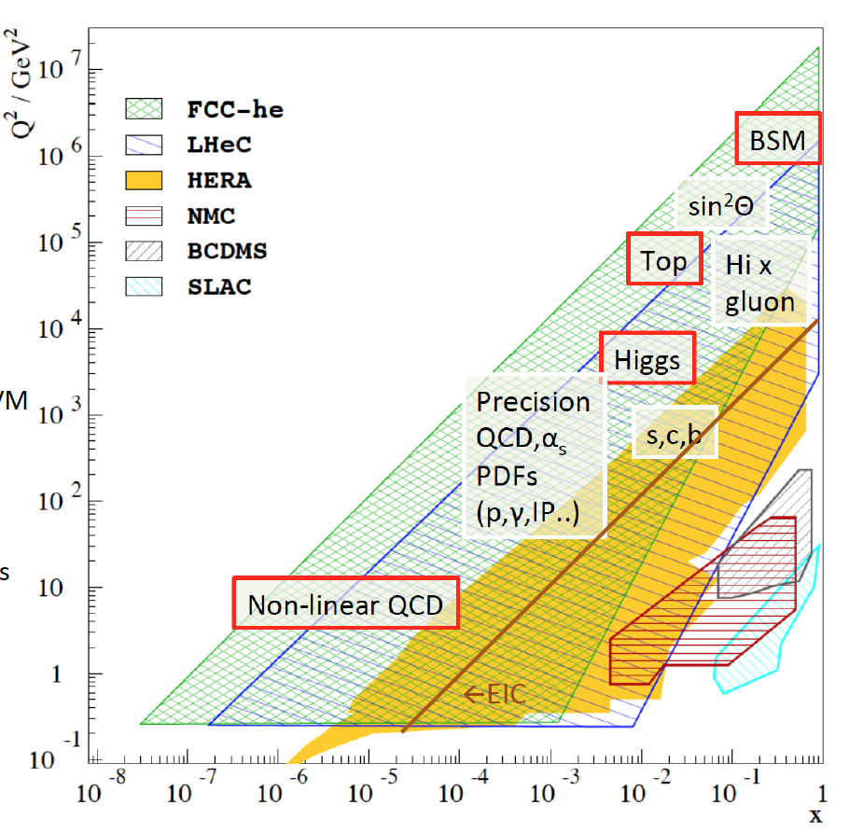
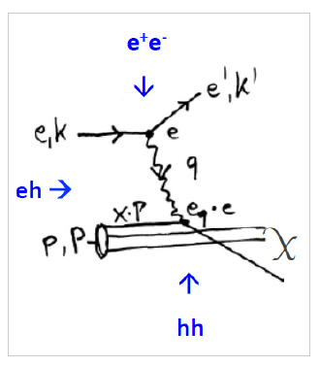
Physics with Energy Frontier DIS
Deep Inelastic Scattering
Raison(s) d’etre of ep/eA
at the energy frontier
Cleanest High Resolution
Microscope: QCD Discovery
Empowering the LHC
Search Programme
Transformation of LHC into
high precision Higgs facility
Discovery (top, H, heavy ν’s..)
Beyond the Standard Model
A Unique
Nuclear Physics Facility

Slide 8
Low x Dynamics
1802.07758
Very large effects of small x dynamics at FCC-hh
FCC-eh (LHeC) resolve low x BFKL-DGLAP question
FCC-hh is low x physics machine: there is no
Precision hh physics at FCC without ep
HERA (and EIC) at too small energy to resolve low x

Slide 9
The physics case is undeniably rich and the ERL accelerator technology being recognised (no slide for this today)

Slide 10
Statement of the IAC to DG, published in 2007.14491

Slide 11
Developments 2020
LHeC: 2007.14491 submitted to J.Phys G (final corrections still possible)
ECFA Newsletter (OB/MK). Idea to combine “ALICE3” and LHeC Detectors into a new design.
Agreement Max with Luciano Musa (ALICE Spokesperson) about contacts and maybe joint design study
Presentation of LHeC Detector/Project to LHCC, maybe in a joint session with A3. Meetings during next days.
FCC-eh: somewhat covered with LHeC paper, but not quite; Session and Talks in November Workshop(s)
PERLE: Priority Project for IN2P3, Collaboration formed, CB Chair: Oliver Bruening,
Project Leader: Walid Kaabi, Spokesperson: MK.
Milestones: TDR 2022, First Beam, Injector 2025, HOM+Dressed Cavity Design 2021, etc.
ASTeC, BINP, CERN, Cornell, IJClab, Jlab, Liverpool – open for further groups
Management Board: WK, MK, with: Alex Bogazc (Jlab), Frank Marhauser (Jlab tbc),
Evgenij Levitchev (BINP), Patxi … (IJClab), Frank Gerik (CERN), Boris Militsyn (ASTeC)
Snowmass: 13 “Letters of Intent” submitted.
ICHEP: 6 Presentations
Interaction Region: Update/New Design (Bernhard, Kevin, Students)– reduced synchrotron load ( 1/5 --> 1/3?)
Bernhard Holzer, Stefan Russenschuck, Kevin, Max: towards a solution without Nb₃Sn – eases all!
Publication of many further papers

Slide 12
Tasks for 2021-2025
ECFA
Newsletter 5
8/2020
OB/MK.

Slide 13
Work has culminated in July paper but carried on

Slide 14
Welcome
Max Klein, Oxford, 11.09.2020
14

Slide 15
Personal Remarks for Discussion
MK: June 2019
LCG Meeting
We see a huge battle for resources, and a lack of
guidance from physics and leadership of this
Process.
Due to lack of money and unclear Asian situation
and HL-LHC to start data taking in 8 years, it is
most likely that this time nothing is really decided.
ALL projects struggle for survival and recognition, not just ep
What is important or new for us:
LHeC: The CDR Update: The LHeC at High Luminosity
for discussion later, important to be out in 11/19
PERLE: to really progress
FCC-eh: to keep developing eh as integrated part of hh
new: the option of a 45 TeV FCChh, to which
the ERL would ideally fit.
ALICE ends LS4, there is a new proposal by some
Members of the Collaboration (cf de Hondt)
The weakest point is the wide support, that is
related to the recognition of DIS physics. We
are progressing but it remains challenging.
IAC (HS) believes the time for ep will come,
Yet the time for LHC moves.
Higgs has given us quite some support and
attention, but as well resistance from ee sides.
The biggest potential is in the understanding
that future hh needs future high energy eh.
That goes with QCD, eweak, BSM, t, ions, and H
We shall keep stressing that this work has been
mandated as a service to the community, the
ep feature is the lack of resources.

Slide 16
Geoff Taylor (ICFA Chair, „Asian“ view) Granada 15.5.
https://indico.ihep.ac.cn/event/11444
← Today (26.10.20): Jie Gao, CEPC WS. TDR 2022

Slide 17
next
J de Hondt (5.10.20 to Snowmass)

Slide 18
Energy frontier DIS has been part of the future plans
It is proposed to continue this development, with appropriate changes in emphasis and the resulting organisation.
Physics complementarity, technology synergy, R+D for detector and IR, PERLE at Orsay…
CERN is the European laboratory for particle physics and the lab for European particle physicists.
It operates in a global context and has until 2040 the primary taks, chosen in 2013, to exploit HL-LHC with 3-4 ab⁻¹

Slide 19
Draft
from
a UK
Document
23.10.20

Slide 20
Tasks for 2021-2025
Draft
from
a UK
Document
23.10.20

Slide 21
Tasks for 2021-2025
Draft
from
a UK
Document
23.10.20

Slide 22
Time should be taken to define an appropriate organisation to coordinate the development
and to (re)present this physics and project to the community and beyond. Initial thoughts:

Slide 23
Next on LHeC/FCC-eh
A - Physics
Continue topical studies
Focus on eh-hh LHC gain
Join Snowmass as is useful
Join ECFA +FCC-eh studies
F - CERN
Get CERN to support this
as an R+D project
E - PERLE
Formal Foundation of Collaboration
Milestones as are being developed
Key PERLE experiments to be selected
TDR end of 2022
First beam in 2025
Participate in ESPP process
G - Other laboratories
Attract [collaborators
from] other labs (link to B)
Form national LHeC/FCC-eh groups
B - Detector
Form a detector collaboration
Go to LHCC end of 2021
Optional jointly with ALICE3
Organisation
Carefully develop from status 2019 to new structure
Keep coherent LHeC/PERLE/FCC-eh coordination
with two central coordinators and a steering group
[perhaps the leaders of A-I].
Co/Coordinators for A-I to be found
Build substructure, surely
in coordinating physics and detector
Invite new IAC, subject to CERN’s d’accord
Fall 2021 – New Big Workshop
H - Young Scientists
Create an ep Group
Define short time scale tasks
as in the detector R+D
C - Accelerator
R+D: Prototype Q1
R+D: Beam Pipe
Bypass IP
Simulations: IR etc
Design Injector ..
I - Outreach
Update the web
Conferences
Social Media
PR Document for FAs
D - FCC-eh
Develop ‘eh’ as
part of FCC-hh
Write the FCC-eh CDR
Thoughts for 26. October 2020
LHeC Coordination Meeting. MK

