Slide 1

The LHeC as a Higgs Facility
Max Klein
U Liverpool and CERN
For the LHeC Study Group
Introduction
Physics
LHeC Developments
Outlook
ICHEP, Valencia, 3rd of July, 2014
http://lhec.web.cern.ch

Slide 2
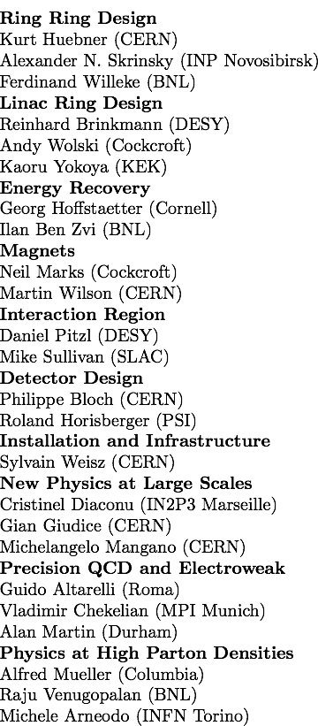
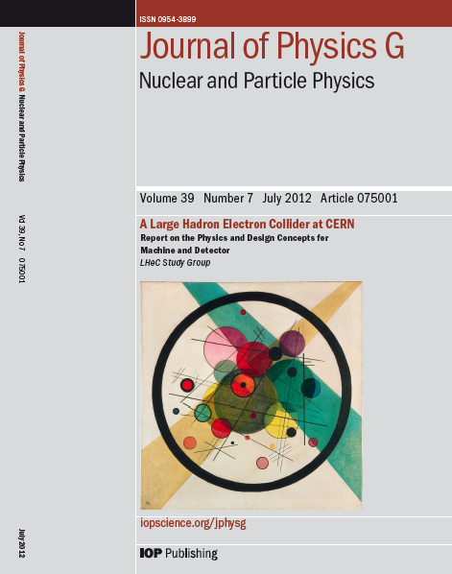
Design Report 2012
CERN Referees
arXiv:1206.2913 http://cern.ch/lhec
The theory of DIS has developed much further: J.Blümlein Prog.Part.Nucl.Phys. 69(2013)28
DIS is an important part of particle physics: G.Altarelli, 1303.2842, S.Forte, G.Watt 1301:6754

Slide 3

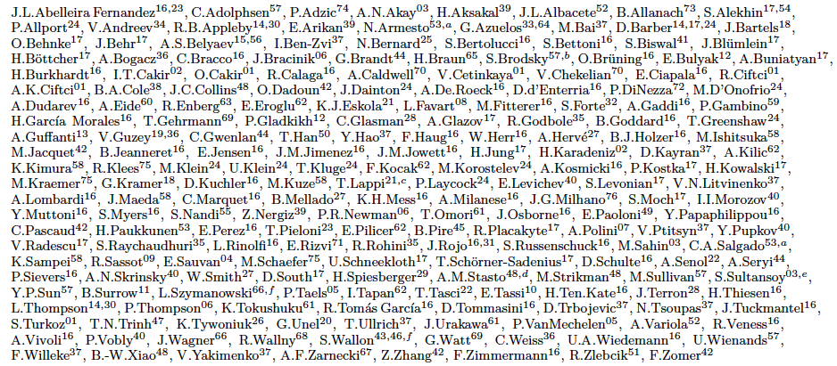
http://lhec.web.cern.ch
LHeC Study group and CDR authors (May 13)

Slide 4
CDR Footprint of the LHeC ERL Electron Beam for synchronous ep and pp OP @ LHC
60 GeV electron beam energy, L= 10³³ cm⁻²s⁻¹, √s=1.3 TeV: Q²_{max}= 10⁶ GeV², 10⁻⁶ < x< 1
Recirculating linac (2 * 1km, 2*60 cavity cryo modules, 3 passes, energy recovery)
Ring-ring as fall back. “SAPHIRE” 4 pass 80 GeV option to do mainly: γγ→ H. CDR

Slide 5





















Accelerator Design: Participating Institutes
TOBB ETU
Source | Power [MW]
Cryogenics (linac) | 21
Linac grid power | 24
SR compensation | 23
Extra RF cryopower | 2
Injector | 6
Arc magnets | 3
Total | 78
KEK

Slide 6
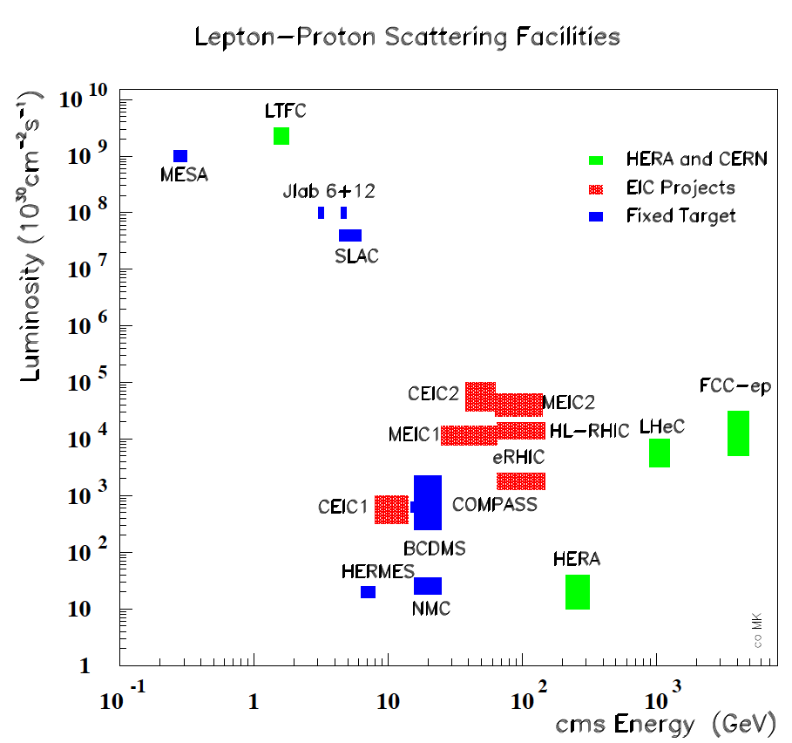
From CERN Courier
MK, H.Schopper
June 2014
With input from
A.Hutton, R.Ent,
F.Maas, T.Rosner
CERN: LHC+FCC: the only realistic opportunity for energy frontier deep inelastic scattering
Huge step in energy (Q²,1/x) and 2-3 orders of magnitude higher luminosity than HERA

Slide 7
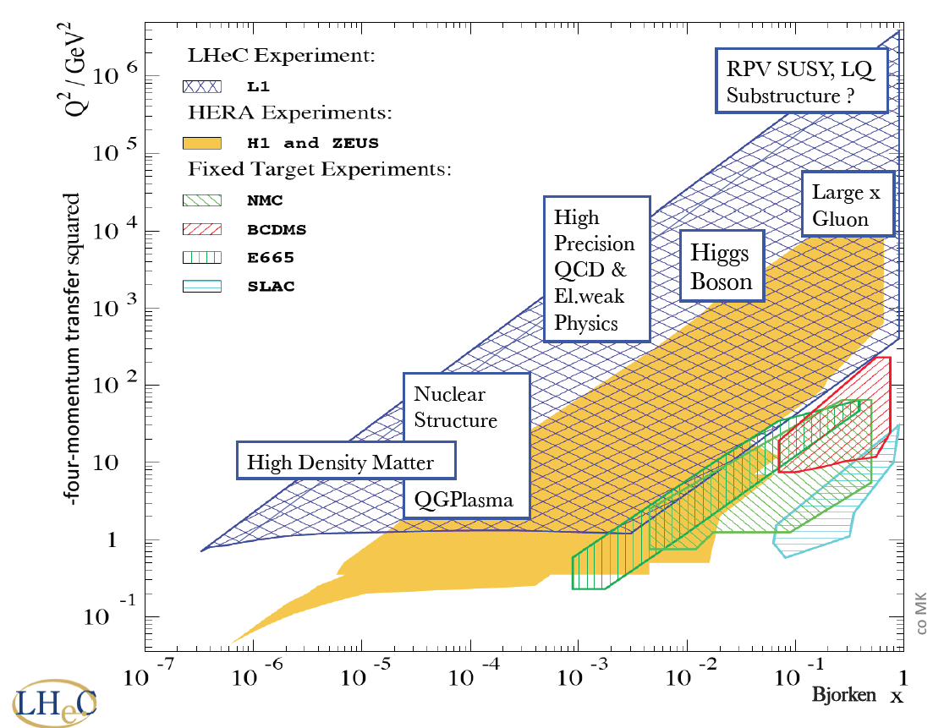
New dreieck
FCC_he

Slide 8
2. Remarks on Higgs ep and pp Physics

Slide 9
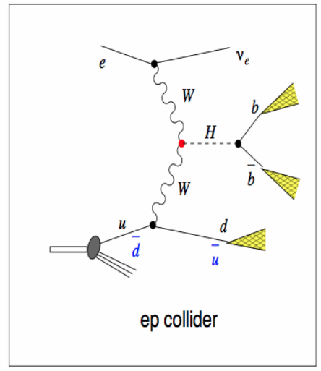
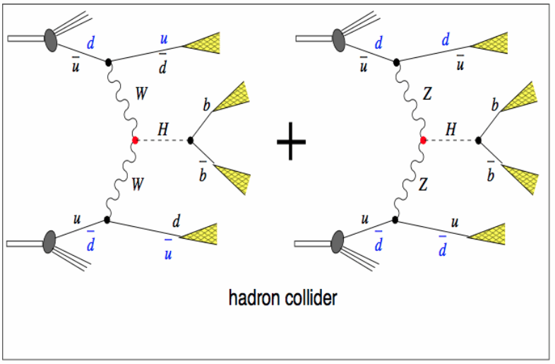
Higgs Production at the LH(e)C
e
Higgs production in ep comes
uniquely from either CC or NC
Cross section at LHeC ~200fb
(about as at the ee colliders).
Pile-up in ep at 10³⁴ is 0.1, 25ns
Clean(er) bb final state, S/B ~ 1
Z
OR
Z
Higgs production in pp comes
predominantly from gg→ H
VBF cross section about 200fb
(about as at the ep colliders).
Pile-up in ep at 5 10³⁴ is 150, 25ns
S/B very small for bb

Slide 10
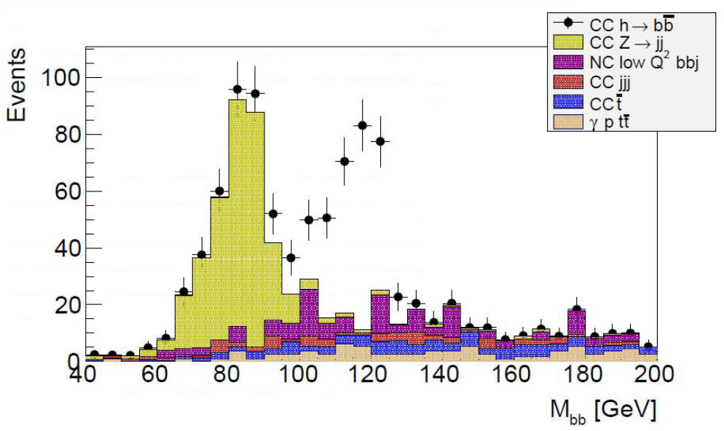
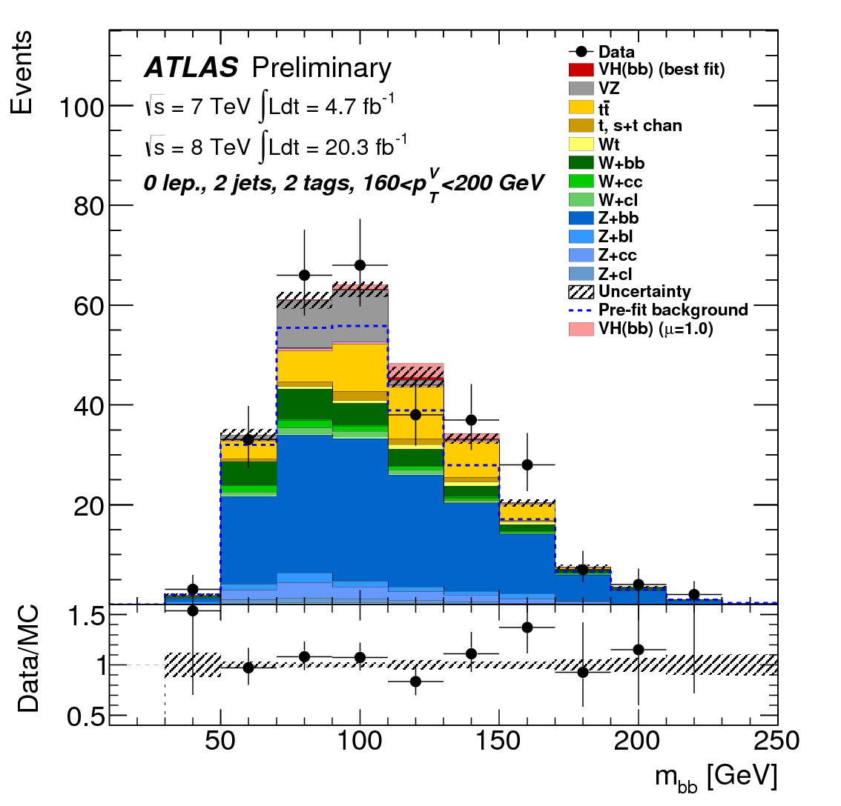
H → bbar
ep→ νH(bb)X
charged currents
σBR~120 fb
S/B ~1-2 → crucial for QCD of H
Pile up 0.1
1% coupling precision at 1 ab⁻¹
pp→ X₁W(lν)H(bb)X₂
associated VH
σBR~130 fb
S/B <~0.01
<Pile up> ~20
ep (new) Simulation 100 fb⁻¹
Confirming CDR initial studies
See Poster U. Klein Higgs in ep – this conference
pp 2013: Measurement
ATLAS CONF-2013-079

Slide 11
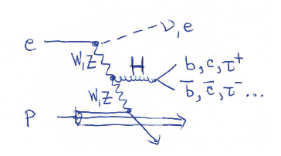
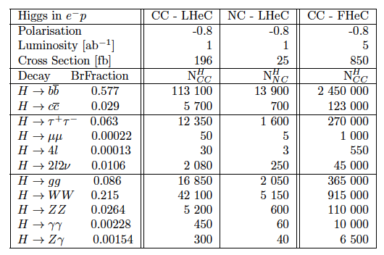
Rates of Higgs Production in e⁻p
Clean VV production and
high S/B in reconstruction
are base for unique
further program as on CP
Biswal et al, PRL109(12)261801
+differential measurements
There is a huge potential
for Higgs physics in ep.
High rates for bb but also WW,gg,ττ,cc → desire for maximum luminosity O(10³⁴) cm⁻²s⁻¹
Note that 10³³ is 100 times HERA (I) and a huge step more than adequate for DIS
Each of the channels requires dedicated simulation study, as has been done for bb
Ahead is use of ep detector and its design optimisation for H and general fwd physics.
For the detector design – see poster ‘A New Detector for ep Scattering’ – this conference

Slide 12
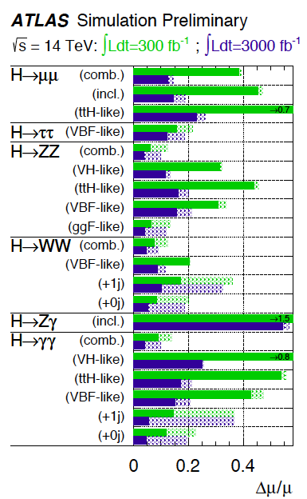
Prospects for H at HL-LHC
Prospects for signal strength measurements
at the LHC and the HL-LHC
Dashed: Theoretical uncertainties from
PDFs, strong coupling and scales
To make the LHC a precision Higgs factory,
one needs: much better PDFs
much more precise α_{s} ,
all determined to a next order pQCD: N³LO
The LHeC provides a unique data basis and
theoretical framework for H physics in pp
while N³LO Higgs calculations have begun
(Anastasio et al)
Note we do not know yet the bb prospect
as it is notoriously difficult in pp, and there
is no cc nor gg prospect for pp either.
ATLAS-PHYS-PUB-2013-014 (10/13) - see also CMS prospects with two assumptions on theory uncertainties

Slide 13
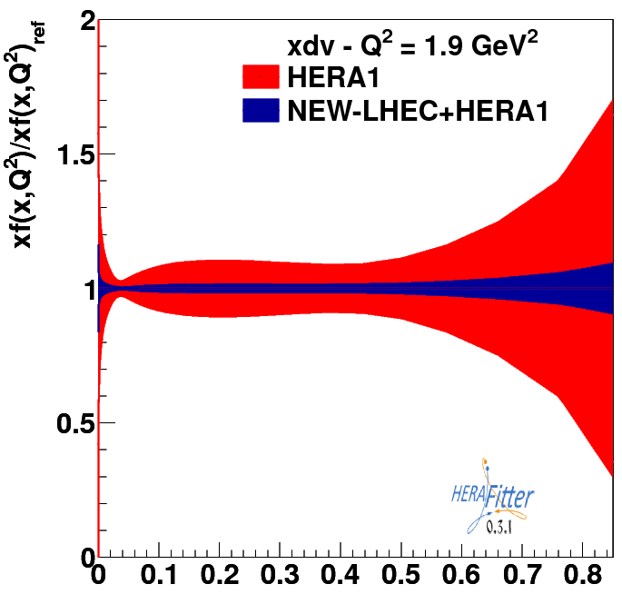

Precision Parton Distributions from ep
LHeC
down valence
LHeC: arXiv:1211.5102
V Radescu, MK [pdf set on LHAPDF]
M D’Onofrio, R.Kleiss et al
Why important: qg dynamics determines the mass of the visible universe.
Low x: nonlinear evolution?, Medium x: Higgs High x: d/u… Searches at HL-LHC – hi Mass
Why ep: Because it is the only way to measure/derive these and they will be needed for HL-LHC
For testing QCD: Factorisation, Resummation, N³LO (Higgs), α_{s} – lattice, HF, intrinsic PDFs, ..
Why LHeC: the only base for fully unfolding PDFs, free of symmetry assumptions (need precision CC), bDF, tDF..

Slide 14
Precision PDFs for Higgs at the LHC
LHeC:
Exp uncertainty
of predicted H
cross section is
0.25% (sys+sta),
using LHeC only.
Leads to H mass
sensitivity.
Strong coupling
underlying
parameter
(0.005 → 10%).
LHeC: 0.0002 !
Needs N³LO
HQ treatment
important …
O.Brüning and M.K. arXiv:1305.2090, MPLA 2013

Slide 15
3. Recent Machine and Developments

Slide 16
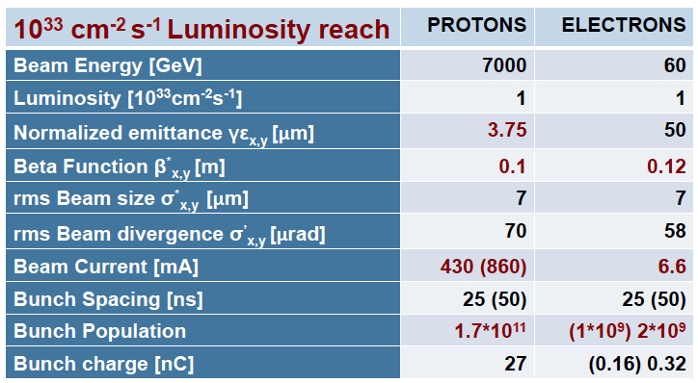
CDR Parameters - LHeC
“Ultimate” proton beam parameters
100 times HERA Luminosity and 4 times cms Energy

Slide 17
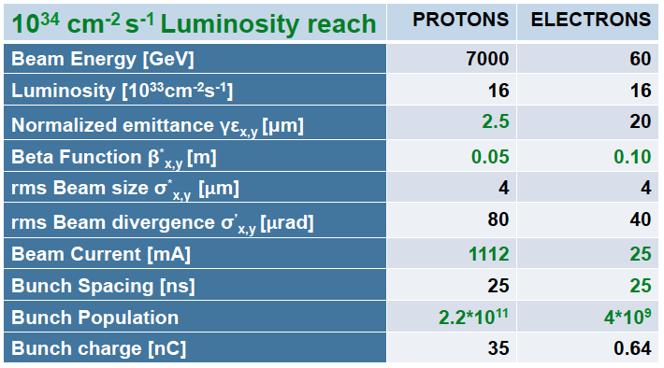
Advanced Luminosity Parameters^{*)} - LHeC
HL-LHC proton beam parameters
*) under study now
1000 times HERA Luminosity and 4 times cms Energy

Slide 18
Areas of Study Post-CDR ^{*)}
More realistic with dedicated tools and evaluation of high luminosity prospect
Choice of RF Frequency – 802 MHz
Optimisation of IR Design [L*(e) < L*(p), inner triplet half? quad…]
Integration of p optics into HL-LHC
Integration of e optics into HL-LHC
Beam-beam effects (phase space deformation)
Multi-bunch beam break up
Wakefield effects on multi-bunch instability at IP
Emittance growth
Coherent synchrotron radiation
Fast beam-ion instability (1/3 gap compensated by 1.3 from pinch effect)
Arc optics FODO vs FMC (flexible momentum compaction)
Lattice design
Spreader and combiner
Civil engineering
…
So far no showstopper found for O(10³⁴)cm⁻² s⁻¹: it requires
further serious study and the development of SCRF within a Testfacility
*) Recent presentations by A.Bogacz, O.Bruening, E.Cruz, E.Jensen, D.Schulte, A.Valloni – see Webpage
Work by E.Cruz, M.Korostelev, E.Nissen, J.Osborne, D.Pellegrini, A.Letina, A.Milanese, A.Valloni and others

Slide 19
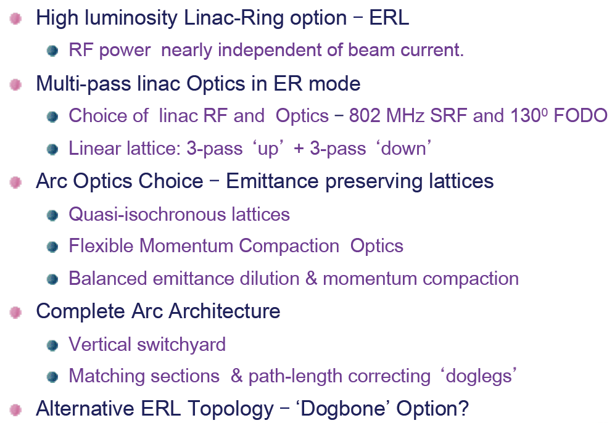
Optics Design Study
Summary of Presentation by Alex Bogacz at EIC14, Jlab, March 20, 2014

Slide 20
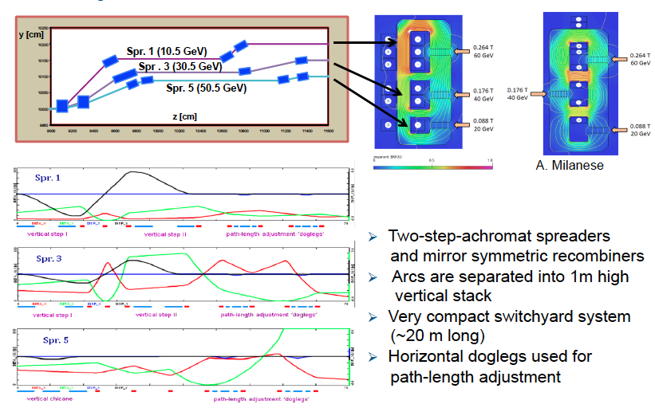
Switchyards
A.Bogacz, A.Milanese, A.Valloni

Slide 21
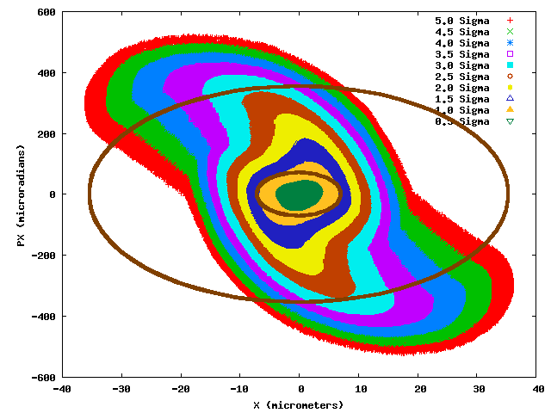
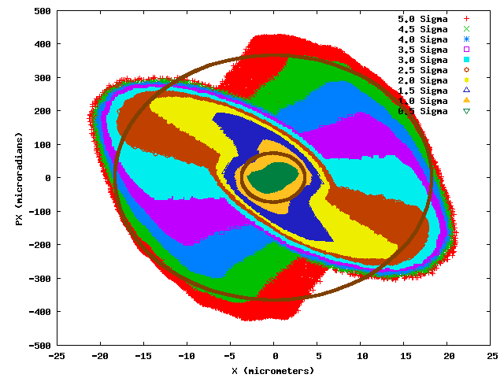
Phase Space Deformation from Beam Beam
CDR
H-LHeC
E.Nissen
px in μrad
x in μm
Hypersphere phase space is significantly deformed by beam-beam interactions.
In the case of the high luminosity configuration, the (5σ) tails are folded back..

Slide 22
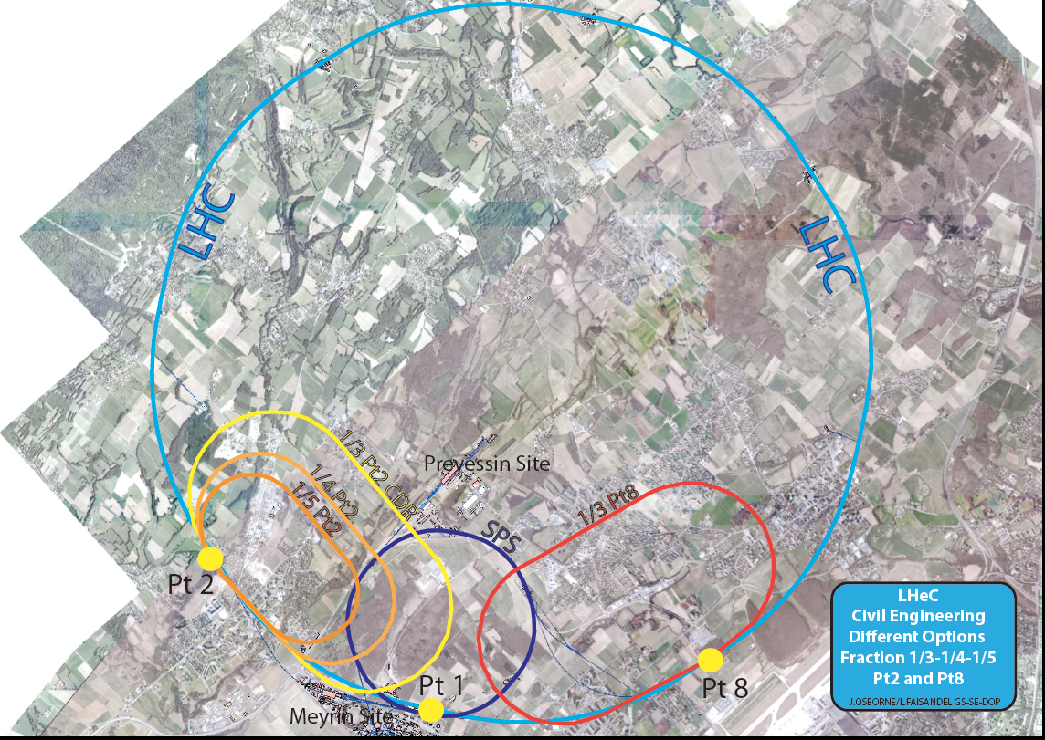
backup
John Osborne
Tentative
6/14

Slide 23
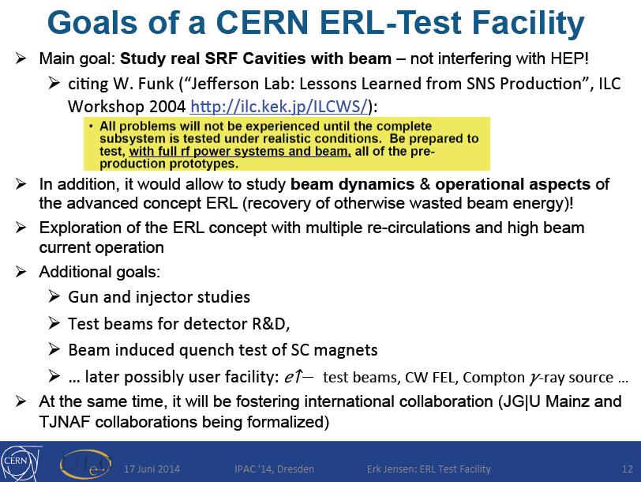
backup

Slide 24
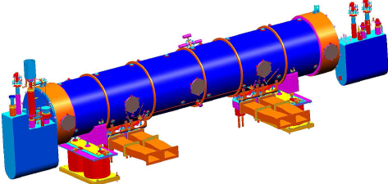
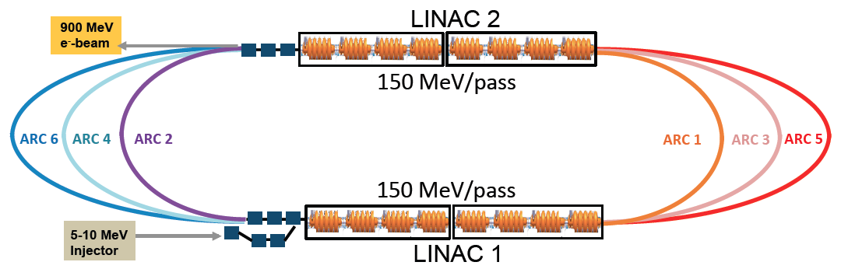
SCRF and LTFC superconducting RF and ERL Test Facility at CERN
Frequency 802 MHz
Design and built of 2 Modules (CERN+Jlab+?)
Tentative Design of the LTFC – end of 2014:
Collaborations being established on
Source, Magnets, Operation, Applications
A.Hutton, B. Rimmer, E.Jensen et al.
MoU between CERN and Jlab - signed
A. Bogazc, A.Valloni et al. presented at IPAC14 at Dresden by Erk Jensen

Slide 25
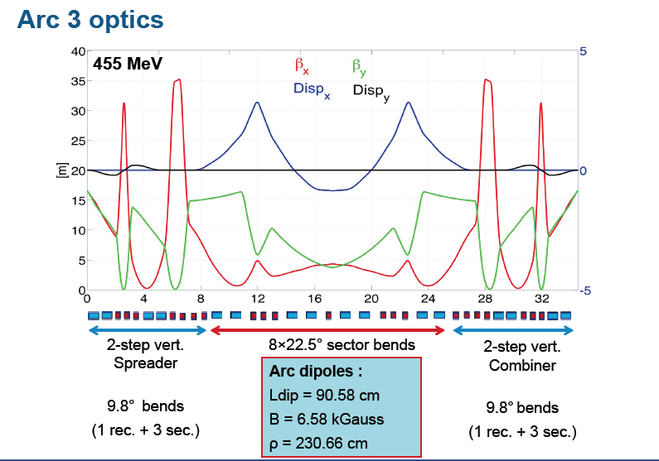
Testfacility Design
A.Valloni, KEK Seminar 6/14
also: multi-pass linac optics

Slide 26
New LHeC International Advisory Committee
The IAC was invited in 12/13 by the DG with the following
Guido Altarelli (Rome)
Sergio Bertolucci (CERN)
Nichola Bianchi (Frascati)
Frederick Bordry (CERN)
Stan Brodsky (SLAC)
Hesheng Chen (IHEP Beijing)
Andrew Hutton (Jefferson Lab)
Young-Kee Kim (Chicago)
Victor A Matveev (JINR Dubna)
Shin-Ichi Kurokawa (Tsukuba)
Leandro Nisati (Rome)
Leonid Rivkin (Lausanne)
Herwig Schopper (CERN) – Chair
Jurgen Schukraft (CERN)
Achille Stocchi (LAL Orsay)
John Womersley (STFC)
Mandate 2014-2017
Advice to the LHeC Coordination Group and the CERN directorate
by following the development of options of an ep/eA
collider at the LHC and at FCC, especially with:
Provision of scientific and technical direction for the physics
potential of the ep/eA collider, both at LHC and at
FCC, as a function of the machine parameters and of a
realistic detector design, as well as for the design and
possible approval of an ERL test facility at CERN.
Assistance in building the international case for the accelerator
and detector developments as well as guidance to the resource,
infrastructure and science policy aspects of the ep/eA collider.
*) IAC Composition June 2014, and
Oliver Brüning Max Klein ex officio

Slide 27
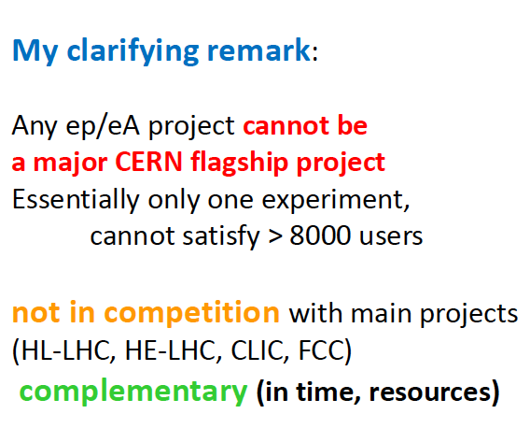
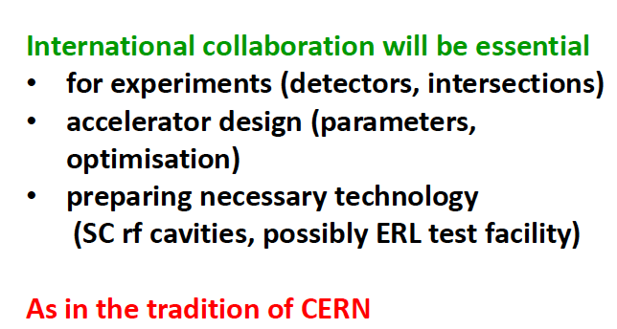
Workshop at Chavannes 20/21.1.2014
Herwig Schopper (Chair IAC) at Chavannes in the Panel Discussion with the CERN Directorate
Truth is stranger than fiction, but it is because fiction is obliged to stick to possibilities
Mark Twain, cited by Stan Brodsky at Chavannes

Slide 28

Road beyond Standard Model
Next decades
Rolf Heuer at
Aix Les Bains
1. 10. 2013
LHC results vital to guide the way at the energy frontier
At the energy frontier through synergy of
hadron - hadron colliders (LHC, (V)HE-LHC?)
lepton - hadron colliders (LHeC ??)
lepton - lepton colliders (LC (ILC or CLIC) ?)

Slide 29
Outlook and Summary
Following the publication of the CDR and the Higgs boson discovery, there has been
a renewed interest in the LHeC, because of the interest in genuine DIS and also for
Higgs, LHC Upgrade and Use, High Gradient Cavity and the Energy Frontier
CERN has called for a new phase of the LHeC development and its consideration
in the FCC [hh,he,ee] context by appointing a new advisory committee and
a coordination group.
The next important steps regard
Physics: H, t, BSM, low x, eA, PDF studies especially with regard to the HL LHC
Detector: Simulation and optimised design for H and forward physics
Accelerator: Study of the prospects and consequences for high luminosity ep
SCRF: Development of two cavity-cryo modules with 802 MHz
Testfacility: Design and collaboration (tentative by 14 and CDR by 15)
This is indeed a continuation and ‘A New Beginning’ H.Schopper, MK Ccourier 6/14
The ERL electron beam is a very economic option to realise ep (and eA) with FCC
(see presentation tomorrow)

Slide 30
backup

Slide 31
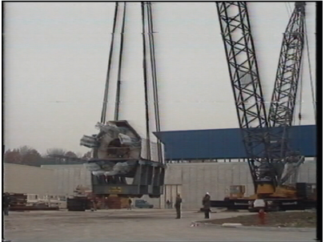
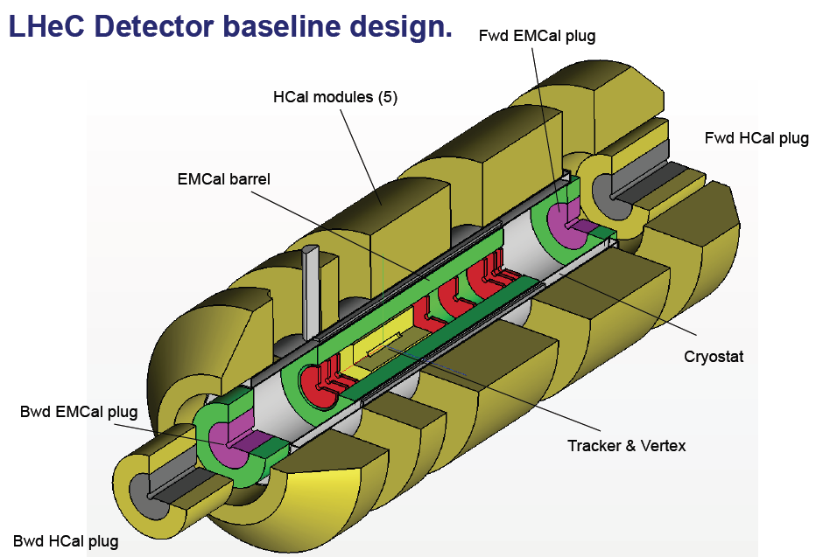
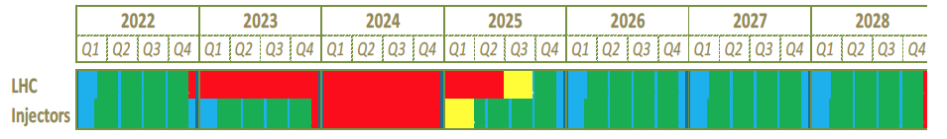
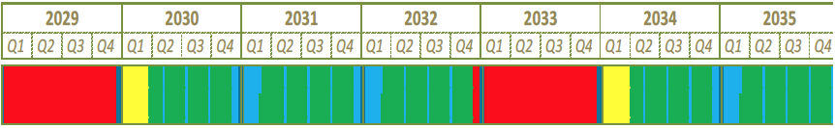
Time Schedule – 2 – Detector
A.Gaddi Chavannes 1/14
Pre-mounting at the surface of a modular detector – independent of LHC
Lowering (7), Installation (2), Connection (6), Field Map (1), Pipe (1) … min of 15 Month
which would be compliant with LS3 and may be with LS4 – depends on the LHC

Slide 32
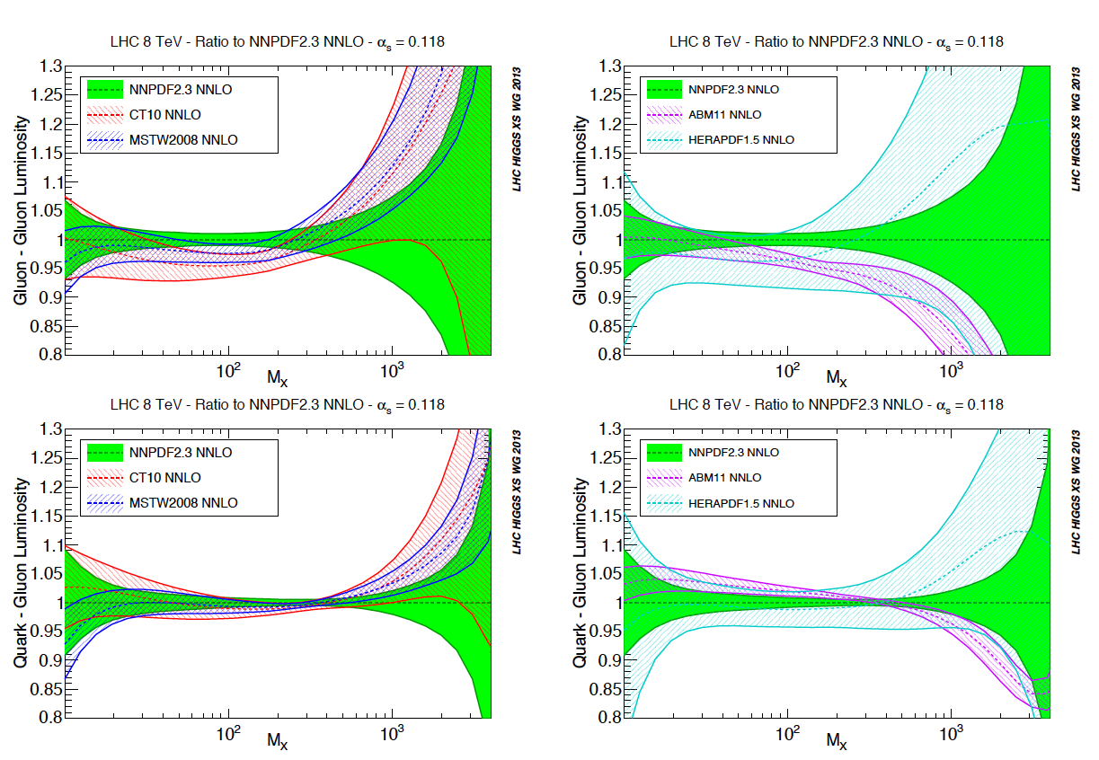
NNLO - PDF Uncertainties vs Mass in Drell-Yan
The mass of the visible universe is provided by the gluon selfinteraction and the
gg interaction dominates the production of the Higgs boson in pp interactions.
gg
qg
Higgs Handbook 7/2013, arXiv:1307.1347 S.Forte, J.Huston, R.Thorne

Slide 33
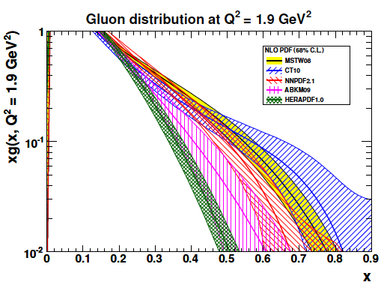
Determination of the Gluon Density at Large x
High(er) precision at x ~ 0.01 for Higgs
and independent accurate PDF input
at x > 0.4 for searches at HL-LHC
MK, V.Radescu, LHeC Note 2013-002 and
Workshop on LHeC, Chavannes, January 14

Slide 34
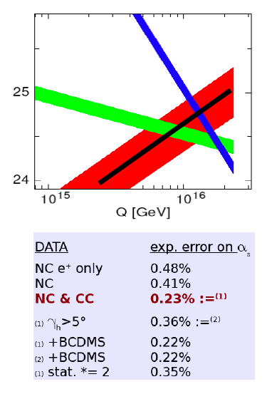
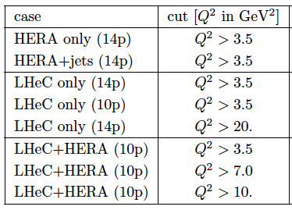
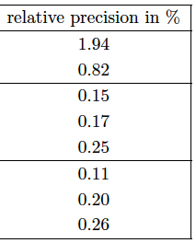
Strong Coupling Constant
α_{s} least known of coupling constants
Grand Unification predictions suffer from δα_{s}
DIS tends to be lower than world average (?)
LHeC: per mille - independent of BCDMS.
Challenge to experiment and to h.o. QCD →
A genuine DIS research programme rather than
one outstanding measurement only.
1/α
fine structure
weak
strong
Two independent QCD analyses using LHeC+HERA/BCDMS

Slide 35
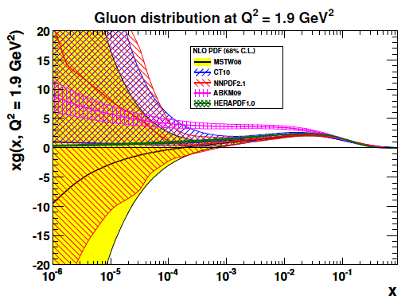
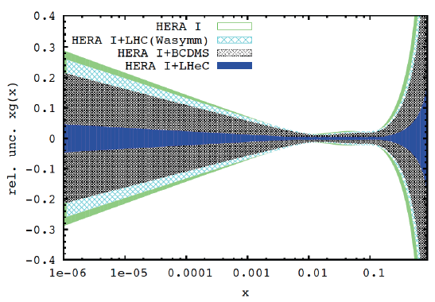
Determination of the Gluon Density at Small x
Small x is related to large x in DY production
x = M/√s exp(±y) = 0.009 … 0.015 (8 … 13 TeV)
HERA constraints end at x ~ 10⁻³ in DIS region
DGLAP may break at small x and the
conventional gluon determinations, linking
also low and large x, will then be inadequate.
The LHeC is the only configuration where this
can be tested with enough confidence.
Measure dF₂/dlnQ² and F_{L} precisely!
MK, V.Radescu, LHeC Note 2013-002 and
Workshop on LHeC, Chavannes, January 14

Slide 36
Possible QCD Developments and Discoveries
AdS/CFT
Instantons
Odderons
Non pQCD
QGP
N^{k}LO
Resummation
Saturation and BFKL
Non-conventional PDFs …
Breaking of Factorisation
Free Quarks
Unconfined Color
New kind of coloured matter
Quark substructure
New symmetry embedding QCD
QCD may break .. (Quigg DIS13)
QCD is the richest part of the Standard Model Gauge Field Theory and
will (have to) be developed much further, on its own and as background

