Slide 1
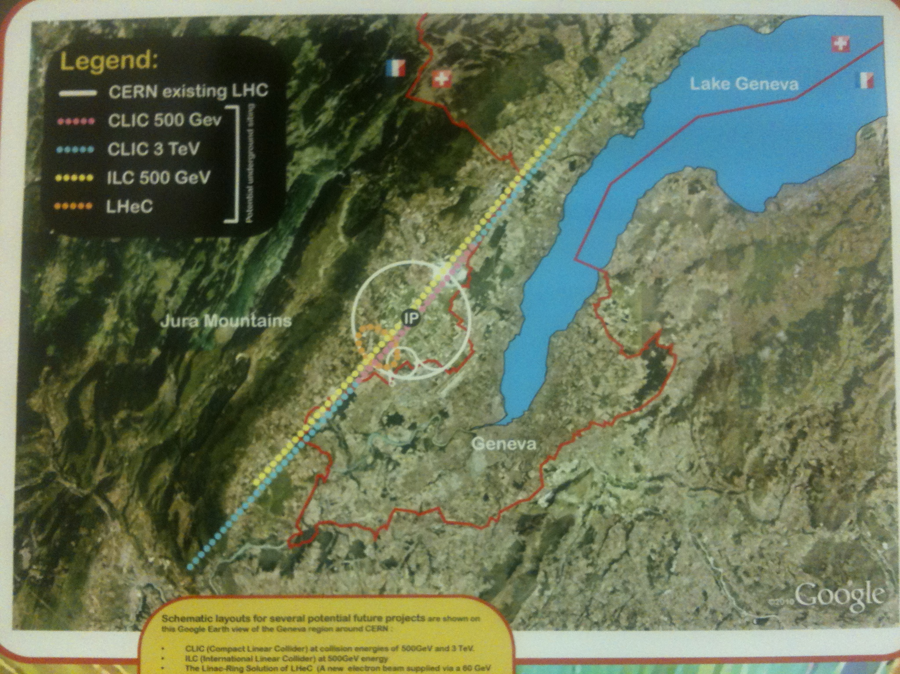
title
The LHeC Design
Max Klein (U.Liverpool+CERN)
for the LHeC Study Group
DRAFT VERSION
24.11. 6pm
TUPC017
Civil Engineering Studies for Major Projects after LHC
Project
Physics
Detector
Accelerator
Schedule
→ O.Brüning
Report to ECFA 25.11.2011 CERN

Slide 2
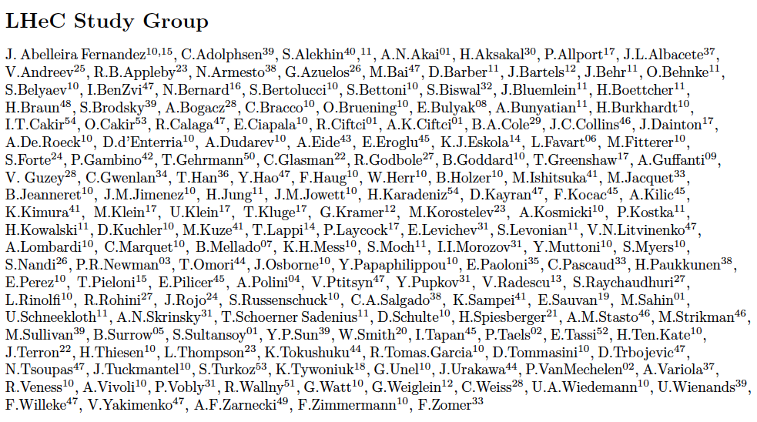
http://cern.ch/lhec
Thanks to all and to
CERN, ECFA, NuPECC
About 150 Experimentalists and Theorists from 50 Institutes
Tentative list

Slide 3
Project Milestones
2007: Invitation by SPC to ECFA and by (r)ECFA to work out a design concept
2008: First CERN-ECFA Workshop in Divonne (1.-3.9.08)
2009: 2nd CERN-ECFA-NuPECC Workshop at Divonne (1.-3.9.09)
2010: 3rd CERN-ECFA-NuPECC Workshop at Chavannes-de-Bogis (12.-13.11.10)
NuPECC puts LHeC to its Longe Range Plan for Nuclear Physics (12/10)
2011: Draft CDR (530 pages on Physics, Detector and Accelerator) (5.8.11)
being refereed and updated
2012: Publication of CDR – European Strategy
New workshop (tentatively in May 10-11, 2012)
Goal: TDR by 2014
Perspective: Operation by 2023 (synchronous to pp)

Slide 4
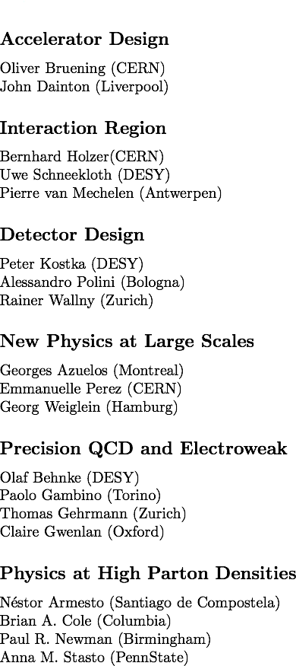
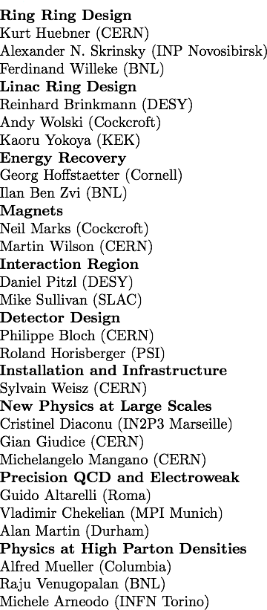
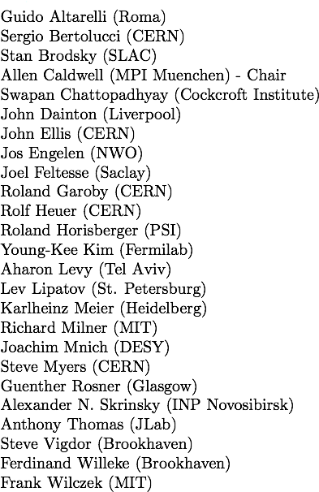
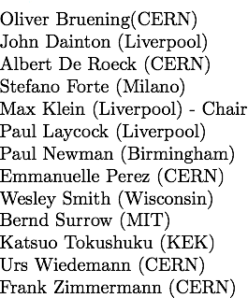
Organisation for CDR
Scientific Advisory Committee
Working Group Convenors
CERN Referees
Steering Committee

Slide 5
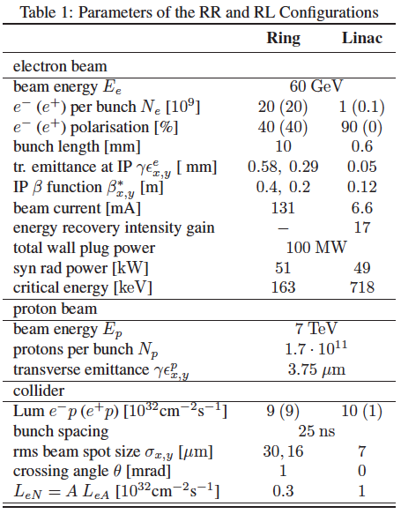
CERN-ECFA-NuPECC:
CDR Draft (530pages) being refereed
Publish early 2012
Steps towards TDR (tentative)
Prototype IR magnet (3 beams)
Prototype Dipole (1:1)
Develop Cavity/Cryomodule
Civil Engineering, …
Build international collaborations
for the accelerator and detector
development. Strong links to ongoing
accelerator and detector projects.
The LHC offers the unique perspective
for a further TeV scale collider. The
LINAC’s are of about 2mile length, yet
the Q² is 10⁵ times larger than was
achieved when SLAC discovered quarks.
Particle physics needs pp, ll and ep.
Here is a realistic prospect to progress.
Both the ring and the linac are feasible and both
come very close to the desired performance.
The pleasant challenge is to soon decide for one.
Summary slide IPAC11 M.Klein

Slide 6
Why an ep/A Experiment at TeV Energies?
For resolving the quark structure of the nucleon with p, d and ion beams
For the development of perturbative QCD [37-28-15]
For mapping the gluon field
For searches and the understanding of new physics
For investigating the physics of parton saturation
QPM symmetries, quark distributions (complete set from data), GPDs, nuclear PDFs ..
N^{k}LO (k≥2) and h.o. eweak, HQs, jets, resummation, factorisation, diffraction
Gluon for ~10⁻⁵ < x <1 , Pomeron, unintegrated gluon
GUT (α_{s} to 0.2%), LQs RPV, Higgs (bb, HWW), PDFs4LHC, instanton, odderon,..?
Non-pQCD (chiral symm breaking, confinement), black disc limit, saturation border..
..For providing data which could be of use for future experiments [Proposal for SLAC ep 1968]

Slide 7
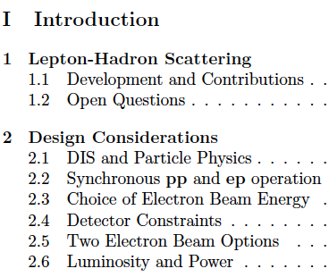
CDR
Why differ leptons from quarks? (Leptopartons)
Higgs? (production via gg (SM), bb(MSSM), quartic selfcoupling)
Mapping of the Gluon Field (next slide)
Non pQCD – 10 dim string theory (BFKL, odderon)
Ultimate precision of α_{s} and sin²Θ (0.1%, μ dependence)
Determination of ALL quark distributions
Confinement?? (Diffraction)
Generalised parton distributions (DVCS)
DGLAP → BFKL? (saturation of gluon density)
Structure of the neutron (no eD at HERA)
Partons in nuclei (4 orders of magnitude extended range)
New singly produced states (e*)
Unfolding of Contact interaction effects (up to 50 TeV)
…
The LHeC has an outstanding, unique programme,
which is complementary to the LHC. It requires:
High energy, high luminosity, polarised e±, p, D, A.
The LHC provides all of that if complemented
by an intense, high energy electron beam. This
determines the schedule, and the site is no question.
Default energy: E_{e}=60 GeV
So far LQ limits ~0.5 TeV
Q² >> M_{Z}²
Gluon saturation at x ~10⁻⁵
in the DIS region Q² >M_{p}²
Synchrotron radiation ~ E_{e}⁴
Cost and Luminosity:
L = 100 L_{HERA}, Q² and 1/x = 20 HERA
[LHC in 2015 may affect that choice.]
M.Klein at IPAC11

Slide 8
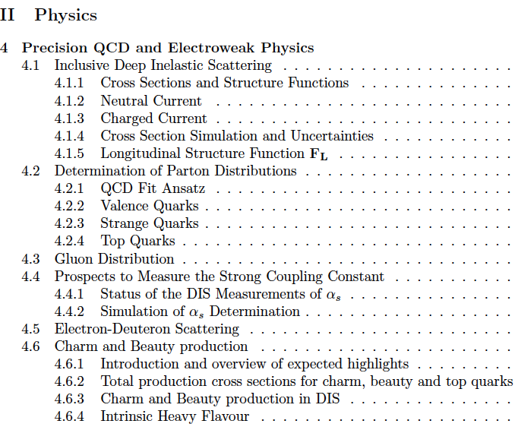
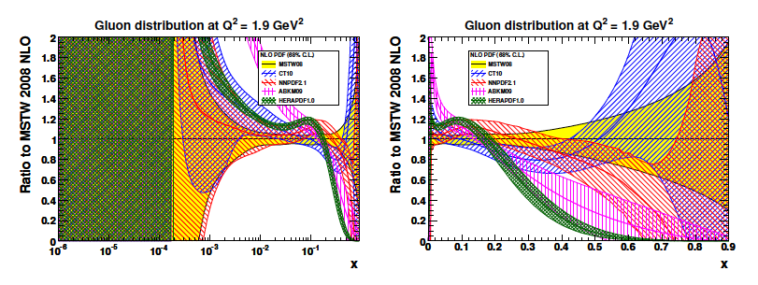
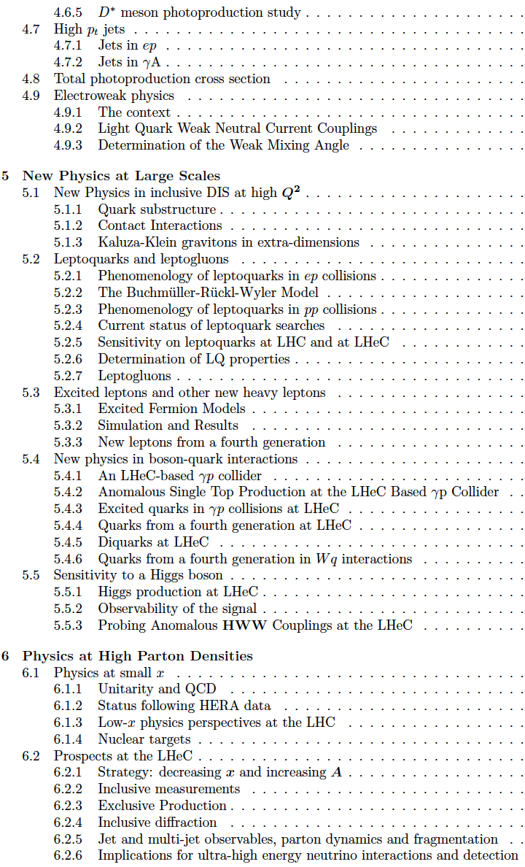
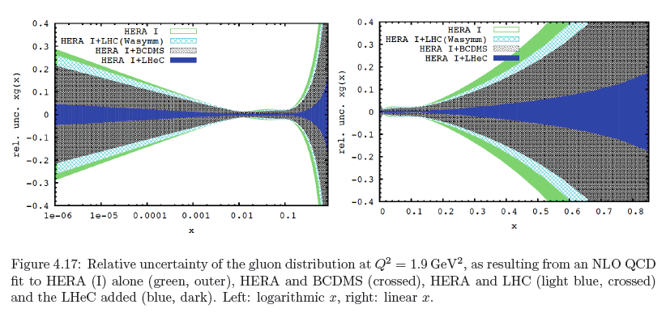
CDR
now
then
Precision measurement of gluon density to extreme x → α_{s}
Low x: saturation in ep? Crucial for QCD, LHC, UHE neutrinos!
High x: xg and valence quarks: resolving new high mass states!
Gluon in Pomeron, odderon, photon, nuclei.. Local spots in p?
Heavy quarks intrinsic or only gluonic?
153 pages

Slide 9
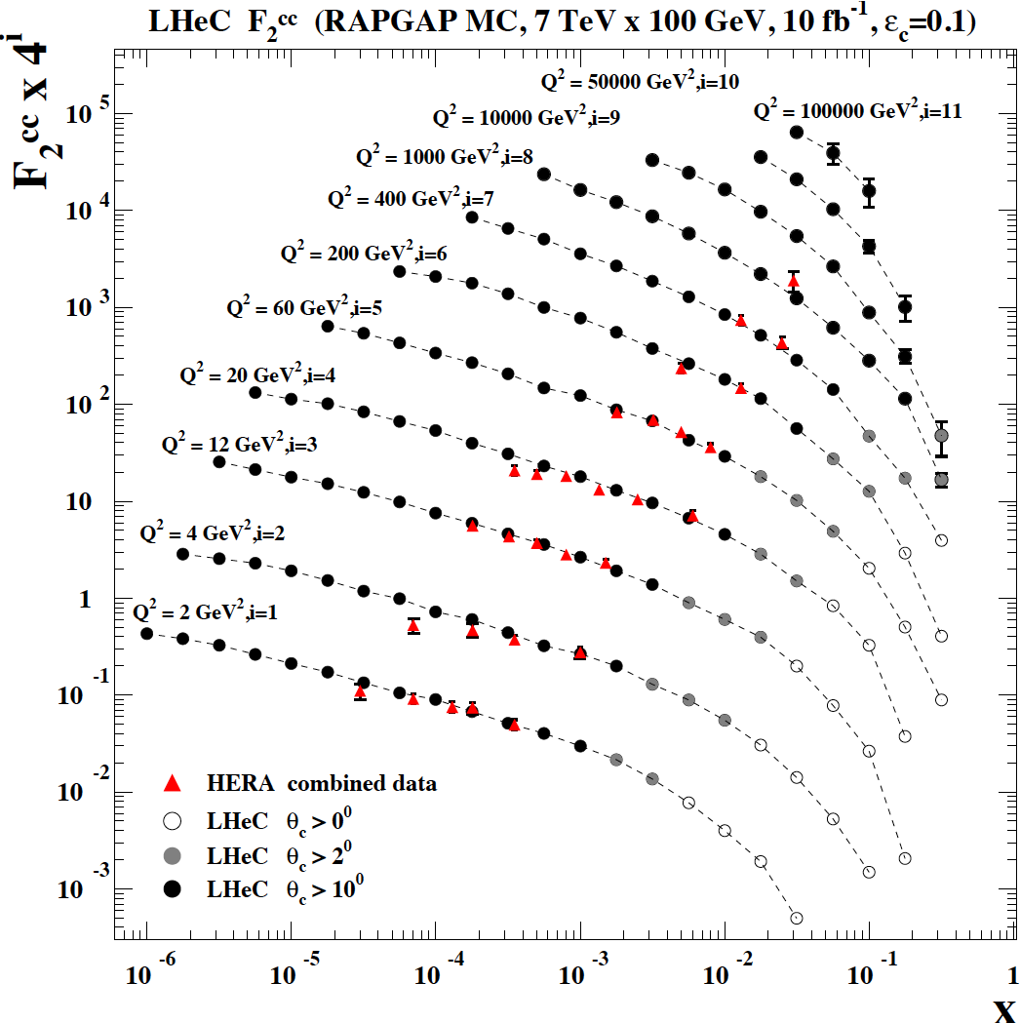
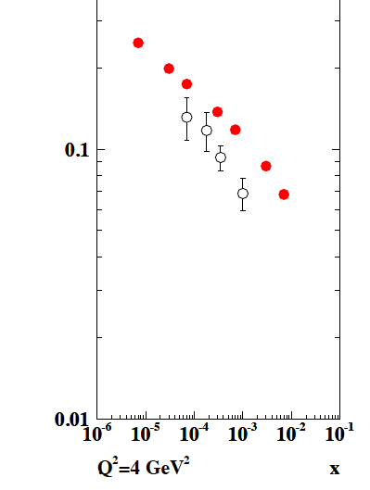
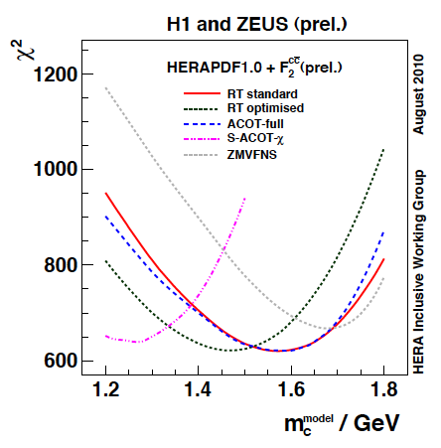
Charm – α_{s}
F₂^{cc}
LHeC
HERA
LHeC vs HERA: higher fraction of c, larger range,
smaller beam spot, better Silicon detectors
CDR

Slide 10
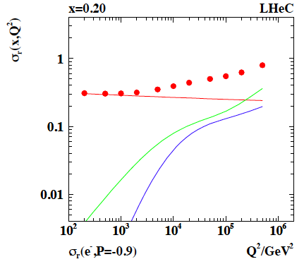
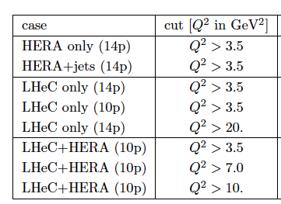
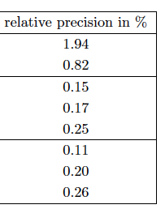
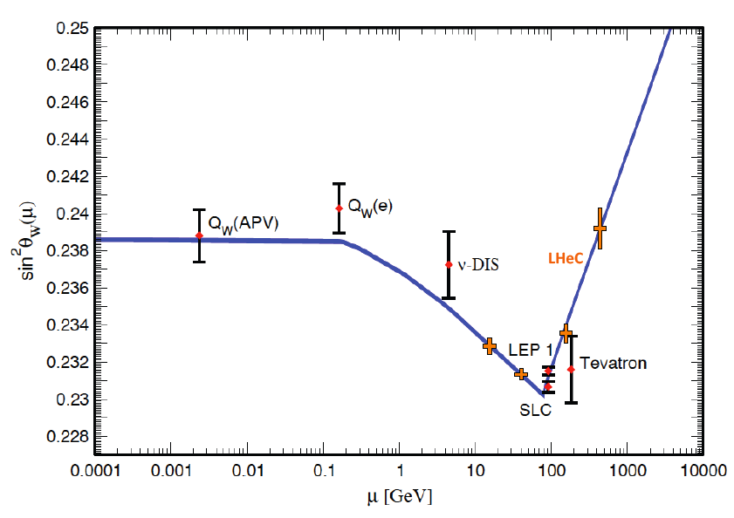
Electroweak+Strong Precision Physics
α_{s} to
permille
GUT
BCDMS
Scale dependence of
weak mixing angle from
polarisation asymmetry
and NC/CC ratio.
Light quark NC couplings
Joint QCD+eweak at high orders becomes crucial at LHC too
CDR

Slide 11
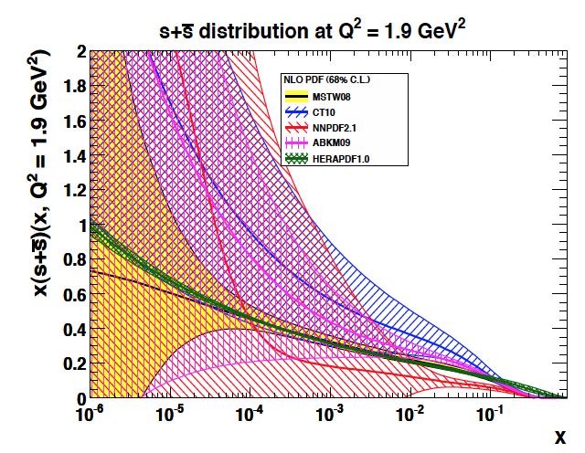
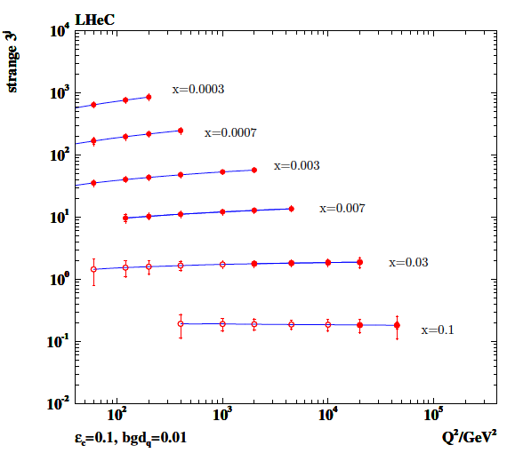
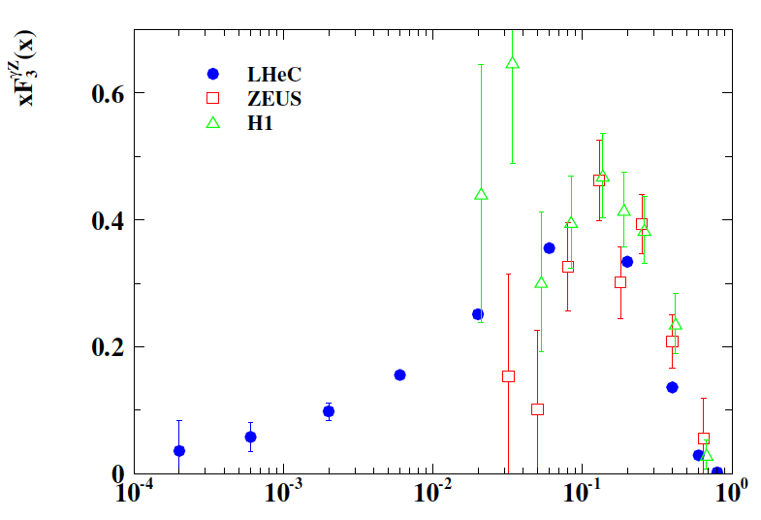
Quarks – strange and valence
W,Z (LHC)
νN→c..
Strange quark density unknown
at low x and controversial at high x~0.1
Low x sea to be unfolded with LHeC
CC and ep and eD measurements
down to x=10^{-4..6}
Sea Quarks=Antiquarks? Need u_{v},d_{v}
CDR
LHeC: much extended range and 100 * L (HERA)

Slide 12
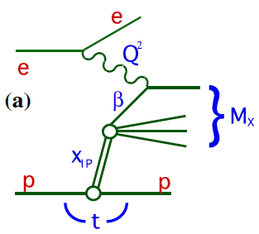
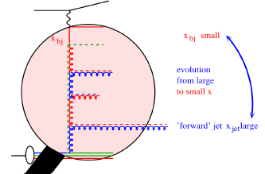
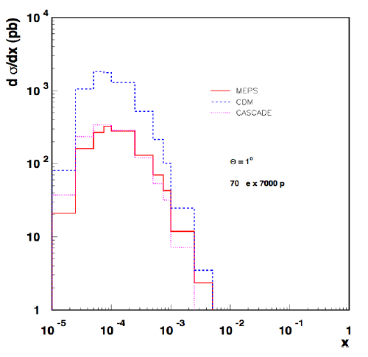
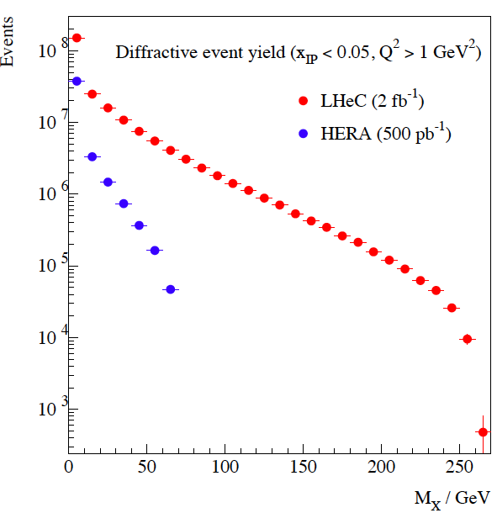
Quark-Gluon Dynamics - Diffraction and HFS (fwd jets)
Factorisation broken
(LHC fwd – LHeC diff)
Understand multi-jet emission (unintegr. pdf’s), tune MC’s
Production of high mass 1⁻ states
CDR
At HERA resolved γ effects mimic non-kt ordered emission

Slide 13
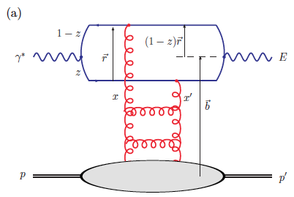
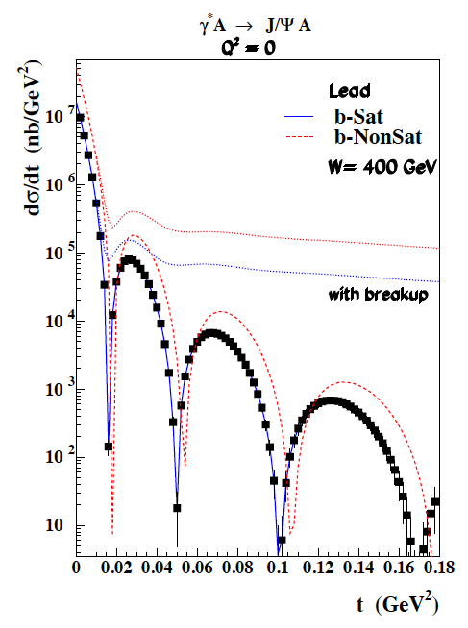
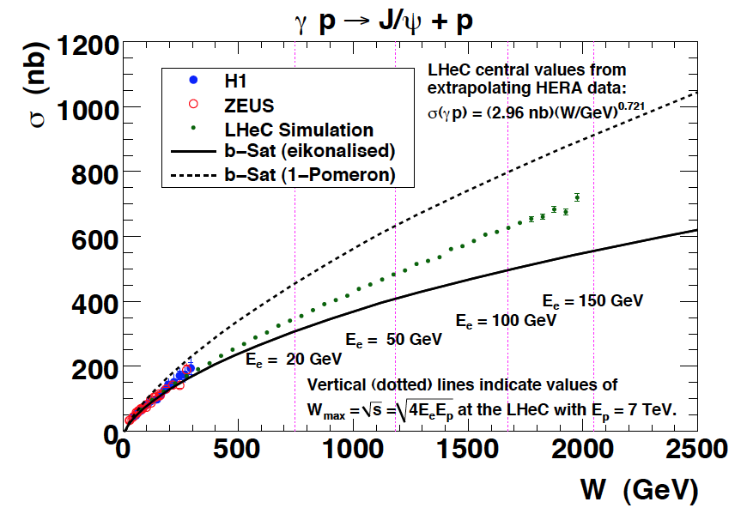
J/ψ in γ*p/A
Test of saturation
E=J/ψ or γ (DVCS)
Optical theorem relates J/ψ to F_{T}=F₂-F_{L}
Coherent production in y*A
Probing of nuclear matter
CDR

Slide 14
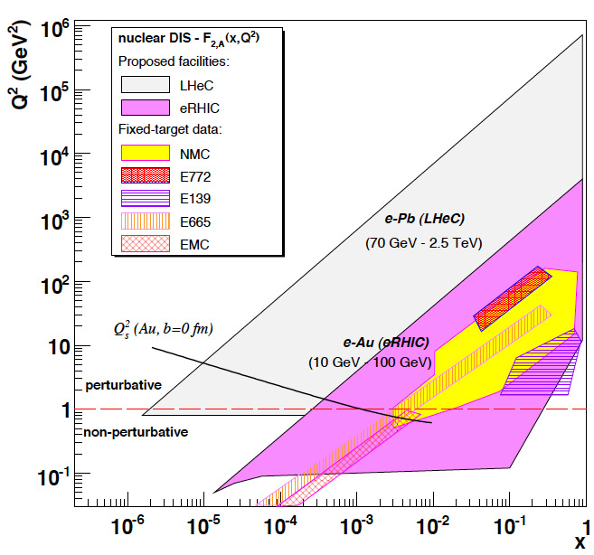
Electron-Ion Scattering
Dipole models predict saturation which
resummation in pQCD moves to lower x..
requires highest energy, low x, Q²>M_{p}²
Expect qualitative changes of behaviour
- Black body limit of F₂
Saturation of cross sections amplified with A^{1/3}
Rise of diffraction to 50%? ….
A huge terra incognita (p without HERA)
below x ~ 10⁻²: DIS data end. NO flavour
separation though indications are that
shadowing is flavour dependent, for example..
Deuterons: tag spectator, shadowing-diffraction!
Neutron structure (light sea, UHE neutrinos, QPM)
q_{A}/208*q_{p}
CDR

Slide 15
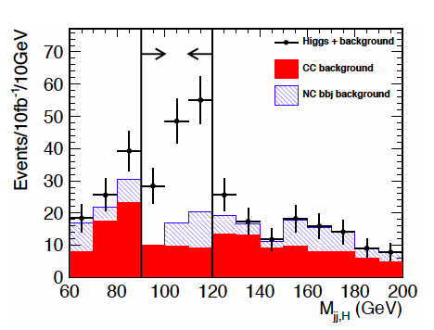
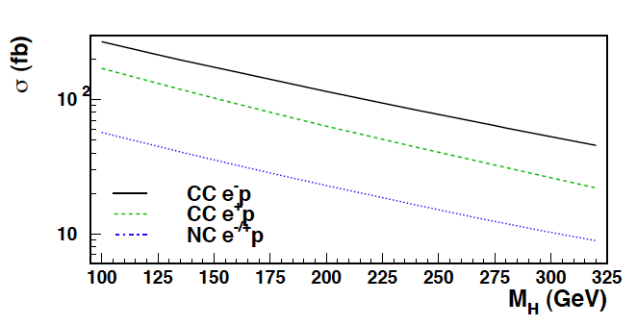
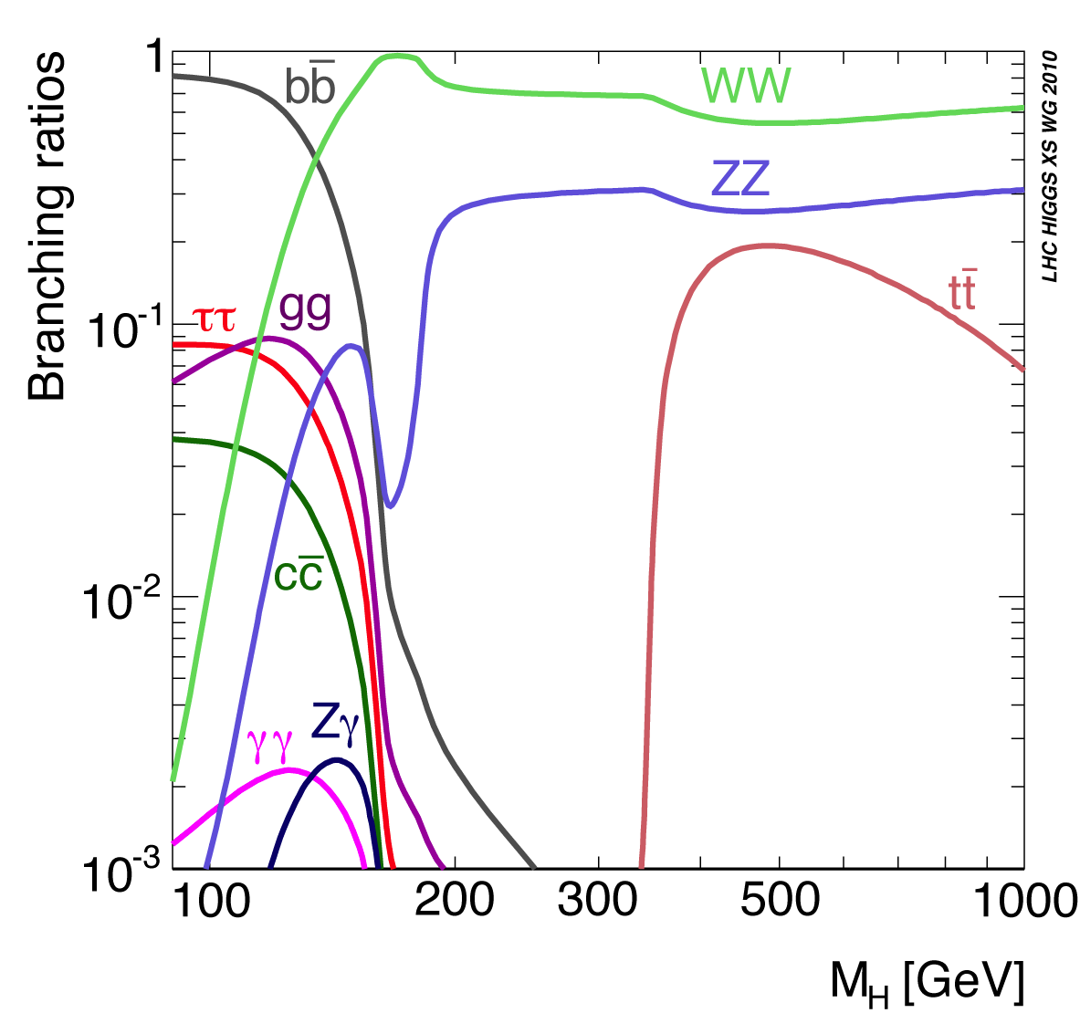
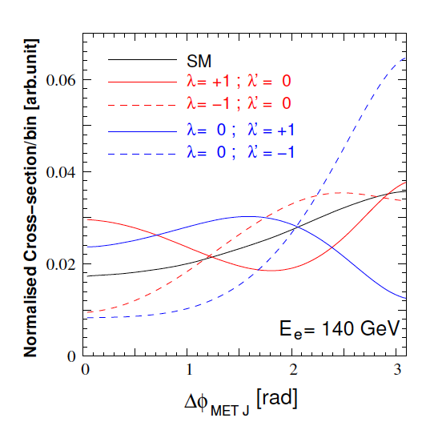
Higgs
Process determines
much of detector
acceptance and
calibration and b tag
(also single top)
and L/E_{e} requirement
Higgs is light (or absent), CC: WW→H→bb
CP even: SM, CP odd: nonSM, mixture?

Slide 16
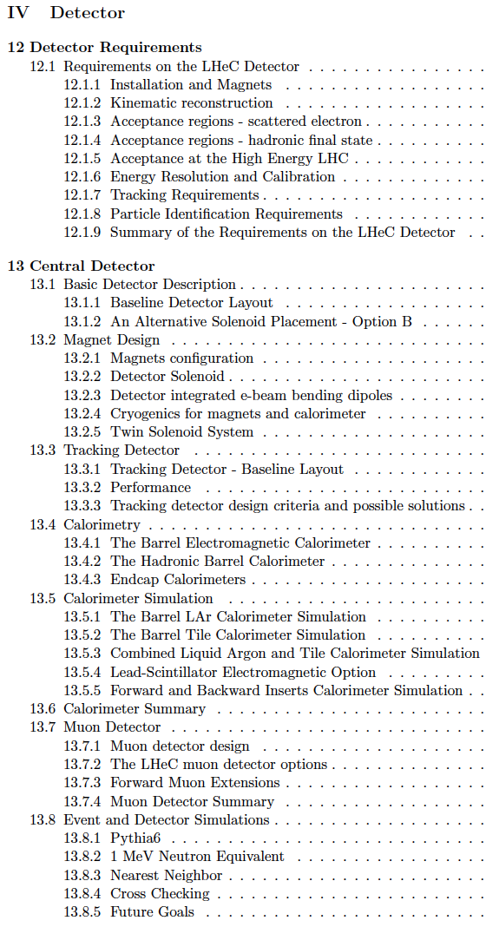
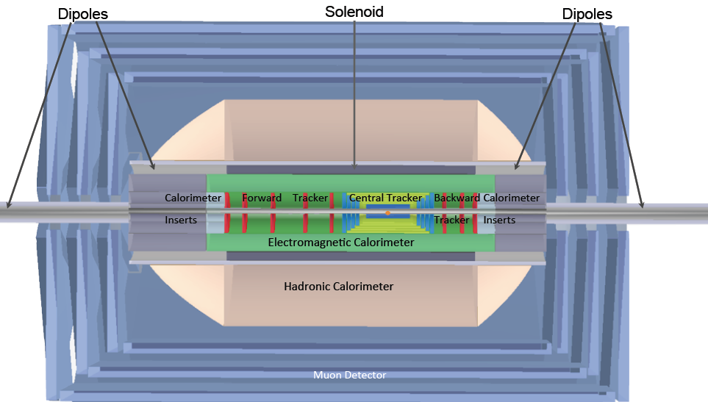
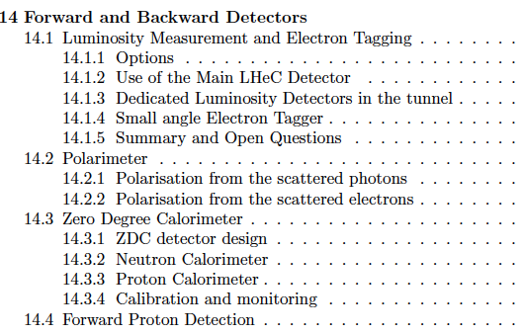
The LHeC Detector Concept
High Precision resolution, calibration, low noise at low y, tagging of b,c;
Based on the recent detector developments, “settled” technology,
avoiding time consuming dedicated R&D programs.
Modular for installation and flexible for access Detector construction above ground (LHC schedule!)
Small radius and thickness of beam pipe optimized in view of 1-179º acceptance [for low x,Q² (e) as for high x (final state), synchrotron radiation and background production.
Affordable - comparatively reasonable cost.
One IR, one detector (no push-pull, two teams/reconstructions..?)
85 pages

Slide 17
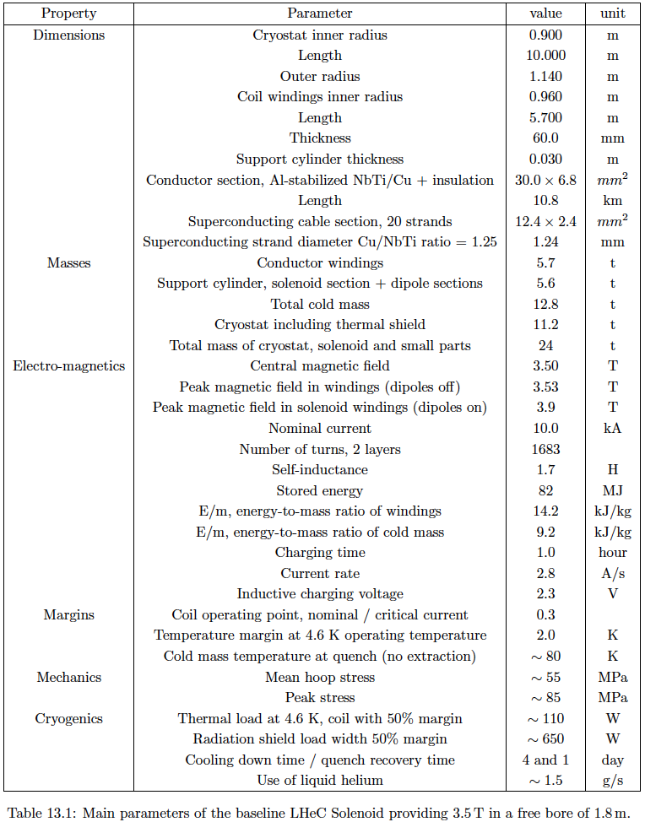
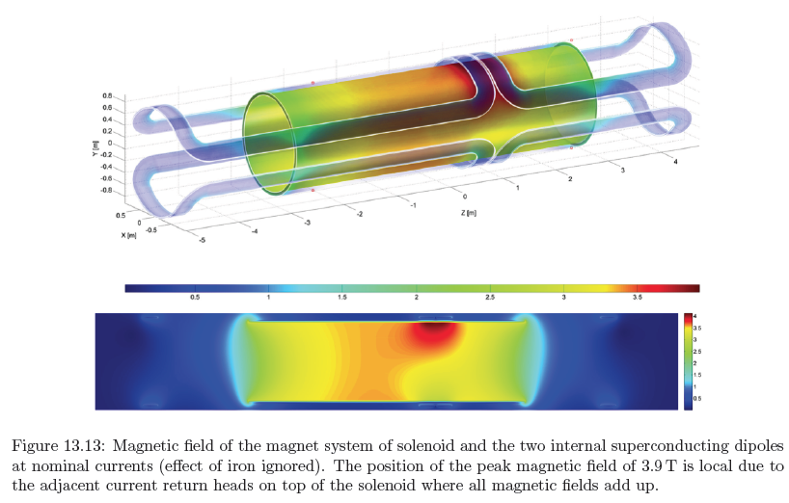
Magnets
Dipole (for head on LR) and
solenoid in common cryostat,
perhaps with electromagnetic LAr
3.5T field at ~1m radius to house
a Silicon tracker
Based on ATLAS+CMS experience

Slide 18
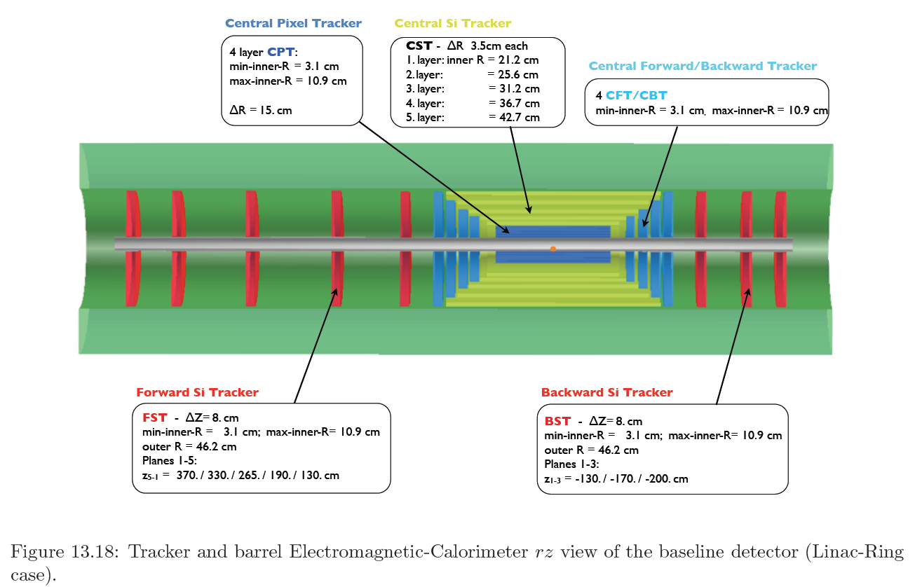
Silicon Tracker and EM Calorimeter
Transverse momentum
Δp_{t}/p²_{t} → 6 10⁻⁴ GeV⁻¹
transverse
impact parameter
→ 10μm

Slide 19
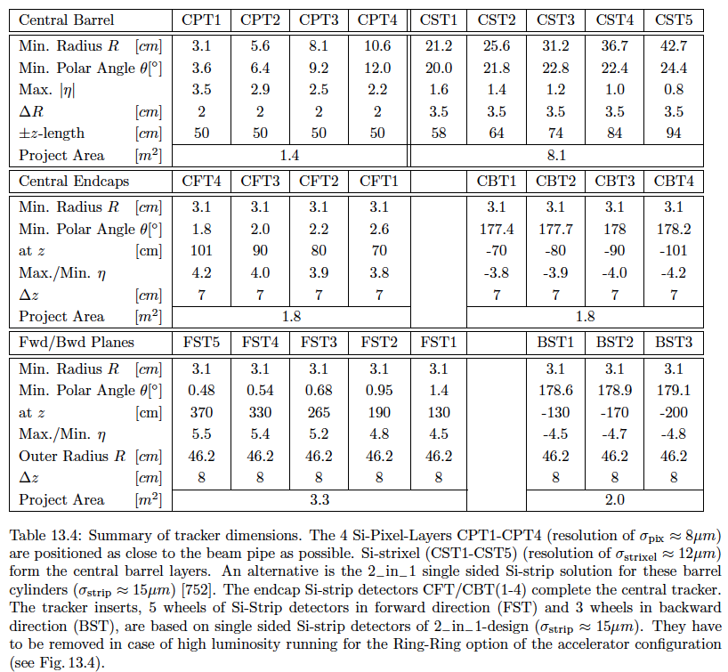
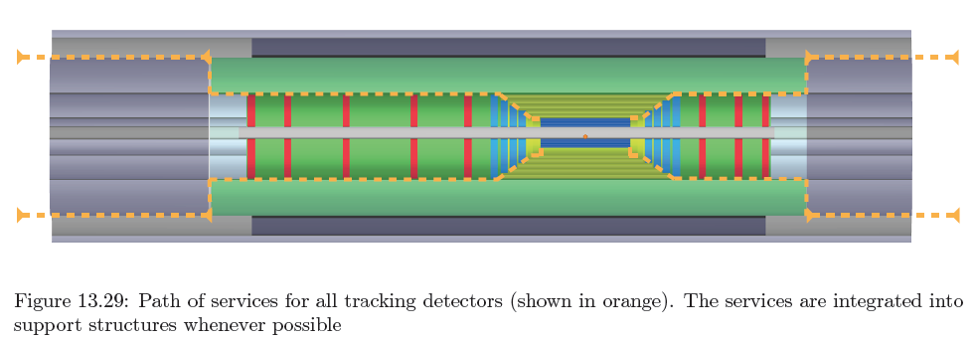
LHeC Si Tracker
Various types of pixel and strip detectors. NO pileup. Less radiation vs pp but be safe

Slide 20
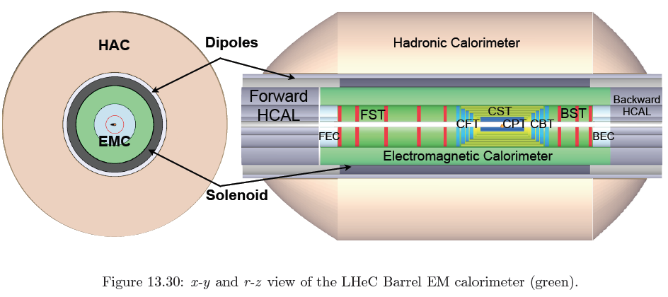
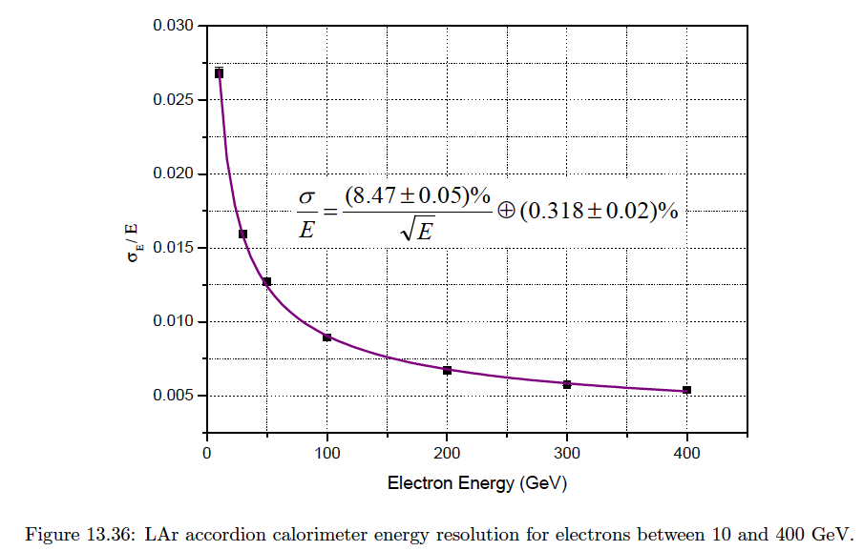
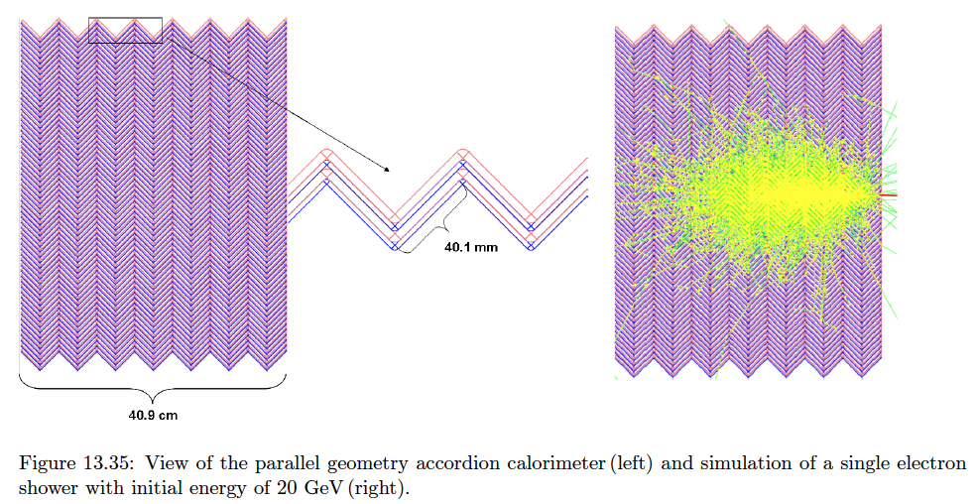
Liquid Argon Electromagnetic Calorimeter
Inside Coil
H1, ATLAS
experience.
Barrel: Pb, 20 X₀ , 11m³
fwd/bwd inserts:
FEC: Si -W, 30 X₀ ,0.3m³
BEC: Si -Pb, 25 X₀,0.3m³
GEANT4 Simulation

Slide 21
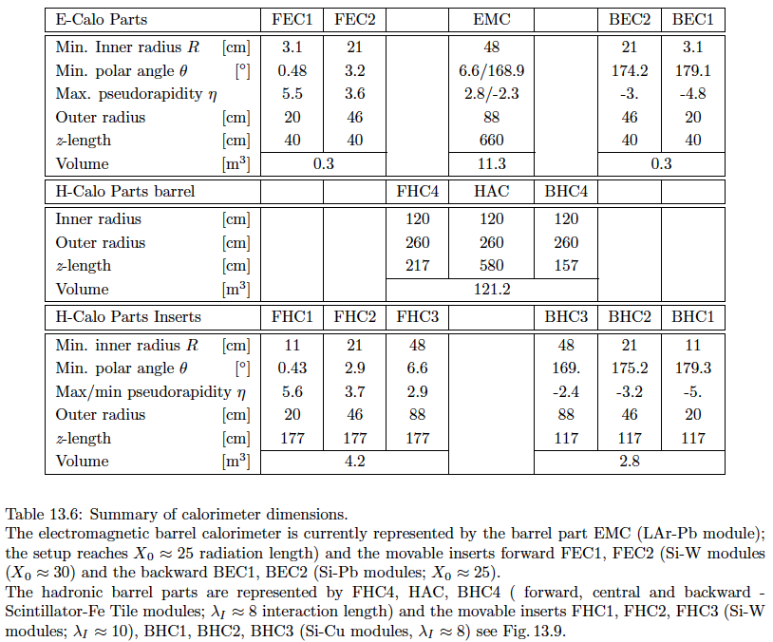
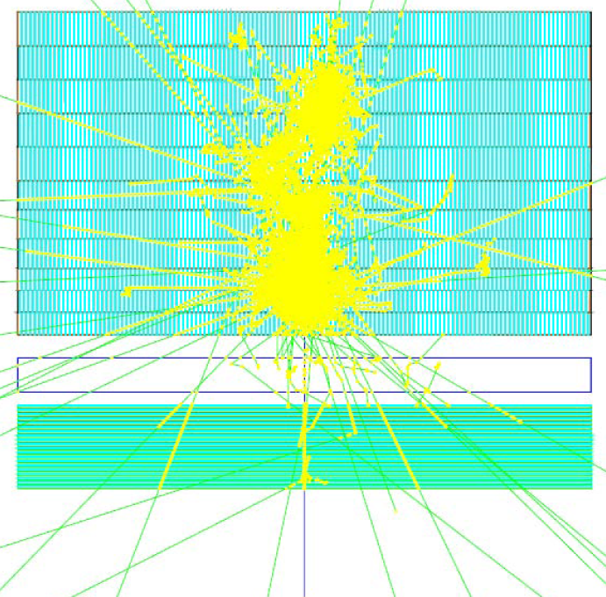
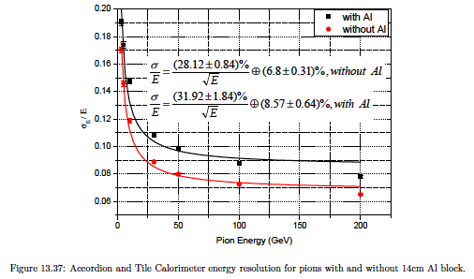
Hadronic Tile Calorimeter
Outside Coil: flux return
Modular. ATLAS experience.
R=2.6m
+5.9m
-3.6m
Combined GEANT4 Calorimeter Simulation

Slide 22
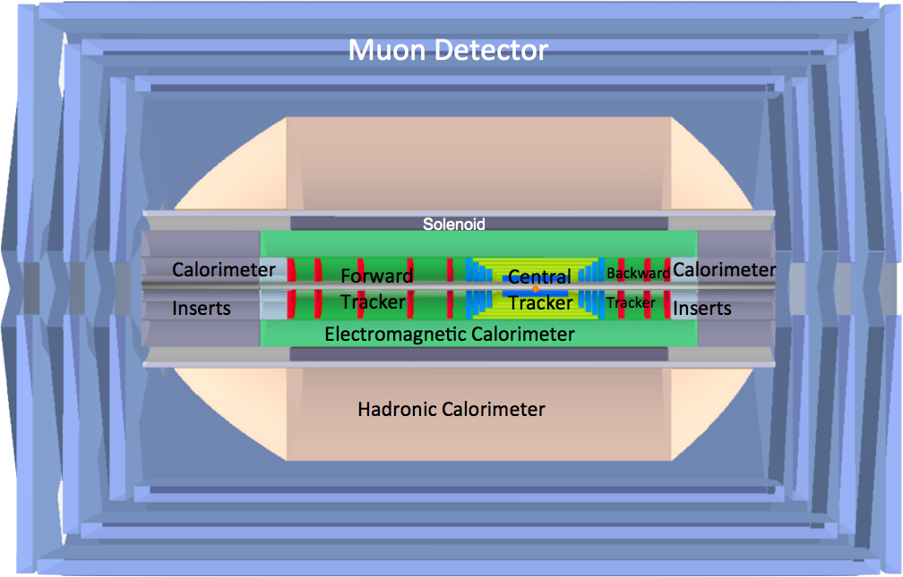
LHeC Detector Overview
LAr electromagnetic calorimeter
Tile Calorimeter
Detector option 1 for LR and full acceptance coverage
Forward/backward asymmetry in energy deposited and thus in geometry and technology
Present dimensions: LxD =14x9m² [CMS 21 x 15m² , ATLAS 45 x 25 m²]
Taggers at -62m (e),100m (γ,LR), -22.4m (γ,RR), +100m (n), +420m (p)

Slide 23
Summary [for physics and detector part or report]
The (draft) Report on Designs for the LHeC has been delivered and
is under review by 24 referees appointed by CERN, publish spring.
The physics of a TeV scale ep collider is unique and complementary
to the LHC at the same time. Its main virtues are: [eq/eeqq,H] new
physics should that occur at the LHC, ultra-high precision QCD and
e.weak measurements, a complete unfolding of the quark and anti-q
structure of the proton, including top, new physics at lowest x related
to UHE neutrinos and the understanding of the QGP initial state with
unique measurements of the partonic structure of nuclei…
A detector concept has been worked out which indicates that the
required acceptance and precision may be reached. Its technology
is suggested to be chosen for a fast installation and in line with mainly
the LHC detector choices, taken and for the ongoing upgrades.
Courage is now required to move towards building a further, unique
LHC experiment at CERN. Half of it is built, and it may start in 2022.
Special thanks to ECFA for an encouraging and demanding Collaboration

Slide 24
backup

Slide 25
Questions on a TeV ep Collider
Divonne 08
G. Altarelli
J.Bartels: Theory on low x

Slide 26
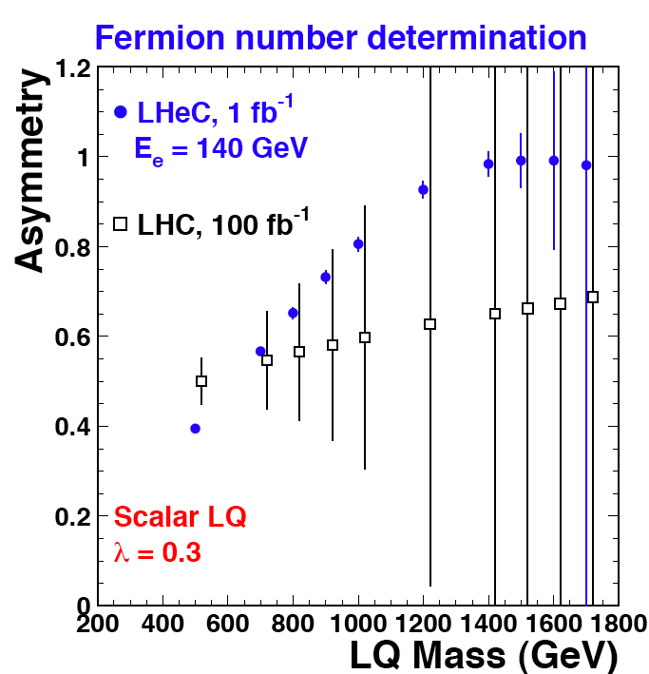
LQ Quantum Numbers
Charge asymmetry much cleaner in ep [in] than in pp [out].
Similar for simultaneous determination of coupling
and quark flavour. Polarisation for spectroscopy
JINST 1 2006 P10001

