Slide 1


The LHeC Project at CERN – An Overview*
Max Klein
For the LHeC Study Group
Choices and Status:
Perspective
Physics
Detector
Ring-Ring
Linac-Ring
Project
LHeC: e±p/A
E_{e}=10…140 GeV
E_{p}=1..7 TeV
E_{A}=E_{p} *Z/A
L=10³³cm⁻²s⁻¹
while LHC runs
DIS11, Newport News, VA, 12.4.11
http://cern.ch/lhec
*All tentative - work in progress - prior to CDR publication..

Slide 2
The 10-100 GeV Energy Scale [1968-1986]
(--)
pp
Drell Yan
Charm
W,Z
Jets
lh
e⁺e⁻
SU(2)_{L} x U(1)
QCD
Quarks
Neutral currents
Singlet e_{R}
Asymptotic Freedom
Charm
3 colours
Gluon Jets

Slide 3
The Fermi Scale [1985-2010]
pp
b quark
top quark
M_{W}, H?
Tevatron
ep
e⁺e⁻
The Standard
Model Triumph
M_{Z} , sin² Θ
3 neutrinos
h.o. el.weak (t,H?)
gluon
h.o. strong
c,b distributions
high parton densities
LEP/SLC
HERA
CKM - B factories
Colliders at the energy frontier

Slide 4
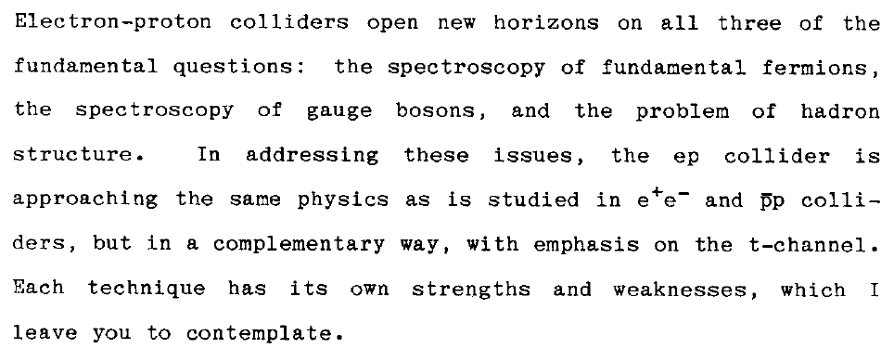
History
Chris Quigg
Early studies
Steps towards the CDR on the LHeC
LEP*LHC (1984, 1990) - Lausanne, Aachen
E.Keil LHC project report 93 (1997)
Thera (2001)
QCD explorer (2003)
J.Dainton et al, 2006 JINST 1 10001
LHeC at DIS conferences since Madison 2005
2007 CERN SPC and [r]ECFA
2008 Divonne I, ICFA,ECFA
2009 Divonne II, NuPECC, ECFA
2010 Divonne III, NuPECC, ECFA
Series of 3 workshops, fall each year

Slide 5
The TeV Scale [2010-2035..]
pp
W,Z,top
Higgs??
New Particles??
New Symmetries?
LHC
ep
e⁺e⁻
New Physics
ttbar
Higgs??
Spectroscopy??
High Precision QCD
High Density Matter
Substructure??
eq-Spectroscopy??
ILC/CLIC
LHeC
CKM - superB

Slide 6
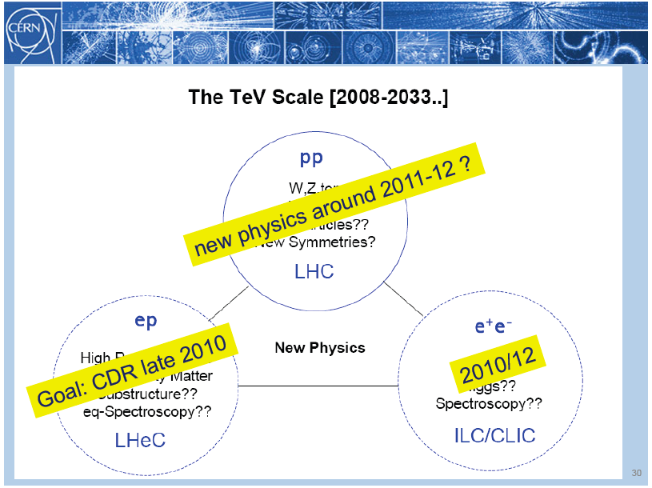
title
Rolf Heuer: 3/4. 12. 09 at CERN: From the Proton Synchroton to the Large Hadron Collider
50 Years of Nobel Memories in High-Energy Physics

Slide 7
LHeC Physics
Grand unification? α_{s} to per mille accuracy: jets vs inclusive
ultraprecision DIS programme: N^{k}LO, charm, beauty, ep/eD,..
2. Complete unfolding of partonic content of the proton,
direct and in QCD and mapping of the gluon field
3. A new phase of hadronic matter: high densities, small α_{s}
saturation of the gluon density? BFKL-Planck scale
superhigh-energy neutrino physics (p-N)
4. Partons in nuclei (4 orders of magnitude extension)
saturation in eA (A^{1/3}?), nuclear parton distributions
black body limit of F₂, colour transparency, …
5. Search for novel QCD phenomena
instantons, odderons, hidden colour, sea=antiquarks (strange)
6. Complementarity to new physics at the LHC
LQ spectroscopy, eeqq CI, Higgs, e*

Slide 8
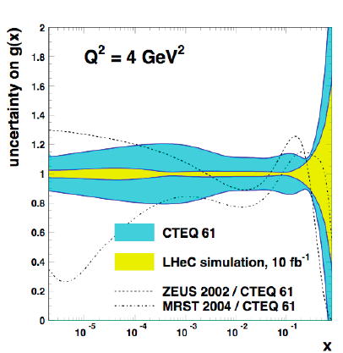
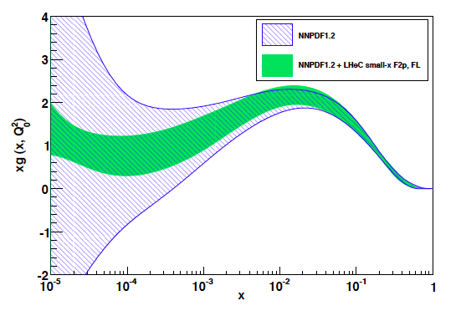
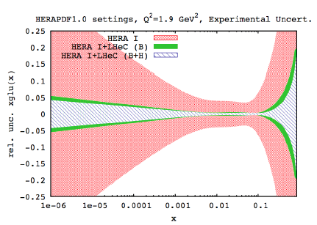
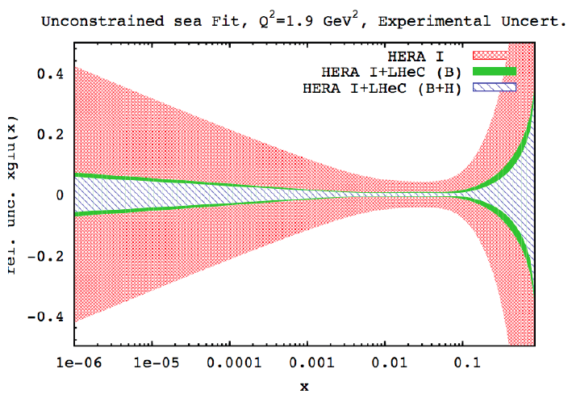
Gluon Distribution
From F₂ and F_{L} simulation - NNPDF
NLO QCD “Fits” of LHeC simulated data

Slide 9
LHeC Physics
Neutron structure free of Fermi motion
Diffraction – Shadowing (Glauber). Antishadowing
Vector Mesons to probe strong interactions
Diffractive scattering “in extreme domains” (Brodsky)
Single top and anti-top ‘factory’ (CC)
GPDs via DVCS
Unintegrated parton distributions
Partonic structure of the photon
Electroweak Couplings to per cent accuracy
….
For numeric studies and plots see recent talks at DIS10/11, ICHEP10, EIC and LHeC Workshops [ cern.ch/lhec] ..CDR
Every major step in energy can lead to new unexpected results
Requires: High energy, e±, p, d, A, high luminosity, 4π acceptance, high precision (e/h)
TeV scale physics, electroweak, top, Higgs, low x unitarity

Slide 10
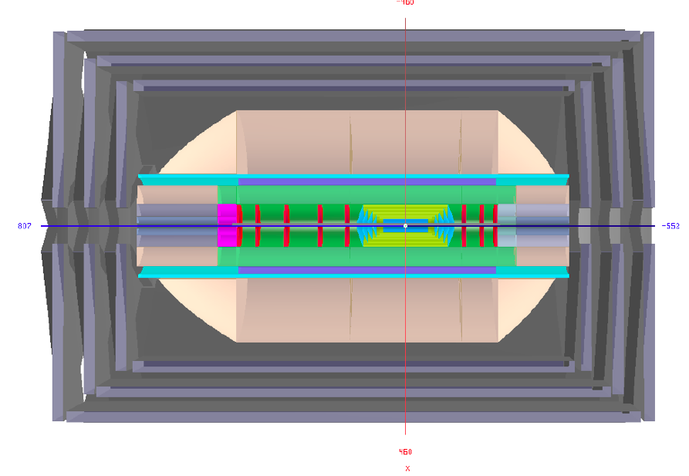
LHeC Detector
Requirements
High Precision
(resolution,
calibration,
low noise at low y
tagging of b,c)
Modular for ‘fast’
installation
State of the art
for ‘no’ R+D
1-179º acceptance
for low Q², high x
Affordable
Muon Detector
Dipole (0.3T - LR)
Solenoid (3.5T)
e →
Tracker
← p
LAr electromagnetic calorimeter
Tile Calorimeter
forward
backward
Present dimensions: LxD =13x9m² [CMS 21 x 15m² , ATLAS 45 x 25 m²]
Taggers at -62m (e),100m (γ,LR), -22.4m (γ,RR), +100m (n), +420m (p)
Tentative 21.3.11

Slide 11



















LHeC Accelerator: Participating Institutes
TOBB ETU
KEK

Slide 12
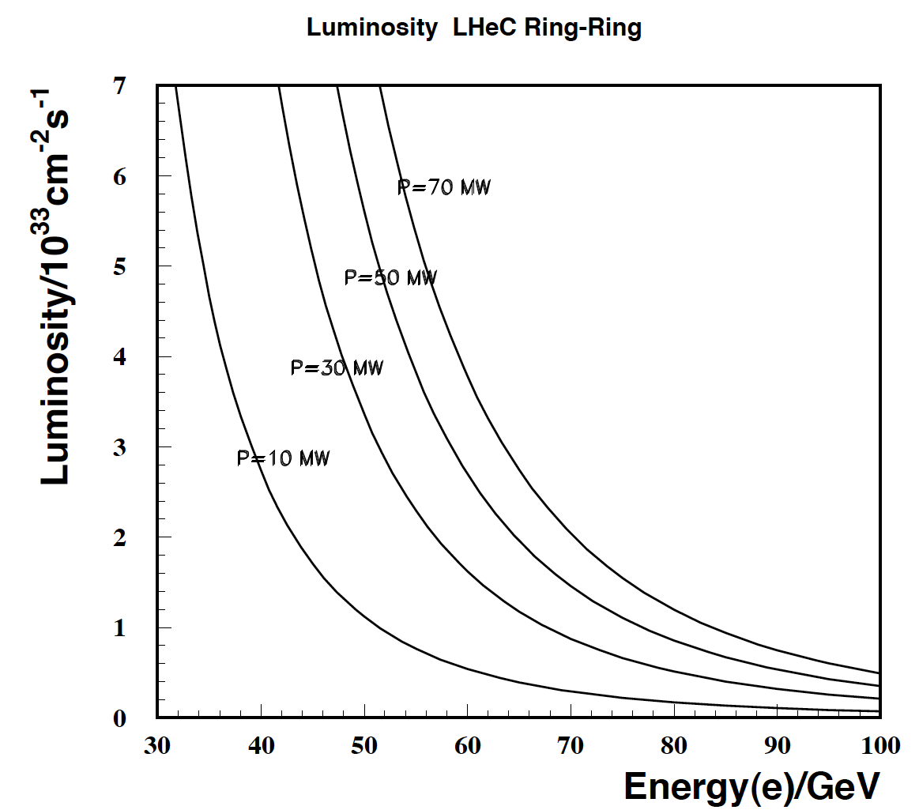
Energy-Power-Luminosity: Ring-Ring
- Power Limit of 100 MW wall plug
- “ultimate” LHC proton beam
- 60 GeV e± beam
L = 2 10³³ cm⁻²s⁻¹ → O(100) fb⁻¹
HERA 1..5 10³¹ → 1 fb⁻¹ (H1+ZEUS)
Proton tune shift from ep interaction
much smaller than from pp: Design
for simultaneous pp and ep operation

Slide 13
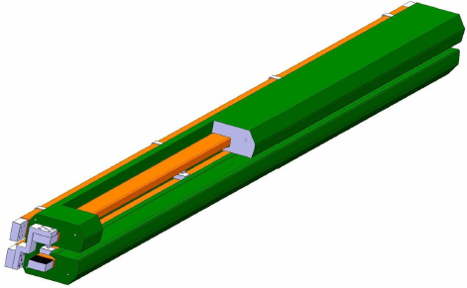
Accelerator: Ring - Ring
Workpackages for CDR [2008 – now available]
Baseline Parameters and Installation Scenarios
Lattice Design [Optics, Magnets, Bypasses]
IR for high Luminosity and large Acceptance
rf Design [Installation in bypasses, Crabs?]
Injector Complex [Sources, Injector]
Injection and Dump
Cryogenics – work in progress
Beam-beam effects
Impedance and Collective Effects
Vacuum and Beam Pipe
Integration into LHC
e Beam Polarization
Deuteron and Ion Beams
LHeC Ring Dipole Magnet
.12-.8T
1.3kA
0.8MW
5.3m long
(35 cm)²
slim + light(er)
3080 magnets
BINP-CERN

Slide 14
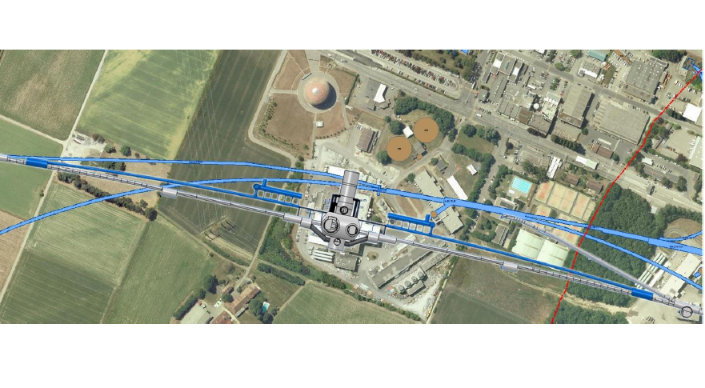
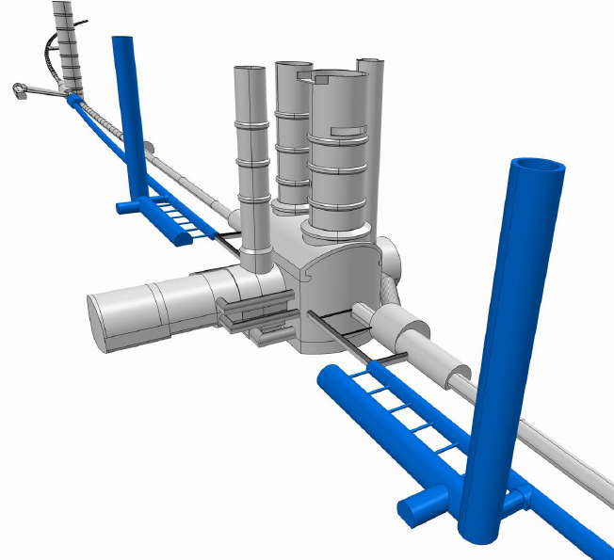
Bypassing ATLAS
For the CDR the bypass concepts
were decided to be confined to
ATLAS and CMS which is no
statement about LHCB or ALICE

Slide 15
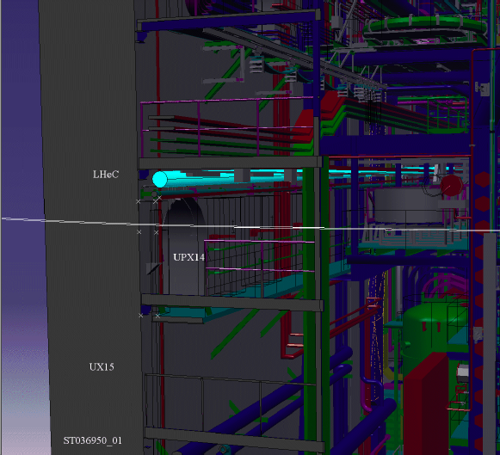
Study
of how
to pass
through
(or by)
ATLAS
August 10
tentative

Slide 16
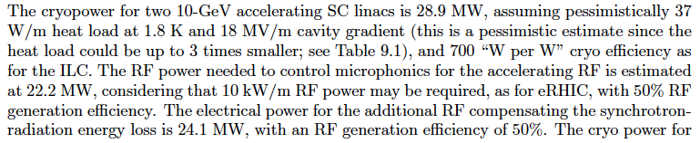
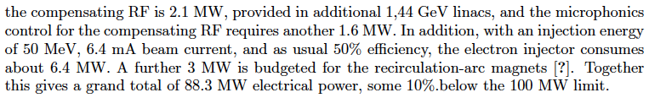
Energy-Power-Luminosity: Linac-Ring
Pulsed, 60 GeV: ~10³²cm⁻²s⁻¹
High luminosity:
Energy recovery: P=P₀/(1-η)
β*=0.1m
[5 times smaller than LHC by
reduced l*, only one p squeezed
and IR quads as for HL-LHC]
L = 10³³ cm⁻²s⁻¹ → O(100) fb⁻¹
Description of LINAC power consumption from draft of CDR

Slide 17

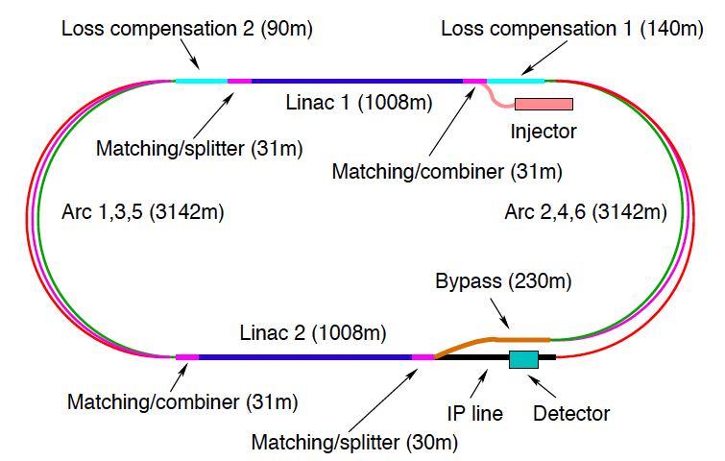
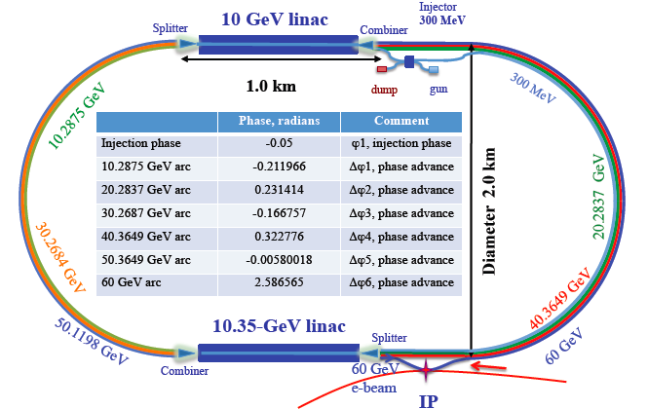
60 GeV e “LINAC”
CERN 1
CERN 2
Jlab
BNL
Two 10 GeV energy recovery Linacs, 3 returns, 720 MHz cavities

Slide 18
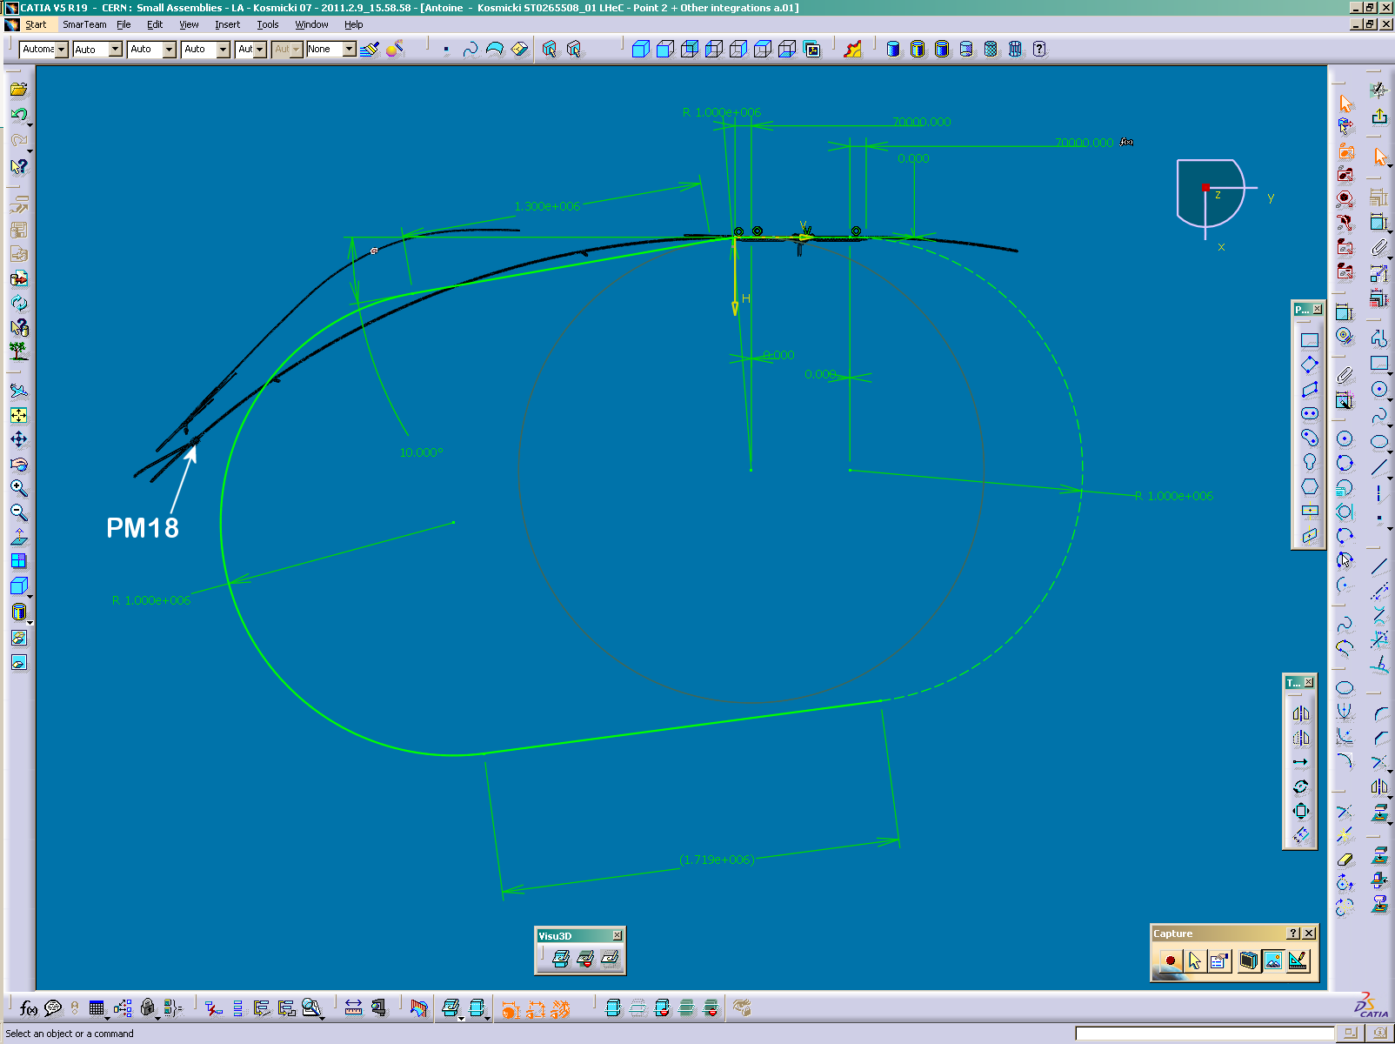
TI2
IP2
Work in progress, 11.4.11
- avoid external territory
cannot use TI2
Design made for IP2

Slide 19
Accelerator: LINAC - Ring
Workpackages for CDR [2008 – now available]
Baseline Parameters [Designs, Real photon option, ERL]
Sources [Positrons, Polarisation] – work in progress
Rf Design
Injection and Dump
Beam-beam effects
Lattice/Optics and Impedance
Vacuum and Beam Pipe
Integration and Layout
Interaction Region
Magnets
Cryogenics – work in progress
1056 cavities
66 cryo modules per linac
721 MHz, 19 MV/m CW
Similar to SPL, ESS, XFEL, ILC, eRHIC, Jlab
21 MW rf
Cryo 29 MW for 37W/m heat load
Magnets in the 2 * 3 arcs:
600 - 4m long dipoles per arc
240 - 1.2m long quadrupoles per arc

Slide 20
Design Parameters
electron beam | RR | LR | LR
e- energy at IP[GeV] | 60 | 60 | 140
luminosity [10³² cm⁻²s⁻¹] | 17 | 10 | 0.44
polarization [%] | 40 | 90 | 90
bunch population [10⁹] | 26 | 2.0 | 1.6
e- bunch length [mm] | 10 | 0.3 | 0.3
bunch interval [ns] | 25 | 50 | 50
transv. emit. γε_{x,y} [mm] | 0.58, 0.29 | 0.05 | 0.1
rms IP beam size σ_{x,y} [μm] | 30, 16 | 7 | 7
e- IP beta funct. β*_{x,y} [m] | 0.18, 0.10 | 0.12 | 0.14
full crossing angle [mrad] | 0.93 | 0 | 0
geometric reduction H_{hg} | 0.77 | 0.91 | 0.94
repetition rate [Hz] | N/A | N/A | 10
beam pulse length [ms] | N/A | N/A | 5
ER efficiency | N/A | 94% | N/A
average current [mA] | 131 | 6.6 | 5.4
tot. wall plug power[MW] | 100 | 100 | 100
proton beam | RR | LR
bunch pop. [10¹¹] | 1.7 | 1.7
tr.emit.γε_{x,y} [μm] | 3.75 | 3.75
spot size σ_{x,y} [μm] | 30, 16 | 7
β*_{x,y} [m] | 1.8,0.5 | 0.1
bunch spacing [ns] | 25 | 25
“ultimate p beam”
1.7 probably conservative
Design also for
D and A (L_{eN} = 10³¹ cm⁻²s⁻¹)
RR= Ring – Ring
LR =Linac –Ring
Parameters from 8.7.2010
New: Ring: use 1º as baseline : L/2
Linac: clearing gap: L*2/3
High E_{e} Linac option (ERL?) if physics demands, HE-LHC?

Slide 21
LHeC DRAFT Timeline
Based on LHC constraints, ep/A programme, series production, civil engineering etc
Year | 2012 | 2013 | 2014 | 2015 | 2016 | 2017 | 2018 | 2019 | 2020 | 2021 | 2022
 | Prototyping- testing
 |  |  |  | Production main components
 |  |  | Civil engineering
 |  |  |  |  |  |  |  | Installation
 |  |  |  |  |  |  |  |  |  | Operation
Variations on timeline:
production of main components can overlap with civil engineering
Installation can overlap with civil engineering
Additional constraints from LHC operation not considered here
in any variation, a start by 2020 requires launch of prototyping of
key components by 2012
[shown to ECFA 11/2010: mandate to 2012]

Slide 22
NuPECC – Roadmap 2010: New Large-Scale Facilities
 |  |  | 2010 |  |  |  |  | 2015 |  |  |  |  | 2020 |  |  |  |  | 2025
FAIR | PANDA | R&D Construction Commissioning |  |  |  |  |  |  |  |  | Exploitation
 | CBM | R&D Construction Commissioning |  |  |  |  |  |  |  |  | Exploitation |  |  | SIS300
 | NuSTAR | R&D Construction Commissioning |  |  |  |  |  |  |  |  | Exploit. |  | NESR FLAIR
 | PAX/ENC | Design Study R&D Tests Construction/Commissioning |  |  |  |  |  |  |  |  |  |  |  |  |  | Collider
SPIRAL2 |  | R&D Constr./Commission. |  |  |  |  | Exploitation |  |  |  |  |  |  | 150 MeV/u Post-accelerator
HIE-ISOLDE |  |  | Constr./Commission. |  |  |  | Exploitation |  |  |  |  |  |  |  | Injector Upgrade
SPES |  |  |  | Constr./Commission. |  |  |  | Exploitation
EURISOL |  | Design Study R&D Preparatory Phase / Site Decision Engineering Study Construction
LHeC |  | Design Study R&D Engineering Study Construction/Commissioning
G. Rosner, NuPECC Chair, Madrid 5/10

Slide 23
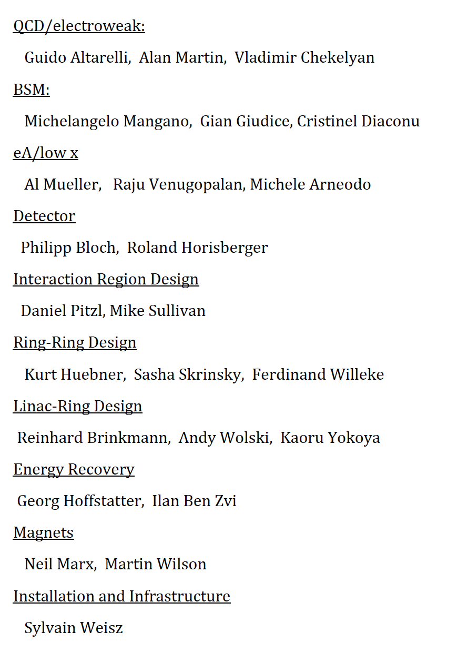
Organization for the CDR
Accelerator Design [RR and LR]
Oliver Bruening (CERN),
John Dainton (CI/Liverpool)
Interaction Region and Fwd/Bwd
Bernhard Holzer (DESY),
Uwe Schneeekloth (DESY),
Pierre van Mechelen (Antwerpen)
Detector Design
Peter Kostka (DESY),
Rainer Wallny (U Zurich),
Alessandro Polini (Bologna)
New Physics at Large Scales
George Azuelos (Montreal)
Emmanuelle Perez (CERN),
Georg Weiglein (Durham)
Precision QCD and Electroweak
Olaf Behnke (DESY),
Paolo Gambino (Torino),
Thomas Gehrmann (Zuerich)
Claire Gwenlan (Oxford)
Physics at High Parton Densities
Nestor Armesto (Santiago),
Brian Cole (Columbia),
Paul Newman (Birmingham),
Anna Stasto (MSU)
Referees invited by CERN
Scientific Advisory Committee
Guido Altarelli (Rome)
Sergio Bertolucci (CERN)
Stan Brodsky (SLAC)
Allen Caldwell -chair (MPI Munich)
Swapan Chattopadhyay (Cockcroft)
John Dainton (Liverpool)
John Ellis (CERN)
Jos Engelen (CERN)
Joel Feltesse (Saclay)
Lev Lipatov (St.Petersburg)
Roland Garoby (CERN)
Roland Horisberger (PSI)
Young-Kee Kim (Fermilab)
Aharon Levy (Tel Aviv)
Karlheinz Meier (Heidelberg)
Richard Milner (Bates)
Joachim Mnich (DESY)
Steven Myers, (CERN)
Tatsuya Nakada (Lausanne, ECFA)
Guenther Rosner (Glasgow, NuPECC)
Alexander Skrinsky (Novosibirsk)
Anthony Thomas (Jlab)
Steven Vigdor (BNL)
Frank Wilczek (MIT)
Ferdinand Willeke (BNL)
Steering Committee
Oliver Bruening (CERN)
John Dainton (Cockcroft)
Albert DeRoeck (CERN)
Stefano Forte (Milano)
Max Klein - chair (Liverpool)
Paul Laycock (secretary) (L’pool)
Paul Newman (Birmingham)
Emmanuelle Perez (CERN)
Wesley Smith (Wisconsin)
Bernd Surrow (MIT)
Katsuo Tokushuku (KEK)
Urs Wiedemann (CERN))
Frank Zimmermann (CERN)
Working Group Convenors

Slide 24
Next Steps of the LHeC Project
2011
Complete CDR Draft
Workshop on positron intensity (20.5.11 at CERN)
Referee Process (5-9/11)
Update and Print and Hand in to ECFA/NuPECC/CERN
Workshop on Linac vs Ring (Fall 2011) [main features, R+D design]
2011/12
Participation in European Strategy Process (EPS Grenoble … 2012 conclusion)
Update physics programme when LHC Higgs/SUSY results consolidate (DIS12)
Form an international accelerator development group based at CERN
Build an LHeC Collaboration for preparation of LoI on the Detector
Predicting is difficult, in particular when it concerns the future (V. Weisskopf)
but there is a project and a plan and so there shall be a future for DIS at the energy frontier

Slide 25
Summary
The LHeC is the only way for the foreseeable future to realize DIS at the TeV
energy scale, leading to new insight and continuing the path from 1911 to now.
It will substantially enrich and extend the physics provided by the LHC, and it
represents a new opportunity for challenging accelerator and detector developments
Talks on Tuesday and Thursday
Miriam Fitterer (CERN) Ring-Ring
Alex Bogacz (Jlab) Linac-Ring
Peter Kostka (DESY) Detector
Anna Stasto (PennState) Inclusive Low x Physics
Paul Newman (Birmingham) Exclusive Low x Physics
Brian Cole (Columbia) Heavy Ion Physics
Voica Radescu (Heidelberg) Partons and α_{s}
Olaf Behnke (DESY) Jets and Heavy Quarks
Uta Klein (Liverpool) BSM with the LHeC
http://cern.ch/lhec

Slide 26
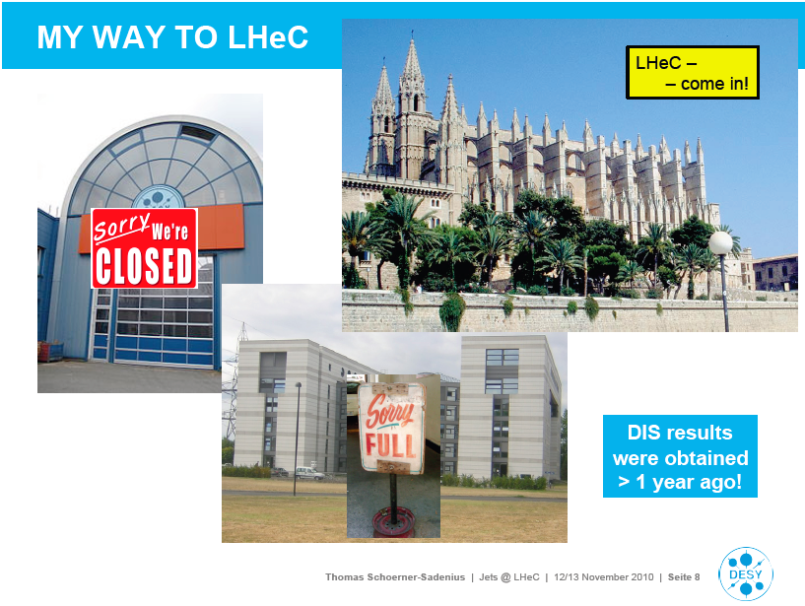
A View on the LHeC
TSS’

Slide 27
Draft CDR Authorlist 11.4.11
C. Adolphsen (SLAC)
H. Aksakal (CERN)
P. Allport (Liverpool)
J.L. Albacete (IPhT Saclay)
R. Appleby (Cockcroft)
N. Armesto (St. de Compostela)
G. Azuelos (Montreal)
M. Bai (BNL)
D. Barber (DESY)
J. Bartels (Hamburg)
J. Behr (DESY)
O. Behnke (DESY)
S. Belyaev (CERN)
I. Ben Zvi (BNL)
N. Bernard (UCLA)
S. Bertolucci (CERN)
S. Bettoni (CERN)
J. Bluemlein (DESY)
S. Brodsky (SLAC)
A. Bogacz (Jlab)
C. Bracco (CERN)
O. Bruening (CERN)
A. Bunyatian (DESY)
H. Burkhardt (CERN)
R. Calaga (BNL)
E. Ciapala (CERN)
R. Ciftci (Ankara)
A.K.Ciftci (Ankara)
B.A. Cole (Columbia)
J.C. Collins (Penn State)
J. Dainton (Liverpool)
A. De Roeck (CERN)
D. d'Enterria (CERN)
A. Dudarev (CERN)
A. Eide (NTNU)
E. Eroglu (Uludag)
K.J. Eskola (Jyvaskyla)
L. Favart (IIHE Brussels)
M. Fitterer (CERN)
S. Forte (Milano)
P. Gambino (Torino)
T. Gehrmann (Zurich)
C. Glasman (Madrid)
R. Godbole (Tata)
B. Goddard (CERN)
T. Greenshaw (Liverpool)
A. Guffanti (Freiburg)
C. Gwenlan (Oxford)
T. Han (Harvard)
Y. Hao (BNL)
F. Haug (CERN)
W. Herr (CERN)
B. Holzer (CERN)
M. Ishitsuka (Tokyo I.Tech.)
B. Jeanneret (CERN)
J.M. Jimenez (CERN)
H. Jung (DESY)
J. Jowett (CERN)
D. Kayran (BNL)
F. Kosac (Uludag)
A. Kilic (Uludag}
K. Kimura (Tokyo I.Tech.)
M. Klein (Liverpool)
U. Klein (Liverpool)
T. Kluge (Hamburg)
G. Kramer (Hamburg)
M. Korostelev (Cockcroft)
Kosmicki (CERN)
P. Kostka (DESY)
H. Kowalski (DESY)
M. Kuze (Tokyo I.Tech.)
T. Lappi (Jyvaskyla)
P. Laycock (Liverpool)
E. Levichev (BINP)
S. Levonian (DESY)
V.N. Litvinenko (BNL)
C. Marquet (CERN)
B. Mellado (Harvard)
K-H. Mess (CERN)
I.I. Morozov (BINP)
Y. Muttoni (CERN)
S. Myers (CERN)
P.R. Newman (Birmingham)
T. Omori (KEK)
J. Osborne (CERN)
E. Paoloni (Pisa)
H. Paukkunen (St. de Compostela)
E. Perez (CERN)
T. Pieloni (EPFL)
E. Pilic (Uludag)
A. Polini (Bologna)
V. Ptitsyn (BNL)
Y. Pupkov (BINP)
V. Radescu (Heidelberg U)
S. Raychaudhuri (Tata)
L. Rinolfi (CERN)
J. Rojo (Milano)
S. Russenschuck (CERN)
C. A. Salgado (St. de Compostela)
K. Sampai (Tokyo I. Tech)
E. Sauvan (Lyon)
U. Schneekloth (DESY)
T. Schoerner Sadenius (DESY)
D. Schulte (CERN)
N. Soumitra (Torino)
H. Spiesberger (Mainz)
A.M. Stasto (Penn State)
M. Strikman (Penn State)
M. Sullivan (SLAC)
B. Surrow (MIT)
S. Sultansoy (Ankara)
Y.P. Sun (SLAC)
W. Smith (Madison)
I. Tapan (Uludag)
H. Ten Kate (CERN)
J. Terron (Madrid)
H. Thiesen (CERN)
L. Thompson (Cockcroft)
K. Tokushuku (KEK)
R. Tomas Garcia (CERN)
D. Tommasini (CERN)
D. Trbojevic (BNL)
N. Tsoupas (BNL)
J. Tuckmantel (CERN)
K. Tywoniuk (Lund)
G. Unel (CERN)
J. Urukawa (KEK)
P. Van Mechelen (Antwerpen)
R. Veness (CERN)
A. Vivoli (CERN)
P. Vobly (BINP)
R. Wallny (ETHZ)
G. Watt (CERN)
G. Weiglein (Hamburg)
C. Weiss (JLab)
U.A. Wiedemann (CERN)
U. Wienands (SLAC)
F. Willeke (BNL)
V. Yakimenko (BNL)
A.F. Zarnecki (Warsaw)
F. Zimmermann (CERN)
Subject to personal ok
No one full time – THANK YOU

Slide 28
backup

Slide 29
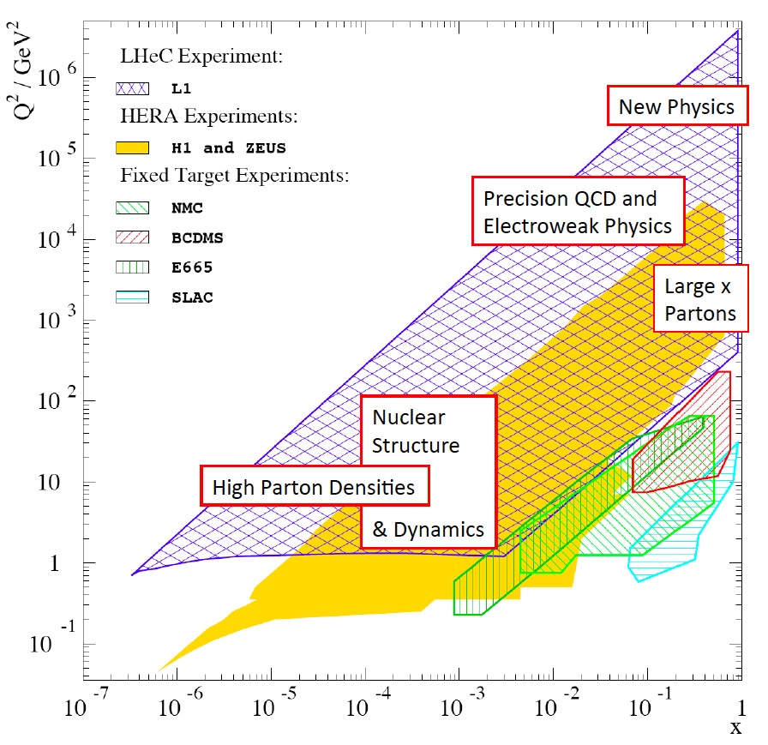
Deep Inelastic e/μ p Scattering

Slide 30
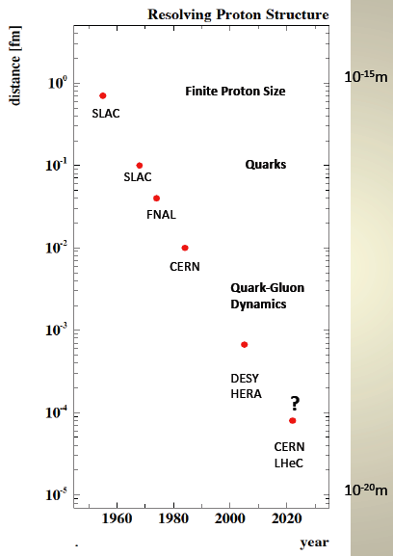
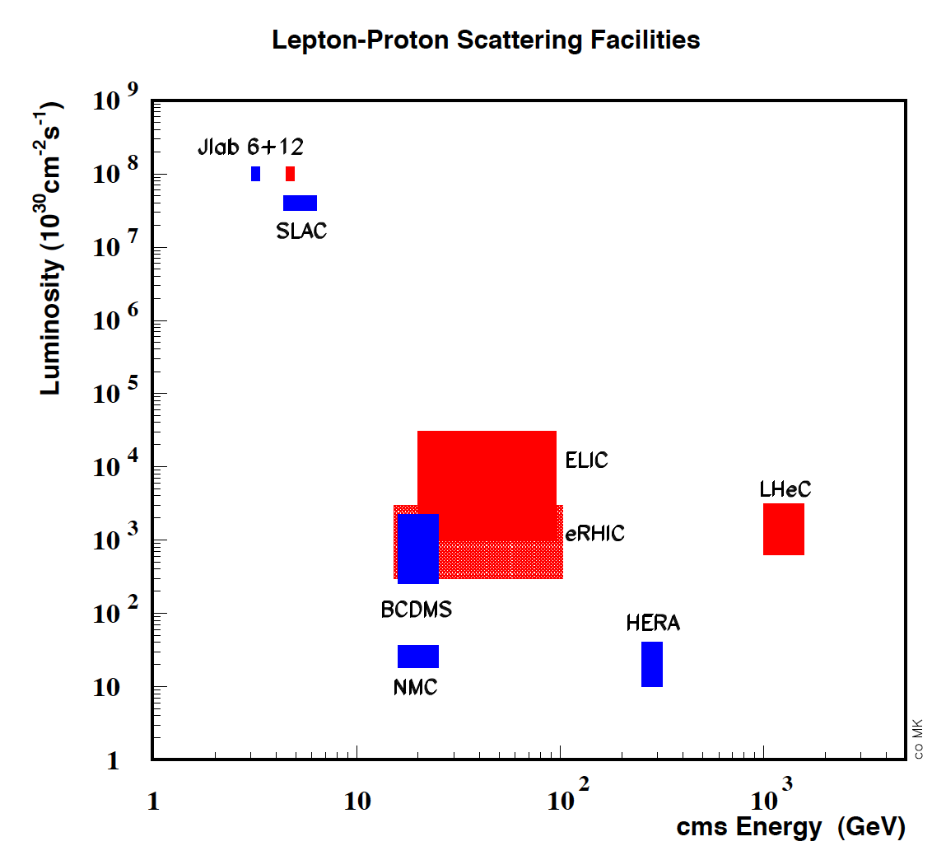
Deep Inelastic Scattering - History and Prospects
History of Deep Inelastic Scattering
Stanford
Stanford

Slide 31
HERA – an unfinished programme
Low x: DGLAP seems to hold though ln1/x is large
Gluon Saturation not proven
High x: would have required much higher luminosity
[u/d ?, xg ?]
Strange quark density ?
Neutron structure not explored
Nuclear structure not explored
New concepts introduced, investigation just started:
-parton amplitudes (GPD’s, proton hologram)
-diffractive partons
-unintegrated partons
Partonic structure of the photon
Instantons not observed
Odderons not found
…
Fermions still pointlike
Lepton-quark states (as in RPV SUSY) not observed

Slide 32
Ring-Ring Option
Luminosity 10³³cm⁻²s⁻¹ rather ‘easy’ to achieve
Electrons and Positrons
Energy limited by synchrotron radiation
Polarisation ~30%
Magnets, Cryosystem: no major R+D, just D
10 GeV Injector possibly using ILC type cavities
Interference with the proton machine
Bypasses for LHC experiments (~3km tunnel)

Slide 33
LINAC-Ring Option
Luminosity 10³³cm⁻²s⁻¹ possible to achieve for e⁻ with ERL
Positrons require E recovery AND recycling, L+ < L-
Energy limited by synchrotron radiation in racetrack mode
Polarisation ‘easy’ for e⁻ ~90%, rather difficult for e⁺
721 MHz Cavities: Synergy with SPL, ESS, XFEL, ILC, eRHIC
Cryo: fraction of LHC cryo system
Smaller interference with the proton machine
Bypass of own IP
Extended dipole at ~1m radius in detector
Shafts on CERN territory (~9km tunnel below St Genis for IP2)

Slide 34
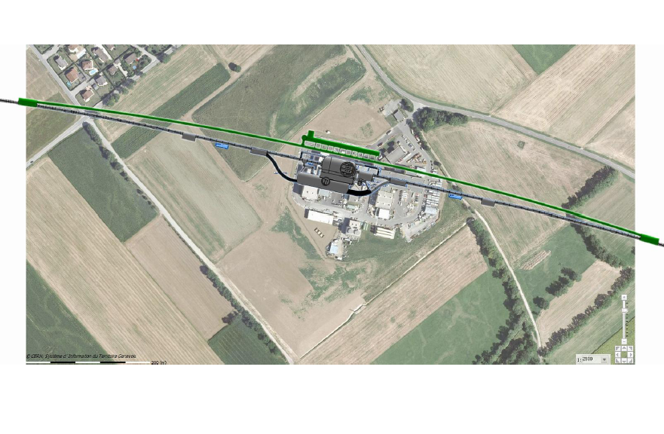
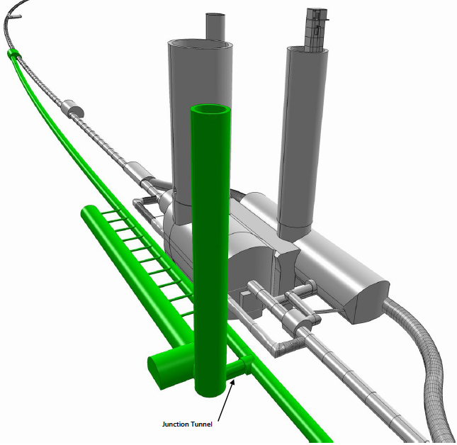
Bypassing CMS

Slide 35
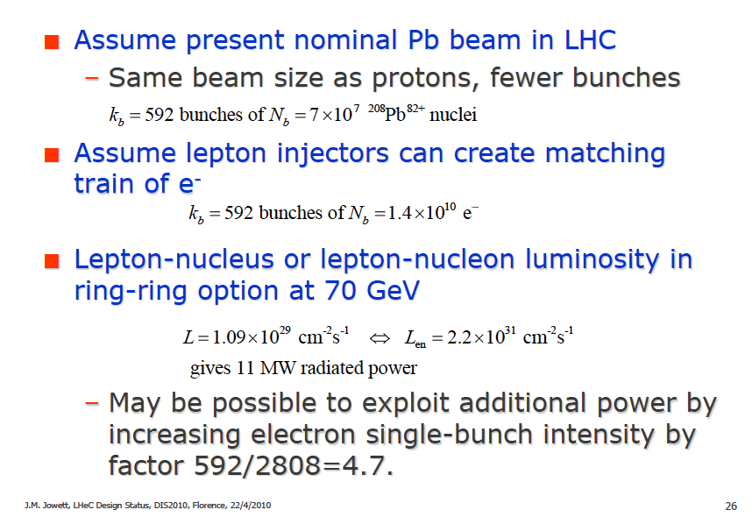
e-Pb Collisions (RR)

