Slide 1
LHeC Detector Design
CDR design 2012
Detector now including FCC-he
Tracker and Calorimeters
Project Development – Next Steps
LHeC:
E_{e}=60 GeV
E_{p}= 7 TeV
For references,
please consult
lhec.web.cern.ch
LHeC CDR
arXiv:1206.2913
J.Phys. G39 (2012) 075001
Max Klein
University of Liverpool
for the LHeC Study Group
FCC_eh:
E_{e} =60 GeV
E_{p} =50 TeV
HE LHC:
E_{p}=14 TeV
Development of the LHeC Detector, DIS17, Brum, 5th of April 2017

Slide 2
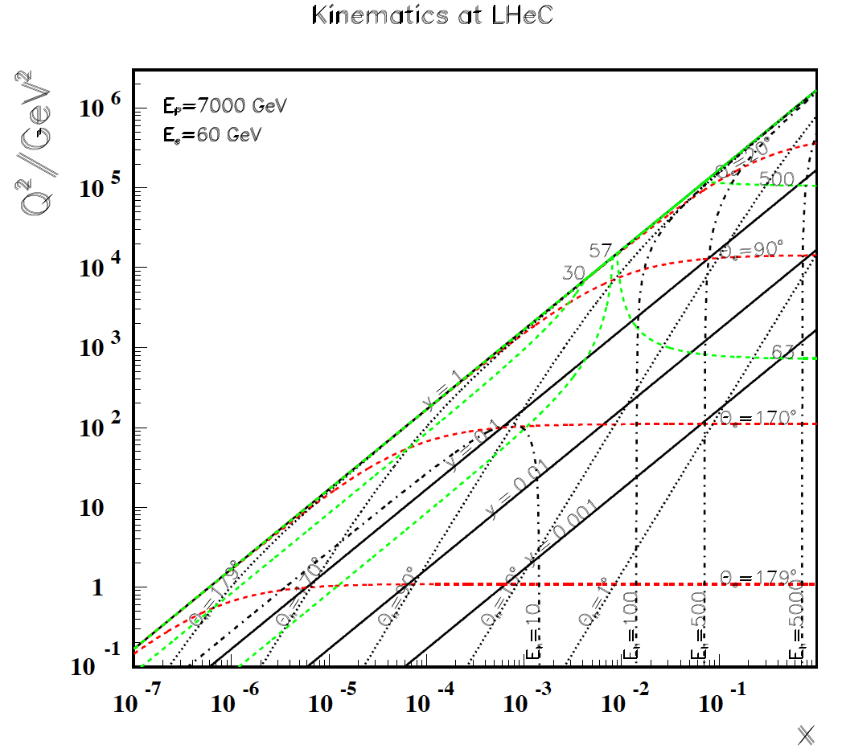
titel
default energies
Observations
Good angular
coverage but at high x
low Q2
High Q² to 10⁶
CC at large x > 0.0001
Low Q² High x
Very fwd hadrons:
High y =0.9 → 6 GeV
F_{L} “easy”

Slide 3
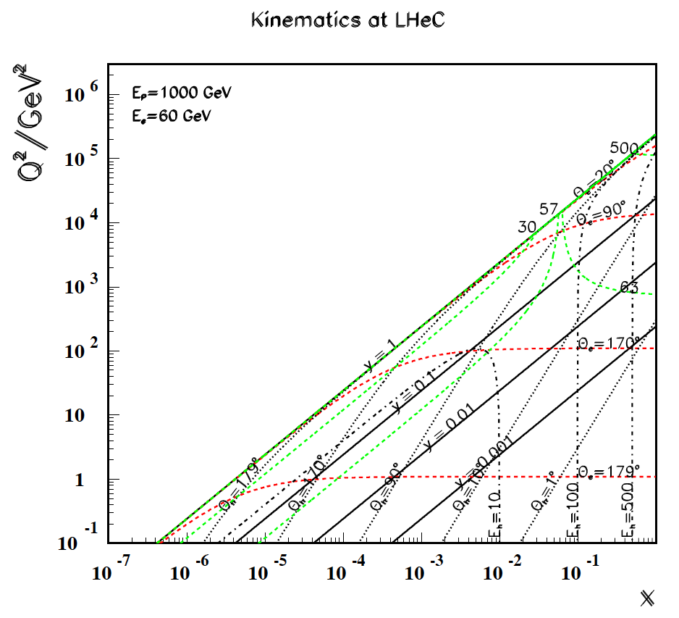
titel
Lower proton energy
← EIC
Lower E_{p}
to access
high x at
lower Q²
Modest
Luminosity
required

Slide 4
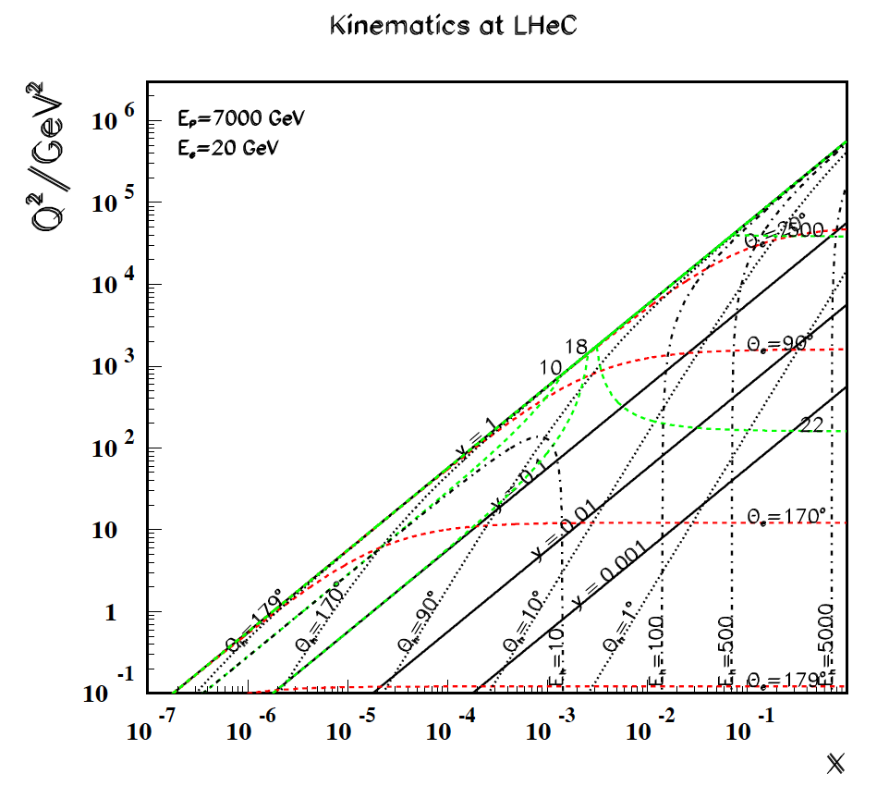
titel
Lower electron energy
E_{e} = 20 GeV
Covers
transition
hadronic
to partonic →
behaviour.
“NO” luminosity
required,
part of F_{L} run

Slide 5
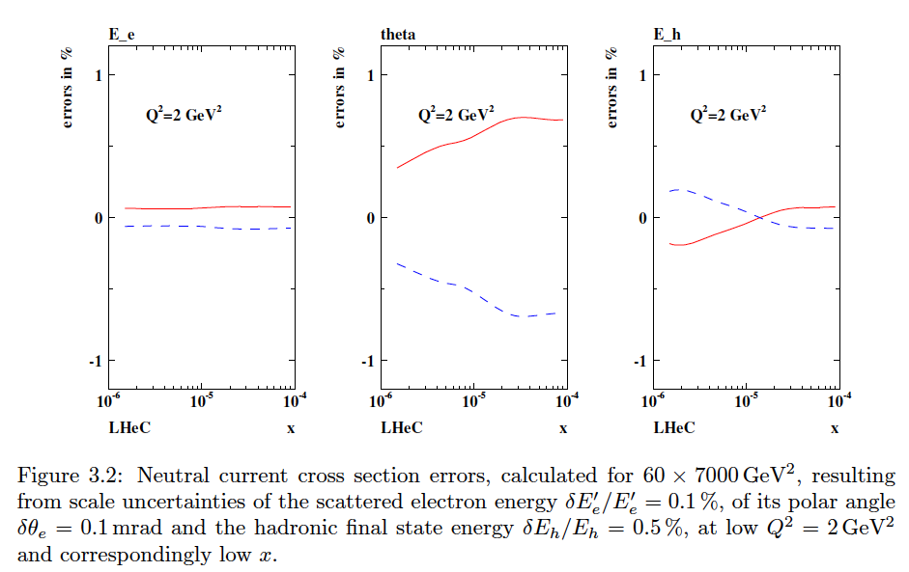
NC Cross Section Correlated Uncertainties (Q²=2 GeV²)
From LHeC CDR

Slide 6
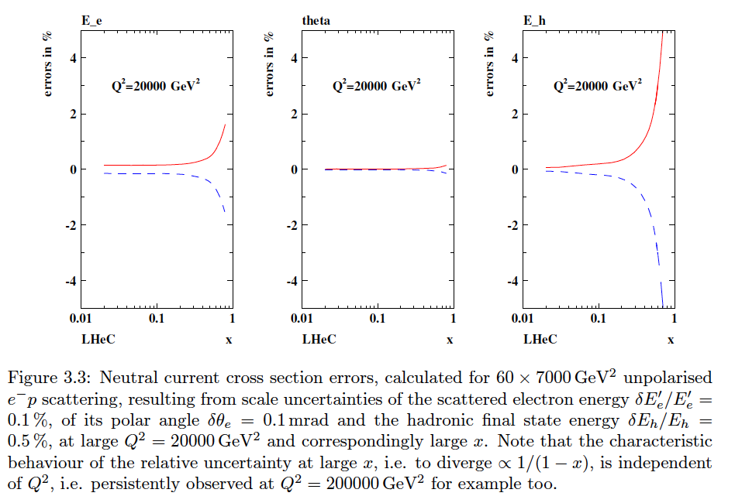
NC Cross Section Correlated Uncertainties (Q²=20000 GeV²)
From LHeC CDR

Slide 7
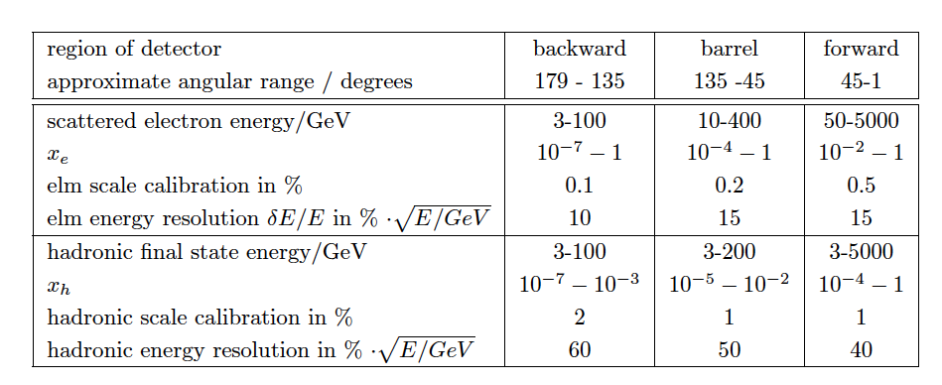
Detector in the CDR
kinematics and requirements
Now: Higgs: maximum fwd acceptance (p direction), better hadronic resolution, crucial
c and b tagging capabilities. Still muon tag only (but muon momentum for FCC-eh for H)

Slide 8
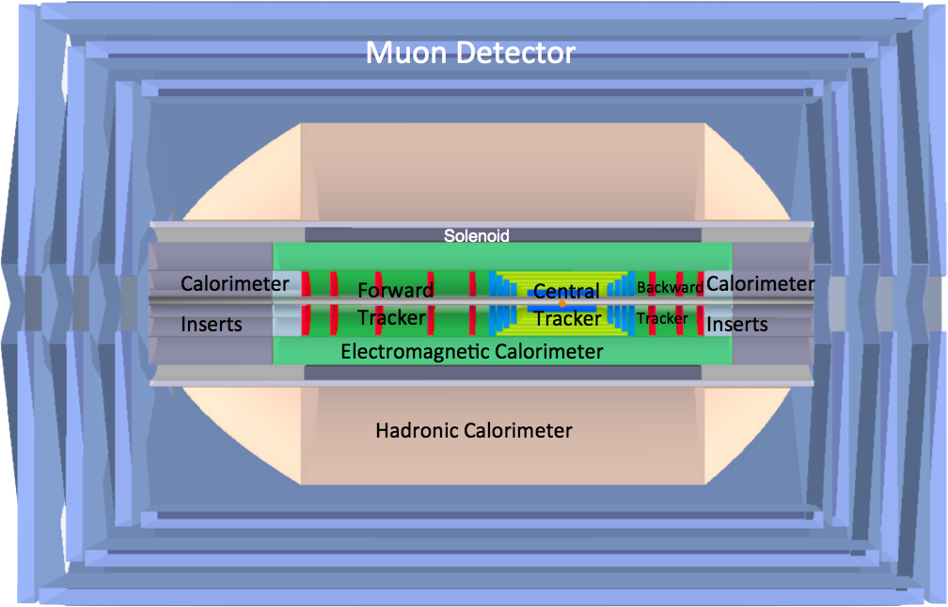
LHeC Detector in the CDR (2012)
LAr electromagnetic calorimeter
Tile Calorimeter
Forward/backward asymmetry in energy deposited and thus in geometry and technology
Present dimensions: LxD =14x9m² [CMS 21 x 15m² , ATLAS 45 x 25 m²]
Taggers at -62m (e), 100m (γ,LR), -22.4m (γ,RR), +100m (n), +420m (p)

Slide 9
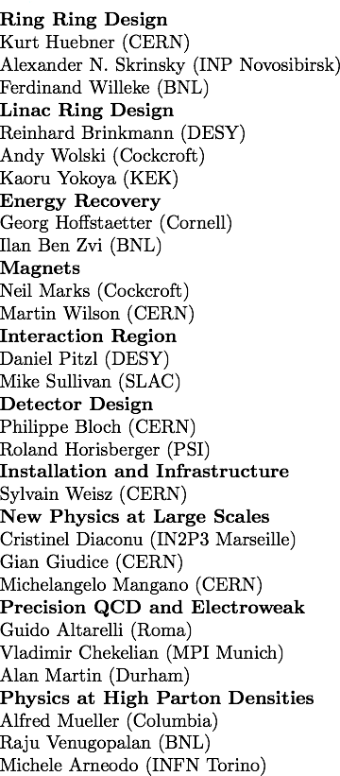
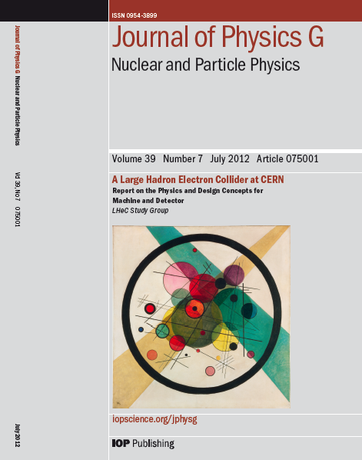
Design Report 2012
CERN Referees
arXiv:1206.2913
600 pages. Physics, Detector and Two Accelerator Options
ring-ring which may be of interest in the HE-LHC context and linac-ring, the default LH(e)C

Slide 10
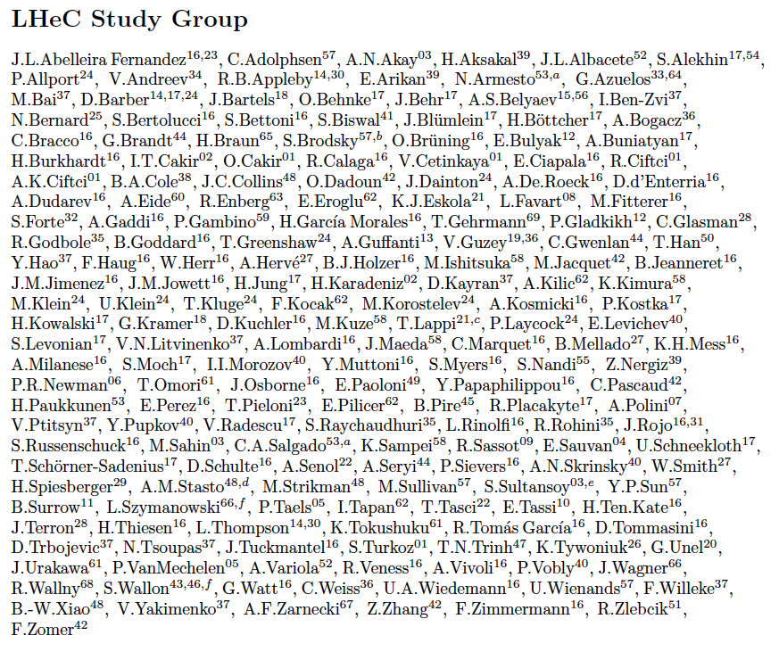
CDR authors

Slide 11
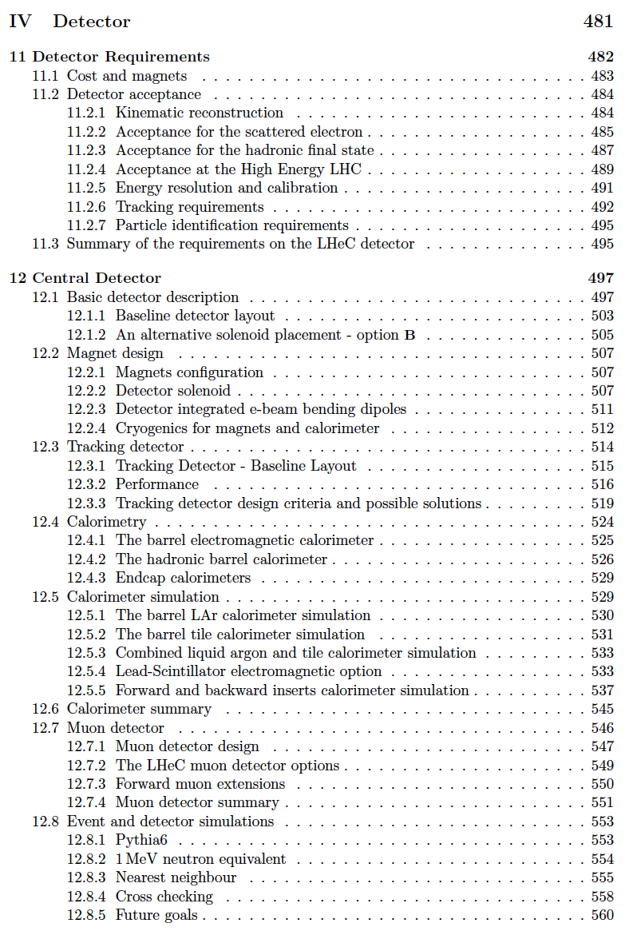
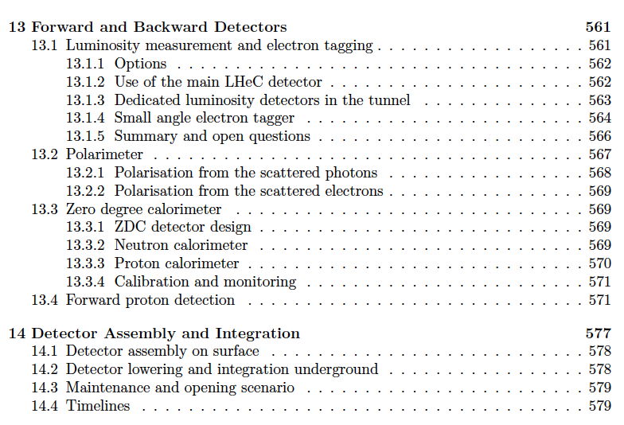
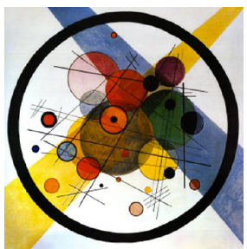
title
LHeC Detector in the CDR (1206.2913)

Slide 12
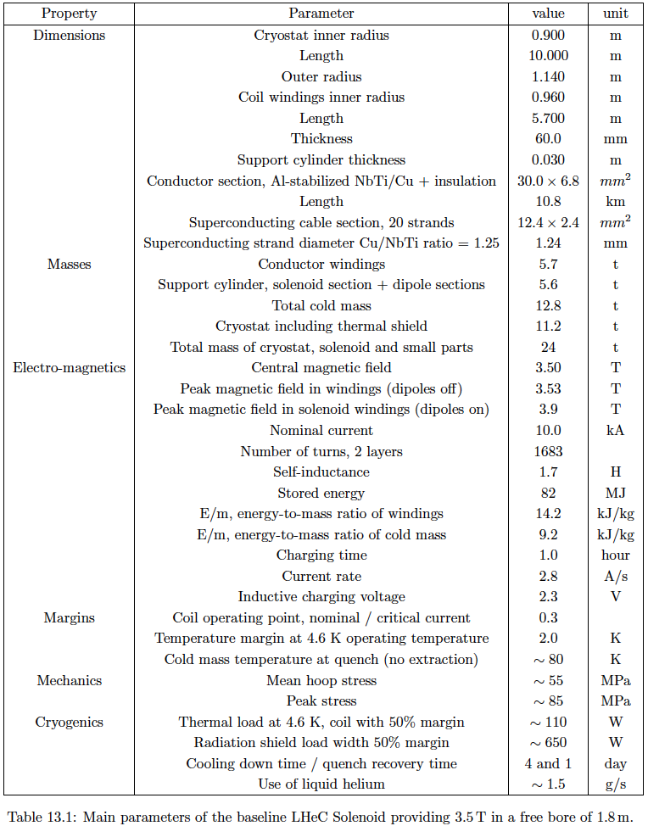
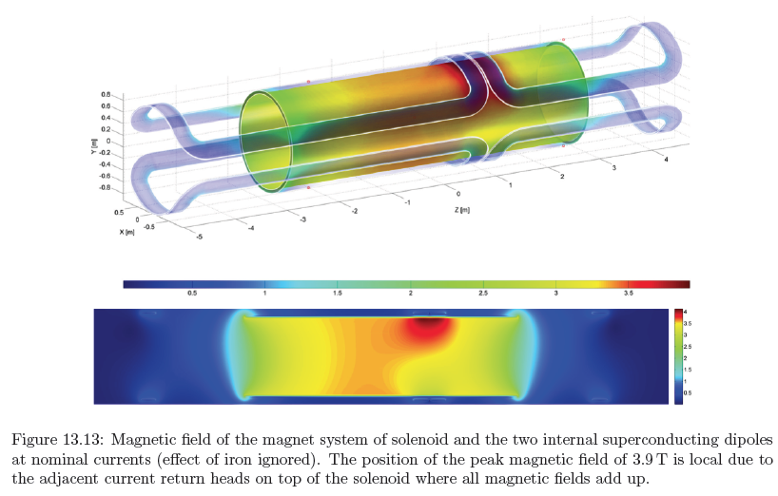
Detector Magnets
Dipole (for head on LR) and
solenoid in common cryostat,
perhaps with electromagnetic LAr
3.5T field at ~1m radius to house
a Silicon tracker
Based on ATLAS+CMS experience

Slide 13
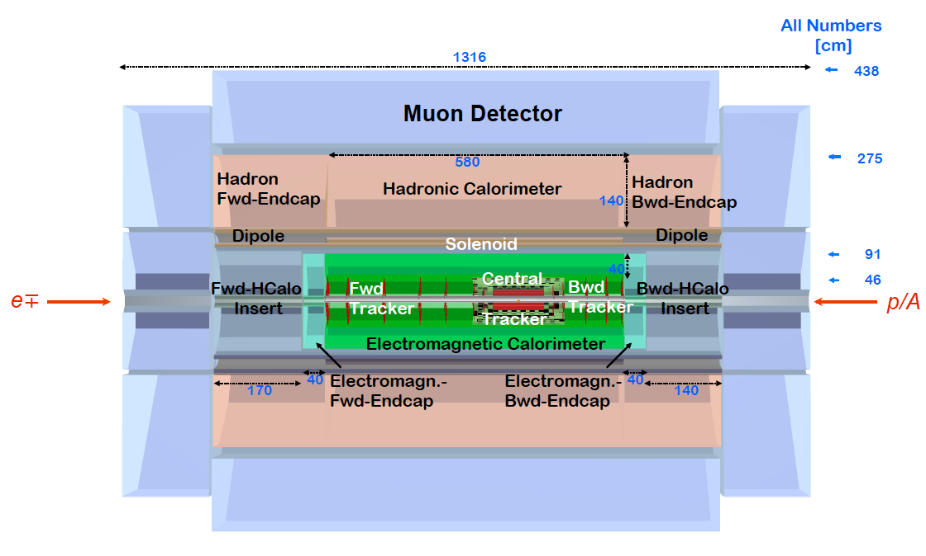
LHeC Detector 2016
PK: Status 11/16

Slide 14
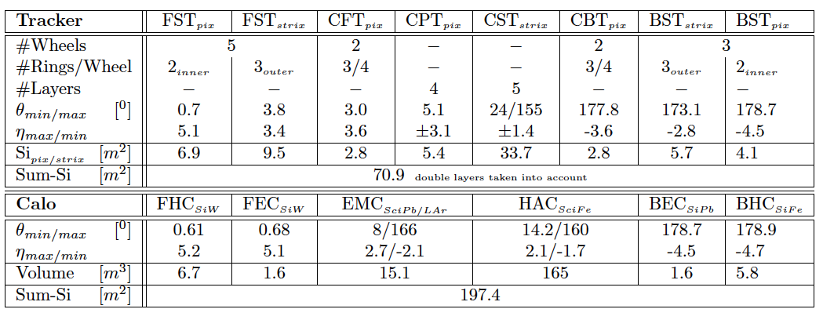
Dimensions and Multitudes - LHeC

Slide 15
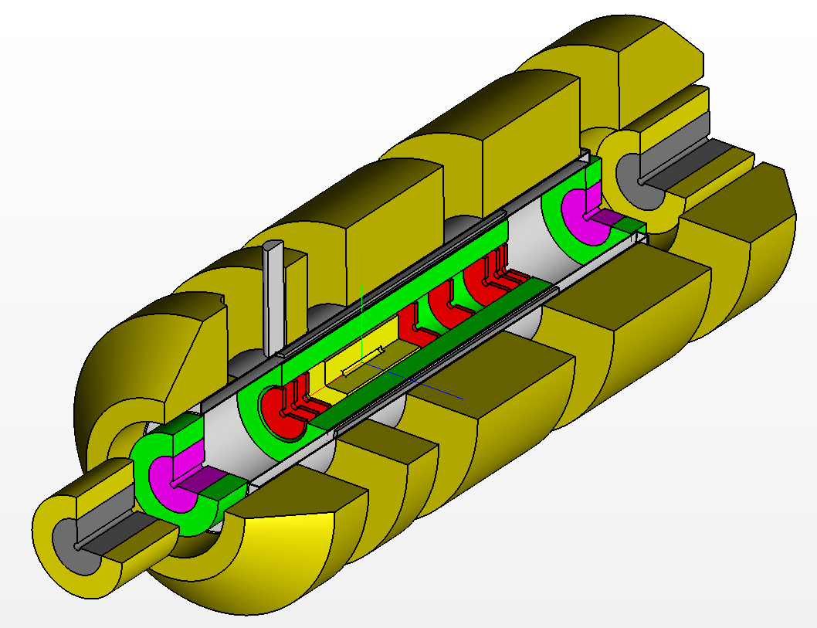
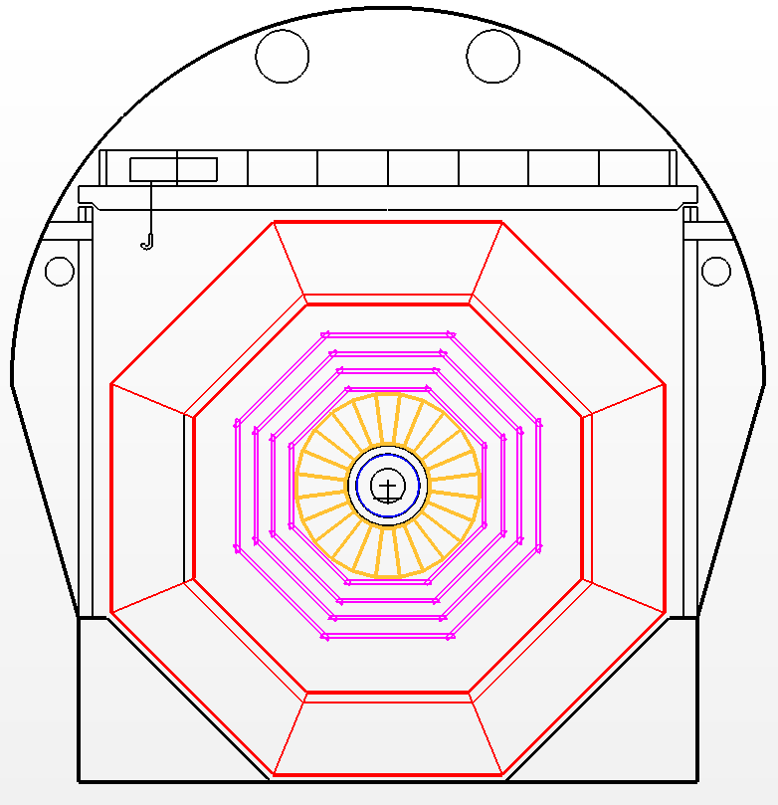
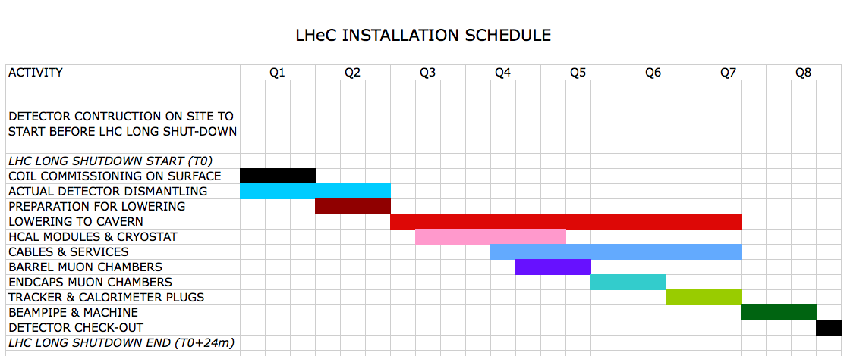
Installation Study
Detector fits in L3 magnet support
Modular structure

Slide 16
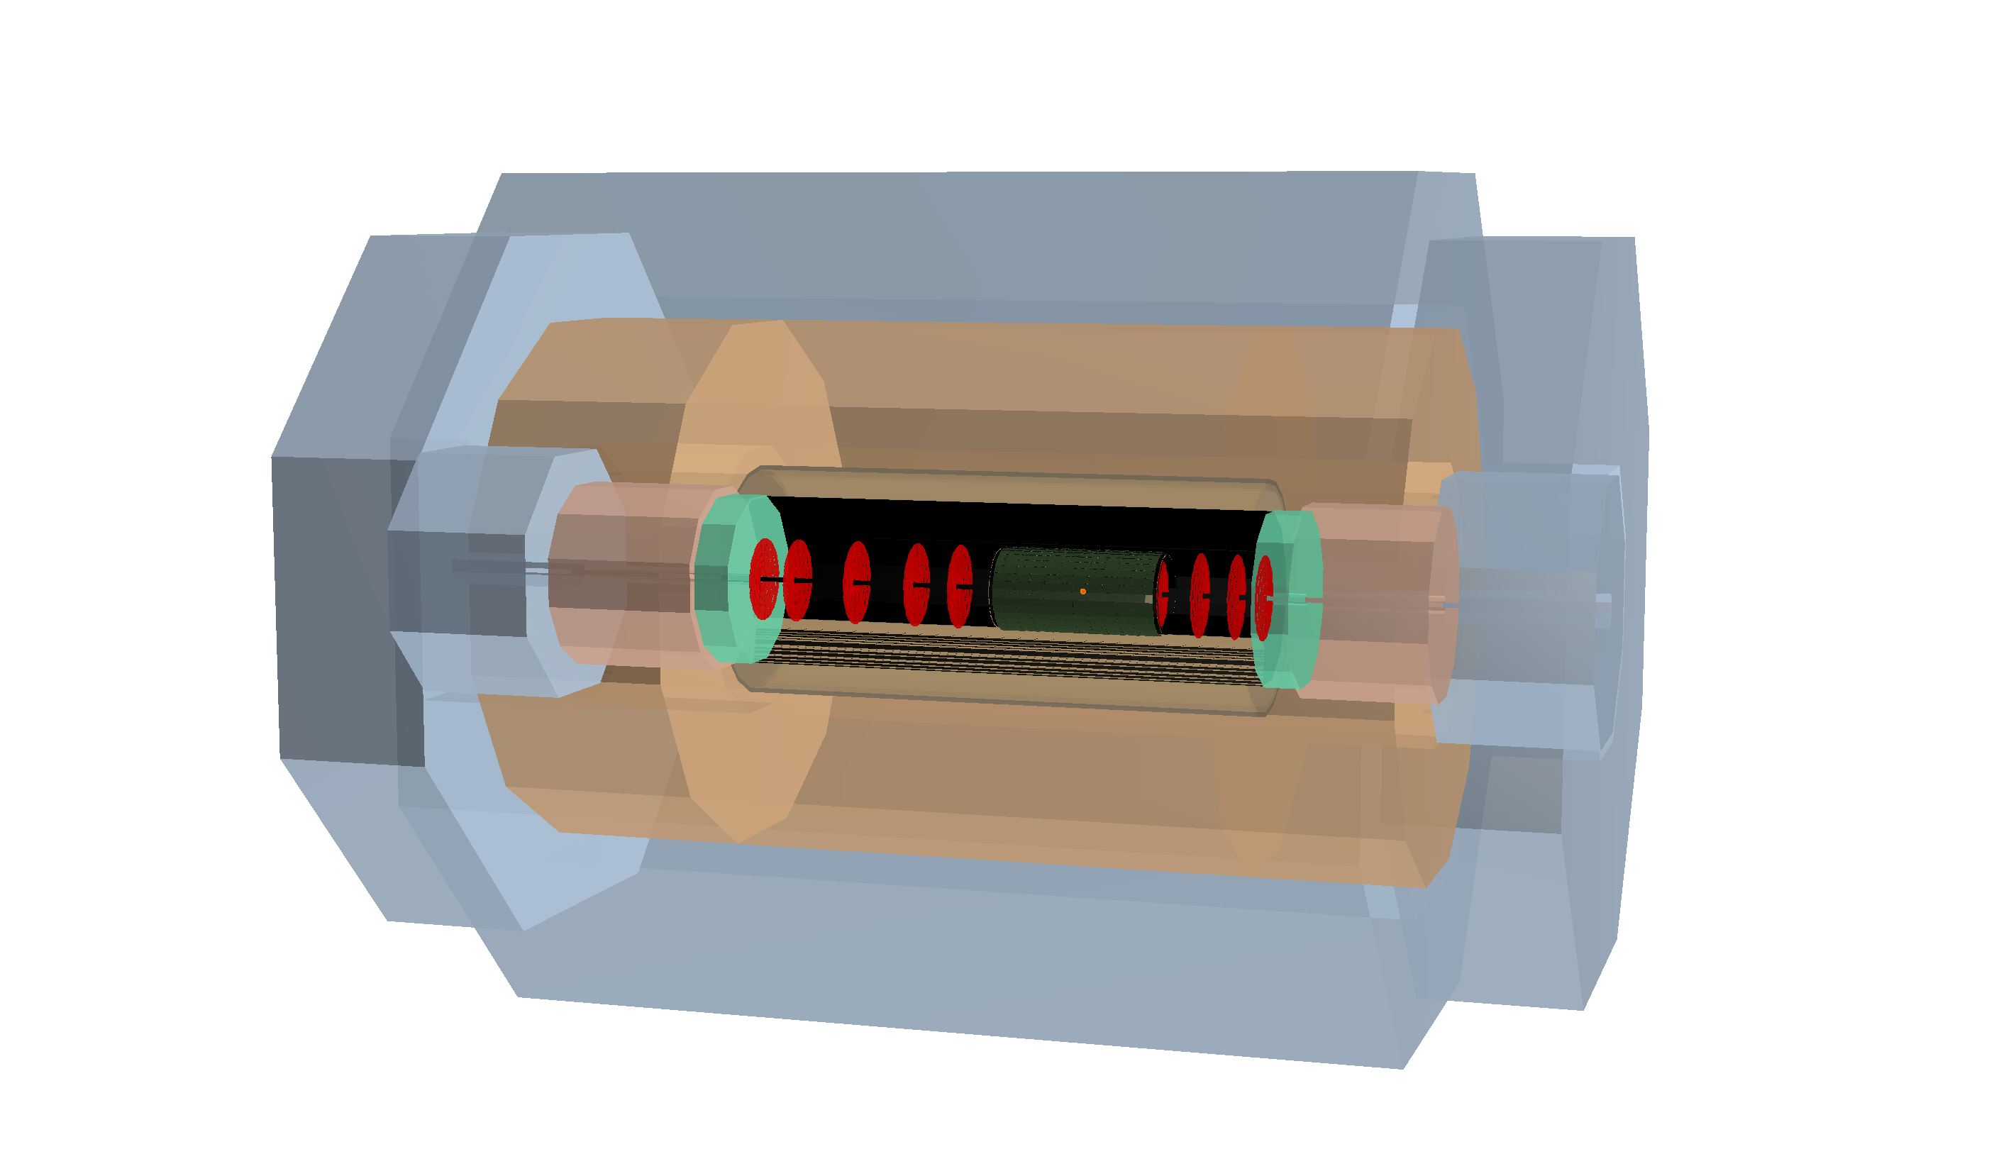
LHeC Detector

Slide 17
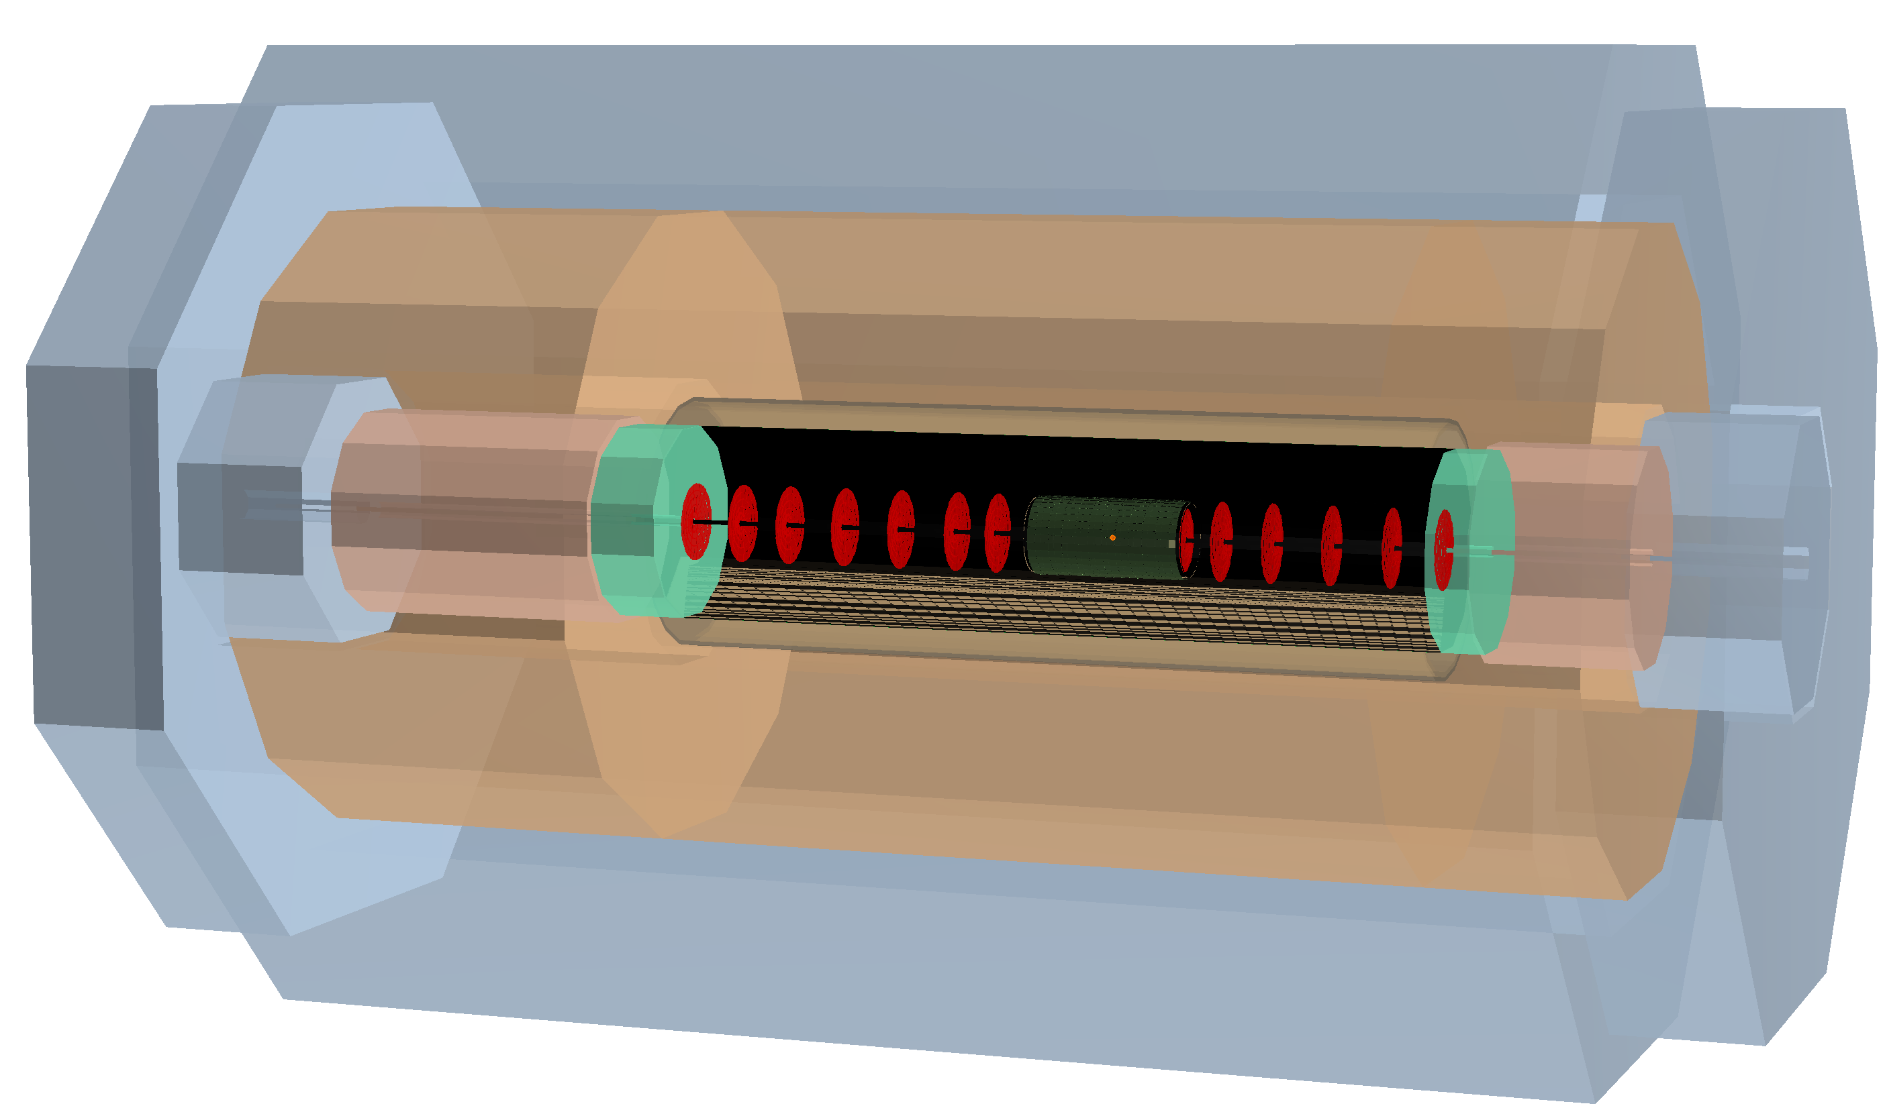
FCC-eh Detector

Slide 18
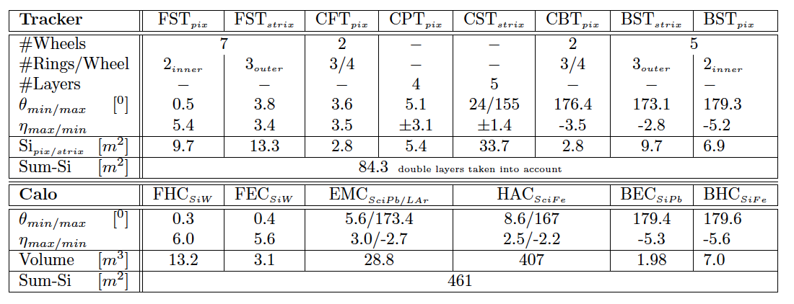
Dimensions and Multitudes – FCC-eh

Slide 19
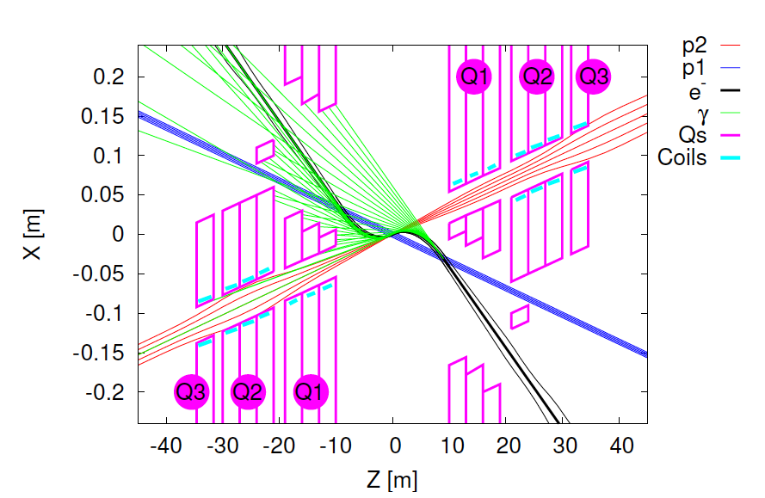
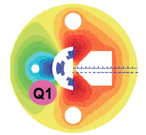
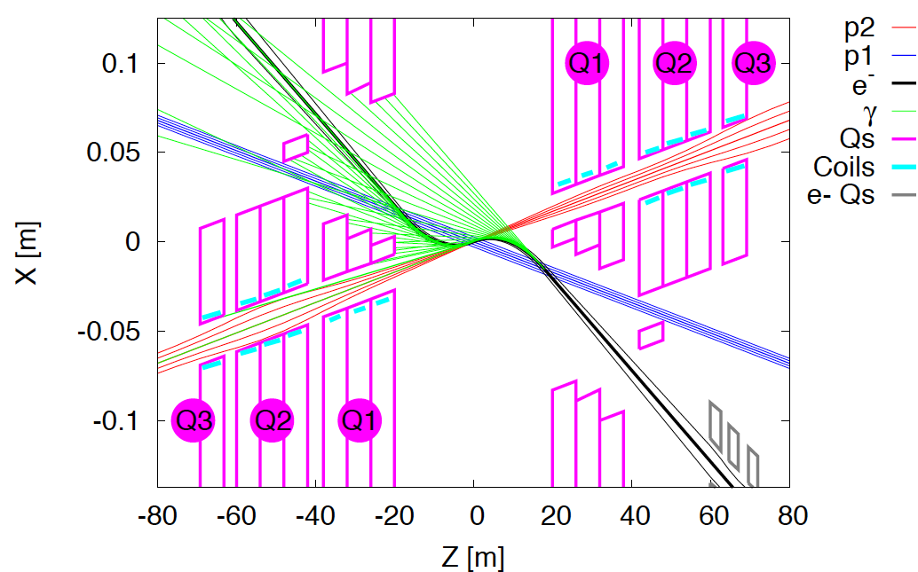
Interaction Regions for ep with Synchronous pp Operation
LHeC (CDR)
60 GeV * 7 TeV
Still work in progress:
may not need half
quad if L*(e) < L*(p)
Non colliding p beam
FCC-he (ERL)
60 GeV * 50 TeV
Tentative: ε_{p}=2μm, β*=20cm → σ_{p}=3μm ≈σ_{e} matched! ε_{e}=5μm ..
Rogelio Tomas et al

Slide 20
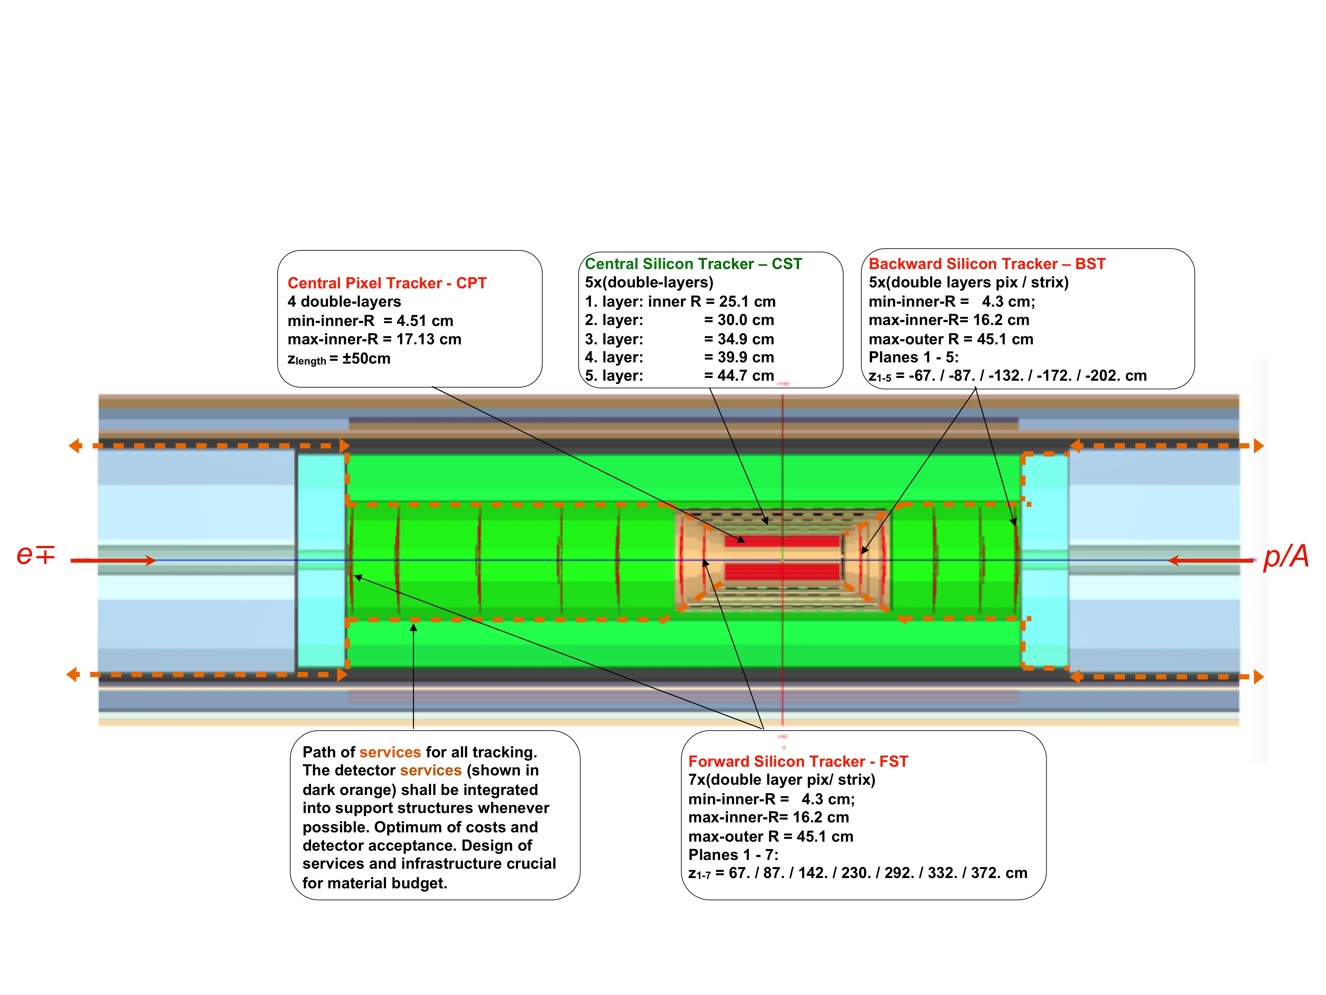
Detector design: Inner Silicon Tracker (status 3/16)
More detailed designs for other components too. DD4HEP software developments..
An opportunity for R+D and building a novel, challenging 4π detector in the twenties.
Profit from HL LHC detector upgrades, also ILC, with no pileup and small radiation load

Slide 21
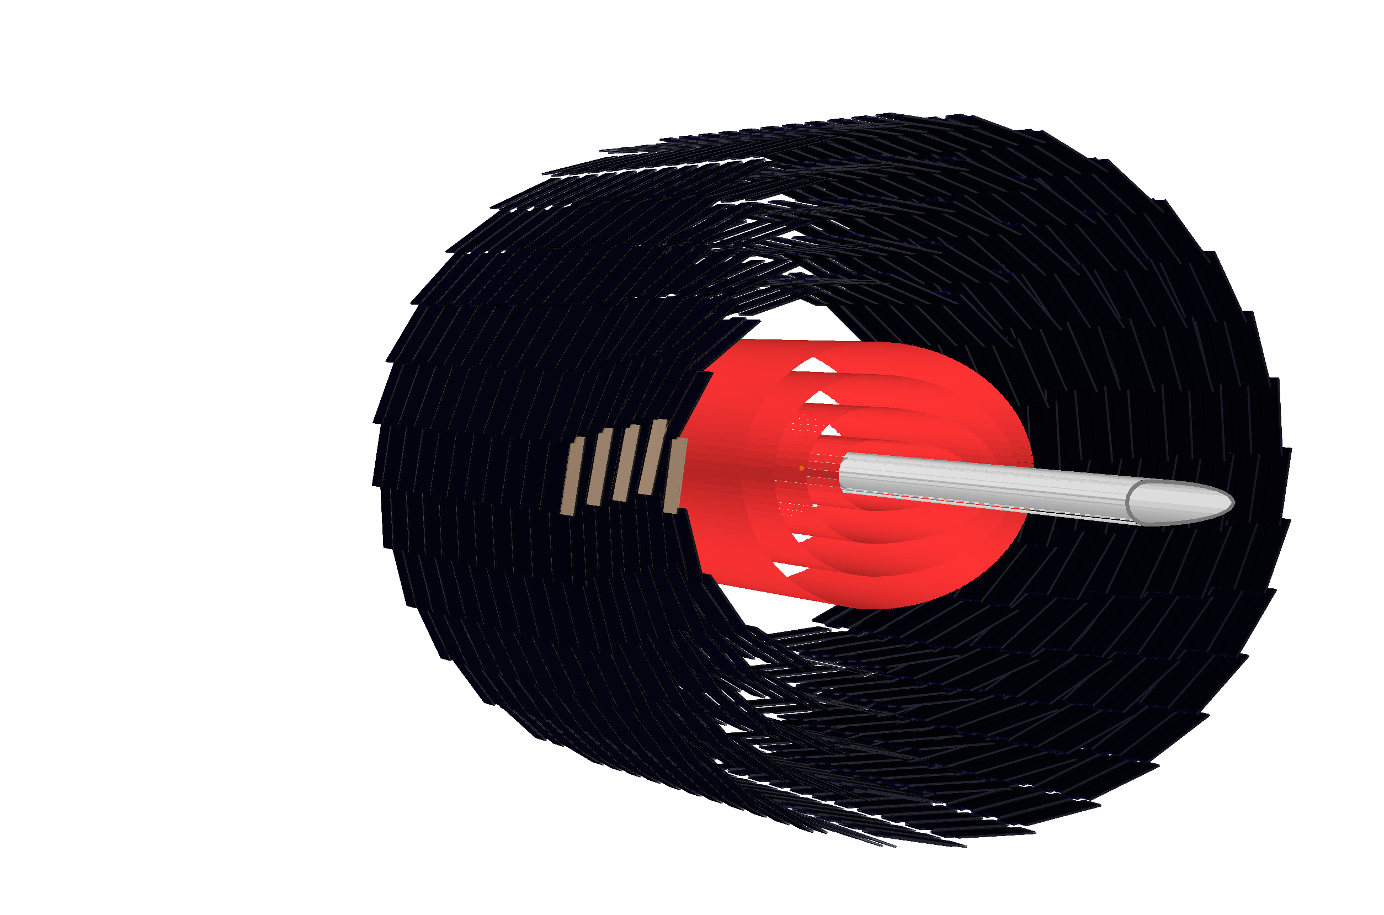
LHeC Silicon Tracker

Slide 22
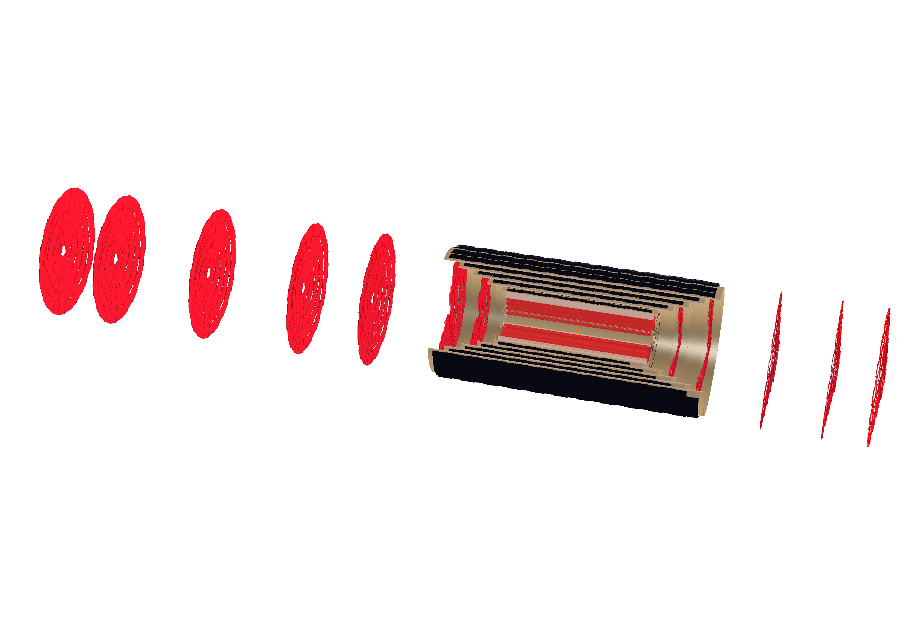
The LHeC Silicon Tracker

Slide 23
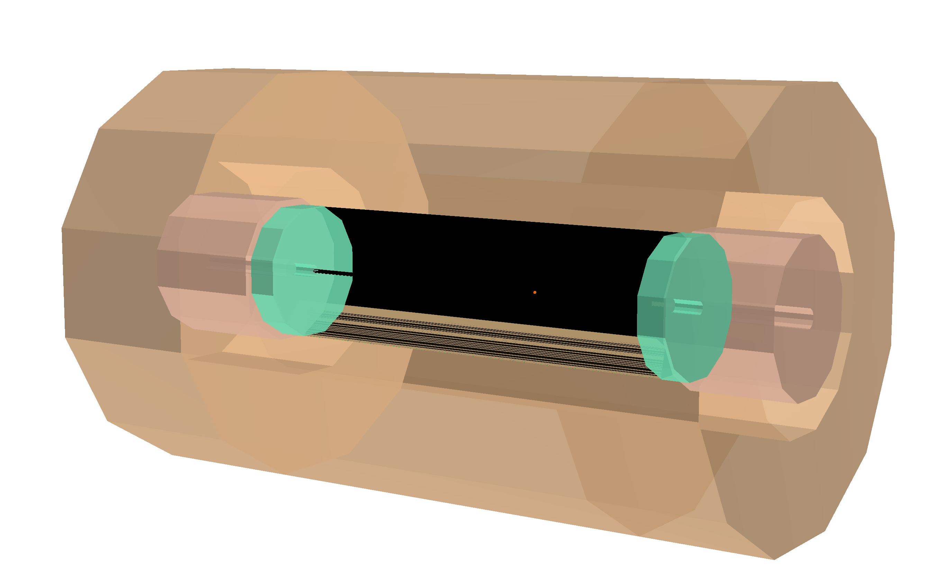
LHeC Calorimeters

Slide 24
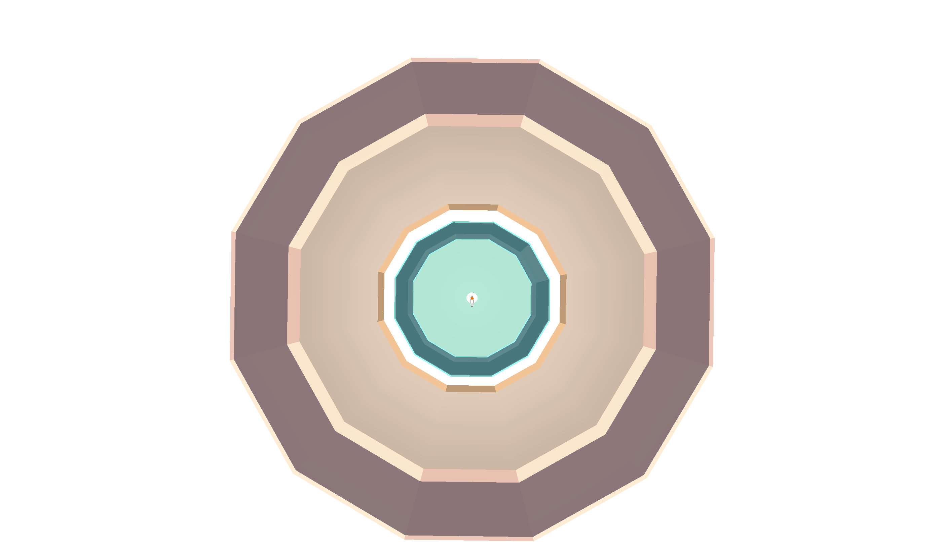
Cut through Calorimeters at z=510cm
HAC
HAC/BHC
EMC
FEC
Outer radius: 3.6m

Slide 25
Software Status
Software based on DD4hep/DDG4 - pre-release software [AIDASoft/DD4hep]; Python, C++
LHeC/FCC detector geometry, material description, R/O description as needed, segmentations and surfaces - ingredients for reconstruction;
DDEve - event display tool for quality judgment and control …
Follow the main developments & build a detector model answering physics questions (reuse of experience and implementations)
Collaboration inside the FCC-Software effort at CERN - information @ http://fccsw.web.cern.ch/fccsw/
Synergies when following closer the FCC-SW initiative - new EDM, geometry/material definitions based of DD4hep as well, using GAUDI for overall steering; aspects of commonly used tracking software (ACTS); fast and detailed simulation ….
Hardware optimisation according to latest R&D (HL-LHC …)

Slide 26
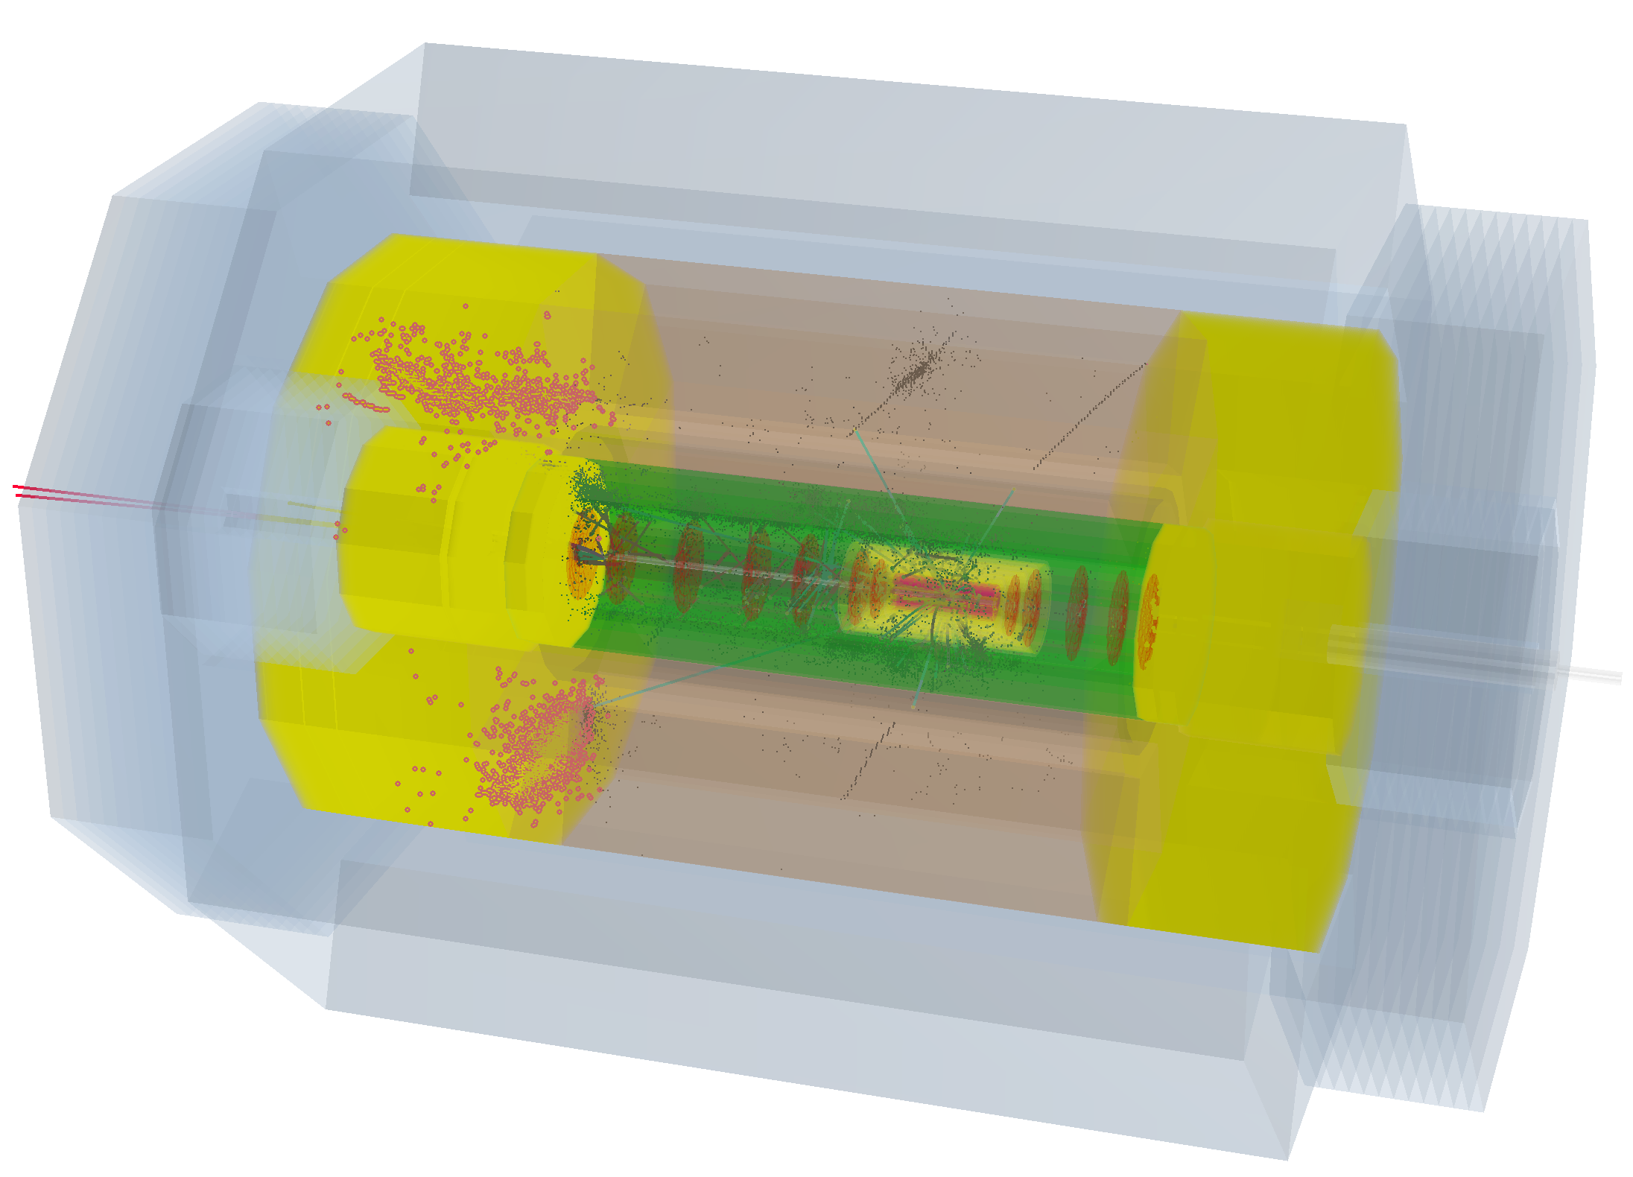
H→ bb in LHeC Detector

Slide 27
Next Steps
Interaction region update
Finish ep Detector software link to Higgs, top, PDF.. physics study
Technology choices for novel, high tech, high precision detector post HL-LHC
CDR for FCC-eh Detector (I/2018)
Update of LHeC Detector Design (IV/2018) – will include cost-energy-physics study
Many thanks to
Andrea Gaddi, Hermann ten Kate, Peter Kostka, Ercan Pilcer,
Brett Parker, Alessandro Polini, Stefan Russenschuck, RogelioTomas and many others

Slide 28
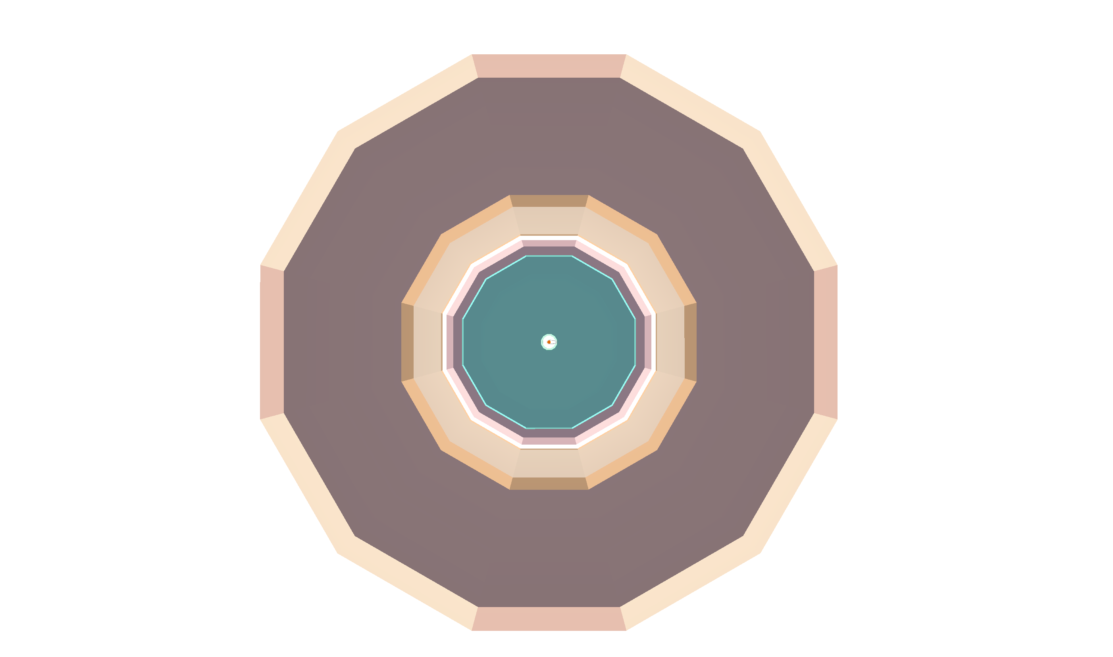
title

Slide 29
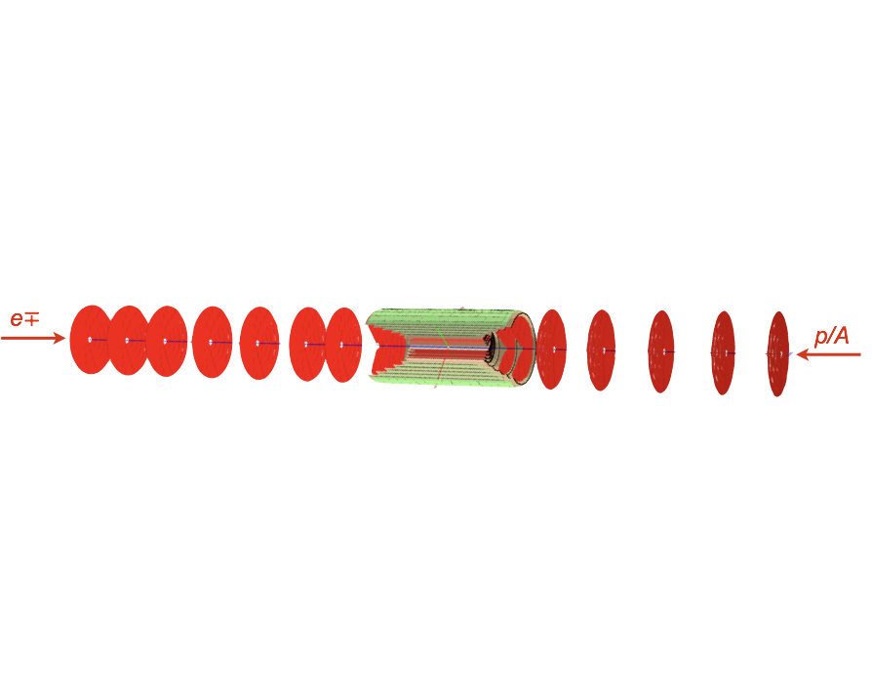
title

