Slide 1



Remarks on the LHeC and PERLE
Raison d’etre de LHeC
Luminosity and Parameters
Status of the LHeC
PERLE
ep Physics with PERLE
Max Klein
For the LHeC Study Group
Kickoff Meeting for the PERLE Technical Design and Report, Orsay, 23.2.2017
Max Klein PERLE@Orsay 23.2.17

Slide 2
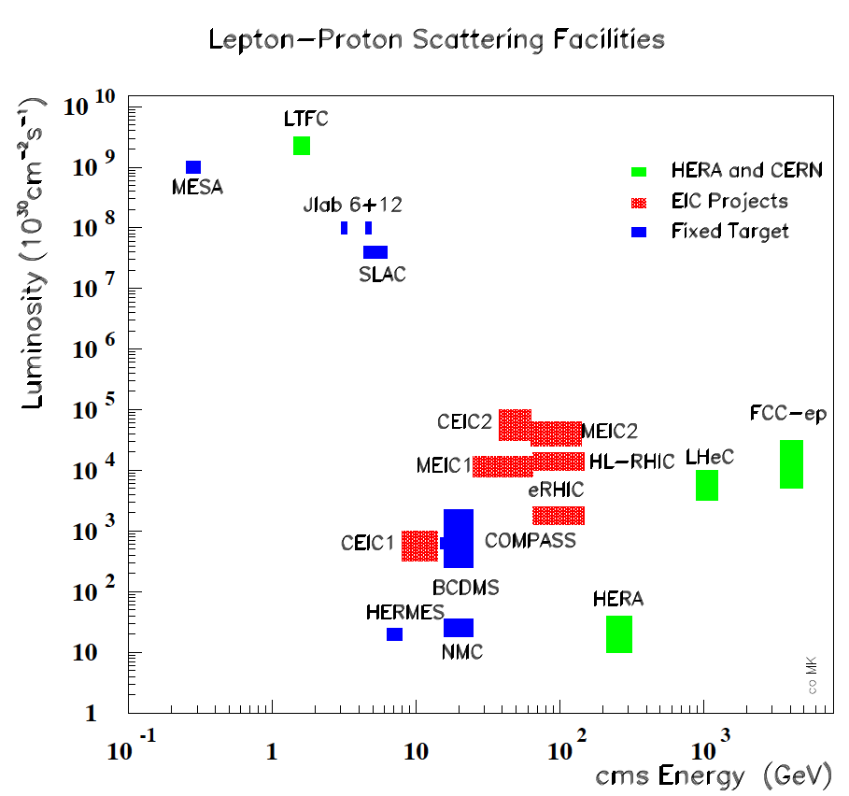
Intensity and Energy Frontier of Future DIS
From CERN Courier
MK, H.Schopper
June 2014
With input from
A.Hutton, R.Ent,
F.Maas, T.Rosner
Max Klein, Vietnam, 27.9.16 2

Slide 3
Intensity and Energy Frontier of Future DIS
PERLE
From CERN Courier
MK, H.Schopper
June 2014
With input from
A.Hutton, R.Ent,
F.Maas, T.Rosner
Max Klein, Vietnam, 27.9.16 3

Slide 4
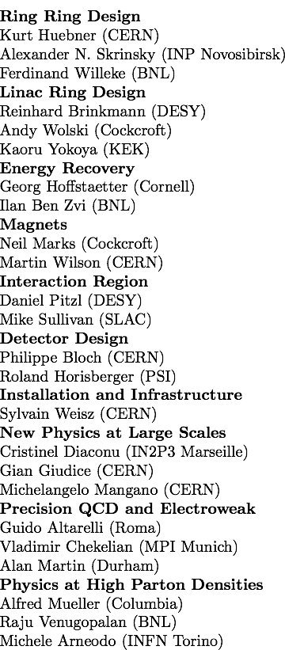
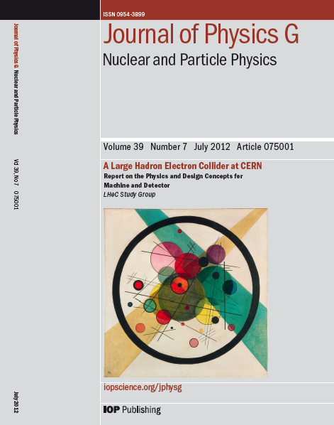
Design Report 2012
CERN Referees
arXiv:1206.2913
600 pages. Physics, Detector and Two Accelerator Options
ring-ring which may be of interest in the HE-LHC context and linac-ring, the default LH(e)C
Max Klein PERLE@Orsay 23.2.17

Slide 5
LHeC Default: 60 GeV ERL
Conceptual Design Report: arXiv:1206.2913, published in JPhysG – 20 referees..
LHeC: 60 GeV off 7 TeV, L(ep) =10³⁴ cm⁻² s⁻¹ (1000 x HERA) in synchronous ep+pp operation
Max Klein PERLE@Orsay 23.2.17

Slide 6
Observations post CDR - 2012+
LHC brightness 2-3 times higher than expected
LHC lifetime now extended to end of 30ies: 3 [4] ab⁻¹
Discovery of the Higgs: L(ep): 10³³ → 10³⁴ cm⁻² s⁻¹
No further discovery at the LHC (as yet)
Detector technology developments (LHC Det. Upgrades)
Strong ERL developments (cβ, Jlab, BerlinPRO, MESA.. )
SC RF: 802 MHz (LHeC), enhanced Q₀ through Ni doping
EU strategy 13: exploit LHC, study Higgs, develop SCRF,
CERN: new accelerators “with emphasis on pp and ee”
Fine with the LHeC cost being a small fraction of ILC,CLIC,FCC
No decision on e⁺e⁻ colliders, for how long?
CERN in 14 set up a new LHeC organisation with a new
mandate to prepare for the next EU strategy 2019
Two main goals: Update of CDR for HL-LHeC + Testfacility
Max Klein PERLE@Orsay 23.2.17

Slide 7
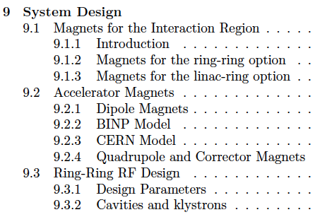
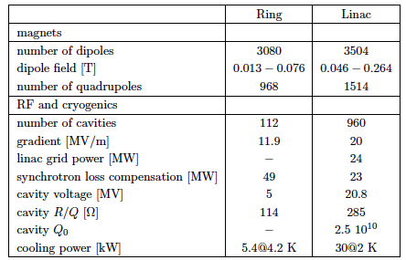
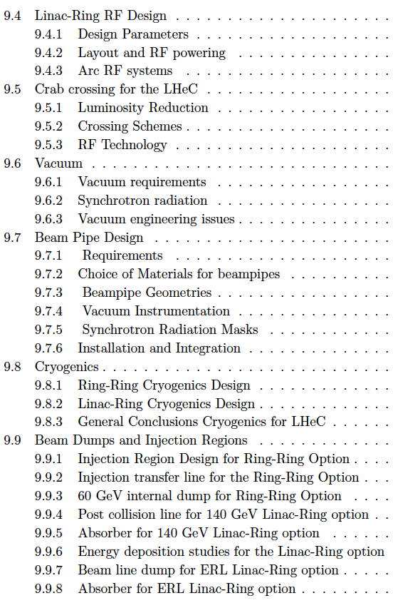
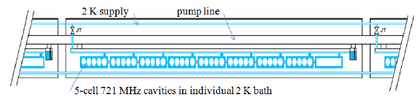

Chapter 9 of CDR
Components and Cryogenics
Need to develop LHeC cavity (cryo-module) [2013]
Max Klein PERLE@Orsay 23.2.17
from CDR LHeC

Slide 8
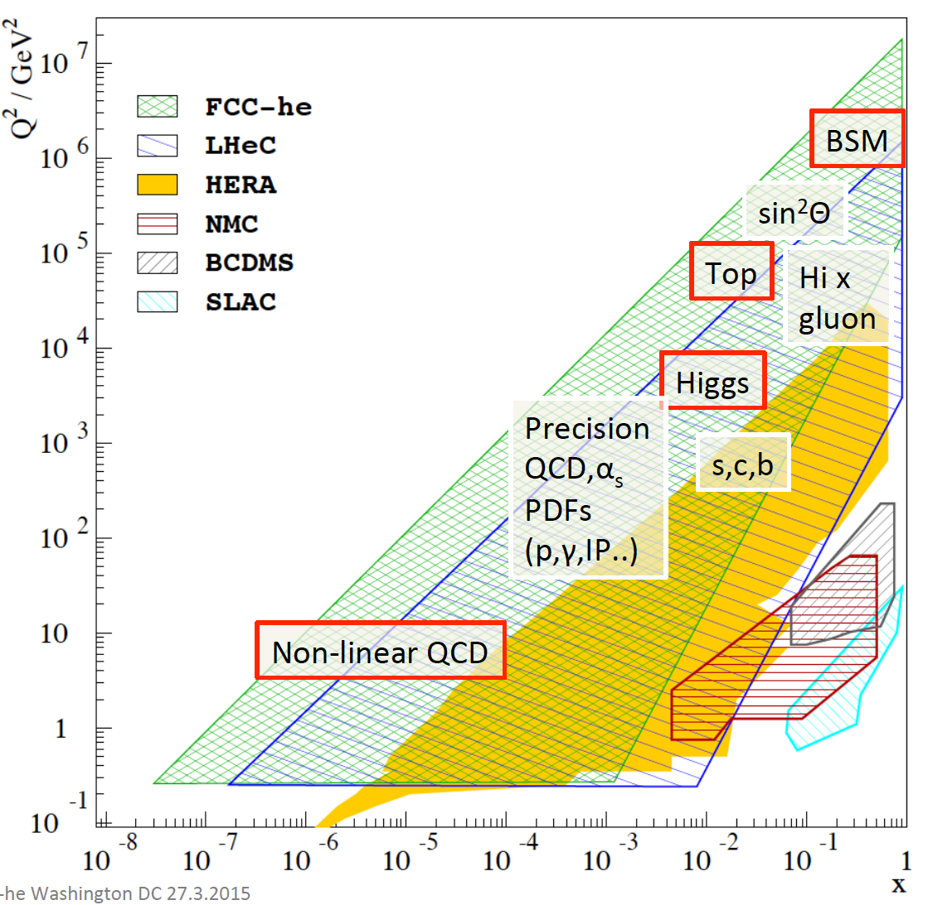
Physics of the LHeC
Recent highlights:
Higgs to heavy quarks to %
Higgs to invisible
Sterile Neutrinos
Strong Coupling to 0.1%
PDFs to N³LO pQCD
completely unfolded
Low x:
Discover/Disprove Saturation
High x:
Enable searches at HL LHC
Raison d’etre
LHC as Precision Higgs Factory
ep: World’sCleanest Microscope
A Bridge to the 10 TeV + BSM
Max Klein PERLE@Orsay 23.2.17

Slide 9
Huge increase in energy and luminosity enables unique development of physics
For example: parton distributions – all heard about collinear, classic PDFs
LHeC will for the first time determine these, but nature+theory are MUCH richer
Generalised Parton Distributions [DVCS] – “proton in 3D - tomography”
Unintegrated Parton Distributions [Final State] – DGLAP/BFKL?
Diffractive Parton Distributions [Diffraction] – pomeron, confinement??
Photon Parton Distribution [Photoproduction Dijets,QQ; F_{2,L}] - fashionable..
Neutron Parton Distributions [Tagged en (eD) Scattering] – ignored at HERA
It is the physics importance and genuine interest which drive the LHeC, directors too:
Max Klein PERLE@Orsay 23.2.17

Slide 10

Road beyond Standard Model
Next decades
Rolf Heuer at
Aix Les Bains
1. 10. 2013
LHC results vital to guide the way at the energy frontier
At the energy frontier through synergy of
hadron - hadron colliders (LHC, (V)HE-LHC?)
lepton - hadron colliders (LHeC ??)
lepton - lepton colliders (LC (ILC or CLIC) ?)

Slide 11
Mandate and Goals
LHeC: Following the CDR in 2012: 2014+16: CERN DGs issued Mandate to continue the study:
DG: Mandate to the International Advisory Committee 2015-2018
Advice to the LHeC Coordination Group and the CERN directorate by following the
development of options of an ep/eA collider at the LHC and at FCC, especially with:
Provision of scientific and technical direction for the physics potential of the ep/eA
collider, both at LHC and at FCC, as a function of the machine parameters and of a
realistic detector design, as well as for the design and possible approval of an ERL
test facility at CERN.
Assistance in building the international case for the accelerator and detector
developments as well as guidance to the resource, infrastructure and science
policy aspects of the ep/eA collider.
Chair: Herwig Schopper
Two major next goals:
-Design and build an LHeC ERL demonstrator (10mA, 3 turn, 802 MHz)
-Update of the CDR by 2018: LHC physics, 10³⁴ lumi, detector and accelerator updates
FCC-eh: Utilize the LHeC design study to describe baseline ep/A option.
Emphasis: 3 TeV physics, IR and Detector: synchronous ep-pp operation.
Open to other configurations and new physics developments (750..)
Max Klein PERLE@Orsay 23.2.17

Slide 12
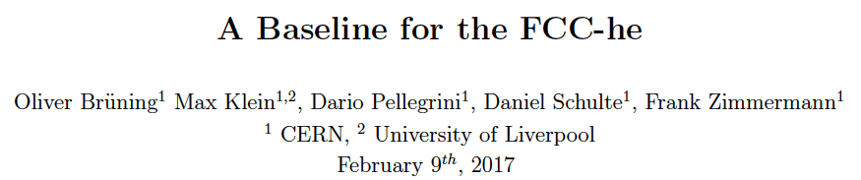
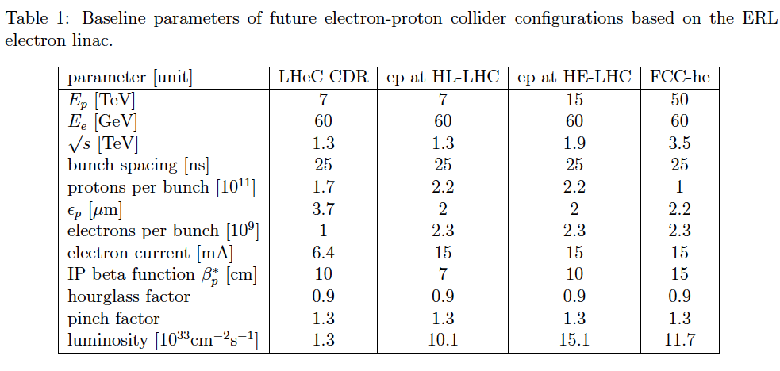
title
Max Klein PERLE@Orsay 23.2.17
Tentative

Slide 13
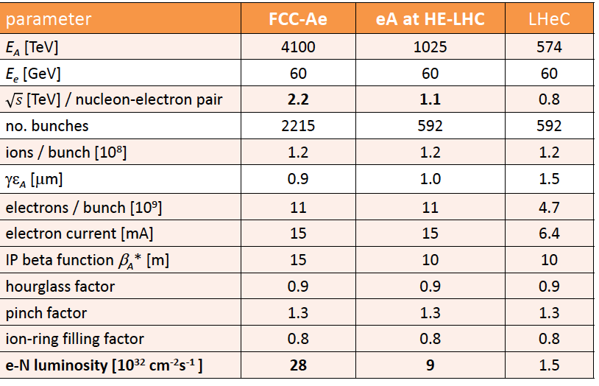
High Energy Electron-Ion Colliders at CERN
F.Zimmermann, January 2017, FCC Physics Week
Note: A at injection energy and lower E_{e} cover EIC range
Max Klein PERLE@Orsay 23.2.17

Slide 14
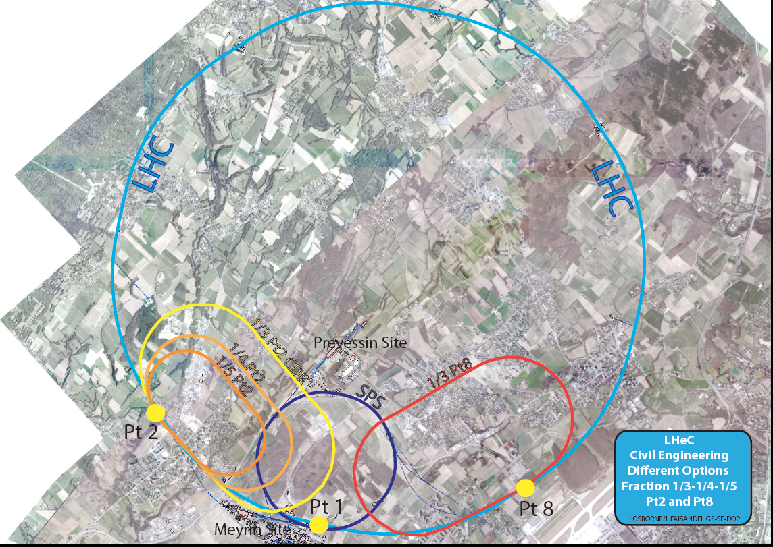
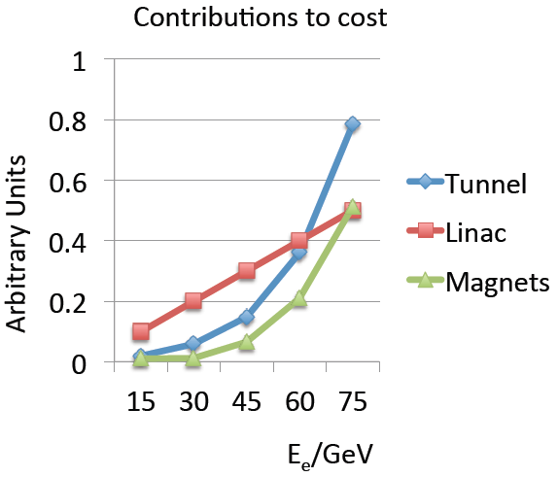
backup
Realization of
the LHeC
~4 years of CE
Physics and cost will
determine footprint
MK 6/14
Max Klein PERLE@Orsay 23.2.17

Slide 15
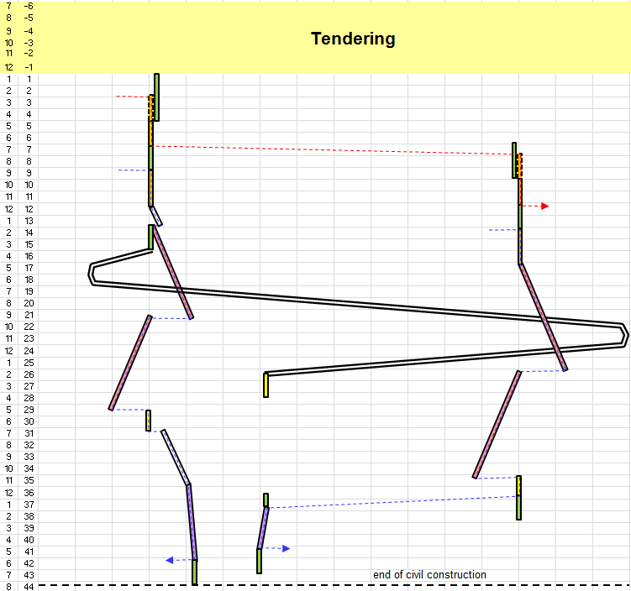
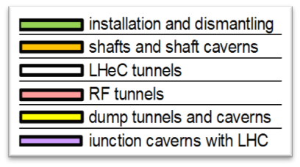
Civil Engineering
Shaft sinking installation
Roadheader 1
CDR: Evaluation of CE, analysis
of ring and linac by Amber Zurich
with detailed cost estimate
[linac CE: 249,928 kSF..] and time:
3.5 years for underground works using 2 roadheaders and 1 TBM
More studies needed for
Integration with all services
(EL,CV, transport, survey etc).
Geology
Understanding vibration risks
Environmental impact assessment
Tunnel connection in IP2
Roadheader 2
J.Osborne, Chavannes

Slide 16
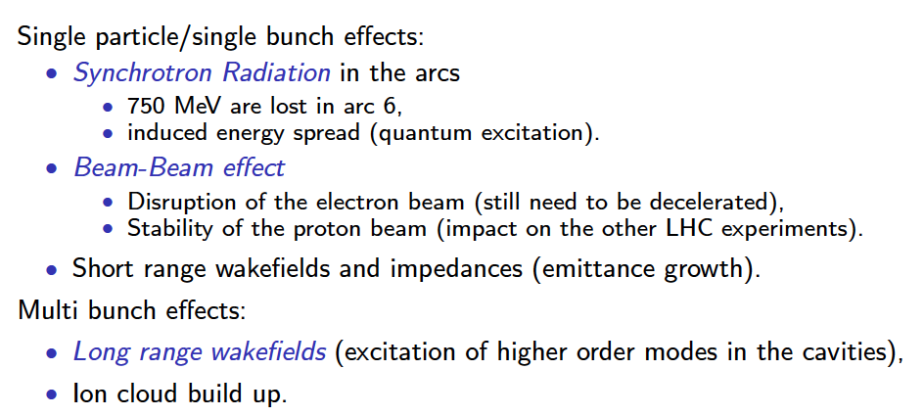
Beam dynamics studies
cf Dario Pellegrini: Talk in August 2016
Accelerators for QCD, Thessaloniki

Slide 17
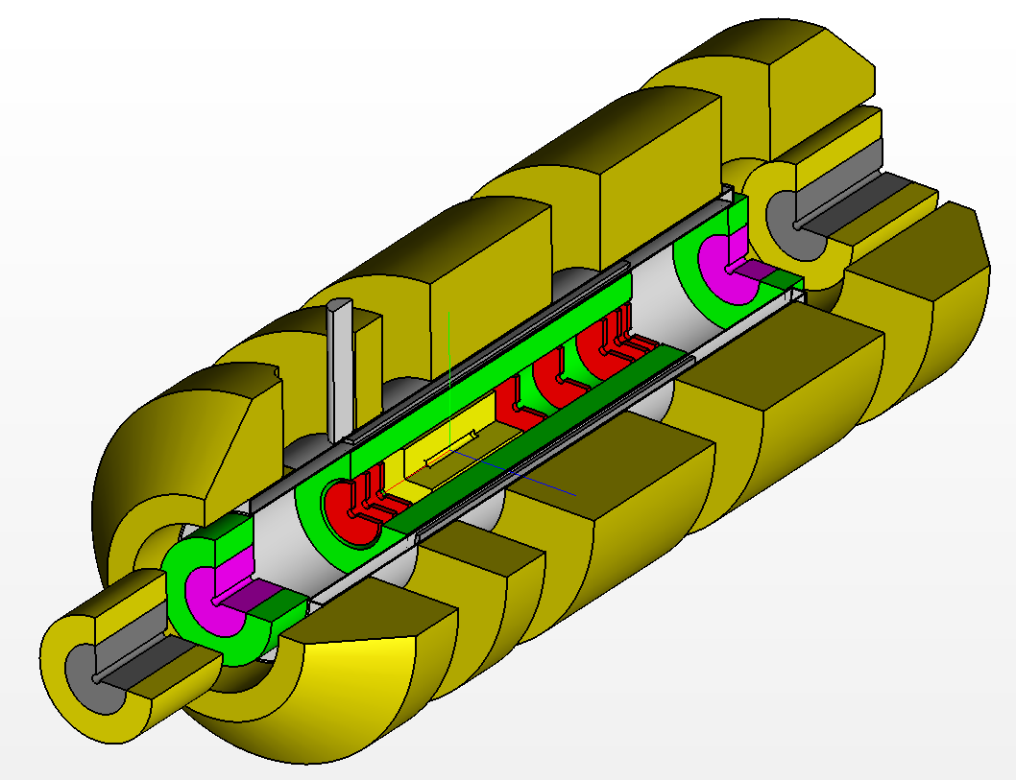
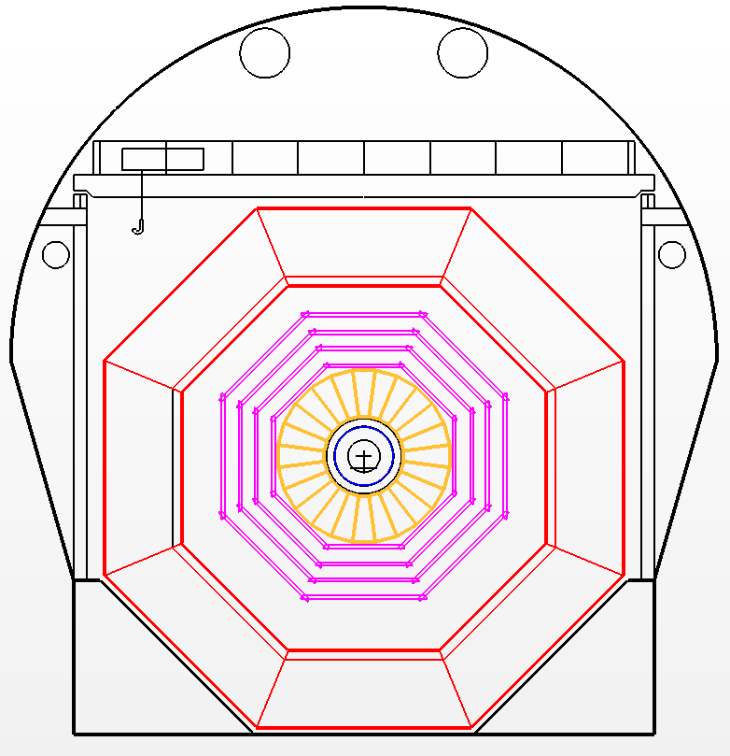
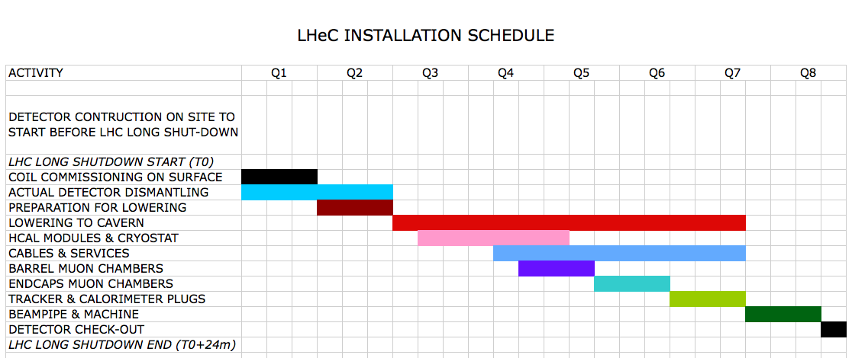
Installation
Study
Detector fits in L3 magnet support
Modular structure

Slide 18
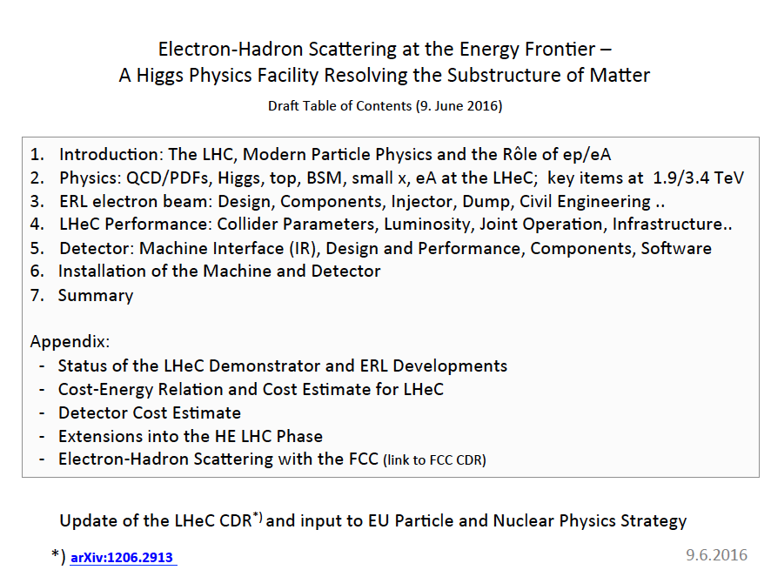
backup
LHeC CDR update because:
- Lumi * 10
- LHC results
- Technology progress
Open for any participation
Max Klein PERLE@Orsay 23.2.17

Slide 19
Organisation^{*)}
Working Groups
International Advisory Committee
“..Direction for ep/A both at LHC+FCC”
PDFs, QCD
Fred Olness,
Voica Radescu
Higgs
Uta Klein,
Masahiro Kuze
BSM
Georges Azuelos,
Monica D’Onofrio
Top
Olaf Behnke,
Christian Schwanenberger
eA Physics
Nestor Armesto
Small x
Paul Newman,
Anna Stasto
Detector
Alessandro Polini
Peter Kostka
Coordination Group
Accelerator+Detector+Physics
Sergio Bertolucci (CERN/Bologna)
Nichola Bianchi (Frascati)
Frederick Bordry (CERN)
Stan Brodsky (SLAC)
Hesheng Chen (IHEP Beijing)
Andrew Hutton (Jefferson Lab)
Young-Kee Kim (Chicago)
Victor A Matveev (JINR Dubna)
Shin-Ichi Kurokawa (Tsukuba)
Leandro Nisati (Rome)
Leonid Rivkin (Lausanne)
Herwig Schopper (CERN) – Chair
Jurgen Schukraft (CERN)
Achille Stocchi (LAL Orsay)
John Womersley (STFC)
Nestor Armesto
Oliver Brüning – Co-Chair
Stefano Forte
Andrea Gaddi
Erk Jensen
Max Klein – Co-Chair
Peter Kostka
Bruce Mellado
Paul Newman
Daniel Schulte
Frank Zimmermann
5(11) are members of the
FCC coordination team
OB+MK: FCC-eh responsibles
MDO: physics co-convenor
IAC being renewed by new DG
We lost Guido Altarelli.
*)February 2017

Slide 20
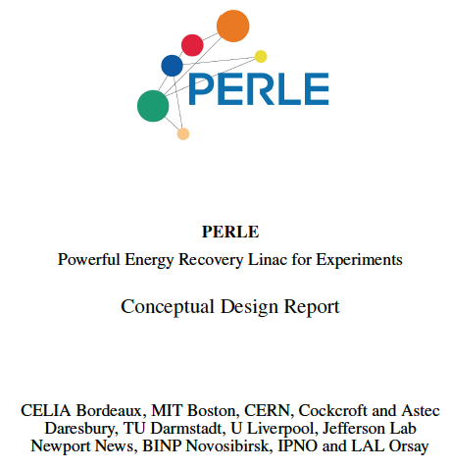

title
Ready to go
Comments by
Boris
Frank
Eric
David
Oliver
Erk
Dario
Walid ..
Max Klein PERLE@Orsay 23.2.17

Slide 21



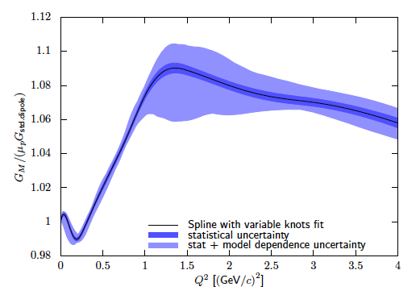
ep Physics with PERLE – proton radius
elastic ep → ep
Jan Bernauer
CDR
R_{p} from Q² dependence of G, Q²=0
thin target (gas jet), high current
angular scan with different Ee < 300MeV
electric and magnetic radius
h.o. QED corrections
Max Klein PERLE@Orsay 23.2.17

Slide 22

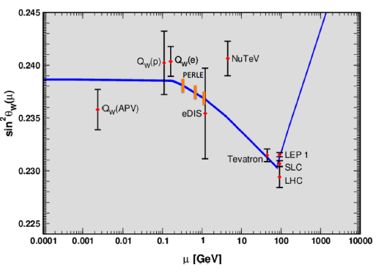
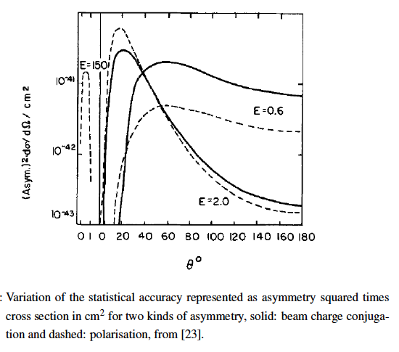
ep Physics with PERLE – sin²Θ_{W}
Polarised, elastic ep → ep
Jlab (Moeller, SOLID)
MESA (beam in 2021)
LHeC 10-1000 GeV
Good acceptance
10mA is 10x the MESA current
Polarisation (and Positrons)
M.K., T Riemann, PhysLett1978
Max Klein PERLE@Orsay 23.2.17

Slide 23
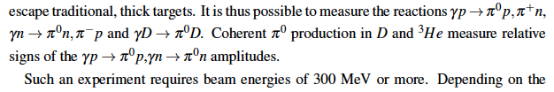
Further ep Physics with PERLE
Confinement scale QCD
Dark photons
Higher luminosity than DarkLight (Jlab)
Max Klein PERLE@Orsay 23.2.17

Slide 24
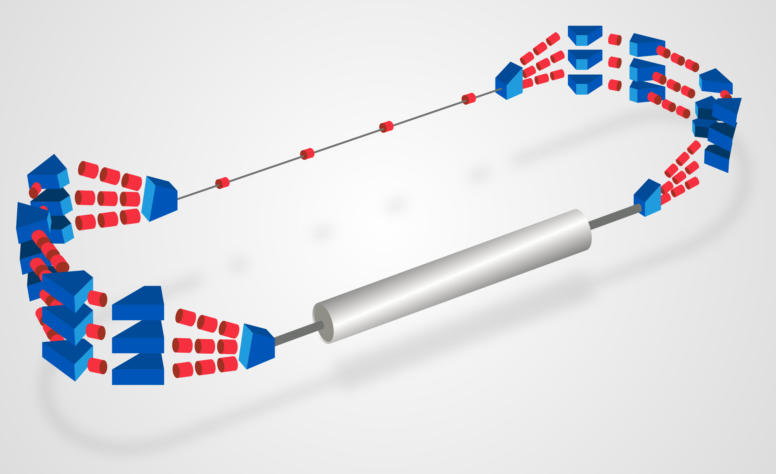
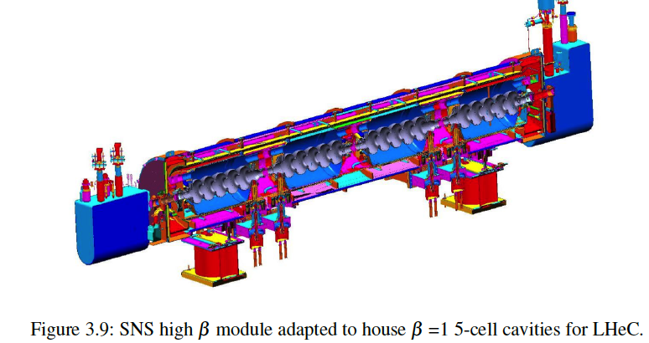
PERLE (“mini”)
Demonstration of high current
(10mA), multi(3)turn ERL
Test and development of 802MHz
SCRF technology
E_{e} = 200 MeV with cryo module
Footprint:12x3.5m²
A.Valloni 2/16
Parameter | Value
Dipoles per arc Dipole length Max B Field | 3/4 50 cm 1.1 T
Quadrupoles per arc Quadrupoles in straight lines | 5 4
Dipoles in Spreader/Combiner Quads in Spreader/Combiner | 1-3 3
Dipoles for Injection-Extraction | 6
PERLE (“centi”)
2 modules, 400 MeV
16x5m²
A.Valloni 6/16
Max Klein PERLE@Orsay 23.2.17

Slide 25
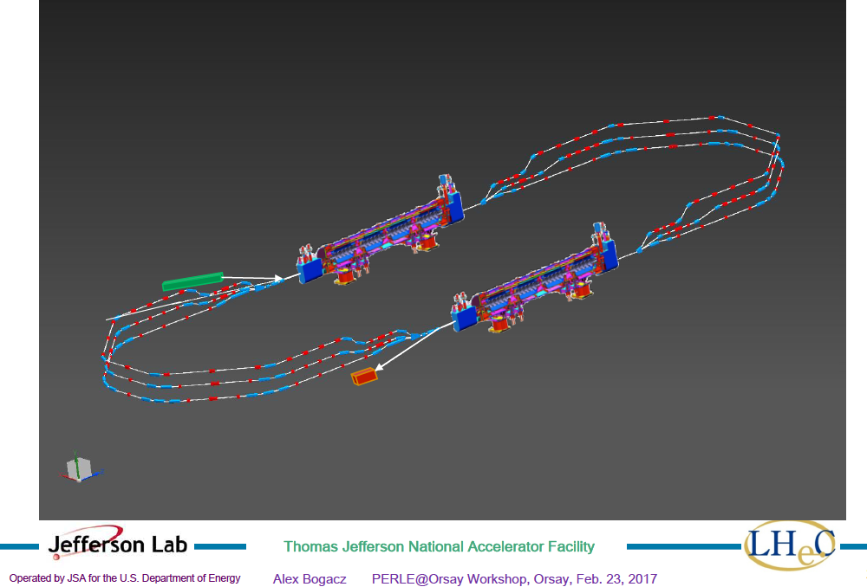
title
larger than 16 x 5..
layout a prime task
Max Klein PERLE@Orsay 23.2.17

Slide 26
Plan for how to proceed to TDR - draft
Achille Stocchi, Walid Kaabi, Sebastien Bousson, Erk Jensen(part time), Max Klein 10/11.10.16
1. Configuration: cPERLE with initially one cryomodule, 2nd optional, termed PERLE [at Orsay]
2. Technical Design Report in International Collaboration, open to participation, until 10/2017
building an international collaboration AND cooperation (cf e.g. cβ )
3. Hardware for TDR: a first 802 MHz 5-cell cavity (Bob: May 17), a magnet prototype tested
4. Contributions to TDR (and possibly beyond) currently/tentatively envisaged:
- Source
- Injector
- 4 (8) Cavities
- 1 (2) cryomodule
- Magnets
- Lattice design
- Dump
- Diagnostics
- Cryogenics and Power
- Shielding
- H+LV
- Goals
5. Optional: physics experiments
6. Regular meetings: December 5+6., February, June (ERL workshop), September
Report to the LHeC
Coordination Group
in October 2016 –
For this meeting to
assess + develop
Max Klein PERLE@Orsay 23.2.17

Slide 27
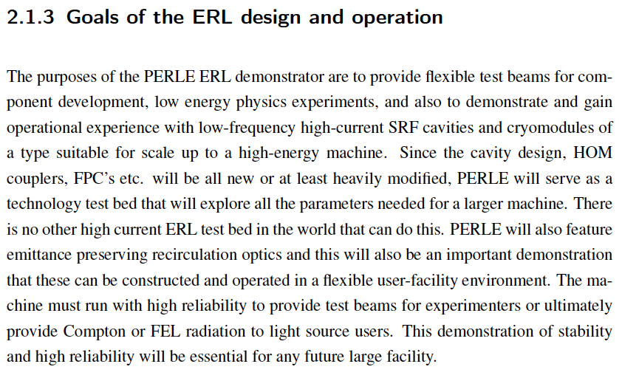
title
CDR
Goals reach further out than to the LHeC (cf Oliver tomorrow)
in order to be successful, they need to be clear, not just to us
Max Klein PERLE@Orsay 23.2.17

Slide 28
Thank you
Max Klein PERLE@Orsay 23.2.17

