Slide 1
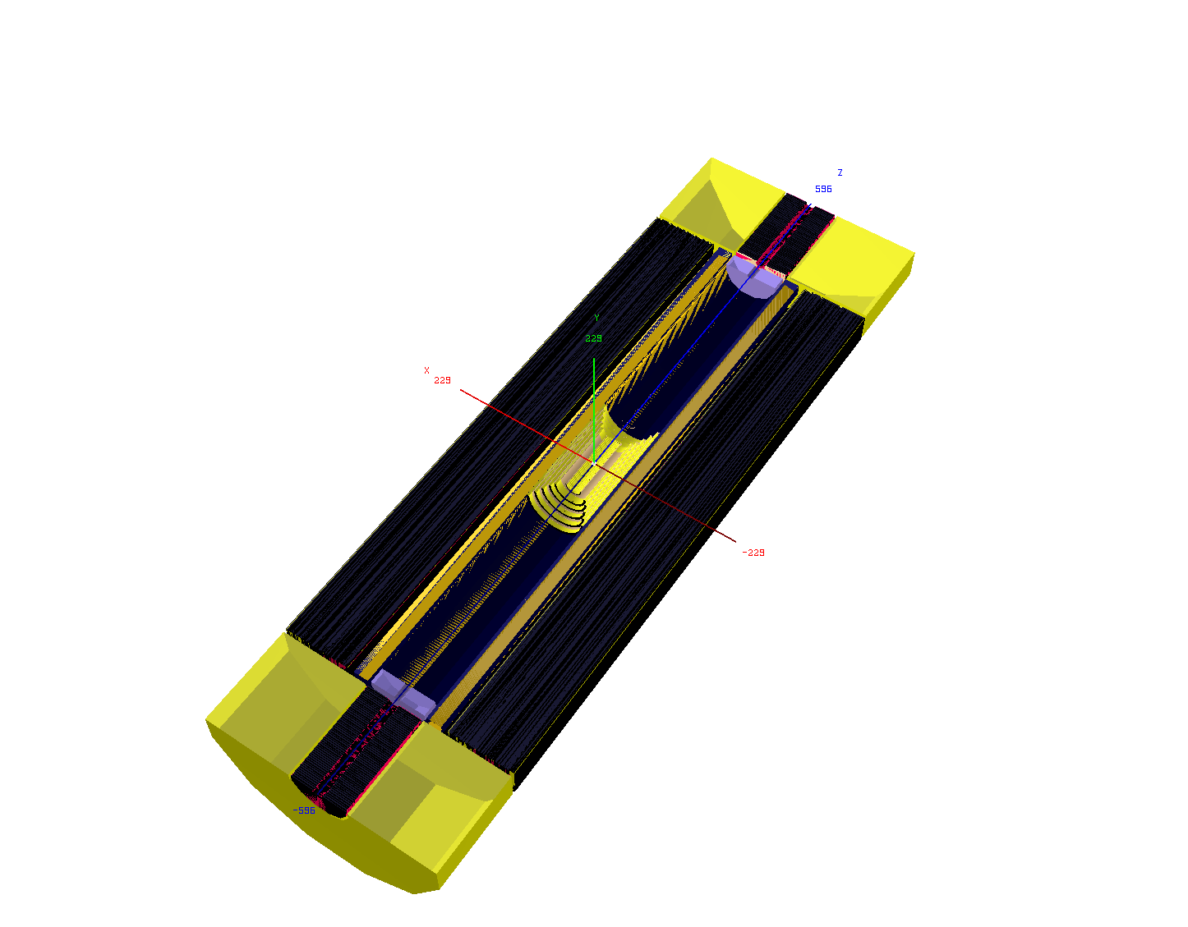

Physics [partons, xg, α_{s}, H] with the LHeC
Max Klein
University of Liverpool, ATLAS
Les Houches Workshop, June 9th , 2013
accompanying slides to
blackboard presentation
http://cern.ch.lhec
LPCC March 2013
CDR LHeC (600p) arXiv:1206.2913 JPhysG
O.Brüning, MK arXiv:1305.2090 MPLA

Slide 2

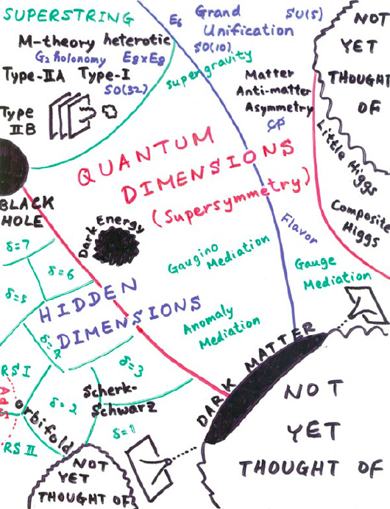
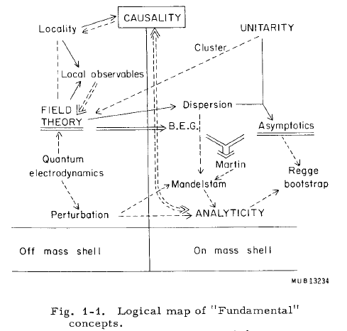
THEORY
M.Froissart ICHEP (“Rochester”) 1966
H.Murayama – ICFA11
→ Quarks in 1969
→ ?in 2015+?
We like to see particle physics as driven by experiment … Burt Richter

Slide 3
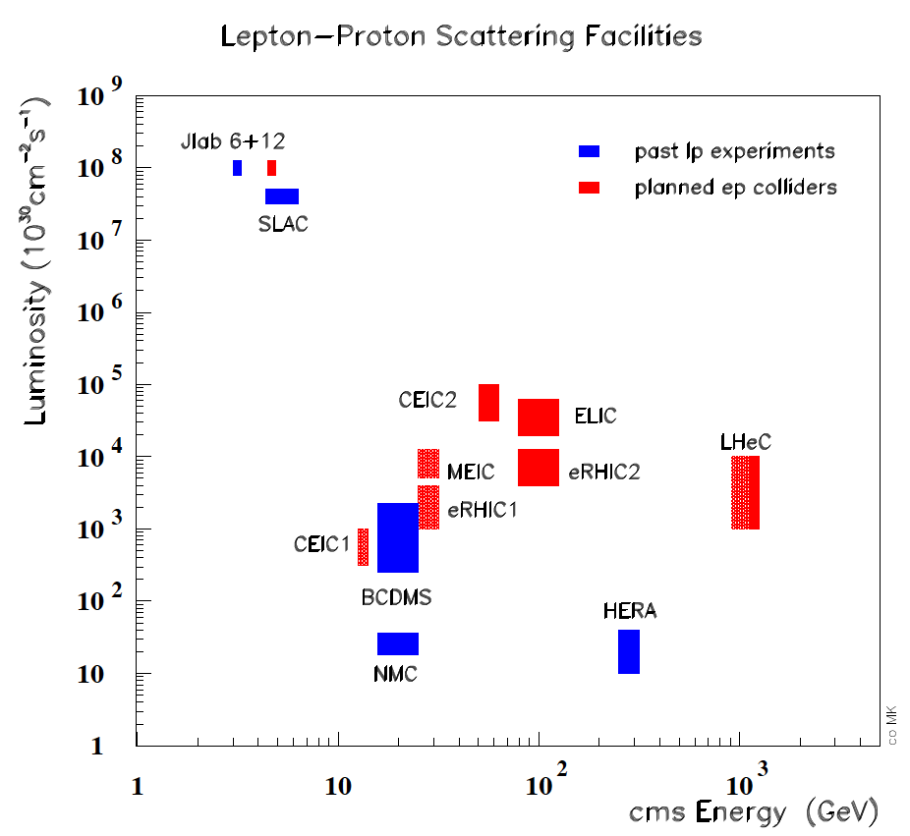
Energy frontier deep inelastic scattering - following HERA with the LHC
LHeC: A new laboratory for particle physics, a 5th large LHC experiment

Slide 4
The TeV Scale [2012-2035..]
pp
W,Z,top
Higgs?
New Particles??
New Symmetries?
LHC
ep
e⁺e⁻
New Physics
ttbar
Higgs?
Spectroscopy??
High Precision QCD
High Density Matter
Higgs?
Substructure??
eq-Spectroscopy??
ILC/CLIC/Ring
LHeC

Slide 5
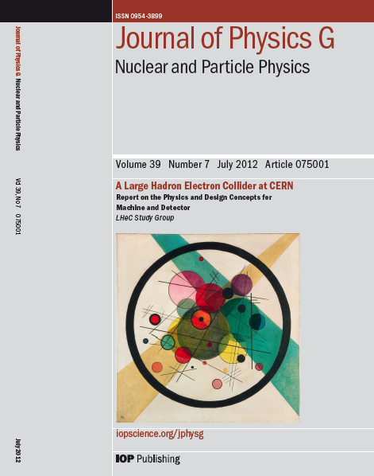
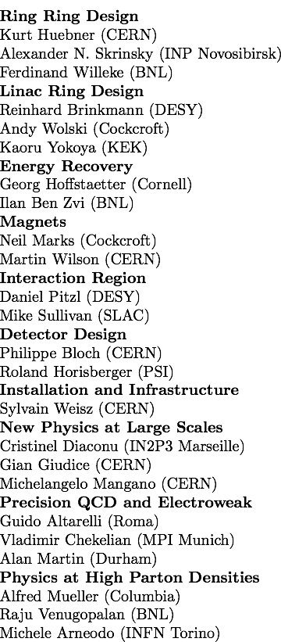
CERN Referees
arXiv:1206.2913
arXiv:1211.4831 and 5102
Published 600 pages conceptual design report (CDR) written by 150 authors from 60 Institutes.
Reviewed by ECFA, NuPECC (long range plan), Referees invited by CERN. Published June 2012.

Slide 6
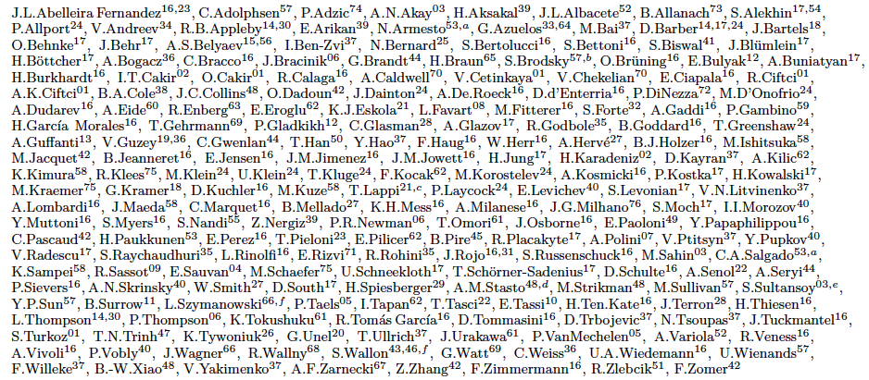
http://cern.ch/lhec
Present LHeC Study group and CDR authors
Supported by
CERN, ECFA, NuPECC
About 200 Experimentalists and Theorists from 76 Institutes

Slide 7
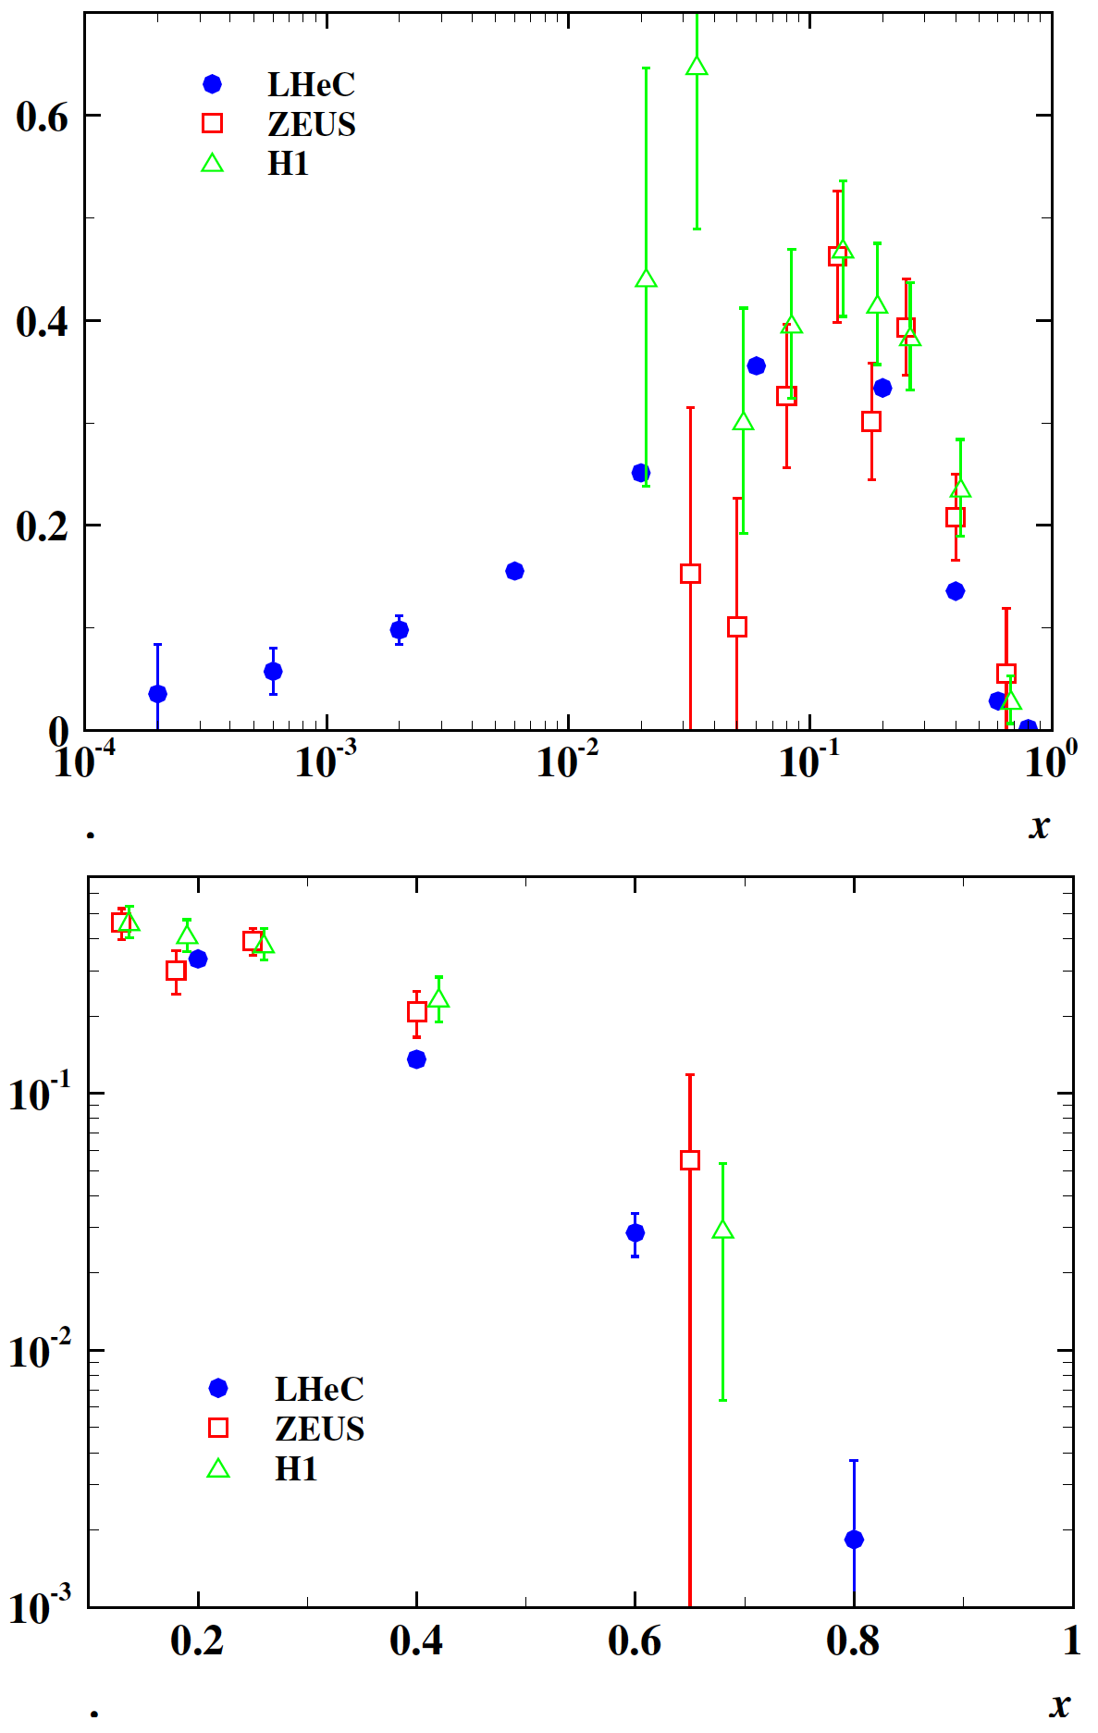
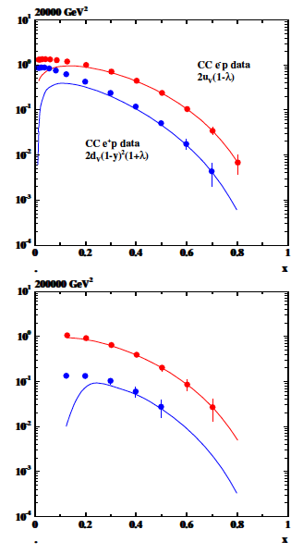
Primary measurements – simulated – high Q²
Precision CC measurements: top [10pb]
valence quarks, high x, V_{tb}, strange, ..
xF₃^{yZ}
xF₃^{yZ}
Precision electroweak measurements
PV with polarisation, F₂^{b,Z}, NC couplings..

Slide 8
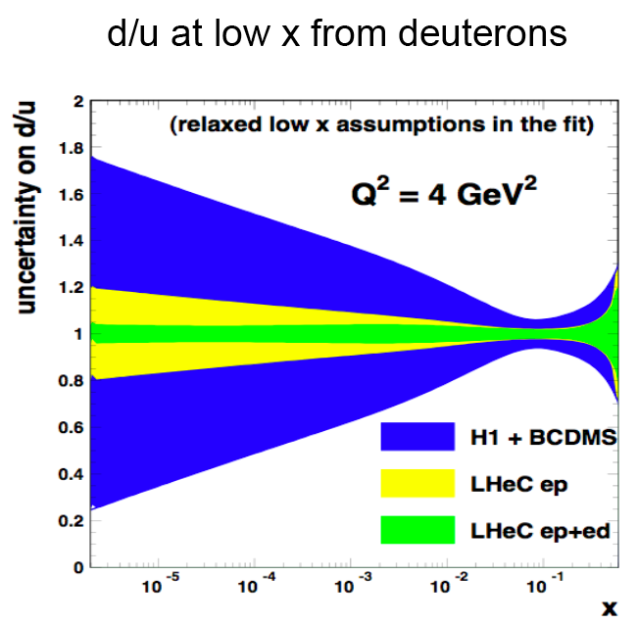
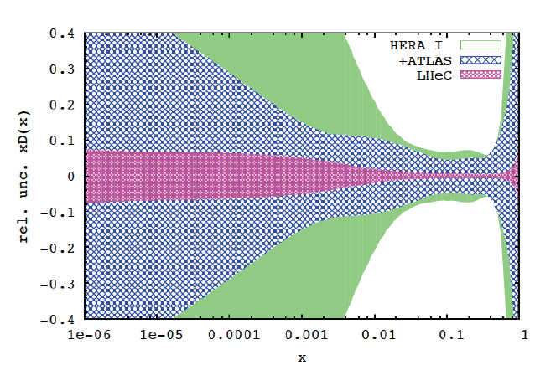

Deuterons and Light Sea Quark Asymmetry
D=“total down” from LHeC (ep) fit
with FREE d-u difference, including
simulated high precision LHC W,Z
CDR
Deuterons: Crucial for
NS-S decomposition
Neutron structure
Flavour separation
Nice: Gribov relation and spectator tagging to get rid off shadowing and Fermi motion!!

Slide 9
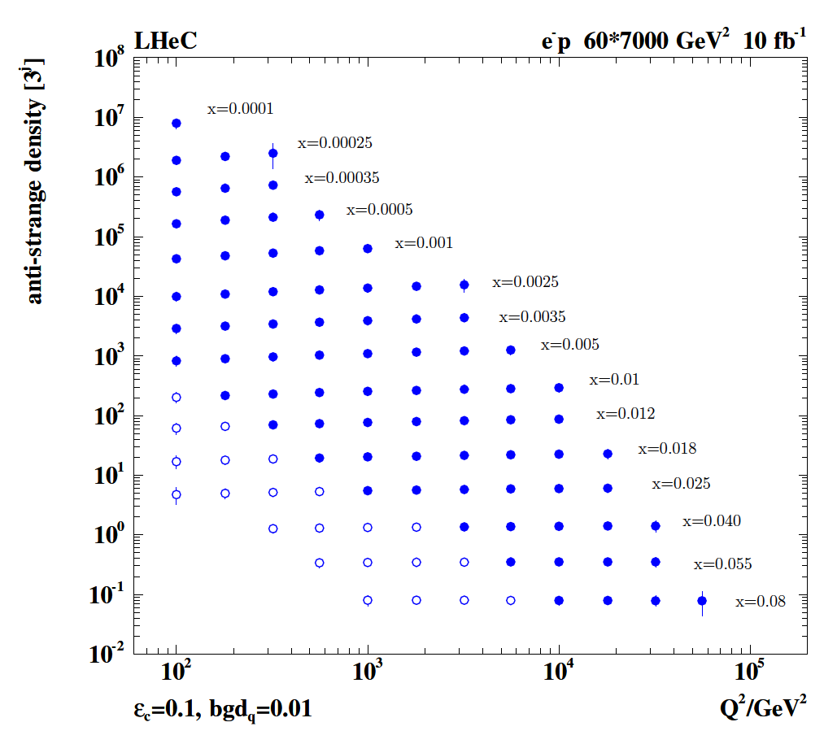
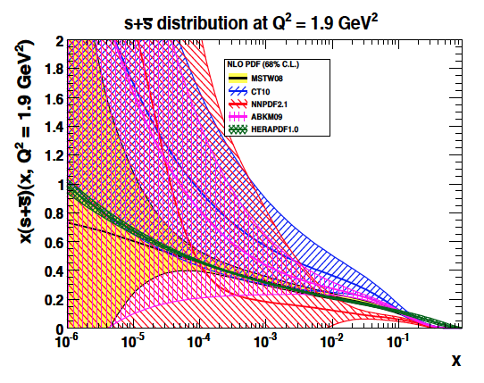
Strange Quark Distribution
High luminosity
High Q²
Small beam spot
Modern Silicon
NO pile-up..
First (x,Q²)
measurement of
the (anti-)strange
density, HQ valence?
x = 10⁻⁴ .. 0.05
Q² = 100 – 10⁵ GeV²
Initial study (CDR): Charm tagging efficiency of 10% and 1% light quark background in impact parameter

Slide 10
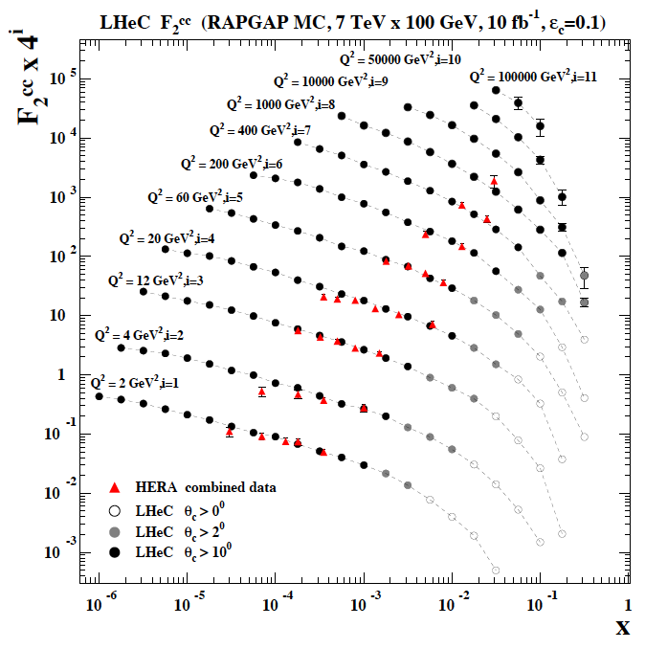
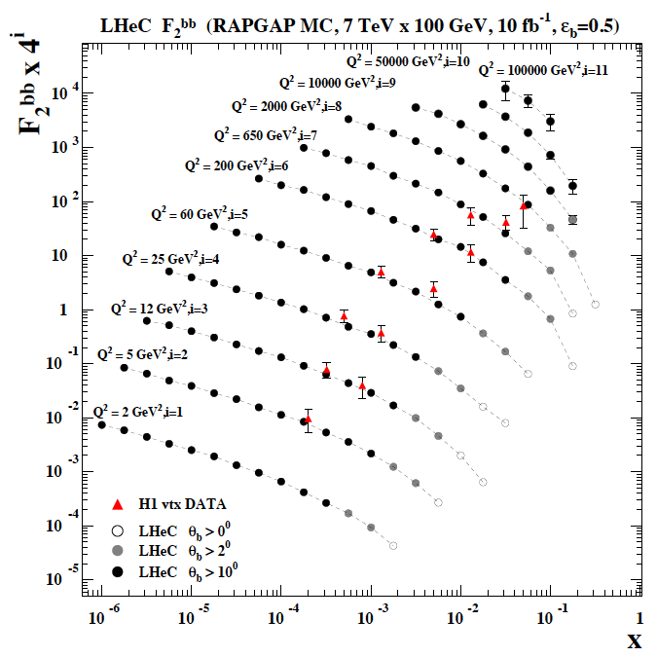
F₂^{charm} and F₂^{beauty} from LHeC
Hugely extended range and much improved precision (δM_{c}=60 HERA → 3 MeV)
will pin down heavy quark behaviour at and far away from thresholds, crucial for precision t,H..
In MSSM, Higgs is produced dominantly via bb → H , but where is the MSSM..

Slide 11
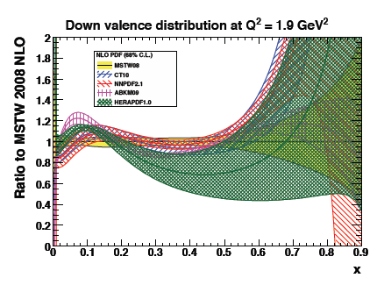
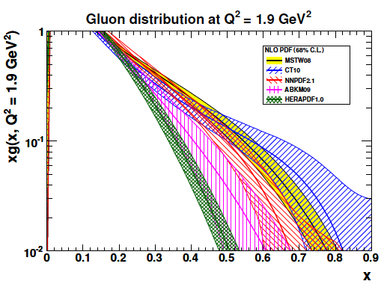
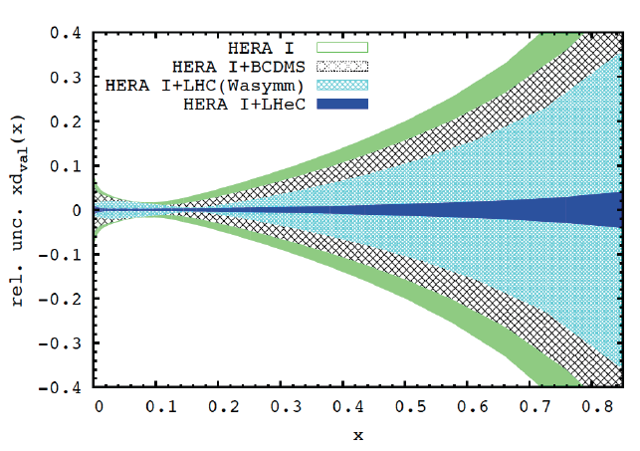
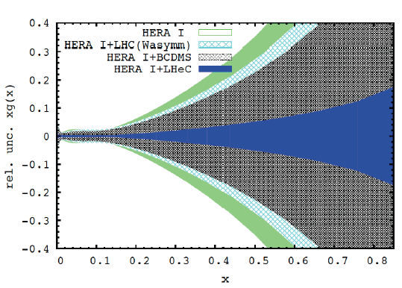
PDFs at Large x
No higher twist corrections, free of nuclear uncertainties, high precision test of factorisation

Slide 12
Exp uncertainty
of predicted H
cross section is
0.25% (sys+sta),
using LHeC only.
Leads to H mass
sensitivity.
Strong coupling
underlying
parameter
(0.005 – 10%).
LHeC: 0.0002
Needs N³LO
HQ treatment
important
PRECISION σ(H)
Calculated for scale of M_{H}/2
Bandurin (ICHEP12) Higgs physics at the LHC is limited by the PDF knowledge

Slide 13

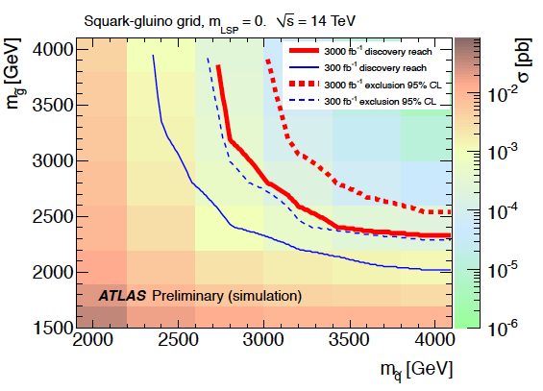
Link to HL LHC, e.g. High Mass SUSY
LHeC: arXiv:1211.5102
ATLAS October 2012 “Physics at High Luminosity”
With high energy and luminosity, the LHC search range will be extended to high masses,
up to 4-5 TeV in pair production, and PDF uncertainties come in ~ 1/(1-x), CI effects?

Slide 14
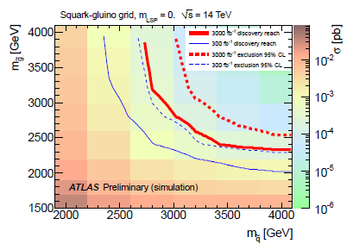
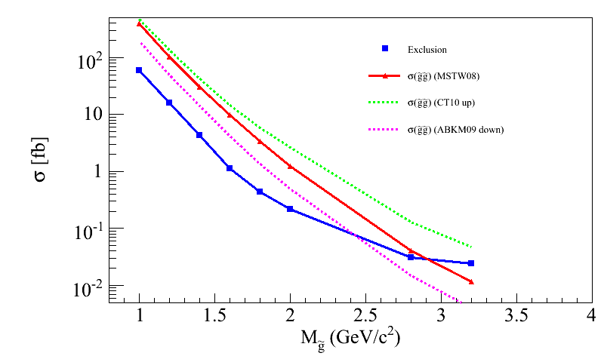
Impact on discovery/exclusion reach
PDF uncertainties impact discovery / exclusion reach:
  Total yields
  Shape variations on discriminating quantities (in progress)
Impact on discovery/exclusion contours under various PDF hypothesis in progress
LHC @ 14 TeV 3 ab-1, M(squark) > 4 TeV
CT10 up
ABKM09 down
MSTW08 equivalent to LHeC PDF
Caution: very very preliminary, mostly as illustration
(UL for gl-gl courtesy of G.Redlinger)
(TeV)
Note: impact of PDF uncertainties on SM background also not negligible
However → mitigated by usage of Control Regions and semi data-driven estimate

Slide 15
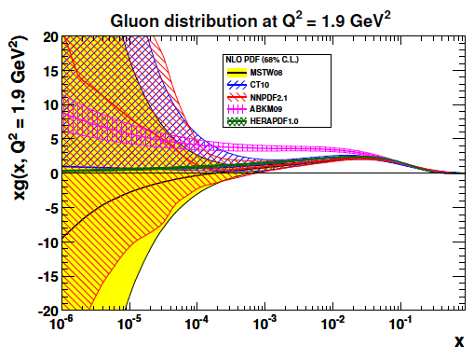
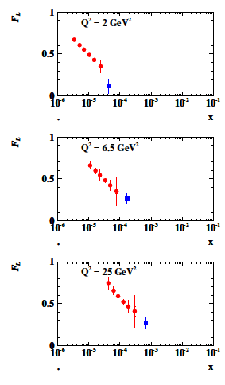
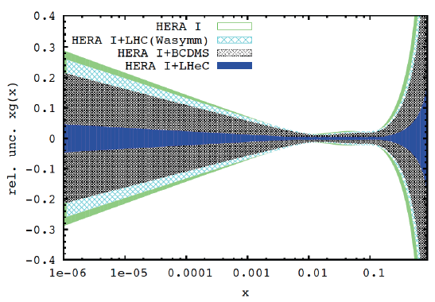
Gluon Saturation at Low x?
LHeC
H1
Gluon measurement down to x=10⁻⁵, Saturation or no saturation (F₂ and precise F_{L})
Non-linear evolution equations? Relations to string theory, and SUSY at ~10 TeV?
cf H.Kowalski, L.Lipatov, D.Ross, arXiv:1205.6713

Slide 16
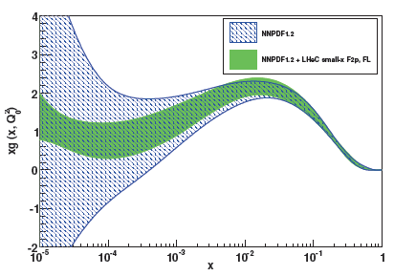
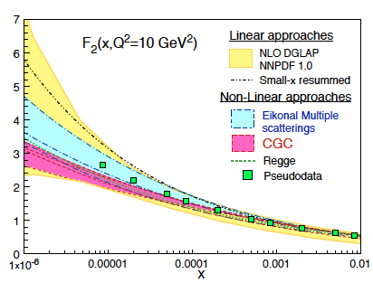
Partons at low x
Studies within NNPDF (CDR 8/12)
High precision F₂ and F_{L} pin down
low x phenomenology and determine
the gluon distribution down to x~10⁻⁵

Slide 17
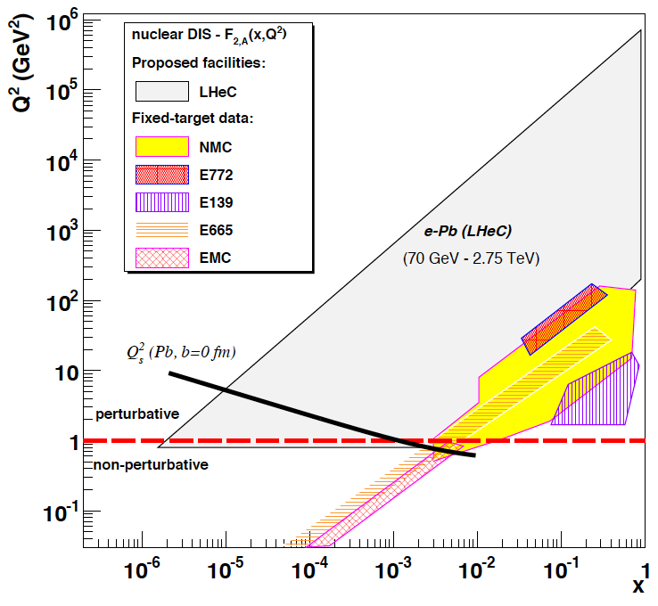
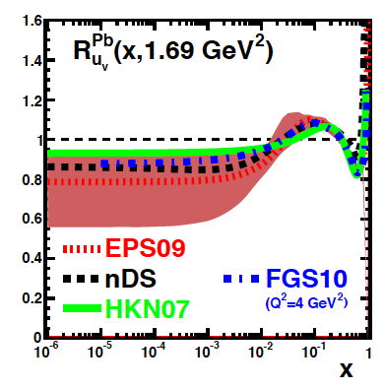
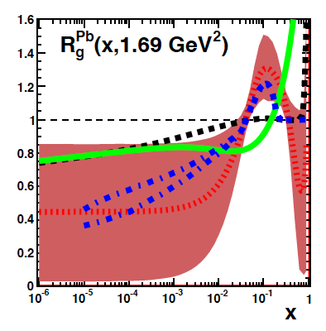
Nuclear Parton Distributions
up valence
gluon
eA physics is essentially not done yet (no eA at HERA!)
→ LHeC has huge discovery potential for new HI physics
(bb limit, saturation, deconfinement, hadronisation,QGP..)
and will put nPDFs on completely new ground
eRHIC/EIC would be an important step beyond fixed targets..
unmeasured | known?

Slide 18
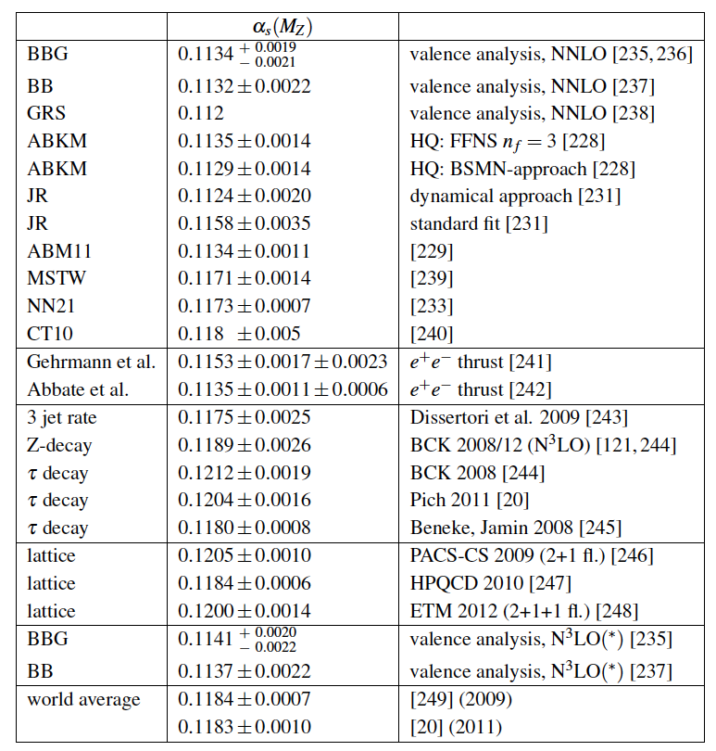
The strong coupling constant
α_{s} is the worst measured
fundamental coupling constant.
Is there grand unification?
In DIS, values (NNLO) range from
0.113 to 0.118.
τ leads to about 0.120
Lattice predictions seem to
determine the world average.
The LHeC has the potential to
measure αs to permille accuracy
(0.0002) from a consistent
data set. This leads to high
precision understanding of all
related effects (low x, δM_{c}=3MeV)
and pQCD at N³LO
J.Bluemlein, Why Precision, arXiv:1205.4991

Slide 19
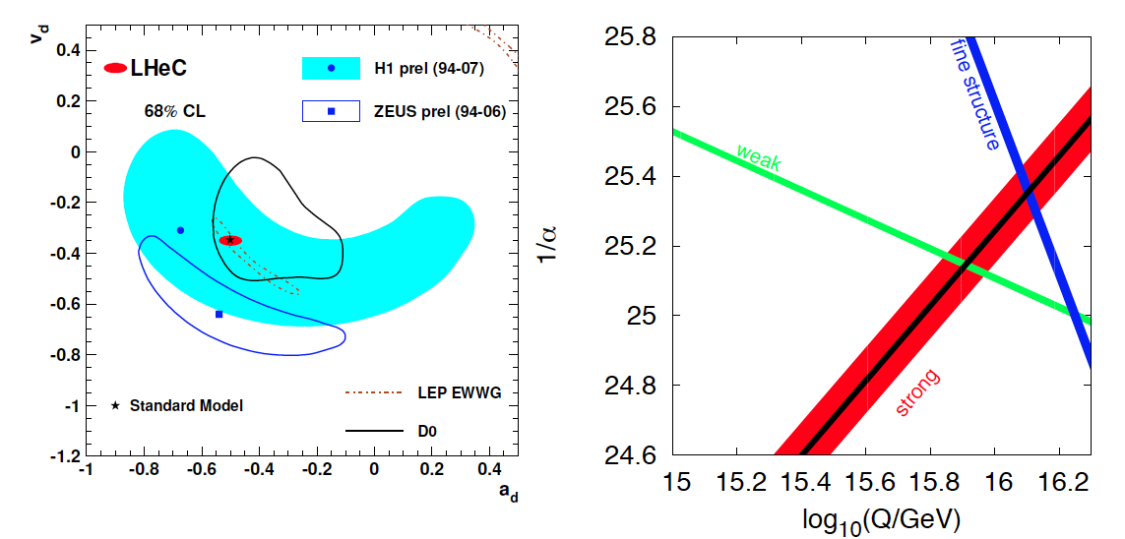
High Precision DIS
High Precision DIS
Q² >> M_{Z,W}², high luminosity, large acceptance
Unprecedented precision in NC and CC
Contact interactions probed to 50 TeV
Scale dependence of sin²θ left and right to LEP
→ A renaissance of deep inelastic scattering ←
Solving a 30 year old puzzle:
α_{s} small in DIS or high with jets?
Per mille measurement accuracy
Testing QCD lattice calculations
Constraining GUT (CMSSM40.2.5)
Charm mass to 3MeV, N³LO

Slide 20
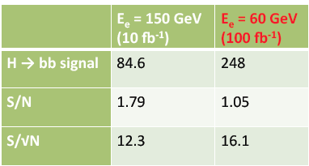
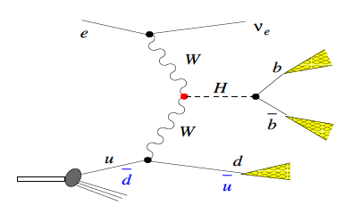
Higgs at the LHeC
Clean final state, no pile-up, low QCD bgd, uniquely WW and ZZ, small theory unc.ties
Default
U. Klein, ICHEP12, Melbourne for the LHeC
Full simulation of ep → nu H X → nu bbar X: reconstruction efficiency of 2.5%
With polarised electrons, 100fb⁻¹ - bb coupling measurement precision of 2-3%.

Slide 21
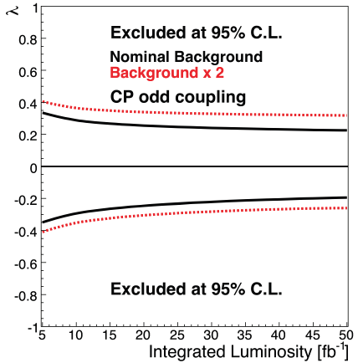
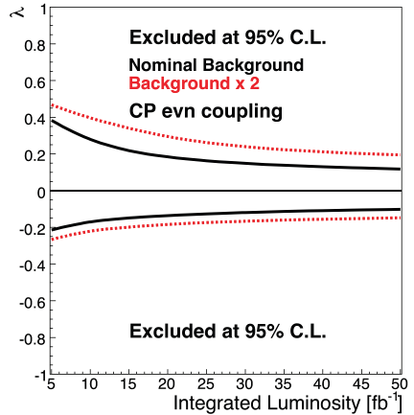
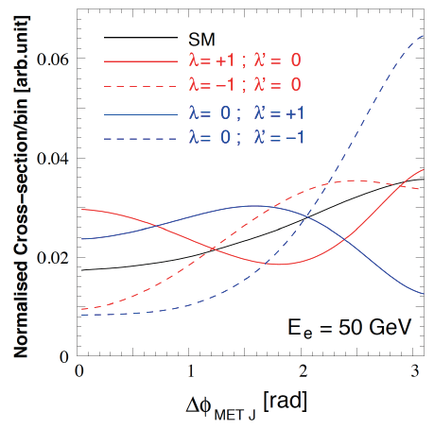



CP Higgs at the LHeC
In the SM the Higgs is a J^{PC}=0⁺⁺ state.
One needs to measure the EV if CP
is conserved, and the mixture of even
and odd states if it is not.
λ (λ’) anomalous CP (non) conserving terms
S.Biswal et al,
PhysRevLett.109.261801

Slide 22
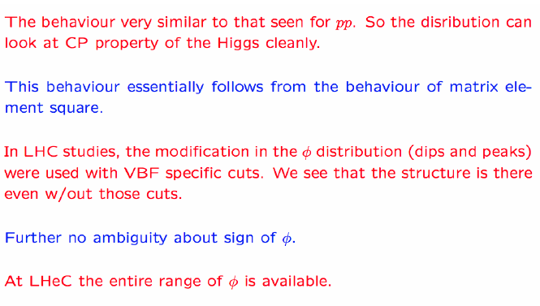
CP Properties
B.Mellado at LPCC 3/13

Slide 23
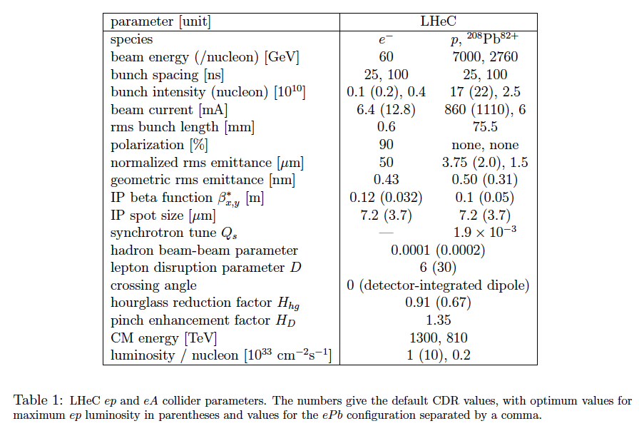
LHeC at 10³⁴ Luminosity
LHeC Collaboration arXiv:1211:5102, see also O.Bruening and M.Klein arXiv:1305.2090

Slide 24
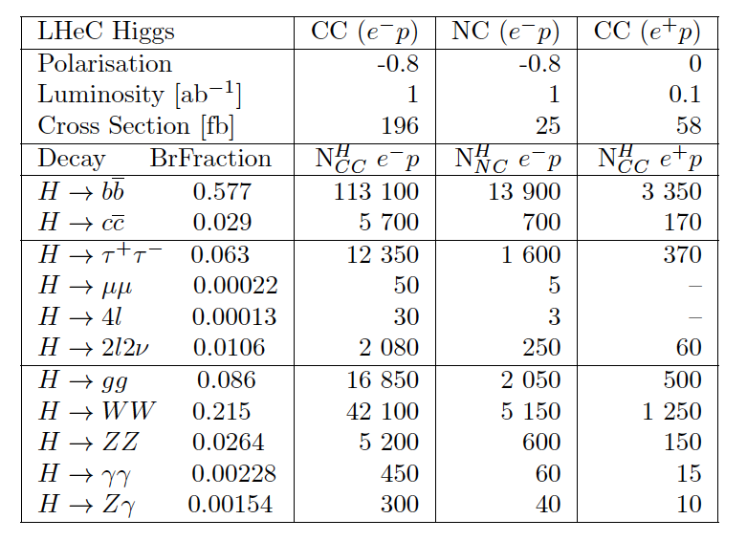
LHeC Higgs Rates

Slide 25
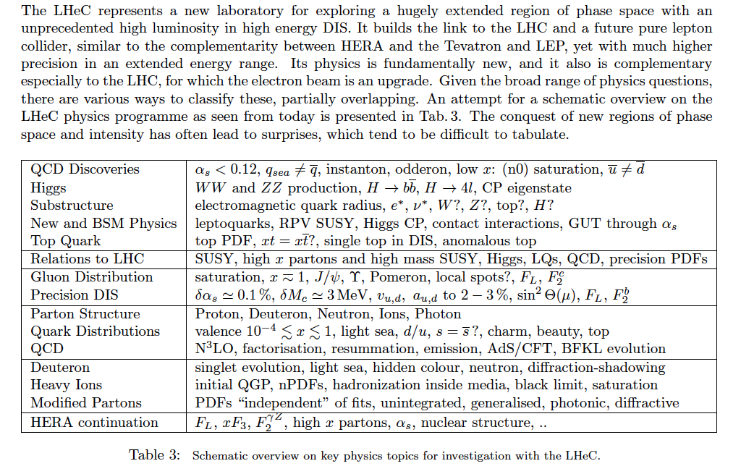
Summary of LHeC Physics [arXiv:1211:4831+5102]

Slide 26
60 GeV electron beam energy, L= 10³³ cm⁻²s⁻¹, √s=1.3 TeV: Q²_{max}= 10⁶ GeV², 10⁻⁶ < x< 1
Recirculating linac (2 * 1km, 2*60 cavity cryo modules, 3 passes, energy recovery)
The default LR LHeC design configuration

Slide 27
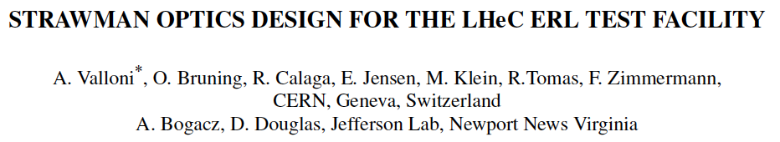


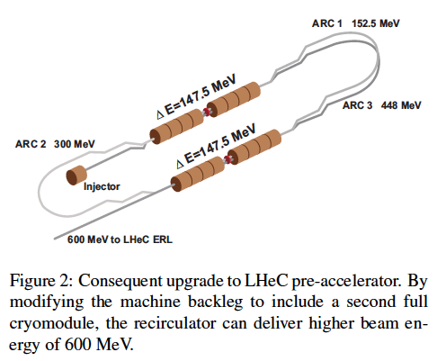
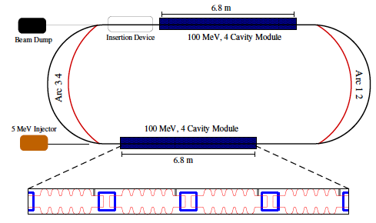
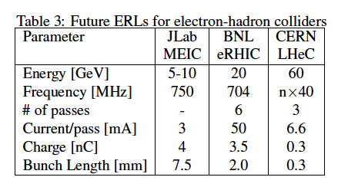
Towards an LHeC ERL Test Facility at CERN
Contribution to IPAC13
Daresbury Workshop:
- Collaboration: CERN, AsTEC, CI, JeffersonLab, U Mainz, +
- LHeC Parameters (C,Q,source,I) rather conservative
- Test Facility to develop full technology, key: cavity
- RF frequency chosen
22/23.1.2013 Daresbury (UK) http://cern.ch/lhec

Slide 28
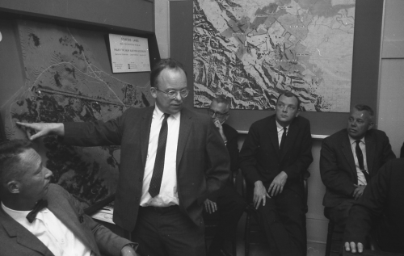
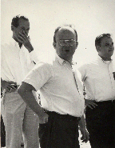
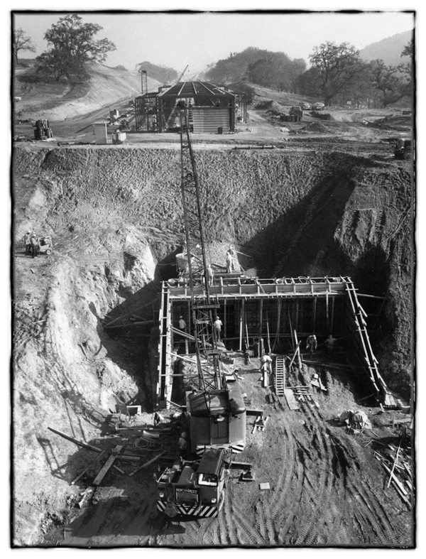
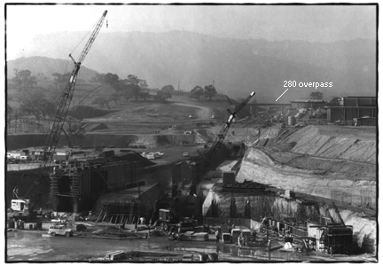
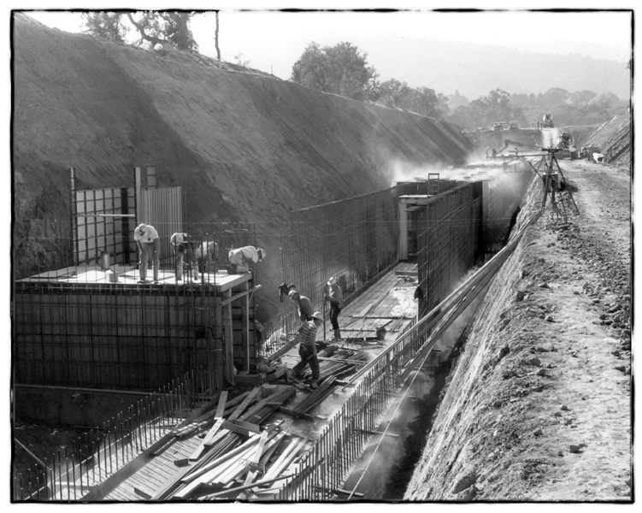
can one build a 2-3-km long linac?
it has been done before
Courtesy F.Zimmermann

Slide 29
Backup

Slide 30


Unique DIS Physics - Results from HERA
The weak and electromagnetic interactions reach similar strength when Q² ≥ M²_{W,Z}
F₂ rises towards low x, and xg too.
Parton evolution - QCD to NNLO
Measurements on α_{s}, Basic tests of QCD: longitudinal structure function, jet production, γ structure
Some 10% of the cross section is diffractive (ep → eXp) : diffractive partons; c,b quark distributions
New concepts: unintegrated parton distributions (k_{T}) , generalised parton distributions (DVCS)
New limits for leptoquarks, excited electrons and neutrinos, quark substructure, RPV SUSY
Interpretation of the Tevatron measurements (high Et jet excess, M_{W}, searches..), + base for PDF fits..
M.Klein, R.Yoshida: Collider Physics at HERA Prog.Part.Nucl.Phys. 61 (2008) 343-393 and recent H1,ZEUS results
A Recent review of The Theory of Deep Inelastic Scattering: J.Bluemlein arXiv:1208.6087 ProgPartNuclPhys 69(2013)28

Slide 31


ECFA Review 2007-2012
CERN SPC, [r]ECFA Mandate given in 2007 to work out the LHeC
physics, detector and accelerator design(s) – looking back to 1994
CDR and referee process carefully evaluated by ECFA committee
…
Stressed: Link to LHC physics and operation, link to HEP, cost estimates, R&D, DIS community
ECFA Statement ECFA/12/279 December 2012

Slide 32


PDF constraints from LHC - Di-Lepton Production
Precision
Drell-Yan
(W,Z) data
constrain
PDFs
PRD D85 (2012) 072004
according to the ATLAS data and
HERA+ATLAS QCD analysis: s = d !
PRL 109(2012)012001
ATLAS-CONF-2012-159
Very high precision required
for any constraint on PDFs
Change of strange affects sea - UHE ν

Slide 33

LHeC Detector Overview
LAr electromagnetic calorimeter
Tile Calorimeter
Detector option 1 for LR and full acceptance coverage
Forward/backward asymmetry in energy deposited and thus in geometry and technology
Present dimensions: LxD =14x9m² [CMS 21 x 15m² , ATLAS 45 x 25 m²]
Taggers at -62m (e),100m (γ,LR), -22.4m (γ,RR), +100m (n), +420m (p)

Slide 34


Kinematics - LHeC and HERA
Access to “saturation” (?) region
in DIS (Q² > 1 GeV²) and ep
Extending beyond the Fermi scale with
precision Z and W exchange data →
high x, H, top PDF, flavour & new physics,

Slide 35
What HERA could not do or has not done
Test of the isospin symmetry (u-d) with eD - no deuterons
Investigation of the q-g dynamics in nuclei - no time for eA
Verification of saturation prediction at low x – too low s
Measurement of the strange quark distribution – too low L
Discovery of Higgs in WW fusion in CC – too low cross section
Study of top quark distribution in the proton – too low s
Precise measurement of F_{L} – too short running time left
Resolving d/u question at large Bjorken x – too low L
Determination of gluon distribution at hi/lo x – too small range
High precision measurement of α_{s} – overall not precise enough
Discovering instantons, odderons – don’t know why not
Finding RPV SUSY and/or leptoquarks – may reside higher up
…

Slide 36



Contact interactions (eeqq)
New currents or heavy bosons may produce indirect effect via new particle exchange interfering with γ/Z fields.
Reach for Λ (CI eeqq): 25-45 TeV with 10 fb⁻¹ of data depending on the model
Similar to LHC
ATLAS and CMS constraints on
eeqq CI (expected up to 30-40
TeV at c.o.m. 14 TeV LHC)

Slide 37


Top Quark and Leptoquarks
The LHeC is a (single) top quark production
factory, via Wb → t. Top was never observed
in DIS. With ep: top-PDF → 6 flavour VFNS,
precision M_{t} direct and from cross section,
anomalous couplings [to be studied]
Leptoquarks (-gluons) are predicted in RPV SUSY,
E6, extended technicolour theories or Pati-Salam.
The LHeC is the appropriate configuration to do their
spectroscopy, should they be discovered at the LHC.

Slide 38

Measurement Simulations
Full simulation of NC and CC inclusive cross section measurements including
statistics, uncorrelated and correlated uncertainties – checked against H1 MC

Slide 39



Strong Coupling Constant
α_{s} least known of coupling constants
Grand Unification predictions suffer from δα_{s}
DIS tends to be lower than world average (?)
LHeC: per mille - independent of BCDMS.
Challenge to experiment and to h.o. QCD →
A genuine DIS research programme rather than
one outstanding measurement only.
1/α
fine structure
weak
strong
Two independent QCD analyses using LHeC+HERA/BCDMS

Slide 40


α_{s}
Per mille precision
NNNLO PDFs
Heavy quarks →
Full set of PDFs
Full exp. error
From LHeC CDR

Slide 41



PDF constraints from LHC – Jets
ATLAS-CONF-2012-128
S.Moch 6th Terascale Workshop (Hamburg, 3.12.12)
μ=3GeV
First constraints on gluon distribution from
jets: cross sections and ratios 2.7/7 TeV
Will improve, but depends on energy scales,
jet definition, non-perturbative effects ..
Similar results from CMS (W±, DY, top..)

Slide 42
Summary and outlook
LHeC provides complementarities to the LHC SUSY search program in the twenties
  Ideal to search and study properties of new bosons with couplings to electron-quark
  Direct searches for CI, excited fermions, leptoquark, RPV SUSY, RPC SUSY in specific scenarios such as compressed, non-degeneracy for squarks
  Interplay with HL-LHC to constraints on PDF crucial for model testing in case of observed deviations → an independent precision measurement of PDFs will be important for an efficient use of the high luminosity for setting reliable high mass limits

Slide 43

Collaboration on ERL
Budker Institute

Slide 44
End

