Slide 1
The LHeC – an Experiment at the LHC
Max Klein, University of Liverpool, for the LHeC/FCC-eh Study Group
The LHeC Project
Physics of DIS
Detector [Overview, Components]
Heavy Ion eA and AA Option
Summary
Circles in a circle
W Kandinsky
CDR: 1206.2913 J.Phys.G
Update:2007.14491, J.Phys.G
to appear
At this workshop
Oliver Bruening: Monday HL-LHC and LHeC Option
Bruce Mellado: Higgs Physics with ep
Presented to the HK Conference, 19.1.2021. special thanks to
Kevin Andre, Nestor Armesto, Oliver Bruening, Andrea Gaddi, Bernhard Holzer, John Jowett, Uta Klein, Peter Kostka, Bruce Mellado, Paul Newman, Ercan Pilicer, Alessandro Polini, Eva Villela, Yuji Yamazaki

Slide 2
LHeC, PERLE and FCC-eh
Powerful ERL for Experiments @ Orsay
CDR: 1705.08783 J.Phys.G
CERN-ACC-Note-2018-0086 (ESSP)
Operation: 2025+, Cost: O(20) MEuro
LHeC ERL Parameters and Configuration
I_{e}=20mA, 802 MHz SRF, 3 turns →
E_{e}=500 MeV → first 10 MW ERL facility
BINP, CERN, Daresbury, Jlab, Liverpool, Orsay (IJC), +
50 x 7000 GeV²: 1.2 TeV ep collider
Operation: 2035+, Cost: O(1) BCHF
CDR: 1206.2913 J.Phys.G (550 citations)
Upgrade to 10³⁴ cm⁻²s⁻¹, for Higgs, BSM
CERN-ACC-Note-2018-0084 (ESSP)
arXiv:2007.14491, subm J.Phys.G
60 x 50000 GeV²: 3.5 TeV ep collider
Operation: 2050+, Cost (of ep) O(1-2) BCHF
Concurrent Operation with FCC-hh
FCC CDR:
Eur.Phys.J.ST 228 (2019) 6, 474 Physics
Eur.Phys.J.ST 228 (2019) 4, 755 FCC-hh/eh
Future CERN Colliders: 1810.13022 Bordry+

Slide 3
Published in 2020
arXiv:2007:14491 (400 pages, 300 authors)
5 page summary: ECFA Newsletter Nr 5., August 20
https://cds.cern.ch/record/2729018/files/ECFA-Newsletter-5-Summer2020.pdf
156 Institutions involved

Slide 4
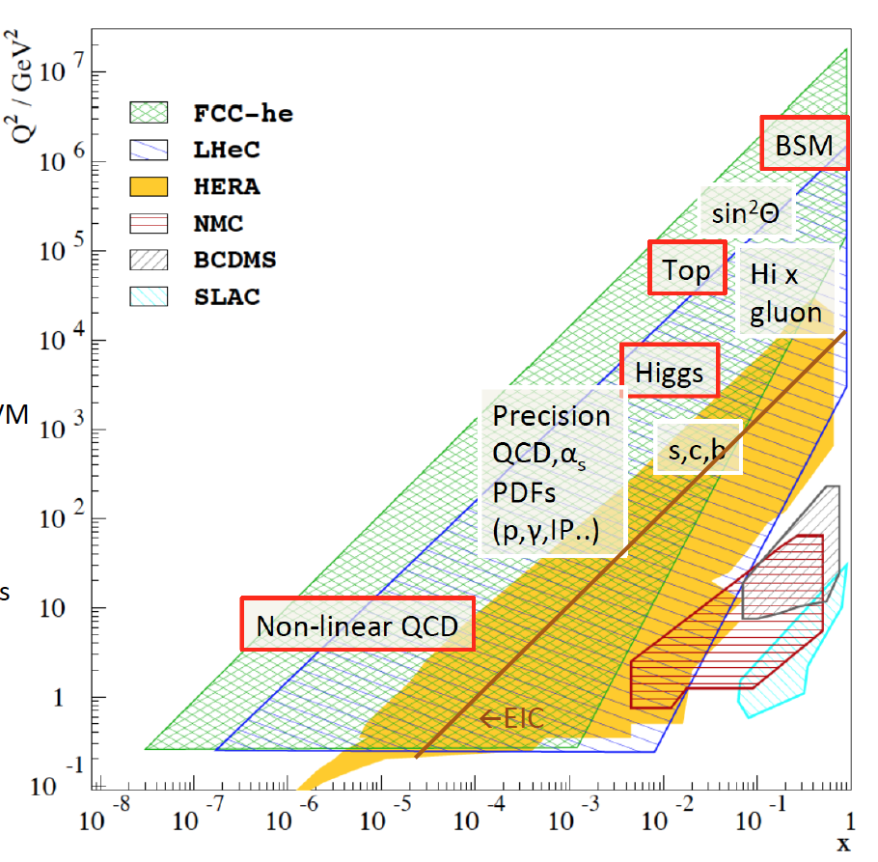
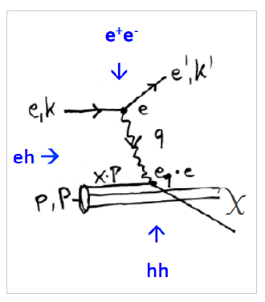
Physics with Energy Frontier DIS
Deep Inelastic Scattering
Raison(s) d’etre of ep/eA
at the energy frontier
Cleanest High Resolution
Microscope: QCD Discovery
Empowering the LHC/FCC
Search Programme
Transformation of LHC/FCChh into
high precision Higgs facility
Discovery (top, H, heavy ν’s..)
Beyond the Standard Model
A Unique
Nuclear Physics Facility

Slide 5
Higgs in ep and pp [LHC and FCC]
LH(e)C

Slide 6
Kinematics: fwd: in p beam direction, bwd: e direction
fwd
bwd
fwd
bwd
Electrons in bwd direction have low energy (E’_{e} < E_{e} beam)
in fwd direction high energy up to Ep, Rutherford backscattering
Q²=1 GeV² is 179º, or eta =4.74 = ln tan theta/2, ~ E_{e}² !
Hadrons in bwd direction have low energy E_{h} < E_{e} beam
in fwd direction hadrons carry energy up to E_{p} beam
Asymmetric energy coverage of LHeC detector. Fwd region: resembles hh conditions

Slide 7
The LHeC Detector Design
LHeC Detector Design 7/2020
No pile up, low radiation wrt pp; high precision through overconstrained kinematics: e-h; modular for rapid installation
Tracker radius 40 → 60cm, B 3.5T; LxD =13 x 9m² [CMS 21 x 15m² , ATLAS 45 x 25 m²]..
arXiv:1206.2913+2007.14491

Slide 8
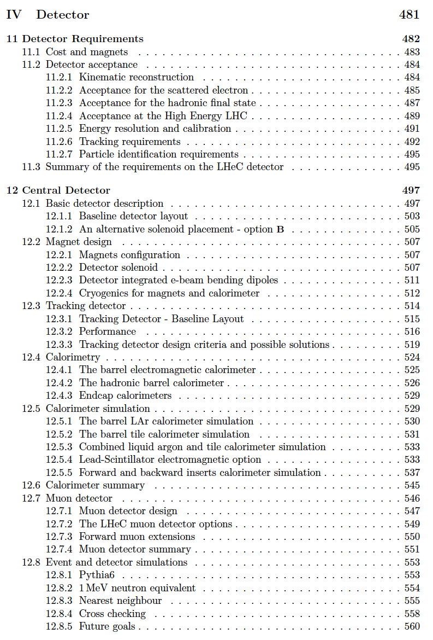
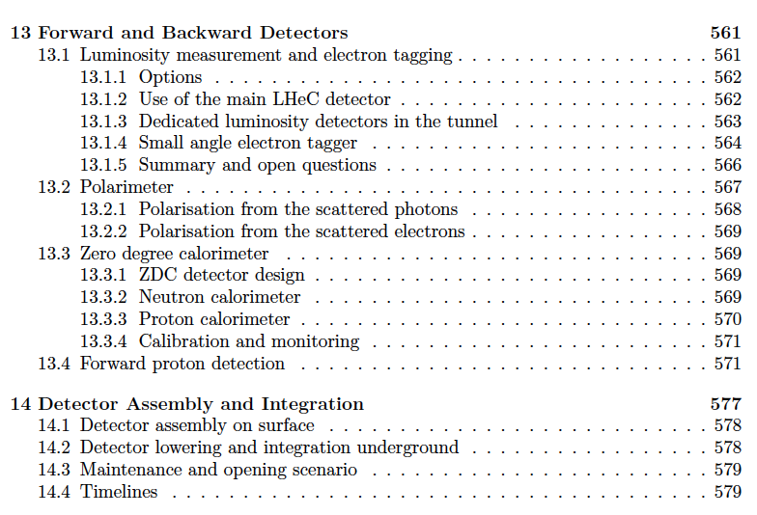
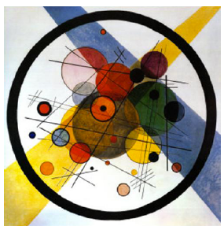
title
LHeC Detector in the CDR (1206.2913)

Slide 9
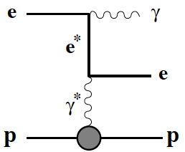
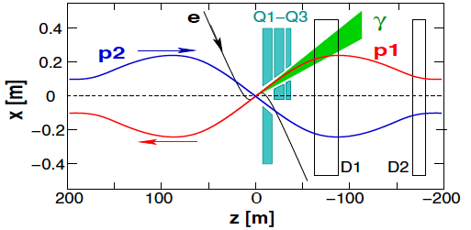
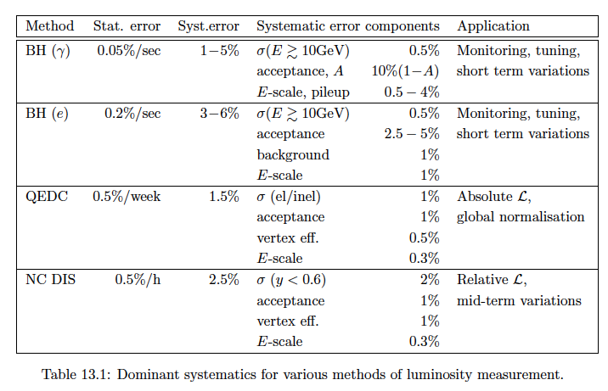
Bethe Heitler - Luminosity measurement at the LHeC
CDR
1206.2913
JPhysG39
075001(12)
p561-566
LR: photon detector
← acceptance 95%
Luminosity from
BH photons to 1%
BH to another order
… BH(e), QCDC, F₂
as cross checks
Forward
Taggers:
See Yuji
Yamazaki
at ICHEP
and in
2007.14491

Slide 10
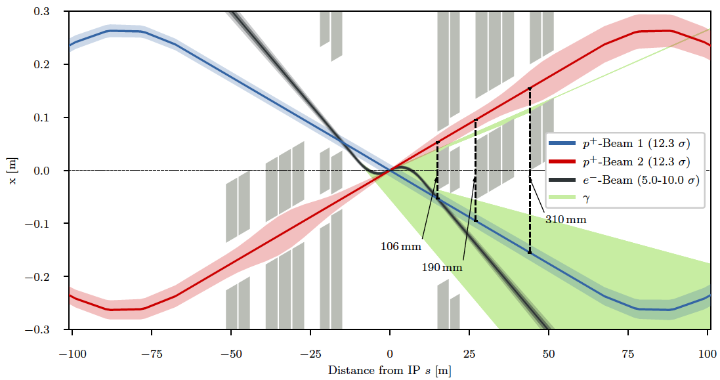
3-beam ep/eA Interaction Region
Head-on collisions →
Dipole magnet before
Hadron Calorimeter
Synchronous ep/pp operation! Non-interacting p beam to freely pass: aperture
Matching e and p beam sizes (experience from HERA, also for magnet placement)

Slide 11
LHeC IR modified for dual purpose
Optimisation of synchrotron
radiation (power and E_{crit})
LHeC HERA
E _{crit} keV 270 150
Synrad
Power kW 30 28
Detector dipole
Staggered quads
Half-quad (NC)
First of triplet qaudrupoles
For ep/A: synchronous with pp/AA in GPDs and LHCb – keep non-colliding beam apart
with option of pp/AA the non-colliding beam needs to be kept inside pipe:
then: shift transversely (as in regular injection mode) and possibly in time
For pp/AA in IP2: no electron beam in. Collisions at nominal IP (or shifted by 25/4ns)

Slide 12
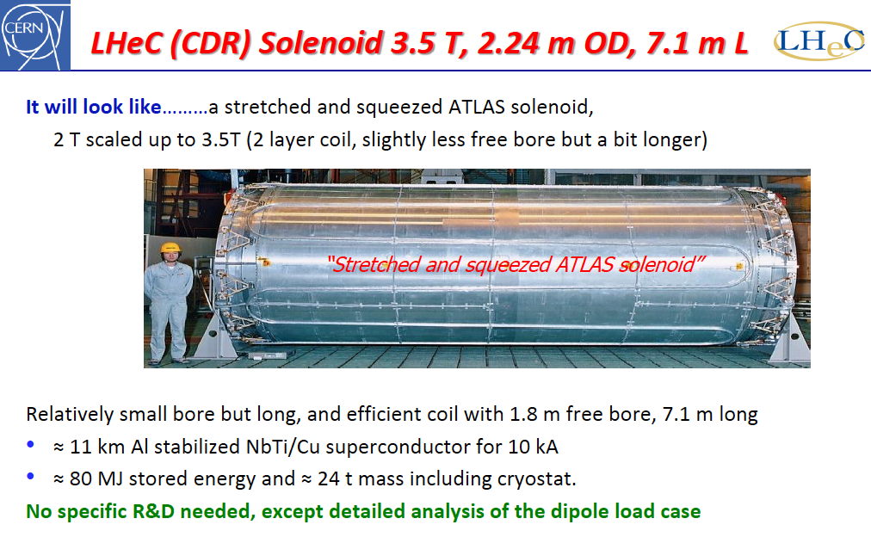
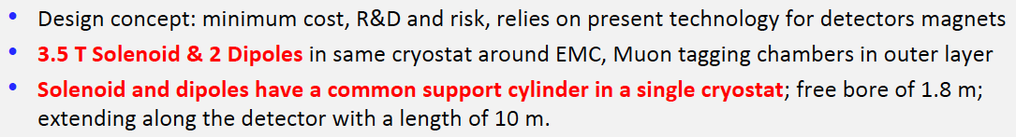
title
For magnet specs, see
CDR: arXiv:1206.2913
H ten Kate (EP-RD, 16.3.18)
New ideas on
thin magnets
cf. E Perez at
FCC workshop

Slide 13
LHeC Calorimeters
Complete coverage to +- 5 in (pseudo)rapidity
Central Region: 2012: LAr, 2020 Sci/Fe option.
Forward Region: dense, high energy jets of few TeV
H → bb and other reactions demand resolution of HFS
Backward Region: in DIS only deposits of E < E_{e}
Barrel Calorimeters
Forward/Backward Calorimeters
arXiv:2007.14491

Slide 14
The LHeC Detector Design
Inner Tracker
Rapidity to ~5
r_{O} = 60 cm
impact resolution
5-10 µm
40.7 m² Si

Slide 15
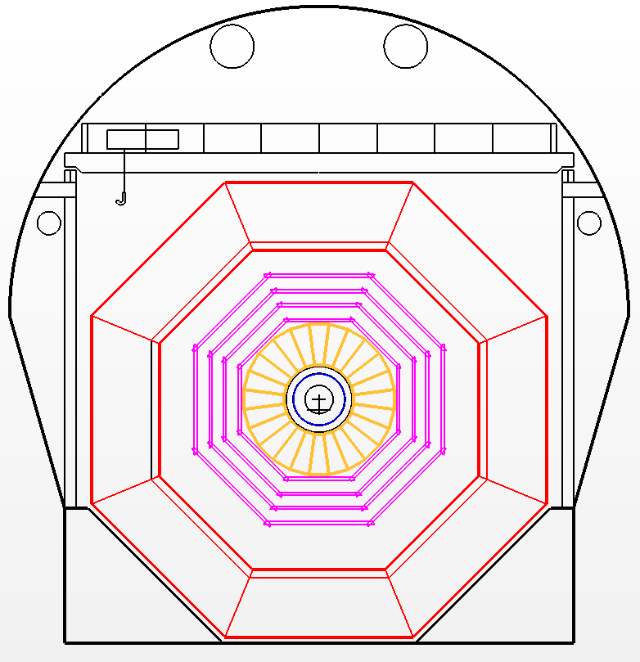
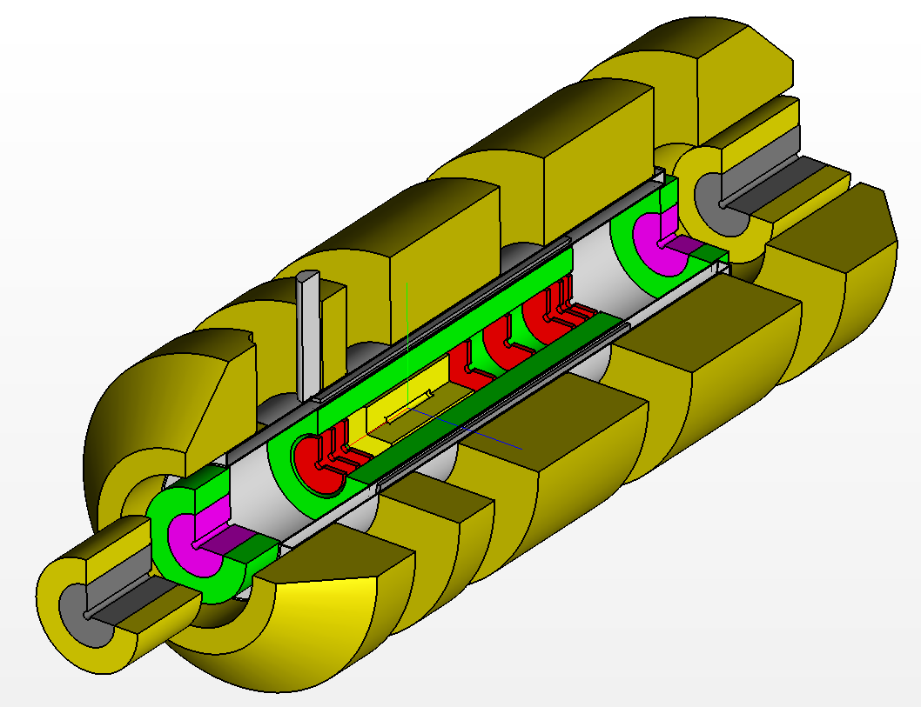
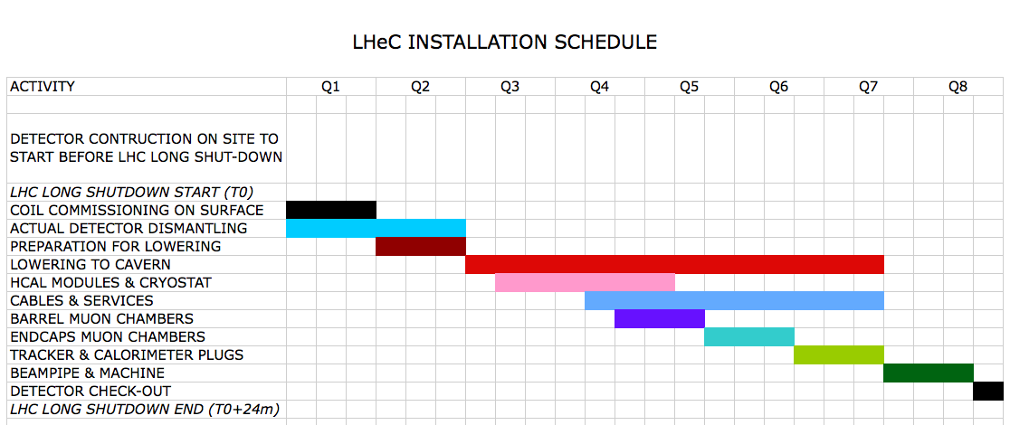
Installation
Study
Detector fits in L3 magnet support
Modular structure
Detector Installation
possible within about
two-years shutdown:
pre-mounting on surface
Andrea Gaddi, L Herve et al arXiv:2007.14491

Slide 16
Integration of eA and AA Detector Concepts
Could one merge the LHeC (2007.14491) and a novel Heavy Ion detector (“A3”, 1902.01211) concepts ?

Slide 17
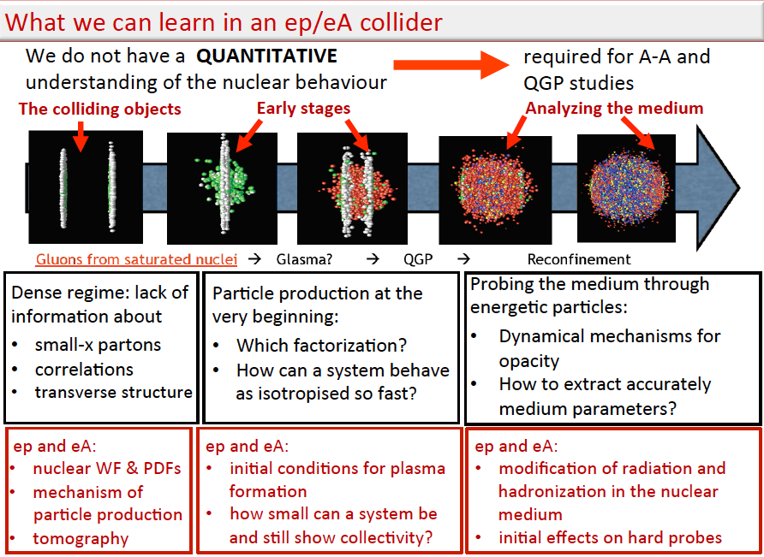
title
N. Armesto DIS2018, Kobe, 17.4.18 and E. Ferreiro, LHeC Workshop 2018, Orsay, 28.6.18 → 2007.14491

Slide 18
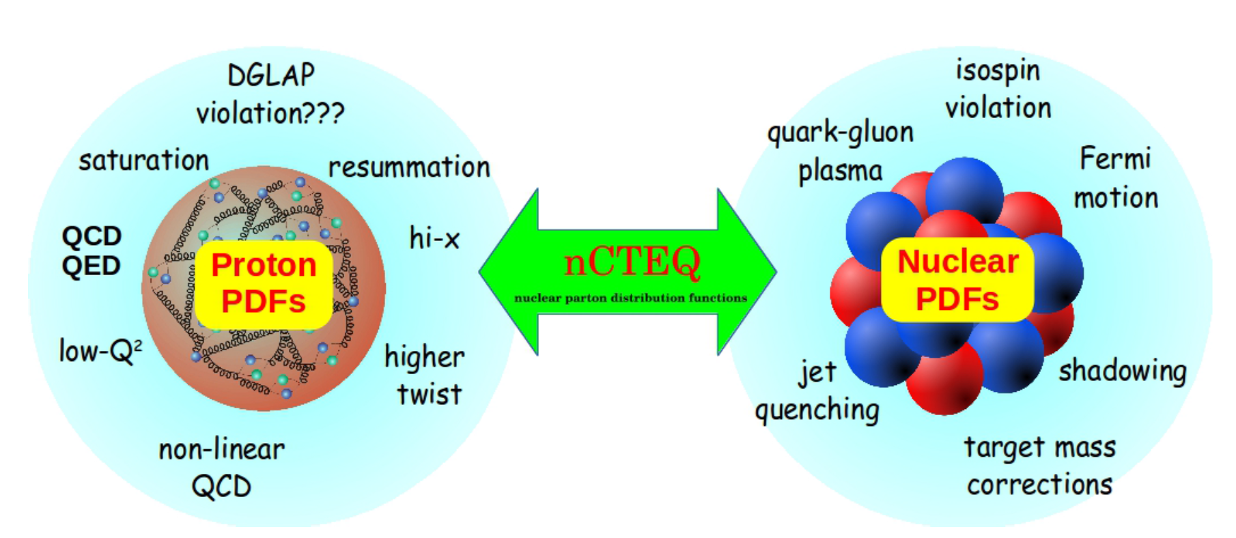
Partons in Nuclei
Complexity of (de) confinement in proton and nuclei
LHeC
EIC
F.Olness
Fixed Target
Direct determination of R_{g} with proton and lead data, full error
Direct measurements of R:
Resolution of complete quark and gluon structure (NC+CC)
Disentanglement of nuclear + parton dynamic effects
Deep into saturation region with small strong coupling (pQCD)
← FT DIS data limit
arXiv:2007.14491

Slide 19
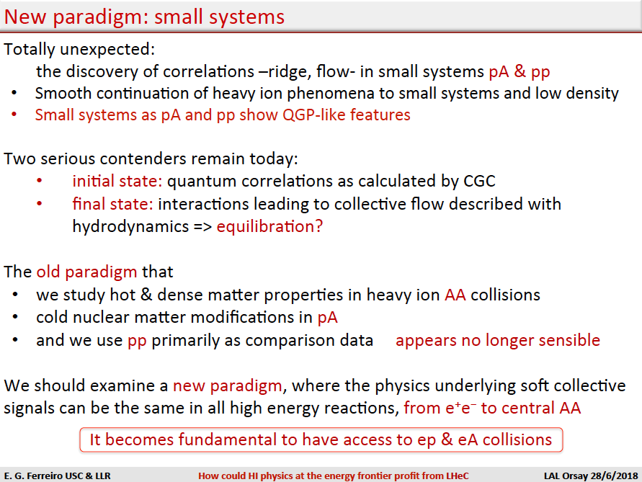
title
Joint eA/ep and pp/pA/AA physics in a
common apparatus is probably an ideal
for new heavy ion physics to very high precision.
A common/dual/joint - you name it-
experiment would have unprecedented
reach into physics
AA
from low p_{T}, to quarkonia + hard scales
eA
DIS extended by 3-4 orders of magnitude.
Invites new and further thinking, and to
carefully evaluate gains and drawbacks
of such an enterprise.

Slide 20
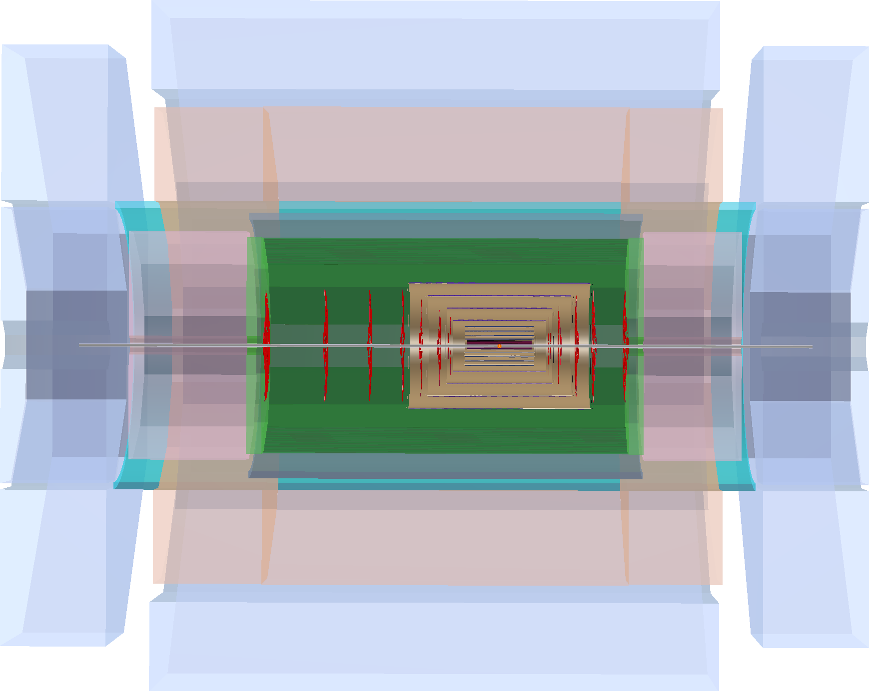
Overlay ALICE_Tracker - LHeC Detector (in scale)
p/A
e⁻
p/A
pp/AA vertex
at +180cm
nominal LHC beam setup

Slide 21
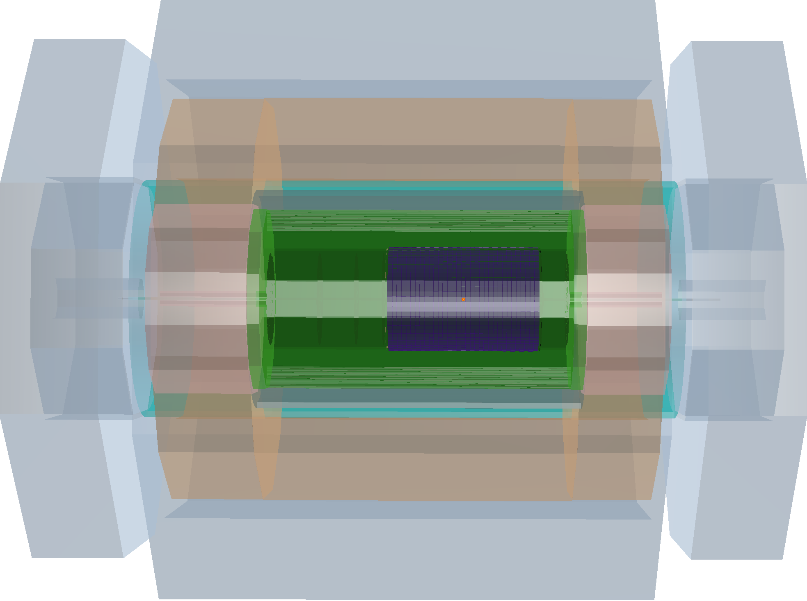
All Numbers [cm]
1315
LHeC detector
with
integrated A3
548
Muon Detector
380
HCAL-
Endcap-Fwd
619
HCAL-
Endcap-Bwd
HCAL-Barrel
148
172
148
Dipole
Dipole
230
Solenoid
170
EMC-Barrel
40
130
100
Tracker Fwd
Tracker
Tracker
Bwd
e⁻
p/A
p/A
FHC-Plug-Fwd
BHC-Plug -Bwd
186
23
154
23
FEC-Plug-Fwd
BEC.-Plug-Bwd
Increase of
radii, tracker to 1m,
may reduce B to 1.3T
for same resolution
Overall detector just
fits in L3 support
R_{free}(L3)=560 cm
Vertex positions: see below
Backward calos
then symmetric
with fwd calos
Work in progress
P.Kostka et al.

Slide 22
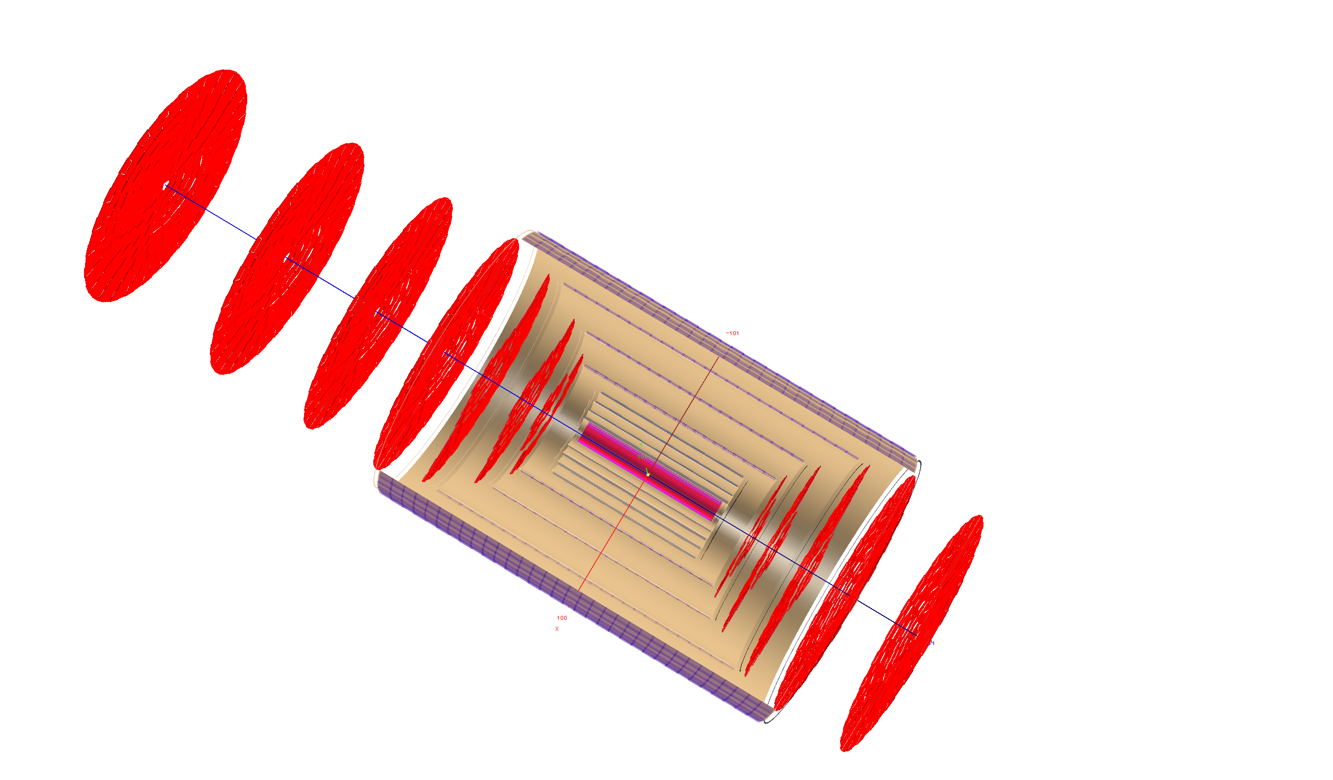
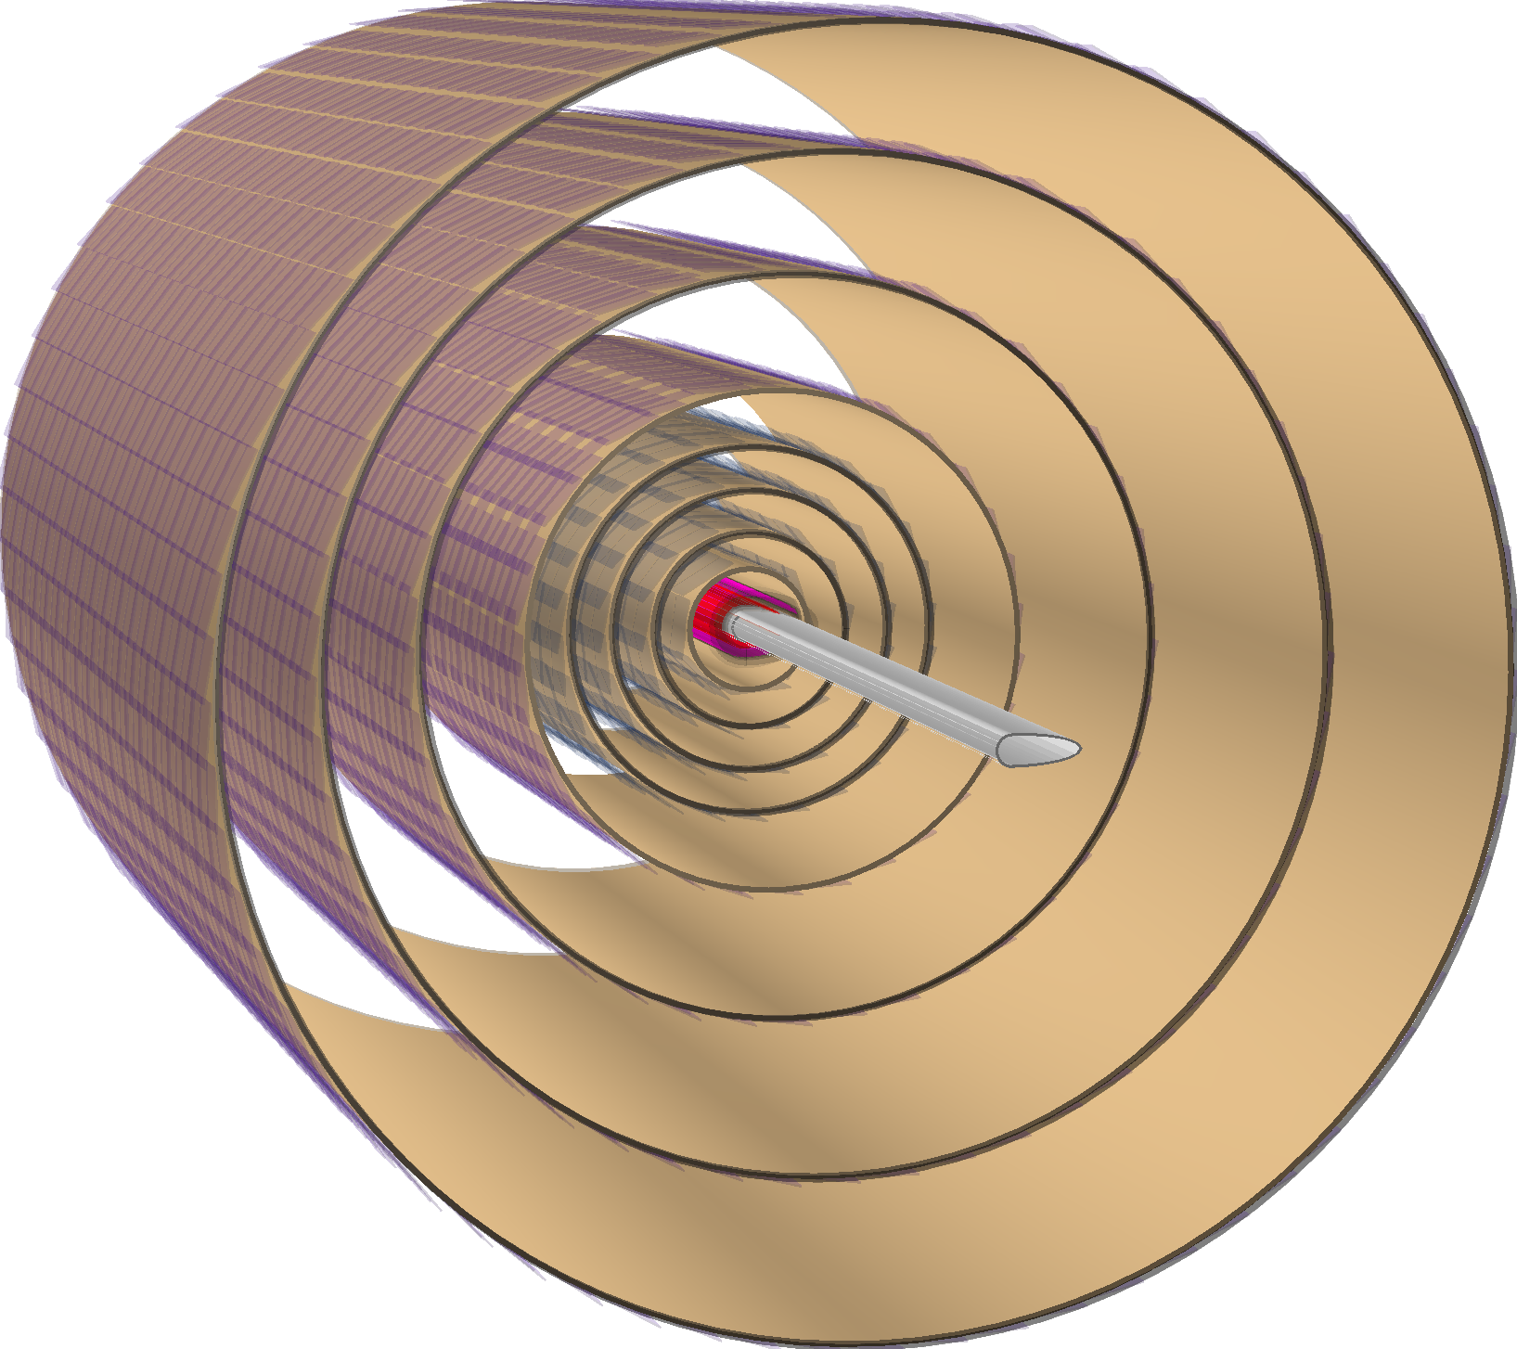
Possible Arrangement for a combined A3 - LHeC Tracker
NOT OPTIMISED
strip-
4layers
macro
pixel - 4layers
length
294 cm
pixel - 2layers
Various Questions:
- Low or HV CMOS
- Thickness, radiation hardness
(note ep: below 10¹⁵cm²n eq.
no pile-up in ep, .. → maybe low)
- Detectors in Vacuum? Elliptic ep pipe ☹
- Bent wafers?
- Same vertex or 1.87 apart? Cost
- …
radius
100 cm

Slide 23
Questions and Tentative Comments on Merger
Initial thoughts and questions: LHeC Meeting 29.10. and tentative answers 23.11.20
First derived questions:
Can we generate luminosity at 0 and +1.8m for pp/AA and ep/eA, respectively? yes, time needed sharing
How does LHeC detector change if we integrate A3 into LHeC extension in radius, B reduced, low V CMOS, ..
How would A3 detector change? Would it profit from the ep detector environment?
Muons, calorimetry? Better answered with A3 insight, one would expect this leads to a hard scale program
How does the physics potential change? eA programme at TeV scales. LHeC is most powerful EIC one can build
Detailed Questions
- Magnetic fields: solenoid: if we go to half our value, and enlarge the radius by 2, we gain factor 2 resolution ok
Dipole: the dipole (and solenoid) would move further out, any problem? Rather not. Note low material magnets
Choice of Silicon technology for IT, are we compatible with them? Probably yes. low V CMOS probably ok for LHeC
Readout and Trigger: speed, data volume, 2 trigger and r/o branches or 1 etc. To be studied
For their design the extended ep beam pipe is a nuisance (as it is for ours) --> place Si inside pipe??? challenging
There are many more..
→ It indeed seems feasible to combine the two detectors and IR concepts (further machine studies ongoing)

Slide 24
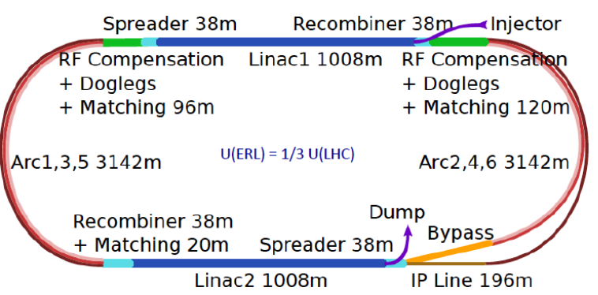
Concluding Remarks
This is indeed affordable - O(1) billion CHF for another TeV collider
It sustains the HL-LHC and exploits this massive O(5) BCHF investment
Physics: Unique: Microscope of substructure (not resolved!), empowers
LHC searches and Higgs measurements challenging e⁺e⁻, Discovery
in electroweak and strong i.a. sector, Revolution of HI physics
Technology: Accelerator: highest energy ERL application - green.
Detector: exciting place for new technology (CMOS, timing,
thin calo.. etc) in classic DIS, low radiation environment, no pileup.
Exciting place also for known technology to reappear and work.
Merging LHeC with A3 resolves conceptual conflict on IP2 and
promises to lead to new chapter of HI and accelerator physics (tentative)
Next steps: PERLE facility at Orsay, considerations for a detector
proposal to LHCC, embedded and subject to CERN’s future,
which is also related to that of the CEPC.
The LHeC group believes that diversity (at the energy frontier too) is
key to help particle physics theory to restore its predictive power..

Slide 25
backup

Slide 26
The ERL in more Detail
←
- LHeC Configuration reduced from 60 to 50 GeV.
- LINAC: 112 cryomodules with 4 cavities each
→ Total number of cavities: 896 [ILC: O(10⁴)]
- Configuration may be staged with less RF
- Tunnel is small part of cost and better not
reduced further, synchrotron loss, upgrades..
- ERL reduces power to << GW and dumps at < GeV
→ novel, “green” accelerator technology
Positrons: 500pC is 3 10⁹e⁻/bunch → 20mA and 1.2 10¹⁷ e⁻/s
LHeC programme needs e⁻p predominantly (Higgs) and only
smaller e⁺p sample, ~fb⁻¹ → O(10¹⁵) e⁺/s, still demanding!

Slide 27
Machine Parameters and Operation - ep
arXiv:2007.14401
No pileup
For comparison, HERA I operated at 10³¹cm⁻²s⁻¹, and was upgraded by a factor of up to 4 for HERA II
The total luminosity delivered was 1 fb⁻¹ over a running period of 15 years, including shutdowns.
LHeC may operate at 20 x 1000 GeV² and ”repeat” all of HERA in a short running period.
The initial CDR considers a Ring-Ring ep collider as a back-up solution. May be revived for HE-LHC.

Slide 28
Machine Parameters - eA
arXiv:2007.14401
The LHeC and FCC-eh are the highest energy, most powerful electron-ion colliders the world may build.
Saturation, Parton Dynamics and Structure in Nuclei, Quarkonia, Jets, Tomography of p and Nuclei, ..

Slide 29
Optics for IP2
Dispersion
ALICE
LHC Optics – beta vs path
Separation bump (std LHC procedure)
Shift in time and vertical xing 140mrad
→ No showstopper for ep and AA
ALICE Luminosity Optics
*=10m
ALICE Luminosity Optics: IP2b=1.87m
B Holzer work in progress

Slide 30
Aperture Staggered Quadrupoles
♟
♟
Non-colliding beam

Slide 31
Aperture Half-Quadrupole
Non-colliding beam
♟
♟

Slide 32
Q1 and further Quadrupoles
Q2, Q3 desirably NOT Nb₃Sn but Nb-Ti as suggested by current experience
B Holzer, S Russenschuck
Aperture of Q1A needs study, when non-colliding p beam is kept in vacuum

Slide 33
Energy Recovery and Synergies
Technical Synergies of LHeC with other applications
SAPPHIRE: a yy collider : Higgs, eweak and QCD machine
F. Zimmermann et al, arXiv:1208.2827
Racetrack as an injector into FCC-ee [direct into Z]
O. Bruening, Y. Papaphilippou
LHeC-FEL
F. Zimmermann et al, work in progress
Injector into FCC-hh
R. Calaga
Proposal of ERL Version of FCC-ee for high Lumi at high E_{e}
V Litvinenko, T Roser, M Chamizo-Llatas arXiv: 1909.04437
802 MHz technology: PERLE, FCC-ee, eSPS
F Marhauser, B Rimmer et al
704 MHz SPL Cryomodule (CERN) modified for PERLE
F Gerigk, E Jensen et al.
ALICE (Daresbury) Gun delivered to Orsay for PERLE
D Angal-Kalinin, B Militsyn et al
JLEIC Booster (Jlab) likely to be used in PERLE
F Hannon, B Rimmer et al
Forward Calorimetry: FCC-hh and ee colliders / CALICE..
Inner Tracker/CMOS: ee colliders, new HI detector at IP2
- ….
LHeC/FCC-eh: high luminosity, high energy
High ERL power facility P=I_{e} E_{e}
This is a programme for high quality SRF (Q₀ > 10¹⁰),
high current sources, and multiturn to reach high E_{e}
Future/current ERL developments: distribution of emphasis
- CBETA: high current, single turn - for e cooler (EIC)
- MESA: polarised beam - for new PV asymmetry exp.
- CEBAF: few GeV energy - for study of syn. radiation
- PERLE: high current, multiturn - for exp’s and future
Plans: Daresbury, Darmstadt, Berlin. Revival of KEK ERL
normal conducting ERL machine at BINP
Coordination: Lab Director Group (A Stocchi IJClab for ERL)
European Accelerator R+D Roadmap: CERN council 9/21
ERL Network. ERL workshop series
MK: Slide from October 20

Slide 34
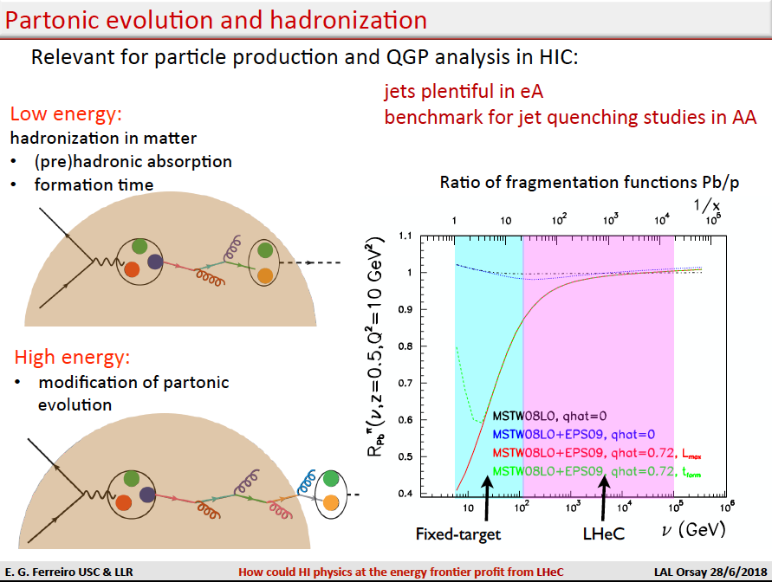
Physics at LHeC as an EIC

Slide 35
Heavy Flavour – Strange in ePb - from CC
x=0.00005
x=0.05
Max Klein nPDFs with LHeC 10.9.2015 POETIC a PARIS

Slide 36
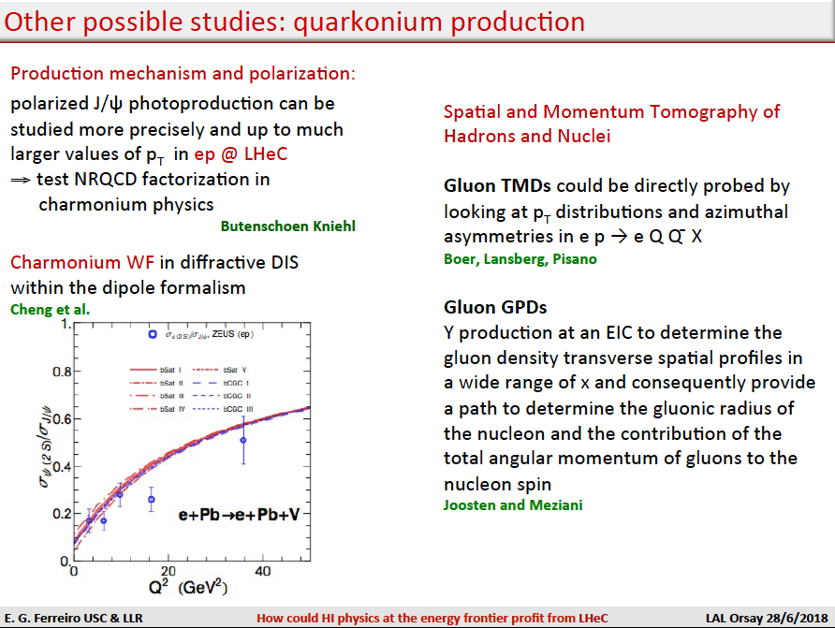
Physics at LHeC as an EIC

Slide 37
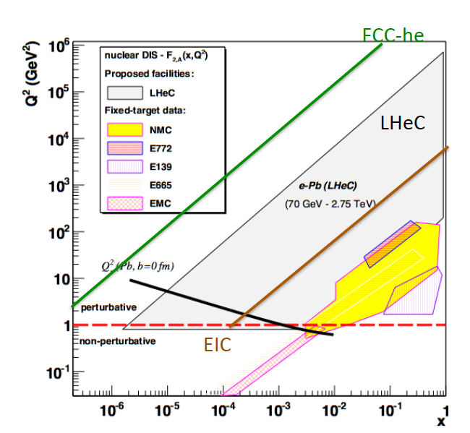
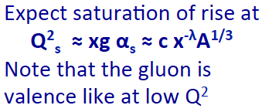
Kinematic Ranges of lA DIS – Past and Future
HERA missed the
electron-ion phase.
No deuterons either.
cf HERA3 in 2001..
Note that LHeC may be
tuned to low energies
√s ≈ 100 GeV instead of
1 TeV – direct overlap
EICs and HERA.
FCC-eh: highest Q², 1/x
Luminosity: crucial for efficient operation, to access rare channels and high x, and Q²
15 years of HERA luminosity collection may shrink to a few days (ATLAS now up to 1fb⁻¹/day)

