Slide 1




The LHeC – Science and Status
Introduction
Five Themes
Important Steps
LHeC:
E_{e}=60 GeV
E_{p}= 7 TeV
For references,
please consult
lhec.web.cern.ch
LHeC CDR
arXiv:1206.2913
J.Phys. G39 (2012) 075001
Max Klein
University of Liverpool
for the LHeC+FCC-eh Study Group
FCC_eh:
E_{e} =60 GeV
E_{p} =50 TeV
HE LHC:
E_{p}=12.5 TeV
DIS Workshop at Birmingham, 7th of April 2017

Slide 2

Road beyond Standard Model
Next decades
Rolf Heuer at
Aix Les Bains
1. 10. 2013
LHC results vital to guide the way at the energy frontier
At the energy frontier through synergy of
hadron - hadron colliders (LHC, (V)HE-LHC?)
lepton - hadron colliders (LHeC ??)
lepton - lepton colliders (LC (ILC or CLIC) ?)

Slide 3
Framework of the Development
Following the CDR in 2012: Mandate issued by CERN:2014 (RH), confirmed in 2016 (FG)
Mandate to the International Advisory Committee
Advice to the LHeC Coordination Group and the CERN directorate by following the
development of options of an ep/eA collider at the LHC and at FCC, especially with:
Provision of scientific and technical direction for the physics potential of the ep/eA
collider, both at LHC and at FCC, as a function of the machine parameters and of a
realistic detector design, as well as for the design and possible approval of an ERL
test facility at CERN.
Assistance in building the international case for the accelerator and detector
developments as well as guidance to the resource, infrastructure and science
policy aspects of the ep/eA collider.
Chair: Herwig Schopper, em. DG of CERN
LHeC has been a development for and initiated by ECFA and NuPECC

Slide 4
Organisation^{*)}
Working Groups
International Advisory Committee
“..Direction for ep/A both at LHC+FCC”
PDFs, QCD
Fred Olness,
Voica Radescu
Higgs
Uta Klein,
Masahiro Kuze
BSM
Georges Azuelos,
Monica D’Onofrio
Top
Olaf Behnke,
Christian Schwanenberger
eA Physics
Nestor Armesto
Small x
Paul Newman,
Anna Stasto
Detector
Alessandro Polini
Peter Kostka
Coordination Group
Accelerator+Detector+Physics
Sergio Bertolucci (CERN/Bologna)
Nichola Bianchi (Frascati)
Frederick Bordry (CERN)
Stan Brodsky (SLAC)
Hesheng Chen (IHEP Beijing)
Eckhard Elsen (CERN)
Andrew Hutton (Jefferson Lab)
Young-Kee Kim (Chicago)
Victor A Matveev (JINR Dubna)
Shin-Ichi Kurokawa (Tsukuba)
Leandro Nisati (Rome)
Leonid Rivkin (Lausanne)
Herwig Schopper (CERN) – Chair
Jurgen Schukraft (CERN)
Achille Stocchi (LAL Orsay)
John Womersley (ESS)
Nestor Armesto
Oliver Brüning – Co-Chair
Stefano Forte
Andrea Gaddi
Erk Jensen
Max Klein – Co-Chair
Peter Kostka
Bruce Mellado
Paul Newman
Daniel Schulte
Frank Zimmermann
5(11) are members of the
FCC coordination team
OB+MK: FCC-eh responsibles
MDO: physics co-convenor
We miss Guido Altarelli.
*)February 2017

Slide 5
Five Major Themes of LHeC PHysics
The Cleanest High Resolution Microscope of the World
The Electron Beam Upgrade of the LHC
The First High Precision Higgs Facility
Discovery Beyond the Standard Model
A Unique Nuclear Physics Facility

Slide 6
Five Major Themes of LHeC PHysics
The Cleanest High Resolution Microscope of the World
The Electron Beam Upgrade of the LHC
The First High Precision Higgs Facility
Discovery Beyond the Standard Model
A Unique Nuclear Physics Facility

Slide 7
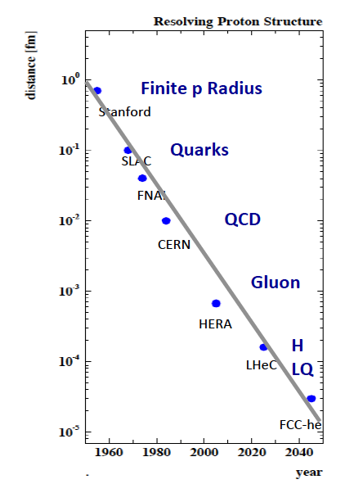
Microscope
Resolve with spectacular range (each high
energy ep collider probes range down to
SLAC’s 0.1fm as Q² varies) and precision:
Structure and Dynamics of
Proton, neutron, photon, pomeron, jets..
in Momentum and Transverse Space
PDFs, TMDs, DVCS, generalised PDFs, ..
presented in the LHeC CDR 1206.2913
Short version see arXiv:1211.4831
Can we continue the pass begun 60 years
ago for the coming decades?
Prospect and challenge:
5 orders of magnitude in 100 years

Slide 8
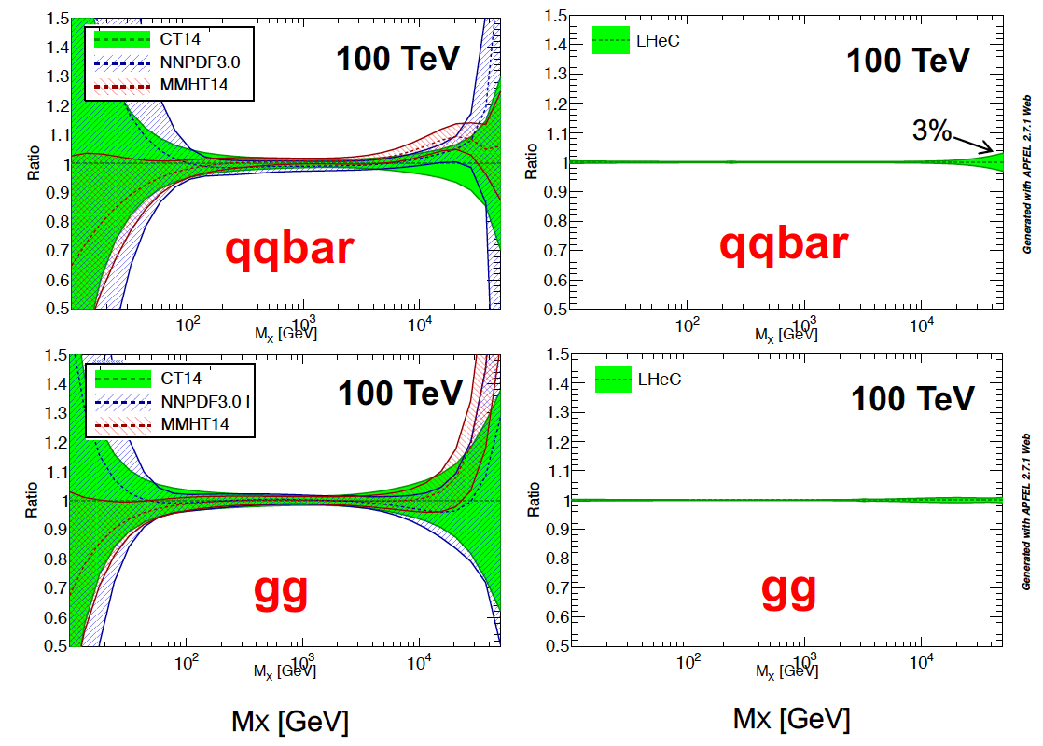
The LHeC PDF Programme
Resolve parton structure of the proton completely: u_{v},d_{v},s_{v}?,u,d,s,c,b,t and xg
Unprecedented range, sub% precision, free of parameterisation assumptions,
Resolve p structure, solve non linear and saturation issues, test QCD, N³LO…
Strong
Coupling in
inclusive
DIS at LHeC
to 0.1%
Lattice??
Jets??
BCDMS??
GUTs?
Higgs in pp
Note that LHC is about to reach its own limits on PDFs. pp is NOT DIS, cf ATLAS W,Z to 0.5%

Slide 9
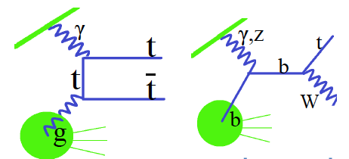
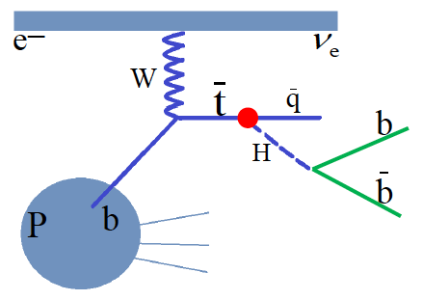
Top Physics
Top electric charge
EDM and MDM
Anomalous t-q-y and t-g-Z
V_{tb}
Top spin
W-t-b
Top PDF
Top mass
Top-Higgs (1602.04670)
CP nature of ttH (1702.03426)
Just started to fully see the huge potential of top physics in ep at high energies
Pair production Single production
FCNC top Higgs CC interaction

Slide 10
Five Major Themes of LHeC PHysics
The Cleanest High Resolution Microscope of the World
The Electron Beam Upgrade of the LHC
The First High Precision Higgs Facility
Discovery Beyond the Standard Model
A Unique Nuclear Physics Facility

Slide 11
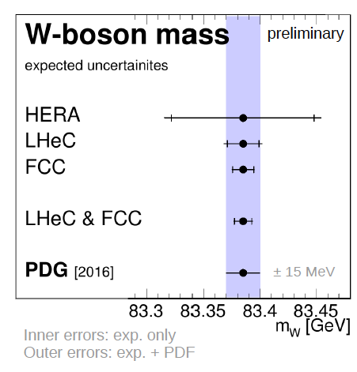
High Precision for the LHC
Spacelike M_{W} to 10 MeV from ep
→ Electroweak thy test at 0.01% !
Predict M_{W} in pp to 2.8 MeV →
Remove PDF uncertainty on M_{W} LHC
Predict the Higg cross section in pp to
0.2% precision which matches the M_{H}
measurement and removes the PDF error

Slide 12

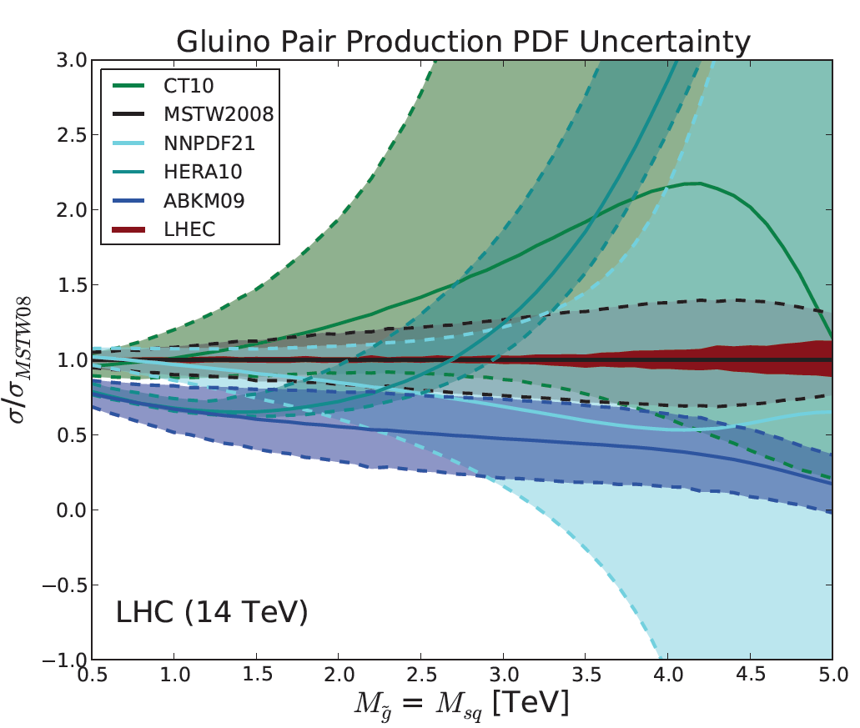
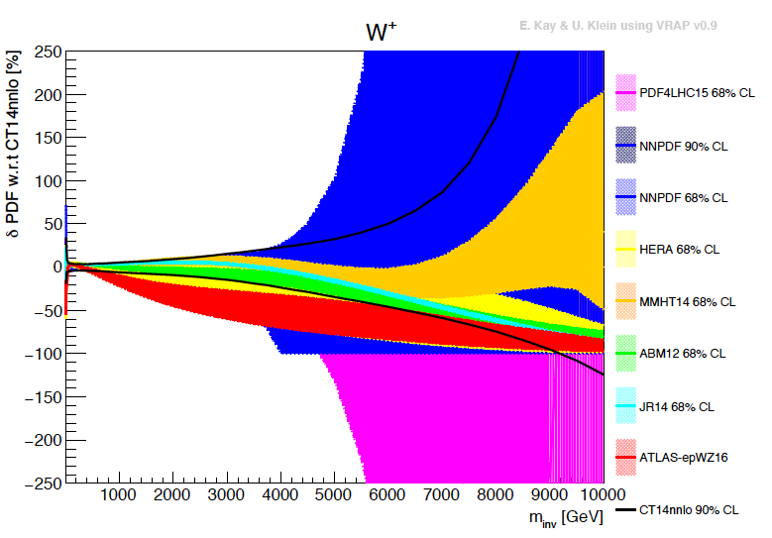
Search Range Extension - worth the Lumi Upgrade
External, reliable input (PDFs, factorisation..) is crucial for range extension + CI interpretation
GLUON
QUARKS
SUSY, RPC, RPV, LQS..
Exotic+ Extra boson searches at high mass

Slide 13
Five Major Themes of LHeC PHysics
The Cleanest High Resolution Microscope of the World
The Electron Beam Upgrade of the LHC
The First High Precision Higgs Facility
Discovery Beyond the Standard Model
A Unique Nuclear Physics Facility

Slide 14
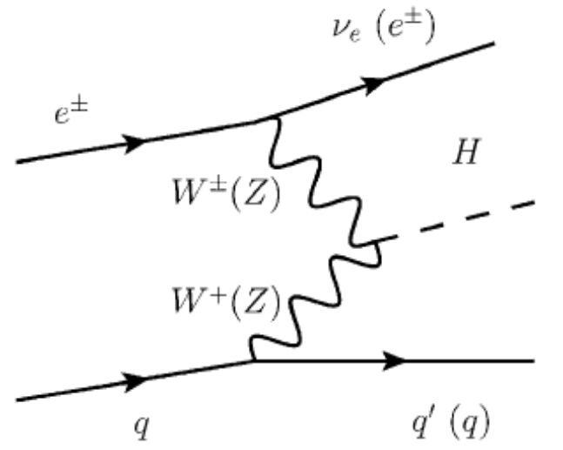
Higgs Physics with ep
κ in % | HL LHC | LHeC HL | LHeC HE | FCC-eh
H → bb | 10 | 0.5 | 0.3 | 0.2
H → cc | 50? | 4 | 2.8 | 1.8
Higgs is produced via an EW process in ep collisions
  No contamination from ggF and no pile-up
  Precise theoretical control of the cross-section
Superior sensitivity of ep with respect to pp in various aspects:
  h → bb,cc,tautau couplings, unique access to WW-H-WW
    Access to h → gg?
  Structure of hVV and top Yukawa couplings
Access to hh and invisible decays (dark matter) in ep collisions
Removal of QCD uncertainties to gg → H calculation for LHC
LHC can be transformed into a high precision Higgs facility.

Slide 15
Five Major Themes of LHeC PHysics
The Cleanest High Resolution Microscope of the World
The Electron Beam Upgrade of the LHC
The First High Precision Higgs Facility
Discovery Beyond the Standard Model
A Unique Nuclear Physics Facility

Slide 16
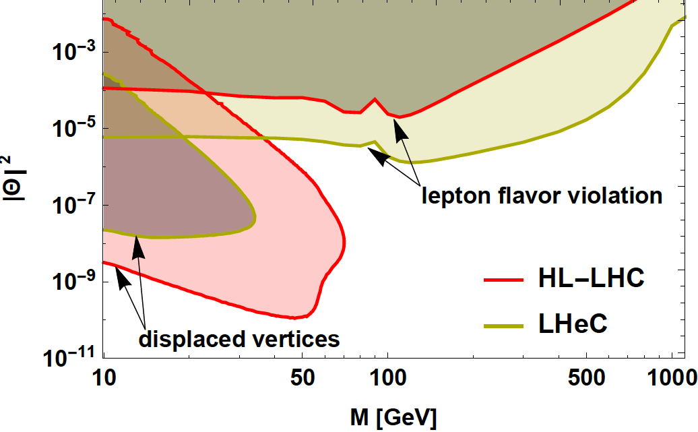
Possible Discoveries Beyond SM with LHeC
QCD:
No saturation
BFKL
Instantons
Higher symmetry embedding QCD
Electroweak:
EFTs
Exotic Higgs Decays
Extension of Higgs Sector
Sterile Neutrinos …
Search for Sterile Neutrinos (LHC LHeC)
It is a wasted p that does NOT collide with an e beam
(Oliver Fischer - 2017)
It would be a waste not to exploit the 7 TeV beams for ep and eA physics at some
stage during the LHC time (Guido Altarelli – 2008)

Slide 17
Five Major Themes of LHeC PHysics
The Cleanest High Resolution Microscope of the World
The Electron Beam Upgrade of the LHC
The First Higgs and Top Precision Facility
Discovery Beyond the Standard Model
A Unique Nuclear Physics Facility

Slide 18
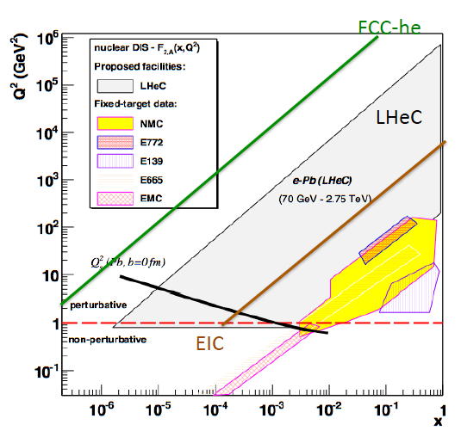
Electron-Ion Nuclear and Particle Physics
Extension of kinematic range in lA
by 4 orders of magnitude:
will change QCD view on nuclear
structure and parton dynamics
May lead to genuine surprises…
No saturation of xg (x,Q²) ?
Small fraction of diffraction ?
Broken isospin invariance ?
Flavour dependent shadowing ?
Relates to LHC Heavy Ion Physics
- Quark Gluon Plasma
- Collectivity of small nuclei (p)?
..
Saturation: needs large xg at small x
ep and eA

Slide 19
Design and Preparations

Slide 20
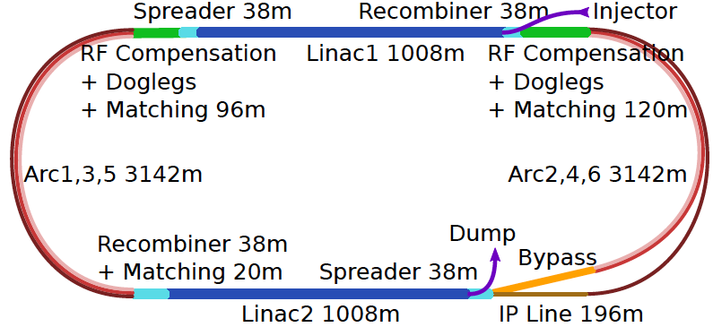
LHeC ERL Baseline Design
Concurrent operation to pp, LHC becomes a 3 beam faclity. P < 100 MW. CW

Slide 21
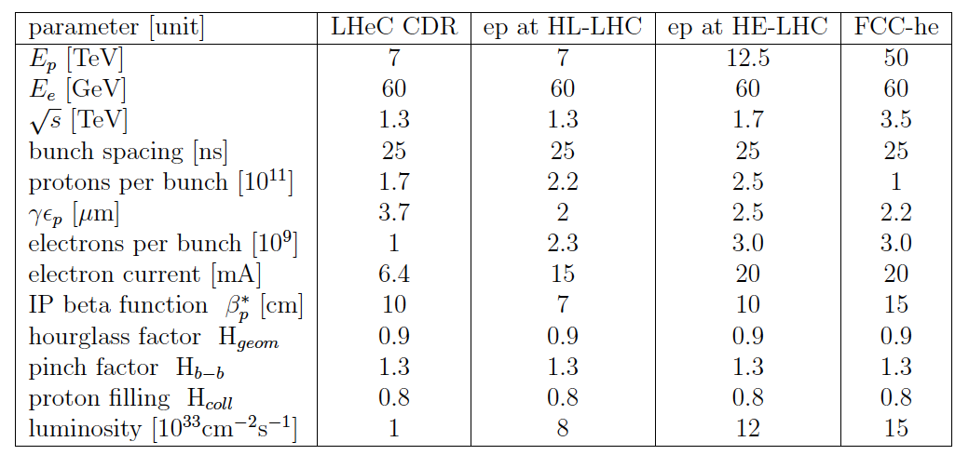
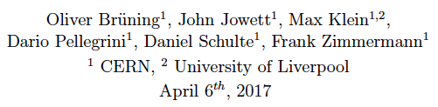
Luminosity for LHeC, HE-LHeC and FCC

Slide 22
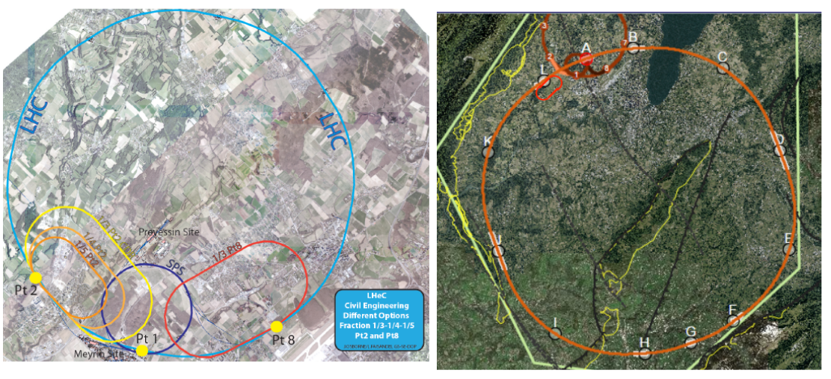
Location + Footprint of the electron ERL
LHC
FCC
A 9km ERL is a small add-on for the FCC
Doubling the energy to 120 GeV hugely
Increases cost and effort.
Energy – Cost – Physics – Footprint
are being reinvestigated

Slide 23
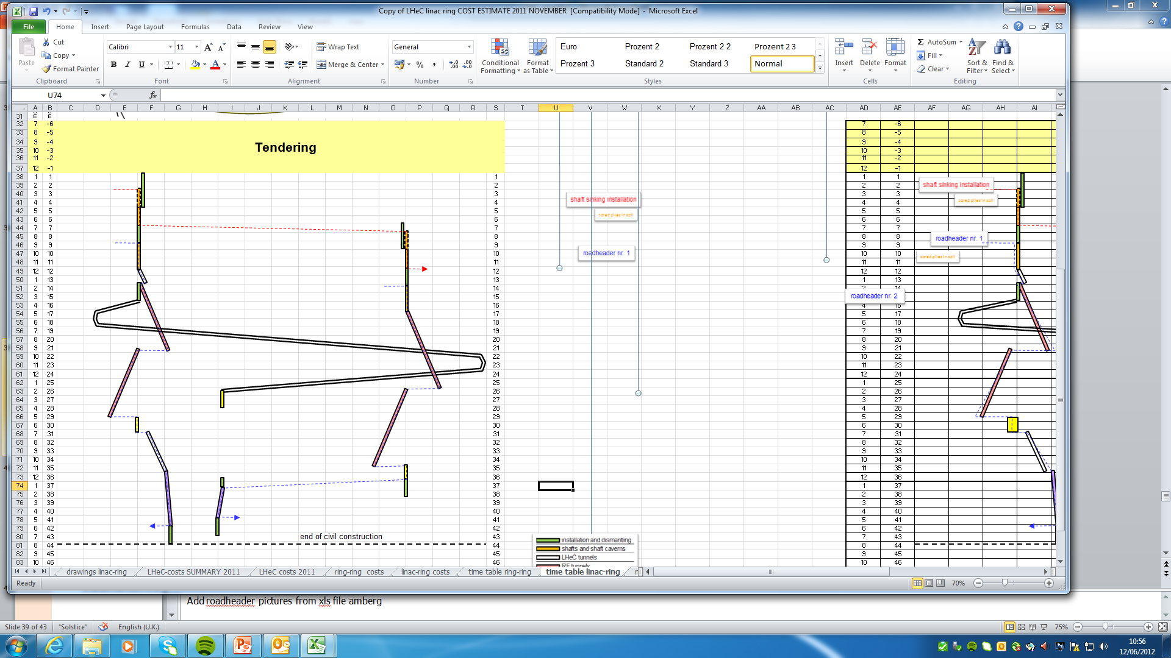
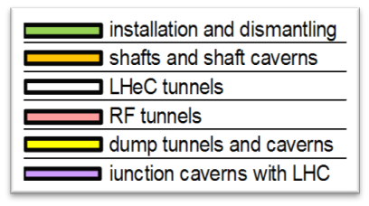
Civil Engineering – full design made
Shaft sinking installation
Roadheader 1
CDR: Evaluation of CE, analysis
of ring and linac by Amber Zurich
with detailed cost estimate
[linac CE: 249,928 kSF..] and time:
3.5 years for underground works using 2 roadheaders and 1 TBM
More studies needed for
Integration with all services
(EL,CV, transport, survey etc).
Geology
Understanding vibration risks
Environmental impact assessment
Tunnel connection in IP2
Roadheader 2
J.Osborne et al.

Slide 24
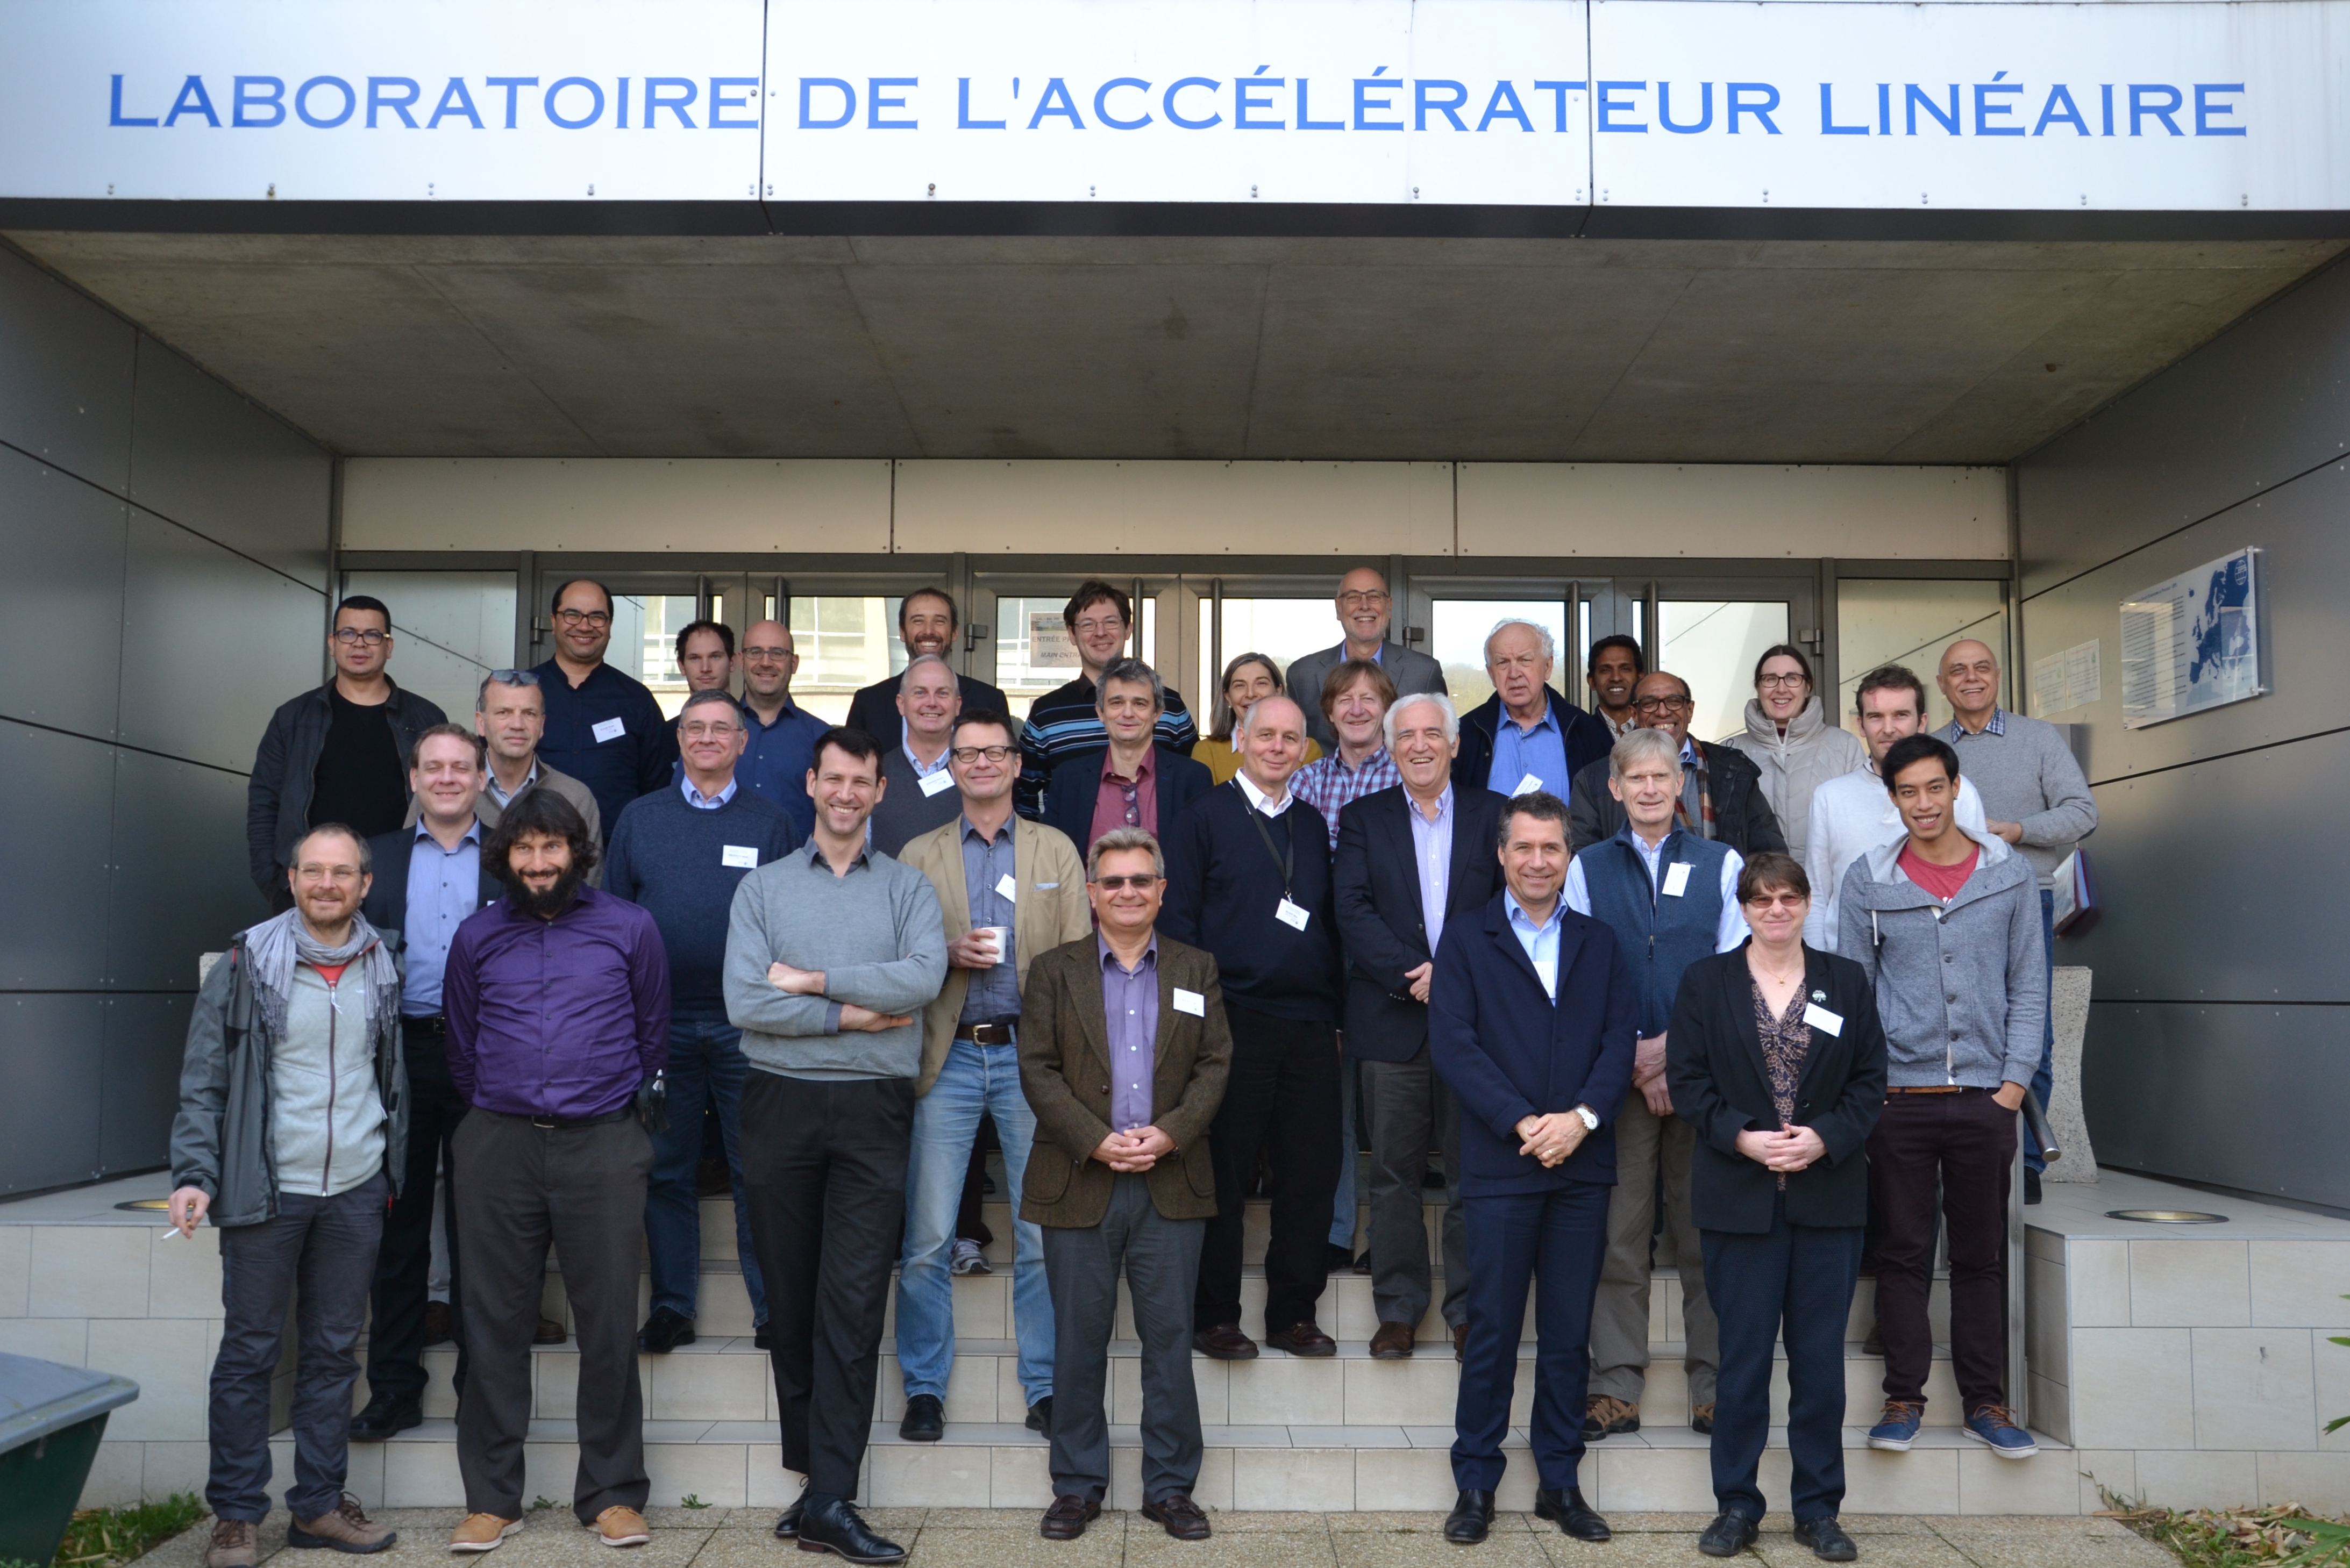
The LHeC – Science + Status
PERLE TDR Kickoff Meeting, Orsay, February 22-24, 2017. PERLE CDR subm to JPhysG

Slide 25
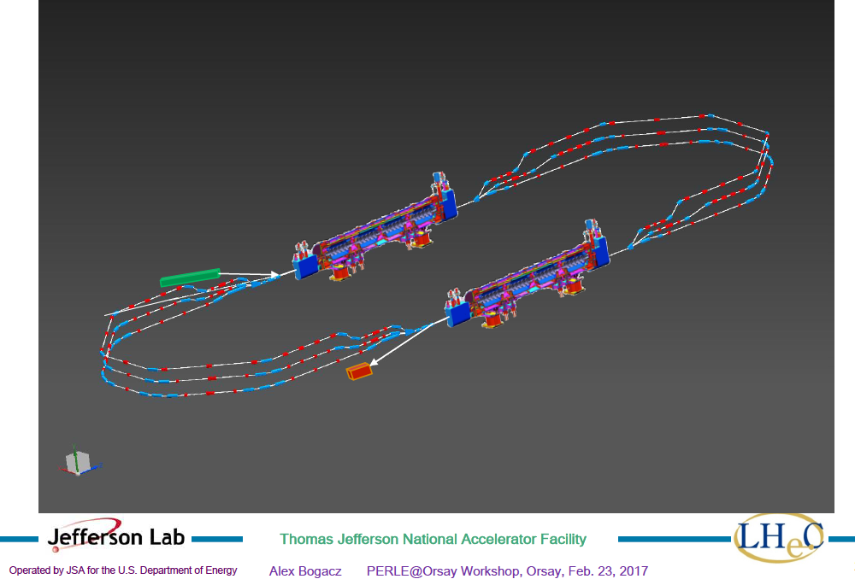
title
Powerful ERL for Experiments (ep.yp): PERLE at Orsay
PERLE at Orsay: New Collaboration: BINP, CERN, Daresbury/Liverpool, Jlab, Orsay +
CDR publication imminent.
3 turns, 2 Linacs, 15mA, 802 MHz ERL facility
-Demonstrator of LHeC
-Technology (SCRF) Development Facility
-Low E electron and photon beam physics
-High intensity: 100 x ELI
See https://indico.lal.in2p3.fr/event/3428/

Slide 26
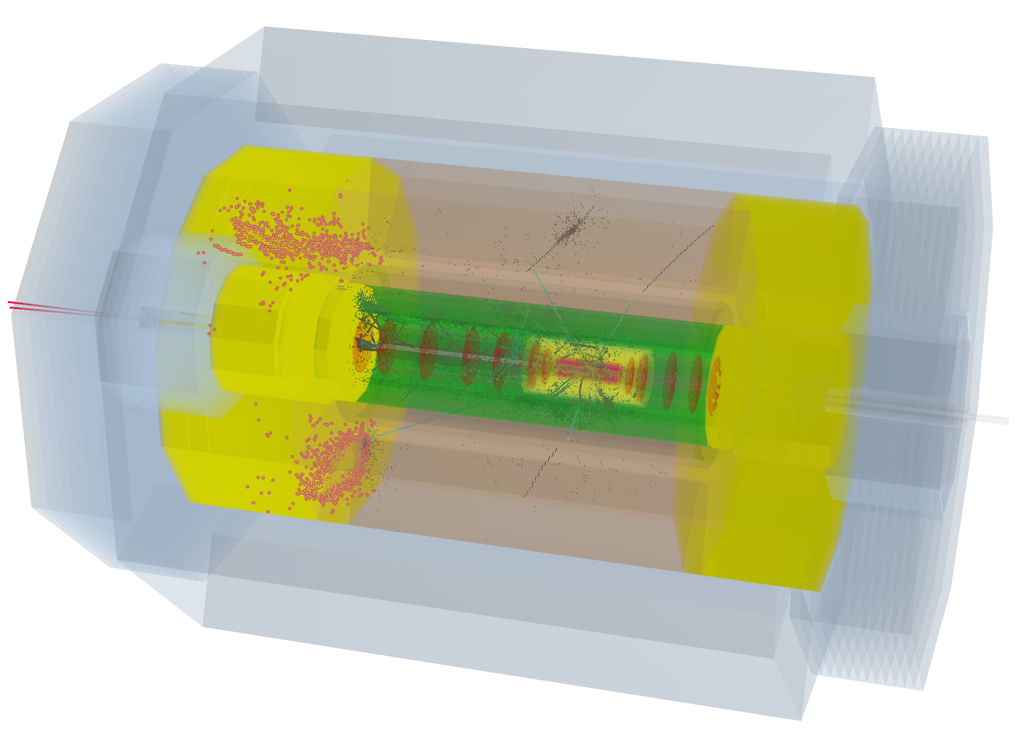
H→ bb in LHeC Detector

Slide 27
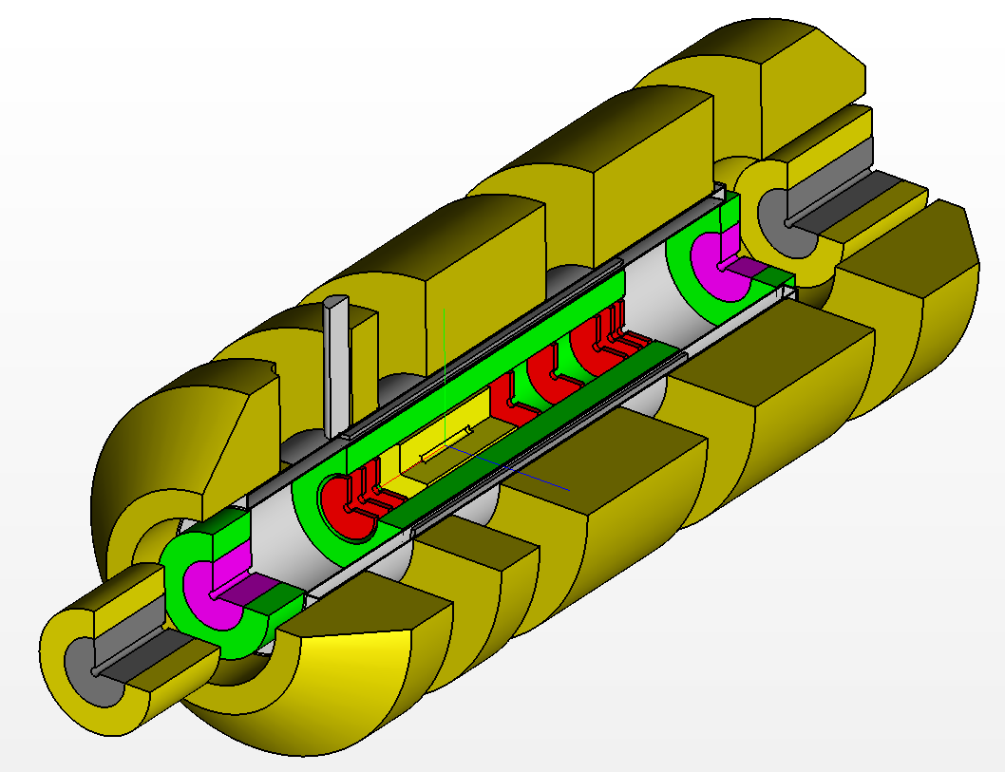
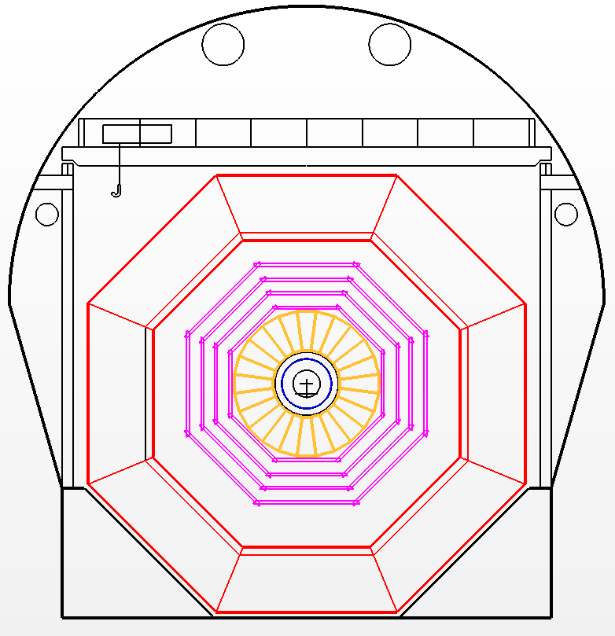
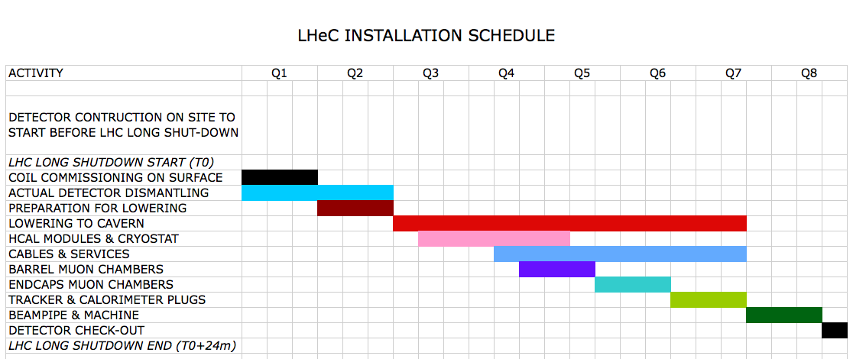
Installation Study
2 years (in LS4)
Detector fits in L3 magnet support
Modular structure

Slide 28
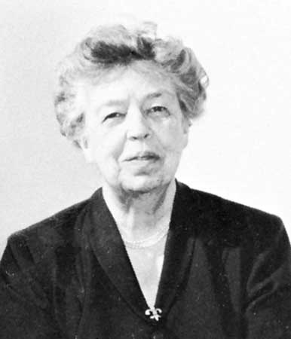
“The future belongs to those who believe in the beauty of their dreams.”
Anna Eleanor Roosevelt
(1884-1962)
Universal Declaration of Human Rights (1948)
cited by Frank Zimmermann at the FCC Meeting at Washington DC, March 2015

Slide 29
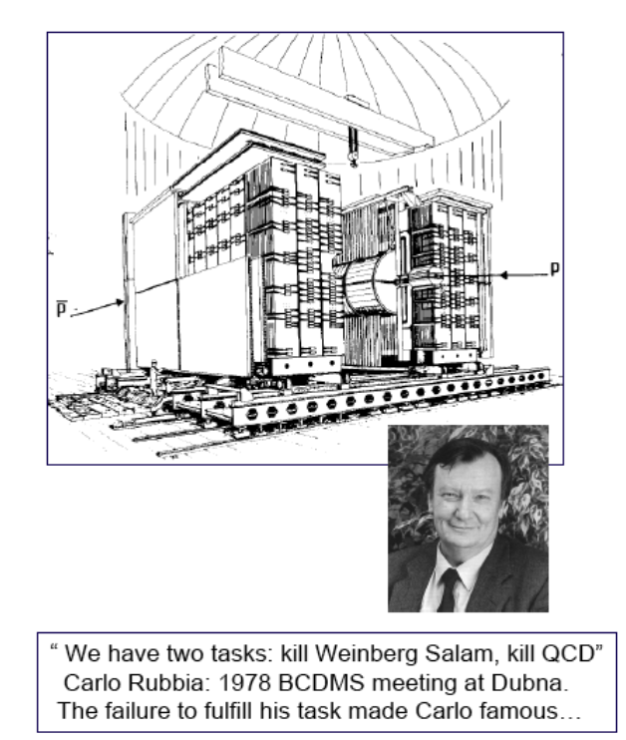
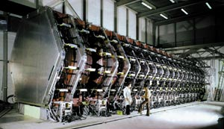
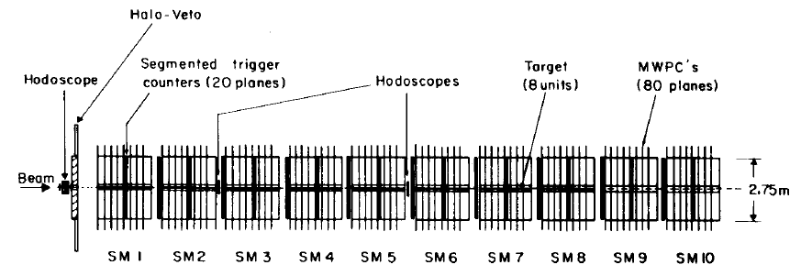

CERN can do pp and lp: in the 80ies it successfully did
Charged Currents
BEBC, CDHS(W), CHARM, CHORUS
UA1
Neutral Currents
UA2
Pierre Darriulat
now in Vietnam
BCDMS, EMC, SMC, COMPASS

Slide 30
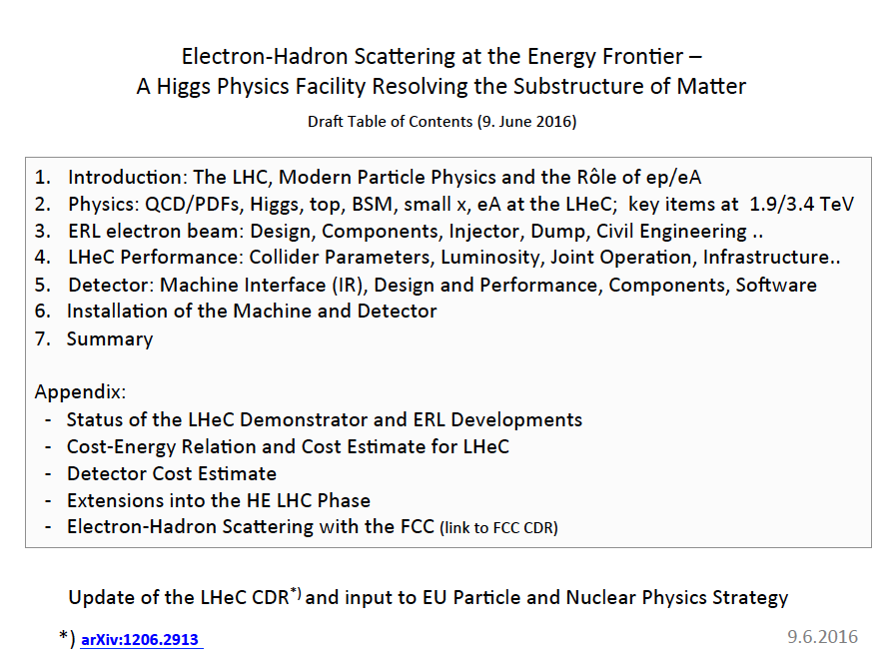
backup
In agreement with DG we
Work on an update of the
LHeC CDR as input to Euro
Strategy. We find it is worth
it the deeper we look.
We’d be glad to have many
of you with us.

Slide 31
The LHeC – Science + Status

