Slide 1
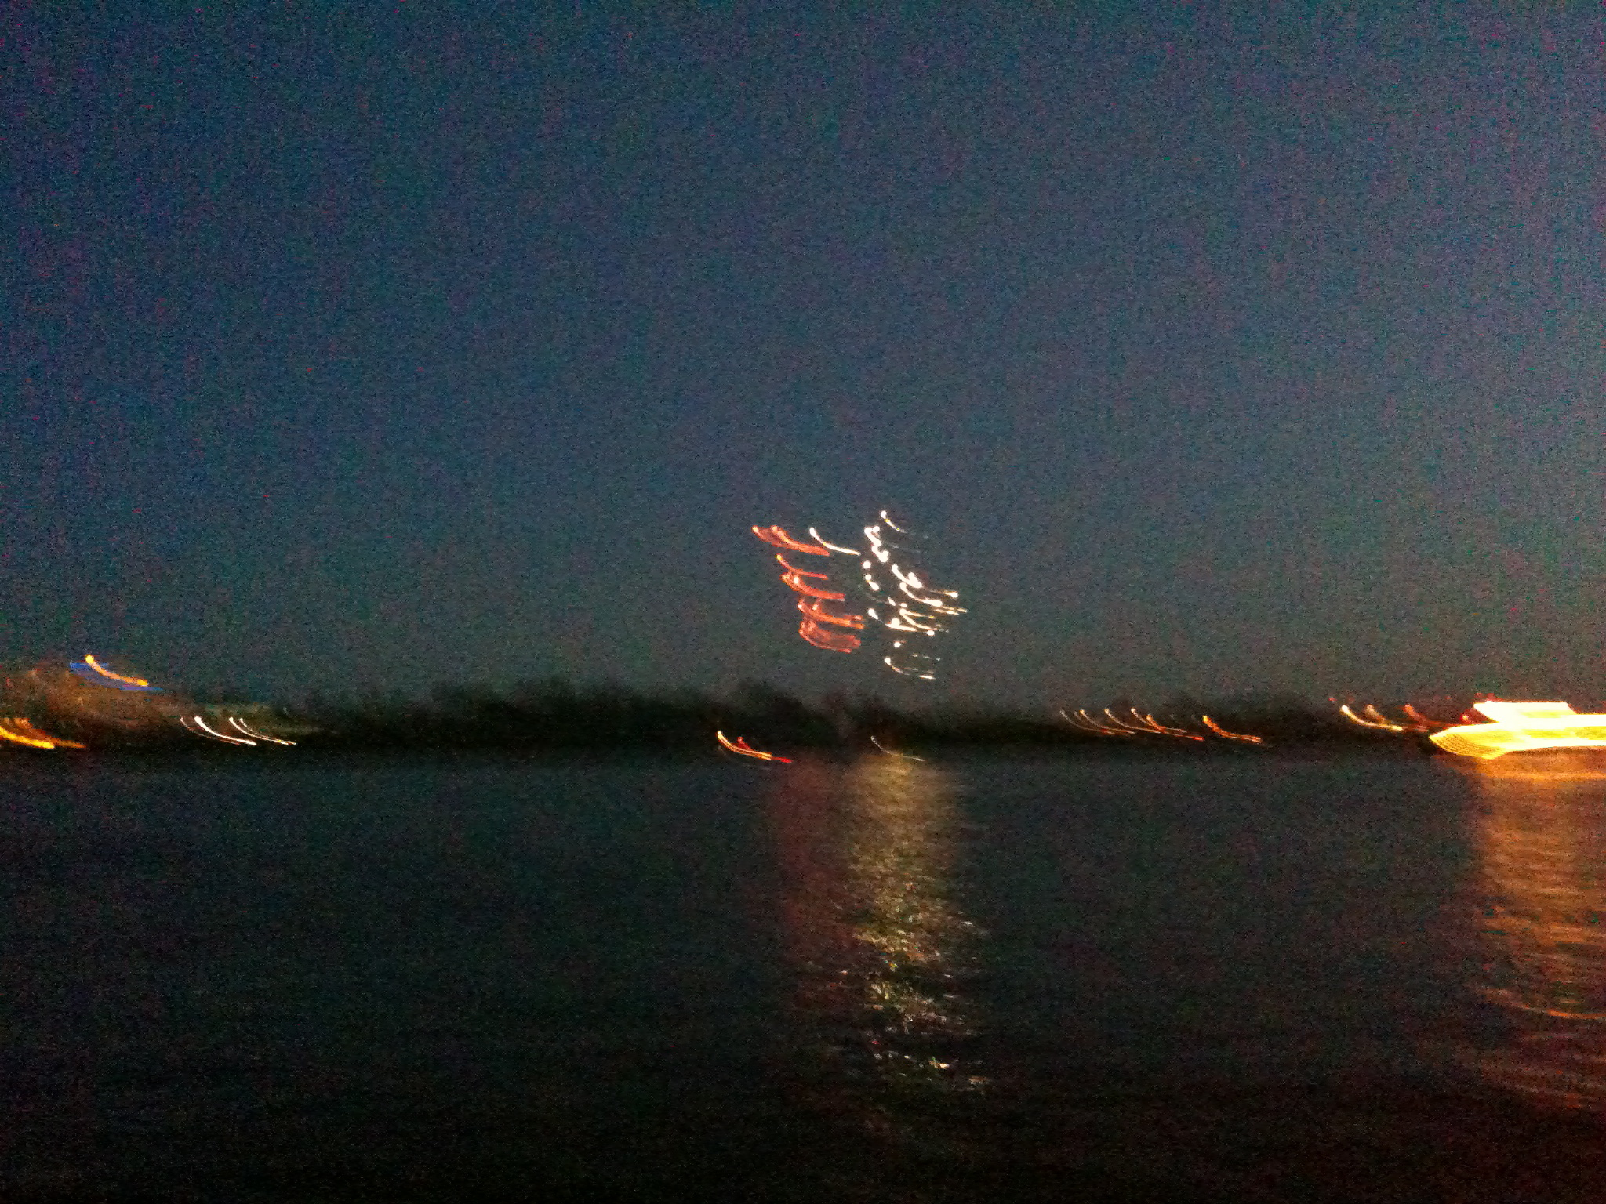
Title
LHC: Overview and Outlook
LHC Status
Results on QCD at the LHC
HL LHC, Partons, Precision
Future Higgs
LHeC Development
Remarks
Max Klein, University of Liverpool
Introduction of/to QCD@LHC, DESY, 2.9.2013
Elbe Fireworks in May 2009

Slide 2
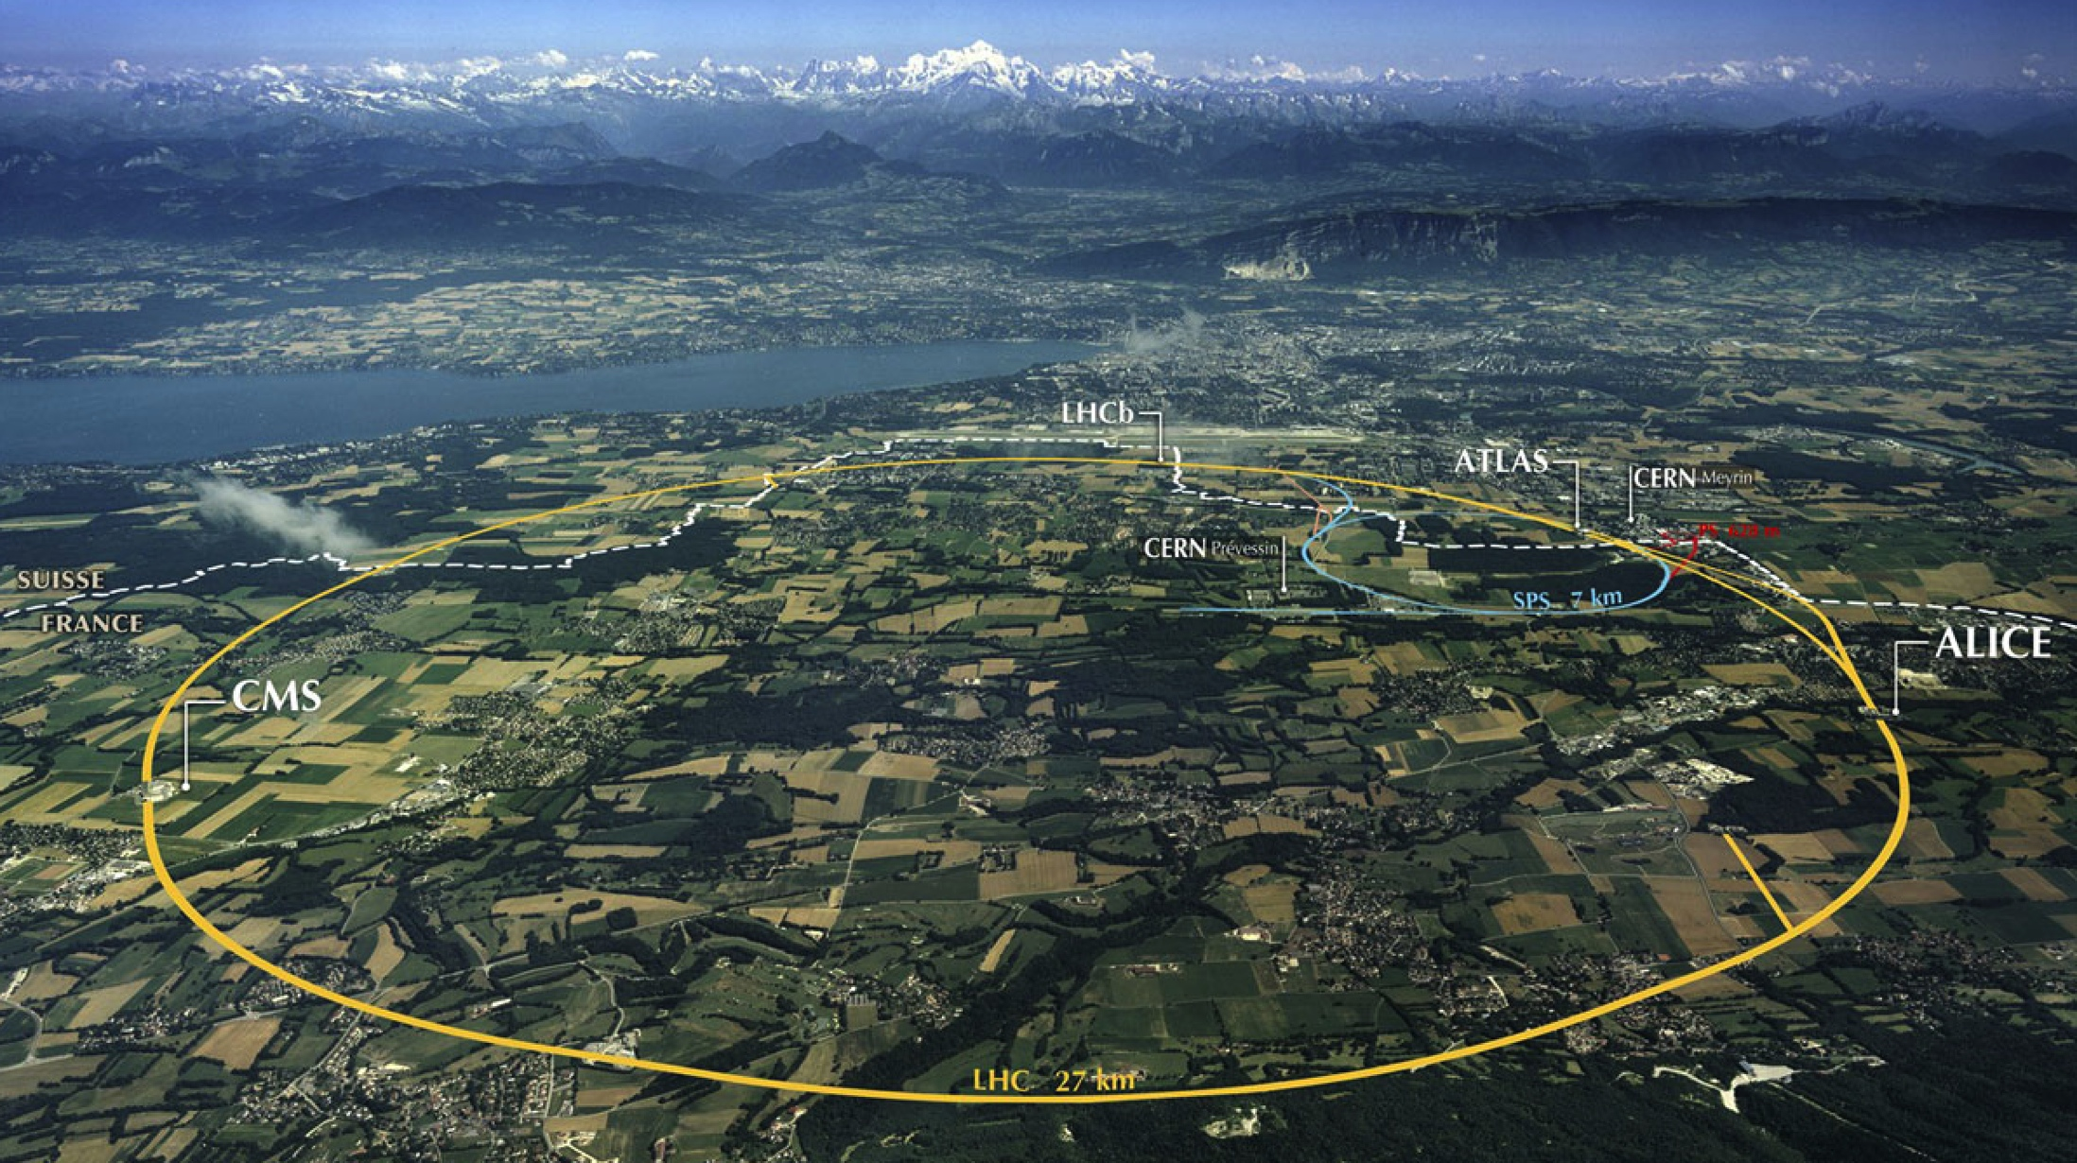
LHC: 27km, cold, high energy
Collimation
Injection B2
Beam dumps
Injection B1
Collimation
RF
1720 Power converters
> 9000 magnetic elements
7568 Quench detection systems
1088 Beam position monitors
~4000 Beam loss monitors
150 tonnes Helium, ~90 tonnes at 1.9 K
140 MJ stored beam energy in 2012
450 MJ magnetic energy per sector at 4 TeV
M.Lamont, EPS13

Slide 3
Development of LHC 2010-2012
 | 2010 | 2011 | 2012 | Nominal
Bunch spacing [ns] | 150 | 50 | 50 | 25
No. of bunches | 368 | 1380 | 1380 | 2808
beta* [m] ATLAS and CMS | 3.5 | 1.0 | 0.6 | 0.55
Max bunch intensity [protons/bunch] | 1.2 x 10¹¹ | 1.45 x 10¹¹ | 1.7 x 10¹¹ | 1.15 x 10¹¹
Normalized emittance [mm.mrad] | ~2.0 | ~2.4 | ~2.5 | 3.75
Peak luminosity [cm⁻²s⁻¹] | 2.1 x 10³² | 3.7 x 10³³ | 7.7 x 10³³ | 1.0 x 10³⁴
O.Bruening at ATLAS US 7/13
Major success of CERN and the basis for the existence of modern particle physics

Slide 4
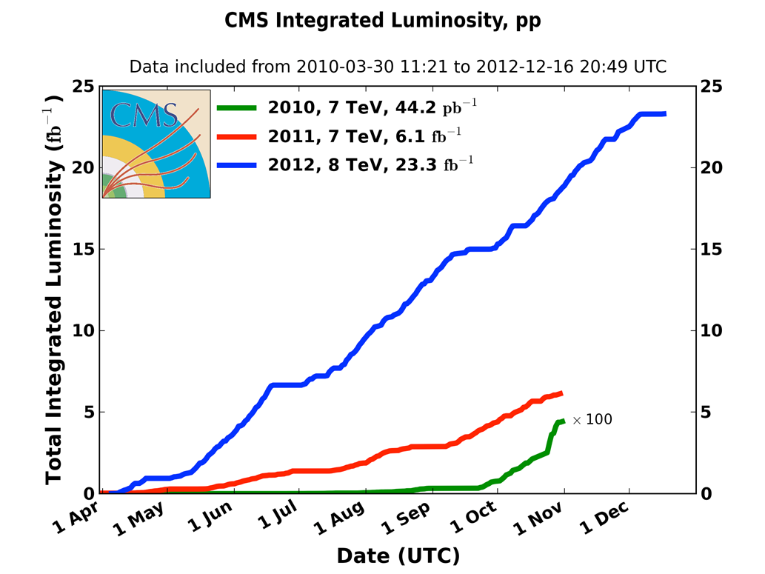
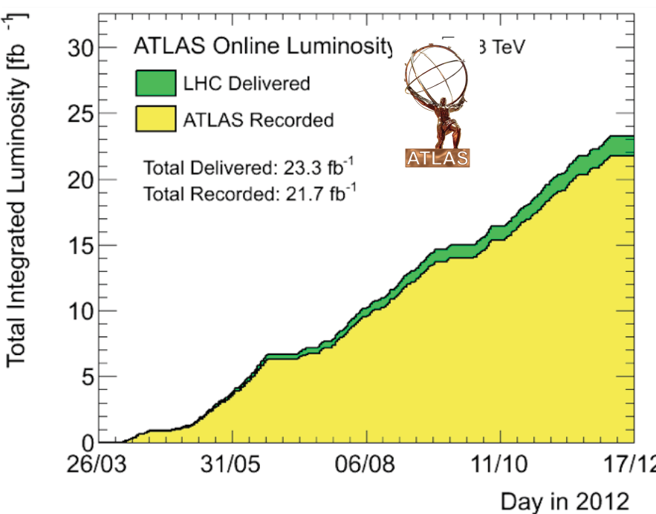
Accumulation of Luminosity
Outstanding efficiency for luminosity recording by the experiments.
Measured with beam scans and forward detectors to 2-4% precision!
4 TeV beam energy: 3988 +-5 +- 26 GeV → J.Wenninger CERN-ATS-2013-040

Slide 5
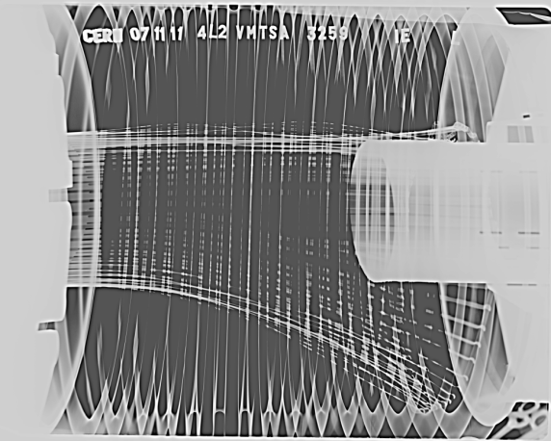
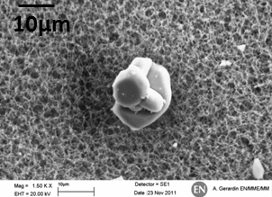
Smooth appearance of LHC …
UFOs
20 dumps in 2012
Timescale 50-200 µs
Conditioning observed
Worry about 6.5 TeV
Beam induced heating
Local non-conformities (design, installation)
Vacuum, RF fingers 7R7, August 2012.
not Au coated..
Al
A. Gerardin, N. Garrel
EDMS: 1162034
O
Blow up of emittance in LHC wrt injectors,
Impedance and beam stability
UFOs
Time for scrubbing – e cloud – 25ns?
Electronics away from radiation..
Spark discharges at injection kicker and arcs
Increase with E and reduced bunch spacing
New calibration of beam loss signals..
….owing to superb accelerator team

Slide 6
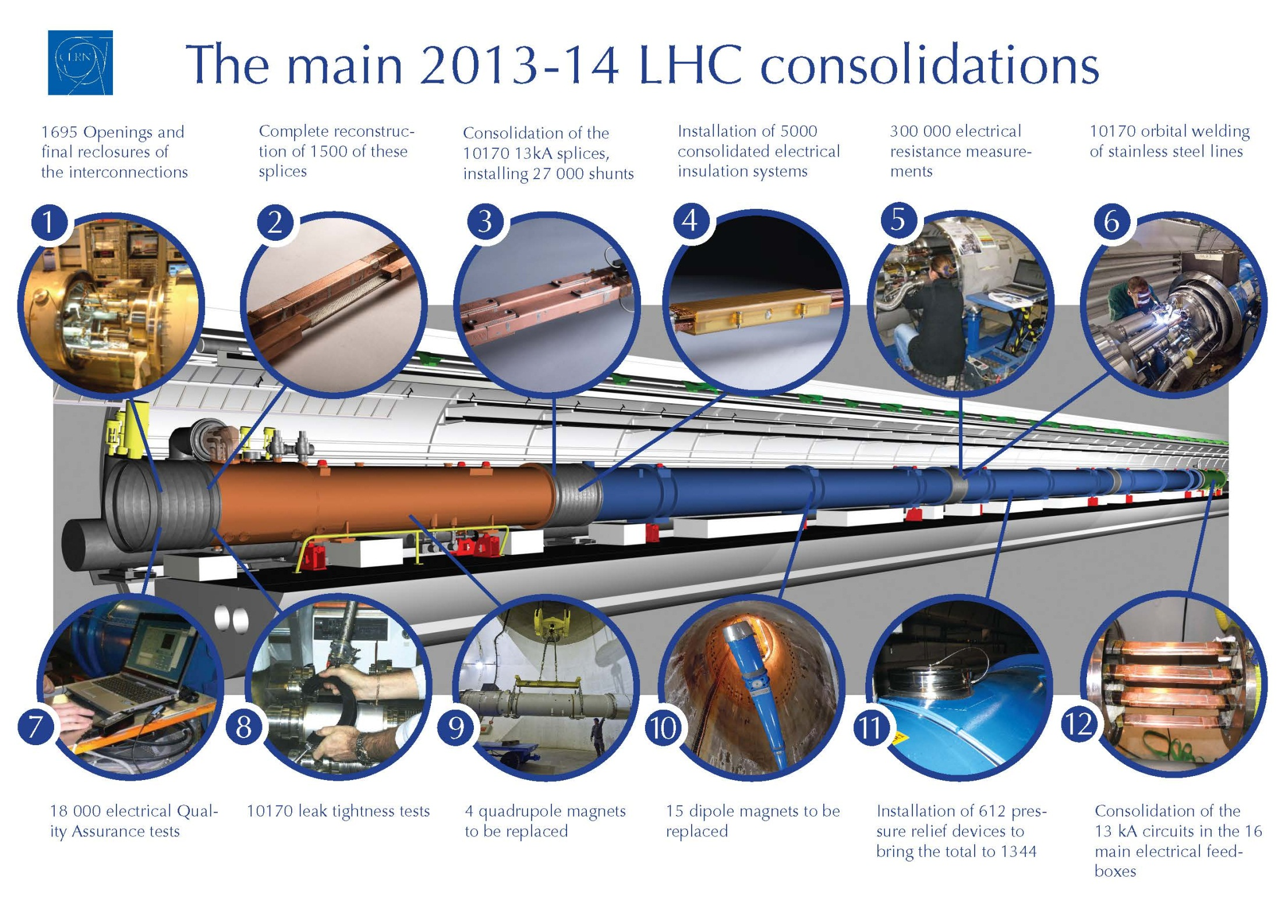
Title

Slide 7
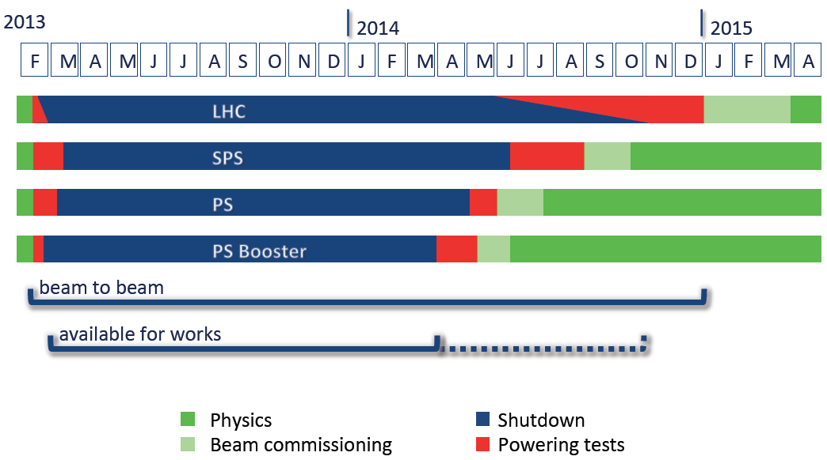
LHC Shutdown LS1
K.Foraz, LHCC June 2014
LHC back for physics in April 2015 with most
probably 13 TeV, i.e. 1.6 times enlarged energy

Slide 8
Conditions for Restart in 2015
 | Number of bunches | Bunch intensity LHC [1e11] | β*X/ β*sep/ Xangle | Emit LHC [μm] | Peak Lumi [cm-²s⁻¹] | ~Pile-up | Int. Lumi per year [fb⁻¹]
25 ns | 2760 | 1.15 | 55/43/189 | 3.75 | 0.93 x 10³⁴ | 25 | ~24
25 ns low emit | 2520 | 1.15 | 45/43/149 | 1.9 | 1.7 x 10³⁴ | 52 | ~45
50 ns | 1380 | 1.6 | 42/43/136 | 2.5 | 1.6 x 10³⁴ level to 0.8 x 10³⁴ | 87 level to 44 | ~40
50 ns low emit | 1260 | 1.6 | 38/43/115 | 1.6 | 2.3 x 10³⁴ level to 0.8 x 10³⁴ | 138 level to 44 | ~40
O.Brüning at ATLAS US 7/13
→ Increase in L_{peak} by 2-3 and energy by 1.6

Slide 9
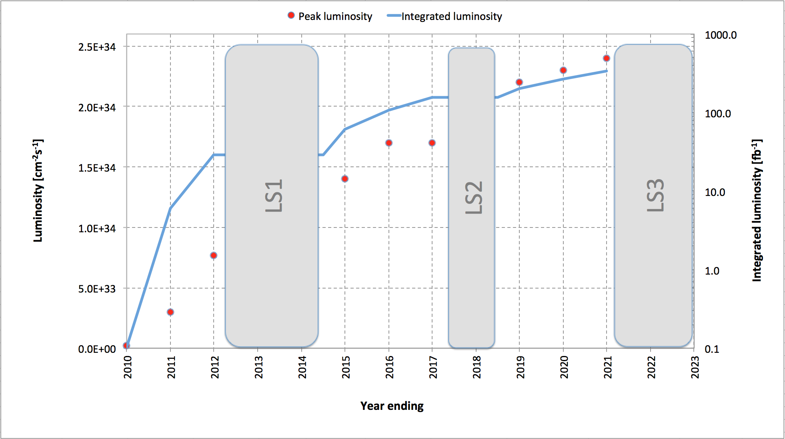
Luminosity Expectation until early Twenties*⁾
*⁾ This fall machine workshop to discuss near and further schedule and plans

Slide 10
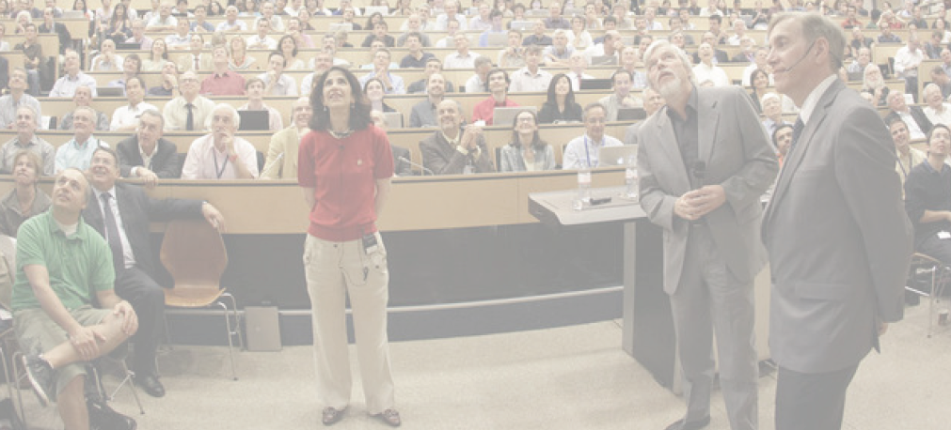
Huge success of the HEP Community
4.7.2012 greeting Melbourne from CERN
“The Higgs: So simple and yet so unnatural” G.Altarelli,arXiv:1308.0545

Slide 11
Searches for New Physics BSM

Slide 12
Searches for New Physics BSM

Slide 13
Results on QCD at the LHC

Slide 14

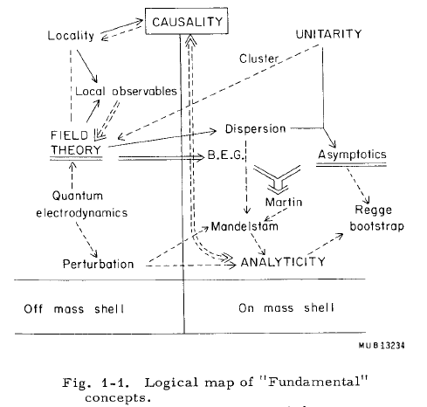
Preface
“We like to see
particle physics
as driven by
experiment …”
Burt Richter
2009
QCD yet a prime
example of the
joint efforts of
experiment AND
theoretical physics
Rapporteur talk by M.Froissart, Rochester Conference 1966

Slide 15
The rise of F₂ to Low x August 1993
First measurements of
low x scaling violations
with ~20nb⁻¹ (!), by
H1 and ZEUS at HERA
“Not for the New York
Times but for the
textbooks of physics..”
Bjoern Wiik
Practically free of
background, apart from
a bit of γp at high y..
Redundant e-h
kinematics → precision
Not rigorously predicted though in accord with QCD:
“Possible non-Regge behaviour of Electroproduction Structure Functions”
A DeRujula, SL Glashow, HD Politzer, SB Treiman, F Wilczek, A Zee: PhysRev D10(1974)1649

Slide 16
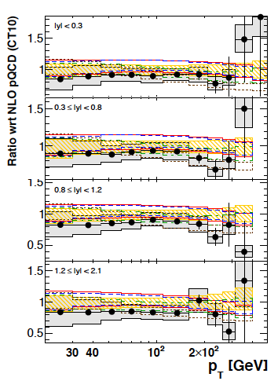
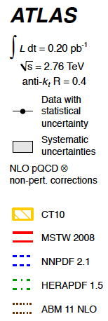
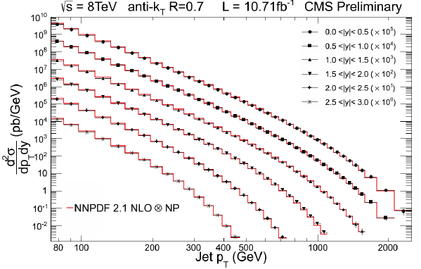
QCD at the LHC
Jets, Photons, Vector Bosons, Vector Bosons+Jets, Soft QCD [lowx, MPI, diffraction]
CMS-PAS-SMP-12-02
arXiv:1304.4739
EPJC(2013)73 2509
.. extends to 4.4
ATLAS-CONF-2013-041:R3/2
α_{s} = .111 +- .006 +0.016-0.003 (thy)
Inclusive jet cross sections and their energy dependent ratios well described by NLO QCD

Slide 17
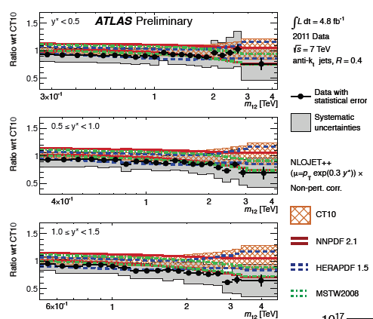
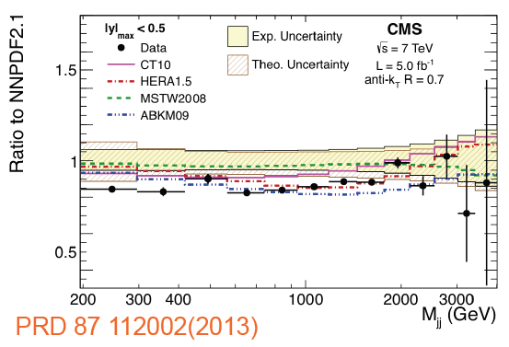
QCD at the LHC
Jets, Photons, Vector Bosons, Vector Bosons+Jets, Soft QCD [lowx, MPI, diffraction]
ATLAS-CONF-2012-021
Di-jet cross sections to about 10% in agreement with QCD + different PDFs

Slide 18
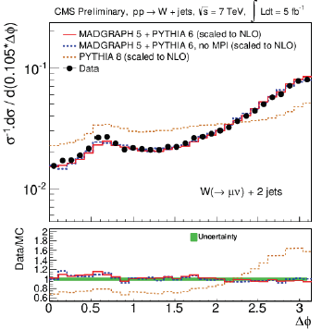
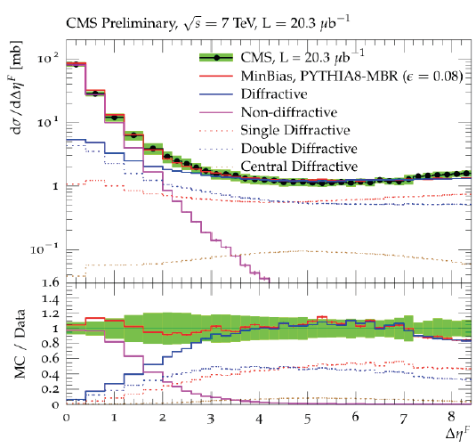
QCD at the LHC
Jets, Photons, Vector Bosons, Vector Bosons+Jets, Soft QCD [lowx, MPI, diffraction]
Diffraction (SD+DD) up to Δη =8
CMS-PAS-FSQ-12-028
MPI’s in W+jj data
ATLAS: New J. Phys. 15 (2013) 033038
CMS-PAS-FSQ-12-005
Consistent with ATLAS EPJC72(2012)1926
Comparisons with PYTHIA and PHOJET

Slide 19
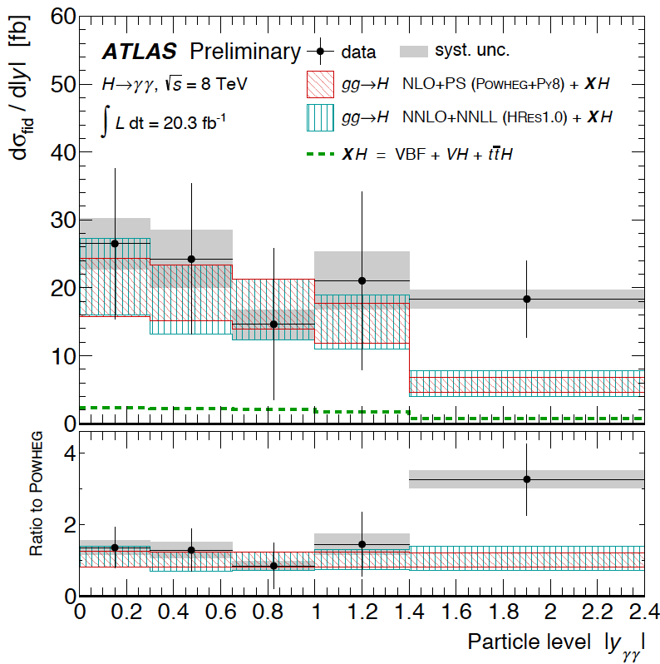
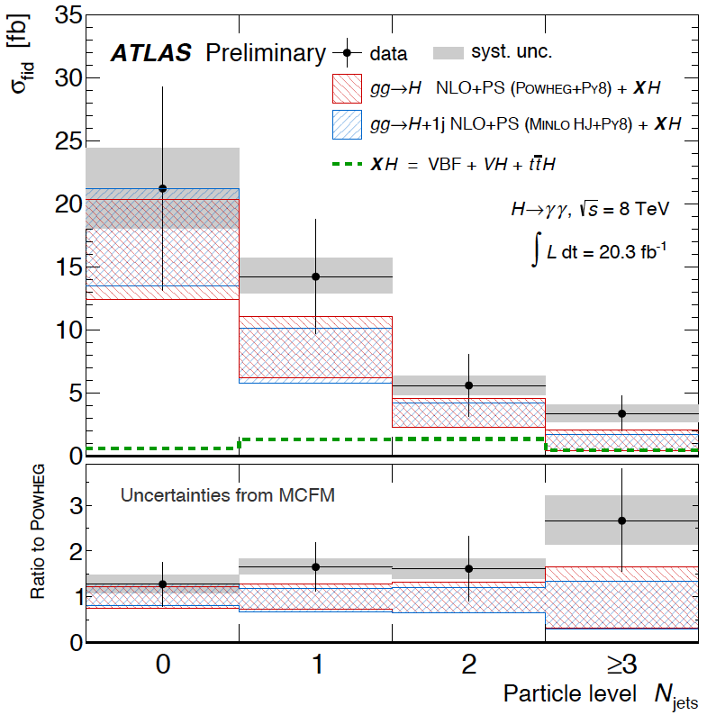
QCD at the LHC
Jets, Photons, Vector Bosons, Vector Bosons+Jets, Soft QCD [lowx, MPI, diffraction]
and since summer 13: Higgs as a QCD object
First differential cross sections of pp→X+H→γγ.
Large background but clear signal observed.
ATLAS-CONF-2013-072

Slide 20
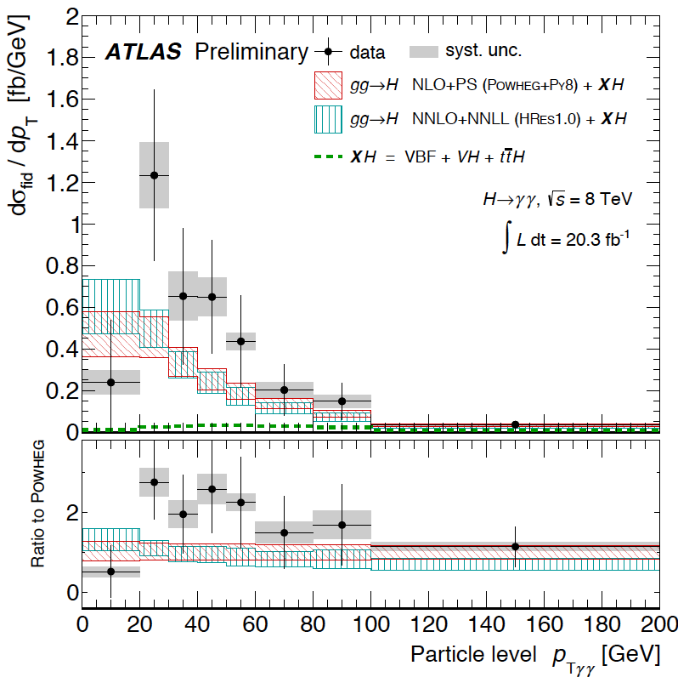
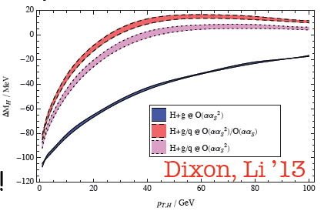
Higgs and QCD at the LHC
The first pt measurement of H:
ATLAS-CONF-2013-072
cf C. Grojean at EPS Stockholm
Small width (4 MeV) results in pt(H) dependent reduction of Mγγ. Very high
precision required to verify this and thus access Higgs width at the LHC..

Slide 21
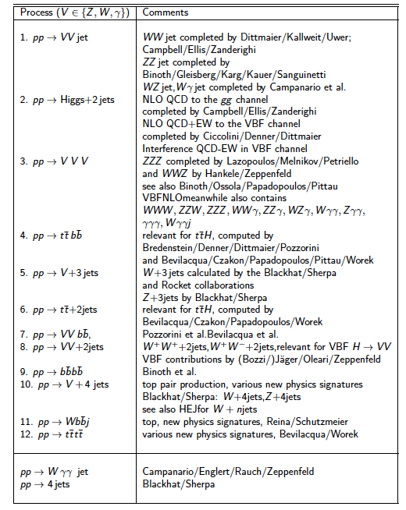
Theory
Experimenters NLO wishlist les Houches 05-09
“The NLO Industrial Revolution”
Subtracting loops as master integrals
Feynmanian reduction
Unitarian approach
Semiautomated programs (BlackHat..)
Automated subtraction
Standalone codes…
cf S. Hoeche ly SLAC 7/13
Now various processes,
as gg→H, are being
calculated at NNLO

Slide 22
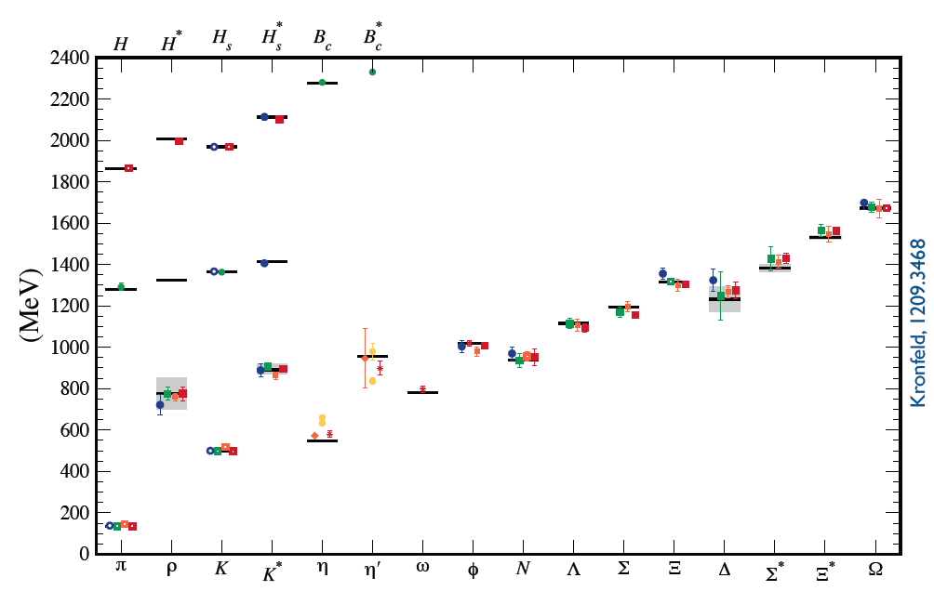
Lattice QCD

Slide 23
HL LHC, Partons and the need for precision
HL-LHC is the program to achieve 3ab⁻¹ in pp at 14 TeV by 2030+

Slide 24
HL-LHC Upgrade Ingredients
Geometric reduction factor ➔ β* ≥ 10 cm & Crab Cavities
Triplet aperture ➔ New large aperture triplet magnets
Bunch intensity ➔ N_{b} = 2.2 10¹¹ (limited in LHC by e-cloud)
➔ injector complex upgrade prerequisite for HL-LHC!!!
Event pile-up in detectors ➔ luminosity leveling
Beam Losses and Radiation ➔ shielding, Cryo upgrade &
relocation of electronics and PC
Collective effects and impedance ➔ Collimator Upgrade
Electron cloud effect ➔ beam scrubbing & feedback
Oliver Brüning CAS 7/13

Slide 25
LHeC - electron beam upgrade
JPhysG:39(2012)075001, arXiv:1206.2913 http://cern.ch/lhec
CDR: default design. 60 GeV. L=10³³⁻³⁴cm⁻²s⁻¹, ERL, synchronous ep/pp

Slide 26
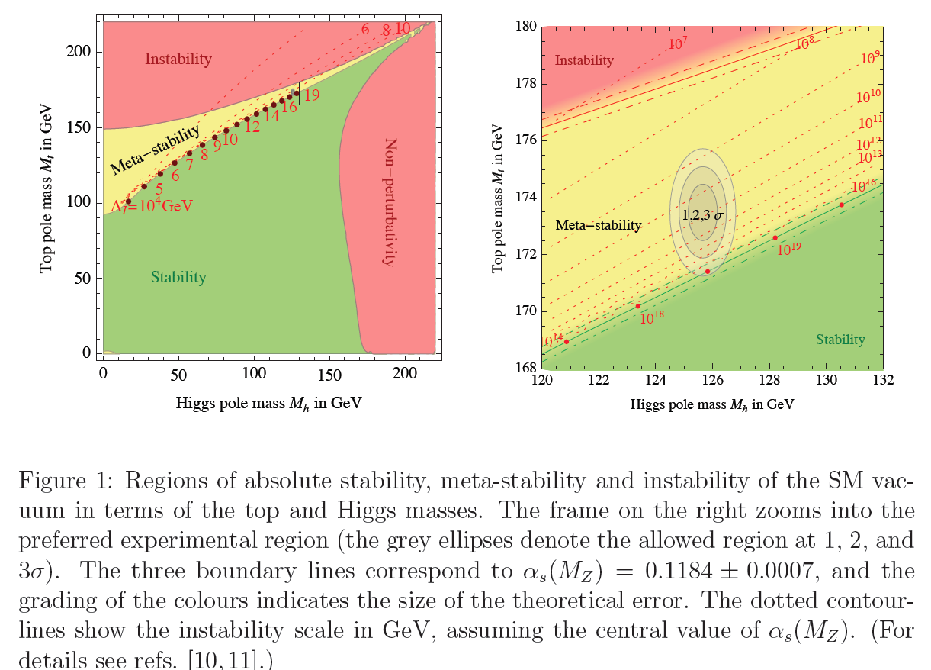
Why Precision?
G Giudice Why Naturalness, arXiv:1307.7879

Slide 27
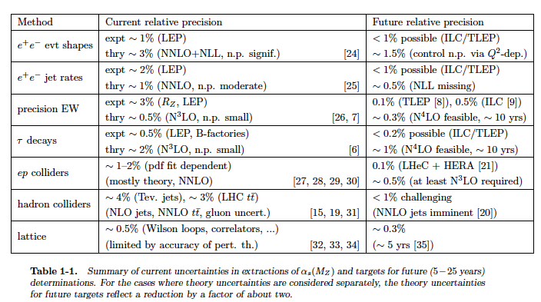
The strong coupling “constant”
Snowmass QCD WG report 9/2013
Prospects to measure α_{s}(M_{Z}²) to per mille precision with future ep and ee colliders
Important for gauge unification, precision Higgs at LHC, and to overcome the past..

Slide 28
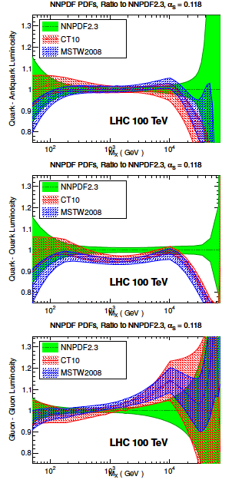
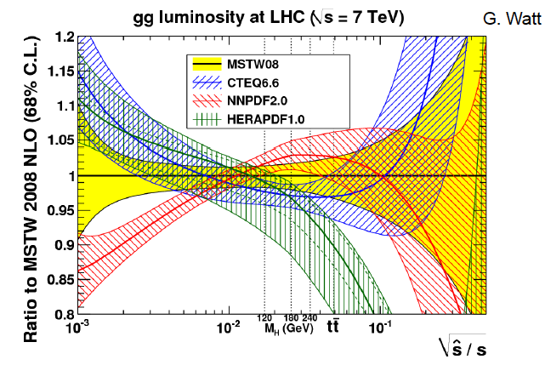
Parton Distributions
Need to know the PDFs much better than
so far, for nucleon structure, q-g dynamics,
Higgs, Searches, future colliders, and
the development of QCD
Snowmass13 QCD WG report

Slide 29
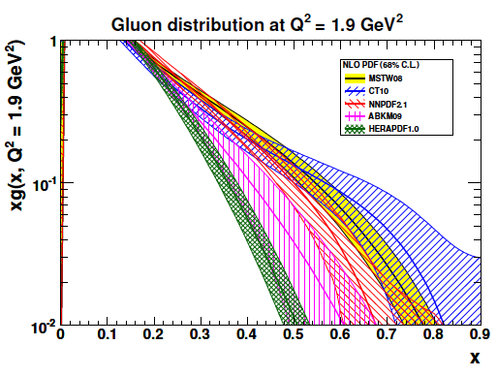
(Un)certainty on PDFs
Light Quarks:
valence x < 0.01, u_{v} x > 0.8, d_{v} x>0.6
light sea (related to strange) -8% ATLAS/F₂,
light sea quark asymmetry, d/u=?
Isospin relations (en!) ??
Strange: unknown, =dbar? strange valence?
Charm: need high precision to % for α_{s}
(recent HERA 5%)
Beauty: HERA 10-20%, bb → A?
Top: tPDF at high Q² >M_{t}² - unknown
Gluon: low x, saturation?, high x - unknown
medium x: preciser for Higgs!
Recent review: cf E.Perez, E.Rizvi 1208.1178, in RPP
..unintegrated, diffractive, generalised,
polarised, photonic, nuclear PDFs ???

Slide 30
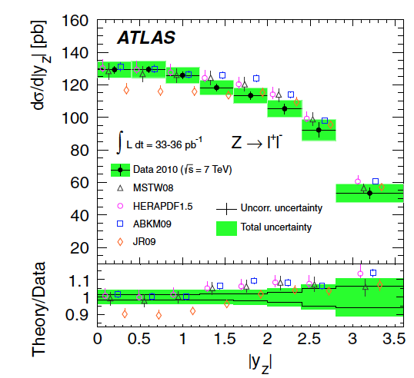
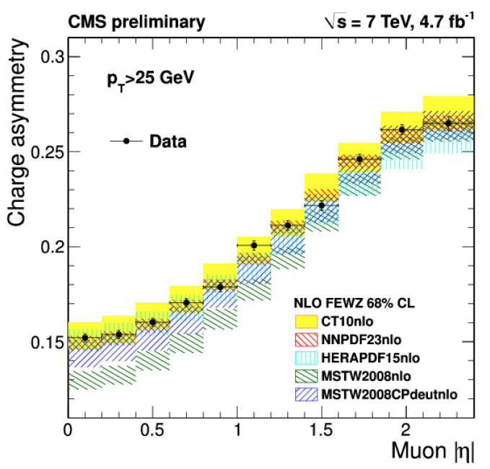
Z, W
Low and high mass Drell-Yan,W,Z, + jets, di-bosons, TGC’s … W,Z in heavy ions…
Inclusive Z and W production and leptonic decay
PRD85(2012)072004, cf also PRL109(2012)012001
CMS PAS SMP-12-021
Constraining PDFs at high Q² ~ M_{W,Z}² - in large rapidity range (very fwd LHCb)
Measurements reach 1% precision level in differential distributions + δ(Lumi).
QCD analysis to NNLO + electroweak corrections to per mille level → s/d=1

Slide 31
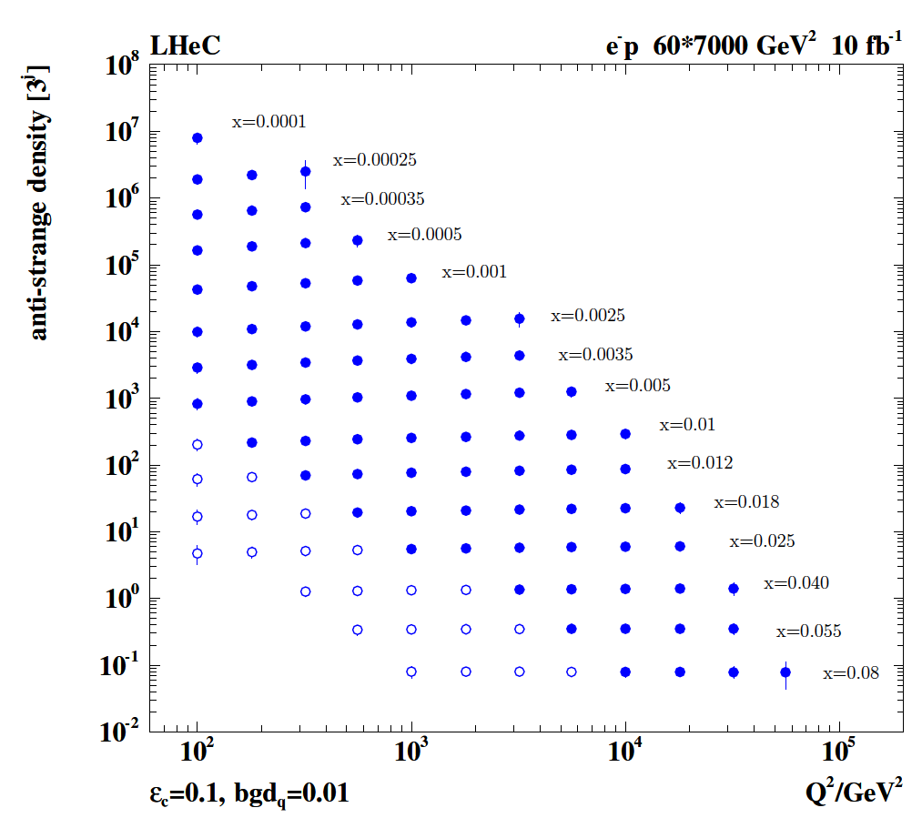
Strange Quark Distribution
Leads to first (x,Q²)
measurement of
the (anti-)strange
density, HQ valence?
x = 10⁻⁴ .. 0.05
Q² = 100 – 10⁵ GeV²
ATLAS+HERA: Recent surprise: s/d =1
JPhysG 39(2012)7
PRL109(2012)012001
cf also HERMES: N_{K} PLB666(2008)446
W+c measurements from ATLAS+CMS
Important PDF constraints from LHC though no direct determinations (Q²,x)
PDF4LHC → PDFs from LHC

Slide 32
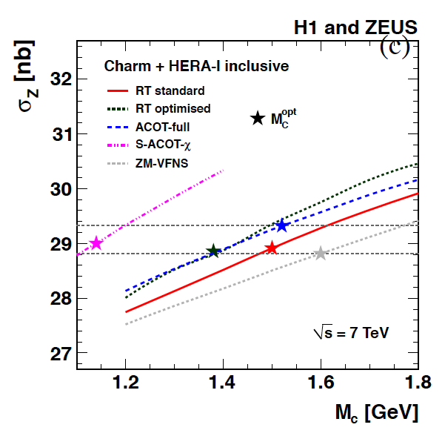
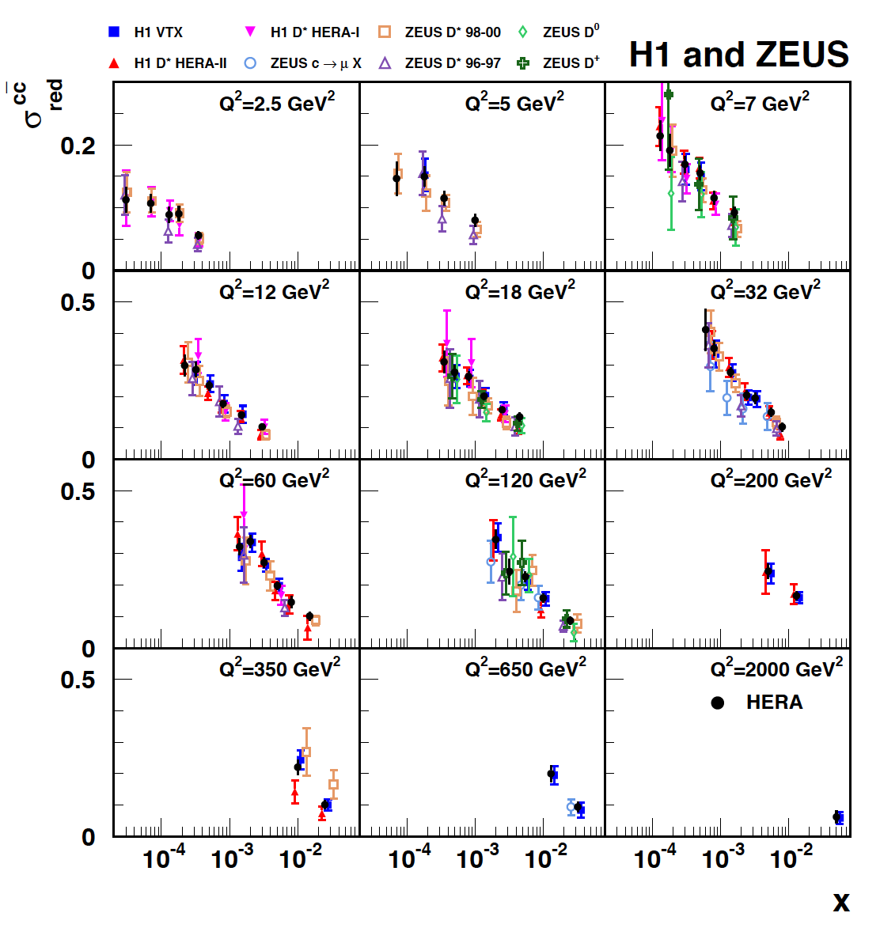
Charm Structure Function - F₂^{c}
Culmination of 20 years of analysis…
EPJC73(2013)2311
Uses FFNS ABM prescription.
δ(m_{c}) = 3 MeV at LHeC (cf CDR)
Understanding of heavy flavour dynamics in the proton is crucial for
QCD [VFNS?, light-heavy?, intrinsic c?..], VHE ν, interpretation of LHC data

Slide 33
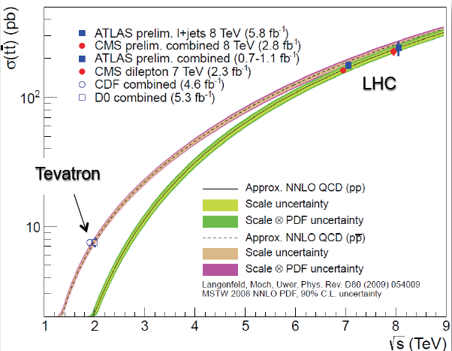
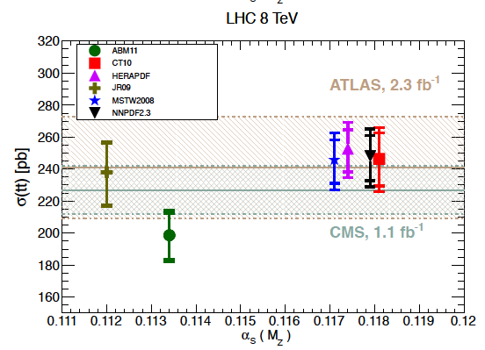
Top at the LHC
Pair production, Decay, Single Top, Top Loop → H, Mass and the SM Universe..
M_{top} to 0.5% precision from Tevatron
and now also the LHC experiments
Top lead the way to Higgs and
it may to further new physics..
J.Varela, “Top Quark Properties” lγ13
Cf. M.Czakon et al: arXiv:1303.6254 & .7215
Is there a “light” stop partner of the top?

Slide 34

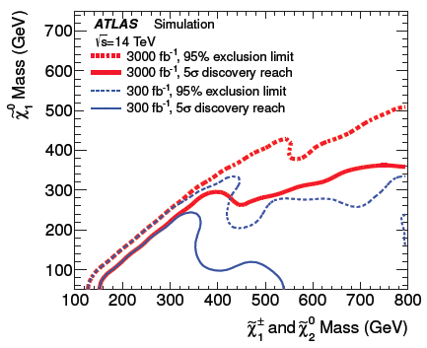
LHC physics @ 3ab⁻¹
Higgs precision and rarer channels
New particles: pairs to ~4 TeV
singly to ~8 TeV
leptoquarks to ~2 TeV
Rare processes as FCNC top decays…
cf P.Wells, ly13, SLAC July13
Increase of L especially important for the investigation of new signals ..

Slide 35

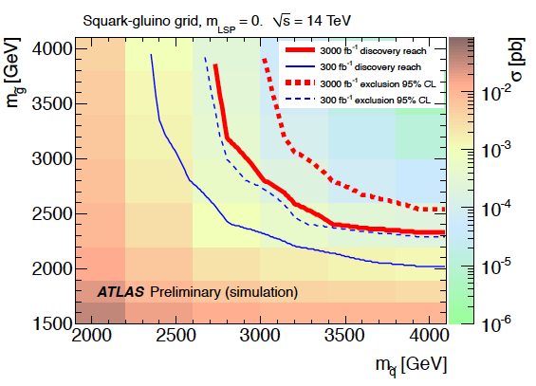
HL-LHC - Searches
ATLAS October 2012 to EU strategy forum LHeC October 2012 to EU forum arXiv:1211.5102
With high energy and luminosity, the search range will be extended to high masses,
up to 4-5 TeV in pair production, and PDF uncertainties come in ~ 1/(1-x), CI effects?

Slide 36
HL-LHC - Searches
High precision
PDFs are needed
for the HL-LHC
Searches in order
to probe into the
range opened by
the luminosity
increase and to
interpret possibly
intriguing effects
based on external
information.
LHeC BSM poster at EPS13 M.D’Onofrio et al. see also arXiv:1211:5102 Relation LHeC-LHC
Simulated PDFs from LHeC are on LHAPDF (Partons from LHeC, MK, V.Radescu LHeC-Note-2013-002 PHY)

Slide 37
Future Higgs

Slide 38
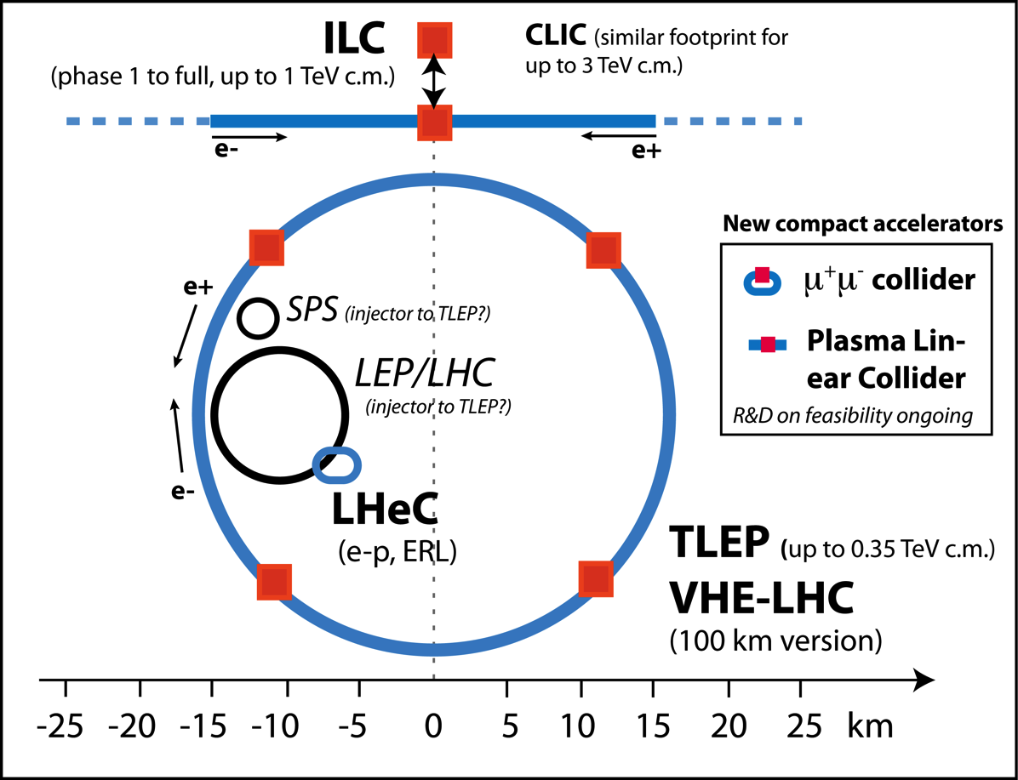
Lepton collider options beyond LHC
TDR’s
published
TDR to be
worked out
R.Aβmann, EPS13

Slide 39
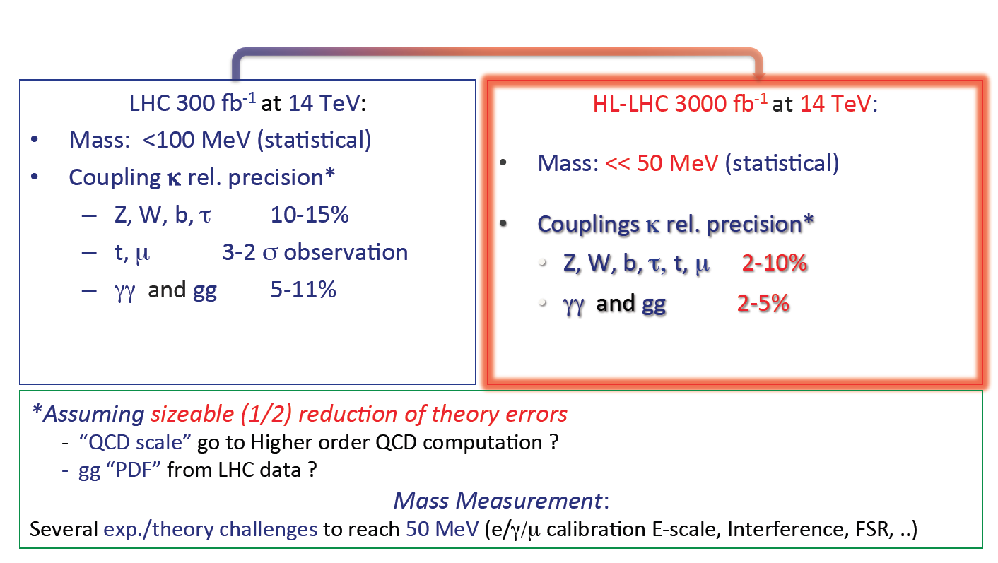
Higgs with HL-LHC
F.Cerutti, “Properties of the New Boson” EPS13 Stockholm
Higgs physics at the LHC is a long term challenge [di-H, CP, M, VV damping..]

Slide 40
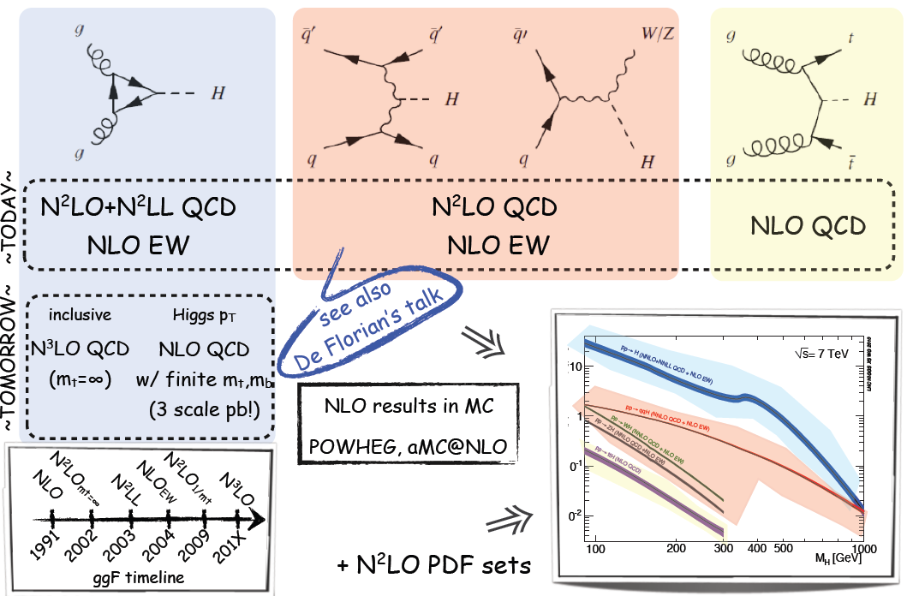
Theory
cf C. Grojean at EPS Stockholm
Will need ultraprecise PDFs to match thy and make the LHC a precision Higgs factory

Slide 41
pp → H Cross Section
LHeC:
Exp uncertainty
of predicted H
cross section is
0.25% (sys+sta),
using LHeC only.
Leads to H mass
sensitivity.
Strong coupling
underlying
parameter
(0.005 – 10%).
LHeC: 0.0002
Needs N³LO
HQ treatment
important …

Slide 42
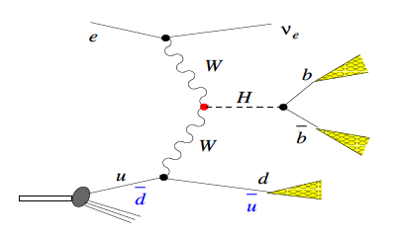
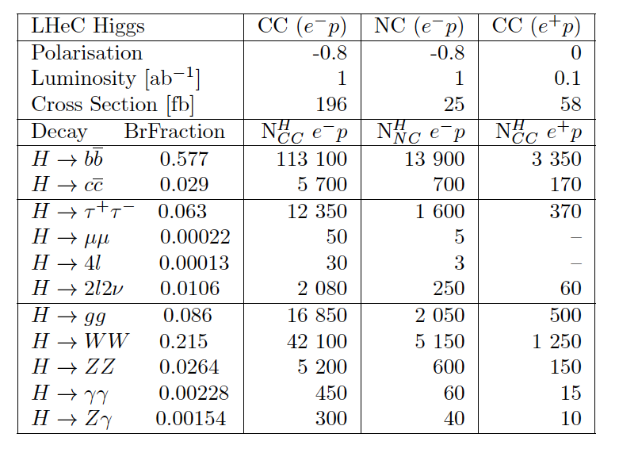
Higgs with the LHeC
Polarised electrons
Maximum lumi
Forward tracking
High resolution
No pile-up
Direction asymmetry
…
H-bbar coupling to 0.7% precision with 1ab⁻¹, at an S/B of 1 – studies of τ, c, .. to come
The LHeC WW → H cross section is as large as the ILC Z*→ZH cross section (300fb)…
→ 50pb@LHC, hiLumi + ep [H + PDFs] +QCD@h.o. : LHC - a high precision H factory

Slide 43
LHeC Development
A next workshop: 20/21. January 2014 near CERN - http://cern.ch/lhec

Slide 44
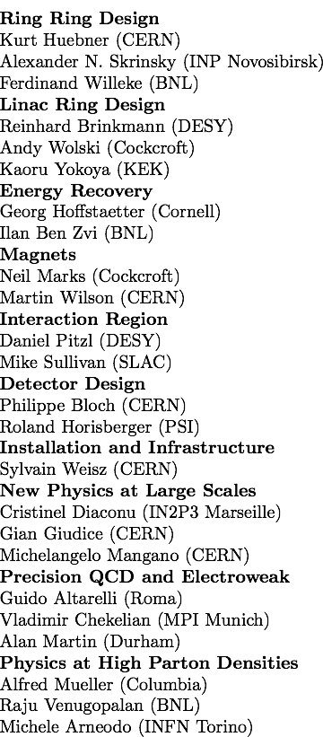
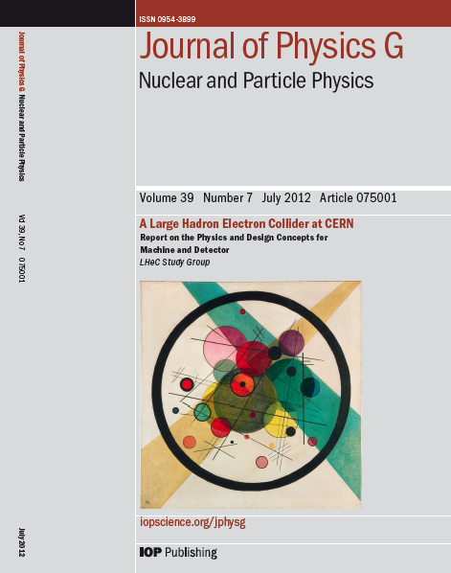
Design Report 2012
CERN Referees
arXiv:1206.2913 http://cern.ch/lhec
The theory of DIS has developed much further: J.Blümlein Prog.Part.Nucl.Phys. 69(2013)28
DIS is an important part of particle physics: G.Altarelli, 1303.2842, S.Forte, G.Watt 1301:6754

Slide 45
LHeC

Slide 46
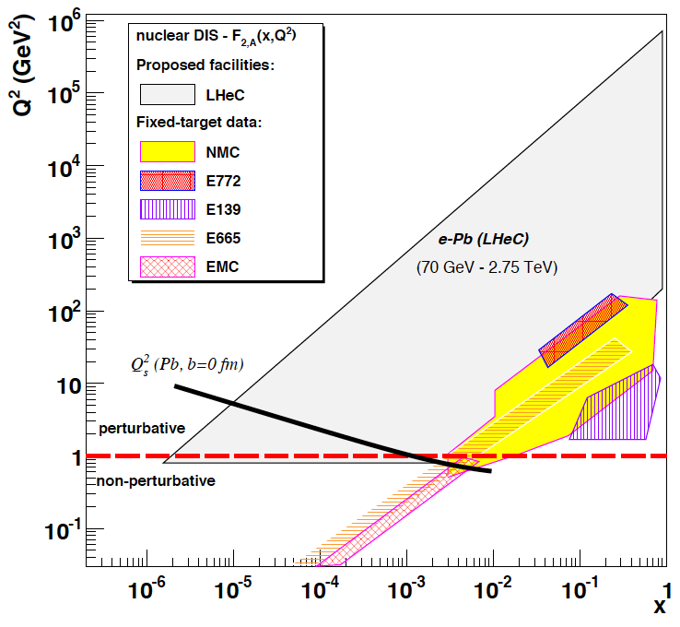
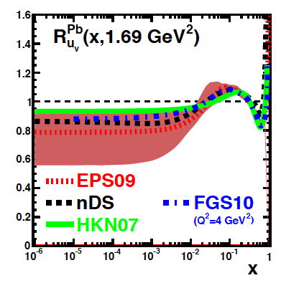
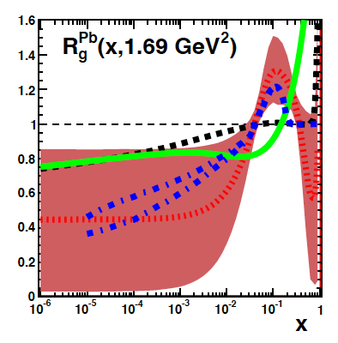
Nuclear Parton Distributions from eA
up valence
gluon
3-4 orders of magnitude extension of lA kinematic range
→ LHeC has huge discovery potential for new HI physics
(bb limit, saturation.. will put nPDFs on completely new ground
unmeasured | known?
Max Klein, Mainz, 6/2013

Slide 47
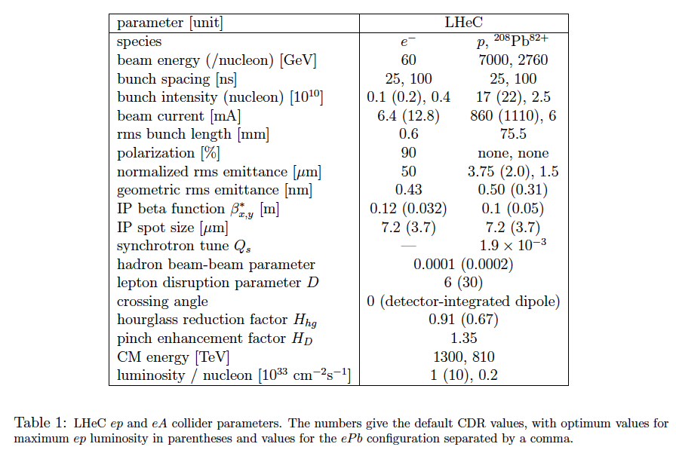

LHeC at 10³⁴cm⁻²s⁻¹ Luminosity
σ(H)=200fb
Access of rare
channels and
differential
measurements:
How to reach 10³⁴ ?
N/ε =brightness*2.5
β* = 5 cm
I_{e} = 12 mA
HERA: 1-4 10³¹ cm⁻²s⁻¹
LHeC Collaboration arXiv:1211:5102, see also O.Brüning and M.Klein arXiv:1305.2090, MPLA A28(2013)16

Slide 48
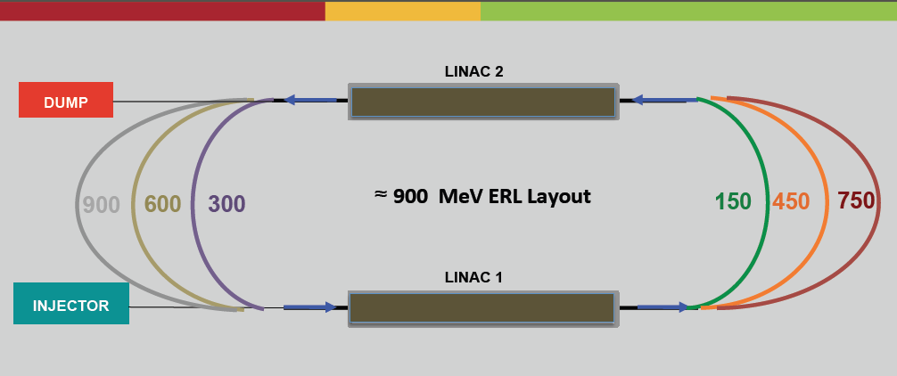
ERL Testfacility
Under design at CERN in international collaboration. f=801.58 MHz SC RF
A.Valloni, LHeCmeeting, 16.7.2013, see also LHeC-Note 2012-001 ACC, and Contribution to IPAC2013
Test of ERL, Operation experience, Sources, Magnet Tests, Injector for the LHeC
Physics: ep with 10⁴⁰cm⁻²s⁻¹ : sin²Θ [high E MESA], proton radius; Testbeam facility

Slide 49

MESA
LTF
Energy frontier deep inelastic scattering - following HERA with the LHC
LHeC: A new laboratory for particle physics, a 5th large LHC experiment

Slide 50
Remarks and Outlook
AdS/CFT
Instantons
Odderons
Non pQCD
QGP
N^{k}LO
Resummation
Non-conventional PDFs …
Breaking of Factorisation
Free Quarks
Unconfined Color
New kind of coloured matter
Quark substructure
New symmetry embedding QCD
QCD may break .. (Quigg DIS13)
QCD is the richest part of the Standard Model Gauge Field Theory and
will (have to) be developed much further, on its own and as background

Slide 51
Future Rings at CERN^{*)}
100km with 20T
provides 50 TeV
per beam.
80km may not be
clever due to Saleve,
if placed below
Lac Leman → 100km.
New tunnel may host
a Triple LEP Higgs
facility.
LHeC to run with
LHC and later
with VHE-LHC
^{*) “}Civil Engineering Feasibility Studies for Future Ring Colliders at CERN”, Contributed by
O.Brüning, M.Klein, S.Myers, J.Osborne, L.Rossi, C.Waaijer, F.Zimmerman to IPAC13 Shanghai

Slide 52

Cost
J.Osborne et al. IPAC13, Shanghai
62% CE, 26% surface, 12% consulting
A 100km machine is very challenging,
it will not be cheap and demands firm,
excellent science reason to become real

Slide 53

Time
30 years from the first p-LEP = LHC paper to LS1

Slide 54

Title
The challenge, again, is to find the way forward, through the dark matter of the
universe and towards a genuine unification of the known and hidden forces:
H.Murayama – ICFA11
Theory needs help and much hope is directed to the near and far future of the LHC
Particle physics is one coherent subject and it better is pursued as an entity further.
Sincere thanks to many colleagues on H1, ATLAS, LHeC, LHC, Theory, ..
Elbe Fireworks in May 2009

Slide 55



Gluon Saturation at Low x?
LHeC
H1
Gluon measurement down to x=10⁻⁵, Saturation or no saturation (F₂ and precise F_{L})
Non-linear evolution equations? Relations to string theory, and SUSY at ~10 TeV?
cf H.Kowalski, L.Lipatov, D.Ross, arXiv:1205.6713

Slide 56



Proton-Lead at the LHC
v₂ for Z is zero, it
decays before the
plasma is formed ..
1303.2084 – ATLAS
1307.3237 – ALICE
Perhaps surprising, recent results indicate that the flow in pPb resembles PbPb
Possibly the determination of nPDFs in AA and pA is reduced to W,Z production
[collective effects in final state – rescattering of produced partons – hydrodynamics]

