Slide 1
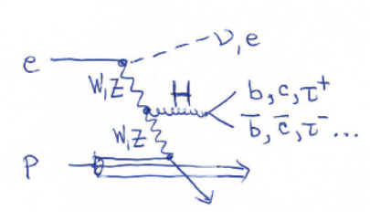



Prospects for Higgs Physics
with Electron-Proton Colliders
Max Klein
on behalf of
the LHeC/FCC-eh Higgs Group
Based on Uta Klein,
Talk at FCC CDR
4.3.2019 at CERN
and Higgs in ep
paper, in preparation
DIS19, Torino, April 11th, 2019

Slide 2
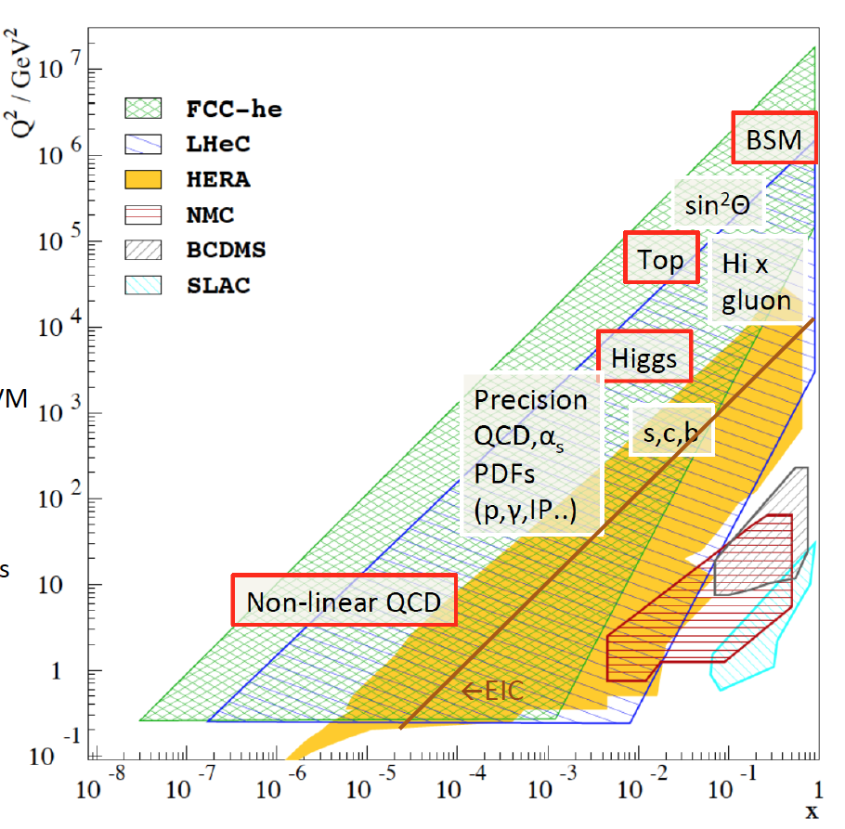
Physics with Energy Frontier DIS
Raison(s) d’etre of the LHeC
Cleanest High Resolution
Microscope: QCD Discovery
Empowering the LHC
Search Programme
Transformation of LHC into
high precision Higgs facility
Discovery (top, H, heavy ν’s..)
Beyond the Standard Model
A Unique
Nuclear Physics Facility

Slide 3

Organisation^{*)}
+ FCC-he
Working Groups
International Advisory Committee
with CERN mandate to provide
“..Direction for ep/eA both at LHC+FCC”
PDFs, QCD
Fred Olness,
Claire Gwenlan
Higgs
Uta Klein,
Masahiro Kuze
BSM
Georges Azuelos,
Monica D’Onofrio
Oliver Fischer
Top
Olaf Behnke,
Christian Schwanenberger
eA Physics
Nestor Armesto
Small x
Paul Newman,
Anna Stasto
Detector
Alessandro Polini
Peter Kostka
Coordination Group
Accelerator+Detector+Physics
Sergio Bertolucci (CERN/Bologna)
Nichola Bianchi (Frascati)
Frederick Bordry (CERN)
Stan Brodsky (SLAC)
Hesheng Chen (IHEP Beijing)
Eckhard Elsen (CERN)
Stefano Forte (Milano)
Andrew Hutton (Jefferson Lab)
Young-Kee Kim (Chicago)
Victor A Matveev (JINR Dubna)
Shin-Ichi Kurokawa (Tsukuba)
Leandro Nisati (Rome)
Leonid Rivkin (Lausanne)
Herwig Schopper (CERN) – Chair
Jurgen Schukraft (CERN)
Achille Stocchi (LAL Orsay)
John Womersley (ESS)
Nestor Armesto
Oliver Brüning – Co-Chair
Andrea Gaddi
Erk Jensen
Walid Kaabi
Max Klein – Co-Chair
Peter Kostka
Bruce Mellado
Paul Newman
Daniel Schulte
Frank Zimmermann
5(11) are members of the
FCC coordination team
OB+MK: FCC-eh coordinators
FCC IAC: Guenter Dissertori +
*) 2018

Slide 4
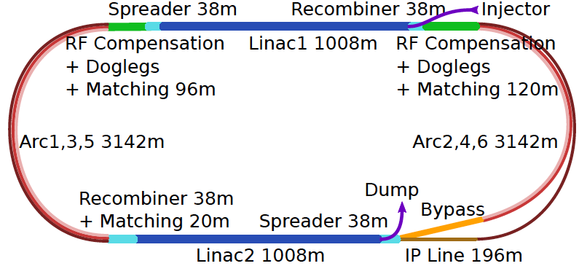
Energy Recovery Linac for LHeC/FCCeh
U(ERL) = 1/3 U(LHC)
Concurrent operation to pp, LHC/FCC become 3 beam facilities. Power limit: 100 MW
10³⁴ cm⁻² s⁻¹ luminosity and factor of 15/120 (LHC/FCCeh) extension of Q², 1/x reach
1000 times HERA luminosity. It therefore extends up to x~1.
Four orders of magnitude extension in deep inelastic lepton-nucleus (ion) scattering.

Slide 5
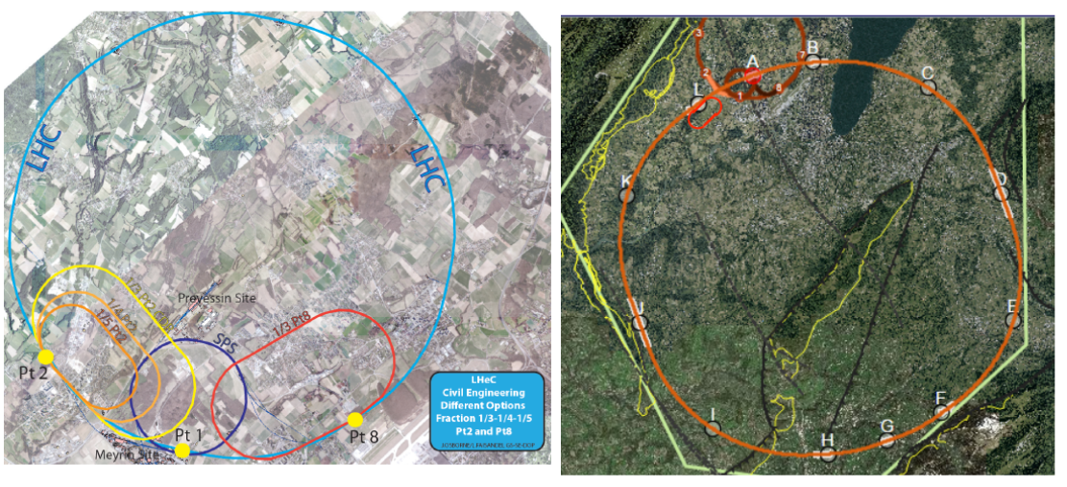
Future ep Colliders at CERN with electron ERL
LHC (HL and HE)
FCC
1.2-1.3 TeV cms energy
10³⁴ luminosity: 1ab⁻¹ in 10 years.]
2 ab⁻¹ with HE LHC [interesting ERL
Programme standalone in transition!]
WW→H Cross section similar to Z*→ ZH
Note: gg→H is about 50pb at LHC
3.5 TeV cms energy
1.5 10³⁴ luminosity: 2-3 ab⁻¹ in 20 years
CC Higgs cross section ~ 1pb
This is 4 times higher than FCC-ee
Expect similar precision for both eh and ee

Slide 6

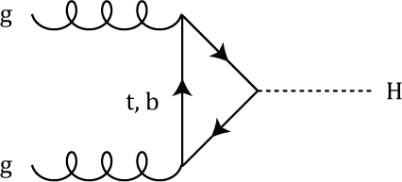
HERA‘s legacy: the gluon dominated proton
Rapidity plateau at x=M_{H}/2E_{p}=0.01: Precise knowledge of xg is a base for LHC Higgs physics
Prospect: very high precision PDFs and coupling from LHeC: to N³LO → precision in pp (+ep)

Slide 7
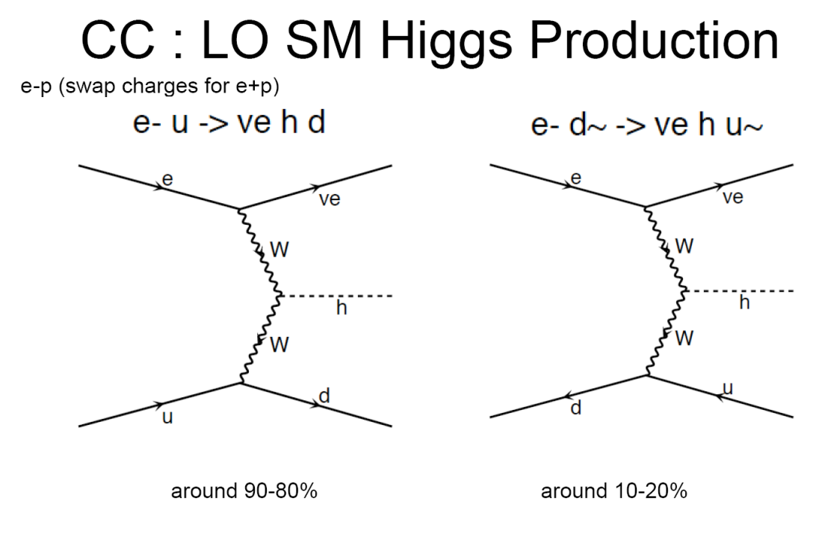
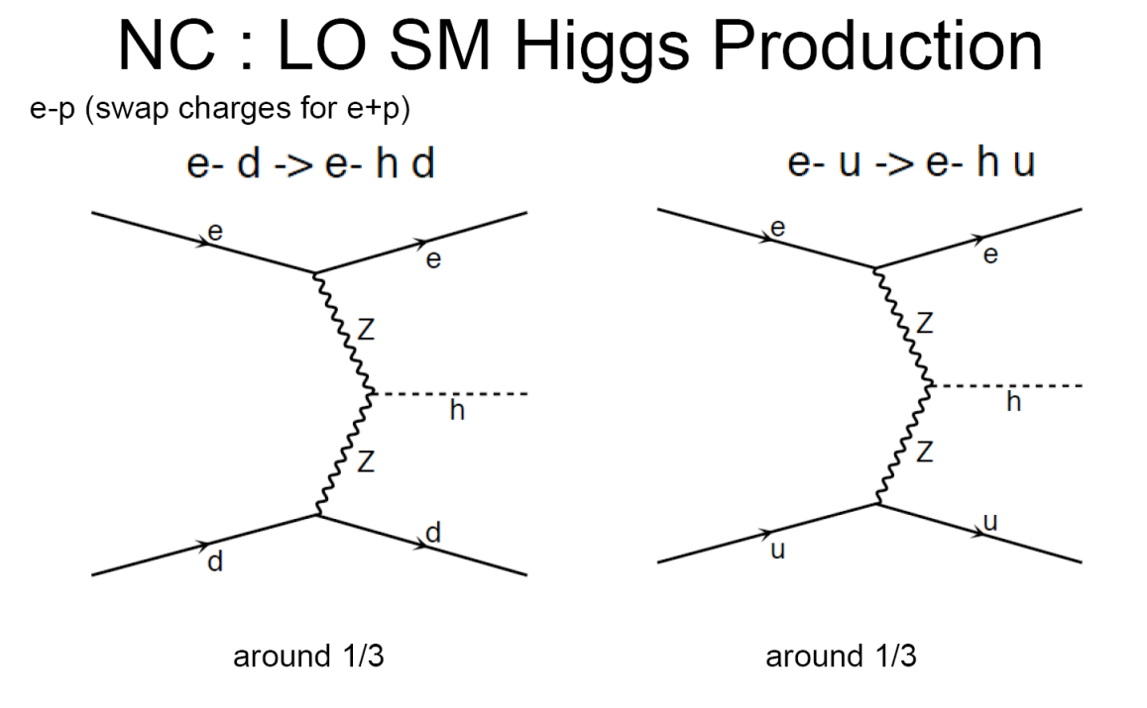
SM Higgs Production in ep well understood
ERL electrons →
E_{T}^{miss}
ERL electrons →
FS electron
WWH
ZZH
FCC protons →
FCC protons →
Fwd jet
Fwd jet
➔ In ep, direction of quark (FS) is well defined.
Total cross section [fb]
(LO QCD CTEQ6L1 M_{H}=125 GeV)
Scale dependencies of the LO calculations are in the range of 5-10%. Tests done with MG5 and CompHep.
NLO QCD corrections are small, but shape distortions of kinematic distributions up to 20%. QED corrections up to -5%.
[J. Bluemlein, G.J. van Oldenborgh , R. Rueckl, Nucl.Phys.B395:35-59,1993]
[B.Jaeger, arXiv:1001.3789]
c.m.s. energy | 1.3 TeV LHeC | 3.5 TeV FCC-he
CC DIS NC DIS | 109 21 | 560 127
P=-80% CC DIS NC DIS | 196 25 | 1008 148

Slide 8
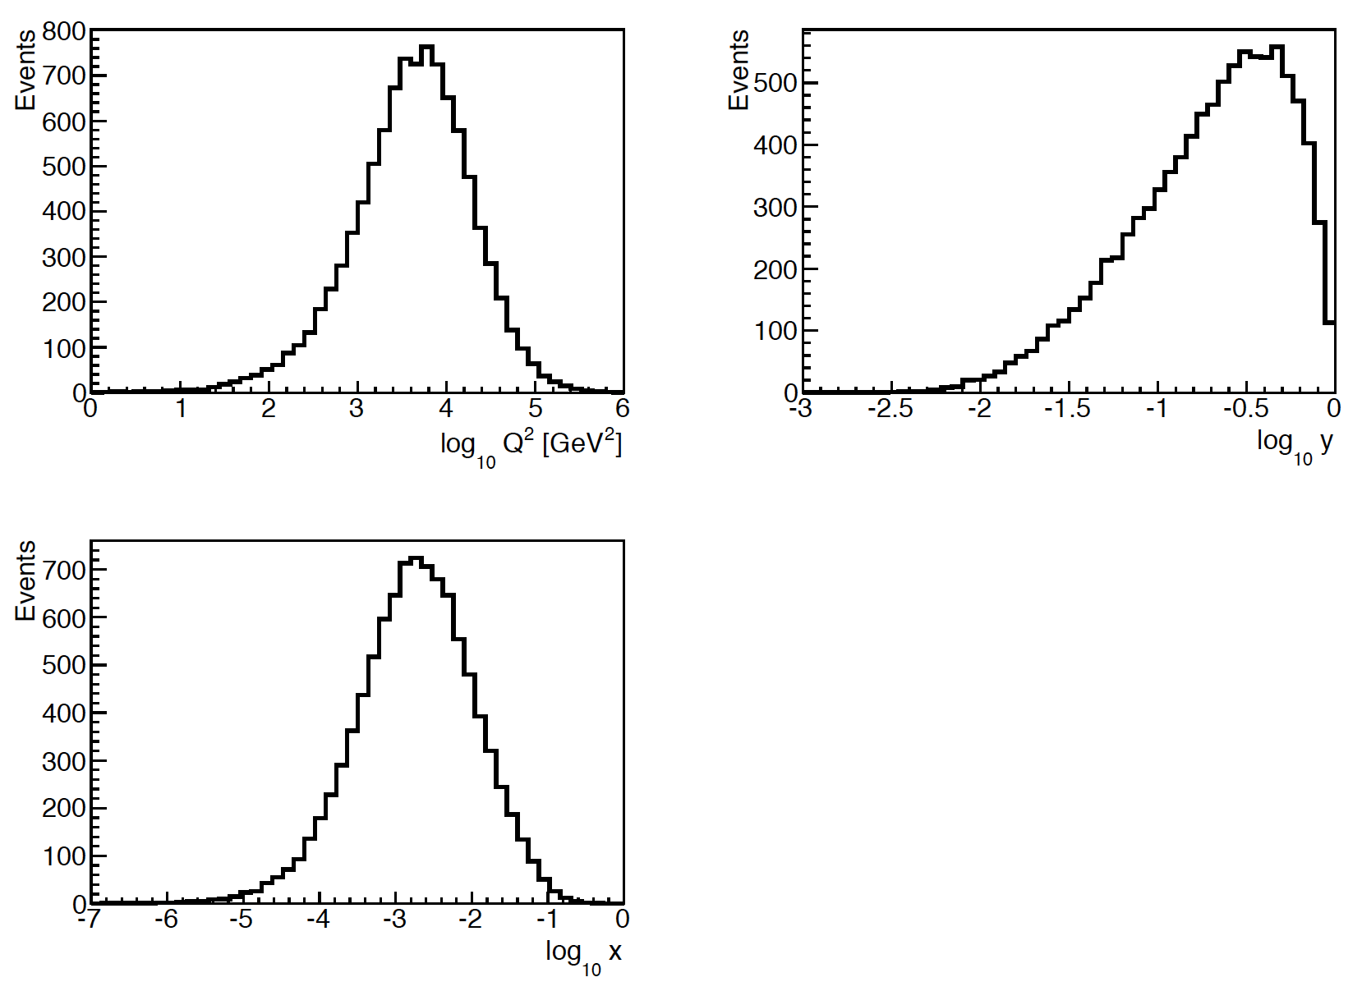
DIS Kinematics at FCC-eh @ √s=3.5 TeV
MadGraph scale: p_{T} of leading jet
Parton-level
M_{h}²
DIS kinematics very well behaved
[btw also at HERA, but the cross
section was 0.7 (0.1) fb in CC (NC)
while H1 and ZEUS each collected
only about 0.5 fb⁻¹ of luminosity.
LHeC: cross section 200 times larger
and luminosity 500 times larger:
ep becomes a Higgs laboratory]

Slide 9
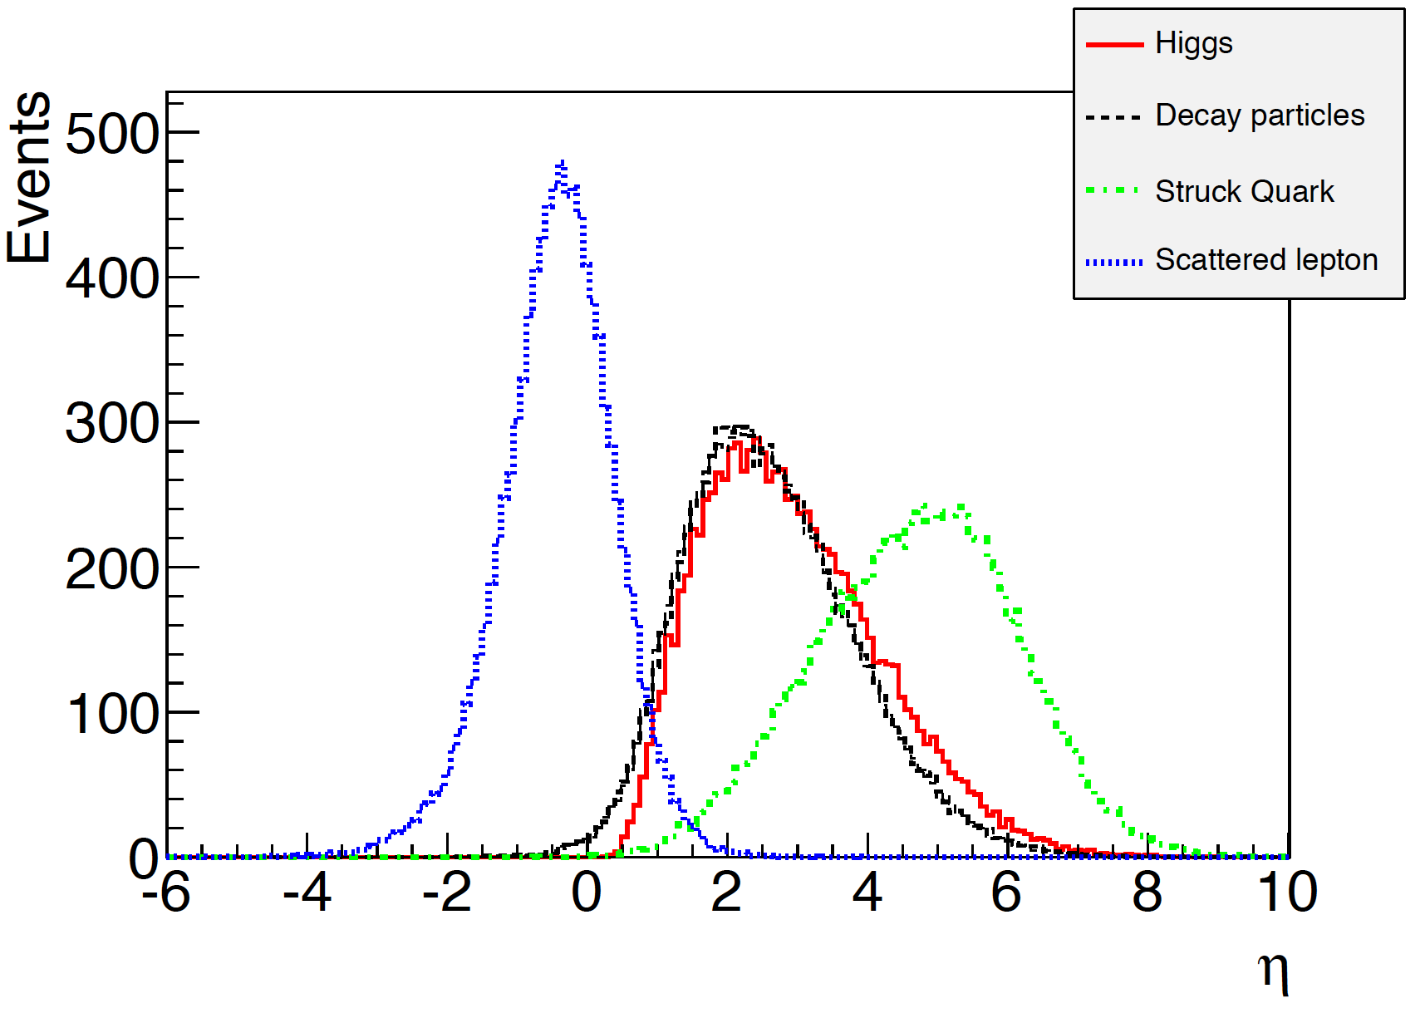
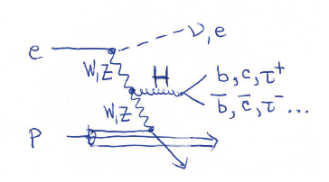
η Distributions in Higgs events at FCC-eh
Parton-level
MG5 scale: p_{T} of leading jet
Higgs &
decay particles
Scattered lepton
Forward Struck Quark
Higgs decay particles (here to WW), struck quark and scattered lepton are well separated in polar angle and in detector acceptance. Very fwd jet at FCC.

Slide 10
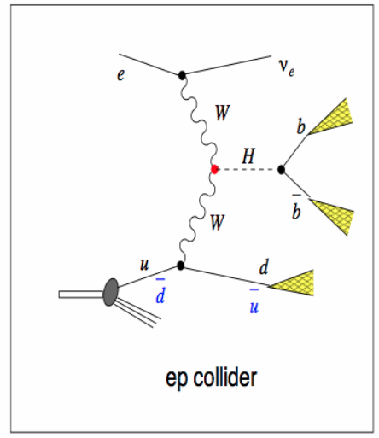
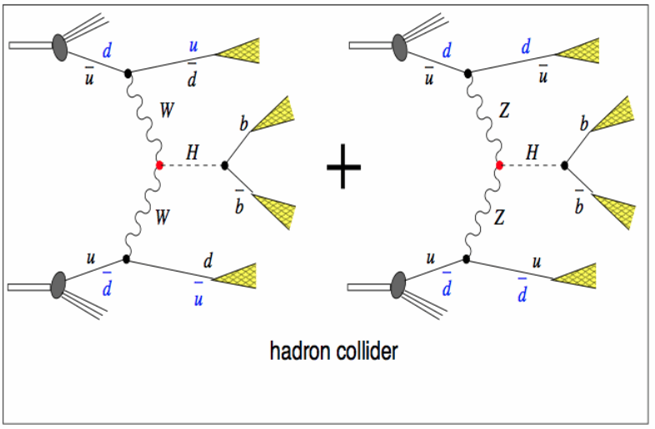
VBF Higgs Production and experimental conditions
ep
e
ep: Higgs production in ep comes
uniquely from either CC or NC DIS via VBF
Clean bb final state, S/B >1
e-h Cross Calibration for Precision ep
Clean, precise reconstruction and
easy distinction of ZZH and WWH
pile-up in ep:
<0.1@LHeC up to 1@FCCeh events
Z
HWW
HZZ
OR
Z
pp: Higgs production in pp comes
predominantly (~80%) from gg→ H :
high rates crucial for rare decays
Pile-up in pp at 5 10³⁴ cm⁻² s⁻¹ is 150@25ns
FCC-hh: pile-up 500-1000 (!)
S/B very small for bb, too harsh for cc
Final precision in pp needs
accurate N³LO PDFs & α_{S}
pp

Slide 11
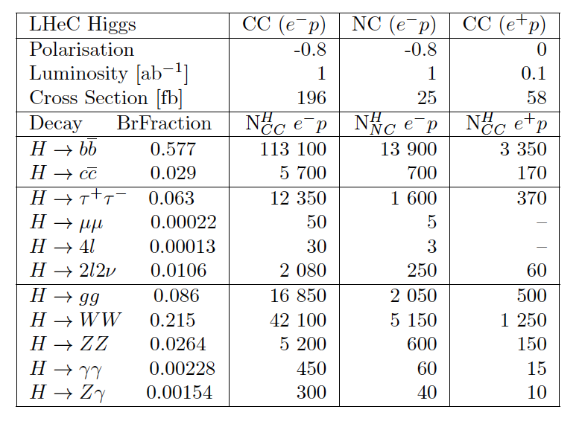
Rates of Higgs production at LHeC
Approximately
x4 at HE LHC
x10 at FCC-eh
a million bb ..
Due to longer
operation, higher
luminosity and
higher cross sections

Slide 12
Analysis Framework and ‘Detector’
Calculate cross section with tree-level Feynman diagrams (any UFO) using pT of scattered quark as scale (CDR ŝ ) for ep processes with MadGraph5 ; parton-level x-check CompHep
Higgs mass 125 GeV as default
Fragmentation & hadronisation uses ep-customised Pythia.
Delphes ‘detector’
→displaced vertices and signed impact parameter distributions → studied for LHeC, and used for FCC-eh SM Higgs extrapolations [PGS for CDR and until 2014]
‘Standard’ GPD LHC-style detectors used and further studied based on optimising Higgs measurements, i.e. vertex resolution a la ATLAS IBL, excellent hadronic and elmag resolutions using ‘best’ state-of-the art detector technologies (no R&D ‘needed’)
Event generation
SM or BSM production
CC & NC DIS background
by MadGraph5/MadEvent
Fragmentation
Hadronization
by PYTHIA (modified for ep)
Fast detector simulation
by Delphes
→ test of LHeC detector
S/B analysis → cuts or BDT

Slide 13
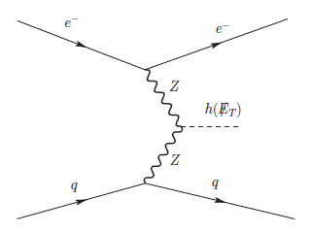
Branching for invisible Higgs
Satoshi Kawaguchi,
Masahiro Kuze
Tokyo Tech
Values given in case of 2σ and L=1 ab⁻¹
Delphes detectors | LHeC [HE-LHeC] 1.3 [1.8 TeV] | FCC-he 3.5 TeV
LHC-style | 4.7% [3.2%] | 1.9%
First ‘ep-style’ | 5.7% | 2.6%
+BDT Optimisation | 5.5% (4.5%*) | 1.7% (2.1%*)
e
e
pe:ZZH
p
jet
PORTAL to Dark Matter ?
LHeC parton-level, cut based <6% [arXiv: 1508.01095]
HL-LHC @ 3 ab⁻¹ < 3.5% [arXiv:1411. 7699]
Uses ZZH fusion process to estimate prospects of Higgs to invisible decay using standard cut/BDT analysis techniques
Results for full MG5+Delphes analyses, done for 3 c.m.s. energies → very encouraging for a measurement of the branching of Higgs to invisible in ep down to 1.2% (1.7%) for 2 (1) ab⁻¹
A lot of checks done: We also checked LHeC ←→ FCC-he scaling with the corresponding cross sections (* results in table) : Downscaling FCC-he simulation results to LHeC would give 4.5%, while up-scaling of LHeC simulation to FCC-he would result in 2.1% ➔ all well within uncertainties of projections of ~25%
➔ further detector and analysis details have certainly an impact on results
Notes:
2 sigma level results

Slide 14
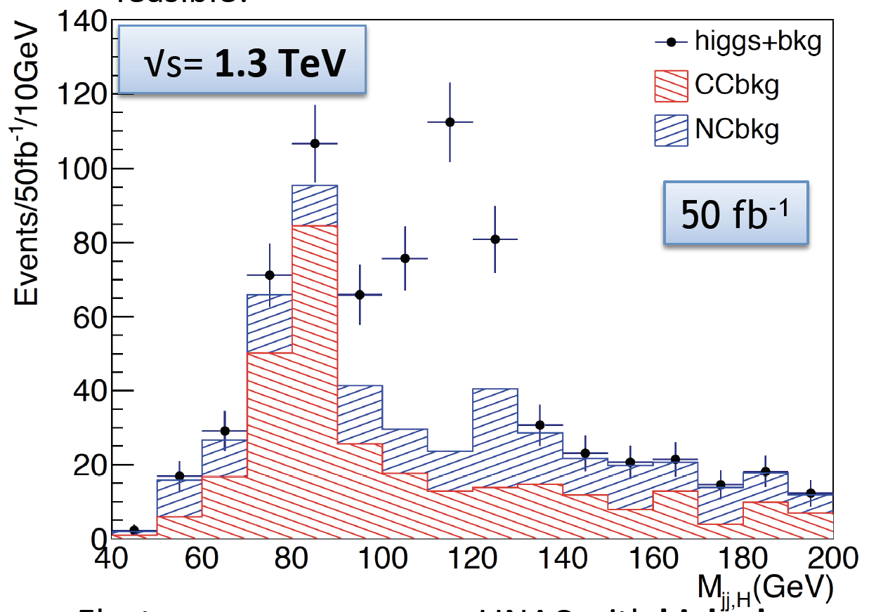

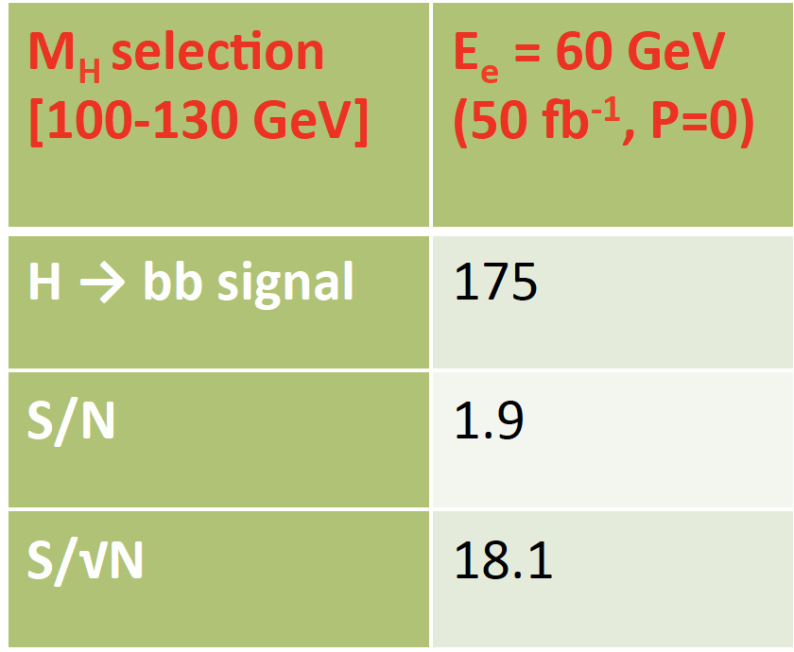
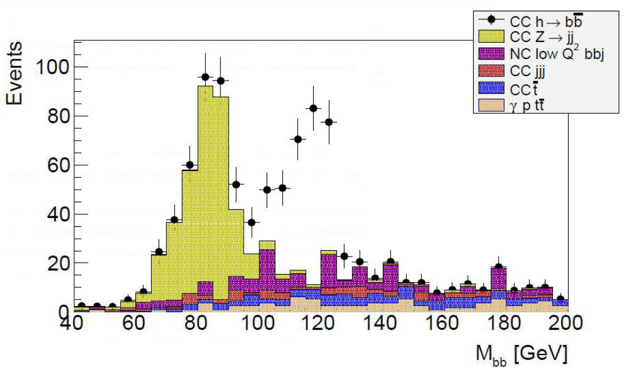
CDR Updates: Two independent analyses
[ after Higgs discovery M_{H}=125 GeV, E_{p}=7 TeV, E_{e}=60 GeV; cut-based & conservative]
PGS of LHC detector
+ flat parton-level b-tagging for |η|<3.0
b: 60%, c: 10%, udsg: 1%
CAL coverage |η|<5.0
ICHEP 2014
Master Thesis Ellis Kay, Liverpool 2014, PGS “detector” ATLAS-style and & modeling of PHP background using low Q² NC DIS
100 fb⁻¹
1 year of data
Confirmed CDR: S/N>1 using conservative light misID and cut-based δμ=2% for 1 ab⁻¹

Slide 15
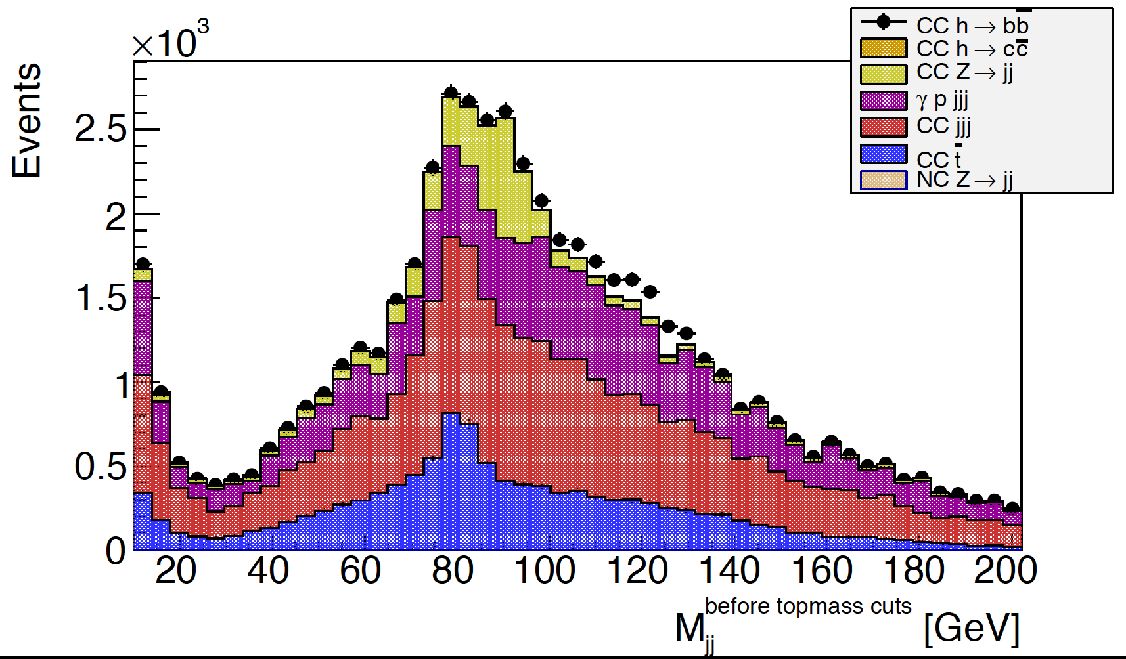
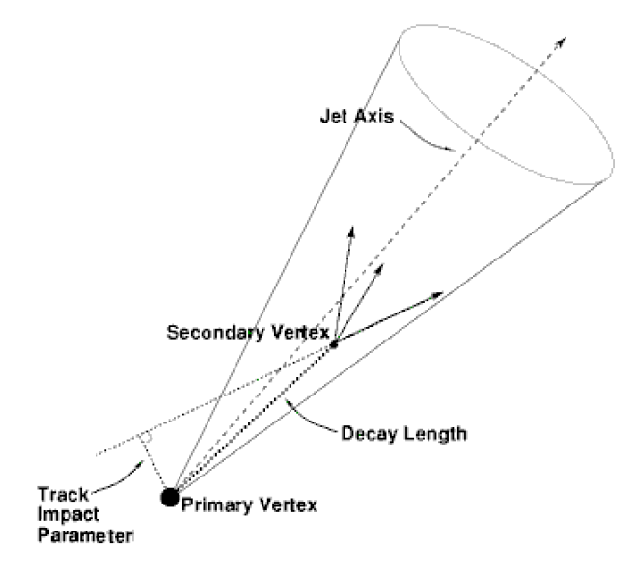
Hunting for Precision Hbb
Dijet Mass Candidates HFL untagged at detector level
Step 1
Basic kinematic cuts and
loose selection (p_{T}>15 GeV)
100 fb⁻¹
1 year of data
Z
H→ bb
Step 2
HFL tagging
Generator
cut of 60 GeV
Step 3
BDT in
Search Window
W
‘Worst’ case scenario plot : Photoproduction background (PHP) is assumed to be 100%!
PHP update: Modelled via Weiszaecker-Williams and cross-checked with Pythia.
→ addition of small angle electron taggers will reduce PHP to ~1-2%

Slide 16
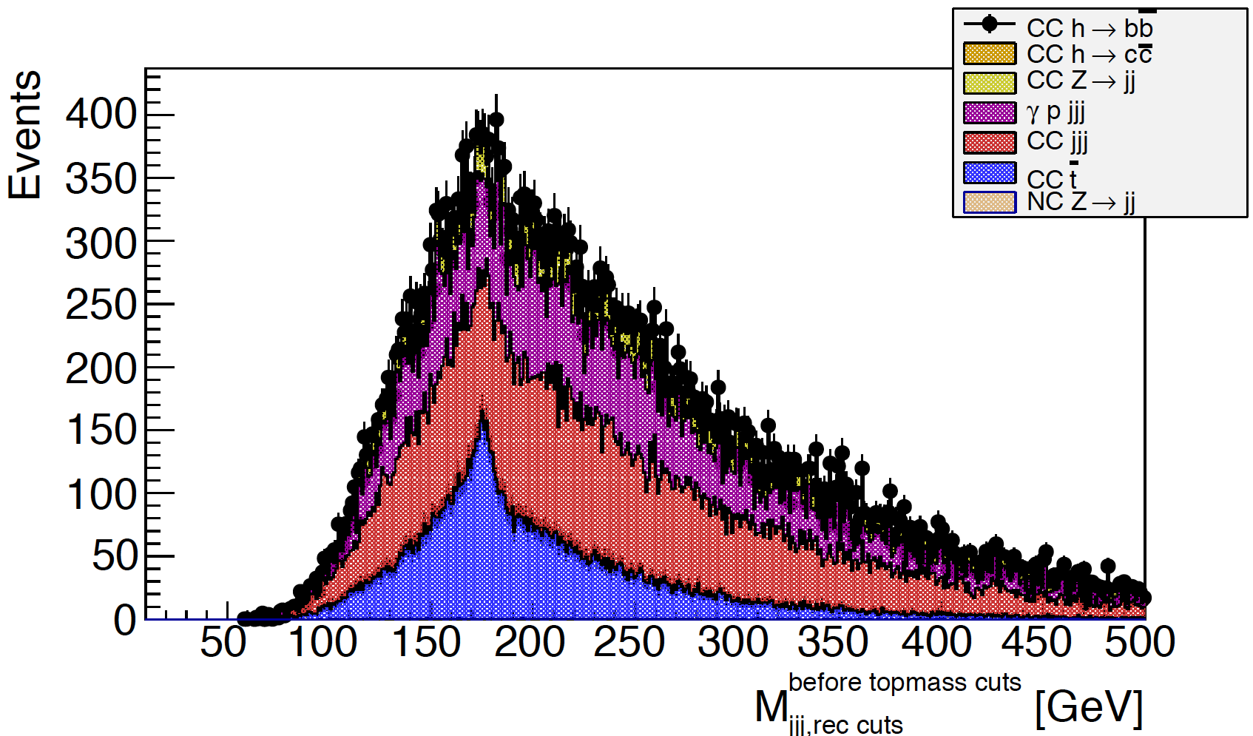
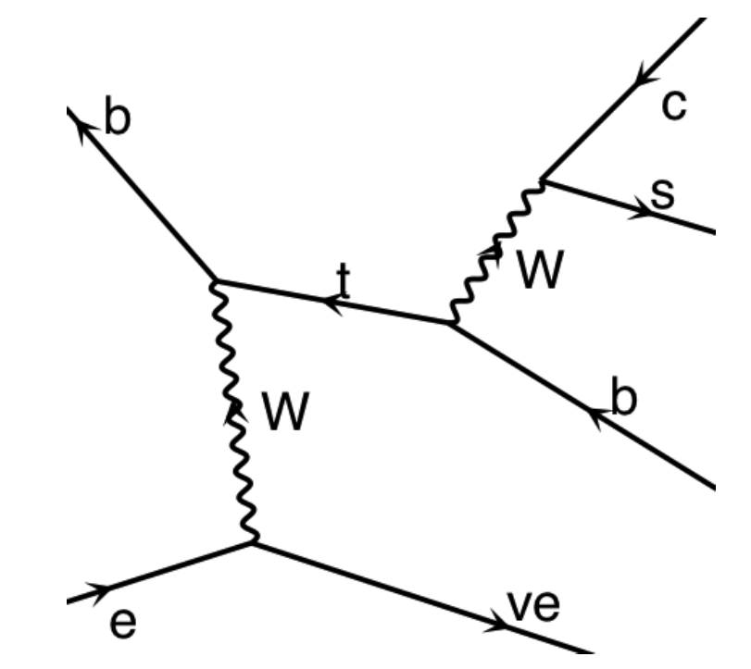
Top: Mass of three highest p_{T} Jets
HFL untagged
100 fb⁻¹
Single top candidates!
top
cut-based analysis: usual cut to accept Higgs
candidates on cost of signal efficiency

Slide 17
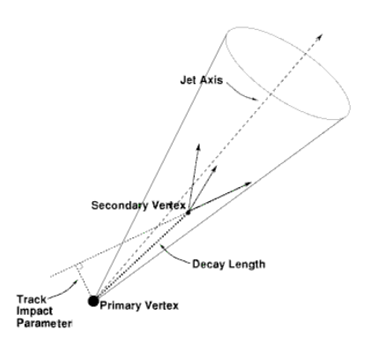
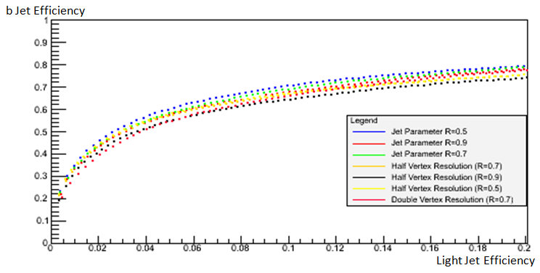
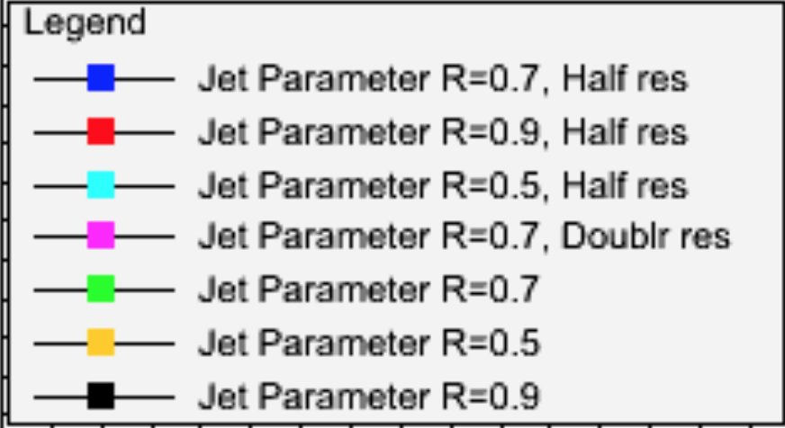
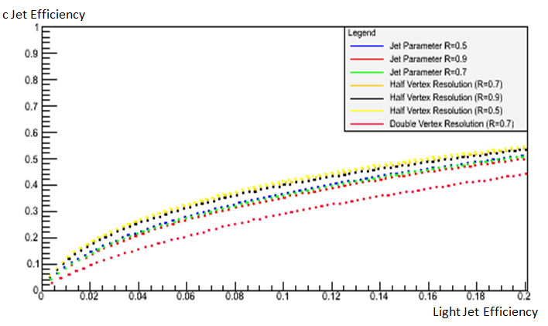
HFL Tagging
Uta Klein & Alan Chan & Jonas Waldendorf MPHYS 2015; Daniel Hampson MPHYS 2016
Beauty
60 %
Realistic and conservative HFL tagging (a la Tevatron) within Delphes realised and dependence on vertex resolution (nominal 10 μm) and anti-kt jet radius studied
Light jet misID efficiency very conservative, worse than ATLAS-BDT-based
used in full LHeC analysis and for FCC-eh extrapolations
Charm
30 %

Slide 18
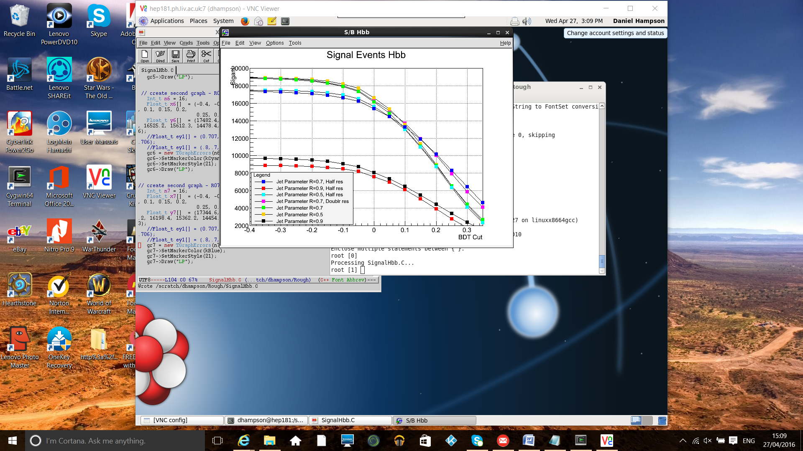

BDT Results for Higgs @ LHeC
Daniel Hampson,
MPHYS 2016
using realistic HFL tagging at Delphes detector level
Hbb : Clear sensitivity to chosen jet radius; rather robust w.r.t. vertex resolution in range of 5 to 20 μm
L=1 ab⁻¹
P_{e}=-80%
Hcc : High sensitivity to vertex resolution (nominal 10 μm) and jet radius
→ expect about 400-600 Hcc candidates

Slide 19
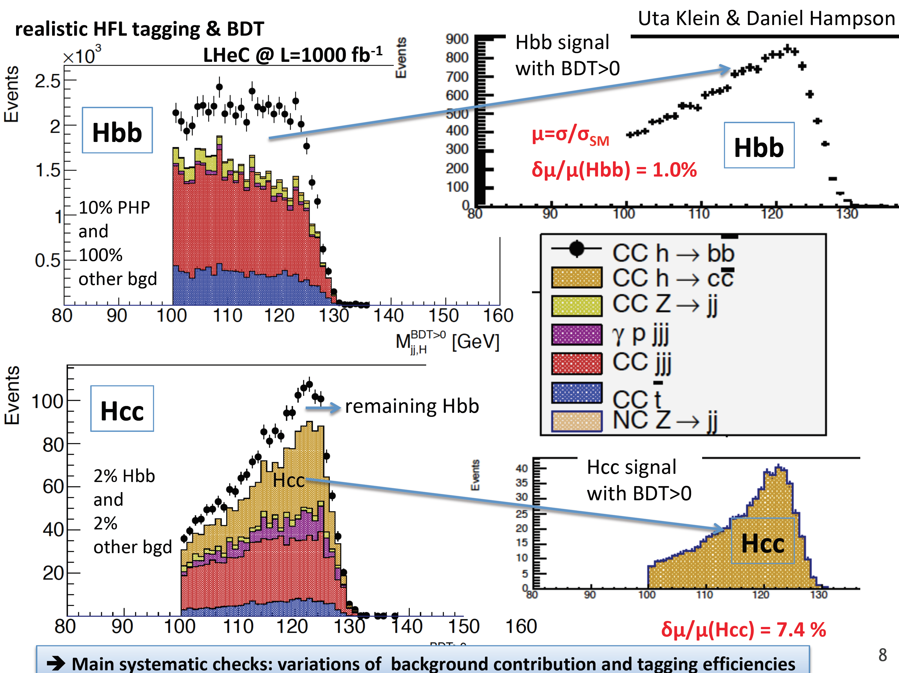
Higgs in ep – clean S/B, no pile-up
& Izzy Harris BSc 2017
0.8%
2% PHP
and 2%
other bgd
Assuming
ATLAS
light
jet misID efficiencies

Slide 20
Further Estimates of Higgs Prospects
Use LO Higgs cross sections σ_{H} for M_{H}=125 GeV, in [fb], and branching fractions BR(H→XX from Higgs Cross Section Handbook (c.f. appendix)
Apply further branching, BR(X→FS) in case e.g. of W→ 2 jets and use acceptance, Acc, estimates based on MG5, for further decay
Use reconstruction efficiencies, ε, achieved at LHC Run-1, see e.g. prospect calculations explored in arXiV:1511.05170
Use fully simulated LHeC Hbb and Hcc results as baseline for S/B ranges
Use fully simulated Higgs to invisible for 3 ep c.m.s. scenarios as guidance for extrapolation uncertainty (~25%)
Estimate HIggs events per decay channel for certain Luminosity in [fb⁻¹]
Calculate uncertainties of signal strengths w.r.t. SM expectation

Slide 21
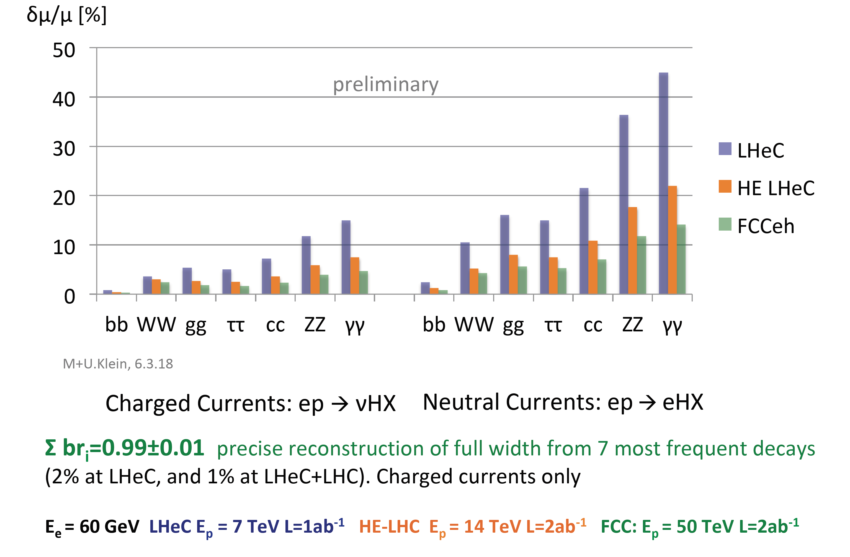
SM Higgs Signal Strengths in ep
HWW and HZZ signal strengths measured at once in DIS
via selection of the final state (e or ν)
E_{e}=60 GeV
WW→H
LHeC 200 fb
FCC-eh 1 pb
ZZ→H
25 fb
150 fb
Uta & Max Klein, Contribution to HL/HE Workshop, 4.4.2018, preliminary.
submitted to EU strategy CERN-ACC-Note-2018-0084
→NC and CC DIS together over-constrain Higgs couplings in a combined SM fit.

Slide 22
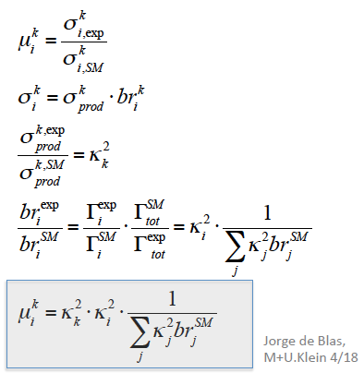


Systematic errors of μ for bb
work in progress
Dominant HFL tagging: light jet misID [ATLAS vs 3 ATLAS]
Photoproduction: reduced down to 10% vs 2%
Acceptance x Efficiency: ±5%
Estimated effects on f
Variation of hadronic energy resolution
(M Tanaka, 2017): 7% on cross section
Luminosity 0.5 to 1%: negligible
Prediction of ep CC SM H→bb cross section: 2%
Based on LHeC measurements and PDFs
δμ/μ = (0.80 ± 0.10 light q ± 0.02 Acc ± 0.02 yp
±0.06 hadr cal ± 0.02 σ_{SM} )%
= (0.80 ± 0.12) % [preliminary]
δκ (bb) = (1.40 ± 0.03)%
δκ (WW) = (0.54 ± 0.03)%
Doubling the WW signal strength uncertainty increases
δκ (bb) from 1.4 to 1.9% and δκ (WW) from .54 to .74%
Note:
N ≈ 10⁵

Slide 23
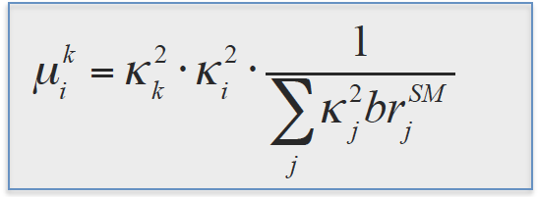
κ Coupling Fit Comparison
So far we considered 7 most abundant SM Higgs decay channels, i=1..7
bb, WW, gg, ττ, cc, ZZ, γγ
ttH may be added. (ep: 1.3 TeV cms!)
eight measurements of κ_{W} and κ_{Z}
two simultaneous measurements
of the other couplings (in CC and NC)
For LHeC nominal
0) Parameter "Kw" : 1 +- 0.0054
1) Parameter "Kz" : 1 +- 0.012
2) Parameter "Kg" : 1 +- 0.030
3) Parameter "Kga" : 1 +- 0.072
4) Parameter "Kc" : 1 +- 0.037
5) Parameter "Kb" : 1 +- 0.014
6) Parameter "Ktau" : 1 +- 0.028
xww 1. 0.54536E-02
xzz 1. 0.11857E-01
xgg 1. 0.30503E-01
xyy 1. 0.72375E-01
xcc 1. 0.37344E-01
xbb 1. 0.13978E-01
xttau 1. 0.28223E-01
J de Blas
M Klein
Two independent fit programs: results are in very good agreement.

Slide 24
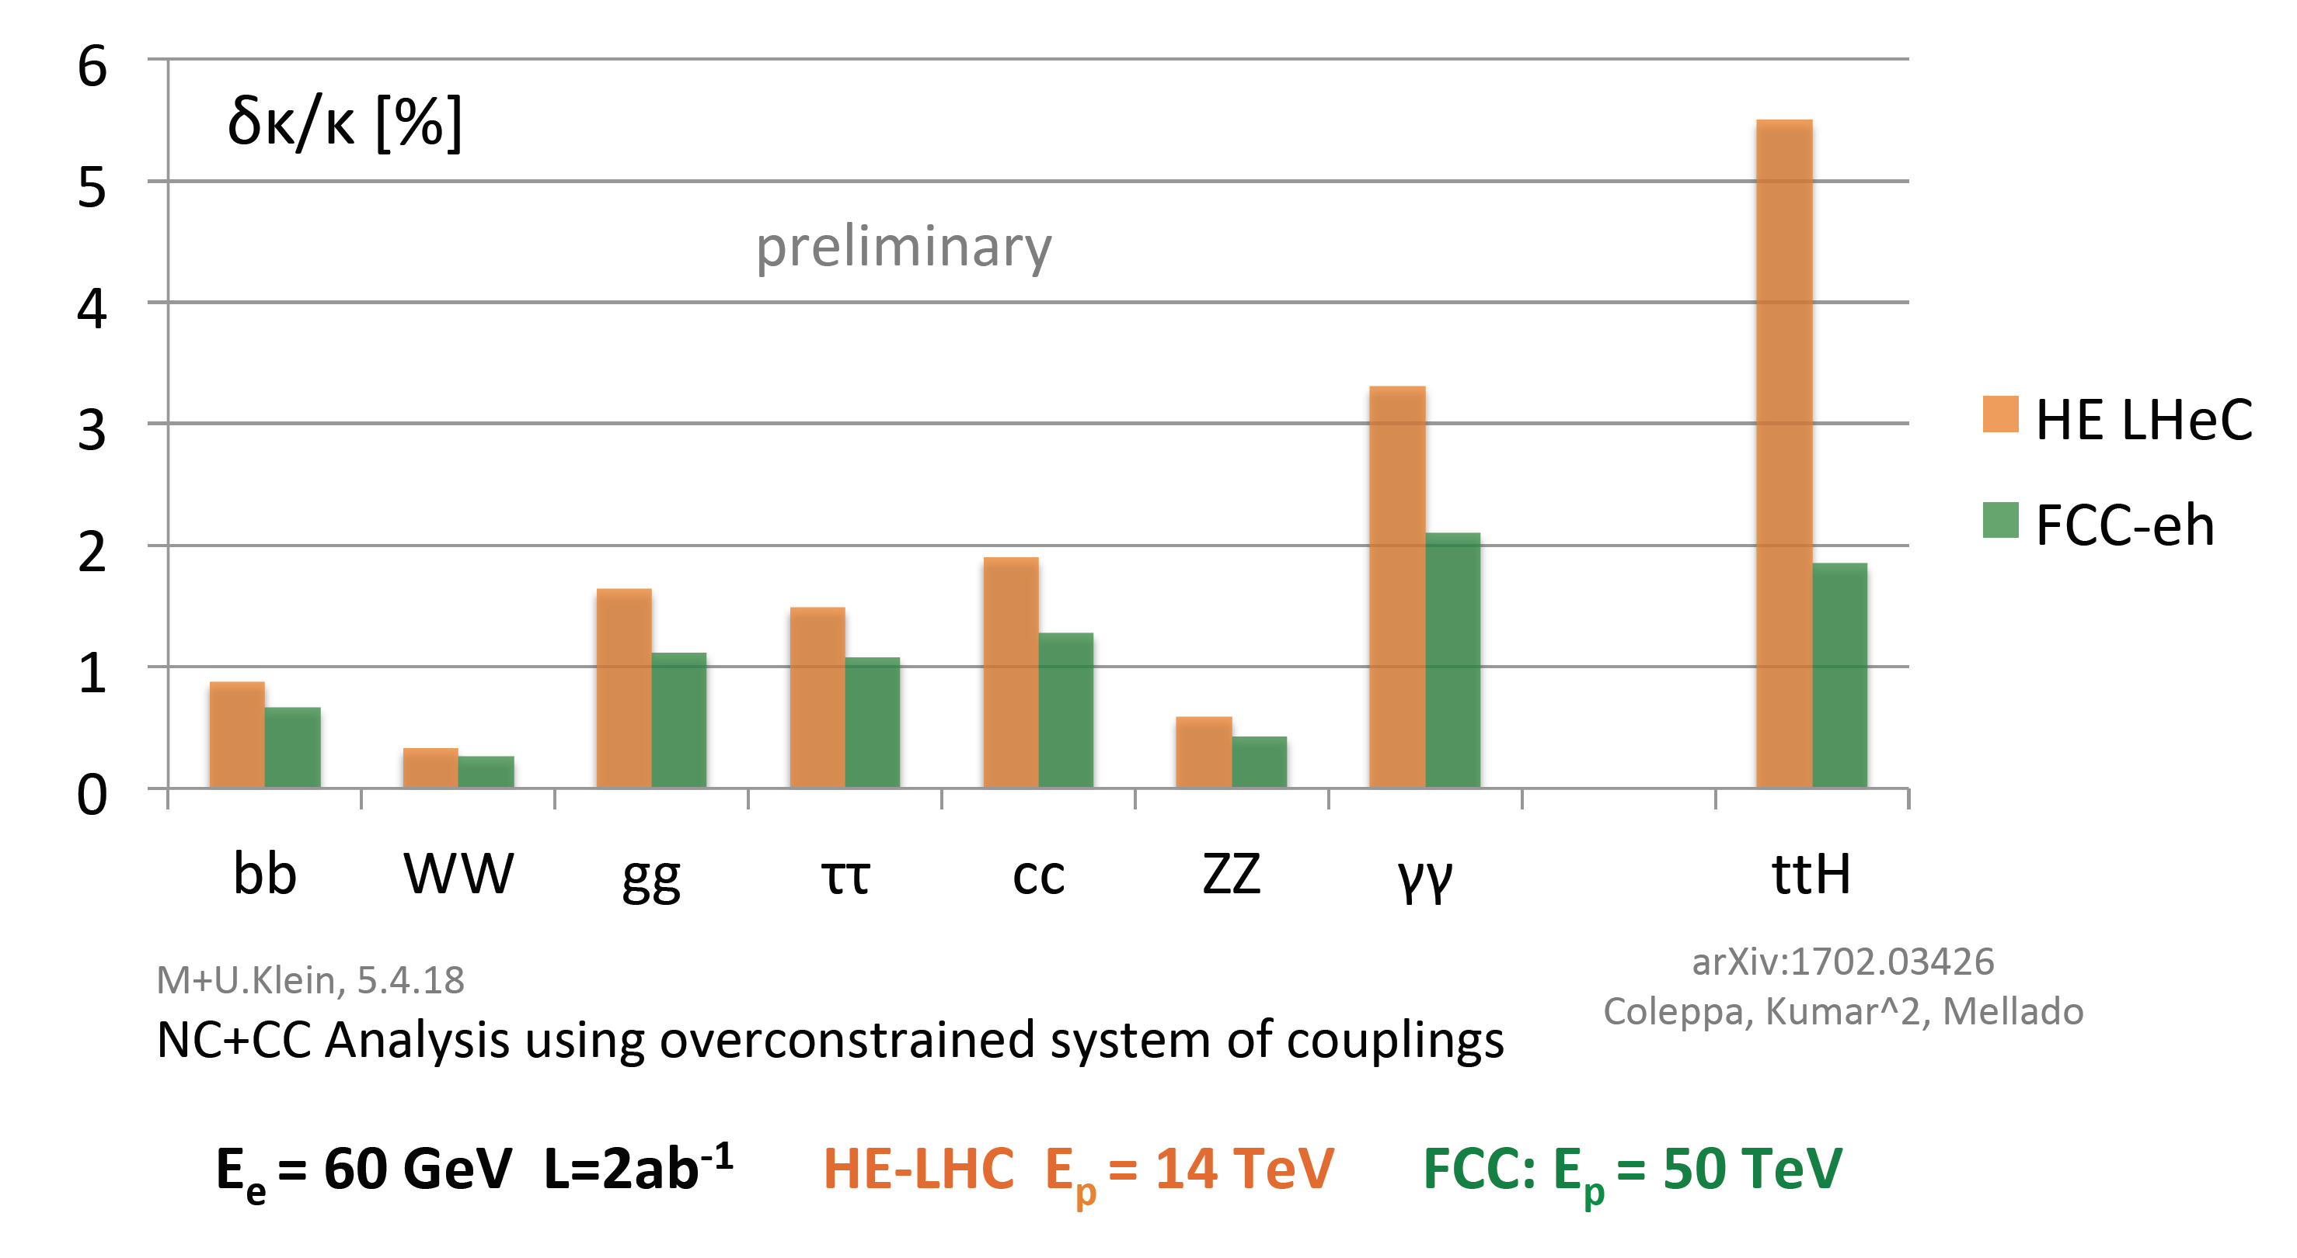
Model-dependent Coupling Fit HE LHeC & FCC-eh
→ Assuming SM branching fractions weighted by the measured κ values, and Γ_{md} (c.f. CLIC model-dependent method)
1.5%
See also talk by Jorge de Blas@FCC-Week2018 for further fits and ep+ee combinations.

Slide 25



... and Consistency Checks of EW Theory
Uta & Max Klein, Contribution to HL/HE Workshop, 4.4.2018, preliminary
→ similar tests possible using various cms energy CLIC machines, however, in ep, we could perform them with one machine
➔ Dominated by H→bb decay channel precision
Very interesting consistency check of EW theory
Values for cos²Θ given here are the PDG value as central value 0.777 and uncertainty from ep Higgs measurement prospects
LHeC: ± 0.010
HE-LHeC ± 0.006
FCC-he ± 0.004
Another nice test: How does the Higgs couple to 3rd and 2nd generation quark?
b is down-type and c is up-type

Slide 26
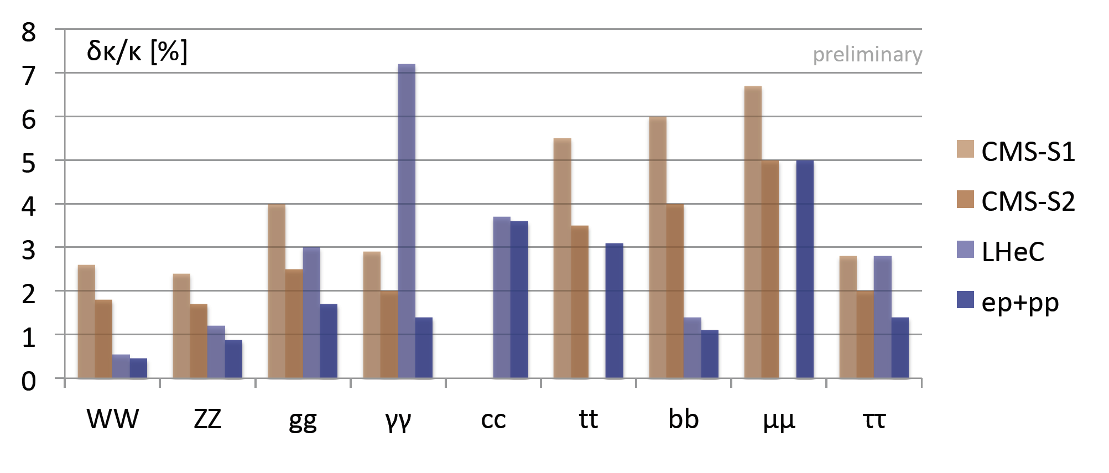
LHeC and HL-LHC Higgs Prospects
Hcc@pp: ~2.0-5.5 σ_{SM}@HL-LHC
[HL-LHC Oct 2017]
submitted to ECFA:
preliminary
2%
→ Amazing prospect for measuring fundamental Higgs couplings to high precision (dark blue) at LHC with pp + ep using SM assumptions.
HL-LHC prospects using new CMS projections (3ab⁻¹) with two scenarios, S1 and S2, in a SM coupling fit

Slide 27
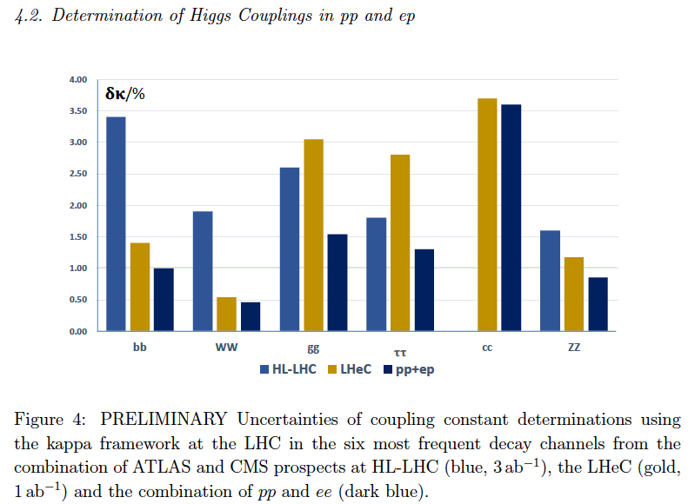
Remarks and Other Views
HL-LH(e)C ensures centre of
Higgs physics stays at CERN
in the thirties. High precision
needs e+e- for total width.
H-HH at HL-LHC!
NEW.
preliminary
Paper soon

Slide 28
Published in book 1 of FCC

Slide 29
Higgs coupling prospects in kappa framework
Table from Book1 of FCC. (w/o LHeC and CepC)
Synergetic evaluation under way by ECFA Higgs working group → preparation for Granada.
Note: rare channels are for pp. Muon has 0.02% branching fraction – 10% error in e+e-

Slide 31
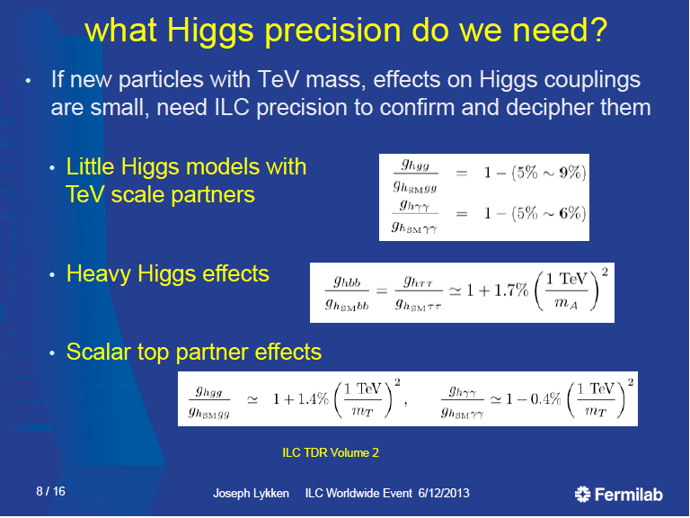
It is not enough to celebrate super-high precision, and it will be very hard to indeed achieve that

Slide 32


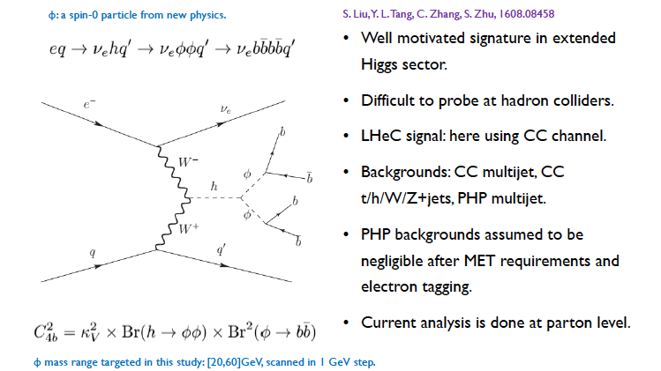
Exotic Higgs Decays
C. Zhang@Poetic 2016
@LHeC: 95% C.L. for m_{φ} of 20, 40, 60 GeV is 0.3%, 0.2% and 0.1% for C_{4b}²

Slide 33
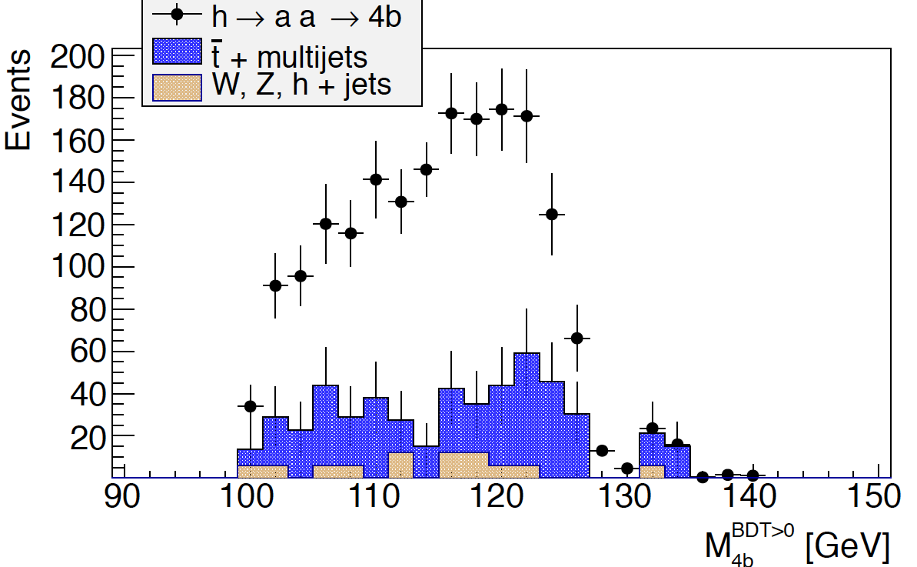
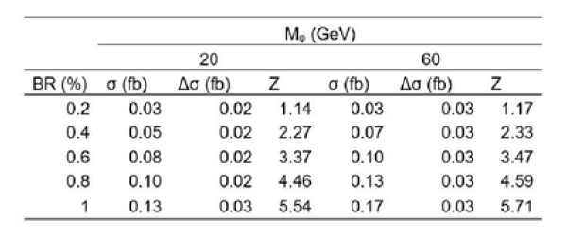

First Results @ FCC-eh
Uta Klein &
Michael O’Keefe
MPHYS 2017
L=1 ab⁻¹
P_{e}=-80%
m_{Φ} = 20 GeV
BR=10%
Very promising first results to discover an exotic Higgs decay into two new light scalars at FCC-he down to a BR of 1% for 1 ab⁻¹.
A BR of 10% could be discovered within 1 year (100 fb⁻¹).
BDT>0
Values for BDT>0

Slide 34

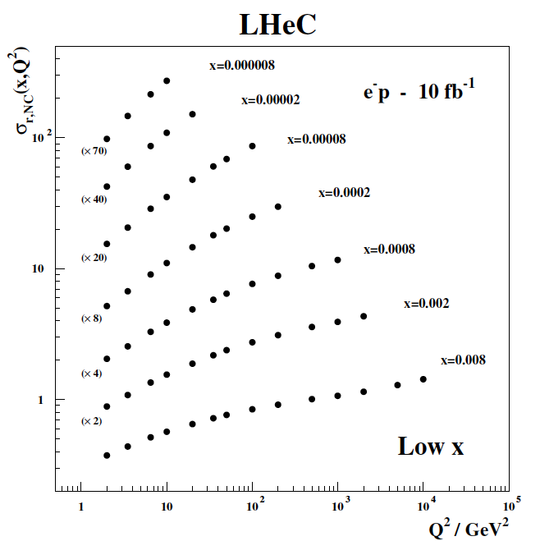

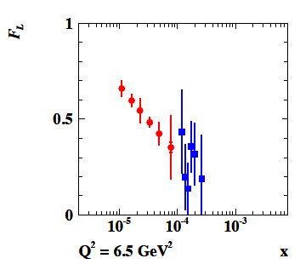

Full simulation of DIS [EM,had calibration, tracking, backgrounds, ..]
Unravelling proton structure needs cleanest DIS constraints, proton
cf Claire Gwenlan, at this workshop
High precision F_{L} from variation
of E_{e} independently of LHC/FCC
LHeC CDR: 1206.2913 J Phys G
High precision F₂(x,Q²) from few days
of nominal ep running. Needs large Q²
and low x ~ 1/s:
Impossible at EIC
MK: 1802.04317
Full set of PDFs and strong coupling: self consistent system!
Discovery of Saturation @ low x; Test of Factorisation; high x

Slide 35
Precision PDFs and LHC Higgs physics
Cross section
to N³LO
needs PDFs to
N³LO
and strong
coupling to
per mile
precision
LHeC with 50fb⁻¹
ep Higgs
paper,
to appear.
C Anastasiou et al, arXiv:1602.00695 → iHixs programe

Slide 36
Draft 9.4. – in preparation

Slide 37
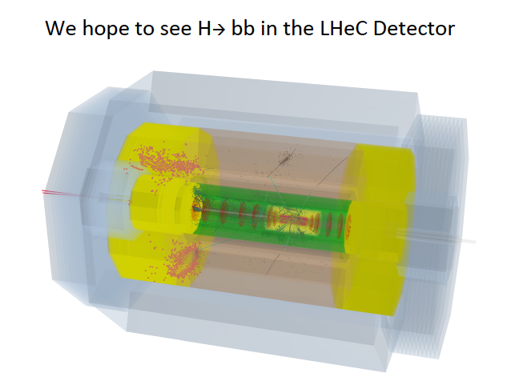
ERL-e
LHC-p
IP
P. Kostka et al., Orsay WS 2018

Slide 38
Wrap Up [Uta Klein at FCC CDR Meeting]
LHeC (FCC-he) could measure the dominant Higgs couplings, including ttH, to 0.6-17% (0.2-2%) precision [CC+NC DIS, no pile-up, clean final state..]
Striking synergy of ep (>~1 TeV) and ee (250-350 GeV) and pp for Higgs coupling measurements!
ep would empower the physics potential of pp (non-resonant searches, EW, Higgs..) through high precision QCD measurements: flavour separated PDFs at N³LO, α_{S} to per mille …
Higgs measurements in ep are self consistent experimentally and theoretically based on DIS cross sections with very small systematic uncertainties
Combining pp with ep, a very powerful Higgs facility can be
established at the LHC and subsequently at higher energy
hadron colliders.

Slide 39
Additional material

Slide 40
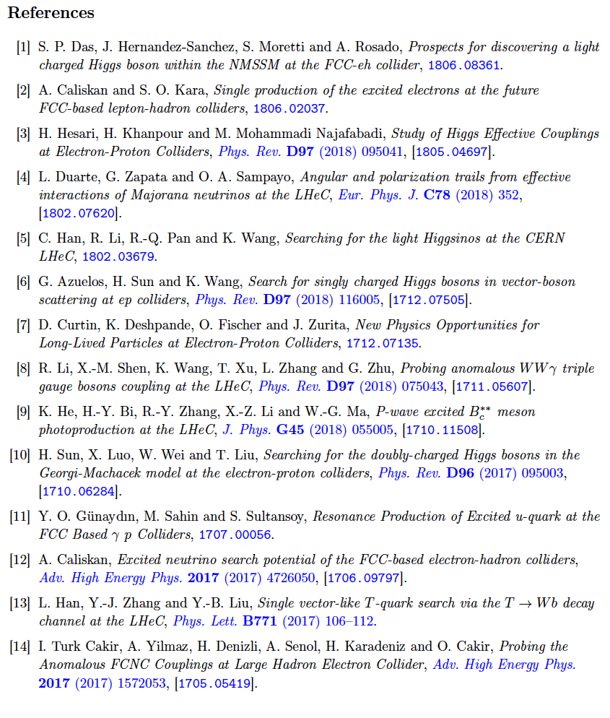
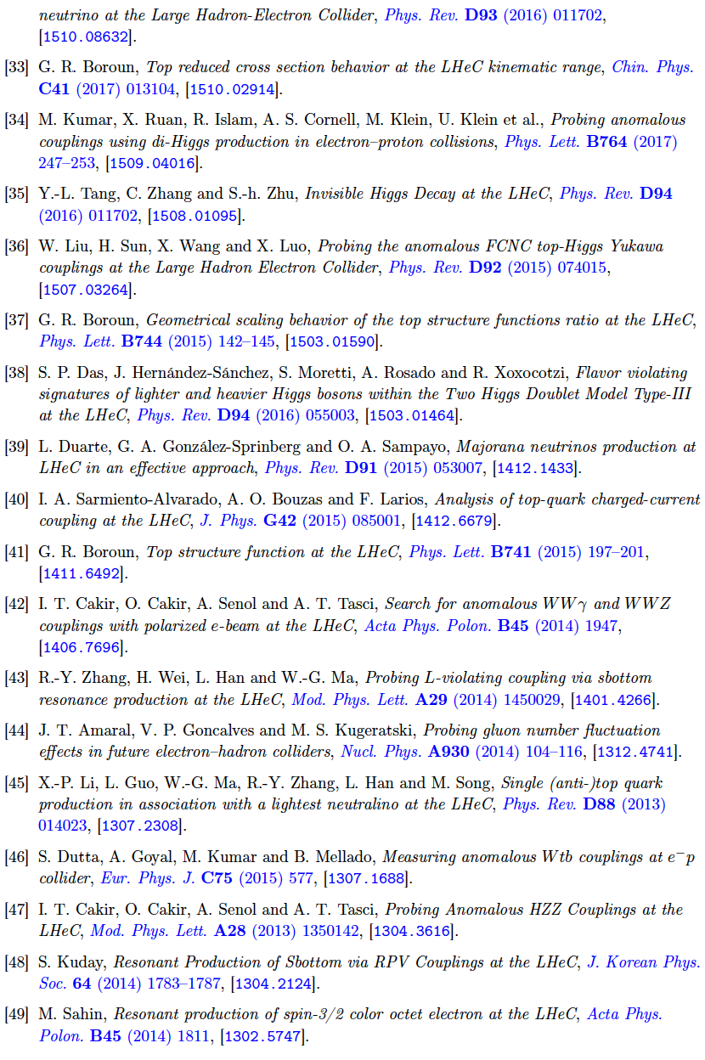
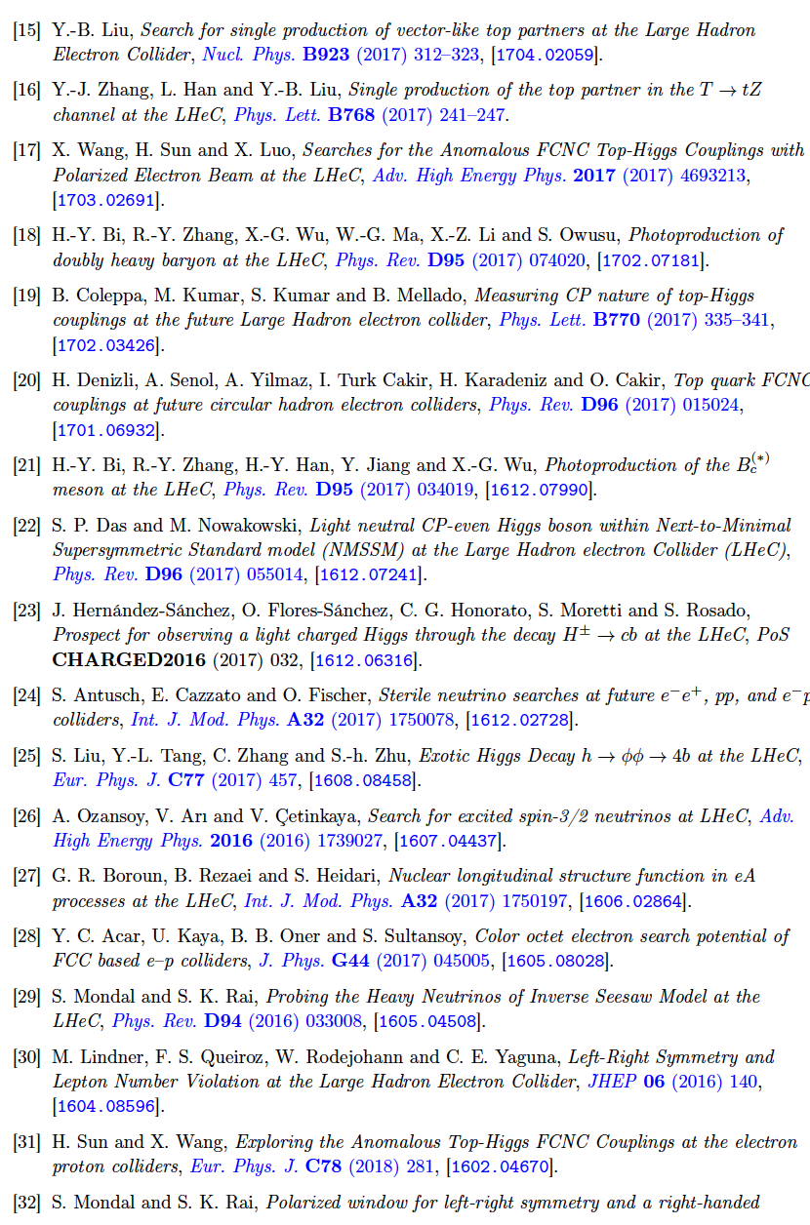

Thanks to Hao Sun
50 journal papers on BSM with LHeC in recent years

Slide 41
Additional material

Slide 42
Additional material

Slide 43
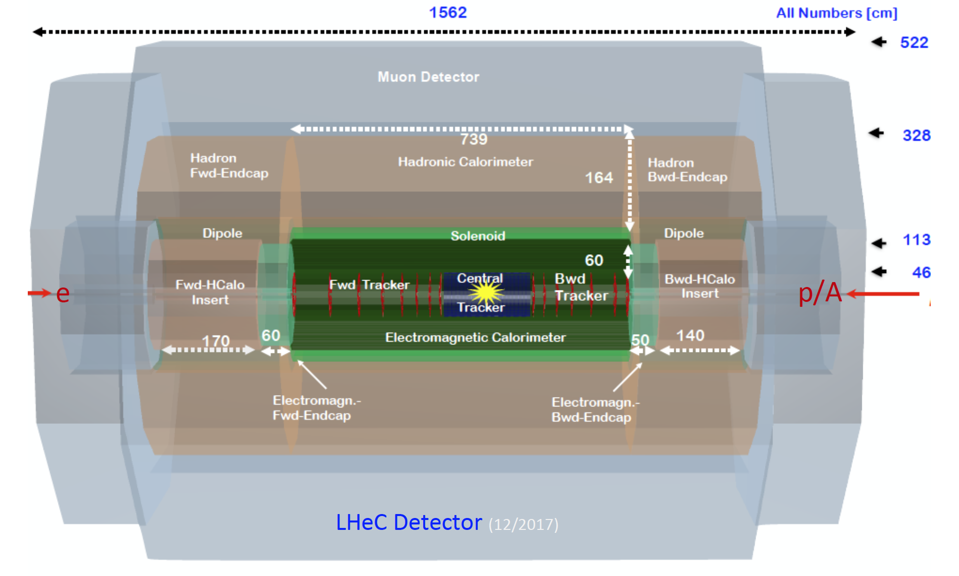
LHeC Detector for the HL/HE-LHC
[arXiv:1802.04317]
e
P.Kostka et al
Length x Diameter: LHeC (13.3 x 9 m²) HE-LHC (15.6 x 10.4) FCCeh (19 x 12)
ATLAS (45 x 25) CMS (21 x 15): [LHeC < CMS, FCC-eh ~ CMS size]
If CERN decides that the HE LHC comes, the LHeC detector should anticipate that
Notes:
Length x Diameter: LHeC (13.3 x 9 m²) HE-LHC (15.6 x 10.4) FCCeh (19 x 12)
ATLAS (45 x 25) CMS (21 x 15): [LHeC < CMS, FCC-eh ~ CMS size]
If CERN decides that the HE LHC comes, the LHeC detector should anticipate that
interaction region in summer extra discussion : suppression synch radiation to get head on collisions (loest ions raus und treffen aud protonen – HI scattering) backscattering of

Slide 44

Model-dependent Coupling Fit
LHeC CLIC (350)
→Couplings of the dominant Higgs decays could be measured to few percent precision at ep@HL-LHC.
Impressive complementarity of ee and ep→ to get model independent couplings, use absolute HZZ cross section from ee.
→ compared to similarly model-dependent fit CLIC@ 350 GeV M_{H}=126 GeV,500 fb⁻¹, stats. errors only [arXiv:1608.07538]
1.5%
ep
ee
Uta & Max Klein, Contribution to HL/HE Workshop, 4.4.2018, preliminary

Slide 45
Additional Sources & Thanks to
Much more material can be found here: LHeC and FCC-eh Workshop, September 2017, CERN https://indico.cern.ch/event/639067/
The LHeC/FCC-eh study group, http://cern.ch/lhec.
“On the Relation of the LHeC and the LHC” [arXiv:1211.5102]
1st FCC Physics Workshop, 16.1.-20.1.2017, CERNhttps://indico.cern.ch/event/550509/
Before April 2018: Higgs branching fractions and uncertainties taken from https://twiki.cern.ch/twiki/bin/view/LHCPhysics/CERNYellowReportPageBR2014
Update used from April 2018https://twiki.cern.ch/twiki/bin/view/LHCPhysics/CERNYellowReportPageBR
FCC Week 2018, Amsterdam, https://indico.cern.ch/event/656491/
Special thanks to my colleagues in the LHeC/FCC-he Higgs group and
to Jorge de Blas for the discussion of model-dependent coupling fits.

Slide 46

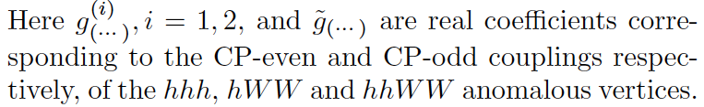
Double Higgs Production
[1509.04016]
FCC-eh cut-based study
FCChe g_{HHH} ~ 20% in ep
95% C.L.Exclusion Limits from σ_{fiducial}
1σ for SM hhh for E_{e}
60 (120)GeV and 10ab⁻¹
SM g¹_{hhh}=1
Probing anomalous couplings: limits are obtained by scanning one of the non-BSM coupling while keeping other couplings to their SM values.
explore He-LHeC/LHeC ep prospects!
CLIC-1.4TeV: δg_{HHH} ~40-50%
5% systemtatic uncertainty included
Integrated luminosity
100 1000 10000 fb⁻¹

Slide 47

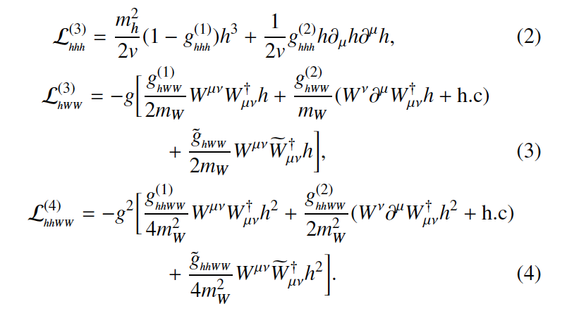
Double Higgs Production at FCC-eh
“Probing anomalous couplings using di-Higgs production in electron-proton collisions” by Mukesh Kumar, Xifeng Ruan, Rashidul Islam, Alan S. Cornell, Max Klein, Uta Klein, Bruce Mellado,
Physics Letters B 764 (2017) 247-253 [arXiv:1509.04016]
SM
FCC-eh
SM(P=-0.8)
σ(HH)=430 ab
in VBF!
All other g
coefficients are anomalous couplings to the hhh, hWW and hhWW
anomalous vertices
→ those are 0 in SM
Notes:
3 and 4 point fermion interactions
6-dimensional operator

Slide 48
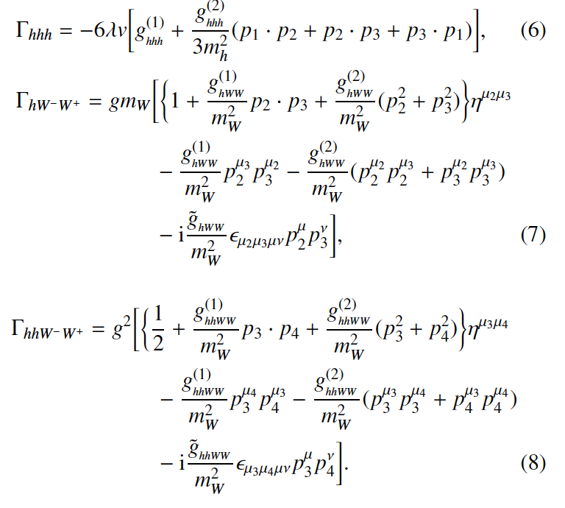
Effective Vertices
[arXiv:1509.04016]
1,2,3=
h,h,h
1,2,3 =
h,W-,W+
1,2,3,4 =
h,h,W-,W+
Note the dependence on momenta in non-SM vertices. This induces significant impact on scattering kinematics.
Notes:
indices 1,2,3 corespond to particles listed in vertex e.g. hhWW = 1,2,3,4
mu_2 = W- mu_3=W+
CP-even g^1(hhWW) and CP-odd g_tilde_hhWW can be uniquiely constraint
also g^2_hhWW well below 10-2 (see factor 10 supression)

Slide 49
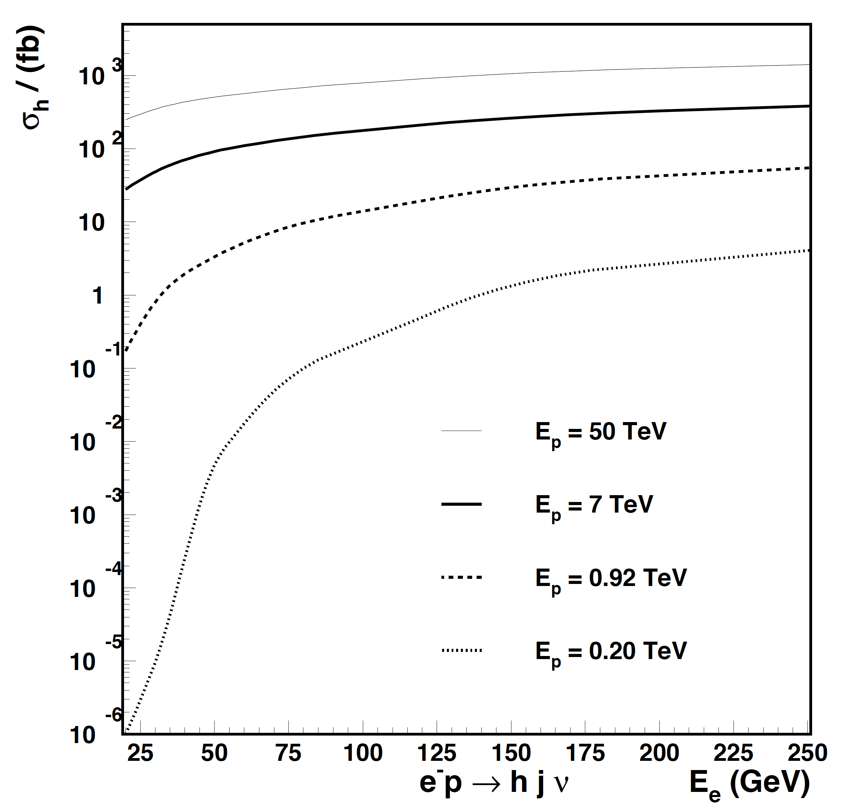
SM Higgs in ep
U. Klein,
@DIS2015
unpolarised
electrons
FCC-eh
√s=3.5 TeV
LheC
√s=1.3 TeV
HERA (L=0.5fb⁻¹)
Higgs in eA @FCC-ePb
σ_{Higgs} [fb]
eff. ‘Ep’=19.7 TeV
protons
E_{e} [GeV] | P_{e} = 0 | -0.8
20 | 105 | 190
30 | 153 | 276
50 | 242 | 436
60 | 282 | 507
σ @ EIC: 7 orders of magnitude lower
US-EIC
LHeC / FCC-eh: Sizeable Higgs rates in charged current (CC) DIS for L=100-1000 fb⁻¹
Notes:
HH (H>bb) cross section at 9.165 TeV is
1.3 fb using only eta<6 cuts for all b and jets no further pT cuts.
-> so 1 fb-1 luminosity will not allow a cross section measurement (like single Higgs for HERA – lumi was too low)
single H expected to be 7 times higher than LHeC and 2.6 times FCC-eh, but luminosity 100-1000 times smaller (1fb-1 lumi expected)

Slide 50
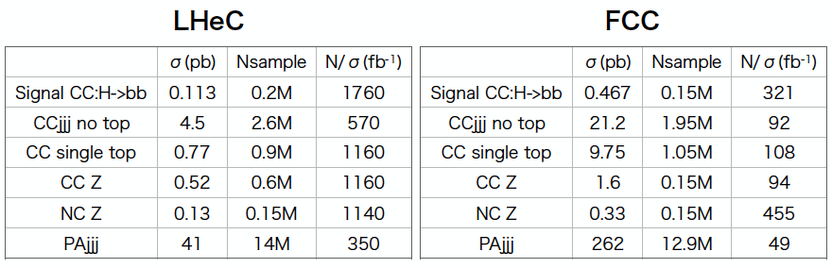
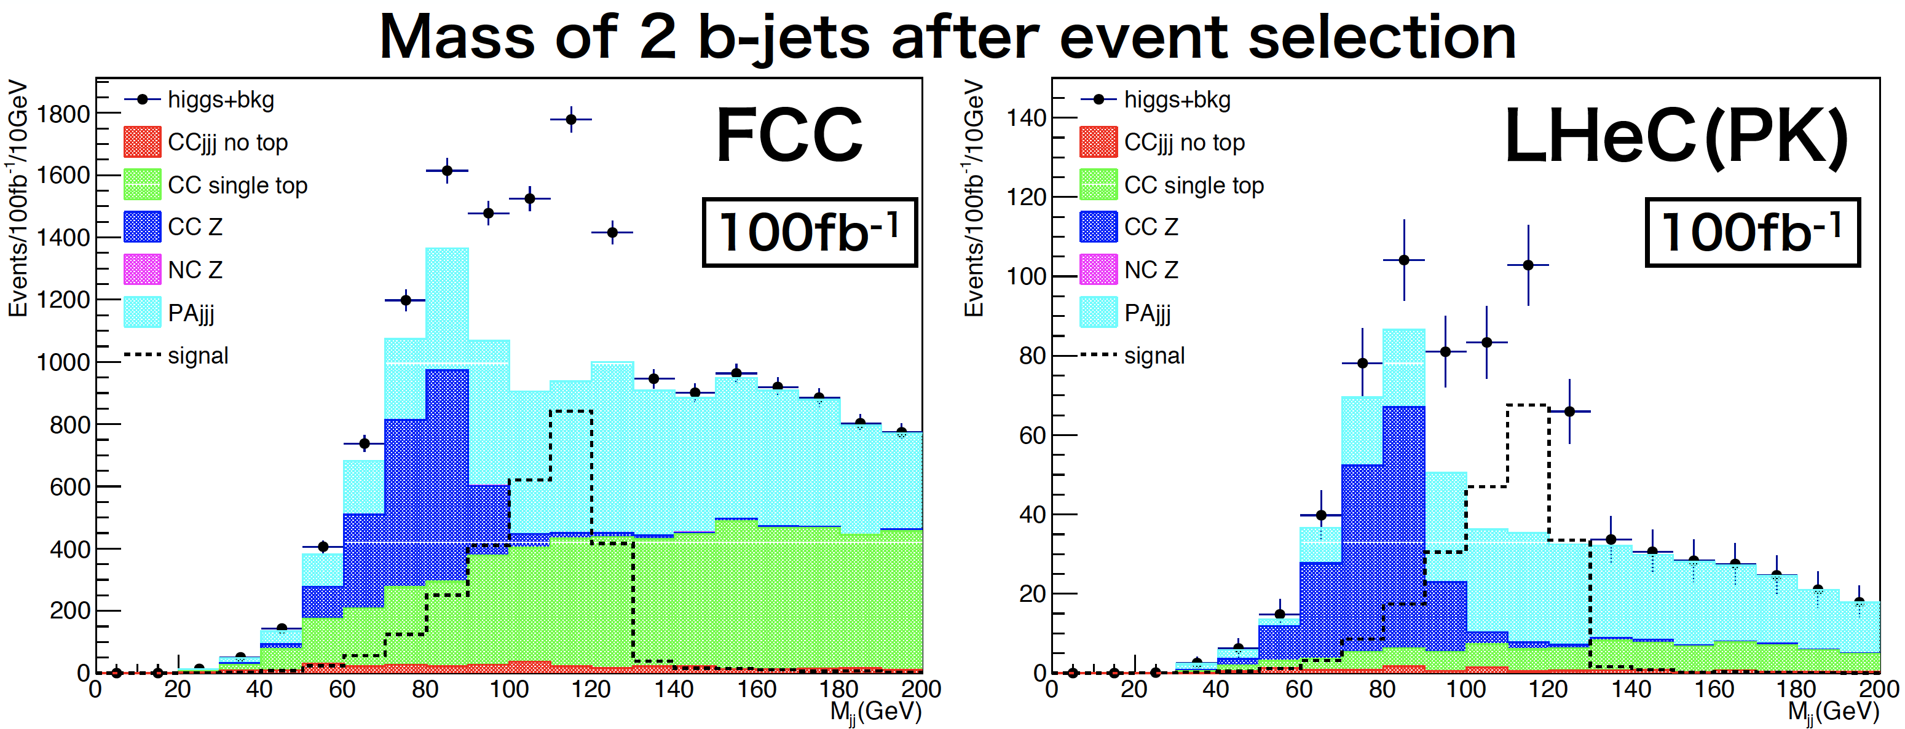
FCC-eh cut based results
Masahiro Tanaka, Masahiro Kuze, Tokyo Tech 2017
unpolarised samples
using E_{e}=60 GeV and
Ep of 7 and 50 TeV

Slide 51


Higgs in ee vs ep
ee
ee: Dominant Higgs productions
HZZ
pe vs e+e- Higgs cross sections
ep
10³
HWW 1pb
ep:CC DIS WW Fusion
ep:HWW
HZZ 148 fb
ep: NC DIS ZZ Fusion
ep
ILC/CEPC
HZZ
ep: HZZ
1300
3500
ee
CLIC 350
1.4 TeV 3 TeV

Slide 52

Azimuthal Angle Distributions
[arXiv:1509.04016]
between missing transverse energy and forward jet, at Delphes detector-level,
including background : bbbbj, bbjjj, Z(bb)h(bb)j, ttj, h(bb)bbj
→ For signal, we consider hh→ bbbb decays motivated by h→bb studies.
normalised DIS cross sections are sensitive to non-BSM vertices
initial study published for this novel variable
potential for a deeper analysis and interpretation

Slide 53
CC DIS WWH → H
Uta & Max Klein, Contribution to FCC Workshop, 16.1.2018, preliminary
FCC-eh L=2 ab⁻¹
 | bb | WW | gg | ττ | cc | ZZ | γγ
BR | 0.577 | 0.215 | 0.086 | 0.0632 | 0.0291 | 0.0264 | 0.00228
δBR_{theory} | 3.2% | 4.2% | 10.1% | 5.7% | 12.2% | 4.2% | 5.0%
N | 1.15 10⁶ | 4.3 10⁵ | 1.72 10⁵ | 1.26 10⁵ | 5.8 10⁴ | 5.2 10⁴ | 4600
f | 2.86 _{BDT} | 16 | 7.4 | 5.9 | 5.6 _{BDT} | 8.9 | 3.23
δμ/μ [%] | 0.27 | 2.45 | 1.78 | 1.65 | 2.36 | 3.94 | 3.23
Sum of first 6 branching fractions
that could be measured
LHeC : 0.9964 +- 0.02
FCC-eh: 0.9964 +- 0.01

