Slide 1




The Large Hadron Electron Collider Project
Deep Inelastic Scattering
Higgs
ep and eA Physics
Accelerator Design
Detector Concept
Max Klein
Seminar at LNF Frascati, Rome, March 21st, 2013

Slide 2
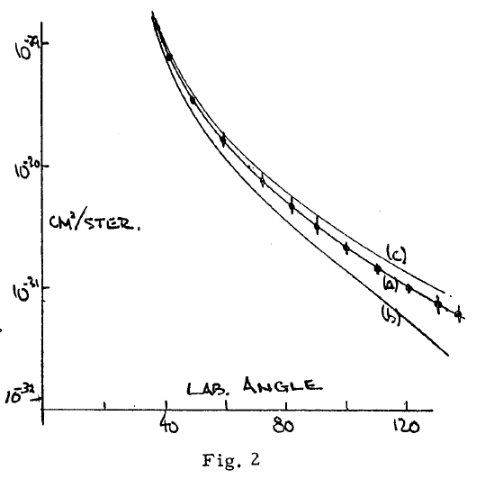
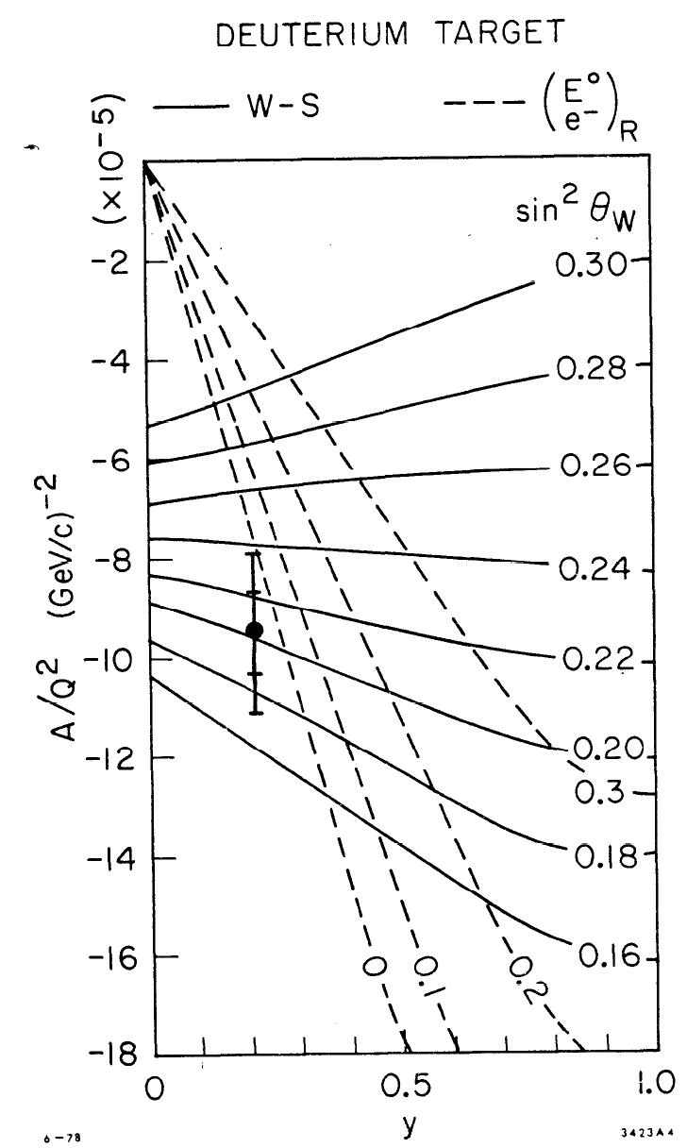
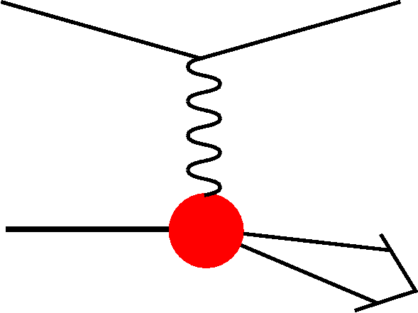
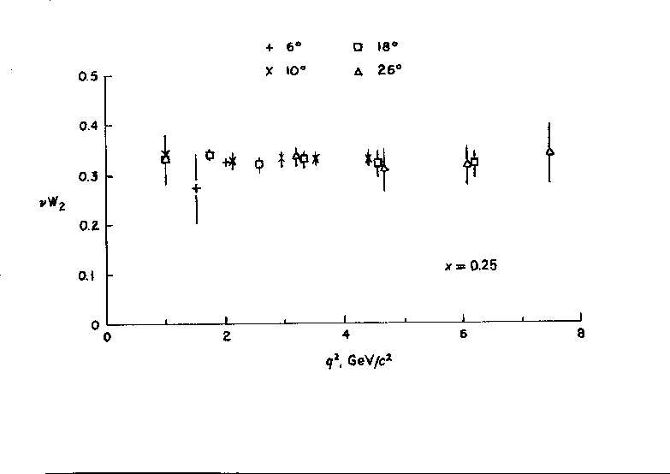


Early ep Scattering
Hofstadter et al, 1955, r_{p}=0.74±0.20fm
In DIS the
x and Q²
scales are
prescribed
by the
electron
kinematics
SLAC-MIT 1968 Bj Scaling → Partons
Prescott et al, 1978, I_{3,R}^{e}=0

Slide 3
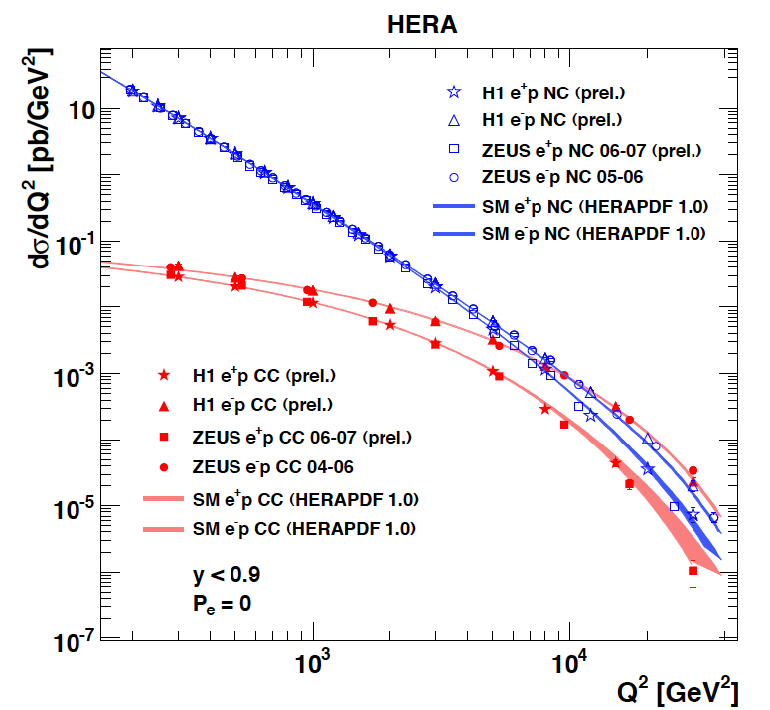
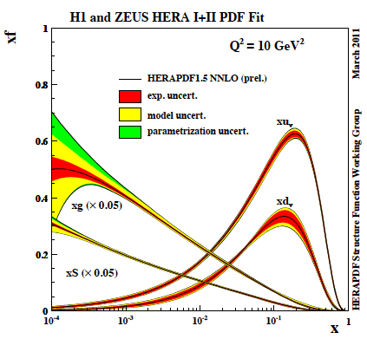
Results from HERA
The weak and electromagnetic interactions reach similar strength when Q² ≥ M²_{W,Z}
F₂ rises towards low x, and xg too.
Parton evolution - QCD to NNLO
Measurements on α_{s}, Basic tests of QCD: longitudinal structure function, jet production, γ structure
Some 10% of the cross section is diffractive (ep → eXp) : diffractive partons; c,b quark distributions
New concepts: unintegrated parton distributions (k_{T}) , generalised parton distributions (DVCS)
New limits for leptoquarks, excited electrons and neutrinos, quark substructure, RPV SUSY
Interpretation of the Tevatron measurements (high Et jet excess, M_{W}, searches..), + base for PDF fits..
M.Klein, R.Yoshida: Collider Physics at HERA Prog.Part.Nucl.Phys. 61 (2008) 343-393 and recent H1,ZEUS results
A Recent review of The Theory of Deep Inelastic Scattering: J.Bluemlein arXiv:1208.6087 ProgPartNuclPhys 69(2013)28

Slide 4
60 GeV electron beam energy, L= 10³³ cm⁻²s⁻¹, √s=1.3 TeV: Q²_{max}= 10⁶ GeV², 10⁻⁶ < x< 1
Recirculating linac (2 * 1km, 2*60 cavity cryo modules, 3 passes, energy recovery)
Ring-ring as fall back. “SAPHIRE” 4 pass 80 GeV option to do mainly: γγ→ H

Slide 5





















Accelerator Design: Participating Institutes
TOBB ETU
Source | Power [MW]
Cryogenics (linac) | 21
Linac grid power | 24
SR compensation | 23
Extra RF cryopower | 2
Injector | 6
Arc magnets | 3
Total | 78
KEK

Slide 6
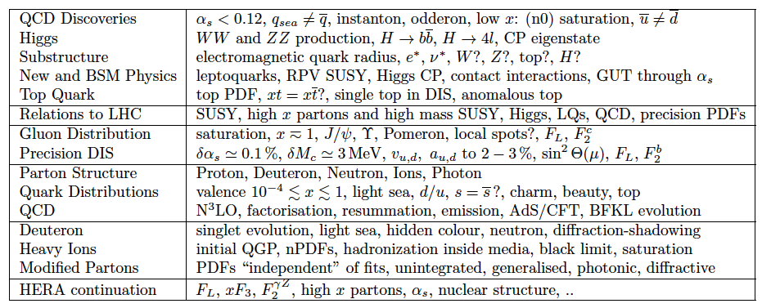
The LHeC Physics Programme
CDR, arXiv:1211.4831 and 5102
http://cern.ch/lhec
Ultra high precision (detector, e-h redundancy) - new insight
Maximum luminosity and much extended range - rare, new effects
Deep relation to (HL-) LHC (precision+range) - complementarity

Slide 7
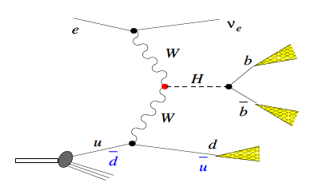
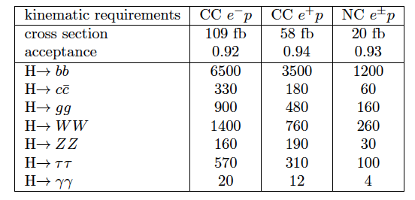
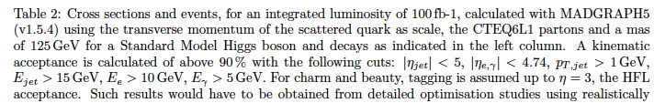
Higgs at the LHeC
In ep the Higgs is radiated from a W or Z exchanged in the t channel. This is a unique production mode. The theoretical uncertainties are very small: J.Blümlein et al, NP B395(1993)35
At the LHC ~90% is gg → H, while VBF is an admixture of WW and ZZ fusion. The ep final state is cleaner than in pp. A first study of the dominant H → bb decay shows the WW-H-bb coupling can be measured to 3% with an S/B=1.
(cf CDR and U.Klein Talk at ICHEP2012)
The rates are high and with a
simpler final state and dedicated
detector also difficult channels
may be accessed (as the charm
2nd generation one). This needs
to be studied. With an ep luminosity
near to 10³⁴, the LHeC generates
as many Higgses as the ILC at that L.
E_{e}=60GeV

Slide 8
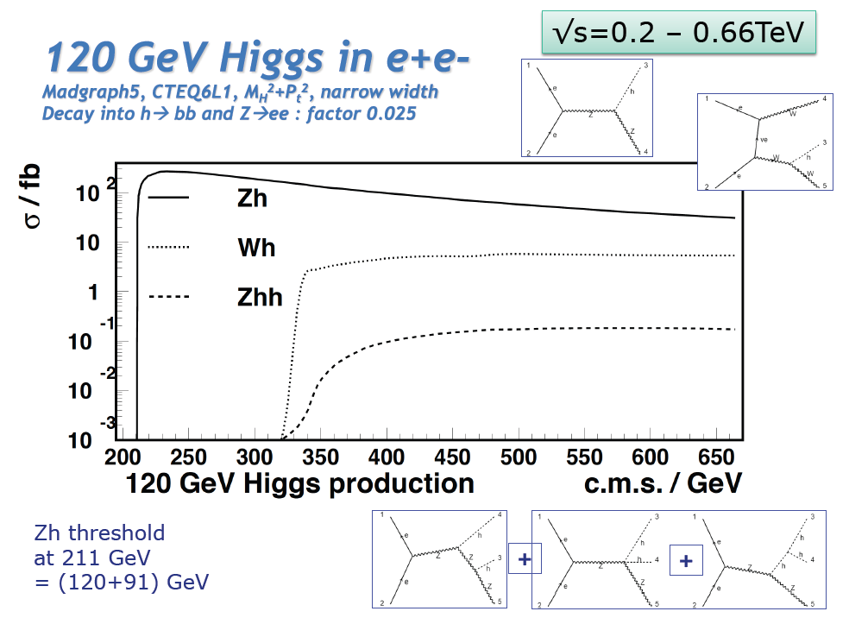
Higgs at the ILC
U.Klein, before June 12

Slide 9
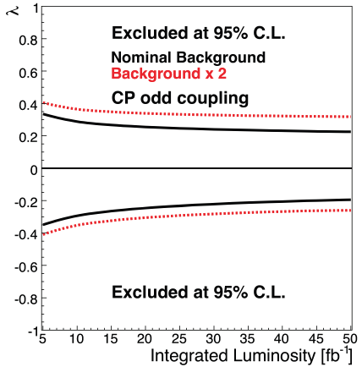
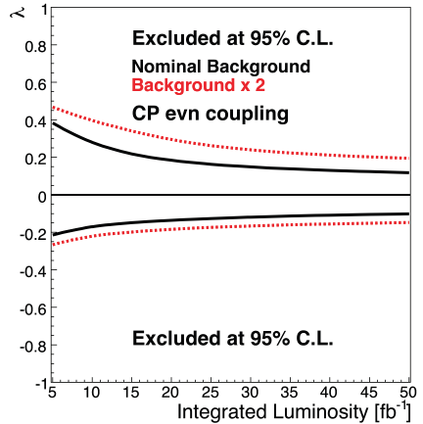
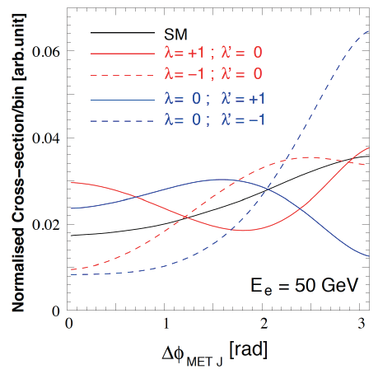



Higgs at the LHeC
In the SM the Higgs is a J^{PC}=0⁺⁺ state.
One needs to measure the EV if CP
is conserved, and the mixture of even
and odd states if it is not.
λ (λ’) anomalous CP (non) conserving terms
S.Biswal et al,
PhysRevLett.109.261801

Slide 10
Exp uncertainty
of LHeC Higgs
cross section is
0.25% (sys+sta),
using LHeC only.
Leads to mass
sensitivity..
Strong coupling
underlying
parameter
(0.005 – 10%).
LHeC: 0.0002
Needs N³LO
HQ treatment
important
PRECISION σ(H)
Calculated for scale of M_{H}/2
Higgs production (gg) at the LHC is
Bandurin (ICHEP12) Higgs physics at the LHC is limited by the PDF knowledge

Slide 11
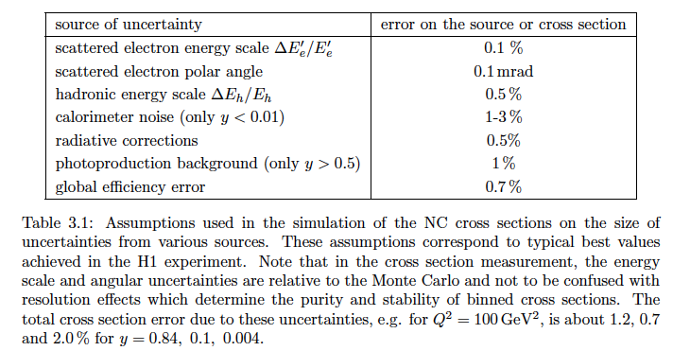
Measurement Simulations
Full simulation of NC and CC inclusive cross section measurements including
statistics, uncorrelated and correlated uncertainties – checked against H1 MC

Slide 12
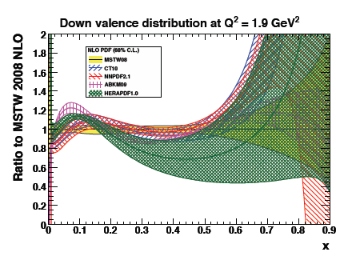
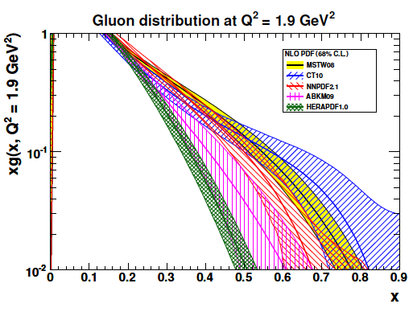
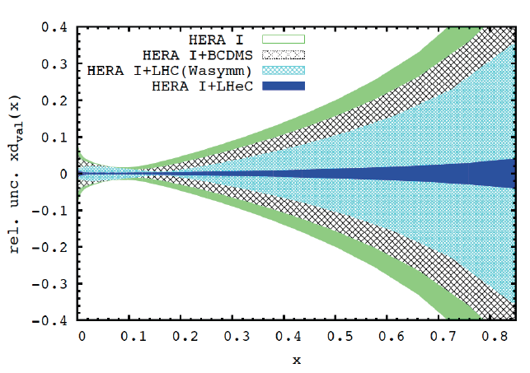
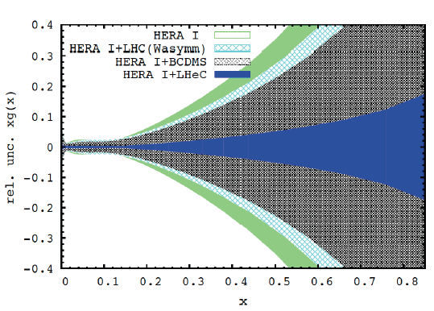
PDFs at Large x
No higher twist corrections, free of nuclear uncertainties, high precision test of factorisation

Slide 13

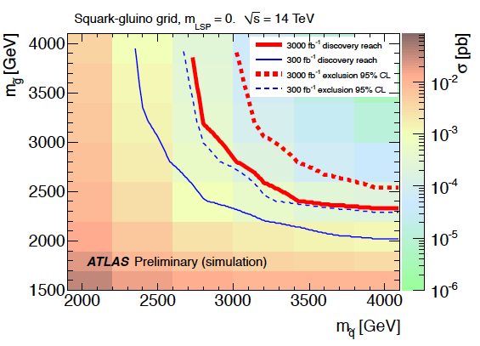
Searching for High Mass SUSY
ATLAS October 2012 “Physics at High Luminosity”
LHeC: arXiv:1211.5102
With high energy and luminosity, the LHC search range will be extended to high masses,
up to 4-5 TeV in pair production, and PDF uncertainties come in ~ 1/(1-x).

Slide 14
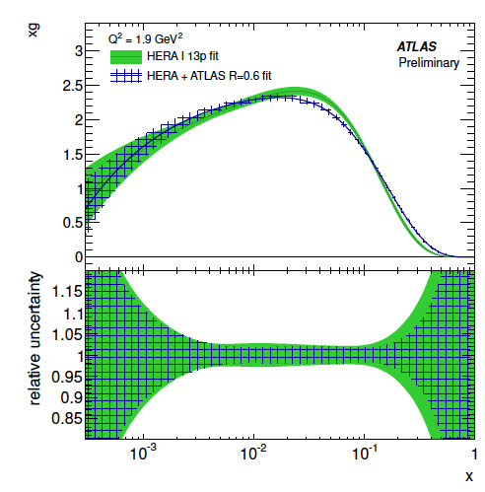
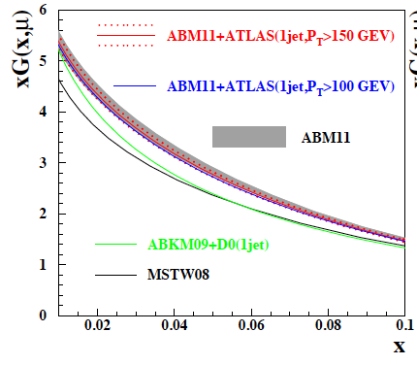
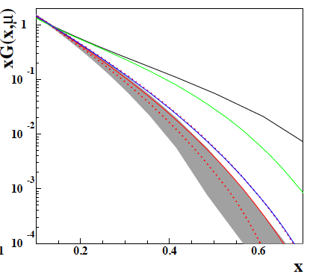
PDF constraints from LHC – Jets
ATLAS-CONF-2012-128
S.Moch 6th Terascale Workshop (Hamburg, 3.12.12)
μ=3GeV
First constraints on gluon distribution from
jets: cross sections and ratios 2.7/7 TeV
Will improve, but depends on energy scales,
jet definition, non-perturbative effects ..
Similar results from CMS (W±, DY, top..)

Slide 15
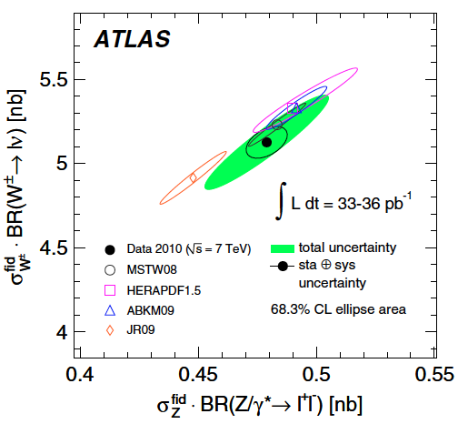
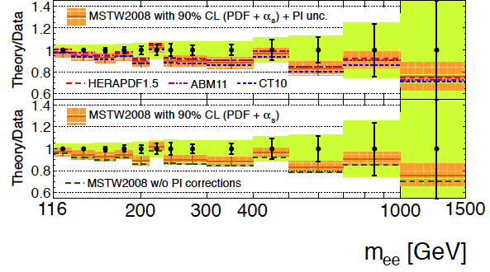
PDF constraints from LHC - Di-Lepton Production
Precision
Drell-Yan
(W,Z) data
constrain
PDFs
PRD D85 (2012) 072004
according to the ATLAS data and
HERA+ATLAS QCD analysis: s = d !
PRL 109(2012)012001
ATLAS-CONF-2012-159
Very high precision required
for any constraint on PDFs
Change of strange affects sea - UHE ν

Slide 16
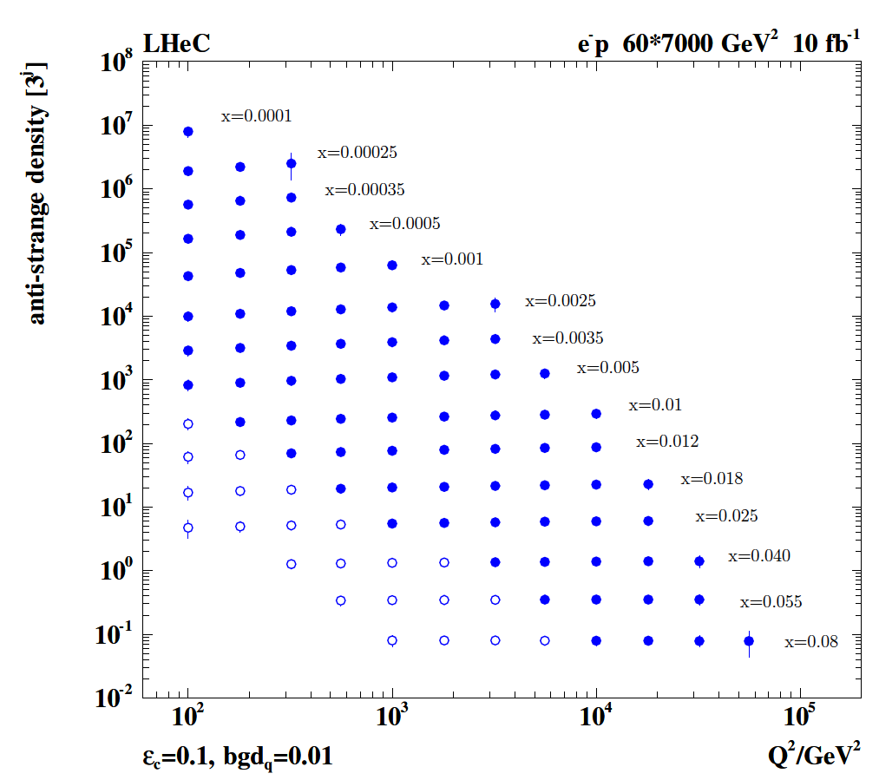
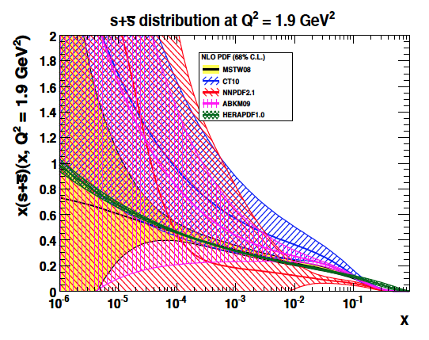
Strange Quark Distribution
High luminosity
High Q²
Small beam spot
Modern Silicon
NO pile-up..
First (x,Q²)
measurement of
the (anti-)strange
density, HQ valence?
x = 10⁻⁴ .. 0.05
Q² = 100 – 10⁵ GeV²
Initial study (CDR): Charm tagging efficiency of 10% and 1% light quark background in impact parameter

Slide 17
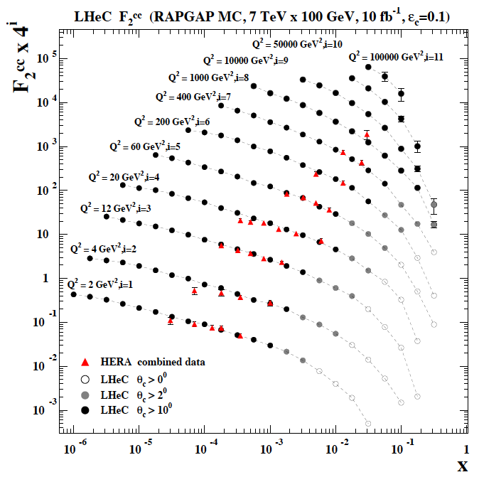
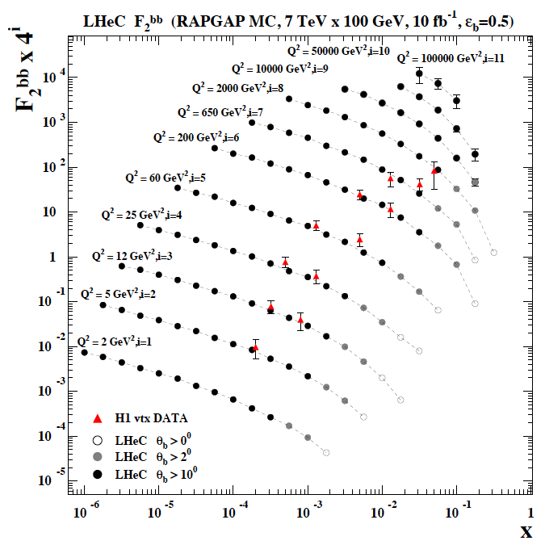
F₂^{charm} and F₂^{beauty} from LHeC
Hugely extended range and much improved precision (δM_{c}=60 HERA → 3 MeV)
will pin down heavy quark behaviour at and far away from thresholds, crucial for precision t,H..
In MSSM, Higgs is produced dominantly via bb → H (Pumplin et al) , but where is the MSSM..

Slide 18
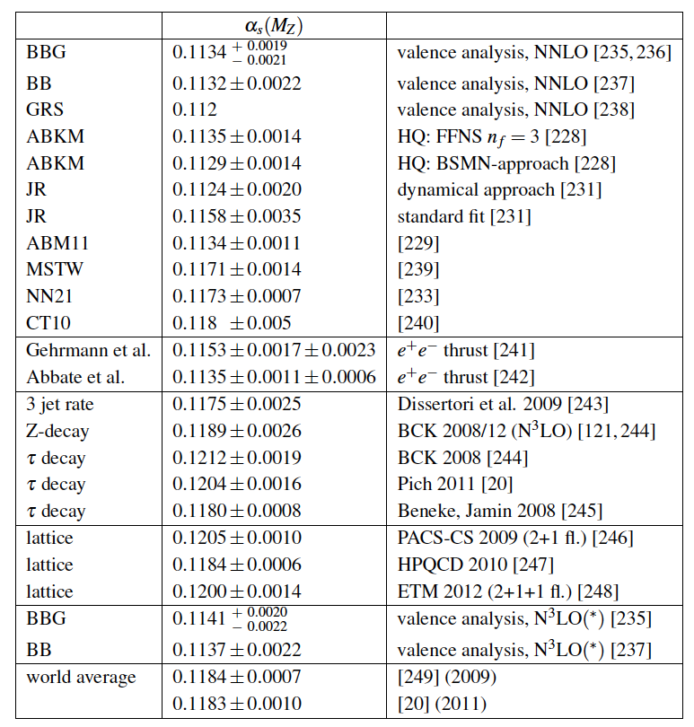
The strong coupling constant
α_{s} is the worst measured
fundamental coupling constant.
Is there grand unification?
In DIS, values (NNLO) range from
0.113 to 0.118.
τ leads to about 0.120
Lattice predictions seem to
determine the world average.
The LHeC has the potential to
measure αs to permille accuracy
(0.0002) from a consistent
data set. This leads to high
precision understanding of all
related effects (low x, δM_{c}=3MeV)
and pQCD at N³LO
J.Bluemlein, Why Precision, arXiv:1205.4991

Slide 19
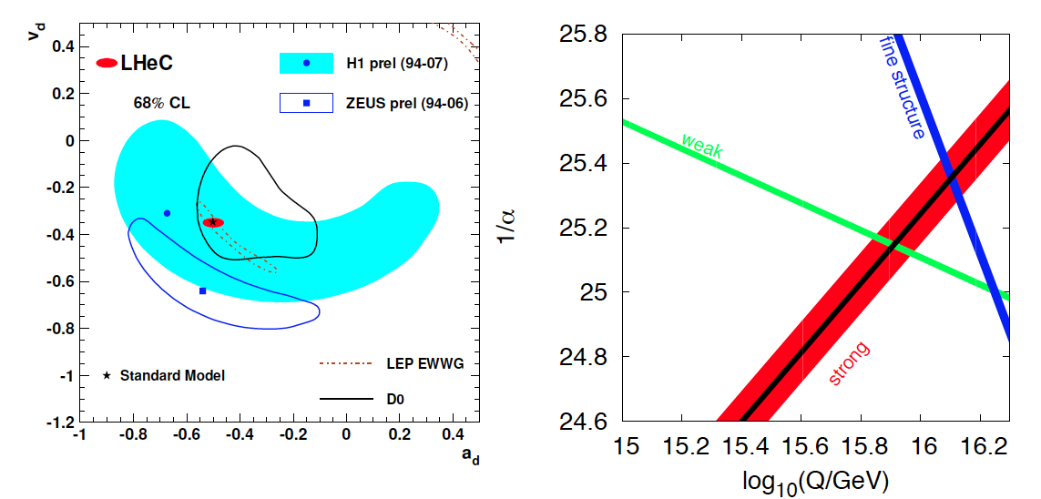
High Precision DIS
High Precision DIS
Q² >> M_{Z,W}², high luminosity, large acceptance
Unprecedented precision in NC and CC
Contact interactions probed to 50 TeV
Scale dependence of sin²θ left and right to LEP
→ A renaissance of deep inelastic scattering ←
Solving a 30 year old puzzle:
α_{s} small in DIS or high with jets?
Per mille measurement accuracy
Testing QCD lattice calculations
Constraining GUT (CMSSM40.2.5)
Charm mass to 3MeV, N³LO

Slide 20
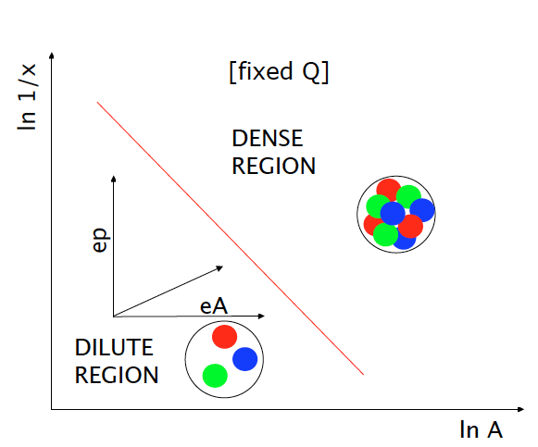
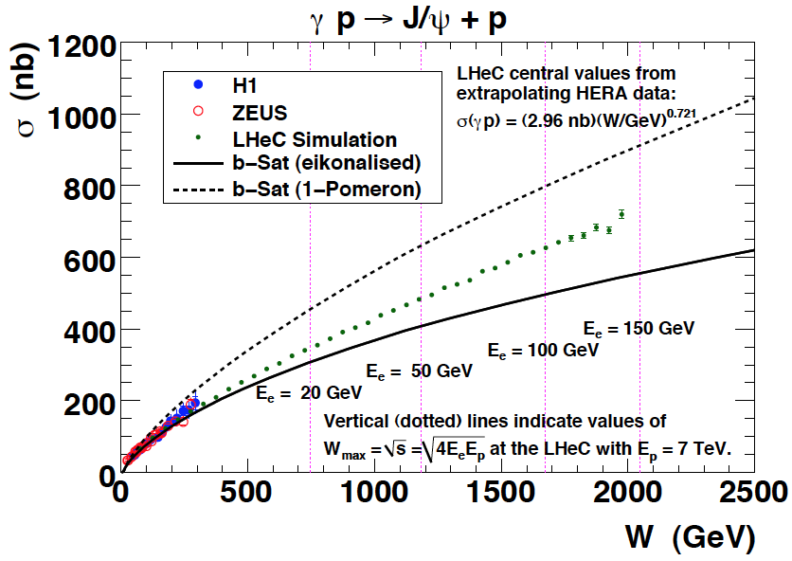
Low x Physics – Gluon Saturation?
Precision Measurements of various
crucial observables (F₂, F_{L}, J/ψ, diffraction
also GPDs with polarisation, charge asymmetries..

Slide 21
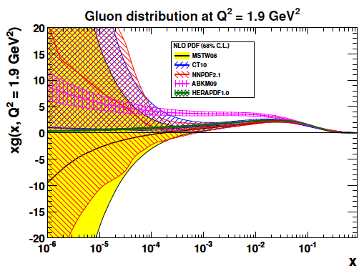
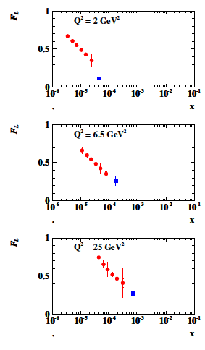
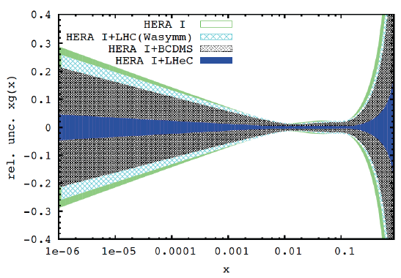
Gluon Saturation at Low x?
LHeC
H1
Gluon measurement down to x=10⁻⁵, Saturation or no saturation (F₂ and precise F_{L})
Non-linear evolution equations? Relations to string theory, and SUSY at ~10 TeV?
cf H.Kowalski, L.Lipatov, D.Ross, arXiv:1205.6713

Slide 22
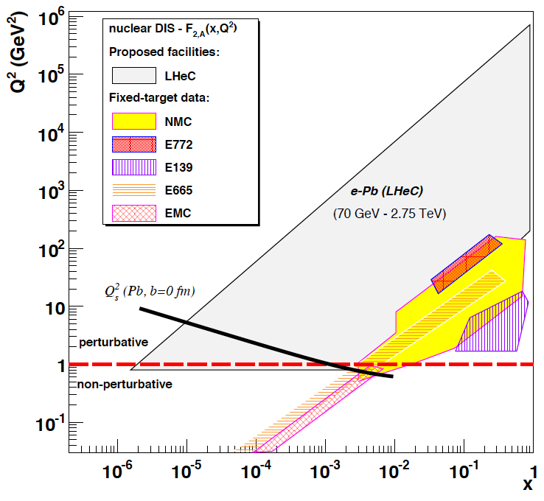
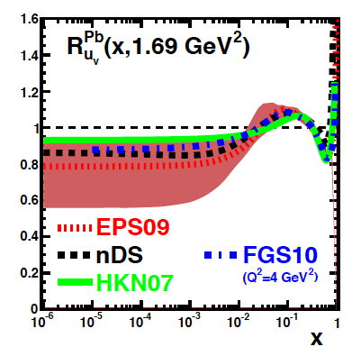
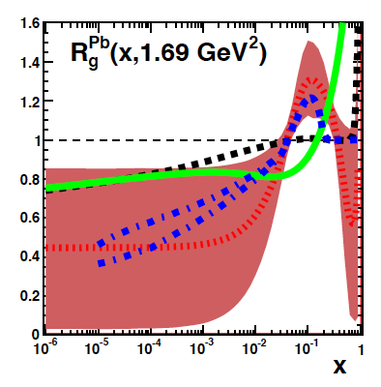
LHeC as an electron-ion collider
up valence
gluon
3-4 orders of magnitude extension of lA kinematic range
→ LHeC has huge discovery potential for new HI physics
(bb limit, saturation, deconfinement, hadronisation,QGP..)
will put nPDFs on completely new ground - Deuterons
unmeasured | known?

Slide 23
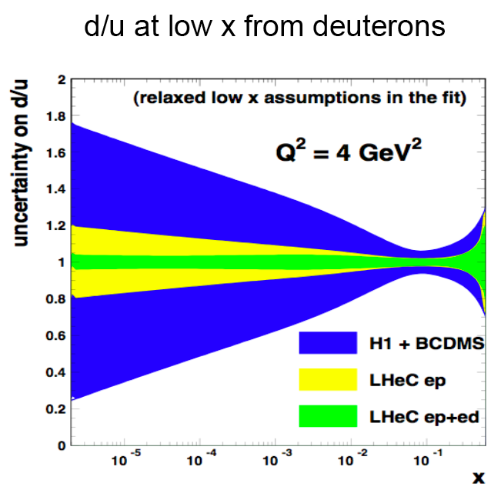
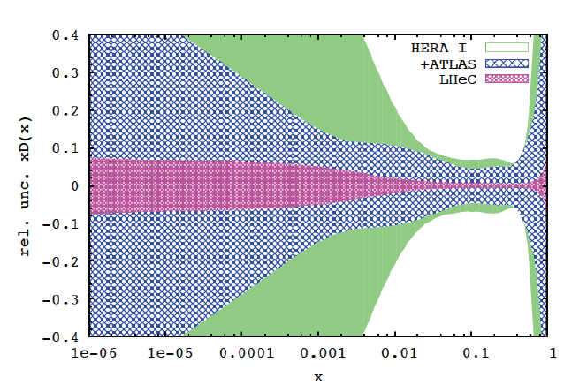

Deuterons and Light Sea Quark Asymmetry
D=“total down” from LHeC (ep) fit
with FREE d-u difference, including
simulated high precision LHC W,Z
CDR
Deuterons: Crucial for
NS-S decomposition
Neutron structure
Flavour separation
Nice: Gribov relation and spectator tagging to get rid off shadowing and Fermi motion!!

Slide 24
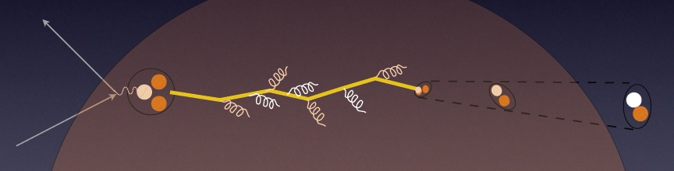
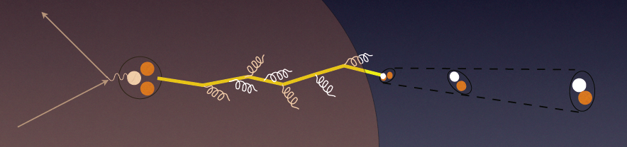
In-medium Hadronisation
The study of particle production in eA (fragmentation functions and hadrochemistry)
allows the study of the space-time picture of hadronisation (the final phase of QGP).
Low energy (ν): need of
hadronization inside.
Parton propagation: pt broadening
Hadron formation: attenuation
High energy (ν): partonic
evolution altered in the
nuclear medium.
W.Brooks, Divonne09
LHeC :
+ study the transition from small to high energies in much extended range wrt. fixed target data
+ testing the energy loss mechanism crucial for understanding of the medium produced in HIC
+ detailed study of heavy quark hadronisation …
Notes:
24

Slide 25
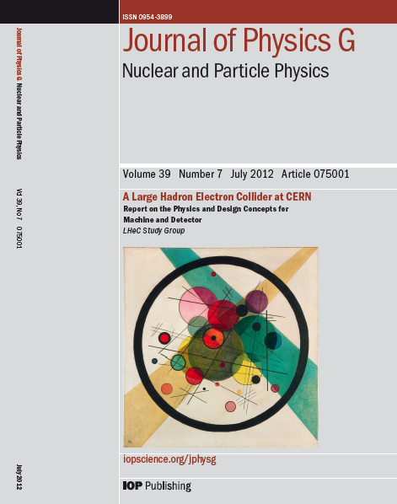
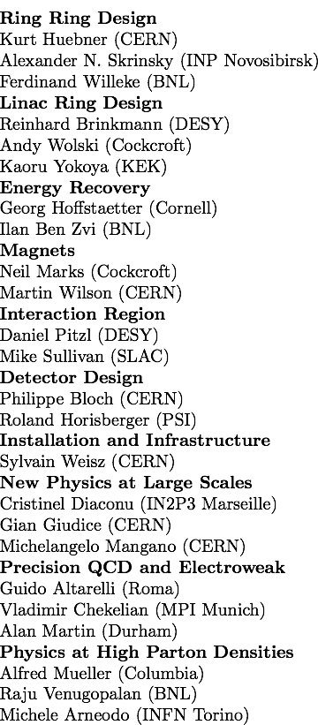
CERN Referees
arXiv:1206.2913
arXiv:1211.4831 and 5102
Published 600 pages conceptual design report (CDR) written by 150 authors from 60 Institutes.
Reviewed by ECFA, NuPECC (long range plan), Referees invited by CERN. Published June 2012.

Slide 26
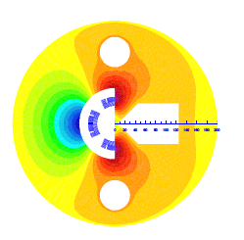
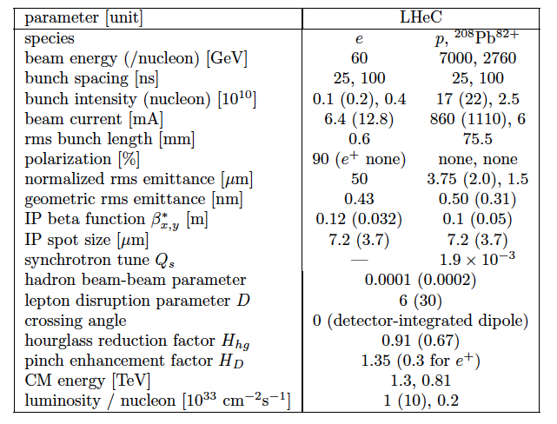
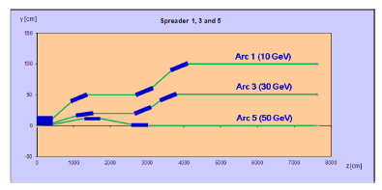
Parameters and Design
257 pages of technical design
in the CDR arXiv:1206:2913, e.g.
“Q1” SC 3-beam IR magnet
Update of parameter table in view of H - arXiv:1211:5102
Designed for synchronous ep and pp operation
1→3 beam spreader design

Slide 27
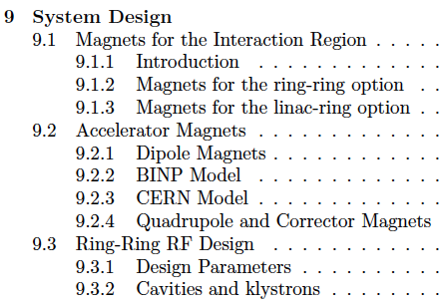
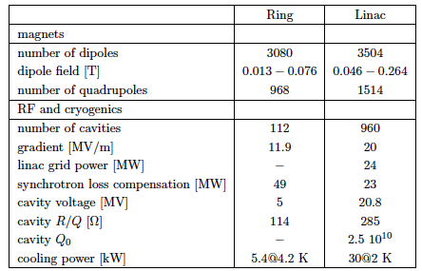



Chapter 9 of CDR
Components and Cryogenics
Jlab:
4 10¹¹
Need to develop LHeC cavity (cryo-module)
from CDR LHeC

Slide 28

60 GeV Electron Accelerator
Two 1km long LINACs
connected at CERN territory
Arcs of 1km radius: ~9km tunnel
3 passages with energy recovery
John Osborne (June LHeC Workshop)

Slide 29


Civil Engineering
Shaft sinking installation
Roadheader 1
CDR: Evaluation of CE, analysis
of ring and linac by Amber Zurich
with detailed cost estimate
[linac CE: 249,928 kSF..] and time:
3.5 years for underground works using 2 roadheaders and 1 TBM
More studies needed for
Integration with all services
(EL,CV, transport, survey etc).
Geology
Understanding vibration risks
Environmental impact assessment
Tunnel connection in IP2
Roadheader 2
J.Osborne, Chavannes

Slide 30


CERN Mandate – TDR by ~2015
S.Bertolucci at Chavannes workshop 6/12 based on
CERN directorate’s decision to include LHeC in the MTP

Slide 31


Frequency and LHeC ERL Testfacility at CERN
Frequency choice: n * 40.079 MHz
n=20: 802 MHz, n=33: 1.3GHz
Lower frequency (than 1.3 GHz)
is preferred: beam stability,
current limitation, higher order
modes, synchrotron loss compensation
801.58 MHz chosen
SPS and LHC harmonic system.
R.Calaga, E.Ciapala, E.Jensen, LHeC-Note-2012-005 ACC
Collaboration with AsTEC, Jlab, Mainz, BNL, Novosibirsk…
~400 MeV, CW, 2 pass ERL
Prototypes: source, magnets, cavity-cryo module (high Q₀)
Operation: stability, HOMs, cryogenics, …
May become injector to the LHeC
SPL cryomodule 704 MHz

Slide 32



Magnets Developments
flux density in the gaps | 0.264 T 0.176 T 0.088 T
magnetic length | 4.0 m
vertical aperture | 25 mm
pole width | 85 mm
number of magnets | 584
current | 1750 A
number of turns per aperture | 1 / 2 / 3
current density | 0.7 A/mm²
conductor material | copper
resistance | 0.36 mΩ
power | 1.1 kW
total power 20 / 40 / 60 GeV | 642 kW
cooling | air
Prototypes for Ring dipoles
Fabricated and tested by
CERN (top) and Novosibirsk
LR recirculator dipoles and quadrupoles
New requirements (aperture, field)?
Combined apertures?
Combined functions (for example, dipole + quad)?
LR linac quadrupoles and correctors
New requirements (aperture, field)?
More compact magnets, maybe with at least two
families for quadrupoles?
Permanent magnets / superconducting for quads?
A.Milanese, Chavannes workshop
1/2m dipole model
Full scale prototype
Quadrupole for Linac
Magnets for ERL test stand
Collaboration of CERN, Daresbury and Budker (Novosibirsk)

Slide 33



Interaction Region Developments
Beam pipe: in CDR 6m, Be, ANSYS calculations
Composite material R+D, prototype, support..
→ Essential for tracking, acceptance and Higgs
Have optics compatible with LHC and β*=0.1m
Head-on collisions mandatory →
High synchrotron radiation load, dipole in detector
Specification of Q1 – NbTi prototype ( with KEK?)
Revisit SR (direct and backscattered),
Masks+collimators
Beam-beam dynamics and 3 beam operation studies
Optimisation: HL-LHC uses IR2 quads to squeeze IR1
(“ATS” achromatic telescopic squeeze) Start in IR3.? R.Tomas et al.

Slide 34

LHeC Detector Overview
LAr electromagnetic calorimeter
Tile Calorimeter
Detector option 1 for LR and full acceptance coverage
Forward/backward asymmetry in energy deposited and thus in geometry and technology
Present dimensions: LxD =14x9m² [CMS 21 x 15m² , ATLAS 45 x 25 m²]
Taggers at -62m (e),100m (γ,LR), -22.4m (γ,RR), +100m (n), +420m (p)

Slide 35


Detector Magnets
Dipole (for head on LR) and
solenoid in common cryostat,
perhaps with electromagnetic LAr
3.5T field at ~1m radius to house
a Silicon tracker
Based on ATLAS+CMS experience

Slide 36


Silicon Tracker and EM Calorimeter
Transverse momentum
Δp_{t}/p²_{t} → 6 10⁻⁴ GeV⁻¹
transverse
impact parameter
→ 10μm
LHeC-LHC: no pile-up, less radiation, smaller momenta apart from forward region

Slide 37



Liquid Argon Electromagnetic Calorimeter
Inside Coil
H1, ATLAS
experience.
Barrel: Pb, 20 X₀ , 11m³
fwd/bwd inserts:
FEC: Si -W, 30 X₀ ,0.3m³
BEC: Si -Pb, 25 X₀,0.3m³
GEANT4 Simulation

Slide 38




Hadronic Tile Calorimeter
Outside Coil: flux return
Modular. ATLAS experience.
R=2.6m
+5.9m
-3.6m
Combined GEANT4 Calorimeter Simulation

Slide 39

The LHeC provides the only, single opportunity to develop DIS as part of HEP for decades, enriching the LHC physics… “it would be a waste not to use it” (G.Altarelli, 2008)

Slide 40

http://cern.ch/lhec
Present LHeC Study group and CDR authors
Supported by
CERN, ECFA, NuPECC
About 200 Experimentalists and Theorists from 76 Institutes

Slide 41
Project Development
2007: Invitation by SPC to ECFA and by (r)ECFA to work out a design concept
2008: First CERN-ECFA Workshop in Divonne (1.-3.9.08)
2009: 2nd CERN-ECFA-NuPECC Workshop at Divonne (1.-3.9.09)
2010: Report to CERN SPC (June)
3rd CERN-ECFA-NuPECC Workshop at Chavannes-de-Bogis (12.-13.11.10)
NuPECC: LHeC on Longe Range Plan for Nuclear Physics (12/10)
2011: Draft CDR (530 pages on Physics, Detector and Accelerator) (5.8.11)
refereed and being updated
2012: Discussion of LHeC at LHC Machine Workshop (Chamonix)
Publication of CDR + 2 Contributions to European Strategy [arXiv]
Chavannes workshop (June14-15, 2012) – CERN: Linac+TDR Mandate
ECFA final endorsement of CDR
2013: EU Strategy places lower priority to the LHeC.
Workshop in early fall. Testfacility at CERN.
http://cern.ch/lhec

Slide 42


“BFKL evolution and Saturation in DIS”
“Critical gravitational collapse”
Circles in a circle
V. Kandinsky, 1923
Philadelphia Museum of Art
5d tiny black holes and perturbative saturation
Talk by A.S.Vera at LHeC Workshop 2008

Slide 43
Summary
1. The LHeC is the natural (and the only possible) successor of the energy frontier exploration of deep inelastic
scattering with fixed target experiments and HERA at 10, 100 and then 1000 GeV of cms energy.
2. Its physics programme has key topics (WW→ H, RPV SUSY, α_{s} , gluon mapping, PDFs, saturation, eA…)
which ALL are closely linked to the LHC (Higgs, searches for LQ and at high masses, QGP ..). With the
upgrade of the LHC by adding an electron beam, the LHC can be transformed to a high precision
energy frontier facility which is crucial for understanding new+”old” physics and its sustainability.
3. The LHeC will deliver vital information to future QCD developments (N3LO, resummation, factorisation,
non-standard partons, neutron and nuclear structure, AdS/CFT, non-pQCD, SUSY..) and as a gigantic
next step into DIS physics it promises to find new phenomena (no saturation, instantons, substructure
of heavy elementary particles ??).
4. The default LHeC configuration is a novel ERL (with < 100MW power demand) in racetrack shape which
is built inside the LHC ring and tangential to IP2. This delivers multi-100fb⁻¹ (> 100 * HERA) and a factor of
larger than 10³ increased kinematic range in lN DIS, accessing the range of saturation at small α_{s} in ep+eA.
5. The LHeC is designed for synchronous operation with the LHC (3 beams) and has to be operational for
the final decade of its lifetime. This gives 10-12 years for its realisation, as for HERA or CMS.
6. A detector concept is described in the CDR suitable for the Linac-Ring IR and to obtain full coverage and
ultimate precision. This can be realised with a collaboration of 500 physicist.
7. Half of the LHeC is operational. The other half requires next: an ERL test facility at CERN, IR related proto-
typing (Q1, pipe), to develop the LHC-LHeC physics links, to simulate and preparing for building the detector.

Slide 44

Bruno Touschek (1921-1978) Sam Currant (1912-1988)
ringrazio per la vostra attenzione

Slide 45
-backup-

Slide 46
L vs E_{e}
Storage Ring
Energy Recovery Linac

Slide 47

The first F₂ from HERA
Not too steep, not flat (Regge)
in accord with 1974 expectation
hidden in pioneering pQCD paper
H1 Collaboration, Nucl. Phys. B407 (1993) 515
ZEUS Collaboration, Phys. Lett. B316( 1993) 412

Slide 48

Industry of PDF Determinations
V.Radescu
The determination of the partonic contents of the proton is a subtle, complex task.
It often involves data which are barely compatible as is tolerated with χ² innovations..
Future high precision needs a new, complete PDF data basis and precision h.o. theory.
(cf arXiv:1310.1073,jb)

Slide 49


Kinematics - LHeC and HERA
Access to “saturation” (?) region
in DIS (Q² > 1 GeV²) and ep
Extending beyond the Fermi scale with
precision Z and W exchange data →
high x, top PDF, flavour & new physics,

Slide 50


Constraints on Strange Quark Distribution - LHC
- Large non-perturbative effects to control
- Ratios (W+c/W+j)
- Use charges to access valence strange
Scale
Q² = M²_{W,Z}
CMS:
PAS-EWK-11-03
W.Stirling, E.Vryonidou, Phys.Rev.Lett. 109 (2012) 082002

Slide 51




CDR
Gluon Distribution
153 pages
now
then
Precision measurement of gluon density to extreme x → α_{s}
Low x: saturation in ep? Crucial for QCD, LHC, UHE neutrinos!
High x: xg and valence quarks: resolving new high mass states!
Gluon in Pomeron, odderon, photon, nuclei.. Local spots in p?
Heavy quarks intrinsic or only gluonic?

Slide 52



LR LHeC IR layout & SC IR quadrupoles
Exit hole for electrons & non-colliding protons
Synchrotron radiation
Q2
Electron beam
Q1
Q2
Q1
Nb₃Sn (HFM46): 5700 A, 175 T/m, 4.7 T at 82% on LL (4 layers), 4.2 K | Nb₃Sn (HFM46): 8600 A, 311 T/m, at 83% LL, 4.2 K
46 mm (half) ap., 63 mm beam sep. | 23 mm ap.. 87 mm beam sep.
0.5 T, 25 T/m | 0.09 T, 9 T/m
colliding proton beam
Non-colliding proton beam
Inner triplets
Inner triplets
High-gradient SC IR quadrupoles based on Nb₃Sn for colliding proton beam with common low-field
As shown by F. Zimmermann at Chamonix12

Slide 53


Top Quark and Leptoquarks
The LHeC is a (single) top quark production
factory, via Wb → t. Top was never observed
in DIS. With ep: top-PDF → 6 flavour VFNS,
precision M_{t} direct and from cross section,
anomalous couplings [to be studied]
Leptoquarks (-gluons) are predicted in RPV SUSY,
E6, extended technicolour theories or Pati-Salam.
The LHeC is the appropriate configuration to do their
spectroscopy, should they be discovered at the LHC.

Slide 54


High Mass Drell Yan
Towards high mass the PDF uncertainties
rise, strongly towards the edge (√s) x → 1…
CMS Di-Jets arXiv:1212:6660
For HL-LHC:
Need to study limits
and interferences (ED?)
in context with energy
calibrations, and thy
uncertainties, + PDFs
vs BSM expectations
14 TeV, VRAP L.Dixon et al, U.Klein

Slide 55
What HERA could not do or has not done
Test of the isospin symmetry (u-d) with eD - no deuterons
Investigation of the q-g dynamics in nuclei - no time for eA
Verification of saturation prediction at low x – too low s
Measurement of the strange quark distribution – too low L
Discovery of Higgs in WW fusion in CC – too low cross section
Study of top quark distribution in the proton – too low s
Precise measurement of F_{L} – too short running time left
Resolving d/u question at large Bjorken x – too low L
Determination of gluon distribution at hi/lo x – too small range
High precision measurement of α_{s} – overall not precise enough
Discovering instantons, odderons – don’t know why not
Finding RPV SUSY and/or leptoquarks – may reside higher up
…
The H1 and ZEUS apparatus were basically well suited
The machine had too low luminosity and running time
HEP needs a TeV energy scale machine with 100 times
higher luminosity than HERA to develop DIS physics
further and to complement the physics at the LHC. The
Large Hadron Collider p and A beams offer a unique
opportunity to build a second ep and first eA collider
at the energy frontier.
HERA in one box
the first ep collider
E_{p}*E_{e}=
920*27.6GeV²
√s=2√E_{e}E_{p}=320 GeV
L=1..4 10³¹cm⁻²s⁻¹
→ ΣL=0.5fb⁻¹
1992-2000 & 2003-2007
Q²= [0.1 -- 3 * 10⁴ ] GeV²
-4-momentum transfer²
x=Q²/(sy) ≅10⁻⁴ .. 0.7
Bjorken x
y≅0.005 .. 0.9
inelasticity

Slide 56



Strong Coupling Constant
α_{s} least known of coupling constants
Grand Unification predictions suffer from δα_{s}
DIS tends to be lower than world average (?)
LHeC: per mille - independent of BCDMS.
Challenge to experiment and to h.o. QCD →
A genuine DIS research programme rather than
one outstanding measurement only.
1/α
fine structure
weak
strong
Two independent QCD analyses using LHeC+HERA/BCDMS

Slide 57




60 GeV Energy Recovery Linac
CERN 1
CERN 2
Jlab
BNL
Two 10 GeV energy recovery Linacs, 3 returns, 720 MHz cavities

Slide 58

Collaboration on ERL
Budker Institute

