Slide 1
LHeC, PERLE and FCC-eh
Max Klein (University of Liverpool)
for the LHeC/PERLE/FCCeh Collaboration
UK and FCC Meeting, 11.9.2020, Oxford online
Powerful ERL for Experiments @ Orsay
CDR: 1705.08783 J.Phys.G
CERN-ACC-Note-2018-0086 (ESSP)
Operation: 2025+, Cost: O(20) MEuro
LHeC ERL Parameters and Configuration
I_{e}=20mA, 802 MHz SRF, 3 turns →
E_{e}=500 MeV → first 10 MW ERL facility
BINP, CERN, Daresbury, Jlab, Liverpool, Orsay (IJC), +
50 x 7000 GeV²: 1.2 TeV ep collider
Operation: 2035+, Cost: O(1) BCHF
CDR: 1206.2913 J.Phys.G (550 citations)
Upgrade to 10³⁴ cm⁻²s⁻¹, for Higgs, BSM
CERN-ACC-Note-2018-0084 (ESSP)
arXiv:2007.14491, subm J.Phys.G
60 x 50000 GeV²: 3.5 TeV ep collider
Operation: 2050+, Cost (of ep) O(1-2) BCHF
Concurrent Operation with FCC-hh
FCC CDR:
Eur.Phys.J.ST 228 (2019) 6, 474 Physics
Eur.Phys.J.ST 228 (2019) 4, 755 FCC-hh/eh
Future CERN Colliders: 1810.13022 Bordry+

Slide 2
Welcome
Max Klein, Oxford, 11.09.2020
14

Slide 3
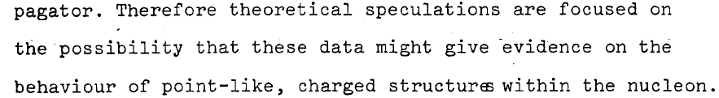
Three Messages from the 2m LINAC at Stanford
Golden Past
-- you do NOT need to promise to discover dark matter or know what new to expect
when you increase the energy range (we yet may have to readjust our perception
about nature, its richness and as well our ability to predict and understand it.
‘we like to see the field to be driven by experiment’ – Burt Richter 2009)
-- you can build a 2 mile electron linac in 3 years time, if you really want it
of course we could build LHeC and FCC-eh when we decided to do so
-- electron-proton scattering is the best means to explore the substructure of matter
a necessary complement to the LHC/FCC and moreover, now a unique Higgs facility
The origin of deep inelastic scattering
50 years since the discovery of quarks by the SLAC-MIT ep scattering experiment
Vienna 8/1968

Slide 4
Beyond the LHC/LHeC: FCC
Far Future
Particle Physics has a long term future,
many of its quests are unresolved,
Nr of families, GUT, substructure, DM..
It has been and will be science at a
global scale, with many question marks
for USA, China and Japan at present.
Former times:
CDHS,BCDMS../SppS/PETRA,PEP
HERA/Tevatron/LEP,SLC
Nearer future, perhaps
LHeC/LHC/ILC,CepC

Slide 5
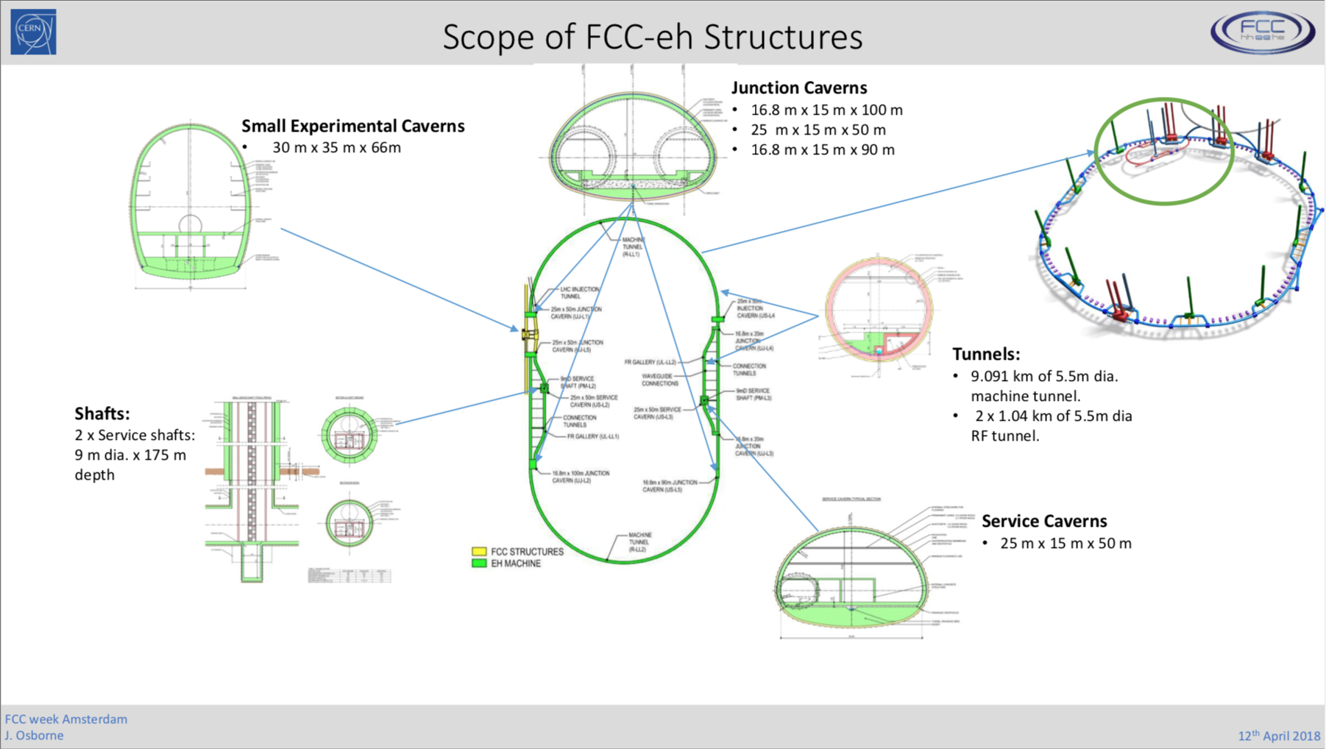

Slide 6
Energy Recovery today and tomorrow
FCC-ee
- Joint 802 MHz cavity development [LHeC+FCC]
- New: Design of FCC-ee with ERL technique:
[extension to higher energy, less SR power, higher lumi > WW]
LHeC: 1 TeV ep collider with 10³⁴ luminosity: P/10! Dump at injection.
Possible injector to FCC-ee in recirculating mode [O.Bruening]
ERL: A revolutionary
technology ripe for
real applications in
HEP, low energy and
industrial areas, of
huge potential
just evolving : to be
recognised in strategy
PERLE BINP, CERN, Daresbury, Liverpool, Jlab, Orsay+. Could be 6 GeV injector to FCC-ee →
ERLs in: Berlin, BINP, Cornell, Daresbury, Darmstadt, Jlab, KEK, Mainz..
High current and E ~ 1GeV: low energy physics [1000 x L(ELI)!, lithography, photofission..
Llatas
M.Klein, LHeC Ghent 12.7.19
Llatas, Litvinenko, Roser: FCC Brussels. tentative

Slide 7
title
FCC-eh
Detector
Concept
Design
Remarks/questions:
- Suitable design
for precision DIS
- Muon tagger
or spectrometer
- LAr or warm calo
- Beam pipe and
Machine-detector
Interface
- Final choices
not now but
later by a
collaboration
Clean FS
No pile-up
NC-CC-yp
clearly
separated
Radiation
1000 less
than in pp
… “easy”
Challenge:
IR and e-h
fwd region
From new paper: 2007:14491

Slide 8
Interaction Region – work in progress
FCC-eh magnet arrangement options (K Andre, FCC Brussels)
Recent optimisation with staggered quads
FCC-eh elonged version of LHeC IR
Prototyping for Nb₃SN under discussion
Next: masking, detector-machine interface
New question: IR with pp and ep collisions
at 25ns/4 shifted IPs (for IP2 at LHC)
Electron optics with staggered quadrupoles
Magnet parameters for LHeC Interaction Region

Slide 9
Machine Parameters and Operation - ep
CERN-ACC-Note-2020-0002 →arXiv (July)
No pileup
For comparison, HERA I operated at 10³¹cm⁻²s⁻¹, and was upgraded by a factor of up to 4 for HERA II
The total luminosity delivered was 1 fb⁻¹ over a running period of 15 years, including shutdowns.
LHeC may operate at 20 x 1000 GeV² and ”repeat” all of HERA in a short running period.
The updated CDR considers a Ring-Ring ep collider as a back-up solution. May be revived for HE-LHC.

Slide 10
Machine Parameters - eA
CERN-ACC-Note-2020-0002 →arXiv (July)
The LHeC and FCC-eh are the highest energy, most powerful electron-ion colliders the world may build.

Slide 11
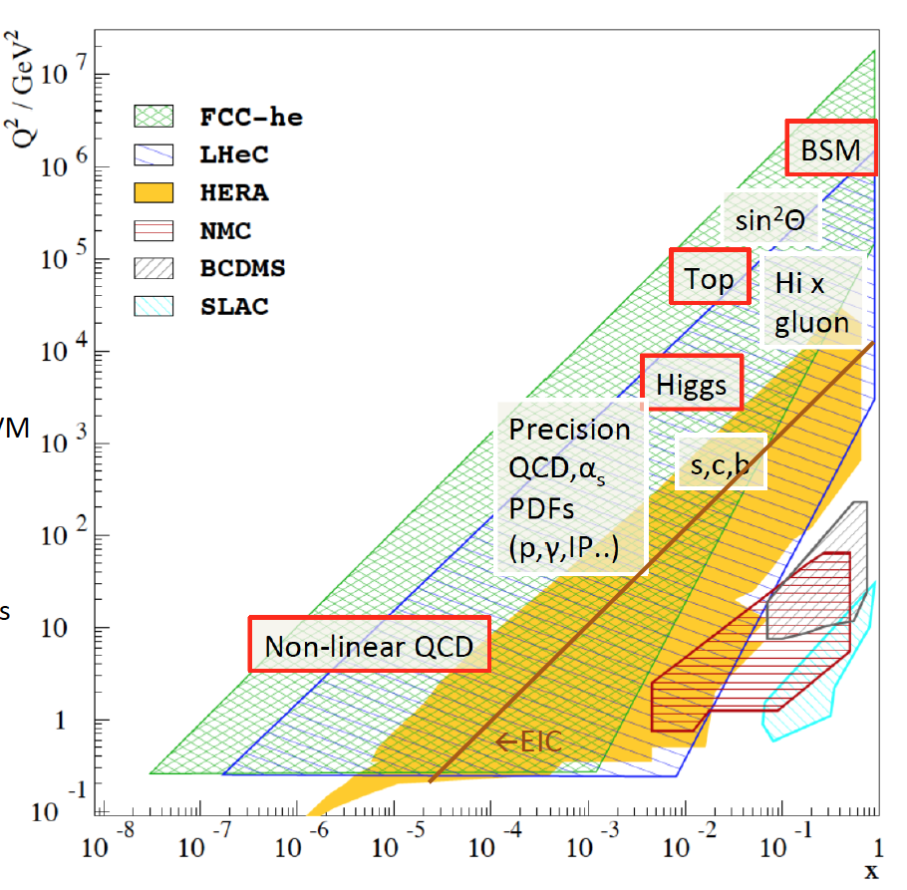
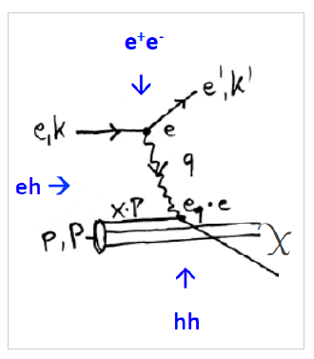
Physics with Energy Frontier DIS
Deep Inelastic Scattering
Raison(s) d’etre of ep/eA
at the energy frontier
Cleanest High Resolution
Microscope: QCD Discovery
Empowering the LHC
Search Programme
Transformation of LHC into
high precision Higgs facility
Discovery (top, H, heavy ν’s..)
Beyond the Standard Model
A Unique
Nuclear Physics Facility

Slide 12
FCC-eh in the CDR [V1 Physics and V3 hh]
Volume 1 had been the collaborative effort to present the entity of FCC physics, in ee, pp and ep, including AA and eA
Volume 3 on FCC hh contains a short summary of the main characteristics of FCC-eh and the detector concept
Some striking physics eh prospects are on searches and the high precision measurements on Higgs and proton structure:
3
Complementary prospects to
discover rh massive neutrinos
in ee, ep and pp
[mixing angle vs mass]
Unique resolution of partonic contents of
and dynamics inside the proton, providing
precise and independent parton luminosities
for interpretation and searches on FCC-hh
Prospects for high precision measurements of
Higgs couplings at FCC ee and ep. Note ee gets
the width with Z recoil. ee is mainly ZHZ, while
ep is mainly WWH: complementary also to pp

Slide 13
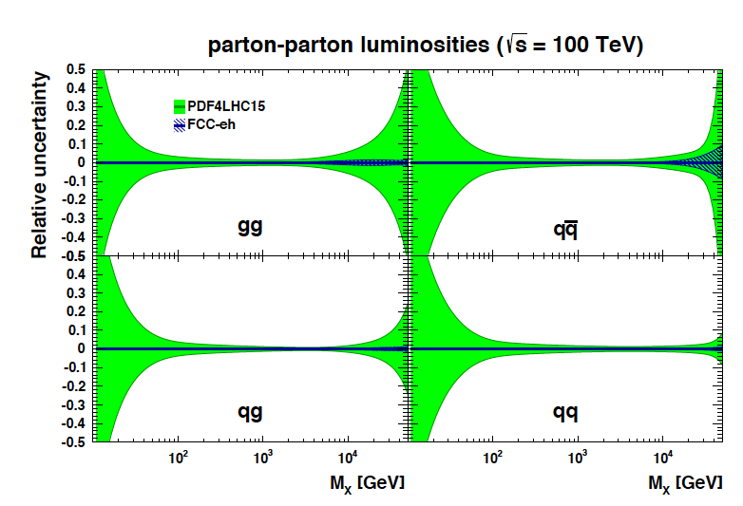
Parton-parton Luminosities
Prospects FCCeh:
Ultimate prediction of pp interactions. external input. Decisive test of factorisation.

Slide 14
Synergy: example QCD
QCD in hh: a tool to understand the observations. Tests at unprecedented scales.
Through LHC QCD got a major boost (theory and phenomenology)
QCD in ee: strong coupling, perturbative parton radiation [jet substructure, fragmentation..]
non-perturbative parton radiation[colour reconnection, hadronisation..]..
QCD in ep: strong coupling to per mille, complete resolution of partonic proton contents
[also n,y,IP and 3D] discovery of non-linear gg interactions, N³LO prediction of H
QCD in eA: establish quantitative understanding of parton interactions in nuclei for the
first time. Disentangle nuclear from non-linear effects. The QGP in QCD
MK March 2019, FCC symposium

Slide 15
Higgs in ep and pp [LHC and FCC]
LH(e)C
Results for FCC-eh at
20 TeV E_{p} x 60 GeV E_{e}
Uncertainties on kappa
Decay FCCep HL-LHC
bb 0.9 2.7
WW 0.3 1.2
gg 1.7 2.2
tau 1.5 1.6
cc 1.9 --
ZZ 0.5 1.0
yy 3.3 1.7
in percent. SM width.

Slide 16
title
Beate Heinemann

Slide 17
Low x Dynamics
1802.07758
Very large effects of small x dynamics at FCC-hh
FCC-eh (LHeC) resolve low x BFKL-DGLAP question
FCC-hh is low x physics machine: there is no
Precision hh physics at FCC without ep
HERA (and EIC) at too small energy to resolve low x

Slide 18
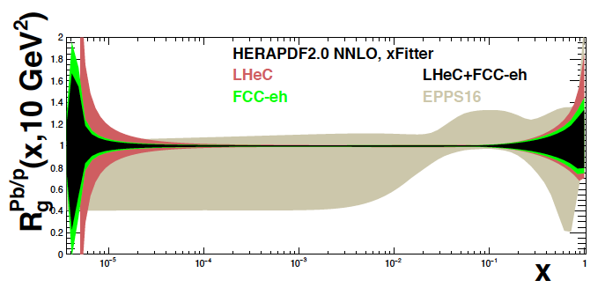
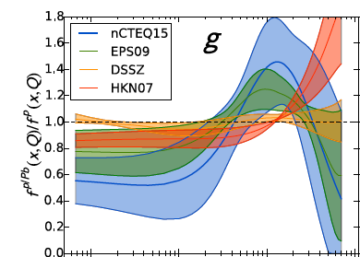

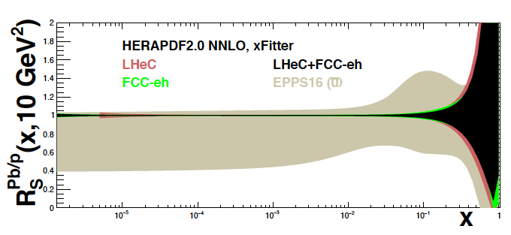
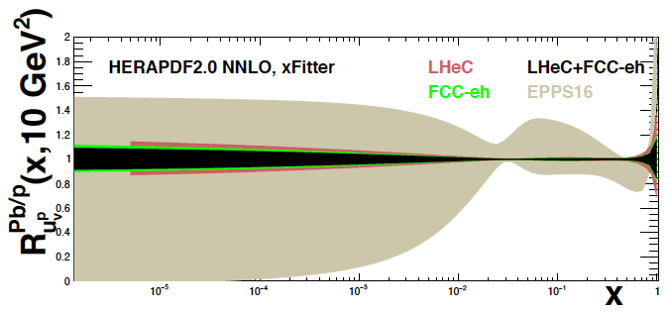
Nuclear PDFs at LHeC/FCCeh
Unique nuclear/HI physics programme
Extension of fixed target range by 10 ³⁻⁴
QCD of QGP, de-confinement, saturation..
nPDFs independent of p PDFs
1509.00792
High
luminosity
~ 10 ³³
enables
high statistics
in short
eA runs
cf J Jowett et al
present
status →
on xg
Pb/p
gluon
N Armesto, FCC Physics Week 1/2018
sea
valence
LHeC: Full error, Δχ² =1. EPPS Δχ² =52

Slide 19
Developments +Partners
Cf recent meeting: https://indico.cern.ch/event/923021/
High Current Source (e⁻, P, e⁺)
SCRF: High Q₀, complete Cryomodule
PERLE will
begin with
5mA ALICE
source, which
has been
transferred
from Daresbury
to Orsay while
UK was in EU..
B Militsyn et al
Jointly with FCC-ee
BINP, BNL/Cornell (cBETA), Daresbury, IJC, Jlab, +
Interaction Region Design and Q₁ Prototype:
B Holzer, B Parker, S Russenschuck et al
PERLE/LHeC
F Marhauser et al
Next: dressed cavity (HOMs), 20mA
Adapt SPL Cryomodule for PERLE
CERN, Jlab, Orsay +
BNL, CERN, +

Slide 20
References
arXiv:2007:14491 (400 pages, 300 authors)
FCC Workshops: CDR March 2019: https://indico.cern.ch/event/789349/ see: http://lhec.web.cern.ch (to be updated)

Slide 21
UK
DIS has strong tradition in UK: from BEBC, EMC to H1 and ZEUS
Various coordinators for Detector, H, QCD and BSM Physics are UK Physicists, including overall coordination
LHeC is a platform to develop FCC-eh
Accelerator focussed on PERLE: AsTEC, Cockcroft, Liverpool, with Novosibirsk, CERN, Jlab, Orsay:
PERLE at Orsay: Project leader W Kaabi (IJClab), Spokesperson M Klein (Liverpool)
Detector design to be continued: Si tracker post ITK (ATLAS), low radiation: CMOS; and other topics
ep/eA is part of ee and pp/AA future for exploring nature and exploiting our investments (LHC and FCC)
It can operate concurrently with pp and should be further developed together with it.
The future may look undecided, uncertain but it offers research insight for decades (ee/hh/eh, neutrinos, fixed target)

Slide 22
backup

Slide 23
title

Slide 24
ERL in more Detail
- LHeC Configuration reduced from 60 to 50 GeV.
- LINAC: 112 cryomodules with 4 cavities each
→ Total number of cavities: 896 [ILC: O(10⁴)]
- Configuration may be staged with less RF
- Tunnel is small part of cost and better not
reduced further, synchrotron loss, upgrades..
- ERL reduces power to << GW and dumps at < GeV
→ novel, “green” accelerator technology
Positrons: 500pC is 3 10⁹e⁻/bunch → 20mA and 1.2 10¹⁷ e⁻/s
LHeC programme needs e⁻p predominantly (Higgs) and only
smaller e⁺p sample, ~fb⁻¹ → O(10¹⁵) e⁺/s, still demanding!
High intensity with yy or FEL options of LHeC (Frank Z)

