Slide 1
Development of Energy Recovery Linacs
Towards a European ERL Roadmap
Max Klein
For the ERL Roadmap Panel
Following a 56 year old idea with the
technology of today and tomorrow:
M Tigner A Possible Apparatus for Electron
Clashing-Beam Experiments, N.Cim 10(1965)1228
EPS Conference, Hamburg – on-line, 30.7.2021

Slide 2
Symposium on ERLs and its Applications, June 4, 21
Activities
18 panel members
from 11 facilities
← 250pp base paper
about 50 authors
Regular meetings
+ reports to LDG
Symposium →
Subpanel on e⁺e⁻
Towards an ERL
Roadmap - fall 21
for integration into
Accelerator R&D
5-10 year plan
Interested in input
Long Write-Up on ERLs - in preparation
https://indico.cern.ch/event/1040671

Slide 3
Particle Physics: The Challenge Ahead
3.5.33-23.7.21
[15] CERN Courier 10/17: SW Model Physicist
[17] GG in Book for Guido Altarelli, 1710.07663
The Development of ERLs. Draft paper
*)
High field magnets, SRF, ERL, Muon Collider, and Plasma Wakefield
The five acc. technology pillars identified last year and by Council/SPC/LDG.
*) cf backup slide
M Klein ERL 30.7.2021

Slide 4
LHeC: Poster at EPS by Kevin Andre
[from a report to LDG 5/21]

Slide 5
Evaluation of ERL concepts for FCC-ee [CERC] and the ILC [ERLC]
Vladimir Litvinenko+ https://doi.org/10.1016/j.physletb.2020.135394 ;
Valery Telnov, https://arxiv.org/abs/2105.11015
The Sub-Panel is evaluating the technical and financial implications of the two novel concepts compared to the FCC-ee and ILC projects:
What are the technical advances, specifically in luminosity?
What are the technical solutions + obstacles requiring R&D?
How much time would that additionally require?
What is the rough cost implication (to about 10%)
Sub-Panel members
Chris Adolphsen (SLAC) Reinhard Brinkmann (DESY)
Oliver Brüning (CERN) Andrew Hutton (JLab) – Chair
Sergei Nagaitsev (Fermilab) Max Klein (Liverpool)
Peter Williams (STFC) Akira Yamamoto (KEK)
Kaoru Yokoya (KEK) Frank Zimmermann (CERN)
The e⁺e⁻ ERL Sub-Panel
Dates for the sub-Panel
Kick-off meeting held June 9, 2021
Completion by September 3, 2021
Deliverable:
A short report (~20 pages) detailing the conclusions of the evaluation, which should be agreed and supported by the entire sub-Panel and published as Appendix B to the full Panel report.
Had/have weekly meetings, initially with proponents
Very lively discussion and development of insight
Too early to summarise (30.7.21)

Slide 6
Recent (June, July) Ideas being incorporated
C. Curatolo, L. Serafini
arXiv:2106.03255
Evaluation not planned
Nikolay
Vinokurov
Talk at
ERL Panel
15.7.21
Sub-ps periodic X ray pulses for time resolved experiments → a 4th example for applications

Slide 7
Andrew Hutton at Future Accelerator R&D Symposium for the HEP Community, July 7, 2021 - from ERL Long Write-Up, in preparation
Three major features: Linac brightness at storage ring powers, Dump at injection, GW class beams unaffordable otherwise
Peter Williams at ERL Symposium June 6. 2021 [considered Free Electron Lasers and Inverse Compton Sources, in Long Write-Up]

Slide 8
Current and coming activities [from an Interim ERL report 7/21]
Facilities
Electron beam energy [MeV] vs current [mA]
Funding
Technology limit
Main goals of development and study:
High current sources, dedicated SRF to take ~100 mA load,
CSR, HOMs, small emittance, efficient multi-turn operation

Slide 9
ERL Facilities DRAFT 19.3.21
New Facilities in the Twenties
CEBAF (Jlab): high energy, 5-turn
MESA (Mainz): polarisation
Cooler (BNL) + bERLinPRO: high current
PERLE (Orsay): high power, 3-turn
Chapter 4 in the Long Write-UP
Key Challenges – a Concerted Effort
Studies:
DICE Darmstadt, DIANA Daresbury
derived from PERLE; also IHEP Beijing

Slide 10
SRF Cavities
← f < 1 GHz
Bob Rimmer
PERLE/LHeC (20 x 6 mA) and FCC-ee 802MHz Nb Cavity
Frank Marhauser et a. l at Jlab (FM talk at PERLE workshop)

Slide 11
High Current Electron Sources
DC photocathode gun: 70mA (Cornell)
Boris Militsyn (ERL symposium)
SRF elliptical cavity gun at bERLinPro (HZB) – upgradeable to 100 mA
ALICE (upgrade 20mA) → Orsay

Slide 12
Associated Technology three examples
LHeC Workshop (9/18)
IPAC, May 2021
SRF Symposium (7/21)
Nick Shipman et al.
1. Diagnostics and Beam Operation
Considering FTRs for
bERLinPRO + PERLE
Large beam power
beam loss, halo diagnostics, radiation detection
Small emittance preservation
view screens, CSR, microbunch instability..
Energy match
arrival time monitors, alignment ..
3. Fast Reactive Tuners
contra microphonic resonance detuning
LHeC case study
2. Simulation Software and Training
PERLE case study
- Wakefields and beam break up in multi-turns
- Longitudinal match
- Front-end simulations, beam profile
- CSR, microbunching
- Lattice design (momentum compaction…)
- Higher order components
- 3D simulation for the electron coolder
challenging software developments
attractive accelerator physics - education

Slide 13
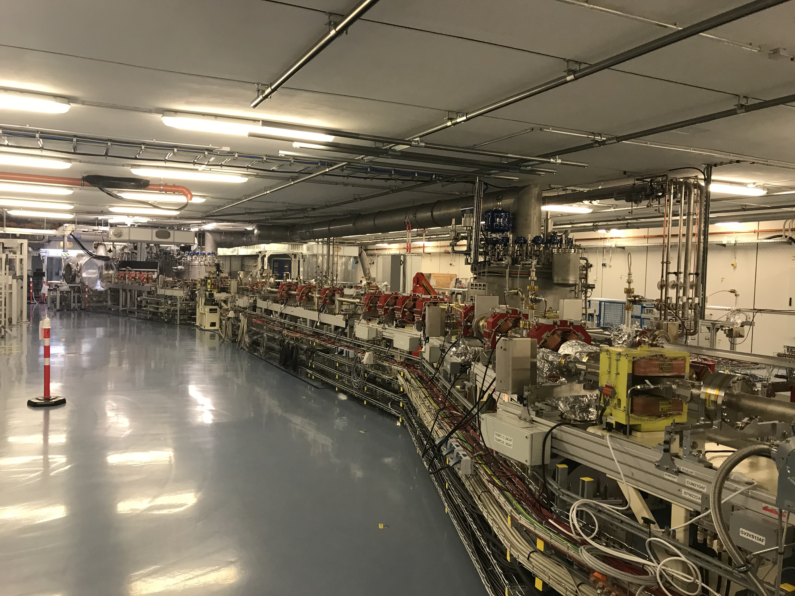
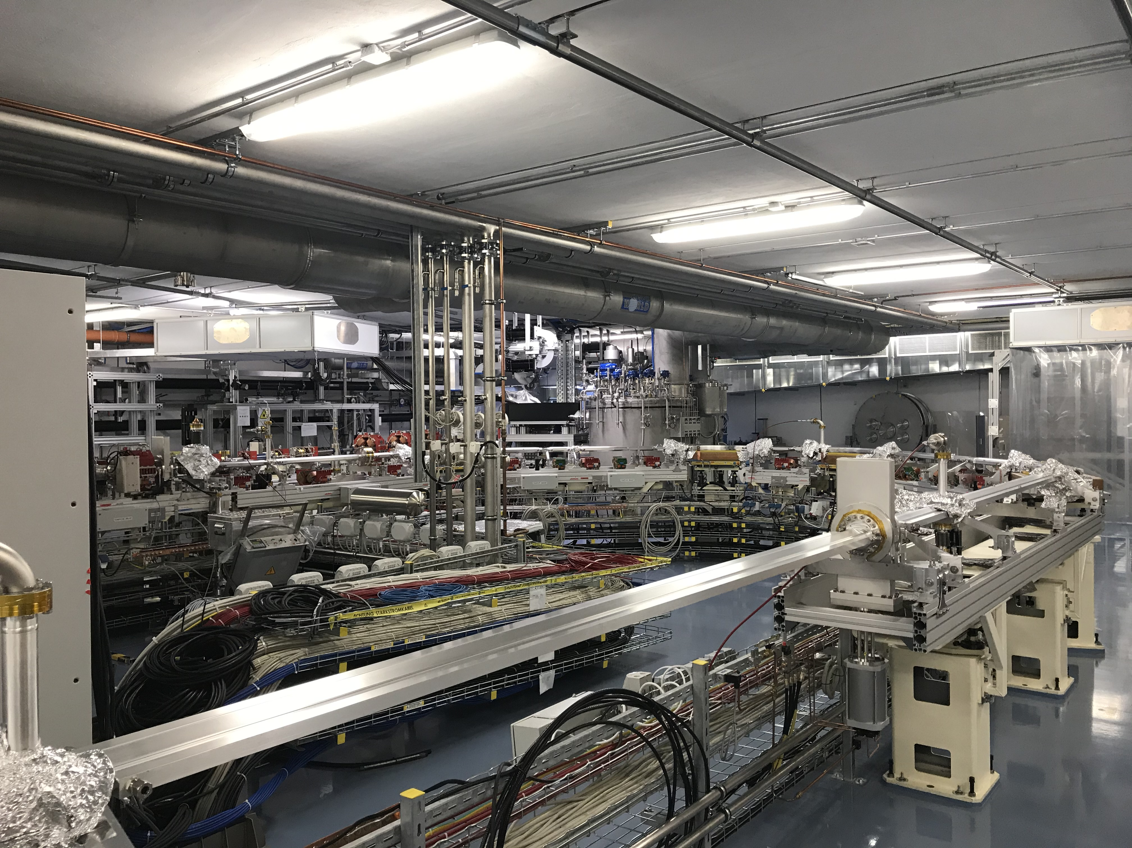
bERLinPRO
Racetrack closed
Dump, 100mA cryogenics
RF transmitter all there.
Well suited for ERL R&D
with 2 x 100 mA load:
Single-turn, 10mA, 1.3 GHz - at Helmholtz Zentrum Berlin
Possibility to upgrade SRF gun to 100 mA (currently power coupler limited)
Adding cavity-cryomodule, possibly equipped with FRT, to complete the facility.
R&D on stability, emittance preservation, beam loss, bunch length..
Missing LINAC cryomodule

Slide 14
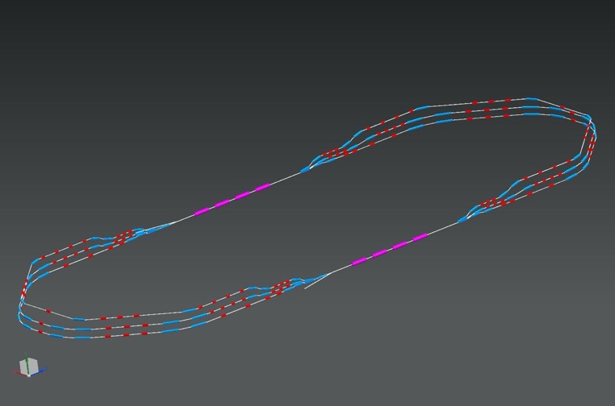
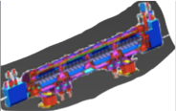
PERLE * (ERL R&D → Physics [NP, PP])
ALICE DC Photocathode, JLEIC Booster and SPL Cryomodule – in kind
Collaboration Agreement signed: CB 16.7.21
1 : 3 : 5
Injector design (ALICE gun, 3Dipole merger - tentative)
Linac: Cavity (Nb, 802 MHz) designed, built, tested
Full [SPL] cryomodule by 2024 for FCCee, PERLE and LHeC
injector
7 MeV
2 : 4 : 6
DE = 80 MeV
TDR by 2022
Beam 2025/6
7 MeV
dump
DC = l_{RF}/2
24 x 5.5 x 0.8 m³
CERN, Cornell, Daresbury, Jefferson Lab, Liverpool, Novosibirsk,
IJCLab Orsay (Host) Collaboration, growing: Grenoble, GANIL +
PERLE characteristics
More information: EPS: Poster by Ben Hounsell
LHeC (and PERLE, FCC-eh) paper: 2007.14491
Alex Bogacz: DIS21 proc.; Long Write-Up on ERLs
* PERLE. Powerful energy recovery linac for experiments. Conceptual design report
Published in: J.Phys.G 45 (2018) 6, 065003 e-Print: 1705.08783 [physics.acc-ph]

Slide 15
EPS talk on EIC by F Willeke 27.7.
CeC1
enlarged by 50
Multi-chicane amplifier - separate beam lines
SHC = strong hadron cooling
Decision expected with CD2
CeC2
Plasma cascade amplifier
Common e/h beam line
0.4 (1.5) MeV DC gun, 100 mA I_{e}, 149 MeV : 15 MW. 1 (3) path facility
L vs cms energy ⎷s = 2 ⎷E_{e} E_{p} ; JLEIC:

Slide 16
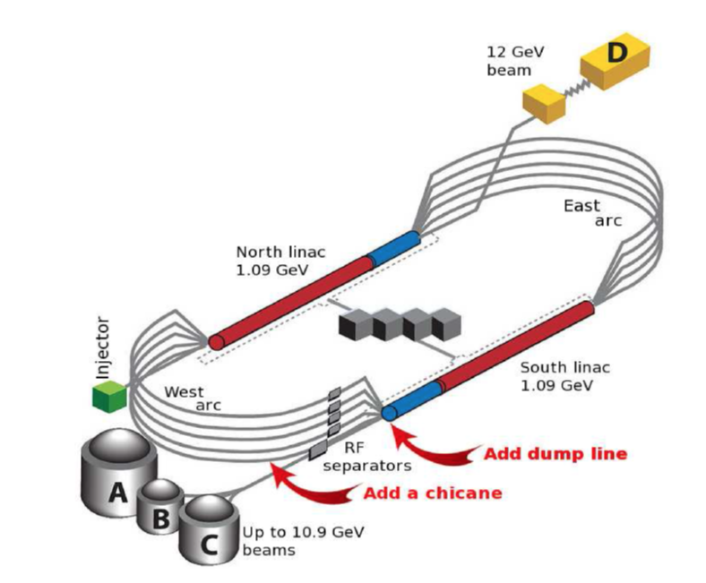
CEBAF 5 pass
Jlab project to study Coherent Synchrotron Radiation
(8 GeV beam energy) in an ERL CEBAF 5 pass configuration
Two additions:
- pathlength chicane to gain half wavelength, four 3m dipoles
(initial bunch suppression, control momentum compaction M56..)
- low power dump line at the south linac end
Multi-pass linac optics – A. Bogacz
12 GeV (11 passes) beam to Hall D, 11 GeV to A,B,C
Experiment Run schedule for 2024
Important test of ERLs for high energy application

Slide 17
Low Energy Physics with ERLs
Three examples from Long Write-UP
Proton Radius Puzzle [role for high intensity ERL, Jan Bernauer
ERL Symposium 6/21
MESA at Mainz
0.15mA
polarised
1mA (HOM!)
105 MeV
AMBER (CERN), MUSE (PSI), PRAD (Jlab), ULQ2 (Tohoku), Mainz .. ??
Nuclear Photonics [inverse y’s: L(PERLE) = O(10³) L(ELI)]
- 1.3 GHz, two ELBE type cryomodules, up to 3 passes
- New building, beam by 2024
- Polarimetry to 0.5% precision
- Current upgrade (unpolarised to 10 mA)
P2 – external target sin2O, w/o energy recovery (“EB”)
MAGIX – gas jet internal target, dark photons, p radius (“ER”)
June 17, 2021, to appear
Electrons Probing Exotic Nuclei
New field, pioneering: SCRIT@RIKEN, PRL 118, 2017
PERLE 500 MeV, 20mA, DESTIN project at Orsay
Outlook: eRI facility at GANIL (Caen, F) 200mA, ~2040

Slide 18
In summary: ERLs - a Progressing, Revolutionary Technology
Based on decades of SRF, FEL, ERL, Facility..
developments*) :
The debate now is about the conditions for ERLs to reach their productivity plateau and the demands on R&D, financial, intellectual and technical support – Roadmap early fall 21
ERL
An initial observation (not only) by the panel:
ERLs are more than an appealing technology:
They (cor)respond to A NEW ERA in
particle and several other fields of physics,
industry, accelerators .. in a world that cannot
proceed without renewed care for our planet.
Europe’s key R&D development prospects:
PERLE (3-turn, 10 MW), bERLinPRO (100 mA)
Concerted global effort (cERL, CEBAF5, etc.)
Including developments outside ERL facilities
Olga Tanaka (KEK)
*) e.g. Ilan Ben-Zvi 2016 Supercond. Sci. Technol. 29 103002
Chris Tennant, ERLs, in “Challenges and Goals for Accelerators
in the XXI Century”, O Bruening, S Myers, World Scientific, 2019

Slide 19
backup

Slide 20
EPS talk on EIC by F Willeke 27.7.
CeC1
enlarged by 50
Multi-chicane amplifier - separate beam lines
SHC = strong hadron cooling
Decision expected with CD2
CeC2
Plasma cascade amplifier
Common e/h beam line
w/o SHC
0.4 (1.5) MeV DC gun, 100 mA I_{e}, 149 MeV : 15 MW. 1 (3) path facility
w/o SHC from FW talk

Slide 21
Future of Particle Physics
The Development of ERLs. draft

