Slide 1
An Energy Recovery Linac for Energy-Frontier eh Scattering at CERN: the LHeC and the FCC-eh
Oliver Brüning (CERN), Max Klein (U Liverpool), Daniel Schulte (CERN)
for the LHeC/PERLE/FCCeh Collaboration
Talk at ICHEP Seoul, 6 July, 2018

Slide 2
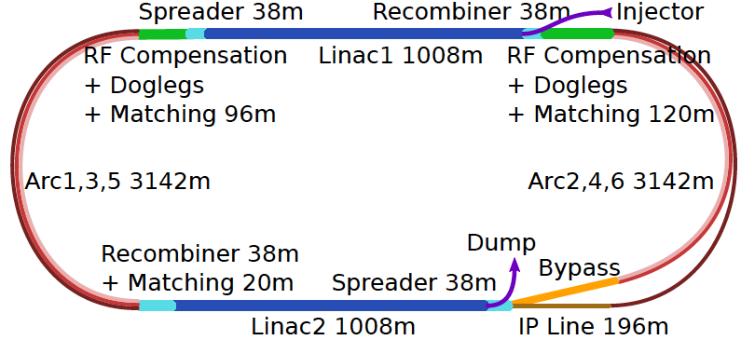
60 GeV Electron ERL added to LHC
U(ERL) = 1/3 U(LHC)
Concurrent operation to pp, LHC/FCC become 3 beam facilities. Power limit: 100 MW
10³⁴ cm⁻² s⁻¹ luminosity and factor of 15/120 (LHC/FCCeh) extension of Q², 1/x reach
1000 times HERA luminosity. It therefore extends up to x~1.
Four orders of magnitude extension in deep inelastic lepton-nucleus (ion) scattering.

Slide 3
title
arXiv:1206.2913

Slide 4
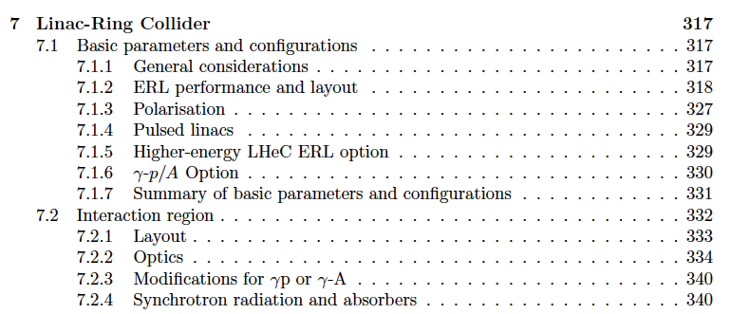
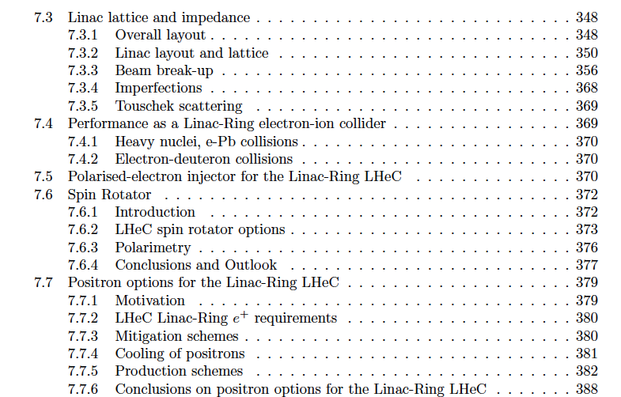
Performance
Interaction Region
Optics
Ions
Polarisation (80-90%)
Positrons
CDR: VERY detailed design of the LHeC Linac (and Ring) – Ring Collider, + components, CE..

Slide 5
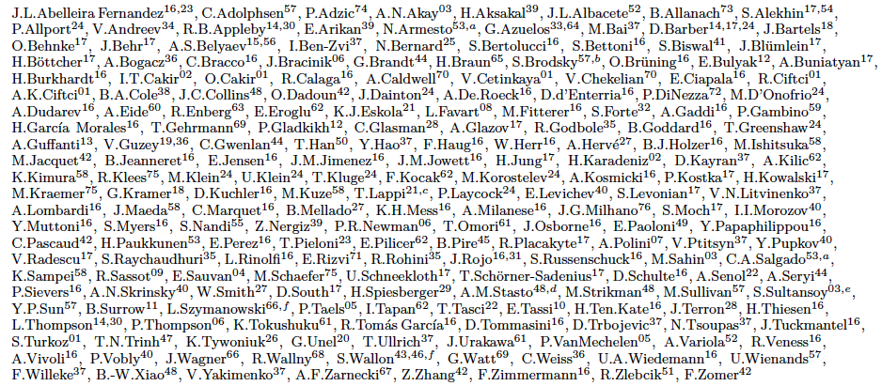
http://lhec.web.cern.ch
LHeC Study group and CDR authors 2014
“you never walk alone”

Slide 6
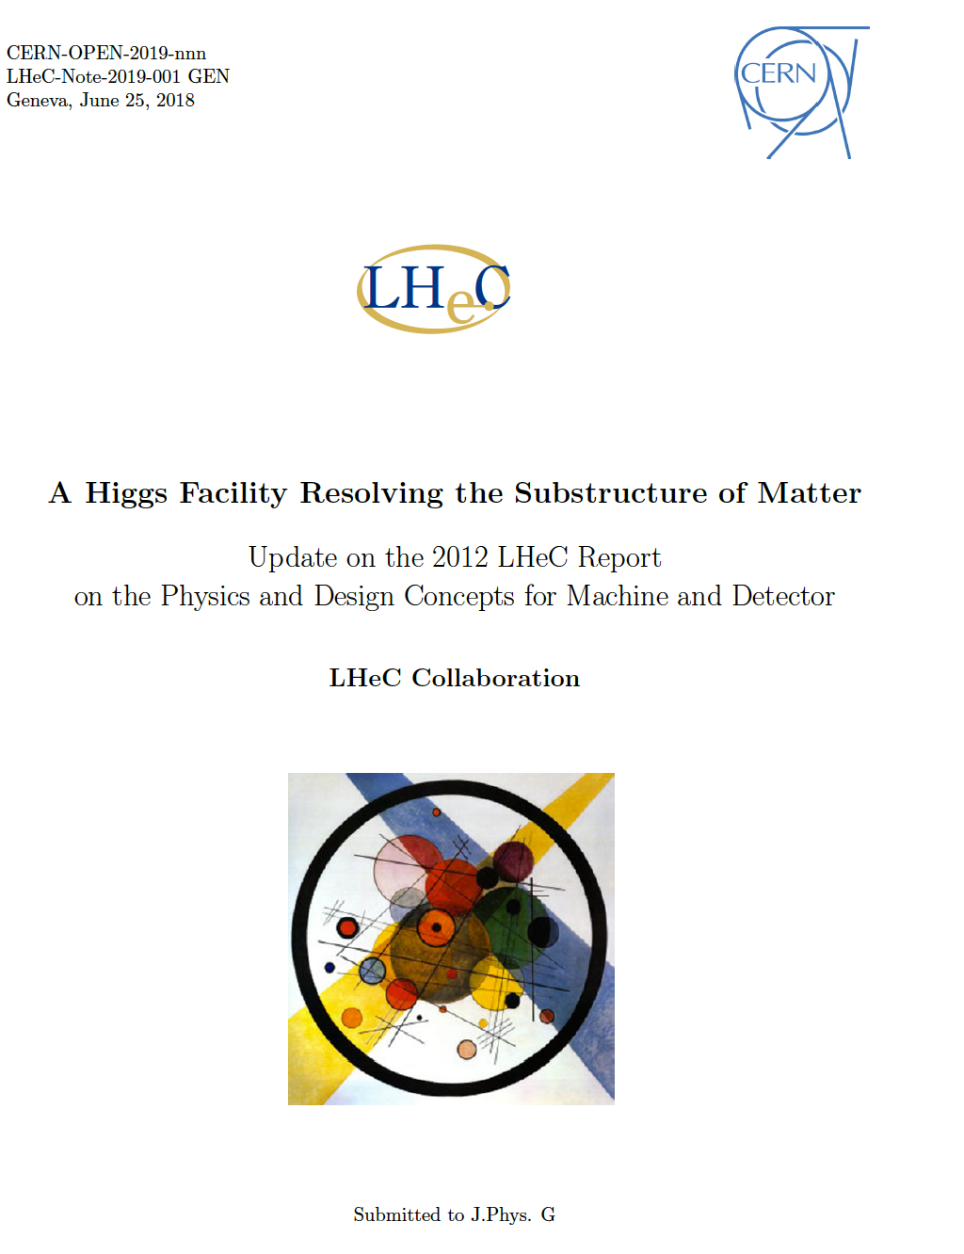
New LHeC Document
Reasons: CERN Mandate and
- Higgs: higher luminosity goal
- LHC: no BSM + precision
- New ep/eA Physics prospects
- eh appeared with FCC design
- Updates on IR, CE, …
- Insight from FCC study
- Vision for eh with HE LHC
- Options for ERL based Physics
beyond eh scattering.
- Low energy test facility PERLE
- Implementation of ERL at CERN
Preparation for early 2019
Submissions of eh Papers to
European Strategy:
- FCC eh as part of FCC hh
- LHeC with HL
- PERLE technology development
DRAFT

Slide 7
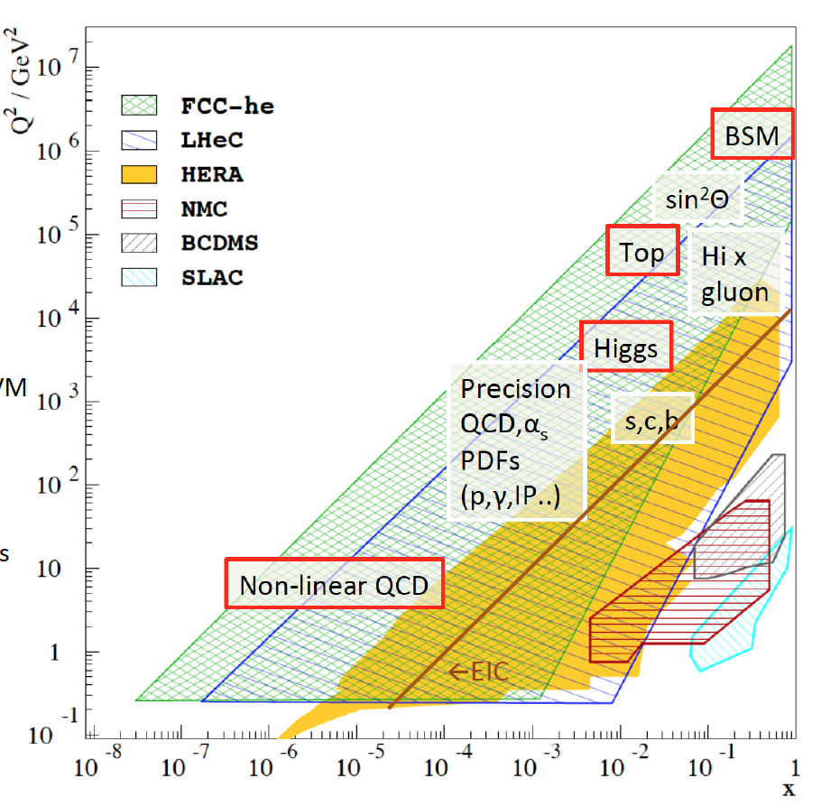
Physics with Energy Frontier DIS
Raison(s) d’etre of the LHeC
Cleanest High Resolution
Microscope: QCD Discovery
Empowering the LHC
Search Programme
Transformation of LHC into
high precision Higgs facility
Discovery (top, H, heavy ν’s..)
Beyond the Standard Model
A Unique
Nuclear Physics Facility

Slide 8
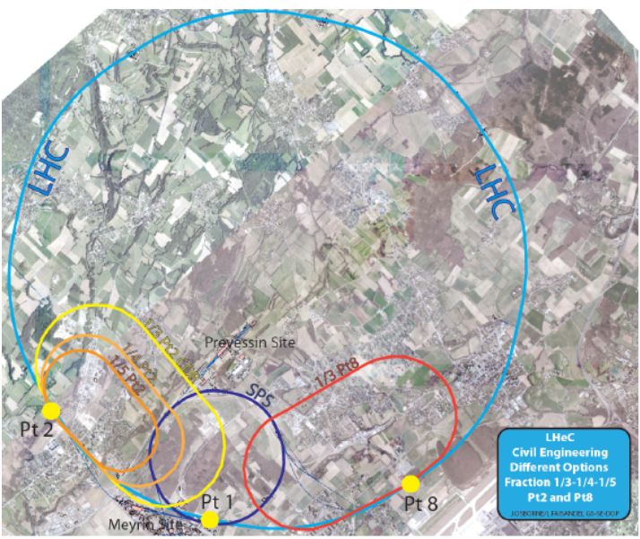
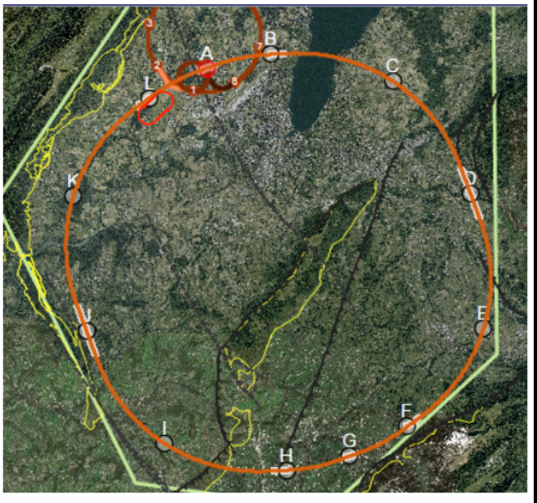
Location, Footprint, Use of the Electron Racetrack
e beam external to LHC. Location suitable for both HL and HE LHC.
- U(ERL) = 1/n U(LHC): 60 GeV: 1/3
BSM, top, Higgs, Low x all want maximum E_{e}
- Cost goes almost linearly down with E_{e}
For FCC can realise ep/A collisions
With IR at point L, not far from CERN
U(ERL) = 1/11 U(FCC)
Energy – Cost – Physics – Footprint are being reinvestigated for EU strategy

Slide 9
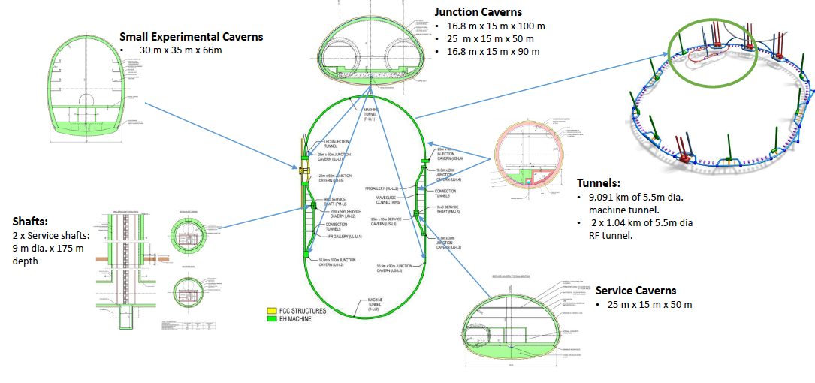
Civil Engineering for ERL
For LHC: re-use IP2. For FCC: deeper shafts, new IP cavern
Refinement of CE study, see J Osborne Amsterdam FCC week
and see Matt Stuart at LHeC Workshop, 28.6.18 at Orsay

Slide 10
→ O(1ab⁻¹) in a decade of operation, see D Schulte, FCC week at Rome, 2016

Slide 11
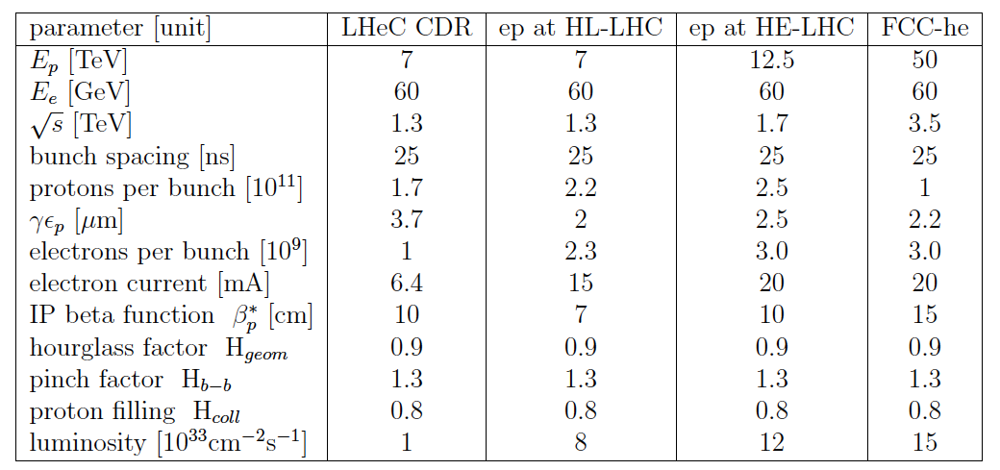
Luminosity for LHeC, HE-LHeC and FCC-ep
Contains update on eA:
6 10³² in e-Pb for LHeC.

Slide 12
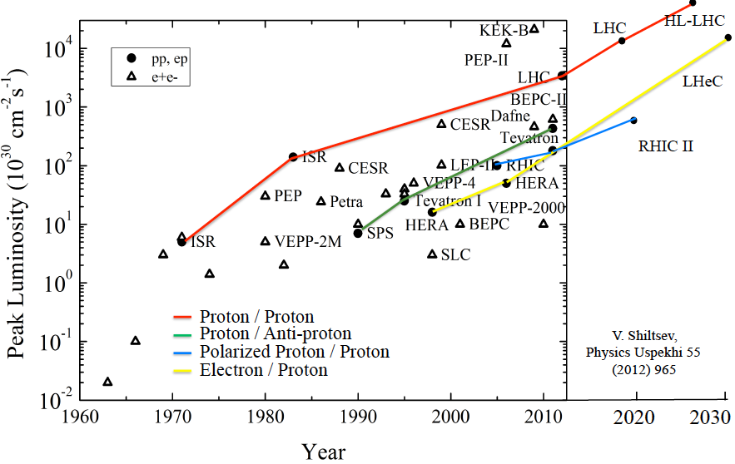
Collider Luminosities vs Year (pp and ep)
O. Bruening 2/17

Slide 13
ichep

Slide 14
ichep
Update of Lattice and IR Design Study: see E Cruz, R Martin and B Parker at Orsay Workshop

Slide 15
ichep

Slide 16
ichep
F Zimmermann at Orsay Workshop 28.6.18

Slide 17
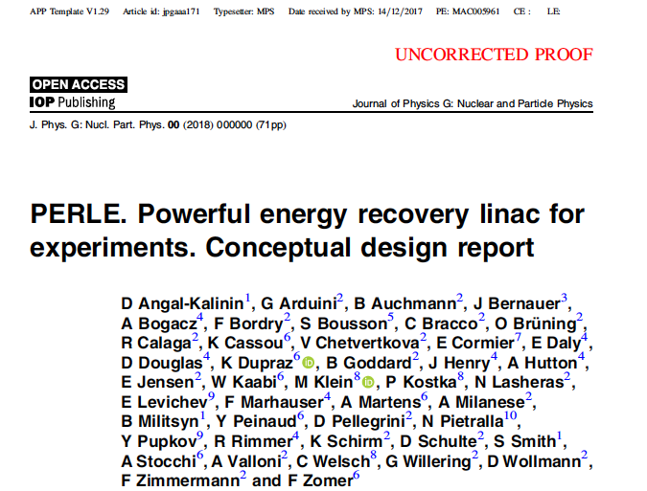
backup

Slide 18
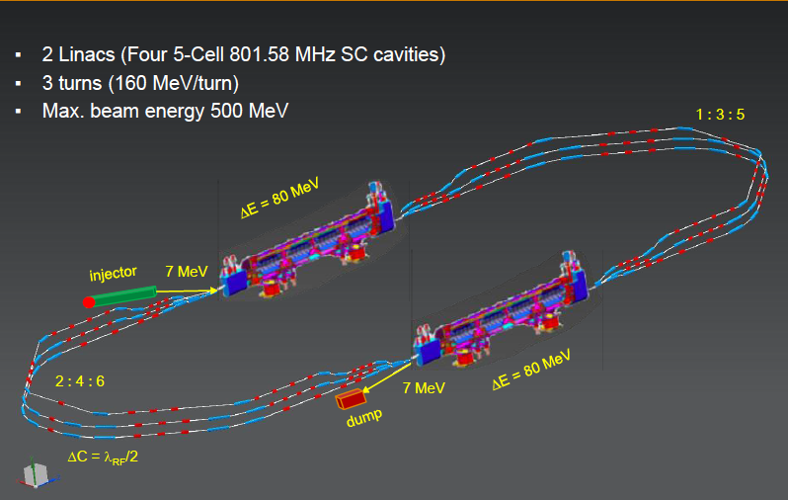
Powerful ERL for Experiments at Orsay
at 20mA → 10 MW
5.5 x 24m²
cf Walid Kaabi at Amsterdam FCC
New SCRF, High Intensity (100 x ELI) ERL Development Facility with unique low E Physics

Slide 20
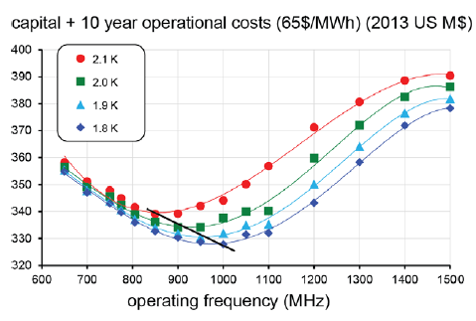
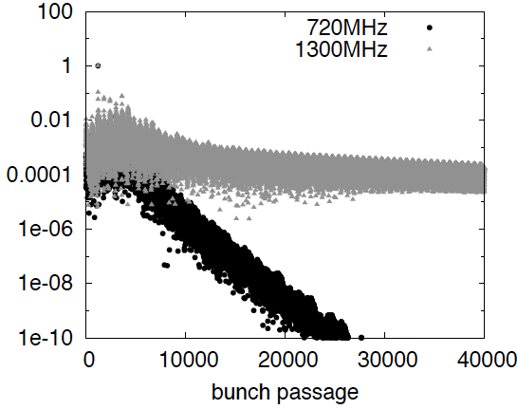
Frequency Choice
Cost, dynamic heat losses, resistance, Q₀… point to f < 1 GHz (F Marhauser, Orsay 2/17)
Beam beam interactions unstable for f > 1 GHz (D Schulte, D Pellegrini March 2013)
Compatibility with LHC: Decision for 802 MHz ( E Jensen CI Workshop 1/2015, FM input)

Slide 21
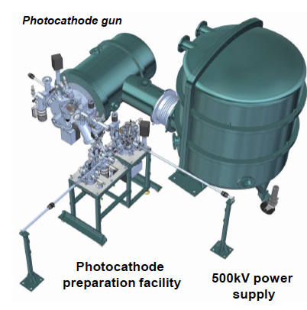
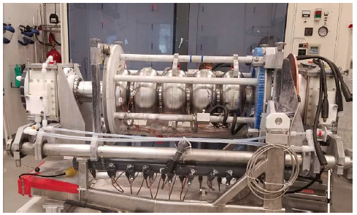
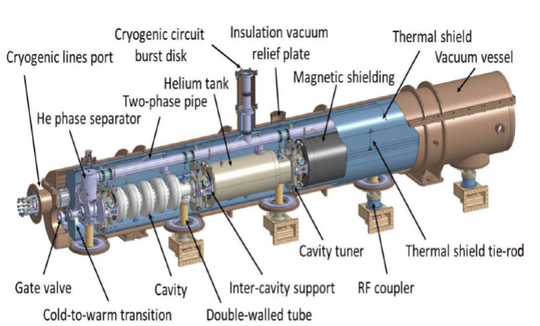
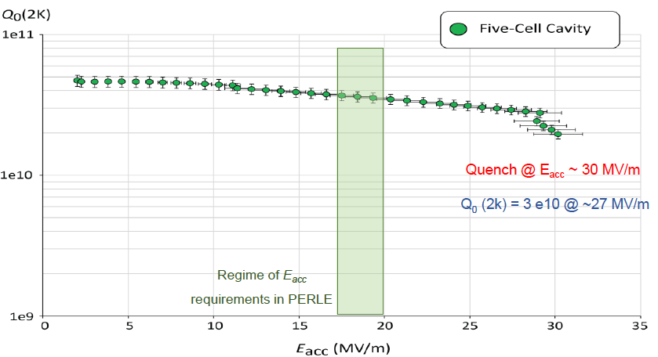
Towards PERLE: 802 MHz cavity, Source, Cryomodule, Magnets
First 802 MHz cavity successfully built (Jlab)
BINP, CERN, Daresbury/Liverpool, Jlab, Orsay, +
CDR 1705.08783 [J.Phys G] → TDR in 2019

Slide 22
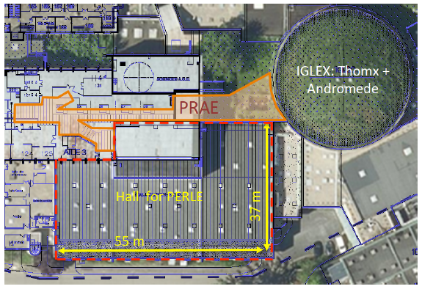
title

Slide 23
Summary and Plans
Following the CDR and the Higgs Boson Discovery in 2012, Physics from LHC, as well
as Technology Developments, the ERL Concept for the LHeC has been updated
to design for 10³⁴ cm⁻² s⁻¹ ep scattering with the HL LHC, HE LHC and the FCCeh.
New physics (Higgs, BSM, top) studies have substantially widened the scope.
The LHeC is designed for concurrent ep operation, with pp, in order to accumulate
O(1) ab⁻¹ of integrated luminosity, at a power limit of 100 MW.
New studies on lattice and the IR optics and configuration support this as a realistic goal.
The heart of ep with HL LHC, HE LHC and FCC-eh is an energy recovery electron linac.
A first SC cavity of 802 MHz frequency has been designed and successfully tested
showing stability of up to 29 MV/m and a weak Q₀-gradient dependence around
3 10¹⁰, exceeding the design goal. Single cells will be infused with N, + the CM designed
A PERLE CDR has been published in 2017 and a TDR is scheduled for 2019. PERLE
will be the first 10 MW, multi-turn 802 MHz facility and is suited to accompany
the development of the LHeC as a technology development facility, with low E physics.
PERLE and LHeC (HL/HE) inputs are under preparation for the HEP strategy update + beyond

Slide 24
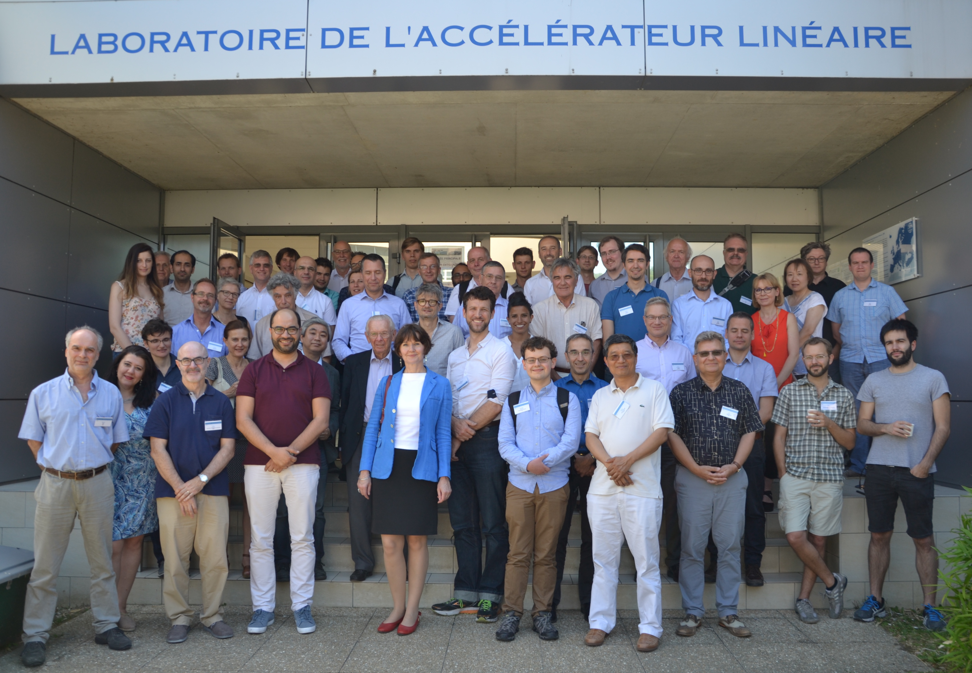
Most up-to-date Information: https://indico.cern.ch/event/698368/
Workshop: LHeC/FCCeh and PERLE
End of June at Orsay near Paris
New and Updates on
Physics (PDFs, QCD, H, t, BSM, eA + Relation eh-hh..)
Accelerator: IR, Optics, Lattice, Cost-Energy, CE..
Detector: the GPD and its fwd and bwd detectors
PERLE: Source, Injector, Cavity, Cryomodule,.. Physics
Project Development towards the ES2020:
LHeC + FCCeh+ PERLE input 12/18. PERLE TDR in 2019.
http://lhec.web.cern.ch

Slide 25
backup

Slide 26
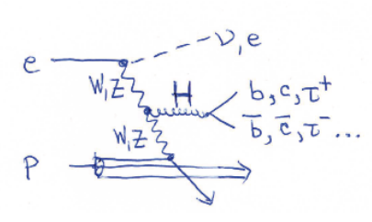
Determination of SM Higgs Couplings, HL-LHC and LHeC → LHC
δκ/κ [%]
preliminary
J. De Blas, M.+U. Klein, 16.4.2018
ttH at LHeC to 15%
LHC: ATLAS prospects PUB Note 2014-016
The addition of ep to pp (LHeC to LHC (HL,HE) and FCC-eh to FCC-pp) transforms these
machines into precision Higgs facilities. Vital complementarity with e⁺e⁻ (JdB Amsterdam)
Note that the HL LHC prospects are being updated (HL/HE LHC Physics workshop).

Slide 27
Large Hadron Electron Collider on one page
E_{e} = 10-60 GeV, E_{p} =1-7 TeV: √s = 200 – 1300 GeV. Kinematics: 0 < Q² < s, 1 > x ≥ 10⁻⁶ (DIS)
Electron Polarisation P=±80%. Positrons: significantly lower intensity, unpolarised
Luminosity: O(10³⁴) cm⁻² s⁻¹. integrated O(1) ab⁻¹ for HL LHC and 2 ab⁻¹ for HE LHC/FCCeh
e-ions 6 10³² cm⁻² s⁻¹ O(10)fb⁻¹ in ePb . O(1)fb⁻¹ for ep F_{L} measurements
Physics: QCD: develop+break? The worlds best microscope. BSM (H, top, ν, SUSY..)
Transformations: Searches at LHC, LHC as Higgs Precision Facility, QCD of Nuclear Dynamics
The LHeC has a deep, unique QCD, H and BSM precision and discovery physics programme.
Time: Determined by the Large Hadron Collider (HL LHC needs till ~2040 for 3 ab⁻¹ )
LHeC: Detector Installation in 2 years, earliest in LS4 (2030/31).
HE LHC: re-use ERL. In between HL-HE, 10 years time of ERL Physics (laser, γγ..)
Very long term: FCC-eh
Challenges: Demonstration of ERL Technology (high electron current, multi-turn)
Design 3-beam IR for concurrent ep+pp operation, New Detector with Taggers - in 10 years.
The LHeC is a great opportunity to sustain deep inelastic physics within future HEP.
The cost of an ep Higgs event is O(1/10) of that at any of the 4 e⁺e⁻ machines under consideration
It can be done: the Linac is shorter than 2 miles and the time we have longer than HERA had.
CERN and world HEP: Vital to make the High Luminosity LHC programme a success.
1802.04317
http://lhec.web.cern.ch
Max Klein Kobe 17.4.18

Slide 28
LHeC Prospects
The ep interaction does not disturb pp, i.e. the LHC may become a twin collider,
ep and pp operate concurrently and no luminosity loss is planned for pp. This
requires a premounted eh detector which may then be inserted in 2 years.
At LS4 (~2030) the heavy ion LHC operation ends and one may propose a
different use of IP2 which currently houses ALICE.
The electron beam energy (> 50 GeV) and luminosity (O(10³⁴) cm⁻² s⁻¹) goals are
derived from Higgs, top and BSM physics, also DIS itself (F_{L}, low x~1/s).
The cost of the O(1) TeV ep collider is a small fraction of any other big project
currently under discussion. The LHC determines the time frame. This may extend
considerably if CERN moves to HE LHC in the fourties.
The ERL technology is being developed worldwide (Darmstadt, Cornell, Berlin,
Novosibirsk, Jefferson Lab). PERLE would be a multi-turn 802 MHZ ERL technology
development and test facility which would timely accompany the LHeC progress.
We celebrate this year the 50th anniversary of the discovery of quarks. This was
not planned and achieved by a step in energy with a linac SHORTER than LHeC’s
- There is a very long term future for eh as part of hh in the FCC vision

Slide 29
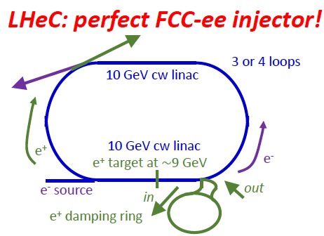
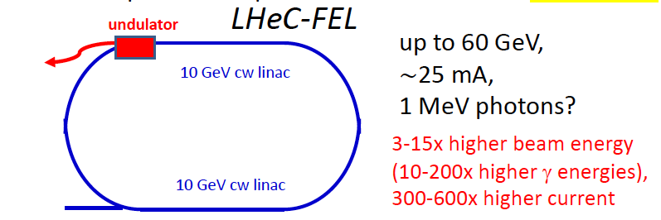
Further use of ERL in between HL and HE LHC
F.Zimmermann at LHeC WS 9/17
XFEL: 20GeV e, 0.03mA, 24keV photons. LCLSII: 4 GeV e, 0.06mA, 5 keV photons

Slide 30
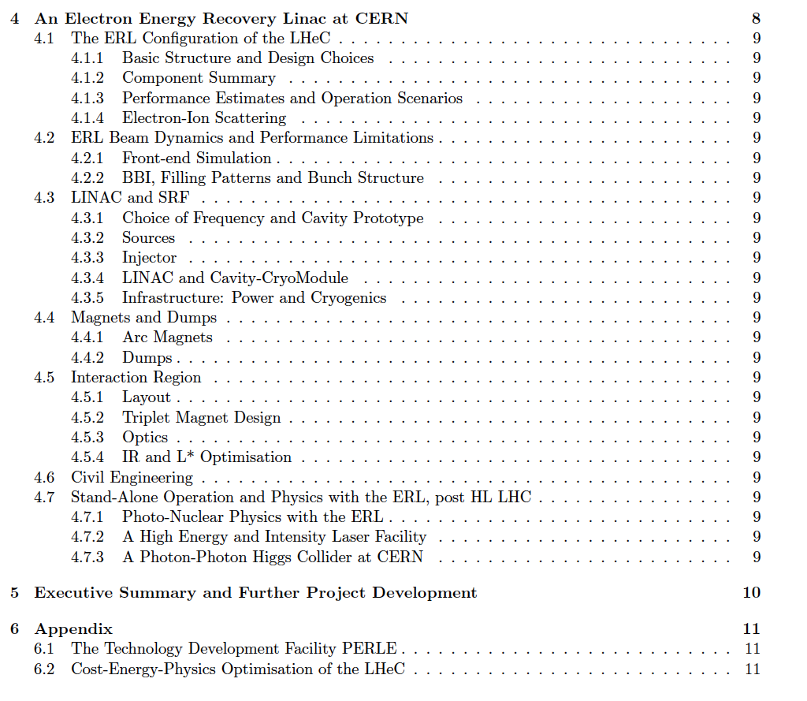
DRAFT

Slide 31
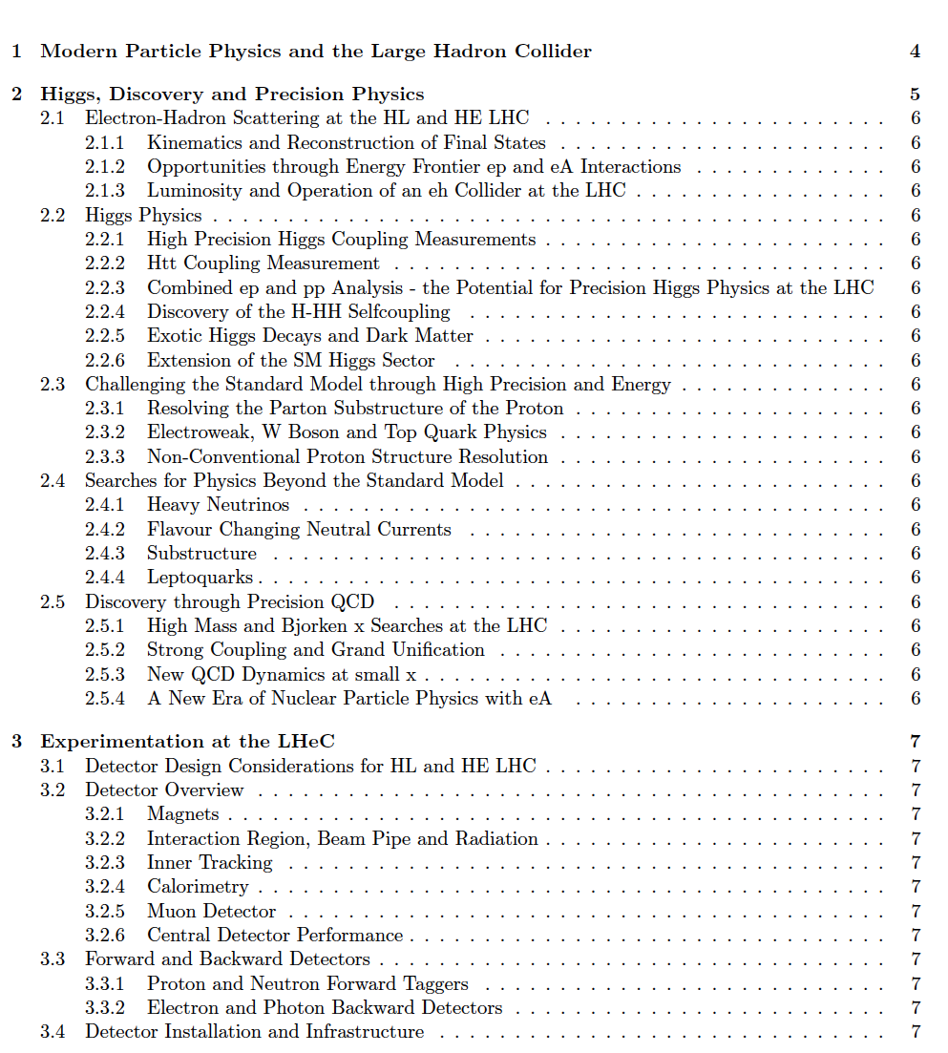
DRAFT

Slide 32
Observations post CDR/EUSPP - 2012+ affecting ep at CERN:
LHC lifetime now extended to ~2040 to collect 3 [4] ab⁻¹ . LS3 2024-2026+..
Discovery of the Higgs: L(ep): 10³³ → 10³⁴ cm⁻² s⁻¹ [HERA in days]
LHC brightness N_{p}/ε about 3 times higher than “ultimately” expected
No further discovery at the LHC, so far
Detector technology developments (LHC Det. Upgrades)
Strong accelerator technology developments, notably SCRF
ERL. LHeC: 720 → 802 MHz. enhanced Q₀ > 10¹⁰
EU strategy 13: exploit LHC, study Higgs, develop SCRF+,
CERN: new accelerators “with emphasis on pp and ee”
Fine with the LHeC cost being a small fraction of ILC,CLIC,FCC
CERN in 14 set up a new LHeC organisation with a new mandate
and IAC (H.Schopper et al) to prepare for the next EU strategy 2019+
Two main tasks (IAC): Update of CDR for HL-LHeC/FCCeh + Testfacility

Slide 33
Framework of the Development
Following the CDR in 2012: Mandate issued by CERN:2014 (RH), confirmed in 2016 (FG)
Mandate to the International Advisory Committee
Advice to the LHeC Coordination Group and the CERN directorate by following the
development of options of an ep/eA collider at the LHC and at FCC, especially with:
Provision of scientific and technical direction for the physics potential of the ep/eA
collider, both at LHC and at FCC, as a function of the machine parameters and of a
realistic detector design, as well as for the design and possible approval of an ERL
test facility at CERN.
Assistance in building the international case for the accelerator and detector
developments as well as guidance to the resource, infrastructure and science
policy aspects of the ep/eA collider.
Chair: Herwig Schopper, em. DG of CERN. IAC+CERN have invited four of its members to follow the study with special attention (Stefano Forte, Andrew Hutton, Leandro Nisati and Lenny Rifkin). Collaboration also with the FCC Review Committee chaired by Guenther Dissertori.
LHeC has been a development for and initiated by CERN, ECFA and NuPECC, so far, it’s formal status is that of a community study, not a proposal, which holds for the FCC also, of which ‘eh’ is a part.

Slide 34
Organisation^{*)}
Working Groups
International Advisory Committee
Mandate by CERN to define
“..Direction for ep/A both at LHC+FCC”
PDFs, QCD
Fred Olness,
Claire Gwenlan
Higgs
Uta Klein,
Masahiro Kuze
BSM
Georges Azuelos,
Monica D’Onofrio
Oliver Fischer
Top
Olaf Behnke,
Christian Schwanenberger
eA Physics
Nestor Armesto
Small x
Paul Newman,
Anna Stasto
Detector
Alessandro Polini
Peter Kostka
Coordination Group
Accelerator+Detector+Physics
Sergio Bertolucci (CERN/Bologna)
Nichola Bianchi (Frascati)
Frederick Bordry (CERN)
Stan Brodsky (SLAC)
Hesheng Chen (IHEP Beijing)
Eckhard Elsen (CERN)
Stefano Forte (Milano)
Andrew Hutton (Jefferson Lab)
Young-Kee Kim (Chicago)
Victor A Matveev (JINR Dubna)
Shin-Ichi Kurokawa (Tsukuba)
Leandro Nisati (Rome)
Leonid Rivkin (Lausanne)
Herwig Schopper (CERN) – Chair
Jurgen Schukraft (CERN)
Achille Stocchi (LAL Orsay)
John Womersley (ESS)
Gianluigi Arduini
Nestor Armesto
Oliver Brüning – Co-Chair
Andrea Gaddi
Erk Jensen
Walid Kaabi
Max Klein – Co-Chair
Peter Kostka
Bruce Mellado
Paul Newman
Daniel Schulte
Frank Zimmermann
5(12) are members of the
FCC coordination team
OB+MK: co-coordinate FCCeh
We miss Guido Altarelli.
*) April 2018

Slide 35
title
CDR: Default configuration, 60 GeV, 3 passes, 720 MHz, synchronous ep+pp, L_{ep}=10³³

Slide 36
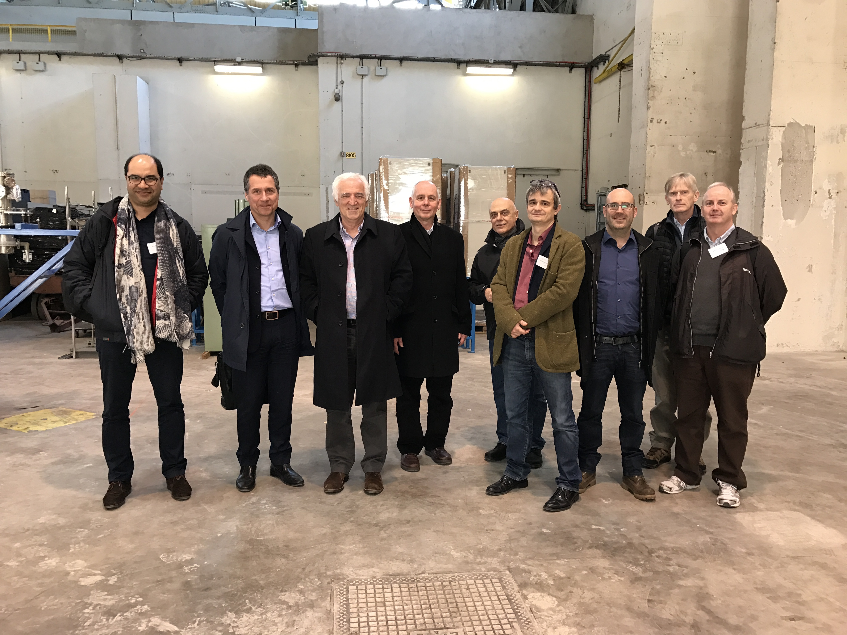
title

