Slide 1
erl

Slide 2

erl
Very recent:
$$eγ→eμ/μ$$
concept of
100 GeV eERL
with X ray FEL
as base for
muon collider
10pmrad emittance
arXiv:2106.03255
Curatolu, Serafini
ERL concepts now
for ep, e⁺e⁻, yy
+ muon colliders

Slide 3
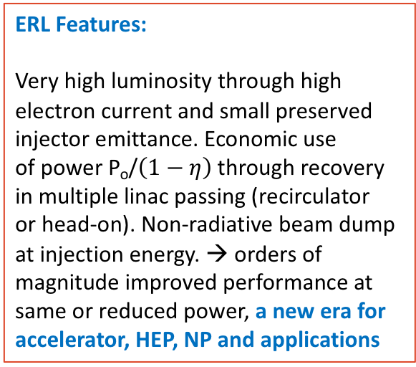
erl
A selection of past, present and proposed ERL facilties vs energy and current
ERL Features:
Very high luminosity through high
electron current and small preserved
injector emittance. Economic use
of power P_{o}/$\left(1−η\right)$through recovery
in multiple linac passing (recirculator
or head-on). Non-radiative beam dump
at injection energy. → orders of
magnitude improved performance at
same or reduced power, a new era for
accelerator, HEP, NP and applications
DRAFT PLOT, 12.6.21
“The ERL concept is well proven
and the technology is well
developed. Many demonstrator
facilities exist worldwide with
increasing sophistication. It
needs a facility comprising
all essential features
simultaneously: high-current,
multi-pass, optimised cavities
and cryo-modules and a
physics quality beam eventually
for experiments”. (Bob Rimmer)

Slide 5
Evaluation of ERL concepts for FCC-ee [CERC] and the ILC [ERLC]
Vladimir Litvinenko+ https://doi.org/10.1016/j.physletb.2020.135394 ;
Valery Telnov, https://arxiv.org/abs/2105.11015
The Sub-Panel should evaluate the technical and financial implications of the two novel concepts compared to the FCC-ee and ILC projects:
What are the technical advances, specifically in luminosity?
What are the technical solutions + obstacles requiring R&D?
How much time would that additionally require?
What is the rough cost implication (to about 10%)
Sub-Panel members
Chris Adolphsen (SLAC) Reinhard Brinkmann (DESY)
Oliver Brüning (CERN) Andrew Hutton (JLab) – Chair
Sergei Nagaitsev (Fermilab) Max Klein (Liverpool)
Peter Williams (STFC) Akira Yamamoto (KEK)
Kaoru Yokoya (KEK) Frank Zimmermann (CERN)
The e⁺e⁻ ERL Sub-Panel
Dates for the sub-Panel
Kick-off meeting held June 9, 2021
Completion by September 3, 2021
Deliverable:
A short report (~20 pages) detailing the conclusions of the evaluation, which should be agreed and supported by the entire sub-Panel and published as Appendix B to the full Panel report.
Methodology: Sessions with proponents to begin with. Sessions open to other ERL panel members
Procedure agreed with the proponents
Valeri Telnov and Vladimir Litvinenko, Tomas Roser

Slide 6
An initial observation (not only) by the panel:
ERLs are more than an appealing technology:
They (cor)respond to A NEW ERA in
particle and several other fields of physics,
industry, accelerators .. in a world that cannot
proceed without renewed care for our planet.
Energy Recovery Linacs are novel technologies
with far reaching impacts on science + society.
→
The symposium was an important event for information, consultation and formation of a more coherent R&D ERL effort.

