Slide 1

University of Liverpool: Energy Day 23 June 2009
Joule Centre:
The
future of energy research
in the Northwest
Prof. Peter Crossley
Director of Joule Centre
23rd June 2009

Slide 2
The Energy debate:
effective research into production, distribution and use of low carbon energy is fundamental to the global economy.
particularly important today (economic crisis, energy security and recognition of effect of fossil fuels on climate change).
NWDA is the lead regional development agency for the Department for Energy and Climate Change.

Slide 3
History of Joule Centre:
formed in 2005 to spearhead collaborative low carbon energy research in the Northwest
  by further leveraging through co-ordination & leadership at regional & national level
  by increasing interdisciplinary and collaborative working that delivers real solutions for the benefit of the Northwest
funded by NWDA with an initial 5yr budget of £5.2m.
Joule Centre serves:
  academic researchers in all the universities in the Northwest
  SME’s and larger businesses in Northwest
  NWDA in promoting research capabilities of the region
  public sector organisations

Slide 4
Main work areas of Joule Centre:
Awarding research grants to Northwest HEIs
Joule Forum
Support of industrial collaboration with HEIs

Slide 5
Joule research funding:
Grants to increase the profile and R&D capacity of Northwest Universities in energy technologies
Financial and management support for specific projects
Catalyst for encouraging further investment
Knowledge for NW sustainable energy community
Since 2006, Joule Centre has awarded 32 grants
Joule Centre is also a partner in two EU projects.

Slide 6
Joule Forum:
Network of representatives from universities, industry and public sector that arrange events to:
  influence and support regional energy policy
  inform and update members on energy matters
  encourage individual & corporate “best practise”
  provide opportunities for collaboration
  stimulate debate on energy R&D
  provide guidance and support to the Joule Centre
Joule Forum organised 14 events with 900 attendees

Slide 7
Support for industrial collaboration:
Joule Centre endeavours to support businesses by linking them with NW academic researchers.
Joule Centre supports these relationships through:
  Joule Forum
  one to one meetings with business
  targeted media and website
  supporting other regional and national energy events
  seminars and conferences

Slide 8
Strategic Fit:
NWDA is main funder of Joule Centre
Joule Centre aims to satisfy strategic objectives of current Regional Economic Strategy
will be achieved by helping to develop energy sector and increasing innovation in region

Slide 9
Strategic Fit:
Joule Centre contributes to Climate Change Action Plan
Priority of plan is to enable move towards a low carbon economy by developing evidence base, providing skills and education, scoping the risks, opportunities and priorities and promoting best practise.
Joule Centre supports this priority and is lead partner for activity 6.3: “maintain and increase capacity of regional universities to deliver a future workforce skilled in research, development and deployment of low carbon technologies”

Slide 10
What Joule has achieved: Research Funding
33 research grant awards, committed expenditure £2.9M
awards range from £7,000 to £340,000
supports a diverse range of topics
Joule Centre seeks to promote industrial/regional linkages
topics include:
    large scale tidal energy prospects for the region
    innovation in small wind turbine technologies
    hydrogen storage & fuel cells
    demand side management
    low carbon aviation pathways
    low carbon manufacturing
    materials for 3rd generation solar cells

Slide 11
External/match funding for Joule supported projects

Slide 12
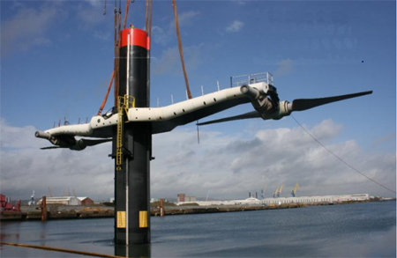
Joule supported research on Marine Energy:
Numerical investigation of a novel wave energy converter (MMU)
Construction of wave/current flume for research on offshore devices (Manchester University)
Tapping the tidal power potential of the Eastern Irish Sea (Liverpool University)
Acceleration of tidal stream turbulence research (Manchester University)

Slide 13
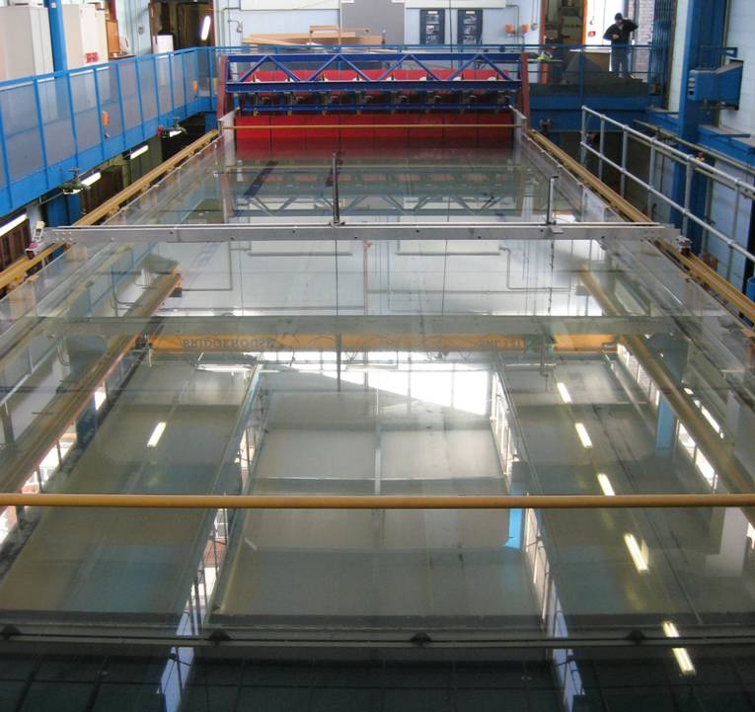
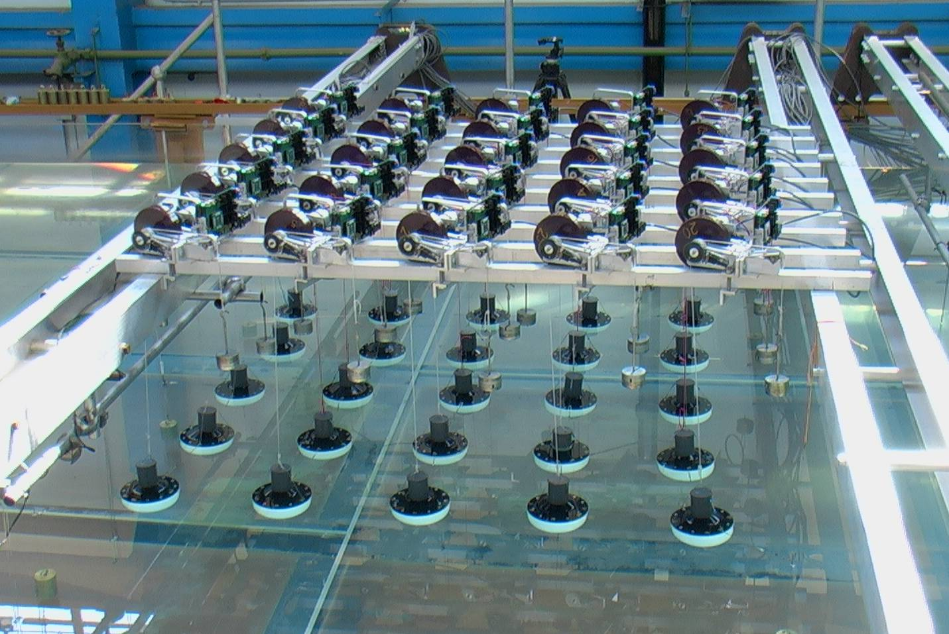
Combined wave and tidal flume (Manchester University)
world class facility for marine renewable energy R&D:- includes a wave maker

Slide 14
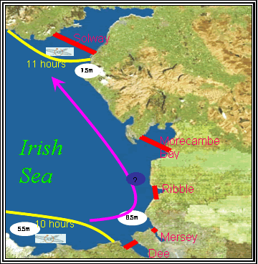
Tidal Energy Potential of Irish Sea (Liverpool Univ.)

Slide 15
Northwest England Hydro Resource Model (Lancaster University):

Slide 16
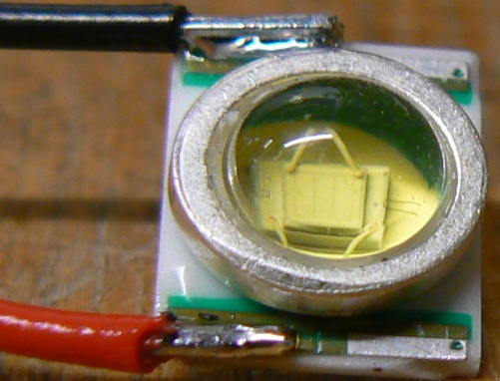
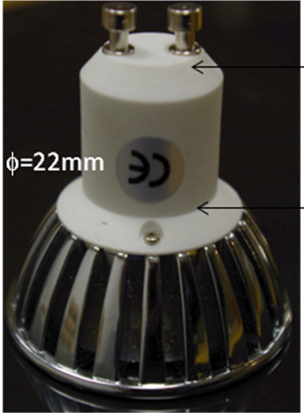
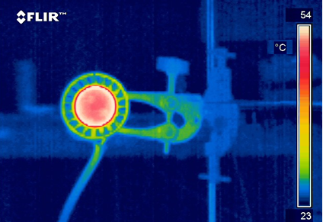

Joule supported research on demand reduction:
Optimisation of heat management in LED based luminaire designs (Manchester University with Luminanz)

Slide 17
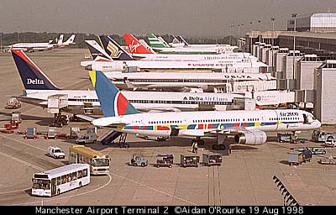
Joule supported research on demand reduction:
Socio-economic analysis of low carbon pathways for aviation (Tyndall Centre)

Slide 18
Joule research on Energy Network Infrastructure:
Energy infrastructure for offshore grids (Manchester Univ. + TNEI)
Mini-grids for renewable energy applications (Bolton University)
Superconducting fault current limiter (Manchester Univ. + Rolls Royce)
Data capture on distribution networks (Manchester Univ. + BPL)
Use of ester oils in transformers (Manchester Univ. + ENW)
Optical detection of transformer degradation (Liverpool Univ. + ENW)

Slide 19
Research on Hydrogen, Fuel Cells & Wind Turbines:
Nano-structured hybrid hydrogen storage materials (Salford Univ.)
PEM fuel cell test stand for low carbon technologies (Manchester Univ.)
Hydrogen from methane using non-thermal plasma (Manchester Univ.)
PV research (Bolton Univ. & Manchester Univ.)
Mini-grids for renewable energy applications (Bolton University)
Innovation of small wind turbine technologies (UCLAN)

Slide 20
Joule Strategy (2009 – 2014)
become a stronger focal point for energy R&D in the North West
improve co-ordination between stakeholders
provide clarity and leadership regarding regional energy strategy
champion exploitation of existing research
ensure financial sustainability of Joule Centre
necessary to demonstrate to NW Universities, NWDA & other funders that Joule can deliver viable, valuable services

Slide 21
Joule Strategy (2009 – 2014)
In addition to ensuring current programme is delivered successfully, Joule Centre will concentrate on two key activity areas:
  co-ordination, networking and dissemination of regional energy research
  leadership and direction on four themes:
    smarter networks
    carbon reduction and low carbon technology development/deployment
    enhanced higher level regional R,D & D skills
    cross-cutting socio-economic issues

Slide 22
NW Energy Research Landscape:
Smarter Networks
Cross-cutting Socio-economic
Low C technology + Carbon Reduction
Energy Skills
Drivers
Outputs
Lancaster
Govt policy -2020 vision and affordability
Collaboration to increase regional capability
Manchester
Salford
Open University
NW Climate change policy
Liverpool
Industrial engagement
JOULE
CEH
Chester
MMU
Increased talent pool
NW business needs and capabilities
Bolton
UoCumbria
UCLAN
LJMU
Increased regional energy “GVA”
Energy Security
Joule Centre serves academic researchers in NW Universities

Slide 23
Benefits of Joule Strategy for Universities
support for Business Development Managers
access to additional funding
inclusion in the Joule database
support from theme leaders
active networks & Joule Forum
promotion through articles/newsletter/website
project management of joint funding applications
matching to potential business partners
help with international links
cohesive and focused links to NWDA

Slide 24
Benefits of Joule Strategy for NWDA/Public Sector:
creation and safeguarding of regional jobs
helping businesses establish and maintain links to NW universities
leveraging of additional funds for energy research, development and deployment
increasing energy research skills in the region
authoritative advice on key energy topics to regional bodies
co-ordinating access to NW universities for inward investment in the energy sector

Slide 25
Benefits of Joule Strategy for Businesses:
co-ordinating access to NW universities
intelligent link to energy researchers in the NW
networking through Joule Forum/theme networks
guidance on funding opportunities
facilitation of Knowledge Transfer Partnerships
matching with researchers

Slide 26




