Slide 1
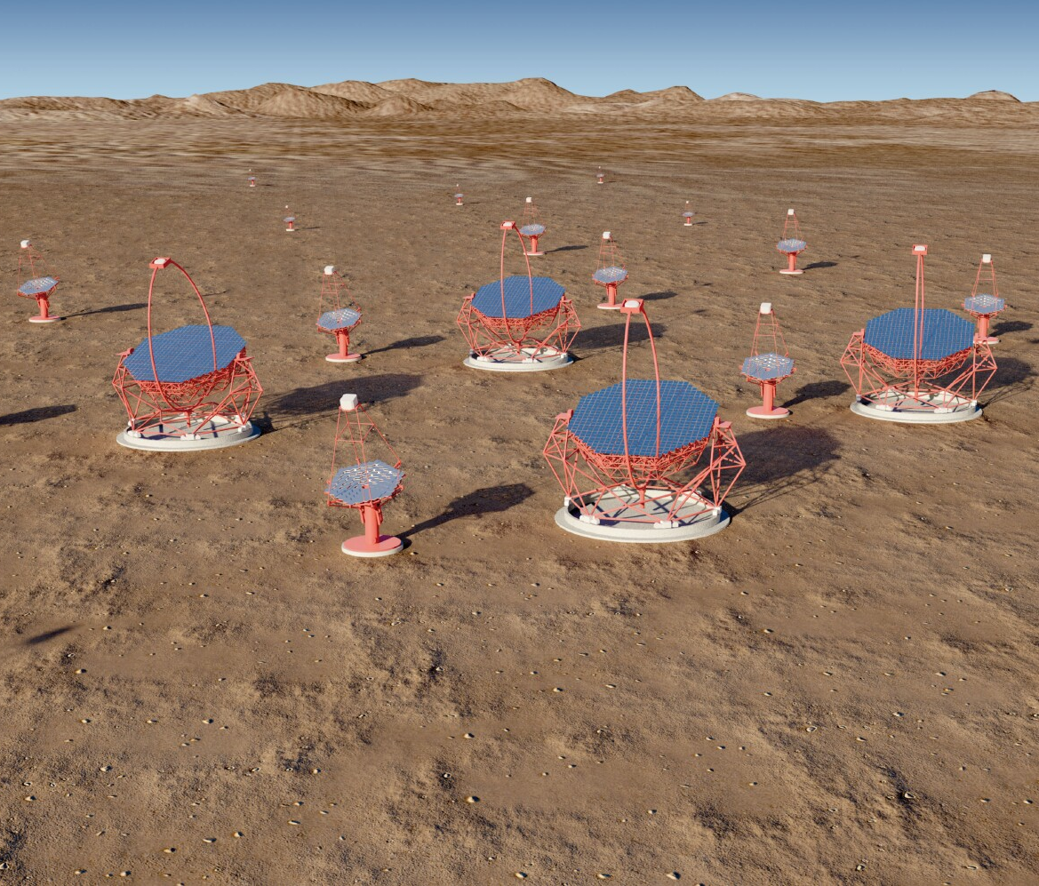
UK participation in CTA
Overview of progress since July 2017 for:
  CTA Consortium (CTAC)
  CTA Observatory (CTAO)
  The Gamma-ray Cherenkov Telescope (GCT)
  Compact High-Energy Camera (CHEC)
Next steps for CTA-UK
Notes:
The Cherenkov Telescope Array (CTA) is the next generation observatory for ground-based gamma-ray astronomy. Current instruments (HESS, MAGIC and VERITAS) have made huge progress in the observation of cosmic sources of photons in the ~ 50 GeV to ~ 50 TeV energy range using Imaging Atmospheric Cherenkov Telescopes (IACTs). CTA will extend the range of these observations at both low and high energies, will improve their sensitivity by a factor of about 10 and will increase the precision of photon energy and direction measurements. This talk presents briefly the designs of the 23 m, 12 m and 4 m diameter IACTs that CTA will use to achieve this performance, before discussing the impact the array will have on studies of Fundamental and Astroparticle Physics. Topics covered include: searches for Dark Matter (DM) and axion-like particles (ALPs); studies of possible violation of Lorentz invariance; and studies of the sources and acceleration mechanisms of high energy cosmic rays.
Remember the Ellis/White paper.
Include EBL studies.

Slide 2
CTAC – physics update
Science with CTA published, https://arxiv.org/abs/1709.07997
2
Notes:
The Cherenkov Telescope Array (CTA) is the next generation observatory for ground-based gamma-ray astronomy. Current instruments (HESS, MAGIC and VERITAS) have made huge progress in the observation of cosmic sources of photons in the ~ 50 GeV to ~ 50 TeV energy range using Imaging Atmospheric Cherenkov Telescopes (IACTs). CTA will extend the range of these observations at both low and high energies, will improve their sensitivity by a factor of about 10 and will increase the precision of photon energy and direction measurements. This talk presents briefly the designs of the 23 m, 12 m and 4 m diameter IACTs that CTA will use to achieve this performance, before discussing the impact the array will have on studies of Fundamental and Astroparticle Physics. Topics covered include: searches for Dark Matter (DM) and axion-like particles (ALPs); studies of possible violation of Lorentz invariance; and studies of the sources and acceleration mechanisms of high energy cosmic rays.
Remember the Ellis/White paper.
Include EBL studies.

Slide 3
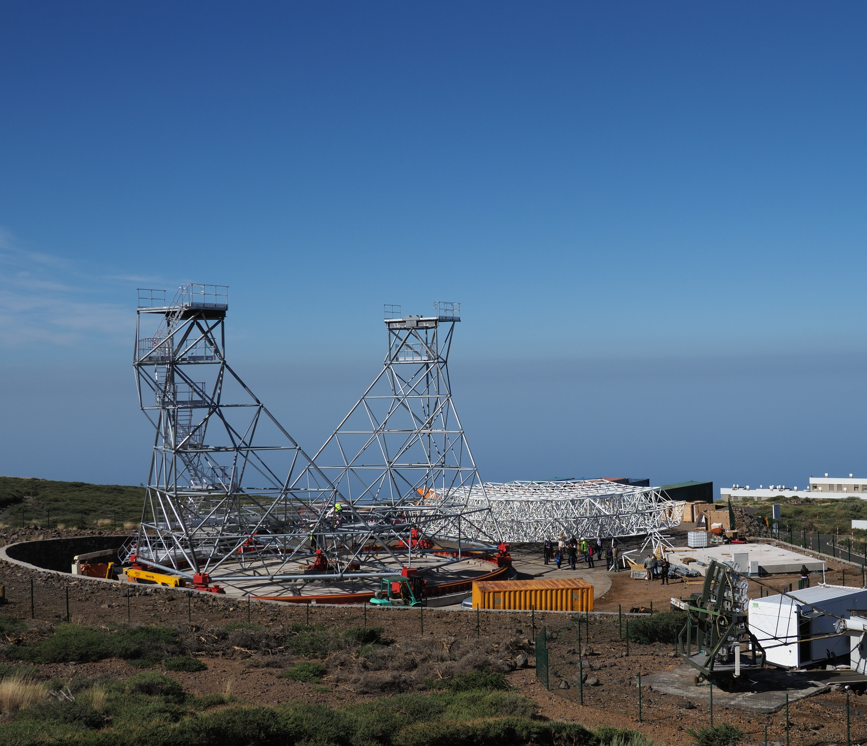
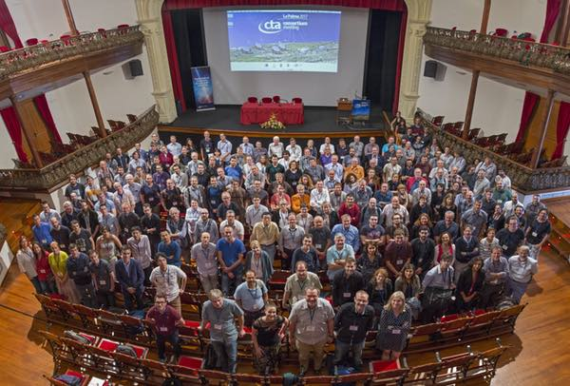
CTAC
Most recent meeting was held in Los Cancajos/Santa Cruz de La Palma.
UK physicists ran SST parallel sessions, reported on CHEC progress in parallel sessions and on CHEC, camera and mirror test facilities in plenary sessions.
On Saturday after meeting, visit was arranged to LST prototype.
Assembly restarted after delay due to problems with permission for construction.
Status of LST on 11/11/17:
3

Slide 4
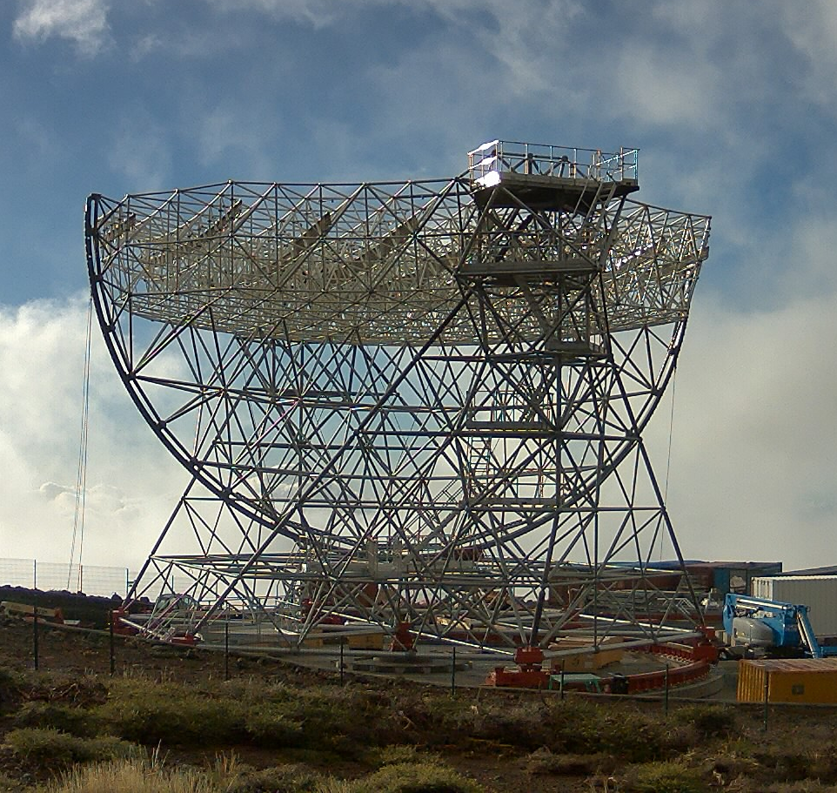
LST
MST +
FlashCam
Rapid progress is being made.
Status on 28/1/18:
MST/FlashCam developments:
First Cherenkov
images within
few days of
arrival of camera
in Adlershof.
Will form MSTS
(southern site).
4
Notes:
The Cherenkov Telescope Array (CTA) is the next generation observatory for ground-based gamma-ray astronomy. Current instruments (HESS, MAGIC and VERITAS) have made huge progress in the observation of cosmic sources of photons in the ~ 50 GeV to ~ 50 TeV energy range using Imaging Atmospheric Cherenkov Telescopes (IACTs). CTA will extend the range of these observations at both low and high energies, will improve their sensitivity by a factor of about 10 and will increase the precision of photon energy and direction measurements. This talk presents briefly the designs of the 23 m, 12 m and 4 m diameter IACTs that CTA will use to achieve this performance, before discussing the impact the array will have on studies of Fundamental and Astroparticle Physics. Topics covered include: searches for Dark Matter (DM) and axion-like particles (ALPs); studies of possible violation of Lorentz invariance; and studies of the sources and acceleration mechanisms of high energy cosmic rays.
Remember the Ellis/White paper.
Include EBL studies.

Slide 5
NectarCam
SCT
NectarCam: 19 modules installed in dark room and tested using pulsed light sources.
MST + NectarCam will form MSTN (northern site).
Low frequency (2.4 Hz), poorly damped (48 s), oscillation found.
Stiffen joints, add tensioning cables.
Frequency increases to 3 Hz, decay time drops to 1 s.
Hope for first light summer 2018.
Ambition: 10 SCTs for CTA northern or southern sites.
5

Slide 6
SST-1M and ASTRI
SST-1M:
DigiCam
installed on
telescope in
Krakow.
Data successfully taken:
ASTRI:
camera
installed
on
prototype.
Cherenkov data recorded
6

Slide 7
CTAO – southern site
Geotechnical survey now complete and 800 page report delivered.
Three “soil” layers on bedrock.
Second layer (at ~ 1.5 m depth) can take ~ 500 kPa load.
“Calculated settlements do not exceed 6 mm”(!)
7

Slide 8
Southern site
Seismic studies carried out using accelerometers mounted on concrete foundations on site.
Some indications that peak accelerations higher than anticipated.
Expert help being sought to understand consequences of these results.
8

Slide 9
Southern site
The first “buildings” are now on the CTA site in Paranal...
…as are some test mirrors:
These look extremely dusty.
Project Office has reopened discussion on shelter.
Data on effectiveness of shelter needed.
9
Notes:
The Cherenkov Telescope Array (CTA) is the next generation observatory for ground-based gamma-ray astronomy. Current instruments (HESS, MAGIC and VERITAS) have made huge progress in the observation of cosmic sources of photons in the ~ 50 GeV to ~ 50 TeV energy range using Imaging Atmospheric Cherenkov Telescopes (IACTs). CTA will extend the range of these observations at both low and high energies, will improve their sensitivity by a factor of about 10 and will increase the precision of photon energy and direction measurements. This talk presents briefly the designs of the 23 m, 12 m and 4 m diameter IACTs that CTA will use to achieve this performance, before discussing the impact the array will have on studies of Fundamental and Astroparticle Physics. Topics covered include: searches for Dark Matter (DM) and axion-like particles (ALPs); studies of possible violation of Lorentz invariance; and studies of the sources and acceleration mechanisms of high energy cosmic rays.
Remember the Ellis/White paper.
Include EBL studies.

Slide 10
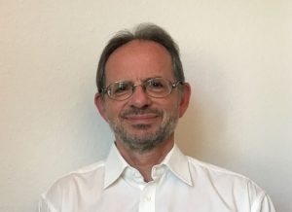
CTAO Project Manager
Project Manager appointed, Wolfgang Wild:
Was responsible for delivering the European part of the ALMA project.
Legal and Human Resources lead also in post, further hires soon.
Immediate priorities for CTA-south.
Prepare as much as possible (understand geotechnical study, prepare for civil engineering…).
Sign agreements.
Meeting with government and ESO in January 2018:
  ESO/CTA agreement finalised.
  ESO/Chile discussions ongoing.
  CTA/CONICYT ditto.
When contract signed: appoint site manager; place contracts for foundation design; for power system design; for road construction through ESO contracts and procurement.
10
Notes:
The Cherenkov Telescope Array (CTA) is the next generation observatory for ground-based gamma-ray astronomy. Current instruments (HESS, MAGIC and VERITAS) have made huge progress in the observation of cosmic sources of photons in the ~ 50 GeV to ~ 50 TeV energy range using Imaging Atmospheric Cherenkov Telescopes (IACTs). CTA will extend the range of these observations at both low and high energies, will improve their sensitivity by a factor of about 10 and will increase the precision of photon energy and direction measurements. This talk presents briefly the designs of the 23 m, 12 m and 4 m diameter IACTs that CTA will use to achieve this performance, before discussing the impact the array will have on studies of Fundamental and Astroparticle Physics. Topics covered include: searches for Dark Matter (DM) and axion-like particles (ALPs); studies of possible violation of Lorentz invariance; and studies of the sources and acceleration mechanisms of high energy cosmic rays.
Remember the Ellis/White paper.
Include EBL studies.

Slide 11
Prerequisites for construction
Sign site agreement.
Complete and agree requirements.
Produce detailed system designs for CTA-N and S.
  Needs work on harmonisation, data formats and data flow, operation and maintenance schemes, better definition of common system components…
Reviews at appropriate stages:
  “Technical” CDR.
  Pre-production Readiness Review (skip this?).
  Production Readiness Review.
Council has agreed that work on site can start under aegis of GmbH – don’t have to wait for ERIC to be established.
Reach threshold of €250M (happens when France signs MoU?).
Fix IKCs with secured funding:
  Update Cost Book.
  Call for EoIs.
  Evaluate these and select preferred options.
  Set up IKC agreements with shareholders/contributors.
11

Slide 12
IKC process
IKC providers responsible for delivering product that meets requirements.
This includes funding, coordination of contributing institutes, assembly on-site, commissioning and testing.
Handover to CTAO through defined acceptance procedure.
CTAO want to establish warranty period (of two years?).
IKC framework being discussed by CTAO, IKRC and Council.
This discussion, other organisational and technical tasks still to be completed before process starts.
Following IKC documents will be presented to Council:
  IKC Framework – overview of the IKC process.
  Delivery schedule.
  CTA Cost Book.
  Acceptance guidelines.
  Financial rules.
  Remit of the IKRC.
Aim for Council approval in March 2018(!).
“Don’t expect call for EoI early in 2018.”
12

Slide 13
GCT – meeting with Project Manager
Preamble:
  CTA must be as simple as possible.
  All telescope interfaces to the central system must be identical.
  Not clear yet if “harmonisation” is enough or if “down-selection” will be needed.
For SSTs:
  Meeting in February will be proposed to agree on review.
  Look for independent reviewers for structures and cameras.
  Review will advise Project Manager and Council.
If one of projects not kept, attempt to find role for group within CTA, matching expertise to needs.
Review criteria:
  Performance.
  Cost.
  RAMS.
  Funding and production capability.
  Technical readiness.
  Long term commitment (guarantee).
  Track record.
  Ease of operation.
  Maturity of technology.
  Origin of components (COTS).

Slide 14
Meeting with Project Manager
Comments on harmonization as opposed to down-selection.
Additional costs driven by:
  Spares.
  Complexity of operation – must insure interfaces common.
  Manpower requirements – maintenance by on-site team, but repair requires shipment to Europe or travel of experts to Chile.
  Increased complexity of data processing and simulations.
Acceptance procedures.
“Pre-acceptance in house”.
E.g. cameras could be tested where they are assembled (responsibility CHEC institutes).
“Pre-acceptance on site”.
Telescope structures and mirrors tested on site (responsibility CNRS/OP).
Integration of camera and final acceptance test of complete assembly on site.

Slide 15
CTAO system
Data items
Interface
to
world
Data flow
System
Collection of
systems
15

Slide 16
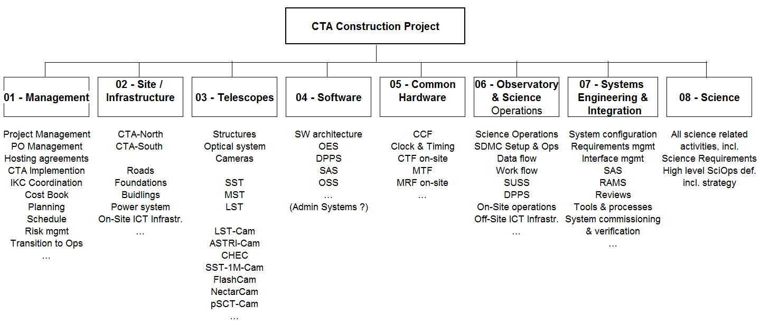
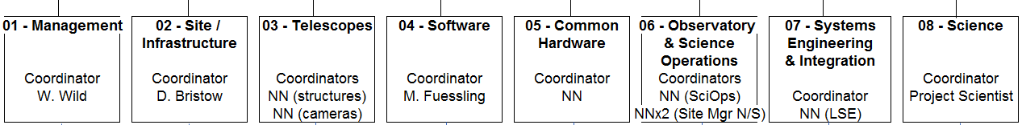
Organisation
16

Slide 17
Some new CTA acronyms
Summary of
the summary
SUSS (Science User Support System)
OES (Observation Execution System)
DPPS (Data Processing and Preservation System)
SAS (Safety and Alarm System)
IAS (Integrated Alarm System)
CSI (Central System Infrastructure)
OSDC (On-Site Data Centre)
OSS (Operations Support System)
ASWG (Analysis and Sim. WG)
SCTA (Scheduler for CTA)
ERIC (European Research Infrastructure Consortium)
AFC (Admin. and Finance Comm.)
Technical progress on the whole good.
CTAO is getting organised…
…and this is revealing the size of the task ahead.
First job, finalise requirements.
Review to decide on harmonisation/down selection
IKC process being organised.
  Framework.
  Cost book.
There will be a call for EoI’s in 2018.
17

Slide 18

GCT
The GCT prototype with its shelter.
Four new M1 petals will be produced, funding not from pre-production grant.
18

Slide 19
Shelter test with CHEC lid
Consider installing CHEC faceplate with doors on Paranal site.
Mount small mirror samples under lid and adjacent to faceplate.
Open and close to simulate observing conditions.
Measure reflectance of samples before test and after a significant period on site – minimum 6 months?
Power is available on site (2 kW solar panels installed).
Slow link to ESO site (upgrade planned).
Weather monitor available.
Probably possible to install on “Meccano” frame on wooden platform anchored using ground screws.

