Slide 1
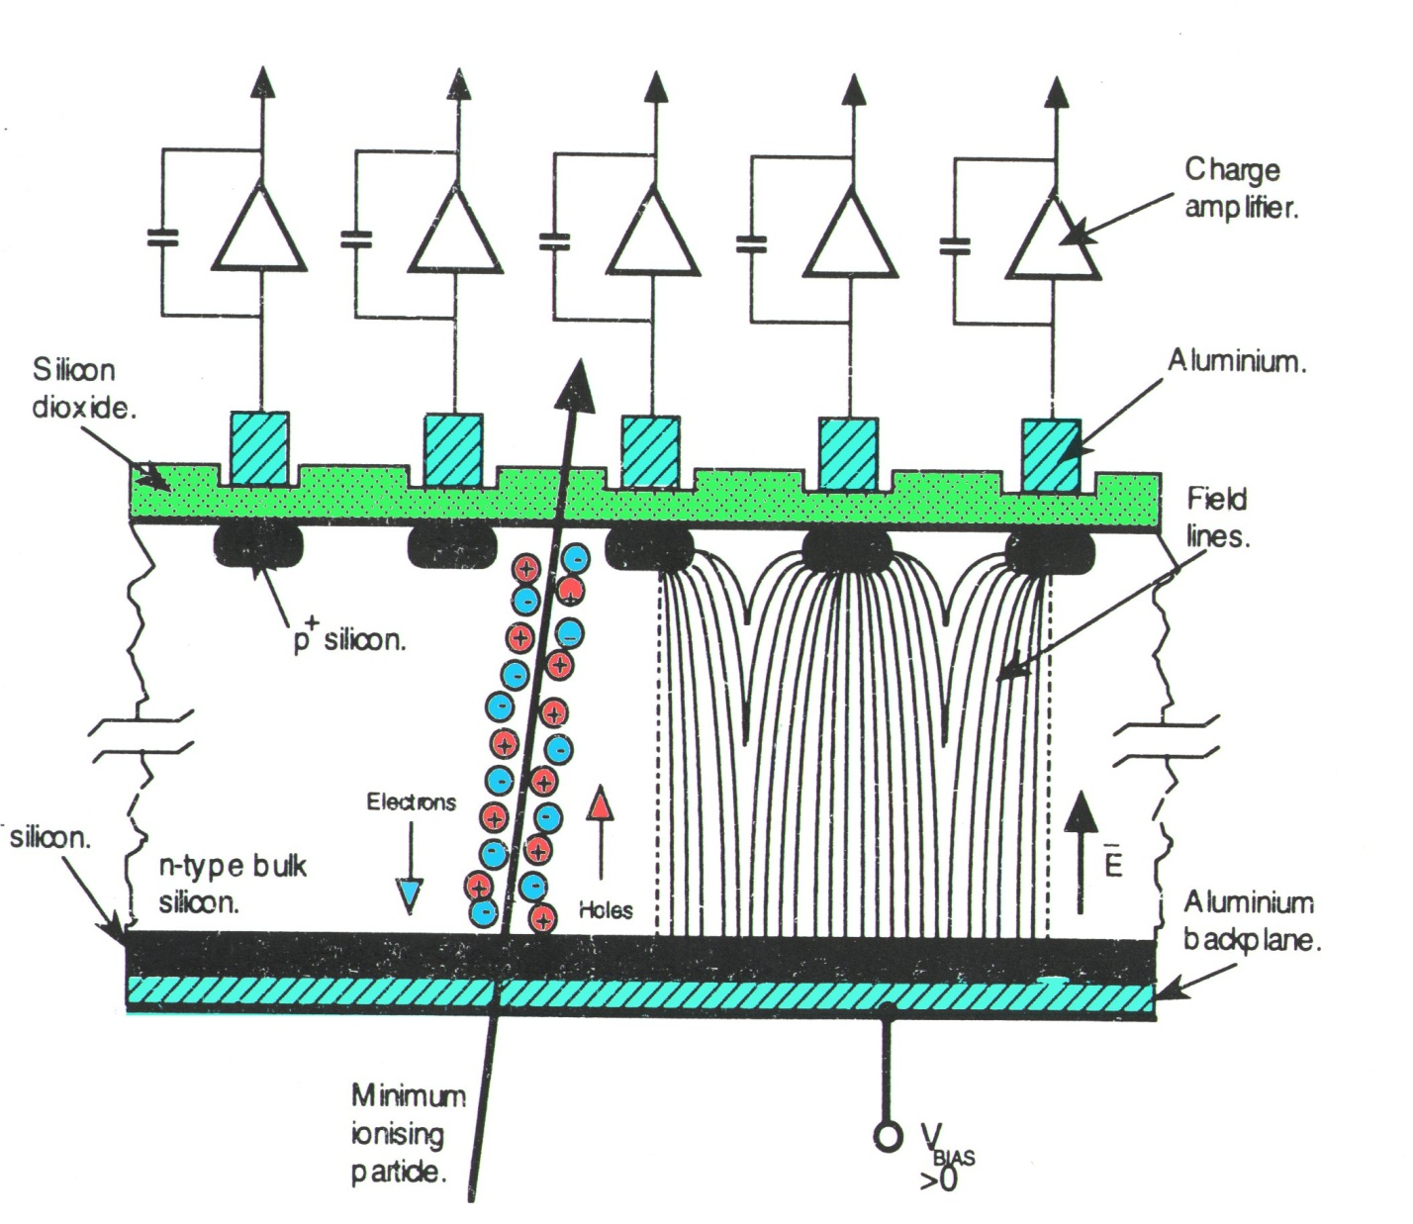
Semiconductor Sensor Development
THE UNIVERSITY of LIVERPOOL
Semiconductor sensors are based on segmented diodes which collect the charge produced by photons or ionising radiation.
The position resolution is determined primarily by the granularity; microchip processing technology enables precisions of a few μm to be attained. Applications are numerous, in high energy physics and other fields.

Slide 2
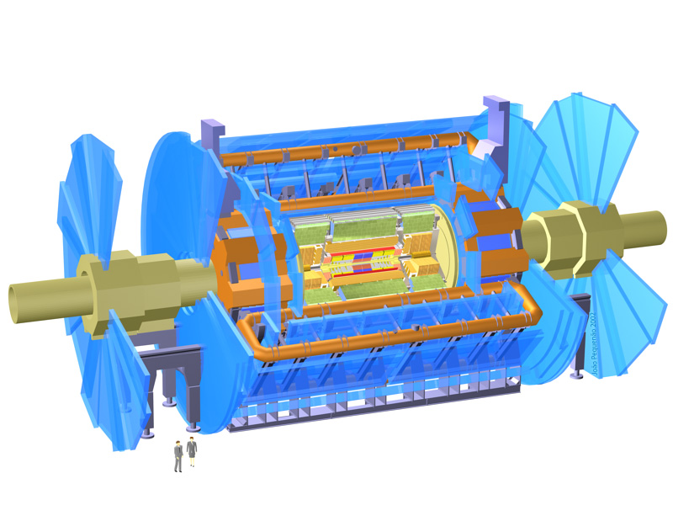
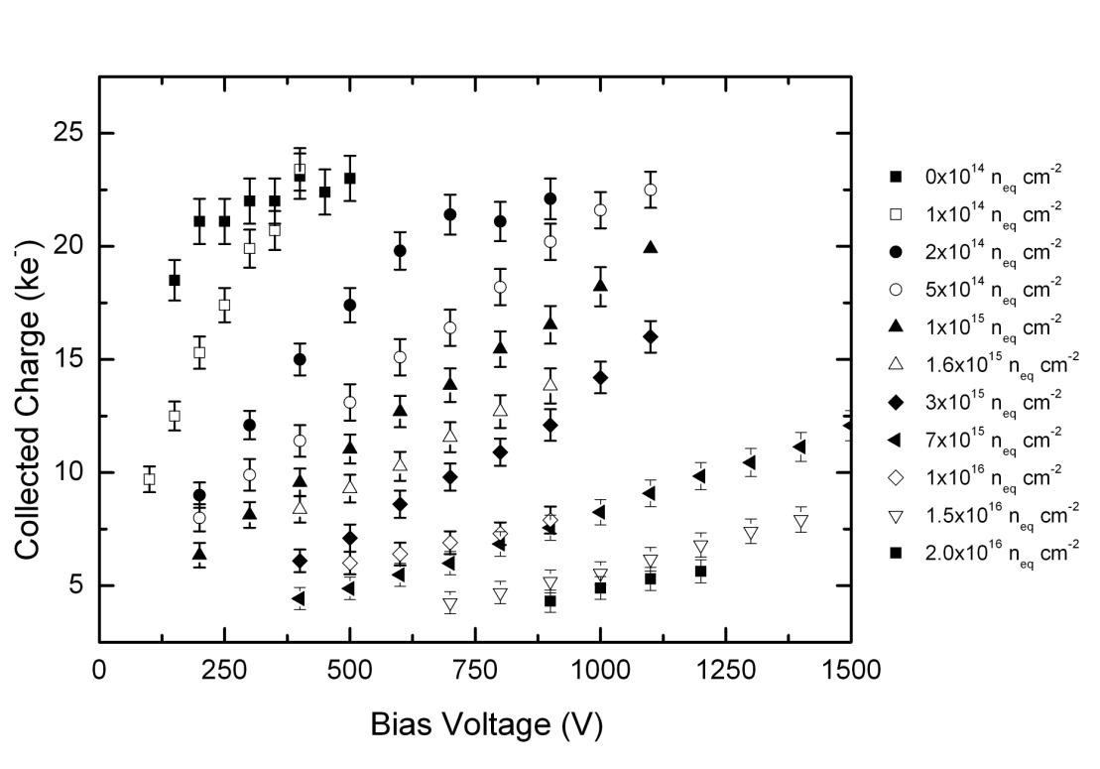
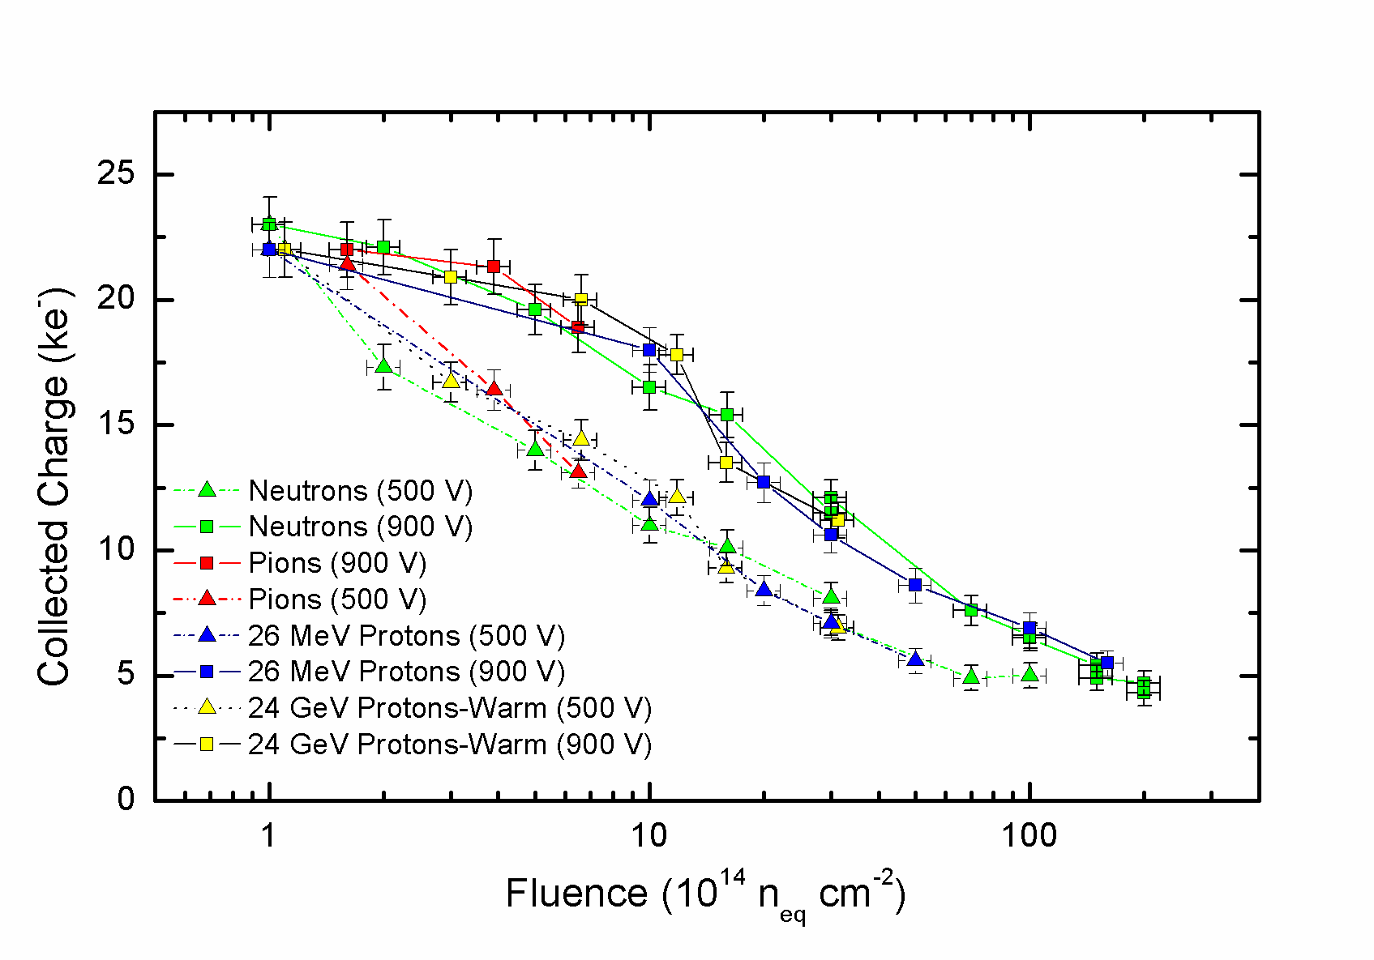
High Radiation Tolerance
Studies of signal generation in radiation damaged silicon at Liverpool have shown that sensors collecting electrons give better efficiency for a given operating voltage than those collecting holes. At the Super LHC (SLHC),radiation levels of up to 2 x10¹⁶ n_{eq} cm⁻², at 4 cm radius, are expected in the innermost layers of the silicon tracker, requiring extremely radiation hard sensors.
Liverpool has designed p-type strip sensors, manufactured by Micron Semiconductor (UK) Ltd and the Centro Nacional de Microelectronica in Barcelona (Spain), irradiated them with low and high energy protons, with neutrons and with pions and studied their performance. The results, shown here, are the first ever studies of charge collection efficiency in segmented silicon sensors following such high radiation doses.
Collected Charge vs Bias voltage for n-in-p planar silicon sensors
after neutron doses of up to 2 × 10¹⁵ n_{eq} cm⁻² (total anticipated dose
for the innermost pixel layer of the upgraded ATLAS at SLHC.)
Liverpool’s measurements show good charge collection from sensors illuminated with minimum ionising particles after irradiation to doses of 2 x10¹⁶ n_{eq} cm⁻². Based on these results, it is accepted that n-side readout planar silicon technology is an option for all the tracker and vertex sensors for the SLHC upgrade. Liverpool is now developing such sensors with the UK companies e2v and Micron Semiconductor.
Degradation of the signal measured at 500V and 900V with n-in-p planar silicon sensors as a function of proton, pion and neutron fluence up to 2 × 10¹⁵ n_{eq} cm⁻².

Slide 3
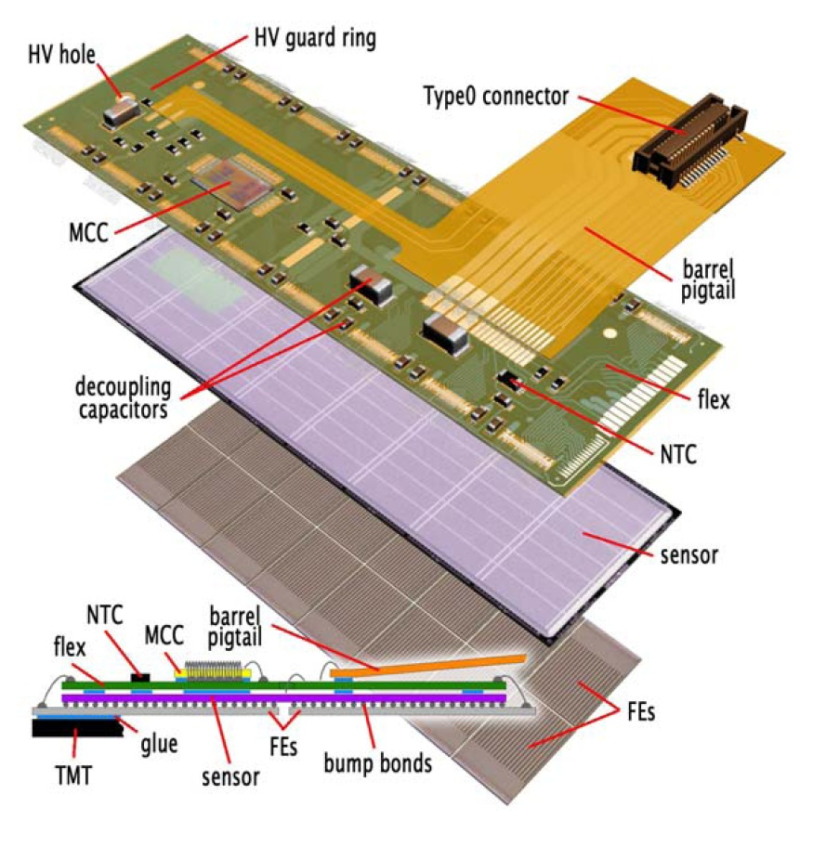
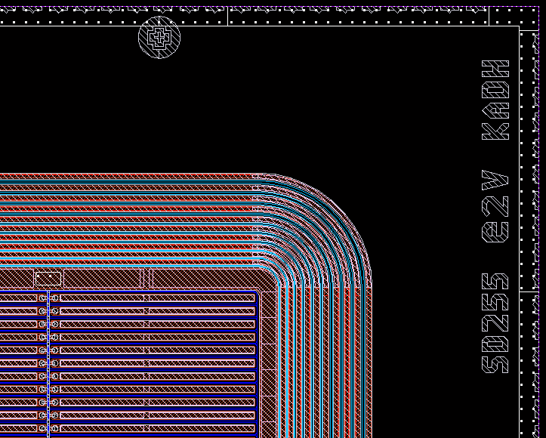
High Granularity
The increased luminosity of the SLHC requires both extreme radiation hardness and increased granularity of the sensors in the tracking systems, particularly in the innermost layers.
The current ATLAS pixel detector will need to be upgraded, as will the LHCb VELO, so Liverpool is investigating the use of hybrid pixel sensors for these detectors. Studies of the radiation hardness of planar p-type pixel sensors designed at Liverpool and manufactured by e2v and Micron Semiconductor are underway. Novel bonding schemes allow measurement of the characteristics of highly irradiated sensors despite the current lack of sufficiently radiation hard readout chips for bump-bonding to the sensors.
Elements of an ATLAS pixel module
A further challenge for future pixel detectors is the reduction of the material budget. Liverpool is investigating techniques for reducing the space required between pixel modules through the optimisation of guard ring structure and the use of through silicon via technology. Novel light support and cooling structures based on silicon carbide and other foams are also being studied.
guard rings
pixels
Liverpool ATLAS pixel masks

Slide 4
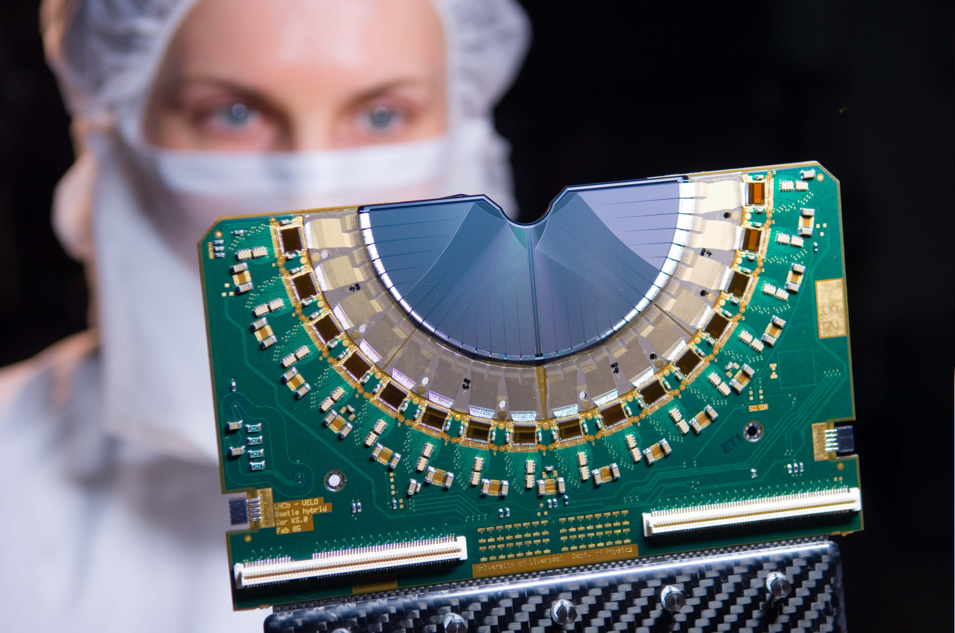
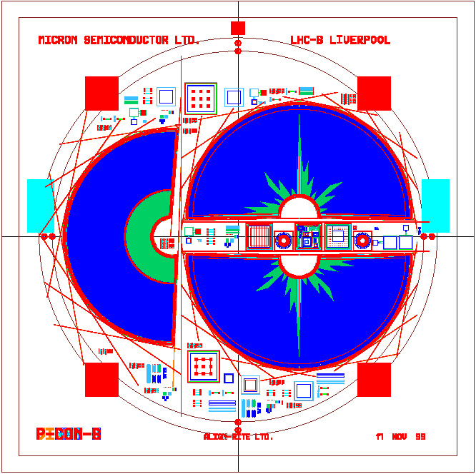
LHCb VELO
The LHCb VELO (VErtex LOcator) contains 42 modules each with R and φ silicon strip detectors. All components of the module, substrate, hybrid circuits, pitch adaptors and the mounting paddle support were designed and built in Liverpool.
Liverpool also designed the 15 cm diameter masks for the VELO silicon wafers. The two different designs are for the φ and R measuring detectors (mounted perpendicular to the beam direction). Routing all the connections from the implants to the wafer edge requires double-metal processing. The sensors were fabricated by Micron Semiconductor (UK) Ltd .

Slide 5
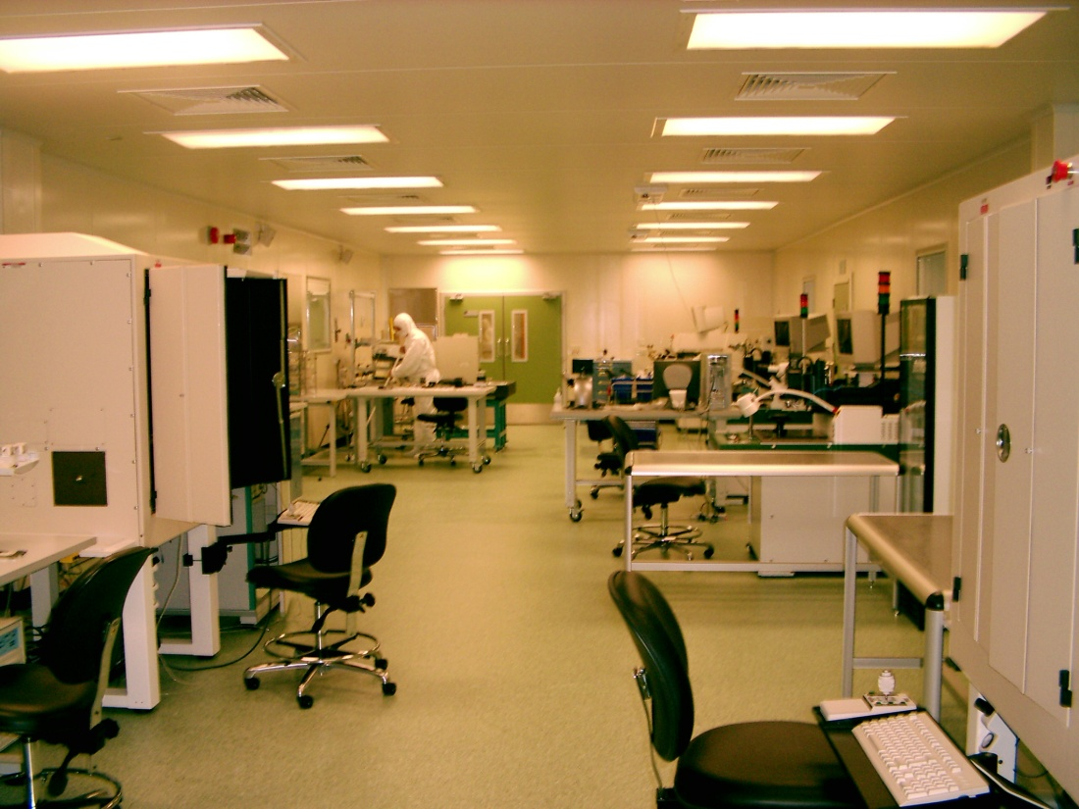
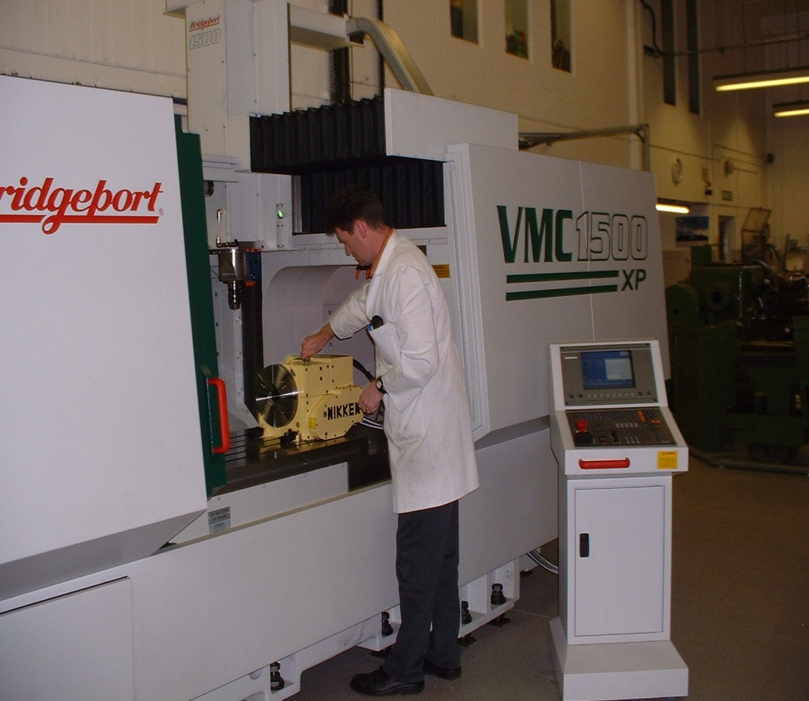
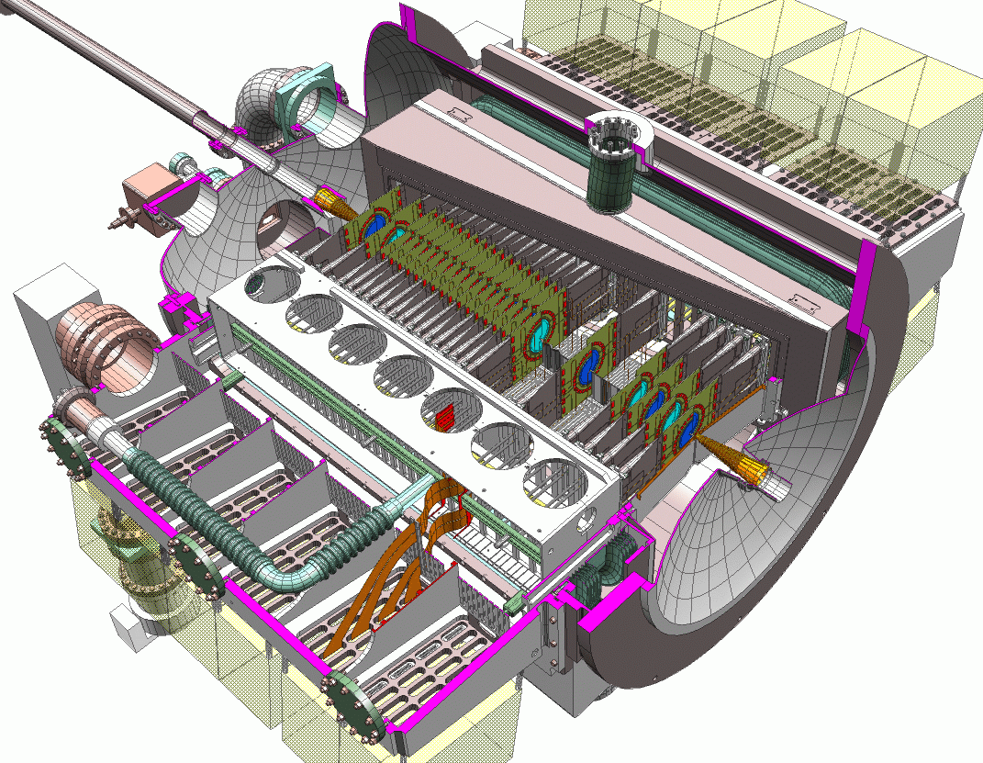
Liverpool Semiconductor Detector Centre
The LSDC, built using a £3M JIF grant, consists of 350m² of class 10,000 and 100 m² of class 100 clean rooms equipped with state-of-the-art automatic wire bonding (200 connections per cm), automated probing and large volume co-ordinate measuring machines.
The large ATLAS and LHC-b sensor arrays must measure particle tracks with precisions of ≤10μm and require low mass precision support structures over many m² to ensure the intrinsic resolution of the sensors is not compromised. The LSDC is complemented by a workshop equipped with high precision automatic machine tools which allow Liverpool to prototype the novel low mass supports and cooling needed for these detectors.
The LHC-b vertex locator, VELO, consisting of many layers of double sided processed, double metal, thinned silicon wafers, is one of the major particle physics arrays for which the microstrip detector modules were and will be constructed in the LSDC in the next few years. Liverpool designed sensors are fabricated in the UK by Micron Semiconductor and e2v.

