Slide 1
Partial differential equations
In this lecture we will:
Introduce a classification scheme for partial differential equations (PDEs).
Revisit the superposition theorem.
Derive the partial differential equation that describes the wave motion of an elastic string.
Solve the PDE by separating variables.
A comprehension question for this lecture:
What is the order of the equation
Is this equation linear?
Is it homogeneous?
1

Slide 2
Classifying PDEs
Principle of superposition
PDE classification is similar to that for ordinary differential equations (ODEs).
The order is given by the highest derivative, e.g. the 1D heat equation is second order.
The equation is linear if the dependent variable (u) and its derivatives appear only to the first power (the heat equation is linear).
The equation is homogeneous if every term contains the dependent variable or one of its derivatives (the heat equation is homogeneous).
Another similarity to ODEs!
If u₁ and u₂ are solutions of a linear PDE, then: where c₁ and c₂ are constants, is also a solution of the PDE.
The proof of this is similar to the proof for the ODE case…
…and is left as an exercise for the student!
2

Slide 3
Equation of motion of string
Want to work out how string behaves, assume:
Homogeneous, with mass per unit length ρ.
Tension much larger than gravity.
Small motions (i.e. angles α and β are small) in one plane:
No motion in horizontal direction:
Vertical motion, Newton’s second law gives:
Using first equation:
Now:
Vertical
T₂
β
u
α
T₁
0
x
x+δx
l
Horizontal
3

Slide 4
Equation of motion of string
So we have:
and hence:
Letting δx → 0 gives:
This is the 1D wave equation, generally written:
(Use c² to indicate constant positive!)
Solution of equation is function u(x, t).
Have boundary conditions u(0, t) = 0 and u(l, t) = 0 (string fixed at ends).
At t = 0, initial deflection is f(x) and initial velocity is g(x).
This means:
Need solution that satisfies all these conditions!
Three steps:
Separate variables, get 2 ODEs.
Solve ODEs satisfying boundary conditions.
Put these solutions together to solve PDE.
4

Slide 5
Solving equation of motion of string – step one
Assume can write solution in form:
Differentiating gives:
Our wave equation becomes:
Rearranging:
LHS depends only on x, RHS only on t, so must both be equal to constant, k.
We have:
This gives:
and
These are two ODEs that we can solve using the techniques we have already developed…
…while ensuring that the boundary conditions are satisfied, i.e. we need:
5

Slide 6
Solving equation of motion of string – step two
First look at positive k = μ²:
Hence:
But force A = 0 and B = 0, so F = 0: not useful!
Try negative k = –p²:
This gives:
The boundary conditions then give:
This means:
Setting B = 1, we have an infinite number of solutions of the form:
The equation for G with k = –(nπ/l)² is:
Writing we get:
This has solutions:
Hence a solution of the PDE is:
6

Slide 7
Solving equation of motion of string – step three
Some jargon:
The u_{n}(x, t) are called eigenfunctions and the λ_{n} eigenvalues (or characteristic functions and values, respectively).
The eigenvalue set λ₁, λ₂, λ₃… is called the spectrum.
The motion of the string with wavelength λ_{n} is called the n^{th} normal mode.
In order to satisfy the initial conditions (the shape and velocity of string at t = 0), we need to exploit the superposition theorem...
We write the solution in the form:
Then and
Choosing the A_{n} to be the Fourier coefficients for f(x) and the B_{n} to be those for g(x) ensures that the initial conditions are satisfied.
7

Slide 8
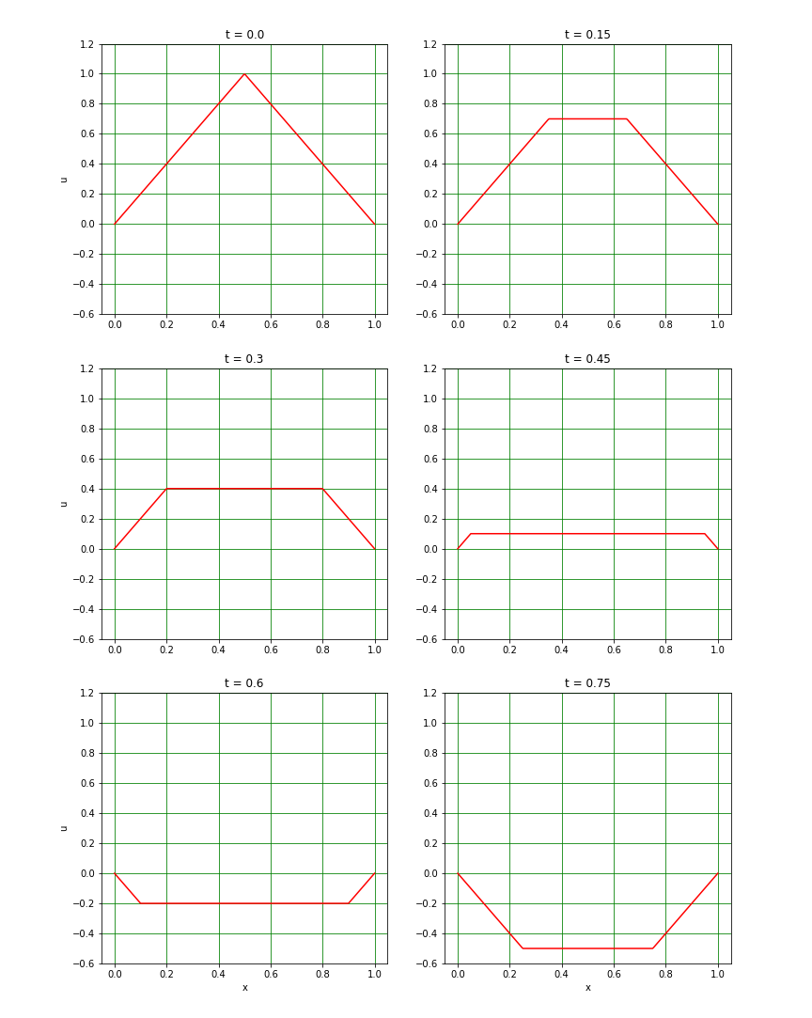
An example – initial deflection triangle
Find solution to 1D wave equation with initial conditions g(x) = 0 and
g(x) = 0 implies B_{n} = 0 for all n.
Fourier analysis of f(x) gives:
Hence:
8

Slide 9
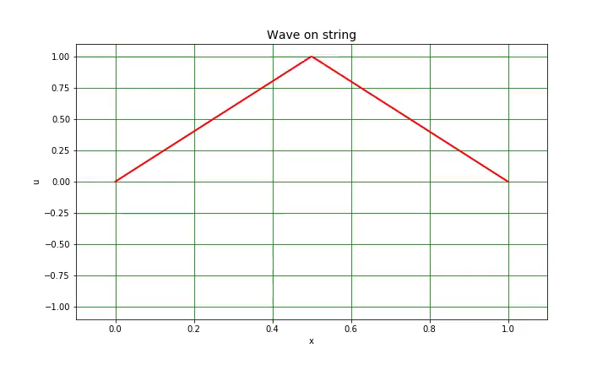
Animation of triangle wave

