Slide 1
Fourier series
In this lecture we will:
See how to represent functions with period 2π using Fourier series.
Derive expressions for the coefficients in these series.
Do an example.
A comprehension question for this lecture:
Show that:
1

Slide 2
Fourier series
Fourier series are a basic tool for representing periodic functions.
A function is periodic, with period T, if .
For example, cosines and sines have period 2π:
If , we can write the function as a sum of cosine and sine terms:
Each term has period 2π, so this is also true for the sum.
Look at an example, a square wave:
First try and visualise how this can be represented as a sum of cosines and sines.
2

Slide 3
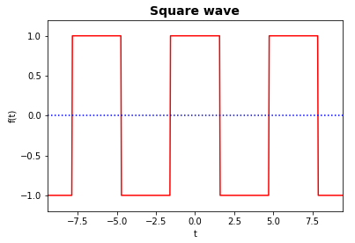
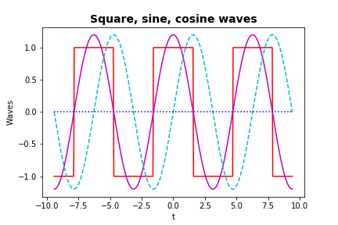
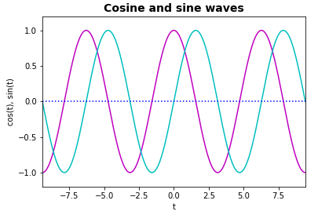
Fourier series of square wave by inspection
Square, cosine and sine waves:
See cosine can form approx. to this square wave, but sine doesn’t work:
(Amplitude of cosine above is 1.3.)
To get better approx. need to flatten peaks and sharpen flanks of cosine.
3

Slide 4
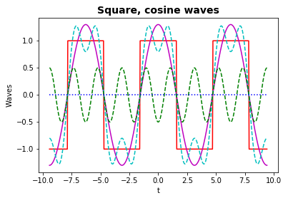
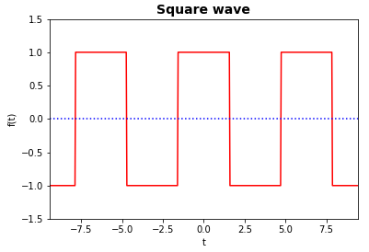
Fourier series of square wave by inspection
Sketch the cosine curve with freq. 1 (period 2π) on the graph, below.
Can adding a cosine with freq. 2 (i.e. period π) and appropriate amplitude improve the approximation?
Try adding a cosine with freq. 3, amp. 0.5:
Looks better!
How can we determine the freq.s and amplitudes of the cosines and sines that give the best approximation?
4

Slide 5
Determining Fourier coefficients
Use the fact that cosines and sines form a set of orthonormal basis functions:
Example proof one:
Now cosine is even, that is, so:
Same is true for 2nd term above.
Hence:
5

Slide 6
Determining Fourier coefficients
Example proof two:
Hence:
We can use these orthonormality properties to determine the coefficients in our Fourier series:
E.g. multiply
Every term is zero except for when
In this case the “sin × cos” term is zero (odd function integrated over symmetric range) and we are left with:
6

Slide 7
Determining Fourier coefficients
Similar proofs lead to the full set of expressions needed to determine the Fourier coefficients.
Go back to the square wave example and work out the coefficients using the above formulae.
First, constant term:
Also, see that a₀ is the average of the function over the interval
Hence, expect for this function.
Function f(t) is even, so there can be no contributions from the odd sine functions, hence
7

Slide 8
Determining Fourier coefficients
Cosine is even, so it will contribute to series.
The first few terms are:
Numerically:
n | a_{n}
1 | 1.27
2 | 0
3 | -0.42
4 | 0
5 | 0.25
8

Slide 9
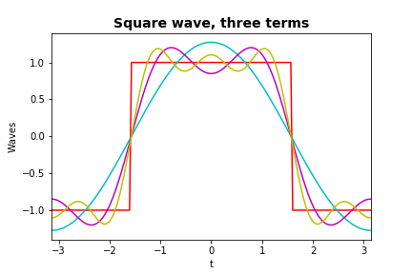
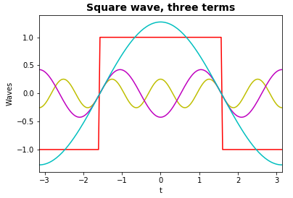
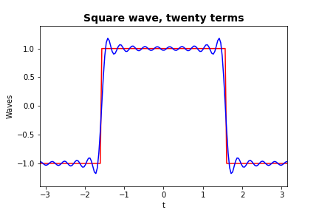
Square wave as Fourier series
Square wave with first three non-zero Fourier terms (i.e. five terms):
Opposite, square wave with:
Fourier series for square wave, first three non-zero terms.
Fourier series, first twenty terms.
9

